Slide 1

Review Session Midterm 1

Slide 2




Important Information
6 Questions-Chapters 2, 3, 4, 5, 6 and 7.
In class exam - Tuesday October 27th at 3:30pm.
Bring your calculator. Cell phones are not allowed.

Slide 3
Important Information
Use formal notation! and explicitly show all your calculations.

Slide 4


Important Topics:
Simultaneous vs. Sequential Move Games
Market structure:
  Monopoly,
  Cournot,
  Stackelberg and
  Bertrand

Slide 5
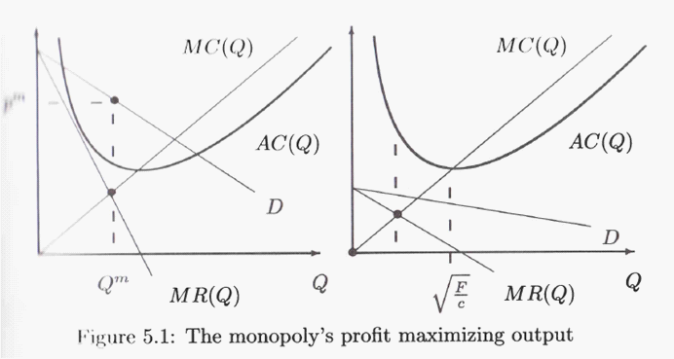
The Monopoly

Slide 6
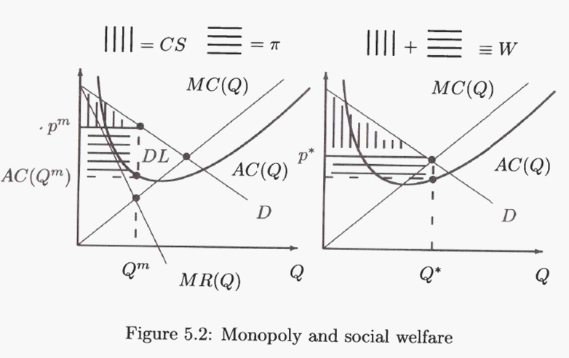
Monopoly and Social Welfare
The conventional argument against a monopoly

Slide 7


$Discriminating Monopoly$
$The Cartel$
$Renting vs Selling$
Cournot vs Stackelberg
Cournot vs Bertrand
Self-Enforcing Collusion
Effects of different Trade agreements on SW
Product Differentiation

Slide 8
An industry consists of 11 identical firms with costs c(q) = 4q +q². Market demand is Q = 100 - p.
What are the equilibrium price, output and profits of each firm if all eleven participate in a cartel?
If a single firm cheated, what would its output and profits be, assuming the other firms maintain the cartel price?

Slide 9
An industry consists of two firms with identical costs C(q) = 5q + q²/2. The firms can either “collude” or “compete.”
If both collude, they each produce q_{m} (half the monopoly output Q_{m}).
If one firm colludes and the other competes, the latter produces the output q** that maximizes its profits given that the other firm produces q_{m}.
If both compete, they play Cournot and each produce q_{n}. Calculate these outputs and the resulting profits if market demand is Q = 125 - p.
Represent your results as a normal-form game. What is the NE if the game is only played once?

Slide 10
Cereals producers X and Y produce and sell substitute cereals (differentiated goods). The inverse demand functions for cereals X and Y, respectively, are p_{X}=60-(3/2)q_{X}-q_{Y} and p_{Y}=60-(3/2)q_{Y}-q_{X}. Assume that firms do not bear any production costs (c_{X}=c_{Y}=0), answer the following questions:
Suppose the firms compete in quantities, where firm X sets q_{X} and firm Y sets q_{Y}, simultaneously. Write down and spell out the exact equations of each firm's maximization problem.
Solve for the firms' quantity best-response functions q_{X}=R_{X}(q_{Y}) and q_{Y}=RY( q_{X}). Plot both functions where you denote the vertical axis by q_{X} and the horizontal axis by q_{Y}. Indicate whether these BRFs are upward or downward sloping.

Slide 11
Solve for the Nash equilibrium quantity levels, q_{X} and q_{Y}, the corresponding prices, p_{X} and p_{Y}, as well as the equilibrium profit levels, π_{X} and π_{Y}.
Solve for the two direct demand functions from the above-given system of two inverse demand functions. Formally, compute the parameters a, b, and c of the direct demand functions q₁=a-bp₁+cp₂ and q₂=a-bp₂+cp₁, which are consistent with the above-given inverse demand functions.
Suppose now that firms compete in prices, where firm X sets p_{X} and firm Y sets p_{Y}, simultaneously. Formulate the profit function of each firm as a function of both prices. Formally, write down and spell out the exact equations of each firm's maximization problem.

Slide 12

Read the textbook!

