Slide 1

Chapter 5

Slide 2




Homework #1 is due this coming Tuesday October 6th.
Turn it in at the beginning of the class.
It must be handwritten.
Important Information

Slide 3
Important Information
Quiz #1 is this coming Tuesday October 6th.
It will start at around 4:30pm.
Two exercises about the material discussed in class.

Slide 4
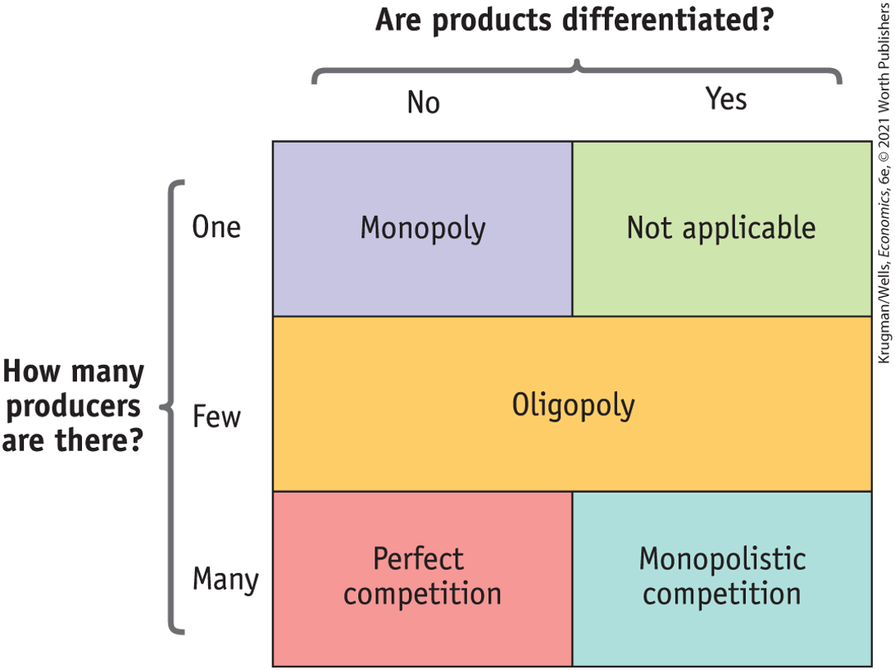
Types of Market Structures

Slide 5


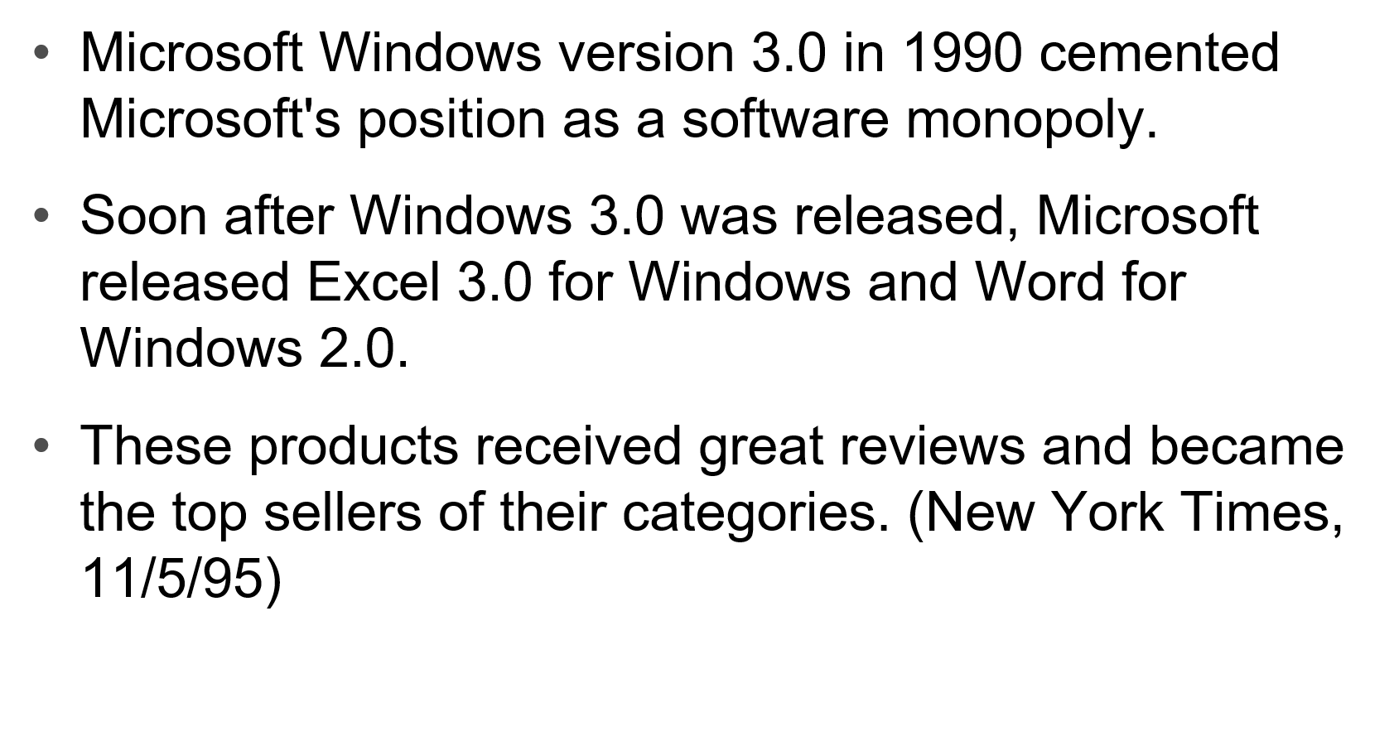
Market Characteristics

Slide 6
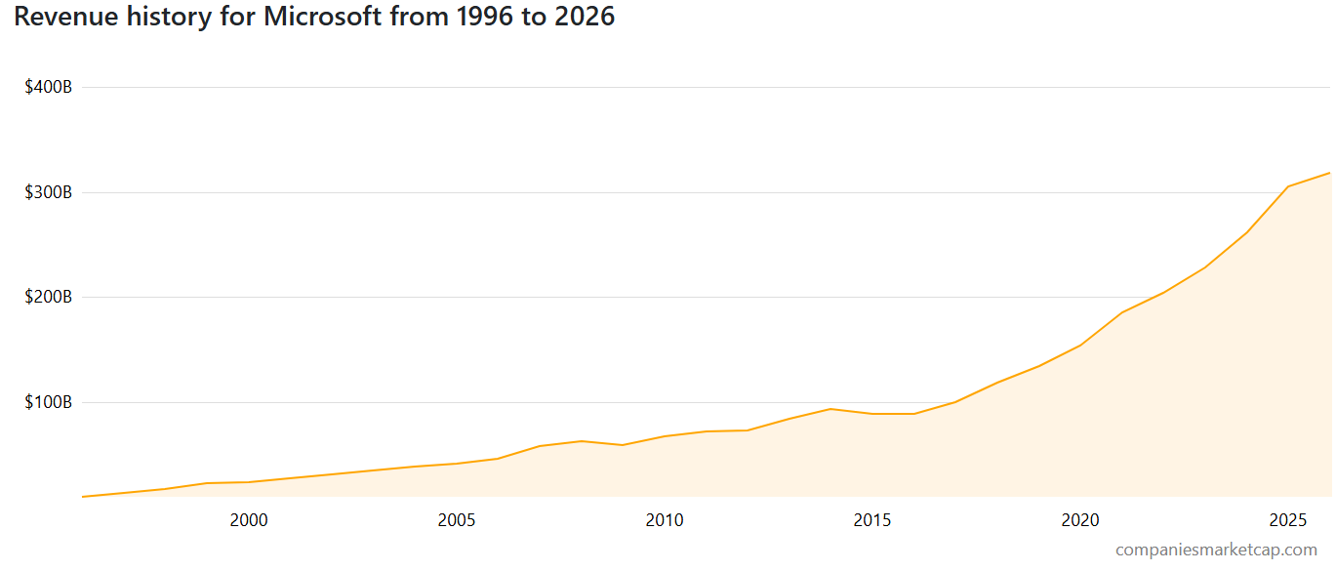
Revenue for Microsoft (MSFT)
Revenue in 2026 (TTM): $318.27 Billion USD
This is equivalent to the annual economic output of countries like Peru (approx. $318 billion), Chile (approx. $300–$340 billion), Czech Republic ($290–$310 billion), or Romania ($300 billion) Source: World Bank Group

Slide 7
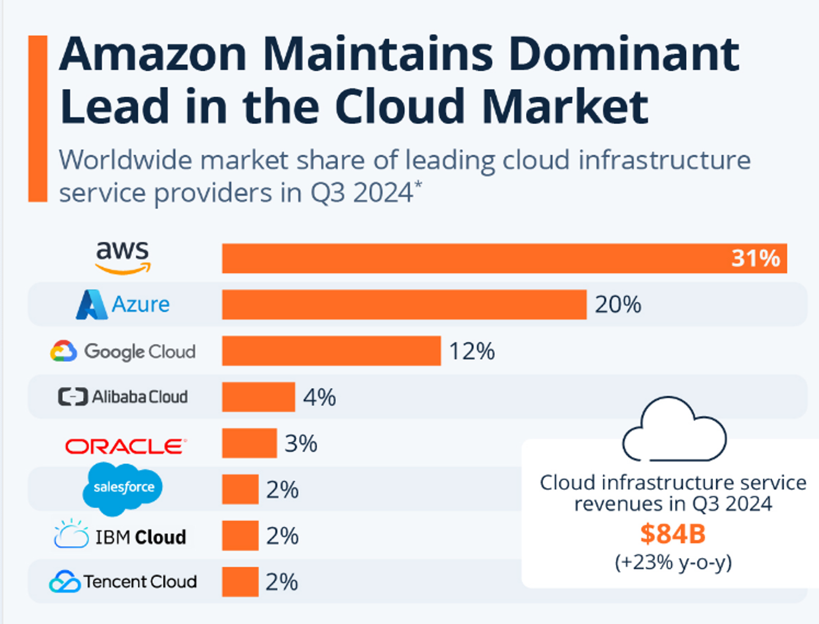
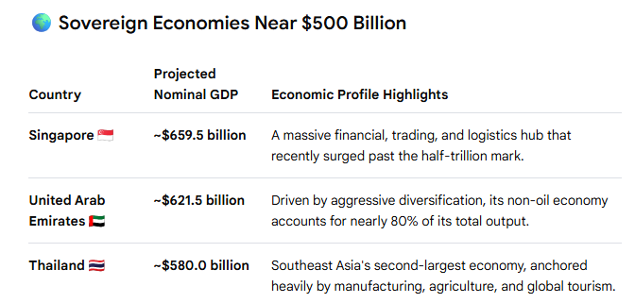
The total global revenue generated by just the cloud infrastructure sector in 2026 is approx. $500B+

Slide 8
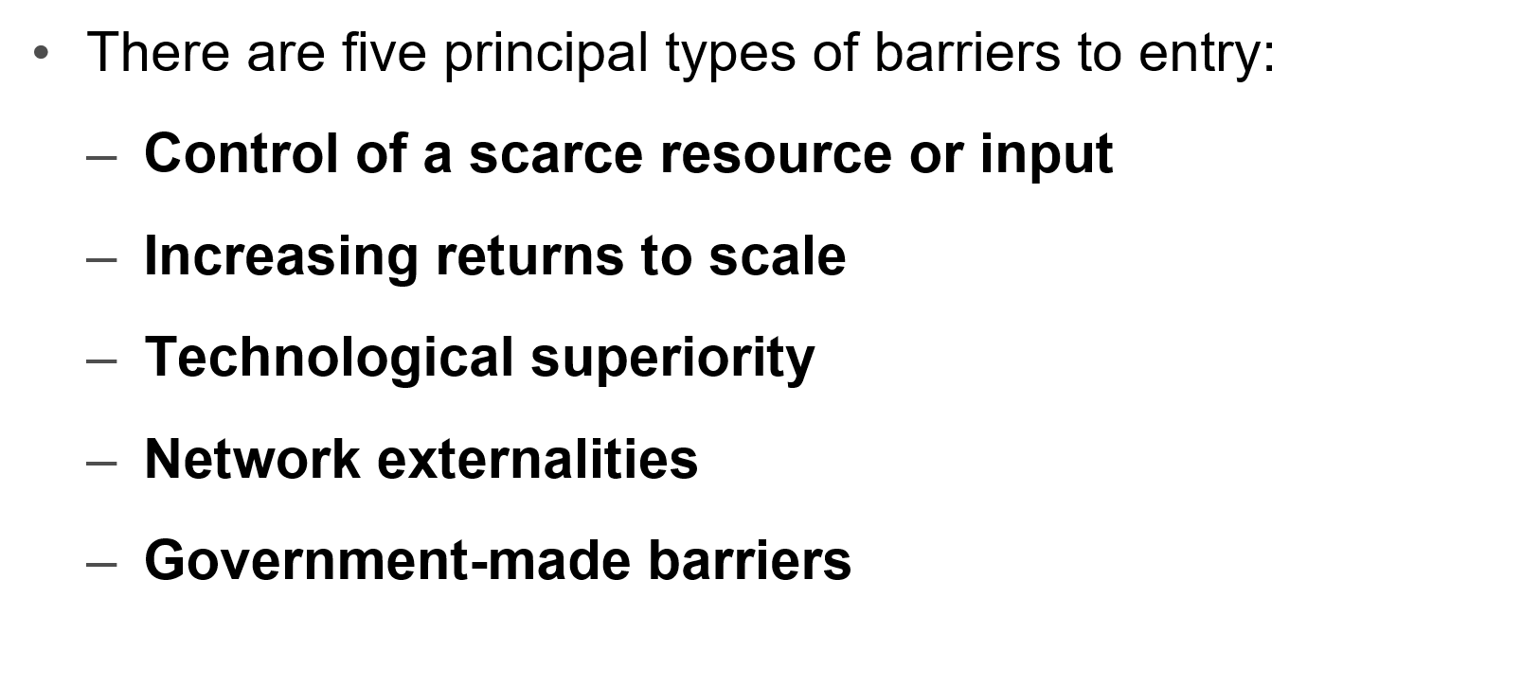

Slide 10

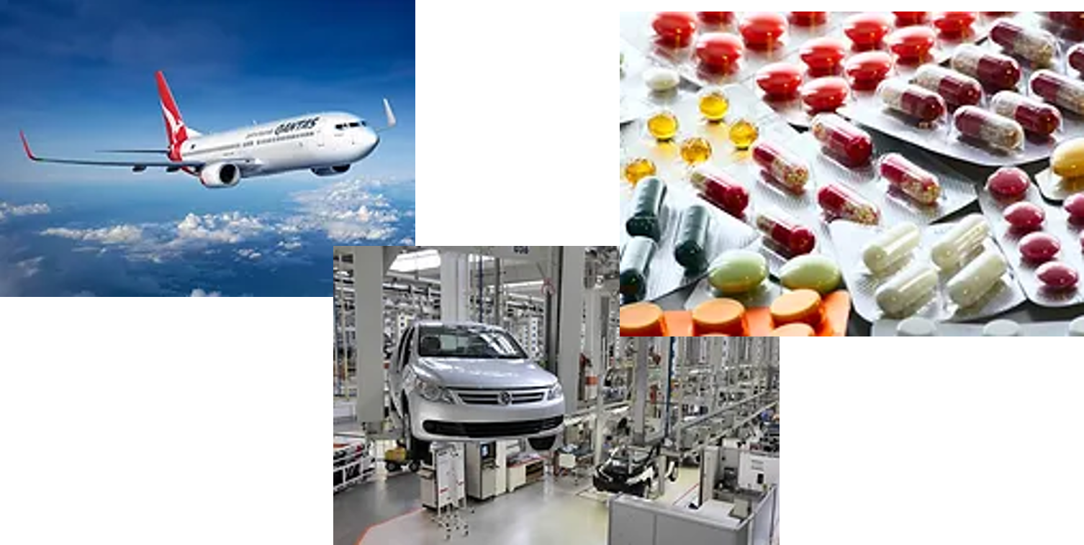

Slide 11
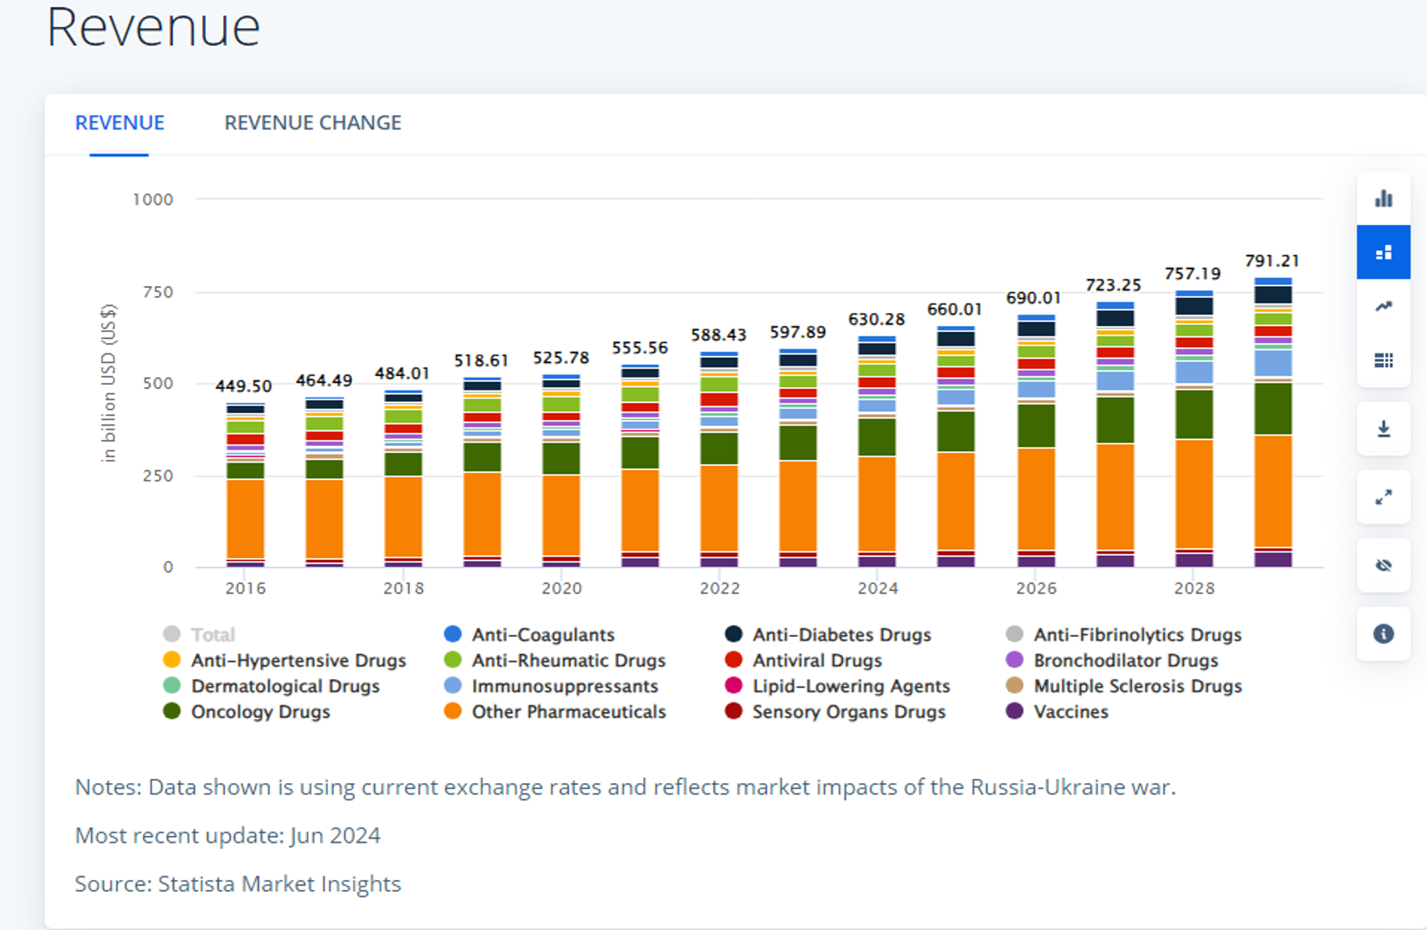
Pharmaceuticals U.S.

Slide 12
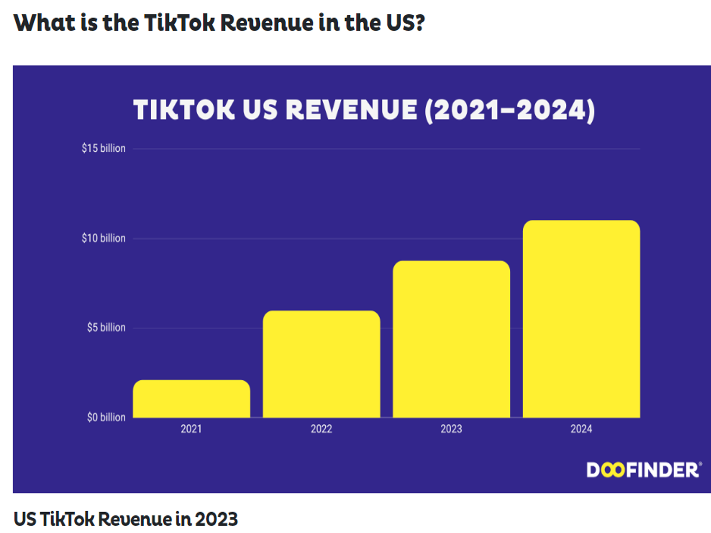
TikTok's standalone global revenue is projected to approach $40 to $45 billion

Slide 13
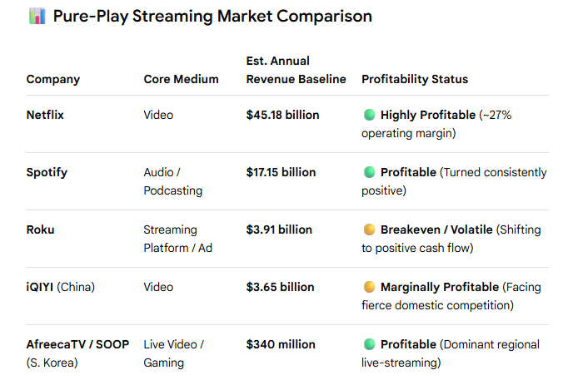
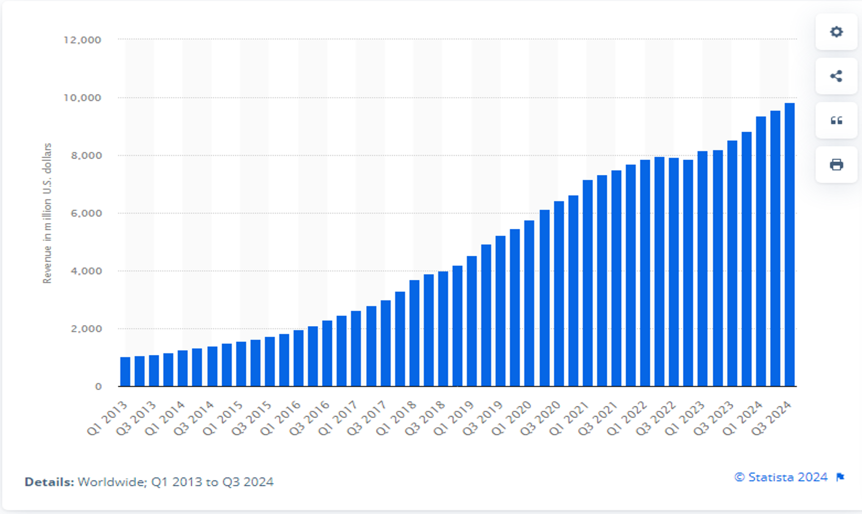


Revenue generated by Netflix from 1st quarter 2013 to 3rd quarter 2024(in million U.S. dollars)

Slide 14

Market Characteristics
Single Seller
Can determine either price or quantity supplied
The monopoly has to familiarize itself with all the demand properties
The monopoly's profit-maximization problem is:
max π(Q ) = TR (Q ) - TC (Q )

Slide 15

A necessary condition for Q^{M} > 0 is:
  $\frac{∂TR(Q^{M})}{∂Q}−\frac{∂TC\left(Q^{M}\right)}{∂Q}=MR\left(Q^{M}\right)−MC\left(Q^{M}\right)=0$
Hence, we obtain Q^{M} in the point where:
  MR (Q^{M} ) = MC (Q^{M} )
  the P^{M} can be found substituting Q^{M} into the demand function.

Slide 16
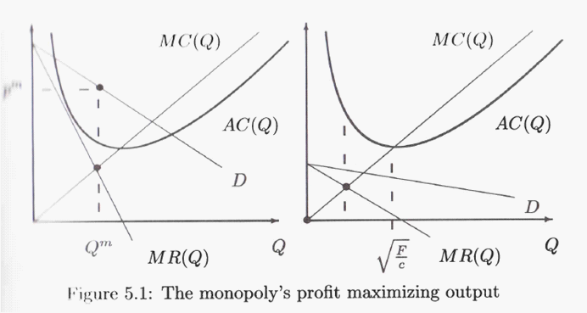
The Monopoly

Slide 17
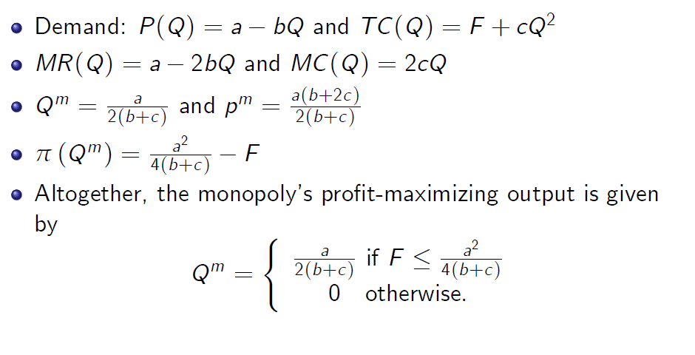

Slide 18





$P=120−\frac{1}{2}Q$
$TC=Q^{2}$
$TR=\left(120−\frac{1}{2}Q\right)Q$
$MR=\frac{∂TR}{∂Q}=120−Q$
$MC=\frac{∂TC}{∂Q}=2Q$

Slide 19










$P=120−\frac{1}{2}Q$
$TC=Q^{2}$
$MR=120−Q$
$MC=2Q$
$$Price$$
$$MC$$
$$120$$
$$Demand$$
$$MR$$
$$Quantity$$
$$120$$
$$240$$

Slide 20
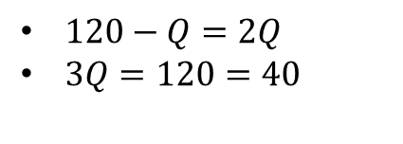





$MR=MC$ Eq. in Monopoly
$120−Q=2Q$
$3Q=120=40$
$$Price$$
$$MC$$
$$120$$
$$100$$
$$Demand$$
$$MR$$
$$Quantity$$
$$40$$
$$120$$
$$240$$
$P=120−\frac{1}{2}40=100$

Slide 21
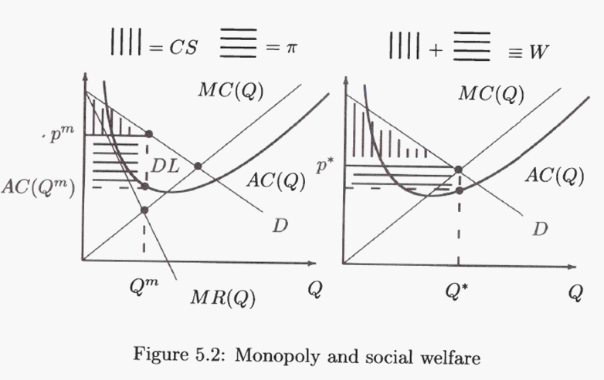
Monopoly and Social Welfare
The conventional argument against a monopoly

Slide 22


$Let^{′}s calculate CS$
$\frac{(120−100)×40}{2}=400$
$$Price$$
$$MC$$
$$120$$
$$100$$
$$Demand$$
$$MR$$
$$Quantity$$
$$40$$
$$120$$
$$240$$

Slide 23






$Let^{′}s calculate PS$
$\left(100−80\right)×40=800$
$$Price$$
$$MC$$
$$120$$
$$80$$
$$Demand$$
$$MR$$
$$Quantity$$
$$40$$
$$120$$
$$240$$
$$MC=2×40=80$$

Slide 24


Social Welfare in Monopoly
$SW=CS+PS$
$SW=400+800$
$SW=1200$

Slide 25


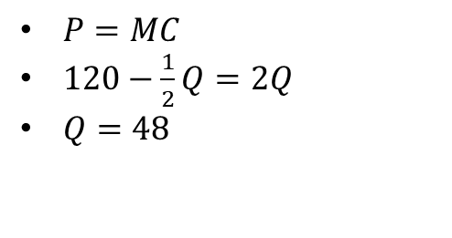


Perfect Competition
$P=MC$
$120−\frac{1}{2}Q=2Q$
$Q=48$
$$Price$$
$$MC$$
$$120$$
$$96$$
$$Demand$$
$$MR$$
$$Quantity$$
$$120$$
$$240$$
$$48$$
$120−\frac{1}{2}48=96$

Slide 26

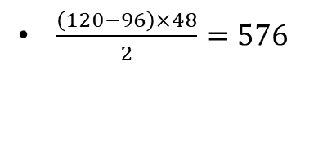
Perfect Competition
$\frac{\left(120−96\right)×48}{2}=576$
$$Price$$
$$MC$$
$$120$$
$$PS=0!$$
$$96$$
$$Demand$$
$$MR$$
$$Quantity$$
$$120$$
$$240$$
$$48$$

Slide 27

Social Welfare in PC
$SW=CS+PS$
$SW=576+0$
$SW=576$
SW(Monopoly)>SW(PC)

Slide 28
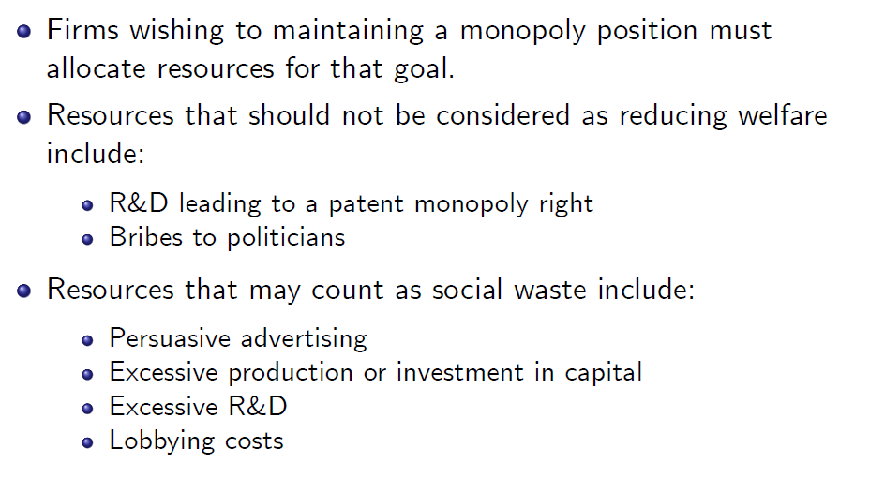
The SociaI Cost of a Monopoly

Slide 29
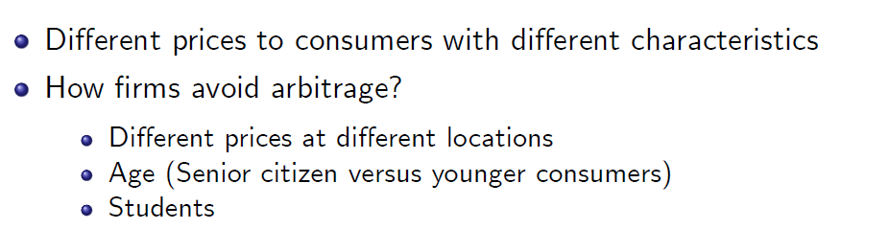
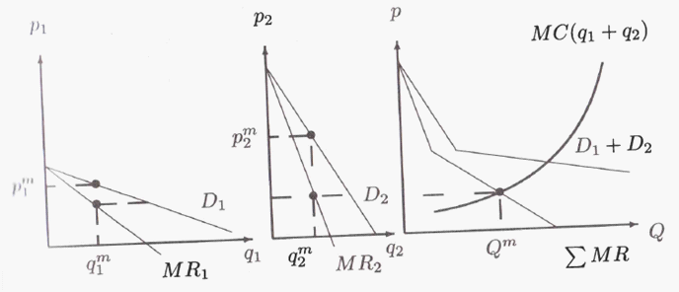
Discriminating Monopoly

Slide 30
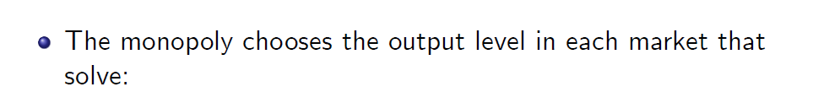
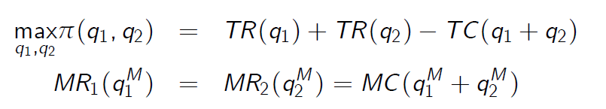
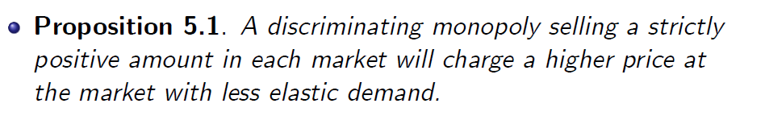
Discriminating Monopoly

Slide 31

Discriminating Monopoly
Suppose you can discriminate
between two markets:
Mk1: $q_{1}=2−p_{1}$
Mk2: $q_{2}=4−p_{1}$
MC: $c=1$

Slide 32




Calculate the profit-maximizing output level that the monopoly sells in each market. Calculate the price charged in each market.
Mk1:
$π_{1}=\left(2−q_{1}\right)×q_{1}−q_{1}$
$$\frac{{∂π}_{1}}{∂q_{1}}=2−2q_{1}−1=0$$
$$q_{1}=\frac{1}{2}$$
Mk2:
$π_{2}=\left(4−q_{2}\right)×q_{2}−q_{2}$
$$\frac{{∂π}_{2}}{∂q_{2}}=4−2q_{2}−1=0$$
$$q_{1}=\frac{3}{2}$$
$$p_{1}=2−\frac{1}{2}=\frac{3}{2}$$
$$p_{2}=4−\frac{3}{2}=\frac{5}{2}$$

Slide 33


Calculate the monopoly s profit level.
Mk1:
$π_{1}=\left(2−\frac{1}{2}\right)×\frac{1}{2}−\frac{1}{2}$
$π_{1}=\frac{3}{2}$ $×\frac{1}{2}−\frac{1}{2}$
$$π_{1}=\frac{3}{4}−\frac{1}{2}=\frac{1}{4}$$
Mk2:
$$π_{2}=\left(4−\frac{3}{2}\right)×\frac{3}{2}−\frac{3}{2}$$
$$π_{2}=\left(\frac{5}{2}\right)×\frac{3}{2}−\frac{3}{2}$$
$π_{2}=\frac{15}{4}−\frac{3}{2}$= $\frac{9}{4}$

Slide 34



The monopoly cannot price discriminate and must charge a uniform price p. Find the profit-maximizing value p.
$$π=Q×p−1×Q$$
$$π=(6−2p)×p−1×(6−2p)$$
$\frac{∂π}{∂p}=6−4p+2=0$ $\left(2−p\right)+\left(4−p\right)$
$p=2$ $Q=\left(6−2×2\right)=2$
$$Lower than when$$
$price discriminat$ion
$$π=2×2−1×2=2$$

Slide 35
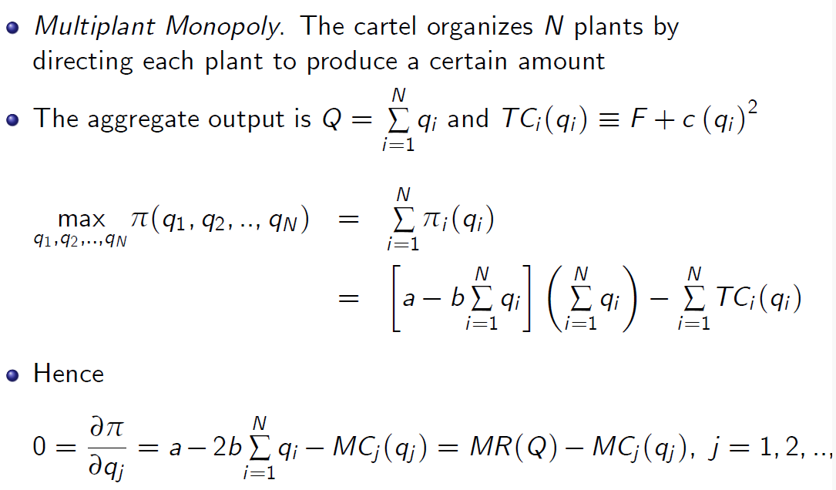
The Cartel

Slide 36
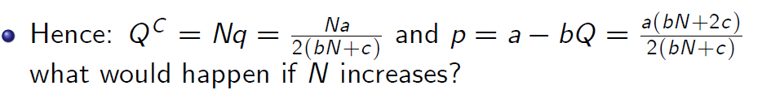
50
45
40
35
30
25
20
15
10
5
0
qi Price Profit
1 2 3 4 5 6 7 8 9 10 11 12 13
Assume a = 20, b = 0.5, c = 5

Slide 37

Durable-Goods Monopolies

Slide 38
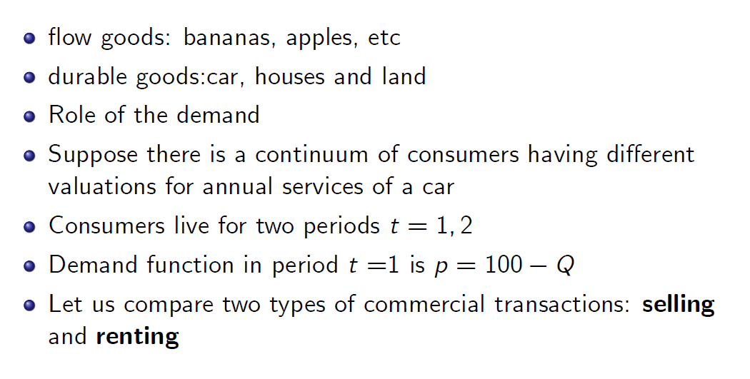
Durable-Goods Monopolies

Slide 39

A Renting Monopoly

Slide 40
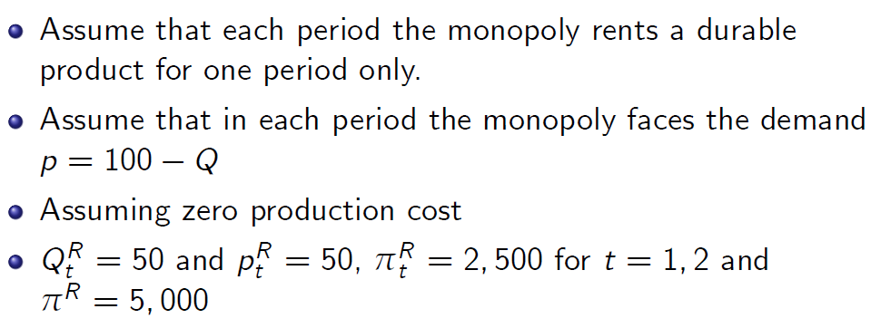
A Renting Monopoly

Slide 41
A Seller Monopoly

Slide 42
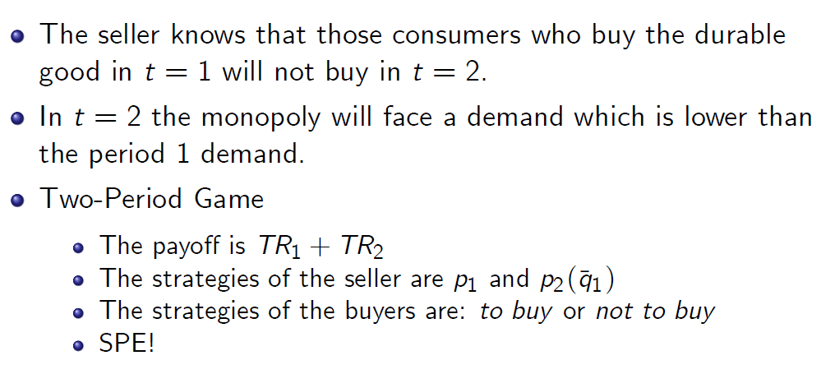
A Seller Monopoly

Slide 43
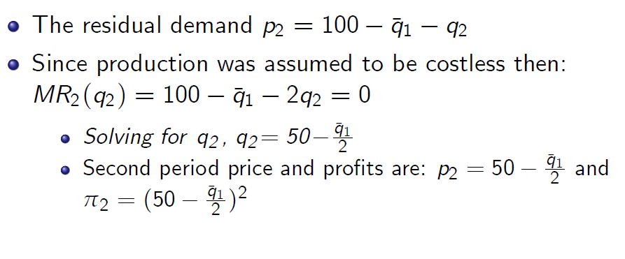
The Second Period

Slide 44
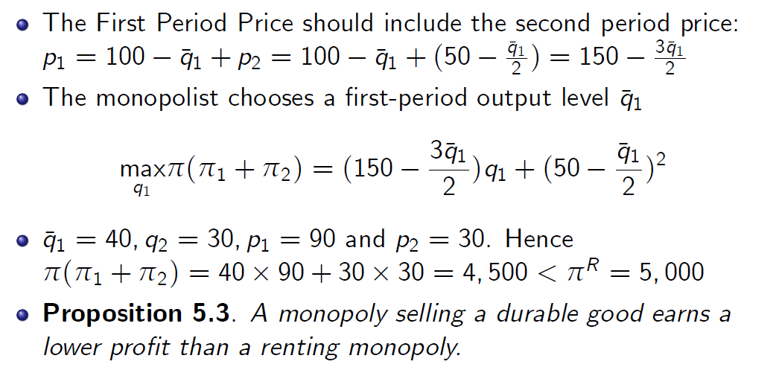
The First Period

Slide 45
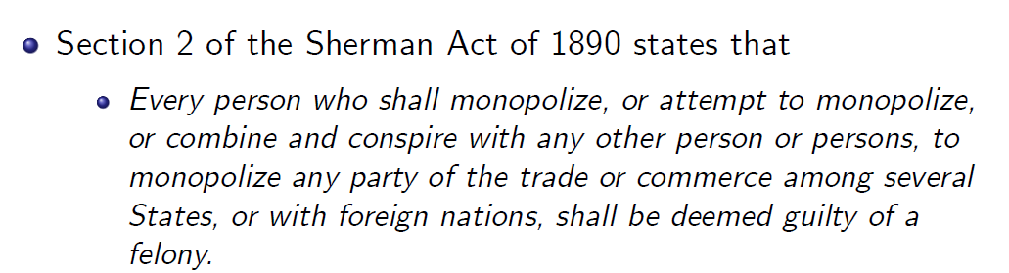
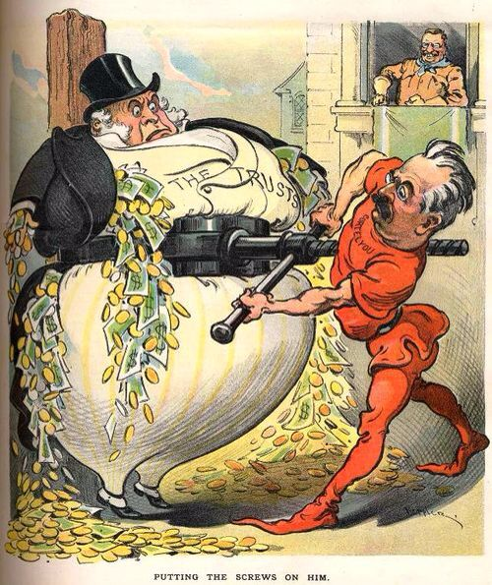
The Legal Approach to Monopoly

