Slide 1

Data Center Incentive Programs and Water Uncertainty
Ana Espinola-Arredondo
Washington State University and
Universitat de Valencia
Felix Munoz-Garcia
Washington State University
Aditi A. Surve
Vrije Universiteit Amsterdam

Slide 2
Motivation
Data centers have become an important component of the digital economy.
5,427 operational facilities in the US, 2,269 in the EU, and over 9,000 worldwide as of April 15, 2026.
Their operations require substantial electricity for computation and cooling.
The US Department of Energy, for instance, reports that US data centers used 176 TWh of electricity in 2023.

Slide 3
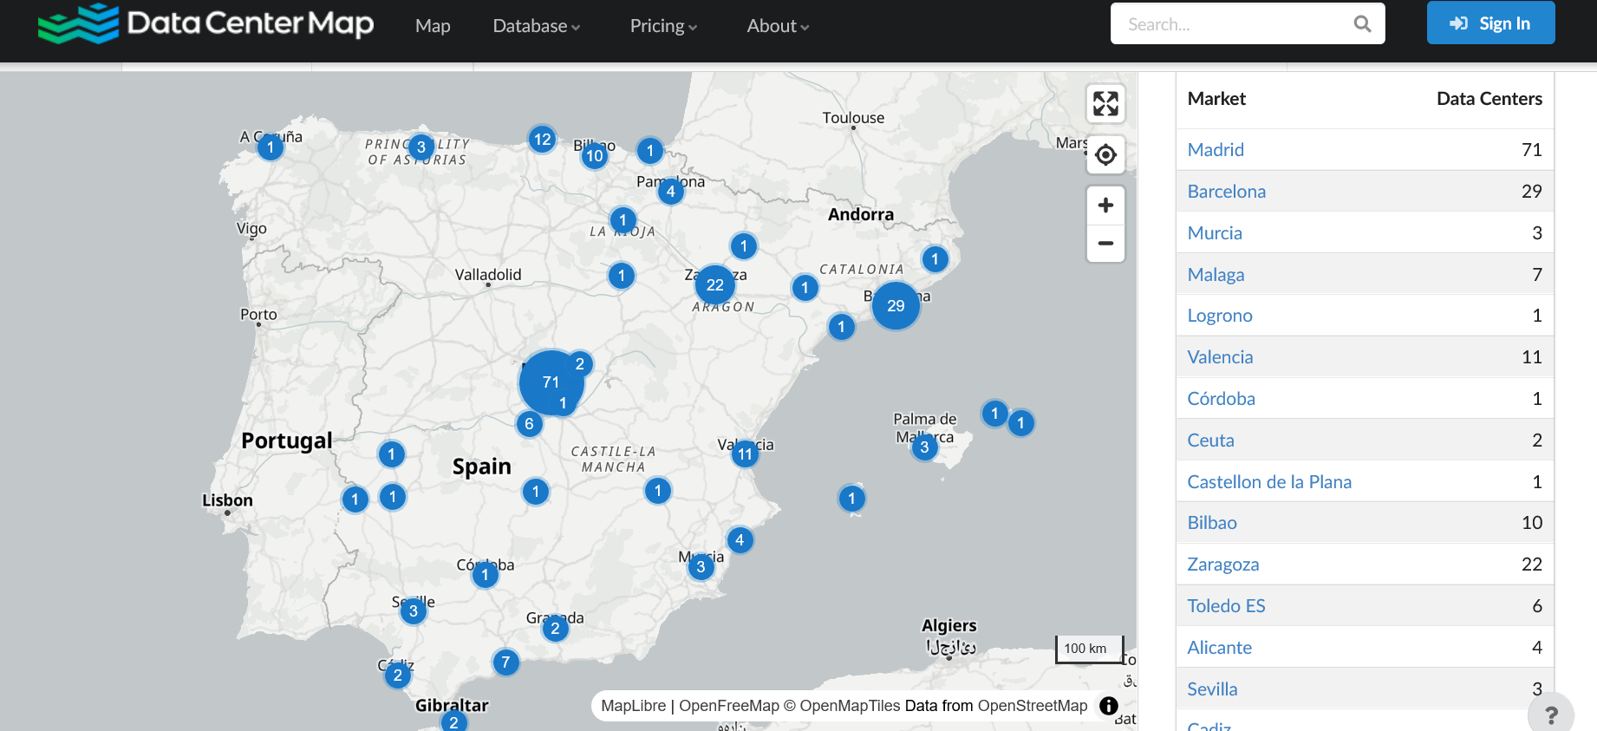
Motivation

Slide 4
Motivation
Water use - Additional Constraint
Data centers rely on water both directly, through cooling systems, and indirectly, through electricity generation.
A large share of computing capacity is located in watersheds already classified as water-stressed.

Slide 5
Motivation - Water use
In the US is estimated at 17.4 billion gallons in 2023, implying average water use of 14,000 gallons/day per facility, or the equivalent consumption of 46 US households; EPRI (2023).
01
Large data centers can consume up to 5 million gallons of water per day, equivalent to more than 10,000 households.
02
These pressures are particularly severe at the regional and local level, with data centers drawing from the same water systems used by municipalities and agriculture.
03

Slide 6

Subsidies for data center location
In the US, at least 38 states offer tax incentives that reduce capital, maintenance, or operating costs; see Gargano and Giacoletti (2025)
Justified in terms of investment attraction, employment, and local economic development.
Their resource implications are often borne locally and contemporaneously.
Multiple large facilities operate alongside irrigated agriculture.

Slide 7

Public incentives for entry and localized competition over a common-pool resource
How should incentive programs be designed when the resource is uncertain and shared?

Slide 8
Three Features:
Competition between a prospective DC and an incumbent farmer over a water CPR [each operating at different markets];
A congestion externality in extraction costs due to shared use ; and
Uncertainty about the available stock at the time the policy is chosen, and the location decision is made.

Slide 9

Subsidy
The local regulator offers a subsidy to attract a DC to its jurisdiction.
How that subsidy should respond to uncertainty about water availability.
The extent to which water reduces production costs, and market conditions that affect the data center's profitability.
Although entry incentives are common in practice, their welfare effects in this setting are not straightforward.

Slide 10
Findings
A more likely high stock produces two opposite effects on the data center’s expected profits:
  A larger expected stock makes entry more attractive (direct effect), but
  it also increases expected congestion costs by encouraging more intensive resource use (indirect effect).
We show that the direct effect dominates, implying that a more abundant resource helps the regulator offer a less generous entry subsidy.

Slide 11
Findings
When demand for data center is strong, in some contexts, entry occurs even without subsidies.
The regulator’s preferred policy can then shift toward limiting entry or charging an entry fee.
When low stock is likely, the increase in extraction costs reduces the intensity of competition for water, which may reduce the incremental harm from entry.
The model does not imply a monotone relationship between water-scarcity risk and optimal subsidy generosity.
Scarcity affects both the entry margin and the within-region externality margin.

Slide 12
Extensions
We endogenize the data center’s outside option.
We consider an alternative policy instrument used in some jurisdictions:
  a subsidy that lowers the data center’s marginal production cost.
We allow for multiple data centers and multiple farmers.

Slide 13
Literature Review
CPRs and strategic behavior under congestion. How institutional design and monitoring can mitigate these inefficiencies.
  McKean (1982), Baland and Platteau (1996), Brunckhorst and Coop (2003), and Ostrom (2008).
The role of uncertainty and information frictions in CPR.
  Suleiman and Rapoport (1988), Suleiman et al. (1996), Apesteguia (2006), and Espinola-Arredondo and Munoz-Garcia (2011).
The effect of data centers on natural resources.
  Lei et al. (2025) show that DC water use in Oregon nearly tripled over 5 years, reaching roughly 29% of total demand.
  Abdelmohsen et al. (2025) reports similar evidence in groundwater depletion in the Colorado River Basin.
  Pan Fang and Greenstein (2025) show that third-party operators are responsive to tax incentives
  Gargano and Giacoletti (2025) examine the impact of US state-level tax incentives. Find evidence that they affect the geographic distribution across states, but do not stimulate local tech-related employment.

Slide 14
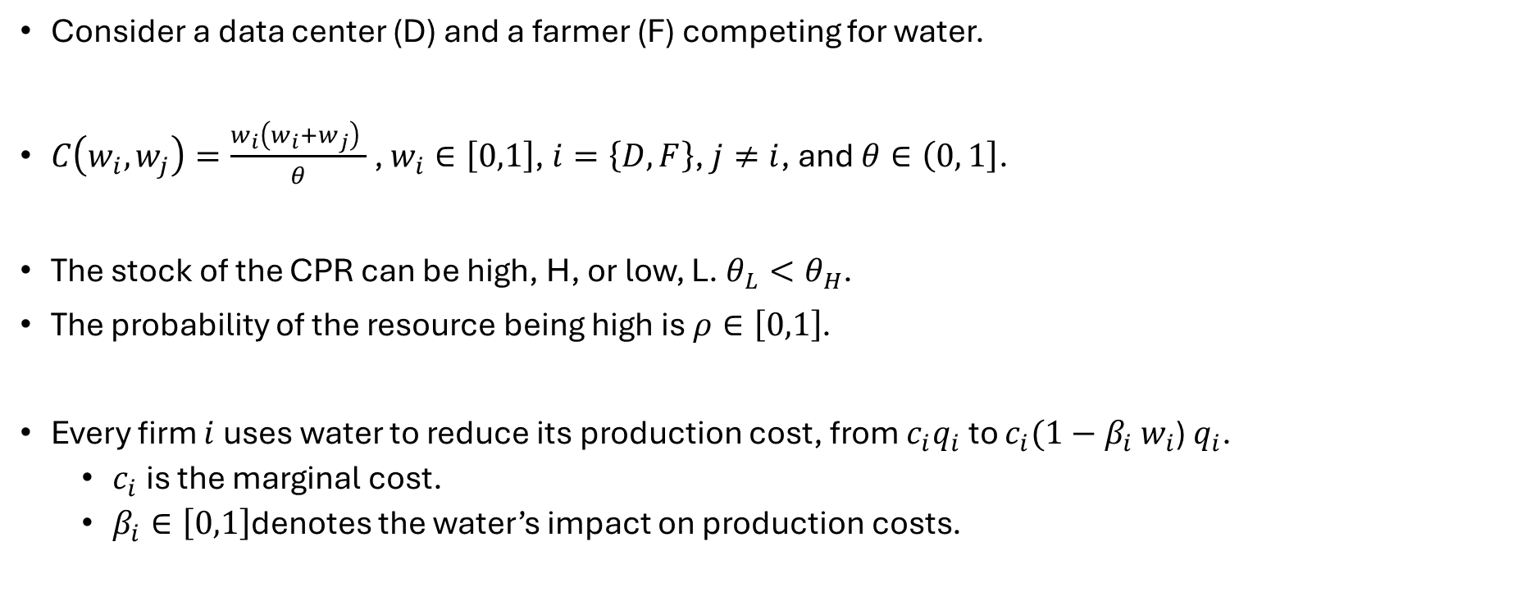
Model
Consider a data center (D) and a farmer (F) competing for water.
$C\left(w_{i},w_{j}\right)=\frac{w_{i}\left({w_{i}+w}_{j}\right) }{θ}$ , $w_{i}∈\left[0,1\right]$, $i=\left\{D,F\right\}$, $j≠i$, and $θ∈\left(0,\left.1\right]\right.$.
The stock of the CPR can be high, H, or low, L. $θ_{L}<θ_{H}$.
The probability of the resource being high is $ρ∈\left[0,1\right]$.
Every firm $i$ uses water to reduce its production cost, from $c_{i}q_{i}$ to $c_{i}(1−$ $β_{i}$ $w_{i}$) $q_{i}$.
  $c_{i}$ is the marginal cost.
  $β_{i}∈\left[0,1\right]$denotes the water’s impact on production costs.

Slide 15
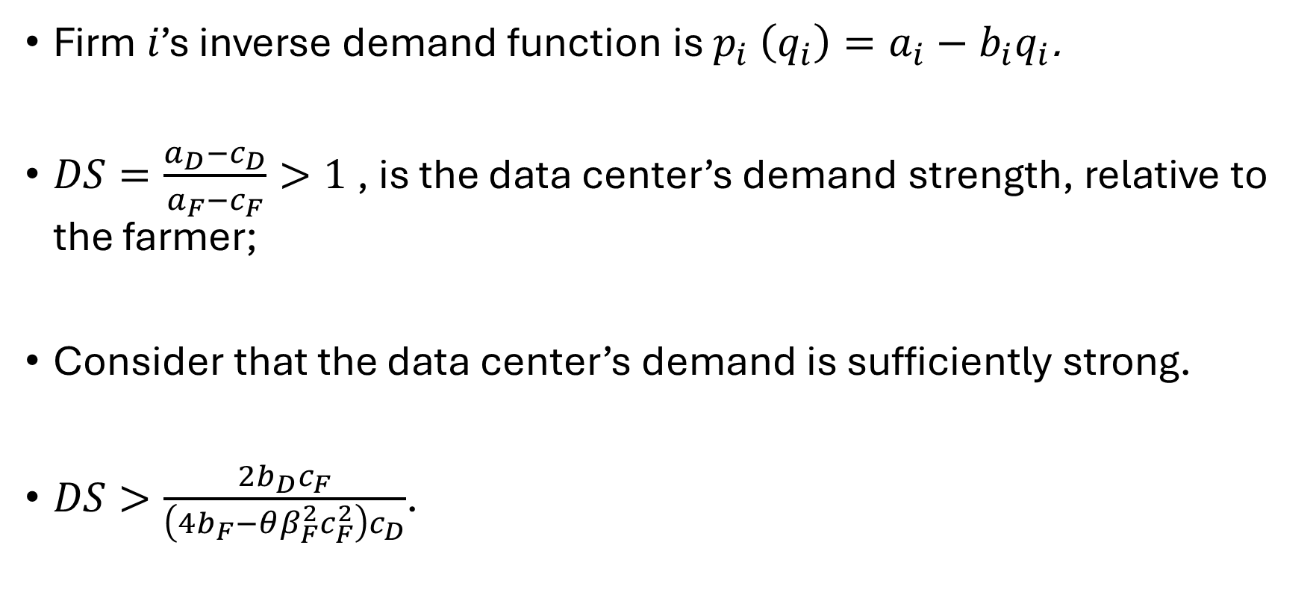
Model
Firm 𝑖’s inverse demand function is $p_{i} \left(q_{i}\right)=a_{i}−b_{i}q_{i}$.
$DS=\frac{a_{D}−c_{D}}{a_{F}−c_{F}}>1$ , is the data center’s demand strength, relative to the farmer;
Consider that the data center’s demand is sufficiently strong.
$DS>\frac{{2b}_{D}c_{F}}{\left({4b}_{F}−θβ_{F}^{2}c_{F}^{2}\right)c_{D}}$.

Slide 16
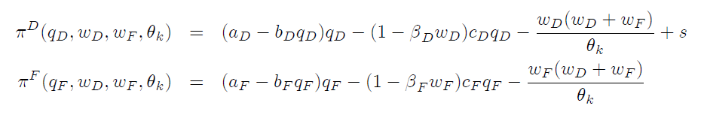
Model
Therefore, the data center’s and farmer’s profits are:

Slide 17

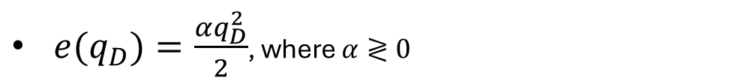
Model
The regulator considers the following social welfare (SW):
$e(q_{D})=\frac{αq_{D}^{2}}{2}$, where $α≷0$

Slide 18

Three-Stage Game
First Stage
A regulator sets a lump-sum subsidy, s to attract location of a DC.
Second Stage.
The DC decides whether to locate in the subsidize region or to pursue an outside option, $\overline{π}$.
Second Stage.
The DC decides whether to locate in the subsidize region or to pursue an outside option, 𝜋 ̅.
Third Stage.
DC and farmer simultaneously choose output and water usage.
Uncertainty about $θ_{k}$ is resolved

Slide 19
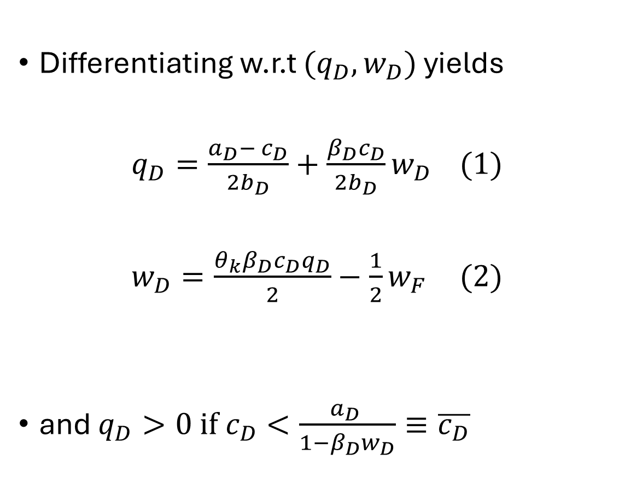
Equilibrium Analysis: Third Stage
Differentiating w.r.t ${(q}_{D},w_{D})$ yields
$q_{D}=\frac{a_{D}−{ c}_{D}}{2b_{D}}+\frac{{β_{D}c}_{D}}{2b_{D}}w_{D}$ (1)
$w_{D}=\frac{θ_{k}{β_{D}c_{D}q}_{D}}{2}−\frac{1}{2}w_{F}$ (2)
and $q_{D}>0{ if c}_{D}<\frac{a_{D} }{1−{β_{D}w}_{D}}≡\overline{c_{D}}$

Slide 20
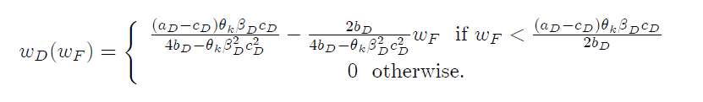
Equilibrium Analysis: Third Stage
Inserting (1) into (2) yields BRF for water

Slide 21
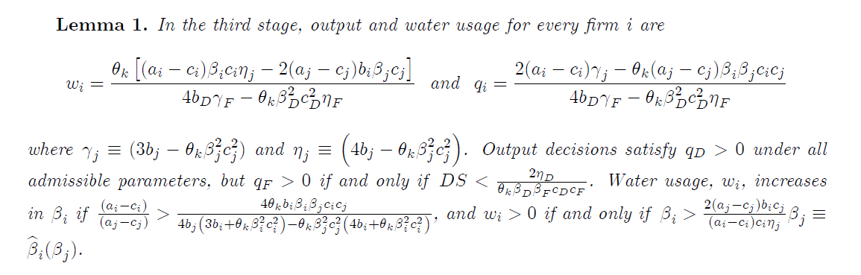


Lemma 1

Slide 22
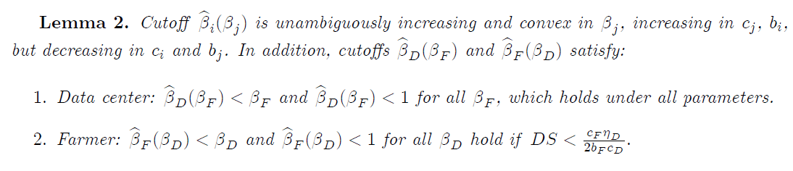
Lemma 2

Slide 23
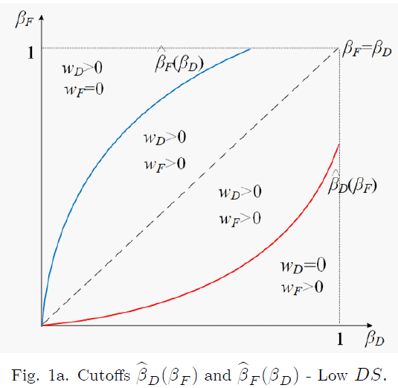
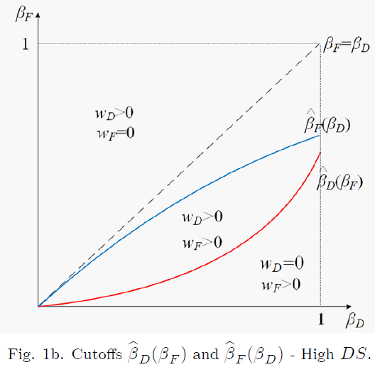
Figures

Slide 24
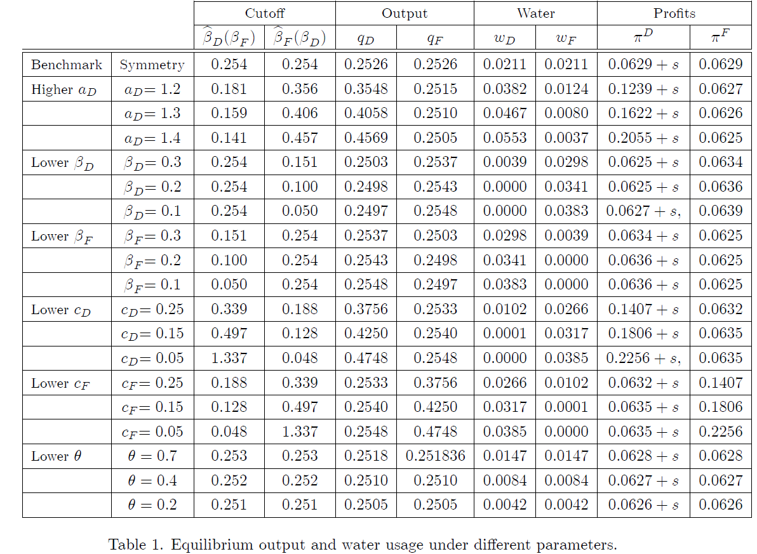




Benchmark: $a_{D}=a_{F}=1, { c}_{D}={ c}_{F}=0.5,b_{D}=b_{F}=1,$
$${ β}_{D}={ β}_{F}=0.5, and θ=1.$$

Slide 25
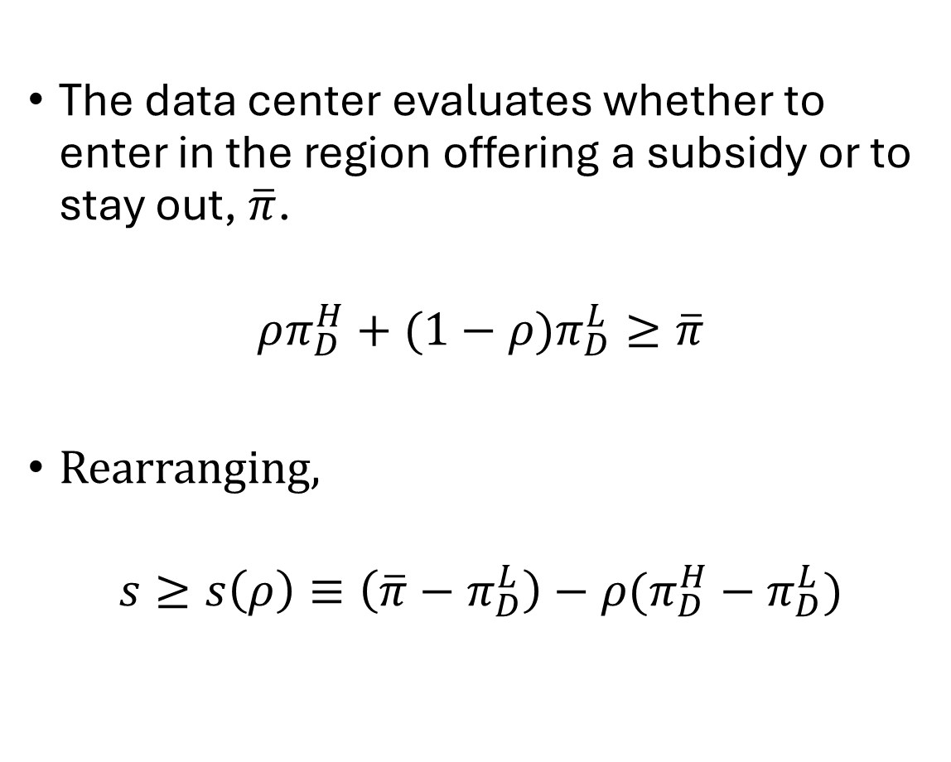
Equilibrium Analysis: Second Stage
The data center evaluates whether to enter in the region offering a subsidy or to stay out, $\overline{π}$.
$$ρπ_{D}^{H}+(1−ρ)π_{D}^{L}≥\overline{π}$$
Rearranging,
$$s≥s\left(ρ\right)≡\left(\overline{π}−π_{D}^{L}\right)−ρ(π_{D}^{H}−π_{D}^{L})$$

Slide 26
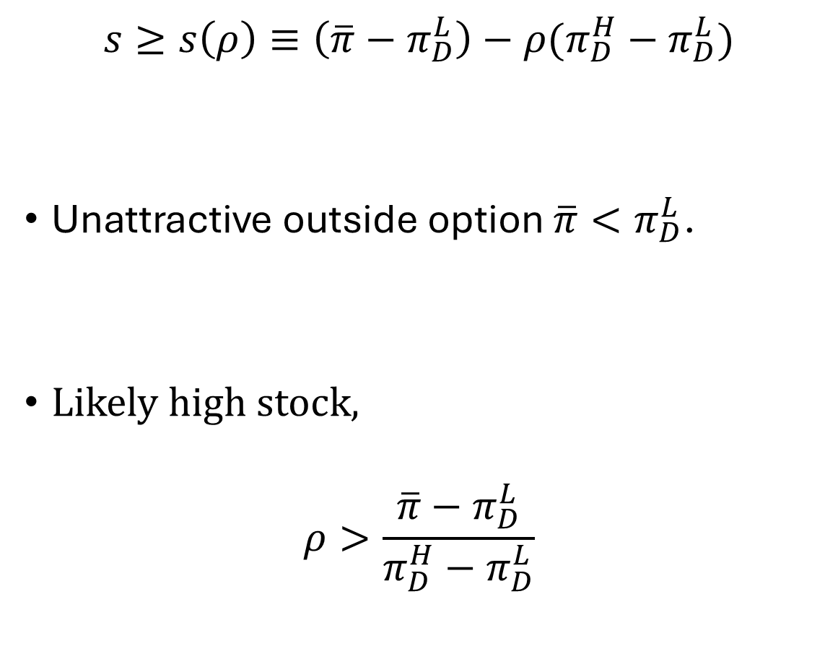
Always Entry
$$s≥s\left(ρ\right)≡\left(\overline{π}−π_{D}^{L}\right)−ρ(π_{D}^{H}−π_{D}^{L})$$
Unattractive outside option $\overline{π}<π_{D}^{L}$.
Likely high stock,
$$ρ>\frac{\overline{π}−π_{D}^{L}}{π_{D}^{H}−π_{D}^{L}}$$

Slide 27
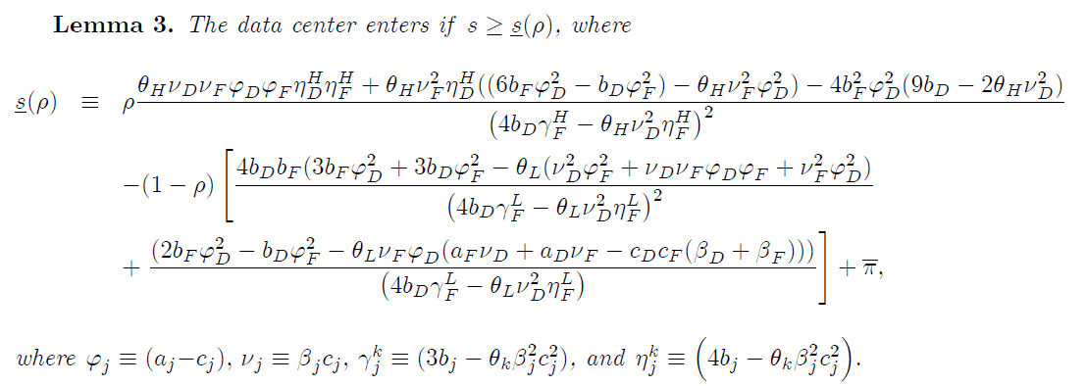
Lemma 3

Slide 28
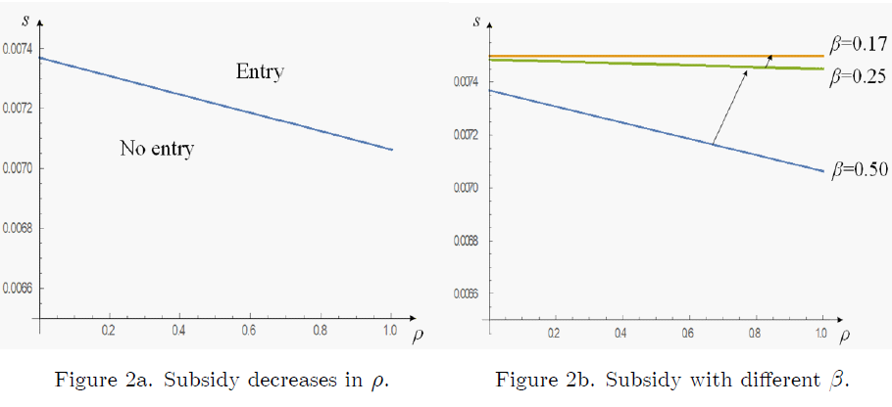

Figures: $\overline{π}=0,07$

Slide 29
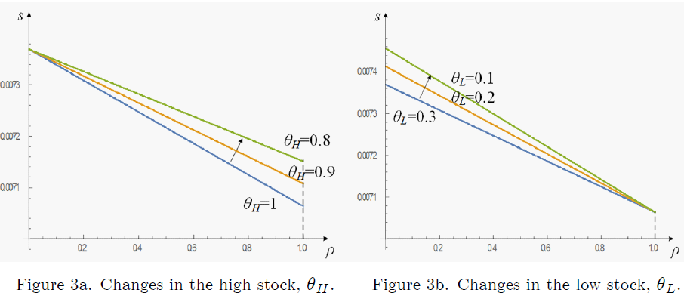
Figures: Changes in Stock

Slide 30
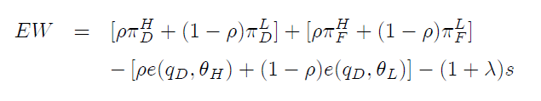
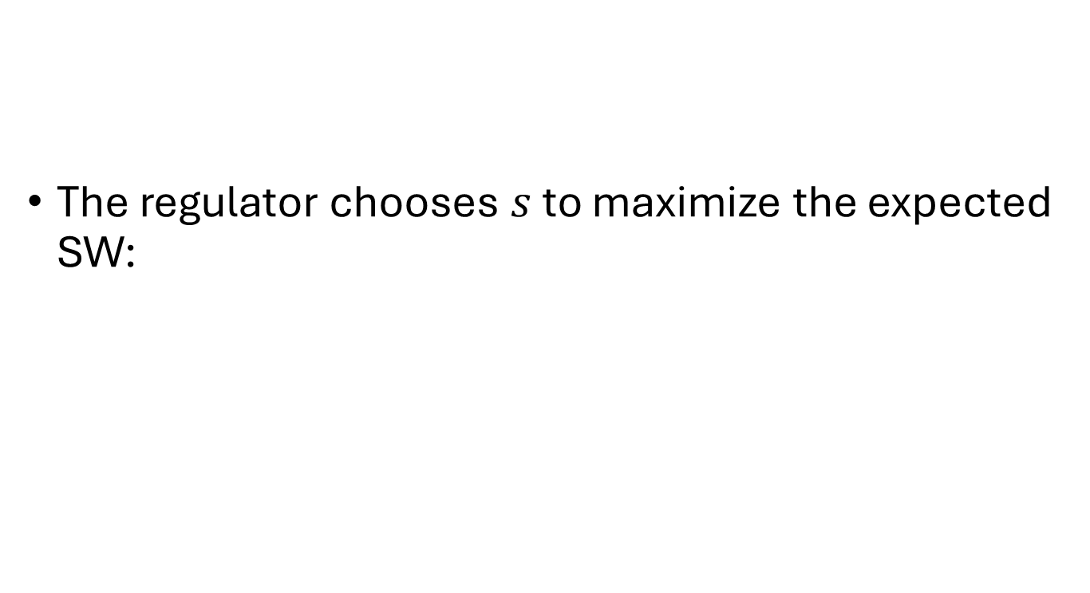
Equilibrium Analysis: First Stage
The regulator chooses $s$ to maximize the expected SW:

Slide 31
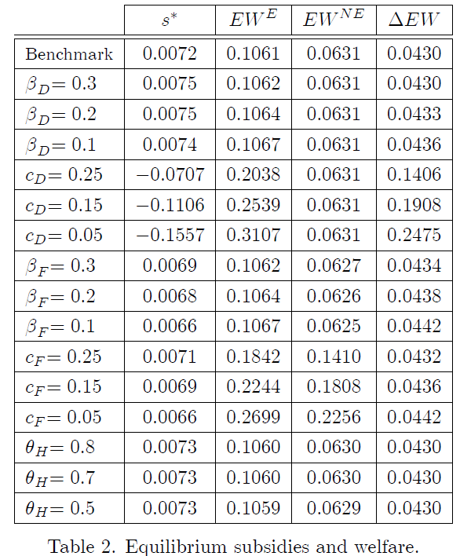

Benchmark: ${α=ρ=λ=0.5,a}_{D}=a_{F}=1, { c}_{D}={ c}_{F}=0.5,b_{D}=b_{F}=1,θ_{H}=1 and θ_{L}=0.3$

Slide 32
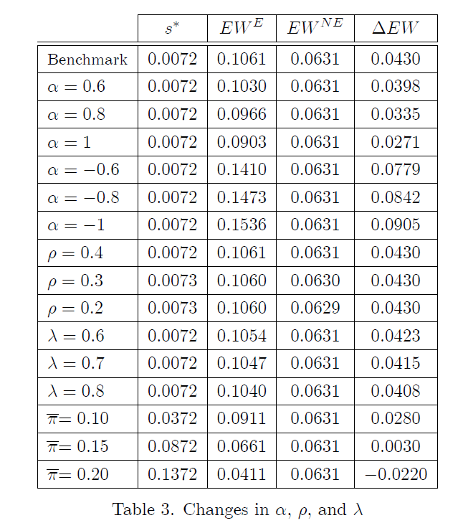

Benchmark: ${α=ρ=λ=0.5,a}_{D}=a_{F}=1, { c}_{D}={ c}_{F}=0.5,b_{D}=b_{F}=1,θ_{H}=1 and θ_{L}=0.3$

Slide 33
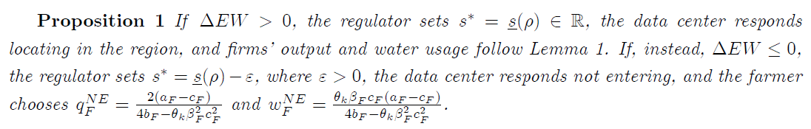
Proposition 1

Slide 34
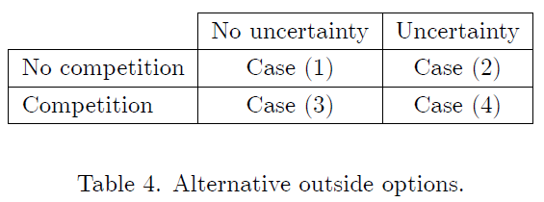
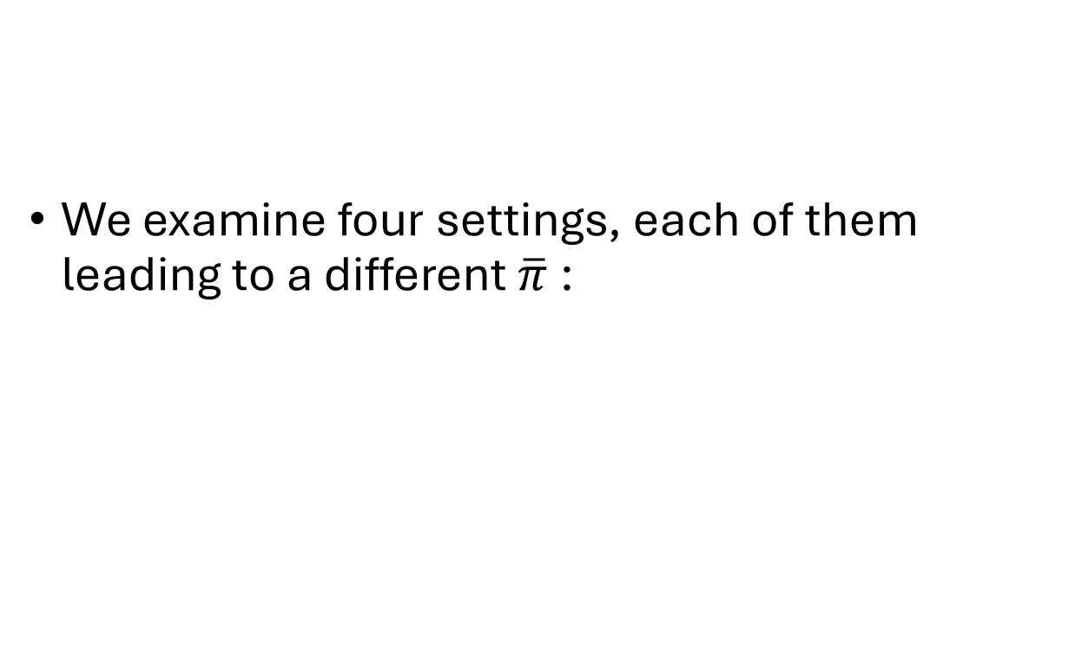
Extension I:
Alternative outside options
We examine four settings, each of them leading to a different $\overline{π}$:

Slide 35
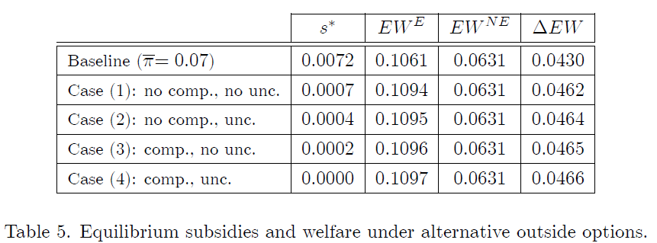
Across all four cases, entry is welfare-improving

Slide 36

Extension III:
Cost-reducing subsidy
The incentive program does not provide a lump-sum subsidy but, instead, reduces the data center’s marginal cost of production.
A more generous subsidy is required to induce entry when the data center is subsidized in its output than in its entry costs.

Slide 37
Discussion
Across-congestion effects:
  Emerges when the DC increases its water extraction.
  Raising the farmer’s marginal extraction costs, inducing the farmer to reduce water use.
Within-congestion effects:
  Emerges when there are multiple data centers and/or multiple farmers.
  Analogous to those in R&D races.

Slide 38
Discussion
Welfare gains from entry:
  Subsidizing entry of the first data centers may be welfare improving.
  Subsequent entry becomes progressively more expensive to subsidized.
Policy designs should make entry progressively more difficult.
  For example, by lowering entry subsidies as the number of incumbent data centers increases;
  Limiting eligibility of entry subsidies to early entrants alone or incorporating subsidy caps.

Slide 39
Discussion
Reallocation of water:
  Our model helps understand how DCs change water use patterns, even when the DC and farmer do not compete in the same market.
  A stronger demand for data-center services can increase pressure on local water resources, shifting extraction away from agriculture, even when they do not directly compete in the same market.

Slide 40
Discussion
Role of uncertainty:
  Produces two opposing effects on profits and entry.
    A higher likelihood of an abundant stock increases expected profits by making extraction cheaper in expectation, which tends to encourage entry.
    But also raises expected extraction and therefore strengthens expected congestion, reducing profits and discourage entry.
  Since (i) dominates, the regulator should offer less generous entry subsidies.

Slide 41
Discussion
Policy instrument choice:
  A lump-sum entry subsidy affects the entry without directly distorting post-entry extraction and output choices.
  A cost-reducing subsidy changes marginal incentives after entry; the DC expand output and water use, inducing the farmer to decrease its extraction.
  A more generous cost-reducing subsidy than a lump-sum transfer.
  Cost-reducing subsidy can exacerbate overuse of water resources relative to the lump-sum policy.

Slide 42

Questions?

Slide 43
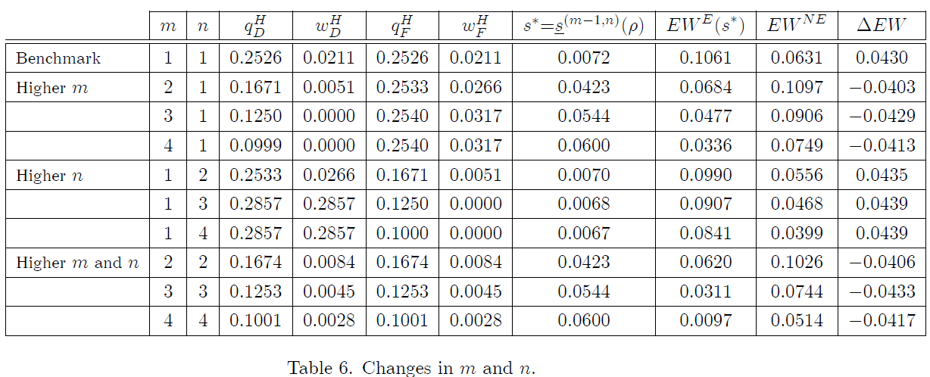
Extension II: More data centers and farmers

