Slide 1

Cournot versus Bertrand

Slide 2
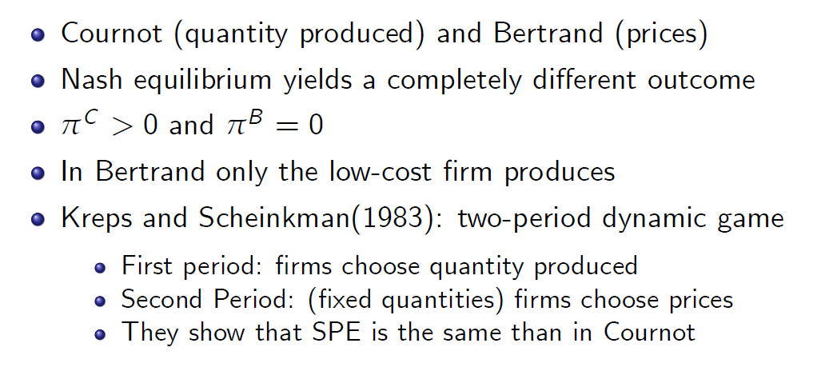
Cournot versus Bertrand

Slide 3
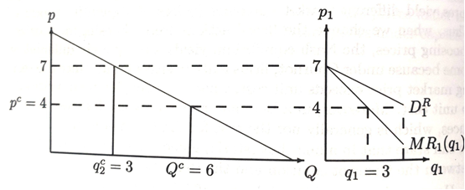
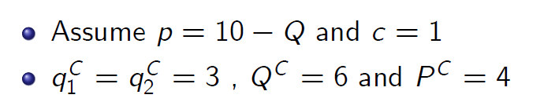
Kreps and Scheinkman(1983)

Slide 4
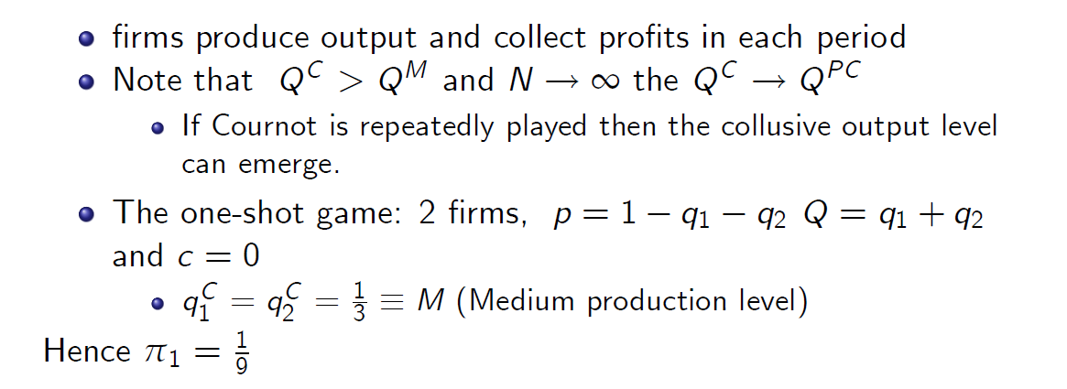
Self-Enforcing Collusion

Slide 5
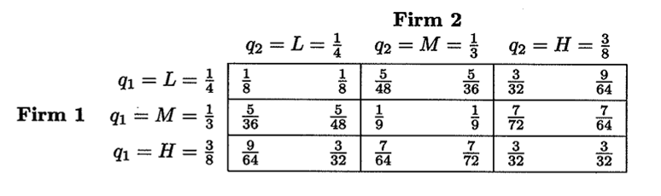
Self-Enforcing Collusion

Slide 6

International Trade in Homogeneous Products
Application of Cournot to International Trade (Brander and Krugman, 1983)

Slide 7
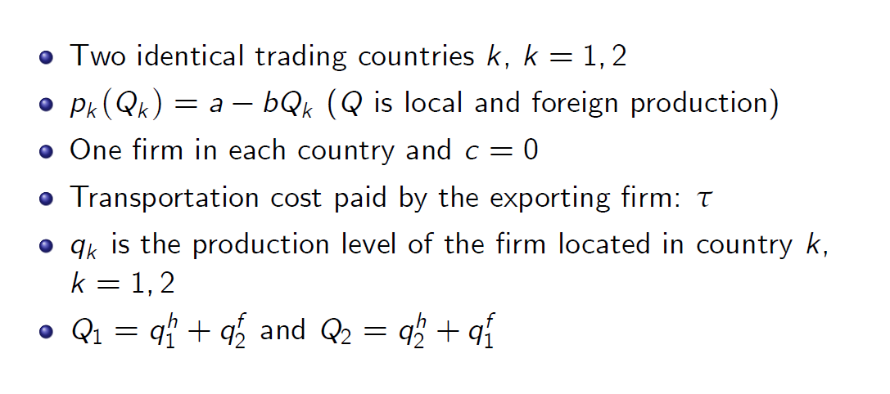
International Trade in Homogeneous Products

Slide 8
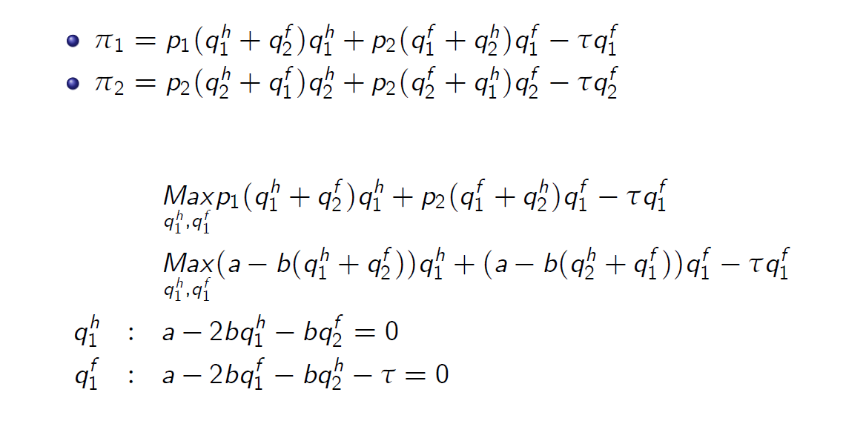
International Trade in Homogeneous Products

Slide 9
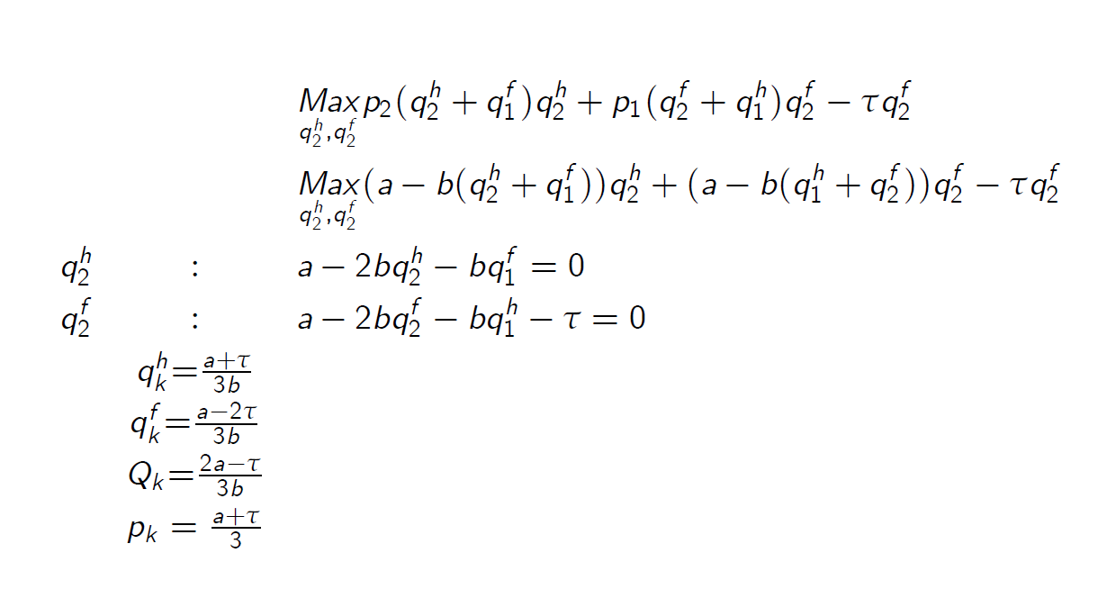
International Trade in Homogeneous Products

Slide 10
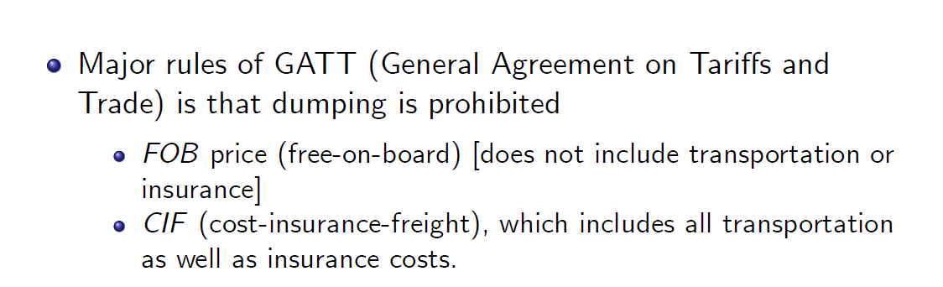

Dumping

Slide 11
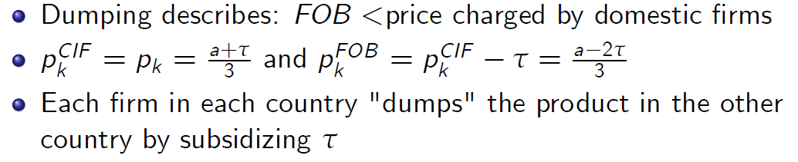
Dumping

Slide 12
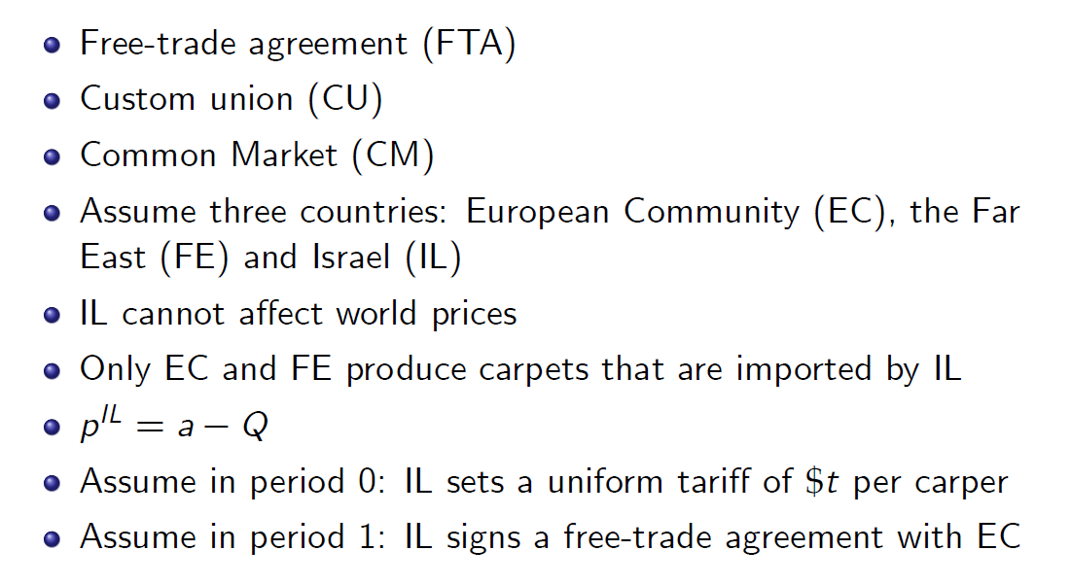
Homogeneous products and preferential trade agreements among countries

Slide 13
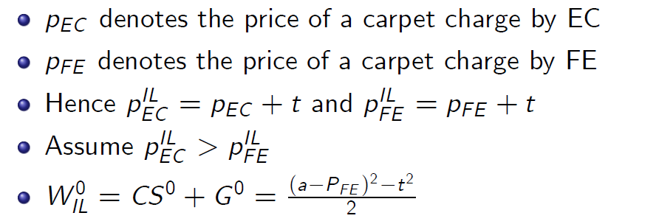
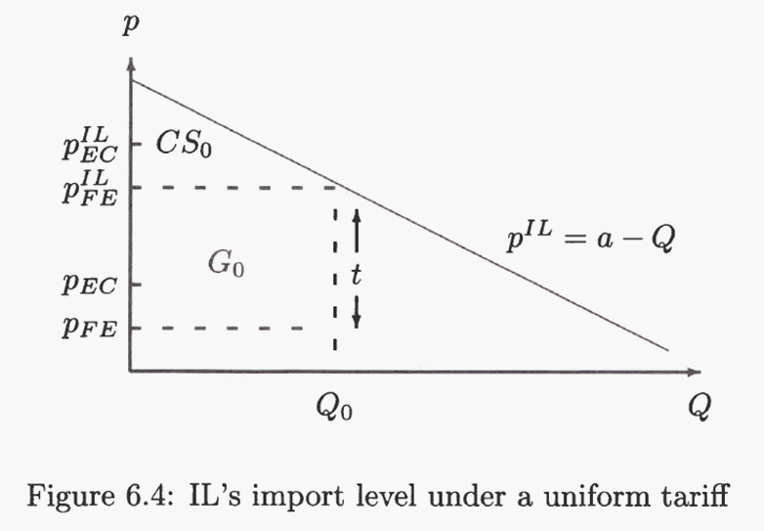
Period 0: uniform tariff

Slide 14
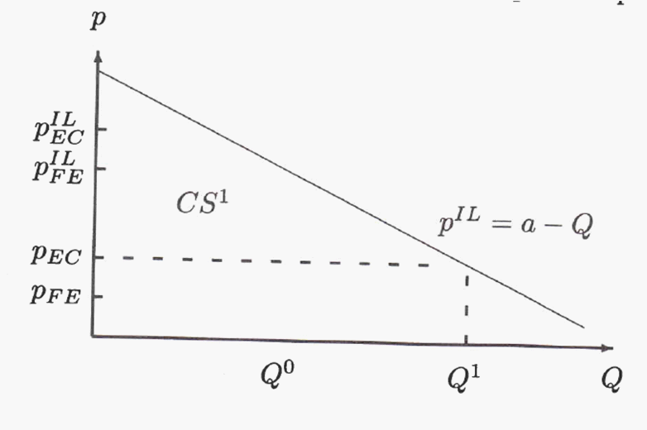
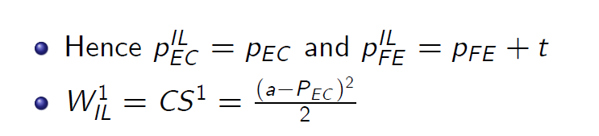
Period 1: free-trade with EC

Slide 15
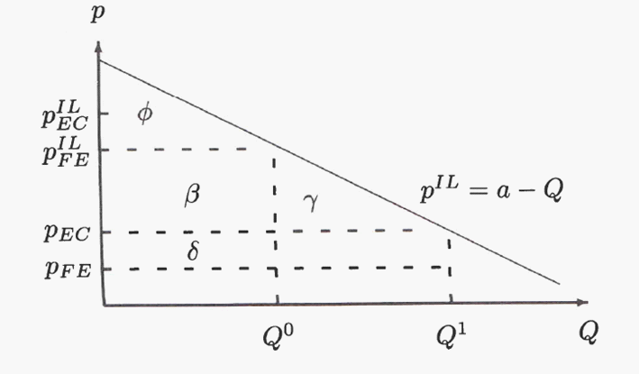

Welfare Analysis of the free-trade agreement

Slide 16
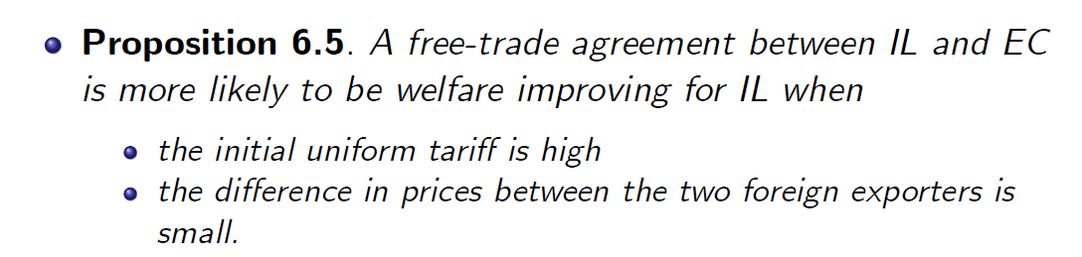
Welfare Analysis of the free-trade agreement

