Slide 1
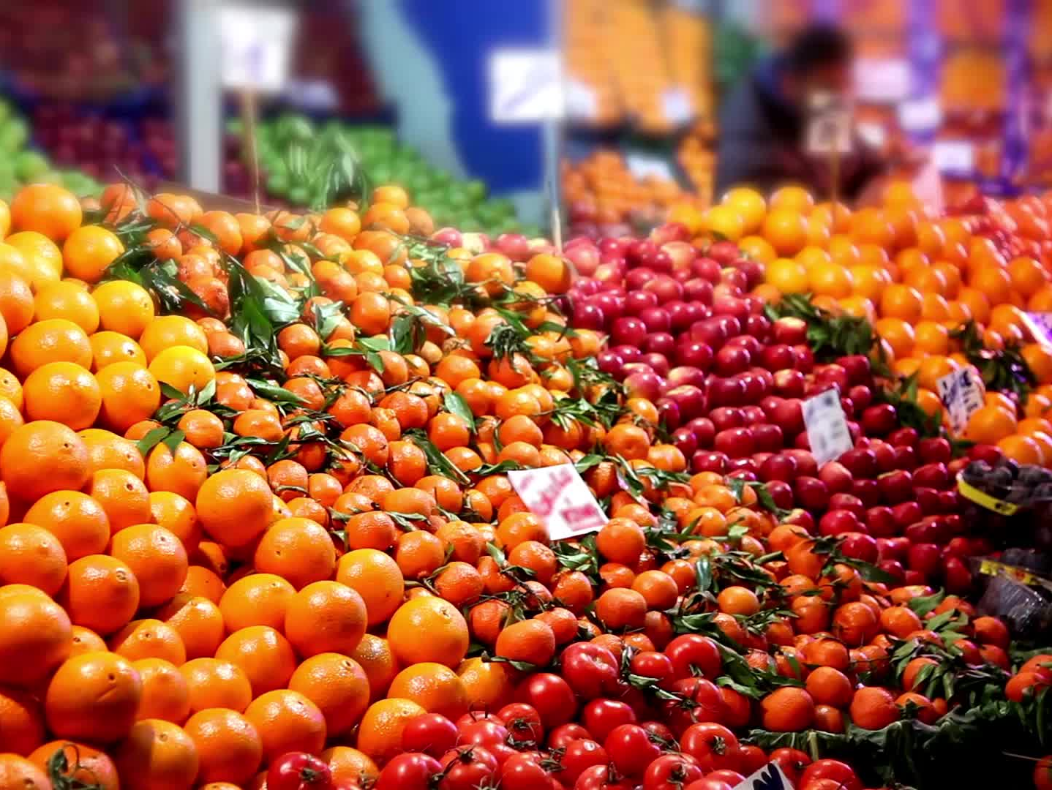
Markets for Homogeneous Products

Slide 2

Models of Imperfect Competition

Slide 3

Important Information
Quiz #2: Tuesday October 20th.
Thursday October 22nd: No class.
Homework #2 is due on Tuesday October 27th.
Midterm #1: Tuesday October 27th. Chapters: 2, 3, 4, 5, 6 and 7.

Slide 4
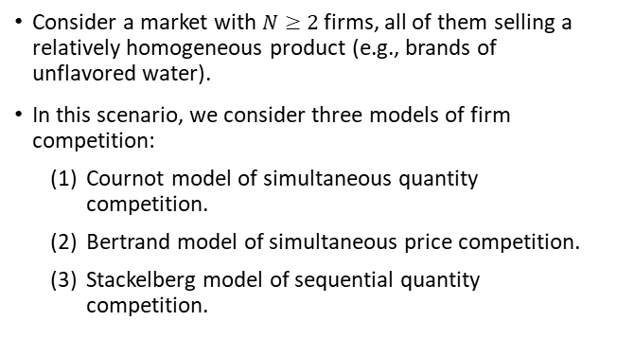
Models of Imperfect Competition
Consider a market with $N≥2$ firms, all of them selling a relatively homogeneous product (e.g., brands of unflavored water).
In this scenario, we consider three models of firm competition:
  Cournot model of simultaneous quantity competition.
  Bertrand model of simultaneous price competition.
  Stackelberg model of sequential quantity competition.

Slide 5

Cournot Model–
Simultaneous Quantity Competition

Slide 6
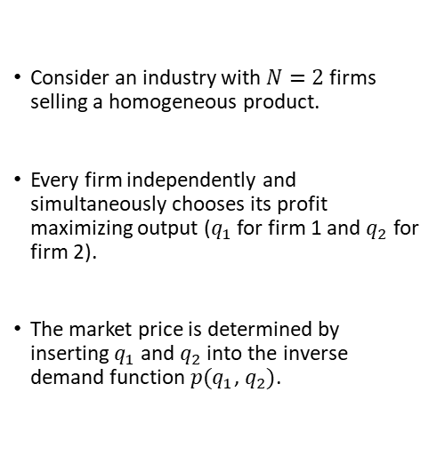
Cournot Model
Consider an industry with $N=2$ firms selling a homogeneous product.
Every firm independently and simultaneously chooses its profit maximizing output ($q_{1}$ for firm 1 and $q_{2}$ for firm 2).
The market price is determined by inserting $q_{1}$ and $q_{2}$ into the inverse demand function $p(q_{1}$, $q_{2})$.

Slide 7
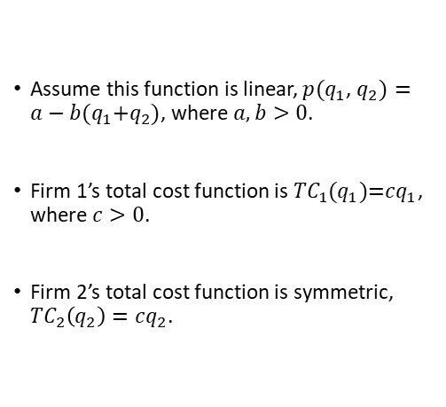
Cournot Model
Assume this function is linear, $p(q_{1}$, $q_{2})=a−b(q_{1}\text{+}q_{2})$, where $a,b>0$.
Firm 1’s total cost function is ${TC}_{1}(q_{1}\text{)=}cq_{1}$, where $c>0$.
Firm 2’s total cost function is symmetric, ${TC}_{2}\left(q_{2}\right)=cq_{2}$.

Slide 8

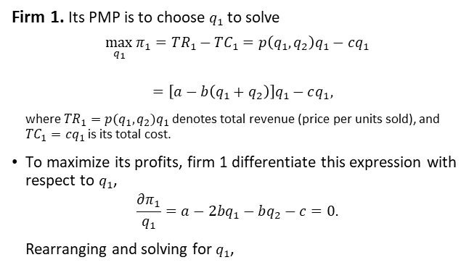

Cournot Model
Firm 1. Its PMP is to choose $q_{1}$ to solve
$$\max_{q_{1}}{π_{1}={TR}_{1}−{TC}_{1}=p\left(q_{1},q_{2}\right)q_{1}−cq_{1}}$$
$$=\left[a−b\left(q_{1}+q_{2}\right)\right]q_{1}−cq_{1},$$
where ${TR}_{1}=p(q_{1},q_{2})q_{1}$ denotes total revenue (price per units sold), and ${TC}_{1}=cq_{1}$ is its total cost.
To maximize its profits, firm 1 differentiate this expression with respect to $q_{1}$,
$$\frac{∂π_{1}}{q_{1}}=a−2bq_{1}−bq_{2}−c=0.$$
Rearranging and solving for $q_{1}$,
$${TR}_{1}$$
$${TC}_{1}$$

Slide 9

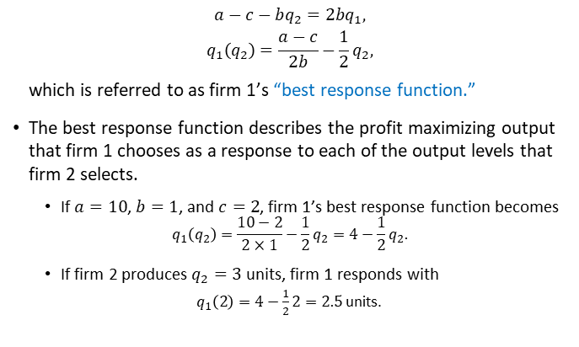
Cournot Model
$$a−c−bq_{2}=2bq_{1},$$
$$q_{1}\left(q_{2}\right)=\frac{a−c}{2b}−\frac{1}{2}q_{2},$$
which is referred to as firm 1’s “best response function.”
The best response function describes the profit maximizing output that firm 1 chooses as a response to each of the output levels that firm 2 selects.
  If $a=10$, $b=1$, and $c=2$, firm 1’s best response function becomes
  $$q_{1}\left(q_{2}\right)=\frac{10−2}{2×1}−\frac{1}{2}q_{2}=4−\frac{1}{2}q_{2}.$$
  If firm 2 produces $q_{2}=3$ units, firm 1 responds with
  $q_{1}\left(2\right)=4−\frac{1}{2}2=2.5$ units.
(${BRF}_{1})$

Slide 10
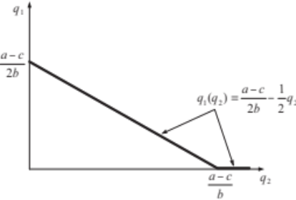
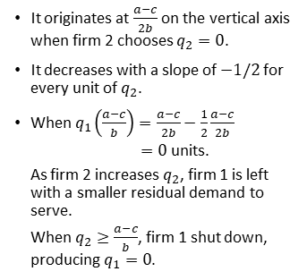
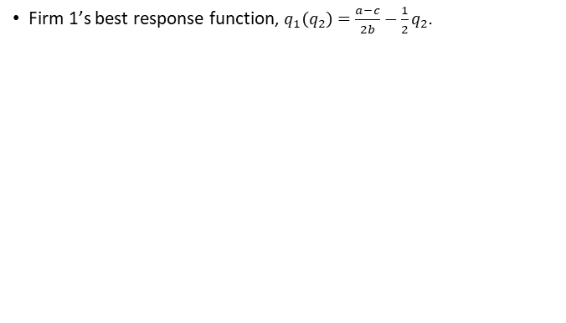
Cournot Model
Firm 1’s best response function, $q_{1}\left(q_{2}\right)=\frac{a−c}{2b}−\frac{1}{2}q_{2}.$
It originates at $\frac{a−c}{2b}$ on the vertical axis when firm 2 chooses $q_{2}=0$.
It decreases with a slope of $−1/2$ for every unit of $q_{2}$.
When $q_{1}\left(\frac{a−c}{b}\right)=\frac{a−c}{2b}−\frac{1}{2}\frac{a−c}{2b}$
$=0$ units.
As firm 2 increases $q_{2}$, firm 1 is left with a smaller residual demand to serve.
When $q_{2}≥\frac{a−c}{b}$, firm 1 shut down, producing $q_{1}=0$.

Slide 11

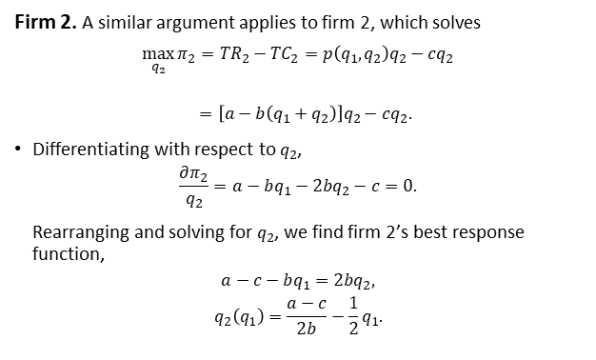


Cournot Model
Firm 2. A similar argument applies to firm 2, which solves
$$\max_{q_{2}}{π_{2}={TR}_{2}−{TC}_{2}=p\left(q_{1},q_{2}\right)q_{2}−cq_{2}}$$
$$=\left[a−b\left(q_{1}+q_{2}\right)\right]q_{2}−cq_{2}.$$
Differentiating with respect to $q_{2}$,
$$\frac{∂π_{2}}{q_{2}}=a−bq_{1}−2bq_{2}−c=0.$$
Rearranging and solving for $q_{2}$, we find firm 2’s best response function,
$$a−c−bq_{1}=2bq_{2},$$
$$q_{2}\left(q_{1}\right)=\frac{a−c}{2b}−\frac{1}{2}q_{1}.$$
$${TR}_{2}$$
$${TC}_{2}$$
(${BRF}_{2})$

Slide 12
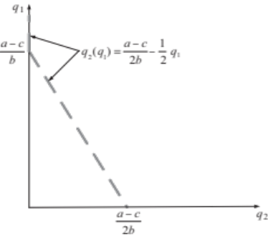
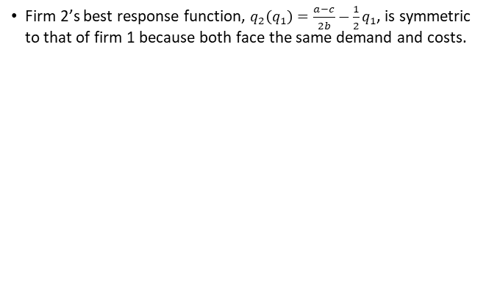
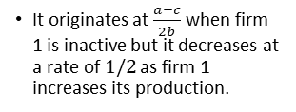
Cournot Model
Firm 2’s best response function, $q_{2}\left(q_{1}\right)=\frac{a−c}{2b}−\frac{1}{2}q_{1}$, is symmetric to that of firm 1 because both face the same demand and costs.
It originates at $\frac{a−c}{2b}$ when firm 1 is inactive but it decreases at a rate of $1/2$ as firm 1 increases its production.

Slide 13
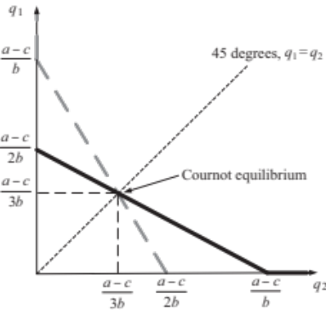
Cournot Model
Superimposing firm 1’s and firm 2’s best response functions, we obtain their crossing point: Cournot Equilibrium.
Both firms are choosing output levels that are the best response to the output of its rival (i.e., firms are selecting mutual best responses, which is the Nash Equilibrium (NE) of a game).

Slide 14

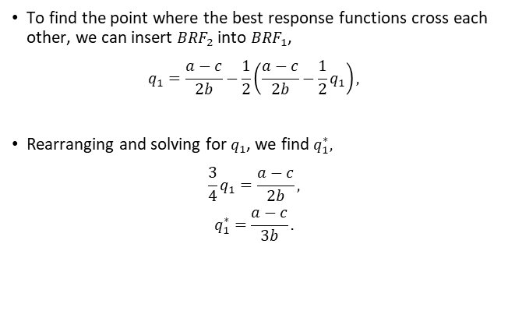
Cournot Model
To find the point where the best response functions cross each other, we can insert ${BRF}_{2}$ into ${BRF}_{1}$,
$$q_{1}=\frac{a−c}{2b}−\frac{1}{2}\left(\frac{a−c}{2b}−\frac{1}{2}q_{1}\right),$$
Rearranging and solving for $q_{1}$, we find $q_{1}^{∗},$
$$\frac{3}{4}q_{1}=\frac{a−c}{2b},$$
$$q_{1}^{∗}=\frac{a−c}{3b}.$$
$$q_{2}$$

Slide 15

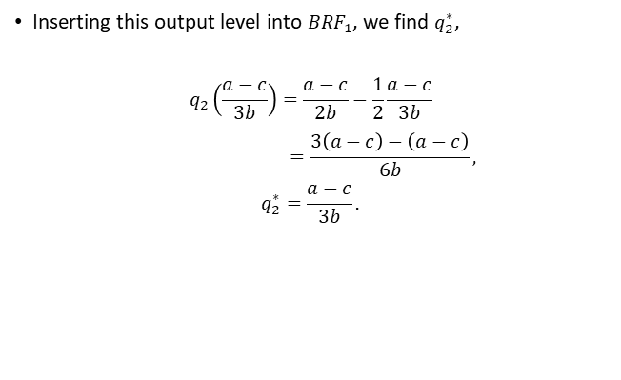
Cournot Model
Inserting this output level into ${BRF}_{1}$, we find $q_{2}^{∗}$,
$$q_{2}\left(\frac{a−c}{3b}\right)=\frac{a−c}{2b}−\frac{1}{2}\frac{a−c}{3b}$$
$$=\frac{3\left(a−c\right)−\left(a−c\right)}{6b},$$
$$q_{2}^{∗}=\frac{a−c}{3b}.$$
$$q_{1}^{∗}$$

Slide 16
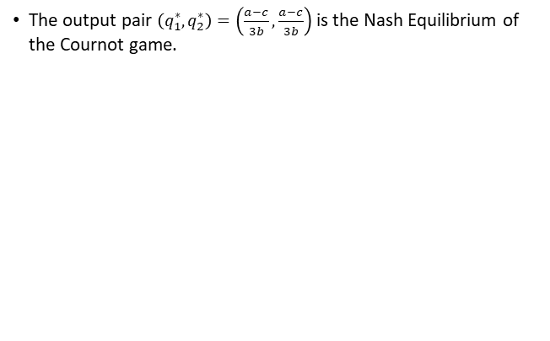
Cournot Model
The output pair $\left(q_{1}^{∗},q_{2}^{∗}\right)=\left(\frac{a−c}{3b},\frac{a−c}{3b}\right)$ is the Nash Equilibrium of the Cournot game.

Slide 17
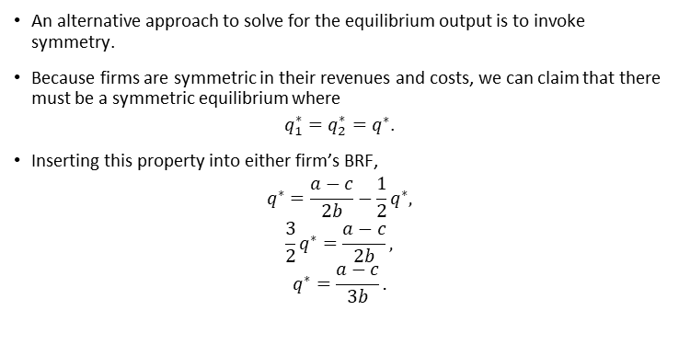
Cournot Model
An alternative approach to solve for the equilibrium output is to invoke symmetry.
Because firms are symmetric in their revenues and costs, we can claim that there must be a symmetric equilibrium where
$q_{1}^{∗}=q_{2}^{∗}=q^{∗}$.
Inserting this property into either firm’s BRF,
$$q^{∗}=\frac{a−c}{2b}−\frac{1}{2}q^{∗},$$
$$\frac{3}{2}q^{∗}=\frac{a−c}{2b},$$
$$q^{∗}=\frac{a−c}{3b}.$$

Slide 18
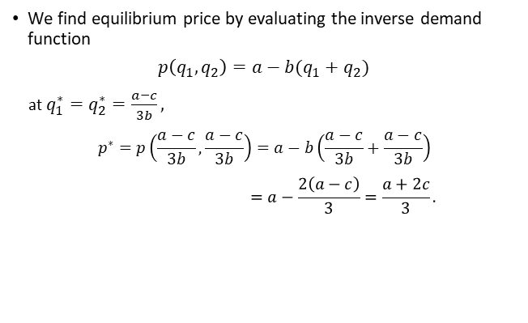
Cournot Model
We find equilibrium price by evaluating the inverse demand function
$p\left(q_{1},q_{2}\right)=a−b(q_{1}+q_{2})$
at $q_{1}^{∗}=q_{2}^{∗}=\frac{a−c}{3b},$
$$p^{∗}=p\left(\frac{a−c}{3b},\frac{a−c}{3b}\right)=a−b\left(\frac{a−c}{3b}+\frac{a−c}{3b}\right)$$
$$=a−\frac{2\left(a−c\right)}{3}=\frac{a+2c}{3}.$$

Slide 19
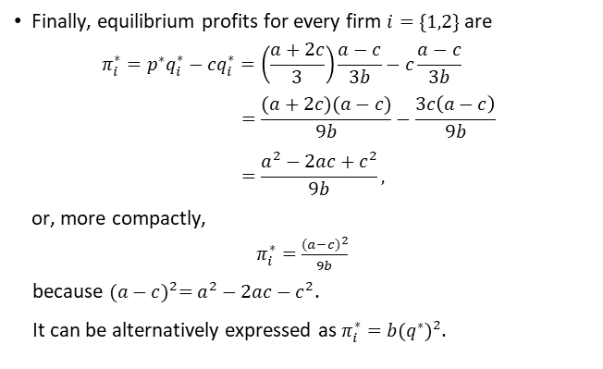
Cournot Model
Finally, equilibrium profits for every firm $i=\{1,2\}$ are
$$π_{i}^{∗}=p^{∗}q_{i}^{∗}−cq_{i}^{∗}=\left(\frac{a+2c}{3}\right)\frac{a−c}{3b}−c\frac{a−c}{3b}$$
$$=\frac{(a+2c)(a−c)}{9b}−\frac{3c\left(a−c\right)}{9b}$$
$$=\frac{a^{2}−2ac+c^{2}}{9b},$$
or, more compactly,
$π_{i}^{∗}=\frac{{(a−c)}^{2}}{9b}$
because ${(a−c)}^{2}=a^{2}−2ac−c^{2}$.
It can be alternatively expressed as $π_{i}^{∗}={b(q^{∗})}^{2}$.

Slide 20
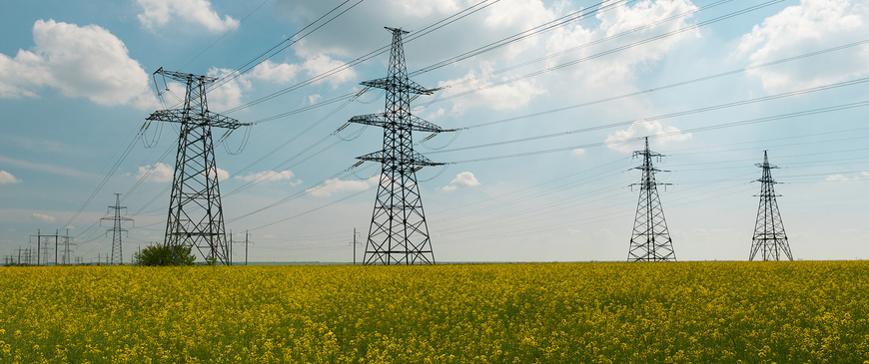
Cournot Model - Application
Let’s consider the Wholesale Electricity Spot Market.
High WTP: During extreme weather or supply crunches, grid operators and utilities will pay astronomical prices.
Inelastic Demand: In the short term, consumers and businesses cannot instantly change their power consumption.
Super efficient: Uses sophisticated, automated locational marginal pricing (LMP) algorithms.

Slide 21
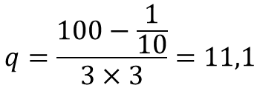


Cournot Model - Application
Therefore, we can consider:
$a=100, b=3$ and $c=\frac{1}{10}$
$$q=\frac{100−\frac{1}{10}}{3×3}=11,1$$
$π={3×\left(11,1\right)}^{2}=369,6$3

Slide 22

Cournot Model - Application
Let’s consider Public Trash Bags (Pay-As-You-Throw Programs).
Low WTP: legally required to buy specific, municipality-branded trash bags to have their garbage collected, WTP is rock bottom.
Inelastic Demand: residents have no legal alternative for waste disposal.
Super efficient: Algorithmic pricing models adjust ticket costs on real-time browsing volume.

Slide 23
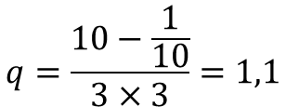


Cournot Model - Application
Therefore, we can consider:
$a=10, b=3$and $c=\frac{1}{10}$
$$q=\frac{10−\frac{1}{10}}{3×3}=1,1$$
$$π={\frac{1}{3}×\left(1,1\right)}^{2}=0,403$$

Slide 24
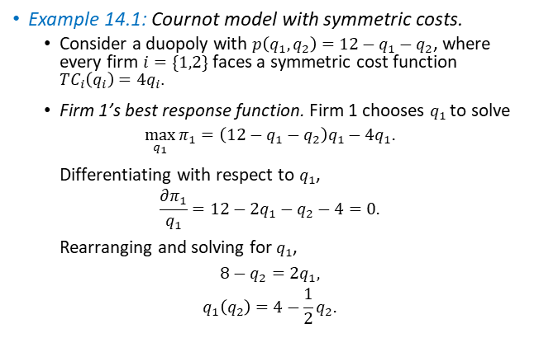
Cournot Model
Example 14.1: Cournot model with symmetric costs.
  Consider a duopoly with $p\left(q_{1},q_{2}\right)=12−q_{1}−q_{2}$, where every firm $i=\{1,2\}$ faces a symmetric cost function ${TC}_{i}\left(q_{i}\right)=4q_{i}$.
  Firm 1’s best response function. Firm 1 chooses $q_{1}$ to solve
  $$\max_{q_{1}}{π_{1}=\left(12−q_{1}−q_{2}\right)q_{1}−4q_{1}.}$$
  Differentiating with respect to $q_{1}$,
  $$\frac{∂π_{1}}{q_{1}}=12−2q_{1}−q_{2}−4=0.$$
  Rearranging and solving for $q_{1}$,
  $$8−q_{2}=2q_{1},$$
  $$q_{1}\left(q_{2}\right)=4−\frac{1}{2}q_{2}.$$
(${BRF}_{1})$

Slide 25

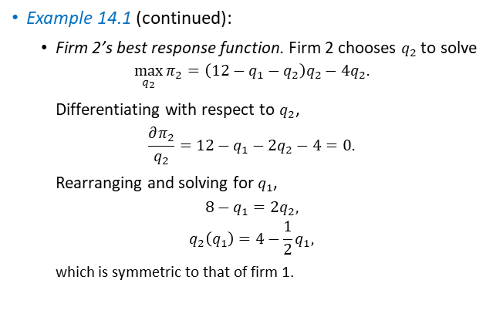
Cournot Model
Example 14.1 (continued):
  Firm 2’s best response function. Firm 2 chooses $q_{2}$ to solve
  $$\max_{q_{2}}{π_{2}=\left(12−q_{1}−q_{2}\right)q_{2}−4q_{2}.}$$
  Differentiating with respect to $q_{2}$,
  $$\frac{∂π_{2}}{q_{2}}=12−q_{1}−{2q}_{2}−4=0.$$
  Rearranging and solving for $q_{1}$,
  $$8−q_{1}=2q_{2},$$
  $$q_{2}\left(q_{1}\right)=4−\frac{1}{2}q_{1},$$
  which is symmetric to that of firm 1.
(${BRF}_{2})$

Slide 26
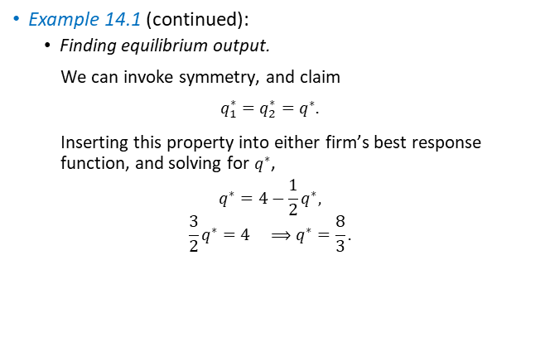
Cournot Model
Example 14.1 (continued):
  Finding equilibrium output.
  We can invoke symmetry, and claim
  $q_{1}^{∗}=q_{2}^{∗}=q^{∗}.$
  Inserting this property into either firm’s best response function, and solving for $q^{∗}$,
  $$q^{∗}=4−\frac{1}{2}q^{∗},$$
  $$\frac{3}{2}q^{∗}=4 ⟹q^{∗}=\frac{8}{3}.$$

Slide 27
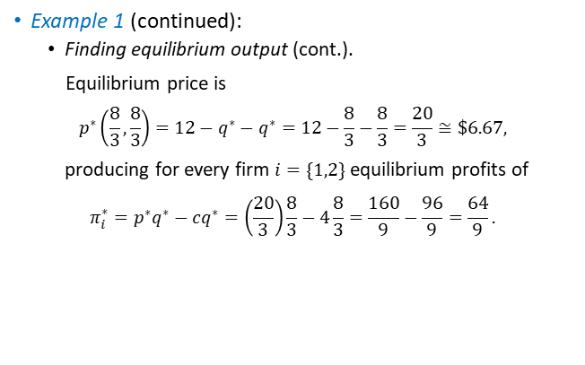
Cournot Model
Example 1 (continued):
  Finding equilibrium output (cont.).
  Equilibrium price is
  $$p^{∗}\left(\frac{8}{3},\frac{8}{3}\right)=12−q^{∗}−q^{∗}=12−\frac{8}{3}−\frac{8}{3}=\frac{20}{3}≅\$6.67,$$
  producing for every firm $i=\{1,2\}$ equilibrium profits of
  $$π_{i}^{∗}=p^{∗}q^{∗}−cq^{∗}=\left(\frac{20}{3}\right)\frac{8}{3}−4\frac{8}{3}=\frac{160}{9}−\frac{96}{9}=\frac{64}{9}.$$

Slide 28
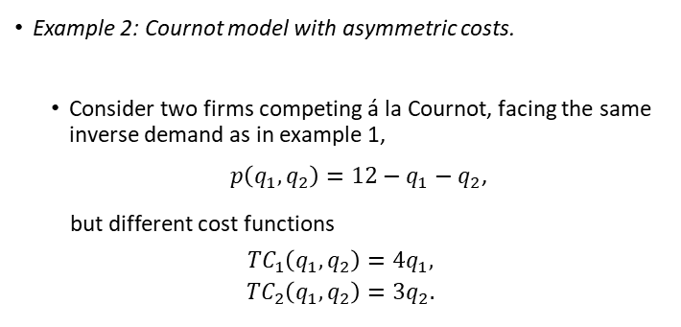
Cournot Model
Example 2: Cournot model with asymmetric costs.
  Consider two firms competing á la Cournot, facing the same inverse demand as in example 1,
  $p\left(q_{1},q_{2}\right)=12−q_{1}−q_{2}$,
  but different cost functions
  $${TC}_{1}\left(q_{1},q_{2}\right)=4q_{1},$$
  $${TC}_{2}\left(q_{1},q_{2}\right)=3q_{2}.$$

Slide 29
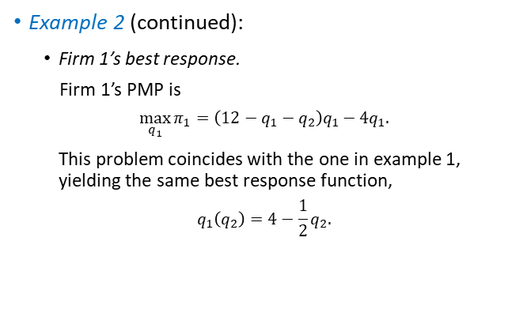
Cournot Model
Example 2 (continued):
  Firm 1’s best response.
  Firm 1’s PMP is
  $$\max_{q_{1}}{π_{1}=\left(12−q_{1}−q_{2}\right)q_{1}−4q_{1}.}$$
  This problem coincides with the one in example 1, yielding the same best response function,
  $$q_{1}\left(q_{2}\right)=4−\frac{1}{2}q_{2}.$$

Slide 30
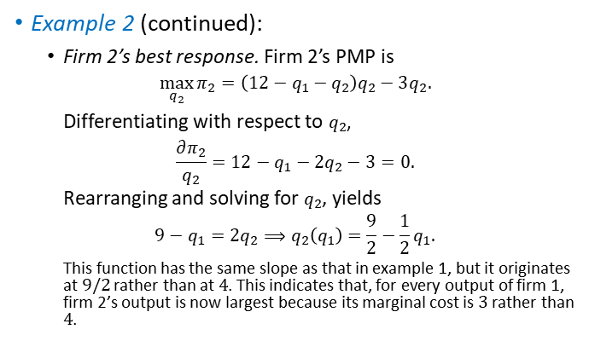
Cournot Model
Example 2 (continued):
  Firm 2’s best response. Firm 2’s PMP is
  $$\max_{q_{2}}{π_{2}=\left(12−q_{1}−q_{2}\right)q_{2}−3q_{2}.}$$
  Differentiating with respect to $q_{2}$,
  $$\frac{∂π_{2}}{q_{2}}=12−q_{1}−2q_{2}−3=0.$$
  Rearranging and solving for $q_{2}$, yields
  $$9−q_{1}=2q_{2}⟹q_{2}\left(q_{1}\right)=\frac{9}{2}−\frac{1}{2}q_{1}.$$
  This function has the same slope as that in example 1, but it originates at $9/2$ rather than at $4$. This indicates that, for every output of firm 1, firm 2’s output is now largest because its marginal cost is$3$rather than $4$.

Slide 31
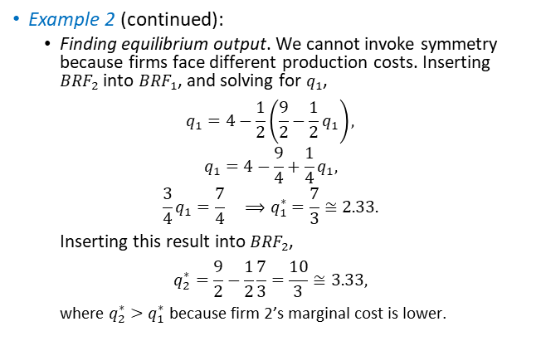
Cournot Model
Example 2 (continued):
  Finding equilibrium output. We cannot invoke symmetry because firms face different production costs. Inserting ${BRF}_{2}$ into ${BRF}_{1}$, and solving for $q_{1}$,
  $$q_{1}=4−\frac{1}{2}\left(\frac{9}{2}−\frac{1}{2}q_{1}\right),$$
  $$q_{1}=4−\frac{9}{4}+\frac{1}{4}q_{1},$$
  $$\frac{3}{4}q_{1}=\frac{7}{4} ⟹q_{1}^{∗}=\frac{7}{3}≅2.33.$$
  Inserting this result into ${BRF}_{2}$,
  $$q_{2}^{∗}=\frac{9}{2}−\frac{1}{2}\frac{7}{3}=\frac{10}{3}≅3.33,$$
  where $q_{2}^{∗}>q_{1}^{∗}$ because firm 2’s marginal cost is lower.

Slide 32
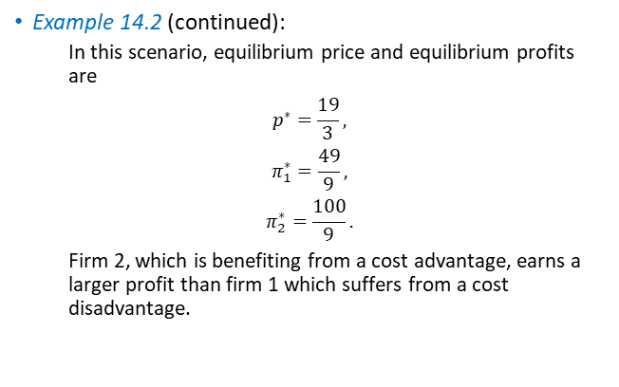
Cournot Model
Example 14.2 (continued):
  In this scenario, equilibrium price and equilibrium profits are
  $$p^{∗}=\frac{19}{3},$$
  $$π_{1}^{∗}=\frac{49}{9},$$
  $$π_{2}^{∗}=\frac{100}{9}.$$
  Firm 2, which is benefiting from a cost advantage, earns a larger profit than firm 1 which suffers from a cost disadvantage.

Slide 33
Bertrand Model–
Simultaneous Price Competition

Slide 34
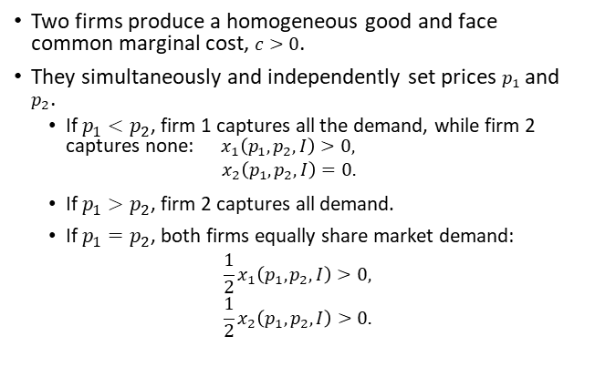
Bertrand Model
Two firms produce a homogeneous good and face common marginal cost, $c>0$.
They simultaneously and independently set prices $p_{1}$ and $p_{2}$.
  If $p_{1}<p_{2}$, firm 1 captures all the demand, while firm 2 captures none: $x_{1}\left(p_{1},p_{2},I\right)>0,$
  $$x_{2}\left(p_{1},p_{2},I\right)=0.$$
  If $p_{1}>p_{2}$, firm 2 captures all demand.
  If $p_{1}=p_{2}$, both firms equally share market demand:
  $$\frac{1}{2}x_{1}\left(p_{1},p_{2},I\right)>0,$$
  $$\frac{1}{2}x_{2}\left(p_{1},p_{2},I\right)>0.$$

Slide 35
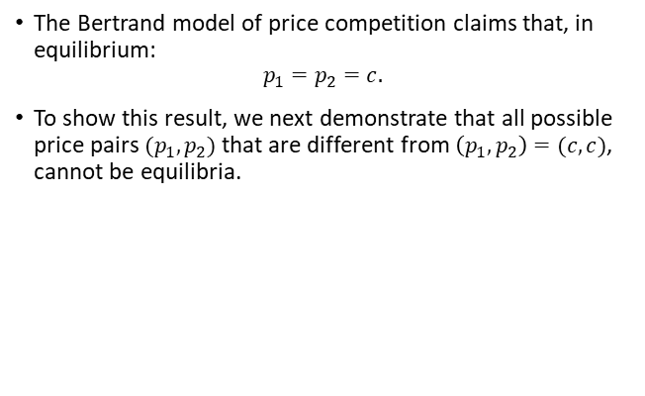
Bertrand Model
The Bertrand model of price competition claims that, in equilibrium:
$$p_{1}=p_{2}=c.$$
To show this result, we next demonstrate that all possible price pairs $(p_{1},p_{2})$ that are different from $\left(p_{1},p_{2}\right)=(c,c)$, cannot be equilibria.

Slide 36
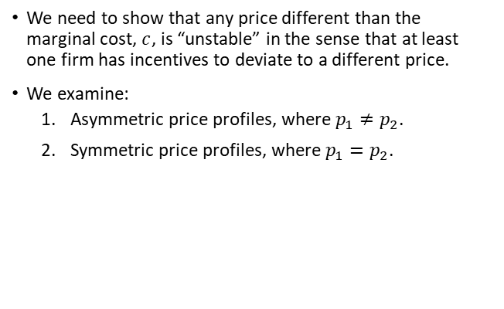
Bertrand Model
We need to show that any price different than the marginal cost, $c$, is “unstable” in the sense that at least one firm has incentives to deviate to a different price.
We examine:
  Asymmetric price profiles, where $p_{1}≠p_{2}$.
  Symmetric price profiles, where $p_{1}=p_{2}$.

Slide 37
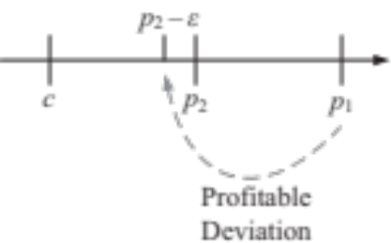
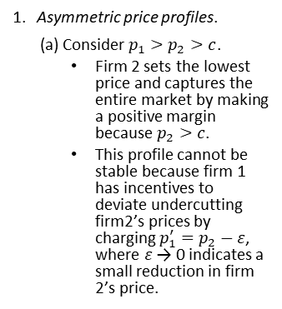
Bertrand Model
Asymmetric price profiles.
(a) Consider $p_{1}>p_{2}>c$.
  Firm 2 sets the lowest price and captures the entire market by making a positive margin because $p_{2}>c$.
  This profile cannot be stable because firm 1 has incentives to deviate undercutting firm2’s prices by charging $p_{1}^{′}=p_{2}−ε$, where $ε$ → 0 indicates a small reduction in firm 2’s price.

Slide 38
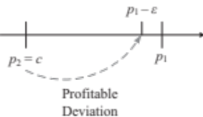
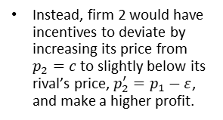
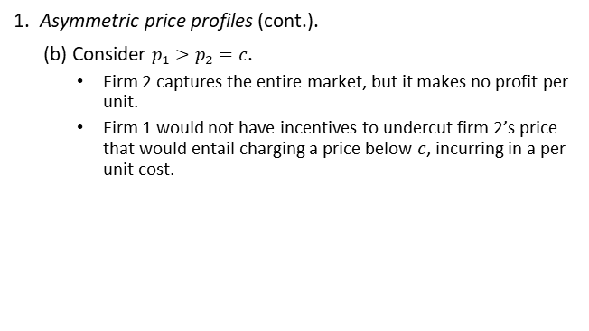
Bertrand Model
Asymmetric price profiles (cont.).
(b) Consider $p_{1}>p_{2}=c$.
  Firm 2 captures the entire market, but it makes no profit per unit.
  Firm 1 would not have incentives to undercut firm 2’s price that would entail charging a price below $c$, incurring in a per unit cost.
Instead, firm 2 would have incentives to deviate by increasing its price from $p_{2}=c$to slightly below its rival’s price, $p_{2}^{′}=p_{1}−ε$, and make a higher profit.

Slide 39
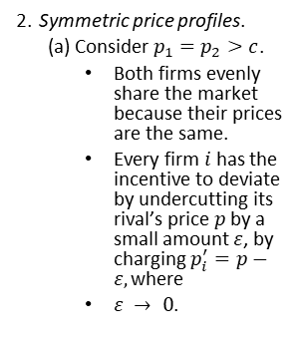
Bertrand Model
Symmetric price profiles.
(a) Consider $p_{1}=p_{2}>c$.
  Both firms evenly share the market because their prices are the same.
  Every firm $i$ has the incentive to deviate by undercutting its rival’s price $p$ by a small amount $ε$, by charging $p_{i}^{′}=p−ε,\text{where }$
  $ε → 0$.

Slide 40
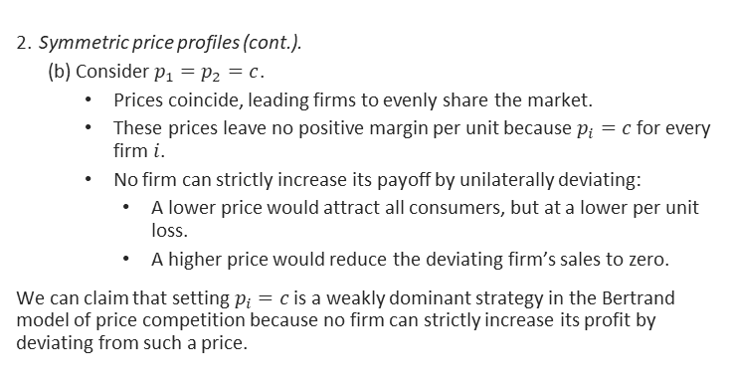
Bertrand Model
Symmetric price profiles (cont.).
(b) Consider $p_{1}=p_{2}=c$.
  Prices coincide, leading firms to evenly share the market.
  These prices leave no positive margin per unit because $p_{i}=c$ for every firm $i$.
  No firm can strictly increase its payoff by unilaterally deviating:
    A lower price would attract all consumers, but at a lower per unit loss.
    A higher price would reduce the deviating firm’s sales to zero.
    We can claim that setting $p_{i}=c$ is a weakly dominant strategy in the Bertrand model of price competition because no firm can strictly increase its profit by deviating from such a price.

Slide 41
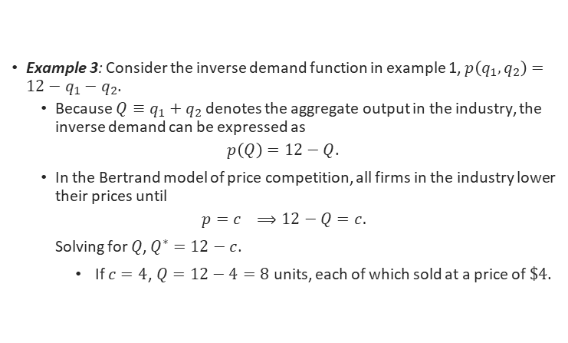
Bertrand Model
Example 3: Consider the inverse demand function in example 1, $p\left(q_{1},q_{2}\right)=12−q_{1}−q_{2}$.
  Because $Q≡q_{1}+q_{2}$ denotes the aggregate output in the industry, the inverse demand can be expressed as
  $p\left(Q\right)=12−Q$.
  In the Bertrand model of price competition, all firms in the industry lower their prices until
  $$p=c ⟹12−Q=c.$$
  Solving for $Q$, $Q^{∗}=12−c$.
    If $c=4$, $Q=12−4=8$ units, each of which sold at a price of $\$4$.

Slide 42

Airlines: Low-cost carriers
Ryanair, Southwest Airlines
Airfares often fell significantly on routes where low-cost carriers entered. Incumbent airlines frequently matched lower prices.

Slide 43
A classic Ryanair entry example is the Dublin-London route. When Ryanair announced entry in 1986, the market was dominated by Aer Lingus and British Airways
Route | Before Ryanair Entry (Incumbent Fare) | Ryanair Fare at Entry | Price Reduction
Dublin - London | £208 round trip (Aer Lingus/British Airways) | £98 round trip | £110 lower (about 53% cheaper)

Slide 44

Walmart (average grocery price effect)
Market/Product | Before Walmart Entry | After Walmart Entry | Price Reduction
Grocery products (8 of 10 products studied across 212 U.S. markets) | 100 (index) | 95.6 - 98.3 (index) | 1.7% to 4.4% decrease

Slide 45

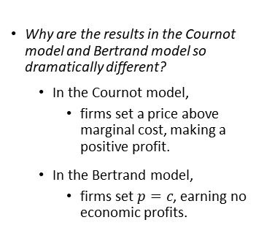
Reconciling the Cournot and Bertrand models
Why are the results in the Cournot model and Bertrand model so dramatically different?
  In the Cournot model,
    firms set a price above marginal cost, making a positive profit.
  In the Bertrand model,
    firms set $p=c$, earning no economic profits.

Slide 46

Reconciling the Cournot and Bertrand models
  These differences are driven by the absence of capacity constraints in the Bertrand model:
    If a firm charges 1 cent less than its rival, it captures the market demand, regardless of its size.
  This assumption might be reasonable for goods such as online movie streaming
    but difficult to justify with others (e.g., smartphones) with a world demand that cannot be served by a single firm.

