Slide 1
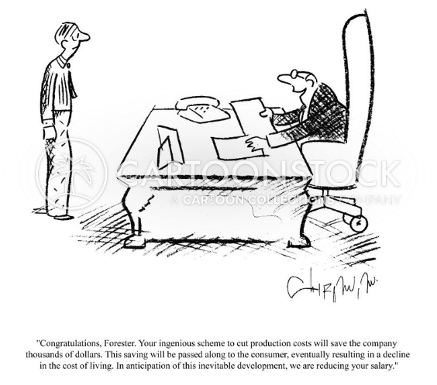
"Technology, Production and Demand"
"Congratulation your ingenious scheme to cut production costs will save the company thousands of dollars. This saving will pass along to the consumers, eventually resulting in a decline of cost of living in anticipation to this inevitable development, we are reducing your salary"

Slide 2
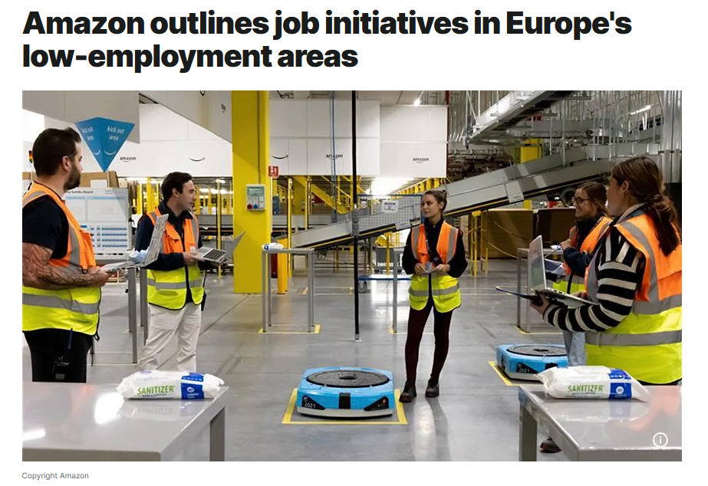
Production function: Q = f (l , k )
Marginal Product of labor : MP_{L} (l , k ) = ^{∂f (l ,k )}
∂l
In France's Hauts-de-France region, where unemployment sits at 8.7% - well above the national average of 7.3% - Amazon has created over 6,000 jobs in the past decade. Source

Slide 3
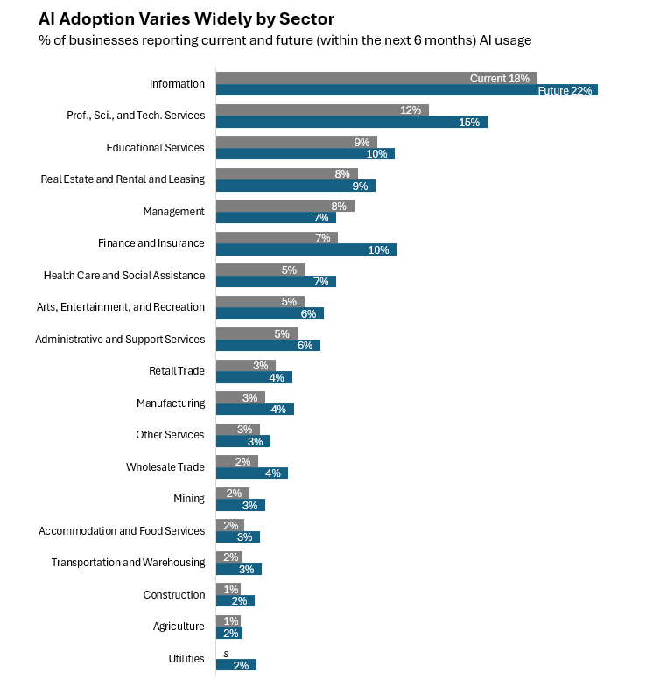
Marginal Product of capital : MP_{K} (l , k ) = ^{∂f (l ,k )}
∂k
(2023-2024) Source

Slide 4
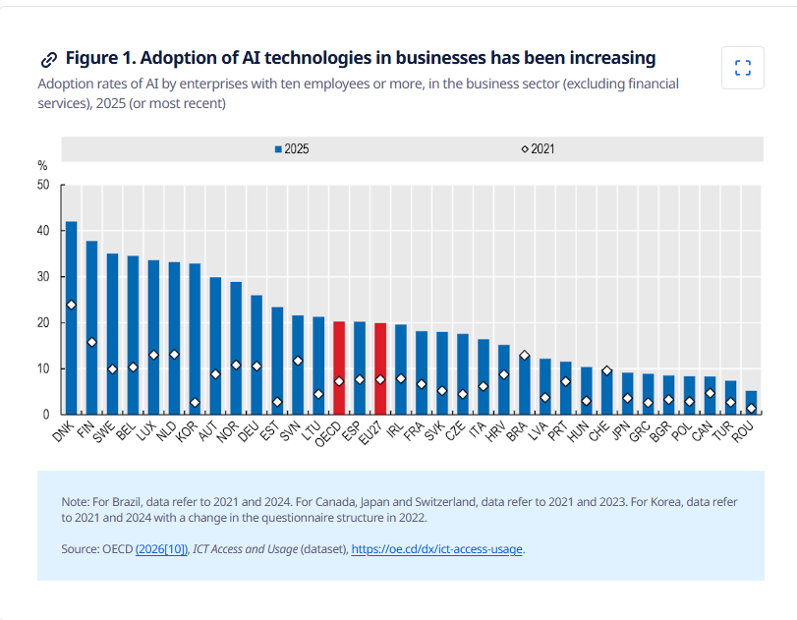

Slide 5
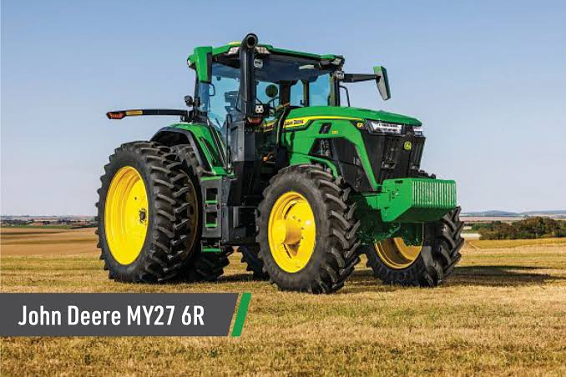

Supporting factor
∂MP_{L} (l , k ) ₌ ∂MP_{K} (l, k ) _{> 0}
∂k ∂l
Substitute factor
∂MP_{L} (l , k ) ₌ ∂MP_{K} (l , k ) _{< 0}
∂k ∂l

Slide 6

Example
Cobb-Douglas Production Function
Q MP_{L} (l , k )
MP_{k} (l , k )
= Al ^{α}k^{β}
= αAl ^{α-l}k^{β} if α < l substitute and if α > l supporting
= βAl ^{α}k^{β-l} if β < l substitute and if β > l supporting
α + β = l α + β > l α + β < l
(CRS )
(IRS )
(DRS )

Slide 7
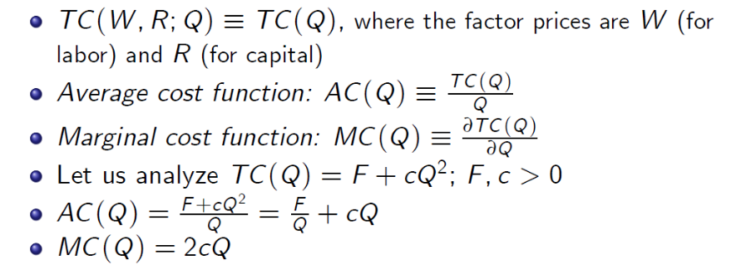
The Cost Function

Slide 8

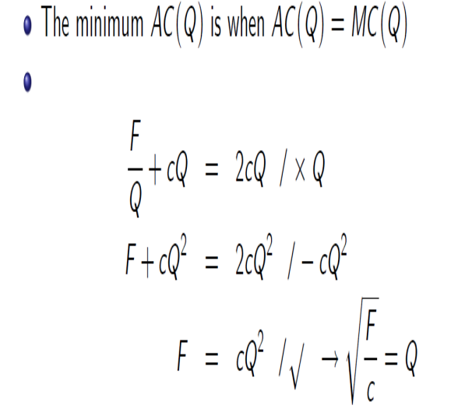
The Cost Function

Slide 9
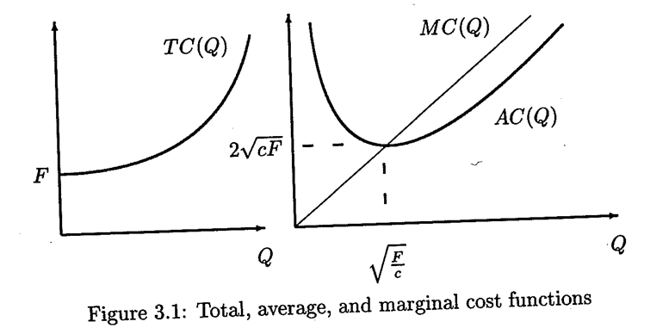
The Cost Function

Slide 10
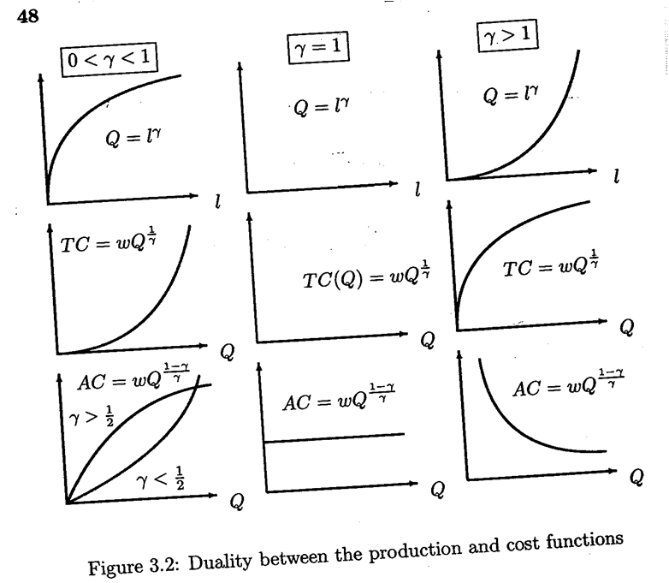
Duality between Production and Cost Functions

Slide 11
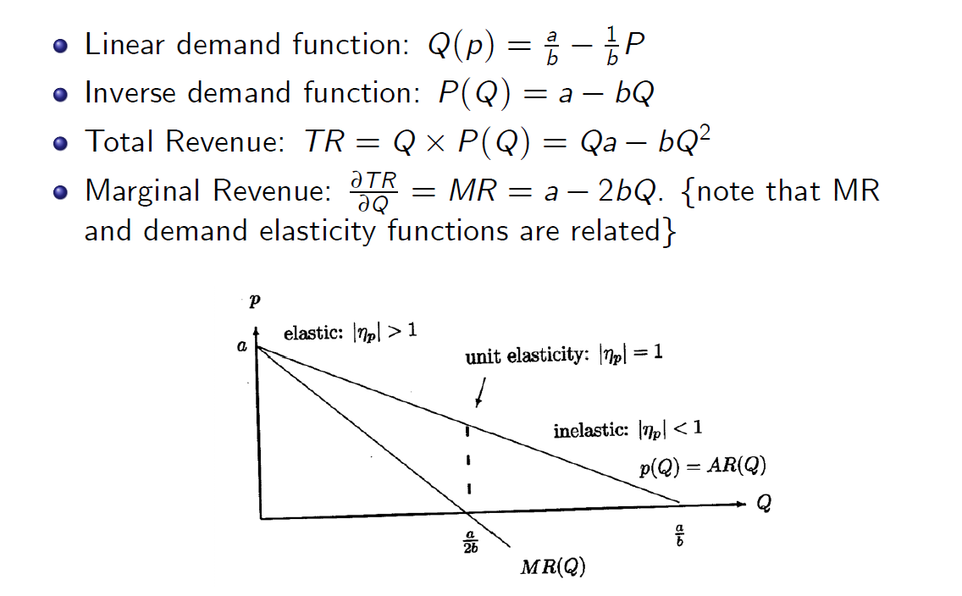
The Demand Function

Slide 12
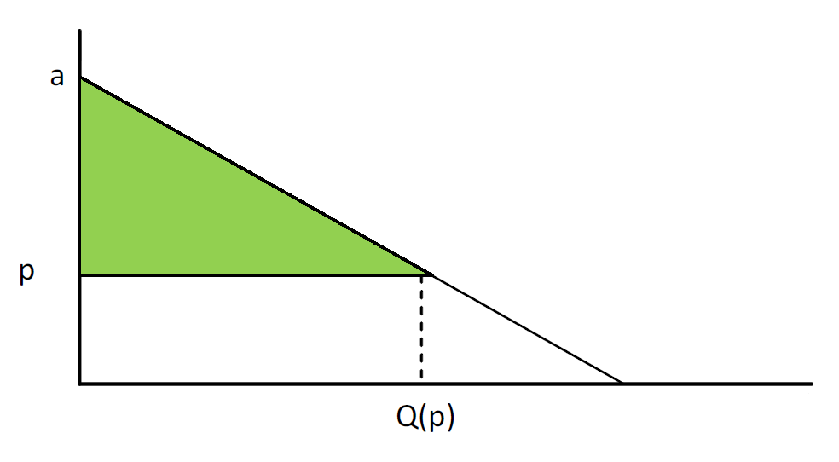
Consumer Surplus

Slide 13


Consumer Surplus

Slide 14
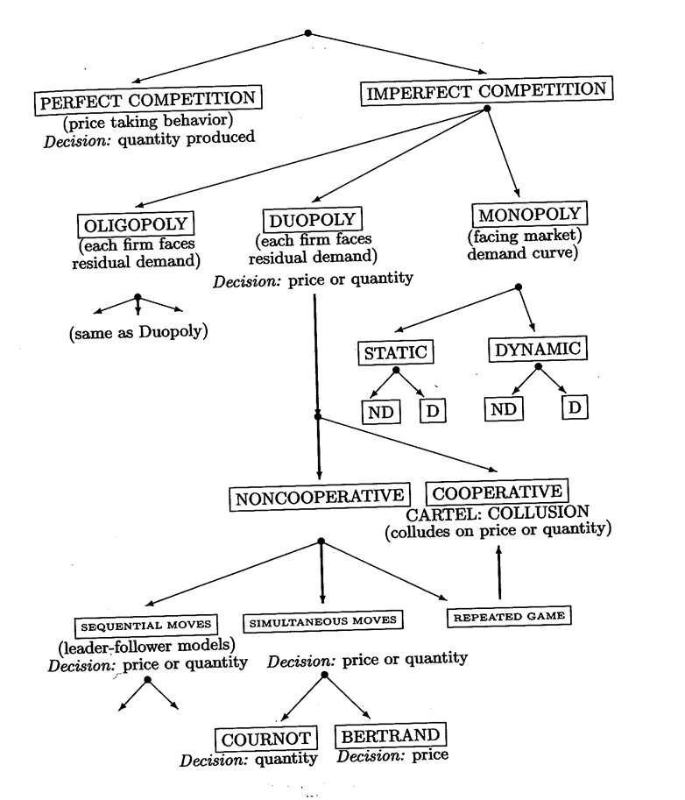
Market Structures and Organization:
Perfect Competition

Slide 15
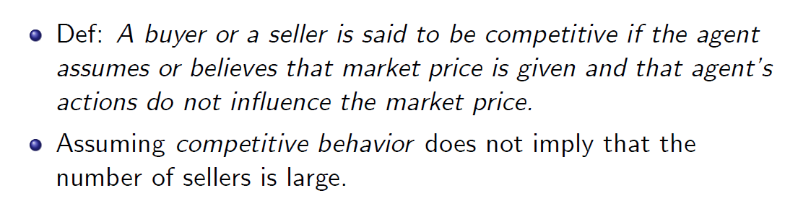
Perfect Competition

Slide 16
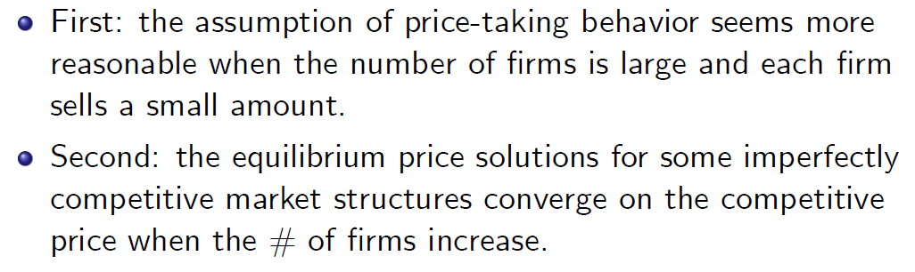
Perfect Competition

Slide 17

Perfect Competition
Economies of scale are small relative to the size of the market
Output is homogeneous
Information is perfect
There are no entry or exit barriers
Assumptions l-3 imply price-taking behavior.

Slide 18
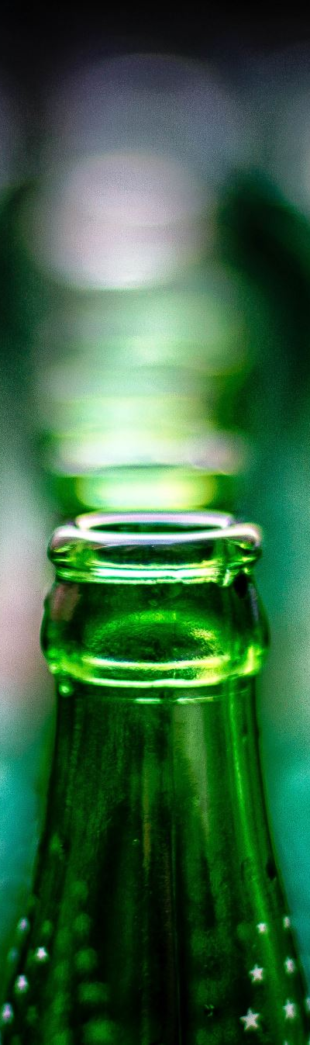
Perfect Competition - Example: Tavern
Suppose that you have a cousin who owns a Tavern on a small and remote island in the South Seas. His tavern is one of ten taverns that serves the beer-drinking inhabitants on the island.
What happens to the price if this Tavern produces less?
beer of similar quality is available at the other taverns (assumptions 2 and 3).
What happens if the Tavern produces more?
the ability of the Tavern to profitably increase its output is limited (assumption l)
Consequently, a firm, like the Tavern, in a perfectly competitive industry will take the market price as given and act as a price taker.

Slide 19
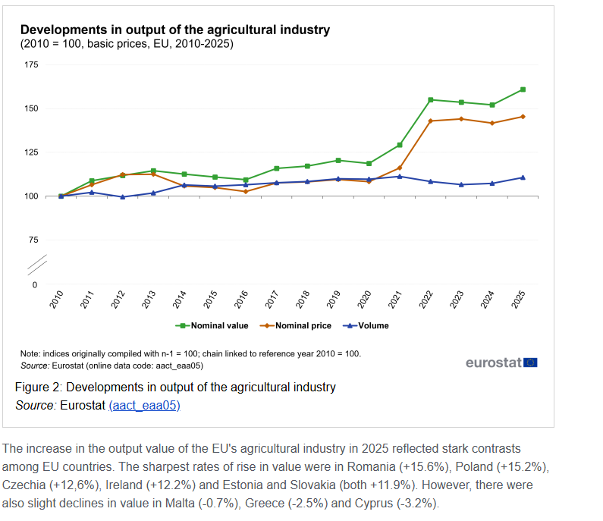

Slide 20
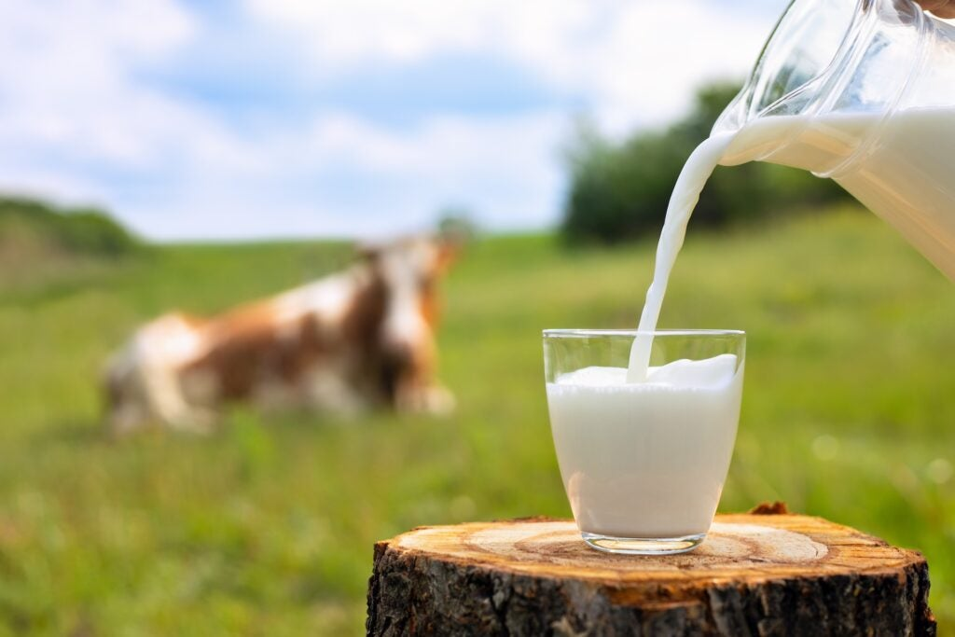
Does Milk Look Like Perfect Competition?

Slide 21
Identical Products: Raw, unpasteurized milk from one dairy farm is virtually indistinguishable from another.
Many Buyers and Sellers: There are thousands of independent dairy farmers and millions of consumers.
Price Takers: Individual farmers have zero control over the market price. If a farmer tries to sell raw milk above the market equilibrium, buyers will instantly switch to a competitor.

Slide 22
Why does the Milk Market Fail to meet "Perfect Competition“?

Slide 23
Government Intervention.
Market Power.
Differentiating Barriers.
Perfect Information.

Slide 24
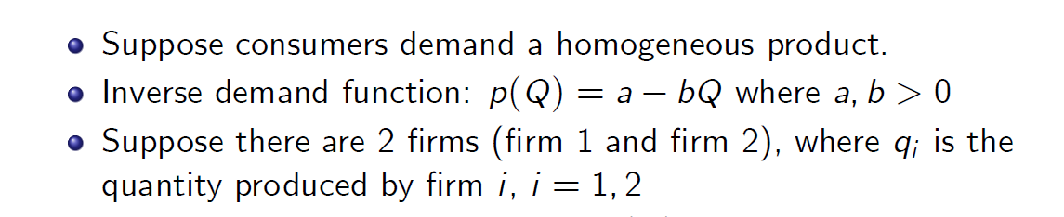
Perfect Competition: Non-Increasing Returns to Scale

Slide 25
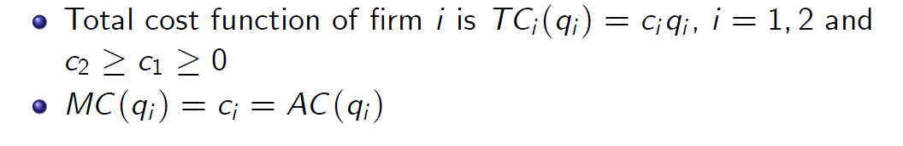
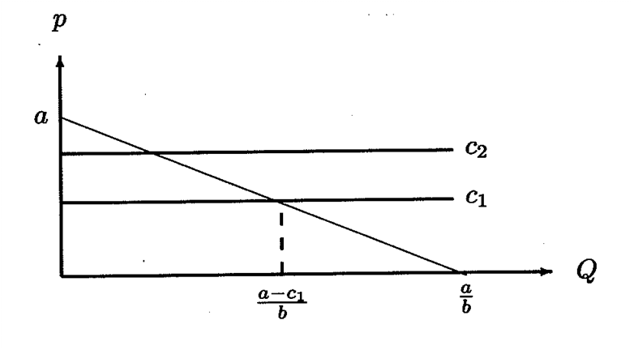
Perfect Competition: Non-Increasing Returns to Scale

Slide 26
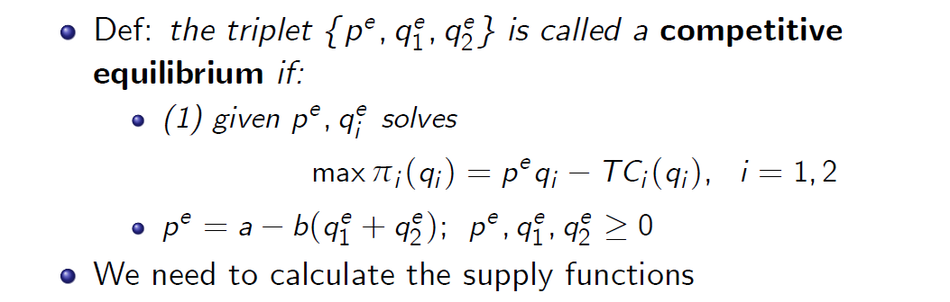
Perfect Competition: Non-Increasing Returns to Scale

Slide 27
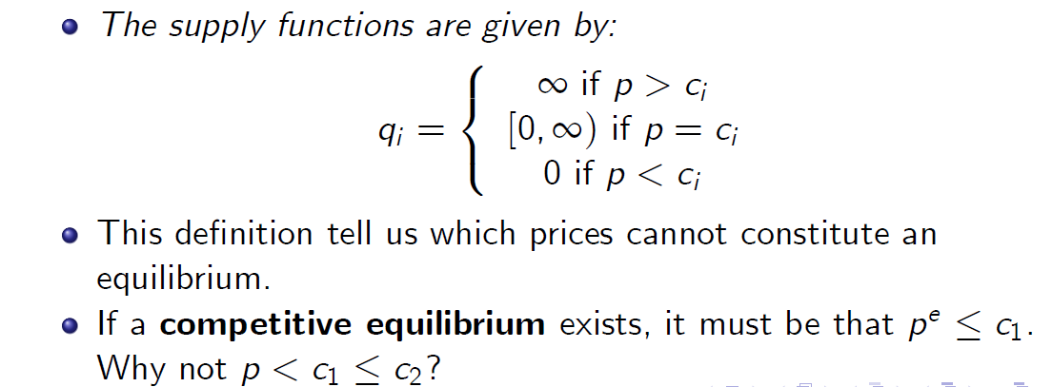
Perfect Competition: Non-Increasing Returns to Scale

Slide 28
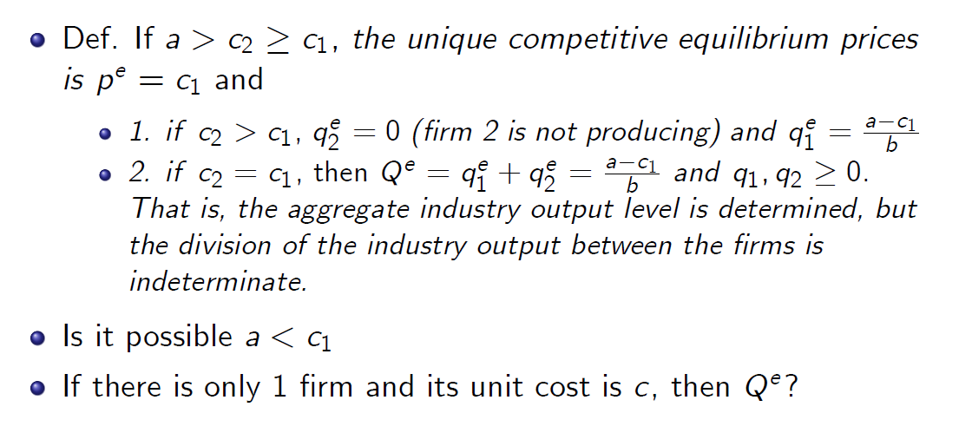
Perfect Competition: Non-Increasing Returns to Scale

Slide 29

Perfect Competition: Increasing Returns to Scale

Slide 30
