Slide 1

Game Theory as the study of interdependence:
No man is an island
Definition
Game Theory: a formal way to analyze interaction among a group of rational agents who behave strategically.

Slide 2
Examples (1):
Output decision of two competing Firms:
Cournot model of output competition.
Research and Development expenditures:
OPEC pricing, how to sustain collusion in the long run...

Slide 3

Examples (2):
Setting tax emission fees to favor domestic firms.
Public goods (everybody wants to be a free-rider).
  I have never played a public good game!
  Are you sure? A group project in class. The slacker you surely faced was our free-rider.

Slide 4

Rules of a General Game (informal):
Who is playing?
Set of players
1
3
4

Slide 5

Rules of a General Game (informal):
What are they playing with?
  Set of available actions
1
3
4

Slide 6


Rules of a General Game (informal):
Where each player gets to play?
  Time structure of the game
1
3
4

Slide 7


Rules of a General Game (informal):
How much players can gain (or lose)?
  Payoffs (measured by a utility function)
1
3
4

Slide 8

We assume Common knowledge about the rules of the game.
As a player, I know the answer to the above four questions (rules of the game)
In addition, I know that you know the rules, and...
that you know that I know that you know the rules,.....(ad infinitum).

Slide 9

Two ways to graphically represent games
Extensive form
We will use a game tree (next slide).
Normal form (also referred as strategic form).
We will use a matrix.

Slide 10

Example of a game tree
Consider the following sequential-move game played by firms 1 and 2: We will use a matrix
(30,20)
C
NC
Firm 2 does
(60,0) not know
High Capacity
Firm 2
whether firm
(20,10) 1 chose high
or low
capacity
Low Capacity
C
Firm 1
NC
Initial Node
No Production
(40,0)
Information Sets
C’
NC’
(0,40)
Available Actions For Firm 1
Firm 2
Different
Lables
Payoffs for the
(0,0) First mover First,
and the Second
mover Second
Terminal Nodes

Slide 11
ANTZ vs. A BUG'S LIFE
PRODUCE ANTZ
KAT
PRODUCE “A BUG’S LIFE”
NOT
EISNER
LEAVE DISNEY
PRODUCE ANTZ
KATENBERG
NOT PRODUCE
KAT
INITIAL NODE
STAY IN DISNEY
NOT
TERMINAL NODES
In this example, Katsenberg observes whether Eisner produced the film A BUG'S LIFE or not before choosing to produce ANTZ.

Slide 12
PRODUCE ANTZ
INFORMATION SET
c
PRODUCE “A BUG’S LIFE”
NOT
LEAVE DISNEY
K
E
NOT PRODUCE
PRODUCE ANTZ
d
K
STAY IN DISNEY
NOT
When Katsenberg is at the move (either at node c or d), he knows that he is at one of these nodes,but he does not know at which one and the igure captures this lack of information with a dashed line connecting the nodes.

Slide 13

Information sets
An information set is graphically represented with two or more nodes connected by a dashed line, including all these connected nodes.
It represents that the player called to move at that information set cannot distinguish between the two or more actions chosen by his opponent before he is called to move.
Hence, the set of available actions must be the same in all the nodes included on that information set (P and N in the previous game tree for Katsenberg).

Slide 14
Guided exercise
Let’s practice how to depict a game tree of a strategic situation on an industry:
Firm A decides whether to enter firm B's industry. Firm B observes this decision.
If firm A stays out, firm B alone decides whether to advertise. In this case, firm A obtains zero profits, and firm B obtains $4 million if it advertises and $3.5 million if it does not.
If firm A enters, both firms simultaneously decide whether to advertise, obtaining the following payoffs.
If both advertise, both firms earn $3 million.
If none of them advertise, both firms earn $5 million.
If only one firm advertises, then it earns $6 million and the other firm earns $1 million.

Slide 15
Guided Exercise, (continued)
a
3,3
Firm A
a
n
1,6
Firm B
n
a
6,1
Firm A
E
n
a’
0,4
5,5
D
Firm B
n’
0,3.5
Let E and D denote firm A's initial alternatives of entering and not entering B's industry.
Let a and n stand for advertise and not advertise, respectively.
Note that simultaneous advertising decisions are captured by firm A's information set.

Slide 16
Definition of Strategy
Let's practice finding the strategies of firm 1 and 2 in the following game tree:
1,1
H
FIRM 2
H
L
0,2
FIRM 1
H’
2,0
L
FIRM 2
L’
1 , 1
2 2
Strategies for Firm 1 : H and L.
Strategies for Firm 2 : HH';HL';LH';LL'

Slide 17

Strategy space and Strategy profile
Strategy profile
It is a vector (or list) describing a particular strategy for every player in the game. For instance, in a two-player game
  s = (s₁ , s₂ )
where s₁ is a specific strategy for firm 1.(for instance, s₁ = H ), and s₂ is a specific strategy for firm 2, e.g., s₂ = LH ‘.
More generally, for N players, a strategy profile is a vector with N components,
  s = (s₁ , s₂ , s₃ , ..., s_{n} )

Slide 18

Strategy profile:
To represent the strategies selected by all players except player i, we write:
s_{-i} = (s₁ , s₂ , ..., s_{i -1} , s_{i +1} , ..., s_{n} )
(Note that these strategies are potentially different)
We can hence write, more compactly, as strategy profile with only two elements:
The strategy player i selects, s_{i} , and the strategies chosen by everyone else, s_{-i} , as:
  s = (s_{i} , s_{-i} )

Slide 19
Let's practice finding strategy sets in the following game tree:
3,3
A
FIRM 2
A
P
4,2
FIRM 1
2,4
P
A
OUT
P
0,4
2,2

Slide 20
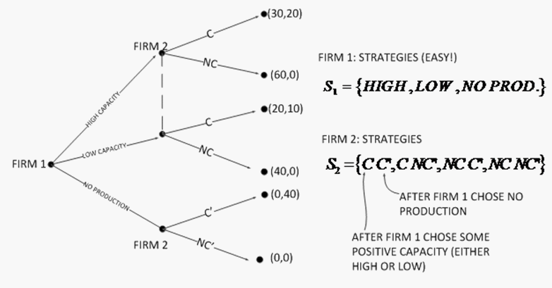
Let’s re-define firm 1 and 2's available strategies in the example of a game tree we described a few minutes ago:

Slide 21
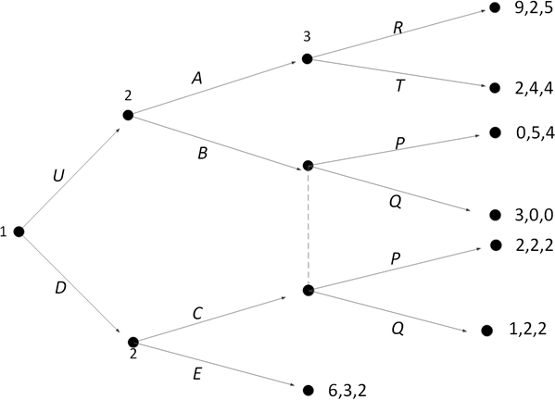
Let's now find the strategy spaces of a game with three players:
S1 = {U, D}
S2 = {AC, AE, BC, BE}; and
S3 ={RP,RQ,TP,TQ}

Slide 22
When a game is played simultaneously, we can represent it using a matrix
Example: Prisoners' Dilemma game.
Prisoner 2
Confess
Don't Confess
Prisoner 1
Confess Don't Confess
-5, -5 | 0, -15
-15, 0 | -1, -1

Slide 23

Another example of a simultaneous-move game:
The battle of the sexes game.(I know the game is sexist, but please don't call it the battle of the sexist game !)
Wife
Opera
Movie
Husband
Opera Movie
1, 2 | 0, 0
0, 0 | 2, 1

Slide 24
Yet, another example of a simultaneous-move game
Pareto-coordination game.
Firm 2
Superior tech. Inferior tech.
Firm 1
Superior tech. Inferior tech.
2, 2 | 0, 0
0, 0 | 1, 1

Slide 25
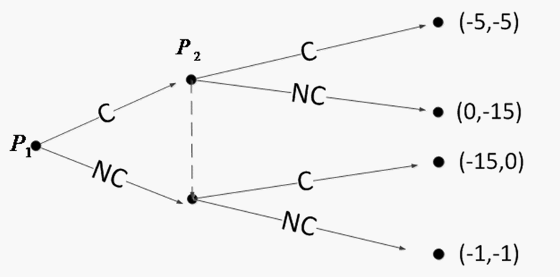
Normal (Strategic) Form
We can alternatively represent simultaneous-move games using a game tree, as long as we illustrate that players choose their actions without observing each others' moves, i.e., using information sets, as we do next for the prisoner's dilemma game:
Extensive form representation of the Prisoner's Dilemma game
P₂
C
NC
P₁ C NC
-5,-5 | 0,-15
-15,0 | -1,-1

Slide 26
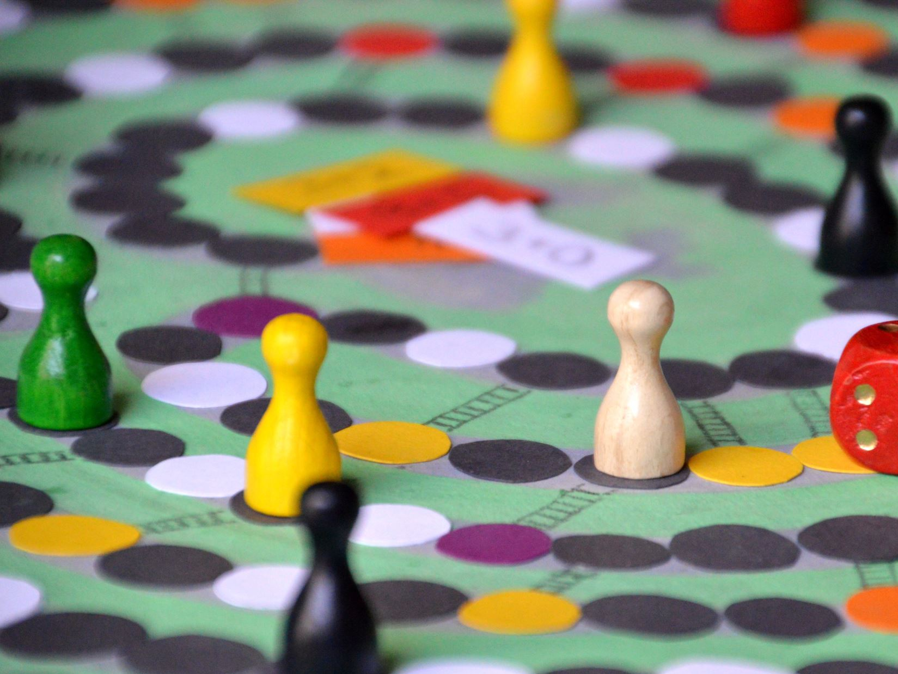
We are done describing games!!
We will use these concepts in the following weeks.
Let's start solving games!!

