Slide 1
Class Time: TU 3:30pm – 5:30pm and TH 5:30pm – 7:30pm
Office Hours: TU 9:30am-12:30pm
Office Number: 3D05
Email: ana.f.espinola@uv.es
Ana Espinola-Arredondo
Industrial Organization

Slide 2
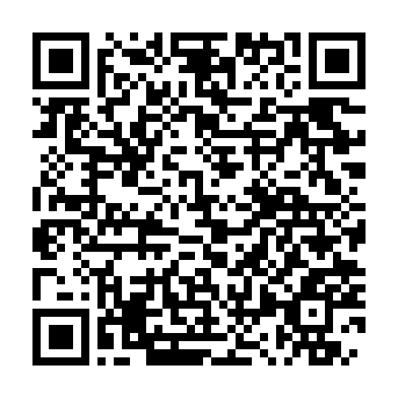
Personal website for this class:
https://anaespinolaarredondo.com/organizacion-industrial-universitat-de-valencia-fall-2026/

Slide 3
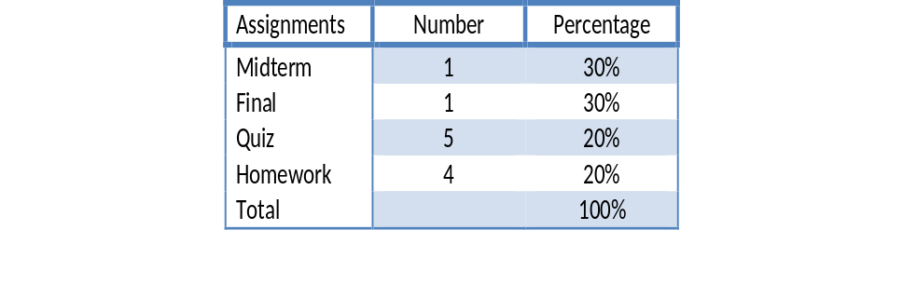
Important Information:
Excellent | 9 - 10
Outstanding | 7 – 8.9
Passed | 5 - 6.9
Failed | 0 - 4.9

Slide 4
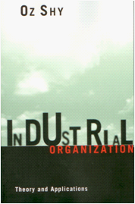
Introduction to Industrial Organization

Slide 5
What should you expect during class?
Class Participation.
No Phone.
I highly encourage you taking handwritten notes.

Slide 6

Concentration
Product Characteristics
Costly Activities
Research and Development (R&D)

Slide 7
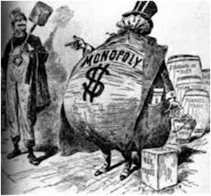
Concentration
Many industries are composed of few firms
Theoretical linkage of the factors that affect concentration
How concentration affects the strategic behavior of firms

Slide 8
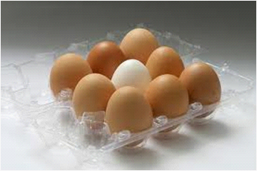
Product Characteristics
Homogeneous vs. differentiated products
Location, service, physical characteristics and subjective image differences.
How consumers determine which brands to buy, how much to buy, and how to search and select the lowest priced brand that fits their specific preferences.
Strategic Approach

Slide 9
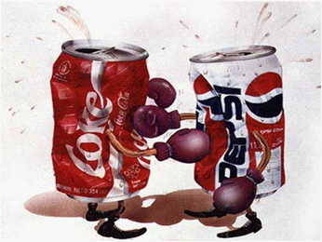
Costly activities
0bjective: enhancing the sales of their brand.
Examples...

Slide 10

R&D
Investing cost reducing production technologies as well as new products (it also includes reverse engineering)
Why is R&D important to some firms?

Slide 11
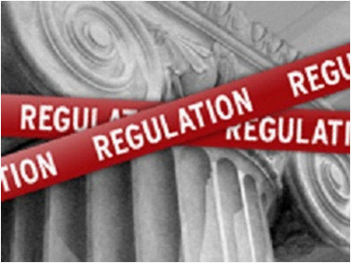
Regulator
Can intervention increase social welfare under various market structures and firms?
How does the legal system affect our industries?

Slide 12
Discussion
Is the technology efficient in the sense of whether it is operated on an optimal scale?
Does the industry produce a socially optimal number of brands corresponding to consumers' preferences and the heterogeneity of the consumers?
Are firms dynamically efficient?

Slide 13
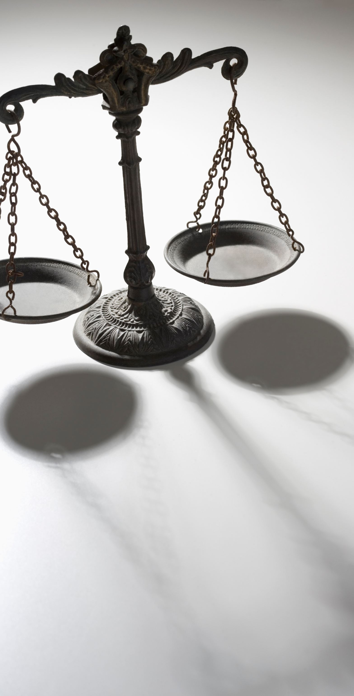
Law and Economics
The legal structure governing the monitoring of the industry is called antitrust law.
The Sherman Antitrust Act (1890): prohibits certain business activities that reduce competition in the marketplace and requires the U.S. federal government to investigate and pursue trusts, companies, and organizations suspected of being in violation.
Industrial Organization and International Trade

