Slide 1

Intermediate Microeconomic
Theory
Tools and Step-by-Step Examples

Slide 2
Outline
Summary of Market Structures
Measuring Market Power
Models of Imperfect Competition
Cournot Model – Simultaneous Quantity Competition
Bertrand Model – Simultaneous Price Competition
Cartels and Collusion
Stackelberg Model – Sequential Quantity Competition
Product Differentiation
Appendix. Cournot Model with N Firms

Slide 3
Summary of Market Structures
Industry | N of firms | Type of Good | Price-takers? | Entry Barriers?
Perfect competition | Many | Homogeneous | Yes | No
Monopoly | One | No close substitutes | No | Yes
Oligopoly | Some | Homogeneous or heterogeneous | No | Yes

Slide 4

Measuring Market Power

Slide 5
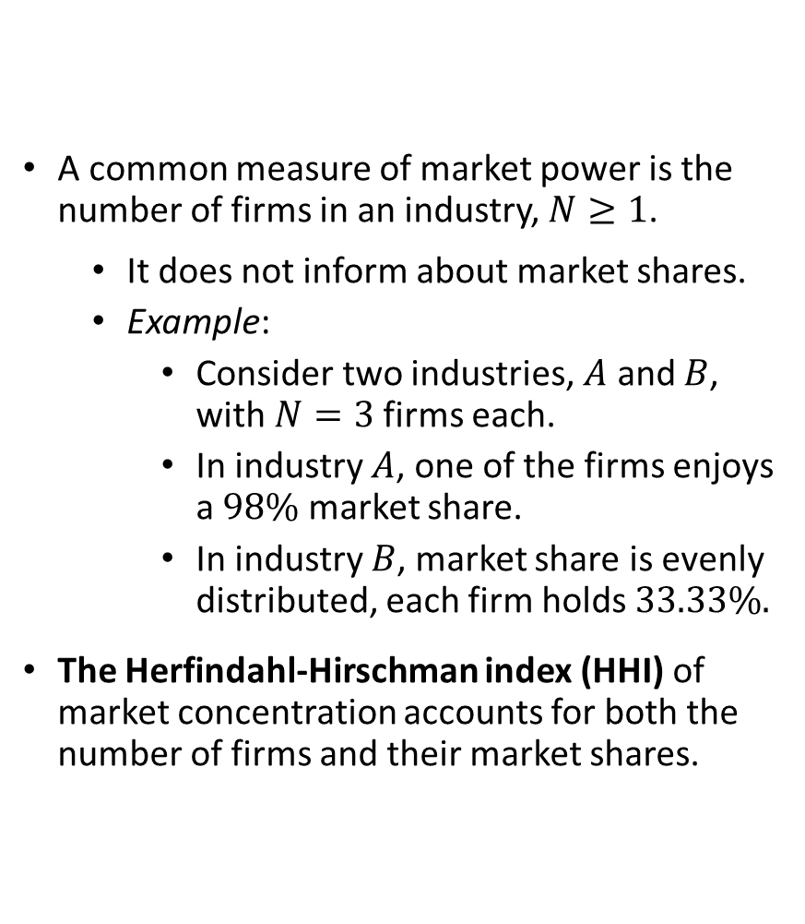
Measuring Market Power
A common measure of market power is the number of firms in an industry, $N≥1$.
  It does not inform about market shares.
  Example:
    Consider two industries, $A$ and $B$, with $N=3$firms each.
    In industry $A$, one of the firms enjoys a $98\%$ market share.
    In industry $B$, market share is evenly distributed, each firm holds $33.33\%.$
The Herfindahl-Hirschman index (HHI) of market concentration accounts for both the number of firms and their market shares.

Slide 6
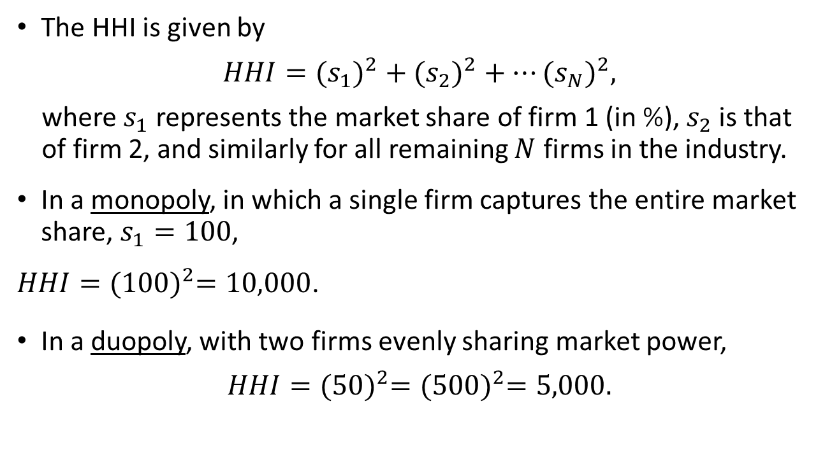
Measuring Market Power
The HHI is given by
$$HHI={{(s}_{1})}^{2}+{{(s}_{2})}^{2}+…{{(s}_{N})}^{2},$$
where $s_{1}$ represents the market share of firm 1 (in %), $s_{2}$ is that of firm 2, and similarly for all remaining $N$ firms in the industry.
In a monopoly, in which a single firm captures the entire market share, $s_{1}=100$,
$HHI={(100)}^{2}=10,000$.
In a duopoly, with two firms evenly sharing market power,
$$HHI={(50)}^{2}={(500)}^{2}=5,000.$$

Slide 7
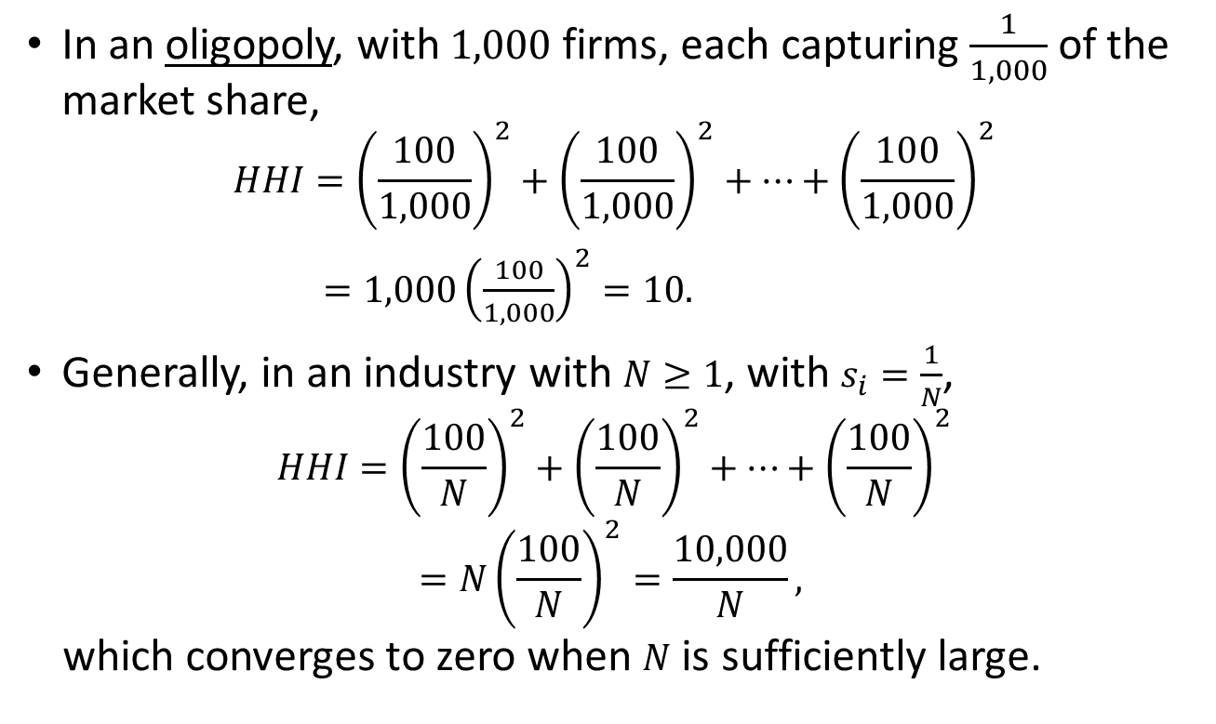
Measuring Market Power
In an oligopoly, with$1,000$firms, each capturing $\frac{1}{1,000}$ of the market share,
$$HHI={\left(\frac{100}{1,000}\right)}^{2}+{\left(\frac{100}{1,000}\right)}^{2}+…+{\left(\frac{100}{1,000}\right)}^{2}$$
$=1,000{\left(\frac{100}{1,000}\right)}^{2}=10.$
Generally, in an industry with $N≥1$, with $s_{i}=\frac{1}{N}$,
$$HHI={\left(\frac{100}{N}\right)}^{2}+{\left(\frac{100}{N}\right)}^{2}+…+{\left(\frac{100}{N}\right)}^{2}$$
$$=N{\left(\frac{100}{N}\right)}^{2}=\frac{10,000}{N},$$
which converges to zero when $N$ is sufficiently large.

Slide 8
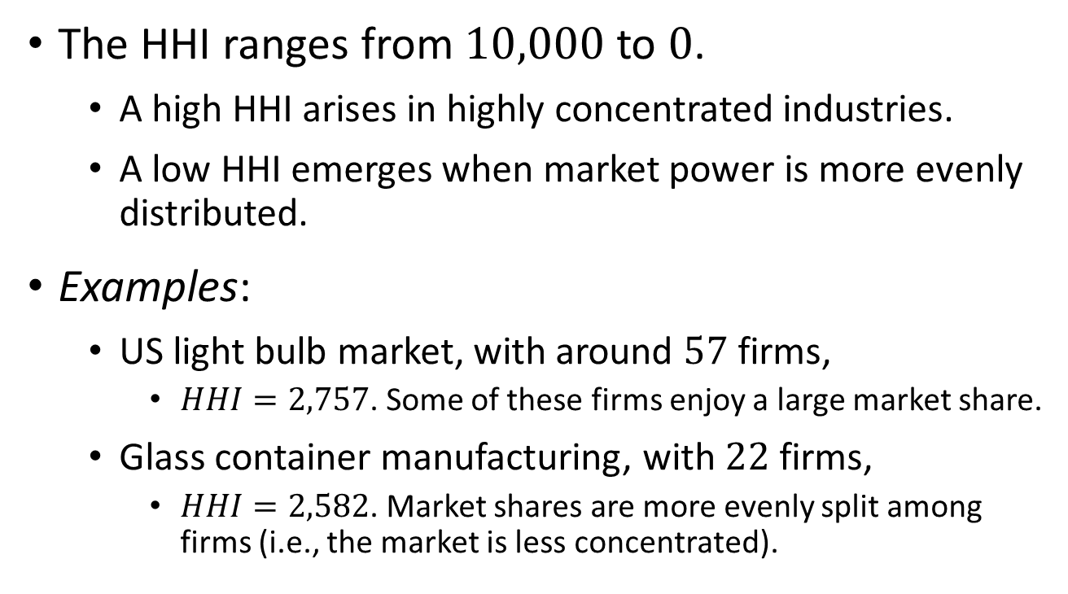
Measuring Market Power
The HHI ranges from $10,000$ to $0$.
  A high HHI arises in highly concentrated industries.
  A low HHI emerges when market power is more evenly distributed.
Examples:
  US light bulb market, with around $57$ firms,
    $HHI=2,757$. Some of these firms enjoy a large market share.
  Glass container manufacturing, with $22$ firms,
    $HHI=2,582$. Market shares are more evenly split among firms (i.e., the market is less concentrated).

Slide 9

Models of Imperfect Competition

Slide 10
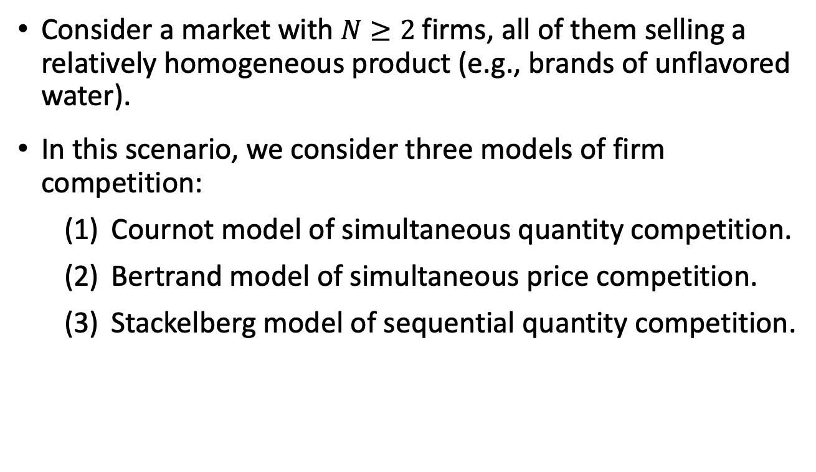
Models of Imperfect Competition
Consider a market with $N≥2$ firms, all of them selling a relatively homogeneous product (e.g., brands of unflavored water).
In this scenario, we consider three models of firm competition:
  Cournot model of simultaneous quantity competition.
  Bertrand model of simultaneous price competition.
  Stackelberg model of sequential quantity competition.

Slide 11

Cournot Model–
Simultaneous Quantity Competition

Slide 12
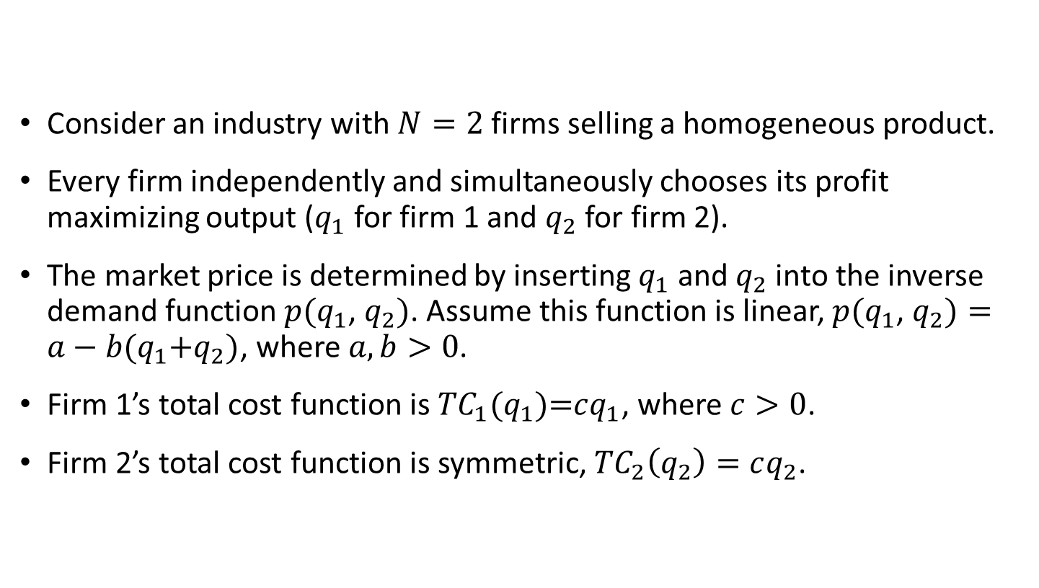
Cournot Model
Consider an industry with $N=2$ firms selling a homogeneous product.
Every firm independently and simultaneously chooses its profit maximizing output ($q_{1}$ for firm 1 and $q_{2}$ for firm 2).
The market price is determined by inserting $q_{1}$ and $q_{2}$ into the inverse demand function $p(q_{1}$, $q_{2})$. Assume this function is linear, $p(q_{1}$, $q_{2})=a−b(q_{1}\text{+}q_{2})$, where $a,b>0$.
Firm 1’s total cost function is ${TC}_{1}(q_{1}\text{)=}cq_{1}$, where $c>0$.
Firm 2’s total cost function is symmetric, ${TC}_{2}\left(q_{2}\right)=cq_{2}$.

Slide 13

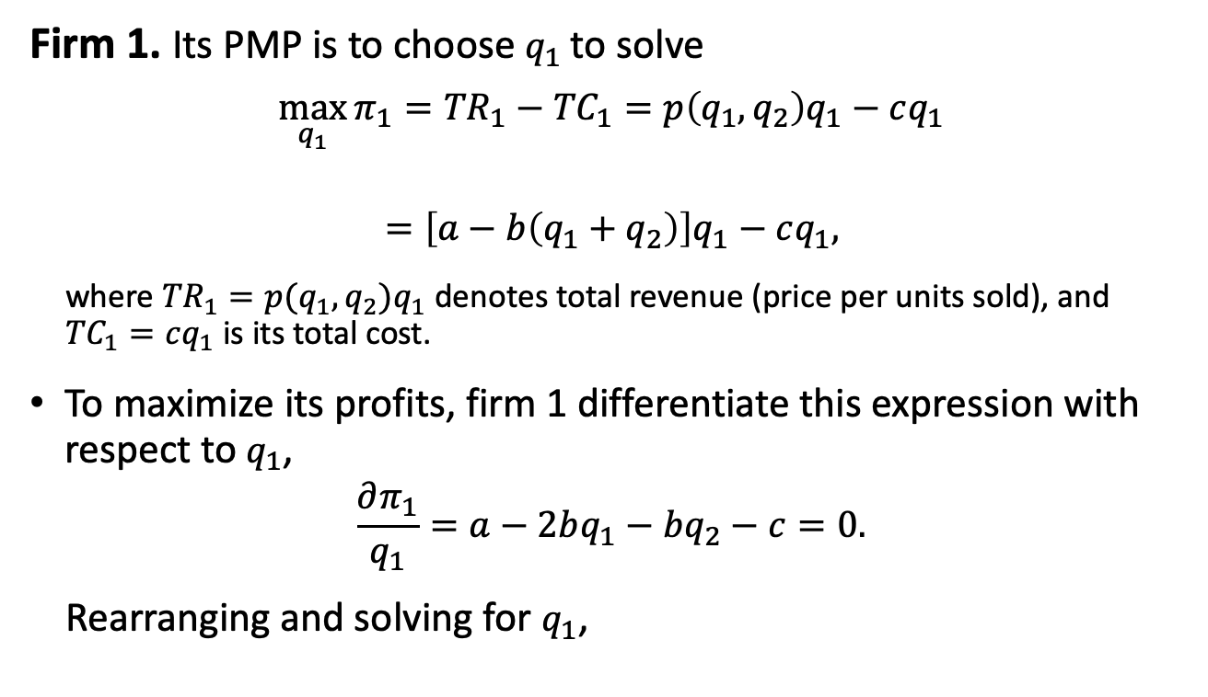

Cournot Model
Firm 1. Its PMP is to choose $q_{1}$ to solve
$$\max_{q_{1}}{π_{1}={TR}_{1}−{TC}_{1}=p\left(q_{1},q_{2}\right)q_{1}−cq_{1}}$$
$$=\left[a−b\left(q_{1}+q_{2}\right)\right]q_{1}−cq_{1},$$
where ${TR}_{1}=p(q_{1},q_{2})q_{1}$ denotes total revenue (price per units sold), and ${TC}_{1}=cq_{1}$ is its total cost.
To maximize its profits, firm 1 differentiate this expression with respect to $q_{1}$,
$$\frac{∂π_{1}}{q_{1}}=a−2bq_{1}−bq_{2}−c=0.$$
Rearranging and solving for $q_{1}$,
$${TR}_{1}$$
$${TC}_{1}$$

Slide 14

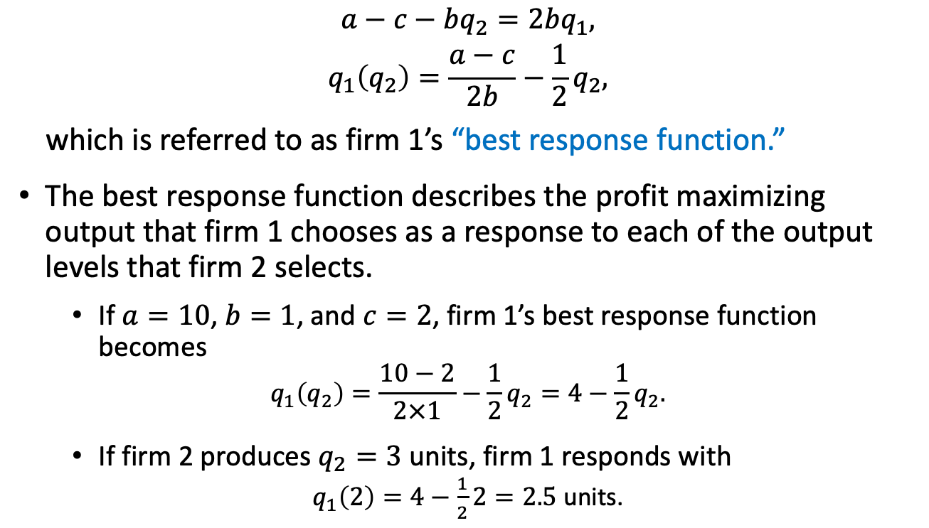
Cournot Model
$$a−c−bq_{2}=2bq_{1},$$
$$q_{1}\left(q_{2}\right)=\frac{a−c}{2b}−\frac{1}{2}q_{2},$$
which is referred to as firm 1’s “best response function.”
The best response function describes the profit maximizing output that firm 1 chooses as a response to each of the output levels that firm 2 selects.
  If $a=10$, $b=1$, and $c=2$, firm 1’s best response function becomes
  $$q_{1}\left(q_{2}\right)=\frac{10−2}{2×1}−\frac{1}{2}q_{2}=4−\frac{1}{2}q_{2}.$$
  If firm 2 produces $q_{2}=3$ units, firm 1 responds with
  $q_{1}\left(2\right)=4−\frac{1}{2}2=2.5$ units.
(${BRF}_{1})$

Slide 15
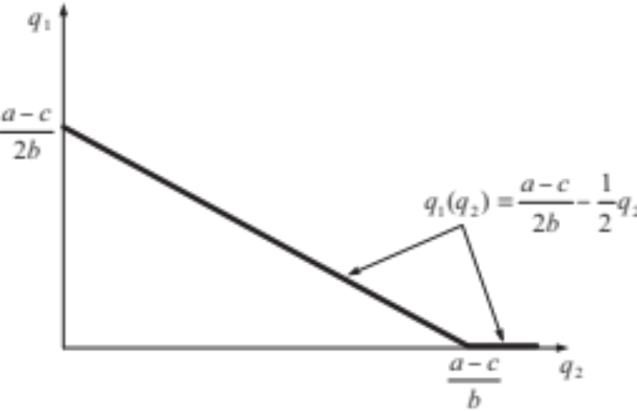
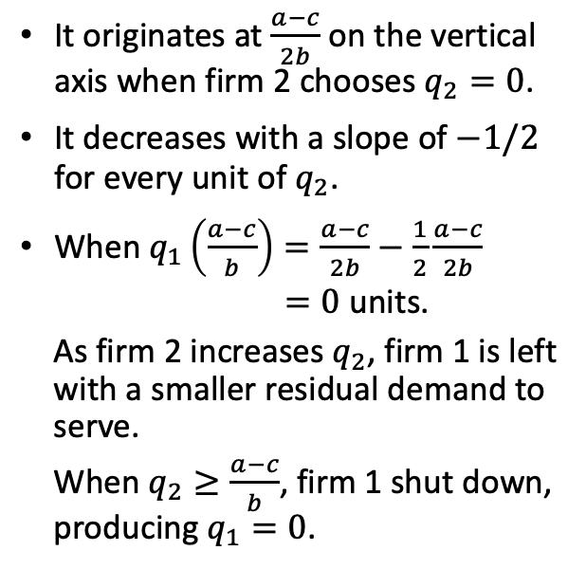
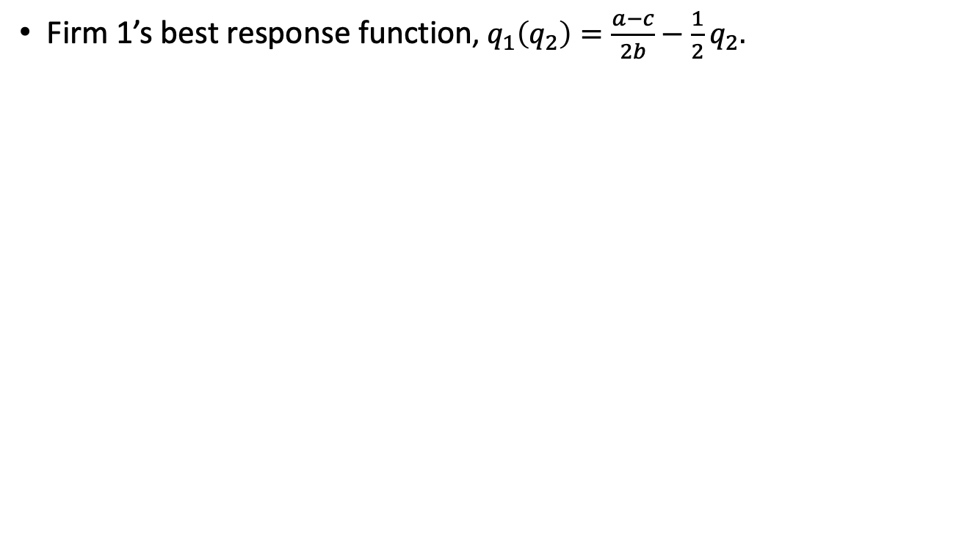
Cournot Model
Firm 1’s best response function, $q_{1}\left(q_{2}\right)=\frac{a−c}{2b}−\frac{1}{2}q_{2}.$
It originates at $\frac{a−c}{2b}$ on the vertical axis when firm 2 chooses $q_{2}=0$.
It decreases with a slope of $−1/2$ for every unit of $q_{2}$.
When $q_{1}\left(\frac{a−c}{b}\right)=\frac{a−c}{2b}−\frac{1}{2}\frac{a−c}{2b}$
$=0$ units.
As firm 2 increases $q_{2}$, firm 1 is left with a smaller residual demand to serve.
When $q_{2}≥\frac{a−c}{b}$, firm 1 shut down, producing $q_{1}=0$.
Figure 14.1

Slide 16

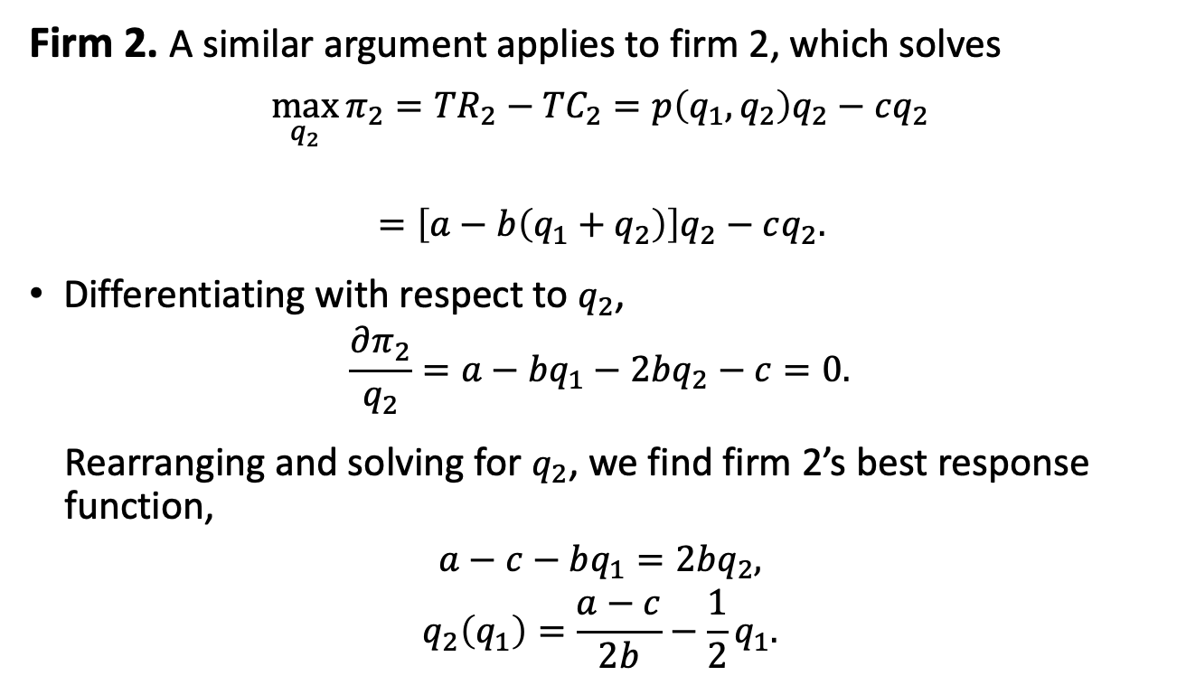


Cournot Model
Firm 2. A similar argument applies to firm 2, which solves
$$\max_{q_{2}}{π_{2}={TR}_{2}−{TC}_{2}=p\left(q_{1},q_{2}\right)q_{2}−cq_{2}}$$
$$=\left[a−b\left(q_{1}+q_{2}\right)\right]q_{2}−cq_{2}.$$
Differentiating with respect to $q_{2}$,
$$\frac{∂π_{2}}{q_{2}}=a−bq_{1}−2bq_{2}−c=0.$$
Rearranging and solving for $q_{2}$, we find firm 2’s best response function,
$$a−c−bq_{1}=2bq_{2},$$
$$q_{2}\left(q_{1}\right)=\frac{a−c}{2b}−\frac{1}{2}q_{1}.$$
$${TR}_{2}$$
$${TC}_{2}$$
(${BRF}_{2})$

Slide 17
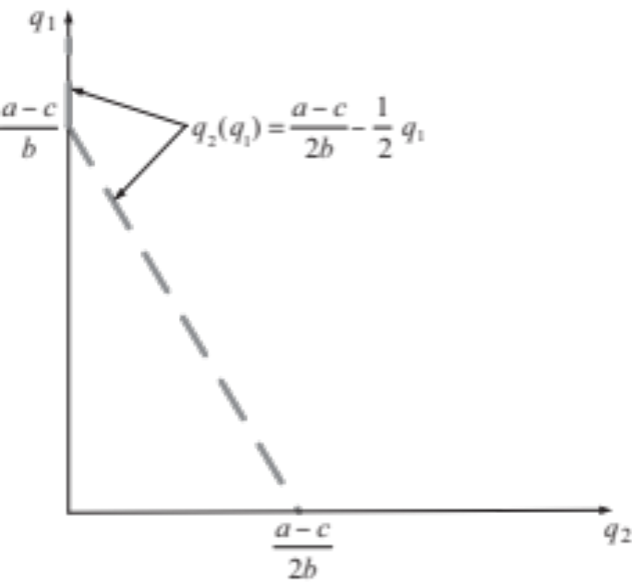
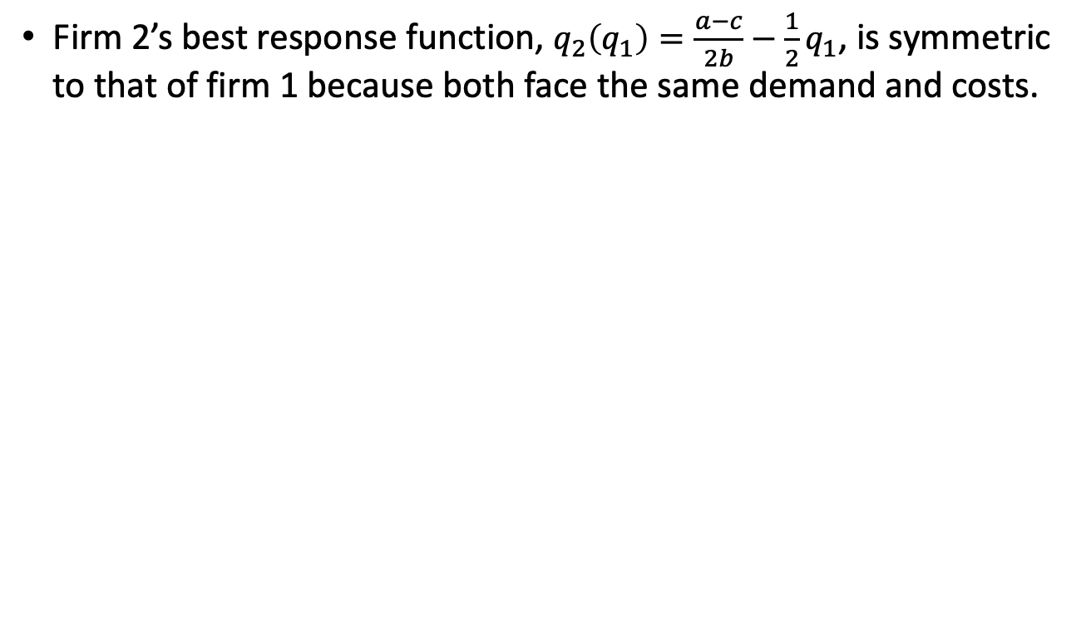
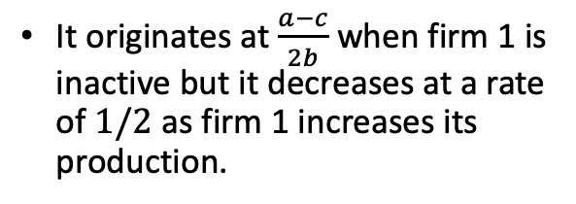
Cournot Model
Firm 2’s best response function, $q_{2}\left(q_{1}\right)=\frac{a−c}{2b}−\frac{1}{2}q_{1}$, is symmetric to that of firm 1 because both face the same demand and costs.
It originates at $\frac{a−c}{2b}$ when firm 1 is inactive but it decreases at a rate of $1/2$ as firm 1 increases its production.
Figure 14.2

Slide 18
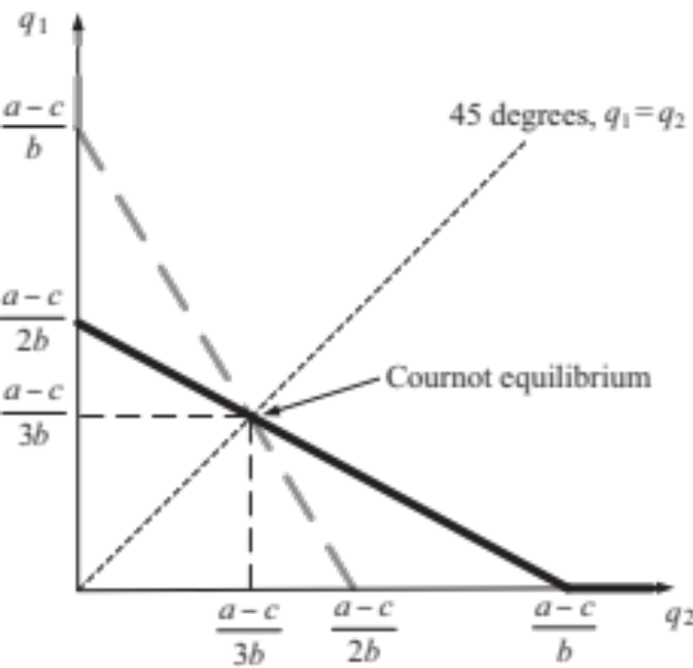
Cournot Model
Superimposing firm 1’s and firm 2’s best response functions, we obtain their crossing point: Cournot Equilibrium.
Both firms are choosing output levels that are the best response to the output of its rival (i.e., firms are selecting mutual best responses, which is the Nash Equilibrium (NE) of a game).
Figure 14.3

Slide 19

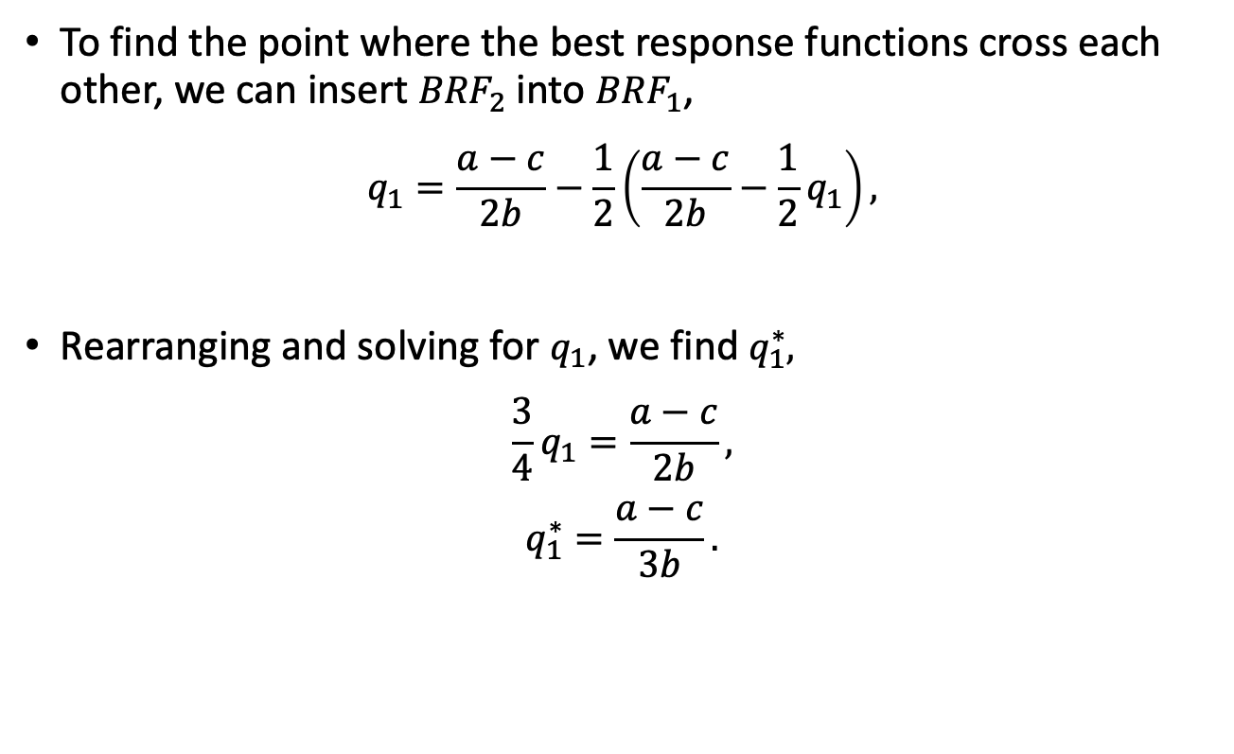
Cournot Model
To find the point where the best response functions cross each other, we can insert ${BRF}_{2}$ into ${BRF}_{1}$,
$$q_{1}=\frac{a−c}{2b}−\frac{1}{2}\left(\frac{a−c}{2b}−\frac{1}{2}q_{1}\right),$$
Rearranging and solving for $q_{1}$, we find $q_{1}^{∗},$
$$\frac{3}{4}q_{1}=\frac{a−c}{2b},$$
$$q_{1}^{∗}=\frac{a−c}{3b}.$$
$$q_{2}$$

Slide 20

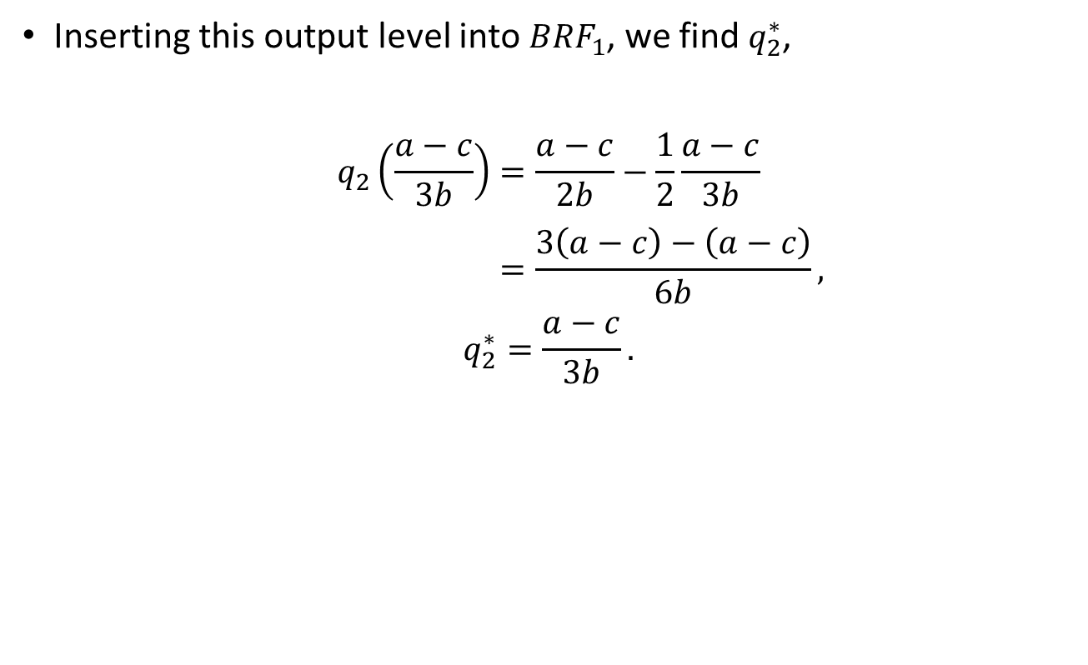
Cournot Model
Inserting this output level into ${BRF}_{1}$, we find $q_{2}^{∗}$,
$$q_{2}\left(\frac{a−c}{3b}\right)=\frac{a−c}{2b}−\frac{1}{2}\frac{a−c}{3b}$$
$$=\frac{3\left(a−c\right)−\left(a−c\right)}{6b},$$
$$q_{2}^{∗}=\frac{a−c}{3b}.$$
$$q_{1}^{∗}$$

Slide 21
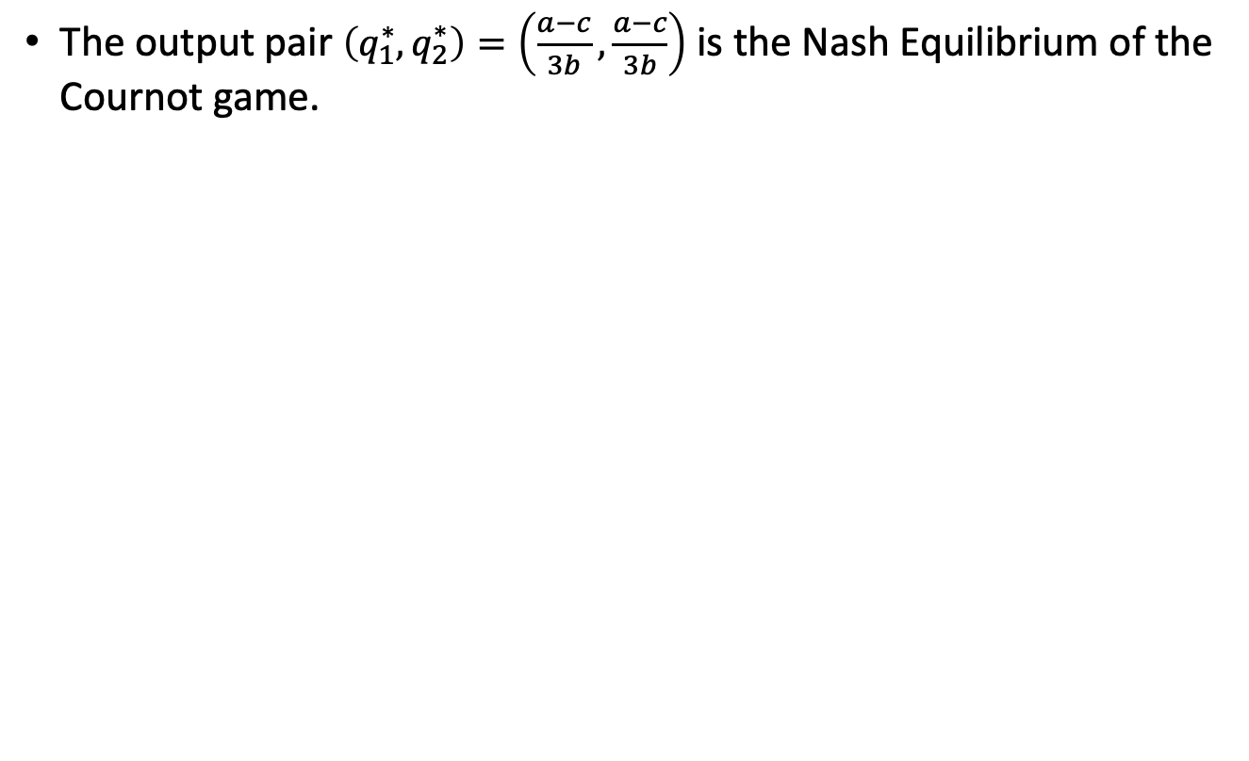
Cournot Model
The output pair $\left(q_{1}^{∗},q_{2}^{∗}\right)=\left(\frac{a−c}{3b},\frac{a−c}{3b}\right)$ is the Nash Equilibrium of the Cournot game.
Figure 14.3

Slide 22
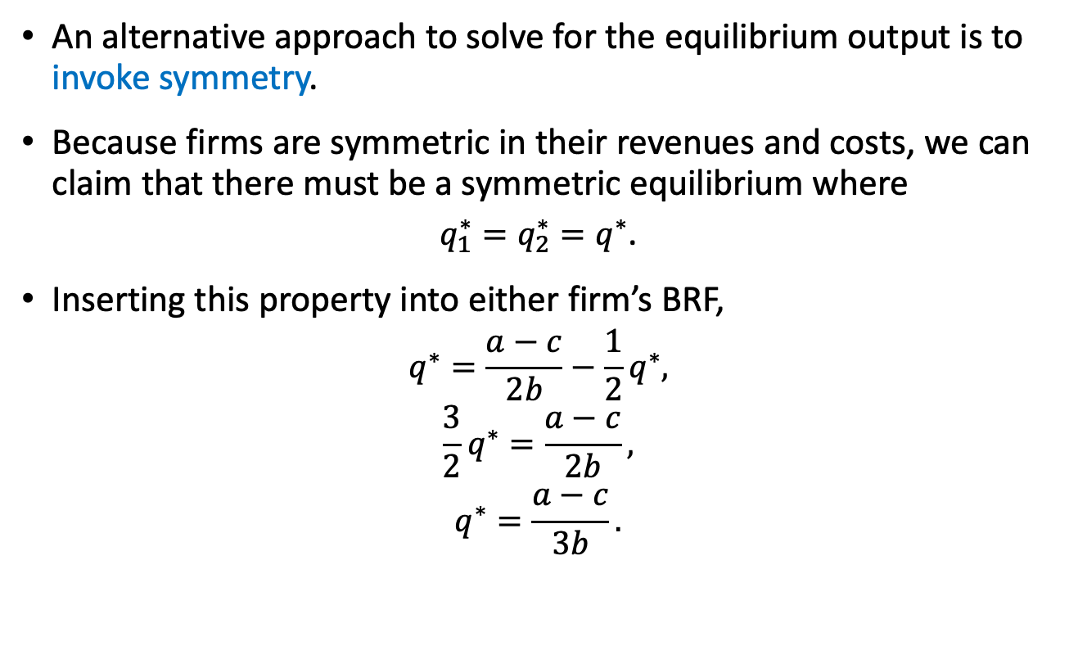
Cournot Model
An alternative approach to solve for the equilibrium output is to invoke symmetry.
Because firms are symmetric in their revenues and costs, we can claim that there must be a symmetric equilibrium where
$q_{1}^{∗}=q_{2}^{∗}=q^{∗}$.
Inserting this property into either firm’s BRF,
$$q^{∗}=\frac{a−c}{2b}−\frac{1}{2}q^{∗},$$
$$\frac{3}{2}q^{∗}=\frac{a−c}{2b},$$
$$q^{∗}=\frac{a−c}{3b}.$$

Slide 23
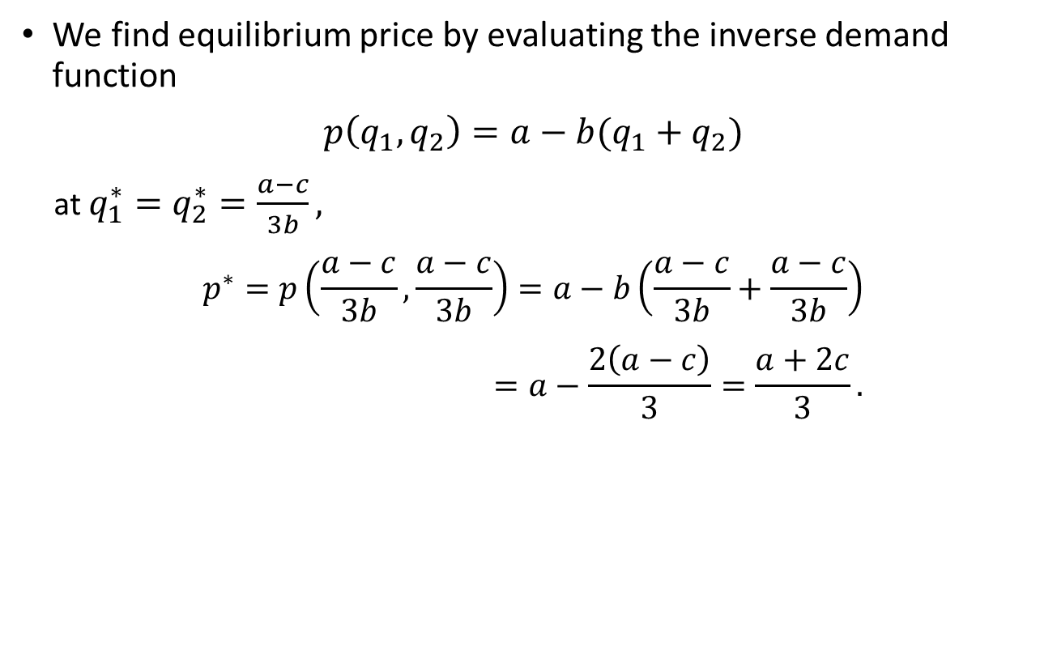
Cournot Model
We find equilibrium price by evaluating the inverse demand function
$p\left(q_{1},q_{2}\right)=a−b(q_{1}+q_{2})$
at $q_{1}^{∗}=q_{2}^{∗}=\frac{a−c}{3b},$
$$p^{∗}=p\left(\frac{a−c}{3b},\frac{a−c}{3b}\right)=a−b\left(\frac{a−c}{3b}+\frac{a−c}{3b}\right)$$
$$=a−\frac{2\left(a−c\right)}{3}=\frac{a+2c}{3}.$$

Slide 24
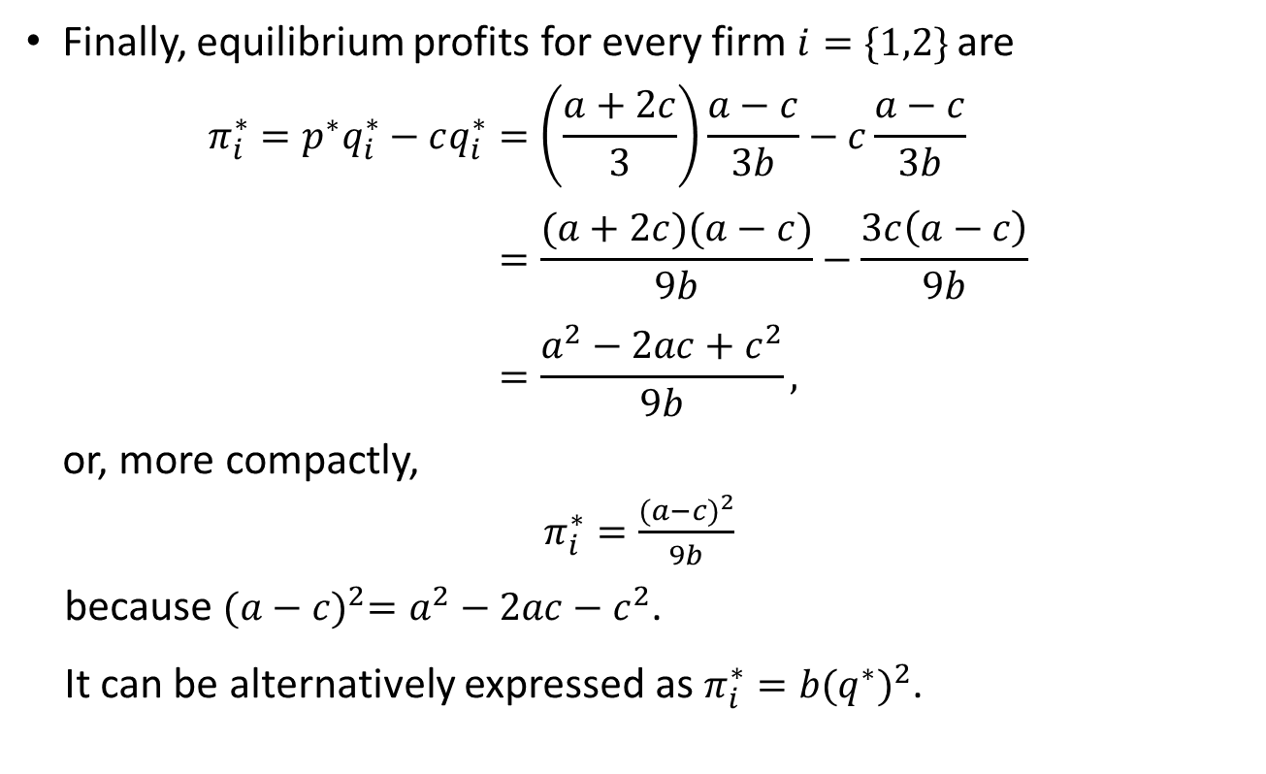
Cournot Model
Finally, equilibrium profits for every firm $i=\{1,2\}$ are
$$π_{i}^{∗}=p^{∗}q_{i}^{∗}−cq_{i}^{∗}=\left(\frac{a+2c}{3}\right)\frac{a−c}{3b}−c\frac{a−c}{3b}$$
$$=\frac{(a+2c)(a−c)}{9b}−\frac{3c\left(a−c\right)}{9b}$$
$$=\frac{a^{2}−2ac+c^{2}}{9b},$$
or, more compactly,
$π_{i}^{∗}=\frac{{(a−c)}^{2}}{9b}$
because ${(a−c)}^{2}=a^{2}−2ac−c^{2}$.
It can be alternatively expressed as $π_{i}^{∗}={b(q^{∗})}^{2}$.

Slide 25

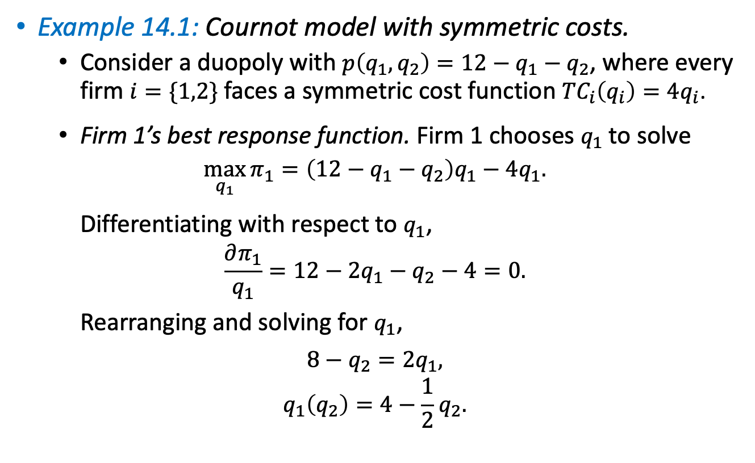
Cournot Model
Example 14.1: Cournot model with symmetric costs.
  Consider a duopoly with $p\left(q_{1},q_{2}\right)=12−q_{1}−q_{2}$, where every firm $i=\{1,2\}$ faces a symmetric cost function ${TC}_{i}\left(q_{i}\right)=4q_{i}$.
  Firm 1’s best response function. Firm 1 chooses $q_{1}$ to solve
  $$\max_{q_{1}}{π_{1}=\left(12−q_{1}−q_{2}\right)q_{1}−4q_{1}.}$$
  Differentiating with respect to $q_{1}$,
  $$\frac{∂π_{1}}{q_{1}}=12−2q_{1}−q_{2}−4=0.$$
  Rearranging and solving for $q_{1}$,
  $$8−q_{2}=2q_{1},$$
  $$q_{1}\left(q_{2}\right)=4−\frac{1}{2}q_{2}.$$
(${BRF}_{1})$

Slide 26

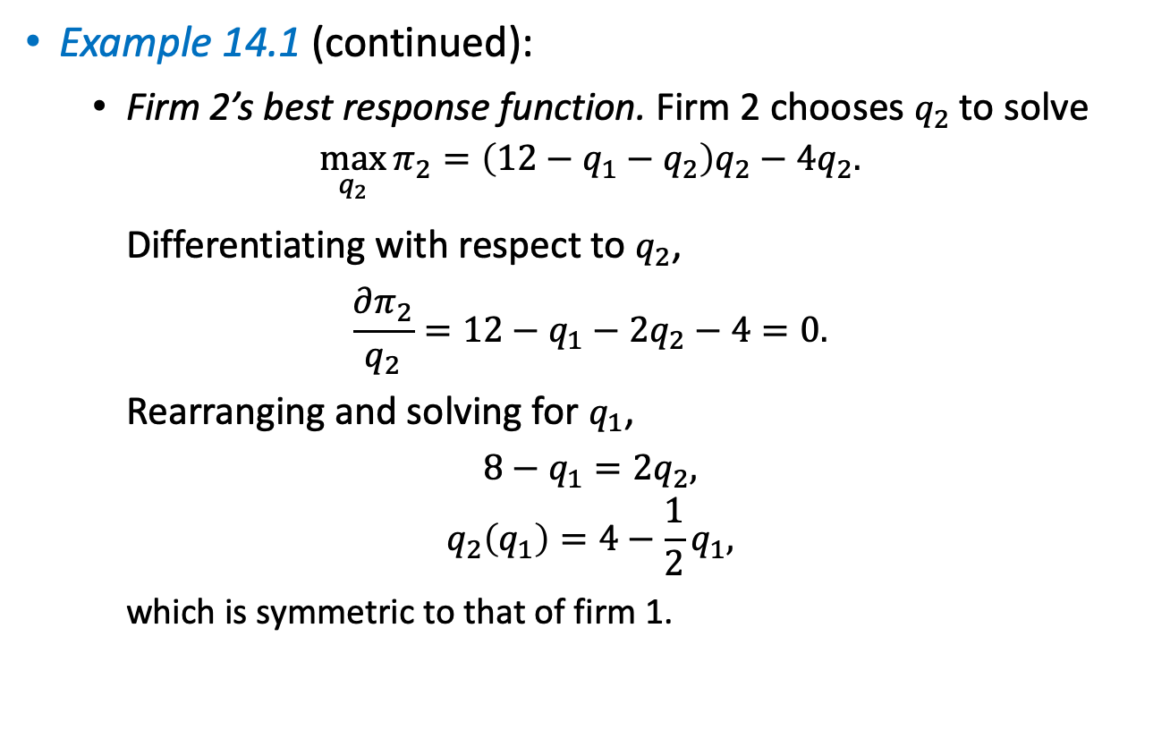
Cournot Model
Example 14.1 (continued):
  Firm 2’s best response function. Firm 2 chooses $q_{2}$ to solve
  $$\max_{q_{2}}{π_{2}=\left(12−q_{1}−q_{2}\right)q_{2}−4q_{2}.}$$
  Differentiating with respect to $q_{2}$,
  $$\frac{∂π_{2}}{q_{2}}=12−q_{1}−{2q}_{2}−4=0.$$
  Rearranging and solving for $q_{1}$,
  $$8−q_{1}=2q_{2},$$
  $$q_{2}\left(q_{1}\right)=4−\frac{1}{2}q_{1},$$
  which is symmetric to that of firm 1.
(${BRF}_{2})$

Slide 27

Cournot Model
Example 14.1 (continued):
  Finding equilibrium output.
  We can invoke symmetry, and claim
  $q_{1}^{∗}=q_{2}^{∗}=q^{∗}.$
  Inserting this property into either firm’s best response function, and solving for $q^{∗}$,
  $$q^{∗}=4−\frac{1}{2}q^{∗},$$
  $$\frac{3}{2}q^{∗}=4 ⟹q^{∗}=\frac{8}{3}.$$

Slide 28

Cournot Model
Example 14.1 (continued):
  Finding equilibrium output (cont.).
  Equilibrium price is
  $$p^{∗}\left(\frac{8}{3},\frac{8}{3}\right)=12−q^{∗}−q^{∗}=12−\frac{8}{3}−\frac{8}{3}=\frac{20}{3}≅\$6.67,$$
  producing for every firm $i=\{1,2\}$ equilibrium profits of
  $$π_{i}^{∗}=p^{∗}q^{∗}−cq^{∗}=\left(\frac{20}{3}\right)\frac{8}{3}−4\frac{8}{3}=\frac{160}{9}−\frac{96}{9}=\frac{64}{9}.$$

Slide 29
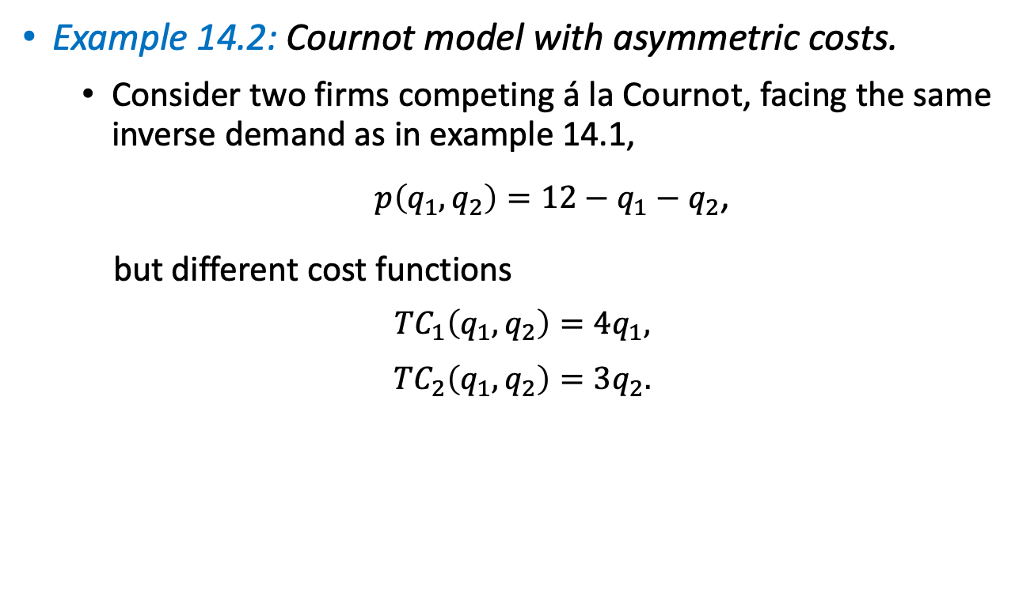
Cournot Model
Example 14.2: Cournot model with asymmetric costs.
  Consider two firms competing á la Cournot, facing the same inverse demand as in example 14.1,
  $p\left(q_{1},q_{2}\right)=12−q_{1}−q_{2}$,
  but different cost functions
  $${TC}_{1}\left(q_{1},q_{2}\right)=4q_{1},$$
  $${TC}_{2}\left(q_{1},q_{2}\right)=3q_{2}.$$

Slide 30
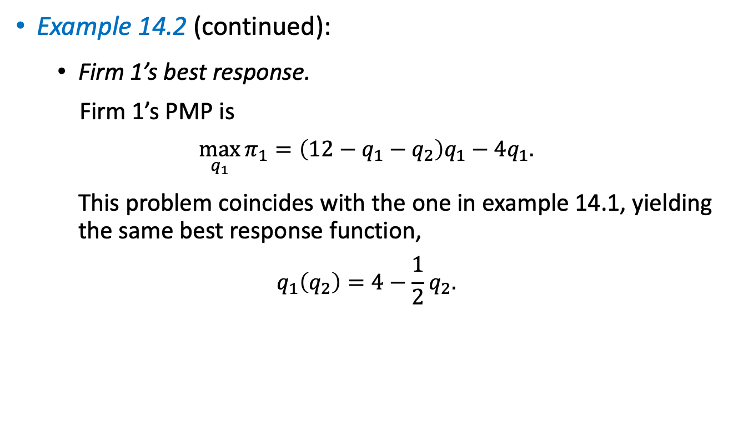
Cournot Model
Example 14.2 (continued):
  Firm 1’s best response.
  Firm 1’s PMP is
  $$\max_{q_{1}}{π_{1}=\left(12−q_{1}−q_{2}\right)q_{1}−4q_{1}.}$$
  This problem coincides with the one in example 14.1, yielding the same best response function,
  $$q_{1}\left(q_{2}\right)=4−\frac{1}{2}q_{2}.$$

Slide 31
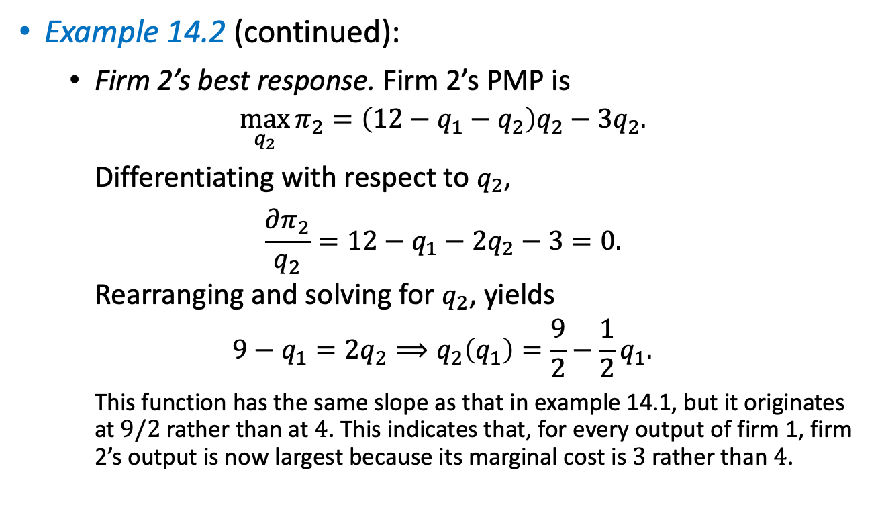
Cournot Model
Example 14.2 (continued):
  Firm 2’s best response. Firm 2’s PMP is
  $$\max_{q_{2}}{π_{2}=\left(12−q_{1}−q_{2}\right)q_{2}−3q_{2}.}$$
  Differentiating with respect to $q_{2}$,
  $$\frac{∂π_{2}}{q_{2}}=12−q_{1}−2q_{2}−3=0.$$
  Rearranging and solving for $q_{2}$, yields
  $$9−q_{1}=2q_{2}⟹q_{2}\left(q_{1}\right)=\frac{9}{2}−\frac{1}{2}q_{1}.$$
  This function has the same slope as that in example 14.1, but it originates at $9/2$ rather than at $4$. This indicates that, for every output of firm 1, firm 2’s output is now largest because its marginal cost is$3$rather than $4$.

Slide 32
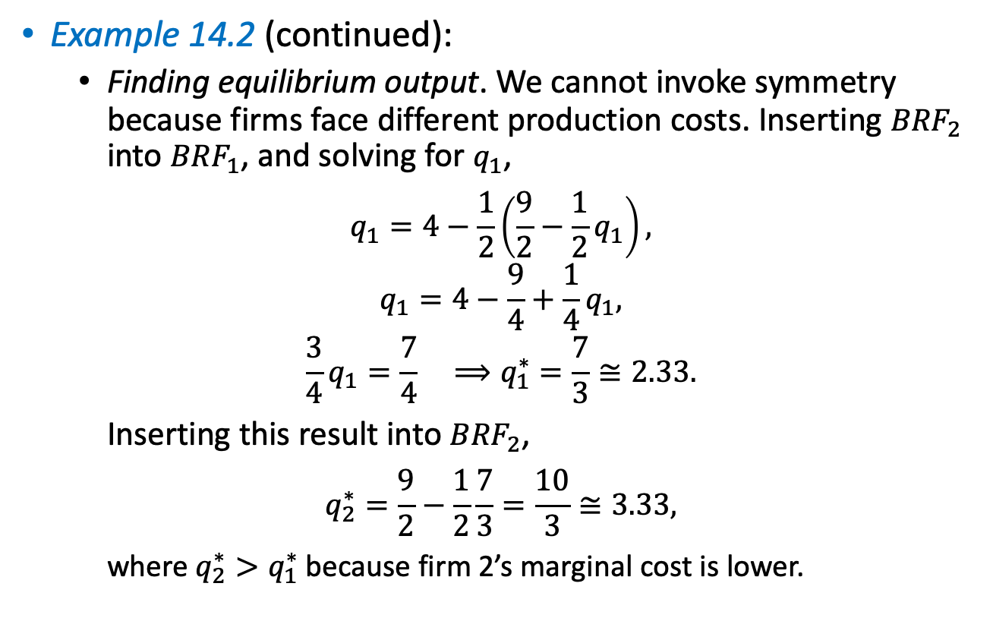
Cournot Model
Example 14.2 (continued):
  Finding equilibrium output. We cannot invoke symmetry because firms face different production costs. Inserting ${BRF}_{2}$ into ${BRF}_{1}$, and solving for $q_{1}$,
  $$q_{1}=4−\frac{1}{2}\left(\frac{9}{2}−\frac{1}{2}q_{1}\right),$$
  $$q_{1}=4−\frac{9}{4}+\frac{1}{4}q_{1},$$
  $$\frac{3}{4}q_{1}=\frac{7}{4} ⟹q_{1}^{∗}=\frac{7}{3}≅2.33.$$
  Inserting this result into ${BRF}_{2}$,
  $$q_{2}^{∗}=\frac{9}{2}−\frac{1}{2}\frac{7}{3}=\frac{10}{3}≅3.33,$$
  where $q_{2}^{∗}>q_{1}^{∗}$ because firm 2’s marginal cost is lower.

Slide 33

Cournot Model
Example 14.2 (continued):
  In this scenario, equilibrium price and equilibrium profits are
  $$p^{∗}=\frac{19}{3},$$
  $$π_{1}^{∗}=\frac{49}{9},$$
  $$π_{2}^{∗}=\frac{100}{9}.$$
  Firm 2, which is benefiting from a cost advantage, earns a larger profit than firm 1 which suffers from a cost disadvantage.

Slide 34
Bertrand Model–
Simultaneous Price Competition

Slide 35
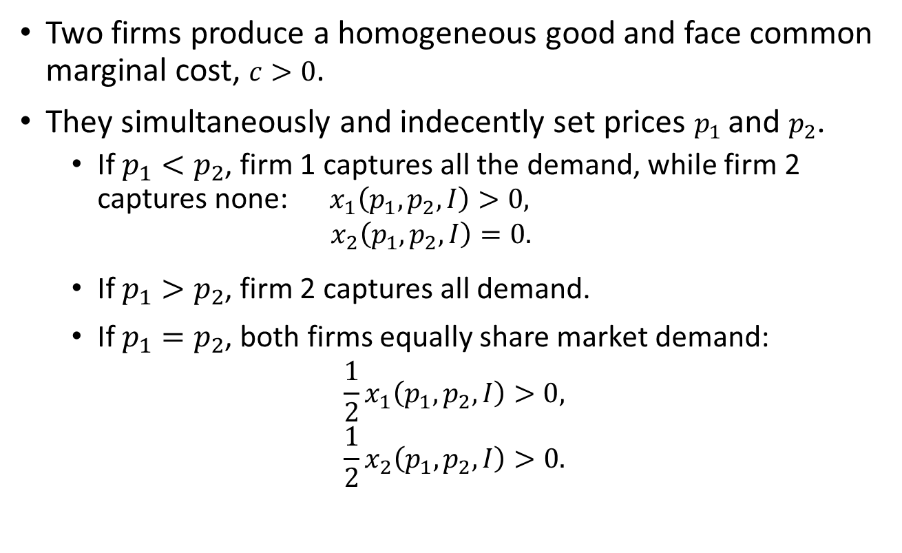
Bertrand Model
Two firms produce a homogeneous good and face common marginal cost, $c>0$.
They simultaneously and indecently set prices $p_{1}$ and $p_{2}$.
  If $p_{1}<p_{2}$, firm 1 captures all the demand, while firm 2 captures none: $x_{1}\left(p_{1},p_{2},I\right)>0,$
  $$x_{2}\left(p_{1},p_{2},I\right)=0.$$
  If $p_{1}>p_{2}$, firm 2 captures all demand.
  If $p_{1}=p_{2}$, both firms equally share market demand:
  $$\frac{1}{2}x_{1}\left(p_{1},p_{2},I\right)>0,$$
  $$\frac{1}{2}x_{2}\left(p_{1},p_{2},I\right)>0.$$

Slide 36
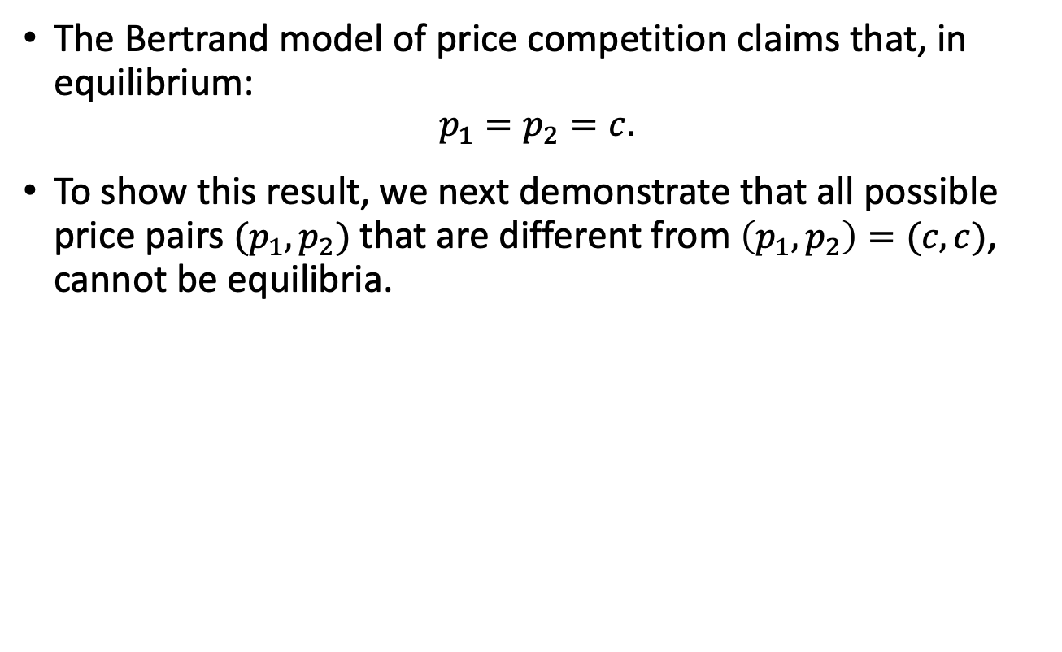
Bertrand Model
The Bertrand model of price competition claims that, in equilibrium:
$$p_{1}=p_{2}=c.$$
To show this result, we next demonstrate that all possible price pairs $(p_{1},p_{2})$ that are different from $\left(p_{1},p_{2}\right)=(c,c)$, cannot be equilibria.

Slide 37
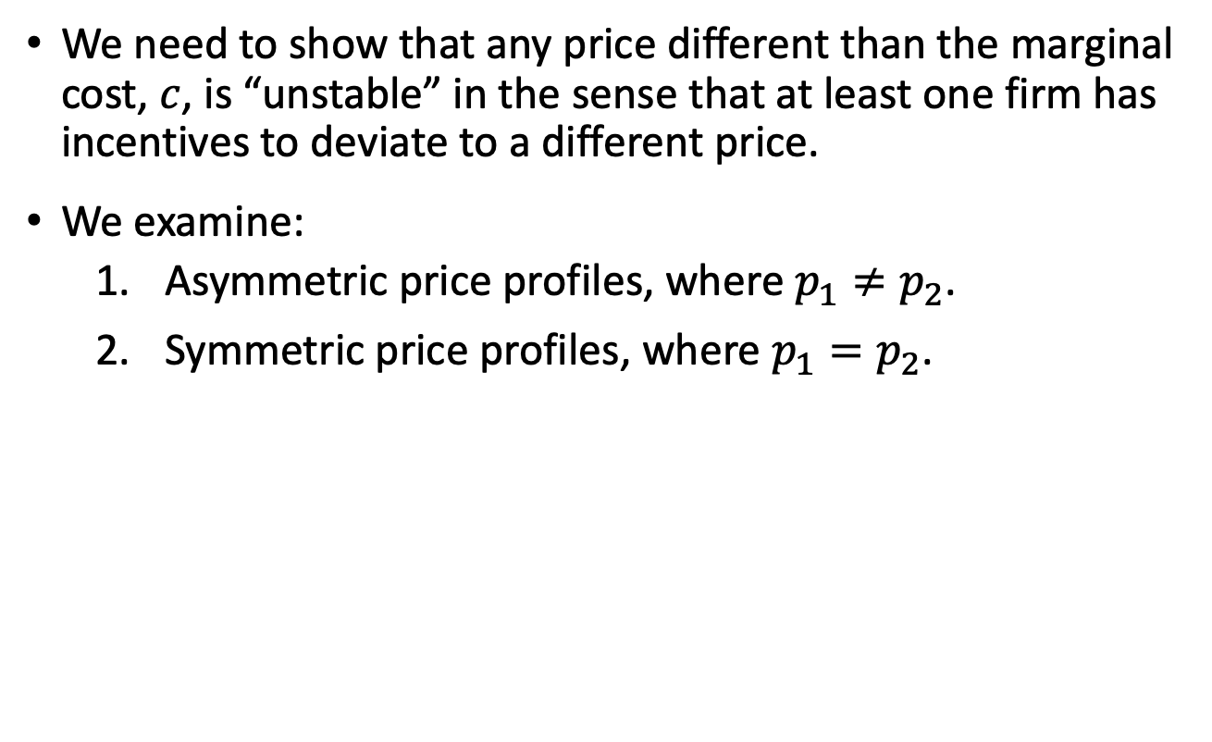
Bertrand Model
We need to show that any price different than the marginal cost, $c$, is “unstable” in the sense that at least one firm has incentives to deviate to a different price.
We examine:
  Asymmetric price profiles, where $p_{1}≠p_{2}$.
  Symmetric price profiles, where $p_{1}=p_{2}$.

Slide 38
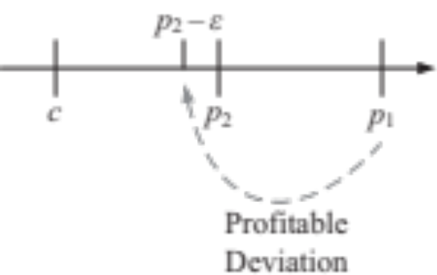
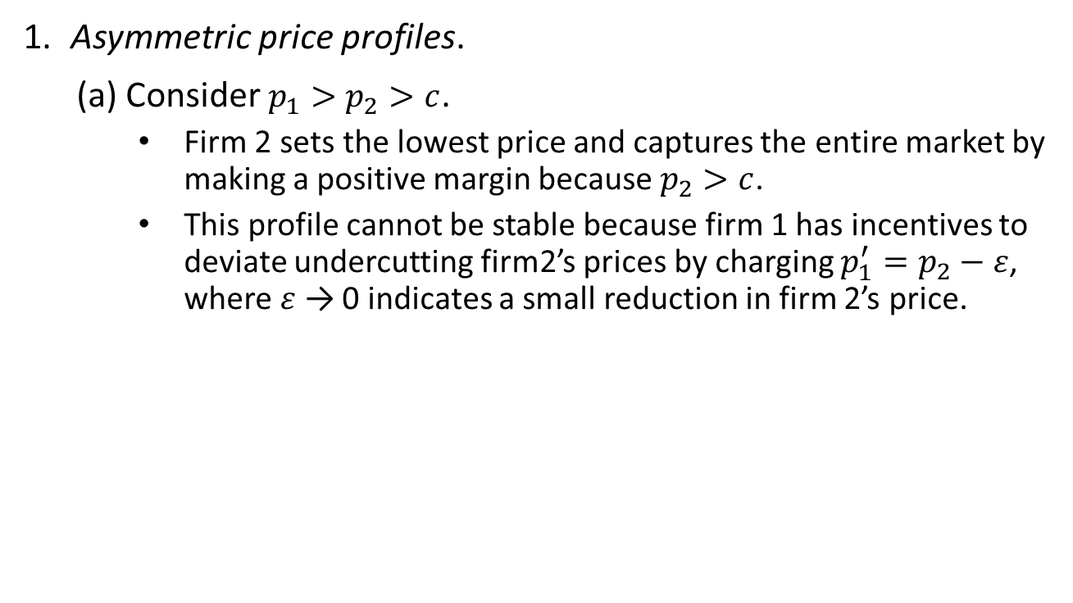
Bertrand Model
Asymmetric price profiles.
(a) Consider $p_{1}>p_{2}>c$.
  Firm 2 sets the lowest price and captures the entire market by making a positive margin because $p_{2}>c$.
  This profile cannot be stable because firm 1 has incentives to deviate undercutting firm2’s prices by charging $p_{1}^{′}=p_{2}−ε$, where $ε$ → 0 indicates a small reduction in firm 2’s price.
Figure 14.4

Slide 39
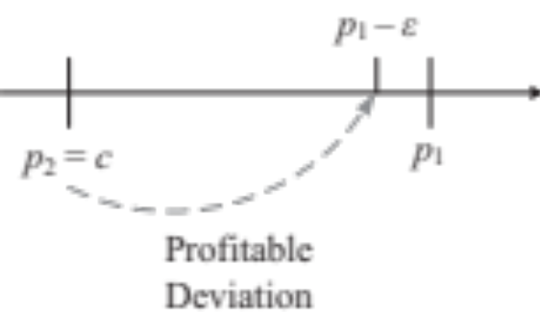
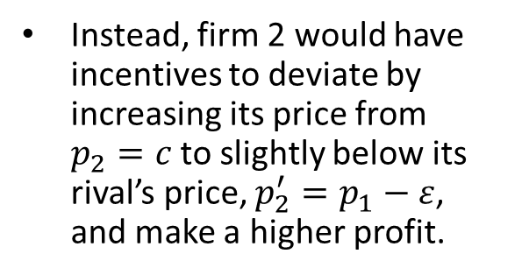
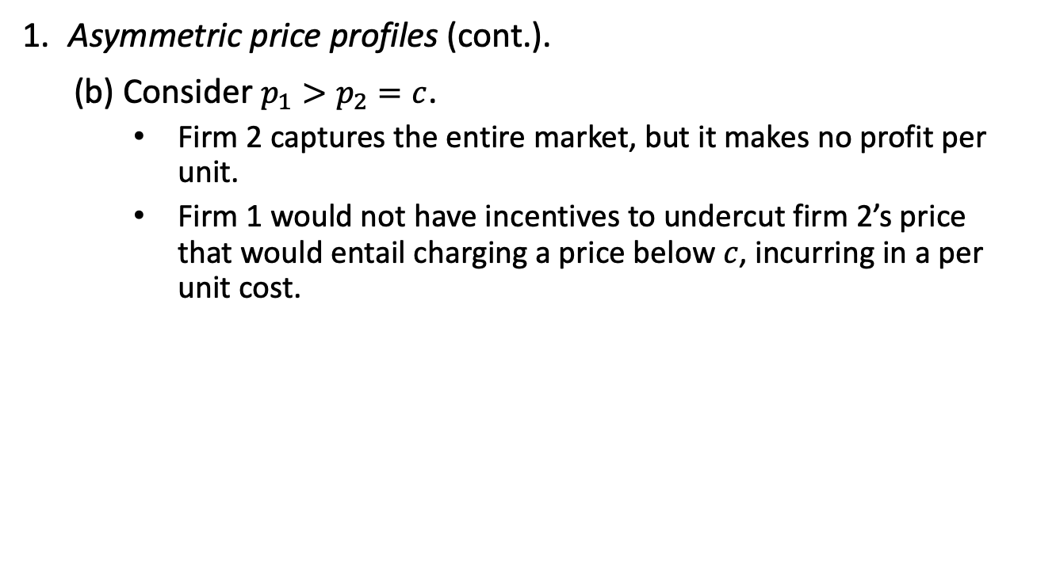
Bertrand Model
Asymmetric price profiles (cont.).
(b) Consider $p_{1}>p_{2}=c$.
  Firm 2 captures the entire market, but it makes no profit per unit.
  Firm 1 would not have incentives to undercut firm 2’s price that would entail charging a price below $c$, incurring in a per unit cost.
Instead, firm 2 would have incentives to deviate by increasing its price from $p_{2}=c$to slightly below its rival’s price, $p_{2}^{′}=p_{1}−ε$, and make a higher profit.
Figure 14.5

Slide 40
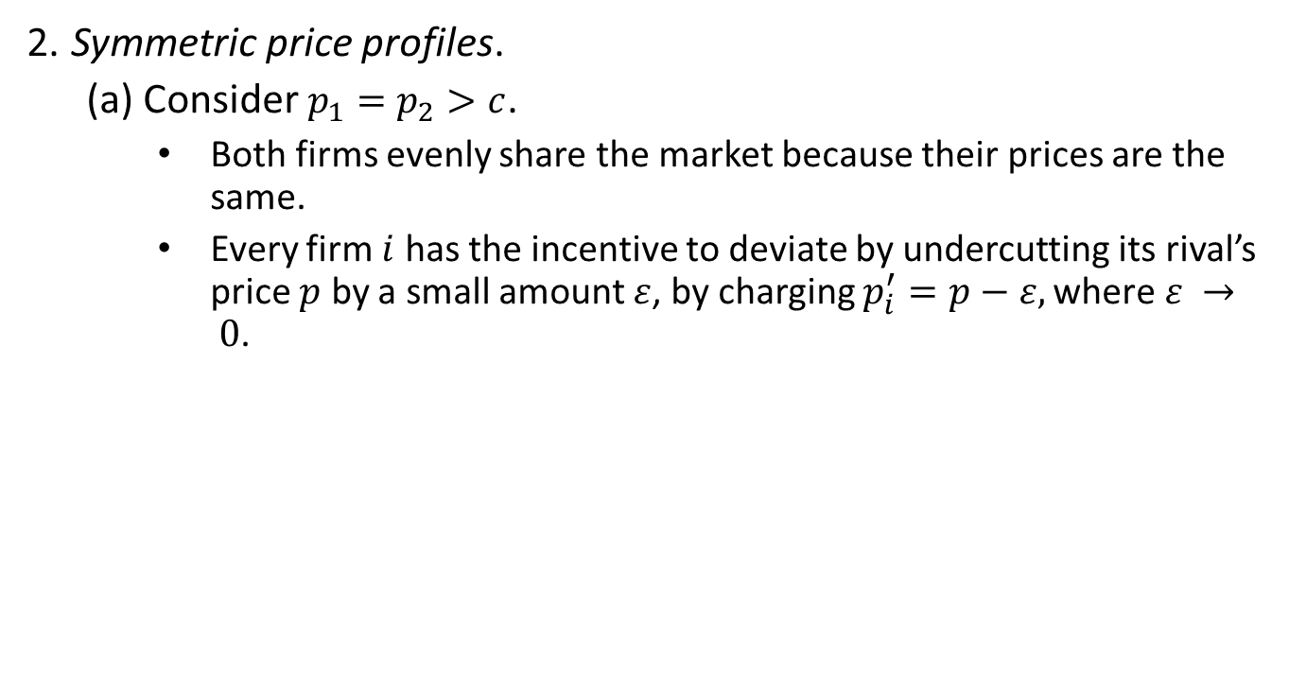
Bertrand Model
Symmetric price profiles.
(a) Consider $p_{1}=p_{2}>c$.
  Both firms evenly share the market because their prices are the same.
  Every firm $i$ has the incentive to deviate by undercutting its rival’s price $p$ by a small amount $ε$, by charging $p_{i}^{′}=p−ε,\text{where} ε → 0$.
Figure 14.6

Slide 41
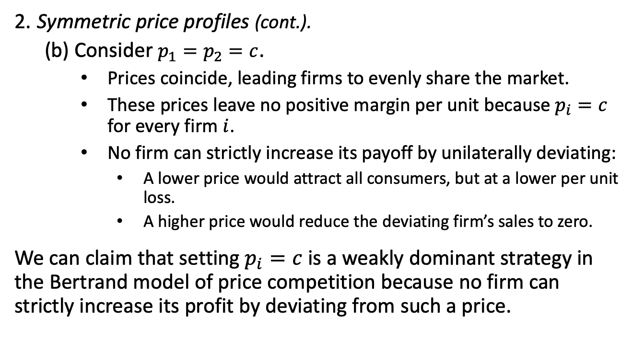
Bertrand Model
Symmetric price profiles (cont.).
(b) Consider $p_{1}=p_{2}=c$.
  Prices coincide, leading firms to evenly share the market.
  These prices leave no positive margin per unit because $p_{i}=c$ for every firm $i$.
  No firm can strictly increase its payoff by unilaterally deviating:
    A lower price would attract all consumers, but at a lower per unit loss.
    A higher price would reduce the deviating firm’s sales to zero.
    We can claim that setting $p_{i}=c$ is a weakly dominant strategy in the Bertrand model of price competition because no firm can strictly increase its profit by deviating from such a price.

Slide 42

Bertrand Model
Example 14.3: Bertrand model.
  Consider the inverse demand function in example 14.1, $p\left(q_{1},q_{2}\right)=12−q_{1}−q_{2}$.
  Because $Q≡q_{1}+q_{2}$ denotes the aggregate output in the industry, the inverse demand can be expressed as
  $p\left(Q\right)=12−Q$.
  In the Bertrand model of price competition, all firms in the industry lower their prices until
  $$p=c ⟹12−Q=c.$$
  Solving for $Q$, $Q^{∗}=12−c$.
    If $c=4$, $Q=12−4=8$ units, each of which sold at a price of $\$4$.

Slide 43
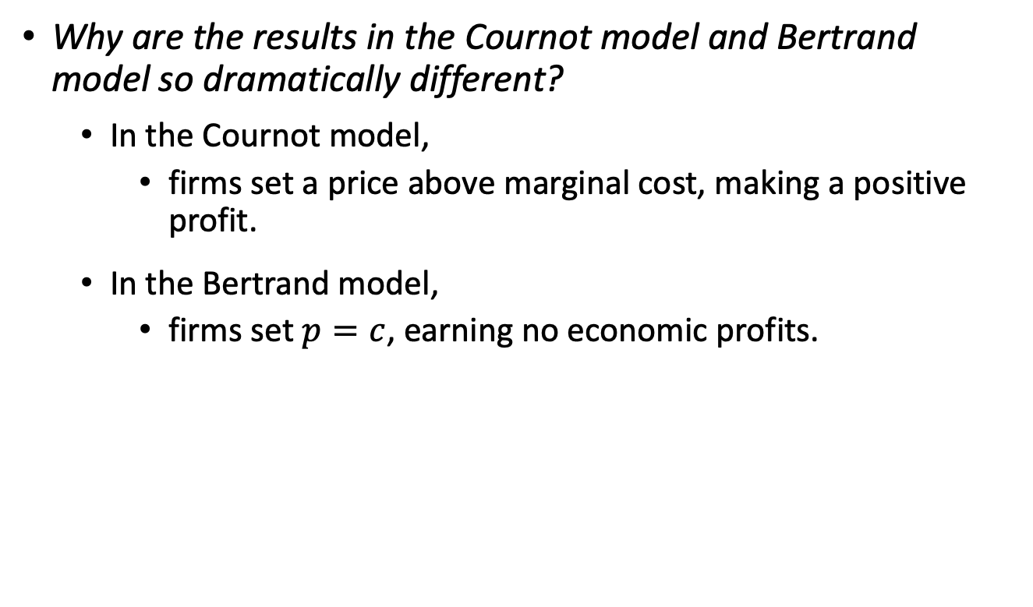
Reconciling the Cournot and Bertrand models
Why are the results in the Cournot model and Bertrand model so dramatically different?
  In the Cournot model,
    firms set a price above marginal cost, making a positive profit.
  In the Bertrand model,
    firms set $p=c$, earning no economic profits.

Slide 44
Reconciling the Cournot and Bertrand models
  These differences are driven by the absence of capacity constraints in the Bertrand model:
    If a firm charges 1 cent less than its rival, it captures the market demand, regardless of its size.
  This assumption might be reasonable for goods such as online movie streaming
    but difficult to justify with others (e.g., smartphones) with a world demand that cannot be served by a single firm.

Slide 45
Cartels and Collusion

Slide 46
Cartels and Collusion
Firms competing in quantities can earn profits below those under monopoly, which is emphasized when firm compete in prices.
What if, rather than competing, firms were to coordinate their production decisions?
We analyze how collusion can help firm increase their profits, and under which condition cooperation holds.
Cartels seek to coordinate production decisions to raise profits and profits for participants.
  In a cartel firms seek to maximize their joint rather than their individual profits.
  Example: OPEC.

Slide 47

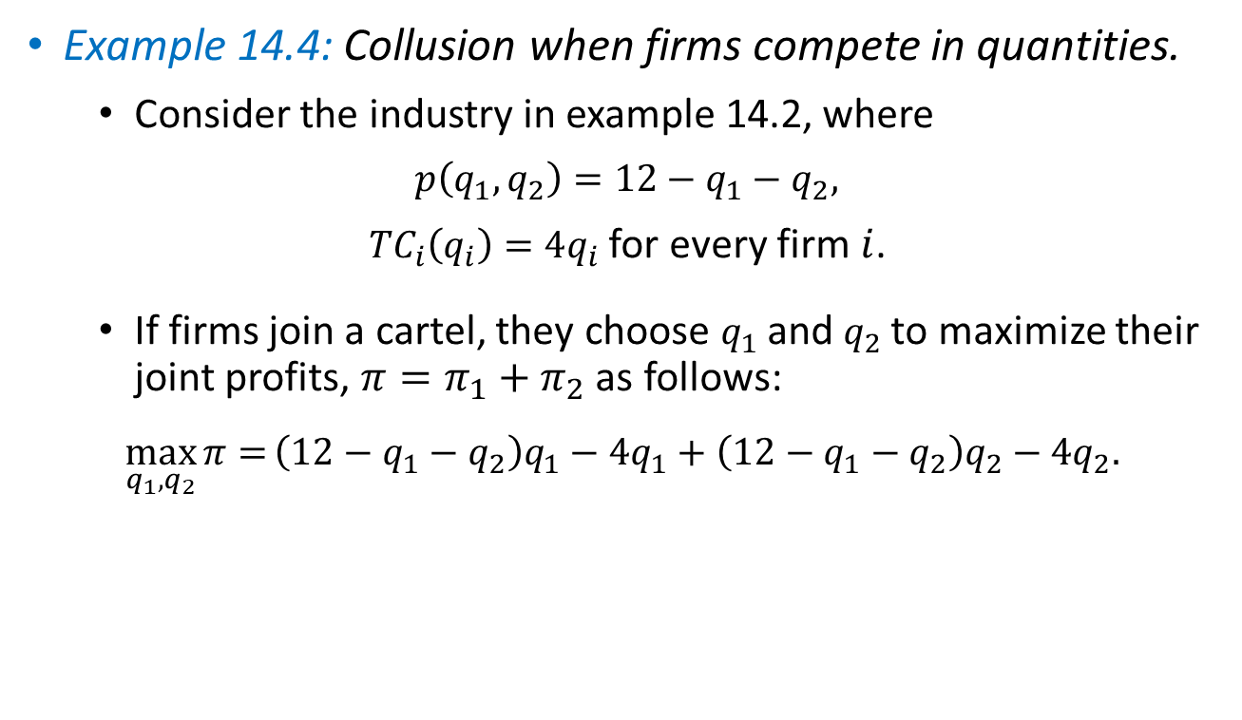

Cartels and Collusion
Example 14.4: Collusion when firms compete in quantities.
  Consider the industry in example 14.2, where
  $$p\left(q_{1},q_{2}\right)=12−q_{1}−q_{2},$$
  ${TC}_{i}\left(q_{i}\right)=4q_{i}$ for every firm $i$.
  If firms join a cartel, they choose $q_{1}$ and $q_{2}$ to maximize their joint profits, $π=π_{1}+$ $π_{2}$as follows:
  $$\max_{q_{1},q_{2}}{π=}\left(12−q_{1}−q_{2}\right)q_{1}−4q_{1}+\left(12−q_{1}−q_{2}\right)q_{2}−4q_{2}.$$
$$π_{1}$$
$$π_{2}$$

Slide 48
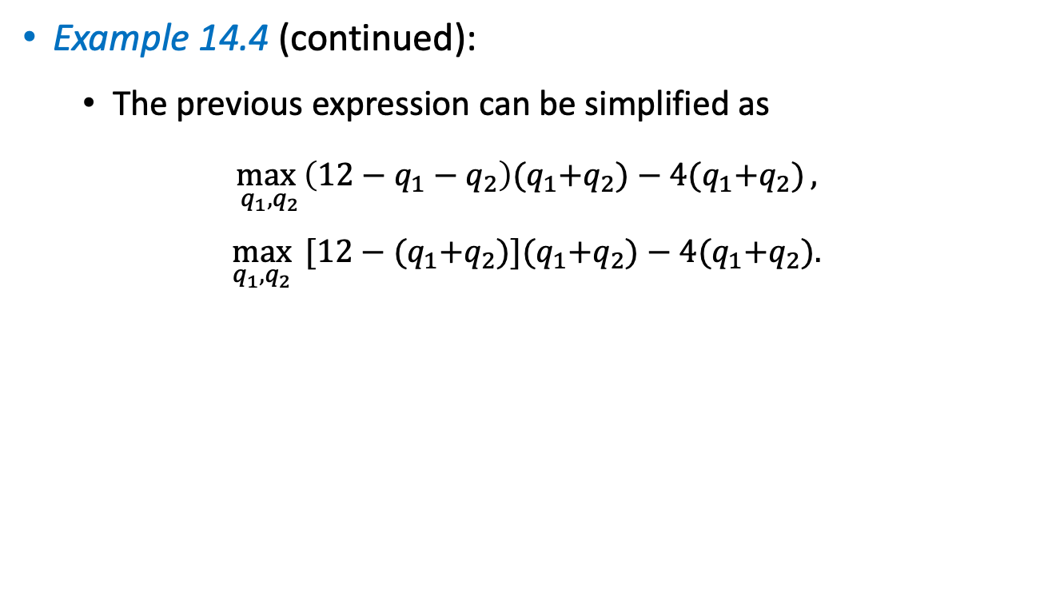
Cartels and Collusion
Example 14.4 (continued):
  The previous expression can be simplified as
  $$\max_{q_{1},q_{2}}\left(12−q_{1}−q_{2}\right){(q}_{1}+q_{2})−4{(q}_{1}+q_{2}),$$
  $$\max_{q_{1},q_{2}}{ [12−{(q}_{1}+q_{2})]{(q}_{1}+q_{2})−4{(q}_{1}+q_{2}).}$$

Slide 49
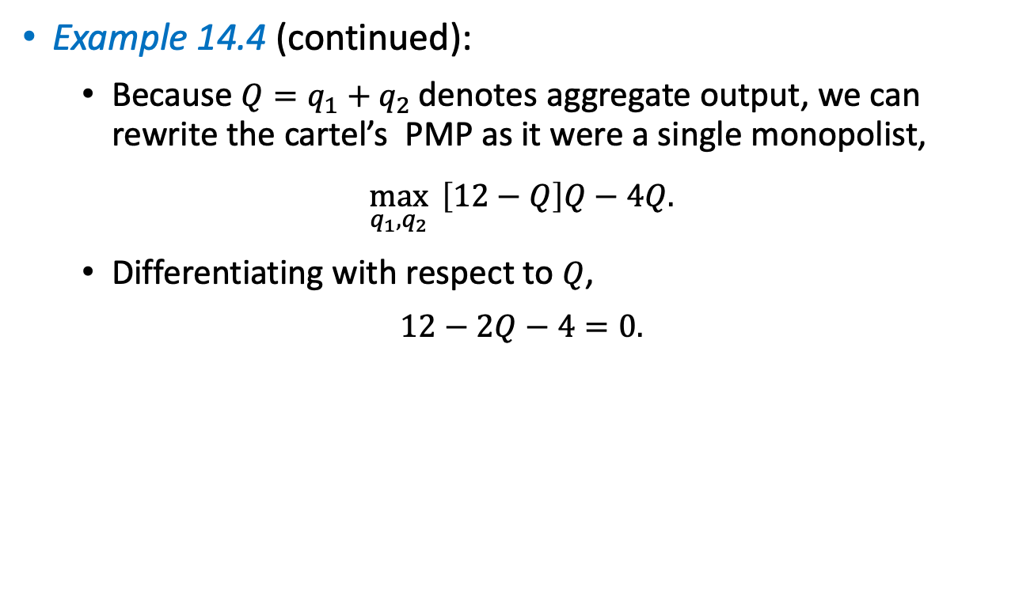
Cartels and Collusion
Example 14.4 (continued):
  Because $Q=q_{1}+q_{2}$ denotes aggregate output, we can rewrite the cartel’s PMP as it were a single monopolist,
  $$\max_{q_{1},q_{2}}{ \left[12−Q\right]Q−4Q.}$$
  Differentiating with respect to $Q$,
  $$12−2Q−4=0.$$

Slide 50

Cartels and Collusion
Example 14.4 (continued):
  Solving for $Q$,
  $Q^{∗}=\frac{8}{2}=4$ units.
  Because firms are symmetric, each produces $q_{i}=\frac{Q^{∗}}{2}=2$ units.
  In contrast, under Cournot competition, every firm produces $q=\frac{8}{3}≅2.66$ units.

Slide 51

Cartels and Collusion
Example 14.4 (continued):
  Under cartel, every firm limits its own production to increase market price and profits.
  We confirm this result by finding that the cartel price is
  $$p\left(2,2\right)=12−2−2=\$8,$$
  which is higher than under Cournot competition ($\$6.67$).
  The cartel profits for every firm $i$ are
  $$π_{i}=\left(12−q_{1}−q_{2}\right)q_{i}−4q_{i}=\left(12−2−2\right)2−\left(4×2\right)=\$8,$$
  while under Cournot competition, $π_{i}^{∗}=\frac{64}{9}≃\$7.11.$

Slide 52
Cartels and Collusion
Why are cartel profits larger than under Cournot competition?
  Under Cournot, when every firm increases its output, it considers the effect of such additional production has in its own profits, but it ignores the effect on its rival’s profit.
  Under the cartel, firms take into account each other’s benefits. Firms produce less but elevate market prices and increase profits.
We next identify the conditions to sustain collusion over time.
  If firms interact only once, cooperation cannot be sustained in equilibrium.
  If firms interact infinitely (there is a probability that firms will be in the industry tomorrow), cooperation can be sustained.

Slide 53
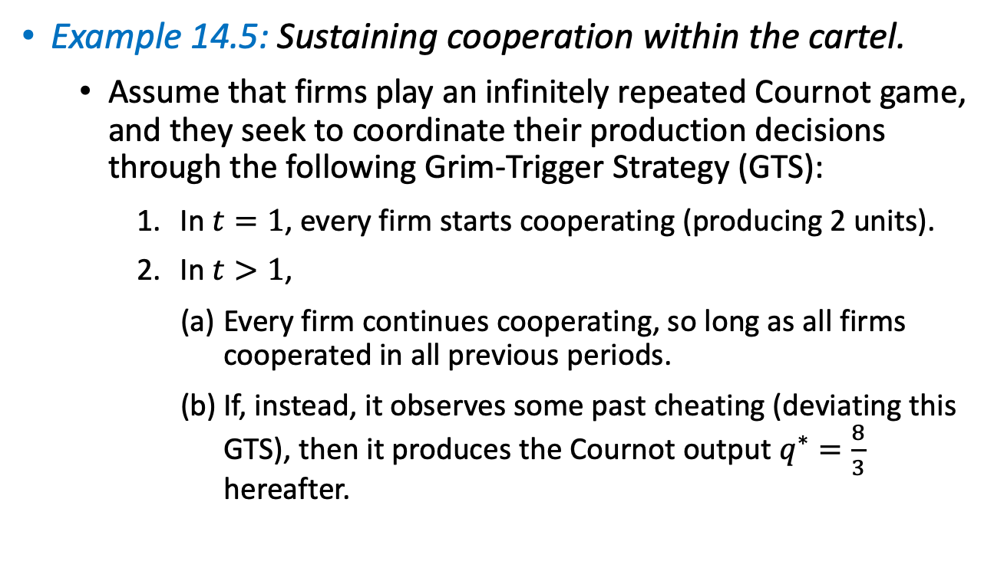
Cartels and Collusion
Example 14.5: Sustaining cooperation within the cartel.
  Assume that firms play an infinitely repeated Cournot game, and they seek to coordinate their production decisions through the following Grim-Trigger Strategy (GTS):
    In $t=1$, every firm starts cooperating (producing 2 units).
    In $t>1$,
    Every firm continues cooperating, so long as all firms cooperated in all previous periods.
    If, instead, it observes some past cheating (deviating this GTS), then it produces the Cournot output $q^{∗}=\frac{8}{3}$ hereafter.

Slide 54

Cartels and Collusion
Example 14.5 (continued):
  We only need to check if every firm has incentives to deviate from the GTS: (1) after observing a history of cooperation; and (2) after observing that some firm/s cheated.
  Cooperation. If firm $i$continues cooperating (producing under cartel $q=2$), it obtains profit of $\$8$. Then, its stream of discounted payoffs from cooperating is
  $$8+δ8+δ^{2}8+…=8(1+δ+δ^{2}+…)$$
  $$=\frac{8}{1−δ},$$
  where $δ$ denotes the discount factor weighting future payoffs.

Slide 55

Cartels and Collusion
Example 14.5 (continued):
  Best deviation. If firm $i$ deviates from $q=2$while its rival sticks to the cartel agreement, its profits could increase.
  What is firm $i$’s best deviation? We need to evaluate its profits when its rival produces the cartel output, $q_{j}=2$,
  $$\left(12−q_{i}−2\right)q_{i}−4q_{i}=\left(10−q_{i}\right)q_{i}−4q_{i}.$$
  Differentiating wit respect to $q_{i}$,
  $10−2q_{i}−4=0 ⟹q_{i}=3$ units.
  Inserting this “best deviation” into firm $i$’s profits, deviation profits are
  $π^{Dev}=\left(10−3\right)3−\left(4×3\right)=\$9>$ cartel profit of $\$8$.

Slide 56
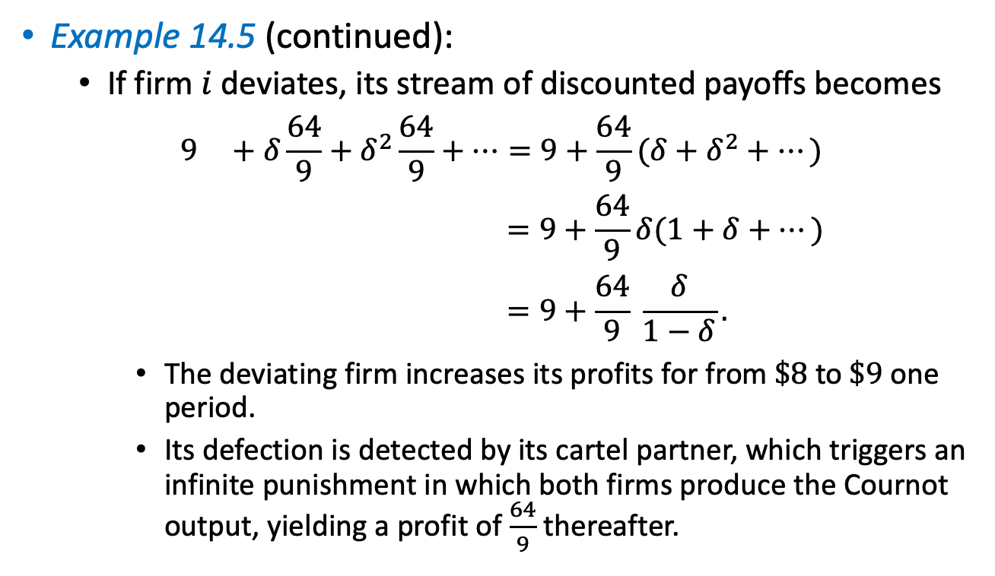
Cartels and Collusion
Example 14.5 (continued):
  If firm $i$ deviates, its stream of discounted payoffs becomes
  $$9 +δ\frac{64}{9}+δ^{2}\frac{64}{9}+…=9+\frac{64}{9}(δ+δ^{2}+…)$$
  $$=9+\frac{64}{9}δ(1+δ+…)$$
  $$=9+\frac{64}{9} \frac{δ}{1−δ}.$$
    The deviating firm increases its profits for from $\$8$to $\$9$one period.
    Its defection is detected by its cartel partner, which triggers an infinite punishment in which both firms produce the Cournot output, yielding a profit of $\frac{64}{9}$ thereafter.
Deviation
Punishment

Slide 57
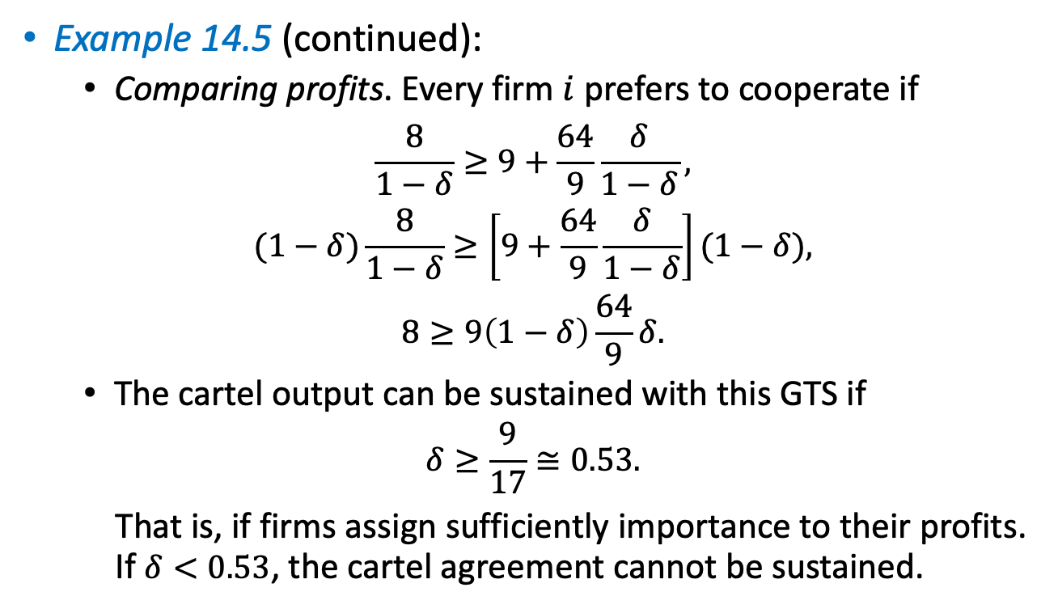
Cartels and Collusion
Example 14.5 (continued):
  Comparing profits. Every firm $i$ prefers to cooperate if
  $$\frac{8}{1−δ}≥9+\frac{64}{9}\frac{δ}{1−δ},$$
  $$(1−δ)\frac{8}{1−δ}≥\left[9+\frac{64}{9}\frac{δ}{1−δ}\right](1−δ),$$
  $$8≥9\left(1−δ\right)\frac{64}{9}δ.$$
  The cartel output can be sustained with this GTS if
  $$δ≥\frac{9}{17}≅0.53.$$
  That is, if firms assign sufficiently importance to their profits. If $δ<0.53$, the cartel agreement cannot be sustained.

Slide 58
Stackelberg Model–
Sequential Quantity Competition

Slide 59
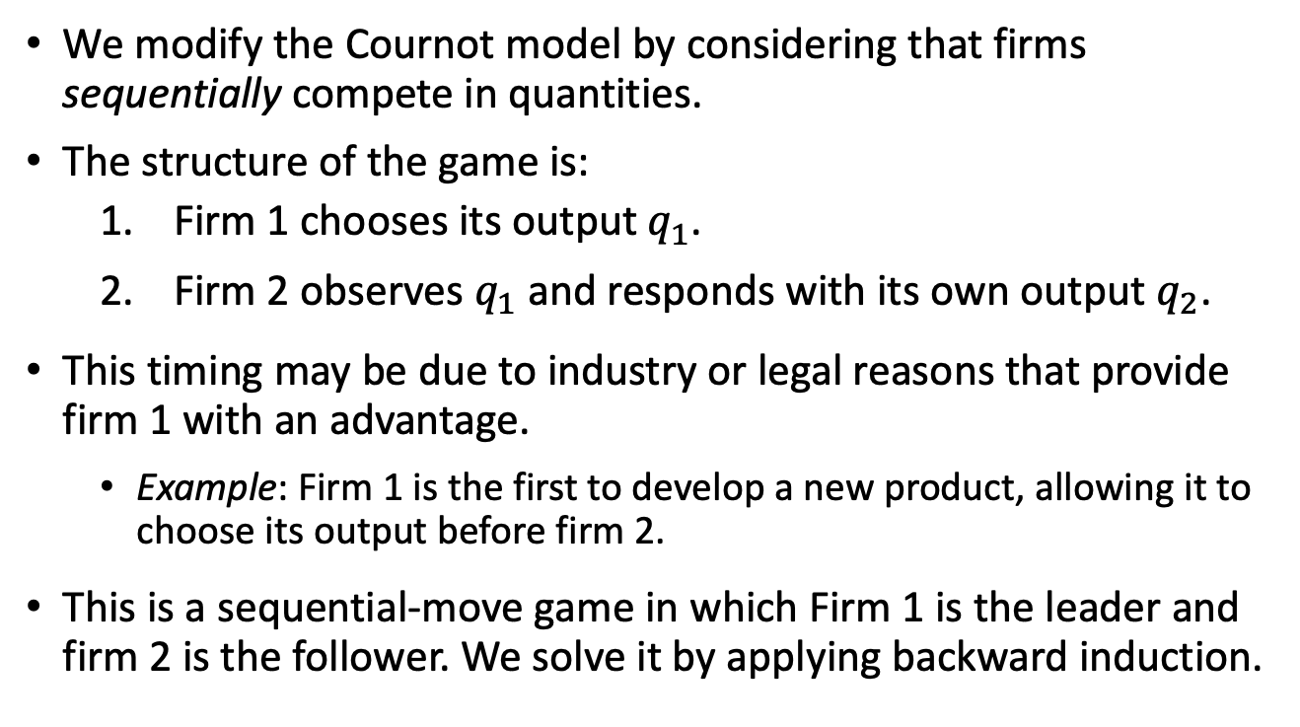
Stackelberg Model
We modify the Cournot model by considering that firms sequentially compete in quantities.
The structure of the game is:
  Firm 1 chooses its output $q_{1}$.
  Firm 2 observes $q_{1}$ and responds with its own output $q_{2}$.
This timing may be due to industry or legal reasons that provide firm 1 with an advantage.
  Example: Firm 1 is the first to develop a new product, allowing it to choose its output before firm 2.
This is a sequential-move game in which Firm 1 is the leader and firm 2 is the follower. We solve it by applying backward induction.

Slide 60

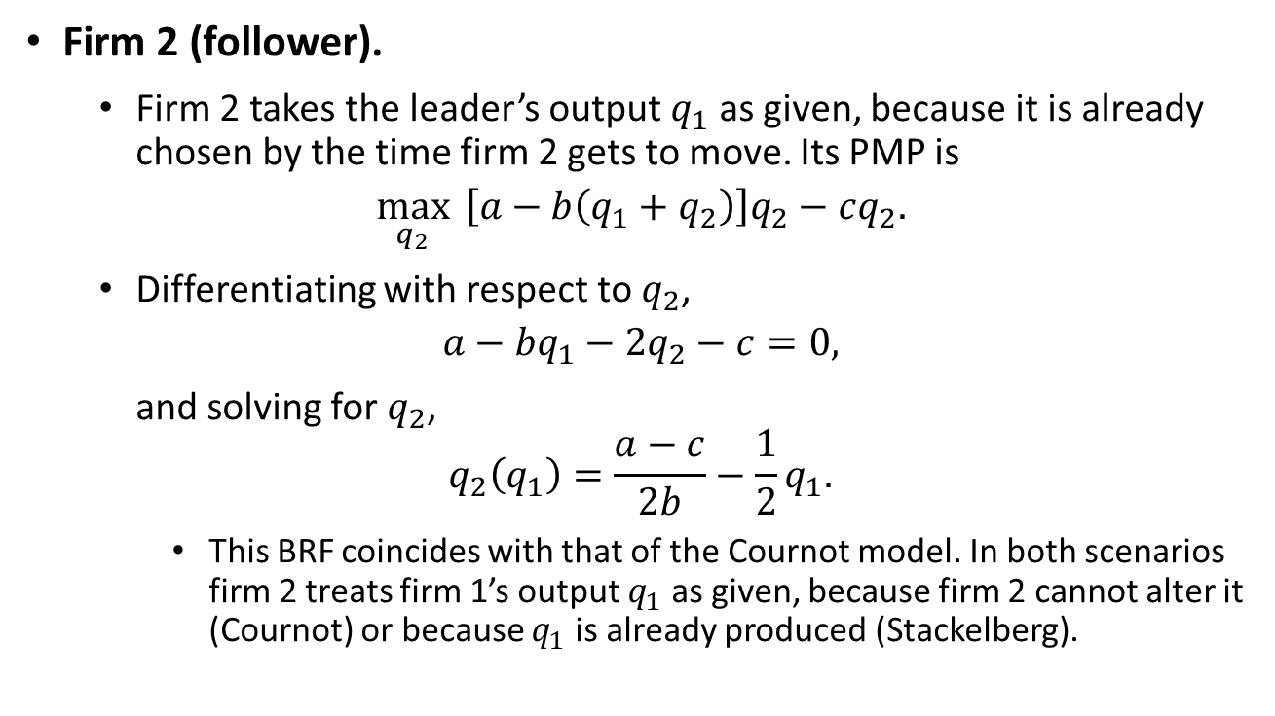
Stackelberg Model
Firm 2 (follower).
  Firm 2 takes the leader’s output $q_{1}$ as given, because it is already chosen by the time firm 2 gets to move. Its PMP is
$$\max_{q_{2}}{ \left[a−b\left(q_{1}+q_{2}\right)\right]q_{2}−cq_{2}.}$$
  Differentiating with respect to $q_{2}$,
$$a−bq_{1}−2q_{2}−c=0,$$
and solving for $q_{2}$,
$$q_{2}\left(q_{1}\right)=\frac{a−c}{2b}−\frac{1}{2}q_{1}.$$
    This BRF coincides with that of the Cournot model. In both scenarios firm 2 treats firm 1’s output $q_{1}$ as given, because firm 2 cannot alter it (Cournot) or because $q_{1}$ is already produced (Stackelberg).
(${BRF}_{2})$

Slide 61
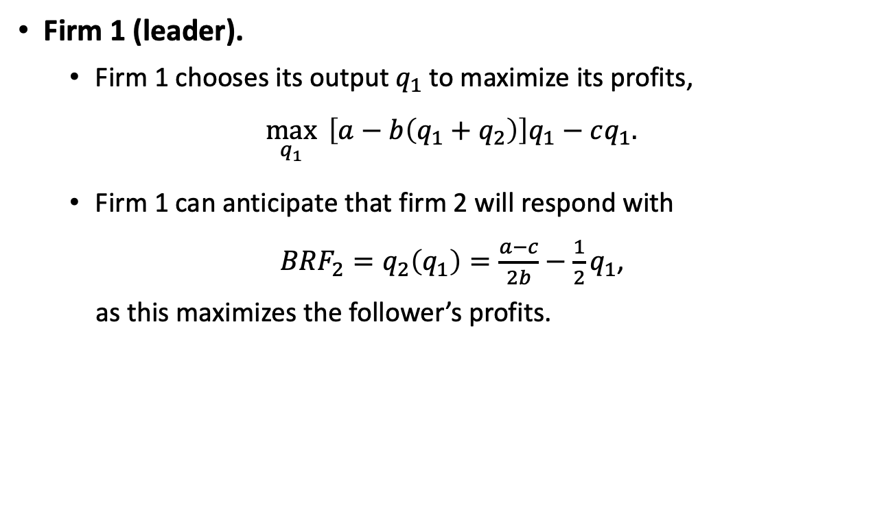
Stackelberg Model
Firm 1 (leader).
  Firm 1 chooses its output $q_{1}$ to maximize its profits,
$$\max_{q_{1}}{ \left[a−b\left(q_{1}+q_{2}\right)\right]q_{1}−cq_{1}.}$$
  Firm 1 can anticipate that firm 2 will respond with
  ${BRF}_{2}=q_{2}\left(q_{1}\right)=\frac{a−c}{2b}−\frac{1}{2}q_{1}$,
  as this maximizes the follower’s profits.

Slide 62

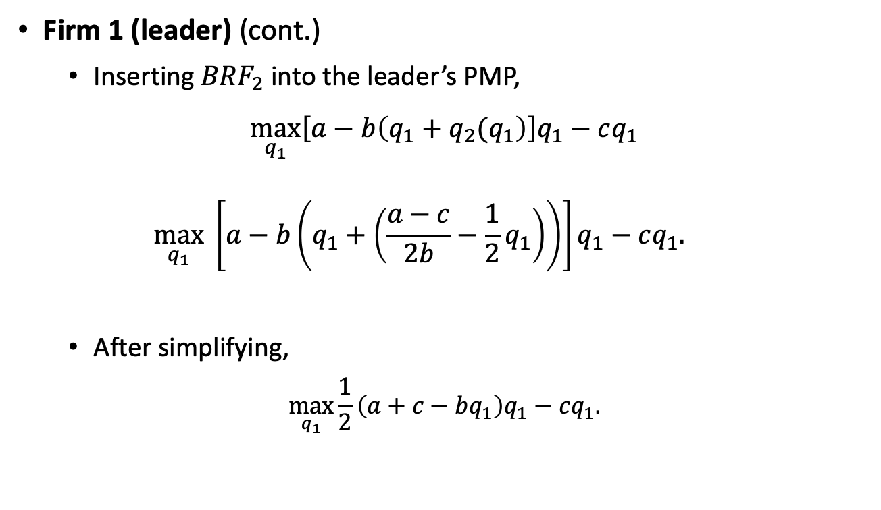

Stackelberg Model
Firm 1 (leader) (cont.)
  Inserting ${BRF}_{2}$ into the leader’s PMP,
$$\max_{q_{1}}\left[a−b\left(q_{1}+q_{2}(q_{1}\right)\right]q_{1}−cq_{1}$$
  $$\max_{q_{1}} \left[a−b\left(q_{1}+\left(\frac{a−c}{2b}−\frac{1}{2}q_{1}\right)\right)\right]q_{1}−cq_{1}.$$
  After simplifying,
$$\max_{q_{1}}{\frac{1}{2}\left(a+c−bq_{1}\right)q_{1}−cq_{1}.}$$
$${BRF}_{2}$$
$q_{2}(q_{1})$ from ${BRF}_{2}$

Slide 63

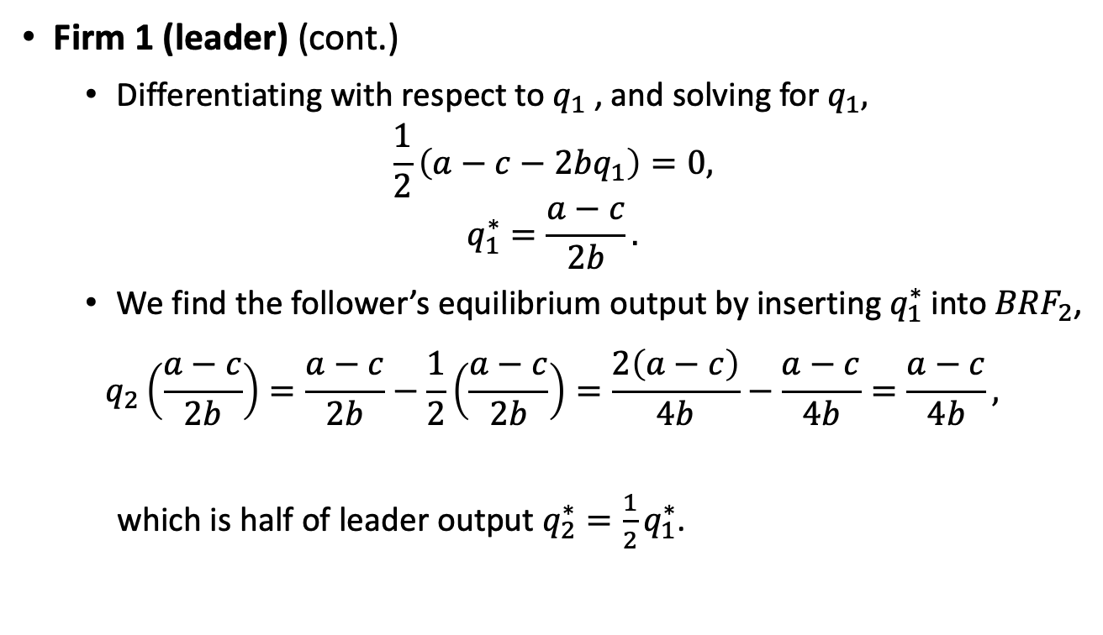
Stackelberg Model
Firm 1 (leader) (cont.)
  Differentiating with respect to $q_{1}$, and solving for $q_{1},$
$$\frac{1}{2}\left(a−c−2bq_{1}\right)=0,$$
$$q_{1}^{∗}=\frac{a−c}{2b}.$$
  We find the follower’s equilibrium output by inserting $q_{1}^{∗}$ into ${BRF}_{2}$,
  $$q_{2}\left(\frac{a−c}{2b}\right)=\frac{a−c}{2b}−\frac{1}{2}\left(\frac{a−c}{2b}\right)=\frac{2\left(a−c\right)}{4b}−\frac{a−c}{4b}=\frac{a−c}{4b},$$
  which is half of leader output $q_{2}^{∗}=\frac{1}{2}q_{1}^{∗}$.
$$q_{1}^{∗}$$

Slide 64

Stackelberg Model
More generally, the subgame perfect equilibrium (SPE) of the game is described as
$$q_{1}^{∗}=\frac{a−c}{2b},$$
$q_{2}\left(q_{1}\right)=\frac{a−c}{2b}−\frac{1}{2}q_{1}$,
because the follower’s BRF allows firm 2 to optimally respond to the leader’s output, both:
  in equilibrium, $q_{1}^{∗}=\frac{a−c}{2b}$ ,
  and off the equilibrium $q_{1}^{∗}≠\frac{a−c}{2b}.$

Slide 65

Stackelberg Model
If instead, the follower chooses $q_{2}^{∗}=\frac{a−c}{4b}$ in the SPE of the game, we would provide no information about how the follower responds if the leader “made a mistake” by deviating from $q_{1}^{∗}$.
The leader produces more in the Stackelberg model than in Cournot,
$$\frac{a−c}{2b}>\frac{a−c}{4b},$$
whereas the follower produces less,
$$\frac{a−c}{4b}<\frac{a−c}{3b}.$$

Slide 66

Stackelberg Model
In this scenario, equilibrium price is
$$p^{∗}=a−b\left(\frac{a−c}{2b}+\frac{a−c}{4b}\right)$$
$$=a−\frac{2\left(a−c\right)}{4}−\frac{a−c}{4}$$
$$=\frac{3a+c}{4}.$$
The equilibrium profits for the leader are
$$π_{1}^{∗}=\left(\frac{3a+c}{4}−c\right)\frac{a−c}{2b}=\frac{{3(a−c)}^{2}}{8b}.$$
And equilibrium profits for the follower are
$$π_{2}^{∗}=\left(\frac{3a+c}{4}−c\right)\frac{a−c}{4b}=\frac{{3(a−c)}^{2}}{16b},$$
that is exactly half of the leader’s profits, $π_{2}^{∗}=\frac{1}{2}π_{1}^{∗}$.

Slide 67

Stackelberg Model
Example 14.6: Stackelberg model.
  Consider the same inverse demand function as in example 14.1, $p\left(q_{1},q_{2}\right)=12−q_{1}−q_{2}$, and marginal cost $c=4$.
  Inserting the follower’s BRF found in example 14.1, $q_{2}\left(q_{1}\right)=4−\frac{1}{2}q_{1}$, into the leader’s PMP,
  $$\max_{q_{1}}\left[12−\left(q_{1}+\left(4−\frac{1}{2}q_{1}\right)\right)\right]q_{1}−4q_{1},$$
  $$\max_{q_{1}}{\frac{1}{2}\left(16−q_{1}\right)q_{1}−4q_{1}.}$$
  Differentiating with respect to $q_{1}$,
  $$8−q_{1}−4=0.$$

Slide 68

Stackelberg Model
Example 14.6 (continued):
  Solving for $q_{1}$ we find the profit-maximizing output for the leader, $q_{1}^{∗}=4$ units.
  Then, $q_{2}=2$ units.
  In this scenario, equilibrium price is $p^{∗}=\$6$.
  And equilibrium profits become
  $$π_{1}^{∗}=\left(6×4\right)−\left(4×4\right)=\$8,$$
  $$π_{2}^{∗}=\left(6×2\right)−\left(4×2\right)=\$4.$$

Slide 69

Product Differentiation

Slide 70

Product Differentiation
Most goods are differentiated from those of their rivals:
  Coke and Pepsi, in the soda industry.
  Dell and Lenovo, the the computer industry.
  iPhone and Samsung Galaxy, in the smartphone market.
Demand for product differentiation.
  Consider two firms, $A$and $B$, with inverse demand functions,
  $$p_{A}\left(q_{A},q_{B}\right)=a−bq_{A}−dq_{B},$$
  $$p_{B}\left(q_{A},q_{B}\right)=a−bq_{B}−dq_{A},$$
  where $b,d≥0$ and $b≥d$
  These demands are symmetric. Let us focus on good $A$.
    An increase in $q_{A}$ or $q_{B}$ reduces $p_{A}$, but the effect of $q_{A}$ is larger because $b>d.$ The “own-price effects” dominate “cross-price” effect.

Slide 71

Product Differentiation
  When $d=0$, the inverse demand function for good $A$ collapses to
  $$p_{A}\left(q_{A},q_{B}\right)=a−bq_{A},$$
  indicating that every firm’s price is unaffected by its rival’s output, as in two separate monopolies.
  When $d=b$, the inverse demand function for good $A$ becomes
  $$p_{A}\left(q_{A},q_{B}\right)=a−bq_{A}−bq_{B}=a−b(q_{A}+q_{B}),$$
  reflecting that $p_{A}$ is symmetrically affected by an increase in either $q_{A}$ or $q_{B}$ as in the Cournot model with homogeneous goods.

Slide 72

Product Differentiation
Best responses with product differentiation.
  Assume every firm $i=\{A,B\}$ faces a cost function $TC\left(q_{i}\right)=cq_{1}$, where $c>0$.
  The PMP of firm $A$ is
  $$\max_{q_{A}}\left[a−bq_{A}−dq_{B}\right]q_{A}−cq_{A}.$$
  Differentiating with respect to $q_{A}$,
  $$a−c−2{bq}_{A}−dq_{B}=0.$$
  Rearranging and solving for $q_{A}$,
  $$a−c−dq_{B}=2bq_{A},$$
  $$q_{A}(q_{B})=\frac{a−c}{2b}−\frac{d}{2b}q_{B}.$$

Slide 73



Product Differentiation
  Figure 14.7 depicts ${BRF}_{A}$, $q_{A}(q_{B}) =\frac{a−c}{2b}−\frac{d}{2b}q_{B}.$
$q_{A}=\frac{a−c}{2b}$ when $q_{B}=0$, but it decrease at rate of $\frac{d}{2b}$.
$q_{A}=0$ when $q_{B}≥\frac{a−c}{d}$.
When $d=0$, ${BRF}_{A}$ reduces to $q_{A}(q_{B})=\frac{a−c}{2b}$ (monopolist).
Figure 14.7

Slide 74

Product Differentiation
  Figure 14.7 depicts ${BRF}_{A}$, $q_{A}(q_{B}) =\frac{a−c}{2b}−\frac{d}{2b}q_{B}.$
When $d=b$, $q_{A}\left(q_{B}\right)=\frac{a−c}{b}−\frac{1}{2}q_{B}$ (Cournot), with a slope of $−1/2$.
When $d<b$, the slope becomes smaller than $−1/2$. Competition is ameliorated, because every firm $i$ is induce to reduce its output when products are differentiated.
Figure 14.7

Slide 75

Product Differentiation
  We can invoke symmetry in equilibrium output $q_{i}^{∗}=q_{j}^{∗}=q^{∗},$
  $$q=\frac{a−c}{2b}−\frac{d}{2b}q,$$
  $$\frac{\left(2b+d\right)q}{2b}=\frac{a−c}{2b},$$
  $$q^{∗}=\frac{a−c}{2b+d}.$$
  When products are completely differentiated ($d=0$), this output becomes $q^{∗}=\frac{a−c}{2b}$, as in monopoly.
  When products are homogeneous ($d=b$), $q^{∗}=\frac{a−c}{2b+b}=\frac{a−c}{3b}$, as in the Cournot model.

Slide 76



Product Differentiation
  Equilibrium price is given by
$$p_{i}^{∗}=a−bq_{i}^{∗}+dq_{j}^{∗}=a−b\frac{a−c}{2b+d}−d\frac{a−c}{2b+d}$$
$$=\frac{ab+c\left(b+d\right)}{2b+d}.$$
  Equilibrium profits for every firm $i$ are
$$π_{i}^{∗}=\left(p^{∗}−c\right)q^{∗}=\left(\frac{ab+c(b+d)}{2b+d}−c\right)\frac{a−c}{2b+d}$$
$$=\frac{{(a−c)}^{2}b}{{(2b+d)}^{2}}.$$
$$q_{i}^{∗}$$
$$q_{j}^{∗}$$

Slide 77

Product Differentiation
  When products are completely differentiated ($d=0)$,
    $$π_{i}^{∗}=\frac{{(a−c)}^{2}}{4b},$$
    as in monopoly.
  When products are homogeneous ($d=b$),
    $$π_{i}^{∗}=\frac{{(a−c)}^{2}b}{{(2b+b)}^{2}}=\frac{{(a−c)}^{2}}{9b},$$
    as in Cournot model.

Slide 78

Stackelberg Model
Example 14.7: Output competition with product differentiation.
  Consider two firms, $A$ and $B$, facing the demand curves
  $$p_{A}\left(q_{A},q_{B}\right)=100−5q_{A}−2q_{B},$$
  $$p_{B}\left(q_{A},q_{B}\right)=100−5q_{B}−2q_{A}.$$
  Parameters are $a=100$, $b=5$, and $d=2$, which indicates that own-price effects are larger than cross-price effect (i.e., $b>d$).
  Both firms have symmetric marginal cost of $c=3$.
  Inserting these parameters in in the previous equilibrium results, equilibrium output is
  $q^{∗}=\frac{100−3}{\left(2×5\right)+2}=\frac{97}{12}≅8.08$ units.

Slide 79

Stackelberg Model
Example 14.7 (continued):
  The equilibrium price is
  $$p_{i}^{∗}=\frac{\left(100×5\right)+3(5+2)}{\left(2×5\right)+2}=\frac{521}{12}≅\$43.41.$$
  And profits become
  $$π_{i}^{∗}=\frac{{(100−3)}^{2}5}{{[\left(2×5\right)+2]}^{2}}≅\$326.7.$$

Slide 80

Appendix.
Cournot Model with N Firms

Slide 81


Cournot Model with N Firms
The inverse demand function is
$$p\left(Q\right)=a−bQ.$$
$Q=q_{i}+Q_{−i}$ denotes the aggregate output by all firms.
  $q_{i}$ is the output that firm $i$ produces.
  $Q_{−i}$ represents the production of all the firms different than firm $i$,
  $$Q_{−i}=q_{1}+q_{2}+…+q_{i−1}+q_{i+1}+…+q_{N}.$$
  If $N=4$, and $i=2$, then $Q_{−2}=q_{1}+q_{3}+q_{4}.$
We can rewrite the inverse demand function as
$$p\left(q_{i},Q_{−i}\right)=a−b\left(q_{i}+Q_{−i}\right).$$
$$Q$$

Slide 82



Cournot Model with N Firms
If all $N$ firms face the same marginal cost $c$, where $a>c>0$, every firm$i$solves the following PMP:
$$\max_{q_{i}}\left[a−b\left(q_{i}+Q_{−i}\right)\right]q_{i}−cq_{i}.$$
Differentiating with respect to firm $i$’s output,
$$a−2bq_{i}−bQ_{−i}−c=0.$$
Rearranging a solving for $q_{i}$, we find firm $i$’s best response function,
$$a−c−bQ_{−i}=2bq_{i},$$
$$q_{i}\left(Q_{−i}\right)=\frac{a−c}{2b}−\frac{1}{2}Q_{−i}.$$
(${PMP}_{i})$
(${BRF}_{i})$

Slide 83

Cournot Model with N Firms
${BRF}_{i}≡q_{i}\left(Q_{−i}\right)=\frac{a−c}{2b}−\frac{1}{2}Q_{−i}$ informs about this firm’s profit maximizing output $q_{i}$, as a function of its rivals’ output $Q_{−i}$.
  It originates at $\frac{a−c}{2b}$ and decreases in $Q_{−i}$ at a rate of $1/2$.
  This function captures the Cournot model with 2 firms as a special case.
  If we consider only two firms, $i$ and $j$, then firm $i$ has a single rival (firm $j$), and $Q_{−i}=q_{j}.$

Slide 84

Cournot Model with N Firms
Because all firms are symmetric, they all solve a problem similar to ${PMP}_{i}$, obtaining ${BRF}_{i}≡q_{i}\left(Q_{−i}\right)=\frac{a−c}{2b}−\frac{1}{2}Q_{−i}$.
We can invoke symmetry in equilibrium output,
$q_{1}=q_{2}=…=q_{N}=q$.
Then,
$$Q=Nq,$$
$Q_{−i}=\left(N−1\right)q.$

Slide 85


Cournot Model with N Firms
Inserting this result into ${BRF}_{i}$,
$$q_{i}\left(Q_{−i}\right)=\frac{a−c}{2b}−\frac{1}{2}\left(N−1\right)q.$$
Rearranging and solving for $q$,
$$\frac{2q+(N−1)q}{2}=\frac{a−c}{2b},$$
$$q\left[2+\left(N−1\right)\right]=\frac{a−c}{b},$$
$$q^{∗}=\frac{1}{N+1}\frac{a−c}{b}.$$
which is decreasing in the number of firms operating in the market, $N$. As more firms compete, the individual production of each firm decreases.
$$Q^{∗}$$

Slide 86

Cournot Model with N Firms
The aggregate output becomes
$$Q^{∗}=Nq^{∗}=N\left(\frac{1}{N+1}\frac{a−c}{b}\right),$$
which increases as more firms enter the industry.
The equilibrium price is
$${p(Q}^{∗})=a−bQ^{∗}=a−b\left[N\left(\frac{1}{N+1}\frac{a−c}{b}\right)\right]$$
$$=\frac{a+Nc}{N+1},$$
which is decreasing in $N$.

Slide 87

Cournot Model with N Firms
Monopoly ($N=1$):
$$q^{∗}=\frac{1}{1+1}\frac{a−c}{b}=\frac{a−c}{2b},$$
$$Q^{∗}=Nq^{∗}=\frac{a−c}{2b},$$
$$p^{∗}=\frac{a+c}{1+1}=\frac{a+c}{2}.$$

Slide 88

Cournot Model with N Firms
Duopoly ($N=2$):
$$q^{∗}=\frac{1}{2+1}\frac{a−c}{b}=\frac{a−c}{3b},$$
$$Q^{∗}=Nq^{∗}=2q^{∗}=2\frac{a−c}{3b},$$
$$p^{∗}=\frac{a+2c}{2+1}=\frac{a+2c}{3}.$$

Slide 89

Cournot Model with N Firms
Perfect competition ($N→+∞$):
$$\lim_{N→+∞}{q^{∗}=\lim_{N→+∞}{\frac{1}{N+1}\frac{a−c}{b}=0}},$$
$$\lim_{N→+∞}{Q^{∗}=\lim_{N→+∞}{N\left(\frac{1}{N+1}\frac{a−c}{b}\right)=\frac{a−c}{b},}}$$
$$\lim_{N→+∞}{p^{∗}=\lim_{N→+∞}{\frac{a+Nc}{N+1}=c.}}$$

