Slide 1

Intermediate Microeconomic
Theory
Sequential and Repeated Games

Slide 2


Outline
Game Trees
Why Don’t We Just Find the Nash Equilibrium of the Game Tree?
Subgame-Perfect Equilibrium
Repeated Games
A Look at Behavioral Economics–Cooperation in the Experimental Lab?

Slide 3


Game Trees

Slide 4

Game Tree
The games analyzed so far assume that players choose their strategies simultaneously.
  The time difference between one player’s choices and her opponent is small enough to be modeled as if players acted as the same time.
  Examples: Rock-Paper-Scissors game, or penalty kicks.
In some real-world scenarios, players may act sequentially, with one player choosing her strategy first (the leader) and another player (the follower) responding with his strategy choice days or even months later.

Slide 5
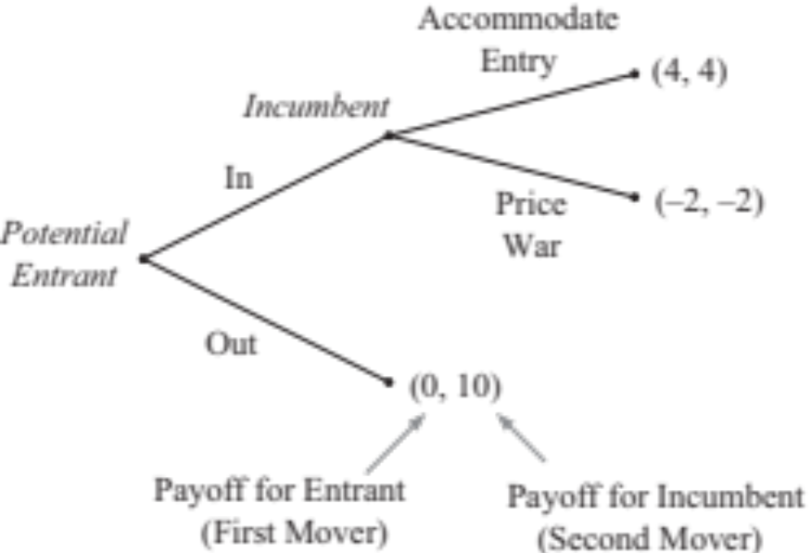
Game Tree
Example: A potential entrant first chooses whether to enter an industry where an incumbent operates as a monopolist.
Figure 13.1a

Slide 6
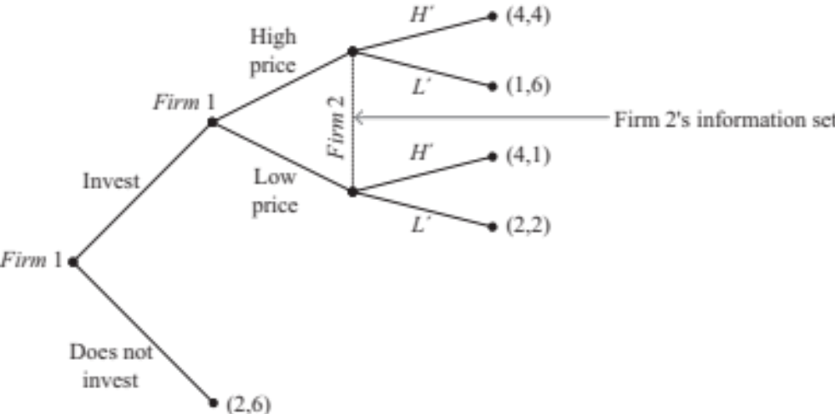
Game Tree
Example: Firm 2 does not observe the move of its opponent (firm 1) in previous stages
“Information set.”
Firm 2 does not know at which node it gets to play.
Figure 13.1b

Slide 7
Why Don’t We Just Find the Nash Equilibrium of the Game Tree?

Slide 8
Why Not to Apply NE to sequential-move games?
NE can help us at identifying equilibrium behavior in a game tree that depicts players’ sequential moves.
But the NE provides us with several equilibria.
Some of these equilibria may be insensible in a context where players act sequentially.

Slide 9

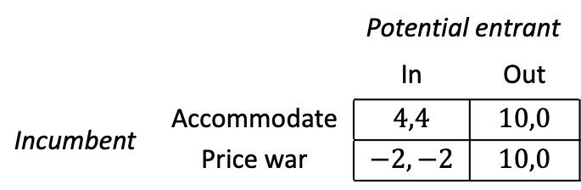
Why Not to Apply NE to sequential-move games?
Example 13.1: Applying NE to the entry game.
  Consider the entry game again. To find the NEs, we first need to represent the game in its matrix form.
 |  | Potential entrant
 |  | In | Out
Incumbent | Accommodate | $$4,4$$ | $$10,0$$
 | Price war | $$−2,−2$$ | $$10,0$$
Matrix 13.1
Figure 13.1a

Slide 10
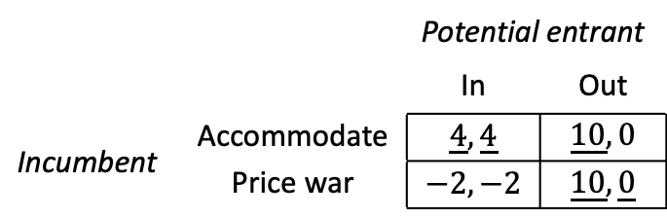
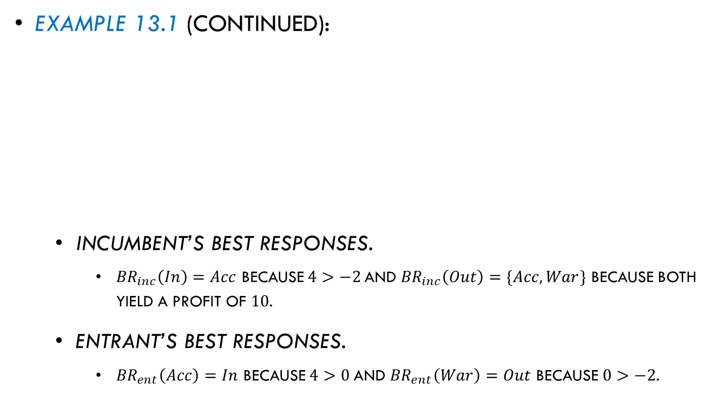
Why Not to Apply NE to sequential-move games?
Example 13.1 (continued):
  Incumbent’s best responses.
    ${BR}_{inc}\left(In\right)=Acc$ because $4>−2$and ${BR}_{inc}\left(Out\right)=\{Acc,War\}$ because both yield a profit of $10$.
  Entrant’s best responses.
    ${BR}_{ent}\left(Acc\right)=In$ because $4>0$and ${BR}_{ent}\left(War\right)=Out$ because $0>−2$.
 |  | Potential entrant
 |  | In | Out
Incumbent | Accommodate | $$\underline{4},\underline{4}$$ | $$\underline{10},0$$
 | Price war | $$−2,−2$$ | $$\underline{10},\underline{0}$$
Matrix 13.2

Slide 11


Why Not to Apply NE to sequential-move games?
Example 13.1 (continued):
  We found two NE (strategy profiles where players choose mutual best responses):
  $(Acc,In)$ and $(War,Out)$.
  Do you notice something fishy about $(War,Out)$?
It is not sequentially rational.
The incumbent must take entry as given. Its best option when the entrant is In is to accommodate instead of initiating a War.
The incumbent’s threat to start a war upon entry is noncredible.
Figure 13.1a

Slide 12

Subgame-Perfect Equilibrium

Slide 13

Subgame-Perfect Equilibrium
Subgame-Perfect Equilibrium (SPE) is a new solution concept which identifies only NEs that are sequentially rational (i.e., those that are not based on incredible beliefs).
To predict how players behave in these sequential contexts, we apply backward induction.

Slide 14
Subgame-Perfect Equilibrium
Tool 13.1. Applying backward induction:
  Go the farthest right side of the game tree, and focus on the last mover.
  Find the strategy that yields the highest payoff for her.
  Shade the branch that you found to yield the highest payoff.
  Go to the next-to-last mover and, following the response of the last mover in step 3, find the strategy maximizing her payoff.
  Shade the branch that you found to yield the highest payoff for the next-to-last mover.
  Repeat steps 4-5 for the player acting before the previous-to-the last mover, and then for each player acting before her, until you reach the first mover at the root of the game.

Slide 15
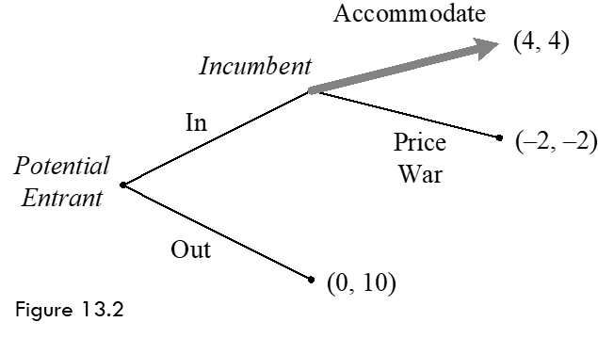
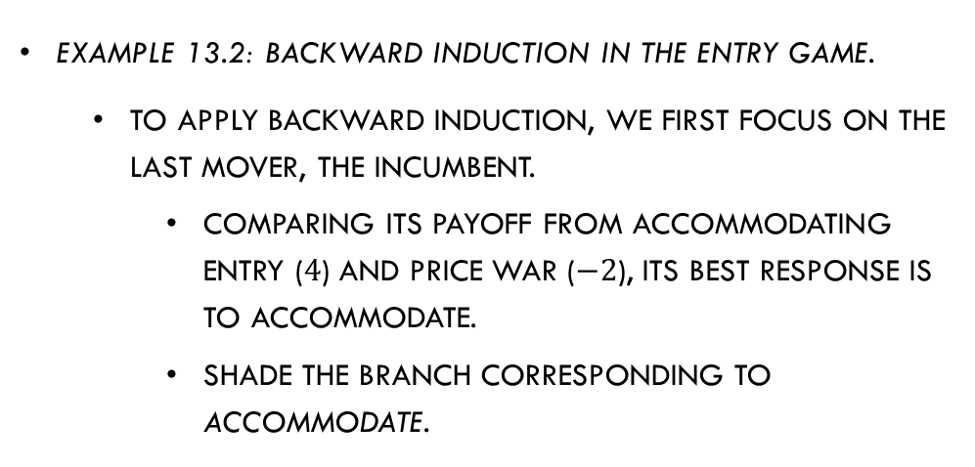
Subgame-Perfect Equilibrium
Example 13.2: Backward induction in the Entry game.
  To apply backward induction, we first focus on the last mover, the incumbent.
    Comparing its payoff from accommodating entry ($4$) and price war ($−2$), its best response is to accommodate.
    Shade the branch corresponding to Accommodate.

Slide 16

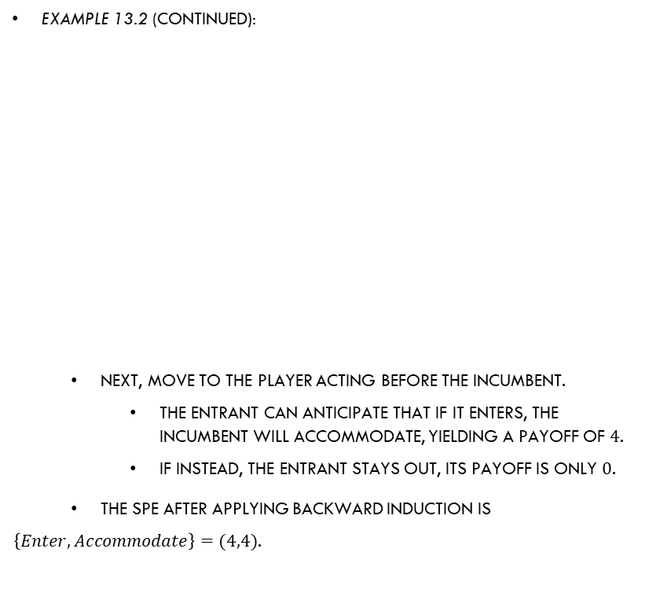
Subgame-Perfect Equilibrium
Example 13.2 (continued):
  Next, move to the player acting before the incumbent.
    The entrant can anticipate that if it enters, the incumbent will accommodate, yielding a payoff of $4$.
    If instead, the entrant stays out, its payoff is only $0$.
  The SPE after applying backward induction is
  $\left\{Enter, Accommodate\right\}=(4,4)$.

Slide 17
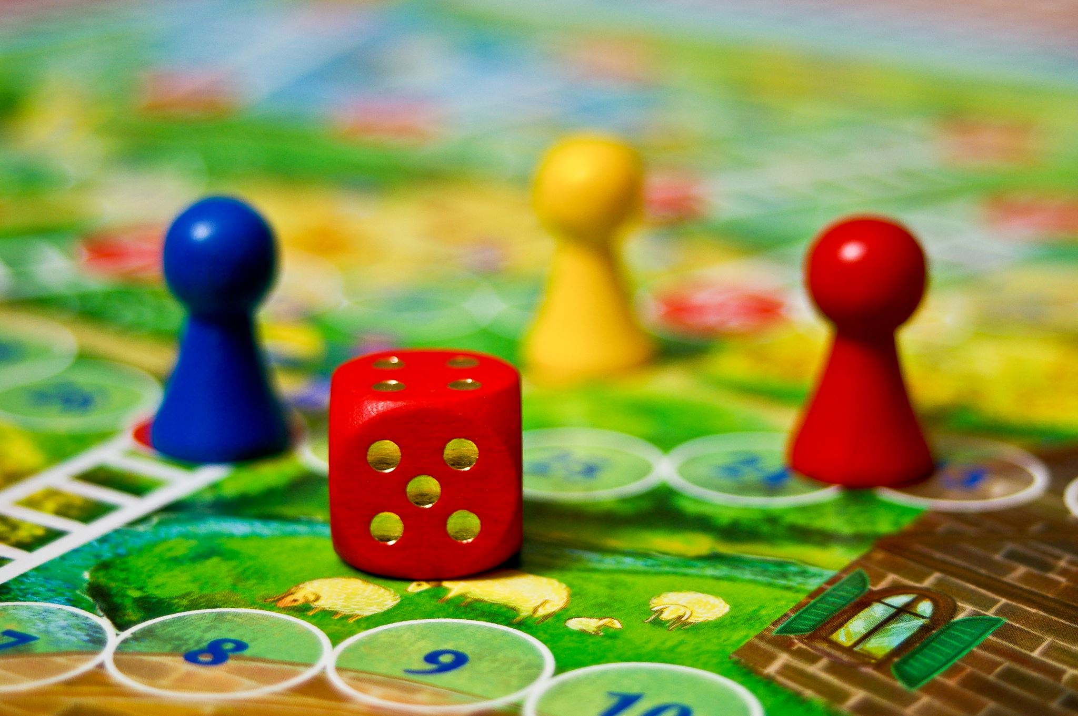
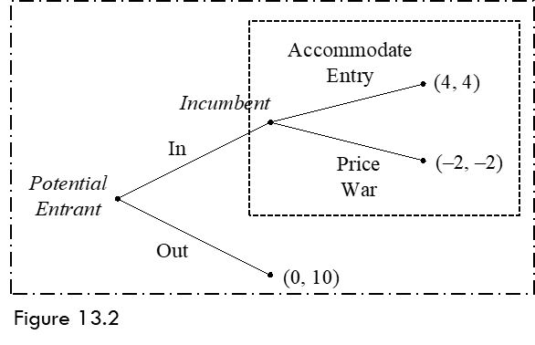
Subgame-Perfect Equilibrium in
More Involved Games
We explore how to apply backward induction, and find SPEs, in games where at least one player faces an information set.
  When she does not observe the moves from a previous player before she is called on to move.
A subgame is a portion of the game tree that can be circled around without breaking any information set.

Slide 18
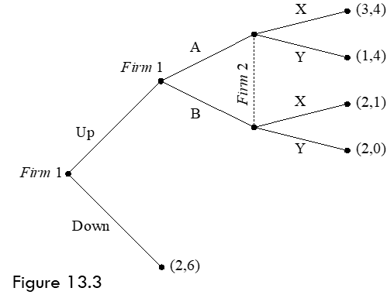
Subgame-Perfect Equilibrium in
More Involved Games
Example 13.3: Applying backward induction in more involved game trees.
  Consider a game where firm 1 acts as the first mover, choosing either Up or Down.
  Firm 2’s uncertainty about which action firm 1’s chooses is represented by the dotted line (“information set”).

Slide 19
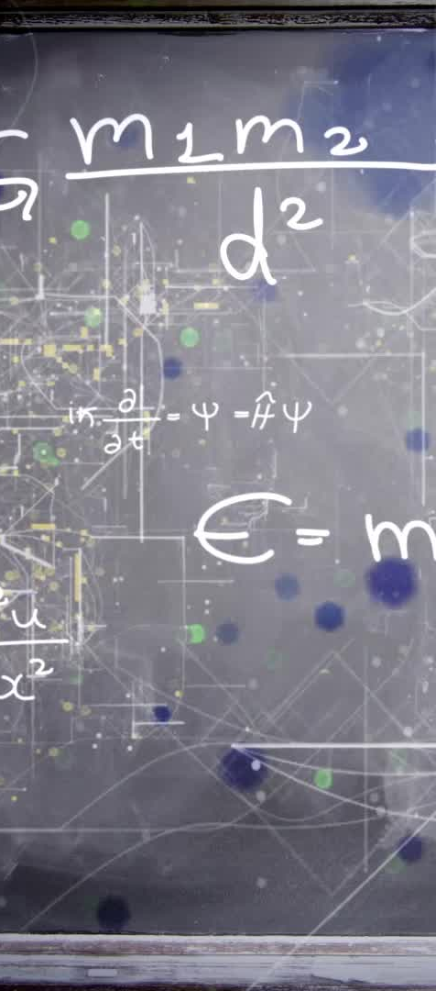
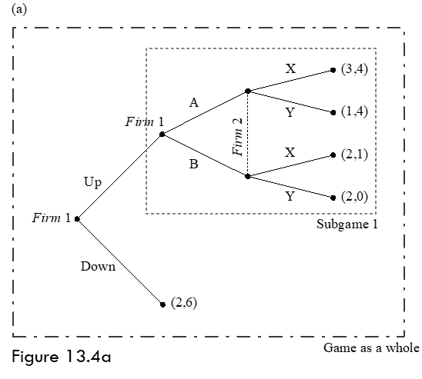
Subgame-Perfect Equilibrium in
More Involved Games
Example 13.3 (continued):
  Before applying backward induction, we first find subgames.
    Starting from firm 2, the smallest subgame is the one initiated after firm 1 chooses Up, labeled as “subgame 1.”
    The only other subgame is the “game as a whole.”

Slide 20

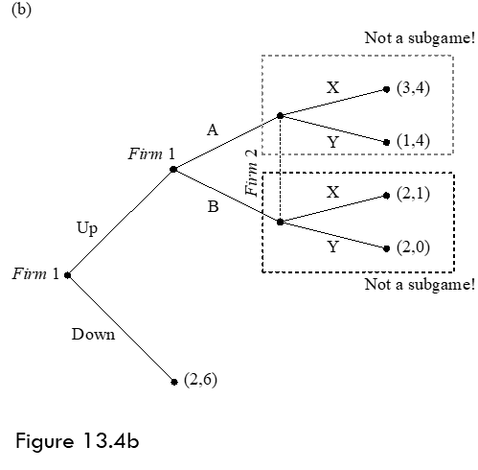
Subgame-Perfect Equilibrium in
More Involved Games
Example 13.3 (continued):
    Circles that break firm 2’s information set are not subgames.

Slide 21
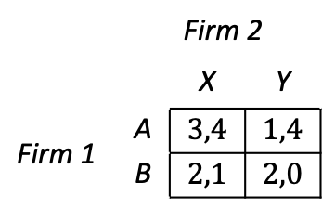
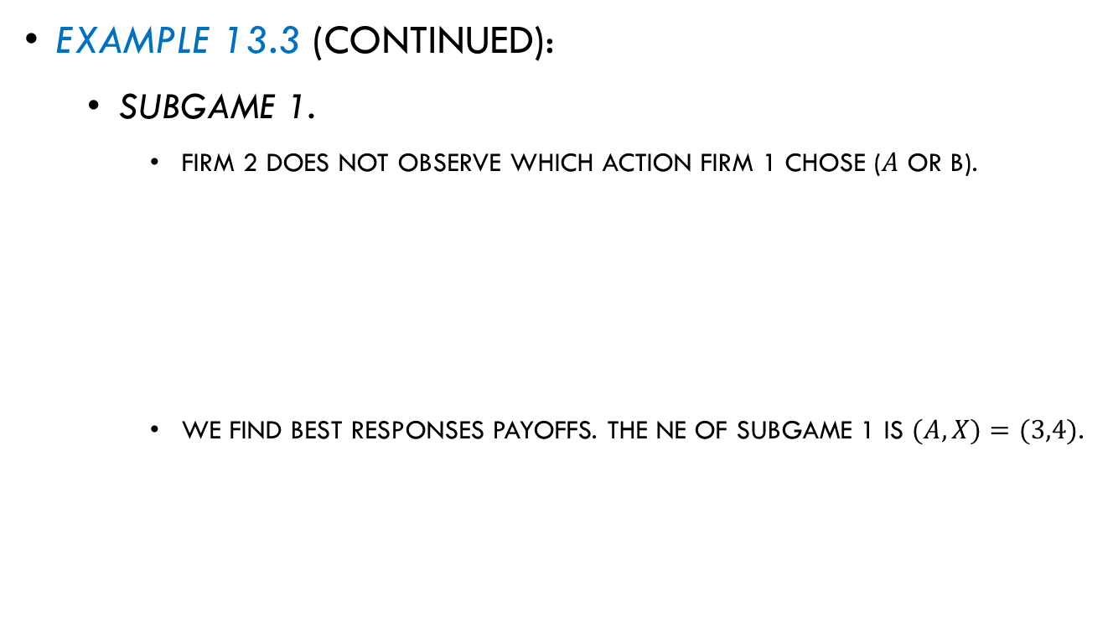
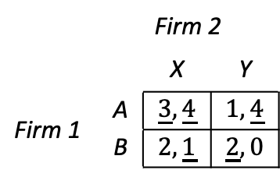
Subgame-Perfect Equilibrium in
More Involved Games
Example 13.3 (continued):
  Subgame 1.
    Firm 2 does not observe which action firm 1 chose ($A$ or B).
    We find best responses payoffs. The NE of subgame 1 is $(A,X)=(3,4)$.
 |  | Firm 2
 |  | X | Y
Firm 1 | A | $$3,4$$ | $$1,4$$
 | B | $$2,1$$ | $$2,0$$
Matrix 13.3
 |  | Firm 2
 |  | X | Y
Firm 1 | A | $$\underline{3},\underline{4}$$ | $$1,\underline{4}$$
 | B | $$2,\underline{1}$$ | $$\underline{2},0$$
Matrix 13.4

Slide 22
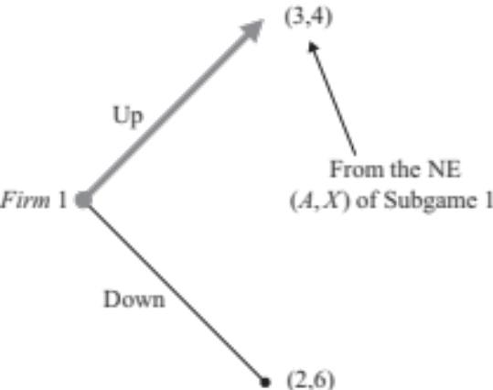
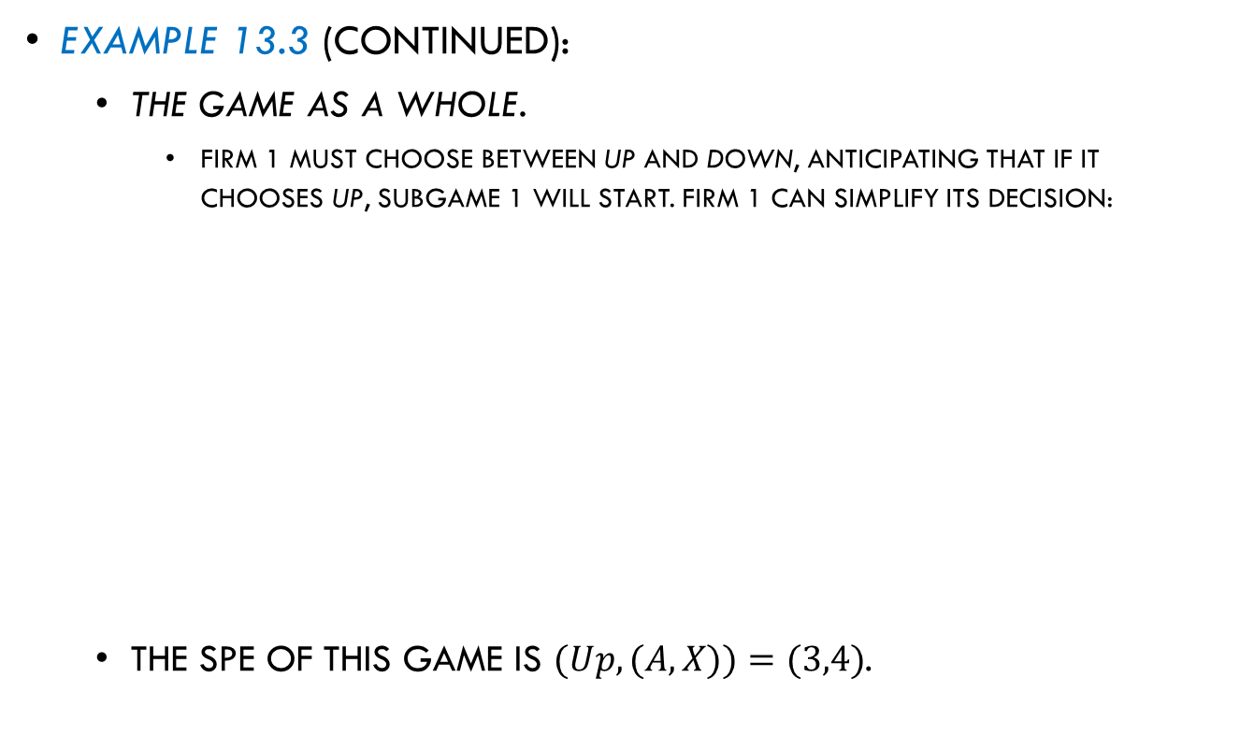
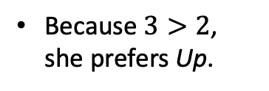
Subgame-Perfect Equilibrium in
More Involved Games
Example 13.3 (continued):
  The game as a whole.
    Firm 1 must choose between Up and Down, anticipating that if it chooses Up, subgame 1 will start. Firm 1 can simplify its decision:
  The SPE of this game is $(Up, (A,X))=(3,4)$.
      Because $3>2$, she prefers Up.
Figure 13.5

Slide 23

Repeated Games

Slide 24
Repeated Games
Games where players interact only once are known as “one-shot games” or “unrepeated games.”
They model scenarios in which players do not anticipate interacting again.
However, there are situations in each agents interact several times, and so they face the game repeatedly.
Examples:
Treasury bill auctions.
Price competition between a group of firms in an industry.
Product decisions of countries participating in the OPEC.

Slide 25
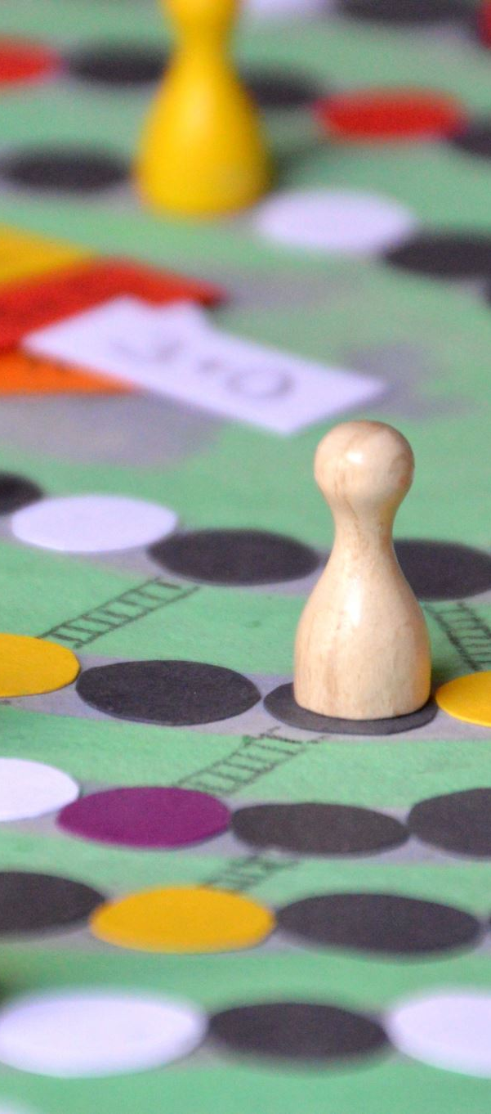
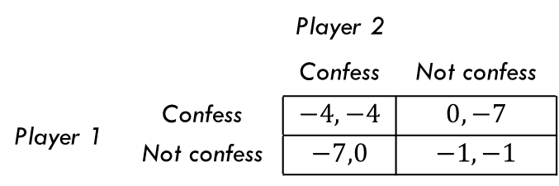
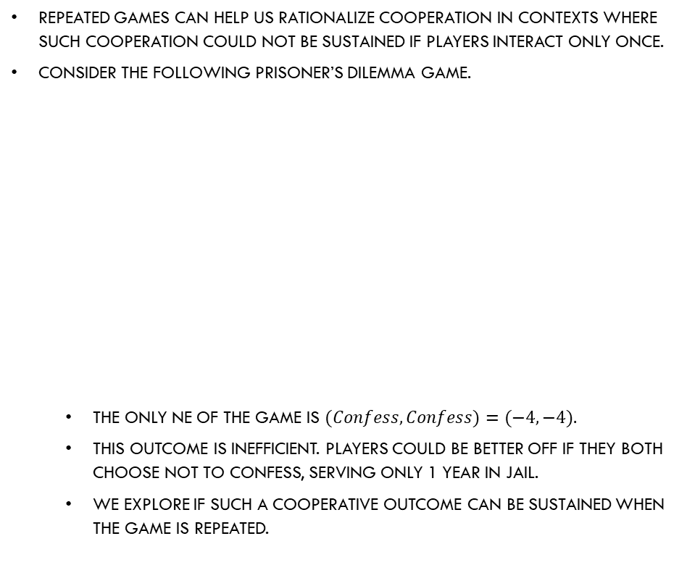
Repeated Games
Repeated games can help us rationalize cooperation in contexts where such cooperation could not be sustained if players interact only once.
Consider the following Prisoner’s Dilemma game.
  The only NE of the game is $(Confess, Confess)=(−4,−4).$
  This outcome is inefficient. Players could be better off if they both choose not to confess, serving only 1 year in jail.
  We explore if such a cooperative outcome can be sustained when the game is repeated.

Slide 26

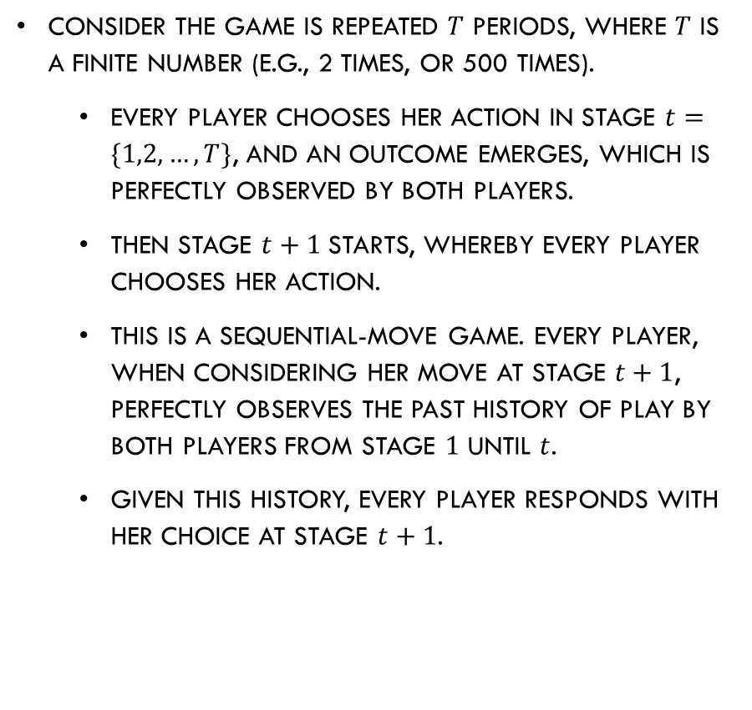
Finite Repetitions
Consider the game is repeated $T$ periods, where $T$ is a finite number (e.g., 2 times, or 500 times).
  Every player chooses her action in stage $t=\{1,2,…,T\}$, and an outcome emerges, which is perfectly observed by both players.
  Then stage $t+1$starts, whereby every player chooses her action.
  This is a sequential-move game. Every player, when considering her move at stage $t+1$, perfectly observes the past history of play by both players from stage $1$ until $t$.
  Given this history, every player responds with her choice at stage $t+1$.

Slide 27
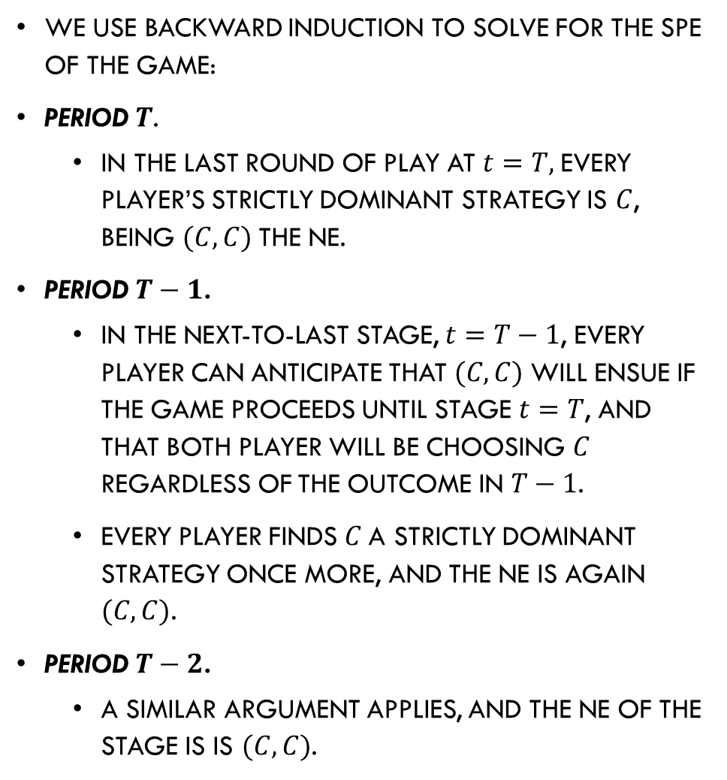
Finite Repetitions
We use backward induction to solve for the SPE of the game:
Period $T$.
  In the last round of play at $t=T,$every player’s strictly dominant strategy is $C$, being $(C,C)$the NE.
Period $T−1$.
  In the next-to-last stage, $t=T−1$, every player can anticipate that $(C,C)$will ensue if the game proceeds until stage $t=T$, and that both player will be choosing $C$ regardless of the outcome in $T−1$.
  Every player finds $C$a strictly dominant strategy once more, and the NE is again $(C,C)$.
Period $T−2$.
  A similar argument applies, and the NE of the stage is is $(C,C)$.

Slide 28
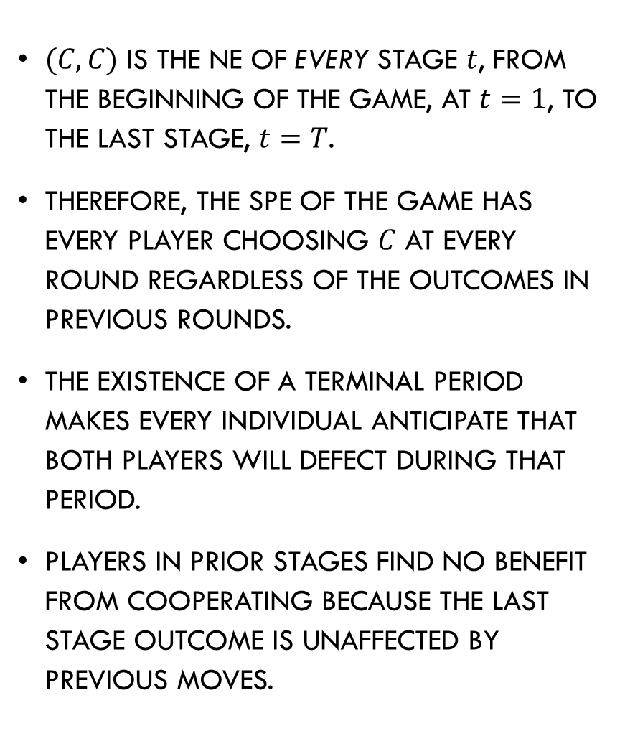
Finite Repetitions
$(C,C)$ is the NE of every stage $t$, from the beginning of the game, at $t=1$, to the last stage, $t=T$.
Therefore, the SPE of the game has every player choosing $C$ at every round regardless of the outcomes in previous rounds.
The existence of a terminal period makes every individual anticipate that both players will defect during that period.
Players in prior stages find no benefit from cooperating because the last stage outcome is unaffected by previous moves.

Slide 29

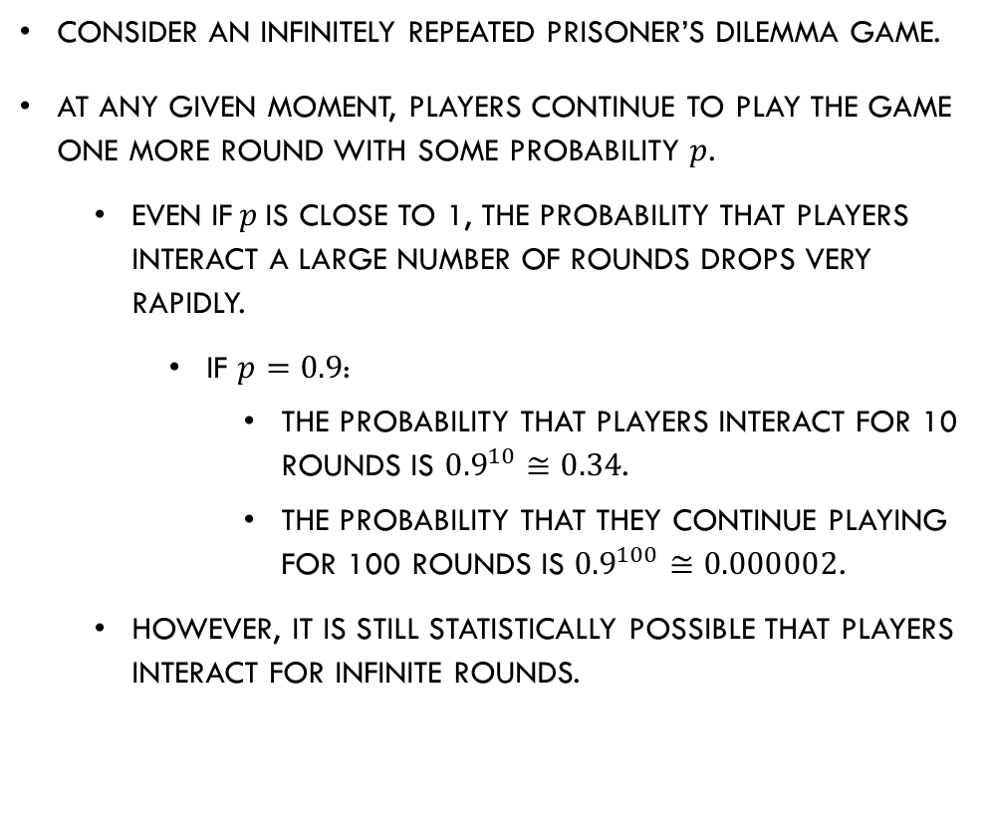
Infinite Repetitions
Consider an infinitely repeated Prisoner’s Dilemma game.
At any given moment, players continue to play the game one more round with some probability $p$.
  Even if$p$is close to 1, the probability that players interact a large number of rounds drops very rapidly.
    If $p=0.9$:
      The probability that players interact for 10 rounds is ${0.9}^{10}≅0.34$.
      The probability that they continue playing for 100 rounds is ${0.9}^{100}≅0.000002$.
  However, it is still statistically possible that players interact for infinite rounds.

Slide 30
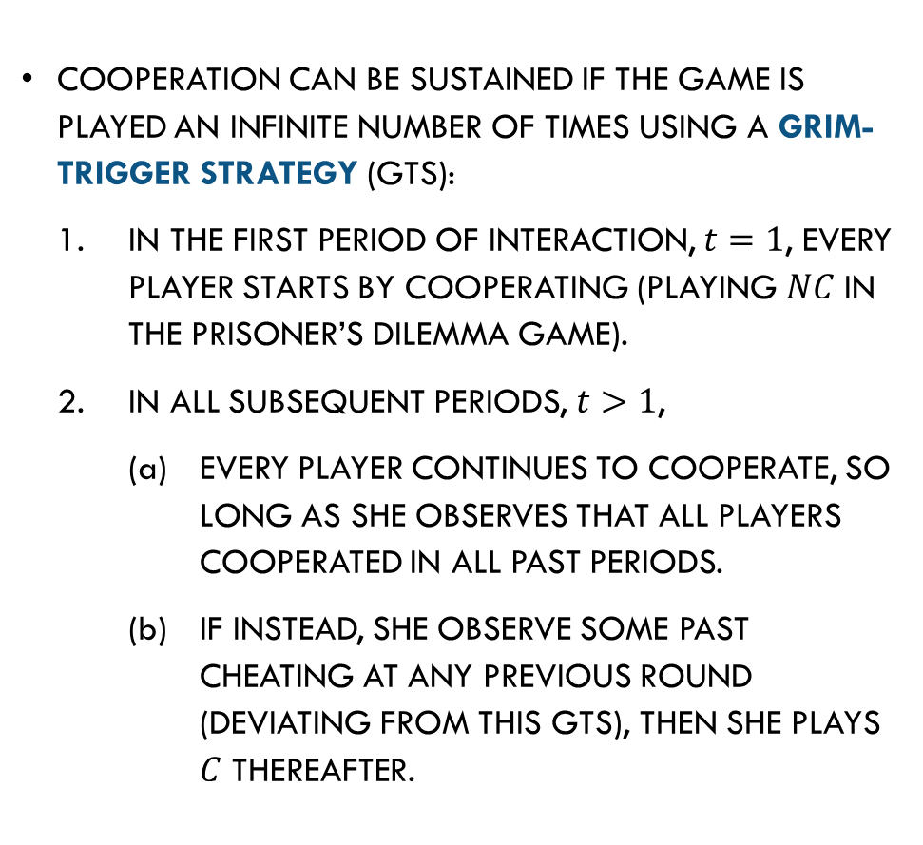
Infinite Repetitions
Cooperation can be sustained if the game is played an infinite number of times using a Grim-Trigger Strategy (GTS):
In the first period of interaction, $t=1$, every player starts by cooperating (playing $NC$ in the Prisoner’s Dilemma game).
In all subsequent periods, $t>1$,
Every player continues to cooperate, so long as she observes that all players cooperated in all past periods.
If instead, she observe some past cheating at any previous round (deviating from this GTS), then she plays $C$ thereafter.

Slide 31

Infinite Repetitions
To show that the GTS can be sustained as a SPE, we need to show:
  Every player finds the GTS optimal at any time period at which she wonders whether she continue with cooperation.
  Every player must find the GTS optimal after any history of play:
    (1) after no history of cheating;
    (2) after some cheating episode.

Slide 32

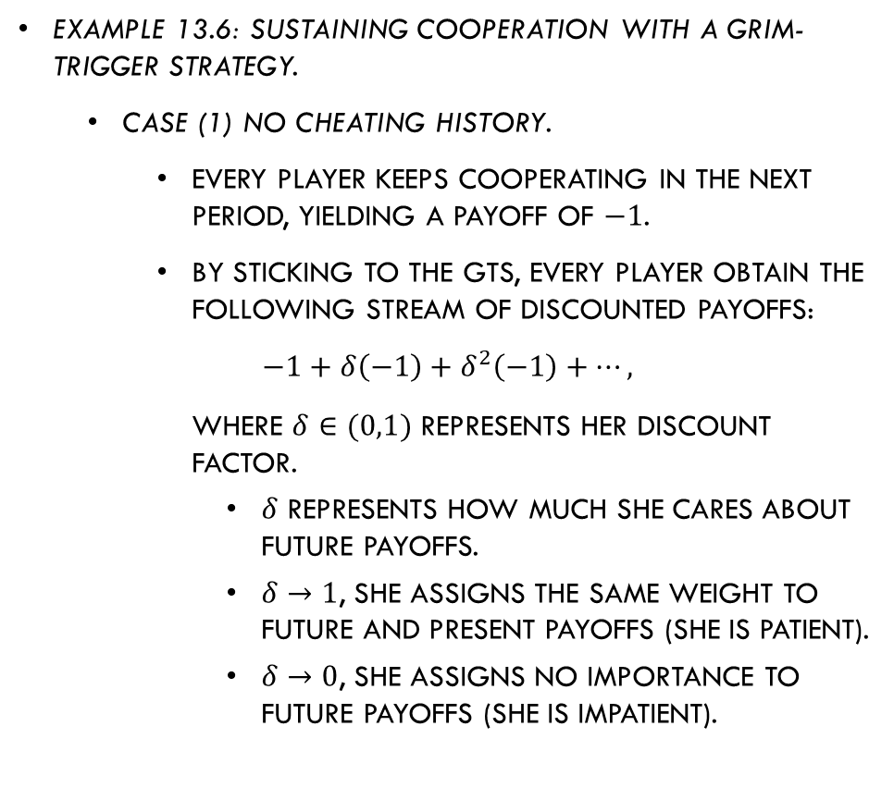
Infinite Repetitions
Example 13.6: Sustaining cooperation with a Grim-Trigger Strategy.
  Case (1) No cheating history.
    Every player keeps cooperating in the next period, yielding a payoff of $−1$.
    By sticking to the GTS, every player obtain the following stream of discounted payoffs:
    $$−1+δ\left(−1\right)+δ^{2}\left(−1\right)+…,$$
    where $δ∈(0,1)$ represents her discount factor.
      $δ$ represents how much she cares about future payoffs.
      $δ→1$, she assigns the same weight to future and present payoffs (she is patient).
      $δ→0$, she assigns no importance to future payoffs (she is impatient).

Slide 33
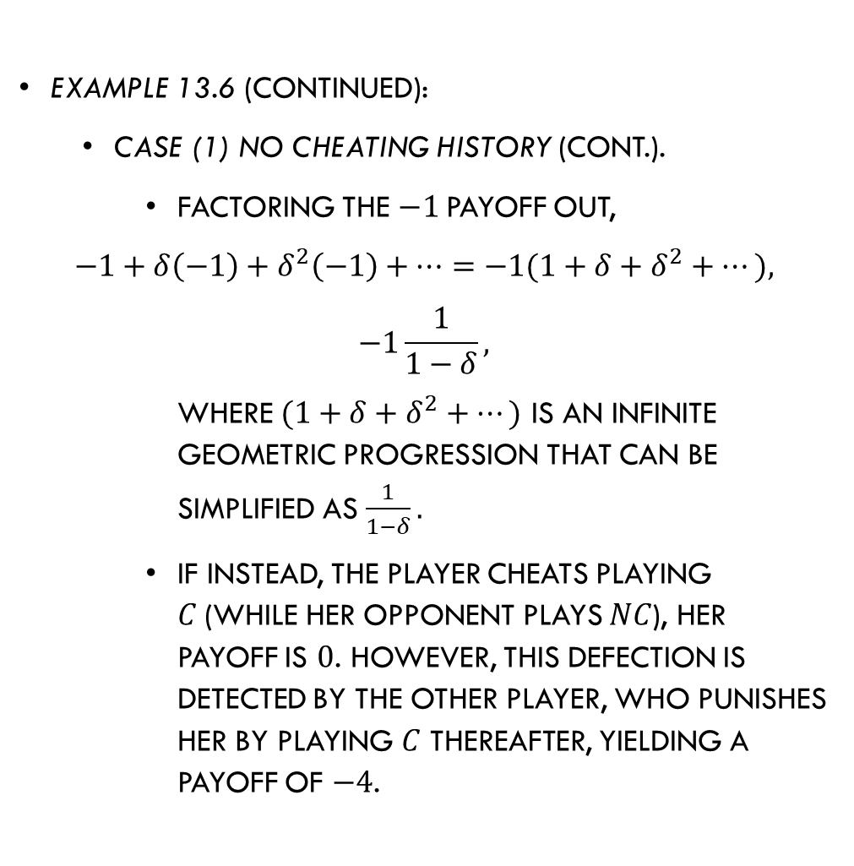
Infinite Repetitions
Example 13.6 (continued):
  Case (1) No cheating history (cont.).
    Factoring the $−1$payoff out,
    $$−1+δ\left(−1\right)+δ^{2}\left(−1\right)+…=−1(1+δ+δ^{2}+…),$$
    $$−1\frac{1}{1−δ},$$
    where $(1+δ+δ^{2}+…)$ is an infinite geometric progression that can be simplified as $\frac{1}{1−δ}.$
    If instead, the player cheats playing $C$(while her opponent plays $NC$), her payoff is $0$. However, this defection is detected by the other player, who punishes her by playing $C$ thereafter, yielding a payoff of $−4$.

Slide 34

Infinite Repetitions
Example 13.6 (continued):
  Case (1) No cheating history (cont.).
    The stream of discounted payoffs from cheating becomes
    $$0 +δ\left(−4\right)+δ^{2}\left(−4\right)+…,$$
    $$−4\left(δ+δ^{2}+δ^{3}+…\right)=−4δ\left(1+δ+δ^{2}+…\right)=−4\frac{δ}{1−δ}.$$
    Every player chooses to cooperate if
    $$−1\frac{1}{1−δ} ≥ −4\frac{δ}{1−δ},$$
    $$−1\frac{1}{1−δ}(1−δ)≥−4\frac{δ}{1−δ}(1−δ),$$
    $$−1≥−4δ⟹δ≥\frac{1}{4}.$$
She cheats
Punishment thereafter
Payoffs from cooperating
Payoffs from defecting

Slide 35
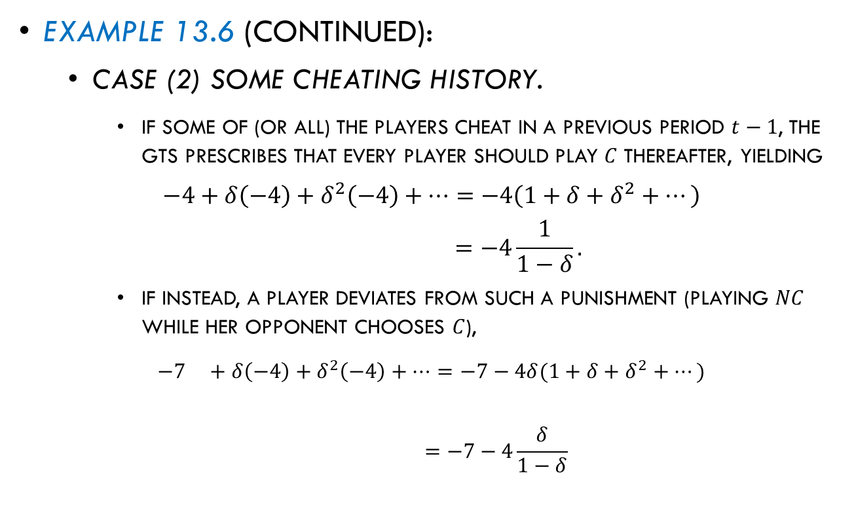
Infinite Repetitions
Example 13.6 (continued):
  Case (2) Some cheating history.
    If some of (or all) the players cheat in a previous period $t−1$, the GTS prescribes that every player should play $C$ thereafter, yielding
    $$−4+δ\left(−4\right)+δ^{2}\left(−4\right)+…=−4\left(1+δ+δ^{2}+…\right)$$
    $$=−4\frac{1}{1−δ}.$$
    If instead, a player deviates from such a punishment (playing $NC$ while her opponent chooses $C$),
    $$−7 +δ\left(−4\right)+δ^{2}\left(−4\right)+…=−7−4δ(1+δ+δ^{2}+…)$$
    $$=−7−4\frac{δ}{1−δ}$$
She deviates
Punishment thereafter

Slide 36
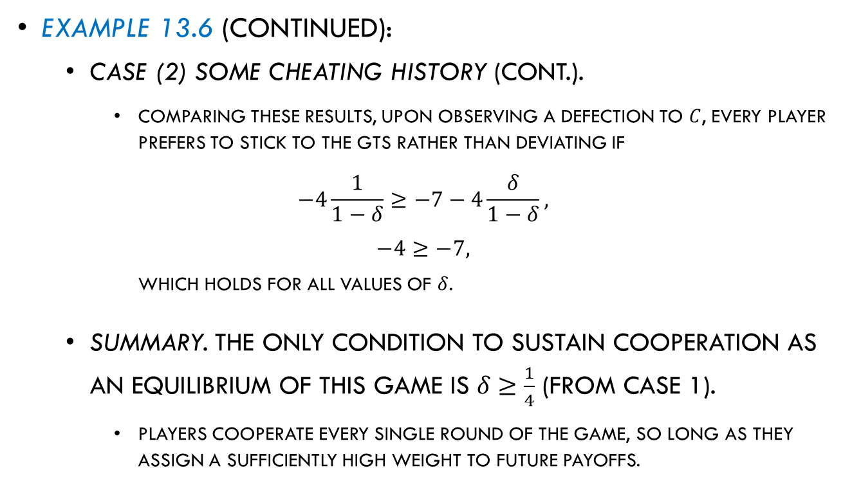
Infinite Repetitions
Example 13.6 (continued):
  Case (2) Some cheating history (cont.).
    Comparing these results, upon observing a defection to $C$, every player prefers to stick to the GTS rather than deviating if
    $$−4\frac{1}{1−δ}≥−7−4\frac{δ}{1−δ},$$
    $$−4≥−7,$$
    which holds for all values of $δ$.
  Summary. The only condition to sustain cooperation as an equilibrium of this game is $δ≥\frac{1}{4}$ (from Case 1).
    Players cooperate every single round of the game, so long as they assign a sufficiently high weight to future payoffs.

Slide 37

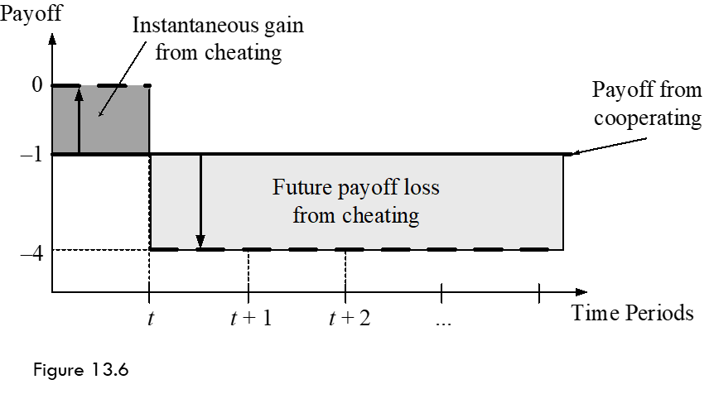
Infinite Repetitions
Figure 13.6 illustrates the trade-off between continue cooperating and cheating, upon observing that no player defected in previous rounds.

Slide 38
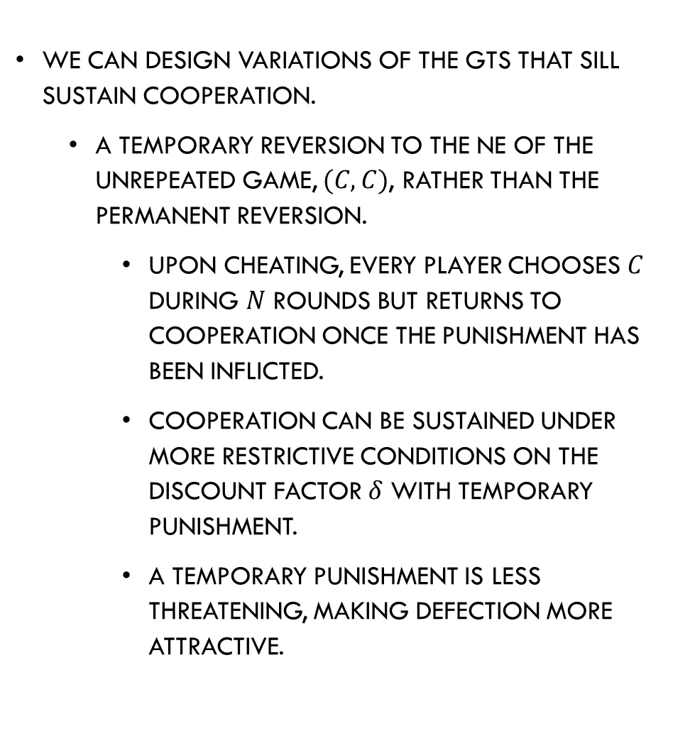
Infinite Repetitions
We can design variations of the GTS that sill sustain cooperation.
  A temporary reversion to the NE of the unrepeated game, $(C,C)$, rather than the permanent reversion.
    Upon cheating, every player chooses $C$ during $N$ rounds but returns to cooperation once the punishment has been inflicted.
    Cooperation can be sustained under more restrictive conditions on the discount factor $δ$ with temporary punishment.
    A temporary punishment is less threatening, making defection more attractive.

Slide 39
A Look at Behavioral Economics– Cooperation in the Experimental Lab?

Slide 40
Cooperation in the Experimental Lab?
The Prisoner’s Dilemma game illustrates the tension between private and group incentives common in real life.
It has been widely tested in experimental labs.
Participants are asked to seat at computer terminals where they are informed about the rules of the game, can ask questions, and can practice for a trial run.
In the finitely repeated version of the game:
  Experiments found that in the last round of interactions, individuals behave as if they were in an unrepeated game, but in the first round they cooperate.
  This behavior contradicts the theoretical prediction.

Slide 41
Cooperation in the Experimental Lab?
In the infinitely repeated version of the game:
  Participants were informed they will play one more round of the game with some probability.
  The literature found that players are more likely to cooperate when there is a higher probability they will interact in future rounds.
  This result is consistent with the theoretical prediction:
    Cooperation is easier to sustain when players care more about the future.
    When players interact during many rounds, they start defecting more frequently.

