Slide 1

Final Exam 301
Thursday April 30th at 9am

Slide 2

Important Points
The exam will start at 9am in Clark 147
Open Book
You can use your class notes or textbook.
No phones are allowed or computer.
Bring a calculator
The exam ends at 11am

Slide 3
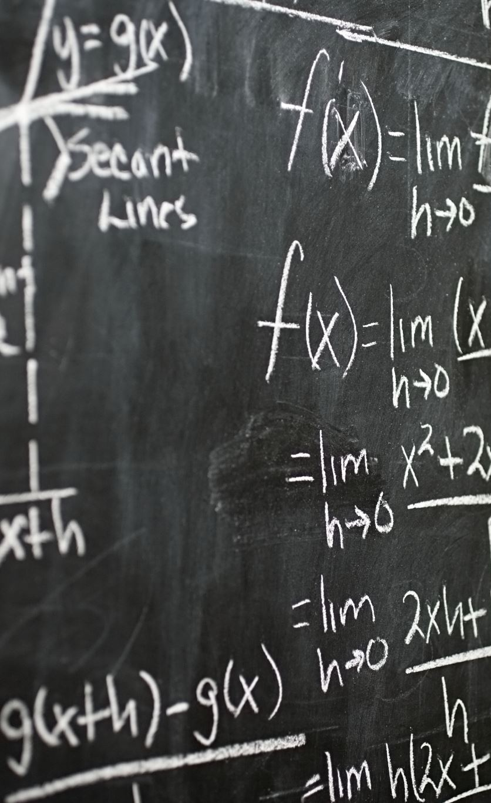
Class Material
Comprehensive Exam
Utility Theory
Utility max. problem
Income and Substitution Effect
Monopoly
Welfare Comparisons
Stackelberg vs Cournot
Common Pool Resources
Joint Max. Problem (aggregate)
Collusion (Grim-Trigger Strategy)
Externality
Emission fee

