Slide 1

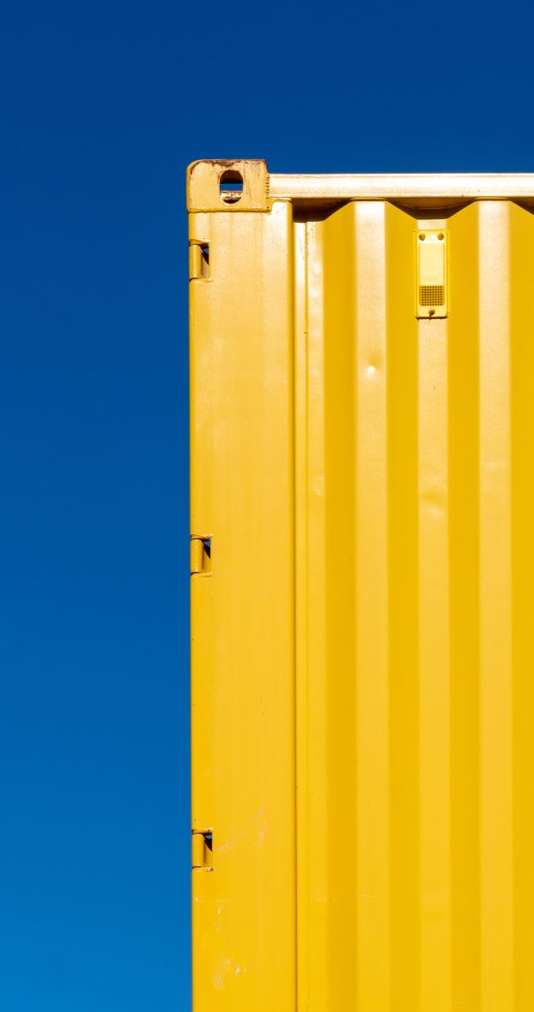
Externalities and Public Goods

Slide 2

Outline
Externalities
Social Optimum
Restoring the Social Optimum
Public Goods
Common-Pool Resources

Slide 3


Externalities

Slide 4
Externalities
Externalities. The effect that the action of an agent has on the welfare of another agent, beyond the effects transmitted by changes in prices.

Slide 5
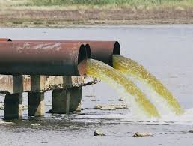
Externalities
  Examples of negative externalities:
    Production externality, a firm’s pollution of a river being used for fishing downstream.

Slide 6
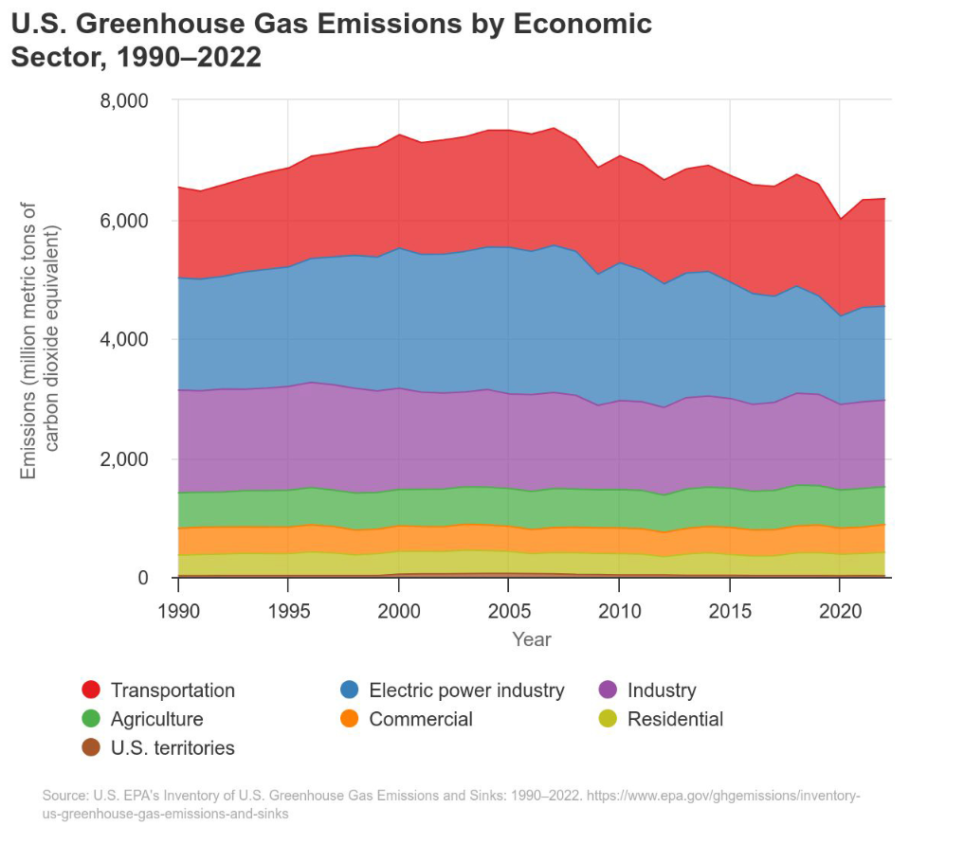

Slide 7
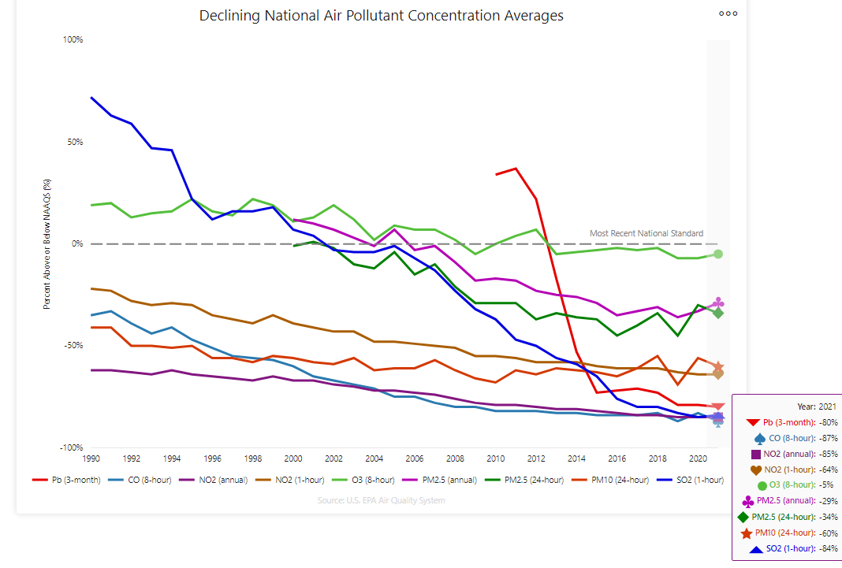

Slide 8
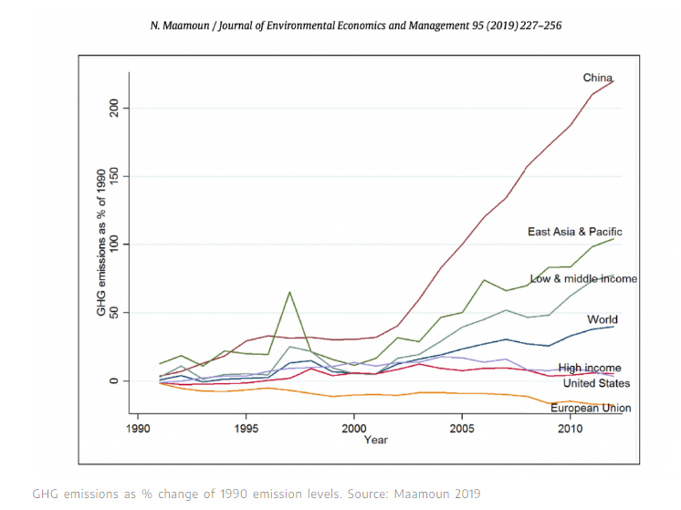

Slide 9
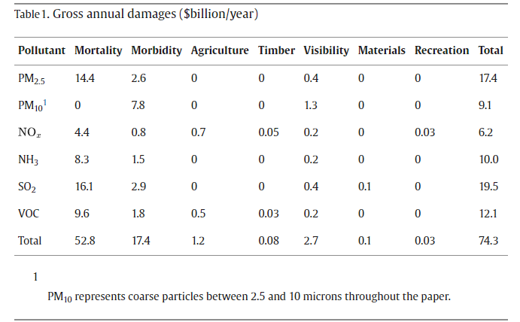

Measuring the damages of air pollution in the United States (Muller and Mendelsohn, 2007, JEEM)
PM2.5 (Fine Particulate Matter) refers to particles in the air that measure less than 2.5 micrometers (μm) in diameter. These particles can include smoke, soot, liquid or solid aerosol particles, and biological matter like mold, bacteria, pollen, and animal dander.
The largest source of SO₂ in the atmosphere is the burning of fossil fuels by power plants and other industrial facilities.

Slide 10
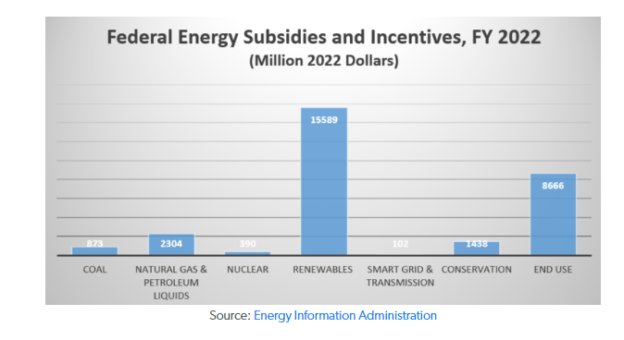
POLICIES TO ADDRESS CLIMATE CHANGE
The US has shifted its subsidies from fossil fuels to renewable energy, with renewables receiving 77% of energy subsidies in 2022 compared to fossil fuels' 16%. This is a reversal from 2017, when fossil fuels received 70% of energy subsidies worldwide
Renewable subsidies more than doubled between FY 2016 and FY 2022, increasing to $15.6 billion in fiscal year 2022 from $7.4 billion in fiscal year 2016 (both in 2022 dollars).

Slide 11
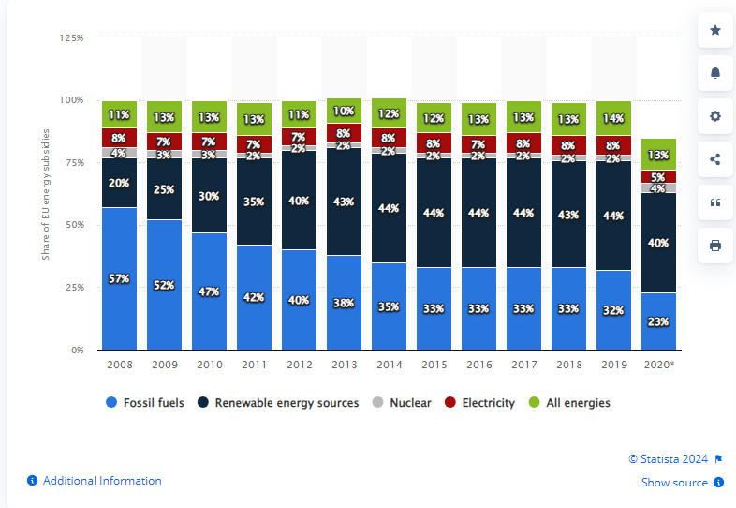
POLICIES TO ADDRESS CLIMATE CHANGE
In 2008 renewable energy subsidies accounted for 20 percent of EU energy subsidies. By 2020, this figure had doubled.

Slide 12


Externalities
  Examples of negative externalities:
    Consumption externality, a roommate streaming online which slows down the internet speed of other roommates.

Slide 13
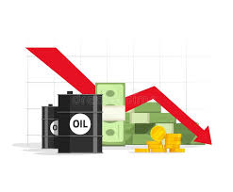
Externalities
  Examples of negative externalities:
    The decrease in market prices after one firm brings more units for sale cannot be considered an externality.
      This effect is transmitted via prices since a market for the good exists.

Slide 14
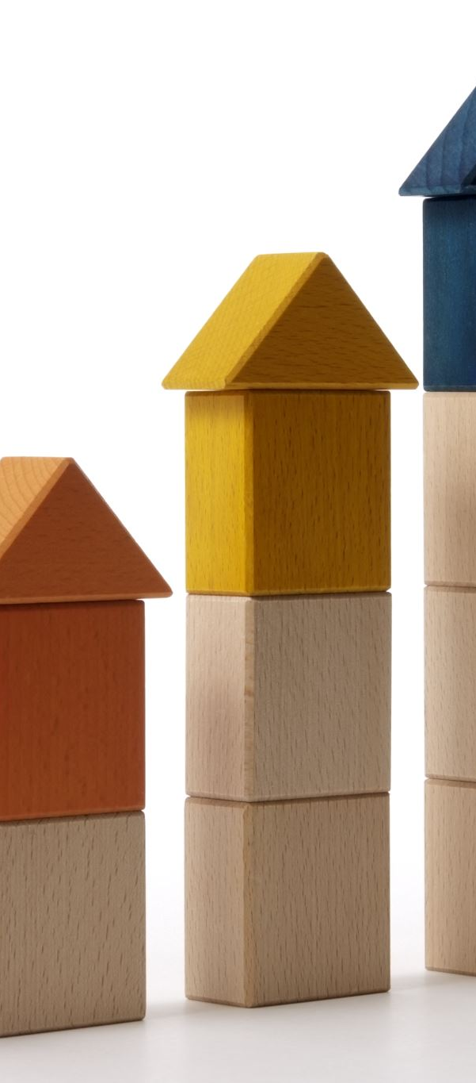

Externalities
  Examples of positive externalities:
    Consumption externality, an individual choosing to vaccinate helps other individuals around to be better protected.

Slide 15

Positive Externalities

Slide 16


Externalities
  Examples of positive externalities:
    Production externality, an unpatented R&D completed by a university which can be used for free.

Slide 17
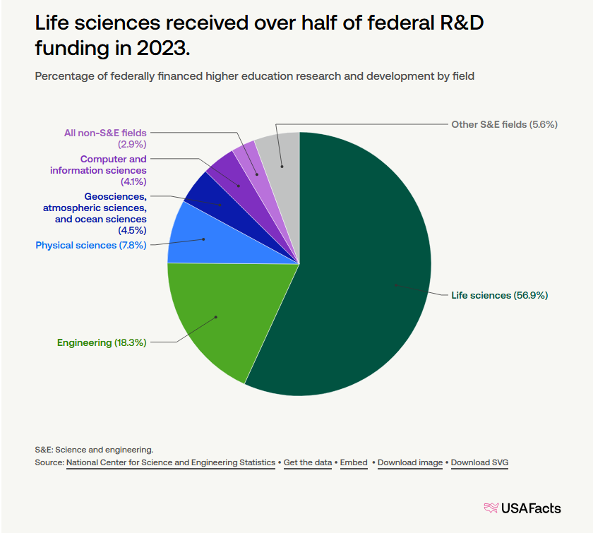

Slide 18
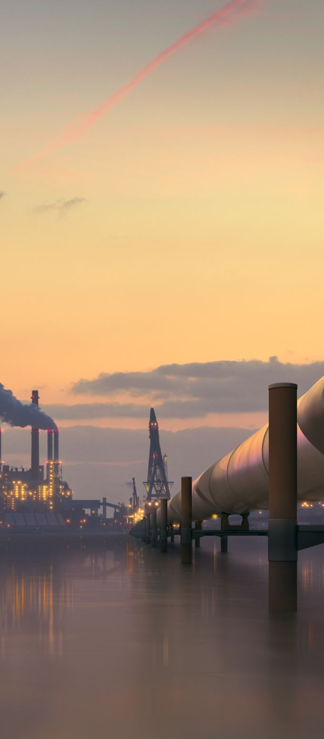
Unregulated Equilibrium
In the case of a negative externality, like a factory polluting a river, the polluter ignores the effect that its actions have on others, such as poor air quality for citizen living in the area.

Slide 19
Unregulated Equilibrium
If left unregulated, this polluting firm would produce a large amount of pollution, which is not necessarily optimal.

Slide 20

Unregulated Equilibrium
Example 17.1: Unregulated equilibrium.
  Consider a monopolist facing inverse demand function $p\left(q\right)=10−q$, and total cost $TC\left(q\right)=2q$.
  The firm’s PMP is:
  $$\max_{q}\left(10−q\right)q−2q.$$
  Differentiating with respect to $q$,
  $$10−2q−2=0,$$
  $$8=2q.$$
  Solving for $q$, we obtain an unregulated equilibrium output of
  $q^{U}=4$ units.

Slide 21
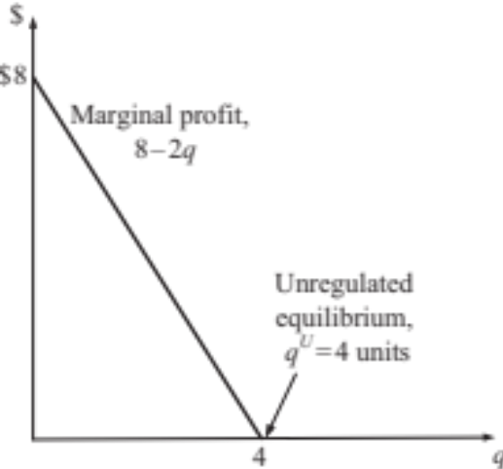

Unregulated Equilibrium
Example 17.1 (continued):
  Each unit of output generates $α≥0$ units of pollution, then the total amount of pollution the firm generates is $4α$.
  Figure 17.1 represents the firm’s problem, which increases output $q$ until marginal profits are zero.
Producing more than 4 units yields negative marginal profits.
Producing fewer than 4 units means the firm could still increase output and further increase its profits.
Figure 17.1

Slide 22

Social Optimum

Slide 23
Social Optimum
How can we evaluate whether the unregulated amount of pollution is socially excessive or not?
We first examine how much pollution would be generated by a social planner who considers both:
  the firm’s profits; and
  the externality that pollution imposes on other individuals and firms.

Slide 24
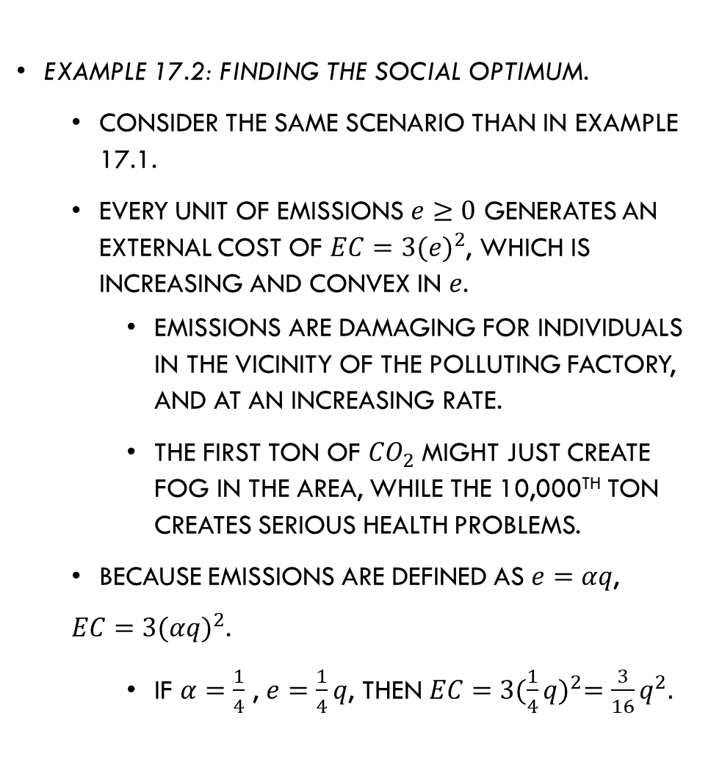
Social Optimum
Example 17.2: Finding the social optimum.
  Consider the same scenario than in example 17.1.
  Every unit of emissions $e≥0$ generates an external cost of $EC=3{(e)}^{2}$, which is increasing and convex in $e$.
    Emissions are damaging for individuals in the vicinity of the polluting factory, and at an increasing rate.
    The first ton of ${CO}_{2}$ might just create fog in the area, while the 10,000th ton creates serious health problems.
  Because emissions are defined as $e=αq$,
  $EC=3{(αq)}^{2}$.
    If $α=\frac{1}{4}$ , $e=\frac{1}{4}q$, then $EC=3{(\frac{1}{4}q)}^{2}=\frac{3}{16}q^{2}.$

Slide 25
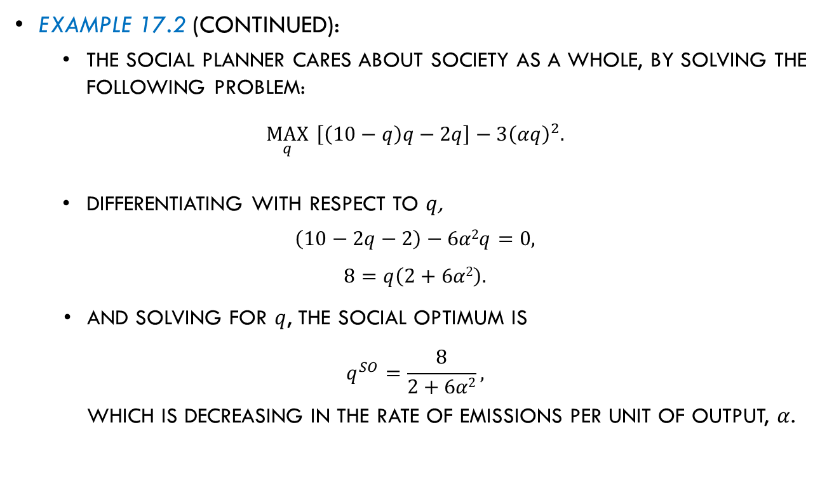
Social Optimum
Example 17.2 (continued):
  The social planner cares about society as a whole, by solving the following problem:
  $$\max_{q}{ \left[\left(10−q\right)q−2q\right]−3{\left(αq\right)}^{2}.}$$
  Differentiating with respect to $q$,
  $$\left(10−2q−2\right)−6α2q=0,$$
  $$8=q\left(2+6α2\right).$$
And solving for $q$, the social optimum is
$$q^{SO}=\frac{8}{2+6α2},$$
which is decreasing in the rate of emissions per unit of output, $α$.
Profits
External cost

Slide 26
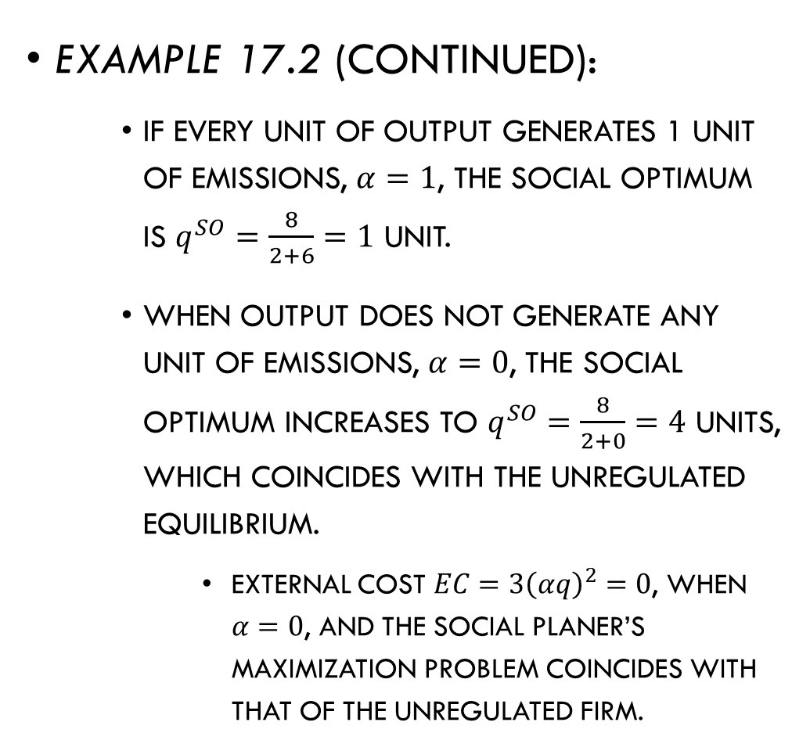
Social Optimum
Example 17.2 (continued):
    If every unit of output generates 1 unit of emissions, $α=1$, the social optimum is $q^{SO}=\frac{8}{2+6}=1$ unit.
    When output does not generate any unit of emissions, $α=0$, the social optimum increases to $q^{SO}=\frac{8}{2+0}=4$ units, which coincides with the unregulated equilibrium.
      External cost $EC=3{\left(αq\right)}^{2}=0$, when $α=0$, and the social planer’s maximization problem coincides with that of the unregulated firm.

Slide 27
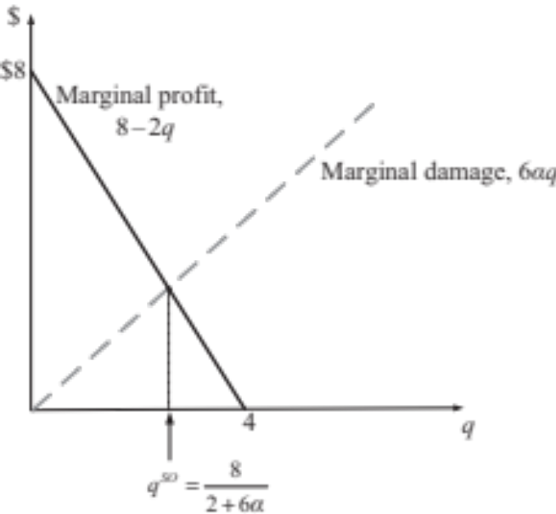
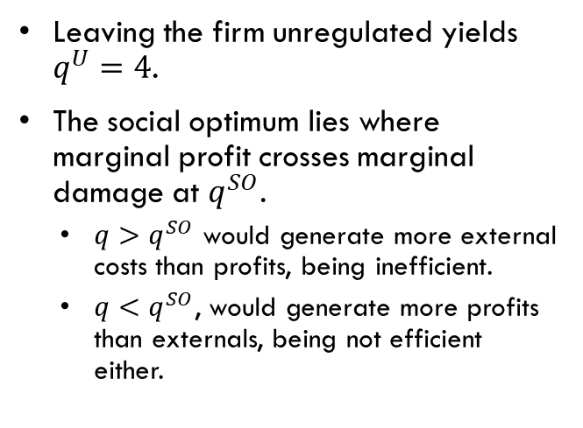
Social Optimum
Example 17.2 (continued):
  Figure 13.2 depicts the social planner’s problem.
Leaving the firm unregulated yields $q^{U}=4$.
The social optimum lies where marginal profit crosses marginal damage at $q^{SO}$.
  $q>q^{SO}$ would generate more external costs than profits, being inefficient.
  $q<q^{SO}$, would generate more profits than externals, being not efficient either.
Figure 13.2

Slide 28
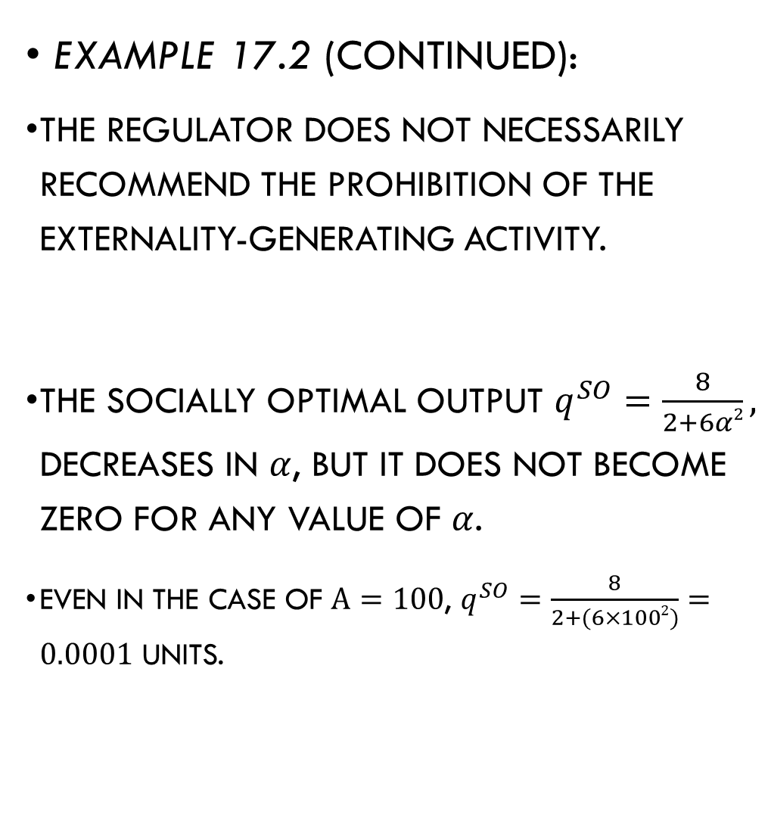
Social Optimum
Example 17.2 (continued):
  The regulator does not necessarily recommend the prohibition of the externality-generating activity.
  The socially optimal output $q^{SO}=\frac{8}{2+6α2},$ decreases in $α$, but it does not become zero for any value of $α$.
    Even in the case of $α=100$, $q^{SO}=\frac{8}{2+(6×1002)}=0.0001$ units.

Slide 29
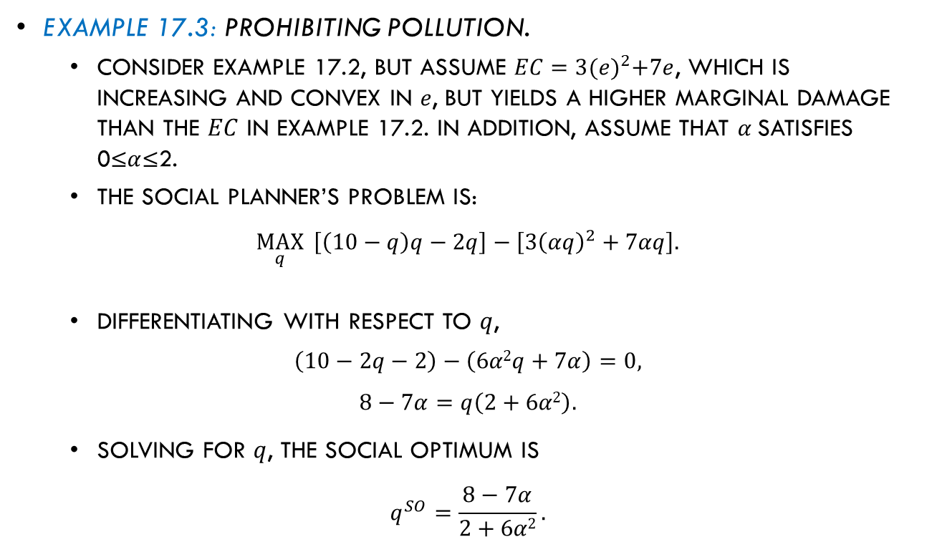
Social Optimum
Example 17.3: Prohibiting pollution.
  Consider example 17.2, but assume $EC=3{(e)}^{2}+7e$, which is increasing and convex in $e$, but yields a higher marginal damage than the $EC$ in example 17.2. In addition, assume that $α$satisfies 0≤$α$≤2.
  The social planner’s problem is:
  $$\max_{q}{ \left[\left(10−q\right)q−2q\right]−\left[3{\left(αq\right)}^{2}+7αq\right].}$$
  Differentiating with respect to $q$,
  $$\left(10−2q−2\right)−\left(6α2q+7α\right)=0,$$
  $$8−7α=q\left(2+6α2\right).$$
  Solving for $q$, the social optimum is
  $$q^{SO}=\frac{8−7α}{2+6α2}.$$
Profits
External cost

Slide 30
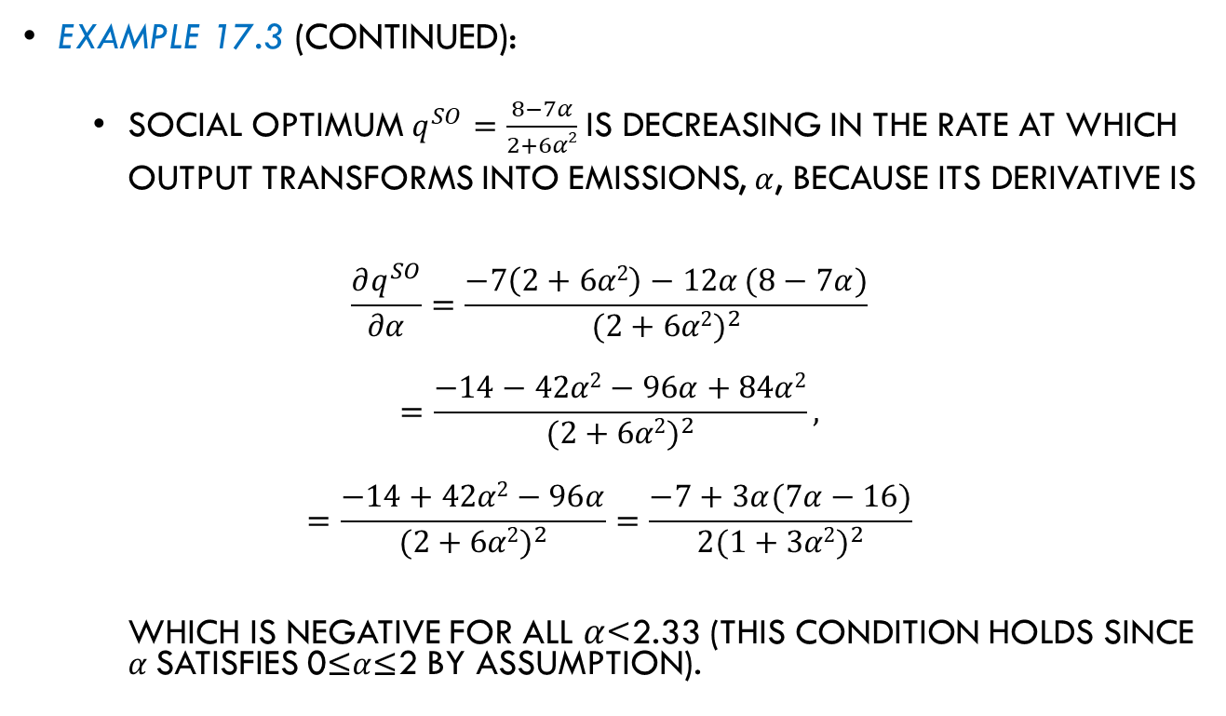
Social Optimum
Example 17.3 (continued):
  Social optimum $q^{SO}=\frac{8−7α}{2+6α2}$ is decreasing in the rate at which output transforms into emissions, $α$, because its derivative is
  $$\frac{∂q^{SO}}{∂α}=\frac{−7\left(2+6α2\right)−12α (8−7α)}{{(2+6α2)}^{2}}$$
  $$=\frac{−14−42α2−96α+84α2}{{(2+6α2)}^{2}},$$
  $$=\frac{−14+42α2−96α}{{(2+6α2)}^{2}}=\frac{−7+3α(7α−16)}{2{(1+3α2)}^{2}}$$
  which is negative for all $α$<2.33 (this condition holds since $α$satisfies 0≤$α$≤2 by assumption).

Slide 31
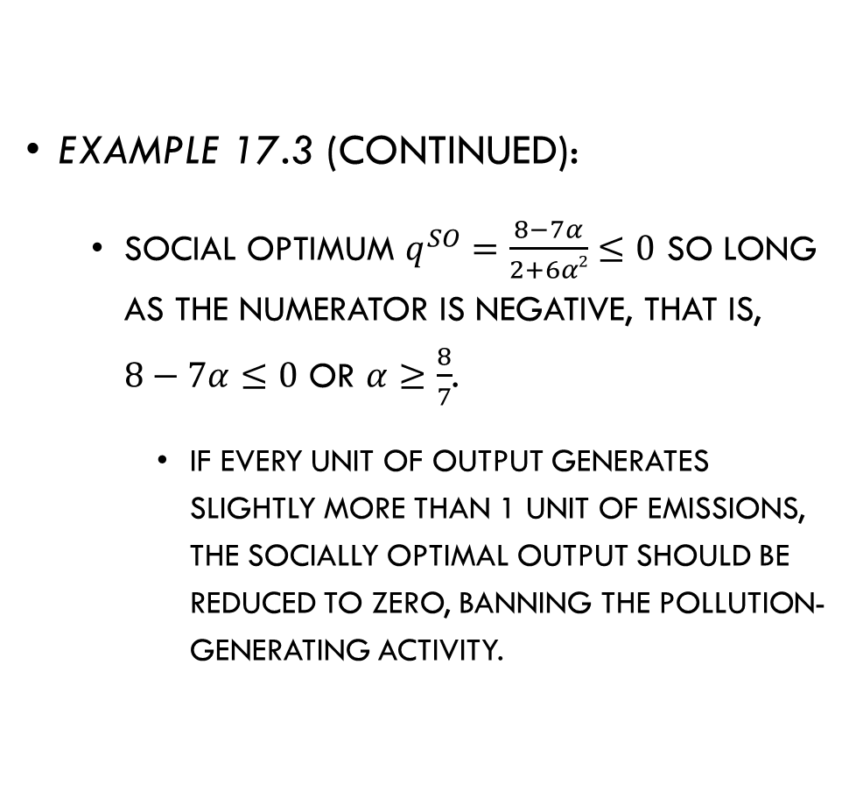
Social Optimum
Example 17.3 (continued):
  Social optimum $q^{SO}=\frac{8−7α}{2+6α2}≤0$ so long as the numerator is negative, that is, $8−7α≤0$ or $α≥\frac{8}{7}$.
    If every unit of output generates slightly more than 1 unit of emissions, the socially optimal output should be reduced to zero, banning the pollution-generating activity.

Slide 32
Restoring the Social Optimum

Slide 33
Restoring the Social Optimum
How to induce agents to internalize externalities, rather than ignoring them completely in the unregulated equilibrium?
  Bargaining between the affected parties.
  Market intervention through government policy.

Slide 34
Bargaining between the Affected Parties
Coase theorem (Coase, 1960). The agents producing the externality and those affected can negotiate, generating a socially optimal amount of externality, if:
All parties are perfectly informed about each other’s benefits and costs.
The negotiation and transaction costs are zero.
The amount of the externality is observable by a third part.
Their agreement is enforceable.

Slide 35
Bargaining between the Affected Parties
This result holds both when the property rights for the resource are assigned to the agent generating the externality, and when they are assigned to the agent affected by the externality.

Slide 36
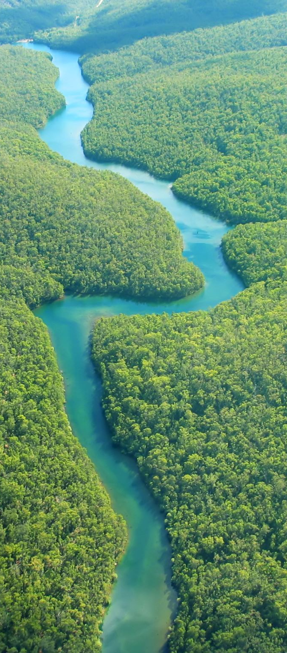
Bargaining between the Affected Parties
Example:
  An upstream firm pollutes a river, affecting a fishing farm located downstream.
  As water becomes more polluted, the fishing farm needs to spend more resources in filtering water.
  A production externality arises because pollution affects the costs of the fishing farm.
  We analyze two cases:
    Property rights over the river are assigned to the fishing farm.
    The polluting firm owns the river.

Slide 37

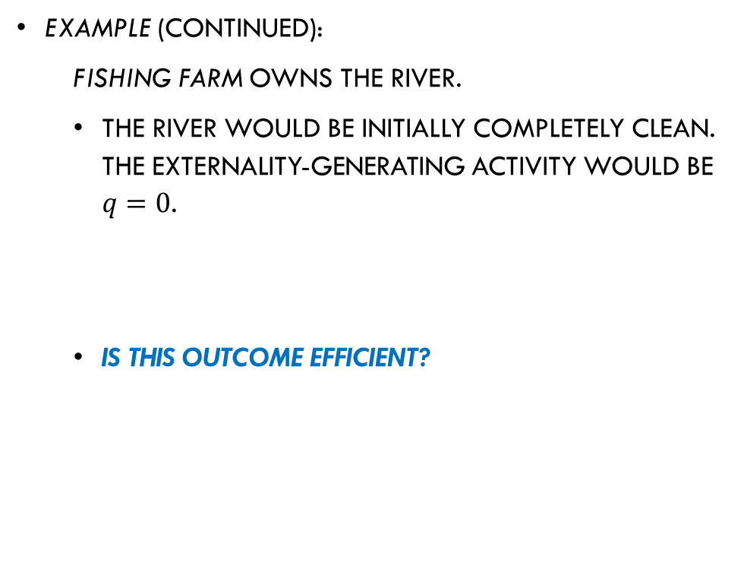
Bargaining between the Affected Parties
Example (continued):
  Fishing farm owns the river.
  The river would be initially completely clean. The externality-generating activity would be $q=0$.
  Is this outcome efficient?

Slide 38
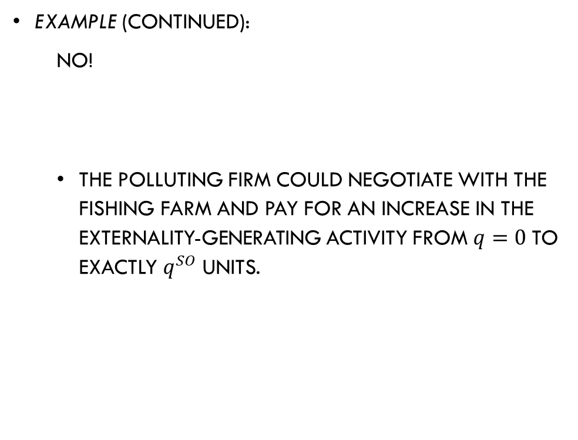
Bargaining between the Affected Parties
Example (continued):
  No!
  The polluting firm could negotiate with the fishing farm and pay for an increase in the externality-generating activity from $q=0$to exactly $q^{SO}$ units.

Slide 39
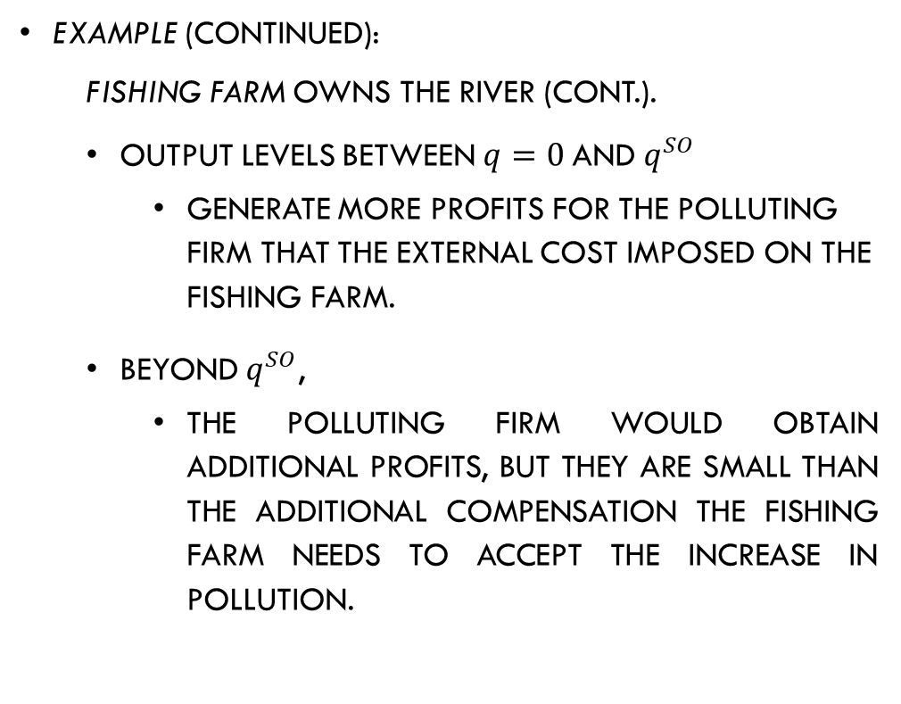
Bargaining between the Affected Parties
Example (continued):
  Fishing farm owns the river (cont.).
  Output levels between $q=0$and $q^{SO}$
    generate more profits for the polluting firm that the external cost imposed on the fishing farm.
  Beyond $q^{SO}$,
    the polluting firm would obtain additional profits, but they are small than the additional compensation the fishing farm needs to accept the increase in pollution.

Slide 40
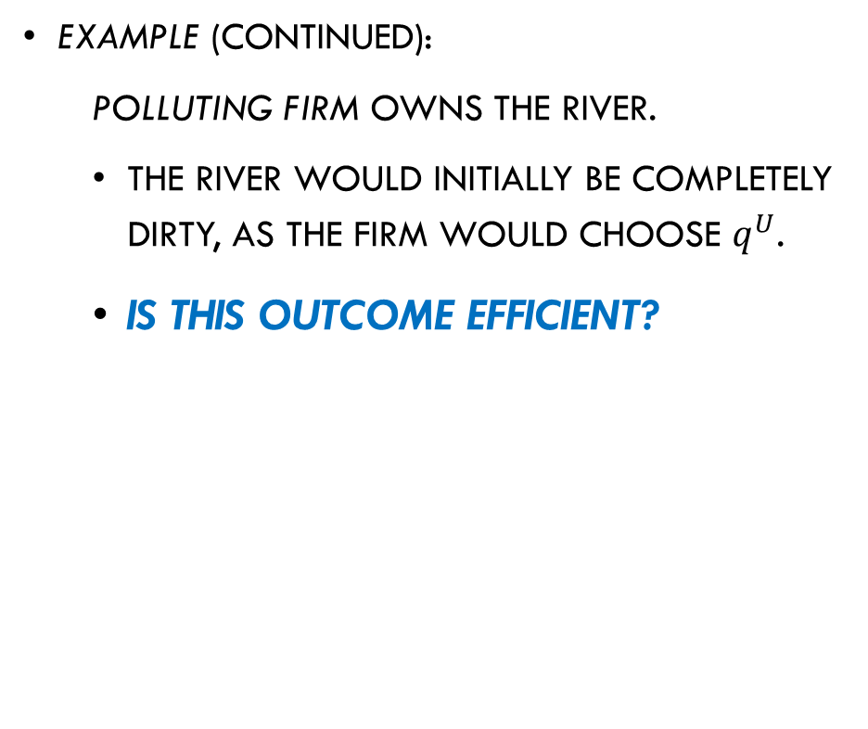
Bargaining between the Affected Parties
Example (continued):
  Polluting firm owns the river.
  The river would initially be completely dirty, as the firm would choose $q^{U}$.
  Is this outcome efficient?

Slide 41
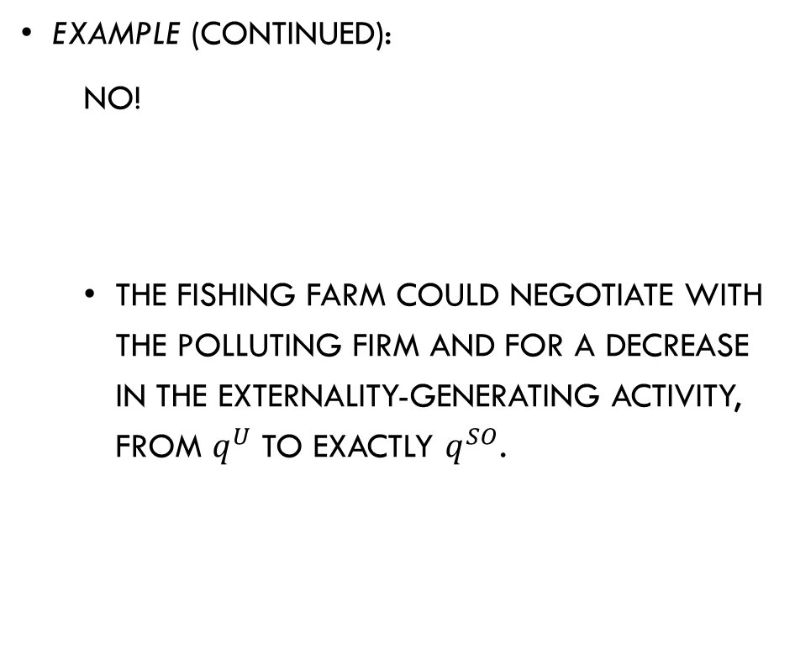
Bargaining between the Affected Parties
Example (continued):
  No!
  The fishing farm could negotiate with the polluting firm and for a decrease in the externality-generating activity, from $q^{U}$ to exactly $q^{SO}$.

Slide 42
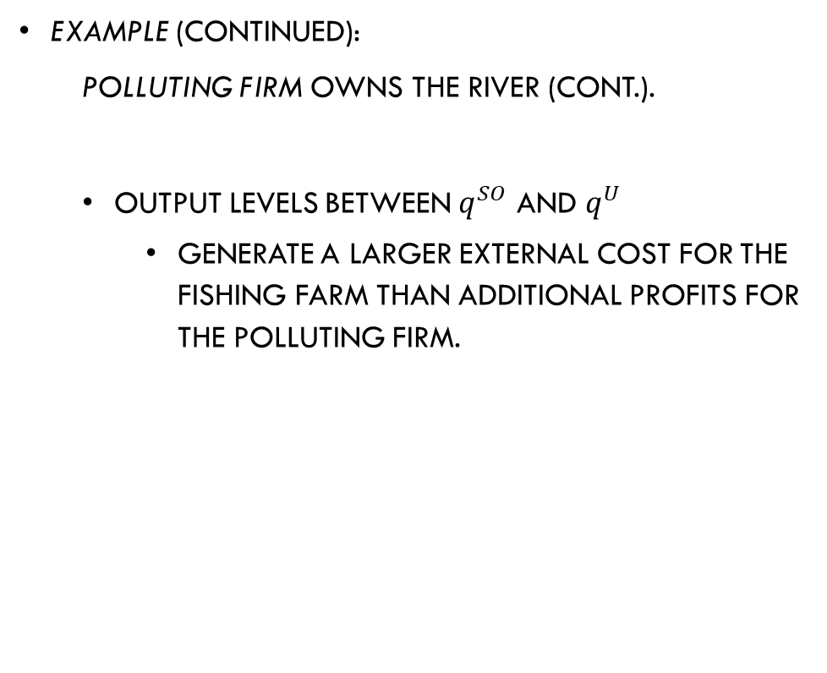
Bargaining between the Affected Parties
Example (continued):
  Polluting firm owns the river (cont.).
  Output levels between $q^{SO}$ and $q^{U}$
    generate a larger external cost for the fishing farm than additional profits for the polluting firm.

Slide 43
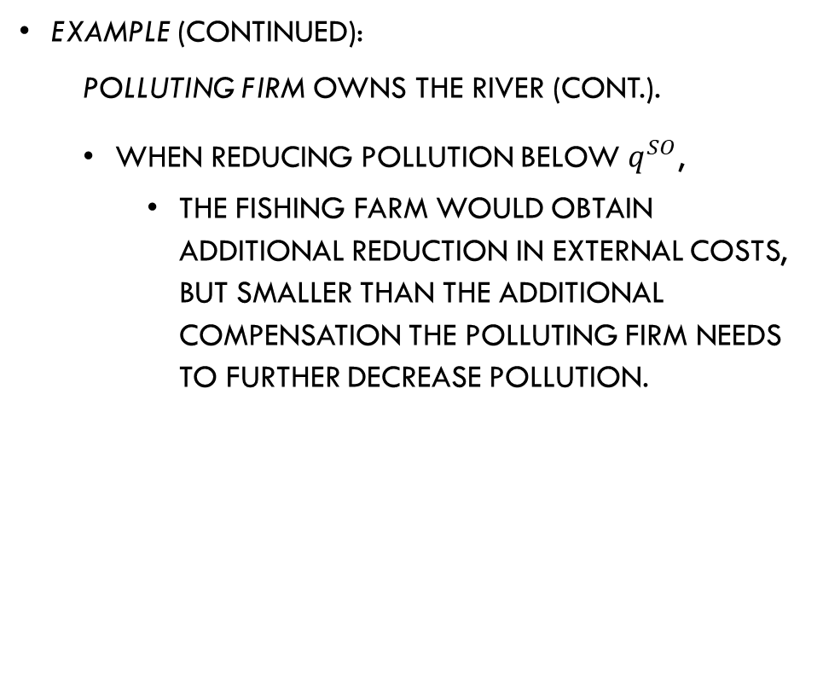
Bargaining between the Affected Parties
Example (continued):
  Polluting firm owns the river (cont.).
  When reducing pollution below $q^{SO}$,
    the fishing farm would obtain additional reduction in external costs, but smaller than the additional compensation the polluting firm needs to further decrease pollution.

Slide 44

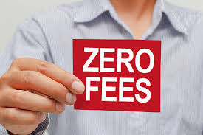
Bargaining between the Affected Parties
The Coase theorem holds when its main assumption are satisfied:
  Zero negotiation costs.
    Negotiation costs increase as more agents generate the externality and more agents are affected.

Slide 45
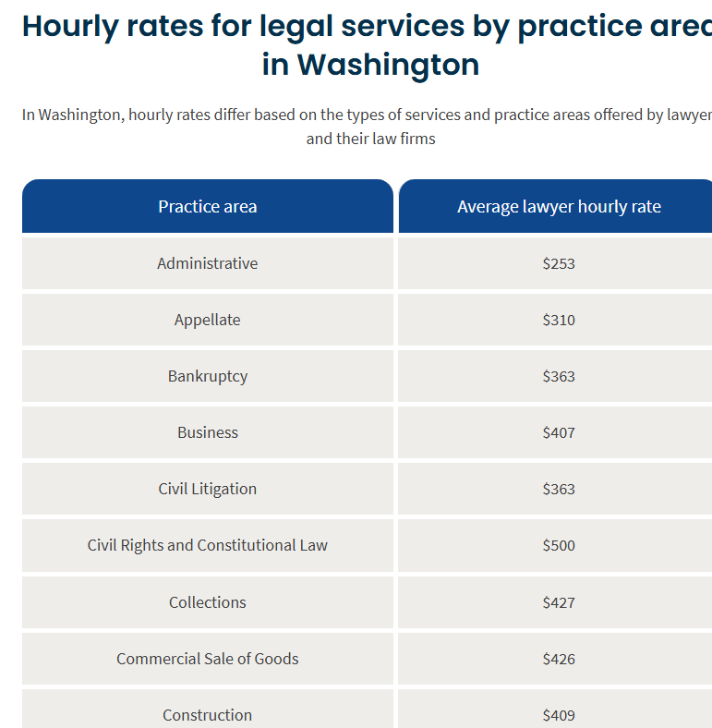
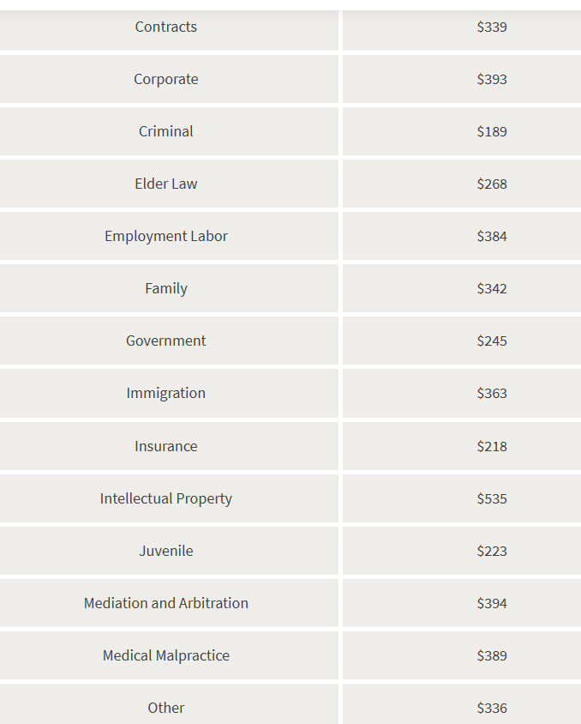

Slide 46

Bargaining between the Affected Parties
The Coase theorem holds when its main assumption are satisfied:
  Well-defined property rights.
    Allowing both parties to know who should be compensated for an increase o decrease of the externality.

Slide 47

Bargaining between the Affected Parties
The Coase theorem holds when its main assumption are satisfied:
  Perfect information.
    Agents must be well informed about the benefits and costs that the other party experiences from the externality.

Slide 48
Bargaining between the Affected Parties
  Observable pollution and enforceable contracts.
    The amount of pollution must be observable by a third party, and the contract must be enforceable in case one of the parties breaks it.
When any of these conditions does not hold, the negotiation does not generate an efficient amount of the externality.

Slide 49
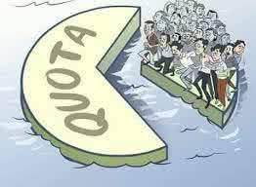

Government Intervention
Public policy seeking to correct externalities can take the form of:
  Quota, which sets an upper limit on the amount of the externality that agents can generate. Examples:
    Maximum tons of ${CO}_{2}$ that firms can emit per year.
    Maximum number of fish that a fishing company can appropriate.

Slide 50
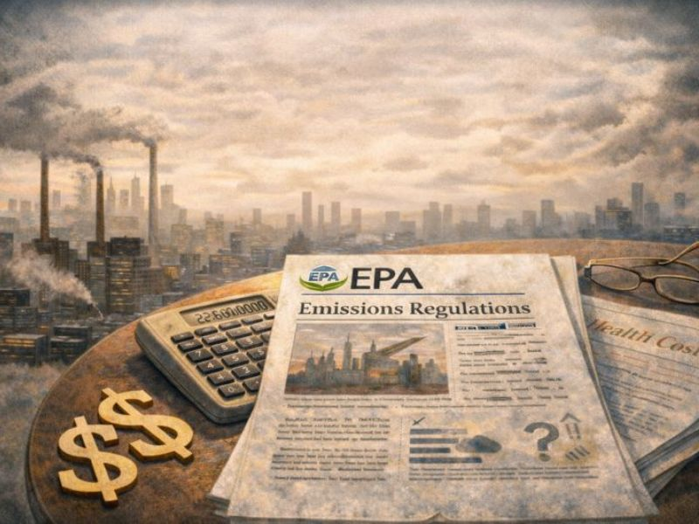

Government Intervention
Public policy seeking to correct externalities can take the form of:
  Emission fee, which increases the cost that the firm faces per unit of the output generating externality. Example:
    The firm pays $\$7$ per ton of cement being produced, as this production generates emissions.

Slide 51
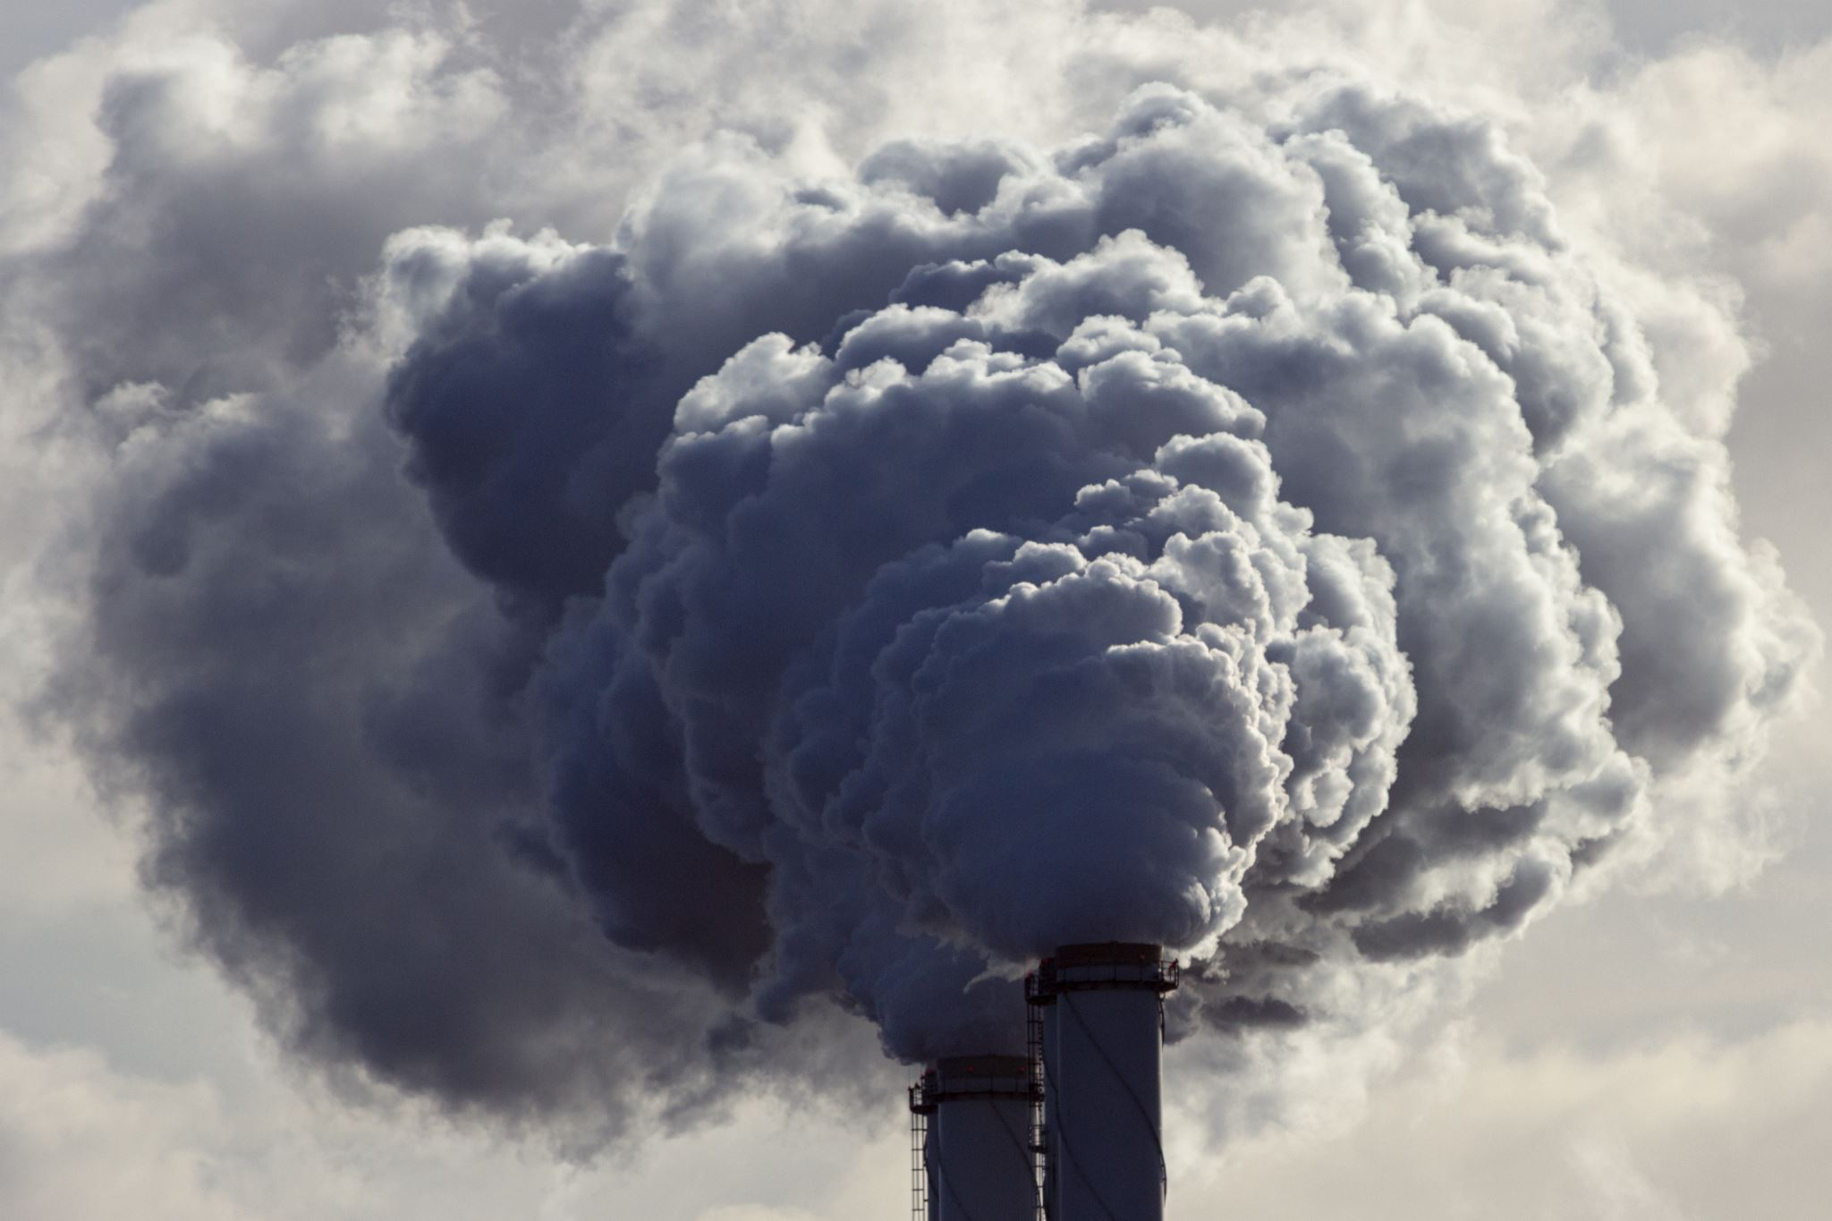
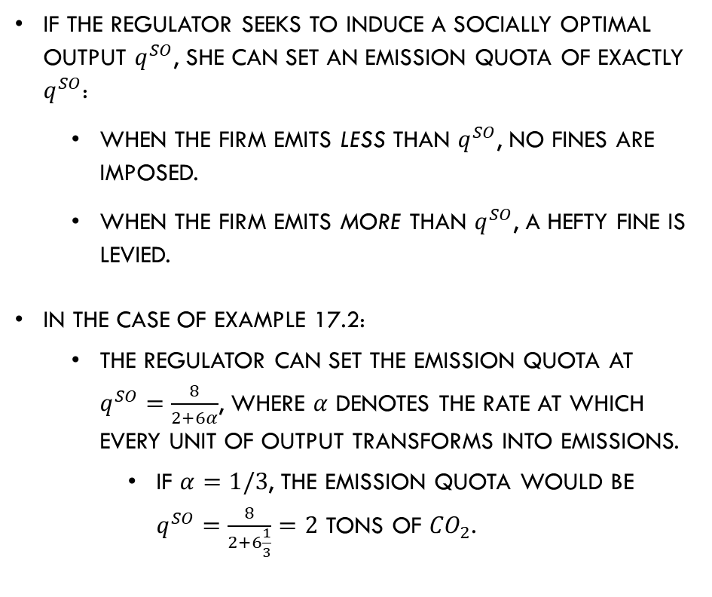
Emission Quotas
If the regulator seeks to induce a socially optimal output $q^{SO}$, she can set an emission quota of exactly $q^{SO}$:
  When the firm emits less than $q^{SO}$, no fines are imposed.
  When the firm emits more than $q^{SO}$, a hefty fine is levied.
In the case of example 17.2:
  The regulator can set the emission quota at $q^{SO}=\frac{8}{2+6α}$, where $α$ denotes the rate at which every unit of output transforms into emissions.
    If $α=1/3$, the emission quota would be $q^{SO}=\frac{8}{2+6\frac{1}{3}}=2$ tons of ${CO}_{2}$.

Slide 52
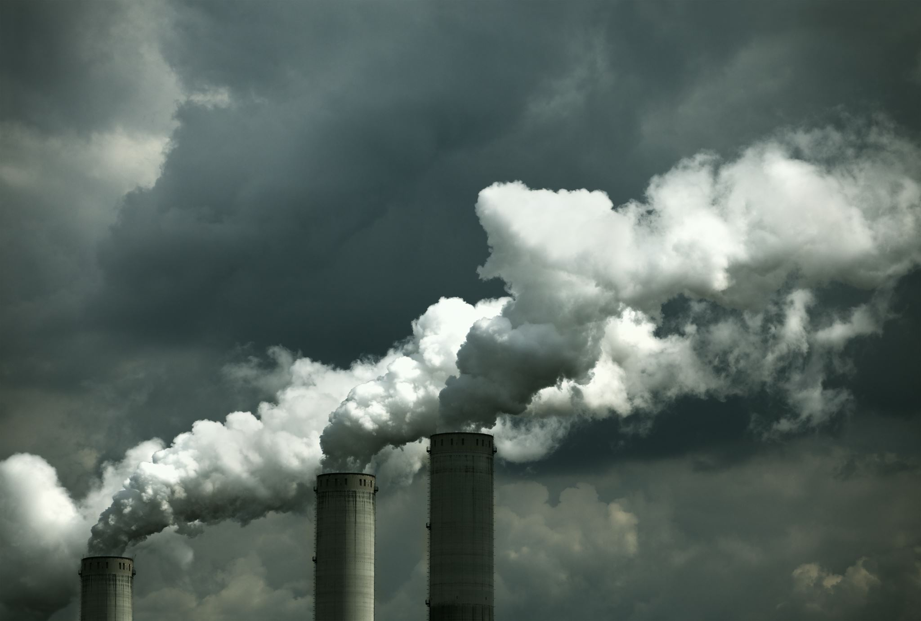
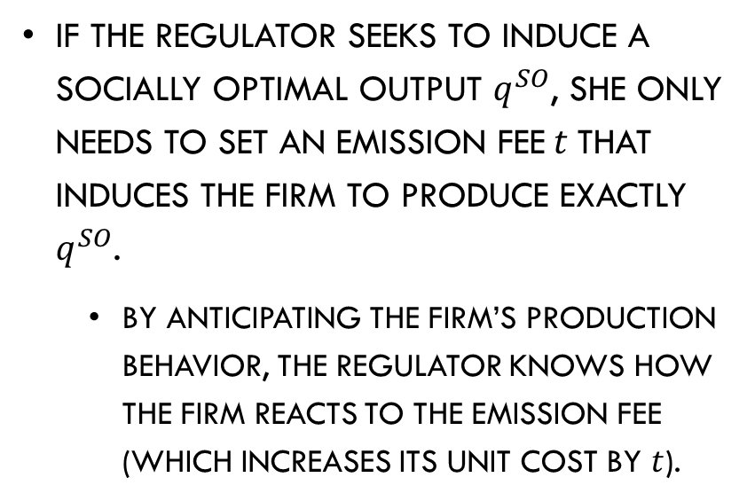
Emission Fees
If the regulator seeks to induce a socially optimal output $q^{SO}$, she only needs to set an emission fee$t$that induces the firm to produce exactly $q^{SO}$.
  By anticipating the firm’s production behavior, the regulator knows how the firm reacts to the emission fee (which increases its unit cost by $t$).

Slide 53
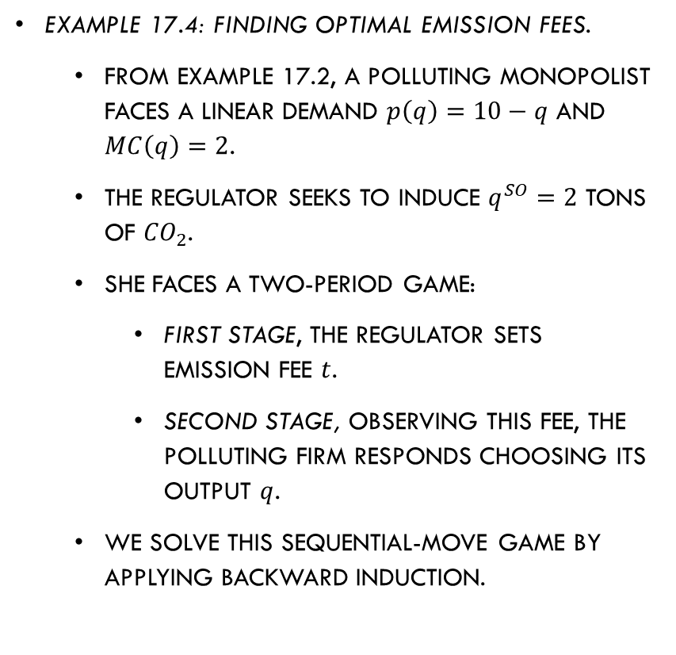
Emission Fees
Example 17.4: Finding optimal emission fees.
  From example 17.2, a polluting monopolist faces a linear demand $p\left(q\right)=10−q$ and $MC\left(q\right)=2$.
  The regulator seeks to induce $q^{SO}=2$ tons of ${CO}_{2}$.
  She faces a two-period game:
    First stage, the regulator sets emission fee $t$.
    Second stage, observing this fee, the polluting firm responds choosing its output $q$.
  We solve this sequential-move game by applying backward induction.

Slide 54
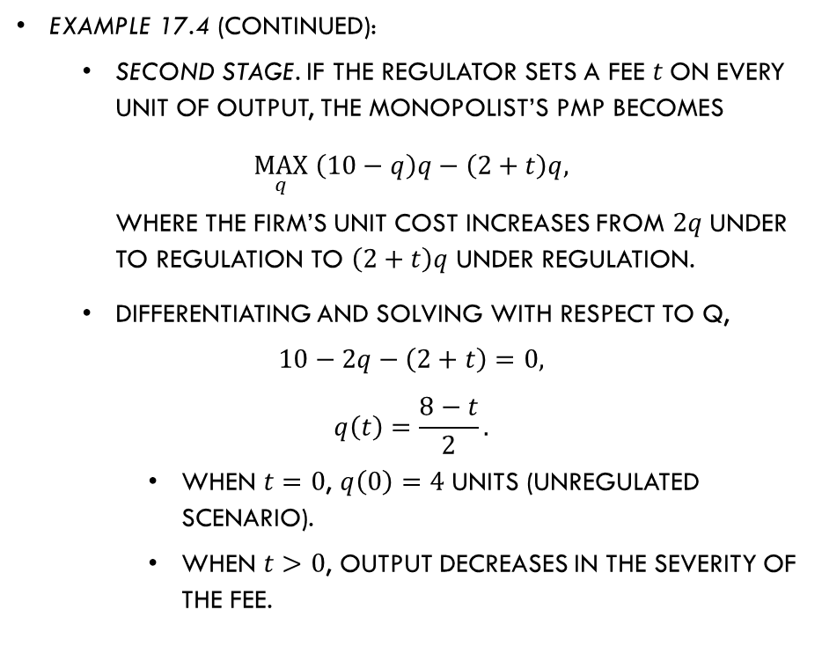
Emission Fees
Example 17.4 (continued):
  Second stage. If the regulator sets a fee $t$on every unit of output, the monopolist’s PMP becomes
  $$\max_{q}\left(10−q\right)q−\left(2+t\right)q,$$
  where the firm’s unit cost increases from $2q$under to regulation to $\left(2+t\right)q$ under regulation.
  Differentiating and solving with respect to q,
  $$10−2q−\left(2+t\right)=0,$$
  $$q\left(t\right)=\frac{8−t}{2}.$$
    When $t=0$, $q\left(0\right)=4$ units (unregulated scenario).
    When $t>0$, output decreases in the severity of the fee.

Slide 55
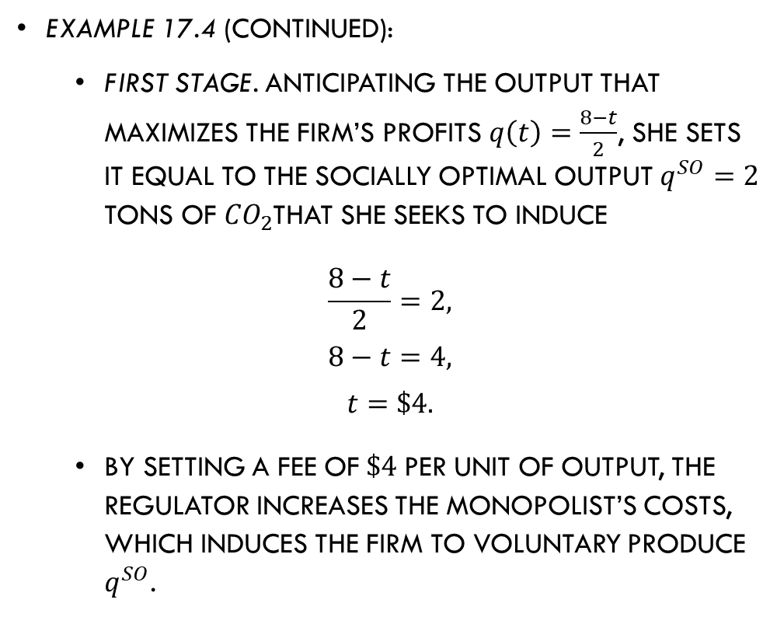
Emission Fees
Example 17.4 (continued):
  First stage. Anticipating the output that maximizes the firm’s profits $q\left(t\right)=\frac{8−t}{2}$, she sets it equal to the socially optimal output $q^{SO}=2$ tons of ${CO}_{2}$that she seeks to induce
  $$\frac{8−t}{2}=2,$$
  $$8−t=4,$$
  $$t=\$4.$$
  By setting a fee of$\$4$per unit of output, the regulator increases the monopolist’s costs, which induces the firm to voluntary produce $q^{SO}$.

Slide 56
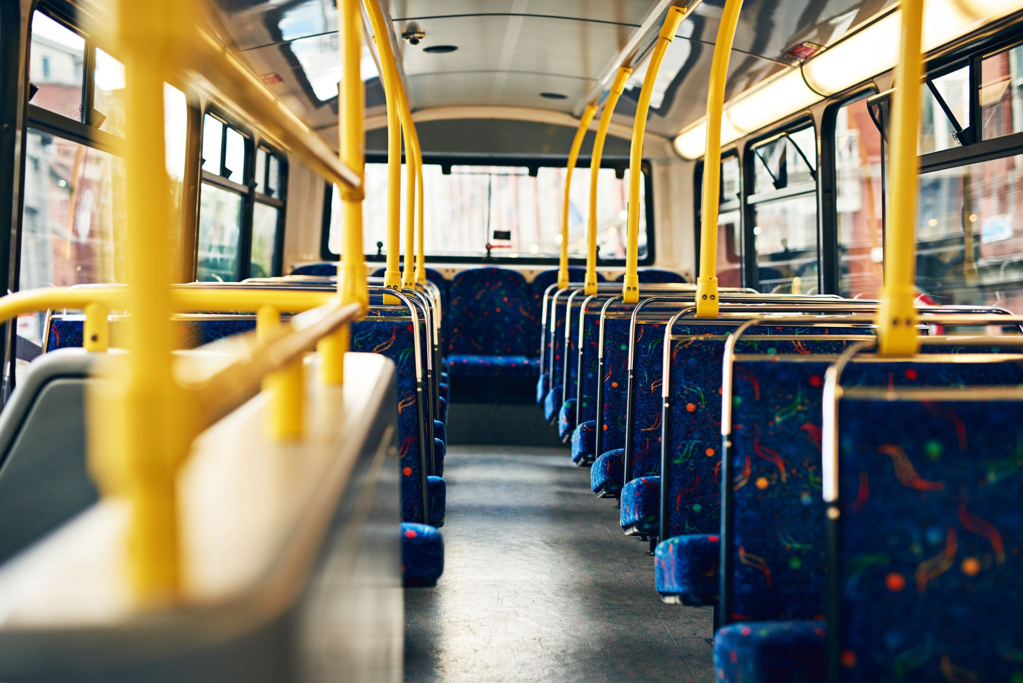
Public Goods

Slide 57
Public Goods
“Public goods” are goods and services which are:
Nonrival, its consumption by one individual does not reduce the amount of the good available to others.
Nonexcludable, preventing an individual from enjoying the good is extremely expensive or impossible.
Examples:
National defense.
Clean air.
Goods that not satisfy either property are “private goods,” such as an apple.

Slide 58
Public Goods
Taxonomy of goods when combining rivalry and excludability properties.
Non-excludable goods result in free-riding behavior, in which consumers do not pay for the goods because they expect that others will pay.
Table 17.1
 | Excludable | Nonexcludable
Rival | Private goods (Apples) | Common-Pool Resources (Fishing grounds)
Nonrival | Club goods (Gyms) | Public Goods (National defense)

Slide 59
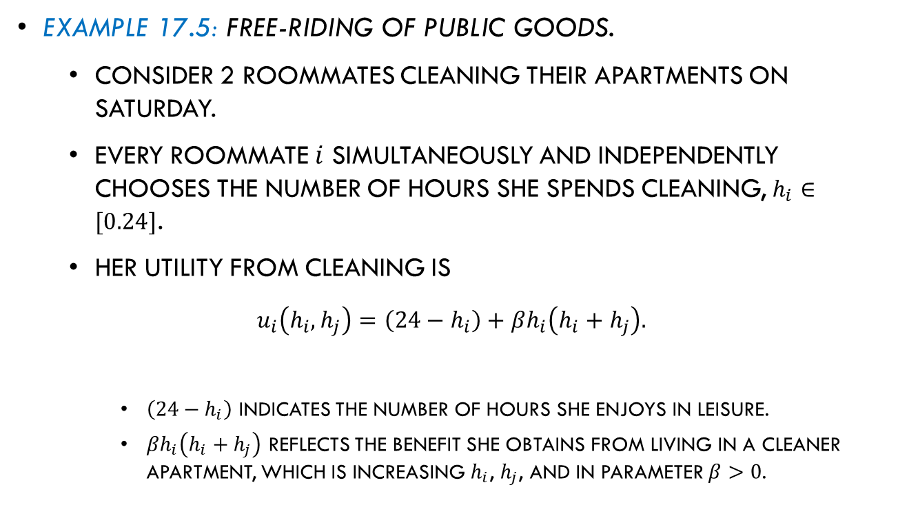
Public Goods
Example 17.5: Free-riding of public goods.
  Consider 2 roommates cleaning their apartments on Saturday.
  Every roommate $i$ simultaneously and independently chooses the number of hours she spends cleaning, $h_{i}∈[0.24]$.
  Her utility from cleaning is
  $$u_{i}\left(h_{i},h_{j}\right)=\left(24−h_{i}\right)+βh_{i}\left(h_{i}+h_{j}\right).$$
    $\left(24−h_{i}\right)$ indicates the number of hours she enjoys in leisure.
    $βh_{i}\left(h_{i}+h_{j}\right)$ reflects the benefit she obtains from living in a cleaner apartment, which is increasing $h_{i}$, $h_{j}$, and in parameter $β>0$.
Leisure
Cleaner apartment

Slide 60
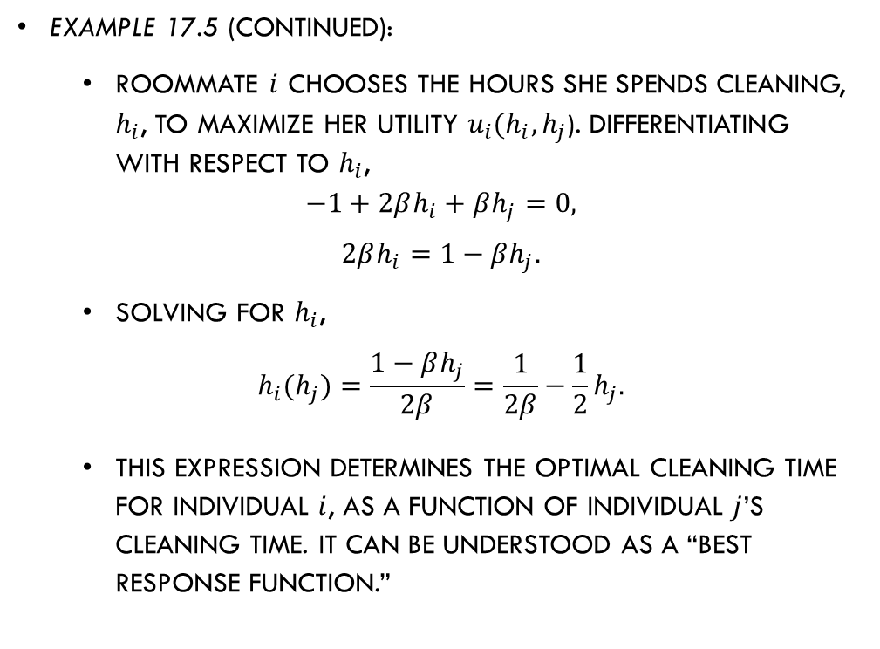
Public Goods
Example 17.5 (continued):
  Roommate $i$ chooses the hours she spends cleaning, $h_{i}$, to maximize her utility $u_{i}(h_{i},h_{j}$). Differentiating with respect to $h_{i}$,
  $$−1+2βh_{i}+βh_{j}=0,$$
  $$2βh_{i}=1−βh_{j}.$$
  Solving for $h_{i}$,
  $$h_{i}(h_{j})=\frac{1−βh_{j}}{2β}=\frac{1}{2β}−\frac{1}{2}h_{j}.$$
  This expression determines the optimal cleaning time for individual $i$, as a function of individual $j$’s cleaning time. It can be understood as a “best response function.”

Slide 61
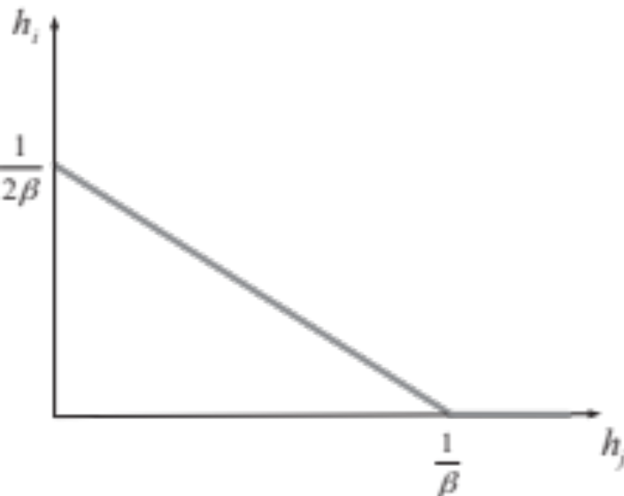
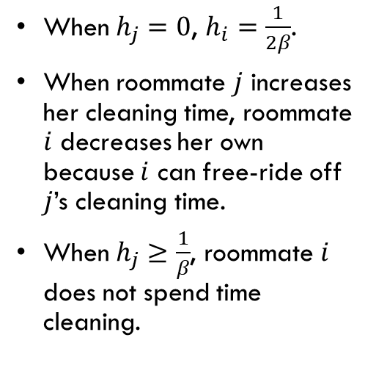

Public Goods
Example 17.5 (continued):
  Roommate $i$’s best response function, $h_{i}(h_{j})=\frac{1}{2β}−\frac{1}{2}h_{j}$.
When $h_{j}=0$, $h_{i}=\frac{1}{2β}$.
When roommate $j$ increases her cleaning time, roommate $i$ decreases her own because $i$ can free-ride off $j$’s cleaning time.
When $h_{j}≥\frac{1}{β}$, roommate $i$ does not spend time cleaning.
Figure 17.3

Slide 62
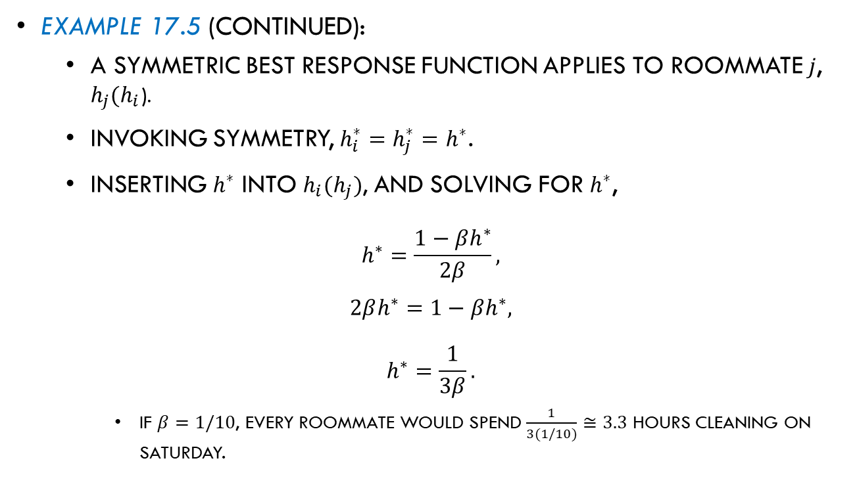
Public Goods
Example 17.5 (continued):
  A symmetric best response function applies to roommate $j$, $h_{j}(h_{i}$).
  Invoking symmetry, $h_{i}^{∗}=h_{j}^{∗}=h^{∗}$.
  Inserting $h^{∗}$ into $h_{i}(h_{j})$, and solving for $h^{∗}$,
  $$h^{∗}=\frac{1−βh^{∗}}{2β},$$
  $$2βh^{∗}=1−βh^{∗},$$
  $$h^{∗}=\frac{1}{3β}.$$
    If $β=1/10$, every roommate would spend $\frac{1}{3(1/10)}≅3.3$ hours cleaning on Saturday.

Slide 63

Public Goods
How can free-riding be prevented?
  Require all individuals (users and nonusers) to pay for the provision of the good via taxes rather than voluntary contributions.
  Require users to pay a certain amount very time they use the good.
  Example: Highways
    Drivers pay tolls every time they access a road, transforming the nature of the good from nonexcludable (freeway) to excludable (controlled-access highway).
    Tolls help to alleviate traffic congestion, as they can vary significantly depending on the time of the day.

Slide 64

Common-Pool Resources

Slide 65
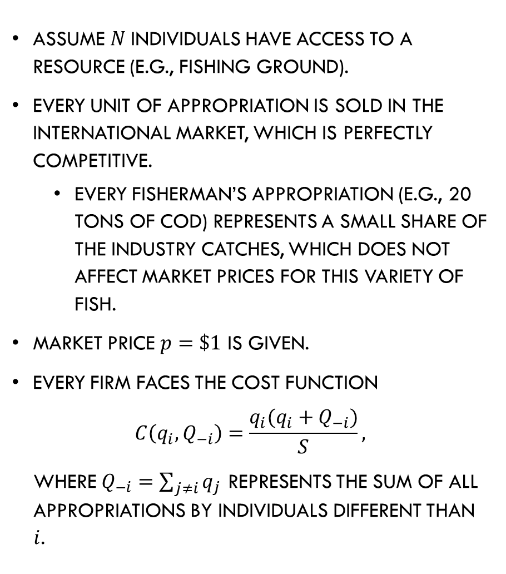
Common-Pool Resources
Assume $N$individuals have access to a resource (e.g., fishing ground).
Every unit of appropriation is sold in the international market, which is perfectly competitive.
  Every fisherman’s appropriation (e.g., 20 tons of cod) represents a small share of the industry catches, which does not affect market prices for this variety of fish.
Market price $p=\$1$ is given.
Every firm faces the cost function
$$C\left(q_{i},Q_{−i}\right)=\frac{q_{i}(q_{i}+Q_{−i})}{S},$$
where $Q_{−i}=\sum_{j≠i}{q_{j}}$ represents the sum of all appropriations by individuals different than $i$.

Slide 66
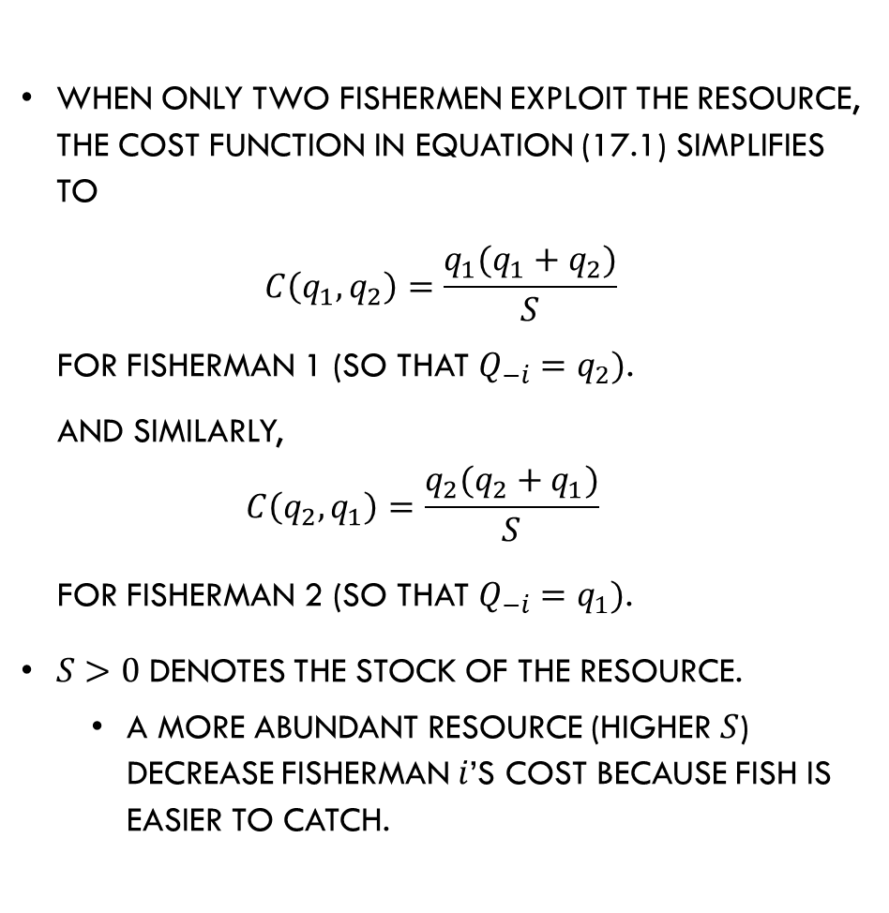
Common-Pool Resources
When only two fishermen exploit the resource, the cost function in equation (17.1) simplifies to
$$C\left(q_{1},q_{2}\right)=\frac{q_{1}(q_{1}+q_{2})}{S}$$
for fisherman 1 (so that $Q_{−i}=q_{2})$.
And similarly,
$$C\left(q_{2},q_{1}\right)=\frac{q_{2}(q_{2}+q_{1})}{S}$$
for fisherman 2 (so that $Q_{−i}=q_{1})$.
$S>0$denotes the stock of the resource.
  A more abundant resource (higher $S$) decrease fisherman $i$’s cost because fish is easier to catch.

Slide 67



Common-Pool Resources
The cost function is increasing in fisherman $i$’s own appropriation, $q_{i}$, and his rivals’ appropriation, $Q_{−i}$.
Every fisherman chooses its appropriation level $q_{i}$ to maximize its profits as follows:
$$\max_{q_{i}}{π_{i}=q_{i}−\frac{q_{1}(q_{i}+Q_{−i})}{S}}.$$
Finding Equilibrium Appropriation.
Differentiating with respect to $q_{i},$
$$1 −\frac{2q_{i}+Q_{−i}}{S}=0$$
The fisherman increases his appropriation until the marginal revenue and the cost exactly offset each other.
$$MR$$
$$MC$$

Slide 68




Common-Pool Resources
Finding Equilibrium Appropriation (cont.).
Rearranging the previous expression and solving for $q_{i},$
$$S=2q_{i}+Q_{−i},$$
$$q_{i}\left(Q_{−i}\right)=\frac{S}{2}−\frac{1}{2}Q_{−i}.$$
(${BRF}_{i}$)
$q_{i}(Q_{−i})$ describes how many units to appropriate, $q_{i}$, as a response to how many units his rivals’ appropriate, $Q_{−i}$.
He appropriates $\frac{S}{2}$ when $Q_{−i}=0$.
His appropriation decreases as $Q_{−i}>0$.
Figure 17.4

Slide 69

Common-Pool Resources
Finding Equilibrium Appropriation (cont.).
Firms are symmetric in this scenario because they face the same price for each unit of fish ($\$1$), and the same cost function.
Therefore, the best response function of any other firm$j$($j≠i$) is symmetric to ${BRF}_{i}$, $q_{j}\left(Q_{−j}\right)=\frac{S}{2}−\frac{1}{2}Q_{−j}$.
In a symmetric equilibrium, $q_{1}^{∗}=q_{2}^{∗}=…=q_{N}^{∗}=q^{∗}$. Therefore $Q_{−i}^{∗}=\sum_{j≠i}{q^{∗}=(N−1)q^{∗}}$.
Inserting this result in the best response function,
$$q^{∗}=\frac{S}{2}−\frac{1}{2}\left(N−1\right)q^{∗}.$$
(17.2)

Slide 70

Common-Pool Resources
Finding Equilibrium Appropriation (cont.).
Rearranging (17.2) and solving for $q^{∗}$,
$$\frac{2q^{∗}+(N−1)q^{∗}}{2}=\frac{S}{2},$$
$$\left(N+1\right)q^{∗}=S,$$
$$q^{∗}=\frac{S}{N+1}.$$
  If $S=100$tons of fins and $N=9$ fishermen, $q^{∗}=\frac{100}{9+1}=10$ tons.
Generally, the equilibrium appropriation $q^{∗}$ increases in the stock of the resource, $S$, but decreases in the number of firms competing for the resource, $N$.

Slide 71

Common-Pool Resources–
Joint Profit Maximization

Slide 72


Common-Pool Resources–
Joint Profit Maximization
Can fishermen increase their profits if they coordinate their catches? YES!
Consider the case of 2 fishermen, $N=2$.
When fishermen 1 and 2 coordinate their catches, they maximize joint profits as follows:
$$\max_{q_{1},q_{2}}{π_{1}+π_{2}=\left(q_{1}−\frac{q_{1}(q_{1}+q_{2})}{S}\right)+\left(q_{2}−\frac{q_{2}(q_{2}+q_{1})}{S}\right)},$$
$$\max_{q_{1},q_{2}}\left(q_{1}+q_{2}\right)−\frac{({q_{1}+q_{2})}^{2}}{S}.$$
Differentiating with respect to $q_{1}$,
$$1 −\frac{2\left(q_{1}+q_{2}\right)}{S}=0.$$
(17.3)
$$MR$$
$$MC$$

Slide 73

Common-Pool Resources–
Joint Profit Maximization
Every fisherman internalizes the cost externality that his appropriation generates on other fishermen, as larger $q_{i}$ increases the cost of fisherman$j$.
Rearranging equation (17.3) and solving for $q_{1}$,
$$S=2\left(q_{1}+q_{2}\right)$$
$$q_{1}\left(q_{2}\right)=\frac{S}{2}−q_{2}.$$
(17.4)

Slide 74



Common-Pool Resources–
Joint Profit Maximization
$q_{1}\left(q_{2}\right)=\frac{S}{2}−q_{2}$ originates at the same height as fisherman $i$’s best response function, but decreases in his rival’s appropriation faster.
For a given $q_{2}$, firm 1 chooses to appropriate fewer units when firms coordinate their exploitation of the resource than when every firm independently selects its own appropriation.
Figure 17.5

Slide 75


Common-Pool Resources–
Joint Profit Maximization
To confirm this finding, simultaneously solve for $q_{1}$ and $q_{2}$in equation (17.4),
$q_{1}\left(q_{2}\right)=\frac{S}{2}−q_{2}$ for fisherman 1,
$q_{2}\left(q_{1}\right)=\frac{S}{2}−q_{1}$ for fisherman 2.
These equations overlap each other, indicating that a continuum of optimal pairs $(q_{1},q_{2})$ solves the joint maximization problem.

Slide 76

Common-Pool Resources–
Joint Profit Maximization
Because firms are symmetric, a natural equilibrium is
$$q_{1}^{JP}=q_{2}^{JP}=q^{JP}.$$
Inserting it in equation $q^{JP}=\frac{S}{2}−q^{JP}$ and solving for $q^{JP}$,
$$q^{JP}=\frac{S}{4}.$$

Slide 77

Common-Pool Resources–
Joint Profit Maximization
Comparing $q^{JP}=\frac{S}{4}$ with $q^{∗}=\frac{S}{N+1}=\frac{S}{2+1}$ (evaluated for the case of $N=2$),
$${q^{∗}>q}^{JP}$$
$$\frac{S}{3}>\frac{S}{4}.$$
  Agents exploit the resource less intensively when they coordinate their appropriation decisions than when they do not coordinate their exploitation.

