Slide 1


A State of Wealthy Entrepreneurs Passes a ‘Millionaires’ Tax’
Lawmakers in Washington State have agreed to create an income tax on high earners, called a “millionaires’ tax” by its supporters, that could generate close to $4 billion annually
Washington State Passes ‘Millionaires’ Tax’ - The New York Times

Slide 2

More details
The measure to create the state’s first income tax passed on Wednesday evening, one day before the end of the 2026 session.
It would impose a 9.9 percent annual tax on personal earnings over $1 million, which is projected to affect about 20,000 households.
WA is one of just nine states that does not tax income, and economists have consistently ranked the state’s current model, which relies on sales and business taxes, as among the most regressive in the country.

Slide 3


The tax structure also has not kept up with spending, and state lawmakers are trying to close a budget gap estimated at $10 billion to 12 billion over the next four years.

Slide 4
They agreed to devote 5% of the new revenue to childcare programs and early learning opportunities and, to help ensure the governor’s support, to expand a tax credit for lower-income families.

Slide 5
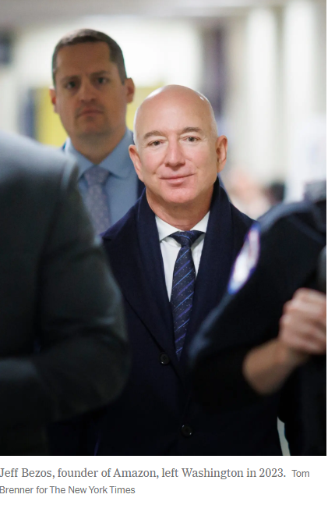
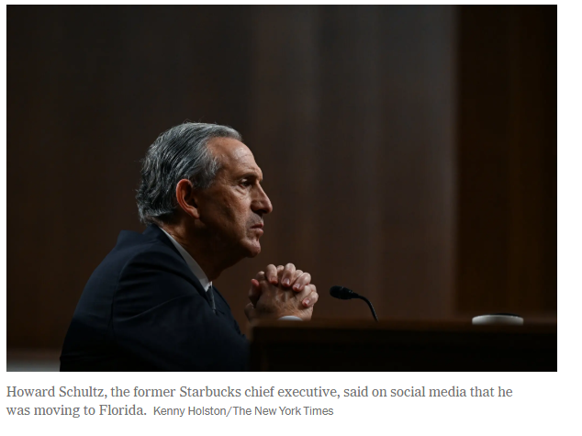

Slide 6


The millionaires’ tax would not begin generating revenue until 2029, and even that timeline could slip. Supporters of the tax anticipate an effort to block it by ballot measure and legal challenges.
Voters in Washington have rejected an income tax 10 times since then. But public sentiment in the state has been turning against the wealthy.
In 2024, voters refused to overturn a capital-gains tax on stock and bond profits over $250,000, which legislators had created several years earlier. Last fall, residents of Seattle and several of its suburbs elected slates of progressive candidates who talked openly of wealth redistribution.

Slide 7
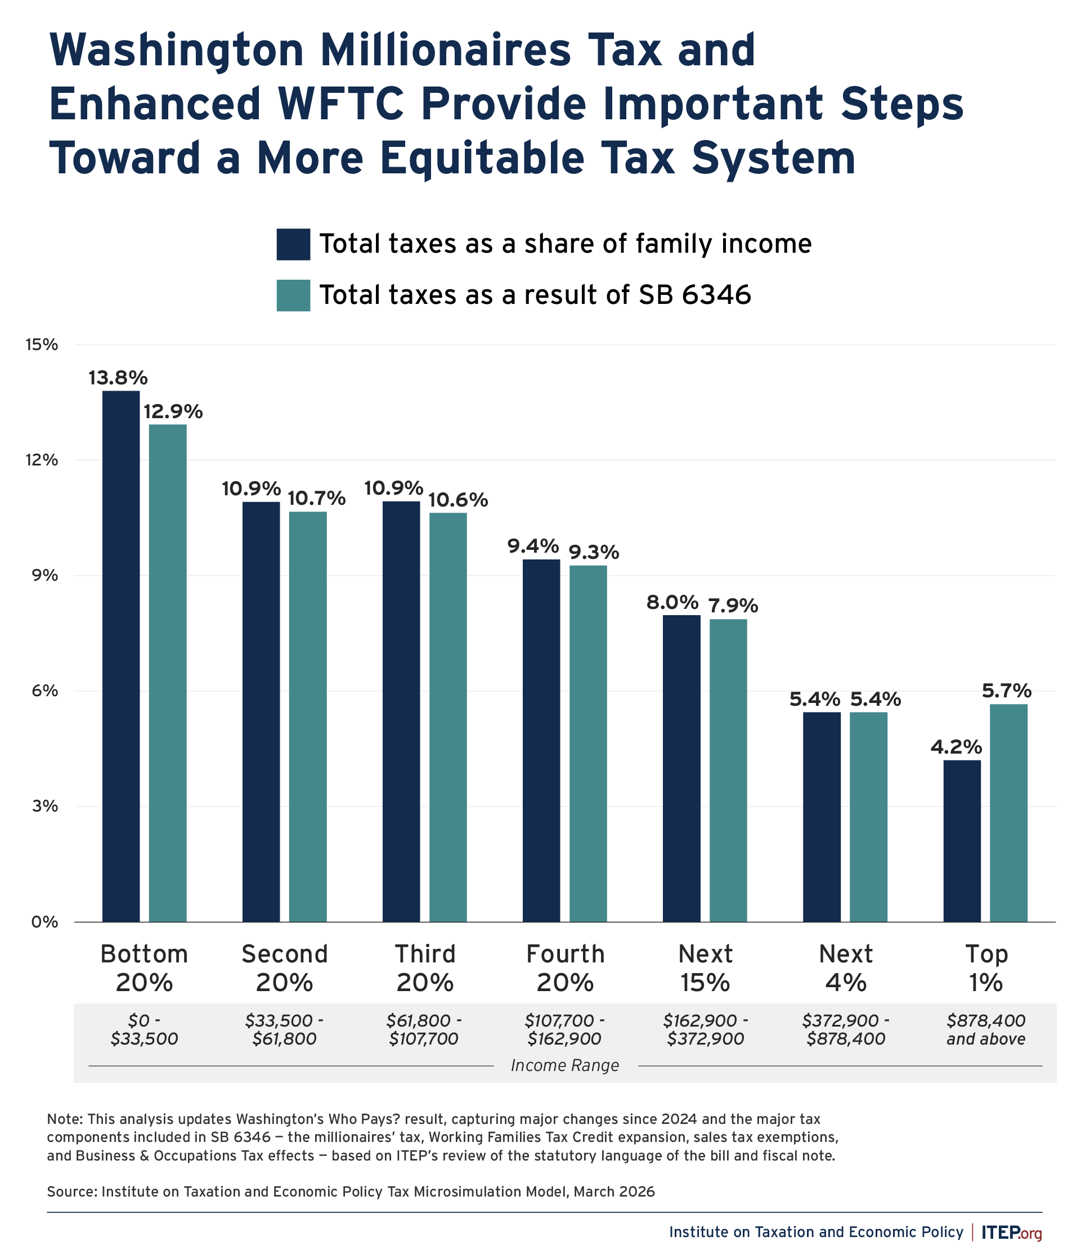
The new tax is projected to raise up to $3 billion in 2029 after it goes into effect in 2028. Not only will this injection of revenue fund vital services, but it will also provide much-needed support for low- and middle-income families

