Slide 1
Intermediate Microeconomic
Theory
Tools and Step-by-Step Examples
Chapter 12:
Simultaneous-Move Games

Slide 2
Outline
What Is a Game?
Strategic Dominance
Nash Equilibrium
Common Games
Mixed-Strategy Nash Equilibrium

Slide 3

What Is a Game?

Slide 4
What Is a Game?
We refer to a “game” every time we consider a scenario in which the action of one agent (either individual, firm, or government) affect other agents’ well-being.
Examples:
When a firm increases its output, it may lower market prices, which decreases profits of other firms in the industry.
When a country sets a higher tariff on imports, it may decrease the volume of imports, affecting the welfare of another country’s welfare.
Most day-to-day life contexts can be modeled as games.

Slide 5
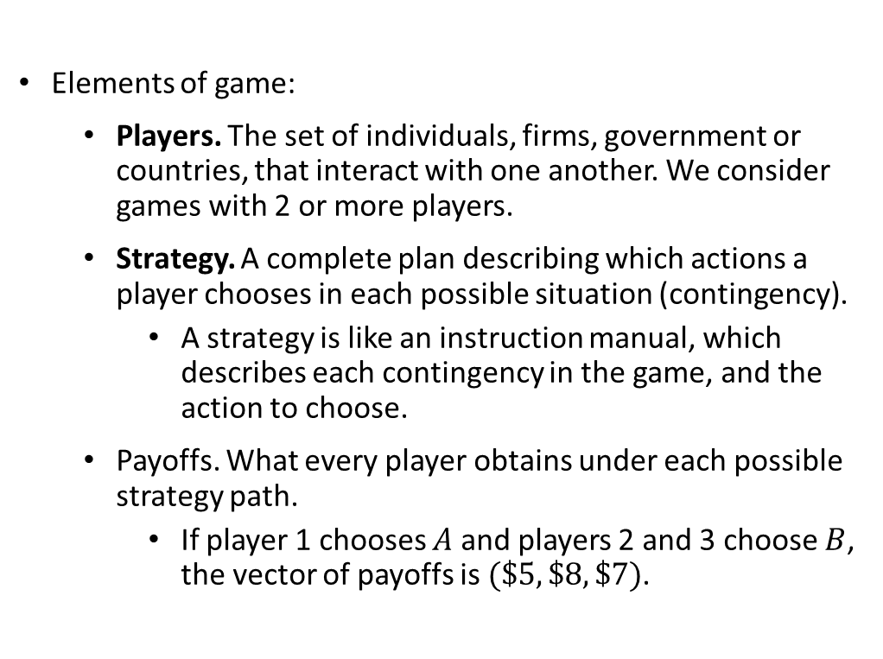
What Is a Game?
Elements of game:
  Players. The set of individuals, firms, government or countries, that interact with one another. We consider games with 2 or more players.
  Strategy. A complete plan describing which actions a player chooses in each possible situation (contingency).
    A strategy is like an instruction manual, which describes each contingency in the game, and the action to choose.
  Payoffs. What every player obtains under each possible strategy path.
    If player 1 chooses $A$ and players 2 and 3 choose $B$, the vector of payoffs is $(\$5, \$8, \$7)$.

Slide 6
What Is a Game?
We assume all players are rational. It requires:
Every player maximizes his utility and that he knows the rules of the game: players, strategy in each contingency, and resulting payoffs in each case.
Every player knows that every player knows the rules of the game, and every player knows that every player knows … ad infinitum.
This assumption is also known as “common knowledge of rationality.”
It guarantees that every player can put herself in the shoes of her opponent at any stage of the game to anticipate her moves.

Slide 7
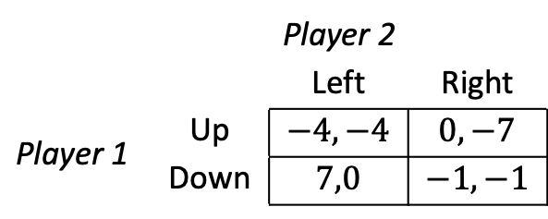
What Is a Game?
Two graphical approaches to represent games:
  Matrices:
    Player 1 is located on the left side, as she chooses rows (referred as the “row player”).
    Player 2 is placed on the top of the matrix because she selects columns (called the “column player”).
    Matrix are often used to represent games in which players choose their actions simultaneously.
 |  | Player 2
 |  | Left | Right
Player 1 | Up | $$−4,−4$$ | $$0,−7$$
 | Down | $$7,0$$ | $$−1,−1$$
Matrix 12.1

Slide 8
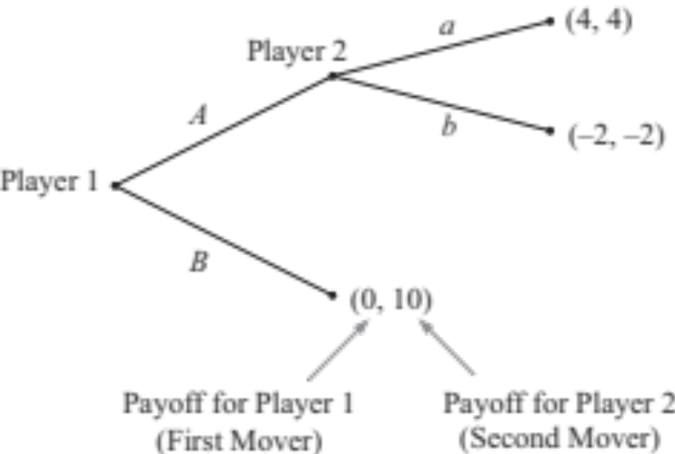
What Is a Game?
Two graphical approaches to represent games:
  Trees:
    Players act sequentially, with player 1 (the leader) acting first, and player 2 (the follower) responding to player 1’s action.
Figure 12.1

Slide 9
What Is a Game?
How do we predict the way in which a game will be played?
How can we forecast players’ behavior in a competitive context?
We seek to identify scenarios in which no player has incentive to alter her strategy choice, given the strategy of her opponents.
These scenarios are called “equilibria” because players have no incentives to deviate from their strategy choices.

Slide 10
Strategic Dominance

Slide 11
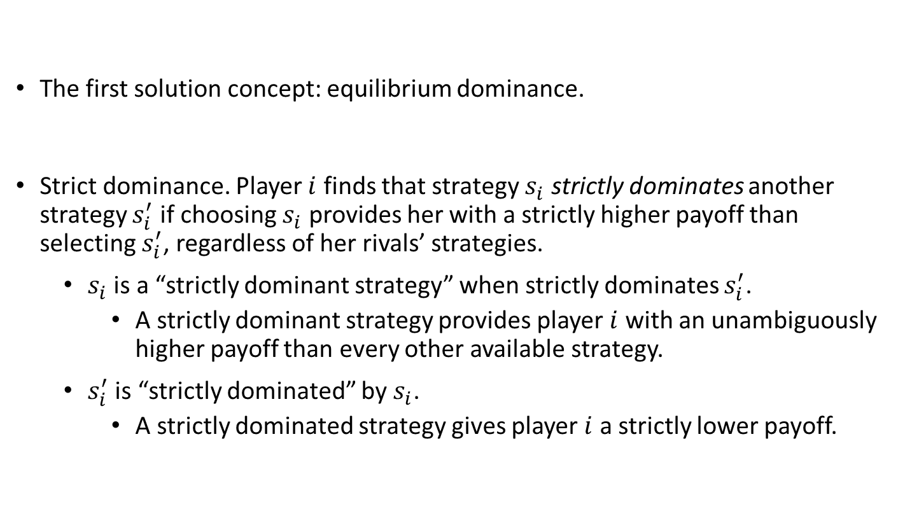
Strategic Dominance
The first solution concept: equilibrium dominance.
Strict dominance. Player $i$ finds that strategy $s_{i}$ strictly dominates another strategy $s_{i}^{′}$ if choosing $s_{i}$ provides her with a strictly higher payoff than selecting $s_{i}^{′}$, regardless of her rivals’ strategies.
  $s_{i}$ is a “strictly dominant strategy” when strictly dominates $s_{i}^{′}$.
    A strictly dominant strategy provides player $i$ with an unambiguously higher payoff than every other available strategy.
  $s_{i}^{′}$ is “strictly dominated” by $s_{i}$.
    A strictly dominated strategy gives player $i$ a strictly lower payoff.

Slide 12
Strategic Dominance
Tool 12.1. How to find a strictly dominated strategy:
  Focus on the row player by fixing attention on one strategy of the column player.
    Cover with your hand all columns not being considered.
    Find the highest payoff for the row player by comparing, across rows, the first component of every pair.
    Underline this payoff.
  Repeat step 1, but fix you attention on a different column.
  If, after repeating step 1 enough times, the highest payoff for the row player always occurs at the same row, this row becomes her dominant strategy.
  For the column player, the method is analogous, but now fix your attention on one strategy of the row player.

Slide 13
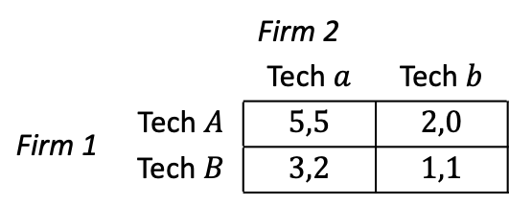
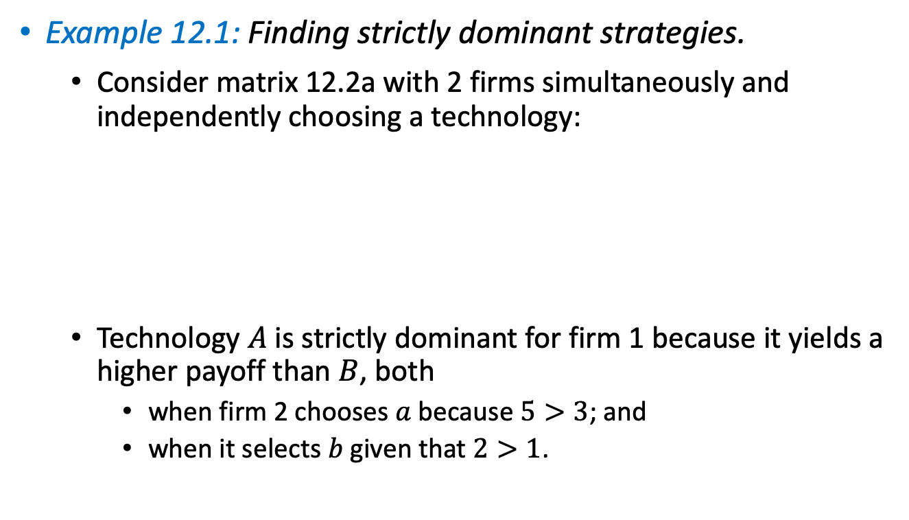
Strategic Dominance
Example 12.1: Finding strictly dominant strategies.
  Consider matrix 12.2a with 2 firms simultaneously and independently choosing a technology:
  Technology $A$ is strictly dominant for firm 1 because it yields a higher payoff than $B$, both
    when firm 2 chooses $a$ because $5>3$; and
    when it selects $b$ given that $2>1$.
 |  | Firm 2
 |  | Tech $a$ | Tech $b$
Firm 1 | Tech $A$ | $$5,5$$ | $$2,0$$
 | Tech $B$ | $$3,2$$ | $$1,1$$
Matrix 12.2a

Slide 14
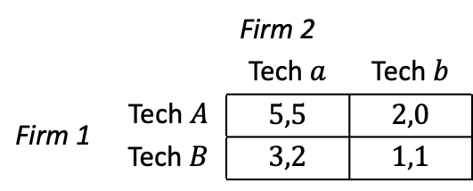
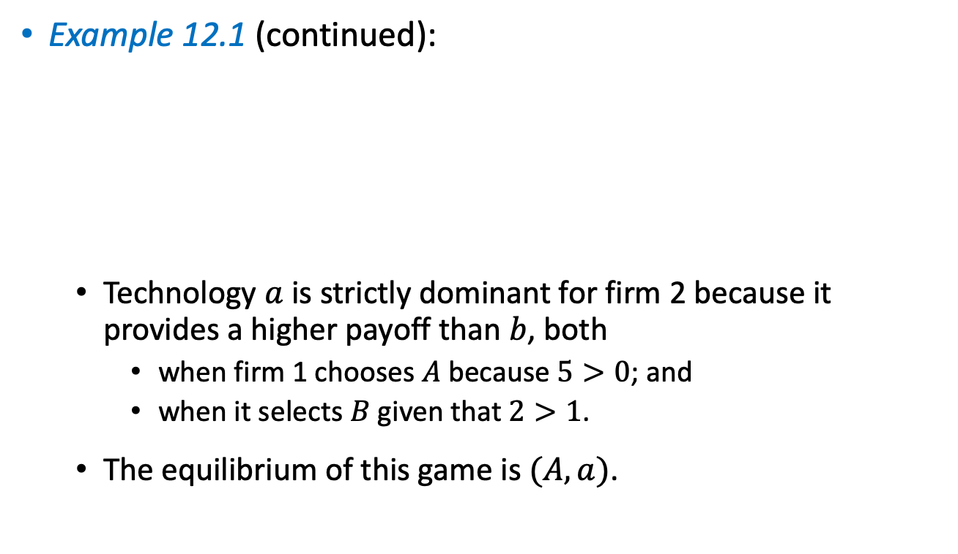
Strategic Dominance
Example 12.1 (continued):
  Technology $a$ is strictly dominant for firm 2 because it provides a higher payoff than $b$, both
    when firm 1 chooses $A$ because $5>0$; and
    when it selects $B$ given that $2>1$.
  The equilibrium of this game is $(A,a)$.
 |  | Firm 2
 |  | Tech $a$ | Tech $b$
Firm 1 | Tech $A$ | $$5,5$$ | $$2,0$$
 | Tech $B$ | $$3,2$$ | $$1,1$$
Matrix 12.2a

Slide 15
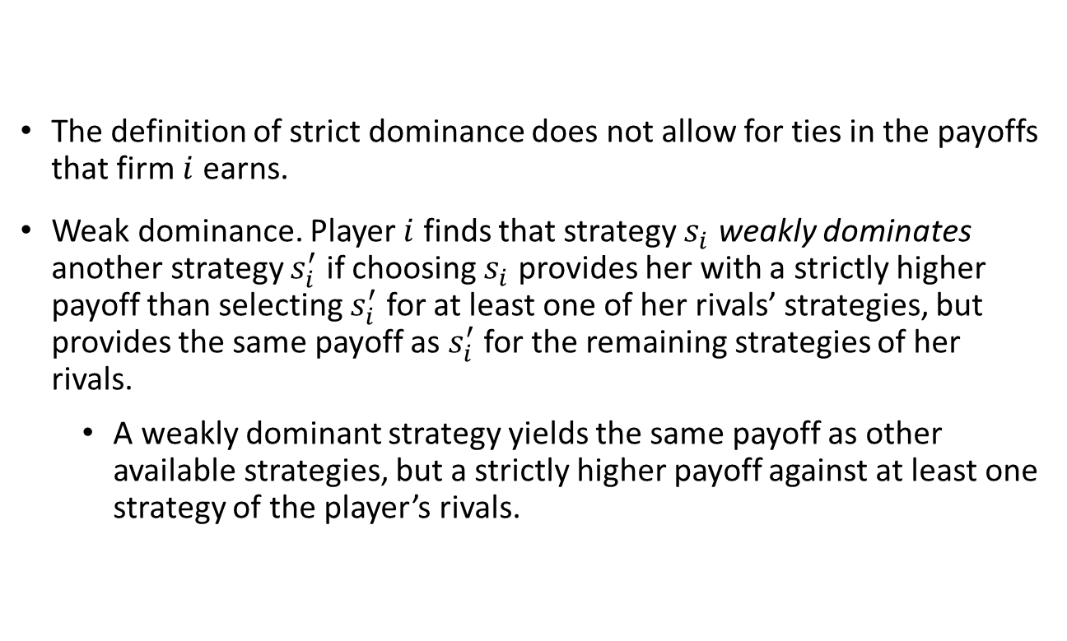
Strategic Dominance
The definition of strict dominance does not allow for ties in the payoffs that firm $i$ earns.
Weak dominance. Player $i$ finds that strategy $s_{i}$ weakly dominates another strategy $s_{i}^{′}$ if choosing $s_{i}$ provides her with a strictly higher payoff than selecting $s_{i}^{′}$ for at least one of her rivals’ strategies, but provides the same payoff as $s_{i}^{′}$ for the remaining strategies of her rivals.
  A weakly dominant strategy yields the same payoff as other available strategies, but a strictly higher payoff against at least one strategy of the player’s rivals.

Slide 16
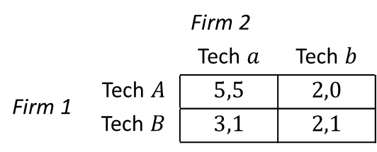
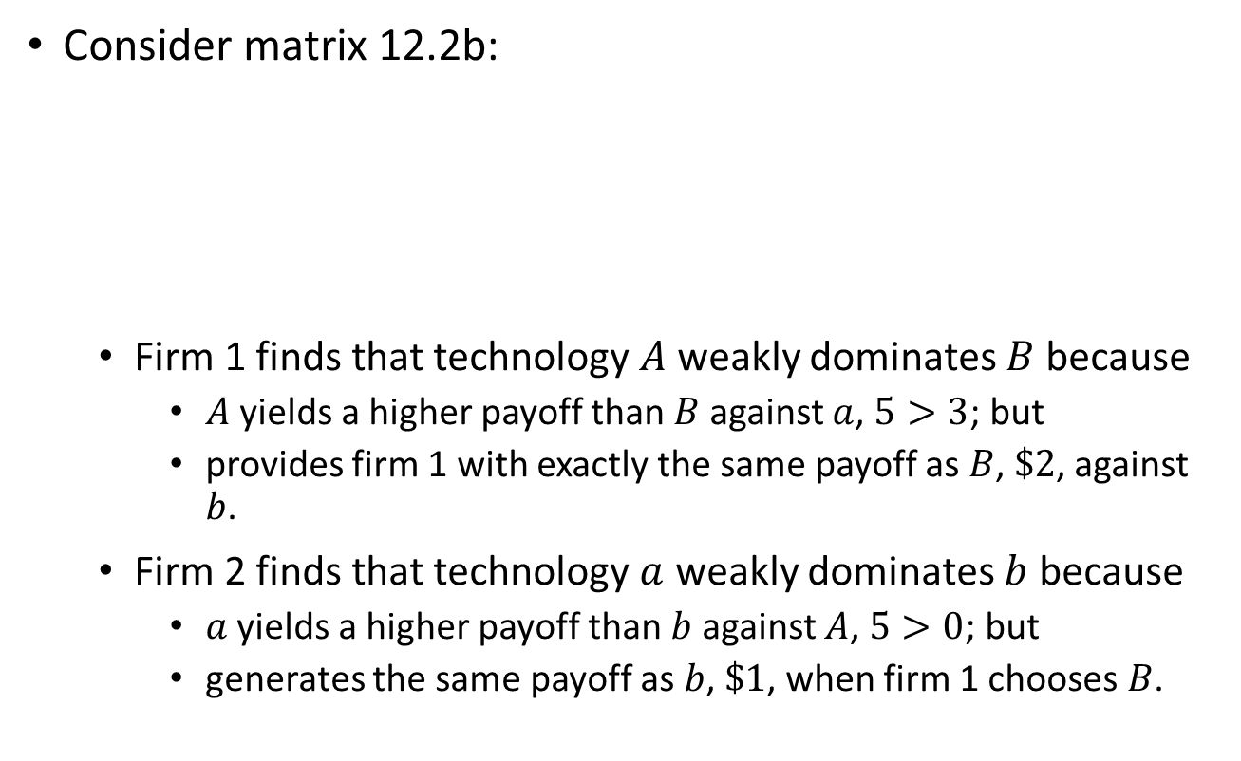
Strategic Dominance
Consider matrix 12.2b:
  Firm 1 finds that technology $A$ weakly dominates $B$ because
    $A$ yields a higher payoff than $B$ against $a$, $5>3$; but
    provides firm 1 with exactly the same payoff as $B$, $\$2$, against $b$.
  Firm 2 finds that technology $a$ weakly dominates $b$ because
    $a$ yields a higher payoff than $b$ against $A$, $5>0$; but
    generates the same payoff as $b$, $\$1$, when firm 1 chooses $B$.
 |  | Firm 2
 |  | Tech $a$ | Tech $b$
Firm 1 | Tech $A$ | $$5,5$$ | $$2,0$$
 | Tech $B$ | $$3,1$$ | $$2,1$$
Matrix 12.2b

Slide 17

Strategic Dominance
In matrices with more than 2 rows and/or columns, finding strictly dominated strategies is helpful.
We can delete those strategies (rows or columns) because the player would not choose them.
Once we have deleted the dominated strategies for one player, we can move to another player and do the same, and subsequently move on to another player.

Slide 18
Strategic Dominance
This process is known as Deletion of Strictly Dominated Strategies (IDSDS).
Once we cannot find any more strictly dominated strategies for either player, we are left with the equilibrium prediction.
IDSDS can yield to multiple equilibria.

Slide 19
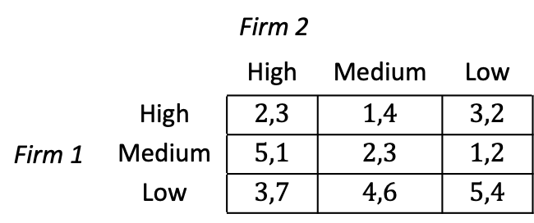
Strategic Dominance
Example 12.2: When IDSDS does not provide a unique equilibrium.
  Consider matrix 12.3 representing the price decision of two firms:
  For firm 1, High is strictly dominated by Low because High yields a lower payoff, regardless of the price chosen by firm 2. We can delete High from firm 1’s rows, resulting in the reduced matrix 12.4.
 |  | Firm 2
 |  | High | Medium | Low
Firm 1 | High | $$2,3$$ | $$1,4$$ | $$3,2$$
 | Medium | $$5,1$$ | $$2,3$$ | $$1,2$$
 | Low | $$3,7$$ | $$4,6$$ | $$5,4$$
Matrix 12.3

Slide 20
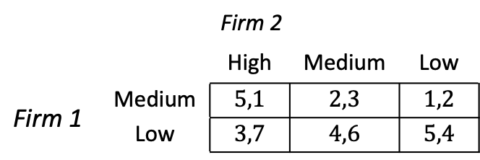
Strategic Dominance
Example 12.2 (continued):
  For firm 2, Low is strictly dominated by Medium because Low yields a strictly than Medium, regardless of the row that firm 1 selects.
  After deleting the Low column from firm 2’s strategies, we are left with a further reduced matrix (matrix 12.5).
  We can now move again to analyze firm 1.
 |  | Firm 2
 |  | High | Medium | Low
Firm 1 | Medium | $$5,1$$ | $$2,3$$ | $$1,2$$
 | Low | $$3,7$$ | $$4,6$$ | $$5,4$$
Matrix 12.4

Slide 21
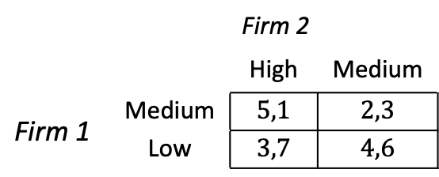
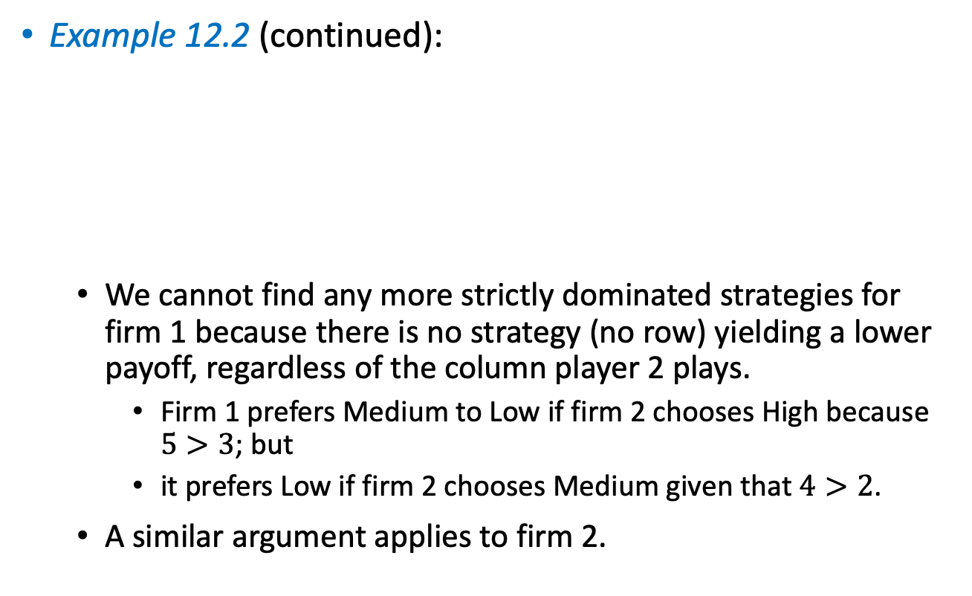
Strategic Dominance
Example 12.2 (continued):
  We cannot find any more strictly dominated strategies for firm 1 because there is no strategy (no row) yielding a lower payoff, regardless of the column player 2 plays.
    Firm 1 prefers Medium to Low if firm 2 chooses High because $5>3$; but
    it prefers Low if firm 2 chooses Medium given that $4>2$.
  A similar argument applies to firm 2.
 |  | Firm 2
 |  | High | Medium
Firm 1 | Medium | $$5,1$$ | $$2,3$$
 | Low | $$3,7$$ | $$4,6$$
Matrix 12.5

Slide 22
Strategic Dominance
Example 12.2 (continued):
  The remaining four cells in this matrix constitute the most precise equilibrium prediction after applying IDSDS.
  This is one of the disadvantages of IDSDS as solution concept.
  In some games IDSDS “does not have a bite” because it does not help to reduce the set of strategies that a rational player would choose in equilibrium.
 |  | Firm 2
 |  | High | Medium
Firm 1 | Medium | $$5,1$$ | $$2,3$$
 | Low | $$3,7$$ | $$4,6$$
Matrix 12.5

Slide 23
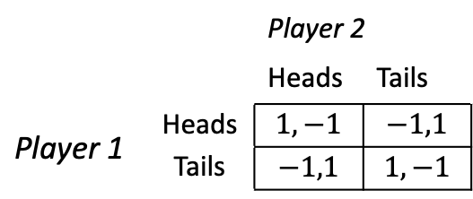
Strategic Dominance
Example 12.3: When IDSDS does not have a bite.
  Matrix 12.6 represents the Matching Pennies game.
  Player 1 does not find any strategy strictly dominated:
    She prefers Heads when player 2 chooses Heads, but Tails when player 2 chooses Tails.
  A similar argument applies to player 2.
  No player has strictly dominated strategies. IDSDS has “no bite.”
 |  | Player 2
 |  | Heads | Tails
Player 1 | Heads | $$1,−1$$ | $$−1,1$$
 | Tails | $$−1,1$$ | $$1,−1$$
Matrix 12.6

Slide 24

Nash Equilibrium

Slide 25
Nash Equilibrium
Applying IDSDS:
  Helps us delete all but one cell from the matrix in some games.
  For other games, IDSDS deletes only a few strategies, providing a relatively imprecise equilibrium prediction.
  And for other games, it does not have a bite.

Slide 26
Nash Equilibrium
We next examine a different solution concept with “more bite”, offering either the same or more precise equilibrium predictions.
The “Nash Equilibrium”, named after Nash (1950) builds on the notion that every player finds her “best response” to each of her rivals’ strategies.

Slide 27
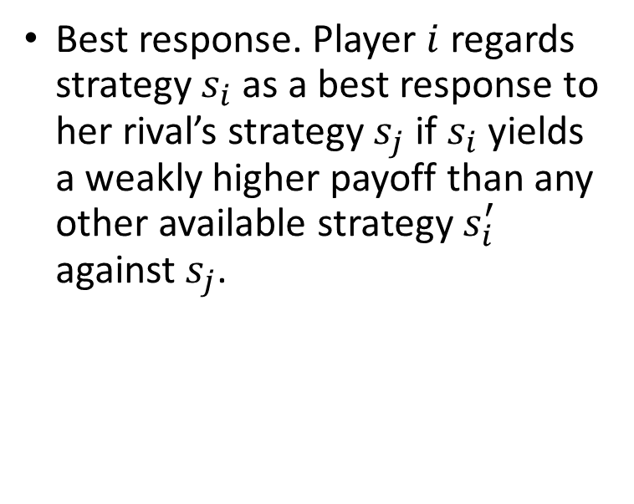
Nash Equilibrium
Best response. Player $i$ regards strategy $s_{i}$ as a best response to her rival’s strategy $s_{j}$ if $s_{i}$ yields a weakly higher payoff than any other available strategy $s_{i}^{′}$ against $s_{j}$.

Slide 28

Nash Equilibrium
Tool 12.2. How to find best responses in matrix games:
  Focus on the row player by fixing attention on one strategy of the column player.
    Cover with your hand all columns not being considered.
    Find the highest payoff for the row player by comparing the first component of every pair.
    Underline this payoff. This is the row player’s best response to the column you considered from the column player.
  Repeat step 1, but fix your attention on a different column.
  For the column player, the method is analogous, but now direct your attention on one strategy of the row player.

Slide 29
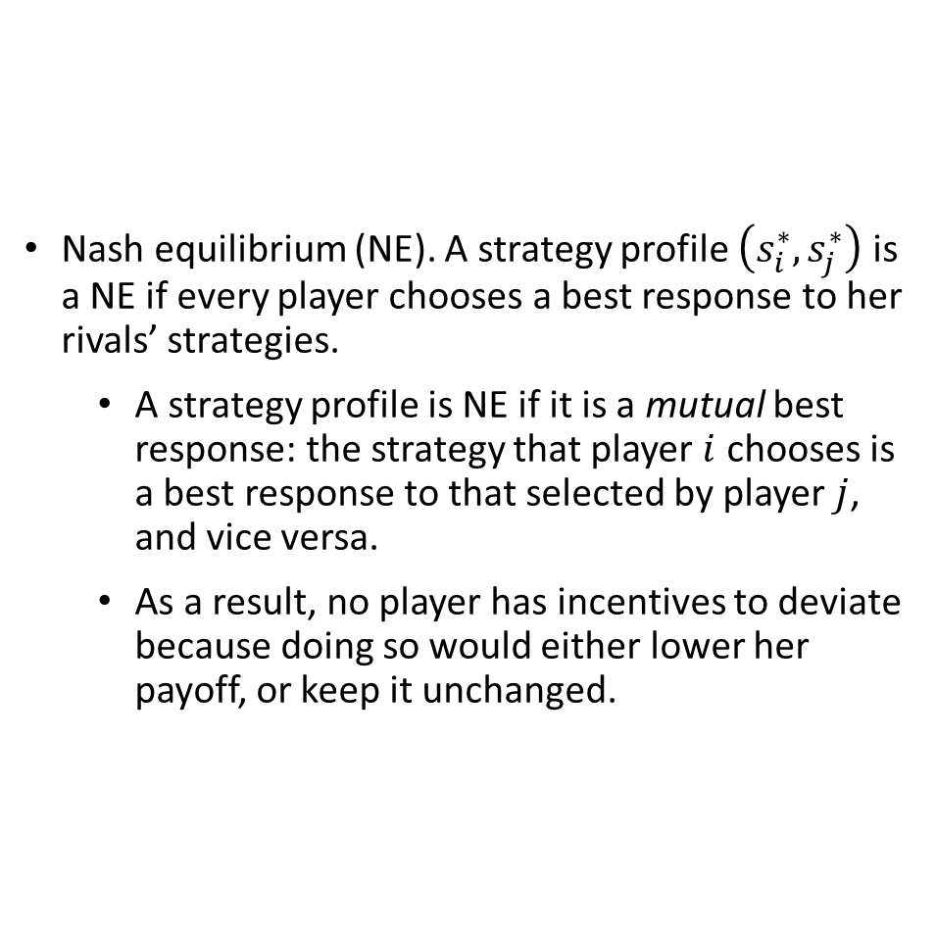
Nash Equilibrium
Nash equilibrium (NE). A strategy profile $\left(s_{i}^{∗},s_{j}^{∗}\right)$ is a NE if every player chooses a best response to her rivals’ strategies.
  A strategy profile is NE if it is a mutual best response: the strategy that player $i$ chooses is a best response to that selected by player $j$, and vice versa.
  As a result, no player has incentives to deviate because doing so would either lower her payoff, or keep it unchanged.

Slide 30
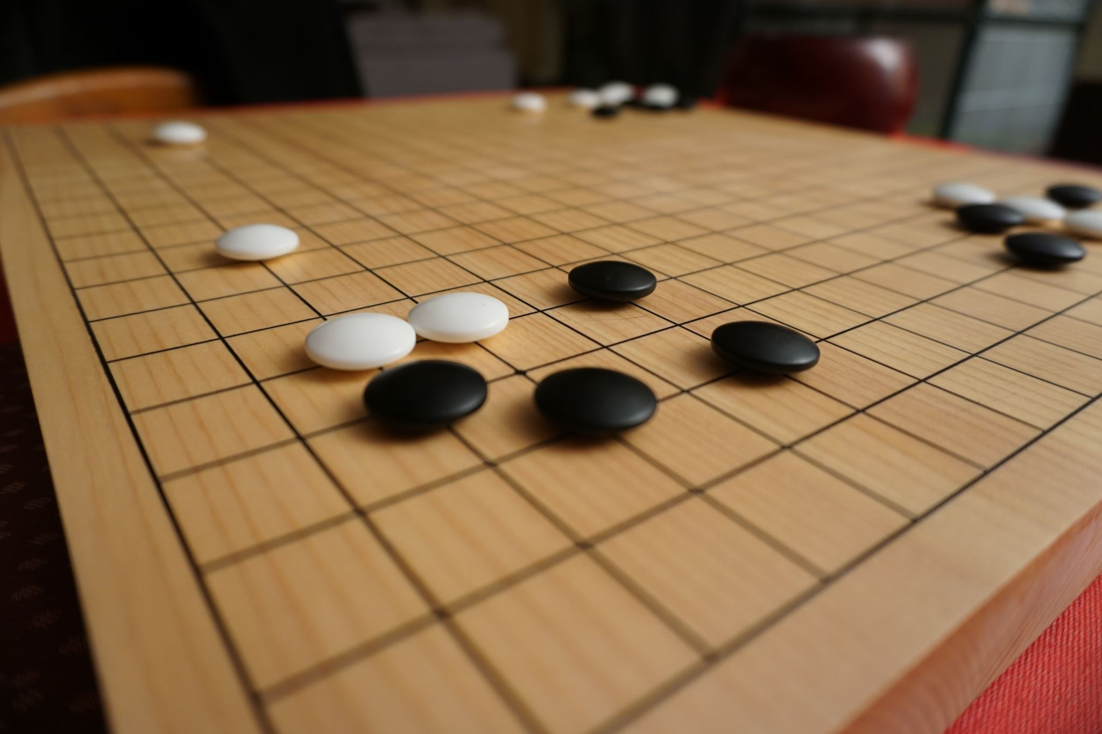
Nash Equilibrium
Tool 12.3. How to find Nash equilibria:
  Find the best responses to all players.
  Identify which cell or cells in the matrix has all payoffs underlined, meaning that all players have a best response payoff. These cells are the NEs of the game.

Slide 31
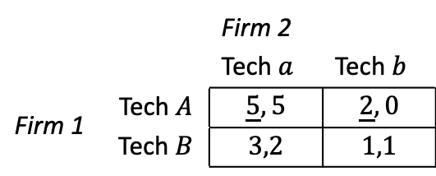
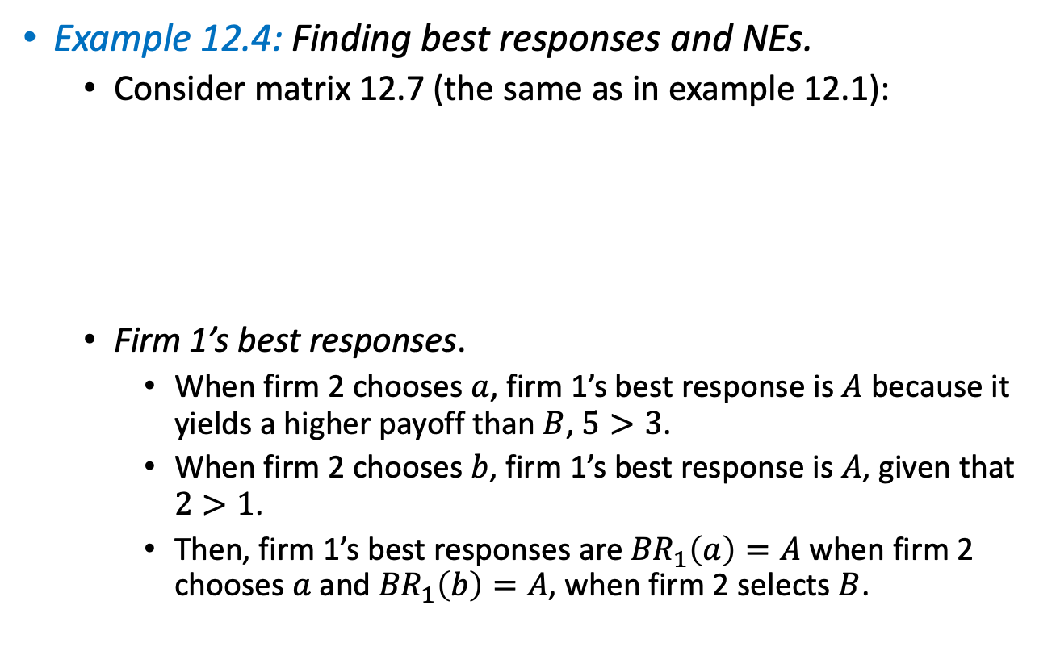
Strategic Dominance
Example 12.4: Finding best responses and NEs.
  Consider matrix 12.7 (the same as in example 12.1):
  Firm 1’s best responses.
    When firm 2 chooses $a$, firm 1’s best response is $A$ because it yields a higher payoff than $B$, $5>3$.
    When firm 2 chooses $b$, firm 1’s best response is $A$, given that $2>1$.
    Then, firm 1’s best responses are ${BR}_{1}\left(a\right)=A$ when firm 2 chooses $a$ and ${BR}_{1}\left(b\right)=A$, when firm 2 selects $B$.
 |  | Firm 2
 |  | Tech $a$ | Tech $b$
Firm 1 | Tech $A$ | $$\underline{5},5$$ | $$\underline{2},0$$
 | Tech $B$ | $$3,2$$ | $$1,1$$
Matrix 12.7

Slide 32
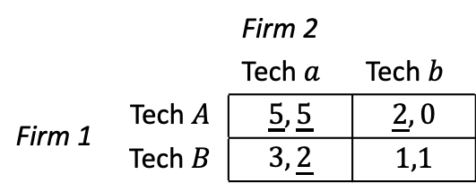

Strategic Dominance
Example 12.4 (continued):
  Firm 2’s best responses.
    When firm 1 chooses $A$, ${BR}_{2}\left(A\right)=a$ because $5>0$.
    When firm 1 chooses $B$, ${BR}_{2}\left(B\right)=a$ because $2>1$.
  Faster tool: underling BR payoffs.
    The cells where all the payoffs are underlined must constitute a NE of the game because all players are playing mutual best responses.
  The NE is $(A,a)$, the same prediction as IDSDS.
 |  | Firm 2
 |  | Tech $a$ | Tech $b$
Firm 1 | Tech $A$ | $$\underline{5},\underline{5}$$ | $$\underline{2},0$$
 | Tech $B$ | $$3,\underline{2}$$ | $$1,1$$
Matrix 12.7

Slide 33
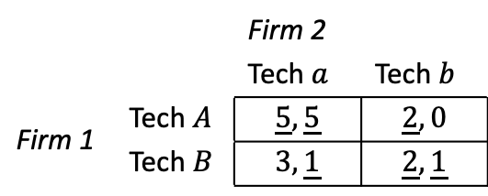
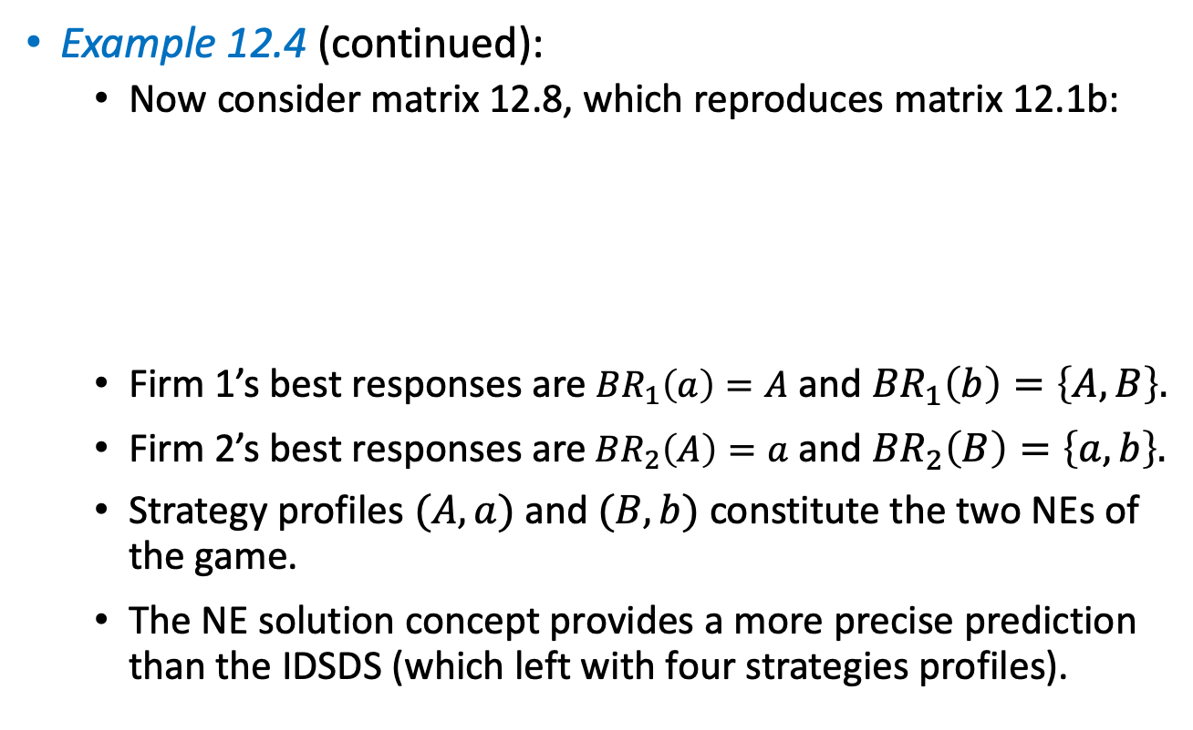
Strategic Dominance
Example 12.4 (continued):
  Now consider matrix 12.8, which reproduces matrix 12.1b:
  Firm 1’s best responses are ${BR}_{1}\left(a\right)=A$ and ${BR}_{1}\left(b\right)=\left\{A,B\right\}.$
  Firm 2’s best responses are ${BR}_{2}\left(A\right)=a$ and ${BR}_{2}\left(B\right)=\left\{a,b\right\}.$
  Strategy profiles $(A,a)$and $(B,b)$ constitute the two NEs of the game.
  The NE solution concept provides a more precise prediction than the IDSDS (which left with four strategies profiles).
 |  | Firm 2
 |  | Tech $a$ | Tech $b$
Firm 1 | Tech $A$ | $$\underline{5},\underline{5}$$ | $$\underline{2},0$$
 | Tech $B$ | $$3,\underline{1}$$ | $$\underline{2},\underline{1}$$
Matrix 12.8

Slide 34

Common Games

Slide 35
Common Games
We apply the NE solution concept to 4 common games in economics and other social sciences:
  The Prisoner’s Dilemma game.
  The Battle of the Sexes game.
  The Coordination game.
  The Anticoordination game.

Slide 36
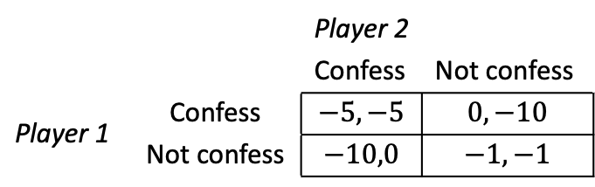
Prisoner’s Dilemma
Example 12.5: Prisoner’s Dilemma game.
  Consider 2 people are arrested by the police, and are placed in different cells. They cannot communicate with each other.
  The police have only minor evidence against them but suspects that the two committed a specific crime.
  The police separately offers to each of them the deal represented in the following matrix (where negative values indicate disutility in years of jail):
 |  | Player 2
 |  | Confess | Not confess
Player 1 | Confess | $$−5,−5$$ | $$0,−10$$
 | Not confess | $$−10,0$$ | $$−1,−1$$
Matrix 12.9a

Slide 37
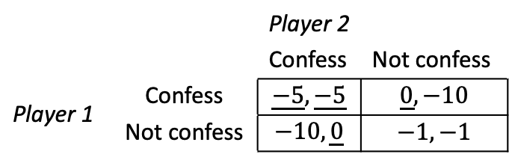

Prisoner’s Dilemma
Example 12.5 (continued):
  Player 1’s best responses are:
    ${BR}_{1}\left(C\right)=C$ because $−5>−10$and ${BR}_{1}\left(NC\right)=C$ because $0>−1$.
  Player 2’s best responses are:
    ${BR}_{2}\left(C\right)=C$ because $−5>−10$and ${BR}_{2}\left(NC\right)=C$ because $0>−1$.
  $(Confess, Confess)$is the unique NE of the game, both players choose mutual best responses.
 |  | Player 2
 |  | Confess | Not confess
Player 1 | Confess | $$\underline{−5},\underline{−5}$$ | $$\underline{0},−10$$
 | Not confess | $$−10,\underline{0}$$ | $$−1,−1$$
Matrix 12.9a

Slide 38
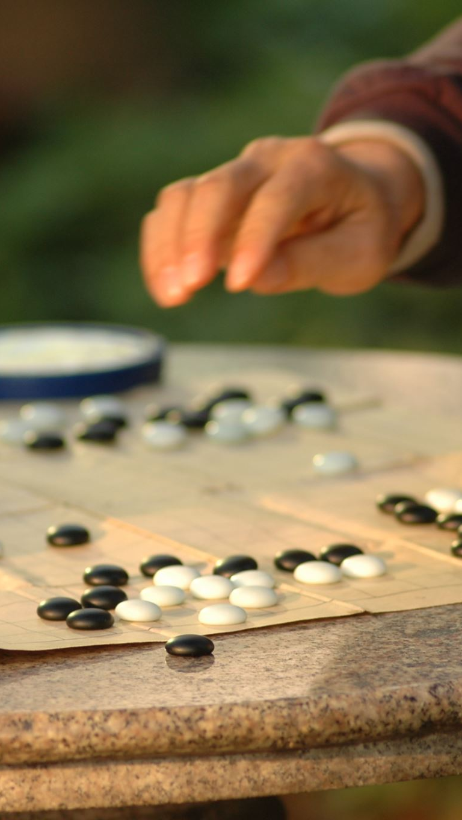
Prisoner’s Dilemma
In NE in the Prisoner’s Dilemma game, every player, seeking to maximize her own payoff, confesses, which entails 5 years of jail for both.
If instead, players could coordinate their actions and no confess, they would only serve 1 year in jail.
This game illustrates strategic scenarios in which there is tension between individual incentives of each player and the collective interest of the group. Examples:
  Price wars between firms.
  Tariff wars between countries.
  Use of negative campaigning in politics.

Slide 39
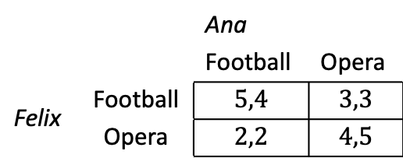
Battle of the Sexes
Example 12.6: Battle of the Sexes game.
  Ana and Felix are incommunicado in separate areas of the city.
  In the morning, they talked about where to go after work, the football game or the opera, but they never agreed.
  Each of them must simultaneously and independently choose where to go.
    Ana and Felix’s payoffs are symmetric. Each of them prefers to go to the event the other goes.
 |  | Ana
 |  | Football | Opera
Felix | Football | $$5,4$$ | $$3,3$$
 | Opera | $$2,2$$ | $$4,5$$
Matrix 12.10a

Slide 40
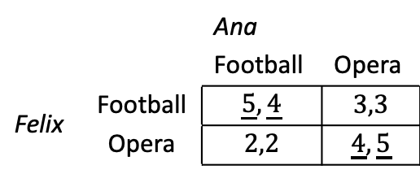
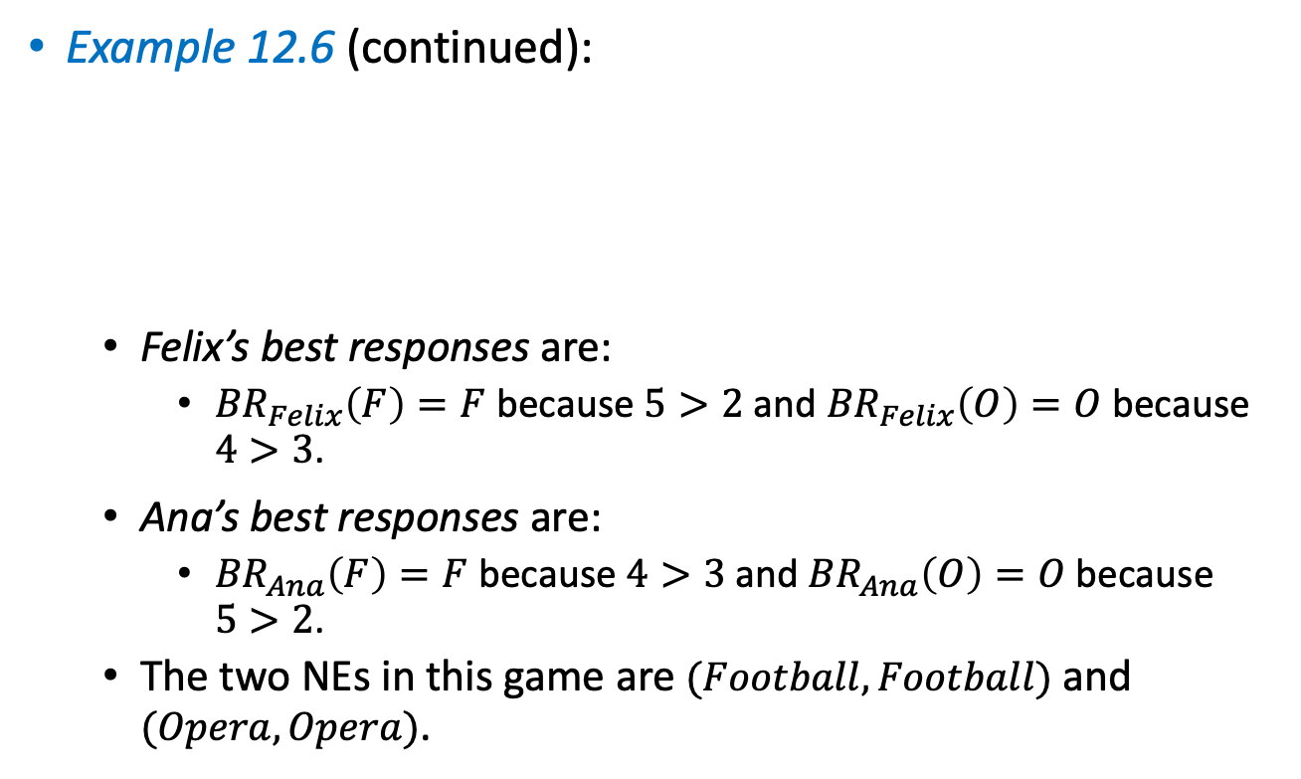
Battle of the Sexes
Example 12.6 (continued):
  Felix’s best responses are:
    ${BR}_{Felix}\left(F\right)=F$ because $5>2$ and ${BR}_{Felix}\left(O\right)=O$ because $4>3$.
  Ana’s best responses are:
    ${BR}_{Ana}\left(F\right)=F$ because $4>3$and ${BR}_{Ana}\left(O\right)=O$ because $5>2$.
  The two NEs in this game are $(Football, Football)$ and $(Opera, Opera)$.
 |  | Ana
 |  | Football | Opera
Felix | Football | $$\underline{5},\underline{4}$$ | $$3,3$$
 | Opera | $$2,2$$ | $$\underline{4},\underline{5}$$
Matrix 12.10b

Slide 41
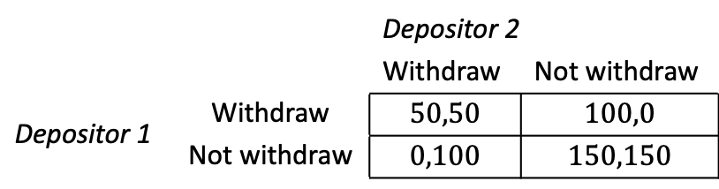
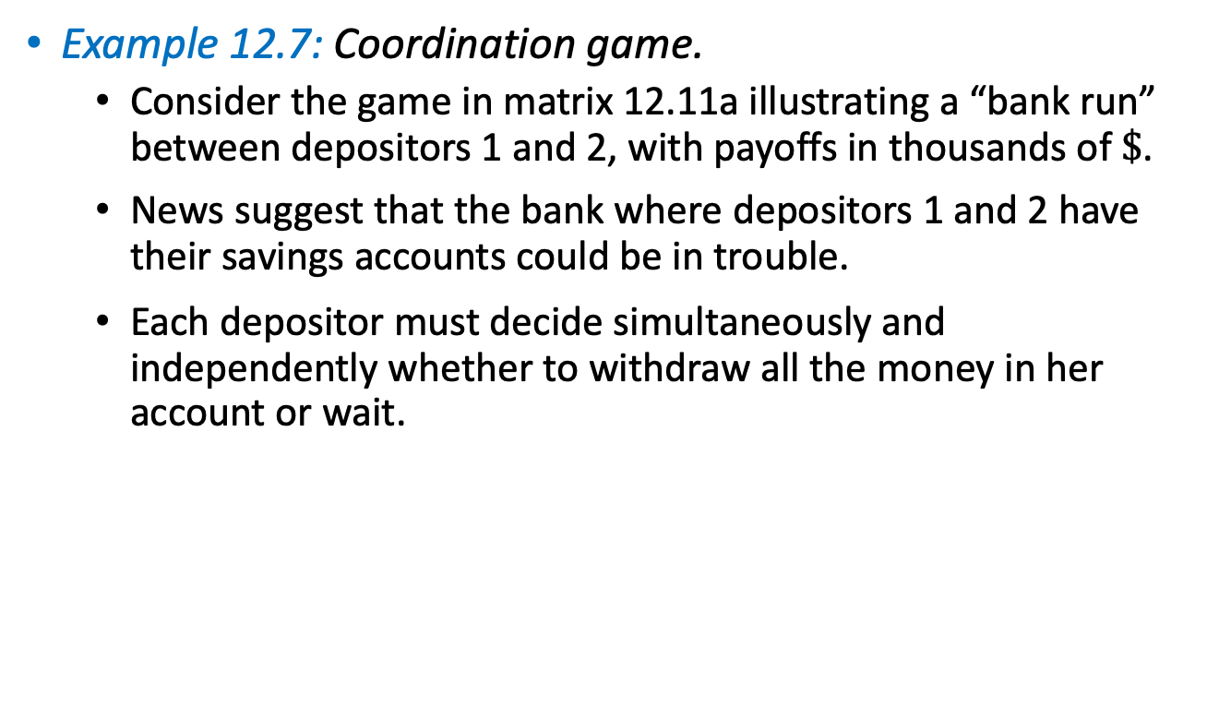
Coordination game
Example 12.7: Coordination game.
  Consider the game in matrix 12.11a illustrating a “bank run” between depositors 1 and 2, with payoffs in thousands of $\$$.
  News suggest that the bank where depositors 1 and 2 have their savings accounts could be in trouble.
  Each depositor must decide simultaneously and independently whether to withdraw all the money in her account or wait.
 |  | Depositor 2
 |  | Withdraw | Not withdraw
Depositor 1 | Withdraw | $$50,50$$ | $$100,0$$
 | Not withdraw | $$0,100$$ | $$150,150$$
Matrix 12.11a

Slide 42
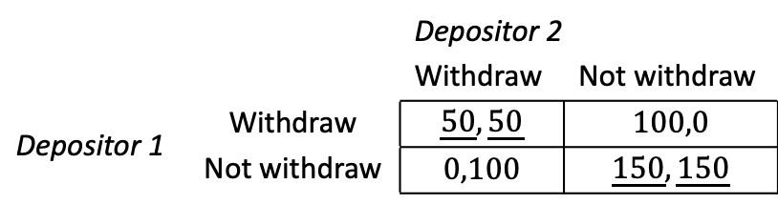
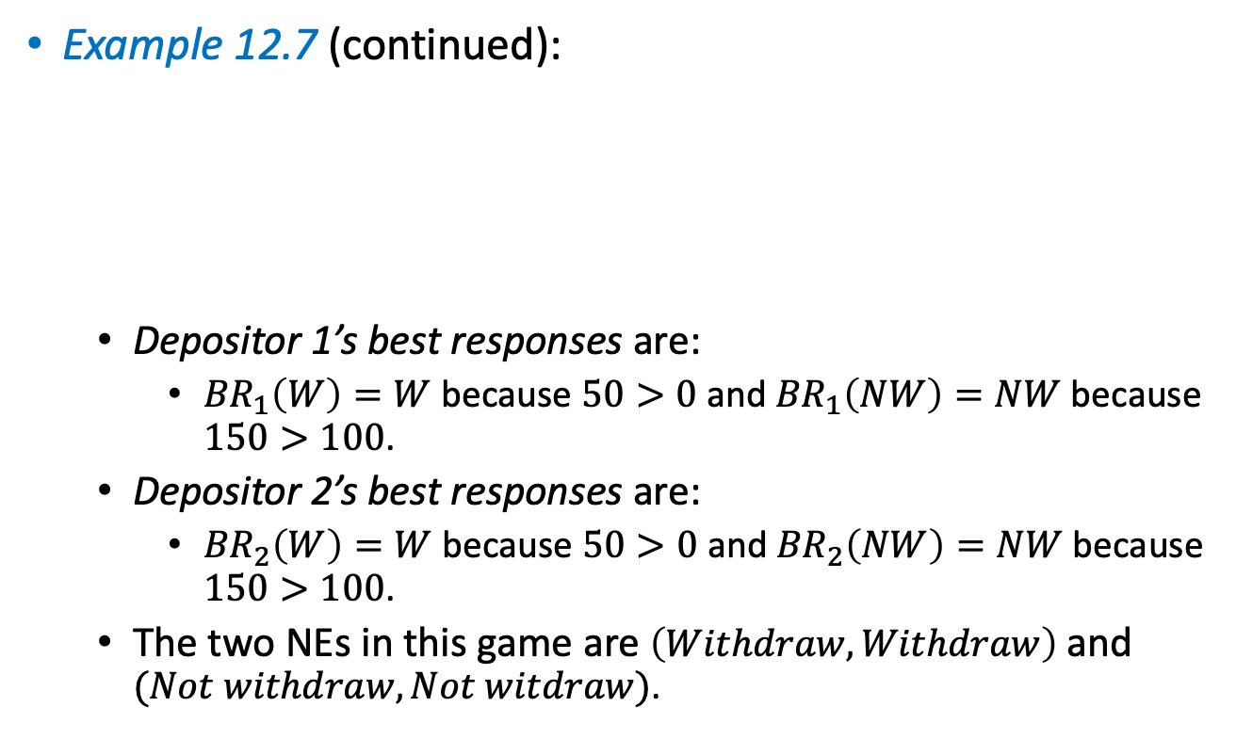
Coordination game
Example 12.7 (continued):
  Depositor 1’s best responses are:
    ${BR}_{1}\left(W\right)=W$ because $50>0$ and ${BR}_{1}\left(NW\right)=NW$ because $150>100$.
  Depositor 2’s best responses are:
    ${BR}_{2}\left(W\right)=W$ because $50>0$ and ${BR}_{2}\left(NW\right)=NW$ because $150>100$.
  The two NEs in this game are $\left(Withdraw, Withdraw\right)$ and $(Not withdraw, Not witdraw)$.
 |  | Depositor 2
 |  | Withdraw | Not withdraw
Depositor 1 | Withdraw | $$\underline{50},\underline{50}$$ | $$100,0$$
 | Not withdraw | $$0,100$$ | $$\underline{150},\underline{150}$$
Matrix 12.11b

Slide 43
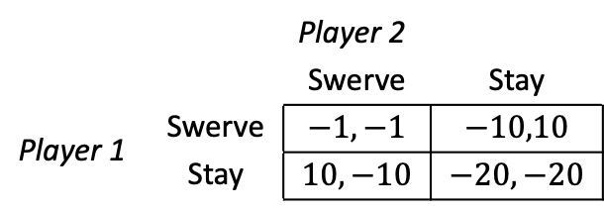
Coordination game
Example 12.8: Anticoordination game.
  Matrix 12.12a presents a game with the opposite strategic incentives as the the Coordination game in example 12.7.
  The matrix illustrates the Game of the Chicken, as seen in movies like Rebel without a Cause and Footloose.
  Two teenagers in cars drive toward each other (or toward a cliff).
    If the swerve they are regarded as “chicken.”
 |  | Player 2
 |  | Swerve | Stay
Player 1 | Swerve | $$−1,−1$$ | $$−10,10$$
 | Stay | $$10,−10$$ | $$−20,−20$$
Matrix 12.12a

Slide 44


Coordination game
Example 12.8 (continued):
  Player 1’s best responses are:
    ${BR}_{1}\left(Swerve\right)=Stay$ because $10>−1$ and ${BR}_{1}\left(Stay\right)=Swerve$ because $−10>−20$.
  Player 2’s best responses are:
    ${BR}_{2}\left(Swerve\right)=Stay$ because $10>−1$ and ${BR}_{2}\left(Stay\right)=Swerve$ because $−10>−20$.
  The two NEs in this game are $\left(Swerve, Stay\right)$ and $(Stay, Swerve)$.
 |  | Player 2
 |  | Swerve | Stay
Player 1 | Swerve | $$−1,−1$$ | $$−10,10$$
 | Stay | $$10,−10$$ | $$−20,−20$$
Matrix 12.12b

Slide 45
Mixed-Strategy Nash Equilibrium

Slide 46

Mixed-Strategy Nash Equilibrium
All games have a NE? YES, under relative general conditions.
Some games may not have a NE if we restrict players to choose a specific strategy $100\%$of the time, rather than allowing them to randomize across some of their available strategies.

Slide 47
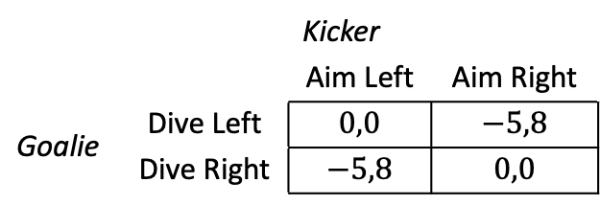
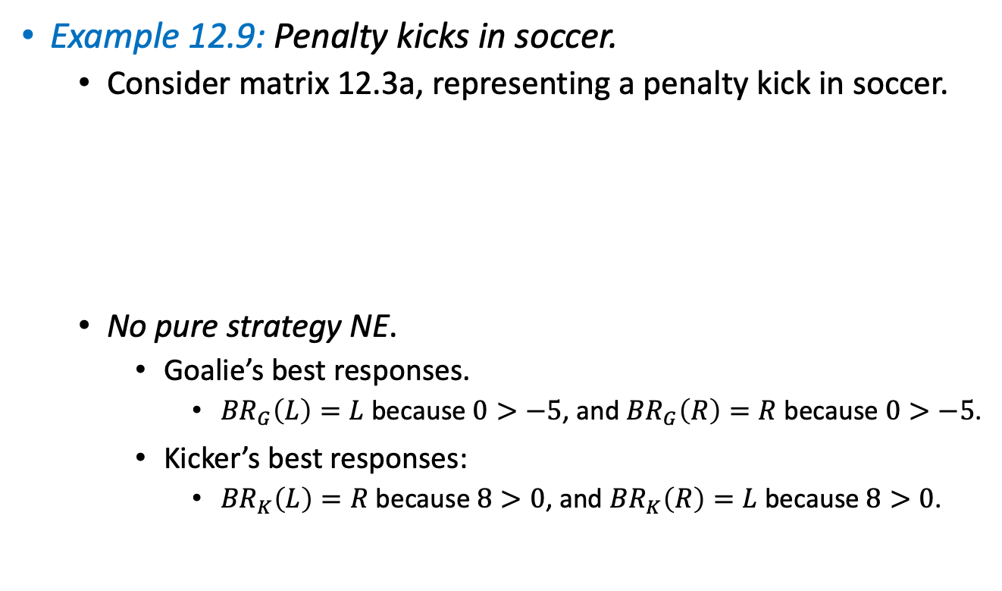
Mixed-Strategy Nash Equilibrium
Example 12.9: Penalty kicks in soccer.
  Consider matrix 12.3a, representing a penalty kick in soccer.
  No pure strategy NE.
    Goalie’s best responses.
      ${BR}_{G}\left(L\right)=L$ because $0>−5$, and ${BR}_{G}\left(R\right)=R$ because $0>−5$.
    Kicker’s best responses:
      ${BR}_{K}\left(L\right)=R$ because $8>0$, and ${BR}_{K}\left(R\right)=L$ because $8>0$.
 |  | Kicker
 |  | Aim Left | Aim Right
Goalie | Dive Left | $$0,0$$ | $$−5,8$$
 | Dive Right | $$−5,8$$ | $$0,0$$
Matrix 12.13a

Slide 48
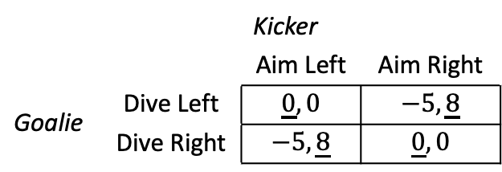

Mixed-Strategy Nash Equilibrium
Example 12.9 (continued):
  There is no cell where the payoffs for all players have been underlined.
    There is no “pure-strategy” NE when restricting players to use a specific strategy (either left of right) with $100\%$probability.
  If instead, we allow players to randomize, we can find the NE of the game.
    Because players mix their strategies, this NE is known as “mixed-strategy NE.”
 |  | Kicker
 |  | Aim Left | Aim Right
Goalie | Dive Left | $$\underline{0},0$$ | $$−5,\underline{8}$$
 | Dive Right | $$−5,\underline{8}$$ | $$\underline{0},0$$
Matrix 12.13b

Slide 49
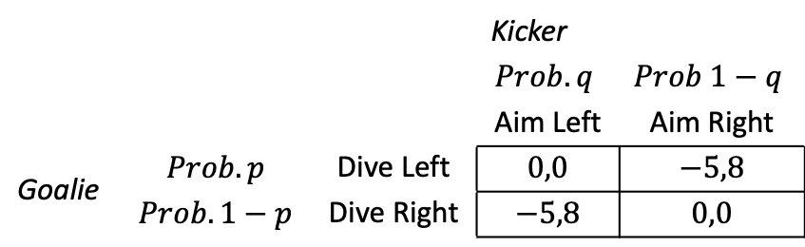

Mixed-Strategy Nash Equilibrium
Example 12.9 (continued):
  Allowing for randomization.
    Consider the goalie dives left, with probability $p$, and right, with probability $1−p$.
      If $p=1$, the goalie would be diving left with $100\%.$
      If $p=0$, she dives right with $100\%$.
      If $0<p<1$, she randomizes her decision.
    And, let the kicker assigns a probability $q$ to aiming left, and $1−q$ to her aiming right.
 |  |  | Kicker
 |  |  | $$Prob. q$$ | $$Prob 1−q$$
 |  |  | Aim Left | Aim Right
Goalie | $$Prob. p$$ | Dive Left | $$0,0$$ | $$−5,8$$
 | $$Prob. 1−p$$ | Dive Right | $$−5,8$$ | $$0,0$$
Matrix 12.13c

Slide 50


Mixed-Strategy Nash Equilibrium
Example 12.9 (continued):
  Goalie (row player).
    If she does not select a particular action with $100\%$probability, it must be she is indifferent between dive left and dive right. That is, her expected utility from both options must coincide.
    Her expected utility from diving left is
    $${EU}_{Goalie}\left(Left\right)= q0 +\left(1−q\right)\left(−5\right)=−5+5q.$$
 |  |  | Kicker
 |  |  | $$Prob. q$$ | $$Prob 1−q$$
 |  |  | Aim Left | Aim Right
Goalie | $$Prob. p$$ | Dive Left | $$0,0$$ | $$−5,8$$
 | $$Prob. 1−p$$ | Dive Right | $$−5,8$$ | $$0,0$$
Matrix 12.13c
kicker aims left
kicker aims right

Slide 51
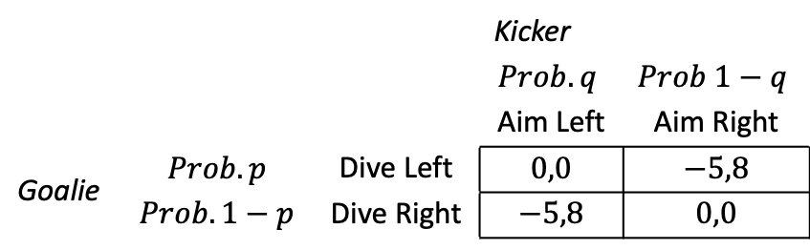
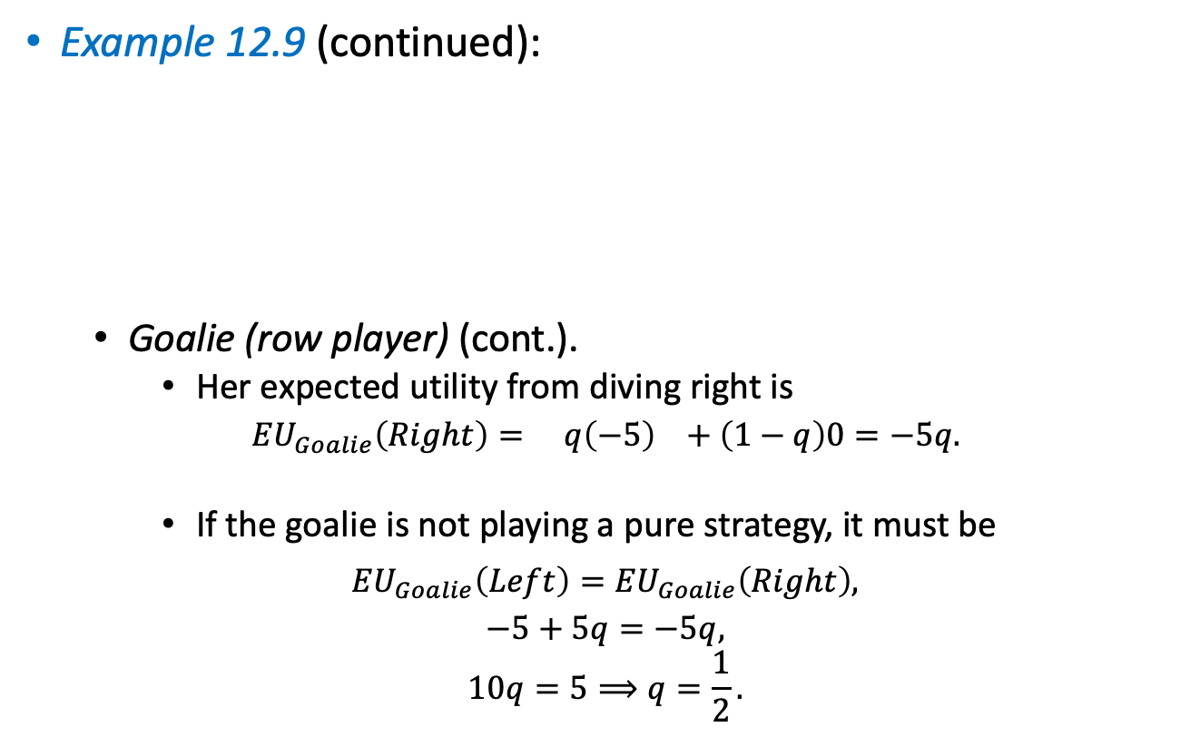
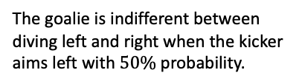
Mixed-Strategy Nash Equilibrium
Example 12.9 (continued):
  Goalie (row player) (cont.).
    Her expected utility from diving right is
    $${EU}_{Goalie}\left(Right\right)= q\left(−5\right) +\left(1−q\right)0=−5q.$$
        If the goalie is not playing a pure strategy, it must be
        $${EU}_{Goalie}\left(Left\right)={EU}_{Goalie}\left(Right\right),$$
        $$−5+5q=−5q,$$
        $$10q=5⟹q=\frac{1}{2}.$$
 |  |  | Kicker
 |  |  | $$Prob. q$$ | $$Prob 1−q$$
 |  |  | Aim Left | Aim Right
Goalie | $$Prob. p$$ | Dive Left | $$0,0$$ | $$−5,8$$
 | $$Prob. 1−p$$ | Dive Right | $$−5,8$$ | $$0,0$$
Matrix 12.13c
kicker aims left
kicker aims right
The goalie is indifferent between diving left and right when the kicker aims left with $50\%$probability.

Slide 52

Mixed-Strategy Nash Equilibrium
Example 12.9 (continued):
  Kicker (column player).
    Her expected utility from aiming left is
    $${EU}_{Kicker}\left(Left\right)= p0 +\left(1−p\right)8=8−8p.$$
    Her expected utility from aiming right is
    $${EU}_{Kicker}\left(Right\right)= p8 +\left(1−p\right)0=8p.$$
 |  |  | Kicker
 |  |  | $$Prob. q$$ | $$Prob 1−q$$
 |  |  | Aim Left | Aim Right
Goalie | $$Prob. p$$ | Dive Left | $$0,0$$ | $$−5,8$$
 | $$Prob. 1−p$$ | Dive Right | $$−5,8$$ | $$0,0$$
Matrix 12.13c
goalie dives left
goalie dives right
goalie dives left
goalie dives right

Slide 53
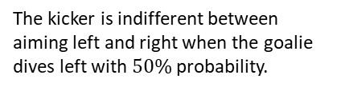

Mixed-Strategy Nash Equilibrium
Example 12.9 (continued):
  Kicker (column player) (cont.).
    If she randomizes, it must be that she is indifferent between aiming left and right,
        $${EU}_{Kicker}\left(Left\right)={EU}_{Kicker}\left(Right\right),$$
        $$8−8p=8p,$$
        $$8=16p⟹p=\frac{1}{2}.$$
  In summary, the only NE of this game has both players randomizing between right and left with $50\%$probability.
    The mixed-strategy NE (msNE) is $p=q=\frac{1}{2}.$
    Players randomize with the same probability because payoffs are symmetric. But may not be always the case.
The kicker is indifferent between aiming left and right when the goalie dives left with $50\%$probability.

Slide 54
Mixed-Strategy Nash Equilibrium
Do all games have a msNE with at least one player randomizing her strategy? Not necessarily.
  The Prisoner’s Dilemma has a psNE in which all players choose to confess.
    Because players find confessing to be a strictly dominant strategy, they have no incentives to randomize their decision.
  In the Battle of the Sexes game or the Coordination game, players do not have a strictly dominant strategy.
    We found two psNE. We can check that each game has one msNE when we allow players to randomize.
  The Penalty Kicks example illustrated that all gams must have at least one NE, either a psNE or a msNE.

Slide 55
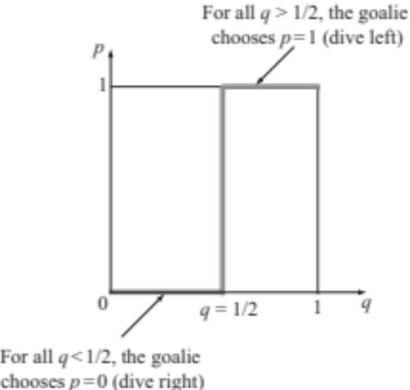
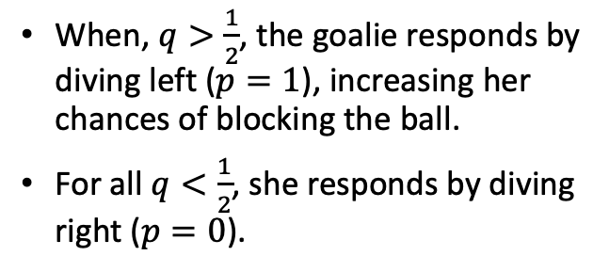
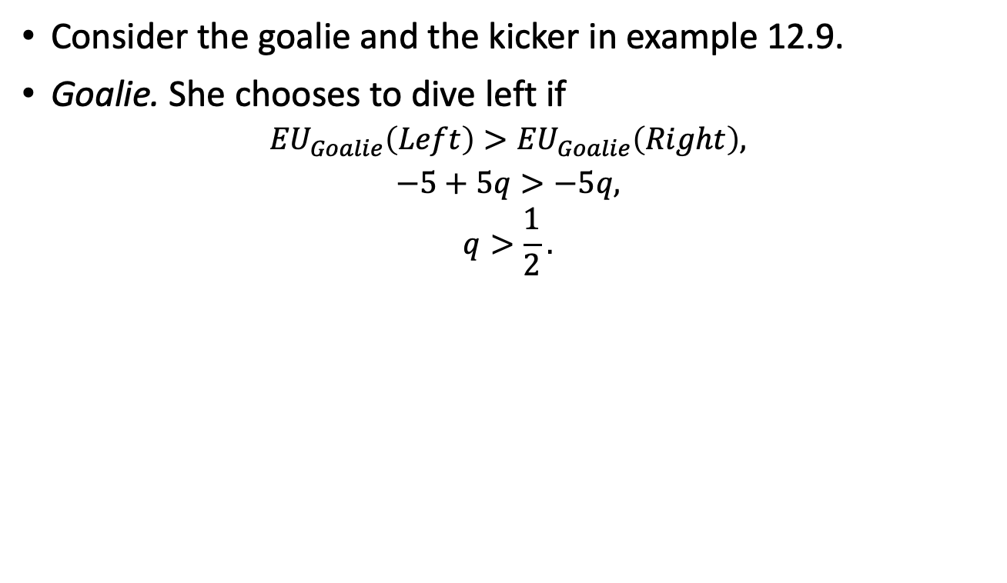
Graphical Representation of
Best Responses
Consider the goalie and the kicker in example 12.9.
Goalie. She chooses to dive left if
$${EU}_{Goalie}\left(Left\right)>{EU}_{Goalie}\left(Right\right),$$
$$−5+5q>−5q,$$
$$q>\frac{1}{2}.$$
When, $q>\frac{1}{2}$, the goalie responds by diving left ($p=1$), increasing her chances of blocking the ball.
For all $q<\frac{1}{2}$, she responds by diving right ($p=0$).
Figure 12.2a

Slide 56
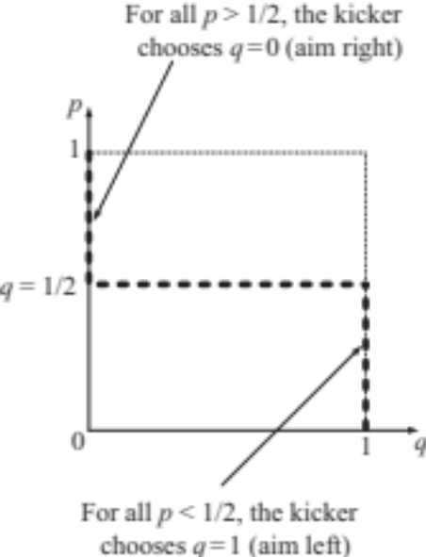
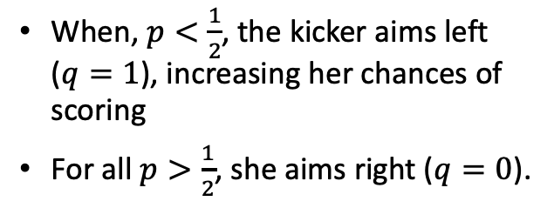
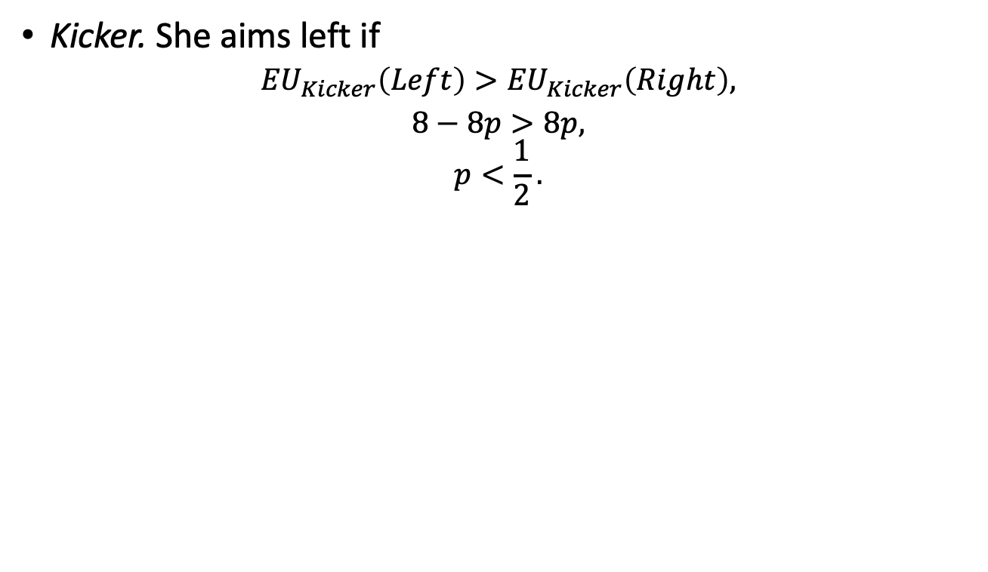
Graphical Representation of
Best Responses
Kicker. She aims left if
$${EU}_{Kicker}\left(Left\right)>{EU}_{Kicker}\left(Right\right),$$
$$8−8p>8p,$$
$$p<\frac{1}{2}.$$
When, $p<\frac{1}{2}$, the kicker aims left ($q=1$), increasing her chances of scoring
For all $p>\frac{1}{2}$, she aims right ($q=0$).
Figure 12.2b

Slide 57
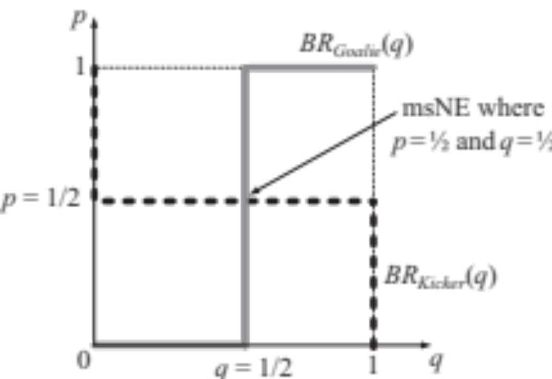

Graphical Representation of
Best Responses
Putting together goalie’s and kicker’s responses.
The goalie’s and kicker’s best responses crosses at $p=q=\frac{1}{2}$.
This fact means that both are using her best responses. That is, the strategy profile is a mutual best response.
The crossing point is the only NE of the game, a msNE.
If the game would have more than one NE, the best responses should cross at more than one point in the $(p,q)\text{–}$quadrant.
Figure 12.3

