Slide 1
Intermediate Microeconomic
Theory
Tools and Step-by-Step Examples
Chapter 10:
Monopoly

Slide 2
Outline
Barriers to entry
Profit Maximization Problem (PMP)
Common Misunderstandings of Monopoly
The Lernex Index and Inverse Elasticity Pricing Rule
Multiplant Monopolist
Welfare Analysis under Monopoly
Advertising in Monopoly
Monopsony

Slide 3

Microsoft Windows version 3.0 in 1990 cemented Microsoft's position as a software monopoly.
Soon after Windows 3.0 was released, Microsoft released Excel 3.0 for Windows and Word for Windows 2.0.
These products received great reviews and became the top sellers of their categories. (New York Times, 11/5/95)

Slide 4
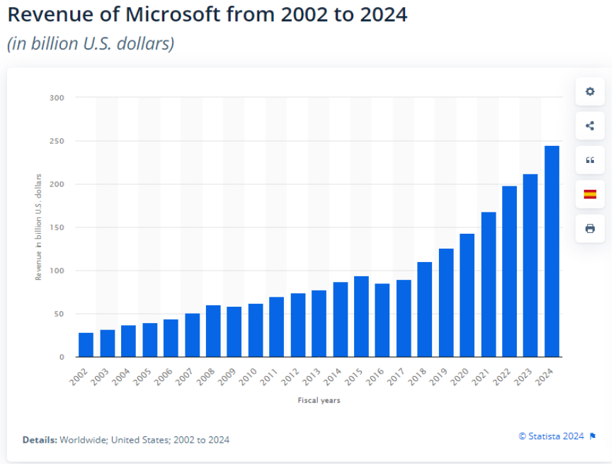

Slide 5


Slide 6

Barriers to Entry

Slide 7

Barriers to entry
“Why do monopolies exist in the first place if they are bad for society?”
Structural barriers: Incumbent firms may have advantages that are unattractive for potential entrants.
Cost advantage (e.g., superior technology)
Demand advantage (e.g., large group of loyal customers)
Legal barriers: Incumbents firms may be legally protected.
Example: Patents.
Strategic barriers: Incumbent firms can take actions to deter entry, by building a reputation of being a tough competitor.
Example: Price wars.

Slide 8
TECHNOLOGICAL SUPERIORITY
A firm that maintains a consistent technological advantage over potential competitors can establish itself as a monopolist.
Example: Intel was technologically superior over other firms from the 1970s to the 1990s.
Technological superiority is typically not a barrier to entry over the longer term

Slide 9
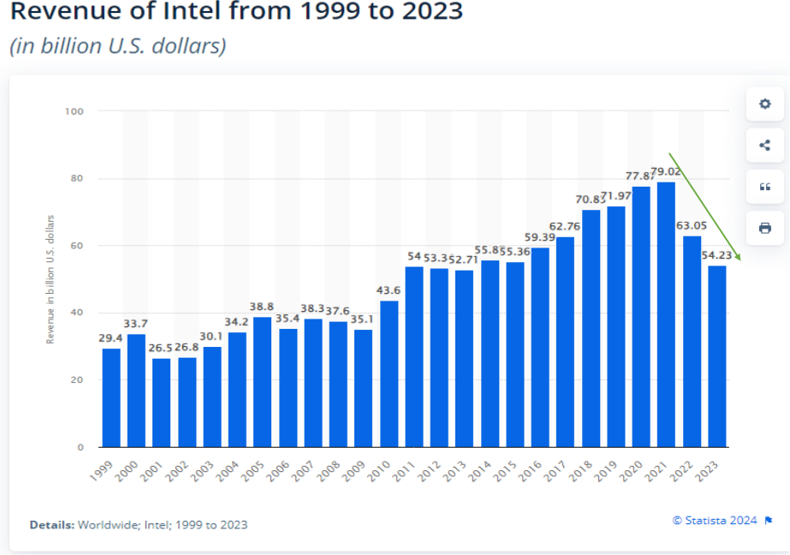

Slide 10
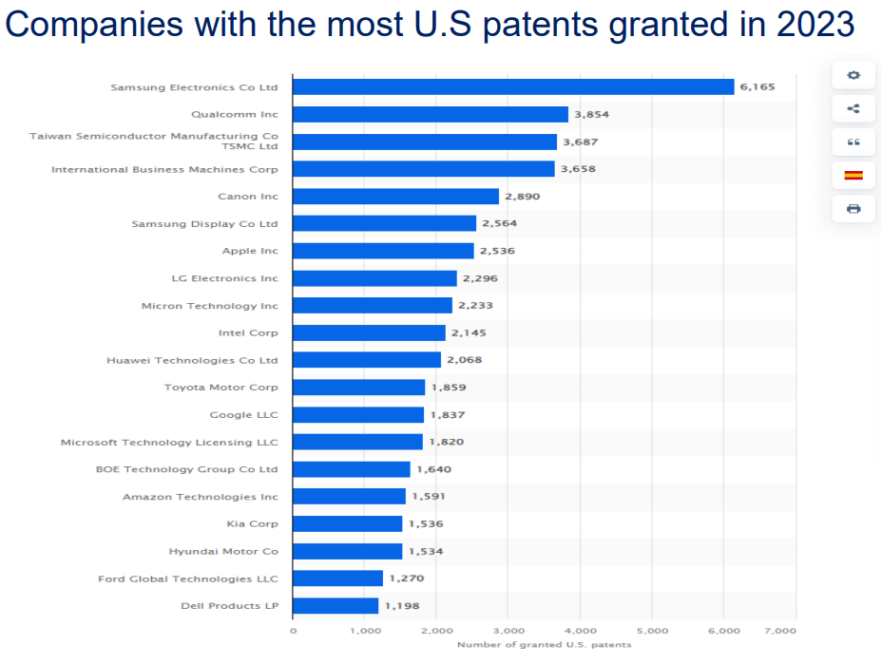

Slide 11


Slide 12


Slide 13

Profit Maximization Problem
(PMP)

Slide 14
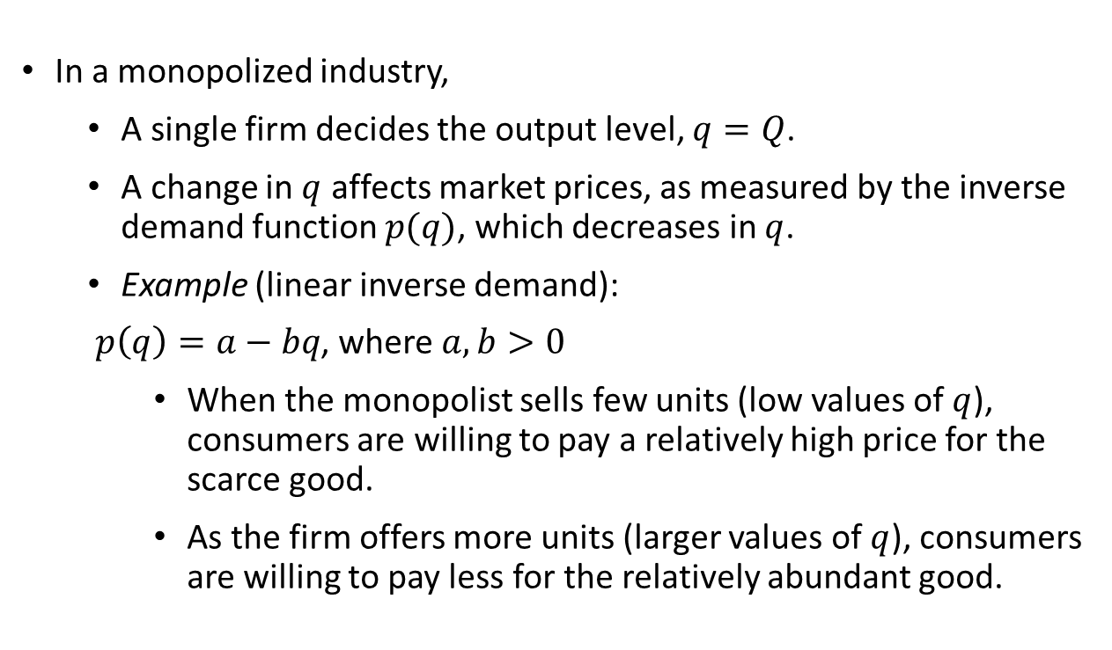
Profit Maximization Problem
In a monopolized industry,
  A single firm decides the output level, $q=Q$.
  A change in $q$ affects market prices, as measured by the inverse demand function $p(q)$, which decreases in $q$.
  Example (linear inverse demand):
  $p\left(q\right)=a−bq$, where $a,b>0$
    When the monopolist sells few units (low values of $q$), consumers are willing to pay a relatively high price for the scarce good.
    As the firm offers more units (larger values of $q$), consumers are willing to pay less for the relatively abundant good.

Slide 15
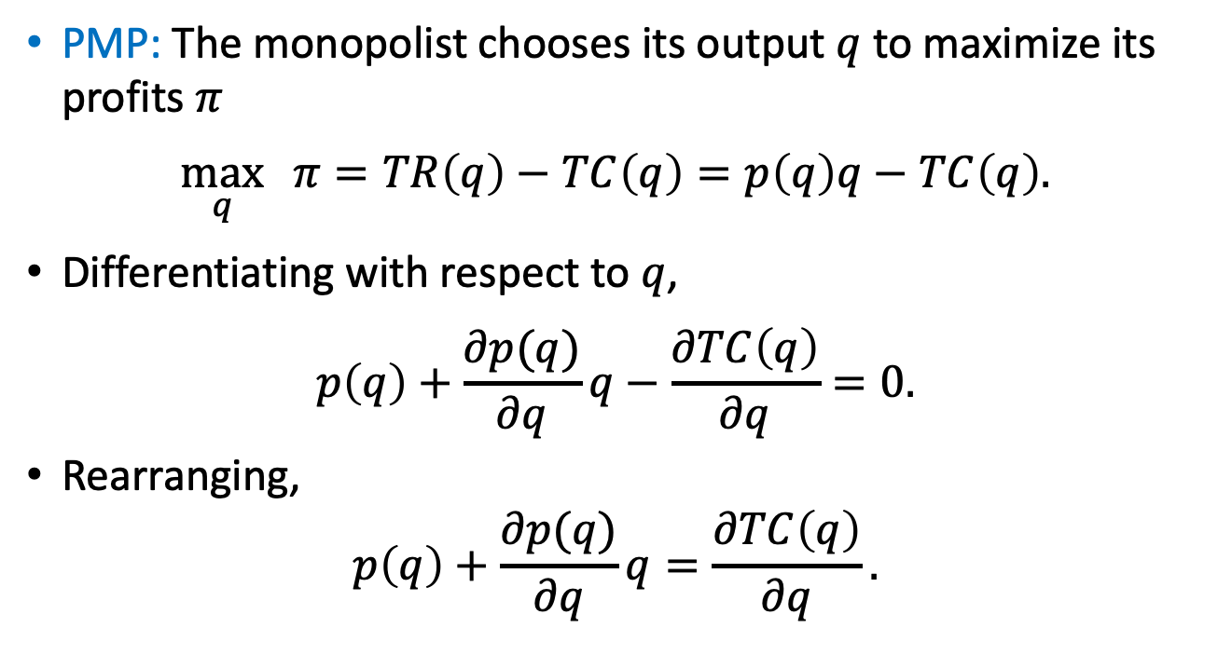
Profit Maximization Problem
PMP: The monopolist chooses its output $q$ to maximize its profits $π$
$$\max_{q}{ π=TR\left(q\right)−TC\left(q\right)=p\left(q\right)q−TC\left(q\right).}$$
Differentiating with respect to $q$,
$$p\left(q\right)+\frac{∂p(q)}{∂q}q−\frac{∂TC\left(q\right)}{∂q}=0.$$
Rearranging,
$$p\left(q\right)+\frac{∂p(q)}{∂q}q=\frac{∂TC\left(q\right)}{∂q}.$$
Marginal revenue, MR(q)
Marginal cost, MC(q)

Slide 16

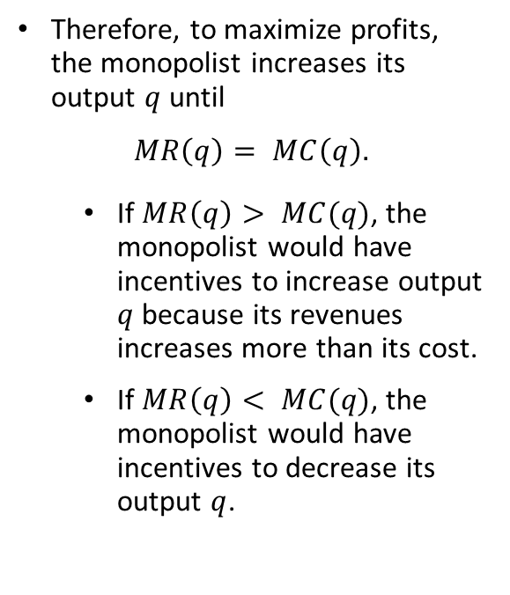
Profit Maximization Problem
Therefore, to maximize profits, the monopolist increases its output $q$until
$$MR\left(q\right)= MC\left(q\right).$$
  If $MR\left(q\right)> MC(q)$, the monopolist would have incentives to increase output $q$ because its revenues increases more than its cost.
  If $MR\left(q\right)< MC(q)$, the monopolist would have incentives to decrease its output $q$.

Slide 17
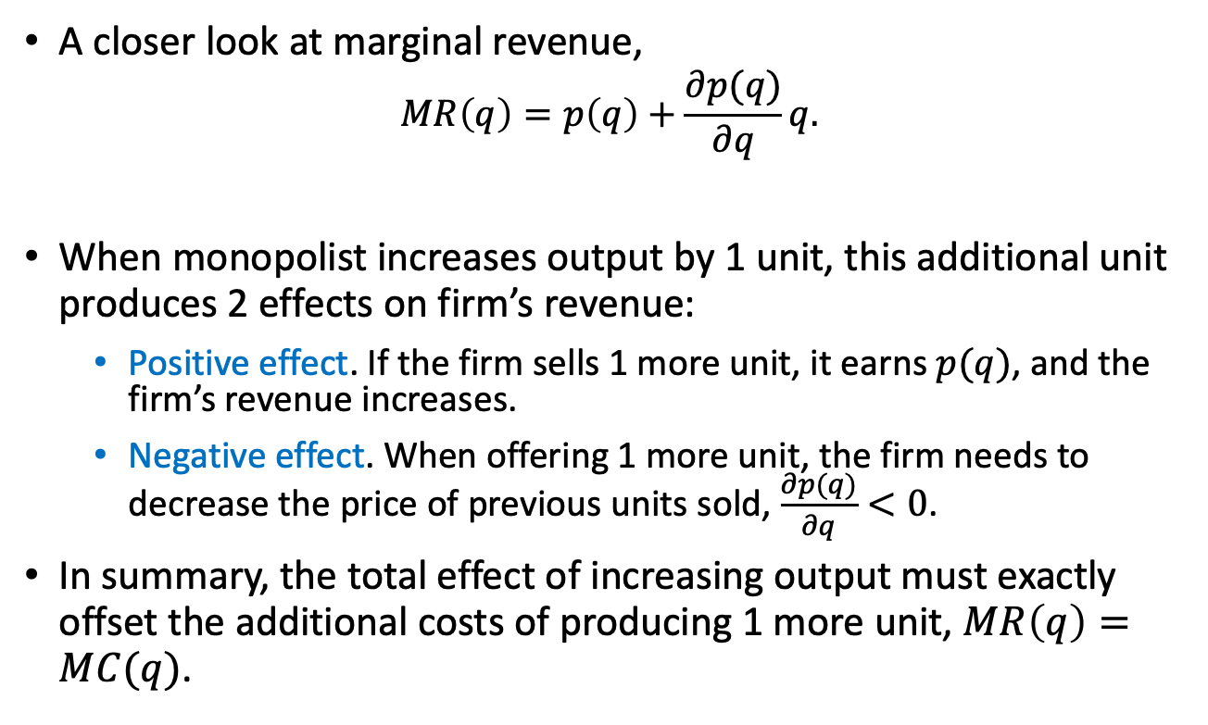
Profit Maximization Problem
A closer look at marginal revenue,
$$MR\left(q\right)=p\left(q\right)+\frac{∂p(q)}{∂q}q.$$
When monopolist increases output by 1 unit, this additional unit produces 2 effects on firm’s revenue:
  Positive effect. If the firm sells 1 more unit, it earns $p(q)$, and the firm’s revenue increases.
  Negative effect. When offering 1 more unit, the firm needs to decrease the price of previous units sold, $\frac{∂p(q)}{∂q}<0$.
In summary, the total effect of increasing output must exactly offset the additional costs of producing 1 more unit, $MR\left(q\right)=MC(q)$.
Positive effect
Negative effect

Slide 18
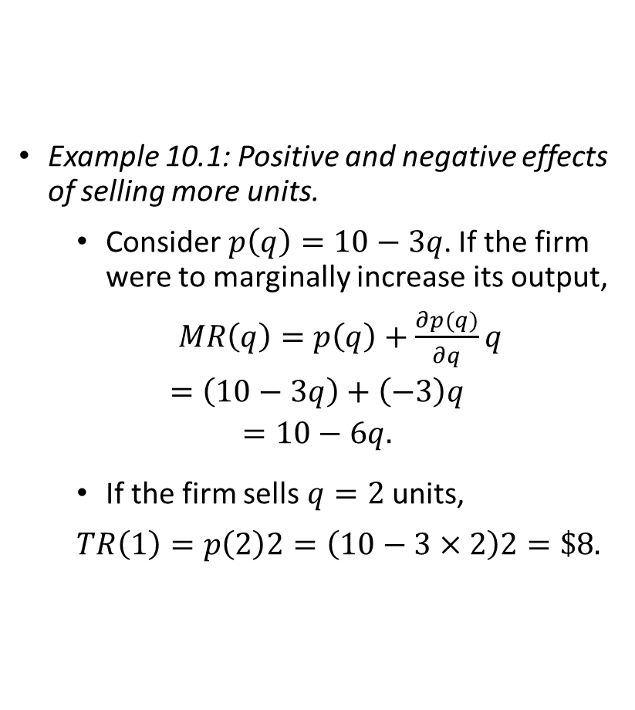
Profit Maximization Problem
Example 10.1: Positive and negative effects of selling more units.
  Consider $p\left(q\right)=10−3q$. If the firm were to marginally increase its output,
  $MR\left(q\right)=p\left(q\right)+\frac{∂p(q)}{∂q}q$
  $$=\left(10−3q\right)+\left(−3\right)q$$
  $$=10−6q.$$
  If the firm sells $q=2$ units,
  $$TR\left(1\right)=p\left(2\right)2=\left(10−3×2\right)2=\$8.$$

Slide 19
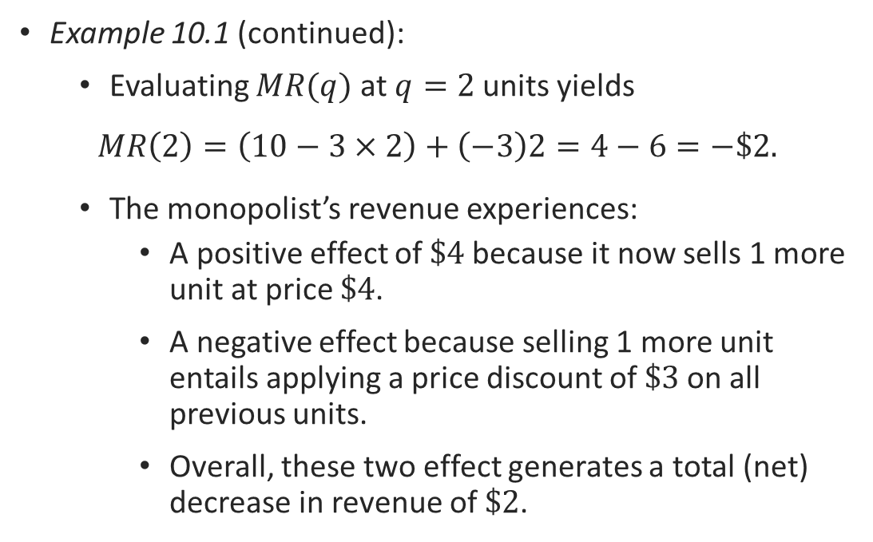
Profit Maximization Problem
Example 10.1 (continued):
  Evaluating $MR(q)$ at $q=2$units yields
  $$MR\left(2\right)=\left(10−3×2\right)+\left(−3\right)2=4−6=−\$2.$$
  The monopolist’s revenue experiences:
    A positive effect of $\$4$because it now sells 1 more unit at price $\$4$.
    A negative effect because selling 1 more unit entails applying a price discount of $\$3$on all previous units.
    Overall, these two effect generates a total (net) decrease in revenue of $\$2$.

Slide 20
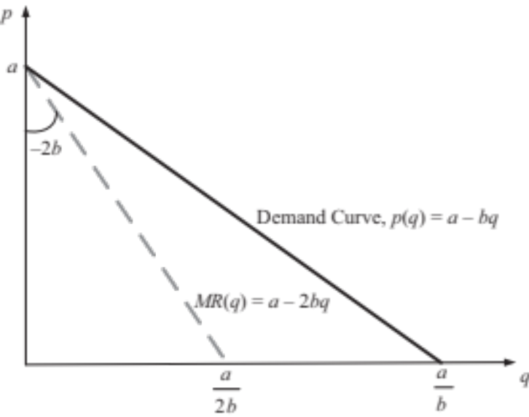
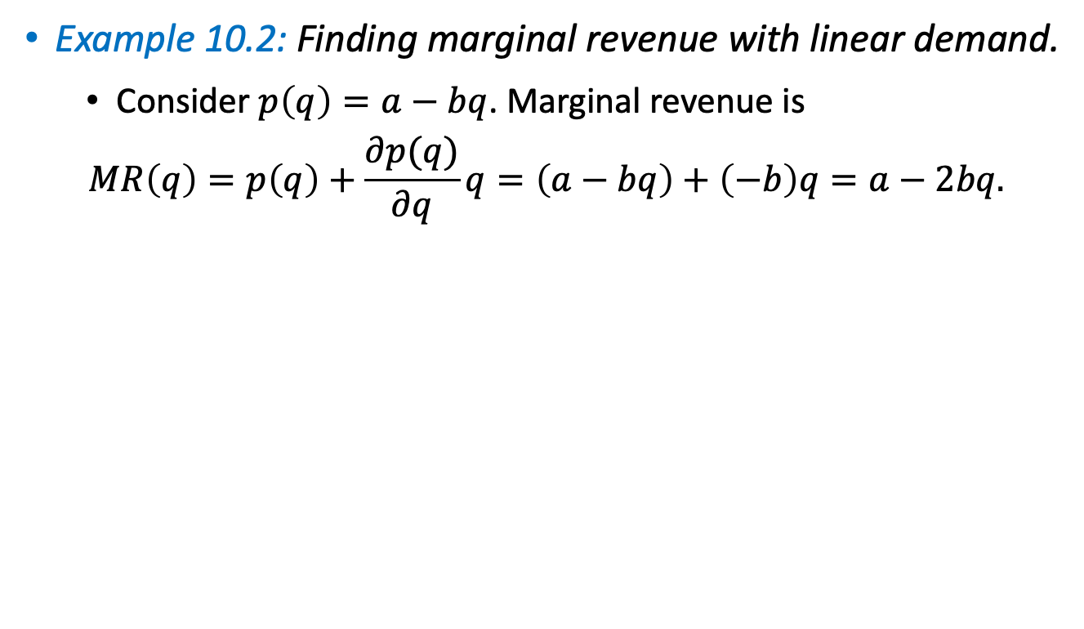
Profit Maximization Problem
Example 10.2: Finding marginal revenue with linear demand.
  Consider $p\left(q\right)=a−bq$. Marginal revenue is
  $$MR\left(q\right)=p\left(q\right)+\frac{∂p(q)}{∂q}q=\left(a−bq\right)+\left(−b\right)q=a−2bq.$$
Figure 10.1

Slide 21
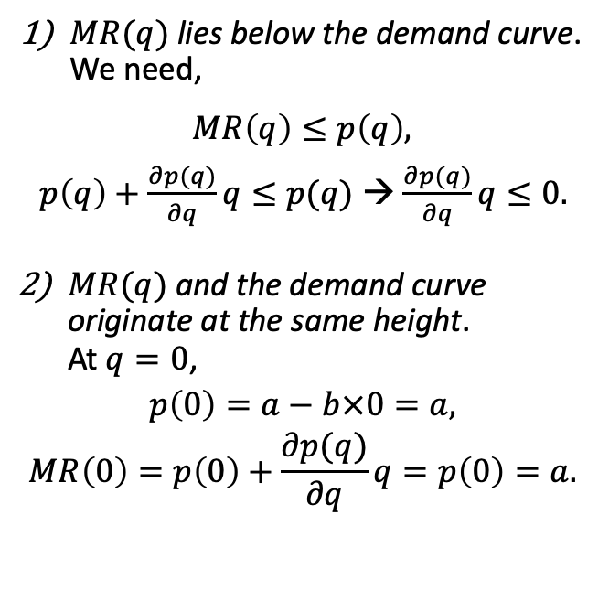
Profit Maximization Problem
Two properties of marginal revenue curve:
$MR(q)$lies below the demand curve. We need,
  $$MR\left(q\right)≤p\left(q\right),$$
  $p\left(q\right)+\frac{∂p(q)}{∂q}q≤p(q)$ → $\frac{∂p(q)}{∂q}q≤0.$
$MR(q)$and the demand curve originate at the same height. At $q=0$,
$$p\left(0\right)=a−b×0=a,$$
$$MR\left(0\right)=p\left(0\right)+\frac{∂p(q)}{∂q}q=p\left(0\right)=a.$$
Figure 10.1

Slide 22

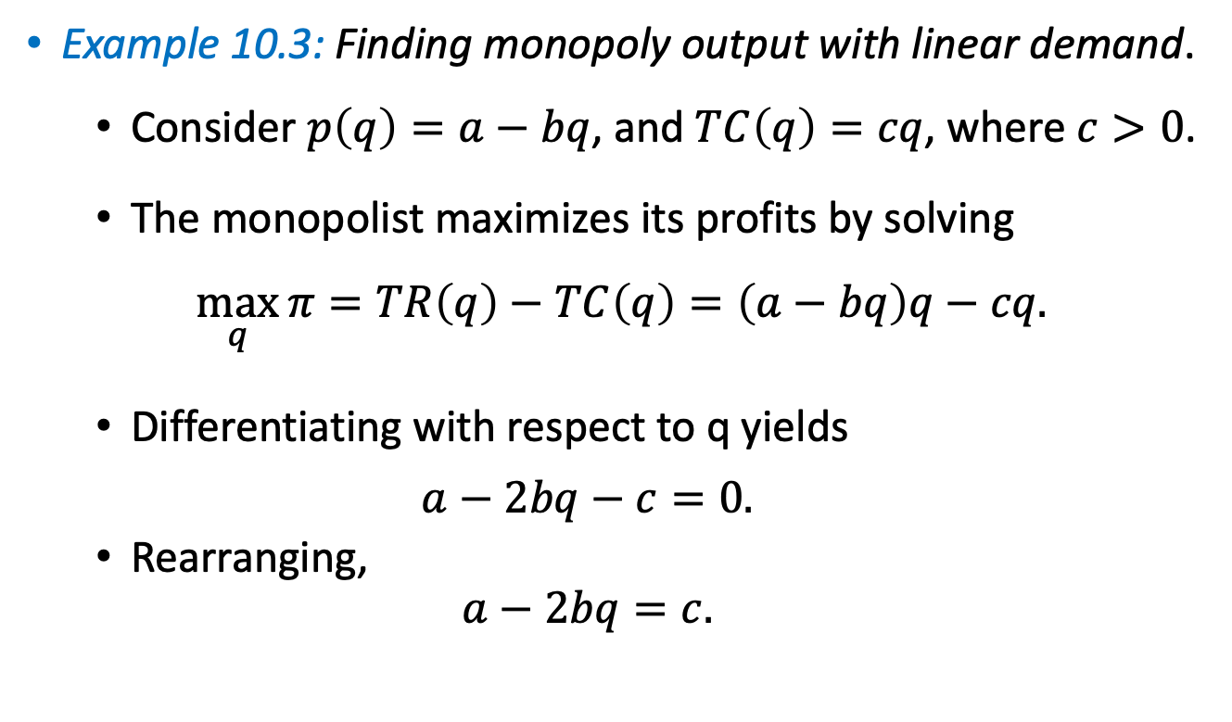



Profit Maximization Problem
Example 10.3: Finding monopoly output with linear demand.
  Consider $p\left(q\right)=a−bq$, and $TC\left(q\right)=cq$, where $c>0$.
  The monopolist maximizes its profits by solving
  $$\max_{q}{π=TR\left(q\right)−TC\left(q\right)=\left(a−bq\right)q−cq.}$$
  Differentiating with respect to q yields
  $$a−2bq−c=0.$$
  Rearranging,
  $$a−2bq=c.$$
$$TR$$
$$TC$$
$$MR(q)$$
$$MC(q)$$

Slide 23

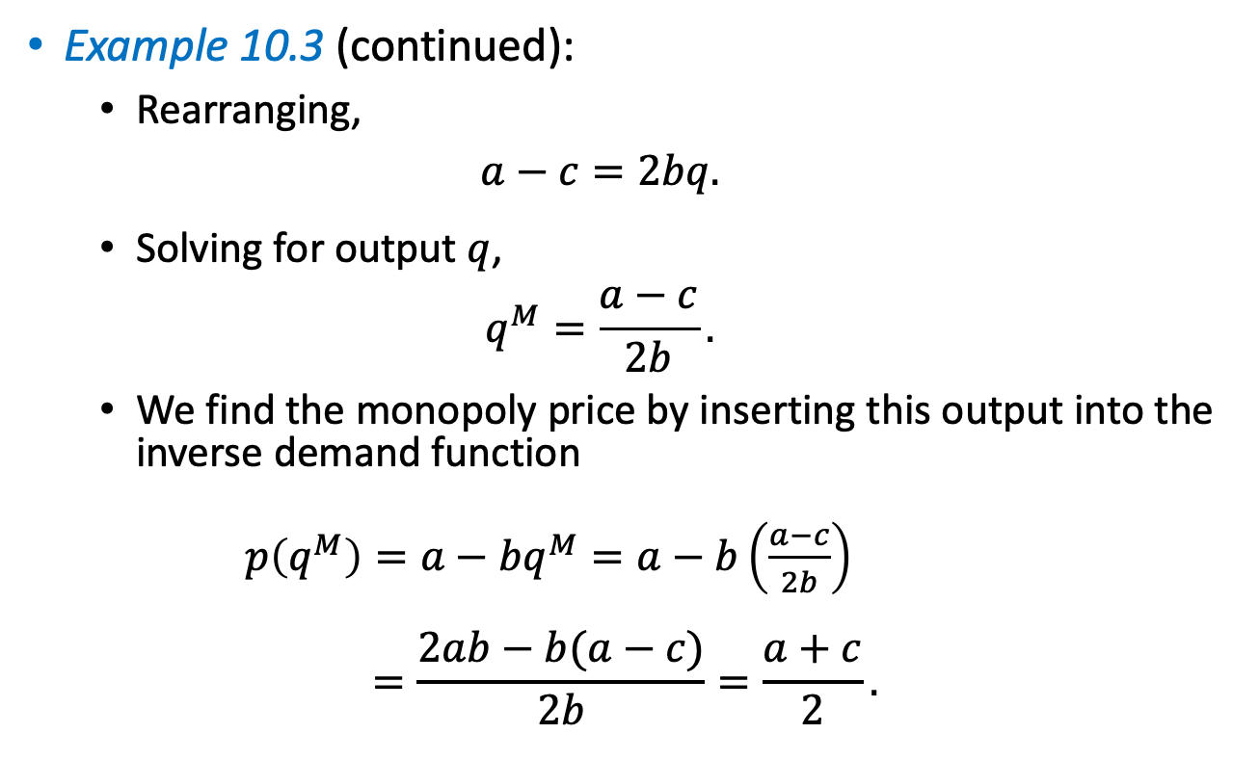
Profit Maximization Problem
Example 10.3 (continued):
  Rearranging,
  $$a−c=2bq.$$
  Solving for output$q$,
  $$q^{M}=\frac{a−c}{2b}.$$
  We find the monopoly price by inserting this output into the inverse demand function
  $p\left(q^{M}\right)=a−bq^{M}=a−b\left(\frac{a−c}{2b}\right)$
  $$=\frac{2ab−b(a−c)}{2b}=\frac{a+c}{2}.$$
$$q^{M}$$

Slide 24
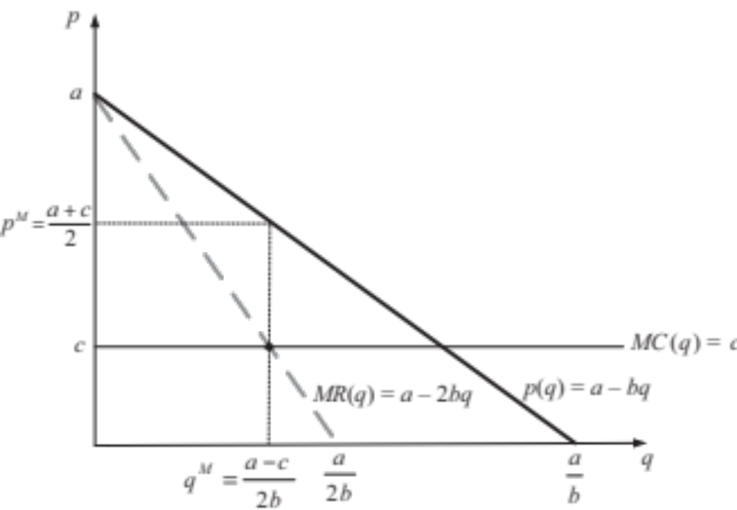
Profit Maximization Problem
Example 10.3 (continued):
Figure 10.2

Slide 25
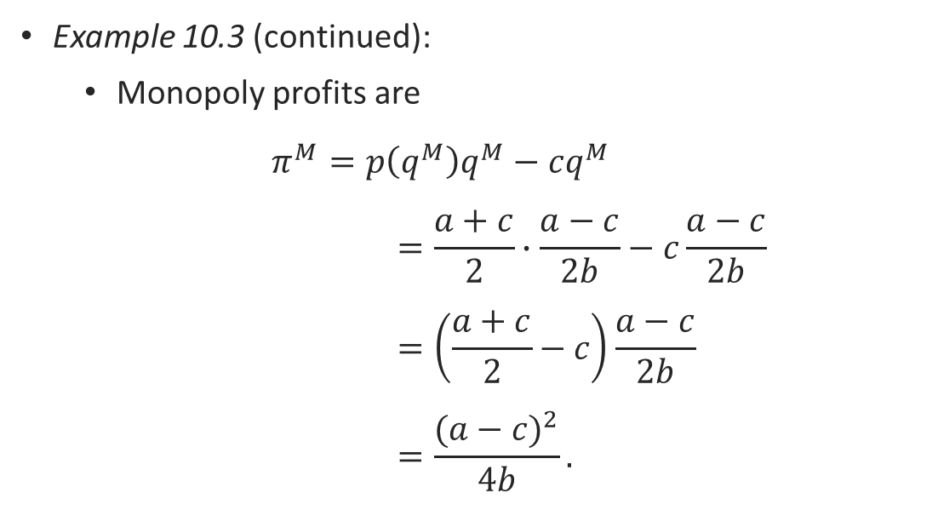
Profit Maximization Problem
Example 10.3 (continued):
  Monopoly profits are
  $$π^{M}=p\left(q^{M}\right)q^{M}−cq^{M}$$
  $$=\frac{a+c}{2}∙\frac{a−c}{2b}−c\frac{a−c}{2b}$$
  $$=\left(\frac{a+c}{2}−c\right)\frac{a−c}{2b}$$
  $$=\frac{{(a−c)}^{2}}{4b}.$$

Slide 26
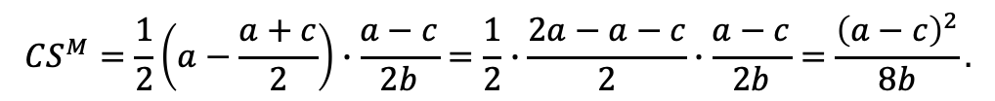
Profit Maximization Problem
Example 10.3 (continued):
  Consumer surplus under this monopoly is
$${CS}^{M}=\frac{1}{2}\left(a−\frac{a+c}{2}\right)∙\frac{a−c}{2b}=\frac{1}{2}∙\frac{2a−a−c}{2}∙\frac{a−c}{2b}=\frac{{\left(a−c\right)}^{2}}{8b}.$$
height
base
Figure 10.2

Slide 27
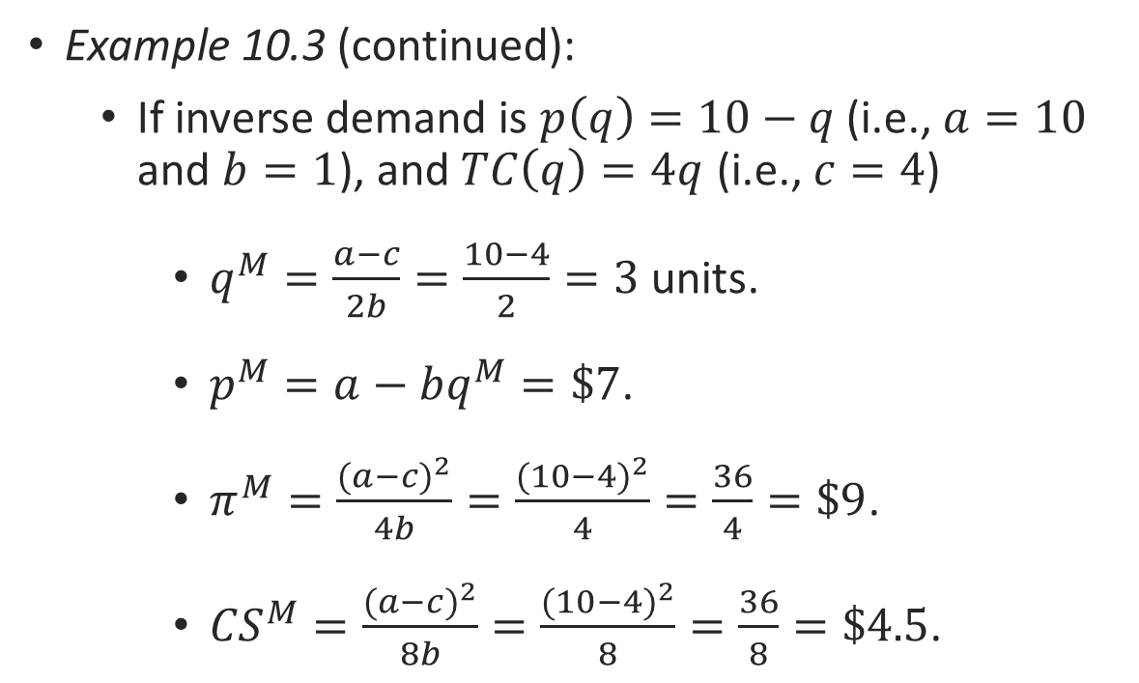
Profit Maximization Problem
Example 10.3 (continued):
  If inverse demand is $p\left(q\right)=10−q$ (i.e., $a=10$ and $b=1$), and $TC\left(q\right)=4q$ (i.e., $c=4$)
    $q^{M}=\frac{a−c}{2b}=\frac{10−4}{2}=3$ units.
    $p^{M}=a−bq^{M}=\$7$.
    $π^{M}=\frac{{(a−c)}^{2}}{4b}=\frac{{(10−4)}^{2}}{4}=\frac{36}{4}=\$9$.
    ${CS}^{M}=\frac{{(a−c)}^{2}}{8b}=\frac{{(10−4)}^{2}}{8}=\frac{36}{8}=\$4.5$.

Slide 28
Common misunderstandings of Monopoly

Slide 29

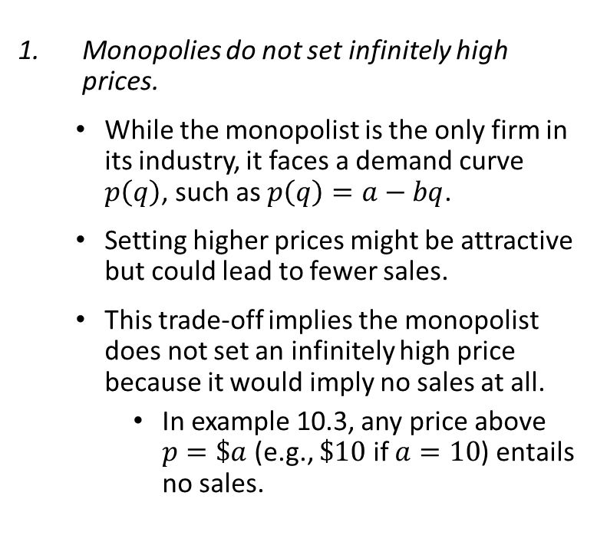
Common Misunderstandings
Monopolies do not set infinitely high prices.
  While the monopolist is the only firm in its industry, it faces a demand curve $p\left(q\right)$, such as $p\left(q\right)=a−bq$.
  Setting higher prices might be attractive but could lead to fewer sales.
  This trade-off implies the monopolist does not set an infinitely high price because it would imply no sales at all.
    In example 10.3, any price above $p=\$a$ (e.g., $\$10$ if $a=10$) entails no sales.

Slide 30


Slide 31


Slide 32
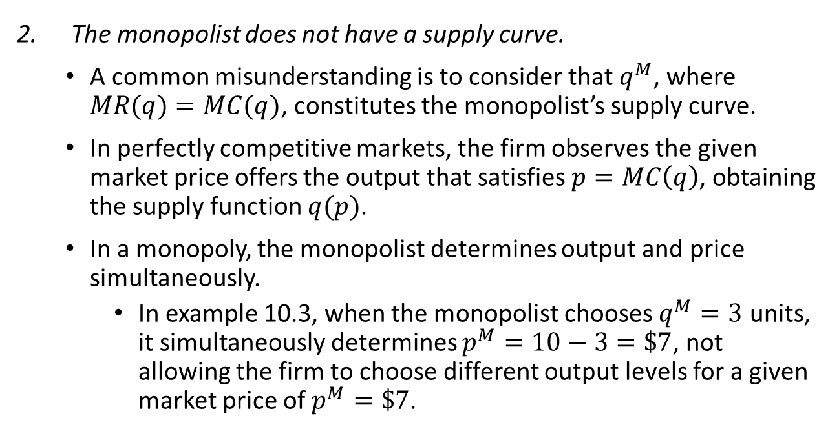
Common Misunderstandings
The monopolist does not have a supply curve.
  A common misunderstanding is to consider that $q^{M}$, where $MR(q)=MC(q)$, constitutes the monopolist’s supply curve.
  In perfectly competitive markets, the firm observes the given market price offers the output that satisfies $p=MC\left(q\right)$, obtaining the supply function $q(p)$.
  In a monopoly, the monopolist determines output and price simultaneously.
    In example 10.3, when the monopolist chooses $q^{M}=3$ units, it simultaneously determines $p^{M}=10−3=\$7$, not allowing the firm to choose different output levels for a given market price of $p^{M}=\$7$.

Slide 33
Common Misunderstandings
The monopolist produces in the elastic portion of the demand curve.
  Goods with few (or no) close substitutes tend to have a relatively inelastic demand curve.
  Monopolies often produce goods with no close substitutes. However, it does not mean that it produces in the inelastic portion of the demand curve.

Slide 34
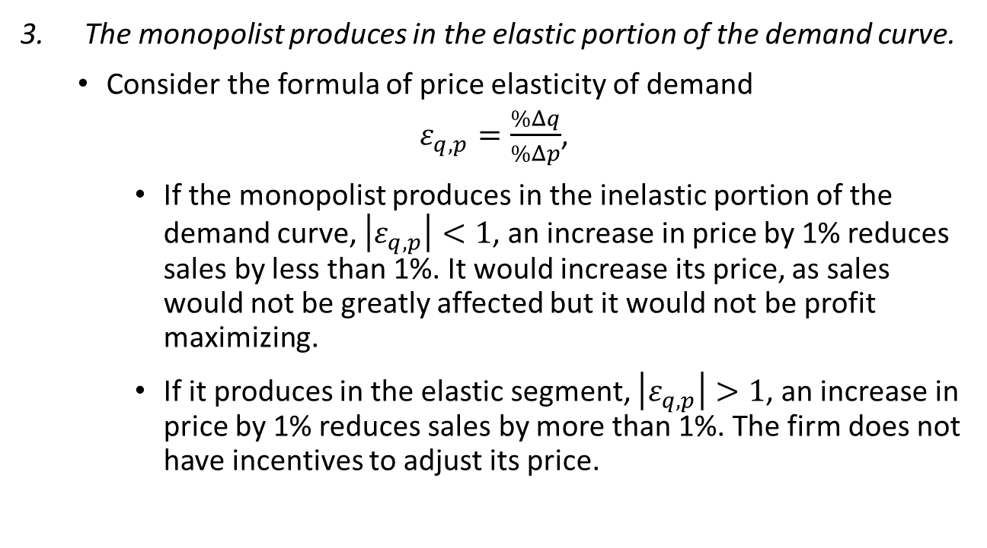
Common Misunderstandings
The monopolist produces in the elastic portion of the demand curve.
  Consider the formula of price elasticity of demand
  $ε_{q,p}=\frac{\%Δq}{\%Δp}$,
    If the monopolist produces in the inelastic portion of the demand curve, $\left|ε_{q,p}\right|<1$, an increase in price by 1% reduces sales by less than 1%. It would increase its price, as sales would not be greatly affected but it would not be profit maximizing.
    If it produces in the elastic segment, $\left|ε_{q,p}\right|>1$, an increase in price by 1% reduces sales by more than 1%. The firm does not have incentives to adjust its price.

Slide 35
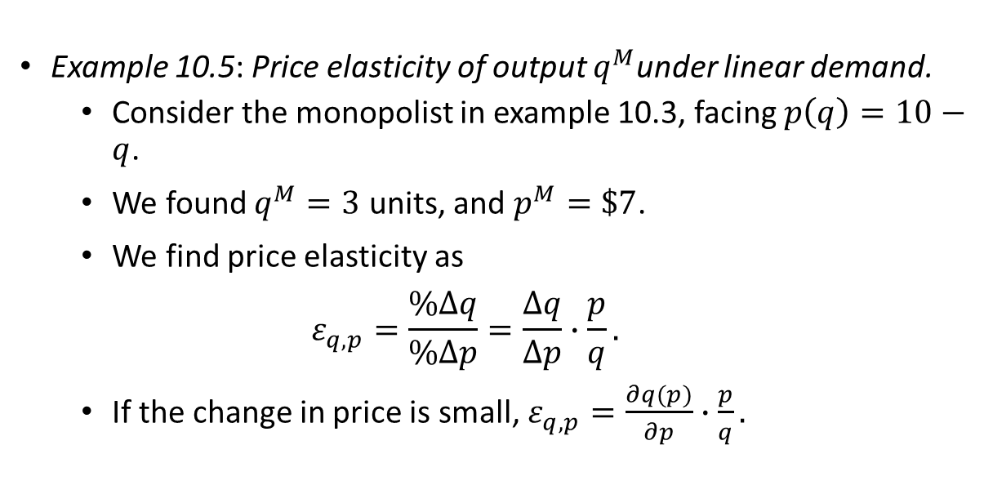
Common Misunderstandings
Example 10.5: Price elasticity of output $q^{M}$under linear demand.
  Consider the monopolist in example 10.3, facing $p\left(q\right)=10−q$.
  We found $q^{M}=3$ units, and $p^{M}=\$7$.
  We find price elasticity as
  $$ε_{q,p}=\frac{\%Δq}{\%Δp}=\frac{Δq}{Δp}∙\frac{p}{q}.$$
  If the change in price is small, $ε_{q,p}=\frac{∂q(p)}{∂p}∙\frac{p}{q}.$

Slide 36
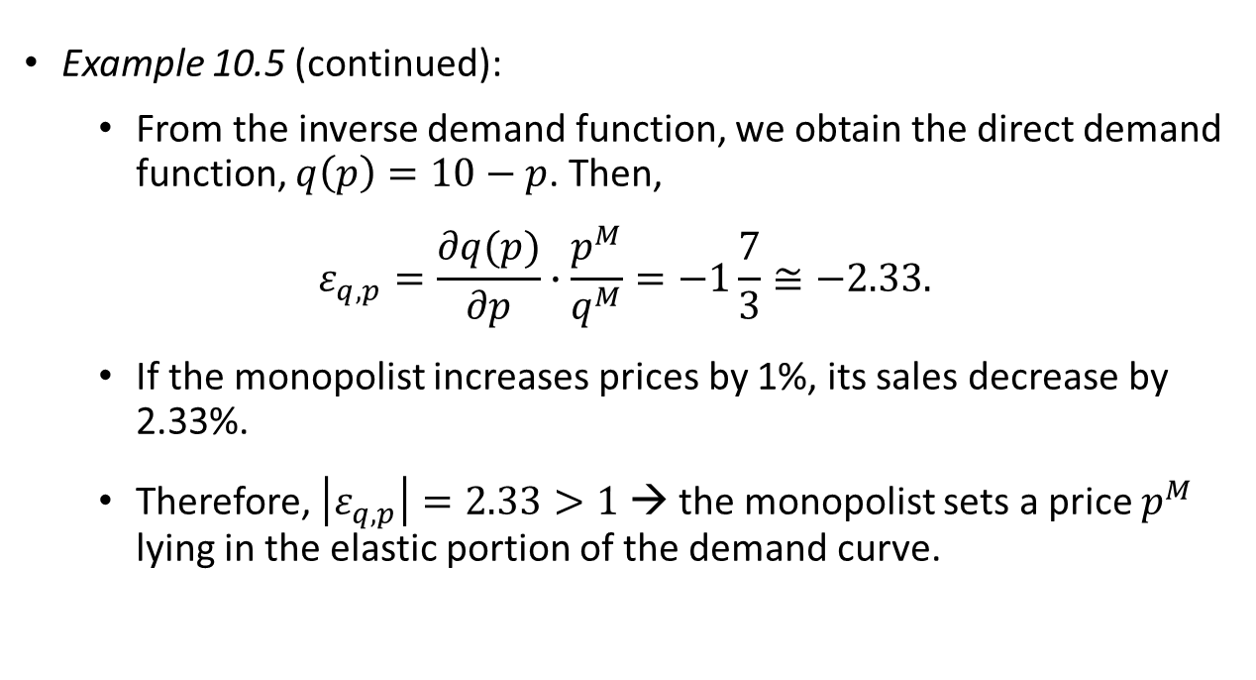
Common Misunderstandings
Example 10.5 (continued):
  From the inverse demand function, we obtain the direct demand function, $q\left(p\right)=10−p$. Then,
  $$ε_{q,p}=\frac{∂q(p)}{∂p}∙\frac{p^{M}}{q^{M}}=−1\frac{7}{3}≅−2.33.$$
  If the monopolist increases prices by 1%, its sales decrease by 2.33%.
  Therefore, $\left|ε_{q,p}\right|=2.33>1$ → the monopolist sets a price $p^{M}$ lying in the elastic portion of the demand curve.

Slide 37

The Lernex Index and
Inverse Elasticity Pricing Rule

Slide 38
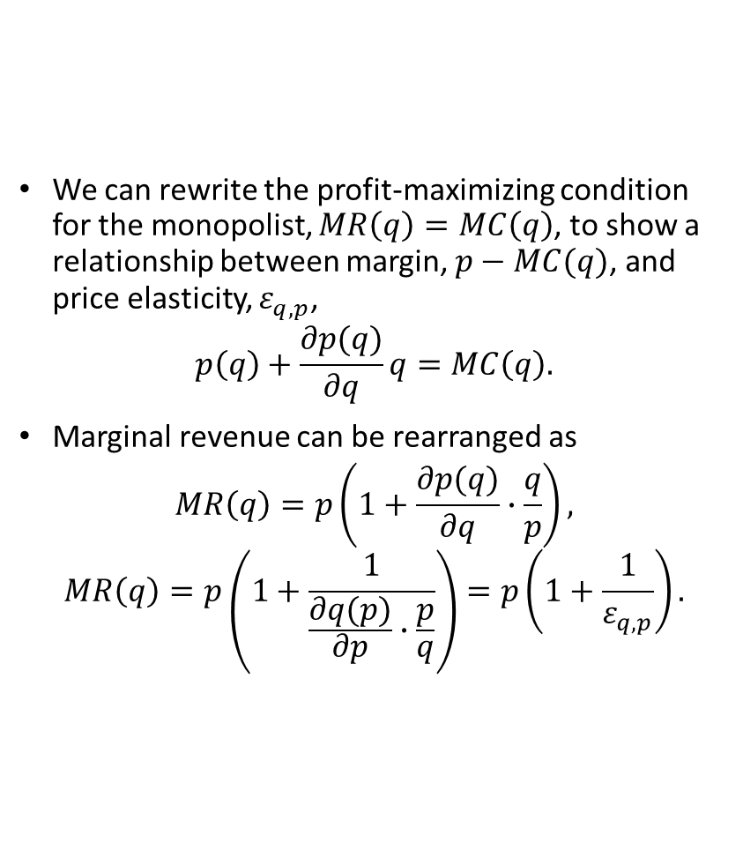
The Lernex Index
We can rewrite the profit-maximizing condition for the monopolist, $MR\left(q\right)=MC\left(q\right)$, to show a relationship between margin, $p−MC(q)$, and price elasticity, $ε_{q,p}$,
$$p\left(q\right)+\frac{∂p(q)}{∂q}q=MC\left(q\right).$$
Marginal revenue can be rearranged as
$$MR\left(q\right)=p\left(1+\frac{∂p(q)}{∂q}∙\frac{q}{p}\right),$$
$$MR\left(q\right)=p\left(1+\frac{1}{\frac{∂q(p)}{∂p}∙\frac{p}{q}}\right)=p\left(1+\frac{1}{ε_{q,p}}\right).$$

Slide 39
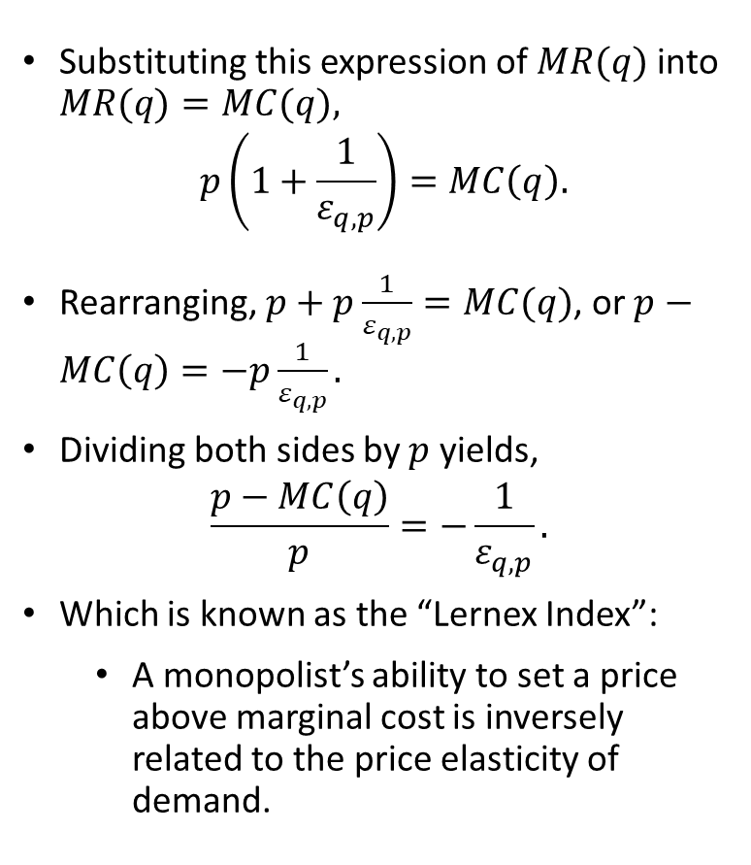
The Lernex Index
Substituting this expression of $MR(q)$ into $MR(q)=MC(q),$
$$p\left(1+\frac{1}{ε_{q,p}}\right)=MC\left(q\right).$$
Rearranging, $p+p\frac{1}{ε_{q,p}}=MC(q)$, or $p−MC\left(q\right)=−p\frac{1}{ε_{q,p}}.$
Dividing both sides by $p$ yields,
$$\frac{p−MC\left(q\right)}{p}=−\frac{1}{ε_{q,p}}.$$
Which is known as the “Lernex Index”:
  A monopolist’s ability to set a price above marginal cost is inversely related to the price elasticity of demand.

Slide 40
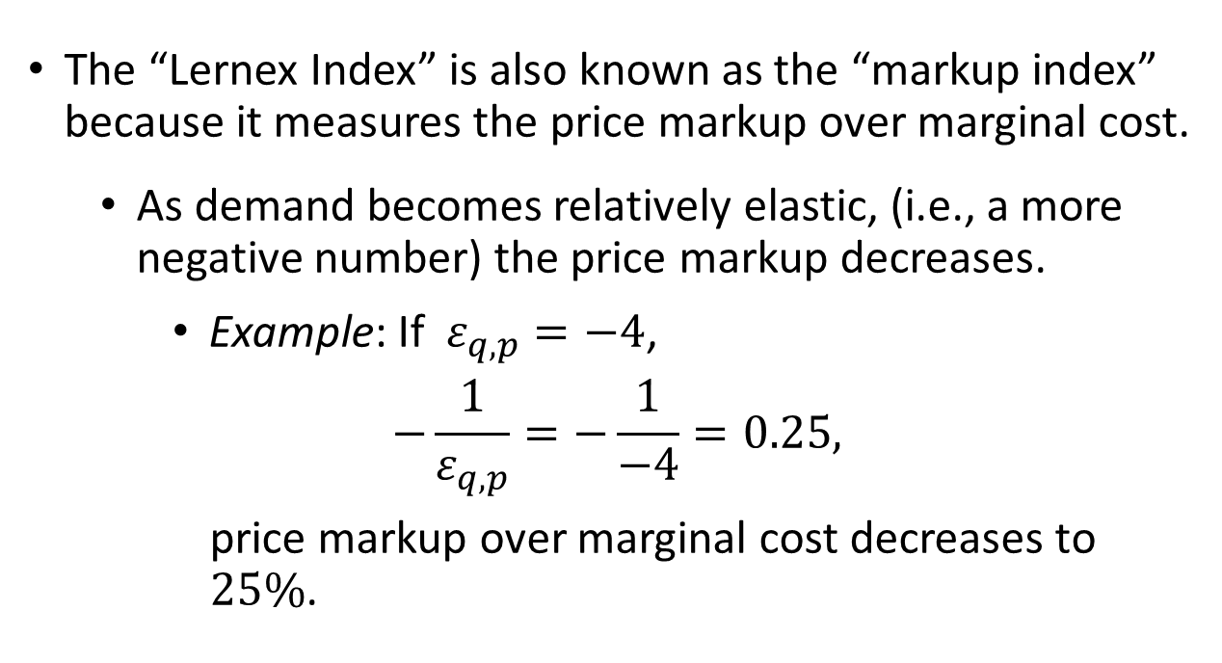
The Lernex Index
The “Lernex Index” is also known as the “markup index” because it measures the price markup over marginal cost.
  As demand becomes relatively elastic, (i.e., a more negative number) the price markup decreases.
    Example: If $ε_{q,p}=−4$,
    $$−\frac{1}{ε_{q,p}}=−\frac{1}{−4}=0.25,$$
    price markup over marginal cost decreases to $25\%$.

Slide 41
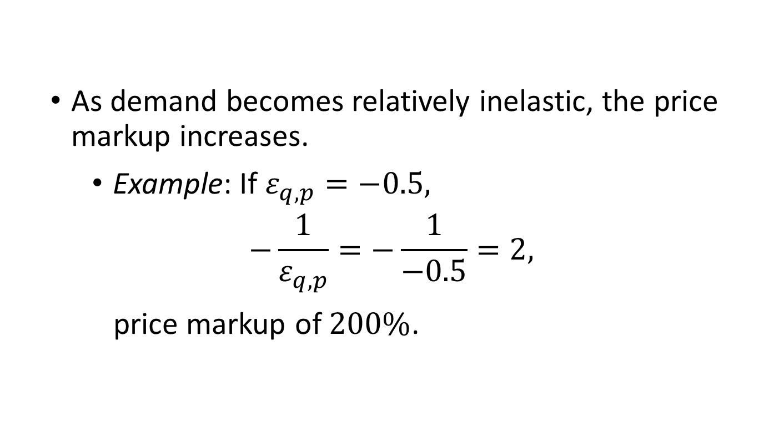
The Lernex Index
  As demand becomes relatively inelastic, the price markup increases.
    Example: If $ε_{q,p}=−0.5,$
    $$−\frac{1}{ε_{q,p}}=−\frac{1}{−0.5}=2,$$
    price markup of $200\%$.

Slide 42
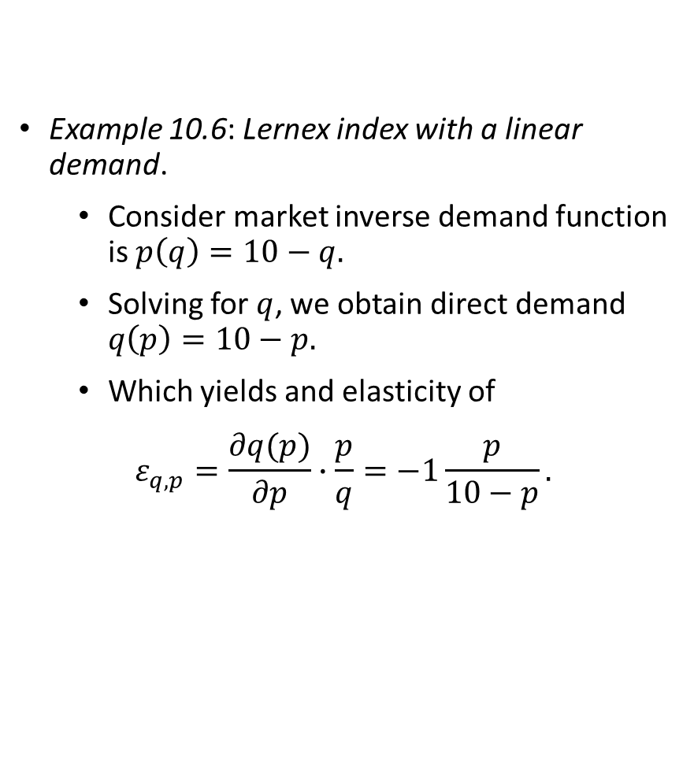
The Lernex Index
Example 10.6: Lernex index with a linear demand.
  Consider market inverse demand function is $p\left(q\right)=10−q.$
  Solving for $q$, we obtain direct demand $q\left(p\right)=10−p.$
  Which yields and elasticity of
  $$ε_{q,p}=\frac{∂q(p)}{∂p}∙\frac{p}{q}=−1\frac{p}{10−p}.$$

Slide 43

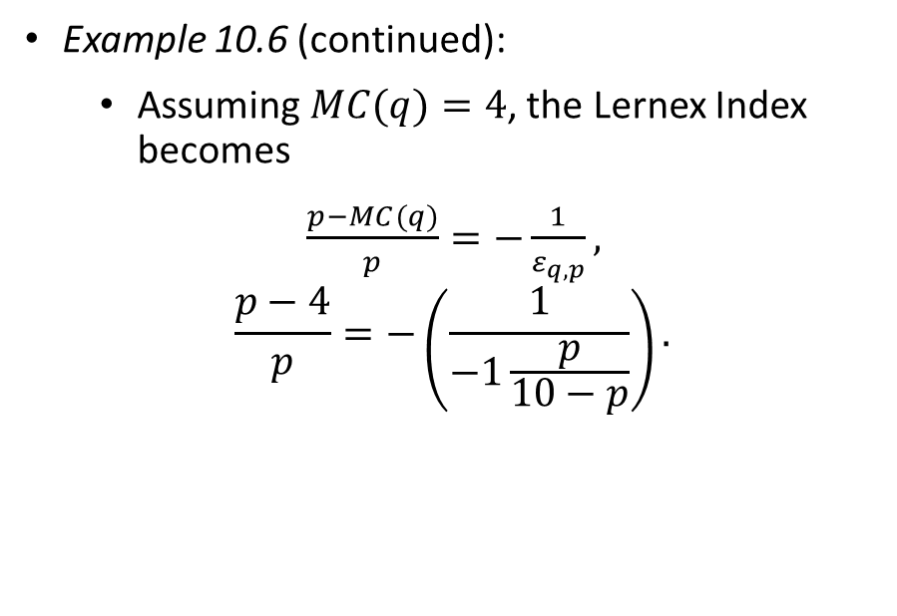
The Lernex Index
Example 10.6 (continued):
  Assuming $MC(q)=4$, the Lernex Index becomes
  $\frac{p−MC(q)}{p}=−\frac{1}{ε_{q,p}},$
  $$\frac{p−4}{p}=−\left(\frac{1}{−1\frac{p}{10−p}}\right).$$

Slide 44
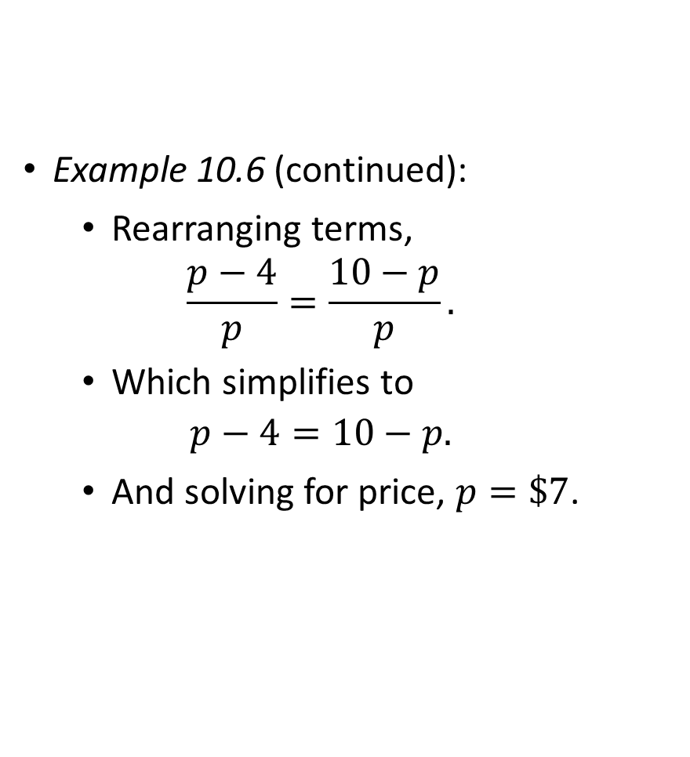
The Lernex Index
Example 10.6 (continued):
  Rearranging terms,
  $$\frac{p−4}{p}=\frac{10−p}{p}.$$
  Which simplifies to
  $$p−4=10−p.$$
  And solving for price, $p=\$7$.

Slide 45
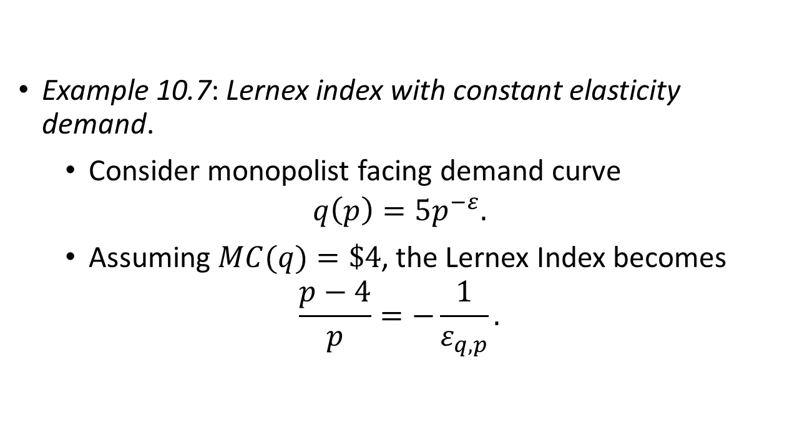
The Lernex Index
Example 10.7: Lernex index with constant elasticity demand.
  Consider monopolist facing demand curve
  $$q\left(p\right)=5p^{−ε}.$$
  Assuming $MC(q)=\$4$, the Lernex Index becomes
  $$\frac{p−4}{p}=−\frac{1}{ε_{q,p}}.$$

Slide 46
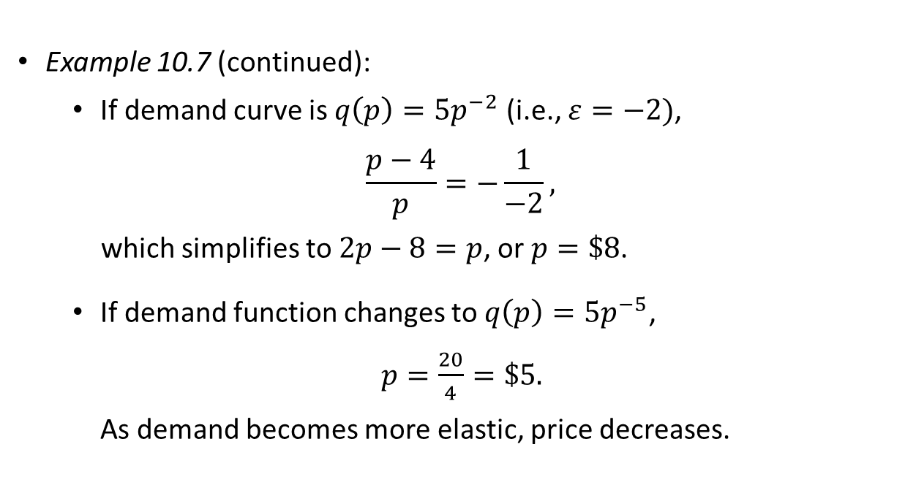
The Lernex Index
Example 10.7 (continued):
  If demand curve is $q\left(p\right)=5p^{−2}$ (i.e., $ε=−2)$,
  $$\frac{p−4}{p}=−\frac{1}{−2},$$
  which simplifies to $2p−8=p$, or $p=\$8$.
  If demand function changes to $q\left(p\right)=5p^{−5}$,
  $p=\frac{20}{4}=\$5.$
  As demand becomes more elastic, price decreases.

Slide 47
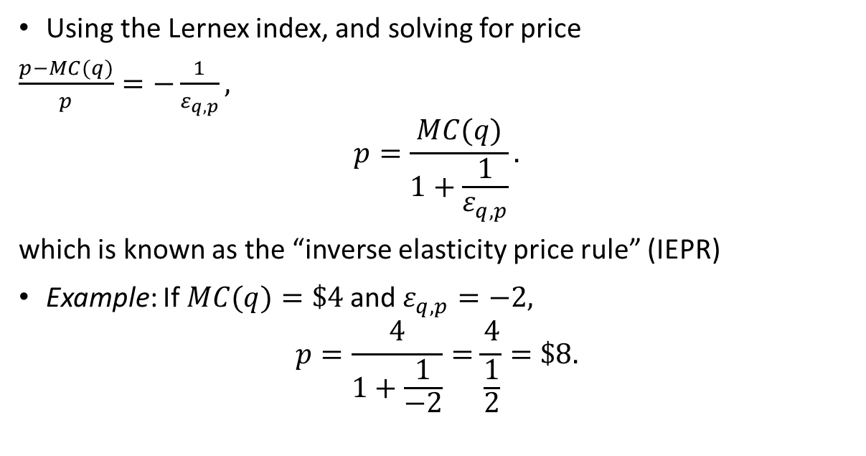
Inverse elasticity pricing rule (IEPR)
Using the Lernex index, and solving for price
$\frac{p−MC(q)}{p}=−\frac{1}{ε_{q,p}},$
$$p=\frac{MC(q)}{1+\frac{1}{ε_{q,p}}}.$$
which is known as the “inverse elasticity price rule” (IEPR)
Example: If $MC(q)=\$4$and $ε_{q,p}=−2,$
$$p=\frac{4}{1+\frac{1}{−2}}=\frac{4}{\frac{1}{2}}=\$8.$$

Slide 48
Multiplant Monopoly

Slide 49

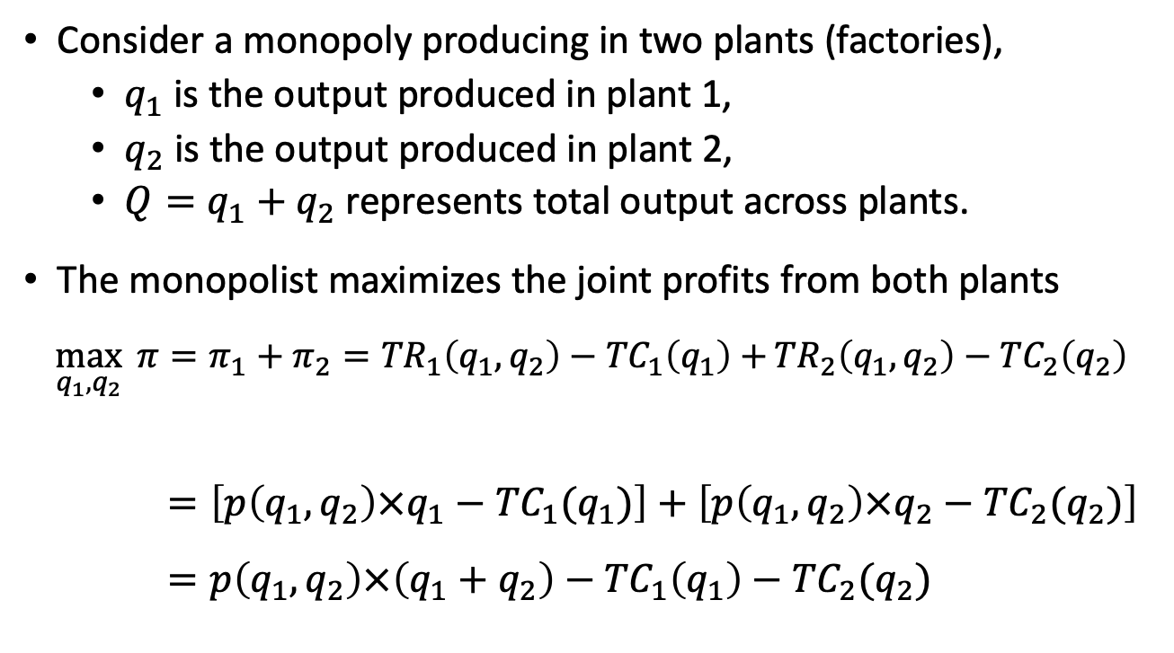

Multiplant Monopoly
Consider a monopoly producing in two plants (factories),
  $q_{1}$ is the output produced in plant 1,
  $q_{2}$ is the output produced in plant 2,
  $Q=q_{1}+q_{2}$ represents total output across plants.
The monopolist maximizes the joint profits from both plants
$$\max_{q_{1},q_{2}}{ π=π_{1}+π_{2}={TR}_{1}\left(q_{1},q_{2}\right)−{TC}_{1}\left(q_{1}\right)+}{TR}_{2}\left(q_{1},q_{2}\right)−{TC}_{2}\left(q_{2}\right)$$
$$=\left[p\left(q_{1},q_{2}\right)×q_{1}−{TC}_{1}(q_{1})\right]+\left[p\left(q_{1},q_{2}\right)×q_{2}−{TC}_{2}(q_{2})\right]$$
$$=p\left(q_{1},q_{2}\right)×\left(q_{1}+q_{2}\right)−{TC}_{1}\left(q_{1}\right)−{TC}_{2}(q_{2})$$
$$π_{1}$$
$$π_{2}$$

Slide 50

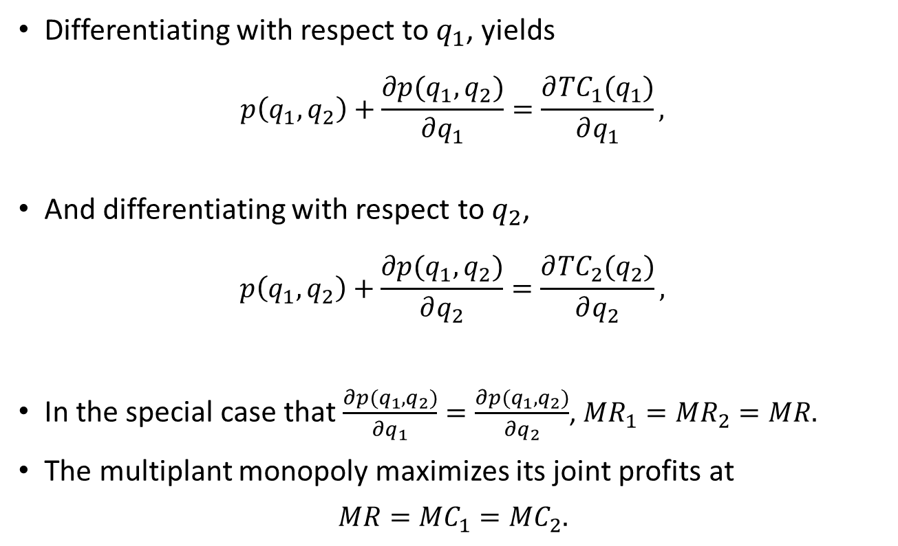



Multiplant Monopoly
Differentiating with respect to $q_{1}$, yields
$$p\left(q_{1},q_{2}\right)+\frac{∂p(q_{1},q_{2})}{∂q_{1}}=\frac{∂{TC}_{1}(q_{1})}{∂q_{1}},$$
And differentiating with respect to $q_{2}$,
$$p\left(q_{1},q_{2}\right)+\frac{∂p(q_{1},q_{2})}{∂q_{2}}=\frac{∂{TC}_{2}(q_{2})}{∂q_{2}},$$
In the special case that $\frac{∂p(q_{1},q_{2})}{∂q_{1}}=\frac{∂p(q_{1},q_{2})}{∂q_{2}}$, ${MR}_{1}={MR}_{2}=MR.$
The multiplant monopoly maximizes its joint profits at
$$MR={MC}_{1}={MC}_{2}.$$
$${MR}_{1}$$
$${MC}_{1}$$
$${MR}_{2}$$
$${MC}_{2}$$

Slide 51
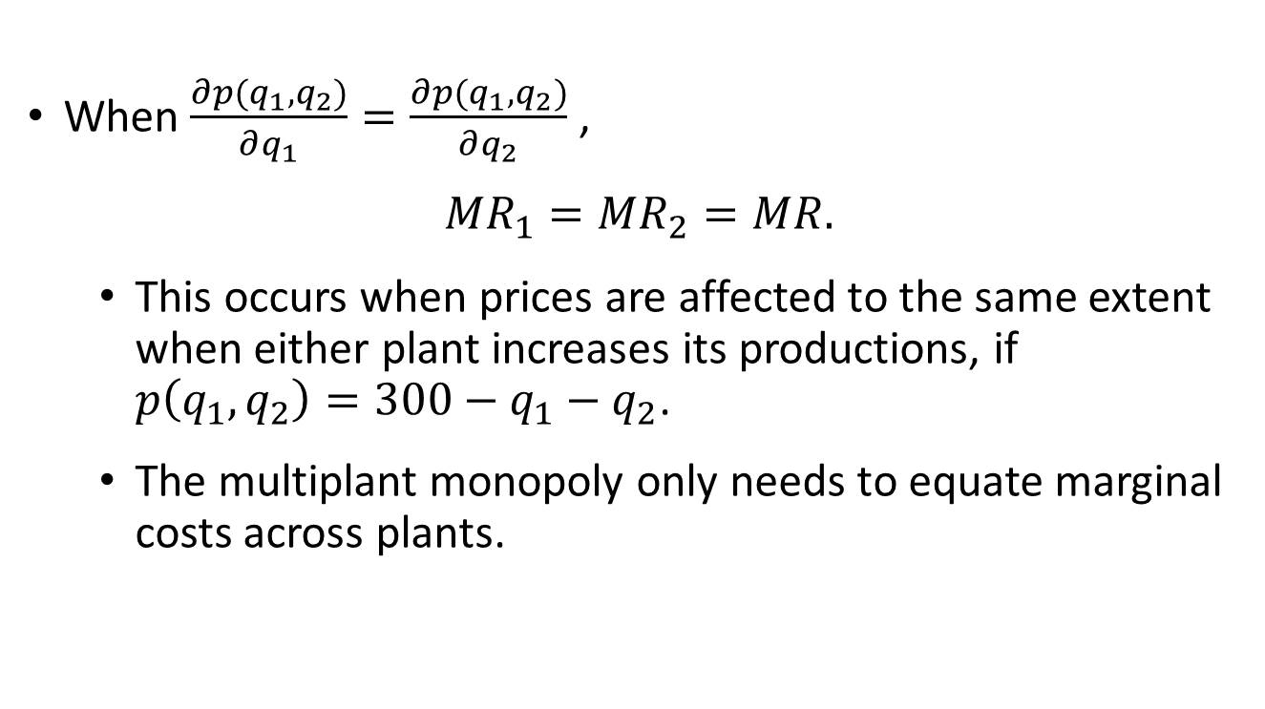
Multiplant Monopoly
When $\frac{∂p(q_{1},q_{2})}{∂q_{1}}=\frac{∂p(q_{1},q_{2})}{∂q_{2}}$,
$${MR}_{1}={MR}_{2}=MR.$$
  This occurs when prices are affected to the same extent when either plant increases its productions, if $p\left(q_{1},q_{2}\right)=300−q_{1}−q_{2}$.
  The multiplant monopoly only needs to equate marginal costs across plants.

Slide 52
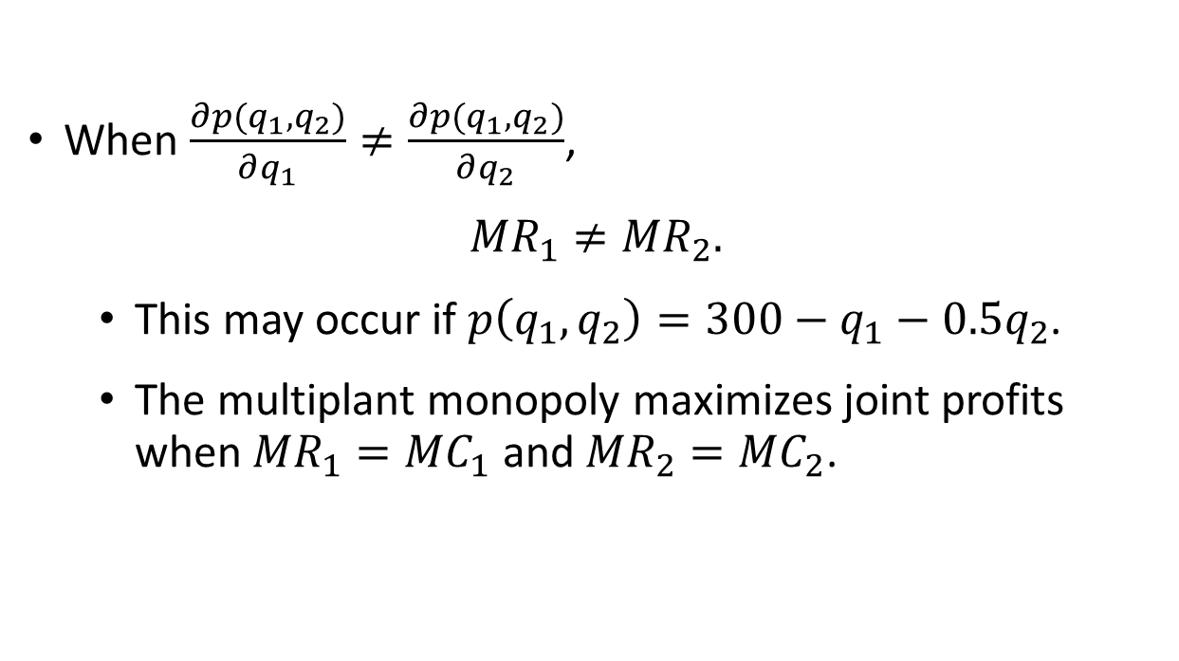
Multiplant Monopoly
When $\frac{∂p(q_{1},q_{2})}{∂q_{1}}≠\frac{∂p(q_{1},q_{2})}{∂q_{2}}$,
$${MR}_{1}≠{MR}_{2}.$$
  This may occur if $p\left(q_{1},q_{2}\right)=300−q_{1}−0.5q_{2}$.
  The multiplant monopoly maximizes joint profits when ${MR}_{1}={MC}_{1}$ and ${MR}_{2}={MC}_{2}$.

Slide 53

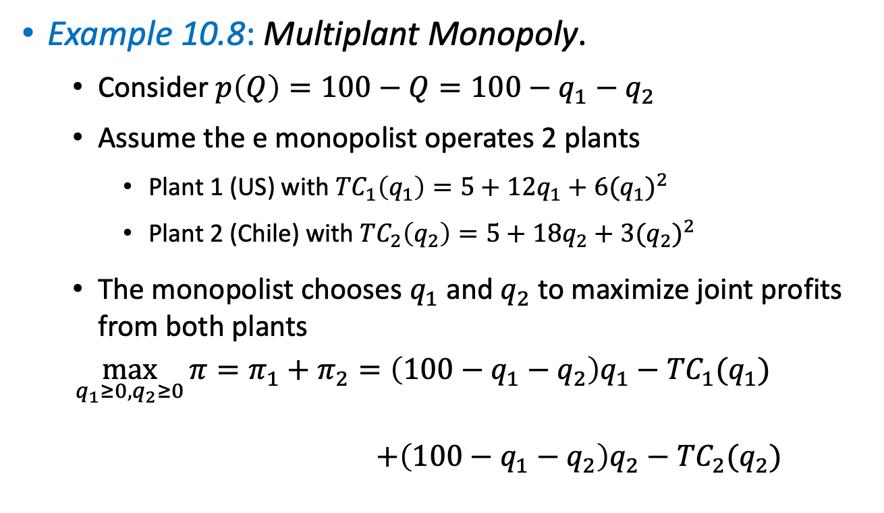

Multiplant Monopoly
Example 10.8: Multiplant Monopoly.
  Consider $p\left(Q\right)=100−Q=100−q_{1}−q_{2}$
  Assume the e monopolist operates 2 plants
    Plant 1 (US) with ${TC}_{1}\left(q_{1}\right)=5+12q_{1}+6{(q_{1})}^{2}$
    Plant 2 (Chile) with ${TC}_{2}\left(q_{2}\right)=5+18q_{2}+3{(q_{2})}^{2}$
  The monopolist chooses $q_{1}$ and $q_{2}$ to maximize joint profits from both plants
  $$\max_{q_{1}≥0, q_{2}≥0}{π}=π_{1}+π_{2}=\left(100−q_{1}−q_{2}\right)q_{1}−{TC}_{1}(q_{1})$$
  $$+\left(100−q_{1}−q_{2}\right)q_{2}−{TC}_{2}(q_{2})$$
$$π_{1}$$
$$π_{2}$$

Slide 54
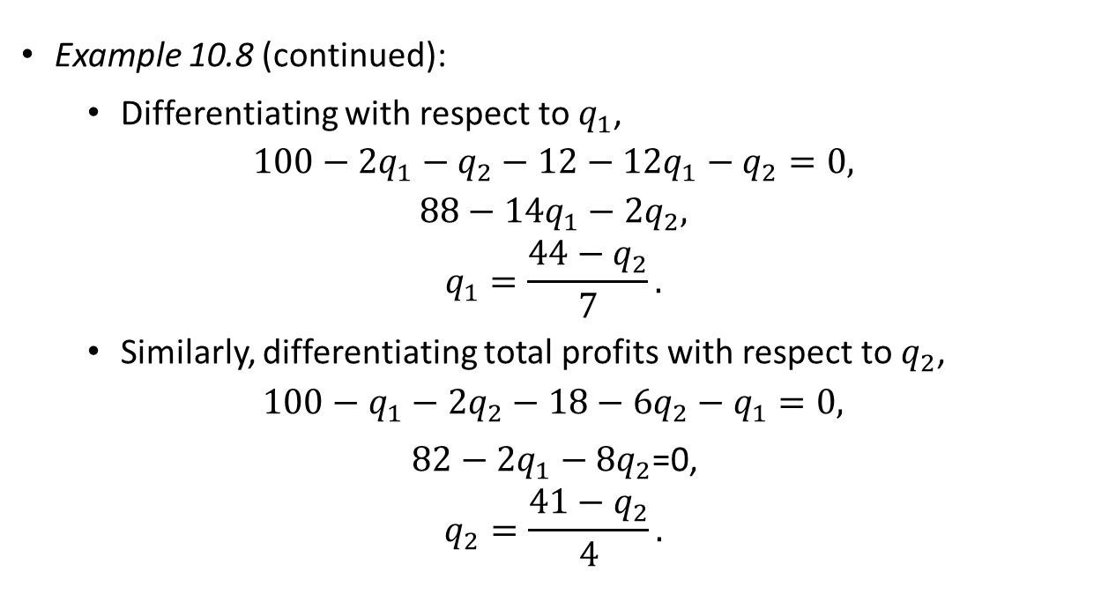
Multiplant Monopoly
Example 10.8 (continued):
  Differentiating with respect to $q_{1}$,
  $$100−{2q}_{1}−q_{2}−12−12q_{1}−q_{2}=0,$$
  $$88−14q_{1}−2q_{2},$$
  $$q_{1}=\frac{44−q_{2}}{7}.$$
  Similarly, differentiating total profits with respect to $q_{2}$,
  $$100−q_{1}−2q_{2}−18−6q_{2}−q_{1}=0,$$
  $82−2q_{1}−8q_{2}$=0,
  $$q_{2}=\frac{41−q_{2}}{4}.$$

Slide 55
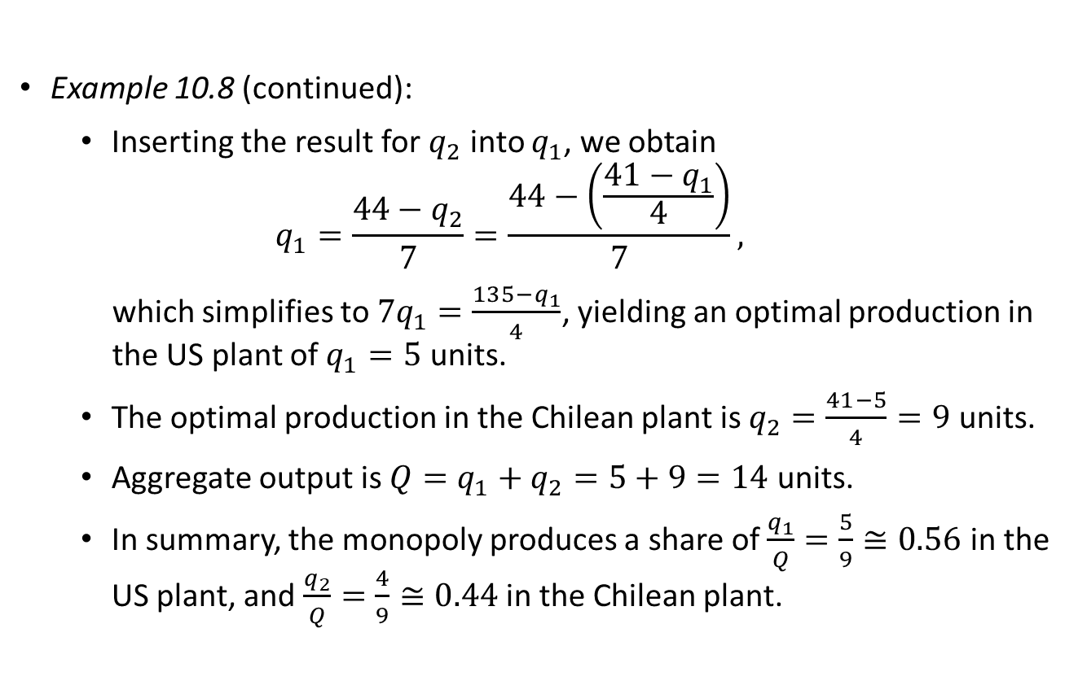
Multiplant Monopoly
Example 10.8 (continued):
  Inserting the result for $q_{2}$ into $q_{1}$, we obtain
  $$q_{1}=\frac{44−q_{2}}{7}=\frac{44−\left(\frac{41−q_{1}}{4}\right)}{7},$$
  which simplifies to $7q_{1}=\frac{135−q_{1}}{4}$, yielding an optimal production in the US plant of $q_{1}=5$ units.
  The optimal production in the Chilean plant is $q_{2}=\frac{41−5}{4}=9$ units.
  Aggregate output is $Q=q_{1}+q_{2}=5+9=14$ units.
  In summary, the monopoly produces a share of $\frac{q_{1}}{Q}=\frac{5}{9}≅0.56$ in the US plant, and $\frac{q_{2}}{Q}=\frac{4}{9}≅0.44$ in the Chilean plant.

Slide 56
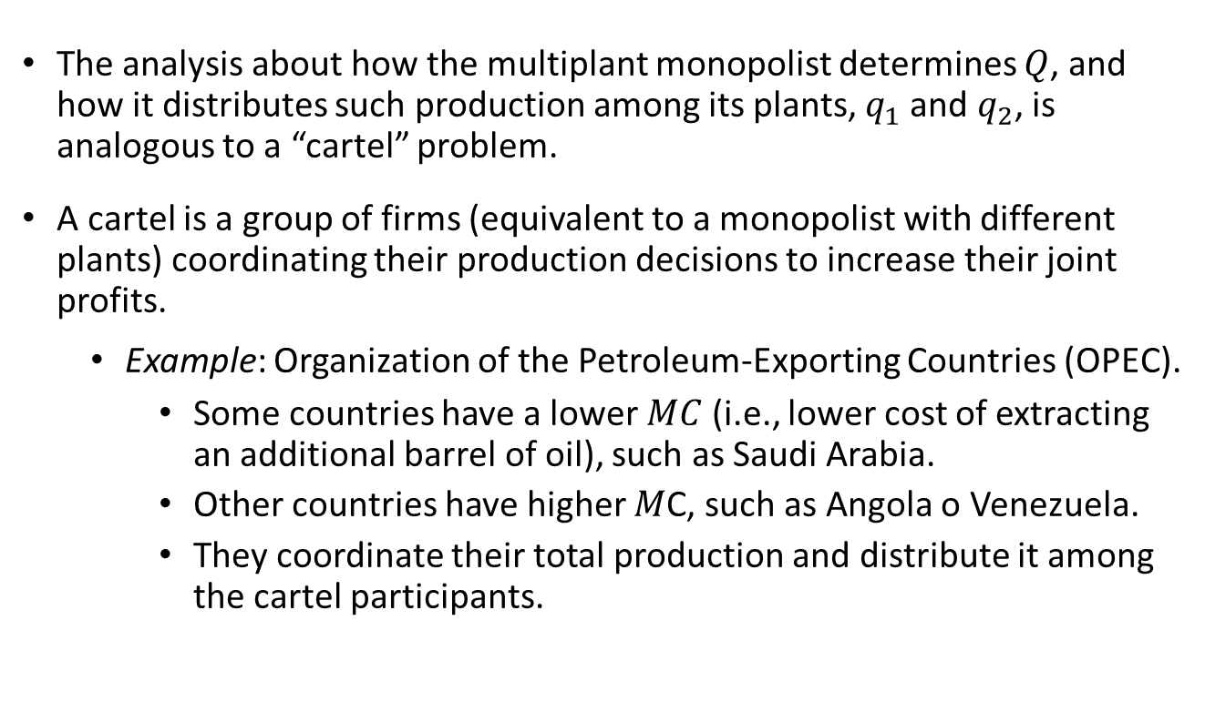
Multiplant Monopoly
The analysis about how the multiplant monopolist determines $Q$, and how it distributes such production among its plants, $q_{1}$and $q_{2}$, is analogous to a “cartel” problem.
A cartel is a group of firms (equivalent to a monopolist with different plants) coordinating their production decisions to increase their joint profits.
  Example: Organization of the Petroleum-Exporting Countries (OPEC).
    Some countries have a lower $MC$ (i.e., lower cost of extracting an additional barrel of oil), such as Saudi Arabia.
    Other countries have higher $M$C, such as Angola o Venezuela.
    They coordinate their total production and distribute it among the cartel participants.

Slide 57
Welfare Analysis under Monopoly

Slide 58
Welfare Analysis
Output is lower under monopoly than under perfectly competitive industries, entailing a higher price.
Consumer surplus is much smaller than under perfect competition because customers pay more per unit and buy fewer units.
In contrast, profits are larger.
However, the firm’s profit gain does not compensate for the loss in consumer surplus, yielding a net loss in social welfare.

Slide 59
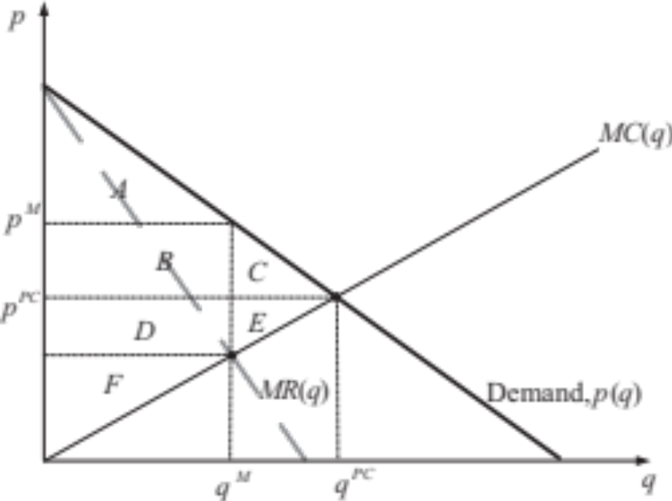
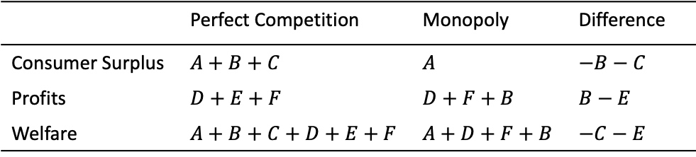
Welfare Analysis
Figure 10.3
Table 10.1
 | Perfect Competition | Monopoly | Difference
Consumer Surplus | $$A+B+C$$ | $$A$$ | $$−B−C$$
Profits | $$D+E+F$$ | $$D+F+B$$ | $$B−E$$
Welfare | $$A+B+C+D+E+F$$ | $$A+D+F+B$$ | $$−C−E$$
“Deadweight loss”

Slide 60
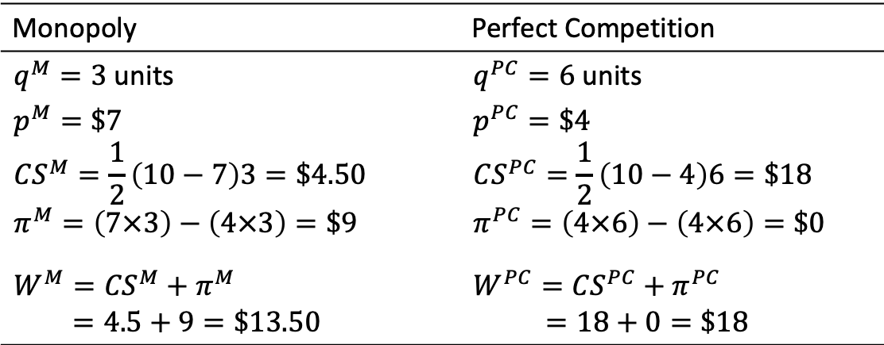
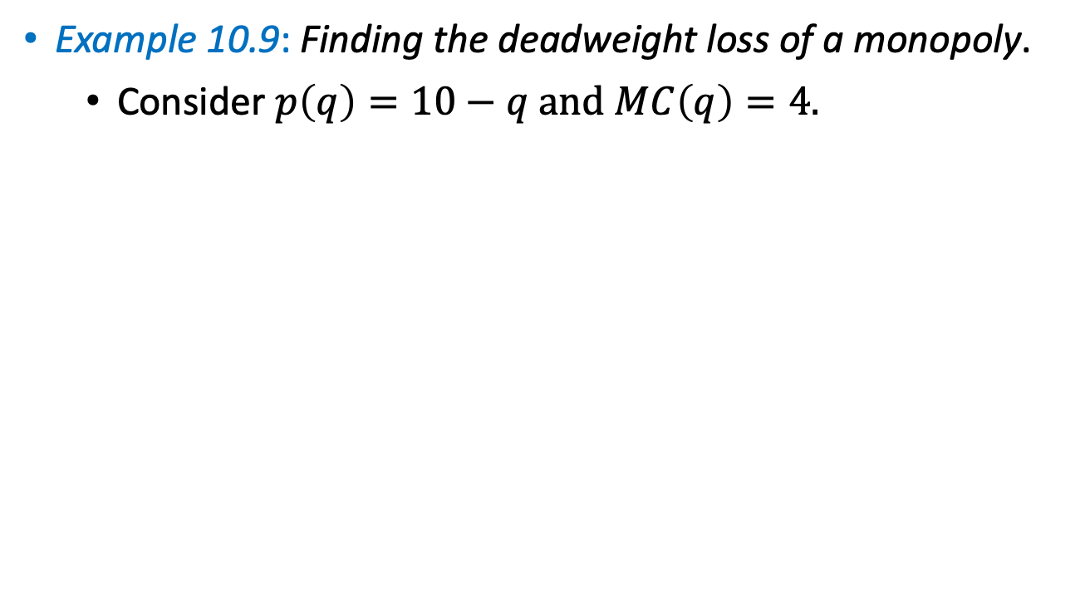

Welfare Analysis
Example 10.9: Finding the deadweight loss of a monopoly.
  Consider $p\left(q\right)=10−q$ and $MC\left(q\right)=4.$
Monopoly | Perfect Competition
$q^{M}=3$ units $$p^{M}=\$7$$ $${CS}^{M}=\frac{1}{2}\left(10−7\right)3=\$4.50$$ $$π^{M}=\left(7×3\right)−\left(4×3\right)=\$9$$ $$W^{M}={CS}^{M}+π^{M}$$ $$=4.5+9=\$13.50$$ | $q^{PC}=6$ units $$p^{PC}=\$4$$ $${CS}^{PC}=\frac{1}{2}\left(10−4\right)6=\$18$$ $$π^{PC}=\left(4×6\right)−\left(4×6\right)=\$0$$ $$W^{PC}={CS}^{PC}+π^{PC}$$ $=18+0=\$18$
$$W^{PC}−W^{M}=18−13.50=\$4.50.$$

Slide 61
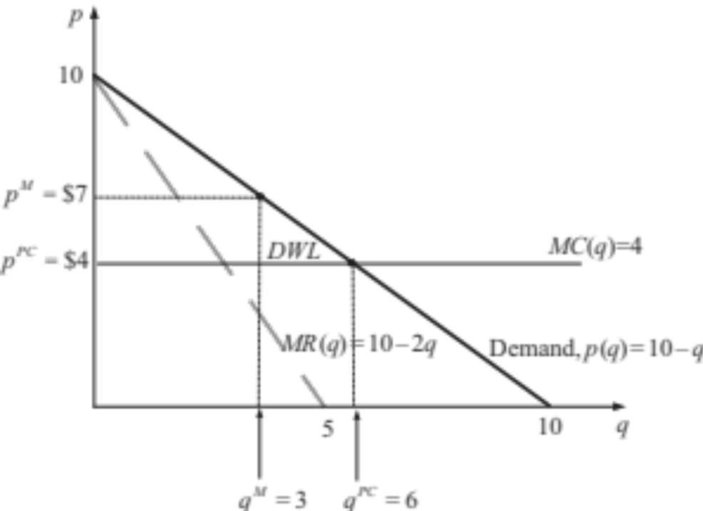
Welfare Analysis
Example 10.9 (continued):
  Deadweight loss under this monopoly is
$$DWL=\frac{1}{2}\left[p^{M}−MC(q^{M})\right]\left(q^{PC}−q^{M}\right)=\frac{1}{2}\left(\$7−\$4\right)\left(6−3\right)=\frac{9}{2}=\$4.50$$
height
base
Figure 10.4

Slide 62

Advertising in Monopoly

Slide 63
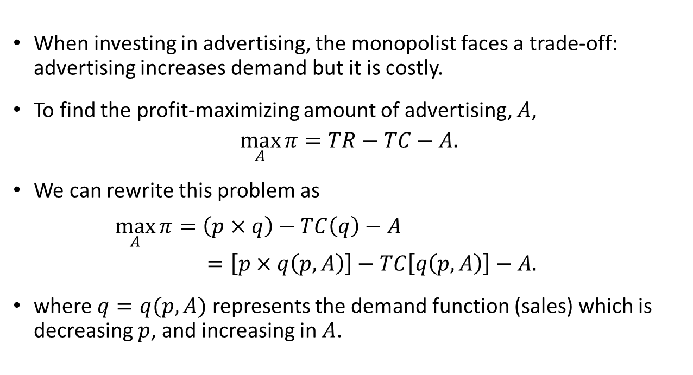
Advertising in Monopoly
When investing in advertising, the monopolist faces a trade-off: advertising increases demand but it is costly.
To find the profit-maximizing amount of advertising, $A$,
$$\max_{A}{π}=TR−TC−A.$$
We can rewrite this problem as
$\max_{A}{π}=\left(p×q\right)−TC\left(q\right)−A$
$$=\left[p×q\left(p,A\right)\right]−TC\left[q\left(p,A\right)\right]−A.$$
where $q=q(p,A)$ represents the demand function (sales) which is decreasing $p$, and increasing in $A$.

Slide 64
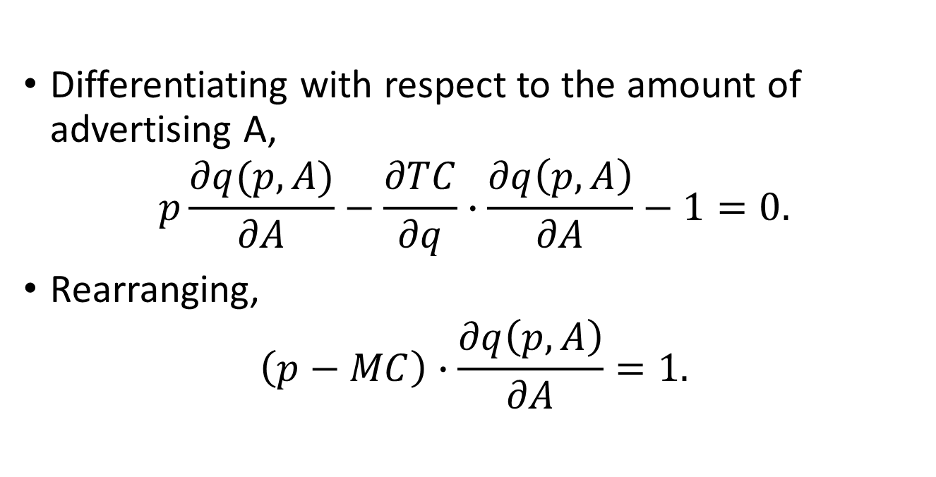
Advertising in Monopoly
Differentiating with respect to the amount of advertising A,
$$p\frac{∂q(p,A)}{∂A}−\frac{∂TC}{∂q}∙\frac{∂q\left(p,A\right)}{∂A}−1=0.$$
Rearranging,
$$\left(p−MC\right)∙\frac{∂q\left(p,A\right)}{∂A}=1.$$

Slide 65
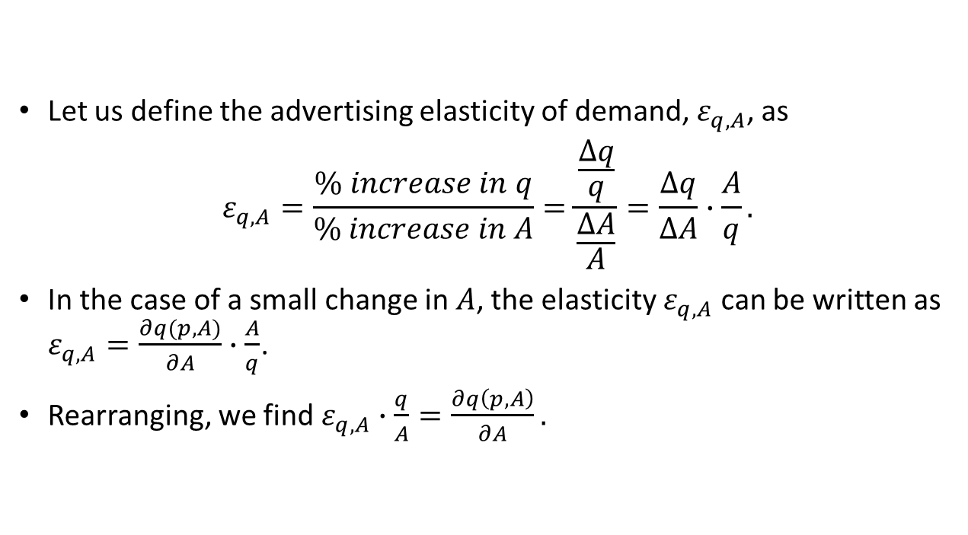
Advertising in Monopoly
Let us define the advertising elasticity of demand, $ε_{q,A}$, as
$$ε_{q,A}=\frac{\% increase in q}{\% increase in A}=\frac{\frac{Δq}{q}}{\frac{ΔA}{A}}=\frac{Δq}{ΔA}∙\frac{A}{q}.$$
In the case of a small change in $A$, the elasticity $ε_{q,A}$ can be written as $ε_{q,A}=\frac{∂q(p,A)}{∂A}∙\frac{A}{q}$.
Rearranging, we find $ε_{q,A}∙\frac{q}{A}=\frac{∂q\left(p,A\right)}{∂A}.$

Slide 66

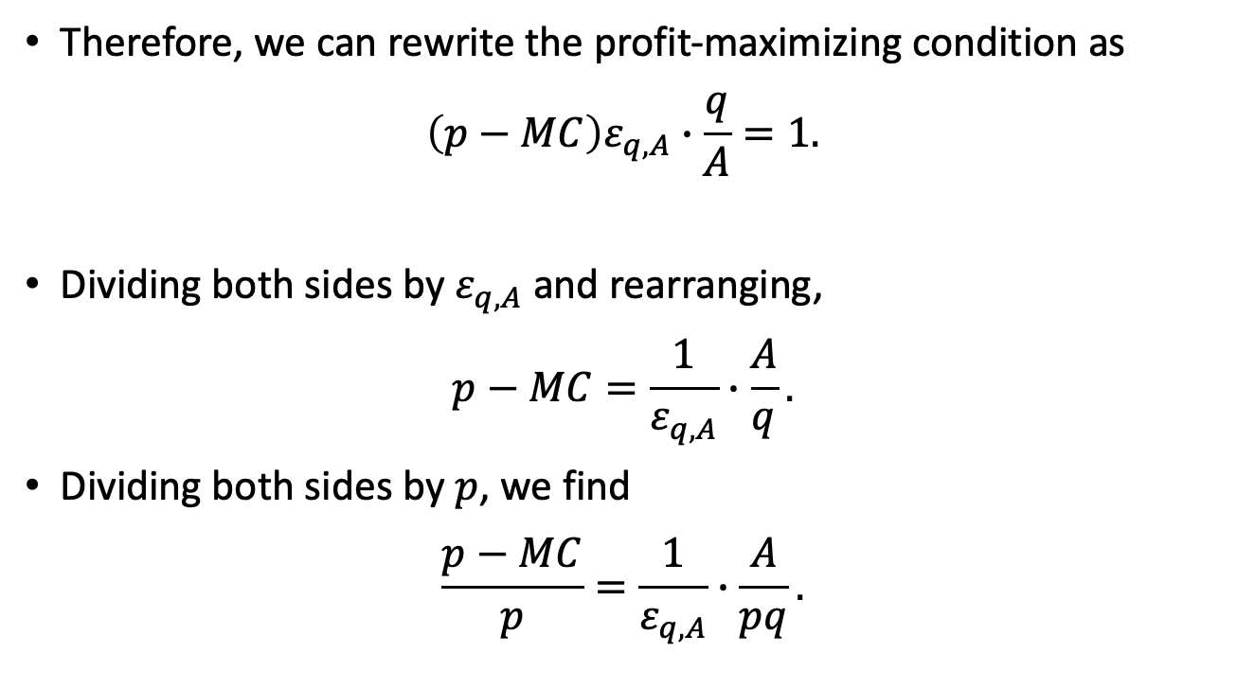
Advertising in Monopoly
Therefore, we can rewrite the profit-maximizing condition as
$$\left(p−MC\right)ε_{q,A}∙\frac{q}{A}=1.$$
Dividing both sides by $ε_{q,A}$ and rearranging,
$$p−MC=\frac{1}{ε_{q,A}}∙\frac{A}{q}.$$
Dividing both sides by $p$, we find
$$\frac{p−MC}{p}=\frac{1}{ε_{q,A}}∙\frac{A}{pq}.$$
$$\frac{∂q\left(p,A\right)}{∂A}$$

Slide 67

Advertising in Monopoly
From the IERP, we know
$\frac{p−MC}{p}=−\frac{1}{ε_{q,p}}.$
Hence,
$$−\frac{1}{ε_{q,p}}=\frac{1}{ε_{q,A}}∙\frac{A}{pq}.$$
$$−\frac{ε_{q,A}}{ε_{q,p}}=\frac{A}{pq}.$$
  The right side represents the advertising-to-sales ratio.
  For two markets with the same $ε_{q,p}$, the advertising-to-sales ratio must be larger in the market where demand is more sensitive to advertising (higher $ε_{q,A}$).

Slide 68

Advertising in Monopoly
Example 10.11: Monopolist’s optimal advertising ratio.
  Consider a monopolist with price elasticity of demand of $ε_{q,p}=−1.5$ and advertising elasticity $ε_{q,A}=0.1$.
  The advertising-to-sales ratio should be
  $$\frac{A}{pq}=−\frac{ε_{q,A}}{ε_{q,p}}$$
  $$=−\frac{0.1}{−1.5}=0.067.$$
  Advertising should account for 6.7% of this monopolist’s total revenue.

Slide 69

Monopsony

Slide 70
Monopsony
Monopsony: only one buyer in the market and several sellers.
Examples: small labor markets, such as a mine or Walmart superstore in a small town.
The buyer (employer) will be able to pay less for each hour of labor (lower wages) than if it had to compete against other employers, as in a perfectly competitive market.

Slide 71


Slide 72


Slide 73

Monopsony
Consider a firm (e.g., a coal mine) with production function $q=f(L)$, which:
  increases with the number of workers hired, $f^{′}\left(L\right)>0$ ,
  but at a decreasing rate, $f^{′′}\left(L\right)<0$.
The profits of the coal mine is given by
$π=TR−TC=pq−w\left(L\right)L.$
  The firm extracts $q$ units of coal, each sold at price$p$, yielding $TR=pq$.
  The firm hires $L$ workers, paying each of them a wage of $w(L)$.
    $w^{′}\left(L\right)>0$, as the firm hires more workers, labor becomes scarce, and a more generous wage must be offered to attract new workers.

Slide 74



Monopsony
The monopsonist’s PMP is
$$\max_{L≥0}{ π=pq−w\left(L\right)L=pf\left(L\right)−w\left(L\right)L.}$$
  Intuitively, this problem says “choose the number of workers you plan to hire, $L$, so as to maximize your profits.”
Differentiating with respect to $L$,
$$pf^{′}\left(L\right)−\left[w\left(L\right)+w^{′}\left(L\right)L\right]=0.$$
Rearranging,
$$pf^{′}\left(L\right)=w\left(L\right)+w^{′}\left(L\right)L.$$
$${MRP}_{L}$$
$${ME}_{L}$$

Slide 75



Monopsony
$$pf^{′}\left(L\right)=w\left(L\right)+w^{′}\left(L\right)L.$$
${MRP}_{L}$ (“marginal revenue product” of labor):
  After hiring 1 more worker (increase in $L$), the firm produces $f’(L)$more units of output (e.g., coal), sold at a price $p$.
${ME}_{L}$ (“marginal expenditure” on labor). After hiring 1 more worker, the firm experiences an increase in cost:
  This extra worker must be paid $w(L)$.
  The additional worker is only attracted to the job if the firm offers her a higher salary because labor becomes scarcer. Such a wage increase, $w’(L)$, must be passed on to all existing worker, entailing a cost increase of $w’(L)L$.
$${MRP}_{L}$$
$${ME}_{L}$$

Slide 76

Monopsony
Example 10.12: Finding optimal $L$ in monopsony.
  Consider a coal company in a small town with production function $q=100×ln(L)$.
  It faces an international perfectly competitive price of coal, $p=\$8$.
  Assume the supply curve for labor is $w\left(L\right)=3+\frac{1}{2}L$. Then,
  $${MRP}_{L}=pf^{′}\left(L\right)=8×100\frac{1}{L}=\frac{800}{L}.$$
  $${ME}_{L}=w\left(L\right)+w^{′}\left(L\right)L=\left(3+\frac{1}{2}L\right)+\frac{1}{2}L=3+L.$$

Slide 77

Monopsony
Example 10.12 (continued):
Figure 10.5

Slide 78

Monopsony
Example 10.12 (continued):
  Setting ${MRP}_{L}={ME}_{L}$,
  $$\frac{800}{L}=3+L,$$
  which expanding yields $800=3L+L^{2}$ or
  $$L^{2}+3L−800=0.$$
  Solving for $L$, we find $L=−29.82$ and $L=26.82$. Because the firm must hire a positive number of workers (or zero), we find that $L^{M}=26$ workers is optimal.
  At $L^{M}=26$, wages become $w\left(26\right)=3+26×\frac{1}{2}=\$16$.

Slide 79

Monopsony
Example 10.12 (continued):
  Under a perfectly competitive labor market, we have ${MRP}_{L}=w(L)$, that is,
  $$\frac{800}{L}=3+\frac{1}{2}L,$$
  which expanding yields $800=3L+\frac{L^{2}}{2}.$
  Solving for $L$, we obtain $L=−43.11$ and $L=37.11$. Then $L^{PC}=37$ is the optimal number of workers.
  At $L^{PC}=37$, wages become $w(37)=3+\frac{1}{2}37=\$21.5$.

