Slide 1
Intermediate Microeconomic
Theory
Tools and Step-by-Step Examples
Chapter 8:
Cost Minimization

Slide 2
Outline
Isocost Lines
Cost-Minimization Problem
Input Demands
Cost Functions
Type of Costs
Average and Marginal Cost
Economies of Scale, Scope, and Experience
Appendix. Cost-Minimization Problem–A Lagrangian Analysis

Slide 3
Isocost Lines

Slide 4
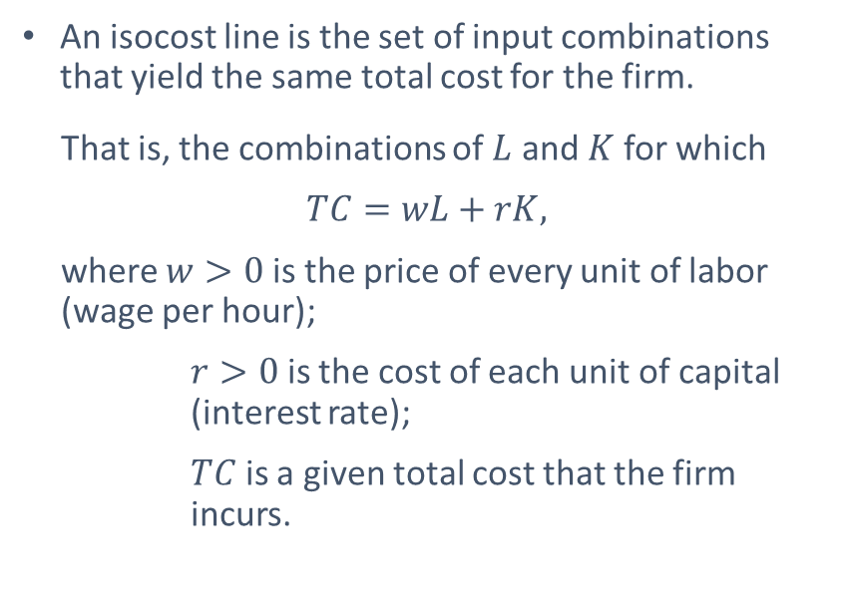
Isocost Lines
An isocost line is the set of input combinations that yield the same total cost for the firm.
That is, the combinations of $L$ and $K$ for which
$$TC=wL+rK,$$
where $w>0$ is the price of every unit of labor (wage per hour);
$r>0$ is the cost of each unit of capital (interest rate);
$TC$ is a given total cost that the firm incurs.

Slide 5
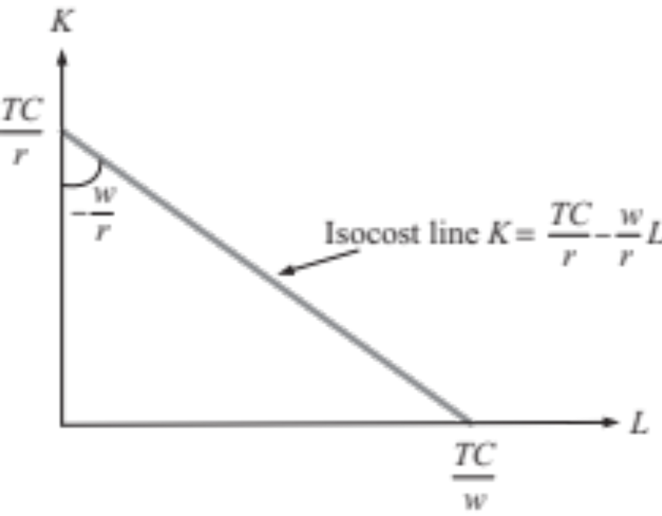
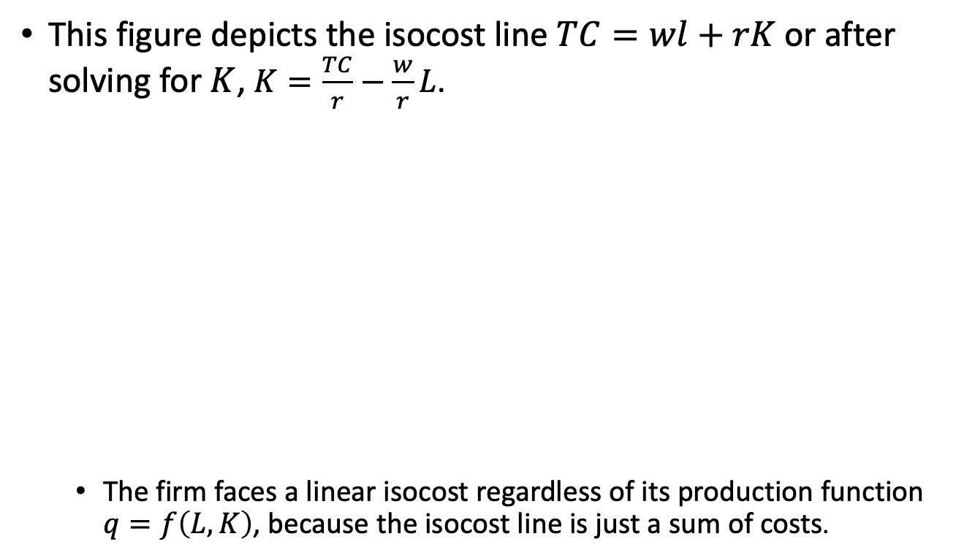
Isocost Lines
This figure depicts the isocost line $TC=wl+rK$ or after solving for $K$, $K=\frac{TC}{r}−\frac{w}{r}L$.
  The firm faces a linear isocost regardless of its production function $q=f\left(L,K\right)$, because the isocost line is just a sum of costs.
Vertical
intercept
Slope
Figure 8.1a

Slide 6
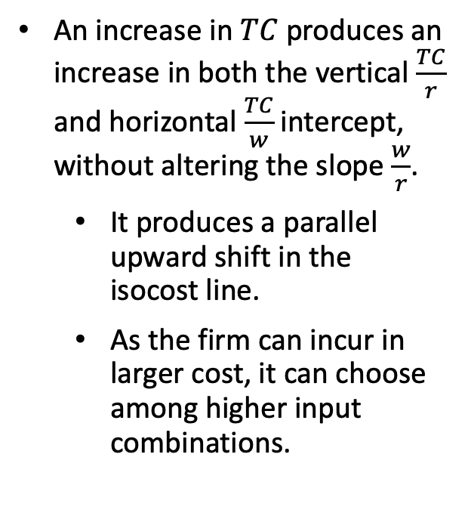
Isocost Lines
An increase in $TC$ produces an increase in both the vertical $\frac{TC}{r}$ and horizontal $\frac{TC}{w}$intercept, without altering the slope $\frac{w}{r}$.
  It produces a parallel upward shift in the isocost line.
  As the firm can incur in larger cost, it can choose among higher input combinations.
Figure 8.1a

Slide 7
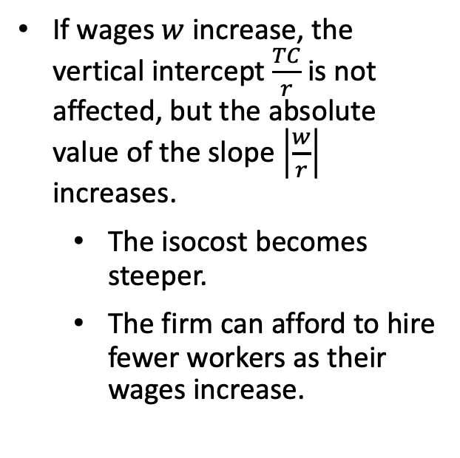
Isocost Lines
If wages $w$ increase, the vertical intercept $\frac{TC}{r}$is not affected, but the absolute value of the slope $\left|\frac{w}{r}\right|$ increases.
  The isocost becomes steeper.
  The firm can afford to hire fewer workers as their wages increase.
Figure 8.1a

Slide 8
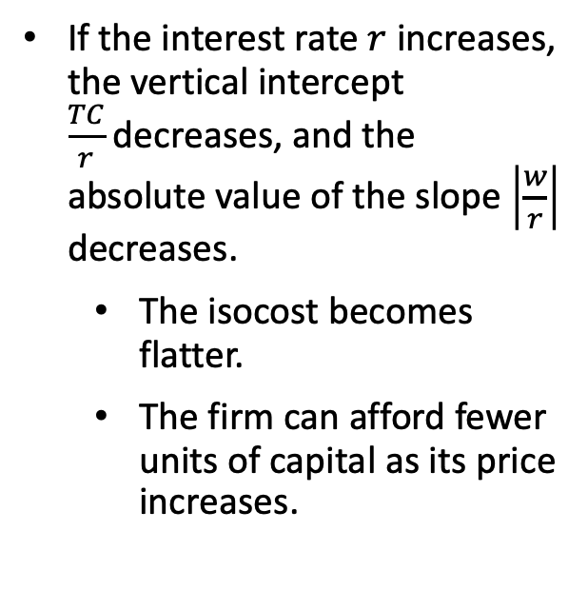
Isocost Lines
If the interest rate $r$ increases, the vertical intercept $\frac{TC}{r}$decreases, and the absolute value of the slope $\left|\frac{w}{r}\right|$ decreases.
  The isocost becomes flatter.
  The firm can afford fewer units of capital as its price increases.
Figure 8.1a

Slide 9
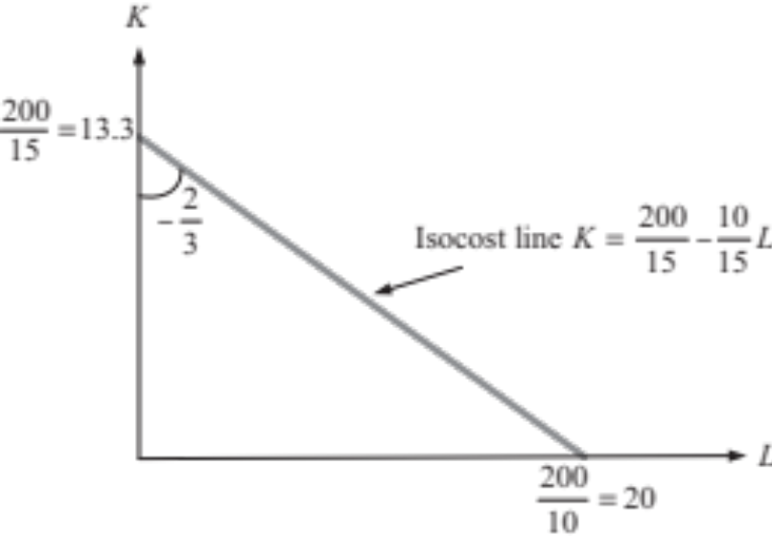
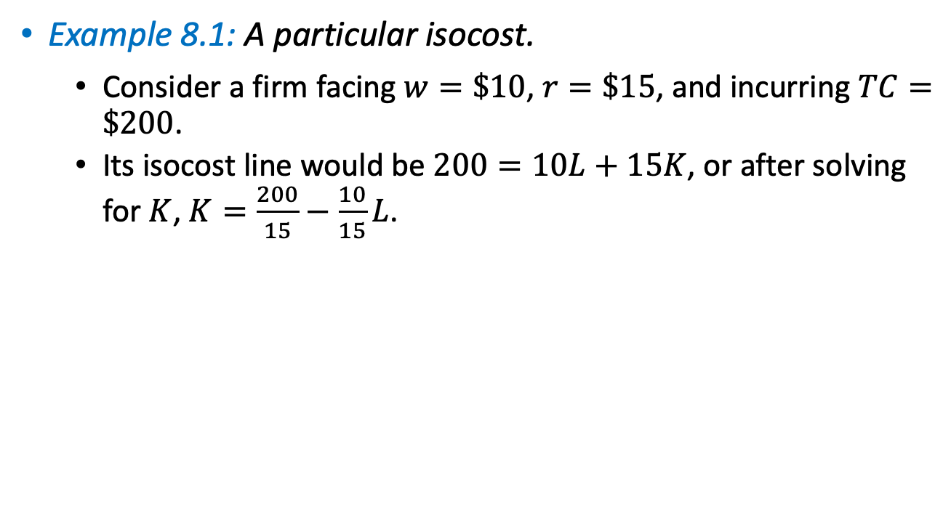
Isocost Lines
Example 8.1: A particular isocost.
  Consider a firm facing $w=\$10$, $r=\$15$, and incurring $TC=\$200$.
  Its isocost line would be $200=10L+15K$, or after solving for $K$, $K=\frac{200}{15}−\frac{10}{15}L$.
Vertical
intercept
Slope
Figure 8.1b

Slide 10

Cost-Minimization Problem

Slide 11
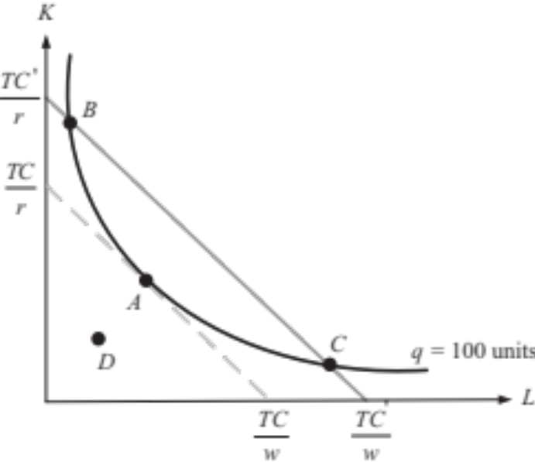
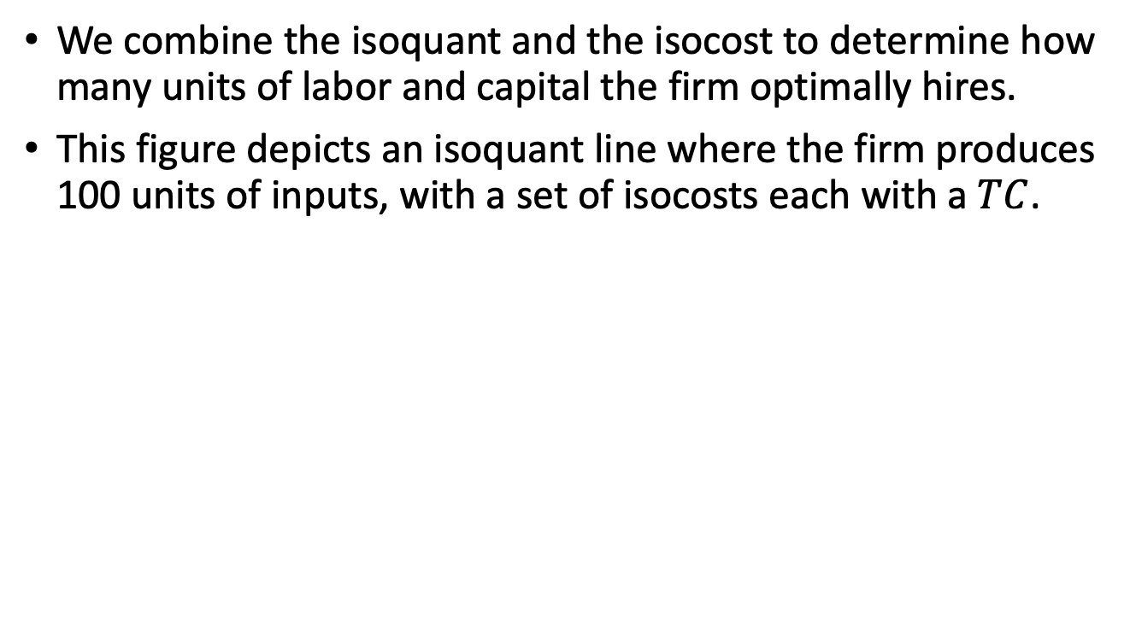
Cost-Minimization Problem
We combine the isoquant and the isocost to determine how many units of labor and capital the firm optimally hires.
This figure depicts an isoquant line where the firm produces 100 units of inputs, with a set of isocosts each with a $TC$.
Figure 8.2

Slide 12
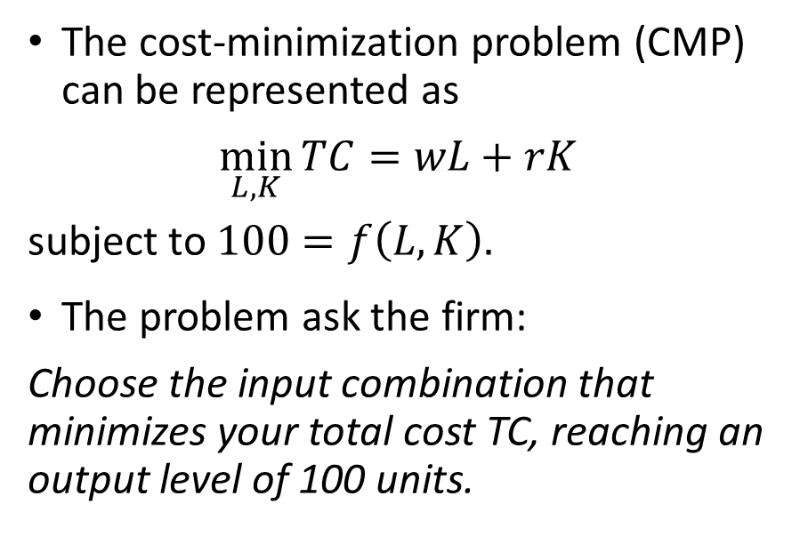
Cost-Minimization Problem
The cost-minimization problem (CMP) can be represented as
$$\min_{L,K}{TC=wL+rK}$$
subject to $100=f\left(L,K\right).$
The problem ask the firm:
Choose the input combination that minimizes your total cost TC, reaching an output level of 100 units.

Slide 13

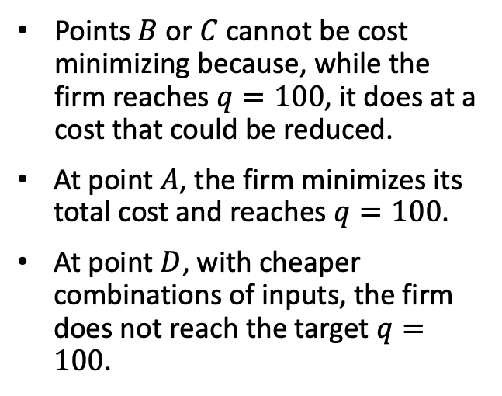
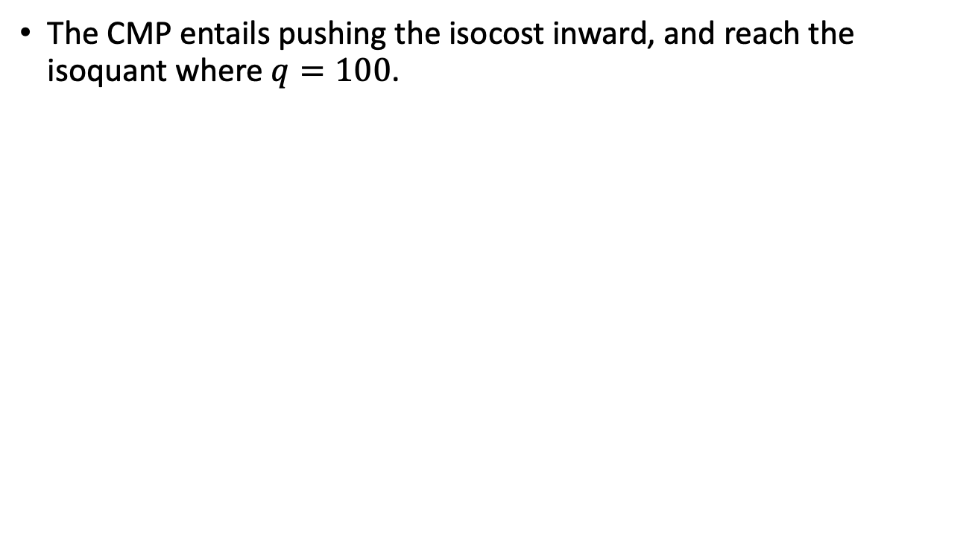
Cost-Minimization Problem
The CMP entails pushing the isocost inward, and reach the isoquant where $q=100$.
Points $B$ or $C$ cannot be cost minimizing because, while the firm reaches $q=100$, it does at a cost that could be reduced.
At point $A$, the firm minimizes its total cost and reaches $q=100$.
At point $D$, with cheaper combinations of inputs, the firm does not reach the target $q=100$.
Figure 8.2

Slide 14


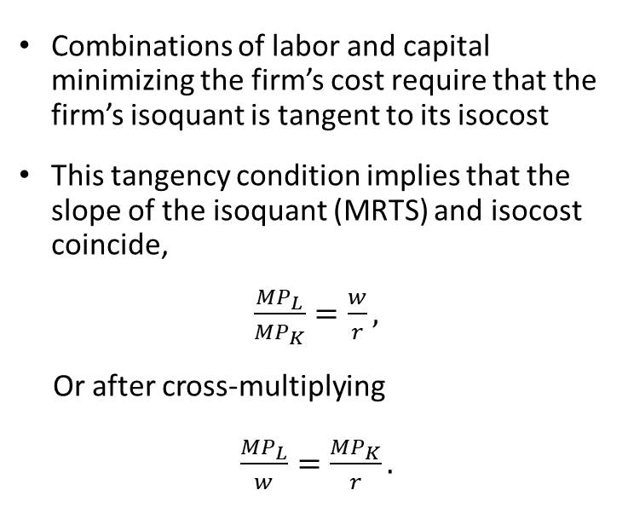
Cost-Minimization Problem
Combinations of labor and capital minimizing the firm’s cost require that the firm’s isoquant is tangent to its isocost
This tangency condition implies that the slope of the isoquant (MRTS) and isocost coincide,
$\frac{{MP}_{L}}{{MP}_{K}}=\frac{w}{r},$
Or after cross-multiplying
$\frac{{MP}_{L}}{w}=\frac{{MP}_{K}}{r}.$

Slide 15
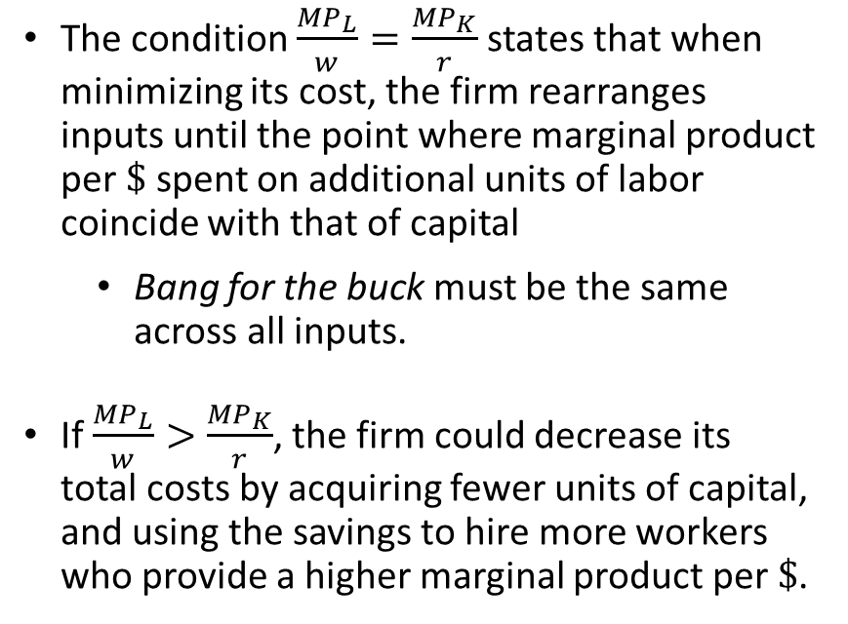
Cost-Minimization Problem
The condition $\frac{{MP}_{L}}{w}=\frac{{MP}_{K}}{r}$ states that when minimizing its cost, the firm rearranges inputs until the point where marginal product per $\$$ spent on additional units of labor coincide with that of capital
  Bang for the buck must be the same across all inputs.
If $\frac{{MP}_{L}}{w}>\frac{{MP}_{K}}{r}$, the firm could decrease its total costs by acquiring fewer units of capital, and using the savings to hire more workers who provide a higher marginal product per $\$$.

Slide 16
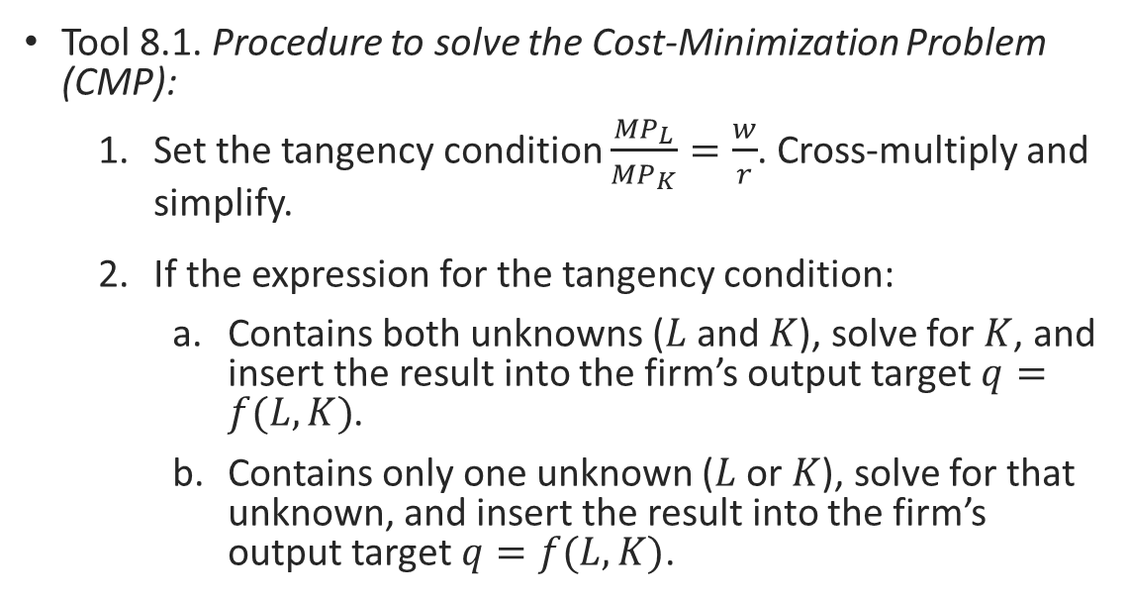
Cost-Minimization Problem
Tool 8.1. Procedure to solve the Cost-Minimization Problem (CMP):
  Set the tangency condition $\frac{{MP}_{L}}{{MP}_{K}}=\frac{w}{r}$. Cross-multiply and simplify.
  If the expression for the tangency condition:
    Contains both unknowns ($L$ and $K$), solve for $K$, and insert the result into the firm’s output target $q=f(L,K)$.
    Contains only one unknown ($L$ or $K$), solve for that unknown, and insert the result into the firm’s output target $q=f(L,K)$.

Slide 17
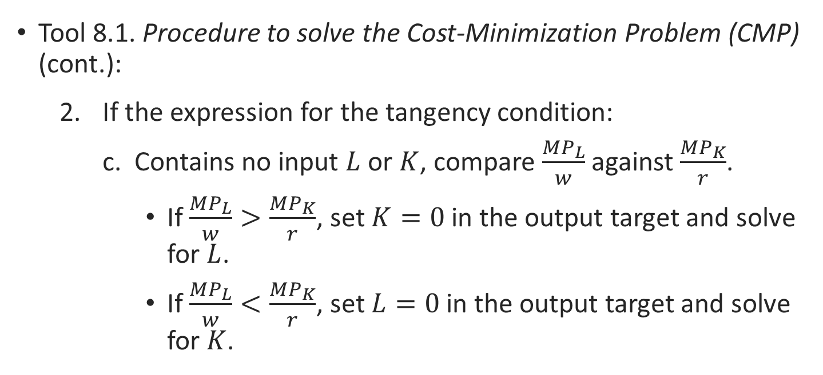
Cost-Minimization Problem
Tool 8.1. Procedure to solve the Cost-Minimization Problem (CMP) (cont.):
  If the expression for the tangency condition:
    Contains no input $L$ or $K$, compare $\frac{{MP}_{L}}{w}$ against $\frac{{MP}_{K}}{r}$.
      If $\frac{{MP}_{L}}{w}>\frac{{MP}_{K}}{r}$, set $K=0$ in the output target and solve for $L$.
      If $\frac{{MP}_{L}}{w}<\frac{{MP}_{K}}{r}$, set $L=0$ in the output target and solve for $K$.

Slide 18
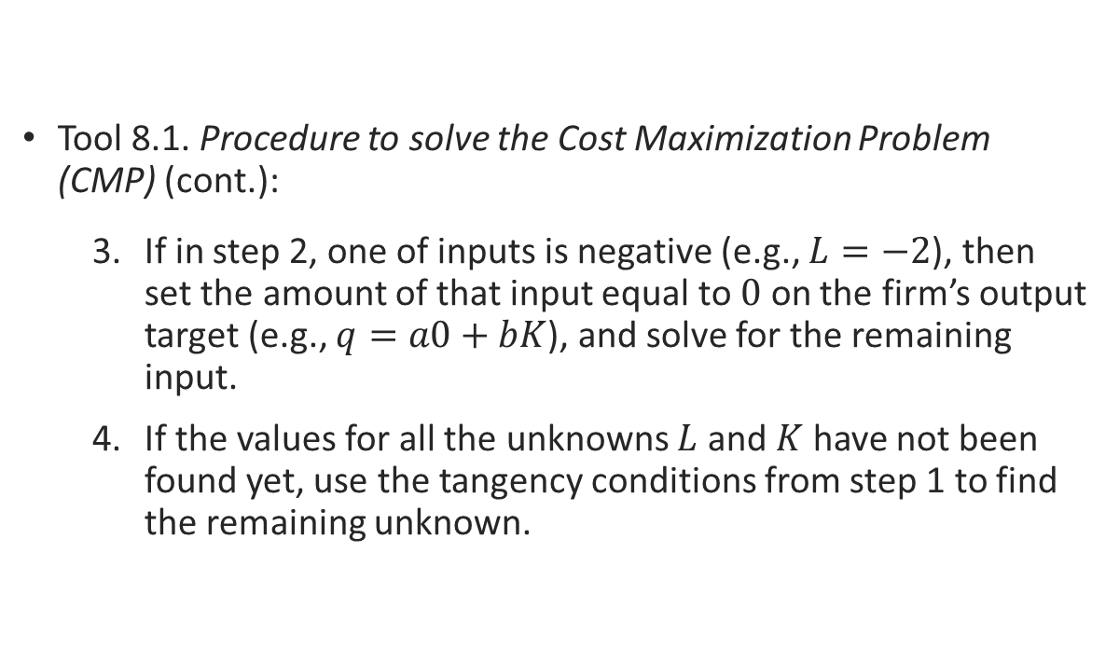
Cost-Minimization Problem
Tool 8.1. Procedure to solve the Cost Maximization Problem (CMP) (cont.):
  If in step 2, one of inputs is negative (e.g., $L=−2$), then set the amount of that input equal to $0$ on the firm’s output target (e.g., $q=a0+bK$), and solve for the remaining input.
  If the values for all the unknowns $L$ and $K$ have not been found yet, use the tangency conditions from step 1 to find the remaining unknown.

Slide 19
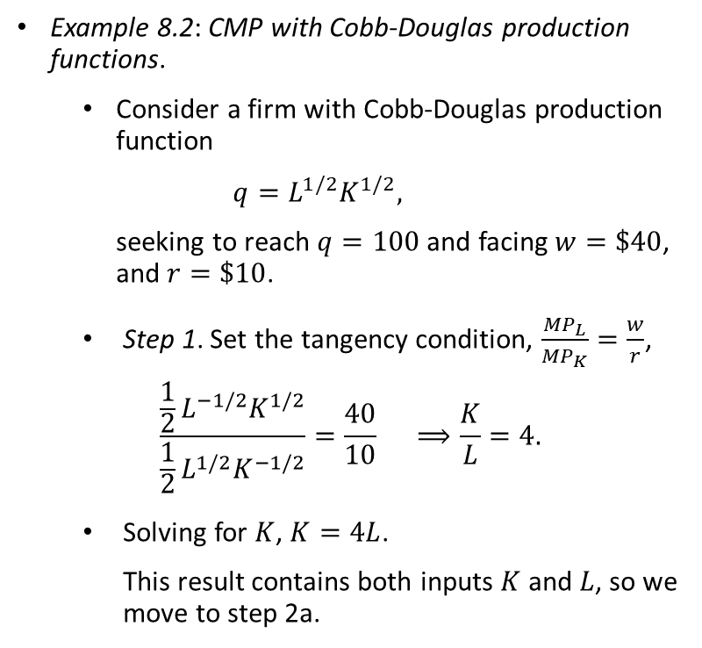
Cost-Minimization Problem
Example 8.2: CMP with Cobb-Douglas production functions.
  Consider a firm with Cobb-Douglas production function
  $$q=L^{1/2}K^{1/2},$$
  seeking to reach $q=100$ and facing $w=\$40$, and $r=\$10$.
Step 1. Set the tangency condition, $\frac{{MP}_{L}}{{MP}_{K}}=\frac{w}{r}$,
$$\frac{\frac{1}{2}L^{−1/2}K^{1/2}}{\frac{1}{2}L^{1/2}K^{−1/2}}=\frac{40}{10} ⟹\frac{K}{L}=4.$$
Solving for $K$, $K=4L$.
This result contains both inputs $K$ and $L$, so we move to step 2a.

Slide 20

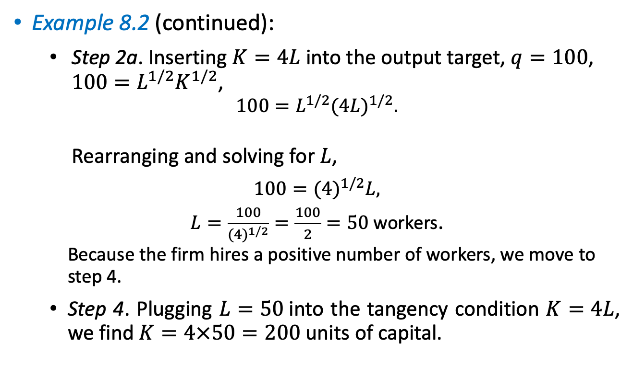
Cost-Minimization Problem
Example 8.2 (continued):
Step 2a. Inserting $K=4L$ into the output target, $q=100$, $100=L^{1/2}K^{1/2}$,
$$100=L^{1/2}{(4L)}^{1/2}.$$
Rearranging and solving for $L$,
$$100={(4)}^{1/2}L,$$
$L=\frac{100}{{(4)}^{1/2}}=\frac{100}{2}=50$ workers.
Because the firm hires a positive number of workers, we move to step 4.
  Step 4. Plugging $L=50$into the tangency condition $K=4L$, we find $K=4×50=200$ units of capital.
$$K$$

Slide 21
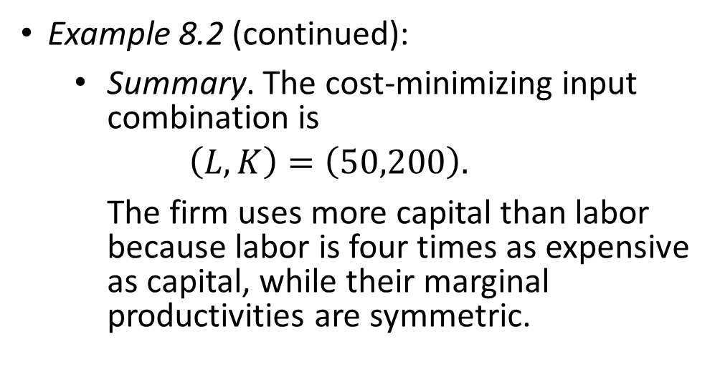
Cost-Minimization Problem
Example 8.2 (continued):
Summary. The cost-minimizing input combination is
$$\left(L,K\right)=\left(50,200\right).$$
The firm uses more capital than labor because labor is four times as expensive as capital, while their marginal productivities are symmetric.

Slide 22
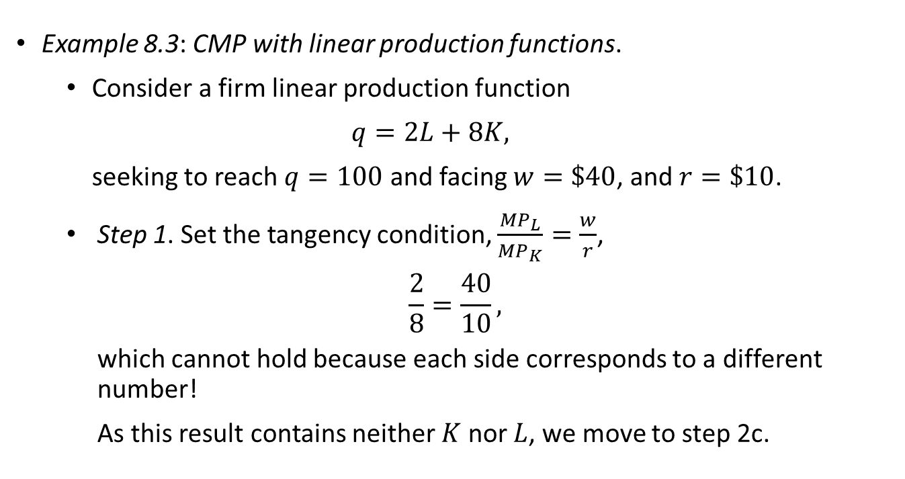
Cost-Minimization Problem
Example 8.3: CMP with linear production functions.
  Consider a firm linear production function
  $$q=2L+8K,$$
  seeking to reach $q=100$ and facing $w=\$40$, and $r=\$10$.
Step 1. Set the tangency condition, $\frac{{MP}_{L}}{{MP}_{K}}=\frac{w}{r}$,
$$\frac{2}{8}=\frac{40}{10},$$
which cannot hold because each side corresponds to a different number!
As this result contains neither $K$ nor $L$, we move to step 2c.

Slide 23
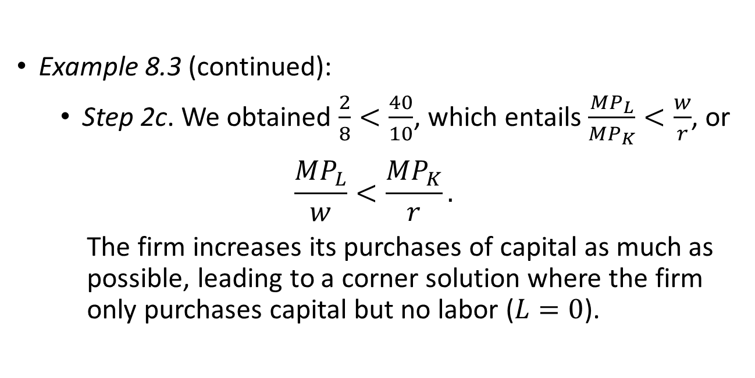
Cost-Minimization Problem
Example 8.3 (continued):
  Step 2c. We obtained $\frac{2}{8}<\frac{40}{10}$, which entails $\frac{{MP}_{L}}{{MP}_{K}}<\frac{w}{r}$, or
$$\frac{{MP}_{L}}{w}<\frac{{MP}_{K}}{r}.$$
The firm increases its purchases of capital as much as possible, leading to a corner solution where the firm only purchases capital but no labor ($L=0$).

Slide 24
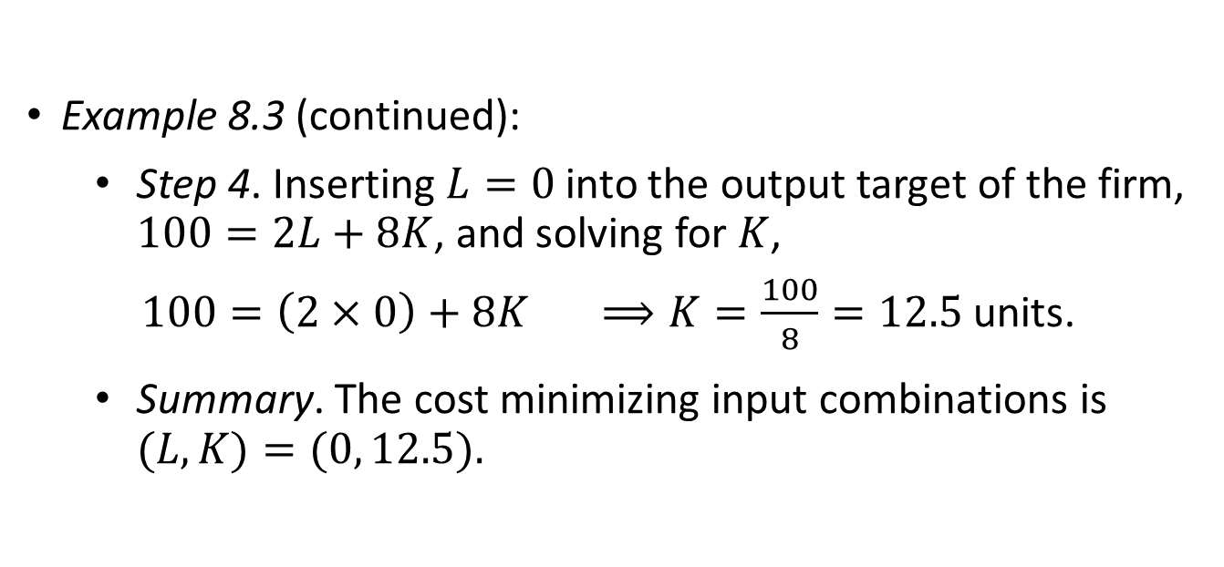
Cost-Minimization Problem
Example 8.3 (continued):
Step 4. Inserting $L=0$into the output target of the firm, $100=2L+8K$, and solving for $K$,
$100=\left(2×0\right)+8K ⟹K=\frac{100}{8}=12.5$ units.
Summary. The cost minimizing input combinations is $(L,K)=(0, 12.5).$

Slide 25

Input Demands

Slide 26

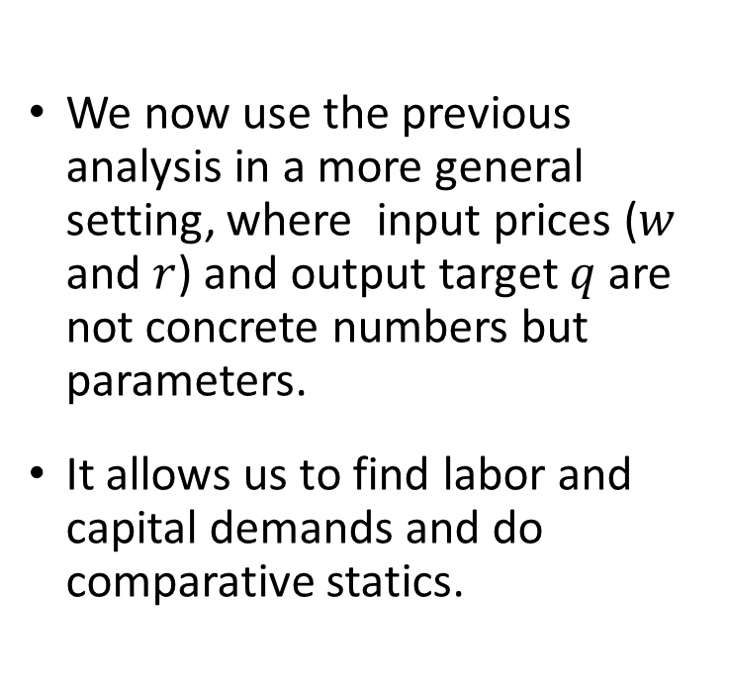
Input Demands
We now use the previous analysis in a more general setting, where input prices ($w$ and $r$) and output target $q$ are not concrete numbers but parameters.
It allows us to find labor and capital demands and do comparative statics.

Slide 27
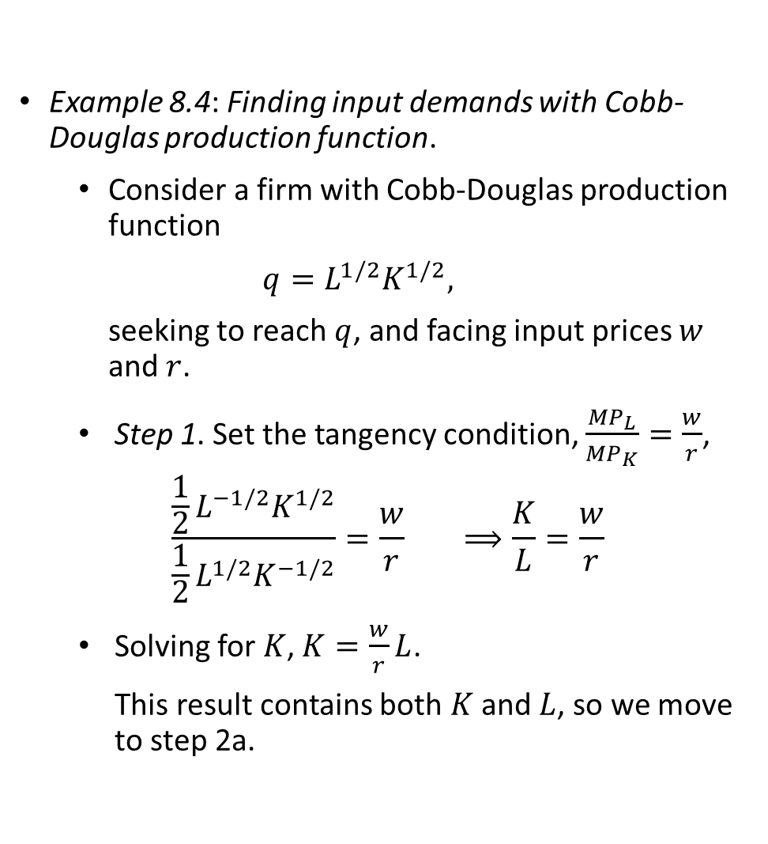
Input Demands
Example 8.4: Finding input demands with Cobb-Douglas production function.
  Consider a firm with Cobb-Douglas production function
  $$q=L^{1/2}K^{1/2},$$
  seeking to reach $q$, and facing input prices $w$ and $r$.
Step 1. Set the tangency condition, $\frac{{MP}_{L}}{{MP}_{K}}=\frac{w}{r}$,
$$\frac{\frac{1}{2}L^{−1/2}K^{1/2}}{\frac{1}{2}L^{1/2}K^{−1/2}}=\frac{w}{r} ⟹\frac{K}{L}=\frac{w}{r}$$
Solving for $K$, $K=\frac{w}{r}L$.
This result contains both $K$ and $L$, so we move to step 2a.

Slide 28

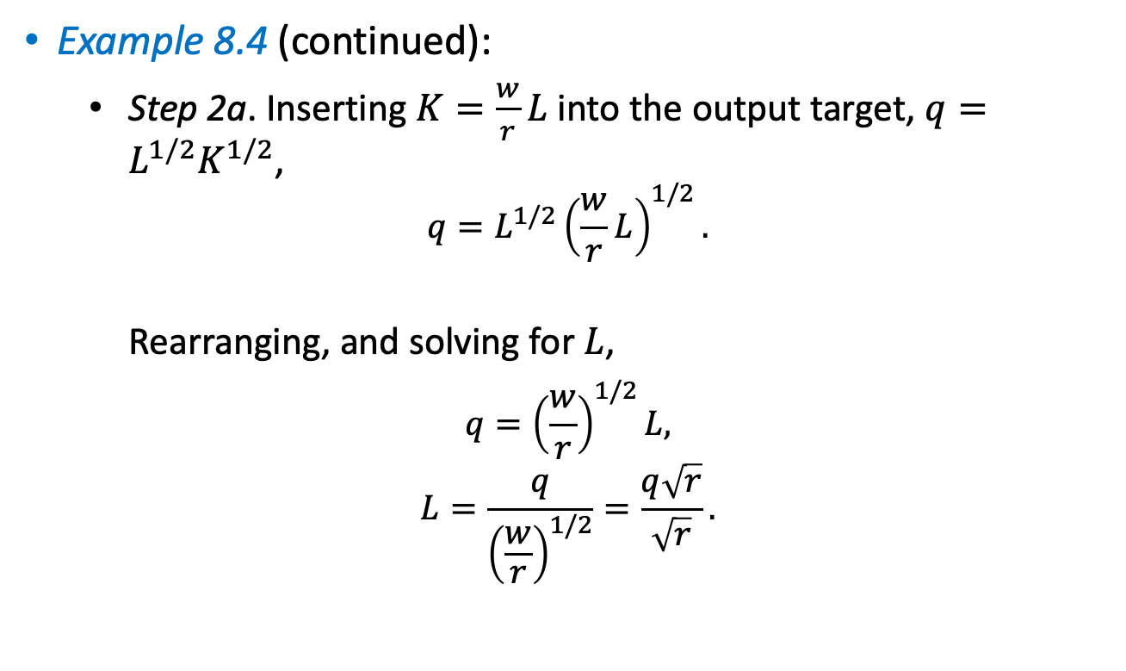
Input Demands
Example 8.4 (continued):
Step 2a. Inserting $K=\frac{w}{r}L$ into the output target, $q=L^{1/2}K^{1/2}$,
$$q=L^{1/2}{\left(\frac{w}{r}L\right)}^{1/2}.$$
Rearranging, and solving for $L$,
$$q={\left(\frac{w}{r}\right)}^{1/2}L,$$
$$L=\frac{q}{{\left(\frac{w}{r}\right)}^{1/2}}=\frac{q\sqrt{r}}{\sqrt{r}}.$$
$$K$$

Slide 29
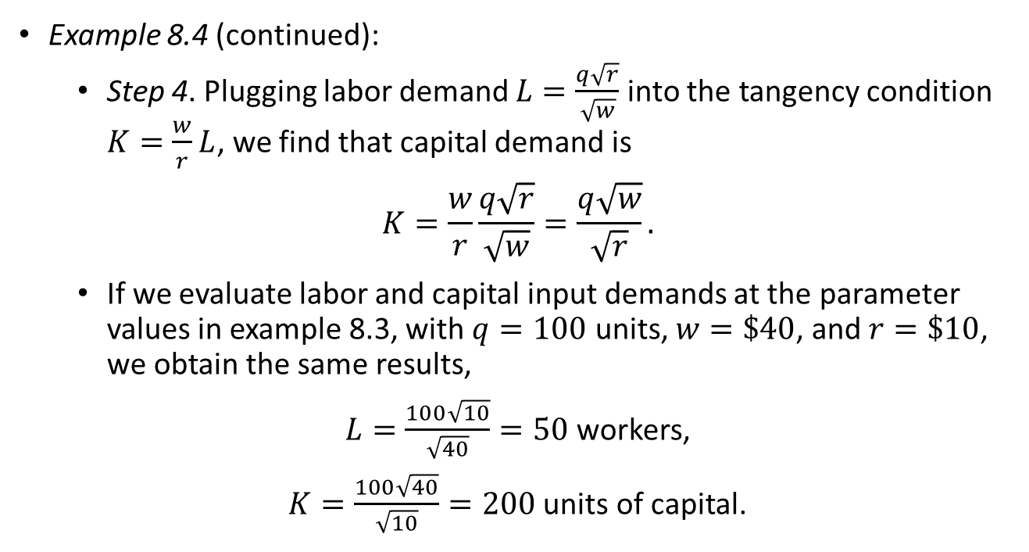
Input Demands
Example 8.4 (continued):
  Step 4. Plugging labor demand $L=\frac{q\sqrt{r}}{\sqrt{w}}$into the tangency condition $K=\frac{w}{r}L$, we find that capital demand is
$$K=\frac{w}{r}\frac{q\sqrt{r}}{\sqrt{w}}=\frac{q\sqrt{w}}{\sqrt{r}}.$$
  If we evaluate labor and capital input demands at the parameter values in example 8.3, with $q=100$ units, $w=\$40$, and $r=\$10$, we obtain the same results,
  $L=\frac{100\sqrt{10}}{\sqrt{40}}=50$ workers,
  $K=\frac{100\sqrt{40}}{\sqrt{10}}=200$ units of capital.

Slide 30
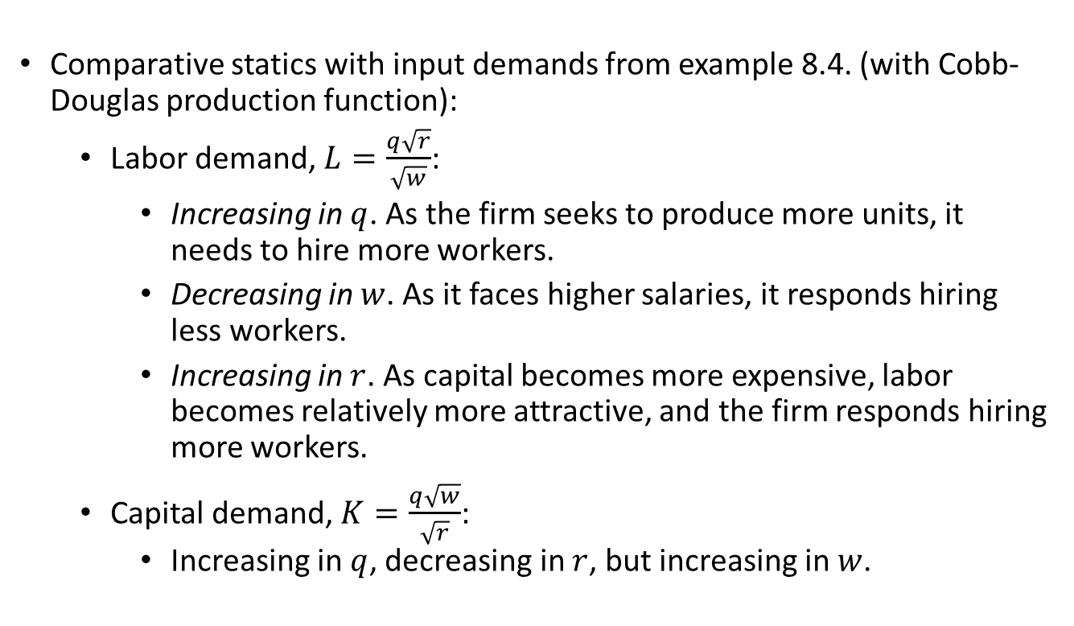
Input Demands
Comparative statics with input demands from example 8.4. (with Cobb-Douglas production function):
  Labor demand, $L=\frac{q\sqrt{r}}{\sqrt{w}}$:
    Increasing in $q$. As the firm seeks to produce more units, it needs to hire more workers.
    Decreasing in $w$. As it faces higher salaries, it responds hiring less workers.
    Increasing in $r$. As capital becomes more expensive, labor becomes relatively more attractive, and the firm responds hiring more workers.
  Capital demand, $K=\frac{q\sqrt{w}}{\sqrt{r}}$:
    Increasing in $q$, decreasing in $r$, but increasing in $w$.

Slide 31
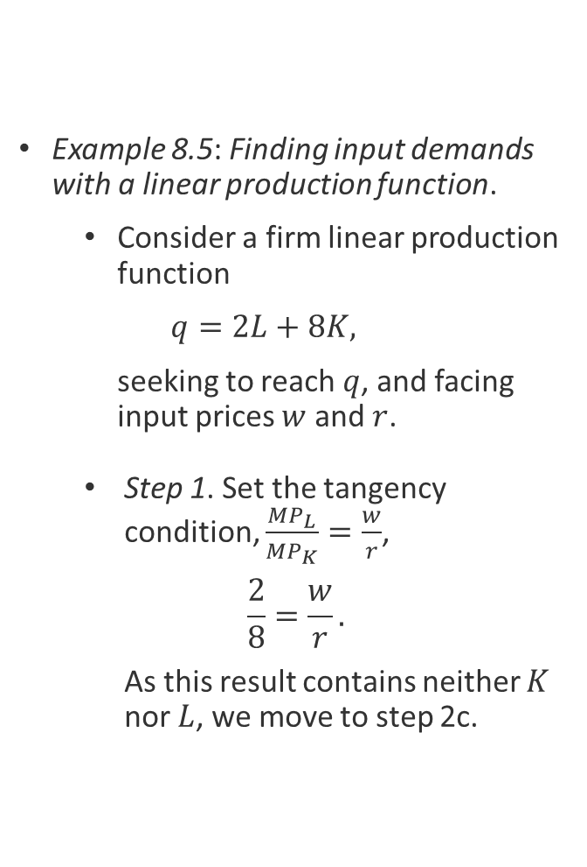
Input Demands
Example 8.5: Finding input demands with a linear production function.
  Consider a firm linear production function
  $$q=2L+8K,$$
  seeking to reach $q$, and facing input prices $w$ and $r$.
Step 1. Set the tangency condition, $\frac{{MP}_{L}}{{MP}_{K}}=\frac{w}{r}$,
$$\frac{2}{8}=\frac{w}{r}.$$
As this result contains neither $K$ nor $L$, we move to step 2c.

Slide 32
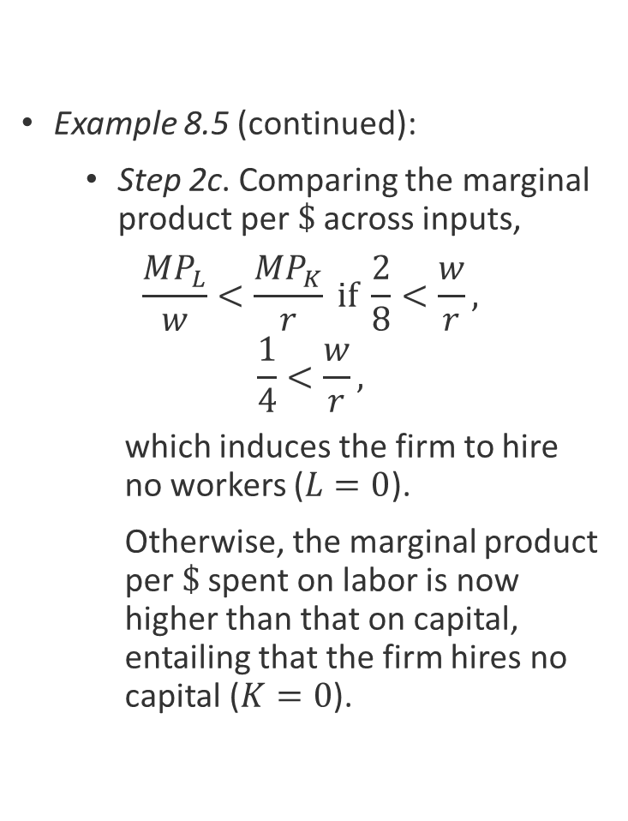
Input Demands
Example 8.5 (continued):
  Step 2c. Comparing the marginal product per$\$$across inputs,
$$\frac{{MP}_{L}}{w}<\frac{{MP}_{K}}{r} if \frac{2}{8}<\frac{w}{r},$$
$$\frac{1}{4}<\frac{w}{r},$$
which induces the firm to hire no workers ($L=0$).
Otherwise, the marginal product per $\$$spent on labor is now higher than that on capital, entailing that the firm hires no capital ($K=0$).

Slide 33
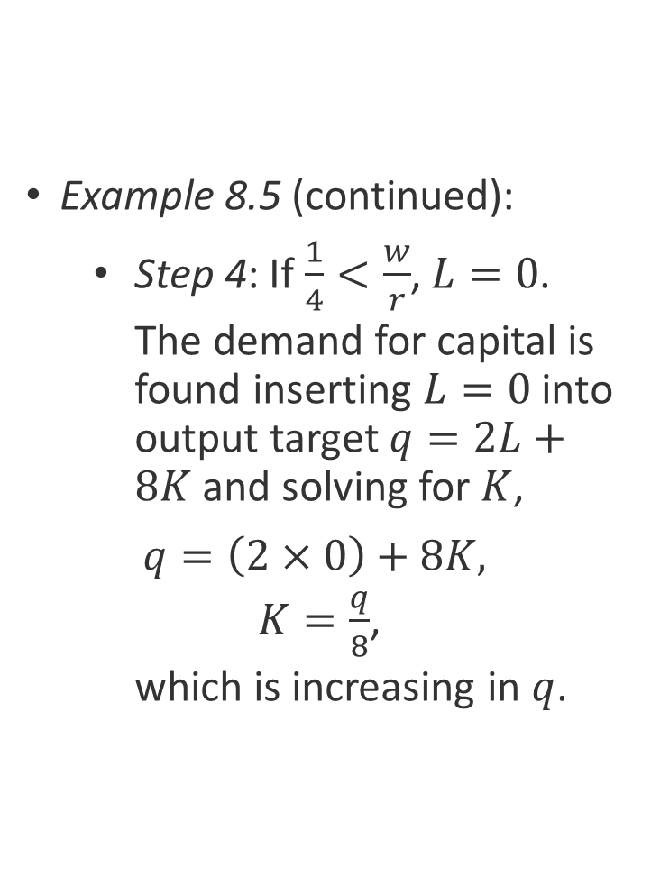
Input Demands
Example 8.5 (continued):
Step 4: If $\frac{1}{4}<\frac{w}{r}$, $L=0$.
The demand for capital is found inserting $L=0$ into output target $q=2L+8K$and solving for $K$,
  $$q=\left(2×0\right)+8K,$$
  $K=\frac{q}{8}$,
  which is increasing in $q$.

Slide 34
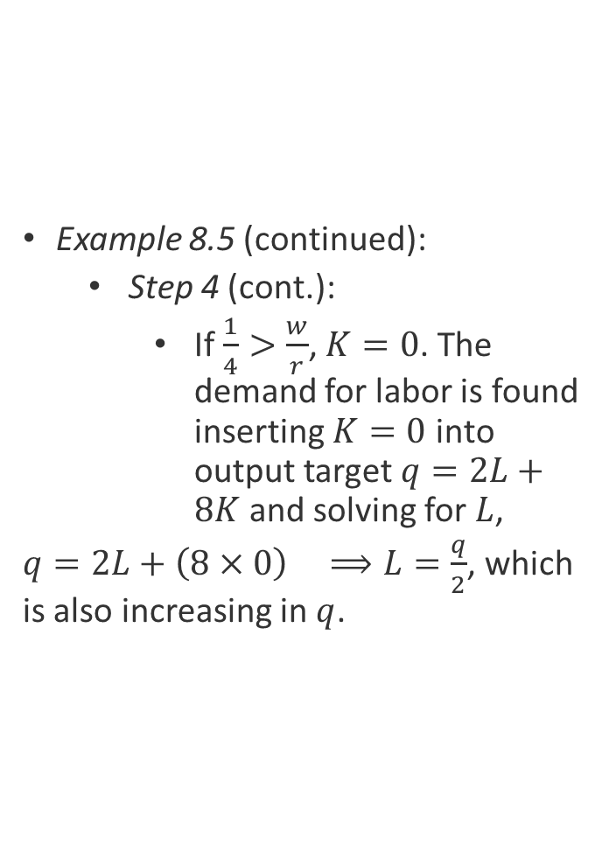
Input Demands
Example 8.5 (continued):
Step 4 (cont.):
  If $\frac{1}{4}>\frac{w}{r}$, $K=0$. The demand for labor is found inserting $K=0$ into output target $q=2L+8K$and solving for $L$,
  $q=2L+\left(8×0\right) ⟹L=\frac{q}{2}$, which is also increasing in $q$.

Slide 35
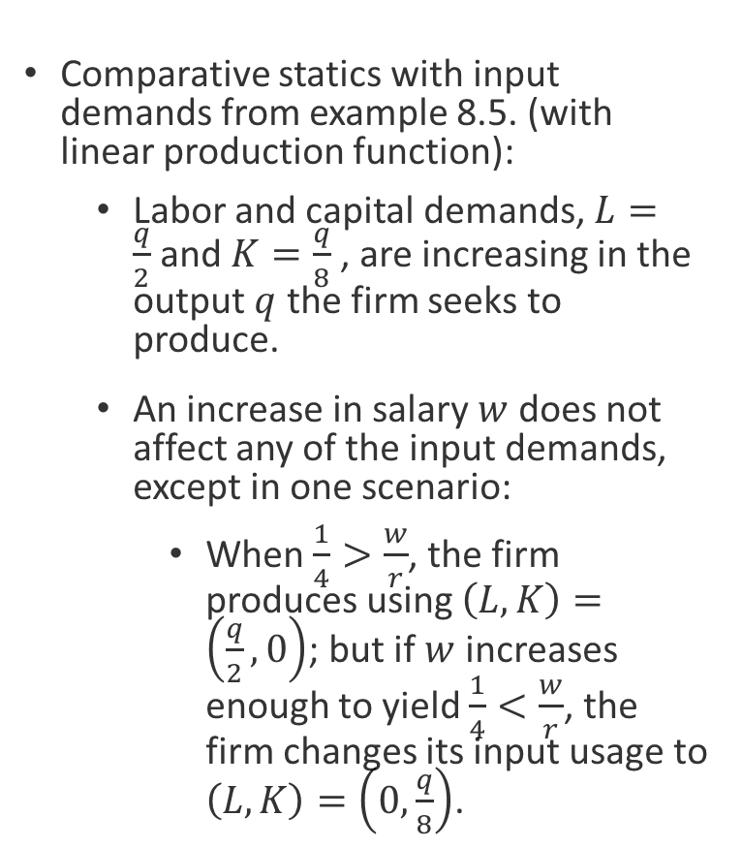
Input Demands
Comparative statics with input demands from example 8.5. (with linear production function):
  Labor and capital demands, $L=\frac{q}{2}$and $K=\frac{q}{8}$, are increasing in the output $q$ the firm seeks to produce.
  An increase in salary $w$ does not affect any of the input demands, except in one scenario:
    When $\frac{1}{4}>\frac{w}{r}$, the firm produces using $\left(L,K\right)=\left(\frac{q}{2},0\right)$; but if $w$ increases enough to yield $\frac{1}{4}<\frac{w}{r}$, the firm changes its input usage to $\left(L,K\right)=\left(0,\frac{q}{8}\right)$.

Slide 36
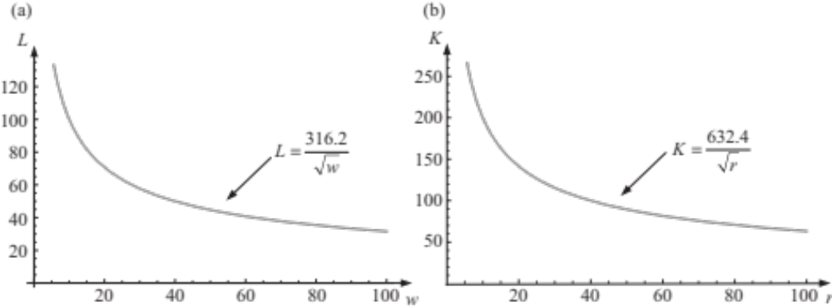
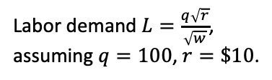
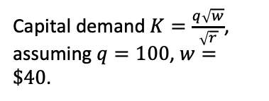
Input Demand–Responses
Response to changes in its own price.
  The demand for an input is decreasing in its own price → the input demand has a negative slope.
Labor demand $L=\frac{q\sqrt{r}}{\sqrt{w}}$,
assuming $q=100$, $r=\$10$.
Capital demand $K=\frac{q\sqrt{w}}{\sqrt{r}}$,
assuming $q=100$, $w=\$40$.
Figure 8.3

Slide 37
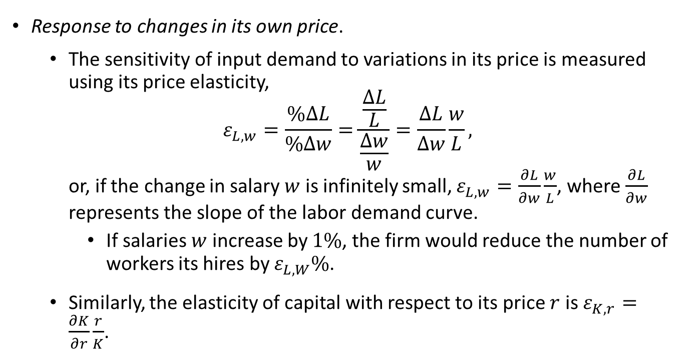
Input Demand–Responses
Response to changes in its own price.
  The sensitivity of input demand to variations in its price is measured using its price elasticity,
  $$ε_{L,w}=\frac{\%∆L}{\%∆w}=\frac{\frac{∆L}{L}}{\frac{∆w}{w}}=\frac{∆L}{∆w}\frac{w}{L},$$
  or, if the change in salary $w$ is infinitely small, $ε_{L,w}=\frac{∂L}{∂w}\frac{w}{L}$, where $\frac{∂L}{∂w}$ represents the slope of the labor demand curve.
    If salaries $w$ increase by $1\%$, the firm would reduce the number of workers its hires by $ε_{L,W}\%$.
  Similarly, the elasticity of capital with respect to its price $r$ is $ε_{K,r}=\frac{∂K}{∂r}\frac{r}{K}$.

Slide 38
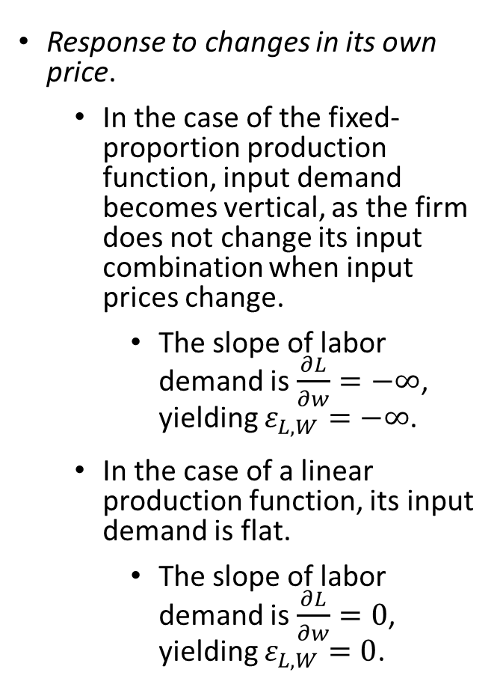
Input Demand–Responses
Response to changes in its own price.
  In the case of the fixed-proportion production function, input demand becomes vertical, as the firm does not change its input combination when input prices change.
    The slope of labor demand is $\frac{∂L}{∂w}=−∞$, yielding $ε_{L,W}=−∞$.
  In the case of a linear production function, its input demand is flat.
    The slope of labor demand is $\frac{∂L}{∂w}=0$, yielding $ε_{L,W}=0$.

Slide 39
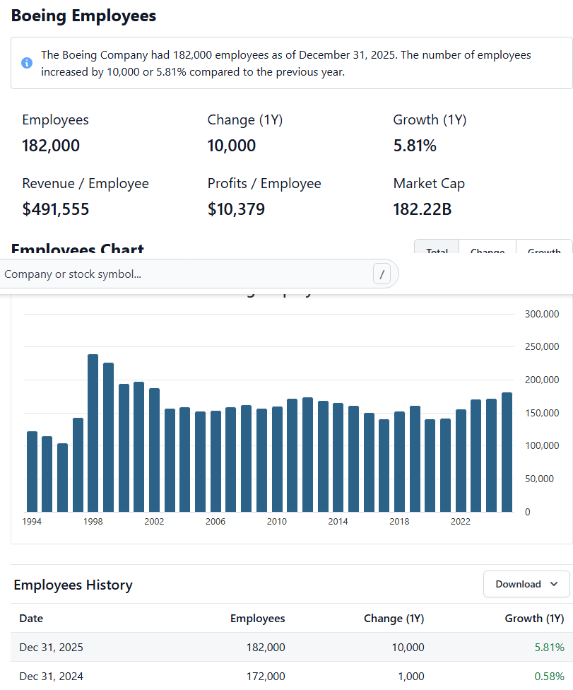

Slide 40


Slide 41
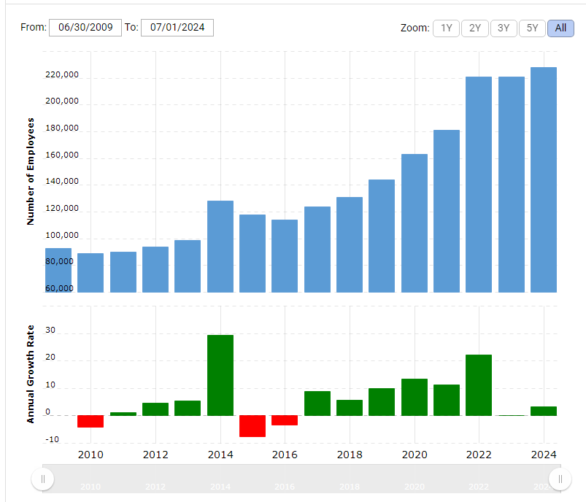
Microsoft: Number of Employees 2010-2024

Slide 42
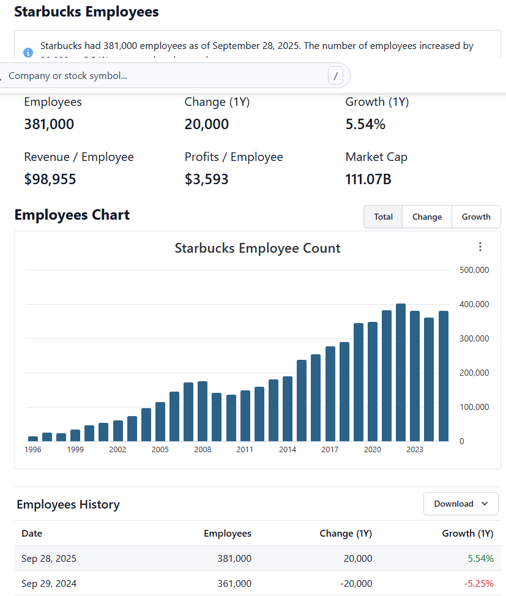

Slide 43

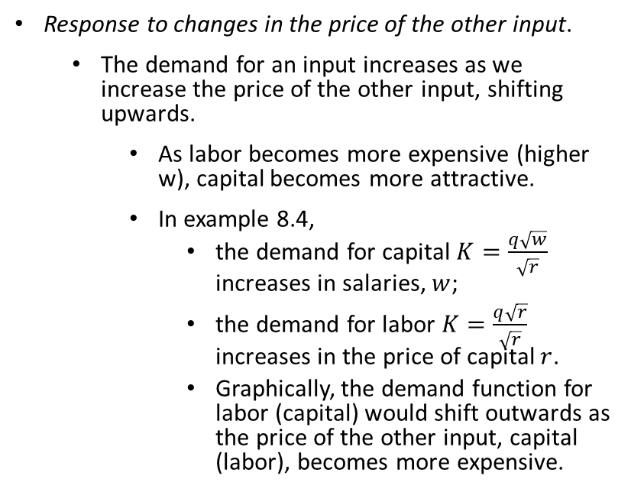
Input Demand–Responses
Response to changes in the price of the other input.
  The demand for an input increases as we increase the price of the other input, shifting upwards.
    As labor becomes more expensive (higher w), capital becomes more attractive.
    In example 8.4,
      the demand for capital $K=\frac{q\sqrt{w}}{\sqrt{r}}$ increases in salaries, $w$;
      the demand for labor $K=\frac{q\sqrt{r}}{\sqrt{r}}$ increases in the price of capital $r$.
      Graphically, the demand function for labor (capital) would shift outwards as the price of the other input, capital (labor), becomes more expensive.

Slide 44
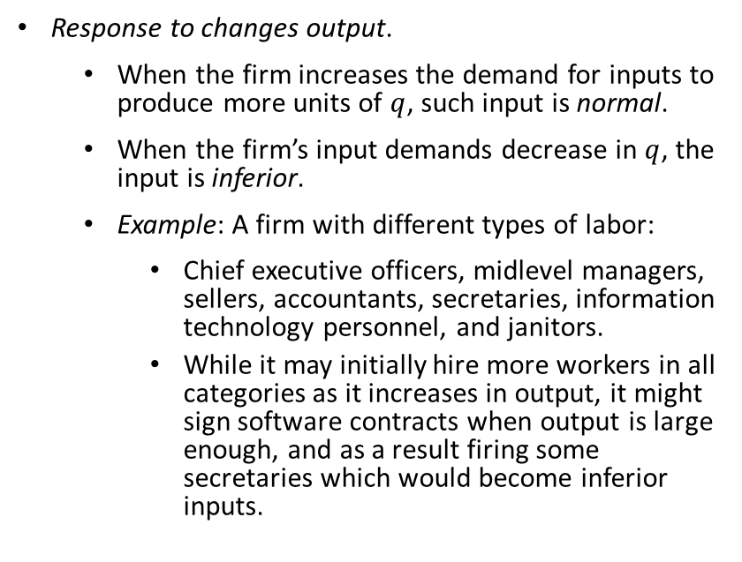
Input Demand–Responses
Response to changes output.
  When the firm increases the demand for inputs to produce more units of $q$, such input is normal.
  When the firm’s input demands decrease in $q$, the input is inferior.
  Example: A firm with different types of labor:
    Chief executive officers, midlevel managers, sellers, accountants, secretaries, information technology personnel, and janitors.
    While it may initially hire more workers in all categories as it increases in output, it might sign software contracts when output is large enough, and as a result firing some secretaries which would become inferior inputs.

Slide 45

Cost Functions

Slide 46

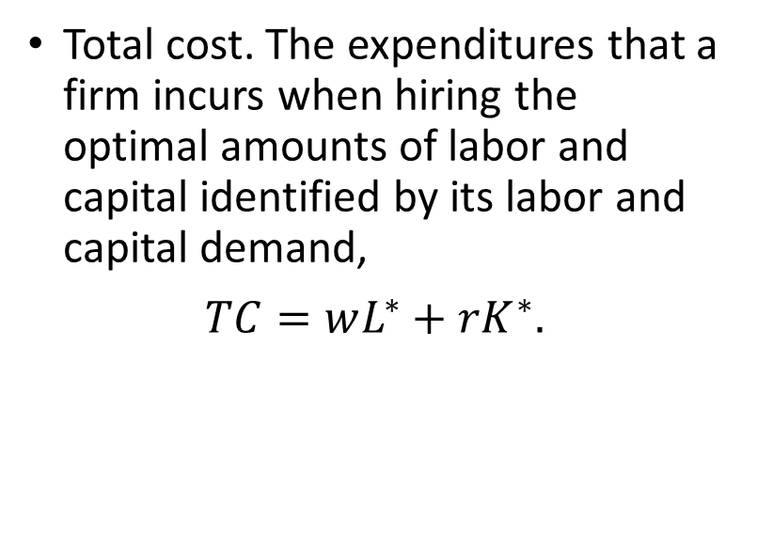
Cost Functions
Total cost. The expenditures that a firm incurs when hiring the optimal amounts of labor and capital identified by its labor and capital demand,
$$TC=wL^{∗}+rK^{∗}.$$

Slide 47

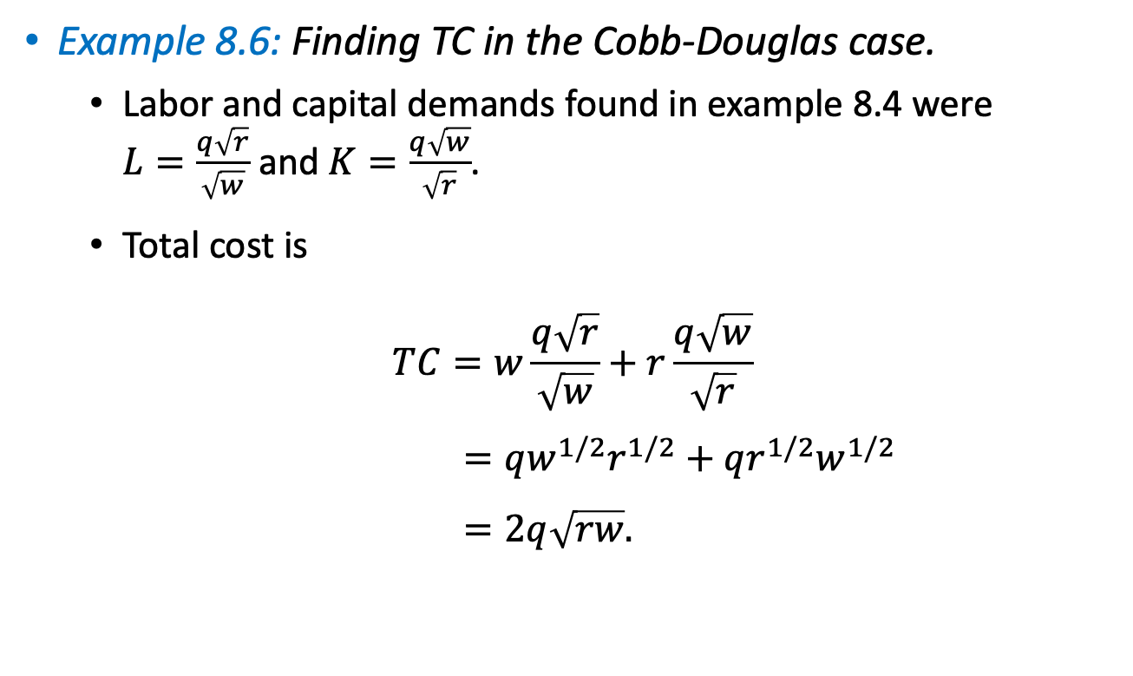

Cost Functions
Example 8.6: Finding TC in the Cobb-Douglas case.
  Labor and capital demands found in example 8.4 were $L=\frac{q\sqrt{r}}{\sqrt{w}}$ and $K=\frac{q\sqrt{w}}{\sqrt{r}}$.
  Total cost is
  $$TC=w\frac{q\sqrt{r}}{\sqrt{w}}+r\frac{q\sqrt{w}}{\sqrt{r}}$$
  $$=qw^{1/2}r^{1/2}+qr^{1/2}w^{1/2}$$
  $$=2q\sqrt{rw}.$$
$$L$$
$$K$$

Slide 48
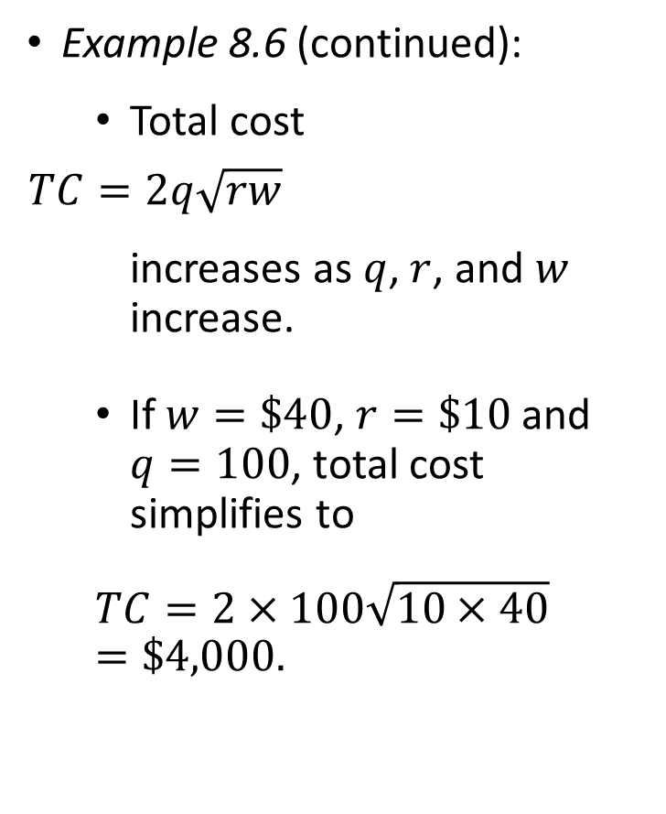
Cost Functions
Example 8.6 (continued):
  Total cost
  $TC=2q\sqrt{rw}$
  increases as $q$, $r$, and $w$ increase.
  If $w=\$40$, $r=\$10$and $q=100$, total cost simplifies to
  $$TC=2×100\sqrt{10×40}=\$4,000.$$

Slide 49
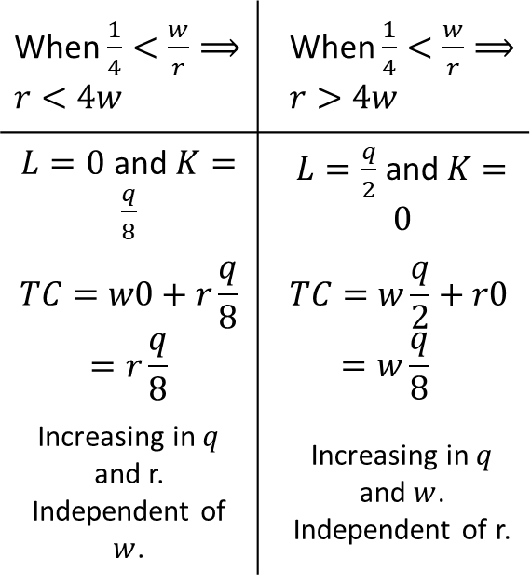
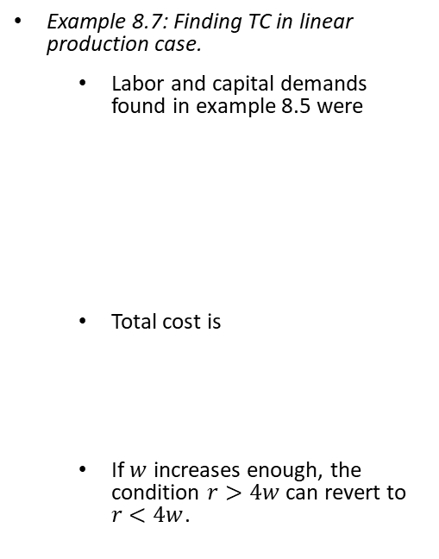
Cost Functions
Example 8.7: Finding TC in linear production case.
  Labor and capital demands found in example 8.5 were
  Total cost is
  If $w$ increases enough, the condition $r>4w$ can revert to $r<4w$.
When $\frac{1}{4}<\frac{w}{r}⟹r<4w$ | When $\frac{1}{4}<\frac{w}{r}⟹r>4w$
$L=0$ and $K=\frac{q}{8}$ | $L=\frac{q}{2}$ and $K=0$
$$TC=w0+r\frac{q}{8}=r\frac{q}{8}$$ | $$TC=w\frac{q}{2}+r0=w\frac{q}{8}$$
Increasing in $q$ and r. Independent of $w$. | Increasing in $q$ and $w$. Independent of r.

Slide 50
Types of Costs

Slide 51
Explicit vs. implicit costs
Explicit costs involve a direct monetary outlay.
Implicit costs do not necessarily involve direct outlays, but they reflect the opportunity cost of an input.
They consider the best alternative use of the input that the firm forgoes when dedicating that input to its production process.
Example: Studying an undergraduate degree.
Explicit costs: monetary outlays (in cash or in debt).
Implicit (opportunity) costs: the forgone salary that you could earn in the years you get your education.

Slide 52

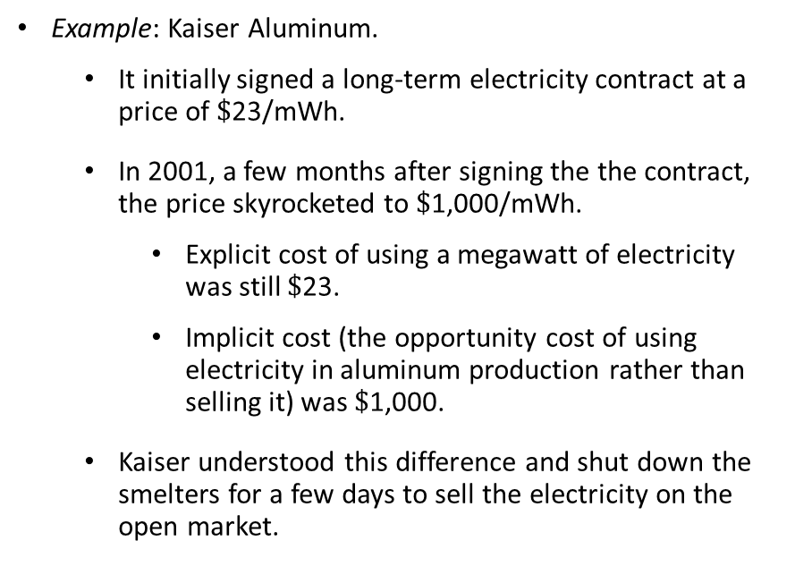
Explicit vs. implicit costs
Example: Kaiser Aluminum.
  It initially signed a long-term electricity contract at a price of $\$$23/mWh.
  In 2001, a few months after signing the the contract, the price skyrocketed to $\$$1,000/mWh.
    Explicit cost of using a megawatt of electricity was still $\$$23.
    Implicit cost (the opportunity cost of using electricity in aluminum production rather than selling it) was $\$$1,000.
  Kaiser understood this difference and shut down the smelters for a few days to sell the electricity on the open market.

Slide 53
Sunk vs. nonsunk costs
Sunk costs. Costs that cannot be recovered, even if the firm chooses to shut down its operations.
Example: The rental a firm pays for the building it uses, if the lease prohibits subletting.
Nonsunk costs. Costs that can be sold back if the firm were to shut down its operations (recovering a portion of the cost).
Example: Most of raw materials.

Slide 54

Long-run vs. short-run costs
In the long run, the firm have enough time to vary the amount of all inputs as much as necessary.
In the short run, the amount of at least one input is considered to be fixed.
Example: Faculty positions at universities.
  Acquiring a new computer (a form of capital) can be done in few hours.
  Hiring a new professor would require a long process (4-5 months if not longer: posting ads, interviews of candidates, fly-outs, offer to selected candidate, and negotiation.
Short-run costs are higher (or equal, but never lower) than long-run costs.

Slide 55


Long-run vs. short-run costs
Example 8.8: Comparing long- and short-run costs.
  Consider a firm with Cobb-Douglas production function $q=L^{1/2}K^{1/2}$.
  Capital in the short run is fixed at $\overline{K}=150$ units.
  We find the cost-minimizing units of labor inserting $\overline{K}=150$ into the firm’s production function and solving for $L$,
  $$q=L^{1/2}{150}^{1/2},$$
  $${(q)}^{2}={\left(L^{1/2}{150}^{1/2}\right)}^{2},$$
  $$q^{2}=150L ⇒L=\frac{q^{2}}{150}.$$
  which increases in $q$.

Slide 56

Long-run vs. short-run costs
Example 8.8 (continued):
  In this context, the short-run total cost becomes
  $$STC=wL^{∗}+r\overline{K}=w\frac{q^{2}}{150}_+r150.$$
  Considering the same input prices as in example 8.4., $w=\$40$ and $r=\$10$,
  $STC=\$1,500+\frac{4}{15}q^{2}$,
  which lies above the long-run total cost in example 8.6, $TC=40q$.

Slide 57



Long-run vs. short-run costs
Example 8.8 (continued):
If $q=150$units,
$$STC=\$7,500,$$
$$TC=\$6,000.$$
$$STC\left(150\right)>TC(150)$$
If $q=75$units,
$$STC\left(75\right)=TC(75)$$
Figure 8.4
To produce $q=75$, the firm has $K=\frac{q\sqrt{w}}{\sqrt{r}}=\frac{75\sqrt{40}}{\sqrt{10}}=150$, which coincides with the fixed amount of capital $\overline{K}=150$ in the short run.
For all other $q≠75$, the fixed amount of capital $\overline{K}=150$, $STC\left(q\right)=TC(q)$.

Slide 58

Long-run vs. short-run costs
Cheat sheet of short-run costs.
  Does the cost increase when the firm increases its production?
    Yes. The cost is variable.
    No. The cost is fixed.
  Does the firm incur a positive cost if it were to shut down its operations ($q=0$)?
    Yes. The cost is sunk because it cannot be recovered.
    No. The cost is nonsunk because it can be recovered.

Slide 59

Average and Marginal Cost

Slide 60

Average and Marginal Cost
Average cost (AC). The total cost that the firm incurs per unit of output,
$AC=\frac{TC}{q}$.
  Example: If $TC=\$1,000$ and $q=20$ monitors, $AC=\frac{1000}{20}=\$50$ per monitor.
Marginal cost (MC). The rate at which total costs increases as the firm produces 1 more unit,
$AC=\frac{∂TC}{∂q}$.

Slide 61

Average and Marginal Cost
Graphically, $MC$ measures the slope of the $TC$ curve:
  When $TC↑$, its slope must be positive → $MC$ is positive.
  When $TC↓$, its slope must be negative → $MC$ is negative.
The $AC$ and $MC$ curves exhibit a similar relationship than the relationship between average and marginal product, $AP$ and $MP$.
The $MC$curve crosses the $AC$ curve at it minimum.

Slide 62

Average and Marginal Cost
Example 8.9: Finding average and marginal cost.
  Consider a firm with Cobb-Douglas function in example 8.4,
  $$q=L^{1/2}K^{1/2}$$
  where $TC=40q$.
  The firm’s average cost and marginal cost are
  $AC=\frac{40q}{q}=40,$
  $MC=\frac{∂(40q)}{∂q}=40$.
    Hence, $AC$ and $MC$ curves are both constant, and $AC=MC$.
    Graphically they are depicted by a horizontal line at height $\$40$.

Slide 63

Average and Marginal Cost
Example 8.9: (continued):
Figure 8.5

Slide 64

Average and Marginal Cost
Example 8.9 (continued):
  In the case of the linear production function in example 8.7,
    $TC=r\frac{q}{8}$ when $r<4w$ (i.e., labor is expensive relative to capital).
    $TC=w\frac{q}{2}$ when $r>4w$ (i.e., labor is relatively cheap).
  In this context,
    When $r<4w$, $AC=\frac{r\frac{q}{8}}{q}=\frac{r}{8}$ and $MC=\frac{∂\left(r\frac{q}{8}\right)}{∂q}=\frac{r}{8}$.
    When $r>4w$, $AC=\frac{w\frac{q}{2}}{q}=\frac{w}{2}$ and $MC=\frac{∂\left(w\frac{q}{2}\right)}{∂q}=\frac{w}{2}$.
  Hence, $AC$ and $MC$ are constant in $q$, and $AC=MC$.
  Graphically, $AC$ and $MC$ overlap, being a flat line.

Slide 65


Output Elasticity to Total Cost
The marginal cost $MC=\frac{∂TC}{∂q}$ measures how much total cost increases if the firm increases its output by 1 units.
However, this measure is not unit-free.
Consider a firm producing computer monitors in the US, and another firm producing cars in Germany.
  The MC from the first firm would be in $/monitor.
  The MC form the second firm would be in €/car.
We can apply the definition of elasticity to obtain a unit-free measure of how total cost changes in output.

Slide 66


Output Elasticity to Total Cost
Output elasticity of total cost is
$$ε_{TC,q}=\frac{\%ΔTC}{\%Δq}=\frac{\frac{ΔTC}{TC}}{\frac{Δq}{q}}=\frac{ΔTC}{Δq}\frac{q}{TC},$$
or $ε_{TC,q}=\frac{∂TC}{∂q}\frac{q}{TC}$ when the change $q$ is small.
Because $MC=\frac{∂TC}{∂q}$, this elasticity can be rewritten as
$$ε_{TC,q}=MC\frac{q}{TC}.$$
As $AC=\frac{TC}{q}$, its inverse is $\frac{1}{AC}=\frac{q}{TC}$,
$$ε_{TC,q}=MC\frac{1}{AC} ⇒ε_{TC,q}=\frac{MC}{AC}.$$

Slide 67

Output Elasticity to Total Cost
When $MC>AC$, $ε_{TC,q}=\frac{MC}{AC}$ satisfies $ε_{TC,q}>1$.
  Total costs increase more than proportionally to $1\%$increase in output.
When $MC<AC$, $ε_{TC,q}=\frac{MC}{AC}$ satisfies $ε_{TC,q}<1$.
  Total costs increase less than proportionally to $1\%$increase in output.
When $MC=AC$, $ε_{TC,q}=\frac{MC}{AC}$ satisfies $ε_{TC,q}=1$.
  Total costs responds proportionally to $1\%$increase in output.

Slide 68

Output Elasticity to Total Cost
Example 8.10: Output elasticity in the Cobb-Douglas case.
  Consider the firm with Cobb-Douglas function in example 8.4,
  $$q=L^{1/2}K^{1/2}$$
  where $TC=40q$.
    The total elasticity is
    $$ε_{TC,q}=\frac{∂TC}{∂q}\frac{q}{TC}=40\frac{q}{40q}=1.$$
      If the firm increases its output by $1\%,$its total costs also increase by $1\%.$

Slide 69

Average and Marginal Cost
Example 8.10 (continued):
  In the firm has the linear production function in example 8.7,
    $TC=r\frac{q}{8}$ when $r<4w$.
    $TC=w\frac{q}{2}$ when $r>4w$.
  When $4r<w$, output elasticity becomes
  $$ε_{TC,q}=\frac{∂TC}{∂q}\frac{q}{TC}=\frac{r}{8}\frac{q}{r\frac{q}{8}}=\frac{q}{r}.$$
    If the firm seeks to produce $1\%$ more units of output, its total cost increase by $\frac{q}{r}\%$.
  When $r>4w$, $ε_{TC,q}=\frac{q}{W}.$

Slide 70
Economies of Scale, Scope, and Experience

Slide 71

Economies of Scale
A firm experiences economies of scale when its average cost, $AC$, decreases in output $q$.
  Examples:
    Task specialization.
    Large capital investments spreaded over large output levels.
A firm suffers from diseconomies of scale when its average cost, $AC$, increases in output $q$.
  Example: Managerial diseconomies.

Slide 72

Economies of Scale
Example 8.11: Testing for economies of scale.
  Consider a firm with $TC=a+bq+cq^{2}$, where $a,b,c≥0$. The average cost is
  $$AC=\frac{TC}{q}=\frac{a+bq+cq^{2}}{q}=\frac{a}{q}+b+cq.$$
  This expression reaches its minimum at
  $$\frac{∂AC}{∂q}=0,$$
  $$−\frac{a}{q^{2}}+c=0,$$
  $q={\left(\frac{a}{c}\right)}^{1/2}.$

Slide 73


Economies of Scale
Example 8.11 (continued):
  For $q<{\left(\frac{a}{c}\right)}^{1/2}$, $AC$ curve is decreasing → economies of scale.
  For $q>{\left(\frac{a}{c}\right)}^{1/2}$, $AC$curve is increasing → diseconomies of scale.
Figure 8.6

Slide 74

Economies of Scale
Example 8.11 (continued):
  The minimum of the $AC$ curve, $q={\left(\frac{a}{c}\right)}^{1/2}$, could alternatively be found by using the property that the $MC$ and $AC$ cross each other at the minimum of t he $AC$ curve.
  First, we find $MC$,
  $$MC=\frac{∂TC}{∂q}=b+2cq.$$
  Second, $MC$ and $AV$curves cross where $MC=AC$,
  $$b+2cq=\frac{a}{q}+b+cq.$$
  Rearranging and solving for $q$,
  $$\frac{a}{q}=cq ⟹q={\left(\frac{a}{c}\right)}^{1/2}.$$

Slide 75

Economies of Scale
Example 8.11 (continued):
  Consider the firm’s total cost function is
  $$TC=10+2q+q^{2},$$
  which implies that $a=10$, $b=2$, and $c=1$.
  The $AC$ curve becomes
  $$AC=\frac{10}{q}+2+q,$$
  which reaches its minimum at $q={\left(\frac{10}{1}\right)}^{1/2}≅3.16$ units.
  For al $q<3.16$, the firm’s $AC$ curve decreases in $q$, while for all $q>3.16$ it increases in $q$.

Slide 76

Economies of Scope
Economies of scope. The situation where a firm incurs a lower total cost producing two different products than the total cost that two firms would incur producing each good separately,
$$TC\left(q_{1},q_{2}\right)<TC\left(q_{1},0\right)+TC\left(0,q_{2}\right).$$
Because often $TC\left(0,0\right)=0$,
$$TC\left(q_{1},q_{2}\right)<TC\left(q_{1},0\right)+TC\left(0,q_{2}\right)−TC\left(0,0\right).$$
zero

Slide 77

Economies of Scope
After rearranging,
$$TC\left(q_{1},q_{2}\right)−TC\left(q_{1},0\right)<TC\left(0,q_{2}\right)−TC\left(0,0\right).$$
The increase in cost from starting to produce one good alone is larger than the additional costs of adding one good to the firm’s product line.
Example: Television channels in a satellite network.

Slide 78


Economies of Scope
Example 8.12: Economies of Scope.
  Consider a soda company producing 2 types of cola.
  When the firm only produces regular cola (good 1),
  $$TC=\left(q_{1},0\right)=3q_{1}+10.$$
  When the firm only produces diet cola (good 2),
  $$TC\left(0,q_{2}\right)=4q_{2}+10.$$

Slide 79


Economies of Scope
Example 8.12 (continued):
  When it simultaneously produces both types of colas,
  $$TC\left(q_{1},q_{2}\right)=\left(3−α\right)q_{1}+\left(4−α\right)q_{2}+\left(10+β\right),$$
  where $α>0$ indicates the cost savings effect that producing related products has on the unit cost of both regular and diet cola.
  $β>0$ represents the increased in fixed costs when producing 2 types of cola rather than 1.

Slide 80

Economies of Scope
Example 8.12 (continued):
  The firm exhibits economies of scope if
  $$TC\left(q_{1},q_{2}\right)<TC\left(q_{1},0\right)+TC\left(0,q_{2}\right),$$
  $$\left(3−α\right)q_{1}+\left(4−α\right)q_{2}+\left(10+β\right)<\left[3q_{1}+10\right]+\left[4q_{2}+10\right],$$
  which simplifies to
  $$β<10+α\left(q_{1}+q_{2}\right).$$
  The firm benefits from economies of scope if the increase in the fixed costs from producing both goods (measured by $β$) is relatively lower than the cost-saving effect from producing both goods (measures by $α$).

Slide 81

Economies of Experience
Economies of experience. The average variable cost (AVC) decreases during the firm’s production history.
  Often emerge because workers learn from previous periods to avoid product defect, because managers arrange workstations to improve work productivity, or achieve higher material yield.
Economies of experience are expressed as
$$AVC\left(E\right)=\frac{A}{E^{ε}}.$$
where $A>0$ denotes the AVC from the 1st unit;
$E=q_{t−1}+q_{t−2}…,$ measures experience from production in previous periods;
$ε∈(0,1)$ represents experience elasticity.

Slide 82

Economies of Experience
Elasticity of experience $ε$ is
$$ε_{AVC,E}=\frac{\%∆AVC}{\%∆E}$$
$$=\frac{\frac{∆AVC}{AVC}}{\frac{∆E}{E}}$$
$$=\frac{∆AVC}{∆E}\frac{E}{AVC}.$$
Or when the change in $E$ is relatively small,
$$ε_{AVC,E}=\frac{∂AVC}{∂E}\frac{E}{AVC}.$$

Slide 83


Economies of Experience
Because $AVC\left(E\right)=\frac{A}{E^{ε}}$, $\frac{∂AVC}{∂E}=−AεE^{−(1+ε)}$.
Then, experience elasticity becomes
$$ε_{AVC,E}=−AεE^{−\left(1+ε\right)}\frac{E}{\frac{A}{E^{ε}}}.$$
A $1\%$increase in the firm’s production experience, $E$, decreases its average variable costs by $ε\%$.

Slide 84

Economies of Experience
Example 8.13: Slope of the experience curve.
  We can analyze the responsiveness of a firm’s average costs ($AVC$) to its production experience by focusing on the slope of the experience curve,
  Slope of the experience curve $=\frac{AVC(2E)}{AVC(E)}=\frac{\frac{A}{{(2E)}^{ε}}}{\frac{A}{E^{ε}}}=\frac{E^{ε}}{2^{ε}E^{ε}}=\frac{1}{2^{ε}}.$
  This slope measures how much the $AVC$ decreases when cumulative output ($E$) doubles.
  Because $ε∈(0,1)$, an increase in $ε$entails a larger slope of the experience curve.

