Slide 1
Intermediate Microeconomic
Theory
Tools and Step-by-Step Examples
Chapter 7:
Production Functions

Slide 2
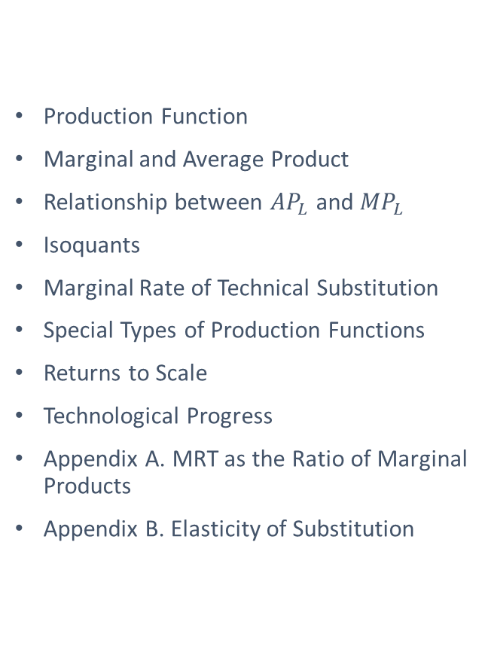
Outline
Production Function
Marginal and Average Product
Relationship between ${AP}_{L}$ and ${MP}_{L}$
Isoquants
Marginal Rate of Technical Substitution
Special Types of Production Functions
Returns to Scale
Technological Progress
Appendix A. MRT as the Ratio of Marginal Products
Appendix B. Elasticity of Substitution

Slide 3

Production Function

Slide 4


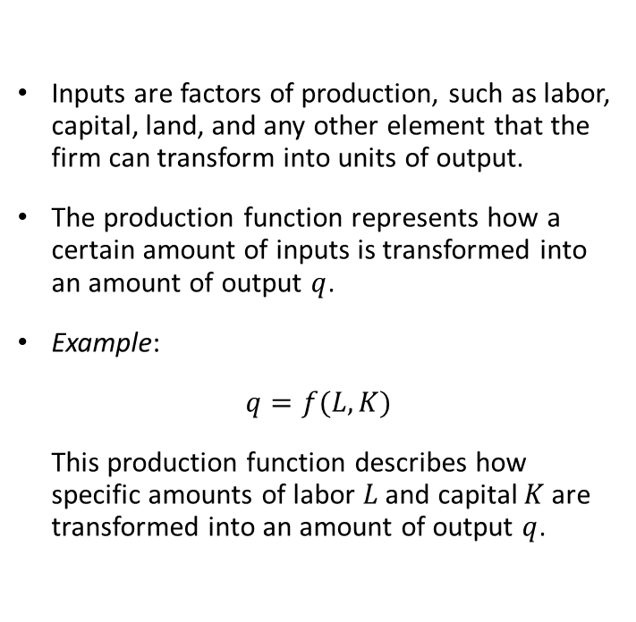
Production Function
Inputs are factors of production, such as labor, capital, land, and any other element that the firm can transform into units of output.
The production function represents how a certain amount of inputs is transformed into an amount of output $q$.
Example:
$q=f(L,K)$
This production function describes how specific amounts of labor $L$ and capital $K$are transformed into an amount of output $q$.

Slide 5
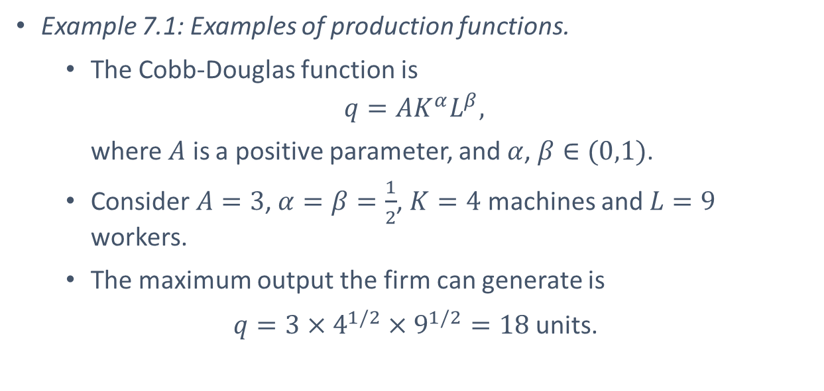
Production Function
Example 7.1: Examples of production functions.
  The Cobb-Douglas function is
  $$q=AK^{α}L^{β},$$
  where $A$ is a positive parameter, and $α$, $β∈(0,1)$.
  Consider $A=3$, $α=β=\frac{1}{2}$, $K=4$ machines and $L=9$ workers.
  The maximum output the firm can generate is
  $q=3×4^{1/2}×9^{1/2}=18$ units.

Slide 6
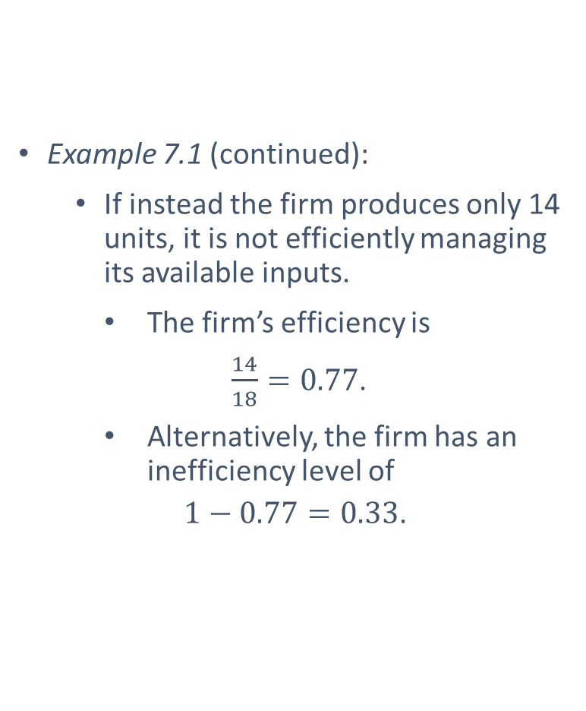
Production Function
Example 7.1 (continued):
  If instead the firm produces only 14 units, it is not efficiently managing its available inputs.
  The firm’s efficiency is
  $\frac{14}{18}=0.77$.
  Alternatively, the firm has an inefficiency level of
  $1−0.77=0.33$.

Slide 7
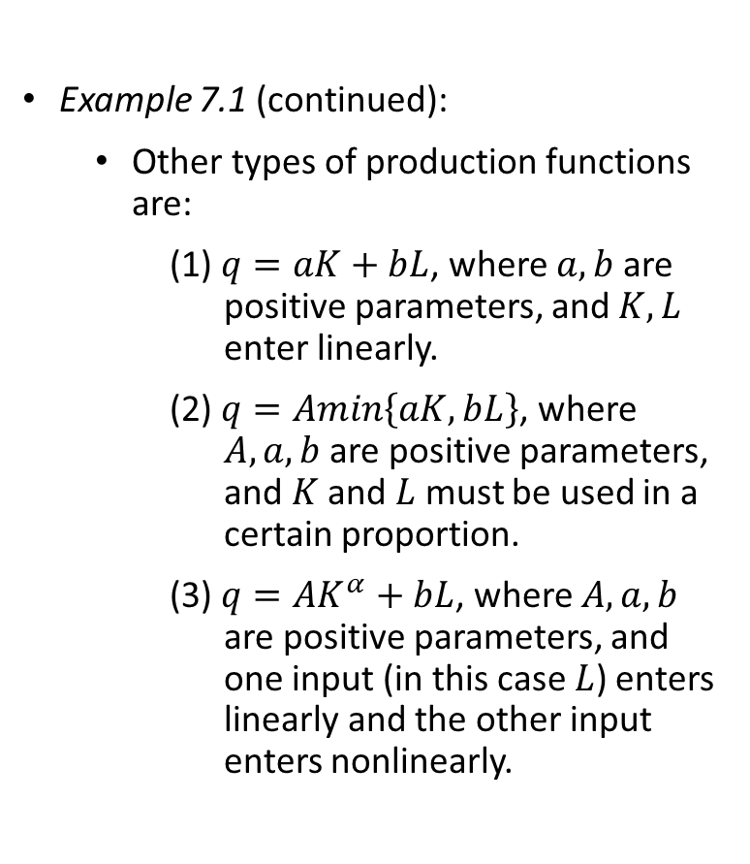
Production Function
Example 7.1 (continued):
  Other types of production functions are:
    (1) $q=aK+bL$, where $a,b$ are positive parameters, and $K,L$ enter linearly.
    (2) $q=Amin\left\{aK,bL\right\}$, where $A, a,b$ are positive parameters, and $K$ and $L$ must be used in a certain proportion.
    (3) $q=AK^{α}+bL$, where $A, a,b$ are positive parameters, and one input (in this case $L$) enters linearly and the other input enters nonlinearly.

Slide 8

Marginal and Average Product

Slide 9
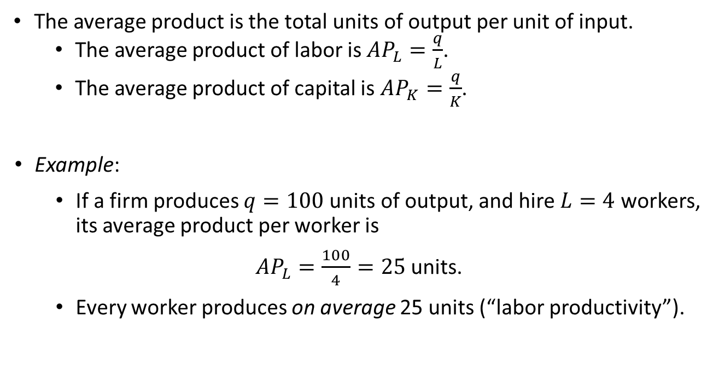
Average Product
The average product is the total units of output per unit of input.
The average product of labor is ${AP}_{L}=\frac{q}{L}$.
The average product of capital is ${AP}_{K}=\frac{q}{K}$.
Example:
  If a firm produces $q=100$units of output, and hire $L=4$ workers, its average product per worker is
${AP}_{L}=\frac{100}{4}=25$ units.
  Every worker produces on average 25 units (“labor productivity”).

Slide 10

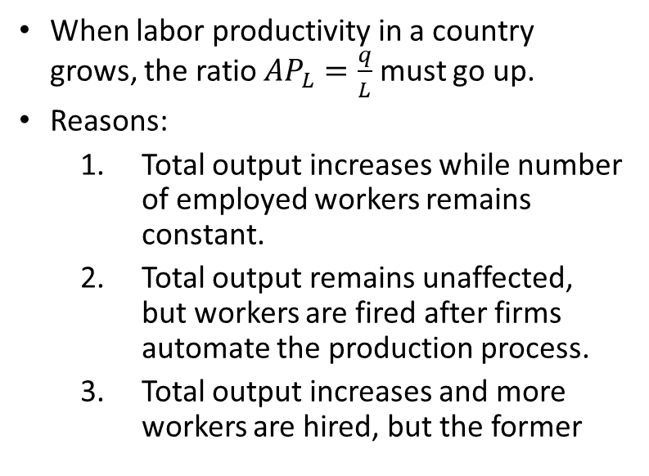
Average Product
When labor productivity in a country grows, the ratio ${AP}_{L}=\frac{q}{L}$ must go up.
Reasons:
  Total output increases while number of employed workers remains constant.
  Total output remains unaffected, but workers are fired after firms automate the production process.
  Total output increases and more workers are hired, but the former

Slide 11


Slide 12
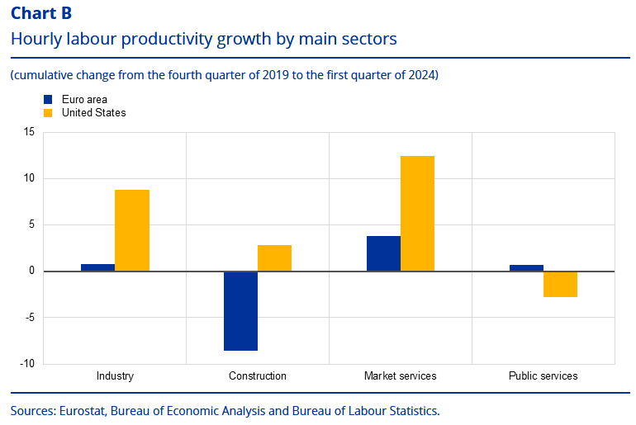

Slide 13
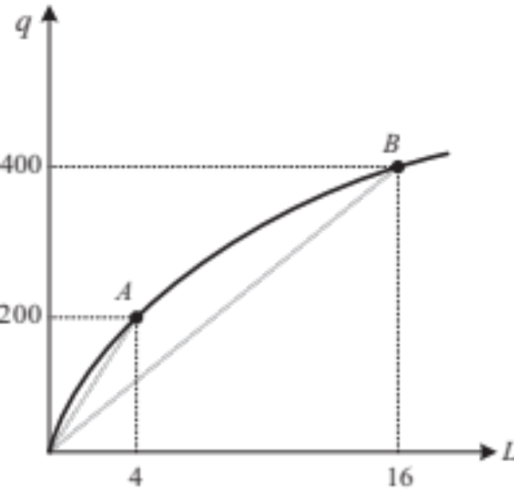
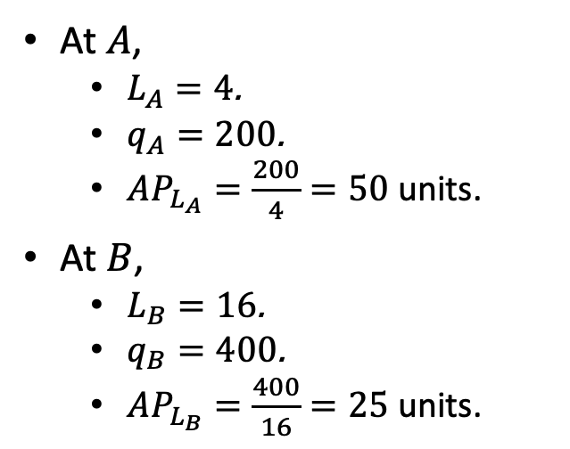
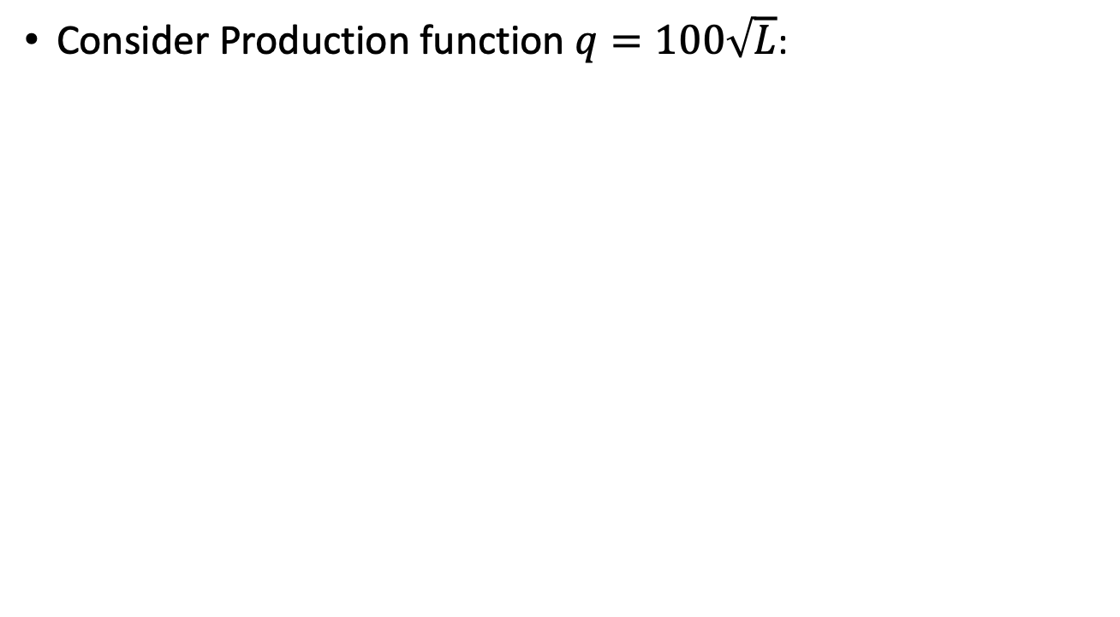
Average Product
Consider Production function $q=100\sqrt{L}$:
  At $A$,
    $L_{A}=4$.
    $q_{A}=200$.
    ${AP}_{L_{A}}=\frac{200}{4}=50$ units.
  At $B$,
    $L_{B}=16$.
    $q_{B}=400$.
    ${AP}_{L_{B}}=\frac{400}{16}=25$ units.
Figure 7.1

Slide 14
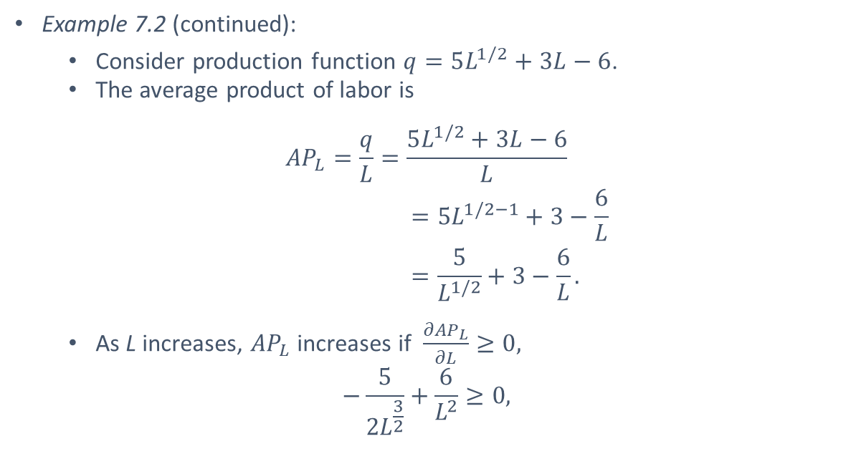
Average Product
Example 7.2 (continued):
  Consider production function $q=5L^{1/2}+3L−6$.
  The average product of labor is
  $${AP}_{L}=\frac{q}{L}=\frac{5L^{1/2}+3L−6}{L}$$
  $$=5L^{1/2−1}+3−\frac{6}{L}$$
  $$=\frac{5}{L^{1/2}}+3−\frac{6}{L}.$$
  As L increases, ${AP}_{L}$ increases if $\frac{∂{AP}_{L}}{∂L}≥0,$
  $$−\frac{5}{2L^{\frac{3}{2}}}+\frac{6}{L^{2}}≥0,$$

Slide 15
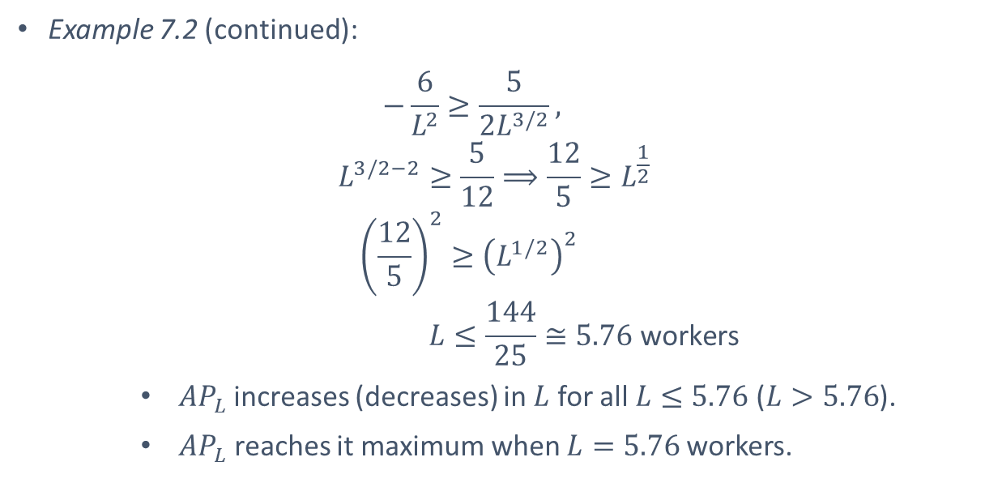
Average Product
Example 7.2 (continued):
  $$−\frac{6}{L^{2}}≥\frac{5}{2L^{3/2}},$$
  $$L^{3/2−2}≥\frac{5}{12}⟹\frac{12}{5}≥L^{\frac{1}{2}}$$
  $${\left(\frac{12}{5}\right)}^{2}≥{\left(L^{1/2}\right)}^{2}$$
  $$L≤\frac{144}{25}≅5.76 \text{workers}$$
      ${AP}_{L}$increases (decreases) in $L$ for all $L≤5.76$ ($L>5.76$).
      ${AP}_{L}$ reaches it maximum when $L=5.76$workers.

Slide 16

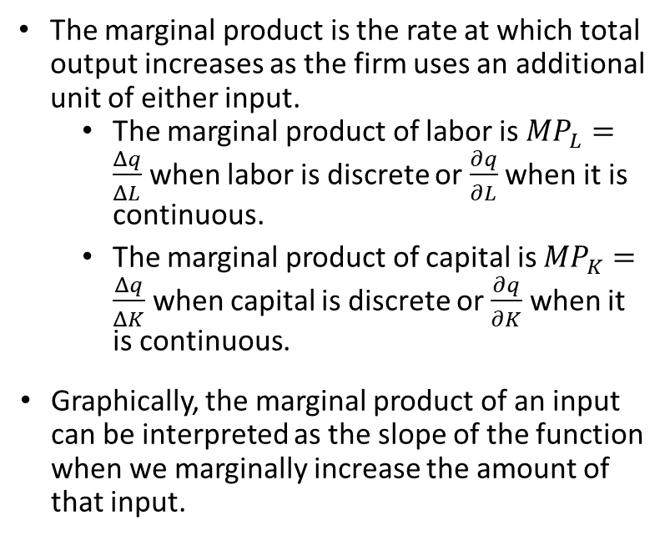
Marginal Product
The marginal product is the rate at which total output increases as the firm uses an additional unit of either input.
The marginal product of labor is ${MP}_{L}=\frac{Δq}{ΔL}$ when labor is discrete or $\frac{∂q}{∂L}$ when it is continuous.
The marginal product of capital is ${MP}_{K}=\frac{Δq}{ΔK}$ when capital is discrete or $\frac{∂q}{∂K}$ when it is continuous.
Graphically, the marginal product of an input can be interpreted as the slope of the function when we marginally increase the amount of that input.

Slide 17
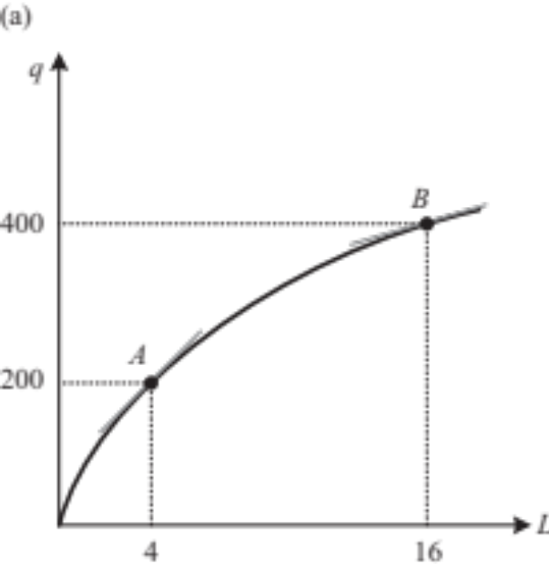
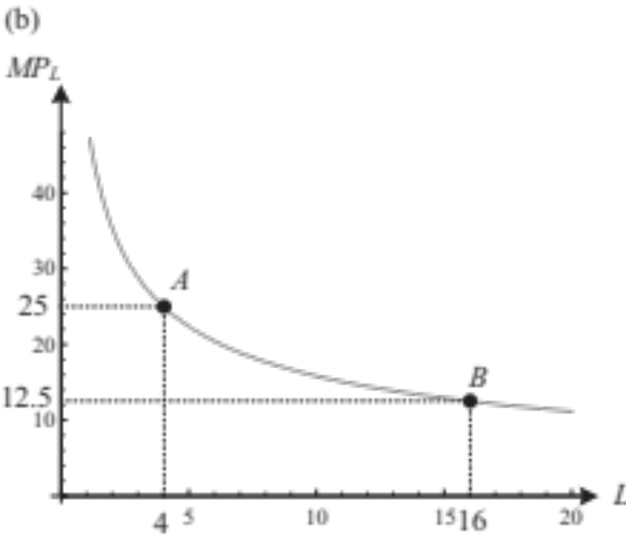

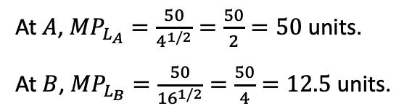

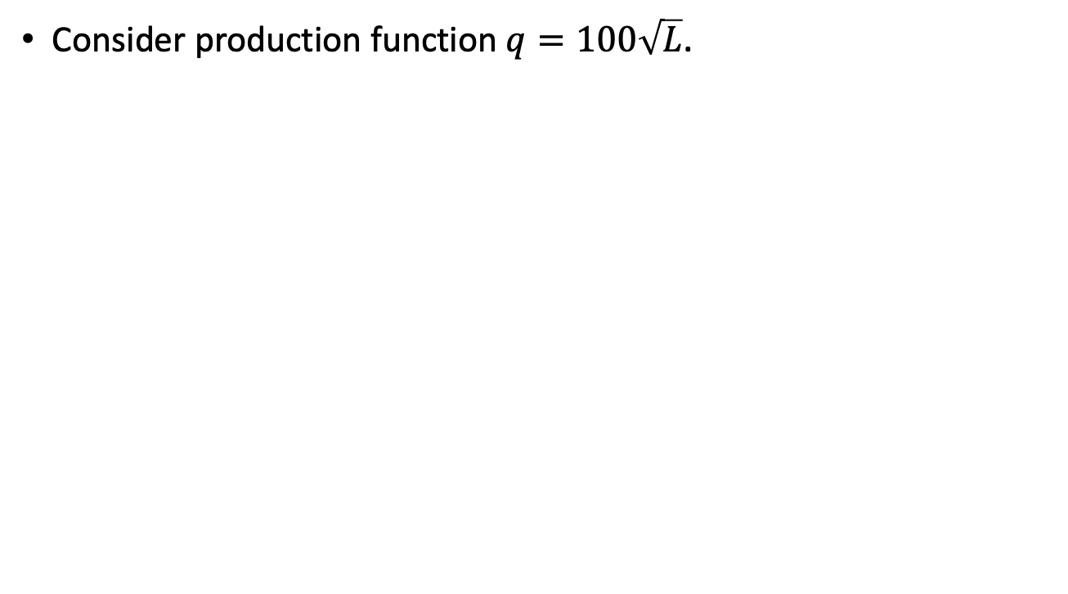

Marginal Product
Consider production function $q=100\sqrt{L}$.
${MP}_{L}$ as the slope of the production function
${MP}_{L}$ directly
  At $A$, ${MP}_{L_{A}}=\frac{50}{4^{1/2}}=\frac{50}{2}=50$ units.
  At $B$, ${MP}_{L_{B}}=\frac{50}{{16}^{1/2}}=\frac{50}{4}=12.5$ units.
Figure 7.2
${MP}_{L}$ is diminishing.

Slide 18
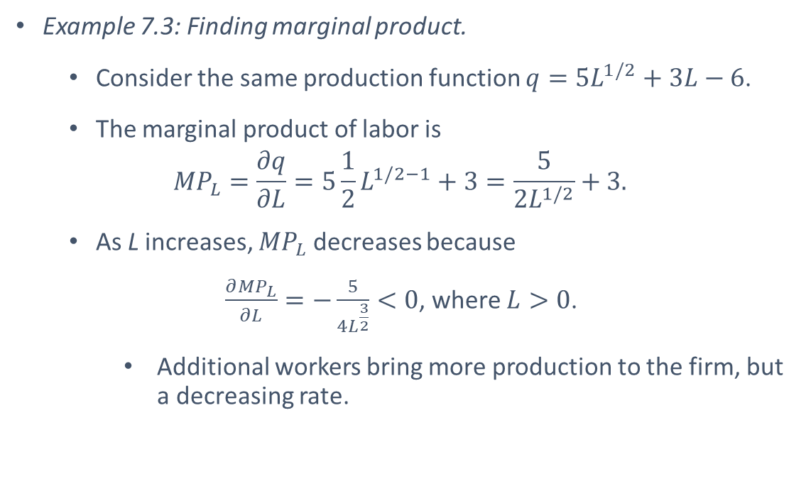
Marginal Product
Example 7.3: Finding marginal product.
  Consider the same production function $q=5L^{1/2}+3L−6$.
  The marginal product of labor is
  $${MP}_{L}=\frac{∂q}{∂L}=5\frac{1}{2}L^{1/2−1}+3=\frac{5}{{2L}^{1/2}}+3.$$
  As L increases, ${MP}_{L}$ decreases because
  $\frac{∂{MP}_{L}}{∂L}=−\frac{5}{4L^{\frac{3}{2}}}<0$, where $L>0$.
      Additional workers bring more production to the firm, but a decreasing rate.

Slide 19

Relationship between AP_{L} and MP_{L}

Slide 20

Relationship between AP_{L} and MP_{L}
The ${AP}_{L}$ and ${MP}_{L}$ exhibit interesting relationships:
  When the ${AP}_{L}$ curve is increasing, ${MP}_{L}$ lies above ${AP}_{L}$;
  When the ${AP}_{L}$ curve is decreasing, ${MP}_{L}$ lies below ${AP}_{L}$;
  When the ${AP}_{L}$ curve is increasing, ${MP}_{L}$ curve crosses ${AP}_{L}$.
Example: Consider grades in a class.
  You take a midterm exam. A few days later, the instructor informs how your average grade in the class is affected by the midterm:
    the midterm increases your average if the midterm grade is higher than your previous average ($MP>AP$); or
    the midterm decreases your average if the midterm grade is lower than your previous average ($MP<AP$); or
    The midterm does not affect your average if the midterm grade coincides with your previous average ($MP=AP$).

Slide 21
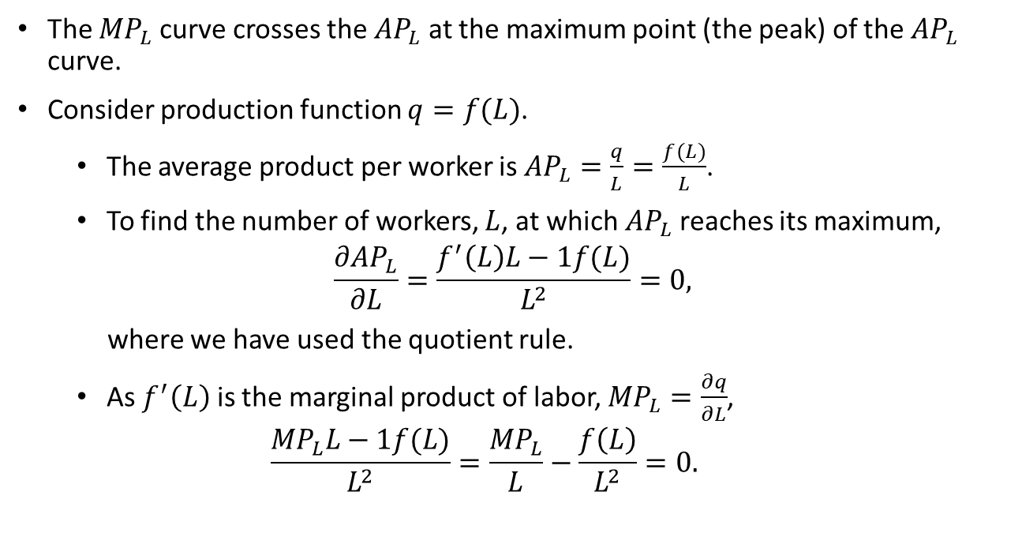
Relationship between AP_{L} and MP_{L}
The ${MP}_{L}$ curve crosses the ${AP}_{L}$ at the maximum point (the peak) of the ${AP}_{L}$ curve.
Consider production function $q=f(L)$.
  The average product per worker is ${AP}_{L}=\frac{q}{L}=\frac{f(L)}{L}$.
  To find the number of workers, $L$, at which ${AP}_{L}$ reaches its maximum,
  $$\frac{∂{AP}_{L}}{∂L}=\frac{f^{′}\left(L\right)L−1f(L)}{L^{2}}=0,$$
  where we have used the quotient rule.
  As $f^{′}\left(L\right)$ is the marginal product of labor, ${MP}_{L}=\frac{∂q}{∂L}$,
  $$\frac{{MP}_{L}L−1f(L)}{L^{2}}=\frac{{MP}_{L}}{L}−\frac{f\left(L\right)}{L^{2}}=0.$$

Slide 22

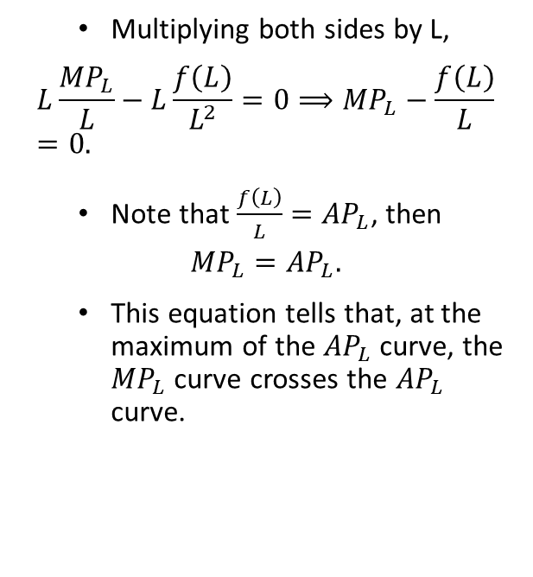
Relationship between AP_{L} and MP_{L}
  Multiplying both sides by L,
  $$L\frac{{MP}_{L}}{L}−L\frac{f\left(L\right)}{L^{2}}=0⟹{MP}_{L}−\frac{f\left(L\right)}{L}=0.$$
  Note that $\frac{f\left(L\right)}{L}={AP}_{L}$, then
  $${MP}_{L}={AP}_{L}.$$
  This equation tells that, at the maximum of the ${AP}_{L}$ curve, the ${MP}_{L}$ curve crosses the ${AP}_{L}$ curve.

Slide 23
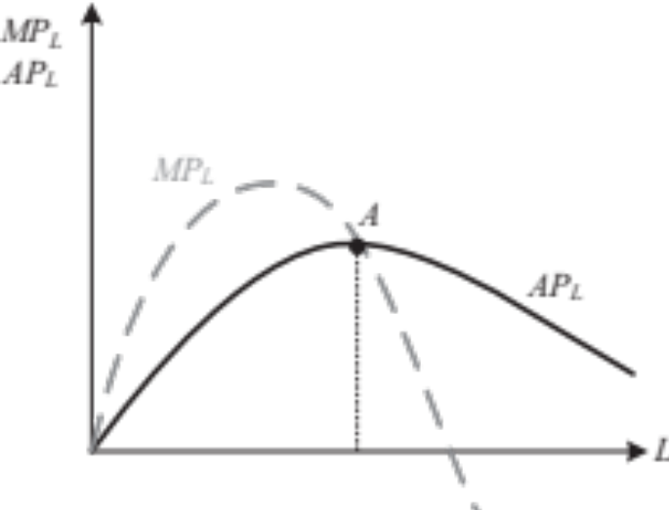
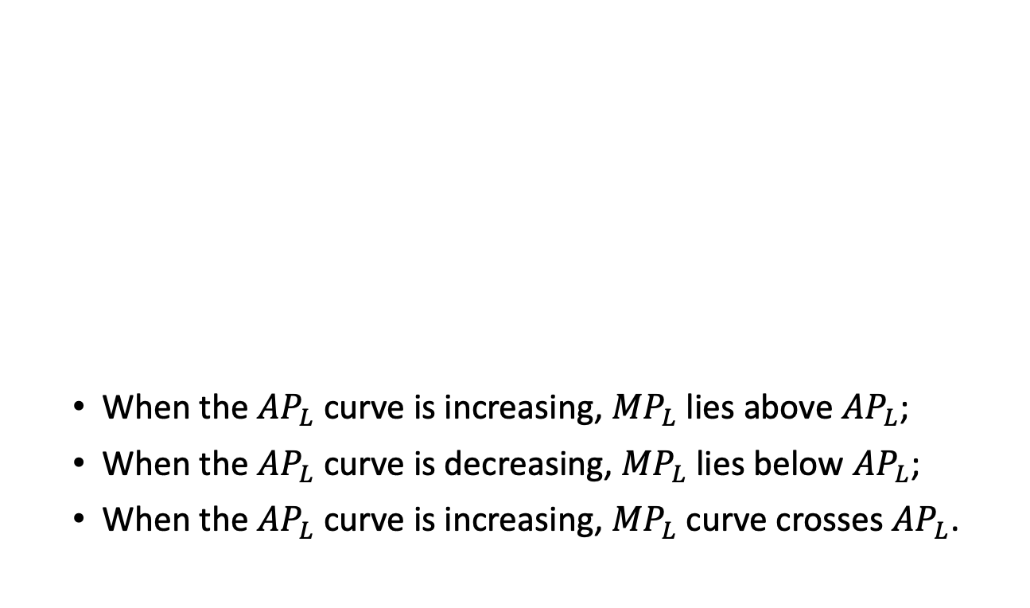
Relationship between AP_{L} and MP_{L}
  When the ${AP}_{L}$ curve is increasing, ${MP}_{L}$ lies above ${AP}_{L}$;
  When the ${AP}_{L}$ curve is decreasing, ${MP}_{L}$ lies below ${AP}_{L}$;
  When the ${AP}_{L}$ curve is increasing, ${MP}_{L}$ curve crosses ${AP}_{L}$.
Figure 7.3

Slide 24

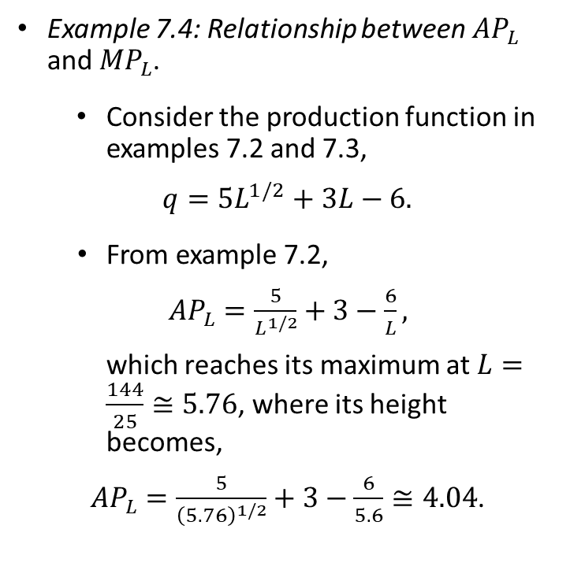
Relationship between AP_{L} and MP_{L}
Example 7.4: Relationship between ${AP}_{L}$ and ${MP}_{L}$.
  Consider the production function in examples 7.2 and 7.3,
  $$q=5L^{1/2}+3L−6.$$
    From example 7.2,
    ${AP}_{L}=\frac{5}{L^{1/2}}+3−\frac{6}{L},$
    which reaches its maximum at $L=\frac{144}{25}≅5.76$, where its height becomes,
    ${AP}_{L}=\frac{5}{{\left(5.76\right)}^{1/2}}+3−\frac{6}{5.6}≅4.04$.

Slide 25
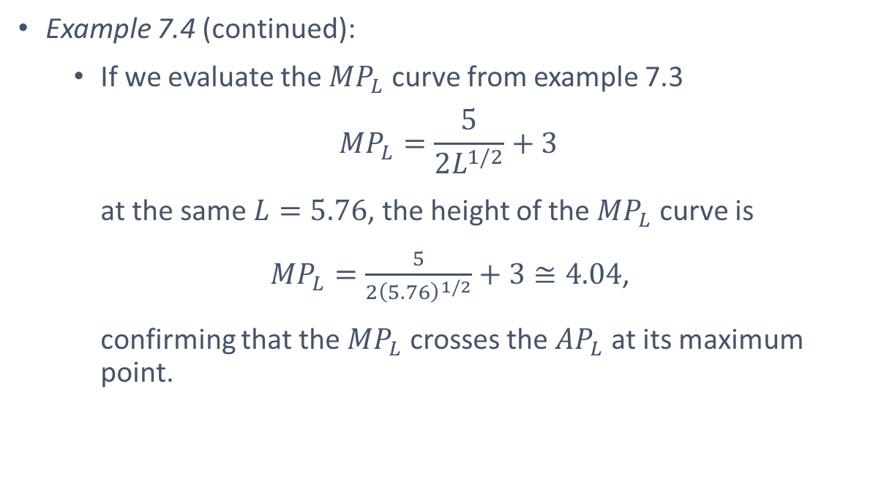
Relationship between AP_{L} and MP_{L}
Example 7.4 (continued):
    If we evaluate the ${MP}_{L}$ curve from example 7.3
    $${MP}_{L}=\frac{5}{2L^{1/2}}+3$$
    at the same $L=5.76$, the height of the ${MP}_{L}$ curve is
    ${MP}_{L}=\frac{5}{{2\left(5.76\right)}^{1/2}}+3≅4.04$,
    confirming that the ${MP}_{L}$ crosses the ${AP}_{L}$ at its maximum point.

Slide 26
Isoquants

Slide 27
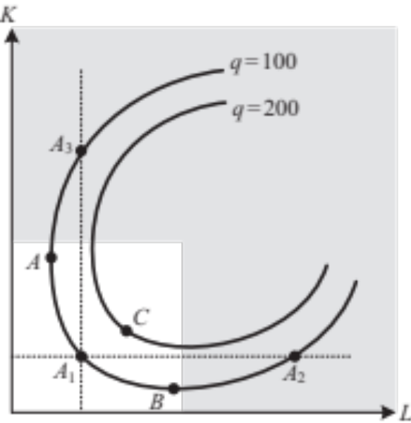
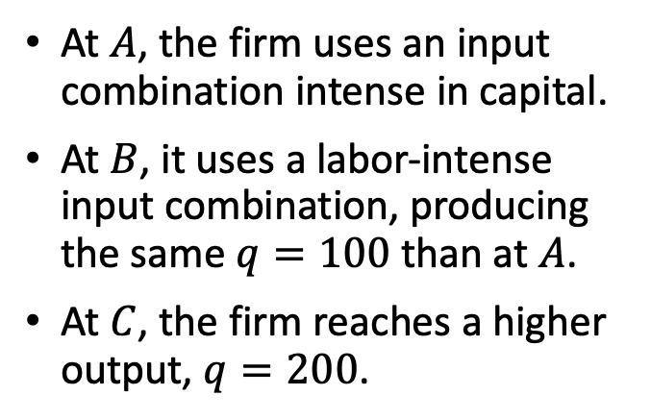
Isoquants
The isoquant curve represents combinations of labor and capital that yield the same amount of output.
At $A$, the firm uses an input combination intense in capital.
At $B$, it uses a labor-intense input combination, producing the same $q=100$than at $A$.
At $C$, the firm reaches a higher output, $q=200$.
Figure 7.4

Slide 28
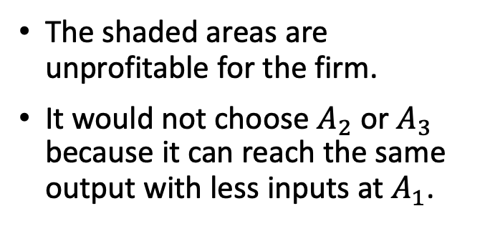
Isoquants
The isoquant curve represents combinations of labor and capital that yield the same amount of output.
The shaded areas are unprofitable for the firm.
It would not choose $A_{2}$ or $A_{3}$ because it can reach the same output with less inputs at $A_{1}$.
Figure 7.4

Slide 29
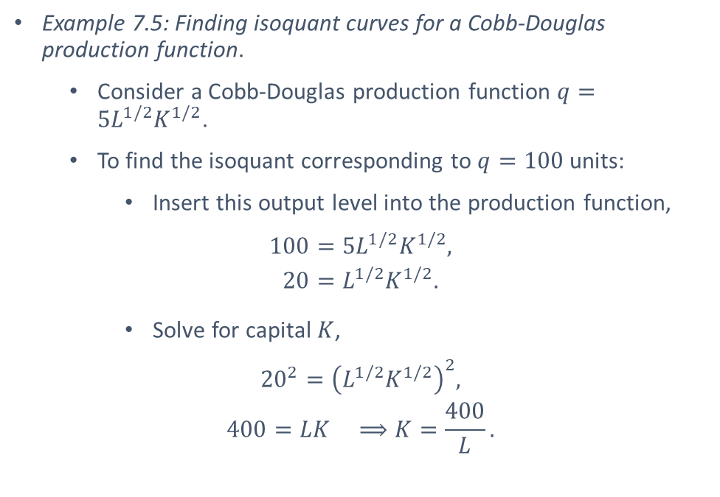
Isoquants
Example 7.5: Finding isoquant curves for a Cobb-Douglas production function.
  Consider a Cobb-Douglas production function $q=5L^{1/2}K^{1/2}$.
  To find the isoquant corresponding to $q=100$units:
    Insert this output level into the production function,
    $$100=5L^{1/2}K^{1/2},$$
    $$20=L^{1/2}K^{1/2}.$$
    Solve for capital $K$,
    $${20}^{2}={\left(L^{1/2}K^{1/2}\right)}^{2},$$
    $$400=LK ⟹K=\frac{400}{L}.$$

Slide 30
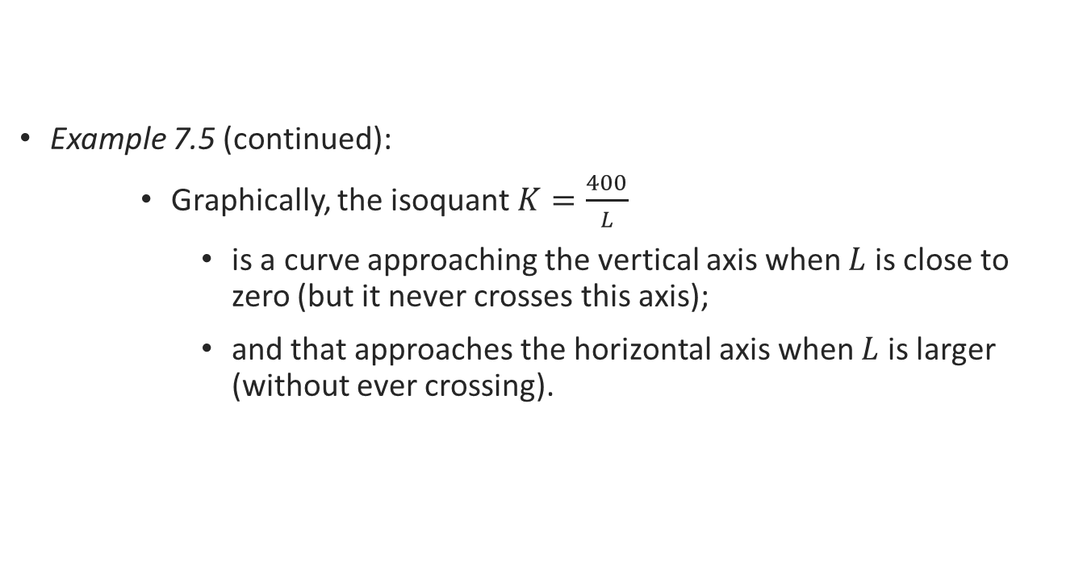
Isoquants
Example 7.5 (continued):
    Graphically, the isoquant $K=\frac{400}{L}$
      is a curve approaching the vertical axis when $L$ is close to zero (but it never crosses this axis);
      and that approaches the horizontal axis when $L$ is larger (without ever crossing).

Slide 31

Marginal Rate of
Technical Substitution

Slide 32
Marginal Rate of Technical Substitution
The slope of the isoquant answers the question:
How many units of capital must the firm give up to maintain its output level unaffected after hiring an extra worker?
Marginal rate of technical substitution (MRTS). After increasing the quantity of labor by 1 unit, the MRST measures the amount by which capital must be reduced so that output remains constant.

Slide 33
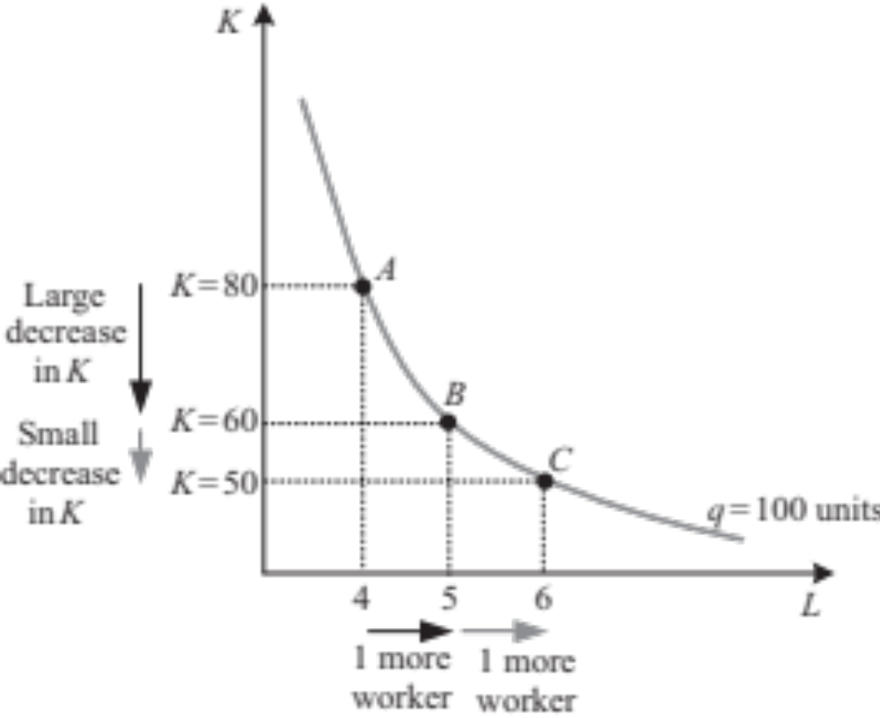
Marginal Rate of Technical Substitution
Figure 7.5

Slide 34
Marginal Rate of Technical Substitution
Intuitively,
  When capital is abundant, the firm is willing to give up many units of capital to hire one more worker.
  When capital becomes scarcer, the firm is less willing to replace it with workers.

Slide 35
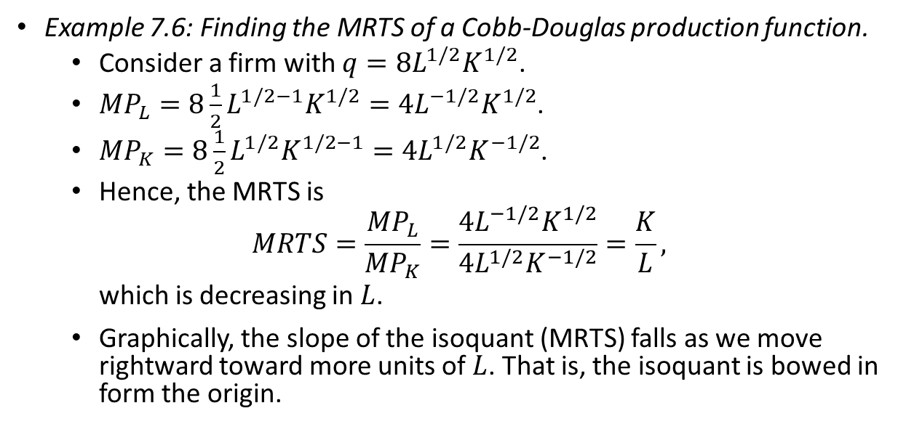
Marginal Rate of Technical Substitution
Example 7.6: Finding the MRTS of a Cobb-Douglas production function.
  Consider a firm with $q=8L^{1/2}K^{1/2}$.
  ${MP}_{L}=8\frac{1}{2}L^{1/2−1}K^{1/2}=4L^{−1/2}K^{1/2}$.
  ${MP}_{K}=8\frac{1}{2}L^{1/2}K^{1/2−1}=4L^{1/2}K^{−1/2}$.
  Hence, the MRTS is
  $$MRTS=\frac{{MP}_{L}}{{MP}_{K}}=\frac{4L^{−1/2}K^{1/2}}{4L^{1/2}K^{−1/2}}=\frac{K}{L},$$
  which is decreasing in $L$.
  Graphically, the slope of the isoquant (MRTS) falls as we move rightward toward more units of $L$. That is, the isoquant is bowed in form the origin.

Slide 36
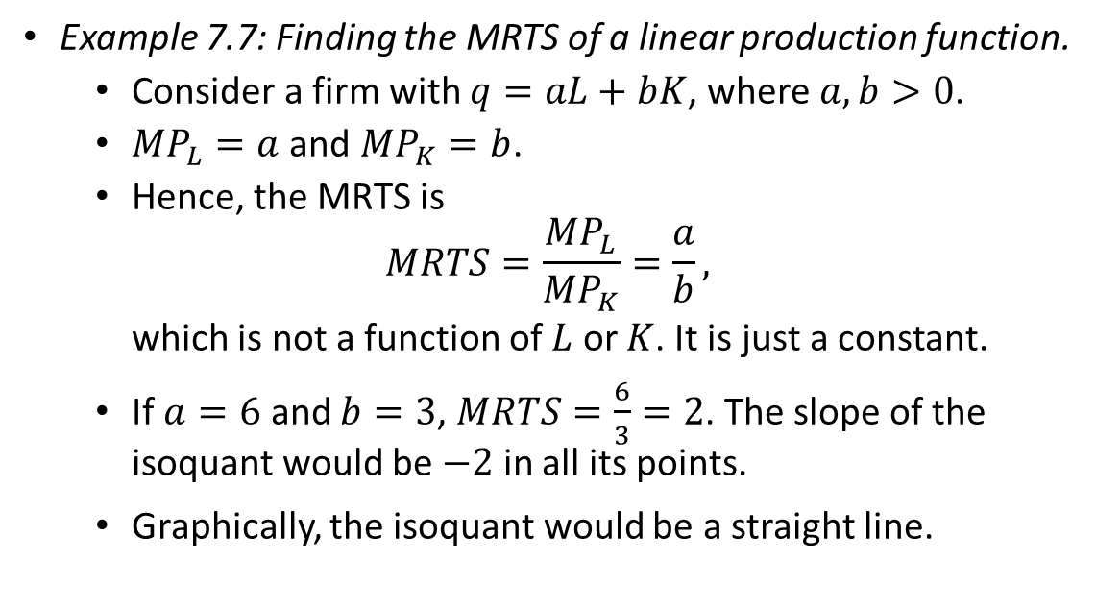
Marginal Rate of Technical Substitution
Example 7.7: Finding the MRTS of a linear production function.
  Consider a firm with $q=aL+bK$, where $a,b>0$.
  ${MP}_{L}=a$ and ${MP}_{K}=b$.
  Hence, the MRTS is
  $$MRTS=\frac{{MP}_{L}}{{MP}_{K}}=\frac{a}{b},$$
  which is not a function of $L$ or $K$. It is just a constant.
  If $a=6$ and $b=3$, $MRTS=\frac{6}{3}=2$. The slope of the isoquant would be $−2$ in all its points.
  Graphically, the isoquant would be a straight line.

Slide 37
Special Types of
Production Functions

Slide 38

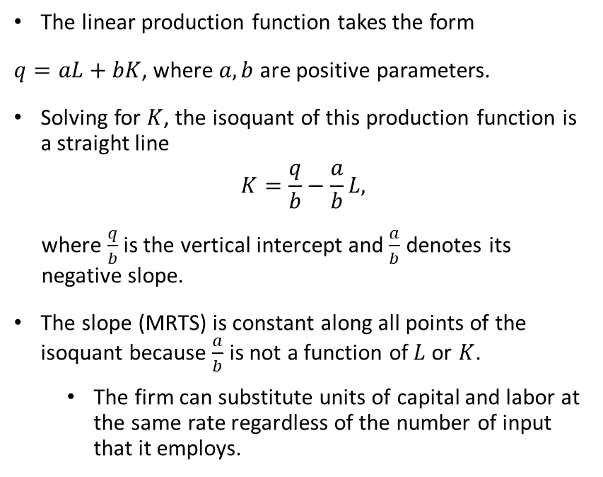
Linear Production Function
The linear production function takes the form
$q=aL+bK$, where $a,b$ are positive parameters.
Solving for $K$, the isoquant of this production function is a straight line
$$K=\frac{q}{b}−\frac{a}{b}L,$$
where $\frac{q}{b}$ is the vertical intercept and $\frac{a}{b}$ denotes its negative slope.
The slope (MRTS) is constant along all points of the isoquant because $\frac{a}{b}$ is not a function of$L$or $K$.
  The firm can substitute units of capital and labor at the same rate regardless of the number of input that it employs.

Slide 39
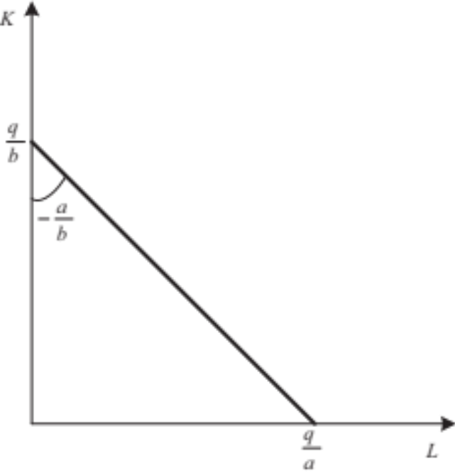
Linear Production Function
Linear production functions can represent firms capable of substituting between inputs, such as two types of oils or computers.
Figure 7.6

Slide 40
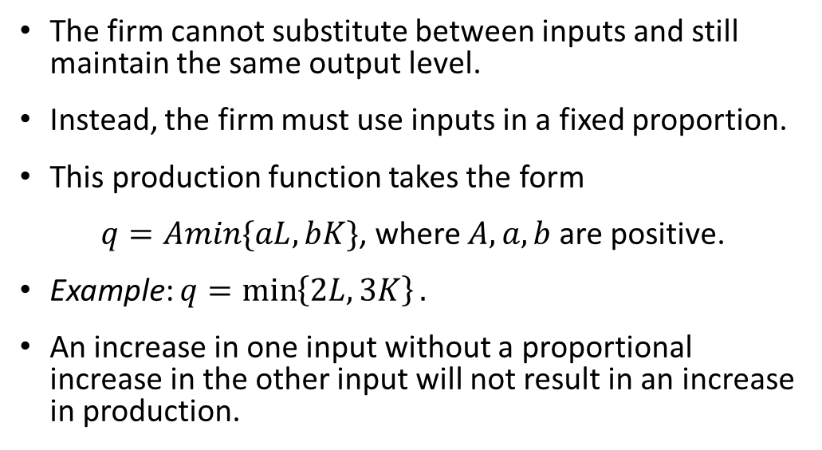
Fixed-Proportions
Production Function
The firm cannot substitute between inputs and still maintain the same output level.
Instead, the firm must use inputs in a fixed proportion.
This production function takes the form
$q=Amin\{aL,bK\}$, where $A,a,b$ are positive.
Example: $q=\min\left\{2L,3K\right\}.$
An increase in one input without a proportional increase in the other input will not result in an increase in production.

Slide 41
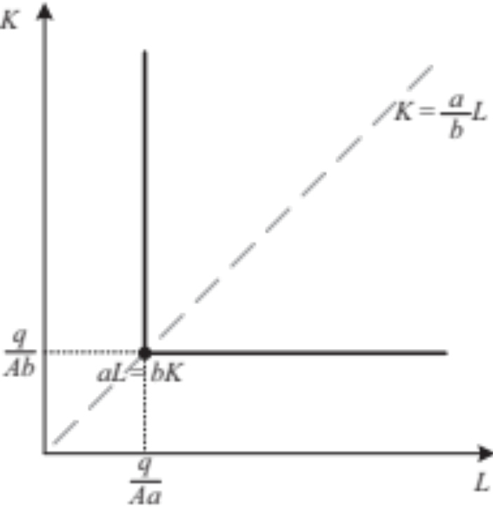
Fixed-Proportions
Production Function
Figure 7.7

Slide 42

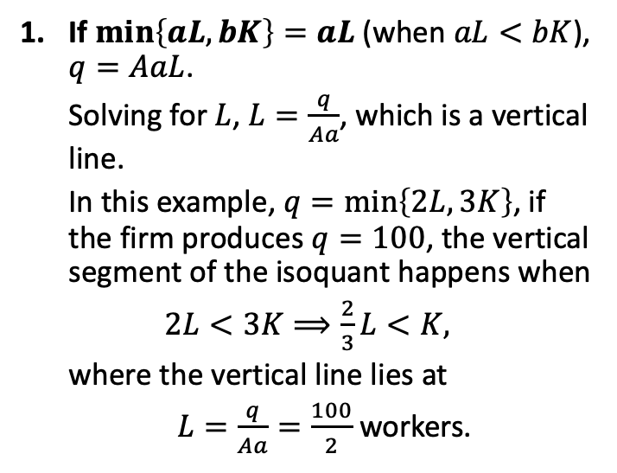
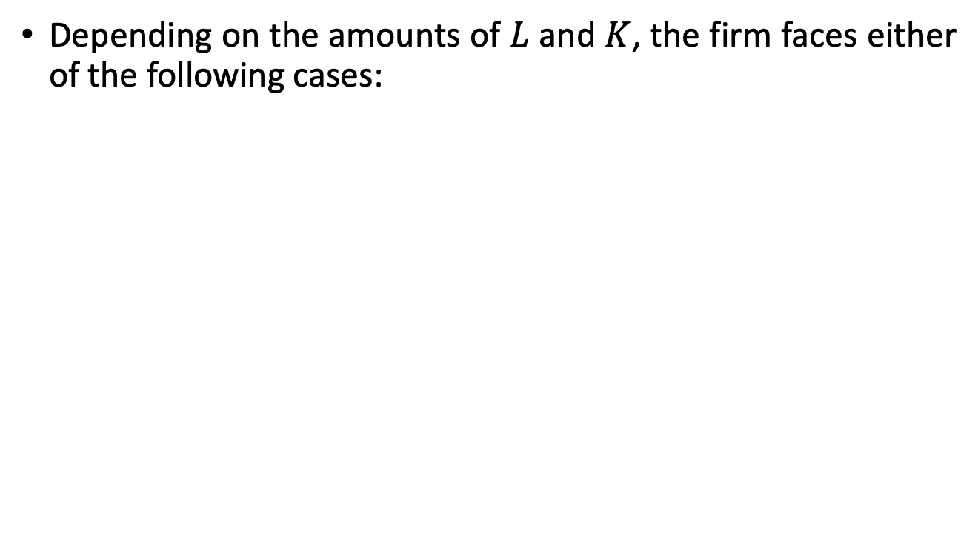
Fixed-Proportions
Production Function
Depending on the amounts of $L$ and $K$, the firm faces either of the following cases:
If $\min\left\{aL,bK\right\}=aL$ (when $aL<bK$), $q=AaL$.
Solving for $L$, $L=\frac{q}{Aa}$, which is a vertical line.
In this example, $q=\min\left\{2L,3K\right\}$, if the firm produces $q=100$, the vertical segment of the isoquant happens when
$2L<3K⟹\frac{2}{3}L<K,$
where the vertical line lies at
$L=\frac{q}{Aa}=\frac{100}{2}$ workers.
Figure 7.7

Slide 43
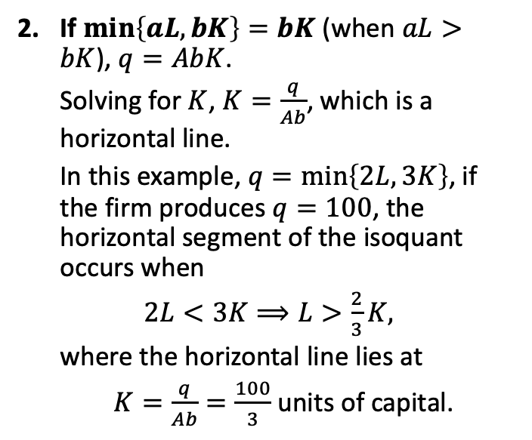
Fixed-Proportions
Production Function
Depending on the amounts of $L$ and $K$, the firm faces either of the following cases:
If $\min\left\{aL,bK\right\}=bK$ (when $aL>bK$), $q=AbK$.
Solving for $K$, $K=\frac{q}{Ab}$, which is a horizontal line.
In this example, $q=\min\left\{2L,3K\right\}$, if the firm produces $q=100$, the horizontal segment of the isoquant occurs when
$2L<3K⟹L>\frac{2}{3}K,$
where the horizontal line lies at
$K=\frac{q}{Ab}=\frac{100}{3}$ units of capital.
Figure 7.7

Slide 44
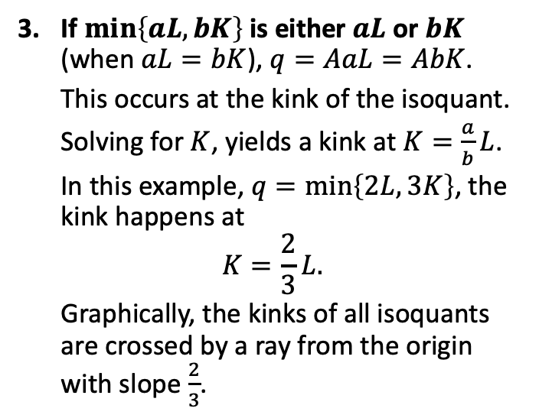
Fixed-Proportions
Production Function
Depending on the amounts of $L$ and $K$, the firm faces either of the following cases:
If $\min\left\{aL,bK\right\}$ is either $aL$ or $bK$ (when $aL=bK$), $q=AaL=AbK$.
This occurs at the kink of the isoquant.
Solving for $K$, yields a kink at $K=\frac{a}{b}L$.
In this example, $q=\min\left\{2L,3K\right\}$, the kink happens at
$$K=\frac{2}{3}L.$$
Graphically, the kinks of all isoquants are crossed by a ray from the origin with slope $\frac{2}{3}$.
Figure 7.7

Slide 45
Fixed-Proportions
Production Function
The MRTS is not well defined because we can find infinitely many slopes for the isoquant at its kink.
We can nonetheless say the slope of the isoquant is infinite in its vertical segment, and zero in its horizontal segment.
This type of production function is common in firms that cannot easily substitute across inputs without altering total output.
Examples:
Firms in the chemical industry.
Firms with a highly automated production process.

Slide 46

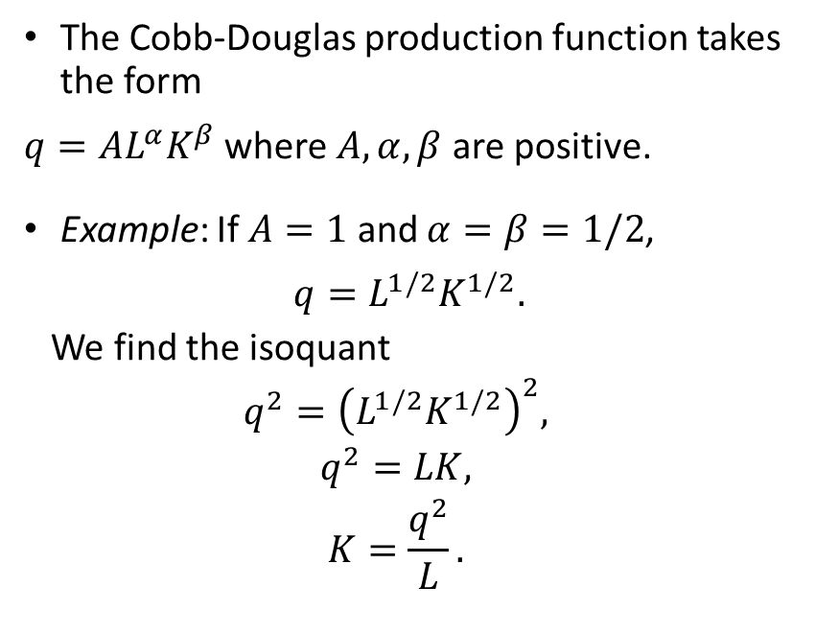
Cobb-Douglas
Production Function
The Cobb-Douglas production function takes the form
$q=AL^{α}K^{β}$ where $A,α,β$ are positive.
Example: If $A=1$ and $α=β=1/2$,
$$q=L^{1/2}K^{1/2}.$$
We find the isoquant
$$q^{2}={\left(L^{1/2}K^{1/2}\right)}^{2},$$
$$q^{2}=LK,$$
$$K=\frac{q^{2}}{L}.$$

Slide 47
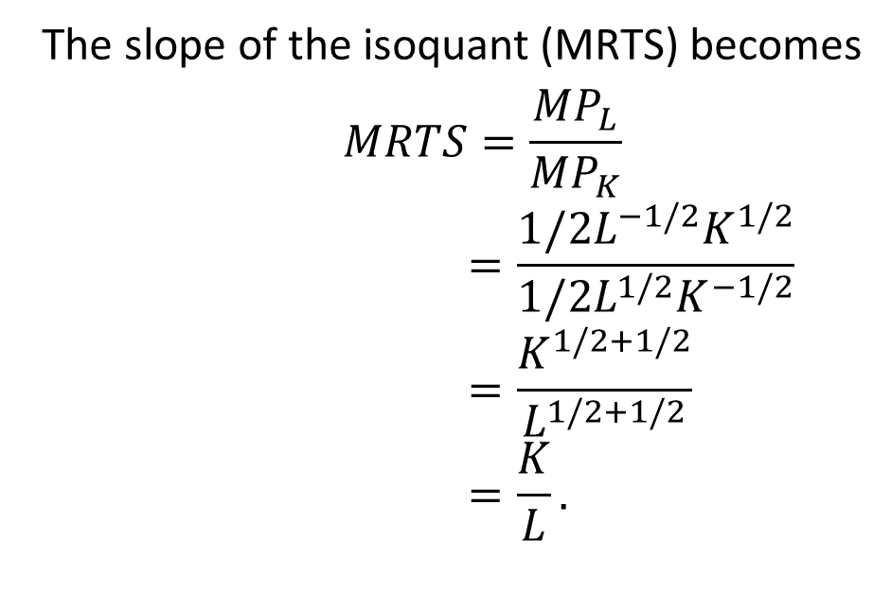
Cobb-Douglas
Production Function
The slope of the isoquant (MRTS) becomes
$$MRTS=\frac{{MP}_{L}}{{MP}_{K}}$$
$$=\frac{1/2L^{−1/2}K^{1/2}}{1/2L^{1/2}K^{−1/2}}$$
$$=\frac{K^{1/2+1/2}}{L^{1/2+1/2}}$$
$$=\frac{K}{L}.$$

Slide 48

Returns to Scale

Slide 49

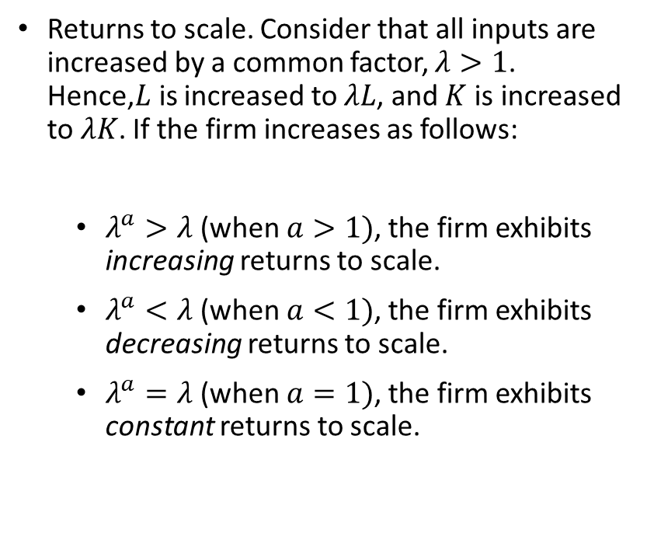
Returns to Scale
Returns to scale. Consider that all inputs are increased by a common factor, $λ>1$. Hence,$L$is increased to $λL$, and $K$ is increased to $λK$. If the firm increases as follows:
  $λ^{a}>λ$ (when $a>1)$, the firm exhibits increasing returns to scale.
  $λ^{a}<λ$ (when $a<1)$, the firm exhibits decreasing returns to scale.
  $λ^{a}=λ$ (when $a=1)$, the firm exhibits constant returns to scale.

Slide 50




Increasing Returns to Scale
Electric power, airplane producers, large express shipping companies, telecommunication companies are examples of markets that exhibit increasing returns to scale.

Slide 51

Decreasing Returns to Scale
Examples of industries that exhibit decreasing returns to scale include companies engaged in exploration of natural resources (because it becomes increasingly difficult to extract as easier low-hanging minerals are extracted).

Slide 52


Constant Returns to Scale
Constant returns to scale prevail in very small businesses. For example, consider a car wash or a small bakery.

Slide 53
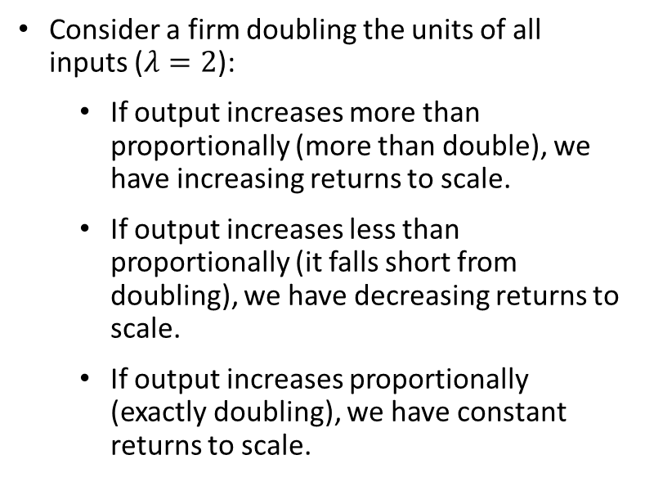
Returns to Scale
Consider a firm doubling the units of all inputs ($λ=2$):
  If output increases more than proportionally (more than double), we have increasing returns to scale.
  If output increases less than proportionally (it falls short from doubling), we have decreasing returns to scale.
  If output increases proportionally (exactly doubling), we have constant returns to scale.

Slide 54

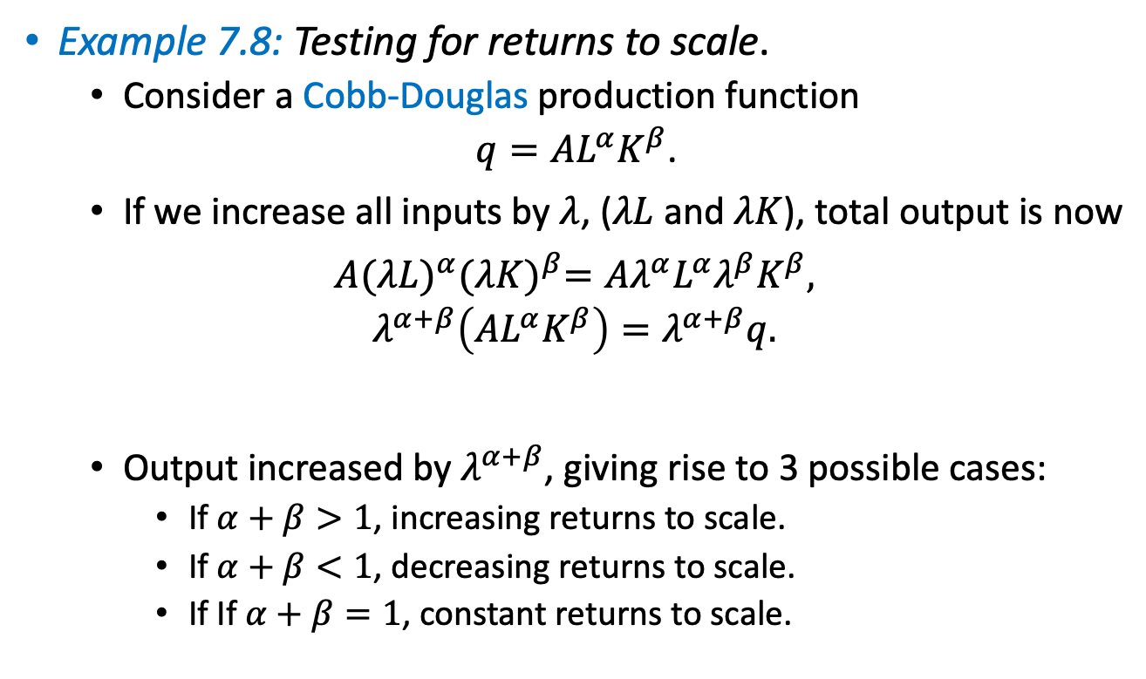
Returns to Scale
Example 7.8: Testing for returns to scale.
  Consider a Cobb-Douglas production function
  $q=AL^{α}K^{β}$.
  If we increase all inputs by $λ$, ($λL$ and $λK$), total output is now
  $$A{(λL)}^{α}{(λK)}^{β}=Aλ^{α}L^{α}λ^{β}K^{β},$$
  $$λ^{α+β}\left(AL^{α}K^{β}\right)=λ^{α+β}q.$$
  Output increased by $λ^{α+β}$, giving rise to 3 possible cases:
    If $α+β>1$, increasing returns to scale.
    If $α+β<1$, decreasing returns to scale.
    If If $α+β=1$, constant returns to scale.
$$q$$

Slide 55

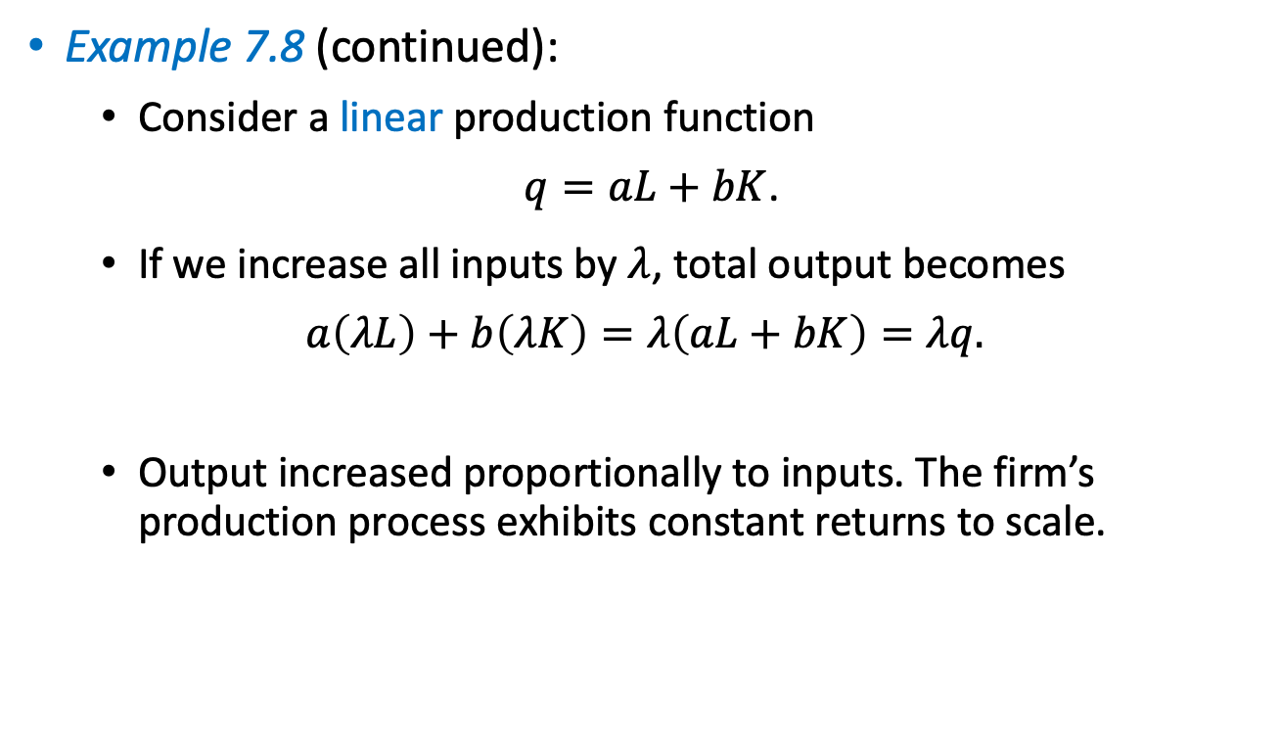
Returns to Scale
Example 7.8 (continued):
  Consider a linear production function
  $q=aL+bK$.
  If we increase all inputs by $λ$, total output becomes
  $$a\left(λL\right)+b\left(λK\right)=λ\left(aL+bK\right)=λq.$$
  Output increased proportionally to inputs. The firm’s production process exhibits constant returns to scale.
$$q$$

Slide 56

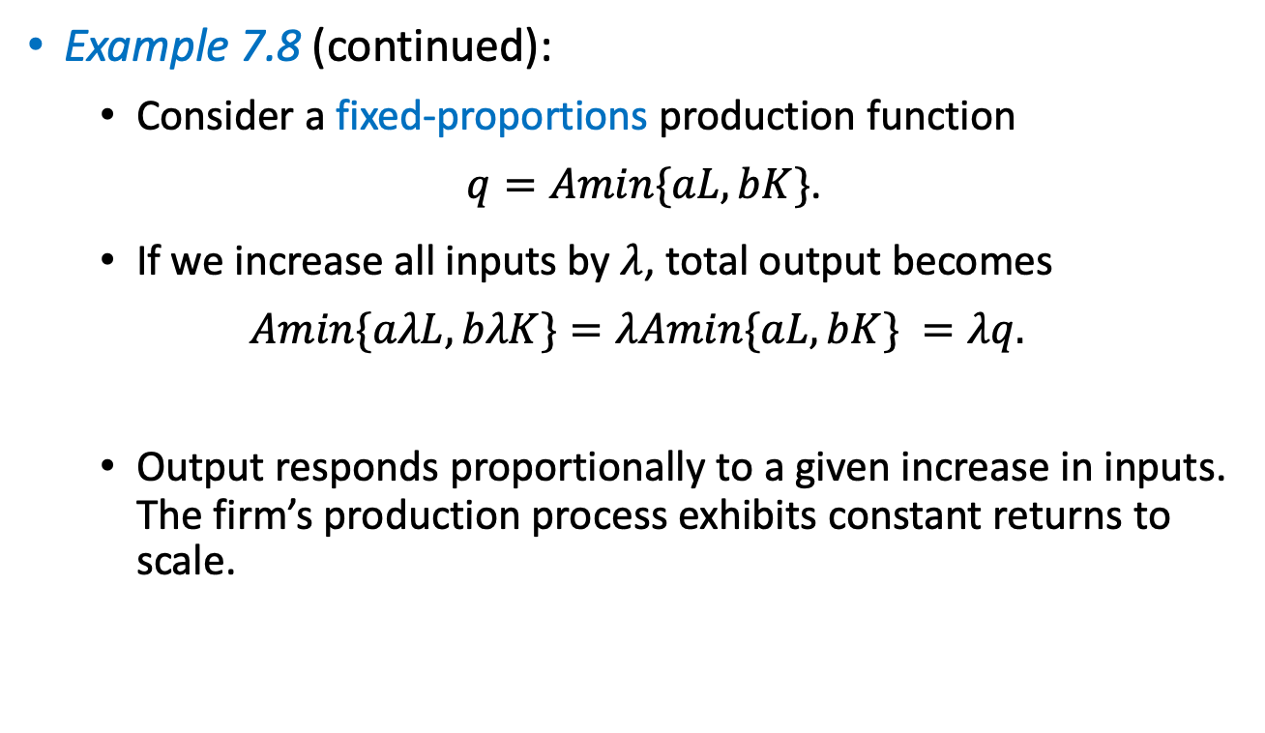
Returns to Scale
Example 7.8 (continued):
  Consider a fixed-proportions production function
  $q=Amin\{aL,bK\}$.
  If we increase all inputs by $λ$, total output becomes
  $$Amin\{aλL,bλK\}=λAmin\{aL,bK\} =λq.$$
  Output responds proportionally to a given increase in inputs. The firm’s production process exhibits constant returns to scale.
$$q$$

Slide 57
Technological Progress

Slide 58

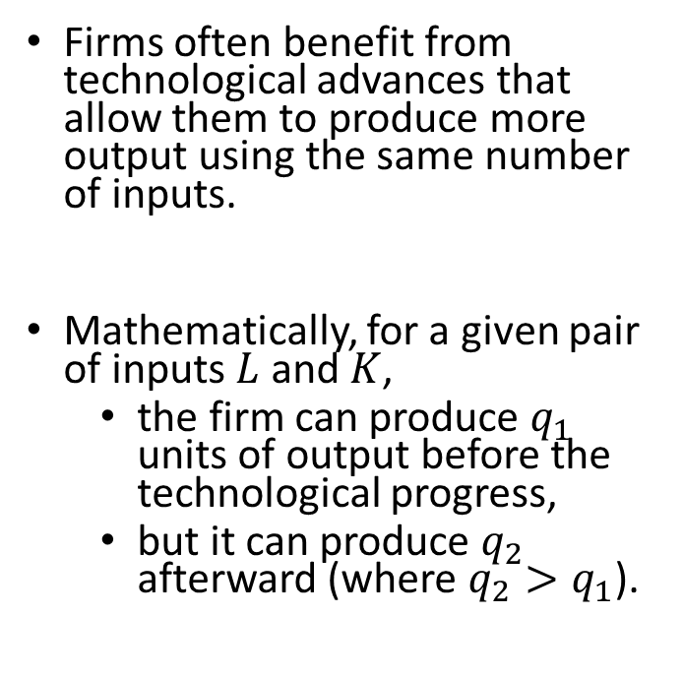
Technological Progress
Firms often benefit from technological advances that allow them to produce more output using the same number of inputs.
Mathematically, for a given pair of inputs$L$and $K$,
  the firm can produce $q_{1}$ units of output before the technological progress,
  but it can produce $q_{2}$ afterward (where $q_{2}>q_{1}$).

Slide 59
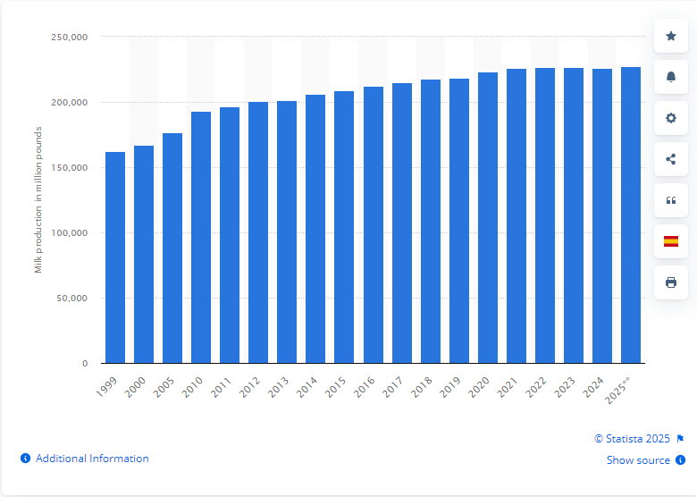
Total U.S. milk production 1999-2025

Slide 60

Technological Progress

Slide 61

Estimated worldwide motor vehicle production from 2000 to 2023

Slide 62

Technological Progress
Example: If the $\text{firm}\text{’}\text{s} \text{production} \text{function} \text{is} q=A_{1}L^{α}K^{β}$ before technological progress, afterward it could be
  $q=A_{2}L^{α}K^{β};$
  $q=A_{1}L^{α+γ}K^{β}$ (where $γ>0$); or
  $q=A_{1}L^{α}K^{β+γ}$ (where $γ>0$).

Slide 63

Technological Progress
Example 7.9: Testing for technological progress.
  Consider a firm which production function changes from
  $q=L^{α}K^{β}$ to $q=L^{2α}K^{β}.$
  The firm benefits from technological progress because
  $L^{α}K^{β}<$ $L^{2α}K^{β}$,
  $L<L^{2}$,
  This condition holds true for any number of workers $L>1$.

Slide 64

Types of Technological Progress
Technological progress can be of three types:
  Labor enhancing.
  Capital enhancing.
  Neutral.

Slide 65

Labor-enhancing Tech Progress
Technological progress is labor enhancing if it increases the marginal product of labor more than that of capital,
$$∆{MP}_{L}>∆{MP}_{K}.$$
Example:
  If higher education allows workers to be more productive while capital does not increase its marginal product as quickly.

Slide 66

Labor-enhancing Tech Progress
As a result,
$MRTS=\frac{{MP}_{L}}{{MP}_{K}}$ increases.
Graphically, the firm’s isoquant becomes steeper after the technological progress.
  The firm is willing to give up more units of capital to hire one more worker.
Also known as “capital saving.”

Slide 67

Productivity vs. Education

Slide 68


Capital-enhancing Tech Progress
Capital-enhancing technological progress means that capital increases its marginal product faster than labor does,
$$∆{MP}_{L}<∆{MP}_{K}.$$
  Example: If new software makes each unit of capital more productive while labor does not increase its marginal product as much.
As a result, $MRTS=\frac{{MP}_{L}}{{MP}_{K}}$ decreases.
Graphically, the firm’s isoquant becomes flatter after the technological progress.
  The firm is willing to give up fewer units of the more productive capital to hire one more worker.
Also known as “labor saving.”

Slide 69


Neutral Tech Progress
Technological progress is regarded as neutral if the marginal product of labor and capital increase at the same amount,
$$∆{MP}_{L}=∆{MP}_{K}.$$
As a result, $MRTS=\frac{{MP}_{L}}{{MP}_{K}}$ is unaffected.
Graphically, the firm’s isoquant does not change its slope after the technological progress.
  The firm is willing to give up as many units of capital to hire one more worker.

Slide 70

Technological Progress
Example 7.10: Identifying the type of technological progress.
  Consider the firm in example 7.9.
  Before technological change,
  $${MRTS}_{Pre}=\frac{α}{β}\frac{K}{L},$$
  while afterward it becomes
  $${MRTS}_{Post}=\frac{2α}{β}\frac{K}{L}.$$
  Comparing them,
  $${MRTS}_{Pre}<{MRTS}_{Post},$$
  Indicating that the technological progress is labor enhancing.

Slide 71

Appendix A.
MRTS as the Ratio of Marginal Products

Slide 72



MRTS as Ratio of Marginal Products
We show that the slope of the isoquant is measured by $\frac{{MP}_{L}}{{MP}_{K}}$.
Consider a firm with production function $q=f(L,K)$.
To evaluate the slope of the isoquant, we simultaneously increase labor (e.g., by 1 unit) and decrease capital.
Hence, we totally differentiate the production function with respect to $L$ and $K$
$$dq=\frac{∂f(L,K)}{∂L}dL+\frac{∂f(L,K)}{∂K}dK,$$
$$dq={MP}_{L}dL+{MP}_{K}dK.$$
$${MP}_{L}$$
$${MP}_{K}$$

Slide 73

MRTS as Ratio of Marginal Products
Because we are moving along different points of the firm’s isoquant, the output level is the same, entailing $dq=0$. Then,
$$dq={MP}_{L}dL+{MP}_{K}dK,$$
$$0={MP}_{L}dL+{MP}_{K}dK,$$
$${MP}_{K}dK={−MP}_{L}dL.$$
Because we are interested in the slope of the isoquant, we solve for $−\frac{dK}{dL}$, which reflects the rate at which the firm needs to decrease $K$ if $L$ increases by 1 unit,
$$−\frac{dK}{dL}=\frac{{MP}_{L}}{{MP}_{K}}.$$
Slope of isoquant
Ratio of marginal products (MRTS)

Slide 74

Appendix B.
Elasticity of Substitution

Slide 75


Elasticity of Substitution
The elasticity of substitution is a common measure of how easy it is for a firm to substitute labor for capital,
$$σ=\frac{\%Δ\frac{K}{L}}{\%∆MRTS}=\frac{\frac{{\left(\frac{K}{L}\right)}_{B}−{\left(\frac{K}{L}\right)}_{A}}{{\left(\frac{K}{L}\right)}_{A}}}{\frac{{MRTS}_{B}−{MRTS}_{A}}{{MRTS}_{A}}}.$$
The elasticity of substitution tells us that, if the MRTS increases by $1\%$, the capital labor ratio that the firm uses, $\frac{K}{L}$, increases by $σ\%$.

Slide 76






Elasticity of Substitution
Finding MRTS at two points to obtain $σ$.
At $A$: $\frac{K_{A}}{L_{A}}=\frac{20}{4}=5$,
$${MRTS}_{A}=6.$$
At $B$: $\frac{K_{B}}{L_{B}}=\frac{8}{10}=0.8,$
$${MRTS}_{B}=2.$$
$$σ=\frac{\frac{{\left(\frac{K}{L}\right)}_{B}−{\left(\frac{K}{L}\right)}_{A}}{{\left(\frac{K}{L}\right)}_{A}}}{\frac{{MRTS}_{B}−{MRTS}_{A}}{{MRTS}_{A}}}=\frac{\frac{0.8−5}{5}}{\frac{2−6}{6}}=\frac{−0.84}{−\frac{2}{3}}=1.26.$$
Figure 7.8
If the MRTS decreases by $2/3$ (about $66\%$), $K/L$ decreases more than proportionally, by $84\%$.

Slide 77


Elasticity of Substitution
Linear production function.
  If the firm has a linear production function, $q=aL+bK$, its isoquants are straight lines.
  $MRTS=\frac{a}{b}$ is constant along all the points of the isoquant.
  $$σ=\frac{\frac{{\left(\frac{K}{L}\right)}_{B}−{\left(\frac{K}{L}\right)}_{A}}{{\left(\frac{K}{L}\right)}_{A}}}{0}=+∞.$$
  Regardless of % change in the $K/L$ ratio, the elasticity of substitution is infinite.
    The firm can substitute labor for capital very easily without altering its output.

