Slide 1
Intermediate Microeconomic
Theory
Chapter 6:
Choice under Uncertainty

Slide 2
Outline
Lotteries
Expected Value
Variance and Standard Deviation
Expected Utility
Risk Attitudes
Measuring Risk
A Look at Behavioral Economics–Nonexpected Utility

Slide 3


What is Uncertainty?
How does it affect your decisions?

Slide 4

Does weather affect your decisions?

Slide 5

Does weather affect your decisions?

Slide 6

Does uncertainty affect your decisions?

Slide 7
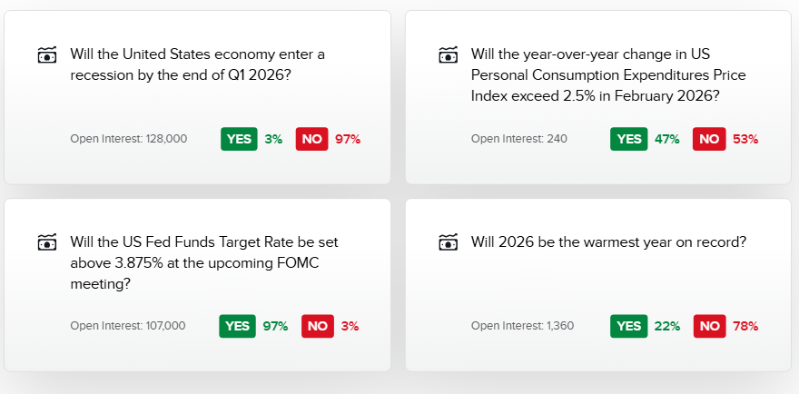
Does uncertainty affect your decisions?

Slide 8

Lotteries

Slide 9
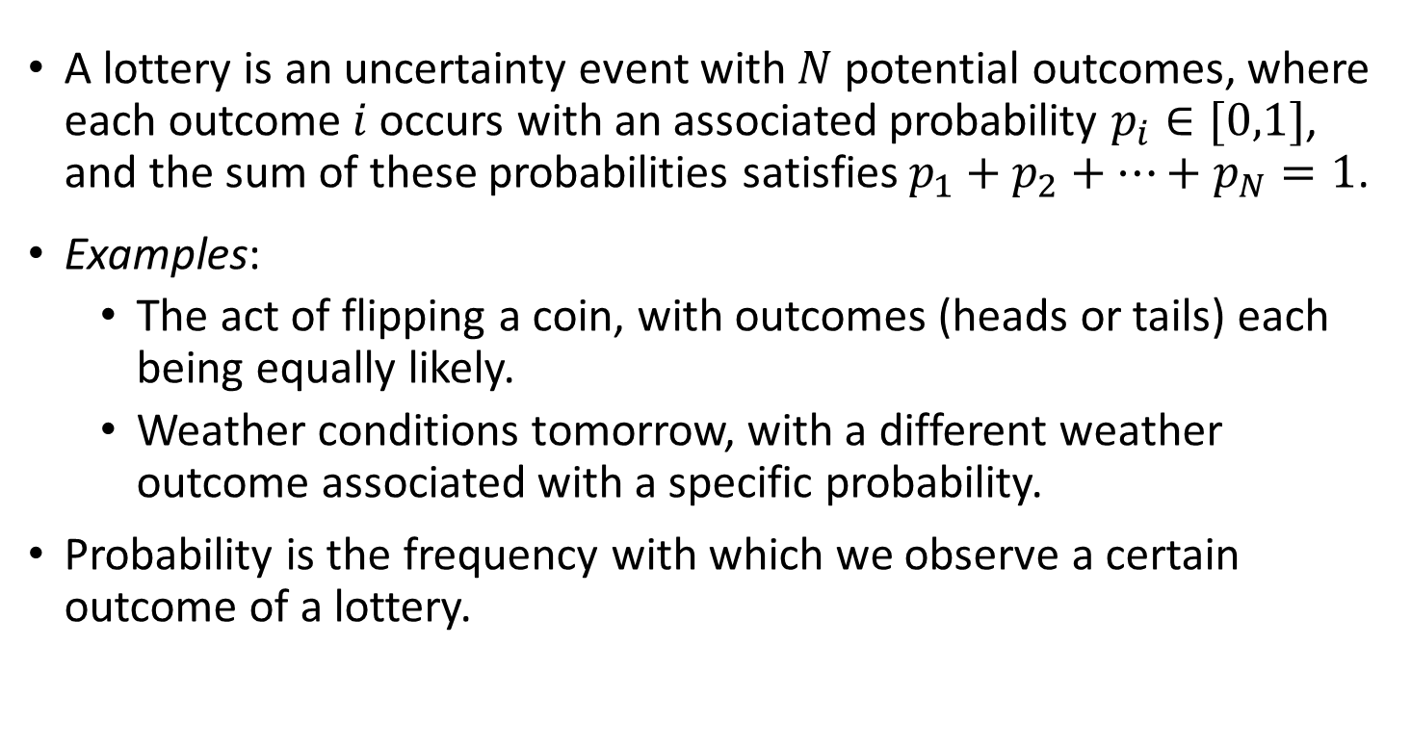
Lotteries
A lottery is an uncertainty event with $N$ potential outcomes, where each outcome $i$ occurs with an associated probability $p_{i}∈[0,1]$, and the sum of these probabilities satisfies $p_{1}+p_{2}+…+p_{N}=1$.
Examples:
  The act of flipping a coin, with outcomes (heads or tails) each being equally likely.
  Weather conditions tomorrow, with a different weather outcome associated with a specific probability.
Probability is the frequency with which we observe a certain outcome of a lottery.

Slide 10
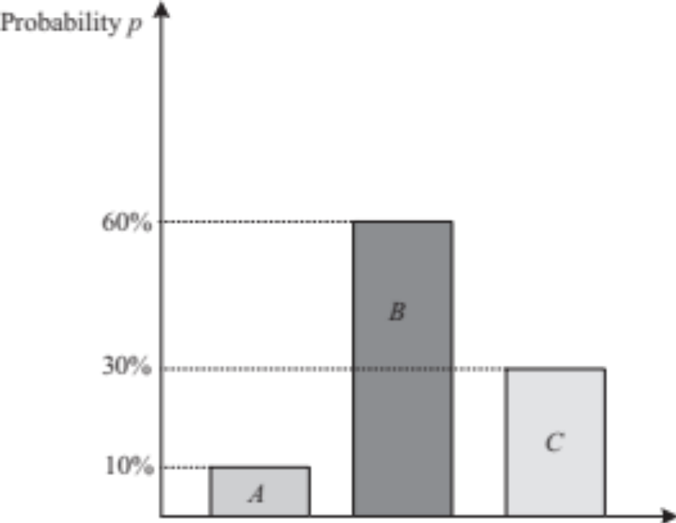
Lotteries
Lotteries can be understood as probability distributions over outcomes.
Figure 6.1

Slide 11

Expected Value

Slide 12
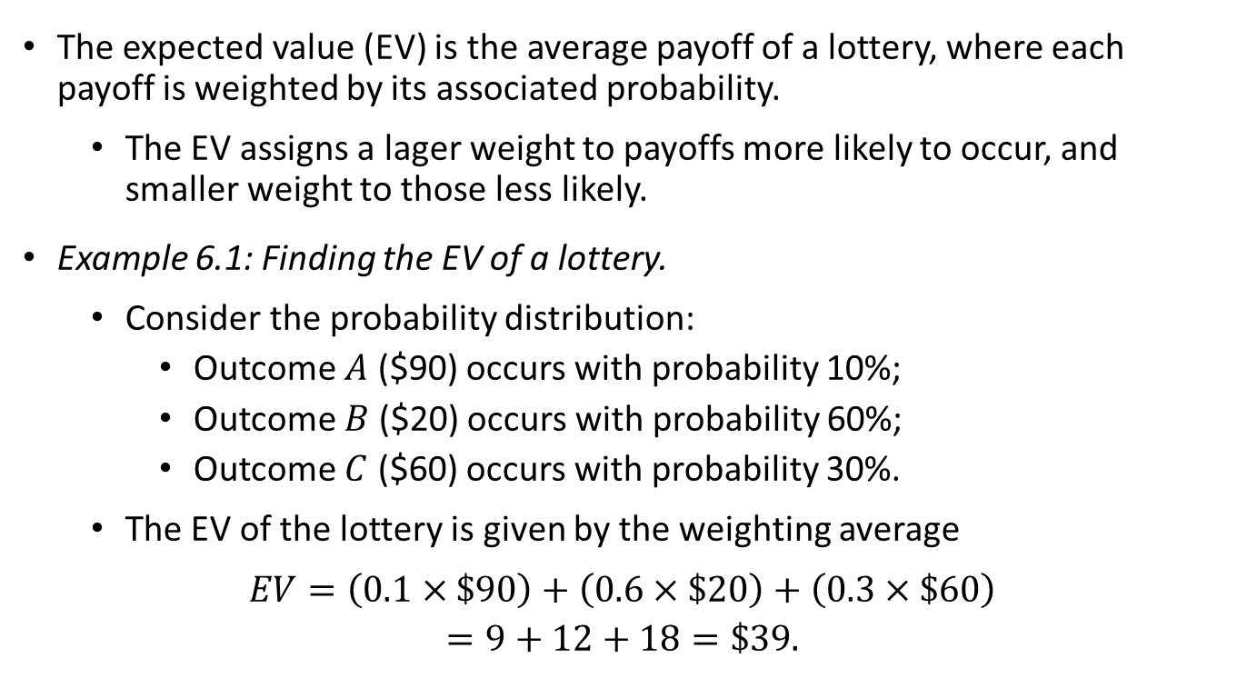
Expected Value
The expected value (EV) is the average payoff of a lottery, where each payoff is weighted by its associated probability.
  The EV assigns a lager weight to payoffs more likely to occur, and smaller weight to those less likely.
Example 6.1: Finding the EV of a lottery.
  Consider the probability distribution:
    Outcome $A$ ($90) occurs with probability 10%;
    Outcome $B$ ($20) occurs with probability 60%;
    Outcome $C$ ($60) occurs with probability 30%.
  The EV of the lottery is given by the weighting average
  $$EV=\left(0.1×\$90\right)+\left(0.6×\$20\right)+\left(0.3×\$60\right)$$
  $$=9+12+18=\$39.$$

Slide 13
Variance and Standard Deviation

Slide 14
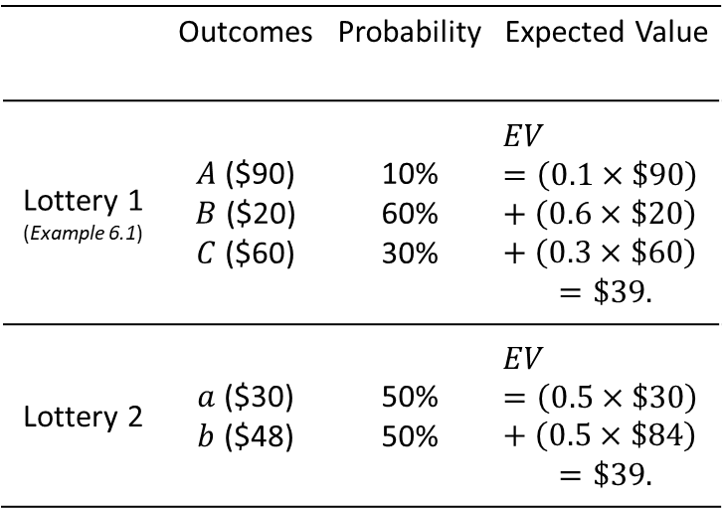
Variance
 | Outcomes | Probability | Expected Value
Lottery 1 (Example 6.1) | $A$ ($90) $B$ ($20) $C$ ($60) | 10% 60% 30% | $$EV=\left(0.1×\$90\right)+\left(0.6×\$20\right)+\left(0.3×\$60\right)$$ $$=\$39.$$
Lottery 2 | $a$ ($30) $b$ ($48) | 50% 50% | $$EV=\left(0.5×\$30\right)+\left(0.5×\$84\right)$$ $$=\$39.$$
The EV informs about the expected payoff of a lottery, but it does not measure how risky a lottery is.
We can find different lotteries with same EV but with different levels of riskiness:
One measure of the riskiness of a lottery is its variance.

Slide 15
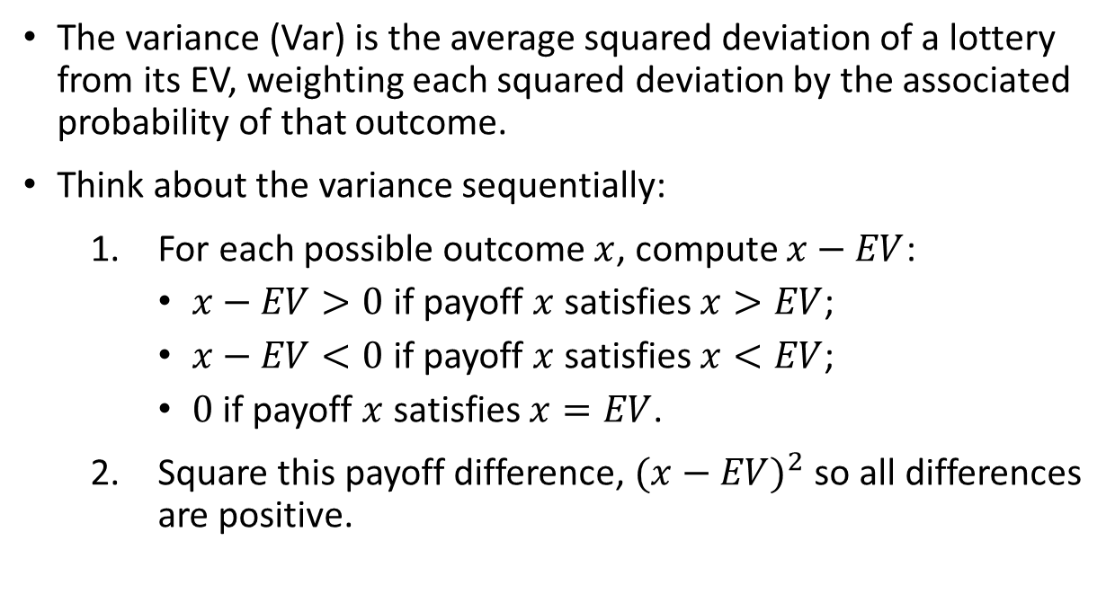
Variance
The variance (Var) is the average squared deviation of a lottery from its EV, weighting each squared deviation by the associated probability of that outcome.
Think about the variance sequentially:
  For each possible outcome $x$, compute $x−EV$:
    $x−EV>0$ if payoff $x$ satisfies $x>EV$;
    $x−EV<0$ if payoff $x$ satisfies $x<EV$;
    $0$ if payoff $x$ satisfies $x=EV$.
  Square this payoff difference, ${(x−EV)}^{2}$ so all differences are positive.

Slide 16
Variance
Multiply this squared deviation by the probability of the outcome, weighting each outcome with its likelihood of occurring.
Repeat steps 1-3 for all possible outcomes, and sum up, obtaining the variance.
The variance measures the dispersion of the data set relative to its mean.
Example: A volatile stock has a high variance.
The variance also increases as outcomes with large squared deviation become more likely.

Slide 17
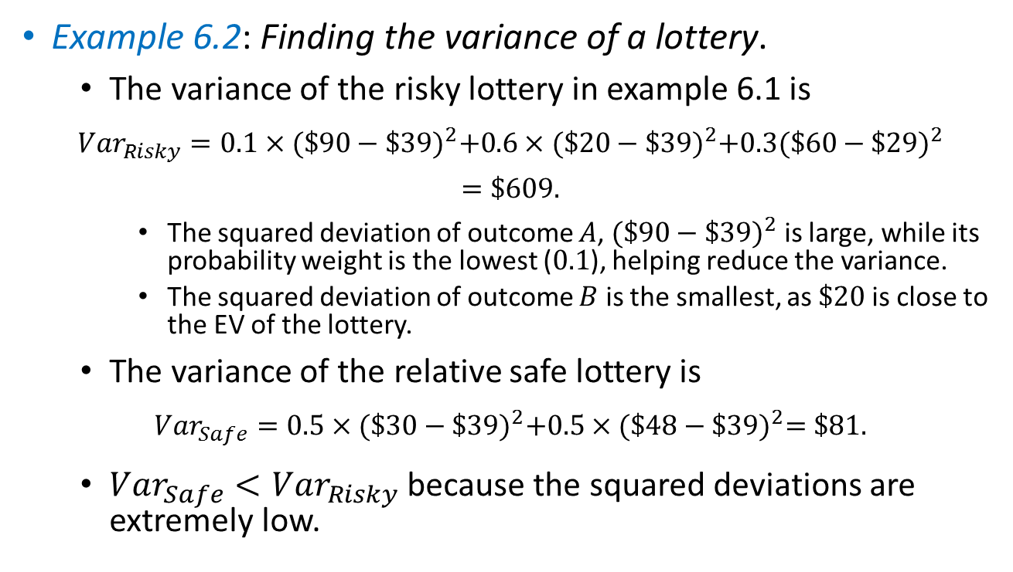
Variance
Example 6.2: Finding the variance of a lottery.
  The variance of the risky lottery in example 6.1 is
  $${Var}_{Risky}=0.1×{(\$90−\$39)}^{2}+0.6×{(\$20−\$39)}^{2}+0.3{(\$60−\$29)}^{2}$$
  $$=\$609.$$
    The squared deviation of outcome $A$, ${(\$90−\$39)}^{2}$ is large, while its probability weight is the lowest ($0.1$), helping reduce the variance.
    The squared deviation of outcome $B$ is the smallest, as $\$20$is close to the EV of the lottery.
  The variance of the relative safe lottery is
  $${Var}_{Safe}=0.5×{(\$30−\$39)}^{2}+0.5×{(\$48−\$39)}^{2}=\$81.$$
  ${Var}_{Safe}<{Var}_{Risky}$ because the squared deviations are extremely low.

Slide 18
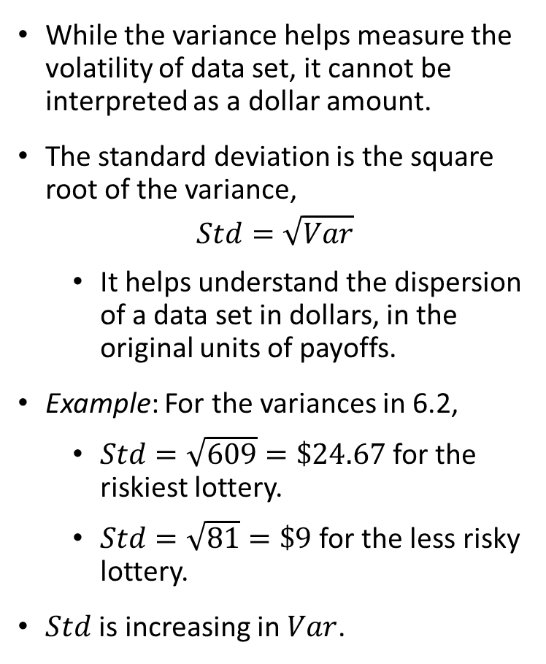
Standard Deviation
While the variance helps measure the volatility of data set, it cannot be interpreted as a dollar amount.
The standard deviation is the square root of the variance,
$$Std=\sqrt{Var}$$
  It helps understand the dispersion of a data set in dollars, in the original units of payoffs.
Example: For the variances in 6.2,
  $Std=\sqrt{609}=\$24.67$ for the riskiest lottery.
  $Std=\sqrt{81}=\$9$ for the less risky lottery.
$Std$ is increasing in $Var$.

Slide 19
Expected Utility

Slide 20
Expected Utility
How to determine which specific lottery a decision maker selects when facing several available lotteries?
The expected utility (EU) is the average utility of a lottery, weighting each utility with the associated probability of that outcome.
EU is similar to EV, as both weight payoffs according to their probabilities by assigning a larger weight to more likely outcomes.
EU plugs each payoff into the individual’s utility function to better assess how important the payoff is for her.
EV considers only payoffs, without evaluating their utility.

Slide 21
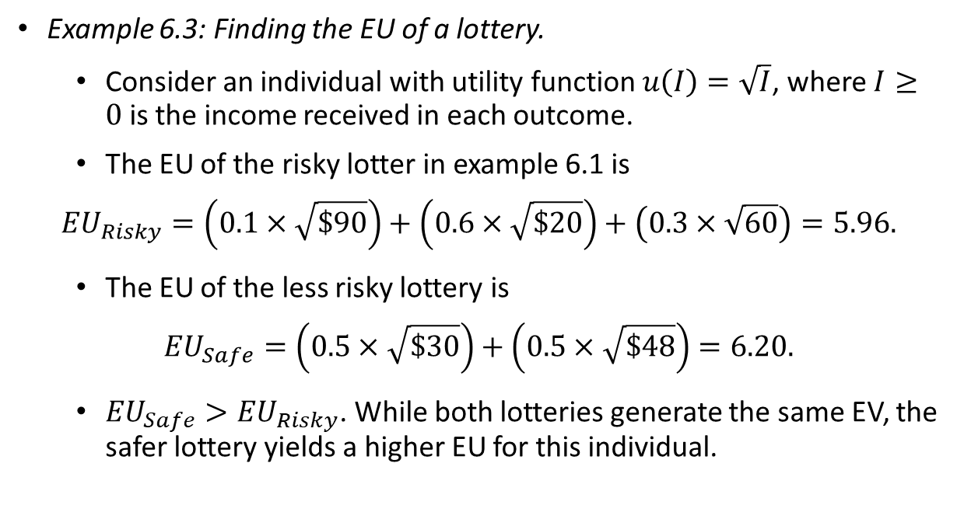
Expected Utility
Example 6.3: Finding the EU of a lottery.
  Consider an individual with utility function $u\left(I\right)=\sqrt{I}$, where $I≥0$ is the income received in each outcome.
  The EU of the risky lotter in example 6.1 is
  $${EU}_{Risky}=\left(0.1×\sqrt{\$90}\right)+\left(0.6×\sqrt{\$20}\right)+\left(0.3×\sqrt{60}\right)=5.96.$$
  The EU of the less risky lottery is
  $${EU}_{Safe}=\left(0.5×\sqrt{\$30}\right)+\left(0.5×\sqrt{\$48}\right)=6.20.$$
  ${EU}_{Safe}>{EU}_{Risky}$. While both lotteries generate the same EV, the safer lottery yields a higher EU for this individual.

Slide 22

Risk Attitudes

Slide 23
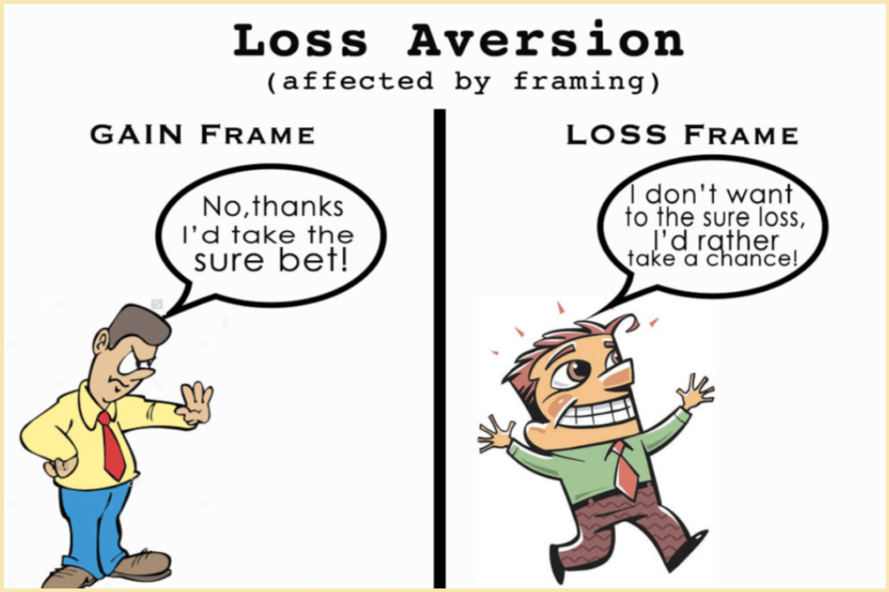
Risk
Attitudes

Slide 24

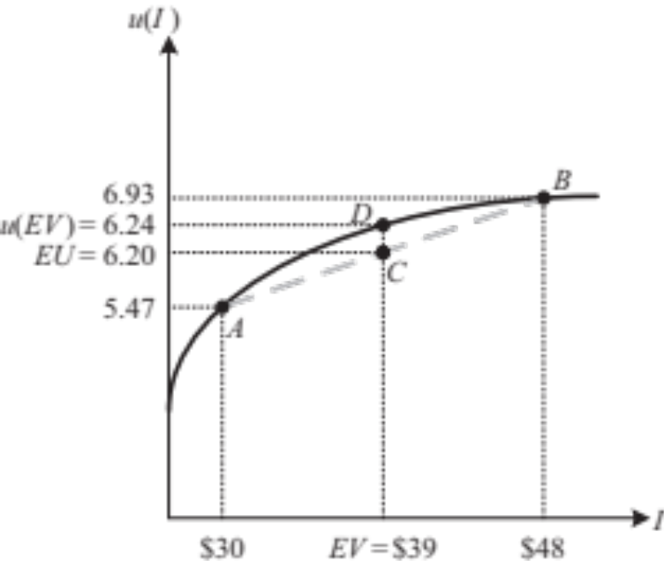
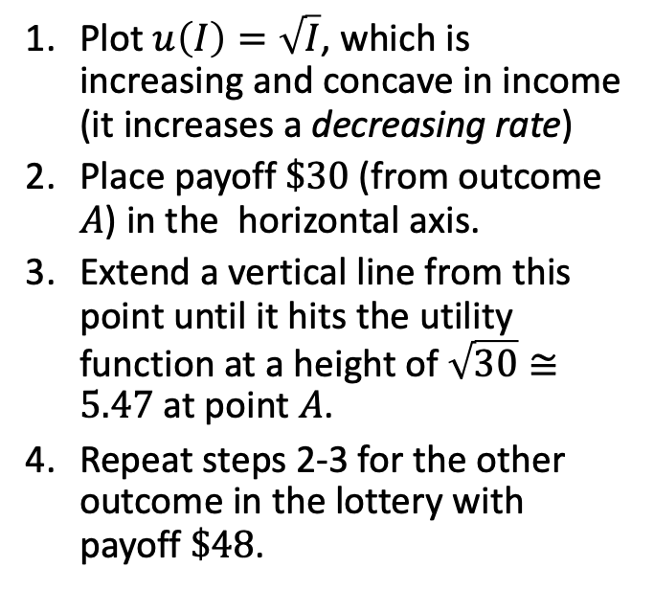
Risk Aversion
EU from the less risky lottery:
Plot $u\left(I\right)=\sqrt{I}$, which is increasing and concave in income (it increases a decreasing rate)
Place payoff $\$30$(from outcome $A$) in the horizontal axis.
Extend a vertical line from this point until it hits the utility function at a height of $\sqrt{30}≅5.47$ at point $A$.
Repeat steps 2-3 for the other outcome in the lottery with payoff $\$48$.
Figure 6.2

Slide 25
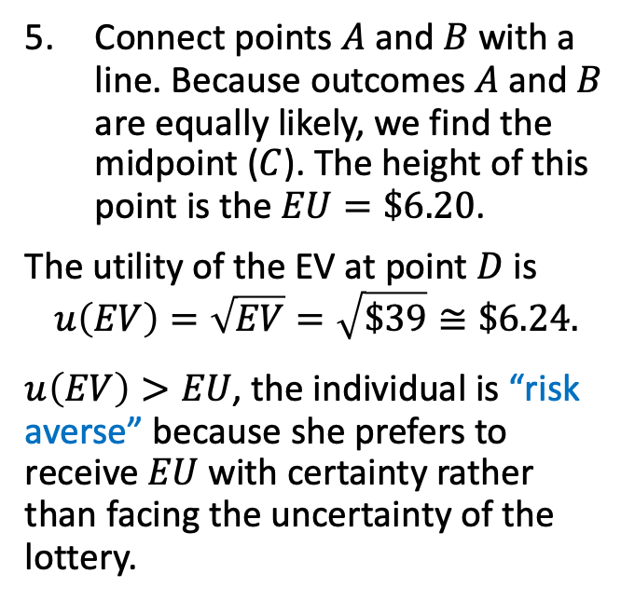
Risk Aversion
EU from the less risky lottery (cont.):
Connect points $A$ and $B$with a line. Because outcomes $A$ and $B$ are equally likely, we find the midpoint ($C$). The height of this point is the $EU=\$6.20$.
The utility of the EV at point $D$ is
$$u\left(EV\right)=\sqrt{EV}=\sqrt{\$39}≅\$6.24.$$
$u\left(EV\right)>EU$, the individual is “risk averse” because she prefers to receive $EU$ with certainty rather than facing the uncertainty of the lottery.
Figure 6.2

Slide 26

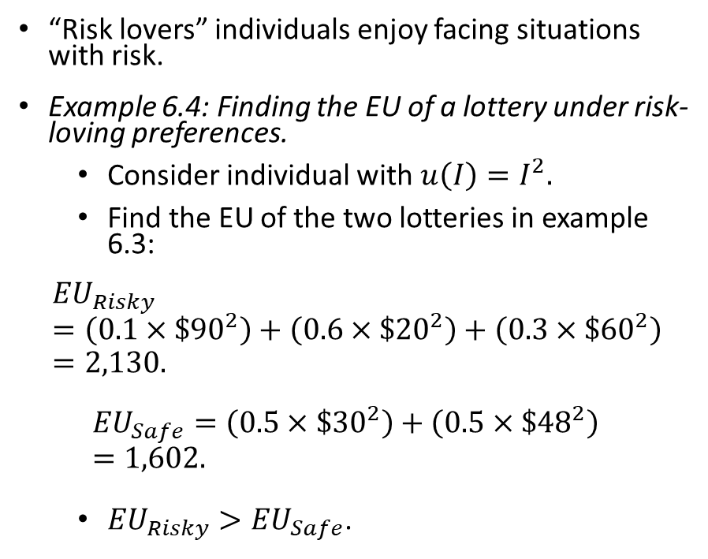
Risk Loving
“Risk lovers” individuals enjoy facing situations with risk.
Example 6.4: Finding the EU of a lottery under risk-loving preferences.
  Consider individual with $u\left(I\right)=I^{2}.$
  Find the EU of the two lotteries in example 6.3:
  $${EU}_{Risky}=\left(0.1×{\$90}^{2}\right)+\left(0.6×{\$20}^{2}\right)+\left(0.3×{\$60}^{2}\right)=2,130.$$
  $${EU}_{Safe}=\left(0.5×{\$30}^{2}\right)+\left(0.5×{\$48}^{2}\right)=1,602.$$
  ${EU}_{Risky}>{EU}_{Safe}$.

Slide 27
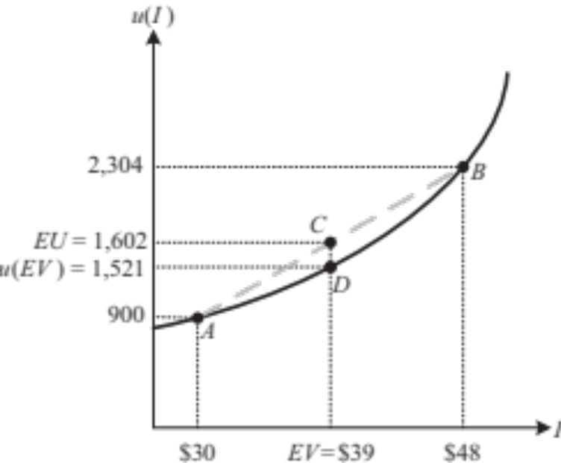
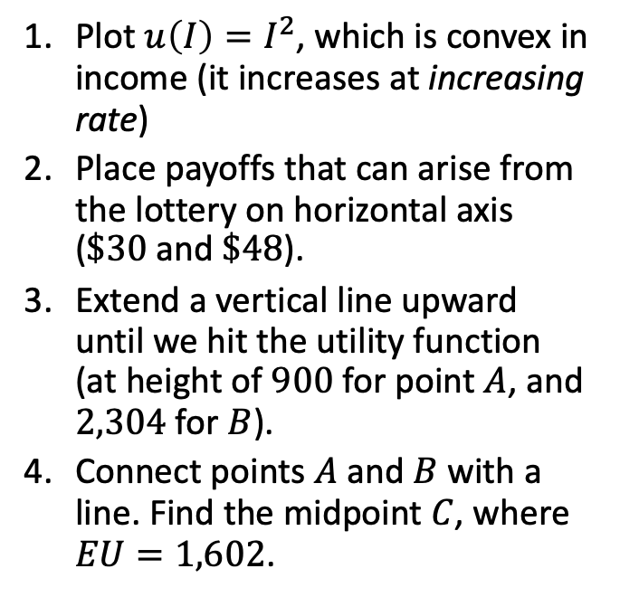
Risk Loving
EU from the safe lottery:
Plot $u\left(I\right)=I^{2}$, which is convex in income (it increases at increasing rate)
Place payoffs that can arise from the lottery on horizontal axis ($\$30$ and $\$48$).
Extend a vertical line upward until we hit the utility function (at height of $900$ for point $A$, and $2,304$ for $B$).
Connect points $A$ and $B$with a line. Find the midpoint $C$, where $EU=1,602$.
Figure 6.3

Slide 28
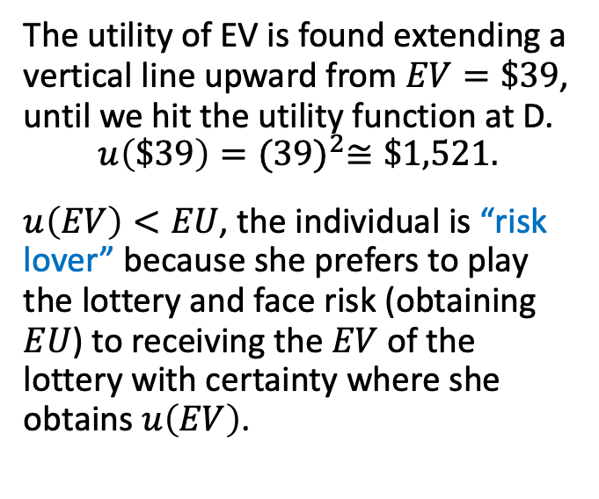
Risk Loving
EU from the safe lottery (cont.):
The utility of EV is found extending a vertical line upward from $EV=\$39$, until we hit the utility function at D.
$$u\left(\$39\right)={(39)}^{2}≅\$1,521.$$
$u\left(EV\right)<EU$, the individual is “risk lover” because she prefers to play the lottery and face risk (obtaining $EU$) to receiving the $EV$ of the lottery with certainty where she obtains $u\left(EV\right)$.
Figure 6.3

Slide 29
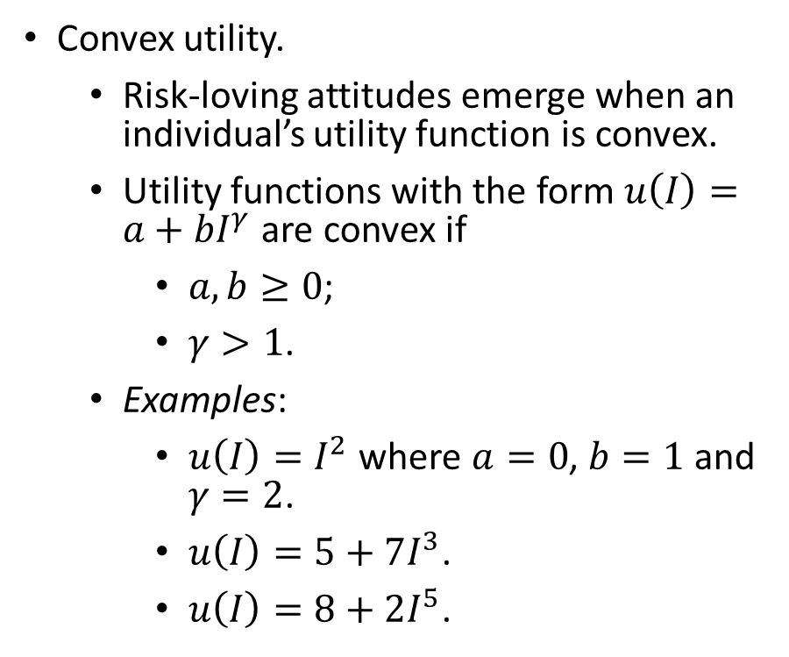
Risk Loving
Convex utility.
  Risk-loving attitudes emerge when an individual’s utility function is convex.
  Utility functions with the form $u\left(I\right)=a+bI^{γ}$ are convex if
    $a,b≥0$;
    $γ>1$.
  Examples:
    $u\left(I\right)=I^{2}$ where $a=0$, $b=1$ and $γ=2$.
    $u\left(I\right)=5+7I^{3}$.
    $u\left(I\right)=8+2I^{5}$.

Slide 30

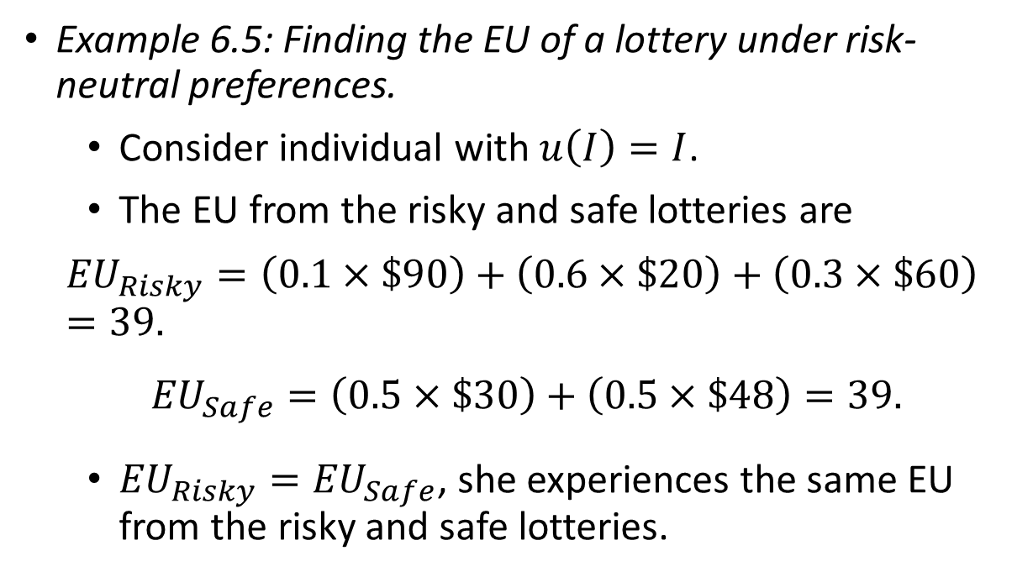
Risk Neutrality
Example 6.5: Finding the EU of a lottery under risk-neutral preferences.
  Consider individual with $u\left(I\right)=I$.
  The EU from the risky and safe lotteries are
  $${EU}_{Risky}=\left(0.1×\$90\right)+\left(0.6×\$20\right)+\left(0.3×\$60\right)=39.$$
  $${EU}_{Safe}=\left(0.5×\$30\right)+\left(0.5×\$48\right)=39.$$
  ${EU}_{Risky}={EU}_{Safe}$, she experiences the same EU from the risky and safe lotteries.

Slide 31
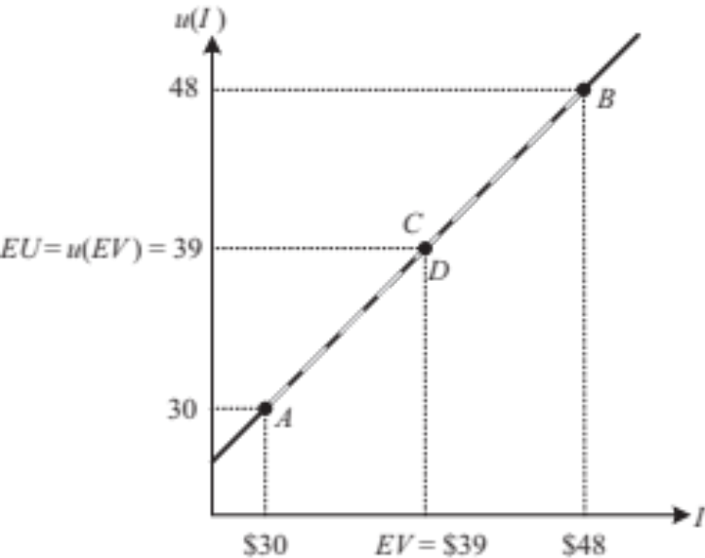
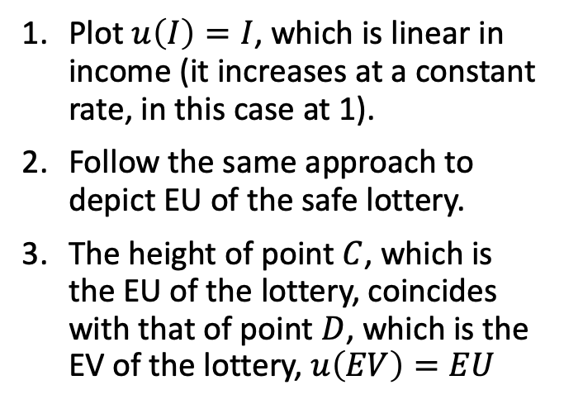
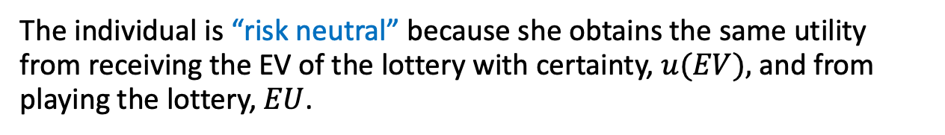
Risk Neutrality
EV and EU from a lottery-risk neutral:
Plot $u\left(I\right)=I$, which is linear in income (it increases at a constant rate, in this case at 1).
Follow the same approach to depict EU of the safe lottery.
The height of point $C$, which is the EU of the lottery, coincides with that of point $D$, which is the EV of the lottery, $u\left(EV\right)=EU$
Figure 6.4
The individual is “risk neutral” because she obtains the same utility from receiving the EV of the lottery with certainty, $u(EV),$and from playing the lottery, $EU$.

Slide 32
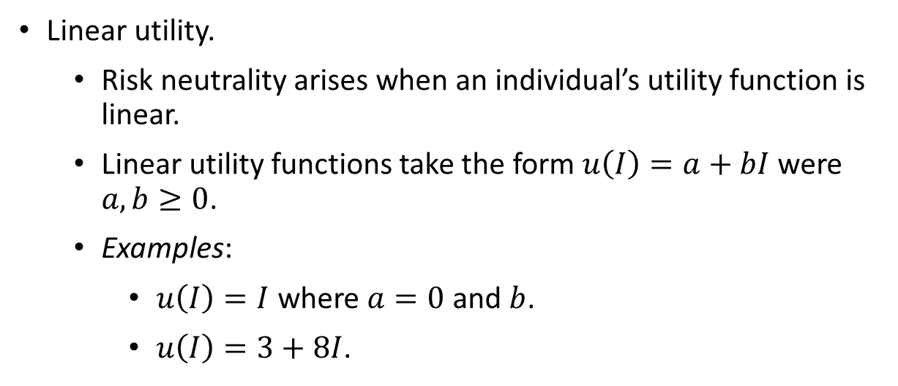
Risk Neutrality
Linear utility.
  Risk neutrality arises when an individual’s utility function is linear.
  Linear utility functions take the form $u\left(I\right)=a+bI$ were $a,b≥0$.
  Examples:
    $u\left(I\right)=I$ where $a=0$ and $b$.
    $u\left(I\right)=3+8I$.

Slide 33

Measuring Risk

Slide 34

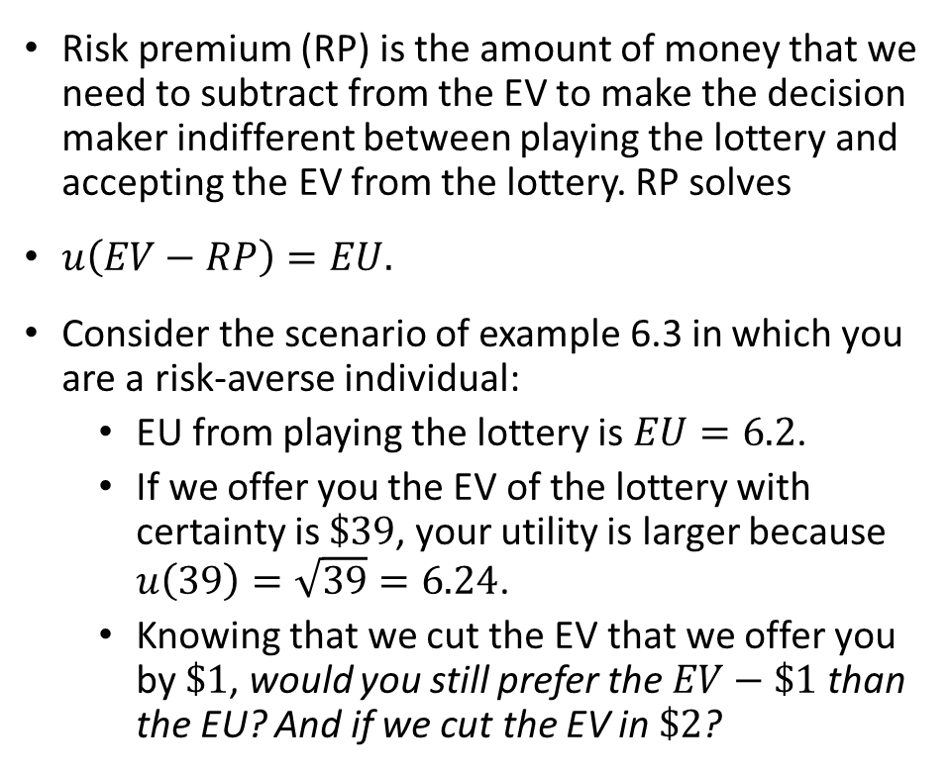
Risk Premium
Risk premium (RP) is the amount of money that we need to subtract from the EV to make the decision maker indifferent between playing the lottery and accepting the EV from the lottery. RP solves
$u\left(EV−RP\right)=EU.$
Consider the scenario of example 6.3 in which you are a risk-averse individual:
  EU from playing the lottery is $EU=6.2$.
  If we offer you the EV of the lottery with certainty is $\$39$, your utility is larger because $u\left(39\right)=\sqrt{39}=6.24$.
  Knowing that we cut the EV that we offer you by $\$1$, would you still prefer the $EV−\$1$than the EU? And if we cut the EV in $\$2$?

Slide 35
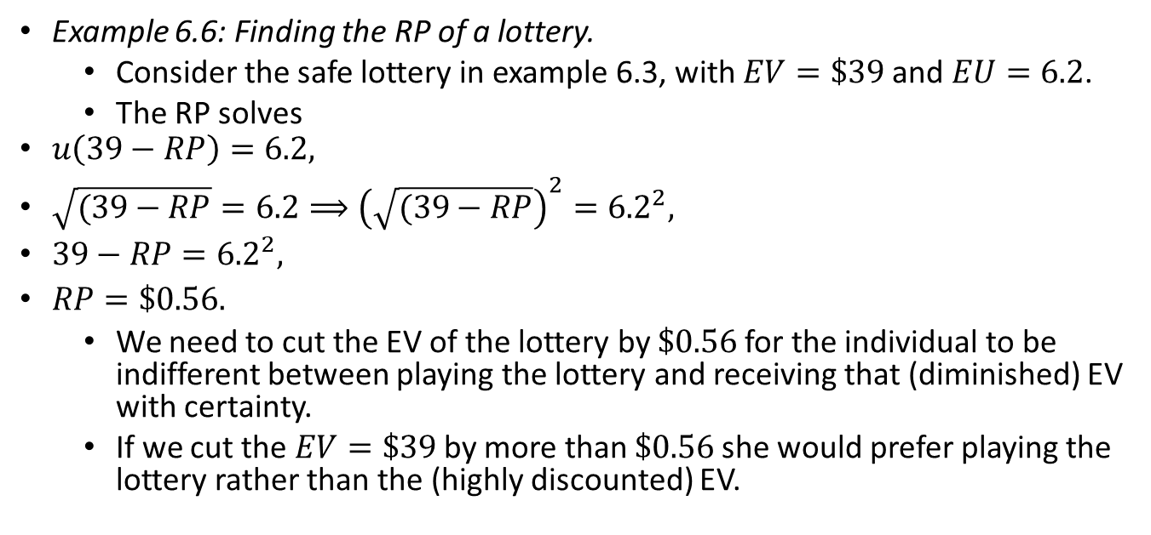
Risk Premium
Example 6.6: Finding the RP of a lottery.
  Consider the safe lottery in example 6.3, with $EV=\$39$and $EU=6.2$.
  The RP solves
  $u\left(39−RP\right)=6.2,$
  $\sqrt{(39−RP}=6.2⟹{\left(\sqrt{(39−RP}\right)}^{2}={6.2}^{2},$
  $39−RP={6.2}^{2},$
  $RP=\$0.56.$
  We need to cut the EV of the lottery by $\$0.56$for the individual to be indifferent between playing the lottery and receiving that (diminished) EV with certainty.
  If we cut the $EV=\$39$by more than $\$0.56$she would prefer playing the lottery rather than the (highly discounted) EV.

Slide 36
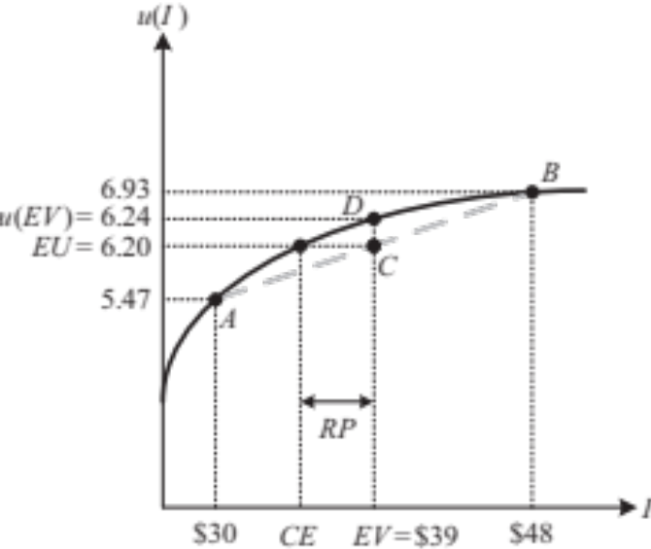
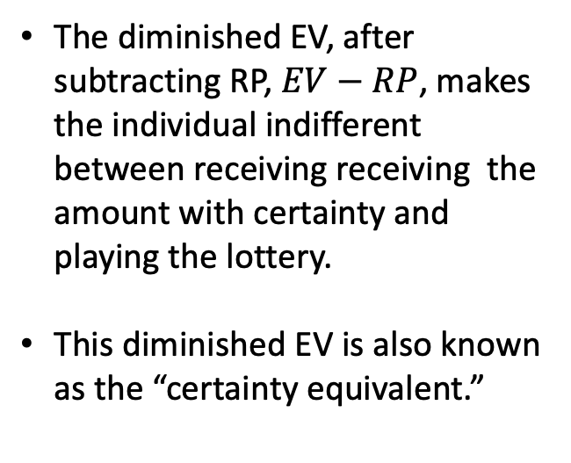
Risk Premium
Example 6.6 (continued):
  Figure 6.5 illustrates the RP.
The diminished EV, after subtracting RP, $EV−RP$, makes the individual indifferent between receiving receiving the amount with certainty and playing the lottery.
This diminished EV is also known as the “certainty equivalent.”
Figure 6.5

Slide 37
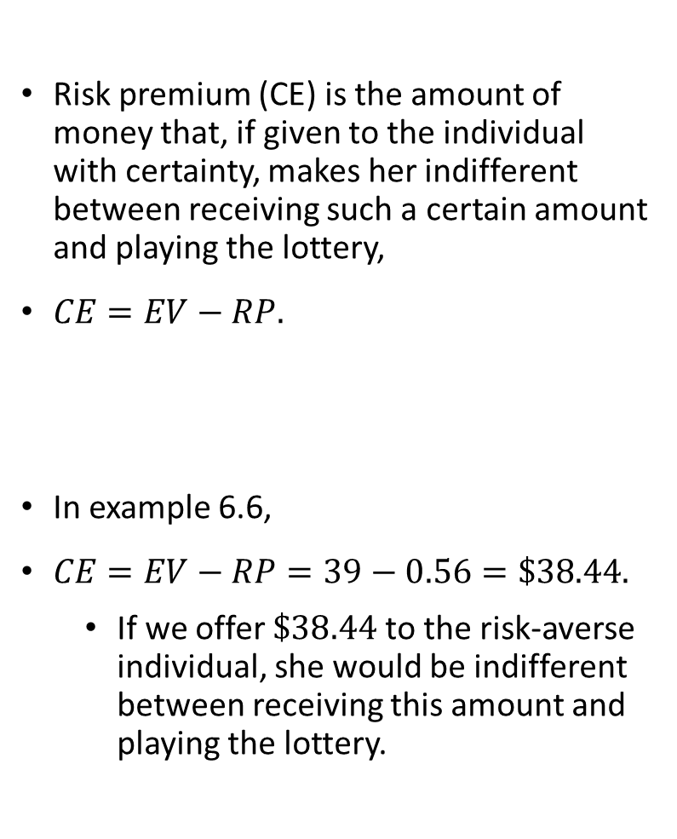
Certainty Equivalent
Risk premium (CE) is the amount of money that, if given to the individual with certainty, makes her indifferent between receiving such a certain amount and playing the lottery,
$CE=EV−RP.$
In example 6.6,
$CE=EV−RP=39−0.56=\$38.44.$
  If we offer $\$38.44$to the risk-averse individual, she would be indifferent between receiving this amount and playing the lottery.

Slide 38
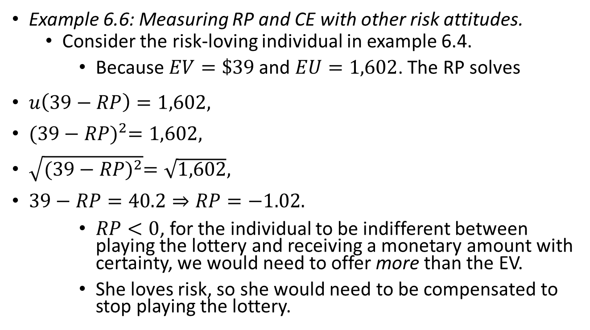
Risk Premium
Example 6.6: Measuring RP and CE with other risk attitudes.
  Consider the risk-loving individual in example 6.4.
    Because $EV=\$39$ and $EU=1,602$. The RP solves
  $u\left(39−RP\right)=1,602,$
  ${(39−RP)}^{2}=1,602,$
  $\sqrt{{(39−RP)}^{2}}=\sqrt{1,602},$
  $39−RP=40.2⇒RP=−1.02.$
  $RP<0$, for the individual to be indifferent between playing the lottery and receiving a monetary amount with certainty, we would need to offer more than the EV.
    She loves risk, so she would need to be compensated to stop playing the lottery.

Slide 39
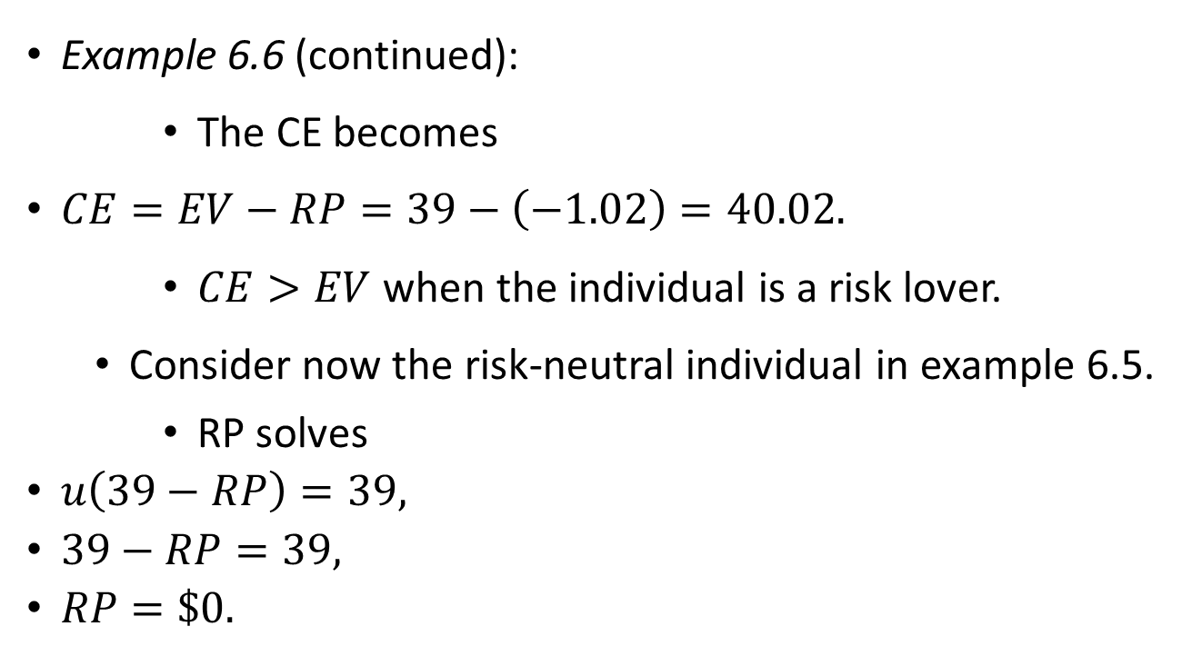
Risk Premium
Example 6.6 (continued):
    The CE becomes
  $CE=EV−RP=39−\left(−1.02\right)=40.02.$
    $CE>EV$ when the individual is a risk lover.
  Consider now the risk-neutral individual in example 6.5.
    RP solves
    $u\left(39−RP\right)=39,$
    $39−RP=39,$
    $RP=\$0.$

Slide 40
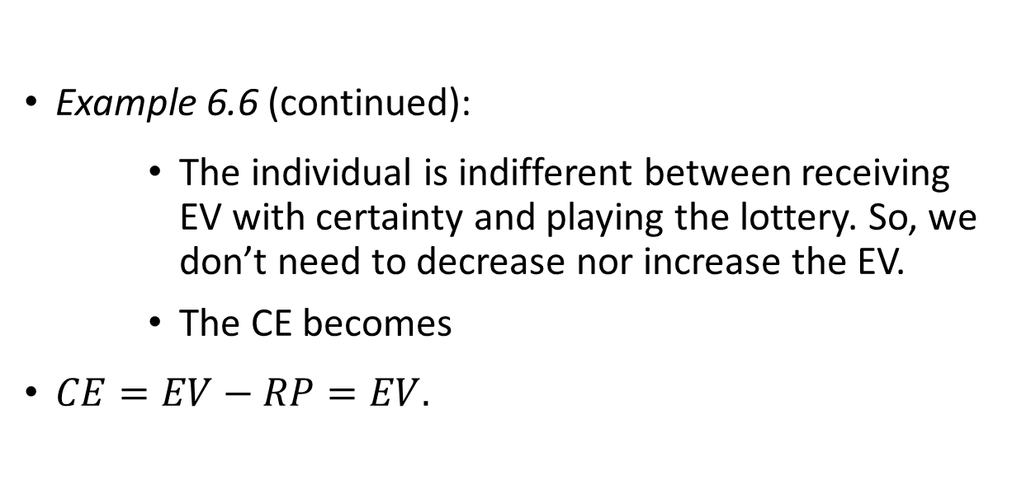
Risk Premium
Example 6.6 (continued):
    The individual is indifferent between receiving EV with certainty and playing the lottery. So, we don’t need to decrease nor increase the EV.
    The CE becomes
    $CE=EV−RP=EV.$

Slide 41

Arrow-Pratt Coefficient of Absolute Risk Aversion
Risk aversion requires utility functions to be concave.
The Arrow-Prat coefficient of absolute risk aversion (AP) uses concavity to measure risk aversion,
$AP≡−\frac{u^{′′}}{u^{′}},$
  $u^{′}$represents the first-order derivate of the individual’s utility function $u\left(I\right)$:
    $u^{′}>0$ always, because the individual enjoys a positive utility when her income increases.
  $u^{′′}$ denotes the second-order derivative:
    $u^{′′}<0$, when utility function concave.
    $u^{′′}>0$, when utility function is convex.
    $u^{′′}=0$, when utility function is linear.

Slide 42
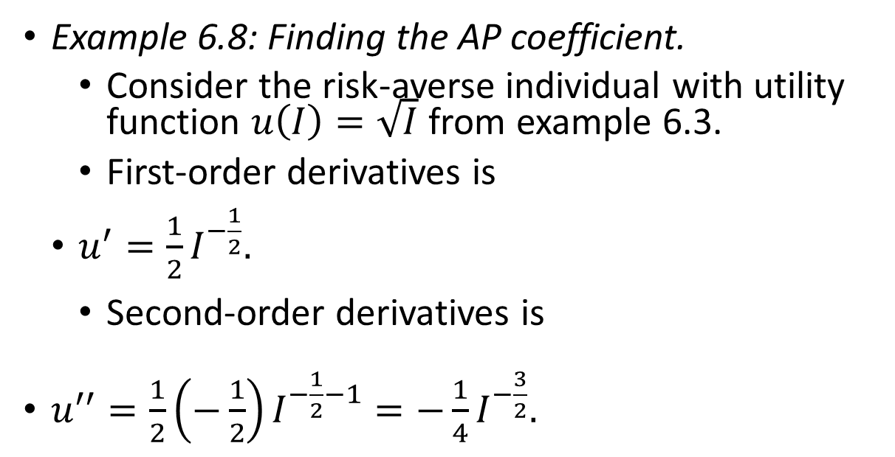
Arrow-Pratt Coefficient of Absolute Risk Aversion
Example 6.8: Finding the AP coefficient.
  Consider the risk-averse individual with utility function $u\left(I\right)=\sqrt{I}$ from example 6.3.
  First-order derivatives is
  $u^{′}=\frac{1}{2}I^{−\frac{1}{2}}.$
  Second-order derivatives is
  $u^{′′}=\frac{1}{2}\left(−\frac{1}{2}\right)I^{−\frac{1}{2}−1}=−\frac{1}{4}I^{−\frac{3}{2}}.$

Slide 43
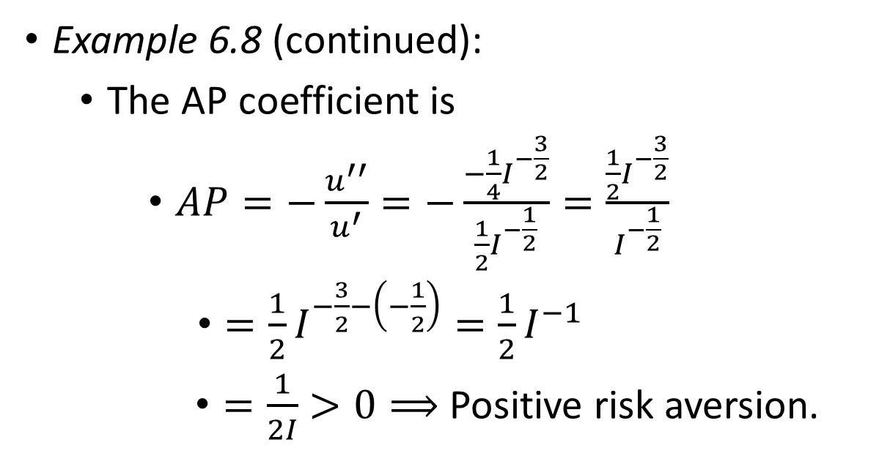
Arrow-Pratt Coefficient of Absolute Risk Aversion
Example 6.8 (continued):
  The AP coefficient is
  $AP=−\frac{u^{′′}}{u^{′}}=−\frac{−\frac{1}{4}I^{−\frac{3}{2}}}{\frac{1}{2}I^{−\frac{1}{2}}}=\frac{\frac{1}{2}I^{−\frac{3}{2}}}{I^{−\frac{1}{2}}}$
  $=\frac{1}{2}I^{−\frac{3}{2}−\left(−\frac{1}{2}\right)}=\frac{1}{2}I^{−1}$
  $=\frac{1}{2I}>0⟹$ Positive risk aversion.

Slide 44

Arrow-Pratt Coefficient of Absolute Risk Aversion
Example 6.8 (continued):
  In contrast, consider risk-loving individual with utility function $u\left(I\right)=I^{2}$ from example 6.4.
  First-order and second-order derivatives are
  $u^{′}=2I,$
  $u^{′′}=2.$
  The AP coefficient is
  $AP=−\frac{u^{′′}}{u^{′}}=−\frac{2}{2I}=−\frac{I}{2I}<0⟹$ $\text{Negative} \text{risk} \text{aversion}\text{.}$
    A risk-neutral individual from example 6.5, with utility function $u\left(I\right)=a+bI$, has
    $AP=−\frac{u^{′′}}{u^{′}}=\frac{0}{b}=0$.

Slide 45
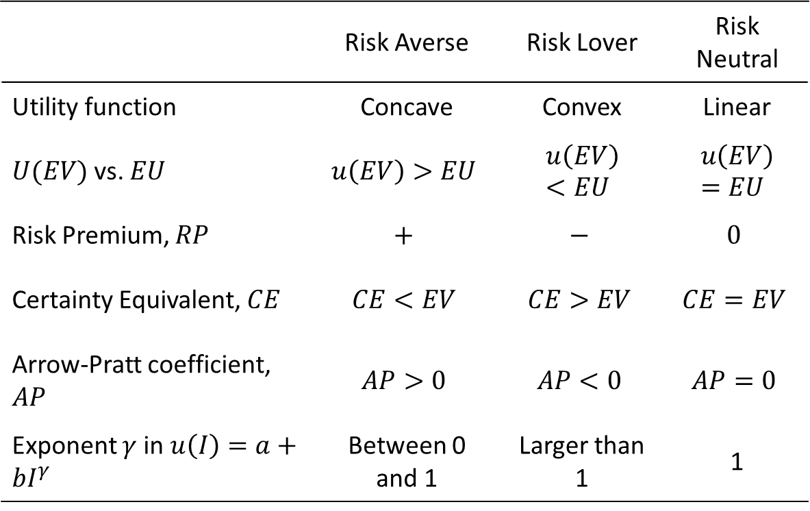
Summary of risk aversion measures
Table 6.1
 | Risk Averse | Risk Lover | Risk Neutral
Utility function | Concave | Convex | Linear
$U(EV)$vs. $EU$ | $$u\left(EV\right)>EU$$ | $$u\left(EV\right)<EU$$ | $$u\left(EV\right)=EU$$
Risk Premium, $RP$ | $$+$$ | $$−$$ | $$0$$
Certainty Equivalent, $CE$ | $$CE<EV$$ | $$CE>EV$$ | $$CE=EV$$
Arrow-Pratt coefficient, $AP$ | $$AP>0$$ | $$AP<0$$ | $$AP=0$$
Exponent $γ$ in $u\left(I\right)=a+bI^{γ}$ | Between 0 and 1 | Larger than 1 | 1

Slide 46
A Look at Behavioral Economics–
Nonexpected Utility

Slide 47
Nonexpected Utility
The EU measure is tractable and intuitive, and can be “experimentally tested.”
In experiments individuals are asked to sit at computer terminals and choose among lotteries.
Monetary incentives are provided.
Experiments have found that participants sometimes behaved differently from what EU would have predicted.
In the field of behavioral economics, researchers have proposed alternative theories of decision-making under under uncertainty to account for these experimental anomalies.

Slide 48
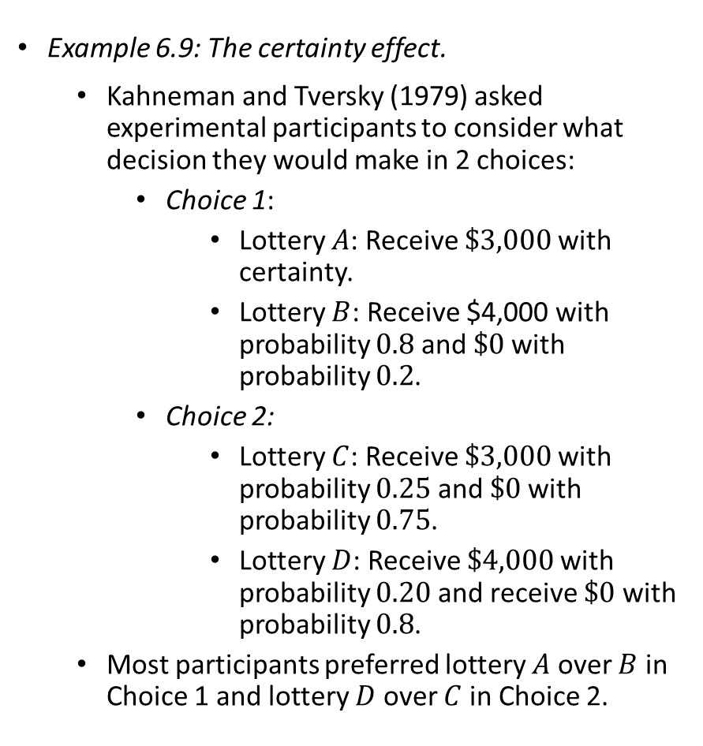
Nonexpected Utility
Example 6.9: The certainty effect.
  Kahneman and Tversky (1979) asked experimental participants to consider what decision they would make in 2 choices:
    Choice 1:
      Lottery $A$: Receive $\$3,000$with certainty.
      Lottery $B$: Receive $4,000 with probability $0.8$and $\$0$with probability $0.2$.
    Choice 2:
      Lottery $C$: Receive $\$3,000$with probability $0.25$ and $\$0$with probability $0.75$.
      Lottery $D$: Receive $\$4,000$with probability $0.20$ and receive $\$0$ with probability $0.8$.
  Most participants preferred lottery $A$ over $B$ in Choice 1 and lottery $D$ over $C$ in Choice 2.

Slide 49
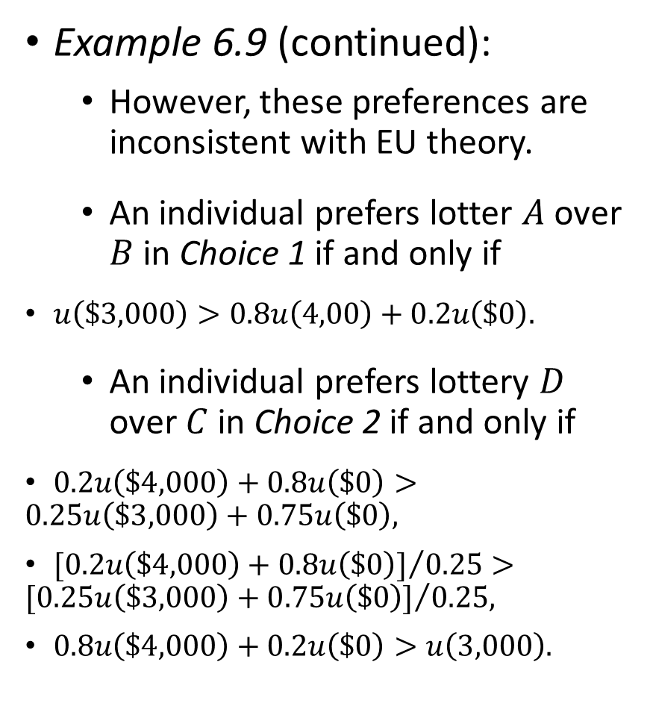
Nonexpected Utility
Example 6.9 (continued):
  However, these preferences are inconsistent with EU theory.
  An individual prefers lotter $A$ over $B$ in Choice 1 if and only if
    $u\left(\$3,000\right)>0.8u\left(4,00\right)+0.2u\left(\$0\right).$
  An individual prefers lottery $D$ over $C$ in Choice 2 if and only if
    $0.2u\left(\$4,000\right)+0.8u\left(\$0\right)>0.25u\left(\$3,000\right)+0.75u\left(\$0\right),$
    ${[0.2u\left(\$4,000\right)+0.8u\left(\$0\right)]}/{0.25}>{[0.25u\left(\$3,000\right)+0.75u\left(\$0\right)]}/{0.25,}$
    $0.8u\left(\$4,000\right)+0.2u\left(\$0\right)>u\left(3,000\right).$

Slide 50
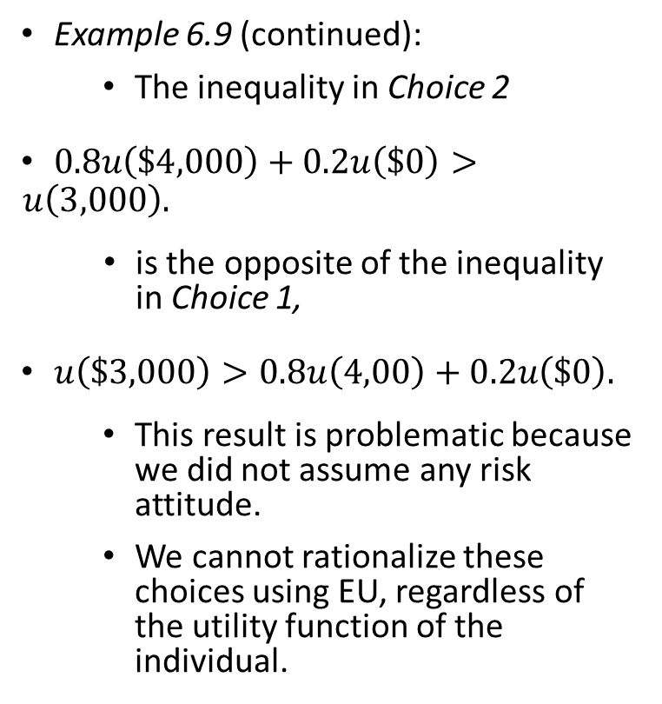
Nonexpected Utility
Example 6.9 (continued):
      The inequality in Choice 2
      $0.8u\left(\$4,000\right)+0.2u\left(\$0\right)>u\left(3,000\right).$
      is the opposite of the inequality in Choice 1,
      $u\left(\$3,000\right)>0.8u\left(4,00\right)+0.2u\left(\$0\right).$
      This result is problematic because we did not assume any risk attitude.
      We cannot rationalize these choices using EU, regardless of the utility function of the individual.

