Slide 1
EconS 301: Intermediate Microeconomic
Theory
Consumer Preferences and Utility

Slide 2
Outline
Bundles
Preferences for Bundles
Utility Functions
Marginal Utility
Indifference Curves
Marginal Rate of Substitution
Special Types of Utility Functions
A Look at Behavioral Economics–Social Preferences
Appendix. Finding Marginal Rate of Substitution

Slide 3
Bundles

Slide 4
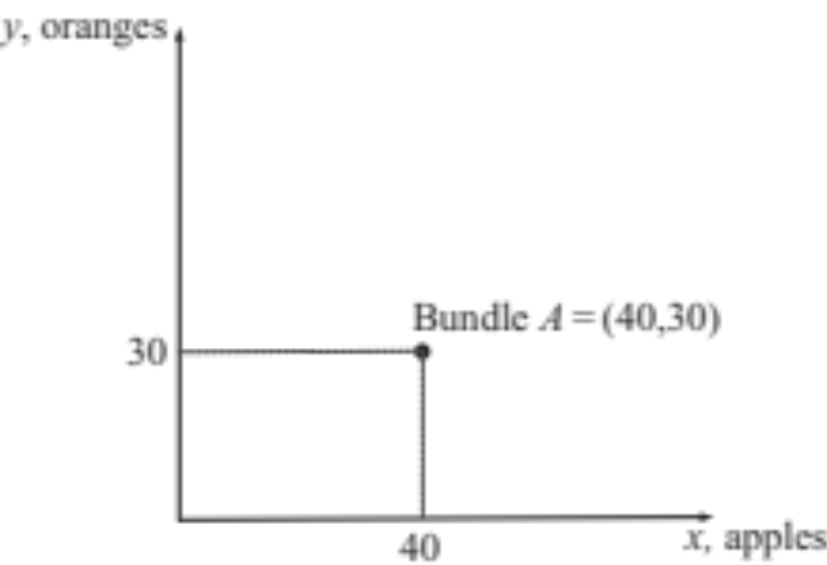
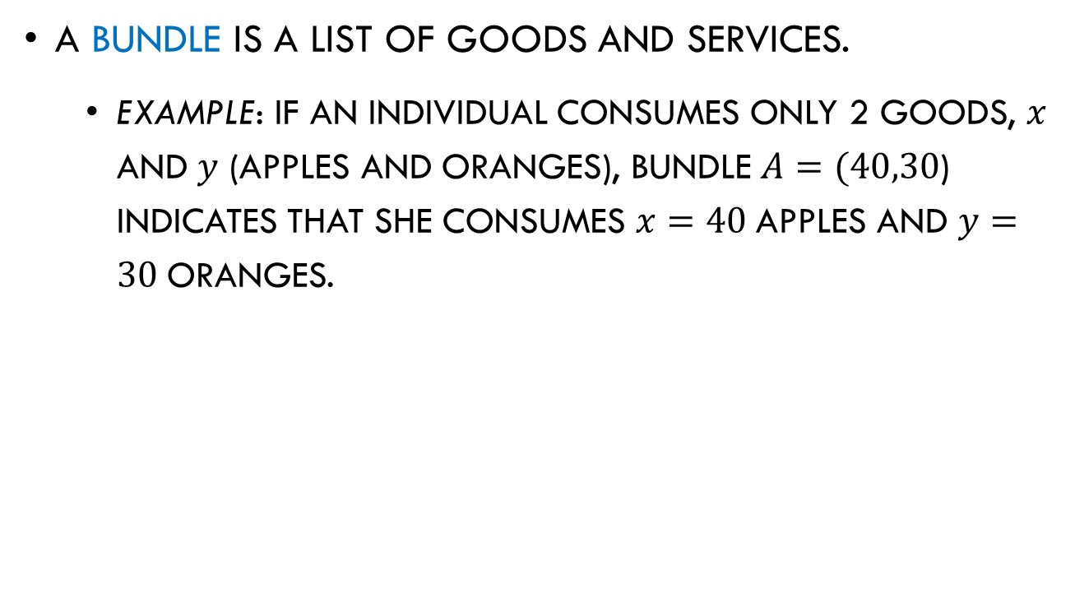
Bundles
A bundle is a list of goods and services.
  Example: If an individual consumes only 2 goods, $x$ and $y$ (apples and oranges), bundle $A=(40,30$) indicates that she consumes $x=40$apples and $y=30$oranges.
Figure 2.1

Slide 5
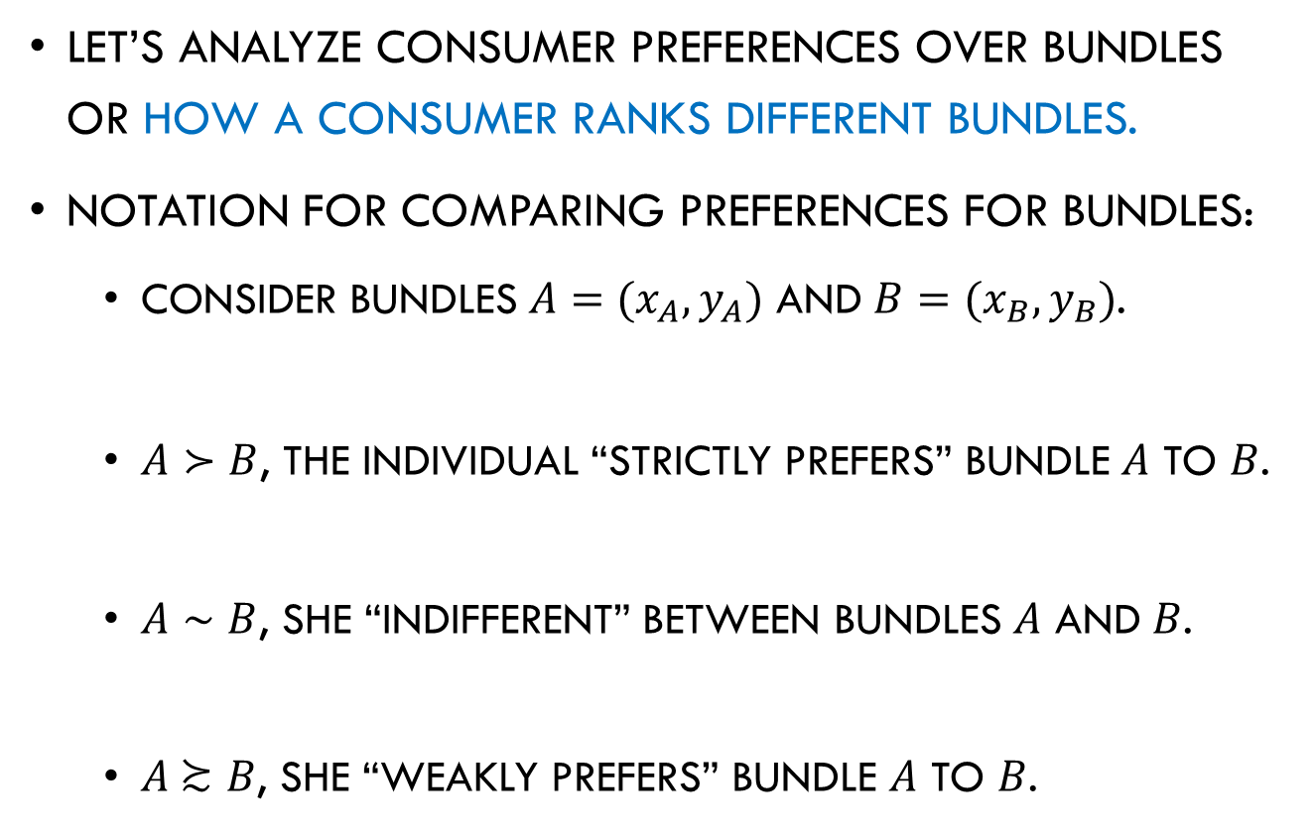
Preferences for Bundles
Let’s analyze consumer preferences over bundles or how a consumer ranks different bundles.
Notation for comparing preferences for bundles:
  Consider bundles $A=(x_{A},y_{A})$ and $B=(x_{B},y_{B})$.
  $A≻B$, the individual “strictly prefers” bundle $A$ to $B$.
  $A∼B$, she “indifferent” between bundles $A$ and $B$.
  $A \text{≿} B$, she “weakly prefers” bundle $A$ to $B$.

Slide 6




Preferences

Slide 7
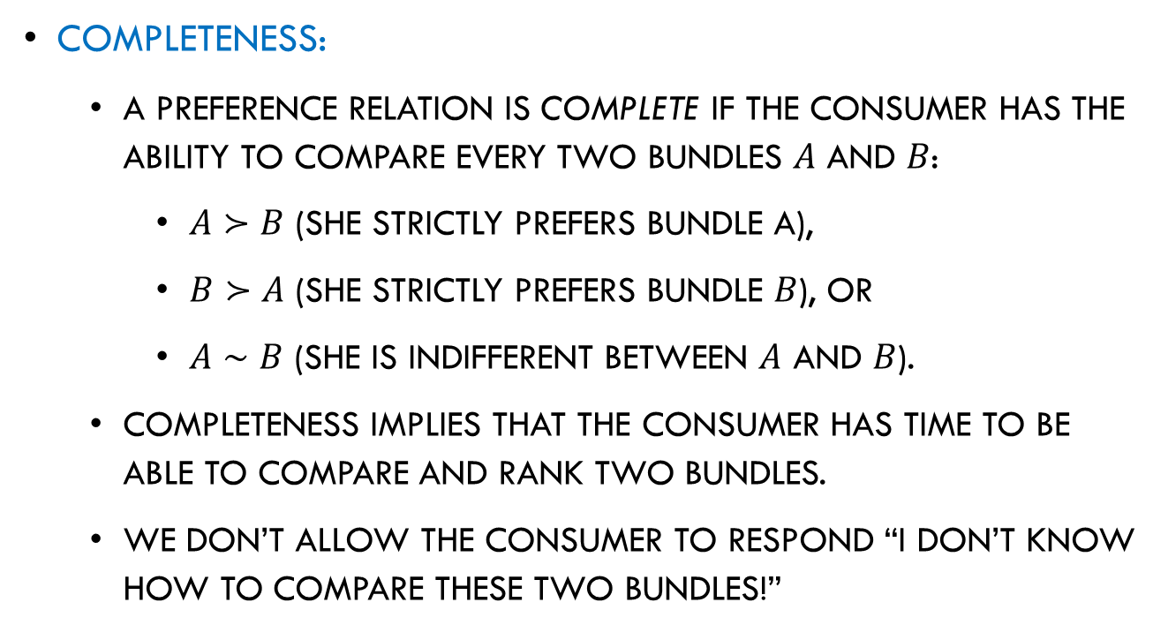
Preferences for Bundles
Completeness:
  A preference relation is complete if the consumer has the ability to compare every two bundles $A$ and $B$:
    $A≻B$ (she strictly prefers bundle A),
    $B≻A$ (she strictly prefers bundle $B$), or
    $A∼B$ (she is indifferent between $A$ and $B$).
  Completeness implies that the consumer has time to be able to compare and rank two bundles.
  We don’t allow the consumer to respond “I don’t know how to compare these two bundles!”

Slide 8
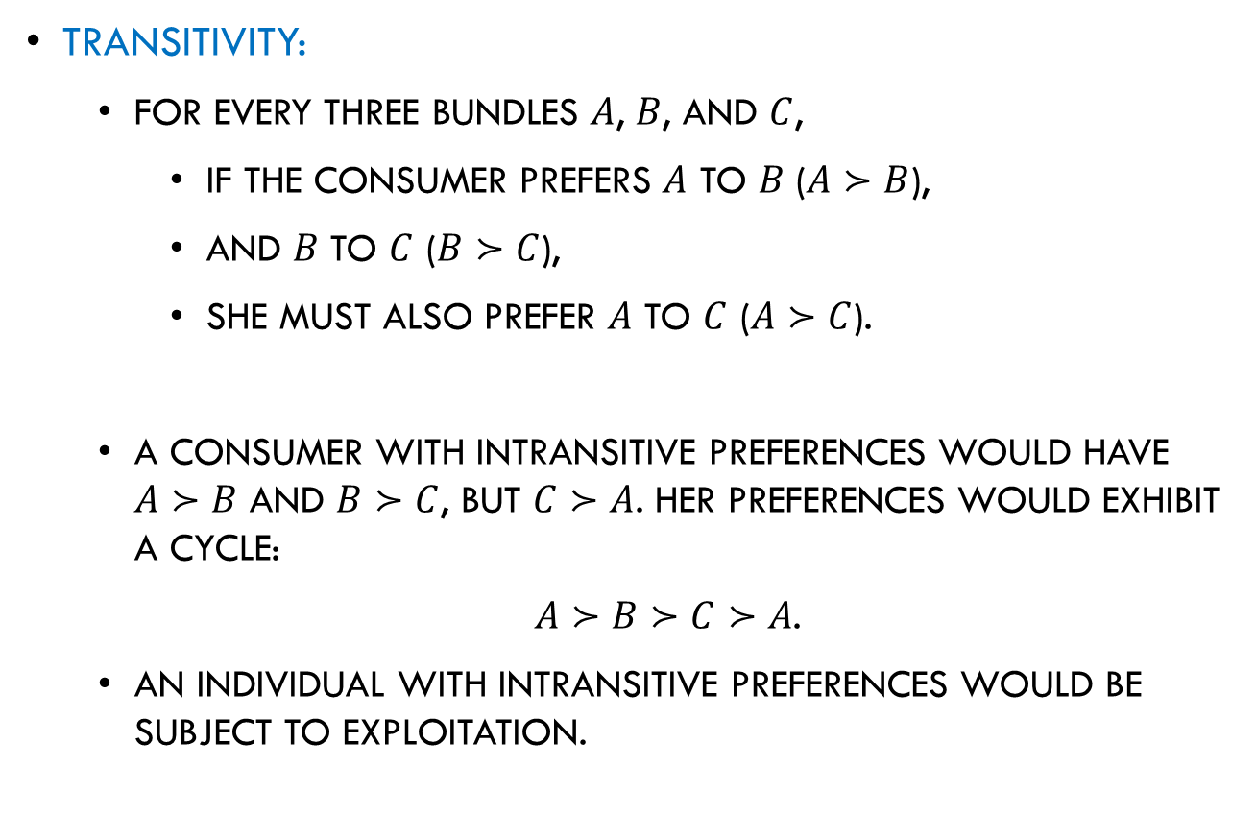
Preferences for Bundles
Transitivity:
  For every three bundles $A$, $B$, and $C$,
    if the consumer prefers $A$ to $B$ ($A≻B$),
    and $B$ to $C$ ($B≻C$),
    she must also prefer $A$ to $C$ ($A≻C$).
  A consumer with intransitive preferences would have $A≻B$ and $B≻C$, but $C≻A$. Her preferences would exhibit a cycle:
  $A≻B≻C≻A$.
  An individual with intransitive preferences would be subject to exploitation.

Slide 9



Preferences for Bundles
Exploitation of intransitive individuals:
  Consider 3 goods, an orange, and apple, and a banana. And a consumer with the following preferences:
≻
≻
≻
Violates Transitivity!

Slide 10


Slide 11


Slide 12


    At the end, the consumer has 1 orange as at the beginning of the exchange, but she has lost $\$3$due to her intransitive preferences.

Slide 13
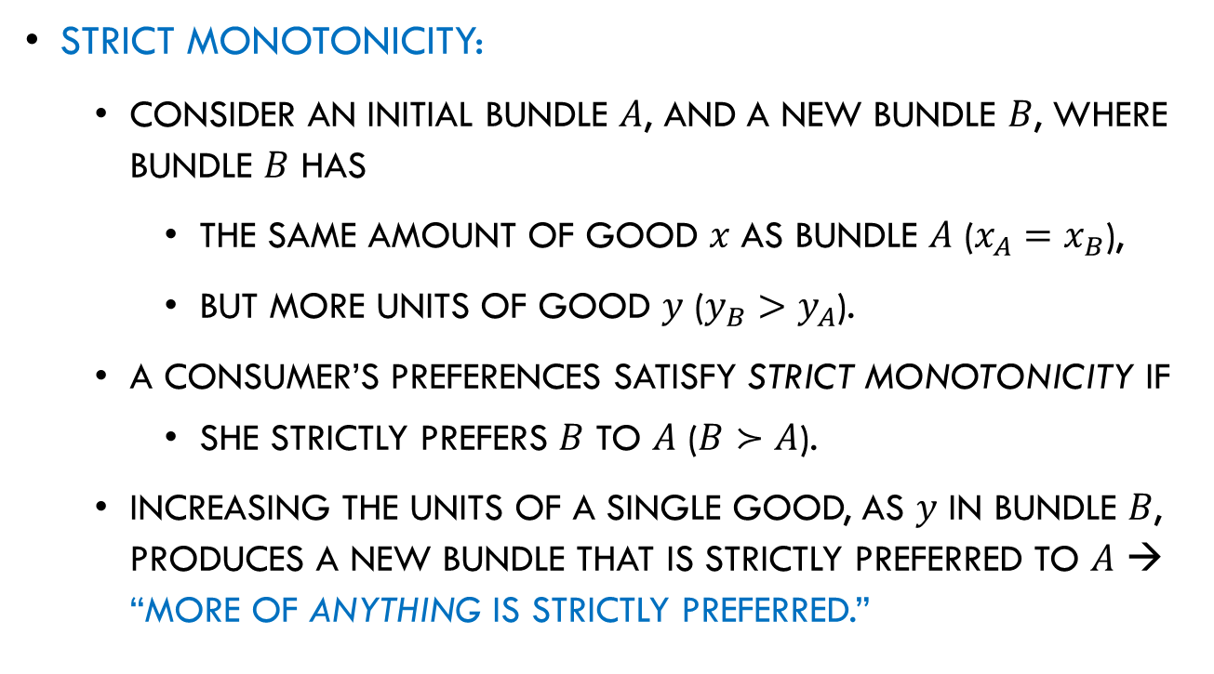
Preferences for Bundles
Strict Monotonicity:
  Consider an initial bundle $A$, and a new bundle $B$, where bundle $B$ has
    the same amount of good $x$ as bundle $A$ ($x_{A}=x_{B}$),
    but more units of good $y$ ($y_{B}>y_{A}$).
  A consumer’s preferences satisfy strict monotonicity if
    she strictly prefers $B$ to $A$ ($B≻A$).
  Increasing the units of a single good, as $y$ in bundle $B$, produces a new bundle that is strictly preferred to $A$ → “more of anything is strictly preferred.”

Slide 14
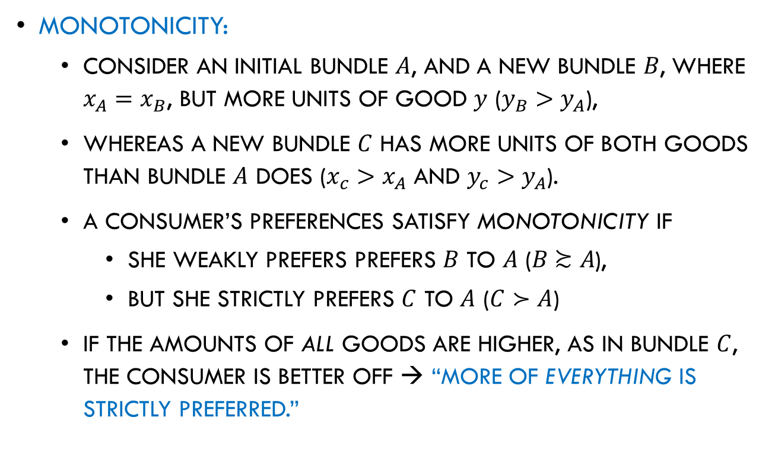
Preferences for Bundles
Monotonicity:
  consider an initial bundle $A$, and a new bundle $B$, where $x_{A}=x_{B}$, but more units of good $y$ ($y_{B}>y_{A}$),
  whereas a new bundle $C$ has more units of both goods than bundle $A$ does ($x_{c}>x_{A}$ and $y_{c}>y_{A}$).
  A consumer’s preferences satisfy monotonicity if
    she weakly prefers prefers $B$ to $A$ ($B \text{≿} A$),
    but she strictly prefers $C$ to $A$ ($C≻A$)
  If the amounts of all goods are higher, as in bundle $C$, the consumer is better off → “more of everything is strictly preferred.”

Slide 15
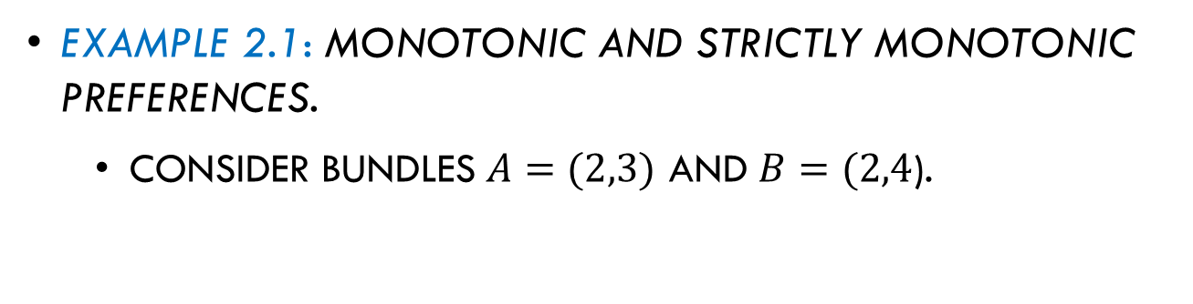
Preferences for Bundles
Example 2.1: Monotonic and strictly monotonic preferences.
  Consider bundles $A=(2,3)$ and $B=(2,4$).
Eric strictly prefers bundle 𝐵 to 𝐴 (𝐵≻𝐴).
If this ranking holds for any two bundles where only one of the good is increased, these preferences satisfy strict monotonicity.

Slide 16
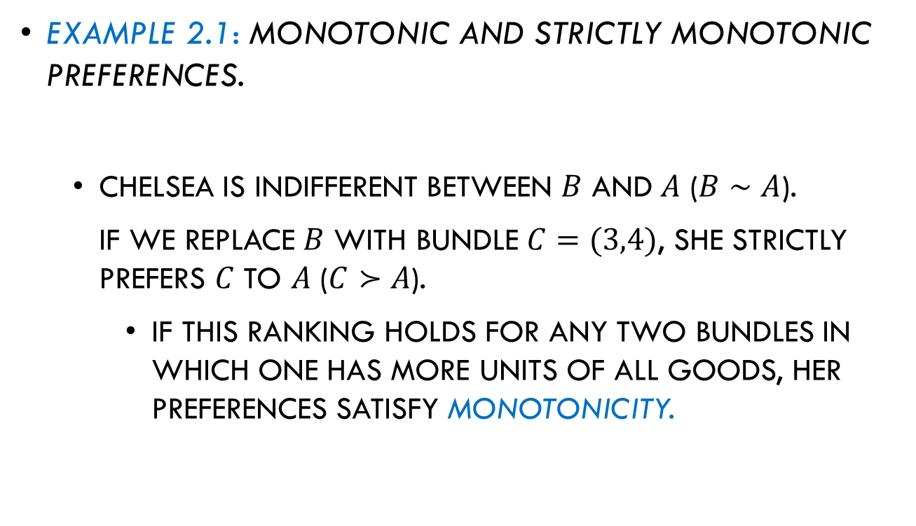
Preferences for Bundles
Example 2.1: Monotonic and strictly monotonic preferences.
  Chelsea is indifferent between $B$ and $A$ ($B∼A$).
  If we replace $B$ with bundle $C=(3,4)$, she strictly prefers $C$ to $A$ ($C≻A$).
    If this ranking holds for any two bundles in which one has more units of all goods, her preferences satisfy monotonicity.

Slide 17
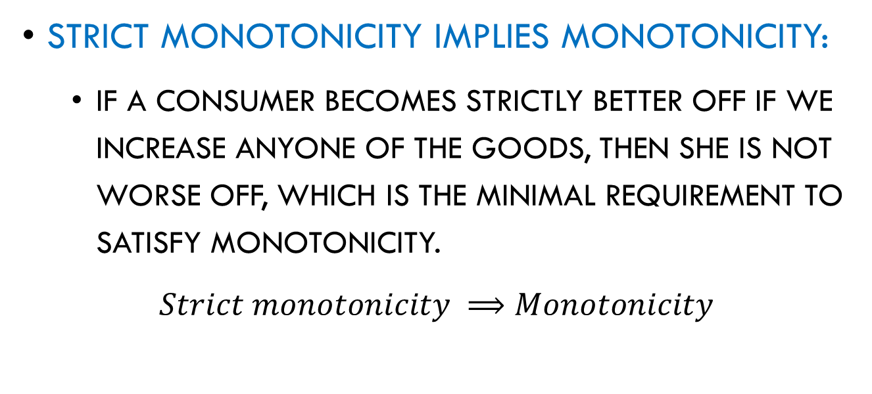
Preferences for Bundles
Strict Monotonicity implies monotonicity:
  If a consumer becomes strictly better off if we increase anyone of the goods, then she is not worse off, which is the minimal requirement to satisfy monotonicity.
  $$Strict monotonicity ⟹Monotonicity$$

Slide 18


Preferences for Bundles
Strict Monotonicity implies monotonicity:
  Monotonicity and strict monotonicity require that the consumer regards all items in her bundle as goods rather than bads (e.g., pollution or garbage).
If some good were a bad, increasing the number of units in initial bundle 𝐴, would produce a new bundle 𝐵 that would be less preferred than bundle 𝐴, violating monotonicity and strict monotonicity.

Slide 19
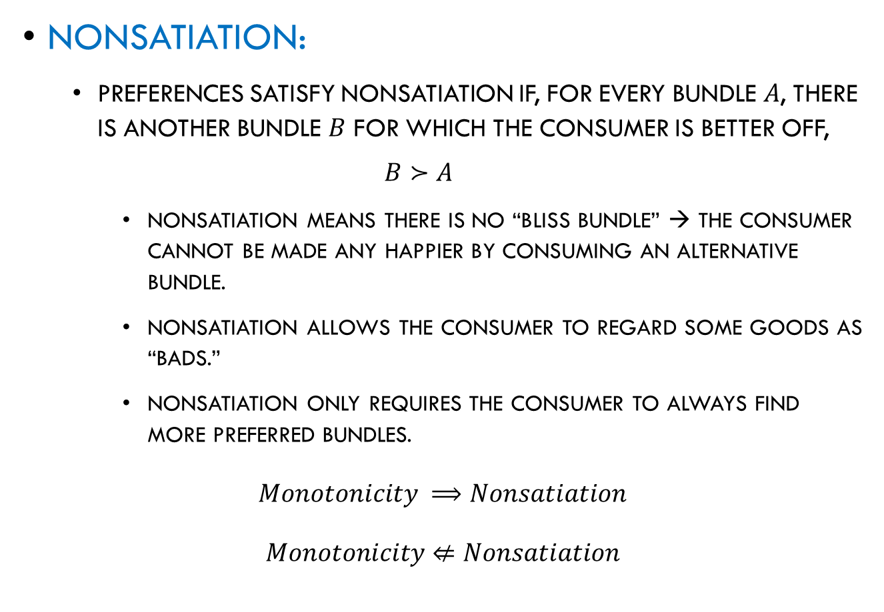
Preferences for Bundles
Nonsatiation:
  Preferences satisfy nonsatiation if, for every bundle $A$, there is another bundle $B$ for which the consumer is better off,
  $$B≻A$$
    Nonsatiation means there is no “bliss bundle” → the consumer cannot be made any happier by consuming an alternative bundle.
    Nonsatiation allows the consumer to regard some goods as “bads.”
    Nonsatiation only requires the consumer to always find more preferred bundles.
  $$Monotonicity ⟹Nonsatiation$$
  $$Monotonicity⇍Nonsatiation$$

Slide 20
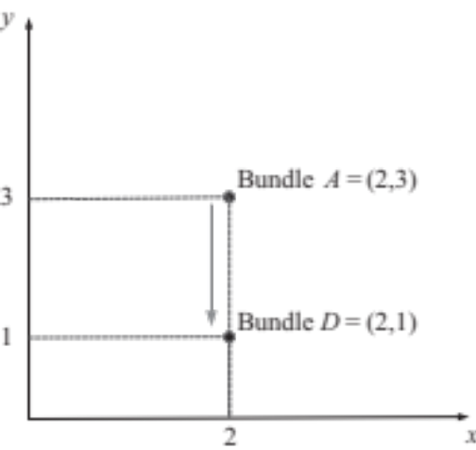
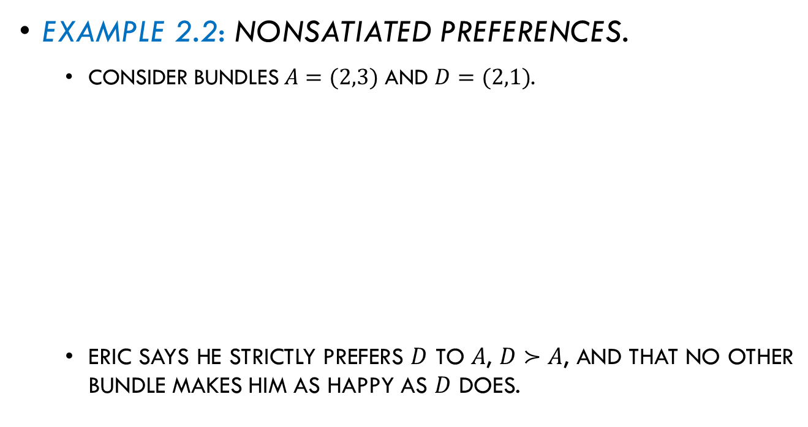
Preferences for Bundles
Example 2.2: Nonsatiated preferences.
  Consider bundles $A=(2,3)$ and $D=(2,1)$.
  Eric says he strictly prefers $D$ to $A$, $D≻A$, and that no other bundle makes him as happy as $D$ does.
Figure 2.2
Do his preferences satisfy nonsatiation?

Slide 21

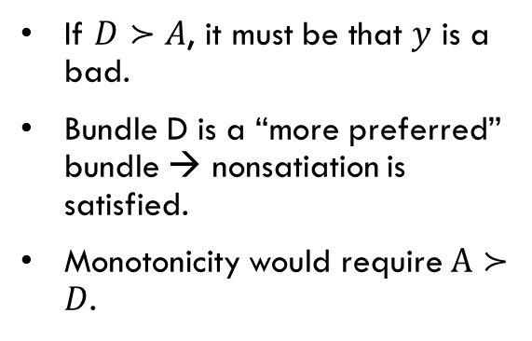
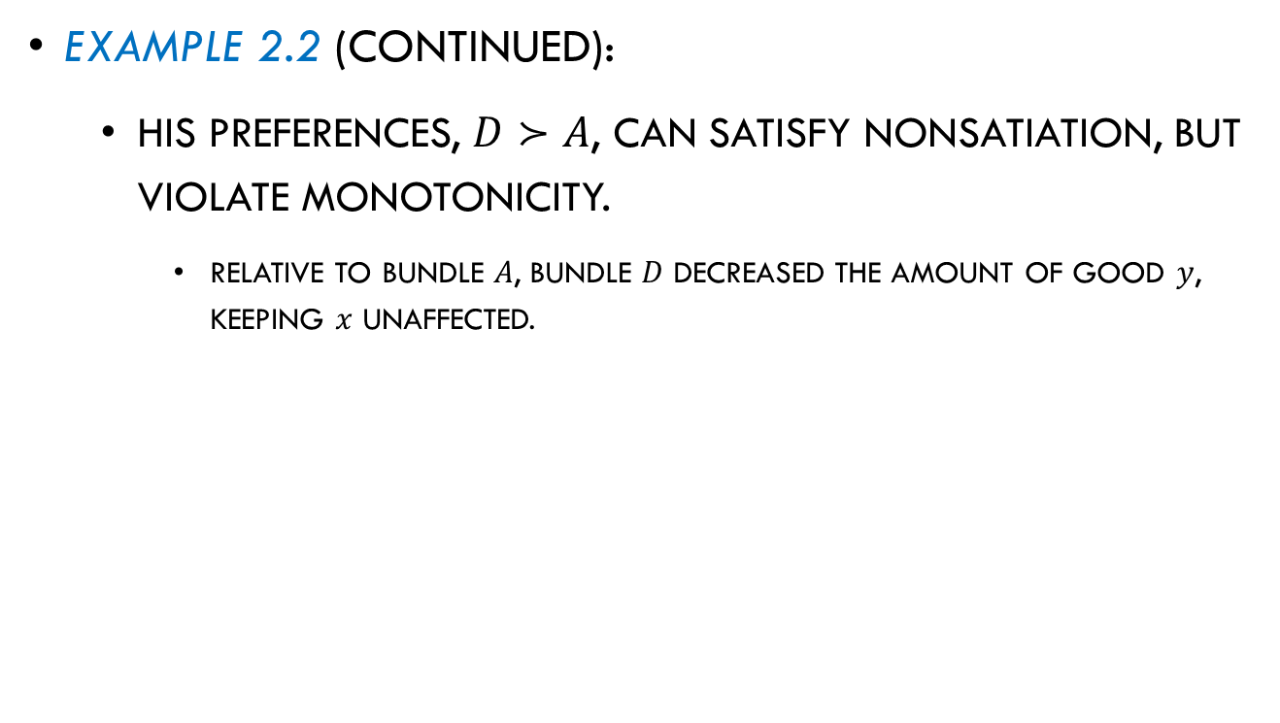
Preferences for Bundles
Example 2.2 (continued):
  His preferences, $D≻A$, can satisfy nonsatiation, but violate monotonicity.
    Relative to bundle $A$, bundle $D$ decreased the amount of good $y$, keeping $x$ unaffected.
If $D≻A$, it must be that $y$ is a bad.
Bundle D is a “more preferred” bundle → nonsatiation is satisfied.
Monotonicity would require $A≻D$.
Figure 2.2

Slide 22
Utility Functions

Slide 23
Utility Functions
A utility function mathematically represents the level of satisfaction that an individual enjoys from consuming a bundle of goods.
Example: If she consumes bundle 𝐴=(40,30) and her utility function is 𝑢(𝑥,𝑦)=3𝑥+5𝑦, her level of utility at bundle 𝐴 is
𝑢(40,30)=(3×40)+(5×30)=270

Slide 24
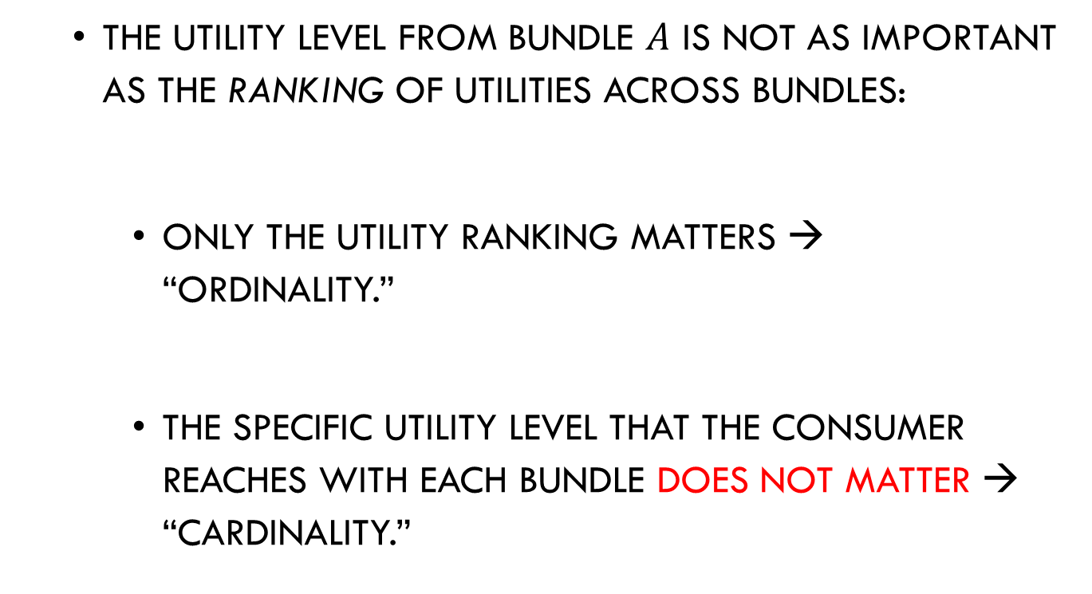
Utility Functions
  The utility level from bundle $A$ is not as important as the ranking of utilities across bundles:
    Only the utility ranking matters → “ordinality.”
    The specific utility level that the consumer reaches with each bundle does not matter → “cardinality.”

Slide 25
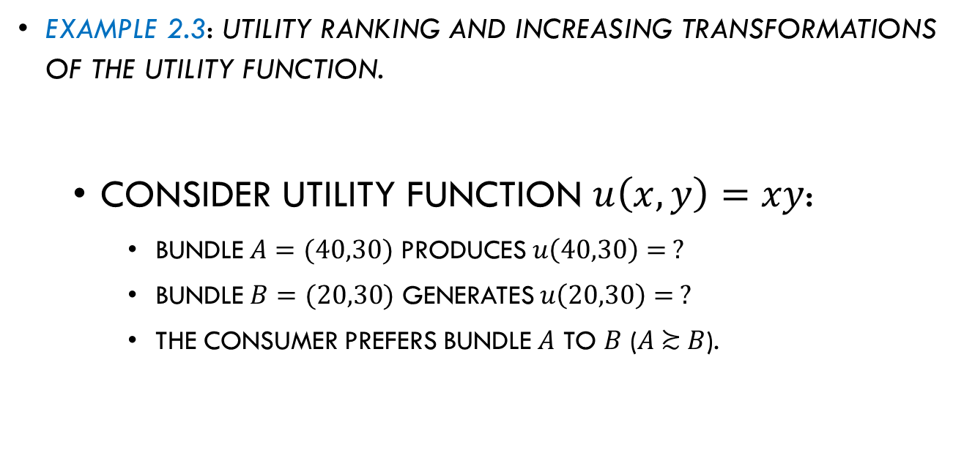
Utility Functions
Example 2.3: Utility ranking and increasing transformations of the utility function.
  Consider utility function $u\left(x,y\right)=xy$:
    Bundle $A=(40,30)$ produces $u\left(40,30\right)= ?$
    Bundle $B=(20,30)$ generates $u\left(20,30\right)=$ ?
    The consumer prefers bundle $A$ to $B$ ($A \text{≿} B$).

Slide 26
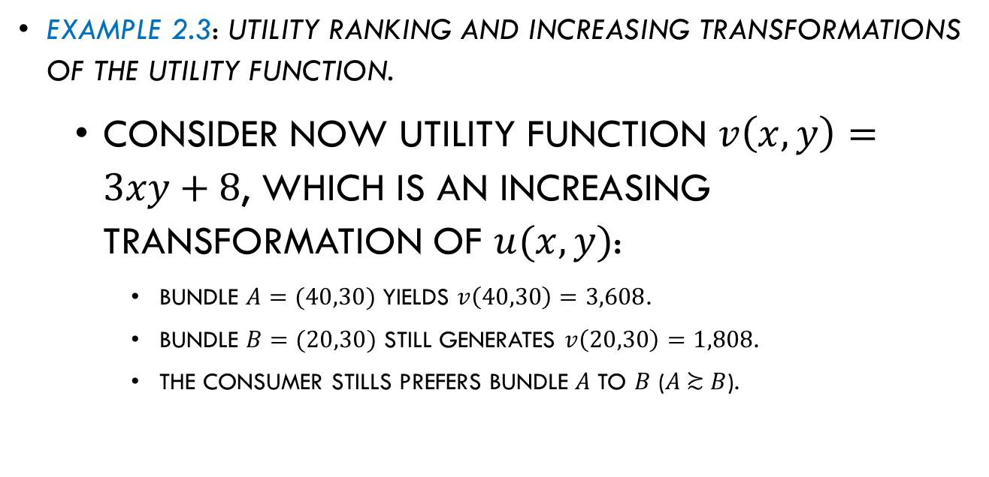
Utility Functions
Example 2.3: Utility ranking and increasing transformations of the utility function.
  Consider now utility function $v\left(x,y\right)=3xy+8$, which is an increasing transformation of $u(x,y)$:
    Bundle $A=(40,30)$ yields $v\left(40,30\right)=3,608$.
    Bundle $B=(20,30)$ still generates $v\left(20,30\right)=1,808$.
    The consumer stills prefers bundle $A$ to $B$ ($A \text{≿} B$).
The consumer’s preference over bundle 𝐴 and 𝐵 is unaffected (i.e., her ranking does not change).

Slide 27
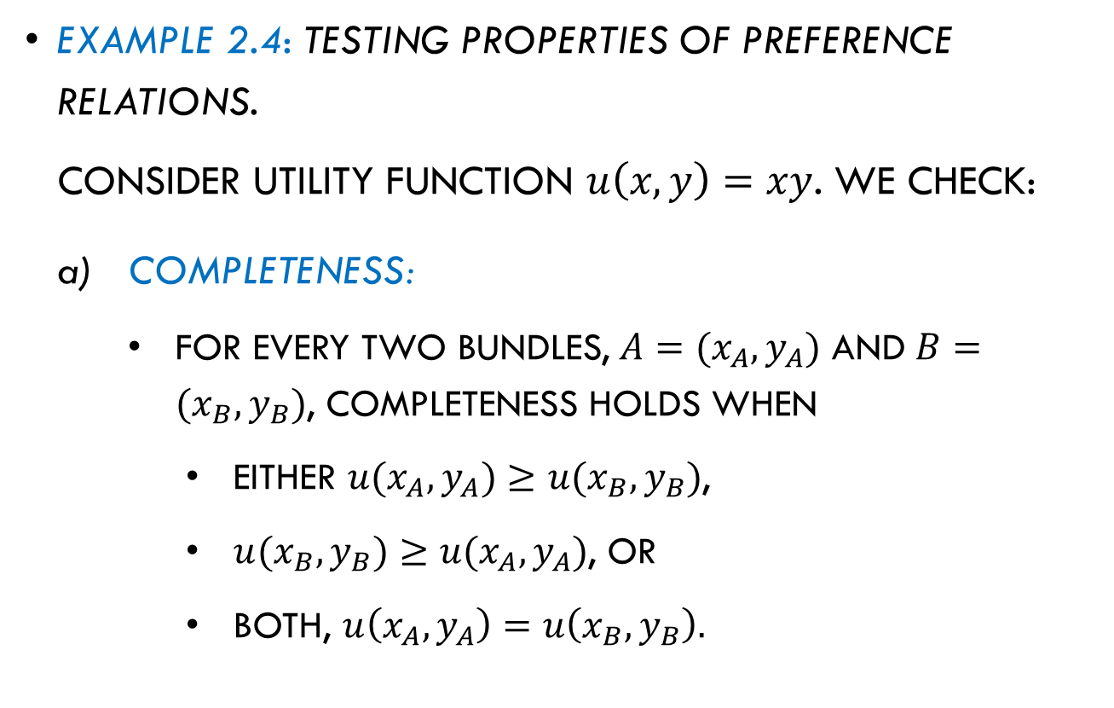
Utility Functions
Example 2.4: Testing properties of preference relations.
Consider utility function $u\left(x,y\right)=xy$. We check:
Completeness:
For every two bundles, $A=(x_{A},y_{A})$ and $B=(x_{B},y_{B})$, completeness holds when
    either $u(x_{A},y_{A})≥u(x_{B},y_{B})$,
    $u(x_{B},y_{B})≥u(x_{A},y_{A})$, or
    both, $u\left(x_{A},y_{A}\right)=u\left(x_{B},y_{B}\right).$

Slide 28
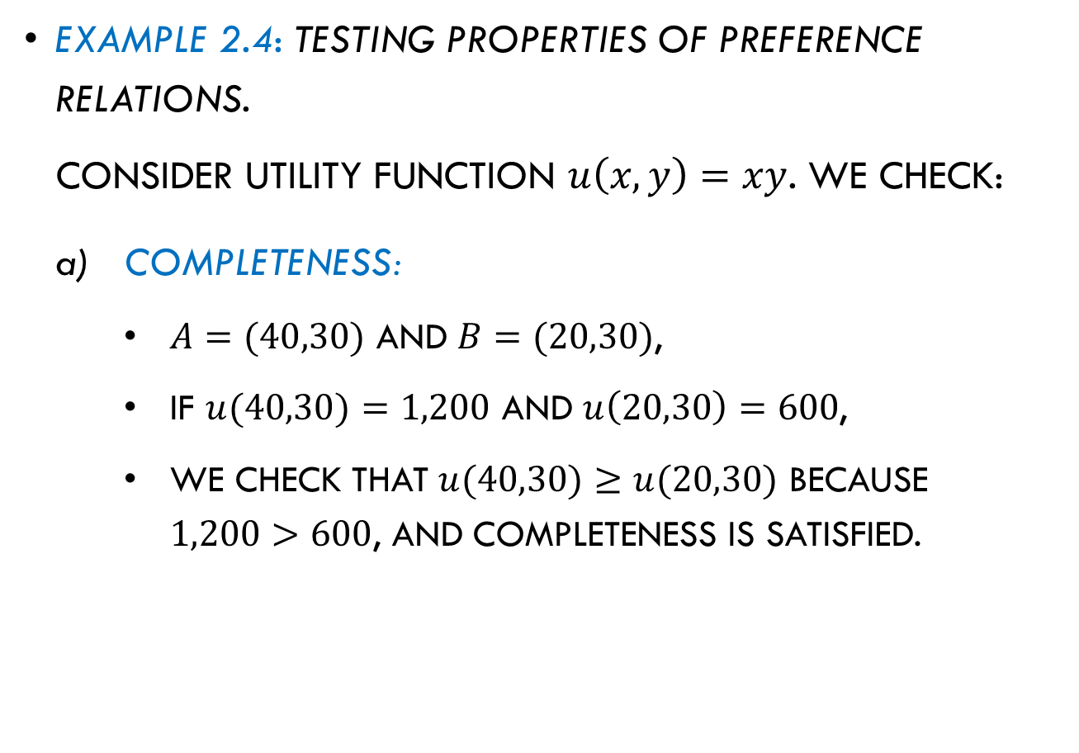
Utility Functions
Example 2.4: Testing properties of preference relations.
Consider utility function $u\left(x,y\right)=xy$. We check:
Completeness:
$A=(40,30)$ and $B=(20,30)$,
If $u(40,30)=1,200$ and $u\left(20,30\right)=600$,
we check that $u(40,30)≥u(20,30)$ because $1,200>600$, and completeness is satisfied.

Slide 29
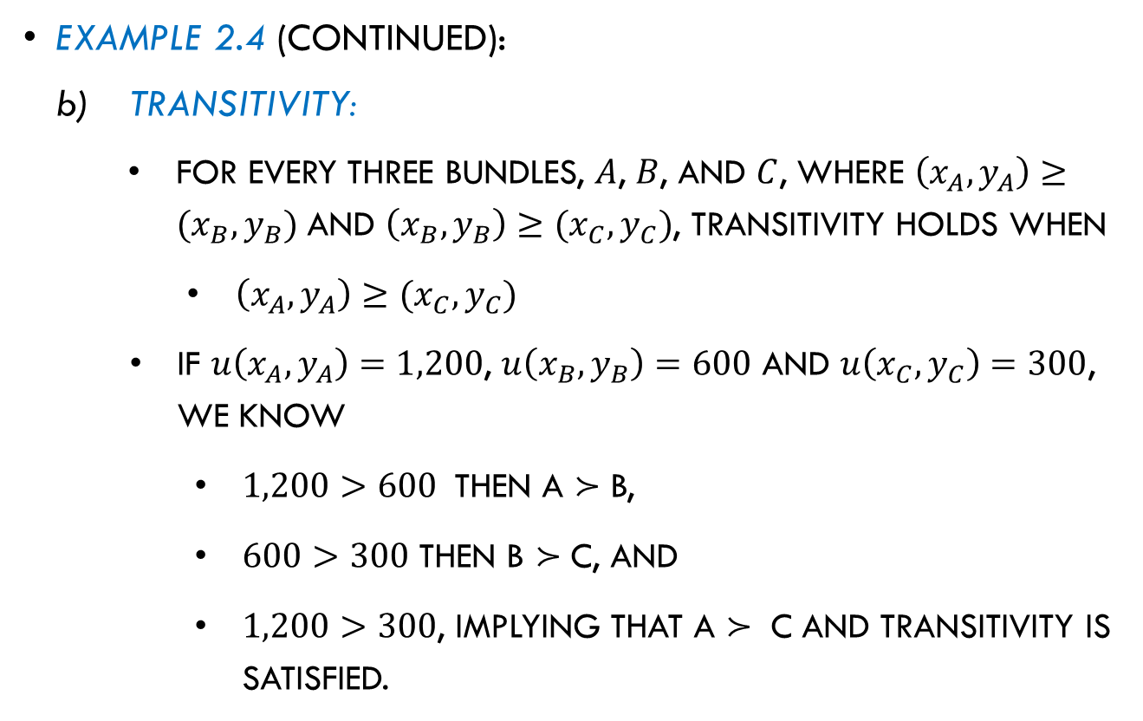
Utility Functions
Example 2.4 (continued):
Transitivity:
For every three bundles, $A$, $B$, and $C$, where $\left(x_{A},y_{A}\right)≥(x_{B},y_{B})$ and $\left(x_{B},y_{B}\right)≥(x_{C},y_{C})$, transitivity holds when
    $\left(x_{A},y_{A}\right)≥(x_{C},y_{C})$
  If $u\left(x_{A},y_{A}\right)=1,200$, $u\left(x_{B},y_{B}\right)=600$ and $u\left(x_{C},y_{C}\right)=300$, we know
    $1,200>600$ then A $≻$ B,
    $600>300$ then B $≻$ C, and
    $1,200>300$, implying that A $≻$ C and transitivity is satisfied.

Slide 30
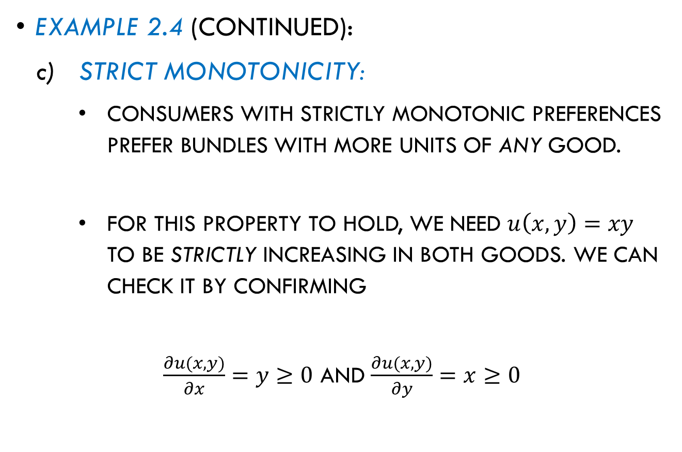
Utility Functions
Example 2.4 (continued):
Strict monotonicity:
Consumers with strictly monotonic preferences prefer bundles with more units of any good.
For this property to hold, we need $u\left(x,y\right)=xy$ to be strictly increasing in both goods. We can check it by confirming
$\frac{∂u(x,y)}{∂x}=y≥0$ and $\frac{∂u(x,y)}{∂y}=x≥0$

Slide 31
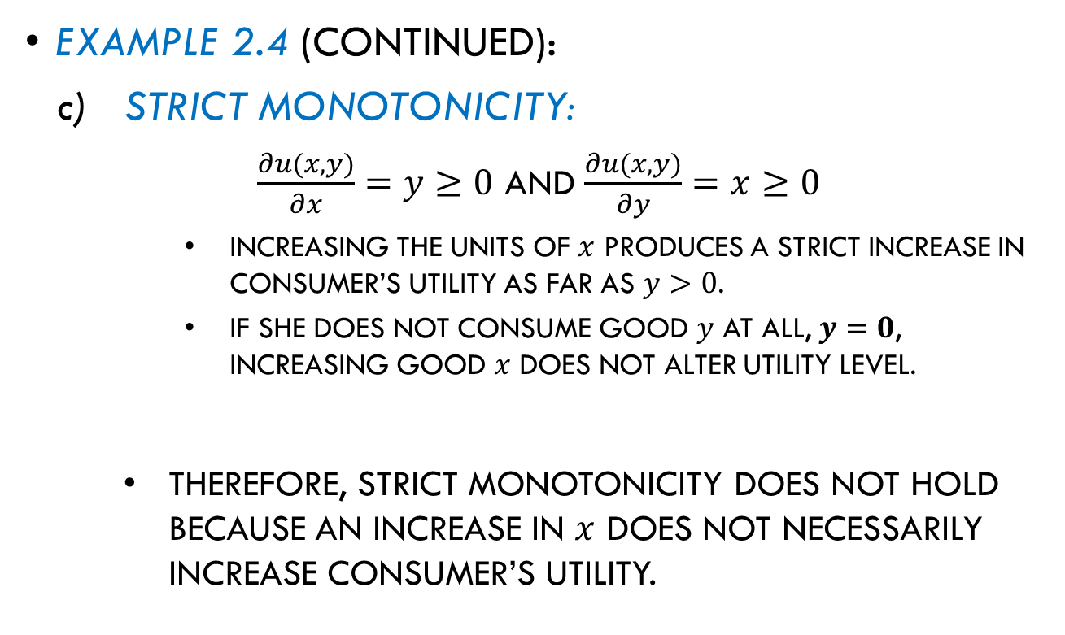
Utility Functions
Example 2.4 (continued):
Strict monotonicity:
$\frac{∂u(x,y)}{∂x}=y≥0$ and $\frac{∂u(x,y)}{∂y}=x≥0$
  Increasing the units of $x$ produces a strict increase in consumer’s utility as far as $y>0$.
  If she does not consume good $y$ at all, $y=0$, increasing good $x$ does not alter utility level.
Therefore, strict monotonicity does not hold because an increase in $x$ does not necessarily increase consumer’s utility.

Slide 32
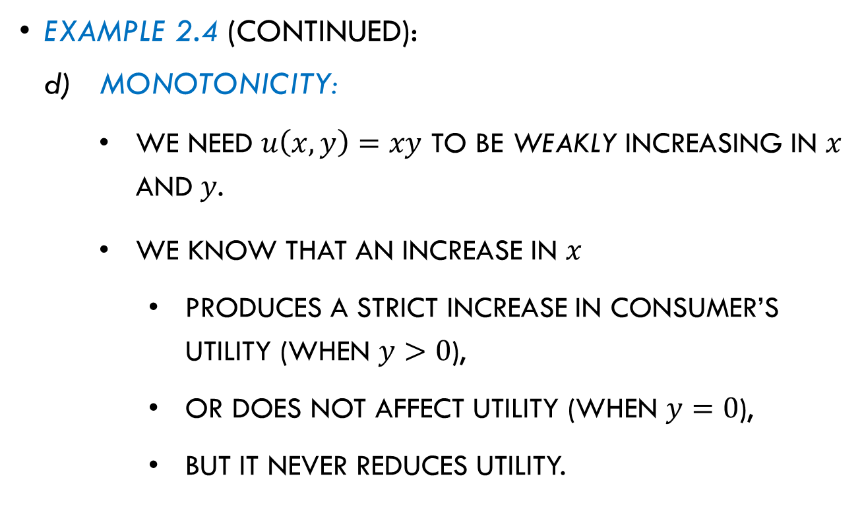
Utility Functions
Example 2.4 (continued):
Monotonicity:
We need $u\left(x,y\right)=xy$ to be weakly increasing in $x$ and $y$.
We know that an increase in $x$
  produces a strict increase in consumer’s utility (when $y>0$),
  or does not affect utility (when $y=0$),
  but it never reduces utility.

Slide 33
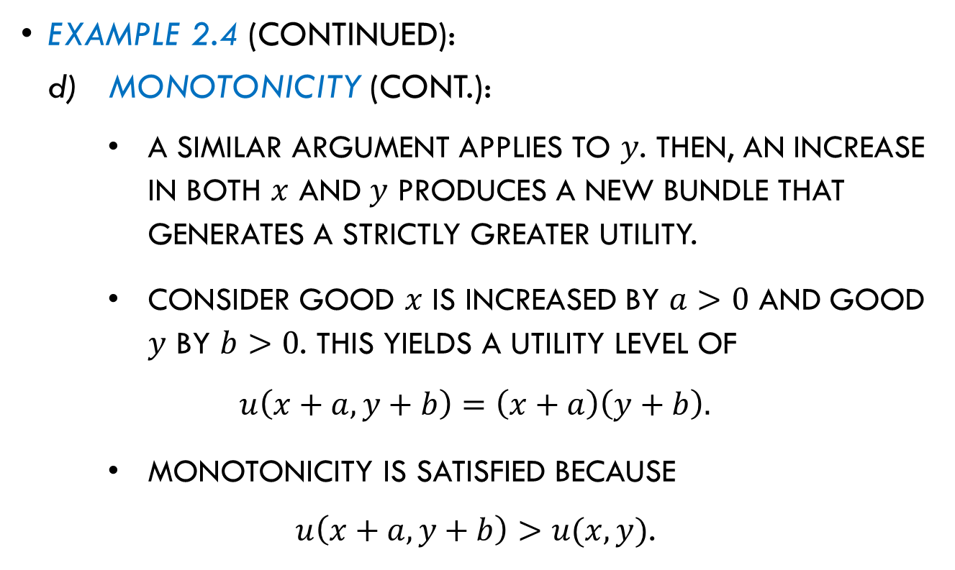
Utility Functions
Example 2.4 (continued):
Monotonicity (cont.):
A similar argument applies to $y$. Then, an increase in both $x$ and $y$ produces a new bundle that generates a strictly greater utility.
Consider good $x$ is increased by $a>0$ and good $y$ by $b>0$. This yields a utility level of
$$u\left(x+a,y+b\right)=\left(x+a\right)\left(y+b\right).$$
Monotonicity is satisfied because
$u\left(x+a,y+b\right)>u(x,y)$.

Slide 34
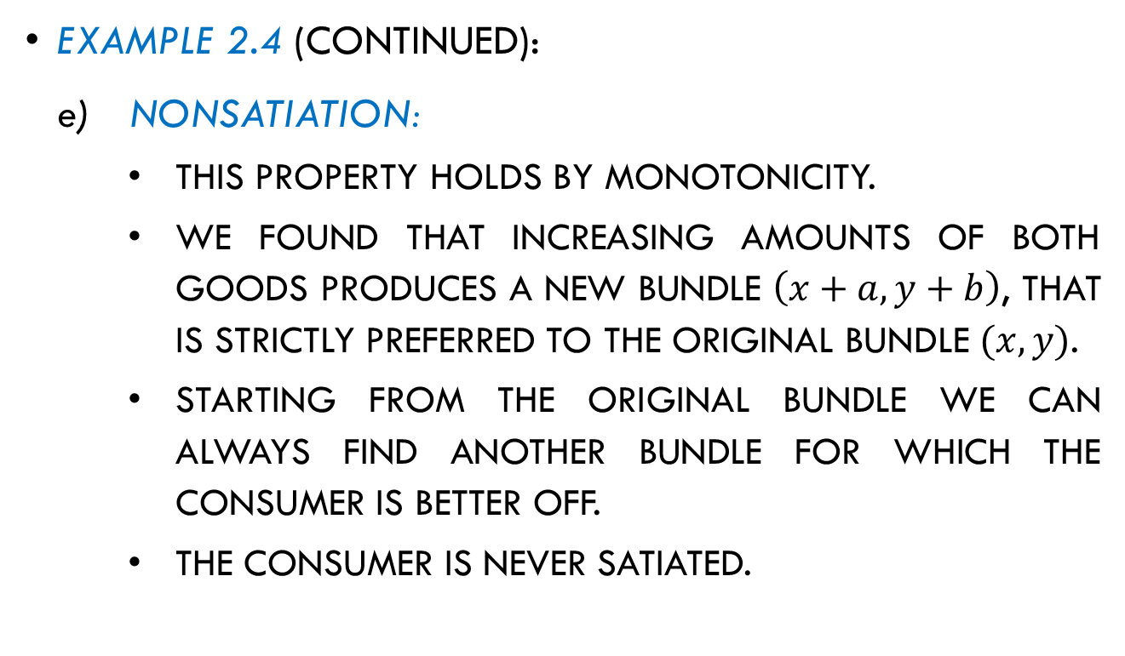
Utility Functions
Example 2.4 (continued):
Nonsatiation:
This property holds by monotonicity.
We found that increasing amounts of both goods produces a new bundle $\left(x+a,y+b\right)$, that is strictly preferred to the original bundle $(x,y)$.
Starting from the original bundle we can always find another bundle for which the consumer is better off.
The consumer is never satiated.

Slide 35

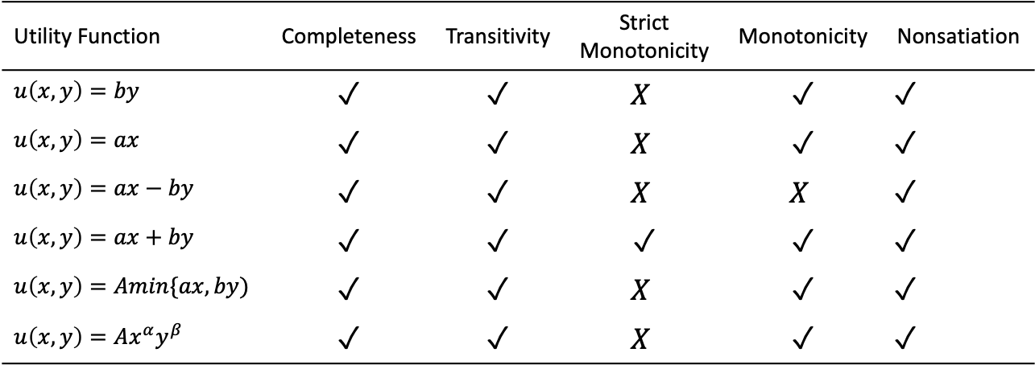
Utility Functions
Utility functions and their properties.
Table 2.1
Utility Function | Completeness | Transitivity | Strict Monotonicity | Monotonicity | Nonsatiation
$$u\left(x,y\right)=by$$ | ✓ | ✓ | $$X$$ | ✓ | ✓
$$u\left(x,y\right)=ax$$ | ✓ | ✓ | $$X$$ | ✓ | ✓
$$u\left(x,y\right)=ax−by$$ | ✓ | ✓ | $$X$$ | $$X$$ | ✓
$$u\left(x,y\right)=ax+by$$ | ✓ | ✓ | ✓ | ✓ | ✓
$$u\left(x,y\right)=Amin\{ax,by)$$ | ✓ | ✓ | $$X$$ | ✓ | ✓
$$u\left(x,y\right)=Ax^{α}y^{β}$$ | ✓ | ✓ | $$X$$ | ✓ | ✓
Paramenters $a, b, A,α,β$ are positive.

Slide 36
Marginal Utility

Slide 37
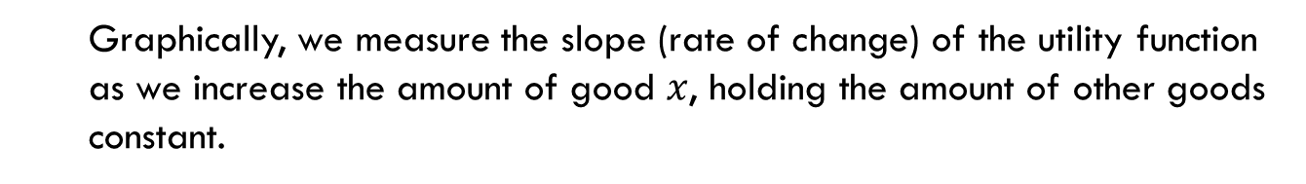
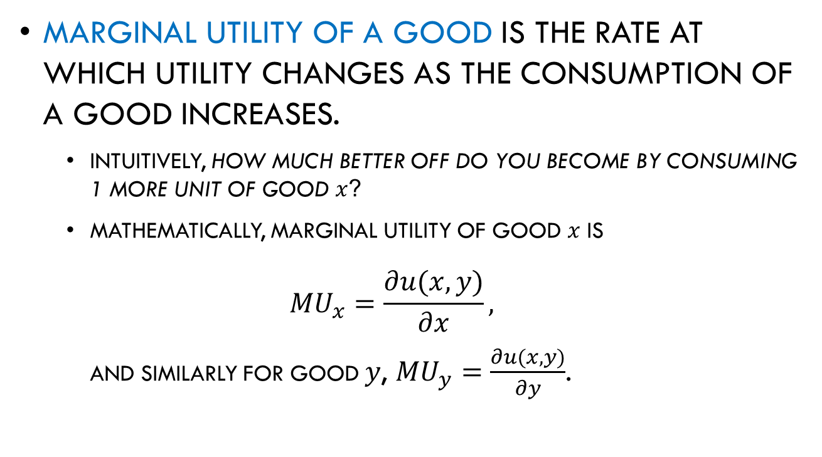
Marginal Utility
Marginal utility of a good is the rate at which utility changes as the consumption of a good increases.
  Intuitively, how much better off do you become by consuming 1 more unit of good $x$?
  Mathematically, marginal utility of good $x$ is
  $${MU}_{x}=\frac{∂u(x,y)}{∂x},$$
  and similarly for good $y$, ${MU}_{y}=\frac{∂u(x,y)}{∂y}$.
  Graphically, we measure the slope (rate of change) of the utility function as we increase the amount of good $x$, holding the amount of other goods constant.

Slide 38
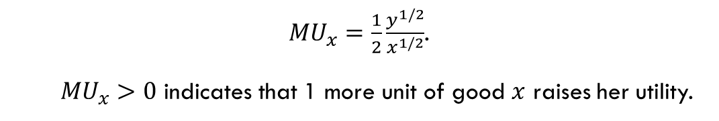
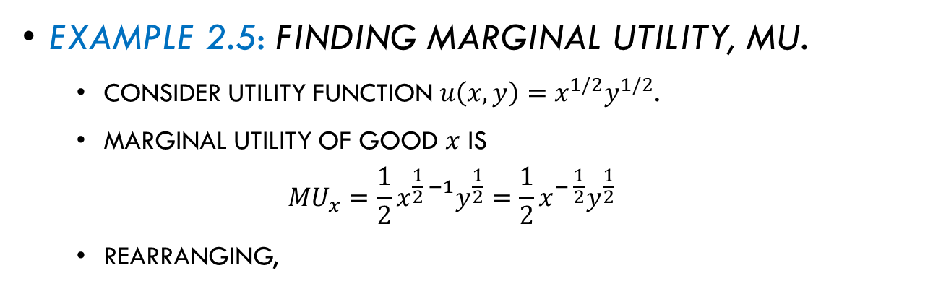
Marginal Utility
Example 2.5: Finding marginal utility, MU.
  Consider utility function $u\left(x,y\right)=x^{1/2}y^{1/2}$.
  Marginal utility of good $x$ is
  $${MU}_{x}=\frac{1}{2}x^{\frac{1}{2} −1}y^{\frac{1}{2}}=\frac{1}{2}x^{− \frac{1}{2}}y^{\frac{1}{2}}$$
  Rearranging,
  ${MU}_{x}=\frac{1}{2}\frac{y^{1/2}}{x^{1/2}}$.
  ${MU}_{x}>0$ indicates that 1 more unit of good $x$ raises her utility.

Slide 39
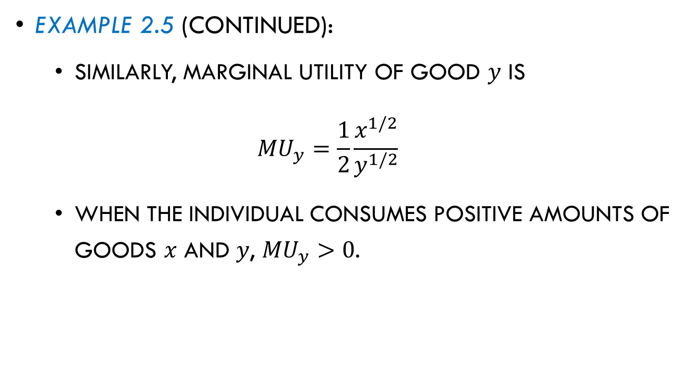
Marginal Utility
Example 2.5 (continued):
  Similarly, marginal utility of good $y$ is
  $${MU}_{y}=\frac{1}{2}\frac{x^{1/2}}{y^{1/2}}$$
  When the individual consumes positive amounts of goods $x$ and $y$, ${MU}_{y}>0$.

Slide 40

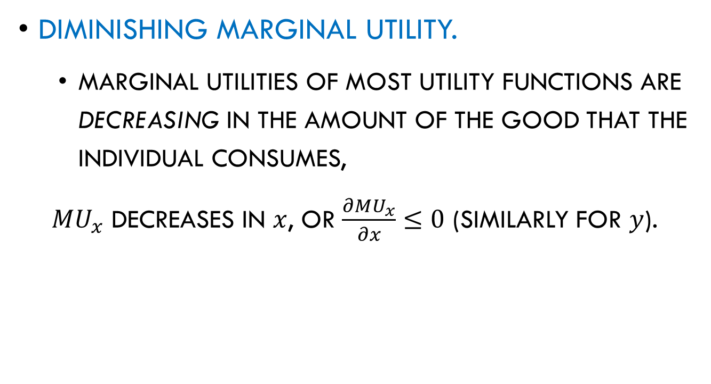
Marginal Utility
Diminishing Marginal Utility.
  Marginal utilities of most utility functions are decreasing in the amount of the good that the individual consumes,
${MU}_{x}$ decreases in $x$, or $\frac{∂{MU}_{x}}{∂x}≤0$ (similarly for $y$).

Slide 41
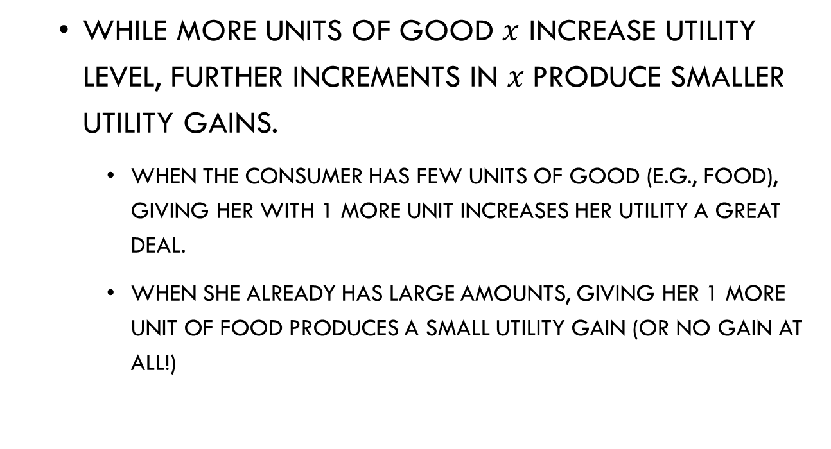
Marginal Utility
  While more units of good $x$ increase utility level, further increments in $x$produce smaller utility gains.
    When the consumer has few units of good (e.g., food), giving her with 1 more unit increases her utility a great deal.
    When she already has large amounts, giving her 1 more unit of food produces a small utility gain (or no gain at all!)

Slide 42
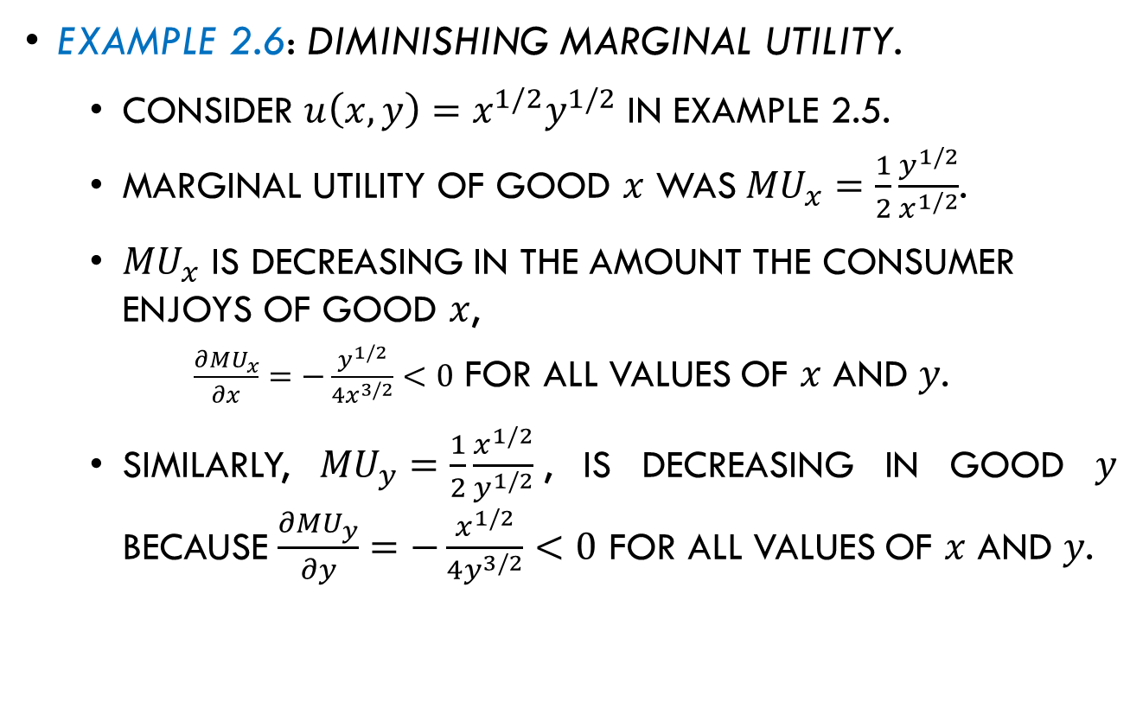
Marginal Utility
Example 2.6: Diminishing marginal utility.
  Consider $u\left(x,y\right)=x^{1/2}y^{1/2}$ in example 2.5.
  Marginal utility of good $x$ was${MU}_{x}=\frac{1}{2}\frac{y^{1/2}}{x^{1/2}}$.
  ${MU}_{x}$ is decreasing in the amount the consumer enjoys of good $x$,
  $\frac{∂{MU}_{x}}{∂x}=−\frac{y^{1/2}}{4x^{3/2}}<0$ for all values of $x$ and $y$.
  Similarly, ${MU}_{y}=\frac{1}{2}\frac{x^{1/2}}{y^{1/2}}$, is decreasing in good $y$ because $\frac{∂{MU}_{y}}{∂y}=−\frac{x^{1/2}}{4y^{3/2}}<0$ for all values of $x$ and $y$.

Slide 43




Indifference Curves

Slide 44
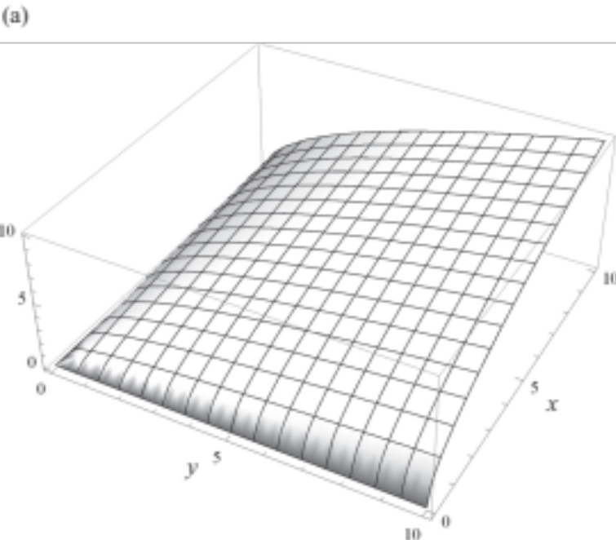
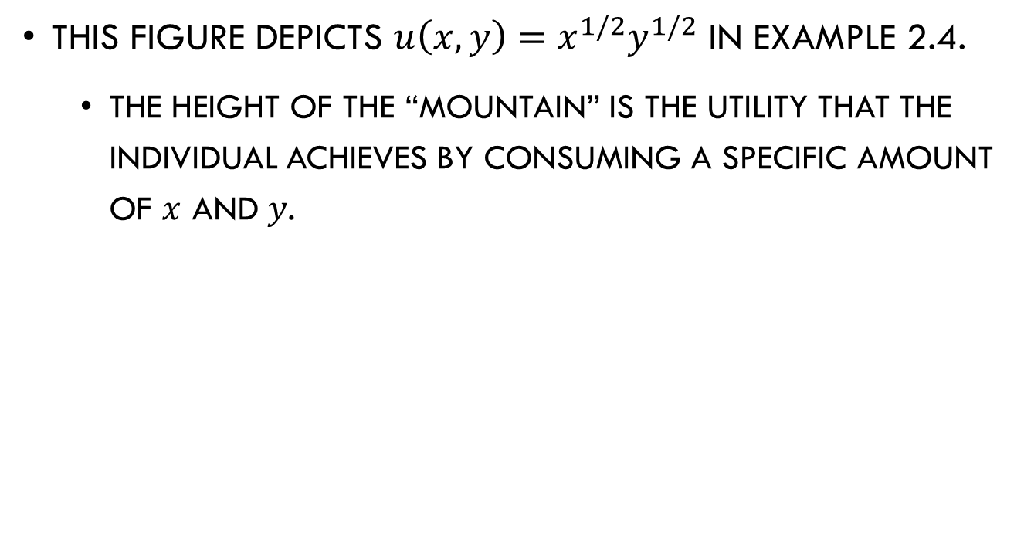
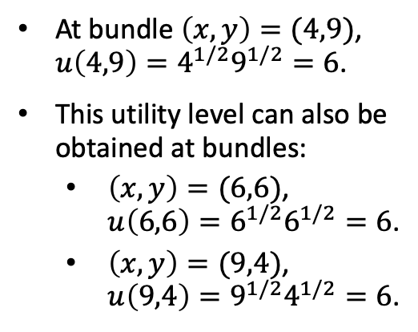
Indifference Curves
This figure depicts $u\left(x,y\right)=x^{1/2}y^{1/2}$ in example 2.4.
  The height of the “mountain” is the utility that the individual achieves by consuming a specific amount of $x$ and $y$.
At bundle $\left(x,y\right)=(4,9)$, $u\left(4,9\right)=4^{1/2}9^{1/2}=6$.
This utility level can also be obtained at bundles:
  $\left(x,y\right)=(6,6)$, $u\left(6,6\right)=6^{1/2}6^{1/2}=6$.
  $\left(x,y\right)=(9,4)$, $u\left(9,4\right)=9^{1/2}4^{1/2}=6$.
Figure 2.3a

Slide 45
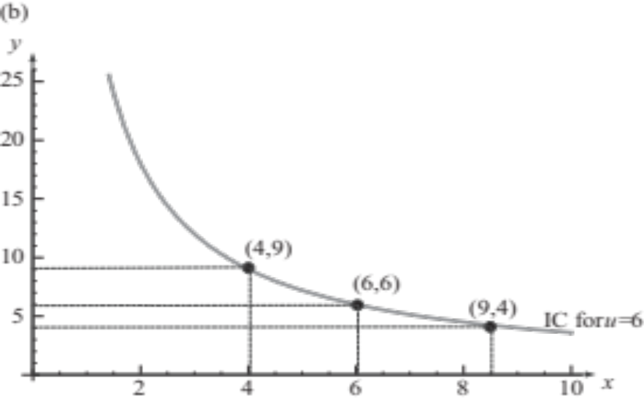

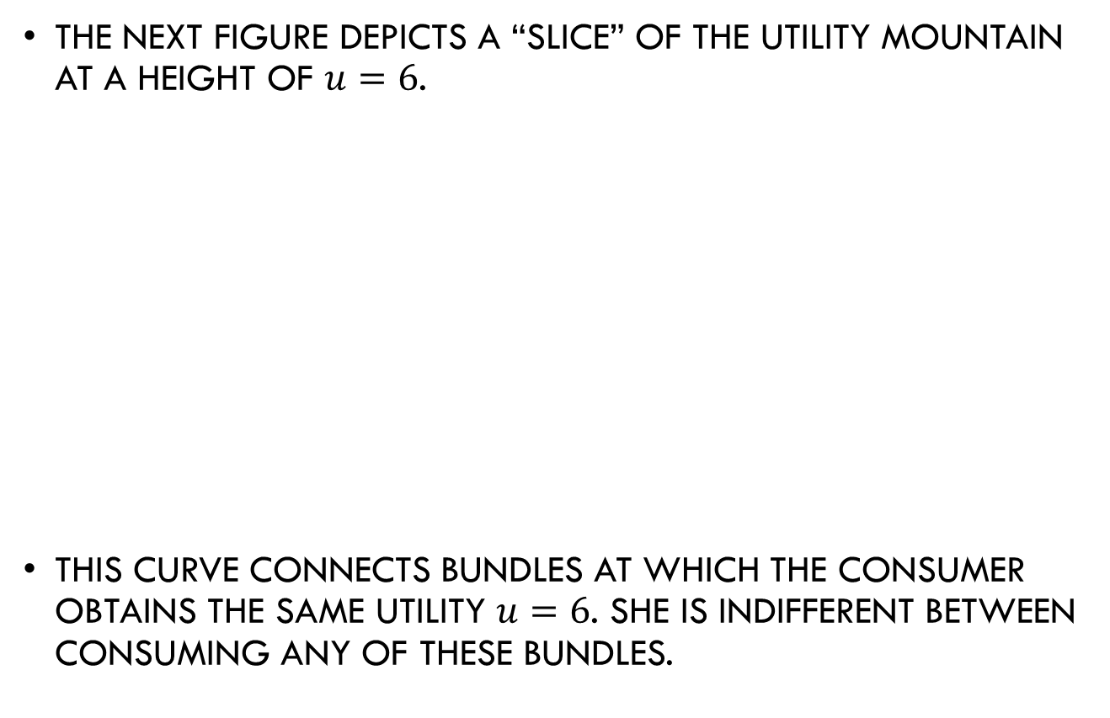
Indifference Curves
The next figure depicts a “slice” of the utility mountain at a height of $u=6$.
This curve connects bundles at which the consumer obtains the same utility $u=6$. She is indifferent between consuming any of these bundles.
Figure 2.3b

Slide 46
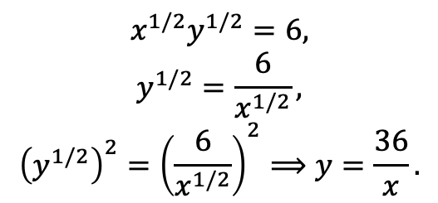
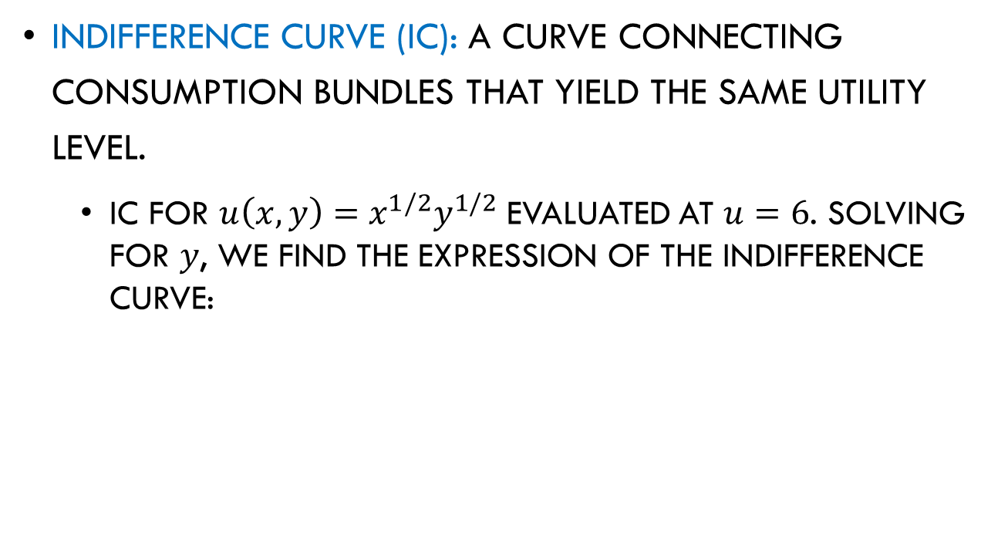
Indifference Curves
Indifference curve (IC): A curve connecting consumption bundles that yield the same utility level.
  IC for $u\left(x,y\right)=x^{1/2}y^{1/2}$ evaluated at $u=6$. Solving for $y$, we find the expression of the indifference curve:
$$x^{1/2}y^{1/2}=6,$$
$$y^{1/2}=\frac{6}{x^{1/2}},$$
$${\left(y^{1/2}\right)}^{2}={\left(\frac{6}{x^{1/2}}\right)}^{2}⟹y=\frac{36}{x}.$$
Figure 2.3b

Slide 47
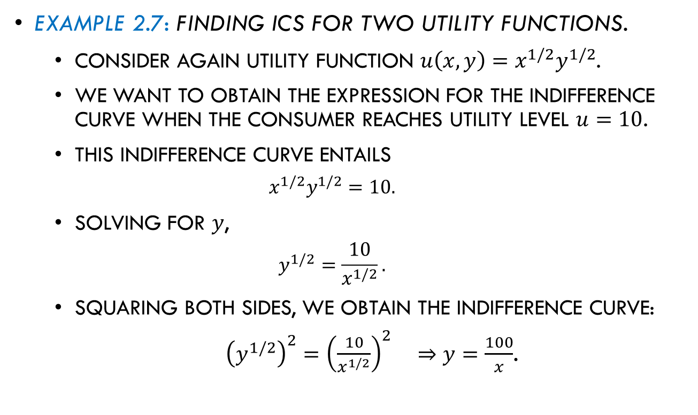
Indifference Curves
Example 2.7: Finding ICs for two utility functions.
  Consider again utility function $u\left(x,y\right)=x^{1/2}y^{1/2}$.
  We want to obtain the expression for the indifference curve when the consumer reaches utility level $u=10$.
  This indifference curve entails
  $$x^{1/2}y^{1/2}=10.$$
  Solving for $y$,
  $$y^{1/2}=\frac{10}{x^{1/2}}.$$
  Squaring both sides, we obtain the indifference curve:
  ${\left(y^{1/2}\right)}^{2}={\left(\frac{10}{x^{1/2}}\right)}^{2} ⇒y=\frac{100}{x}$.

Slide 48
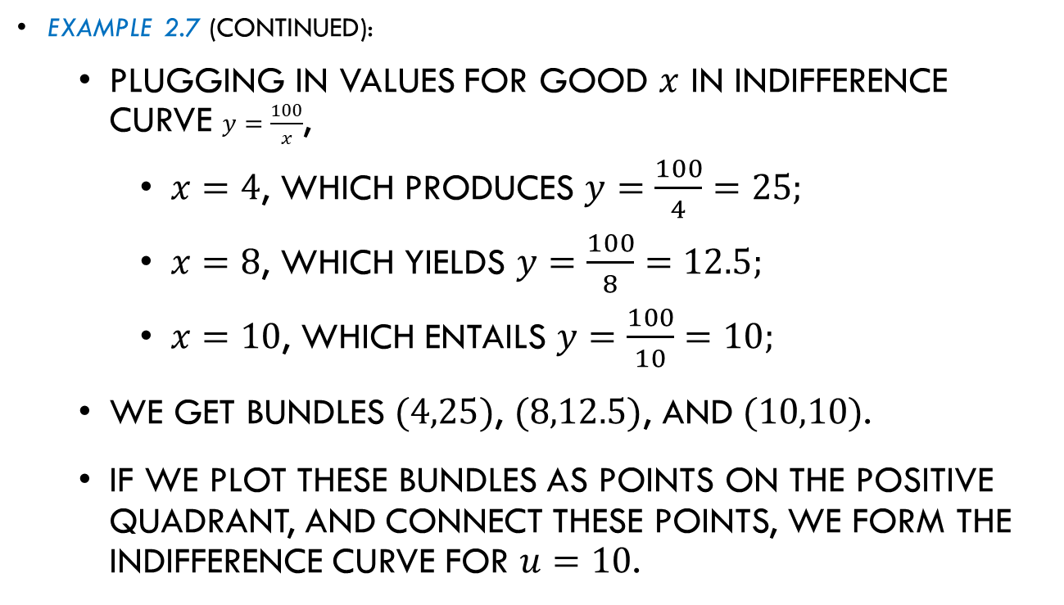
Indifference Curves
Example 2.7 (continued):
  Plugging in values for good $x$ in indifference curve $y=\frac{100}{x}$,
    $x=4$, which produces $y=\frac{100}{4}=25;$
    $x=8$, which yields $y=\frac{100}{8}=12.5;$
    $x=10$, which entails $y=\frac{100}{10}=10;$
  We get bundles $(4,25)$, $(8,12.5)$, and $(10,10)$.
  If we plot these bundles as points on the positive quadrant, and connect these points, we form the indifference curve for $u=10$.

Slide 49
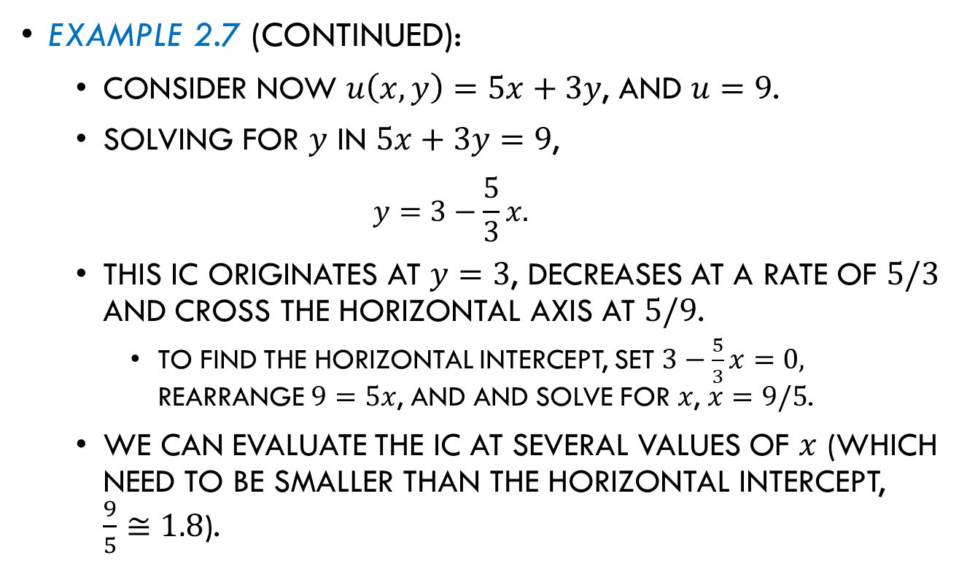
Indifference Curves
Example 2.7 (continued):
  Consider now $u\left(x,y\right)=5x+3y$, and $u=9$.
  Solving for $y$ in $5x+3y=9$,
  $$y=3−\frac{5}{3}x.$$
  This IC originates at $y=3$, decreases at a rate of $5/3$ and cross the horizontal axis at $5/9$.
    To find the horizontal intercept, set $3−\frac{5}{3}x=0,$ rearrange $9=5x$, and and solve for $x$, $x=9/5$.
  We can evaluate the IC at several values of $x$ (which need to be smaller than the horizontal intercept, $\frac{9}{5}≅1.8$).

Slide 50
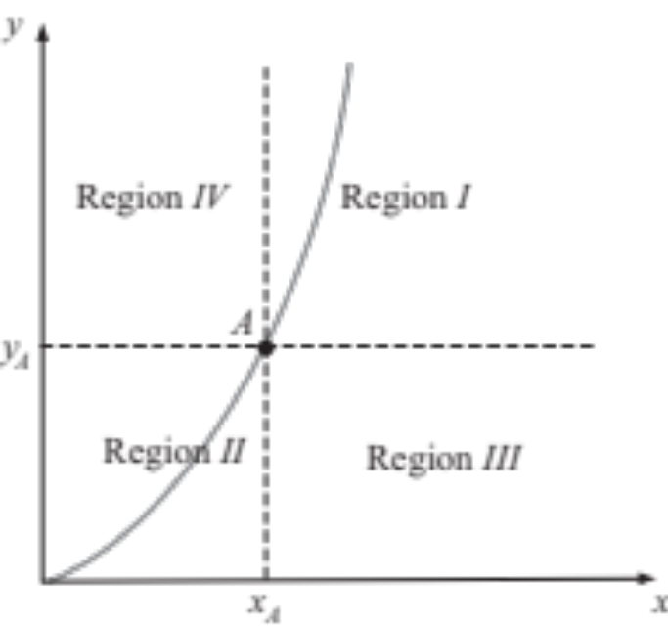
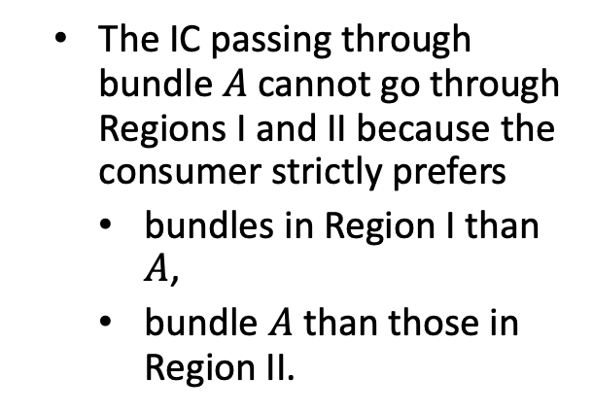
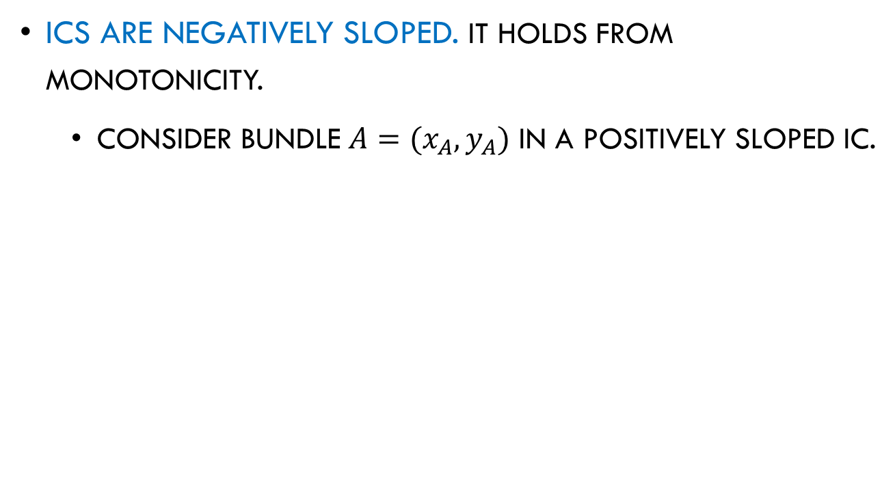
Properties of Indifference Curves
ICs are negatively sloped. It holds from monotonicity.
  Consider bundle $A=(x_{A},y_{A})$ in a positively sloped IC.
  The IC passing through bundle $A$ cannot go through Regions I and II because the consumer strictly prefers
    bundles in Region I than $A$,
    bundle $A$ than those in Region II.
Figure 2.4

Slide 51

Properties of Indifference Curves
ICs are negatively sloped.
  The IC passing through bundle $A$ can only go through Region III and IV.
  IC must be negatively sloped.
Figure 2.4

Slide 52
Properties of Indifference Curves
ICs are negatively sloped.
  Negatively sloped ICs are referred as “convex.”
  For any two bundles, a straight line connecting them lies:
strictly above the curve, yielding a higher utility (when the IC curve is strictly decreasing); or
on the indifference curve, yielding the same utility level (when the IC is a straight line).
Figure 2.3b

Slide 53
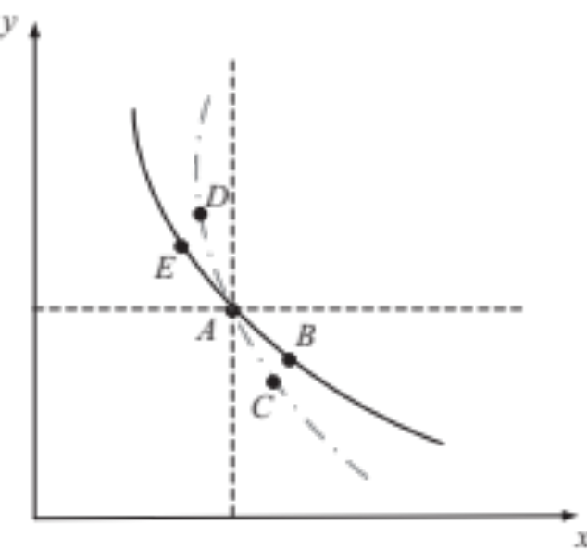
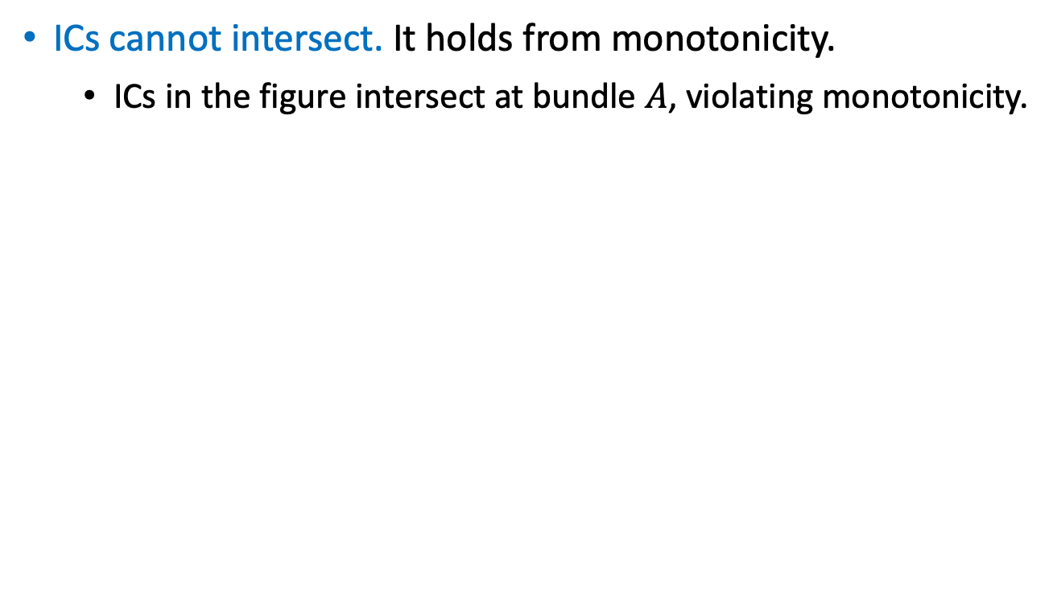

Properties of Indifference Curves
ICs cannot intersect. It holds from monotonicity.
  ICs in the figure intersect at bundle $A$, violating monotonicity.
Bundle $B$ lies northeast of $C$. With monotonicity, $u_{B}>u_{C}$.
Bundle $D$ lies northeast of $E$. With monotonicity $u_{D}>u_{E}$.
Bundles $C$ and D lie on the same IC, $u_{C}=u_{D}$. Similarly, $u_{B}=u_{E}$.
Figure 2.5

Slide 54

Properties of Indifference Curves
ICs cannot intersect.
Combining with $u_{B}>u_{C}$,
$$u_{E}=u_{B}>u_{C}=u_{D},$$
$$u_{E}{>u}_{D},$$
which contradicts the result about bundles $E$ and $D$ ($u_{D}>u_{E}).$
Monotonicity → ICs cannot intersect.
Figure 2.5

Slide 55


Properties of Indifference Curves
ICs are not thick. It holds from monotonicity.
  The thick IC depicted in the figure violates monotonicity.
Bundles $A$ and $B$ lie in the same thick IC.
But, bundle $B$ contains larger amounts of goods $x$ and $y$ than A. Then,
  The consumer is not indifferent between $A$ and $B$.
  By monotonicity, $u_{B}>u_{A}$.
Monotonicity → ICs cannot be thick.
Figure 2.6

Slide 56
Marginal Rate of Substitution

Slide 57



Marginal Rate of Substitution
Marginal rate of substitution (MRS) is the rate at which a consumer is willing to give up units of good $y$ as she receives an additional unit of good $x$, in order to keep her utility level constant.

Slide 58



Marginal Rate of Substitution
Marginal rate of substitution (MRS) is the rate at which a consumer is willing to give up units of good $y$ as she receives an additional unit of good $x$, in order to keep her utility level constant.
Formally,
$${MRS}_{x,y}=\frac{{MU}_{x}}{{MU}_{y}}.$$
When ${MU}_{x}>0$ and ${MU}_{y}<0$,
$${MRS}_{x,y}=\frac{(+)}{(−)}=\left(−\right).$$
MRS represents the slope of the IC.
Figure 2.7

Slide 59



Marginal Rate of Substitution
Diminishing MRS. The IC is relatively steep for small amounts of good $x$, but becomes flatter as we move rightward toward greater amounts of good $x$.
  Preference for variety. ICs are bowed in toward the origin.
The consumer is indifferent between extreme bundles, such as $A$ and $B$, which yield utility level of $u_{1}$.
She prefers more balanced bundles, such $C$, yielding a higher utility of $u_{2}$.
Figure 2.8

Slide 60


Marginal Rate of Substitution
Diminishing MRS.
  Decreasing willingness to substitute.
At $A$, ${MU}_{x}$ is high while ${MU}_{y}$ is low.
  The consumer is willing to give up several units of $y$ to obtain more units of$x$.
At $C$, ${MU}_{x}$ is low and ${MU}_{y}$ becomes high.
  Willingness to give up units of $y$ decreases once she has more units of$x$.
Figure 2.9

Slide 61

Marginal Rate of Substitution
Example: Finding MRS.
  Consider utility function $u\left(x,y\right)=x^{1/2}y^{1/2}$
  $${MRS}_{x,y}=\frac{{MU}_{x}}{{MU}_{y}}=\frac{\frac{1}{2}x^{−\frac{1}{2}}y^{\frac{1}{2}}}{\frac{1}{2}x^{\frac{1}{2}}y^{−\frac{1}{2}}}=\frac{y^{\frac{1}{2}−\left(−\frac{1}{2}\right)}}{x^{\frac{1}{2}−\left(−\frac{1}{2}\right)}}=\frac{y}{x},$$
  where we cancel $1/2$ on numerator and denominator; and we use the property $\frac{x^{a}}{x^{b}}=x^{a−b}$ for exponents $a$ and $b$.
  ${MRS}_{x,y}$ is decreasing in $x$, yielding ICs that are bowed in toward the origin.

Slide 62

Marginal Rate of Substitution
Example (continued):
  Consider the linear utility function $u\left(x,y\right)=ax+by$ where $a,b>0$,
  $${MRS}_{x,y}=\frac{{MU}_{x}}{{MU}_{y}}=\frac{a}{b}.$$
  ${MRS}_{x,y}$ is constant in $x$.
  For instance, if $a=10$ and $b=4$, ${MRS}_{x,y}=2.5$, indicating that the slope of the IC is $−2.5$along all its points (i.e., a straight line).

Slide 63

Marginal Rate of Substitution
Example (continued):
  Consider utility function $u\left(x,y\right)=ax^{2}+by^{3}$.
  ${MRS}_{x,y}=\frac{{MU}_{x}}{{MU}_{y}}=\frac{2ax}{3by^{2}}$.
  ${MRS}_{x,y}$ is increasing in $x$, yielding ICs bowed away from the origin. The IC is relatively flat for low values of $x$, but becomes steeper as we move rightward along the $x$-axis.

Slide 64
Special Types of Utility Functions

Slide 65

Special Types of Utility Functions
Perfect Substitutes:
  Consider goods $x$ and $y$. The consumer can use either good without significantly affecting her utility.
    Examples: Two brands of mineral water, butter and margarine.
    soybeans that are of the same quality.
    Electricity from different power plants.

Slide 66

Special Types of Utility Functions
Perfect Substitutes:
  The consumer’s utility function takes the form
  $u\left(x,y\right)=ax+by$, where $a,b>0.$
  This utility is linear in both goods because marginal utilities are constant, ${MU}_{x}=a$ and ${MU}_{y}=b.$
  MRS is also constant,
  $${MRS}_{x,y}=\frac{{MU}_{x}}{{MU}_{y}}=\frac{a}{b}.$$

Slide 67




Special Types of Utility Functions
Perfect Substitutes (cont.):
  Solving for $y$ in $u(x,y)=ax+by$,
  $y=\frac{u}{b}−\frac{a}{b}x.$
  ICs are straight lines:
Originating at $\frac{u}{b}$.
Decreasing at rate $\frac{a}{b}$.
Crossing the $x$-axis at $\frac{u}{a}$.
Figure 2.10 illustrates ICs evaluated at $u=1$, and at $u=2$.
Figure 2.10

Slide 68

Special Types of Utility Functions
Perfect Substitutes (cont.):
  Recall that MRS measures the consumer’s willingness to give up units of good $y$ to obtain 1 more unit of $x$, keeping her utility level unaffected.
    A constant MRS (i.e., a number) → the consumer’s willingness to substitute $y$ for additional units of $x$ is “always the same.”
    A decreasing MRS → the consumer is willing to give up more units of good $y$ when $x$ becomes relatively scarce.

Slide 69

Special Types of Utility Functions
Perfect Complements:
  The consumer must consume goods in fixed proportions.
    Examples: cars and gasoline, left and right shoes.
  The utility function (referred as “Leontief”) takes the form
  $u\left(x,y\right)=A min\{ax,by\}$, where $A,a,b>0.$
    If $A=1$ and $a=b=2$, the utility function reduces to
  $$u\left(x,y\right)=min\left\{2x,2y\right\}=2\min\left\{x,y\right\}.$$

Slide 70

Special Types of Utility Functions
Perfect Complements (cont.):
  If the consumer increases the amount of $x$ by 1 unit without increasing the amount of $y$, her utility does not necessarily increase.
    If $x≥y$, an increase in $x$ does not increase her utility.
    If $y>x$, an increase in $x$ does increase her utility.

Slide 71

Special Types of Utility Functions
Perfect Complements (cont.):
  Consider the consumer has 10 units of each good, yielding
  $$u\left(10,10\right)=\min\left\{2×10,2×10\right\}=\min\left\{20,20\right\}=20$$
  If good $x$ is increased from 10 to 11 units, but good $y$ is unaffected, her utility remains the same
  $$u\left(11,10\right)=\min\left\{2×11,2×10\right\}=\min\left\{22,20\right\}=20$$

Slide 72


Special Types of Utility Functions
Perfect Complements (cont.):
  Increasing the amount of one of the goods alone does not yield utility gains, as the consumer needs to enjoy both goods in fixed proportions.
  Formally, preferences for complementary goods violate the monotonicity property.

Slide 73


Special Types of Utility Functions
Perfect Complements (cont.):
  ICs have an L-shape:
    The king occurs at points where $ax=by$.
    The slope is zero in the flat segment.
    The slope is $−∞$ in the vertical segment.
Figure 2.11

Slide 74

Special Types of Utility Functions
Cobb-Douglas:
  The consumer regards goods $x$ and $y$ as neither perfectly substitutable nor complementary.
  The utility function takes the form
  $u\left(x,y\right)=Ax^{α}y^{β}$, where $A,α,β>0$.
  Marginal utilities are
  ${MU}_{x}=Aαx^{α−1}y^{β}$ and ${MU}_{y}=Aβx^{α}y^{β−1}.$
  which yield
${MRS}_{x,y}=\frac{{MU}_{x}}{{MU}_{y}}=\frac{Aαx^{α−1}y^{β}}{Aβx^{α}y^{β−1}}=\frac{αy^{β−(β−1)}}{βx^{α−(α−1)}}=\frac{αy}{βx}$.

Slide 75


Special Types of Utility Functions
Cobb-Douglas (cont.):
  ${MRS}_{x,y}=\frac{αy}{βx}$ is decreasing in $x$.
  ICs are bowed in the origin, they become flatter as $x$ increases.
Figure 2.9

Slide 76

Special Types of Utility Functions
Cobb-Douglas (cont.):
  Special cases:
    $A=α=β=1$,
    $u\left(x,y\right)=xy ⇒{MRS}_{x,y}=\frac{y}{x}$.
    $A=1$, $α=β$,
    $u\left(x,y\right)=x^{α}y^{α}={(xy)}^{α} ⇒{MRS}_{x,y}=\frac{y}{x}$.
    $A=1$, $β=1−α$,
    $u\left(x,y\right)=x^{α}y^{1−α} ⇒{MRS}_{x,y}=\frac{α}{1−α}\frac{y}{x}$.

Slide 77

Utility Elasticity of good
Exponents in the Cobb-Douglas utility function can be interpreted as elasticities.
“Utility elasticity” of good $x$, $ε_{u,x}$, is the % increase in utility (if $ε_{u,x}>0$) or % decrease in utility (if $ε_{u,x}<0$) that the consumer experiences after increasing the amount of good $x$ by 1%. Formally,
  $$ε_{u,x}=\frac{\%Δu(x,y)}{\%Δx}.$$
  Rearranging,
  $ε_{u,x}=\frac{\%Δu(x,y)}{\%Δx}=\frac{\frac{Δu(x,y)}{u(x,y)}}{\frac{Δx}{x}}=\frac{Δu(x,y)}{Δx}\frac{x}{u(x,y)}$.

Slide 78





Utility Elasticity of a good
When the increase in the amount of good $x$ is marginally small,
  $ε_{u,x}=\frac{∂u(x,y)}{∂x} \frac{x}{u(x,y)}$.
Applying the definition of $ε_{u,x}$ to the Cobb-Douglas utility function,
$$ε_{u,x}=\frac{∂u(x,y)}{∂x}\frac{x}{u\left(x,y\right)}=Aαx^{α−1}y^{β}\frac{x}{Ax^{α}y^{β}}.$$
Amount of $x$ consumed
$${MU}_{x}$$
Utility function
$$\frac{∂u(x,y)}{∂x}$$
$$u(x,y)$$

Slide 79

Utility Elasticity of a good
Simplifying,
$$ε_{u,x}=\frac{Aαx^{α−1+1}y^{β}}{Ax^{α}y^{β}}=\frac{Aαx^{α}y^{β}}{Ax^{α}y^{β}}=α.$$
Hence, when facing a utility function like $u\left(x,y\right)=Ax^{α}y^{β}$, we can claim the exponent in good $x$, $α$, represents the utility elasticity of a marginal increase in $x$.
  A 1% increase in the amount of good $x$ increases utility by $α\%$.
And $β$ is the utility elasticity of good $y$.

Slide 80

Special Types of Utility Functions
Quasilinear:
  Consumers who use all their additional income on one good alone, $y$ (e.g., video games).
  Additional income is never spent on good $x$ (e.g., toothpaste).
  This utility function takes the form
  $$u\left(xy\right)=v\left(x\right)+by.$$
  where $b>0$, and $v(x)$ is a nonlinear function in $x$.

Slide 81

Special Types of Utility Functions
Quasilinear (cont.):
  Examples:
    $v\left(x\right)=x^{1/2}$
    $v\left(x\right)=lnx$.
    Any $v(x)$ which $v^{′}(x)$ is not a constant, but instead depends on the units of good $x$, good $y$, or both.
      E.g., $v\left(x\right)=axy$, which $v^{′}\left(x\right)=ay$ (not constant).

Slide 82

Special Types of Utility Functions
Quasilinear (cont.):
  For $u\left(x,y\right)=v\left(x\right)+by$, the marginal utilities are ${MU}_{x}=v′(x)$ and ${MU}_{y}=b$, which yield
  $${MRS}_{x,y}=\frac{{MU}_{x}}{{MU}_{y}}=\frac{v^{′}(x)}{b}.$$
  For a given value of $x$, the MRS is constant because it does not depend on the amount of good $y$.

Slide 83

Special Types of Utility Functions
Quasilinear (cont.):
  For a given value of $x$, the MRS is constant because it does not depend on the amount of good $y$.
  Example: $u\left(x,y\right)=x^{1/2}+3y$, where $v\left(x\right)=x^{1/2}$, $b=3$.
  $${MRS}_{x,y}=\frac{\frac{1}{2}x^{−1/2}}{3}=\frac{1}{6\sqrt{x}}.$$
  For $x=16$, ${MRS}_{x,y}=\frac{1}{6\sqrt{16}}=\frac{1}{24}$, which is constant in $y$.

Slide 84


Special Types of Utility Functions
Quasilinear (cont.):
  ICs are parallel shifts of each other.
  If we fix constant the value of good $x$ (e.g., $x=16$), the slope of the IC (${MRS}_{x,y}$) is unaffected by the amount of good $y$.
Figure 2.12

Slide 85

Special Types of Utility Functions
Stone-Geary:
  It takes a Cobb-Douglas shape, but requires the individual have a minimum amount of each good (e.g., half a gallon of water), represented as $\overline{x}$ and $\overline{y}$.
  This utility function takes the form
  $u\left(x,y\right)=A{(x−\overline{x})}^{α}{(y−\overline{y})}^{β}$, where $A,α,β>0$.
    The consumer obtains a positive utility from good $x$ only after exceeding her minimal consumption $\overline{x}$, when $x>\overline{x}$. And similarly, for good $y$, $y>\overline{y}$.
    When $\overline{x}=\overline{y}=0$, the utility reduces to $u\left(x,y\right)=Ax^{α}y^{β}$, which coincides with Cobb-Douglas utility function.

Slide 86

Special Types of Utility Functions
Stone-Geary (cont.):
  For $u\left(x,y\right)=A{(x−\overline{x})}^{α}{(y−\overline{y})}^{β}$, marginal utilities are
  $${MU}_{x}=A{α(x−\overline{x})}^{α−1}{(y−\overline{y})}^{β},$$
  $${MU}_{y}=Aβ{(x−\overline{x})}^{α}{(y−\overline{y})}^{β−1}.$$
  which imply
  $${MRS}_{x,y}=\frac{{MU}_{x}}{{MU}_{y}}=\frac{A{α(x−\overline{x})}^{α−1}{(y−\overline{y})}^{β}}{Aβ{(x−\overline{x})}^{α}{(y−\overline{y})}^{β−1}}=\frac{α{(y−\overline{y})}^{β−(β−1)}}{β{(x−\overline{x})}^{α−(α−1)}}=\frac{α(y−\overline{y})}{β(x−\overline{x})}.$$
  When $\overline{x}=\overline{y}=0$, MRS collapses to MRS with Cob-Douglas function,
  ${MRS}_{x,y}=\frac{α(y−\overline{0})}{β(x−\overline{0})}=\frac{αy}{βx}$.

Slide 87
A Look at Behavioral Economics–
Social Preferences

Slide 88
Social Preferences
Previous utility functions assume the consumer cares about the bundle she receives but ignore the bundle (or money) that other individuals enjoy.
However, there are scenarios where we care about the well-being of family members or friends.

Slide 89
Appendix. Finding the Marginal
Rate of Substitution

Slide 90


Finding MRS
We increase good $x$ by 1 unit and seek to measure how many units of good $y$ the consumer must give up to preserve her utility level.
Because we simultaneously alter the amounts of x and y, we totally differentiate $u(x,y)$,
$$du=\frac{∂u(x,y)}{∂x}dx+\frac{∂u(x,y)}{∂y}dy.$$
Because the consumer is moving along an IC, her utility does not vary, implying $du=0$.
Plugging this result and using ${MU}_{x}=\frac{∂u(x,y)}{∂x}$ and ${MU}_{y}=\frac{∂u(x,y)}{∂y},$
$$0={MU}_{x}dx+{MU}_{y}dy.$$
$$du=0$$

Slide 91

Finding MRS
After rearranging,
$$−{MU}_{y}dy={MU}_{x}dx.$$
Because we are interested in the rate at which $y$ changes for a 1-unit increase in $x$,
$$−\frac{dy}{dx}=\frac{{MU}_{x}}{{MU}_{y}}.$$
Therefore, the slope of the indifference curve, coincides with the ratio of marginal utilities.
This ratio is referred to as the marginal rate of substitution between goods $x$ and$y$, or ${MRS}_{x,y}$.

