Slide 1
EconS 301: Intermediate Microeconomic
Theory
Introduction

Slide 2
Important Information
Instructor: Ana Espinola-Arredondo (anaespinola@wsu.edu)
  Office Hours: Fridays 9am-10Am (Hulbert 101B)\
TA: Shejuti Haque (shejuti.haque@wsu.edu)
  Office hours: Tuesdays 1:30pm-2:30pm [207A Hulbert]
  Class website: https://anaespinolaarredondo.com/econs-301-intermediate-microeconomic-theory/
Required Text:
  Ana Espinola-Arredondo and Felix Munoz-Garcia (2020). Intermediate Microeconomic Theory: Tools and Step-by-Step Examples. MIT Press.

Slide 3
Important Information
Your grade for the course will be based on:
  Problem sets (35% from written assignments)
  Two midterm exams (15% each)
  Quizzes (10%) and
  Final exam (25%).

Slide 4
Important Information
Exam dates:
  Midterm #1: Thursday, February 12th, in class
  Midterm #2: Take-home exam.
    It will be posted on the course website on March 31st at 10am, and it will be DUE on Thursday, April 2nd AT 9:10AM (submit it at the beginning of class).
  Final Exam: Wednesday May 6th, 9:00am-11am, in class (CLAR 147).
  Recitations will be held On Fridays (before the exam) at 11:10am-12:00pm in CLAR 147.
    Recitation 1: Friday, February 6th
    Recitation 2: Friday, March 27th
    Recitation 3: Friday, May 1st
  Assignment #1 is due on Tuesday January 27th at the beginning of the class.
  Quiz #1: Thursday January 29th at 10am.

Slide 5

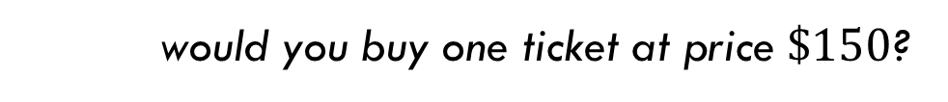
What is Microeconomics?
Microeconomics seeks to understand “individual” behavior.
  Consumers. Purchasing decisions.
    would you buy one ticket at price $\$150$?

Slide 6
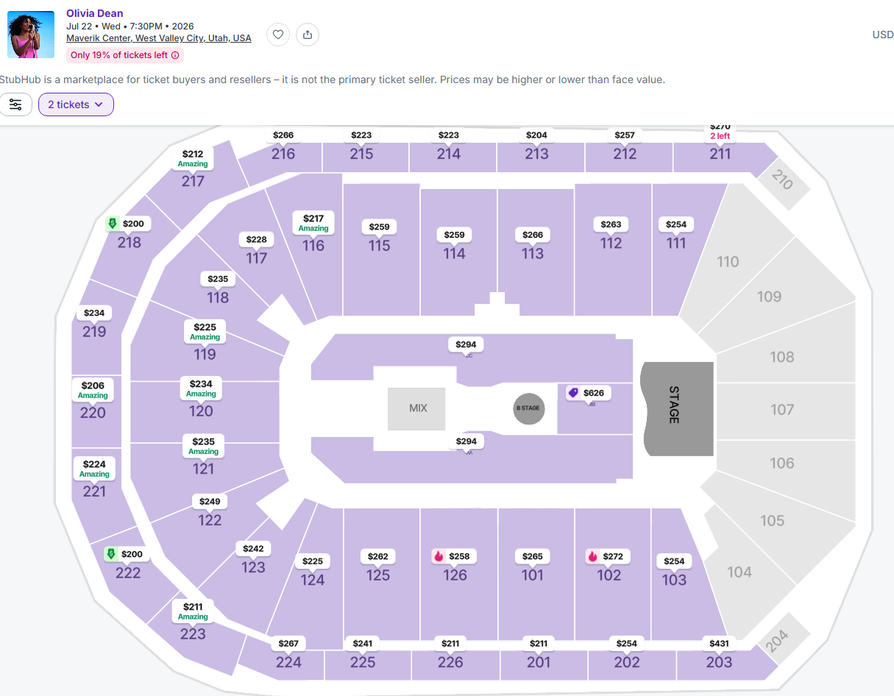
What is Microeconomics?

Slide 7

What is Microeconomics?
  Consumers. Purchasing decisions.
    would you buy one ticket at price $\$150$?

Slide 8
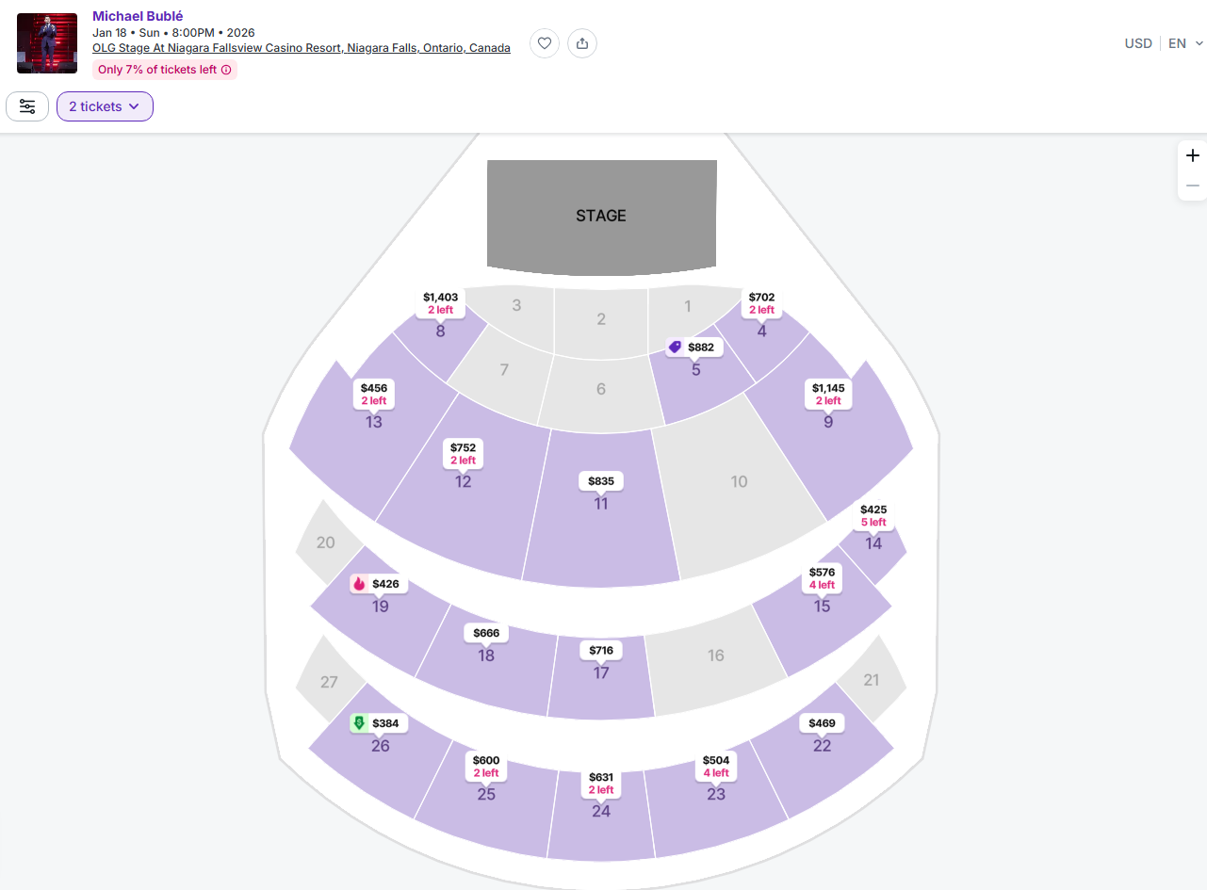
What is Microeconomics?

Slide 9


What is Microeconomics?
  Firms. Input decisions.
    How many workers to hire and computer to purchase?

Slide 10
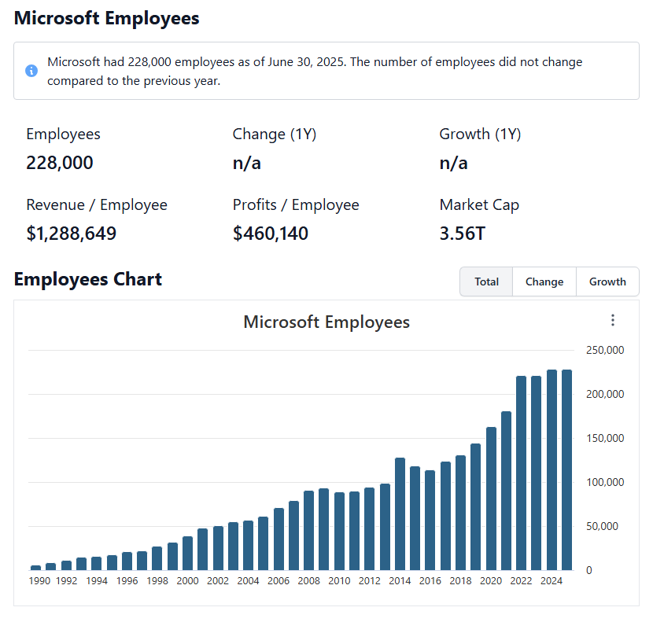

Slide 11
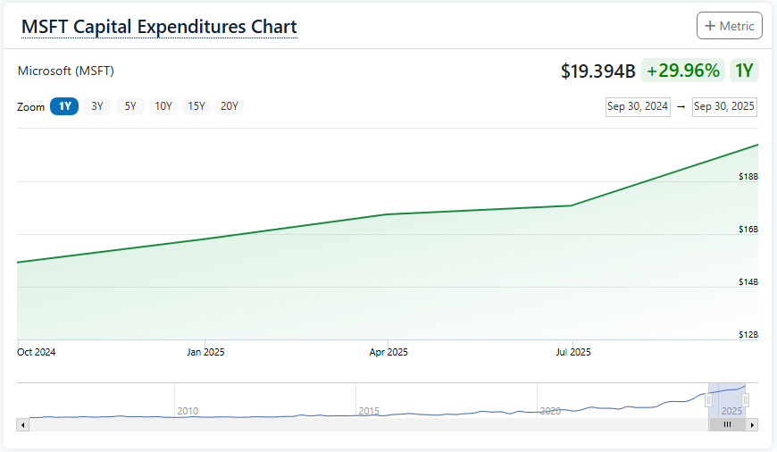

Slide 12
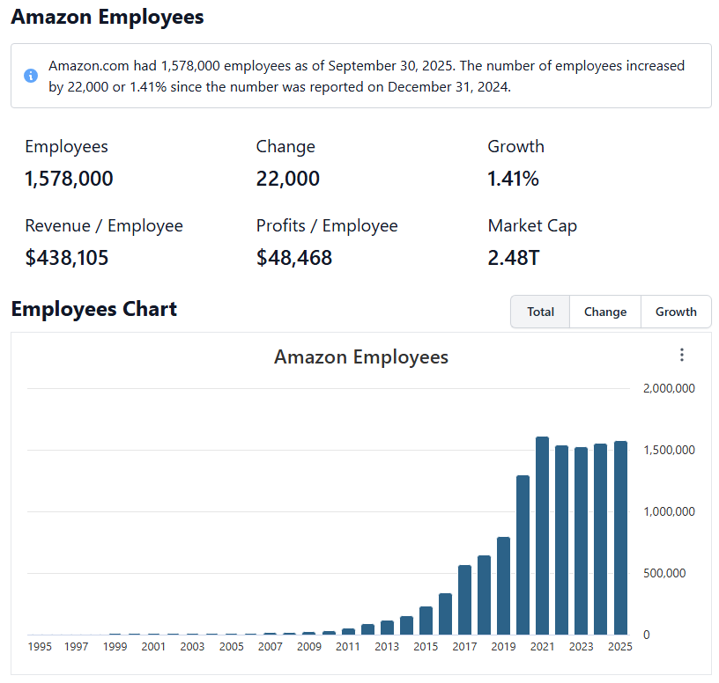

Slide 13
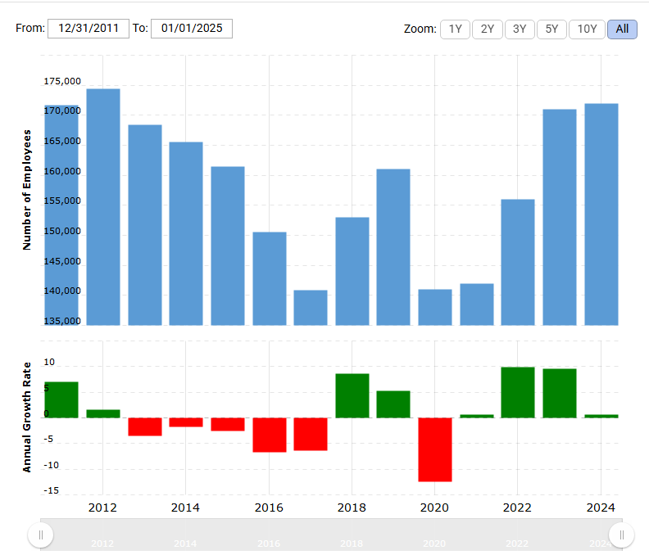
Boeing: Number of Employees 2010-2024

Slide 14


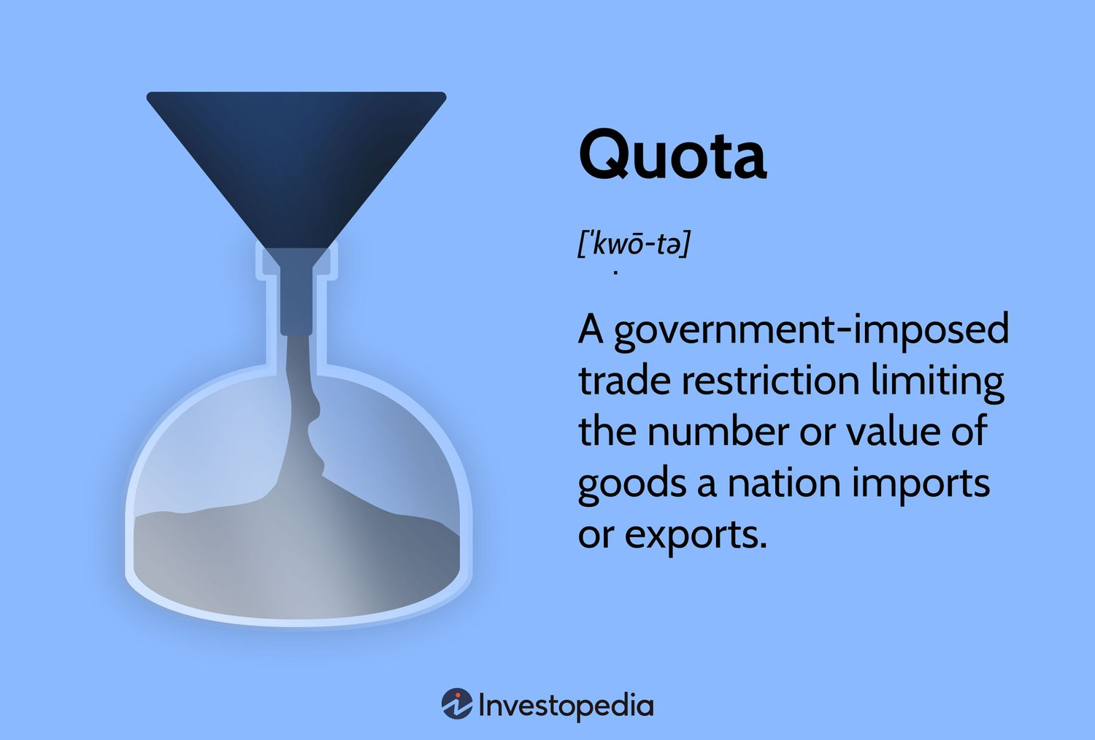
What is Microeconomics?
  Regulators. Public officials can anticipate how firms and consumers behave in different markets.
    Can some policy tools, such as taxes or quotas on consumers or firms, be beneficial?

Slide 15
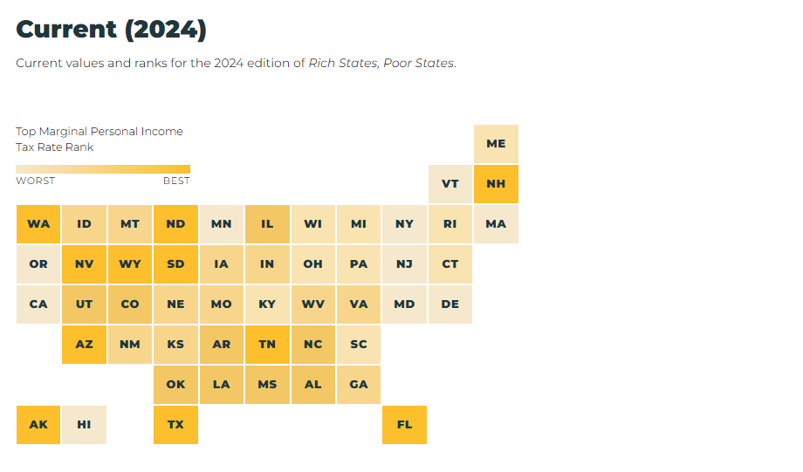
Current Economic Outlook Ranks (2024 Edition)

Slide 16
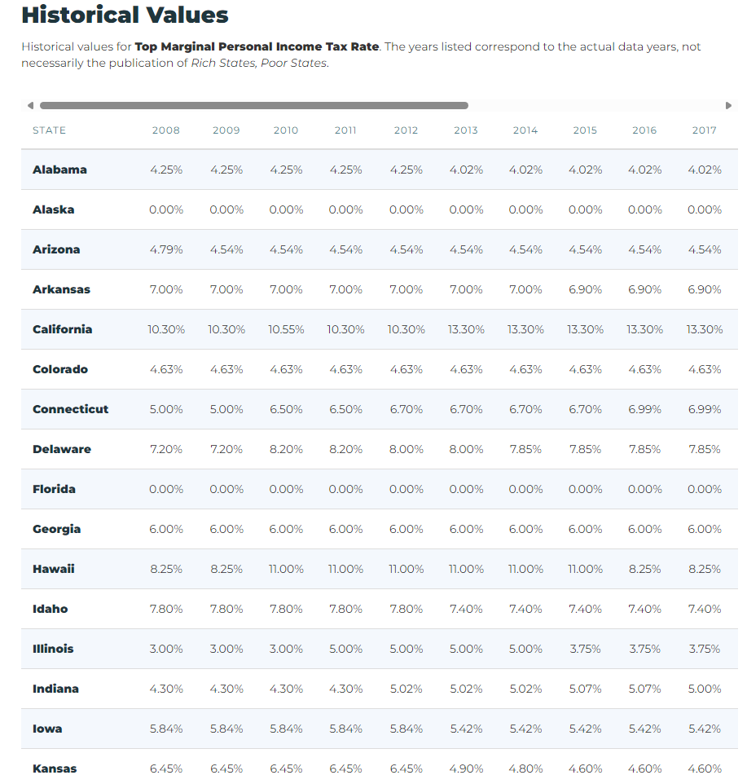
What is Microeconomics?

Slide 17
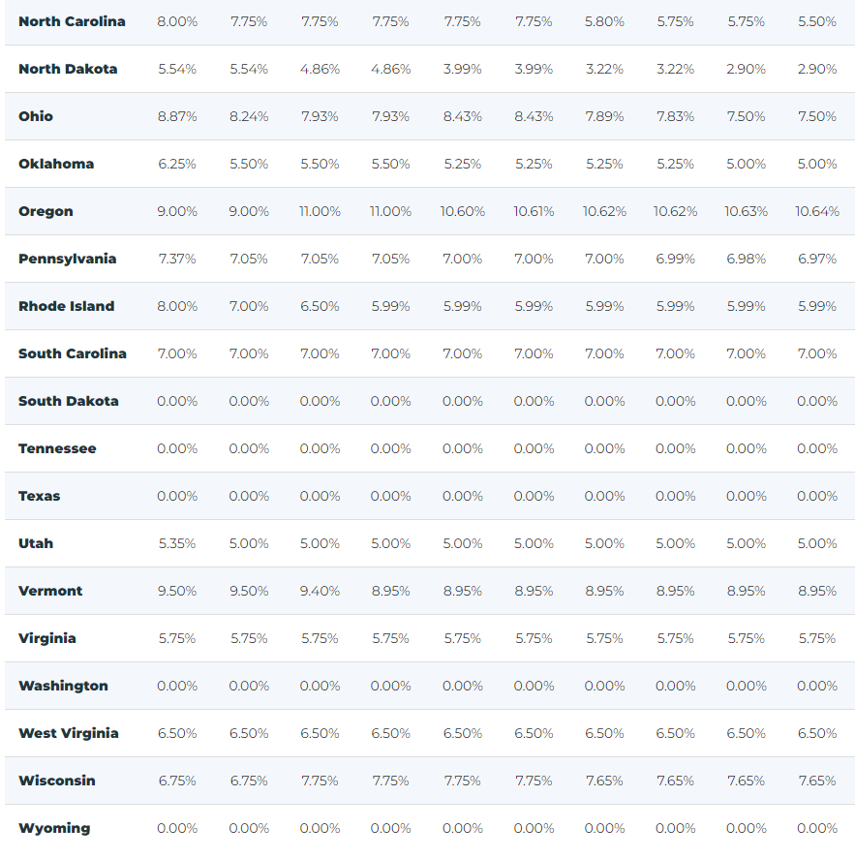

What is Microeconomics?

Slide 18

What is Microeconomics?
The behavior of economic agents is investigated under the assumption of rationality:
  Each agent seeks to maximize her payoff (i.e., utility of the consumer, or profits for the firm), given her resources, and the information to which she has access.

Slide 19


What is Microeconomics?
Two contexts:
  When she maximizes a combination of her own and other agents’ payoffs (allowing her to be selfish or altruistic).

Slide 20
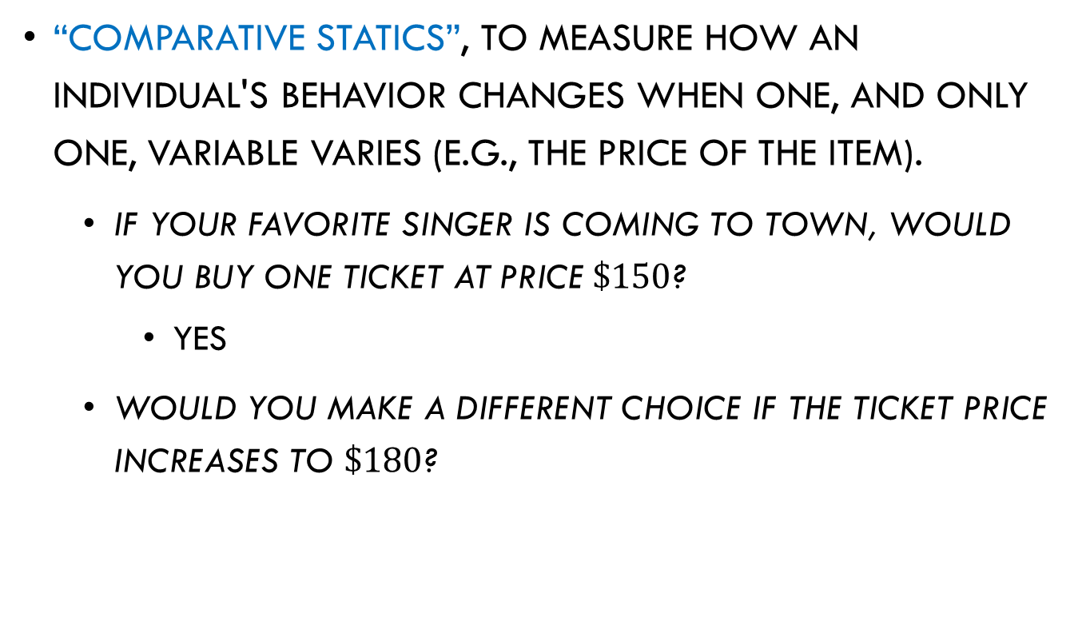
Comparative Statics
“Comparative statics”, to measure how an individual's behavior changes when one, and only one, variable varies (e.g., the price of the item).
  If your favorite singer is coming to town, would you buy one ticket at price$\$150$?
    Yes
  Would you make a different choice if the ticket price increases to $\$180$?

Slide 21
Overview
Consumer Theory
Chapter 2: A model to represent a consumer.
    Notion of consumption bundle (i.e., a list of goods and services).
    How a consumer’s preferences rank different bundles.
    How to represent these preferences in a utility function, measuring the consumer’s well-being from each bundle.
    Properties that utility functions can satisfy.

Slide 22
Overview
Consumer Theory
Chapter 3: The consumer’s optimal purchasing decision.
    Budget constraints, which are dictated by good prices and available income.
    Consumer’s purchasing decision (“demand” for a good):
      Buy the bundle that increases my utility as much as possible but … without breaking the bank!

Slide 23
Overview
Consumer Theory
Chapter 4: Changes in a consumer’s demand for a good.
    When her income increases by a small amount.
      After winning the lotto, you may increase purchases for most goods (e.g., a nicer car), and yet may decrease purchases of some goods (e.g., fast food).
    When the price of the good experiences a small increase.

Slide 24
Overview
Consumer Theory
  Chapter 5: Welfare loss due to a price increase.
    Three measures to evaluate this welfare loss:
      Change in consumer surplus.
      Compensating variation.
      Equivalent variation.
    Similarities and differences, and applications to different contexts.

Slide 25
Overview
Production Theory
  Chapter 7: The firm’s optimal production decision.
    Use of inputs (how many workers to hire or machines to purchase).
    Technological constraints, indicating the output levels the firm can produce given its technology.

Slide 26
Overview
Production Theory
  Chapter 8: The firm’s costs from its output decision.
    Units of each input that the firm hires.
    Average cost (i.e., cost per unit of output).
    Marginal cost (i.e., increase in cost when the firm increases its output by one unit).
    How the firm’s average cost is affected when:
      Its scale expands (economies of scale).
      It offers more product lines (economies of scope).

Slide 27
Overview
Markets
Chapter 9: Perfectly competitive market.
    Many firms, each producing a small share of industry output.
    Firms are “price takers.” When choosing to produce a larger output, every firm can anticipate that this decision will not affect market prices.

Slide 28
Overview
Markets
  Chapter 10: Monopoly.
    A single firm operates choosing the optimal output to maximize profits.
    The monopolist is a “price setter.” His output decision uniquely determines market price.
    Multiplant monopolies, a firm is the only seller of a product, which is made at two or more plants.
    Welfare loss under a monopolized industry.

Slide 29
Overview
Strategy–Let’s Play Games
Chapter 12-13: Game Theory.
    The branch of economics studying strategic behavior.
    Interactions among “players” (firms, consumers, or governments), when the action of one player affects the payoffs of other players.
    Games in which all players (e.g., firms) choose their actions (e.g., output levels) simultaneously (chapter 12).
    Games in which player act sequentially (chapter 13).
    “Equilibrium behavior” (how player behave) in each game.

Slide 30
Overview
Putting Game Theory to Work
  Chapter 14: Imperfectly competitive markets.
    Application of game theory tools to industries with a limited number of firms.
    Markets in which firms simultaneously choose their actions, either competing in price or quantity.
    Industries where firms act sequentially.
    Settings where firms sell products that consumers regards as close (but not perfect) substitutes.

Slide 31
Overview
Market Failures–When Markets Work Well and When They Don’t
  Chapter 17: Externalities and public goods.
    Situations where actions of one agent produce external effects on another agent’s well-being.
    Sustainability issues in common-pool resources (e.g., fishing ground).
      In the short-run, when agents ignore the long-term effects, they may exploit the resource intensively.
      When considering long-run effects, their optimal behavior dictates a less intense exploitation.

