Slide 1
EconS 301: Intermediate Microeconomic
Theory
Consumer Choice

Slide 2
Outline
Budget Constraint
Utility Maximization Problem (UPM)
Utility Maximization Problem in Extreme Scenarios
Revealed Preference
Kinked Budget Lines
Appendix A. Lagrange Method to Solve the UPM
Appendix B. Expenditure Minimization Problem

Slide 3
Budget Constraint

Slide 4
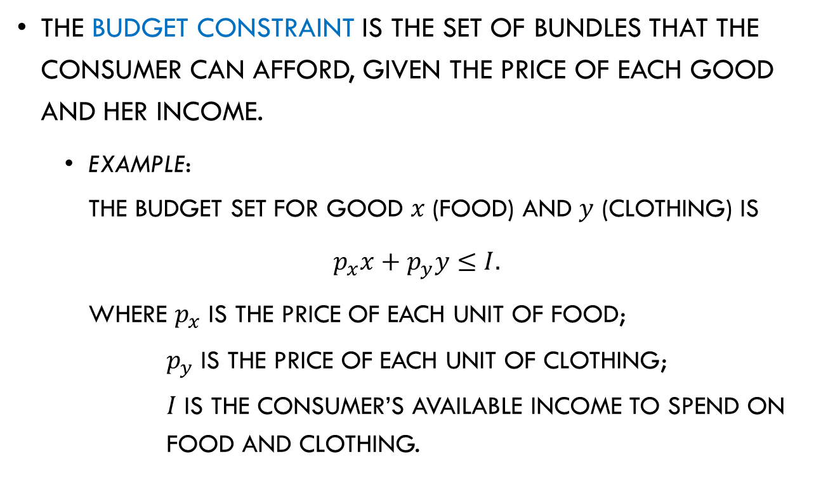
Budget Constraint
The budget constraint is the set of bundles that the consumer can afford, given the price of each good and her income.
  Example:
  The budget set for good $x$ (food) and $y$ (clothing) is
  $$p_{x}x+p_{y}y≤I.$$
  where $p_{x}$ is the price of each unit of food;
  $p_{y}$ is the price of each unit of clothing;
  $I$ is the consumer’s available income to spend on food and clothing.

Slide 5
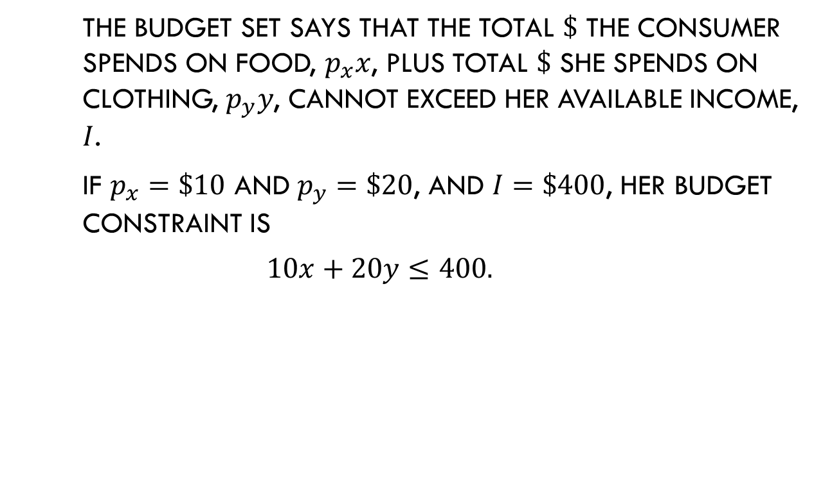
Budget Constraint
  The budget set says that the total $\$$ the consumer spends on food, $p_{x}x$, plus total $\$$ she spends on clothing, $p_{y}y$, cannot exceed her available income, $I$.
  If $p_{x}=\$10$ and $p_{y}=\$20$, and $I=\$400$, her budget constraint is
  $$10x+20y≤400.$$

Slide 6
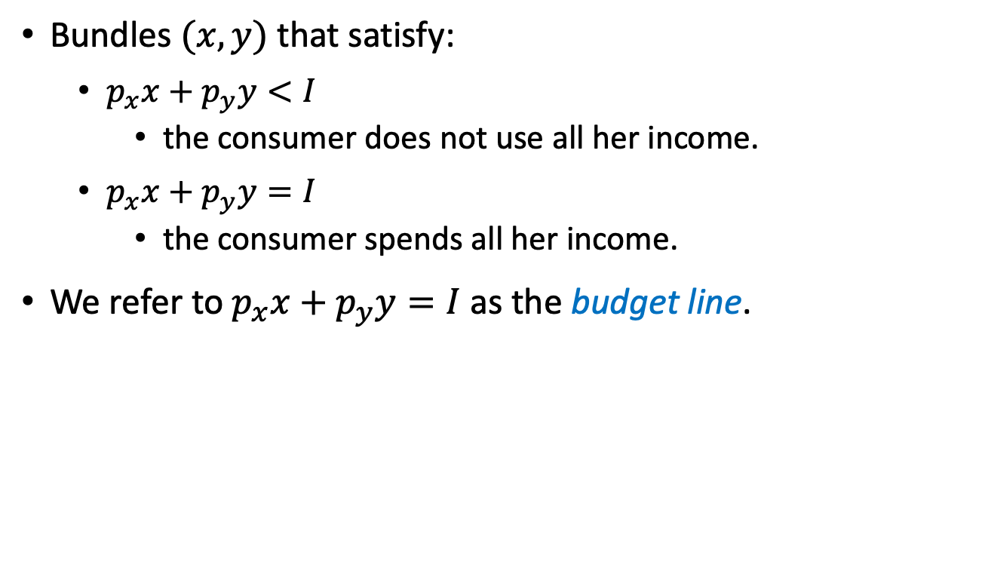
Budget Constraint
Bundles $(x,y)$ that satisfy:
  $p_{x}x+p_{y}y<I$
    the consumer does not use all her income.
  $p_{x}x+p_{y}y=I$
    the consumer spends all her income.
We refer to $p_{x}x+p_{y}y=I$ as the budget line.

Slide 7
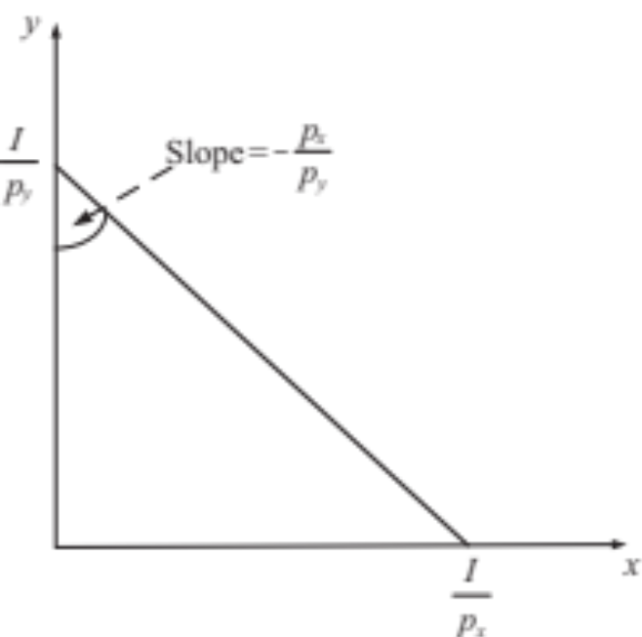
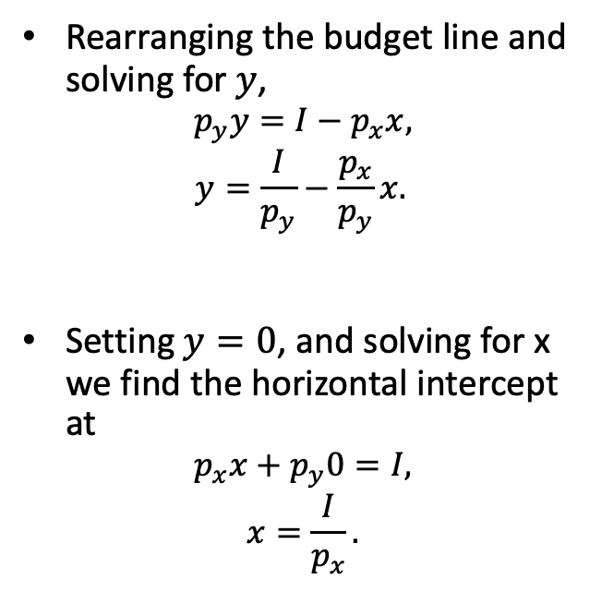
Budget Constraint
    Rearranging the budget line and solving for$y$,
    $$p_{y}y=I−p_{x}x,$$
    $$y=\frac{I}{p_{y}}−\frac{p_{x}}{p_{y}}x.$$
    Setting $y=0$, and solving for x we find the horizontal intercept at
    $$p_{x}x+p_{y}0=I,$$
    $$x=\frac{I}{p_{x}}.$$
Vertical intercept
Slope
Figure 3.1

Slide 8
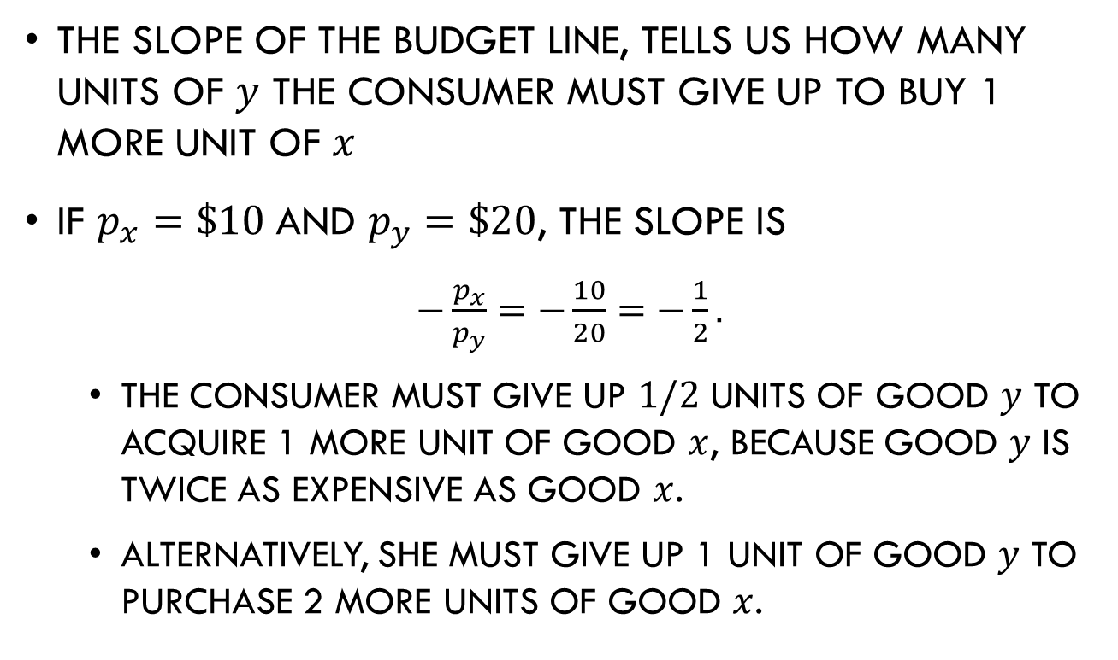
Budget Constraint
The slope of the budget line, tells us how many units of $y$ the consumer must give up to buy 1 more unit of $x$
If $p_{x}=\$10$ and $p_{y}=\$20$, the slope is
$−\frac{p_{x}}{p_{y}}=−\frac{10}{20}=−\frac{1}{2}.$
  The consumer must give up $1/2$ units of good $y$ to acquire 1 more unit of good $x$, because good $y$ is twice as expensive as good $x$.
  Alternatively, she must give up 1 unit of good $y$ to purchase 2 more units of good $x$.

Slide 9
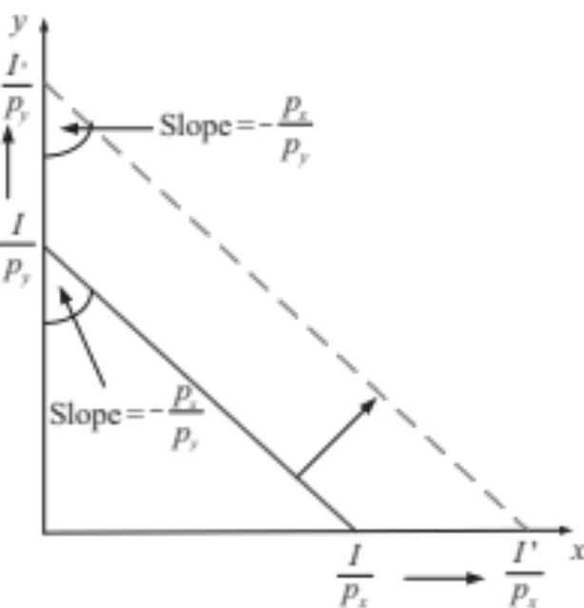
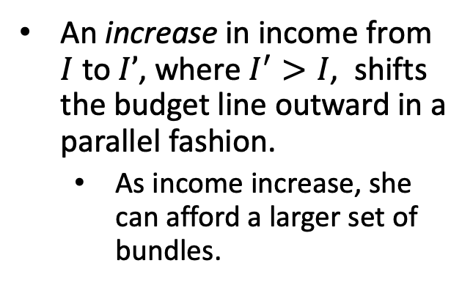
Budget Constraint
Changes in income:
An increase in income from $I$ to $I’$, where $I^{′}>I$, shifts the budget line outward in a parallel fashion.
  As income increase, she can afford a larger set of bundles.
Figure 3.2

Slide 10
Budget Constraint
Changes in income (cont.):
A decrease in income produces the opposite, a shifting inward in a parallel fashion.
Figure 3.2

Slide 11
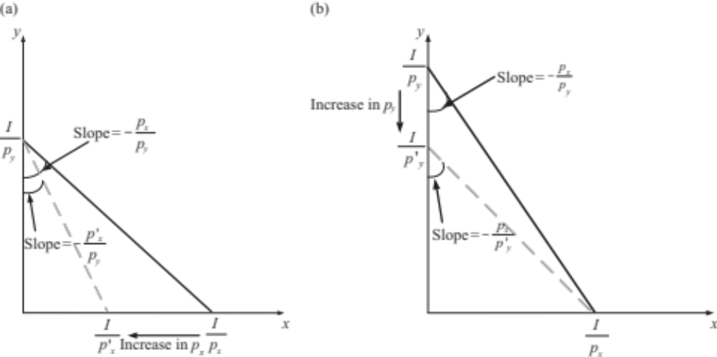
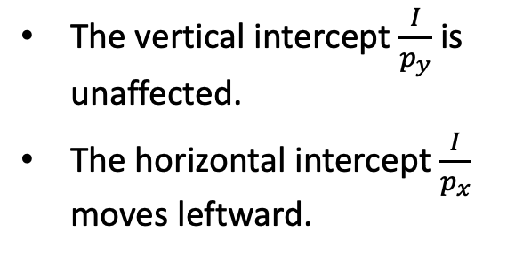
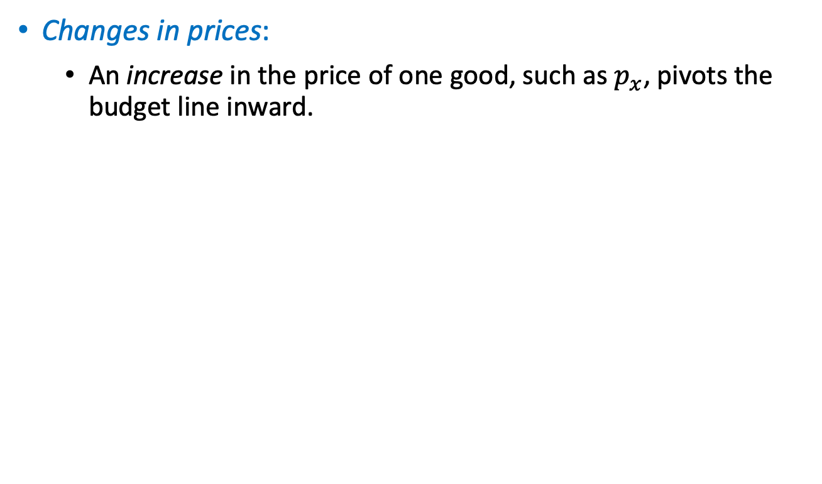
Budget Constraint
.
Changes in prices:
  An increase in the price of one good, such as $p_{x}$, pivots the budget line inward.
The vertical intercept $\frac{I}{p_{y}}$ is unaffected.
The horizontal intercept $\frac{I}{p_{x}}$ moves leftward.
Figure 3.3a

Slide 12
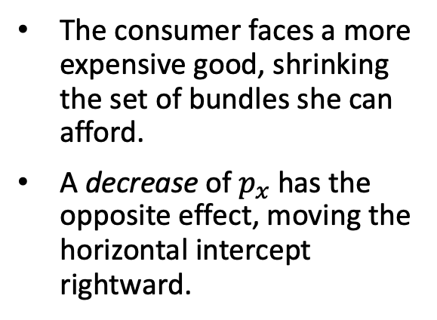
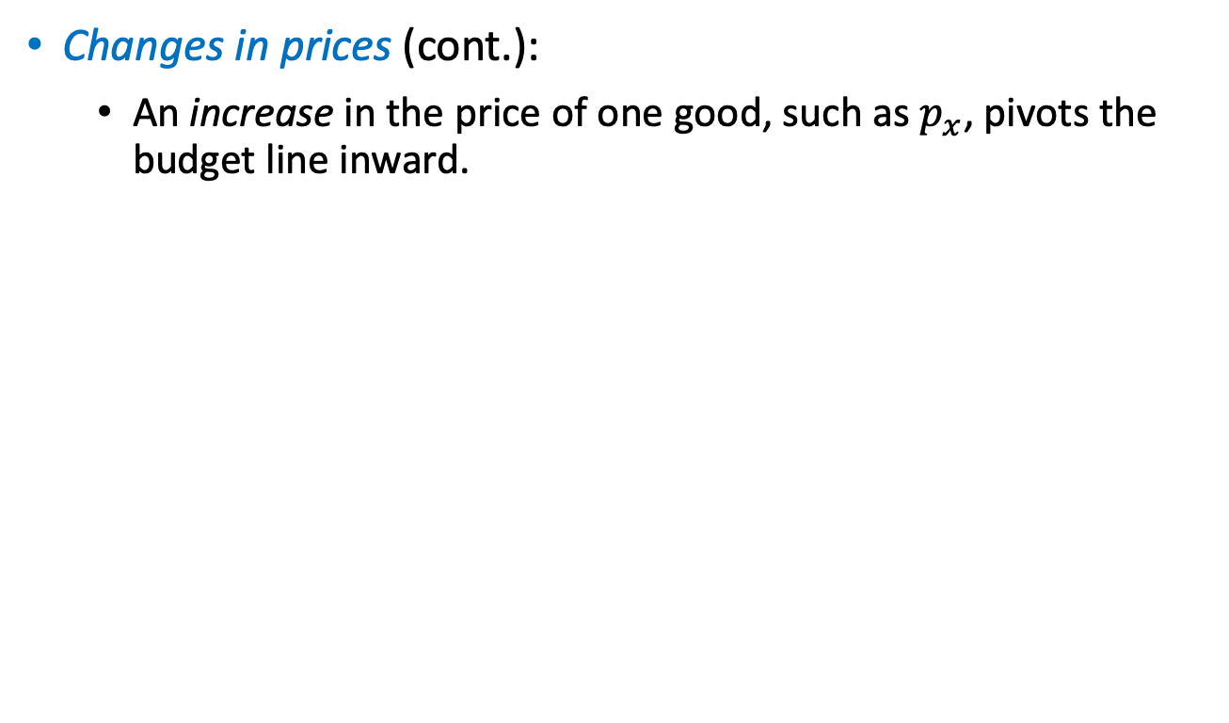
Budget Constraint
.
Changes in prices (cont.):
  An increase in the price of one good, such as $p_{x}$, pivots the budget line inward.
The consumer faces a more expensive good, shrinking the set of bundles she can afford.
A decrease of $p_{x}$ has the opposite effect, moving the horizontal intercept rightward.
Figure 3.3a

Slide 13
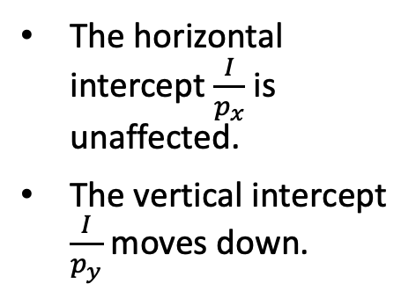

Budget Constraint
Changes in prices (cont.):
  A similar argument applies if the price of good $y$, $p_{y}$, increases.
The horizontal intercept $\frac{I}{p_{x}}$ is unaffected.
The vertical intercept $\frac{I}{p_{y}}$ moves down.
Figure 3.3b

Slide 14
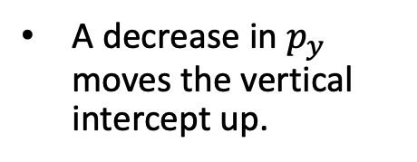
Budget Constraint
Changes in prices (cont.):
  A similar argument applies if the price of good $y$, $p_{y}$, increases.
A decrease in $p_{y}$ moves the vertical intercept up.
Figure 3.3b

Slide 15
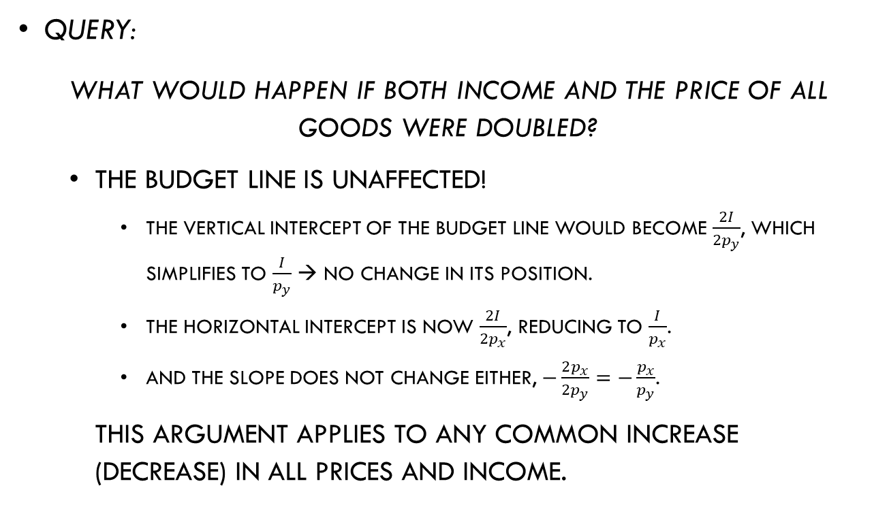
Budget Constraint
Query:
What would happen if both income and the price of all goods were doubled?
  The budget line is unaffected!
    The vertical intercept of the budget line would become $\frac{2I}{2p_{y}}$, which simplifies to $\frac{I}{p_{y}}$ → no change in its position.
    The horizontal intercept is now $\frac{2I}{2p_{x}}$, reducing to $\frac{I}{p_{x}}$.
    And the slope does not change either, $−\frac{2p_{x}}{2p_{y}}=−\frac{p_{x}}{p_{y}}$.
    This argument applies to any common increase (decrease) in all prices and income.

Slide 16
Utility Maximization Problem

Slide 17
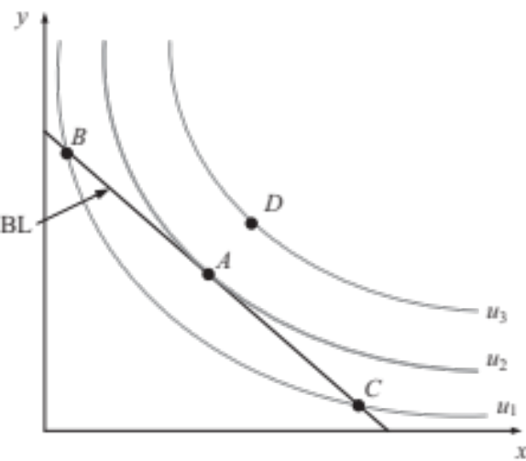
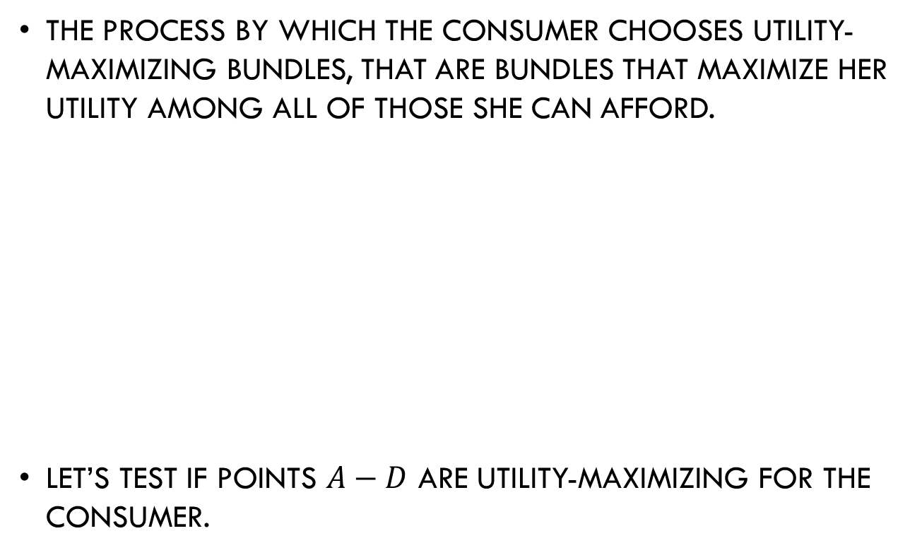
Utility Maximization Problem
The process by which the consumer chooses utility-maximizing bundles, that are bundles that maximize her utility among all of those she can afford.
Let’s test if points $A−D$ are utility-maximizing for the consumer.
Figure 3.4

Slide 18

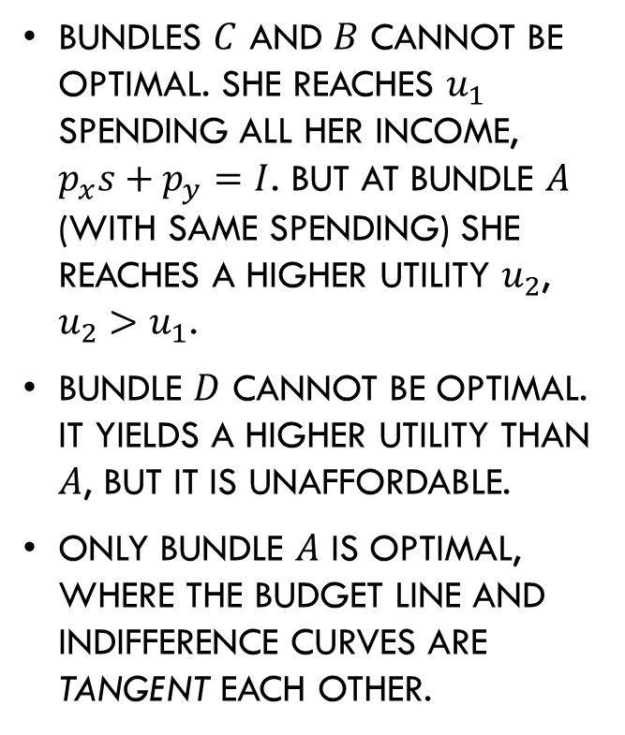
Utility Maximization Problem
Bundles $C$ and $B$ cannot be optimal. She reaches $u_{1}$ spending all her income, $p_{x}s+p_{y}=I$. But at bundle $A$ (with same spending) she reaches a higher utility $u_{2}$, $u_{2}>u_{1}$.
Bundle $D$ cannot be optimal. It yields a higher utility than $A$, but it is unaffordable.
Only bundle $A$ is optimal, where the budget line and indifference curves are tangent each other.
Figure 3.4

Slide 19
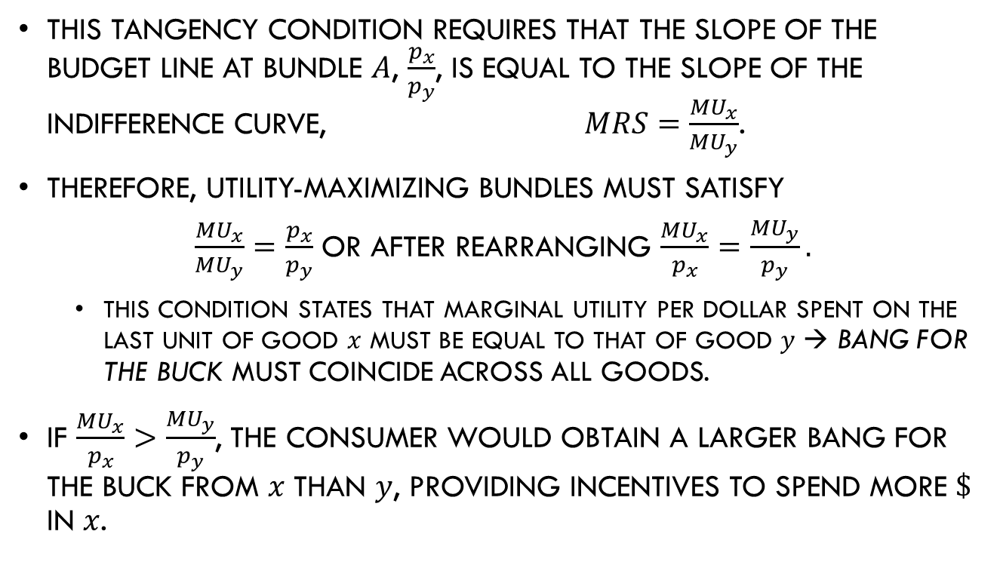
Utility Maximization Problem
This tangency condition requires that the slope of the budget line at bundle $A$, $\frac{p_{x}}{p_{y}}$, is equal to the slope of the indifference curve, $MRS=\frac{{MU}_{x}}{{MU}_{y}}$.
Therefore, utility-maximizing bundles must satisfy
$\frac{{MU}_{x}}{{MU}_{y}}=\frac{p_{x}}{p_{y}}$ or after rearranging $\frac{{MU}_{x}}{p_{x}}=\frac{{MU}_{y}}{p_{y}}.$
  This condition states that marginal utility per dollar spent on the last unit of good $x$ must be equal to that of good $y$ → bang for the buck must coincide across all goods.
If $\frac{{MU}_{x}}{p_{x}}>\frac{{MU}_{y}}{p_{y}}$, the consumer would obtain a larger bang for the buck from $x$ than $y$, providing incentives to spend more $\$$ in $x$.

Slide 20
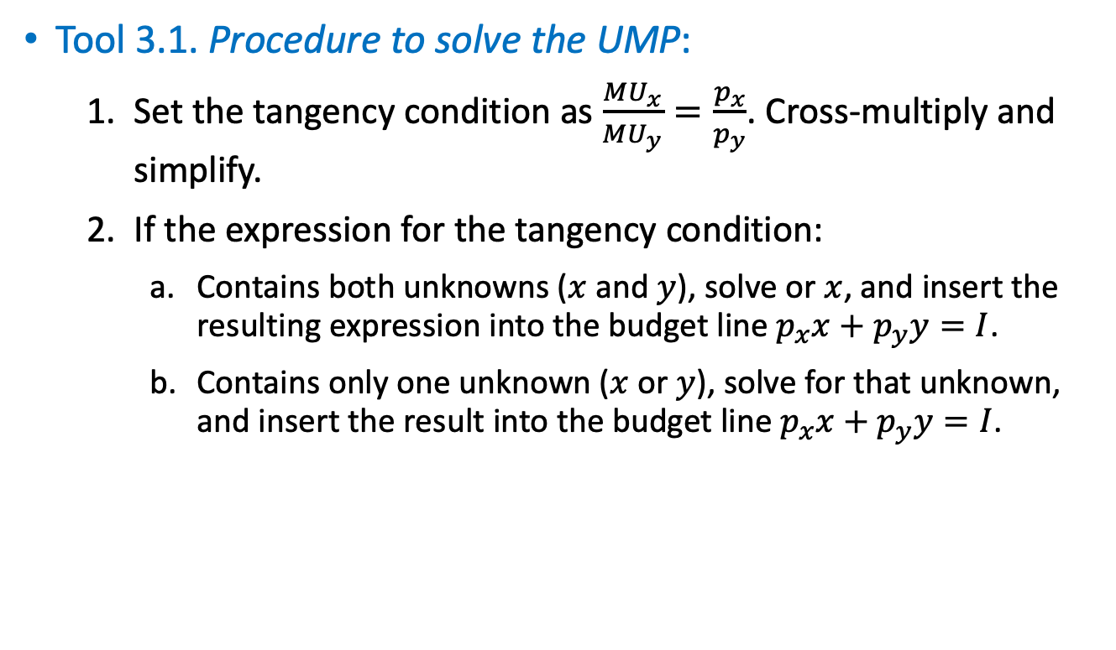
Utility Maximization Problem
Tool 3.1. Procedure to solve the UMP:
  Set the tangency condition as $\frac{{MU}_{x}}{{MU}_{y}}=\frac{p_{x}}{p_{y}}$. Cross-multiply and simplify.
  If the expression for the tangency condition:
    Contains both unknowns ($x$ and $y$), solve or $x$, and insert the resulting expression into the budget line $p_{x}x+p_{y}y=I$.
    Contains only one unknown ($x$ or $y$), solve for that unknown, and insert the result into the budget line $p_{x}x+p_{y}y=I$.

Slide 21
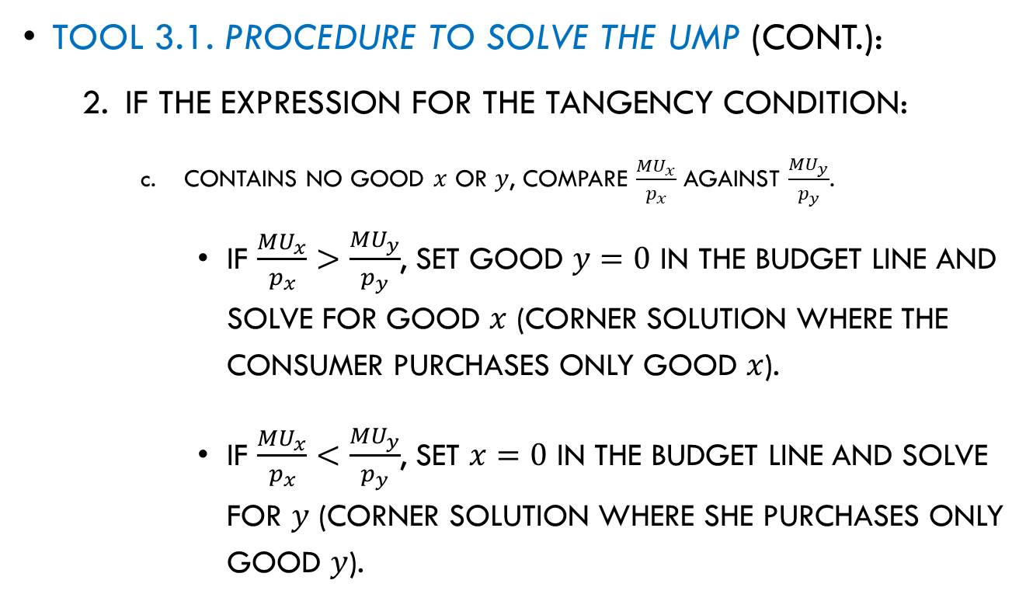
Utility Maximization Problem
Tool 3.1. Procedure to solve the UMP (cont.):
  If the expression for the tangency condition:
    Contains no good $x$ or $y$, compare $\frac{{MU}_{x}}{p_{x}}$ against $\frac{{MU}_{y}}{p_{y}}$.
      If $\frac{{MU}_{x}}{p_{x}}>\frac{{MU}_{y}}{p_{y}}$, set good $y=0$ in the budget line and solve for good $x$ (corner solution where the consumer purchases only good $x$).
      If $\frac{{MU}_{x}}{p_{x}}<\frac{{MU}_{y}}{p_{y}}$, set $x=0$ in the budget line and solve for $y$ (corner solution where she purchases only good $y$).

Slide 22
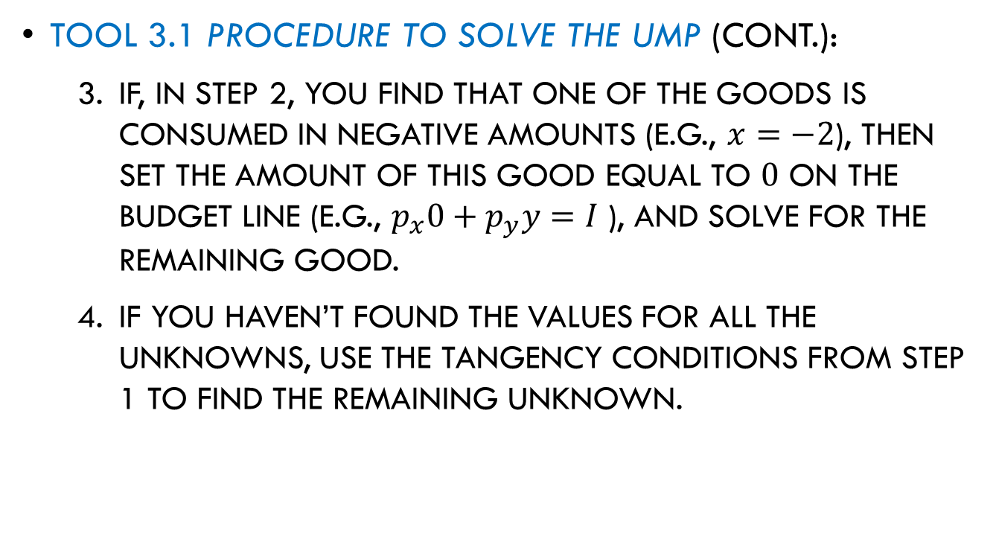
Utility Maximization Problem
Tool 3.1 Procedure to solve the UMP (cont.):
  If, in step 2, you find that one of the goods is consumed in negative amounts (e.g., $x=−2$), then set the amount of this good equal to $0$ on the budget line (e.g., $p_{x}0+p_{y}y=I$ ), and solve for the remaining good.
  If you haven’t found the values for all the unknowns, use the tangency conditions from step 1 to find the remaining unknown.

Slide 23
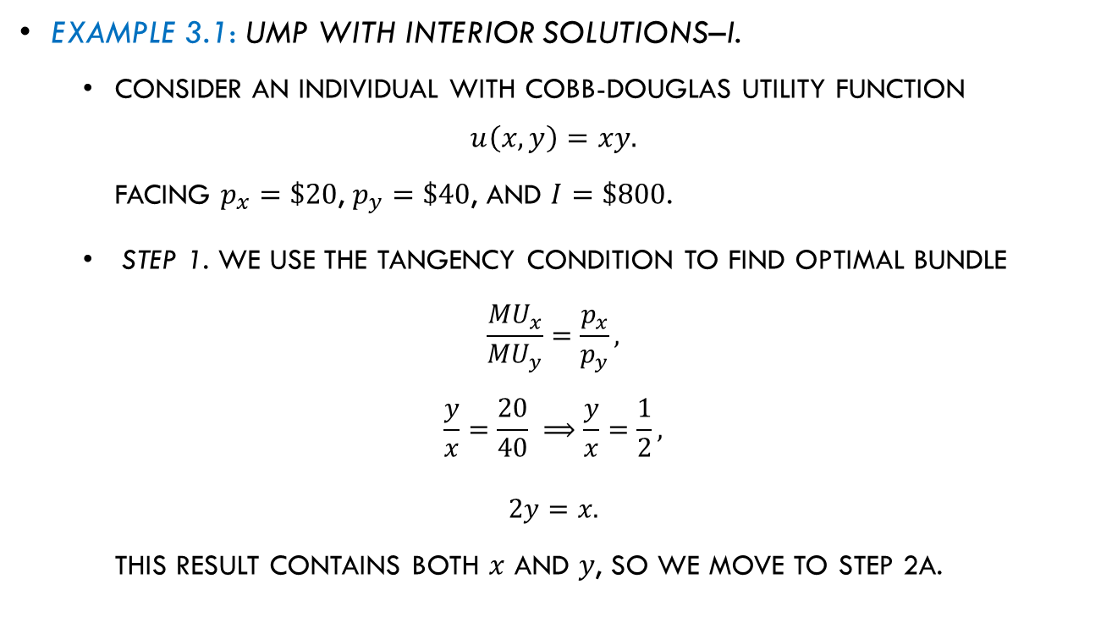
Utility Maximization Problem
Example 3.1: UMP with interior solutions–I.
  Consider an individual with Cobb-Douglas utility function
  $$u\left(x,y\right)=xy.$$
  facing $p_{x}=\$20$, $p_{y}=\$40$, and $I=\$800$.
Step 1. We use the tangency condition to find optimal bundle
$$\frac{{MU}_{x}}{{MU}_{y}}=\frac{p_{x}}{p_{y}},$$
$$\frac{y}{x}=\frac{20}{40} ⟹\frac{y}{x}=\frac{1}{2},$$
$$2y=x.$$
This result contains both $x$ and $y$, so we move to step 2a.

Slide 24

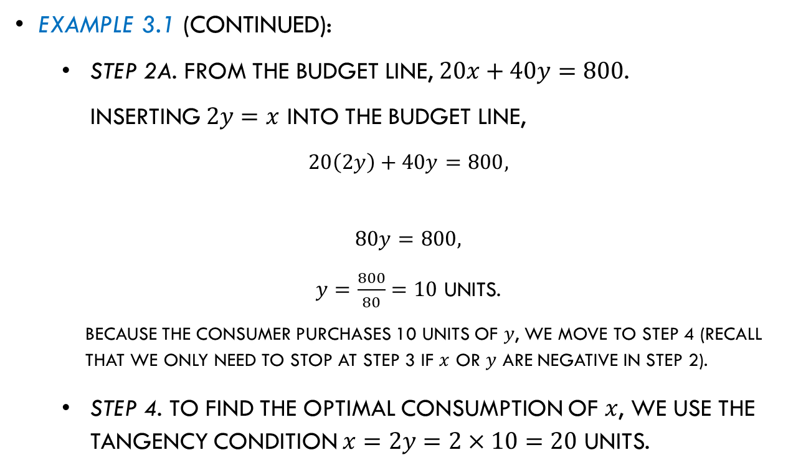
Utility Maximization Problem
Example 3.1 (continued):
Step 2a. From the budget line, $20x+40y=800$.
Inserting $2y=x$ into the budget line,
$$20\left(2y\right)+40y=800,$$
$$80y=800,$$
$y=\frac{800}{80}=10$ units.
Because the consumer purchases 10 units of $y$, we move to step 4 (recall that we only need to stop at step 3 if $x$ or $y$ are negative in step 2).
Step 4. To find the optimal consumption of $x$, we use the tangency condition $x=2y=2×10=20$ units.
$$x$$

Slide 25
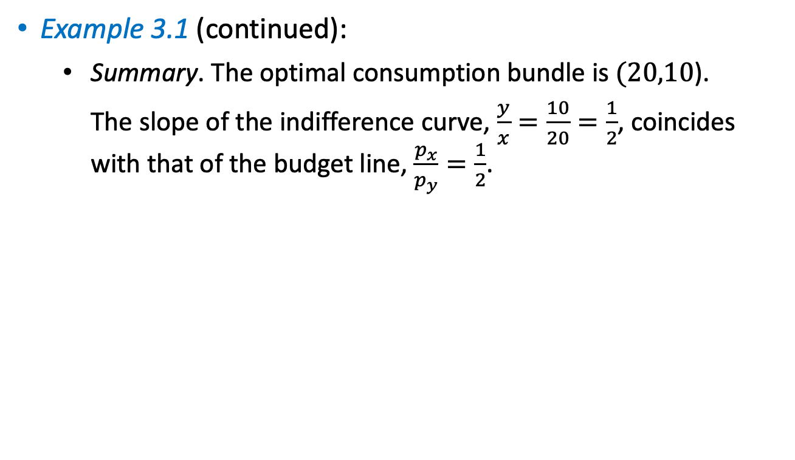
Utility Maximization Problem
Example 3.1 (continued):
Summary. The optimal consumption bundle is $(20,10$).
The slope of the indifference curve, $\frac{y}{x}=\frac{10}{20}=\frac{1}{2}$, coincides with that of the budget line, $\frac{p_{x}}{p_{y}}=\frac{1}{2}$.

Slide 26
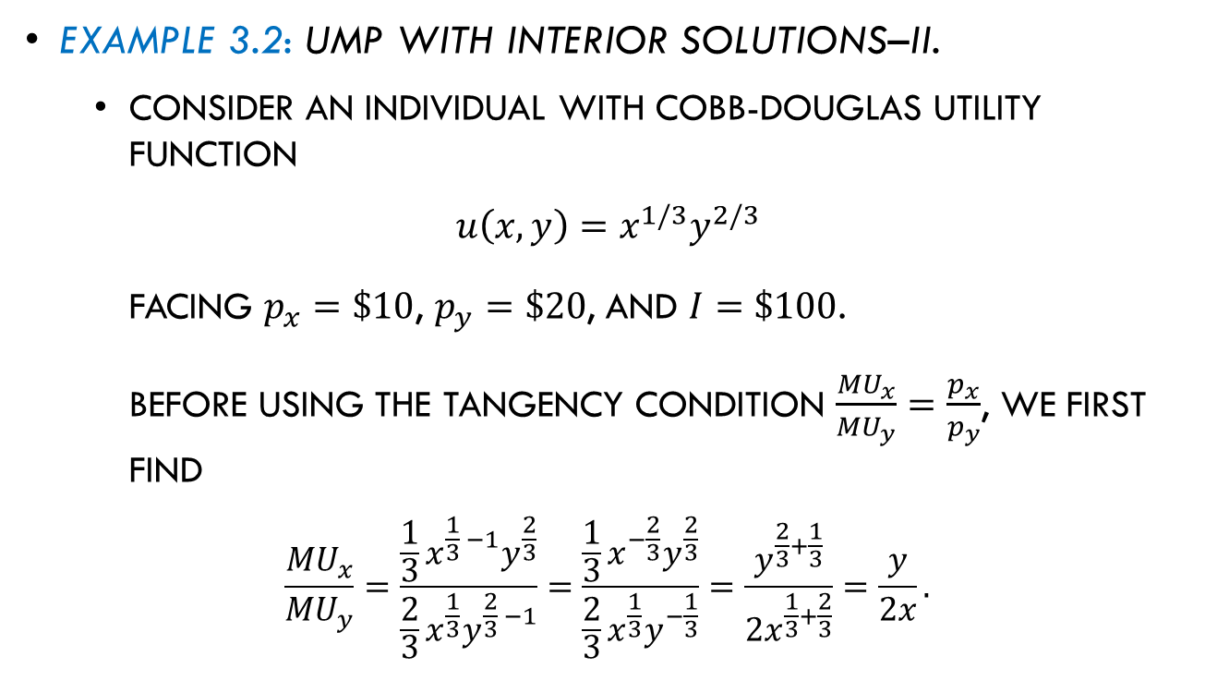
Utility Maximization Problem
Example 3.2: UMP with interior solutions–II.
  Consider an individual with Cobb-Douglas utility function
  $$u\left(x,y\right)=x^{1/3}y^{2/3}$$
  facing $p_{x}=\$10$, $p_{y}=\$20$, and $I=\$100$.
  Before using the tangency condition $\frac{{MU}_{x}}{{MU}_{y}}=\frac{p_{x}}{p_{y}}$, we first find
  $$\frac{{MU}_{x}}{{MU}_{y}}=\frac{{\frac{1}{3}x}^{\frac{1}{3} −1}y^{\frac{2}{3}}}{{\frac{2}{3}x}^{\frac{1}{3}}y^{\frac{2}{3} −1}}=\frac{{\frac{1}{3}x}^{−\frac{2}{3}}y^{\frac{2}{3}}}{{\frac{2}{3}x}^{\frac{1}{3}}y^{−\frac{1}{3}}}=\frac{y^{\frac{2}{3}+\frac{1}{3}}}{{2x}^{\frac{1}{3}+\frac{2}{3}}}=\frac{y}{2x}.$$

Slide 27
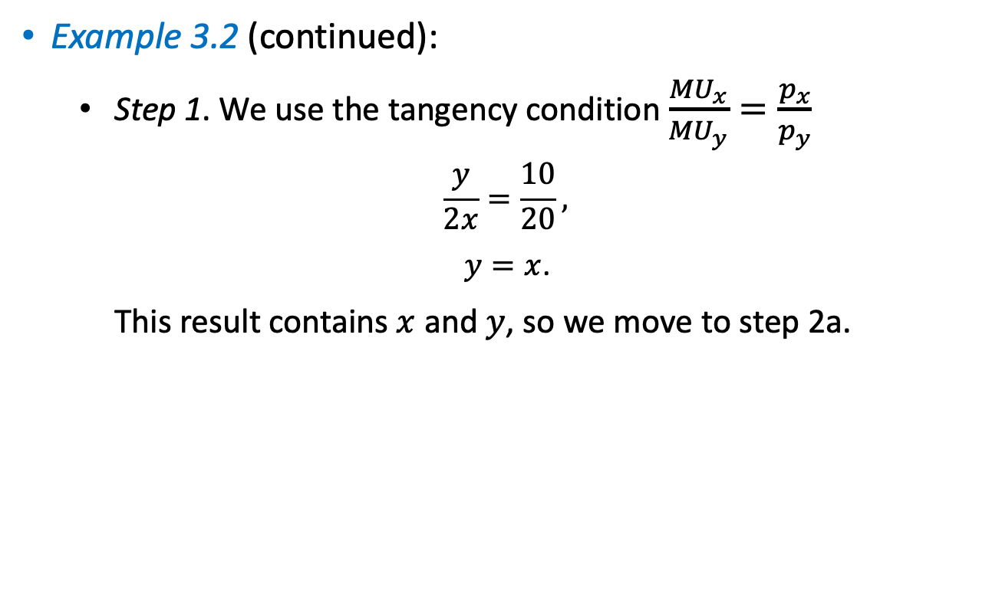
Utility Maximization Problem
Example 3.2 (continued):
  Step 1. We use the tangency condition $\frac{{MU}_{x}}{{MU}_{y}}=\frac{p_{x}}{p_{y}}$
  $$\frac{y}{2x}=\frac{10}{20},$$
  $y=x$.
  This result contains $x$ and $y$, so we move to step 2a.

Slide 28
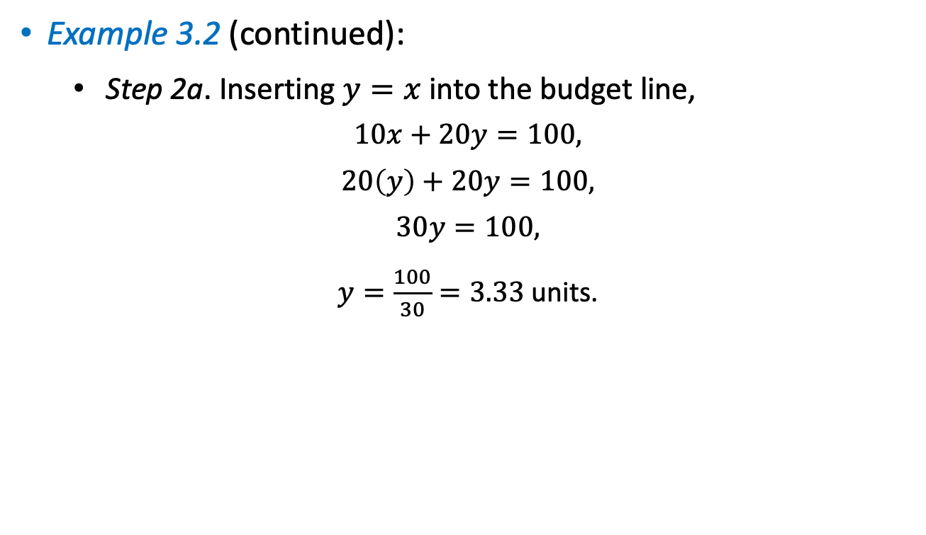
Utility Maximization Problem
Example 3.2 (continued):
Step 2a. Inserting $y=x$ into the budget line,
$$10x+20y=100,$$
$$20\left(y\right)+20y=100,$$
$$30y=100,$$
$y=\frac{100}{30}=3.33$ units.

Slide 29

Utility Maximization Problem
Example 3.2 (continued):
Step 4. The optimal consumption of $x$ can be found by using the tangency condition
$y=x=3.33$ units.
Summary. The optimal consumption bundle is $(3.33, 3.33)$.

Slide 30
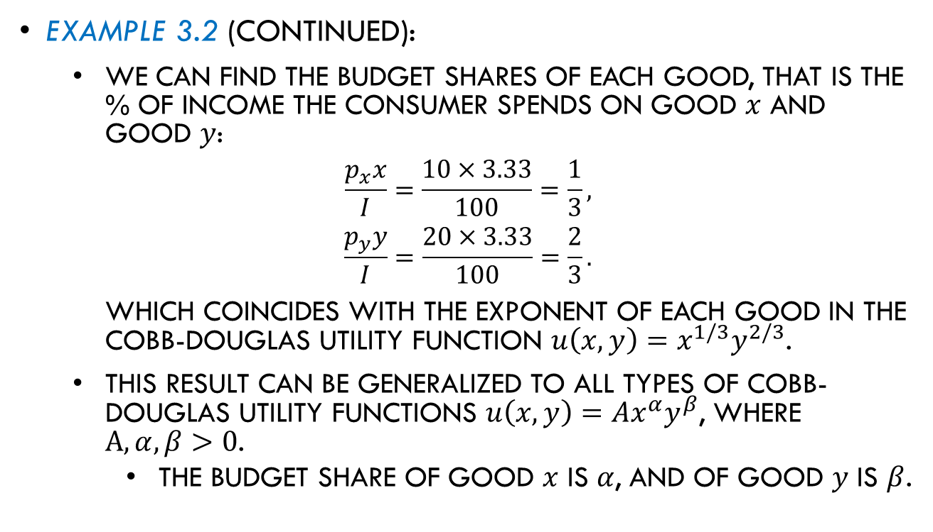
Utility Maximization Problem
Example 3.2 (continued):
We can find the budget shares of each good, that is the % of income the consumer spends on good $x$ and good $y$:
$$\frac{p_{x}x}{I}=\frac{10×3.33}{100}=\frac{1}{3},$$
$$\frac{p_{y}y}{I}=\frac{20×3.33}{100}=\frac{2}{3}.$$
which coincides with the exponent of each good in the Cobb-Douglas utility function $u\left(x,y\right)=x^{1/3}y^{2/3}$.
This result can be generalized to all types of Cobb-Douglas utility functions $u\left(x,y\right)={Ax}^{α}y^{β}$, where $A,α,β>0$.
  The budget share of good $x$ is $α$, and of good $y$ is $β$.

Slide 31
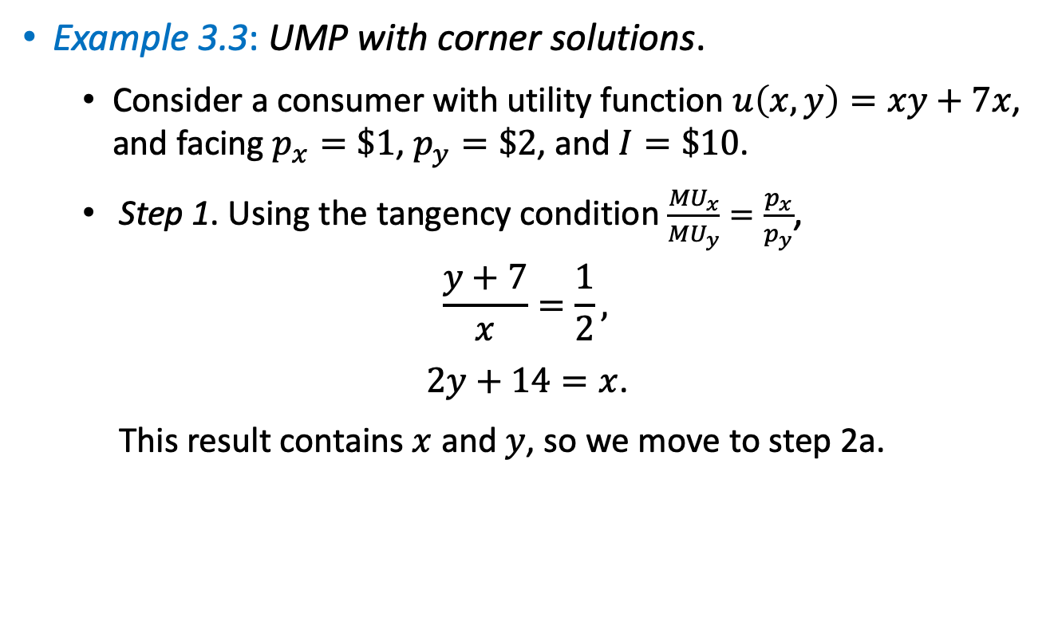
Utility Maximization Problem
Example 3.3: UMP with corner solutions.
  Consider a consumer with utility function $u\left(x,y\right)=xy+7x$, and facing $p_{x}=\$1$, $p_{y}=\$2$, and $I=\$10$.
  Step 1. Using the tangency condition $\frac{{MU}_{x}}{{MU}_{y}}=\frac{p_{x}}{p_{y}}$,
  $$\frac{y+7}{x}=\frac{1}{2},$$
  $2y+14=x$.
  This result contains $x$ and $y$, so we move to step 2a.

Slide 32


Utility Maximization Problem
Example 3.3 (continued):
  Step 2. Inserting $2y+14=x$ into the budget line
  $$x+2y=10,$$
  $$\left(2y+14\right)+2y=10,$$
  $$4y=−4,$$
  $$y=−1.$$
$$x$$

Slide 33

Utility Maximization Problem
Example 3.3 (continued):
Step 3. Because the amounts of $x$ and $y$ cannot be negative, the consumer would like to reduce her consumption of good $y$ as much as possible (i.e., $y=0$). Inserting this result into the budget line
$x+\left(2×0\right)=10$ → $x=10$ units.
Summary. We have found a corner solution, where the consumer uses all her income to purchase good alone.
Graphically, her optimal budget $(x,y)=(10,0)$ is located in the horizontal intercept of her budget line.

Slide 34
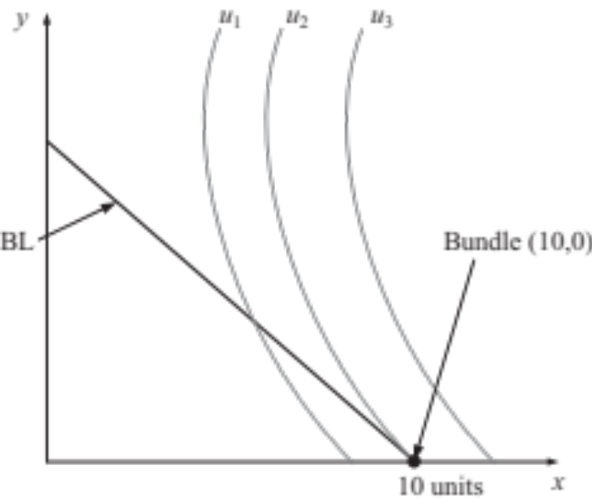
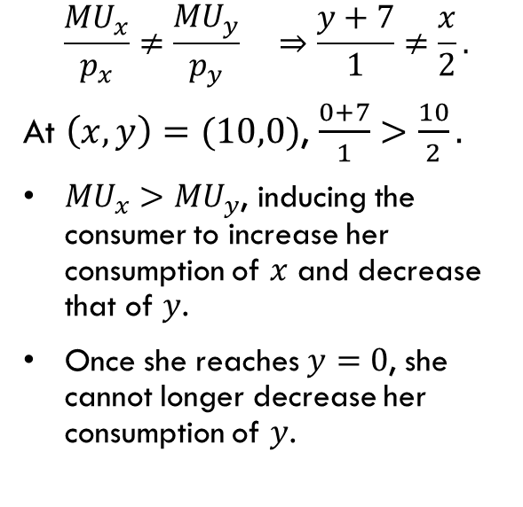
Utility Maximization Problem
Example 3.3 (continued):
At the corner solution, the tangency condition does not hold,
$$\frac{{MU}_{x}}{p_{x}}≠\frac{{MU}_{y}}{p_{y}} ⇒\frac{y+7}{1}≠\frac{x}{2}.$$
At $\left(x,y\right)=(10,0)$, $\frac{0+7}{1}>\frac{10}{2}.$
${MU}_{x}>{MU}_{y}$, inducing the consumer to increase her consumption of $x$ and decrease that of $y$.
Once she reaches $y=0$, she cannot longer decrease her consumption of $y$.
Figure 3.5

Slide 35
UMP in Extreme Scenarios

Slide 36
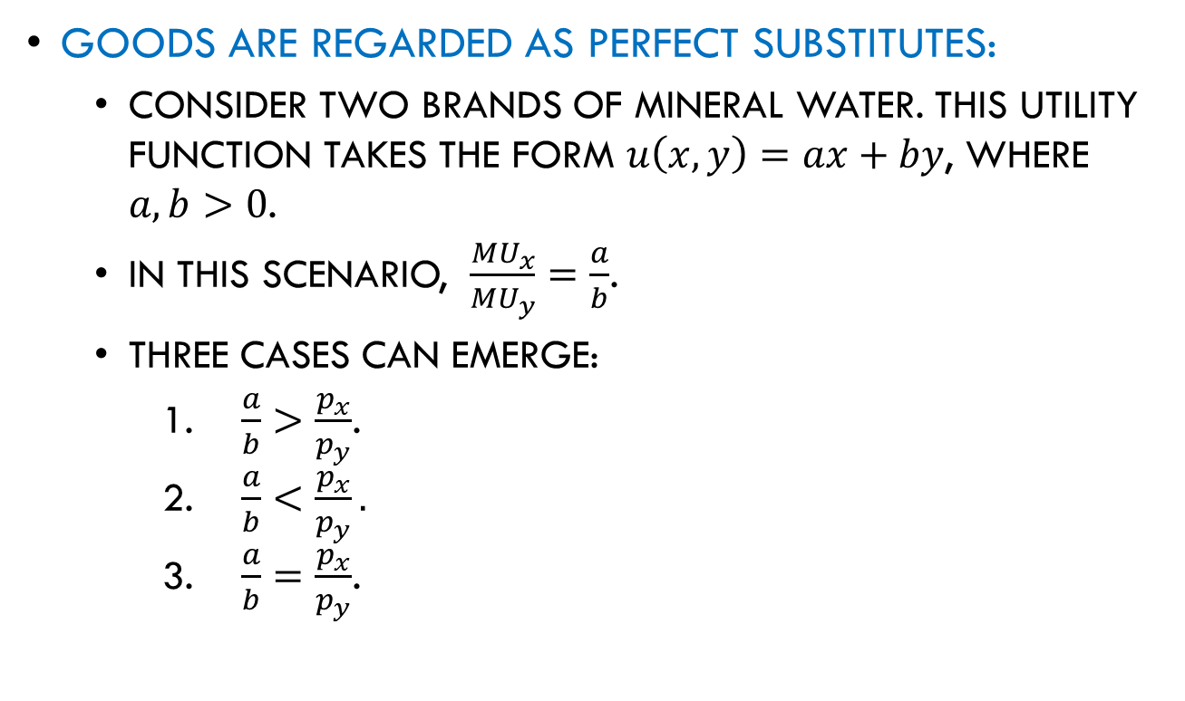
UMP in Extreme Scenarios
Goods are regarded as perfect substitutes:
  Consider two brands of mineral water. This utility function takes the form $u\left(x,y\right)=ax+by$, where $a,b>0$.
  In this scenario, $\frac{{MU}_{x}}{{MU}_{y}}=\frac{a}{b}$.
  Three cases can emerge:
    $\frac{a}{b}>\frac{p_{x}}{p_{y}}$.
    $\frac{a}{b}<\frac{p_{x}}{p_{y}}.$
    $\frac{a}{b}=\frac{p_{x}}{p_{y}}$.

Slide 37
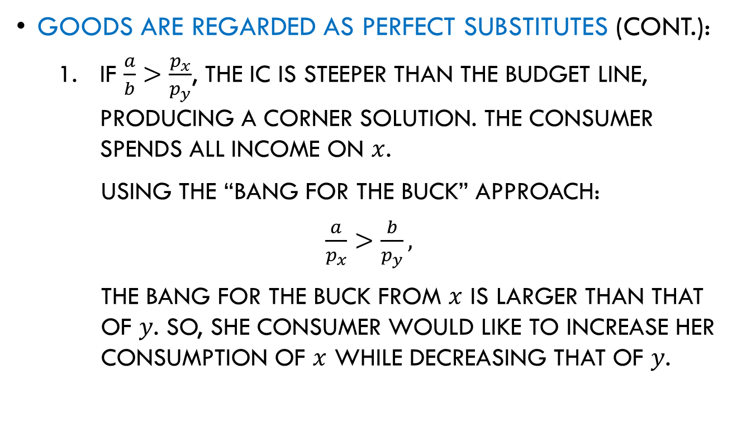
UMP in Extreme Scenarios
Goods are regarded as perfect substitutes (cont.):
  If $\frac{a}{b}>\frac{p_{x}}{p_{y}}$, the IC is steeper than the budget line, producing a corner solution. The consumer spends all income on $x$.
  Using the “bang for the buck” approach:
  $\frac{a}{p_{x}}>\frac{b}{p_{y}},$
  the bang for the buck from $x$ is larger than that of $y$. So, she consumer would like to increase her consumption of $x$ while decreasing that of $y$.

Slide 38
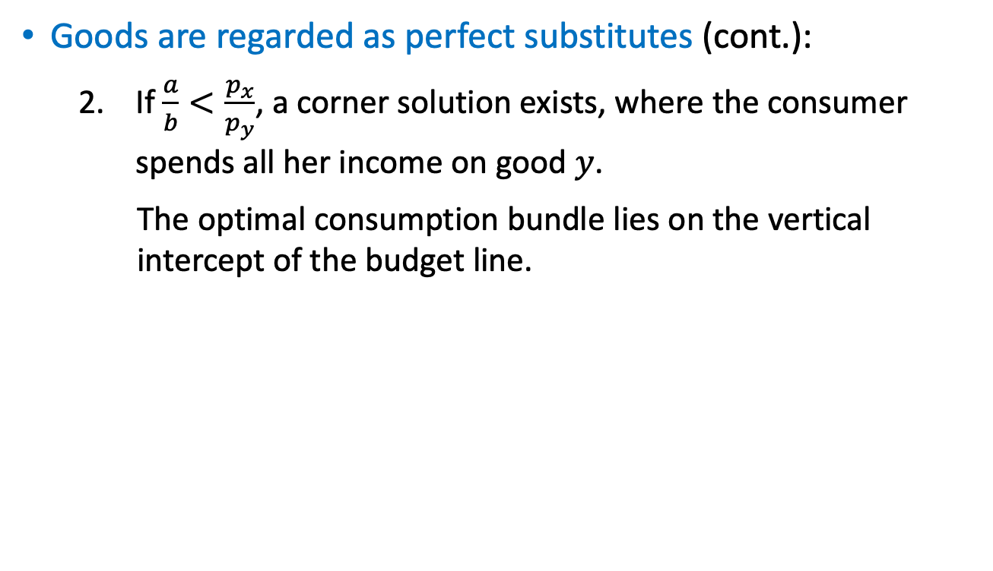
UMP in Extreme Scenarios
Goods are regarded as perfect substitutes (cont.):
  If $\frac{a}{b}<\frac{p_{x}}{p_{y}}$, a corner solution exists, where the consumer spends all her income on good $y$.
  The optimal consumption bundle lies on the vertical intercept of the budget line.

Slide 39
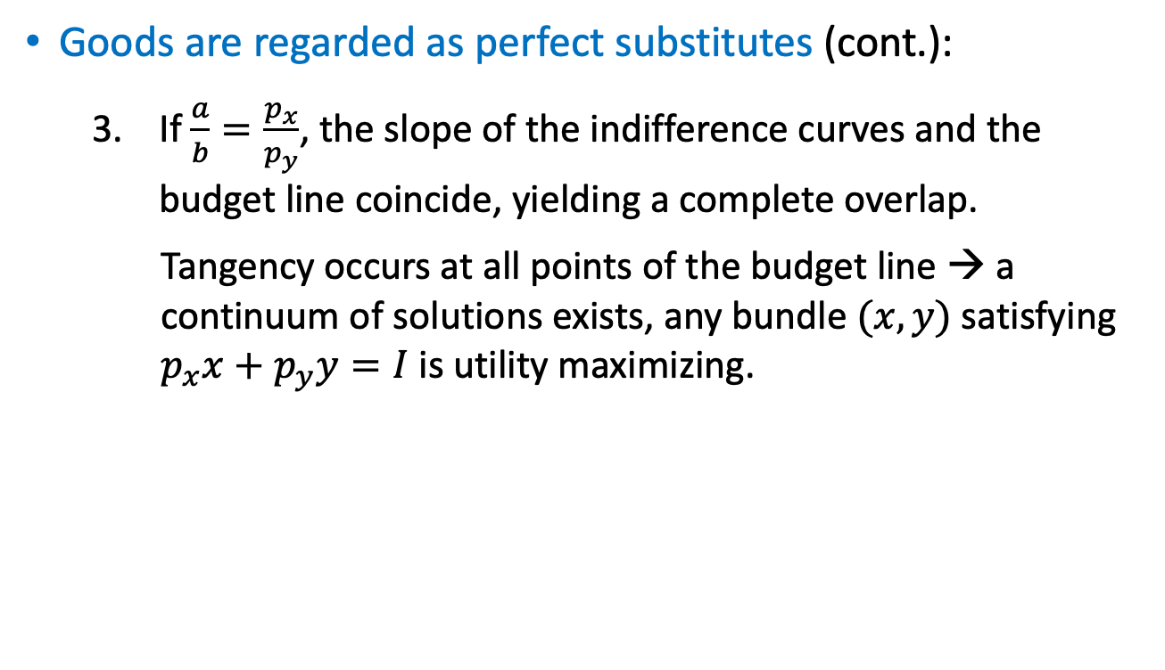
UMP in Extreme Scenarios
Goods are regarded as perfect substitutes (cont.):
  If $\frac{a}{b}=\frac{p_{x}}{p_{y}}$, the slope of the indifference curves and the budget line coincide, yielding a complete overlap.
  Tangency occurs at all points of the budget line → a continuum of solutions exists, any bundle $(x,y)$ satisfying $p_{x}x+p_{y}y=I$ is utility maximizing.

Slide 40
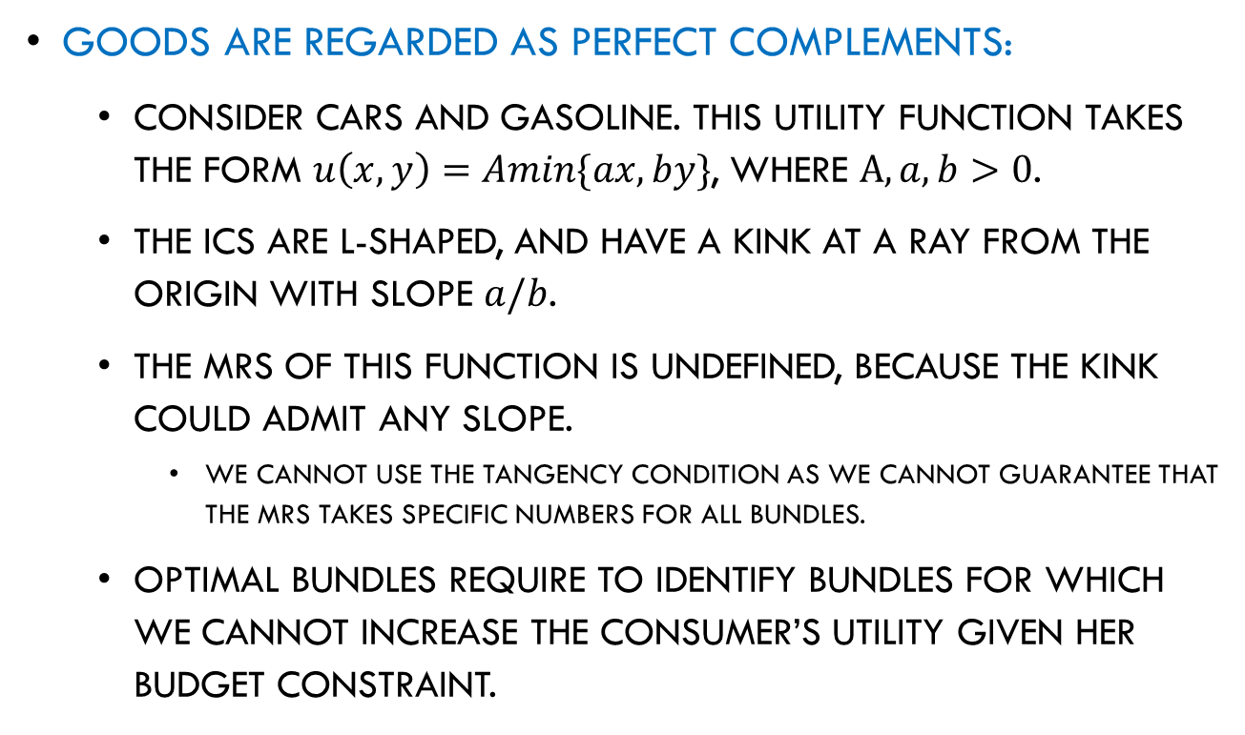
UMP in Extreme Scenarios
Goods are regarded as perfect complements:
  Consider cars and gasoline. This utility function takes the form $u\left(x,y\right)=Amin\{ax,by\}$, where $A, a,b>0$.
  The ICs are L-shaped, and have a kink at a ray from the origin with slope $a/b$.
  The MRS of this function is undefined, because the kink could admit any slope.
    We cannot use the tangency condition as we cannot guarantee that the MRS takes specific numbers for all bundles.
  Optimal bundles require to identify bundles for which we cannot increase the consumer’s utility given her budget constraint.

Slide 41

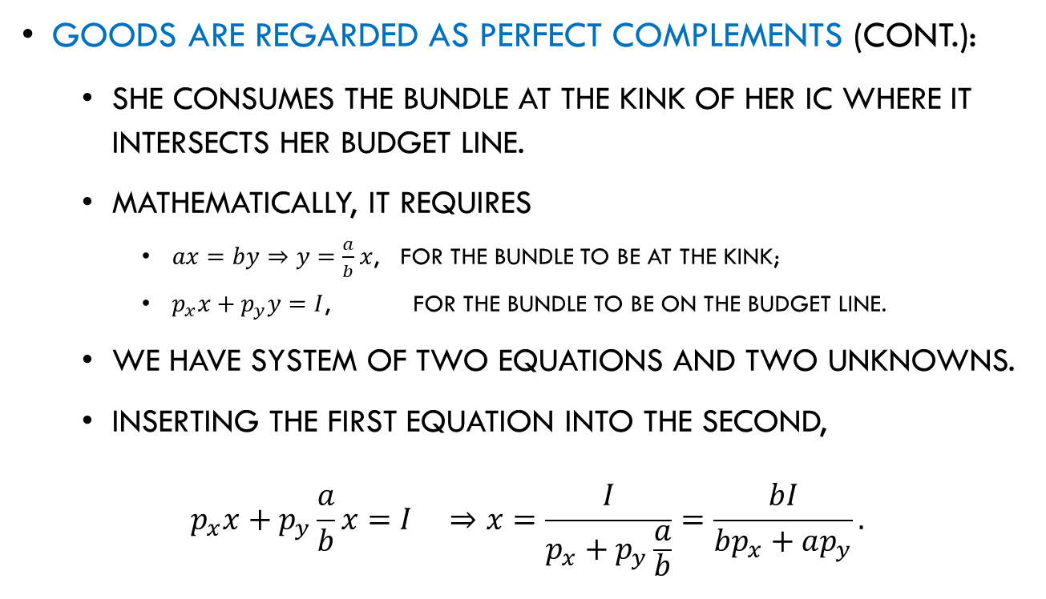
UMP in Extreme Scenarios
Goods are regarded as perfect complements (cont.):
  She consumes the bundle at the kink of her IC where it intersects her budget line.
  Mathematically, it requires
    $ax=by⇒y=\frac{a}{b}x$, for the bundle to be at the kink;
    $p_{x}x+p_{y}y=I$, for the bundle to be on the budget line.
  We have system of two equations and two unknowns.
  Inserting the first equation into the second,
  $$p_{x}x+p_{y}\frac{a}{b}x=I ⇒x=\frac{I}{p_{x}+p_{y}\frac{a}{b}}=\frac{bI}{bp_{x}+ap_{y}}.$$
$$y$$

Slide 42

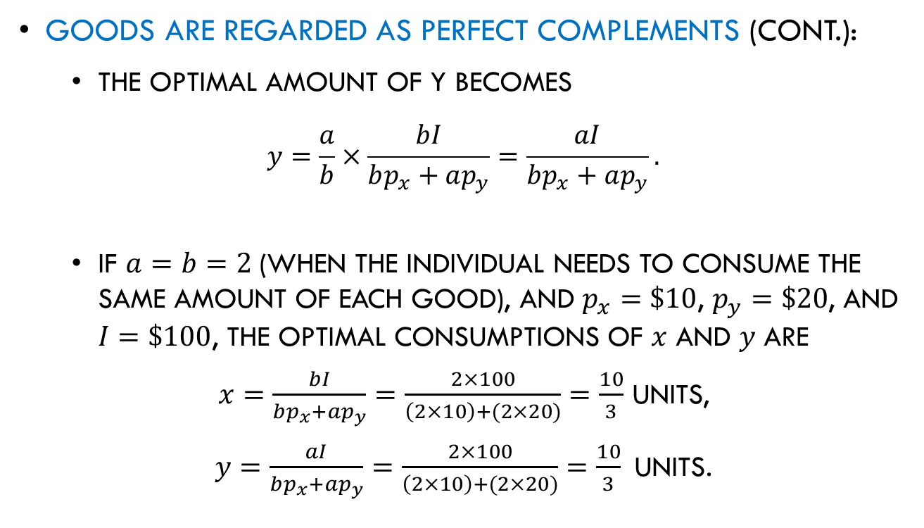
UMP in Extreme Scenarios
Goods are regarded as perfect complements (cont.):
  The optimal amount of y becomes
  $$y=\frac{a}{b}×\frac{bI}{bp_{x}+ap_{y}}=\frac{aI}{bp_{x}+ap_{y}}.$$
  If $a=b=2$ (when the individual needs to consume the same amount of each good), and $p_{x}=\$10$, $p_{y}=\$20$, and $I=\$100$, the optimal consumptions of $x$ and $y$ are
  $x=\frac{bI}{bp_{x}+ap_{y}}=\frac{2×100}{\left(2×10\right)+(2×20)}=\frac{10}{3}$ units,
  $y=\frac{aI}{bp_{x}+ap_{y}}=\frac{2×100}{\left(2×10\right)+(2×20)}=\frac{10}{3} \text{units}$.
$$x$$

Slide 43
Revealed Preferences

Slide 44
Revealed Preference
Previously, we have analyzed how to find optimal bundles, assuming we observe consumer’s preferences represented with her utility function.
What if we only know which choices she made when facing different combinations of prices and income?
We still can check if the consumer made optimal choices using the Weak Axiom of Revealed Preferences (WARP).

Slide 45
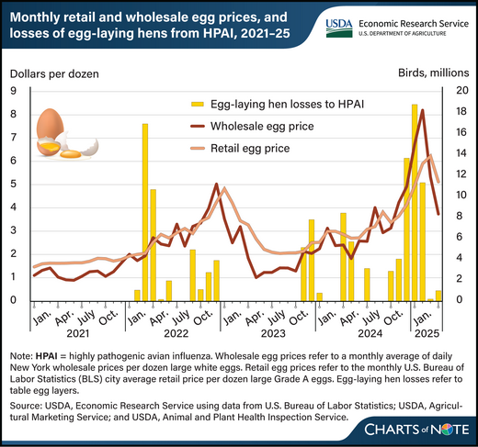
Revealed Preference

Slide 46
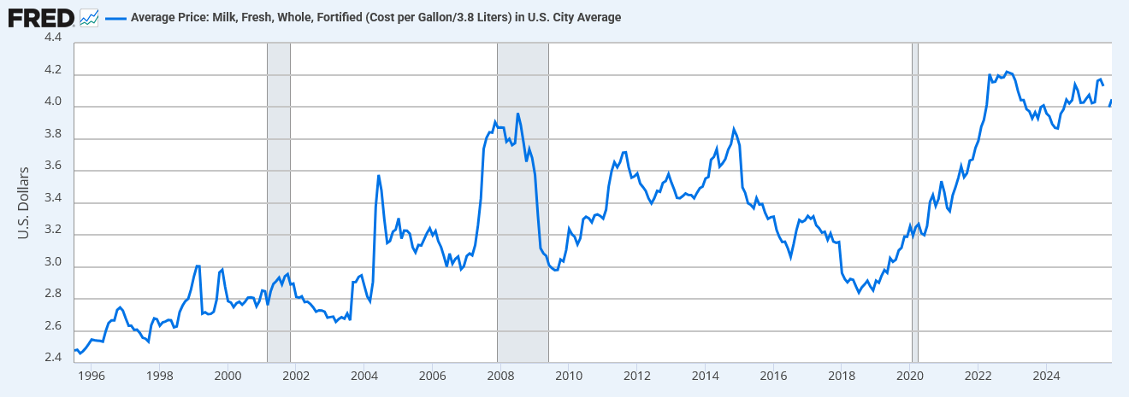
Revealed Preference

Slide 47
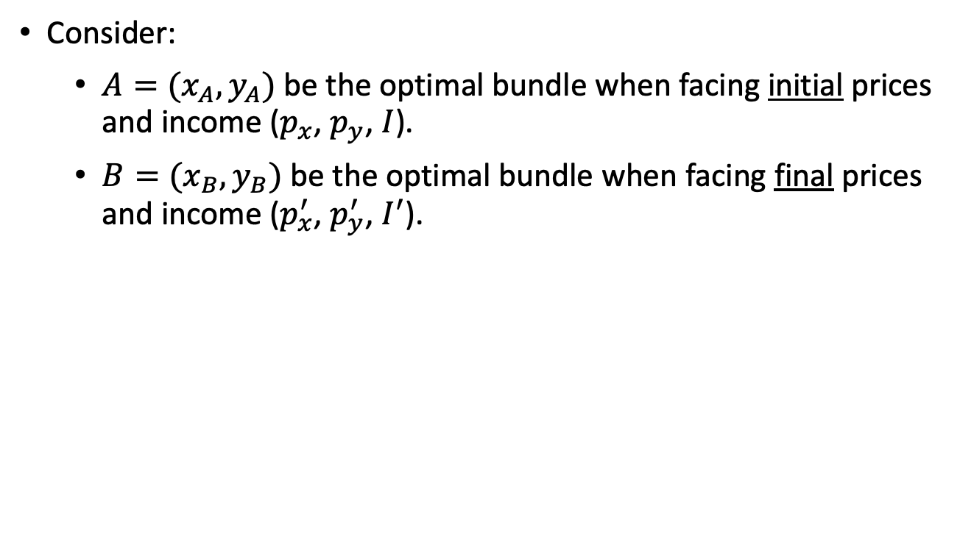
Revealed Preference
Consider:
  $A=(x_{A},y_{A})$ be the optimal bundle when facing initial prices and income ($p_{x}$, $p_{y}$, $I$).
  $B=(x_{B},y_{B})$ be the optimal bundle when facing final prices and income ($p_{x}^{′}$, $p_{y}^{′}$, $I^{′}$).

Slide 48
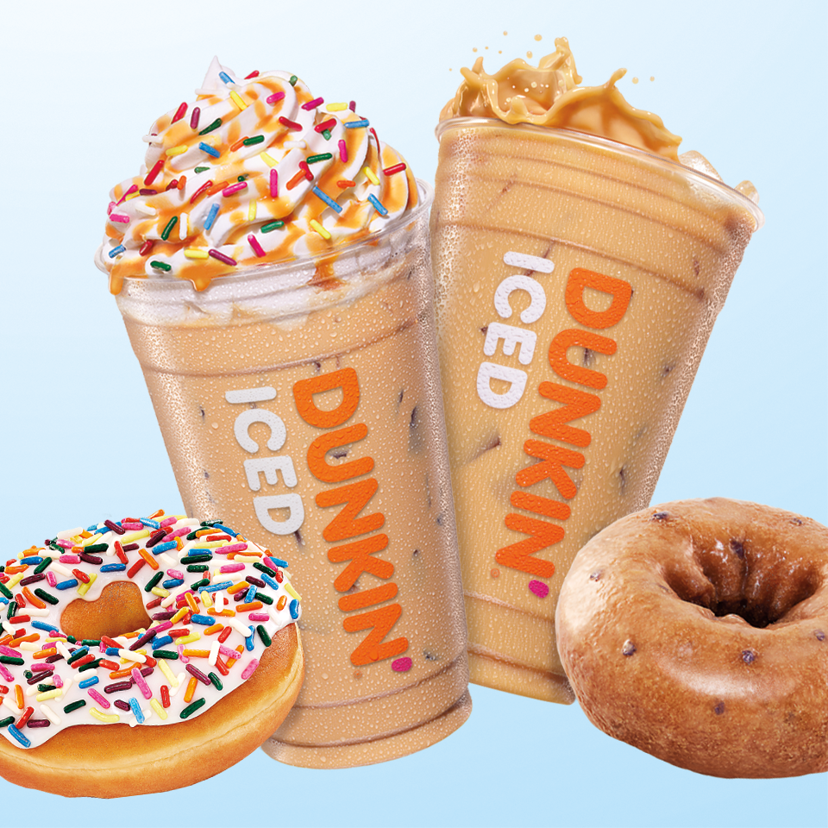




Revealed Preference

Slide 49



Revealed Preference

Slide 50
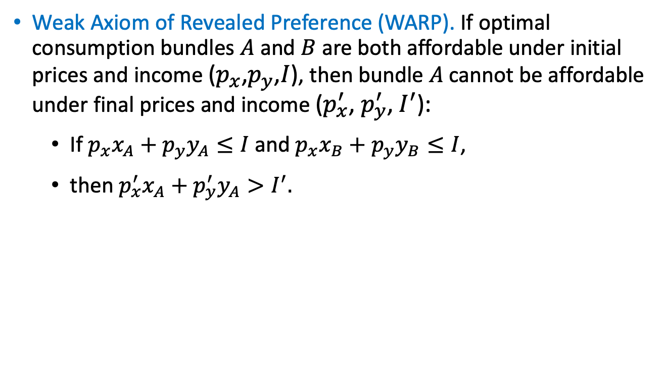
Revealed Preference
Weak Axiom of Revealed Preference (WARP). If optimal consumption bundles $A$ and $B$ are both affordable under initial prices and income ($p_{x}$,$p_{y}$,$I$), then bundle $A$ cannot be affordable under final prices and income ($p_{x}^{′}$, $p_{y}^{′}$, $I^{′}$):
  If $p_{x}x_{A}+p_{y}y_{A}≤I$ and $p_{x}x_{B}+p_{y}y_{B}≤I$,
  then $p_{x}^{′}x_{A}+$ $p_{y}^{′}y_{A}>I^{′}.$

Slide 51
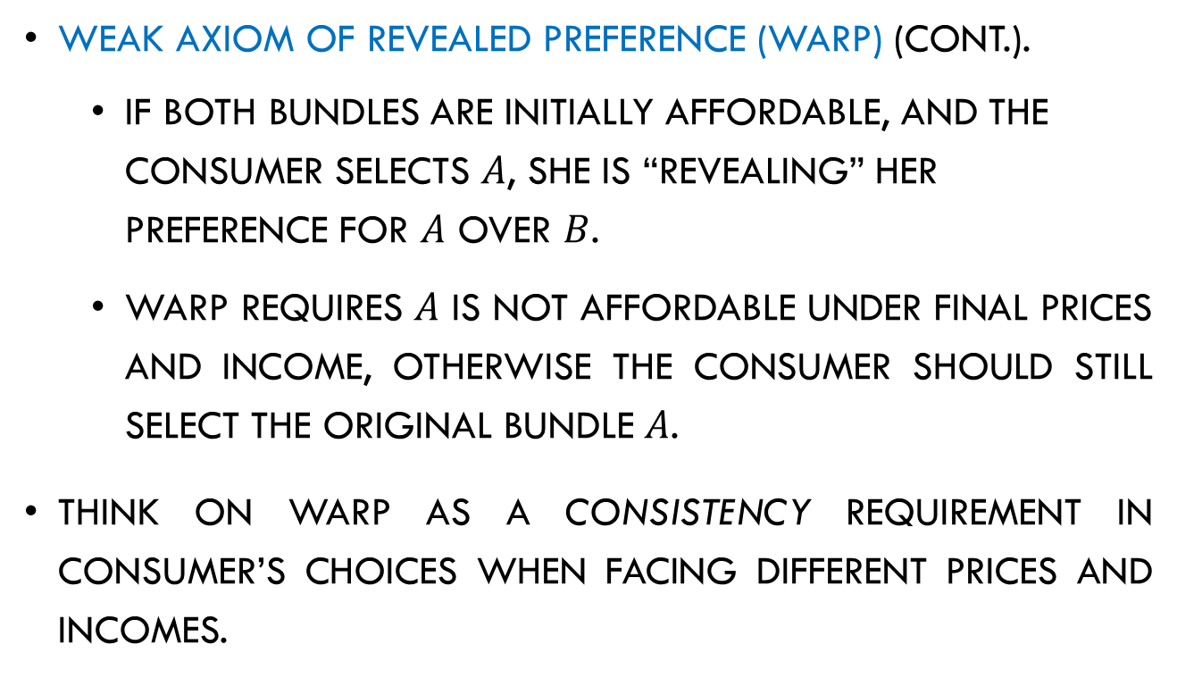
Revealed Preference
Weak Axiom of Revealed Preference (WARP) (cont.).
  If both bundles are initially affordable, and the consumer selects $A$, she is “revealing” her preference for $A$ over $B$.
  WARP requires $A$ is not affordable under final prices and income, otherwise the consumer should still select the original bundle $A$.
Think on WARP as a consistency requirement in consumer’s choices when facing different prices and incomes.

Slide 52

Revealed Preference
Tool 3.2. Checking for WARP:
  Checking the premise. Check if bundles $A$ and $B$ are initially affordable → they lie on or below the budget line, $BL$, ($p_{x},p_{y},I$).
    1a. If step 1 holds, move to step 2.
    1b. If step 1 does not hold, stop. We can only claim that the consumer choices do not violate WARP.
  Checking the conclusion. Check that bundle A is no longer affordable → it lies strictly above the final budget line $BL’$, ($p_{x}^{′},p_{y}^{′},I′$).
  2a. If step 2 holds, WARP is satisfied.
  2b. If step 2 does not hold, WARP is violated.

Slide 53
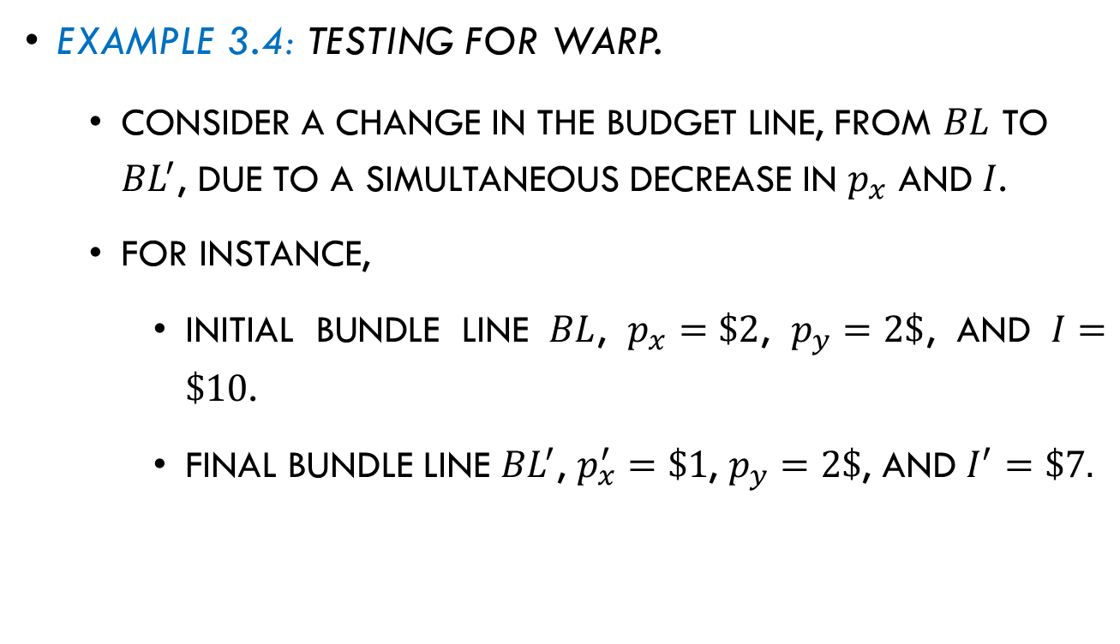
Revealed Preference
Example 3.4: Testing for WARP.
  Consider a change in the budget line, from $BL$ to ${BL}^{′}$, due to a simultaneous decrease in $p_{x}$ and $I$.
  For instance,
    Initial bundle line $BL$, $p_{x}=\$2$, $p_{y}=2\$$, and $I=\$10$.
    Final bundle line ${BL}^{′}$, $p_{x}^{′}=\$1$, $p_{y}=2\$$, and $I^{′}=\$7.$

Slide 54

Revealed Preference
Example 3.4 (continued):
    The vertical intercept of the budget line
    decreases from $\frac{I}{p_{y}}=\frac{10}{2}=5$ units to $\frac{I^{′}}{p_{y}}=\frac{7}{2}=3.5$ units.
    The vertical intercept of the budget line
    increases from $\frac{I}{p_{x}}=\frac{10}{2}=5$ units to $\frac{I^{′}}{p_{x}^{′}}=\frac{7}{1}=7$ units.

Slide 55
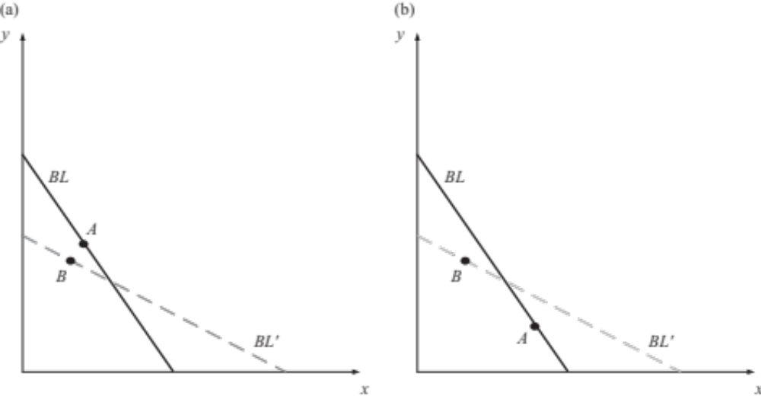
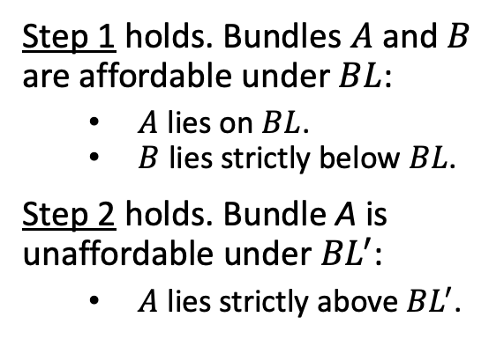
Revealed Preference
Example 3.4 (continued):
  Scenario (a). WARP is satisfied.
Step 1 holds. Bundles $A$ and $B$ are affordable under $BL$:
  $A$ lies on $BL$.
  $B$ lies strictly below $BL$.
Step 2 holds. Bundle A is unaffordable under ${BL}^{′}$:
  $A$ lies strictly above ${BL}^{′}$.
Figure 3.6a

Slide 56
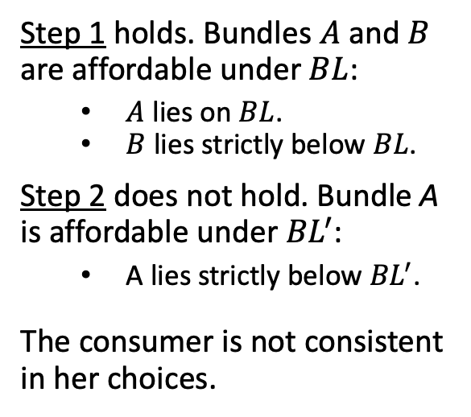
Revealed Preference
Example 3.4 (continued):
  Scenario (b). WARP is violated.
Step 1 holds. Bundles $A$ and $B$ are affordable under $BL$:
  $A$ lies on $BL$.
  $B$ lies strictly below $BL$.
Step 2 does not hold. Bundle A is affordable under ${BL}^{′}$:
  A lies strictly below ${BL}^{′}$.
The consumer is not consistent in her choices.
Figure 3.6b

Slide 57


Revealed Preference
Example 3.4 (continued):
  Scenario (c). WARP is not violated.
Step 1 does not hold.
Bundle $A$ is affordable under $BL$ but $B$ is unaffordable:
  $A$ lies on $BL$.
  $B$ lies strictly above $BL$.
Figure 3.6c

Slide 58


Revealed Preference
Example 3.4 (continued):
  Scenario (d). WARP is not violated.
Step 1 does not hold.
Bundle $A$ is affordable under $BL$ but $B$ is unaffordable :
  $A$ lies on $BL$.
  $B$ lies strictly above $BL$.
Figure 3.6d

Slide 59
Kinked Budget Lines

Slide 60

Quantity Discounts
Sellers offer quantity discounts making first units more expensive than each unit afterwards.
Formally,
  the consumer faces a price $p_{x}$ for all units of $x$ between $0$ and $\overline{x}$ (i.e., for all $x≤\overline{x}$);
  but she faces a lower price $p_{x}^{′}$, where $p_{x}^{′}<p_{x}$, for each subsequent unit (i.e., for all $x>\overline{x}$).

Slide 61


Quantity Discounts

Slide 62

Quantity Discounts
Graphically,
Figure 3.7

Slide 63



Quantity Discounts
Mathematically, the equation of the budget line is
For all $x≤\overline{x}$,
For all $x>\overline{x}$,
  Note $\frac{p_{x}^{′}}{p_{y}}<$ $\frac{p_{x}}{p_{y}}$, and $\frac{I}{p_{y}}−\frac{p_{x}−p_{x}^{′}}{p_{y}}\overline{x}<$ $\frac{I}{p_{y}}$.
$y=$ $\frac{I}{p_{y}}$ $− \frac{p_{x}}{p_{y}}x.$
Vertical intercept
Slope
$y=$ $\left(\frac{I}{p_{y}}−\frac{p_{x}−p_{x}^{′}}{p_{y}}\overline{x}\right)$ $−\frac{p_{x}^{′}}{p_{y}}x.$
Vertical intercept
Slope
Figure 3.7

Slide 64

Quantity Discounts
Effect of a large or small price discount:
  A large discount makes the difference $p_{x}−p_{x}^{′}$ larger, shifting the vertical intercept downward and flattering the right segment of the budget line.
  A small discount produces a small difference $p_{x}−p_{x}^{′}$, pushing the vertical intercept upward and steepening the right segment of the budget line.
Figure 3.7

Slide 65

Quantity Discounts
Example 3.5: Quantity discounts.
  Eric has $I=\$100$ to purchase video games (good $x$) and food (good $y$).
  The price of food is $p_{y}=\$5$, regardless of how many units he buys.
  The price of video games is $p_{x}=\$4$ for the first 2 units, but $p_{x}^{′}=\$1$ for unit 3 and beyond.
  Cutoff is at $\overline{x}=2$.

Slide 66

Quantity Discounts
Example 3.5 (continued):
  Then, Eric’s budget line is:
    For all $x≤2$,
  $$y=\frac{100}{5}−\frac{4}{5}x$$
  $$=20−\frac{4}{5}x.$$
    For all $x>2$,
  $$y=\left(\frac{100}{5}−\frac{4−1}{5}2\right)−\frac{1}{5}x$$
  $$=\left(20−\frac{3}{5}2\right)−\frac{1}{5}x$$
  $$=\frac{94}{5}−\frac{1}{5}x.$$

Slide 67

Quantity Discounts
Example 3.5 (continued):
    Graphically,
      For $x≤2$, the budget line originates at $\frac{I}{p_{y}}=\frac{100}{5}=20$ units in the vertical axis and decreases at a rate of $−\frac{p_{x}}{p_{y}}=−\frac{4}{5}=−0.8$.
      For $x>2$, the budget line originates at $y=\frac{94}{5}≅18.8$ units, has a slope of $−\frac{p_{x}^{′}}{p_{y}}=−\frac{1}{5}$, becoming flatter, and cross the horizontal axis at $x=\frac{I}{p_{x}^{′}}−\frac{p_{x}−p_{x}^{′}}{p_{x}^{′}}\overline{x}=\frac{100}{1}−\left(\frac{\left(4−1\right)}{1}×2\right)=100−6=94$ units.

Slide 68

Introducing Coupons
the Emergency Price Control Act was passed in 1942, it gave the government the ability to institute price limits and to ration food and other items, the government instituted a coupon system that Americans had to use to buy items such as sugar, coffee, food, and gasoline.

Slide 69


The 1990s to Now: What is the future of coupons?
Coupons began to appear online with downloadable coupons and online coupon codes.
Two major coupon websites were founded in the early 2000s: RetailMeNot.com in 2006 and Groupon in 2008.

Slide 70

The 1990s to Now: What is the future of coupons?
In 2011, Ibotta revolutionized saving on groceries and other items with their free digitized cash back app. Instead of clipping coupons, you simply upload your receipt or link your store account to receive cash back on eligible items from over 1,500 brands and retailers.

Slide 71




Introducing Coupons
Consider a market where the government offers coupons, letting consumers purchase the first $\overline{x}$ units of good $x$ for free.
  The coupons expand the set of bundles the consumer can afford.
${BL}_{C}$, budget line with coupons.
${BL}_{NC}$, budget line without coupons.
Figure 3.8

Slide 72

Introducing Coupons
Mathematically, this kinked budget line ${BL}_{C}$ is
$${BL}_{C}\left\{\begin{aligned}p_{y}y=I \text{for} \text{all} x<\overline{x}\text{, }\text{and} \\ p_{x}\left(x−\overline{x}\right)+p_{y}y=I \text{for} \text{all} x≥\overline{x}\text{.}\end{aligned}\right.$$
  For $x<\overline{x}$, the consumer faces $p_{x}=\$0$, thanks to the coupons. Then ${BL}_{C}$ is $p_{y}y+0x=I ⇒p_{y}y=I$.
  For $x≥\overline{x}$, the consumer exhausted all coupons and faces market prices $p_{x}$ and $p_{y}$. Then, ${BL}_{C}$ becomes $p_{x}\left(x−\overline{x}\right)+p_{y}y=I$.

Slide 73



Introducing Coupons
Solving for $y$, we can represent ${BL}_{C}$ as
  For $x<\overline{x}$, $y=\frac{I}{p_{y}}$
  For $x≥\overline{x}$, $y=\frac{I}{p_{y}}+\frac{p_{x}}{p_{y}}(x−\overline{x})$
  or
$$y=\left(\frac{I}{p_{y}}+\frac{p_{x}}{p_{y}}\overline{x}\right)−\frac{p_{x}}{p_{y}}x$$
Vertical intercept
Slope
    Setting $y=0$, and solving for $x$, we find the horizontal intercept at $x=\frac{I}{p_{x}}+\overline{x}$.
Figure 3.8

Slide 74

Introducing Coupons
Example 3.6: Coupons.
  John income is $I=\$100$, the price of electricity is $p_{x}=\$1$, and the price of bikes is $p_{y}=\$4$.
  The government agency distributes coupons for the first 200 kWh per month, making them free.
  Because $\overline{x}=200$, John’s budget line ${BL}_{C}$ is
    For $x<200$, $y=\frac{I}{p_{y}}=\frac{100}{4}=25$ units.
    For $x≥200$, $y=\left(\frac{I}{p_{y}}+\frac{p_{x}}{p_{y}}\overline{x}\right)−\frac{p_{x}}{p_{y}}x=\left(\frac{100}{4}+\frac{1}{4}200\right)−\frac{1}{4}x=75−\frac{1}{4}x$.

Slide 75

Introducing Coupons
Example 3.6 (continued):
  Graphically, the dashed segment of the ${BL}_{C}$
    originates at $y=75$,
    decreases at a rate of $\frac{1}{4}$,
    and hits the horizontal axis at
    $x=\frac{I}{p_{x}}+\overline{x}=\frac{100}{1}+200=300$ units.
Figure 3.8

Slide 76
Appendix A.
Lagrange Method to Solve UMP

Slide 77

A. Lagrange Method to Solve UMP
We have used the tangency condition $\frac{{MU}_{x}}{{MU}_{y}}=\frac{p_{x}}{p_{y}}$ to find optimal consumption bundles.
Now, we show that this condition must be satisfied at the optimum of the UMP. The UMP can be expressed as
$$\max_{x,y}{u(x,y)}$$
subject to $p_{x}x+p_{y}y=I.$
  We use the budget line $p_{x}x+p_{y}y=I$, rather than the budget constraint $p_{x}x+p_{y}y≤I$, because the consumer will always spend all her available income.
  The consumer faces a “constrained maximization problem.”

Slide 78

A. Lagrange Method to Solve UMP
Constrained maximization problems are often solved by setting up a Lagrangian function,
$ℒ\left(x,y;λ\right)=u\left(x,y\right)+λ\left[I−p_{x}x−p_{y}y\right]$,
where $λ$ represents the Lagrange multiplier, which multiplies the budget line.
To solve this problem, we take FOP with respect to $x$, $y$, and $λ$,
$\frac{∂ℒ}{∂x}={MU}_{x}−λp_{x}=0$,
$\frac{∂ℒ}{∂y}={MU}_{y}−λp_{y}=0$, and
$\frac{∂ℒ}{∂λ}=I−p_{x}x−p_{y}y=0$.

Slide 79

A. Lagrange Method to Solve UMP
The first and the second conditions can be rearranged to
$\frac{{MU}_{x}}{p_{x}}=λ$ and $\frac{{MU}_{y}}{p_{y}}=λ.$
Because both conditions are equal to $λ$, we obtain
$$\frac{{MU}_{x}}{p_{x}}=λ=\frac{{MU}_{y}}{p_{y}}$$
This is the “bang for the buck” coinciding across goods.
Alternatively, this condition can be expressed as
$\frac{{MU}_{x}}{{MU}_{y}}=\frac{p_{x}}{p_{y}}$,
which coincides with the tangency condition used in the previous analysis.

Slide 80
Appendix B.
Expenditure Minimization Problem

Slide 81
Expenditure Minimization Problem
The UMP considers a fixed budget and finds which bundle provides the consumer with the highest utility.
Alternatively, the consumer could minimize her expenditure while reaching a fixed utility level.
This is the approach that the expenditure minimization problem (EMP) follows.

Slide 82



Expenditure Minimization Problem
Graphically, the EMP is understood as the consumer seeking to reach an IC with a target utility level $\overline{u}$, but shifting her budget line as close to the origin as possible.
Bundles $B$ or $C$ cannot be optimal despite reaching $\overline{u}$. She spends more income than in $A$.
Bundle $D$ cannot be optimal. She can find cheaper bundles and reach $\overline{u}$.
Figure 3.9

Slide 83

Expenditure Minimization Problem
Bundle $A$ must be optimal. There are no other bundles reaching at a lower expenditure than ${BL}_{2}$.
At $A$, the indifference curve and the budget line are tangent,
$$\frac{{MU}_{x}}{{MU}_{y}}=\frac{p_{x}}{p_{y}}.$$
Her constraint is $u(x,y)=\overline{u}$, rather than $u(x,y)≥\overline{u}$. She would never choose bundle satisfying $u\left(x,y\right)>\overline{u}$, such as $D$.
Figure 3.9

Slide 84

Expenditure Minimization Problem
Bundle $D$ cannot be optimal. She can find cheaper bundles and reach $\overline{u}$. These bundles that still satisfy the constraint and can be purchased at lower cost.
Figure 3.9

Slide 85

Expenditure Minimization Problem
Tool 3.3. Procedure to solve the EMP:
  Set the tangency condition as $\frac{{MU}_{x}}{{MU}_{y}}=\frac{p_{x}}{p_{y}}$. Cross-multiply and simplify.
  If the expression for the tangency condition:
    Contains both unknowns ($x$ and $y$), solve or $y$, and insert the resulting expression into the utility constraint $u(x,y)=\overline{u}$.
    Contains only one unknown ($x$ or $y$), solve for that unknown, and insert the result into the utility constraint $u(x,y)=\overline{u}$.

Slide 86

Expenditure Minimization Problem
Tool 3.3. Procedure to solve the EMP (cont.):
  If the expression for the tangency condition:
    Contains no good $x$ or $y$, compare $\frac{{MU}_{x}}{p_{x}}$ against $\frac{{MU}_{y}}{p_{y}}$.
      If $\frac{{MU}_{x}}{p_{x}}>\frac{{MU}_{y}}{p_{y}}$, set good $y=0$ in the utility constraint and solve for good $x$
      If $\frac{{MU}_{x}}{p_{x}}<\frac{{MU}_{y}}{p_{y}}$, set $x=0$ in the utility constraint and solve for $y$.

Slide 87

Expenditure Minimization Problem
Tool 3.3. Procedure to solve the EMP (cont.):
  If, in step 2, you find that one of the goods is consumed in negative amounts (e.g., $x=−2$), then set the amount of this good equal to $0$ on the utility constraint (e.g., $u\left(0,y\right)=\overline{u}$ ), and solve for the remaining good.
  If you haven’t found the values for all the unknowns, use the tangency conditions from step 1 to find the remaining unknown.

Slide 88

Expenditure Minimization Problem
Example 3.7: EMP with a Cobb-Douglas utility function.
  Consider an individual with Cobb-Douglas utility function
  $$u\left(x,y\right)=x^{\frac{1}{3}}y^{\frac{2}{3}},$$
  facing $p_{x}=\$10$, $p_{y}=\$20$, and a utility target $\overline{u}$.
We seek to apply the tangency condition, $\frac{{MU}_{x}}{{Mu}_{y}}=\frac{p_{x}}{p_{y}}$. We first need to find $\frac{{MU}_{x}}{{Mu}_{y}}$,
$$\frac{{MU}_{x}}{{Mu}_{y}}=\frac{\frac{1}{3}x^{−\frac{2}{3}}y^{\frac{2}{3}}}{\frac{2}{3}x^{\frac{1}{3}}y^{−\frac{1}{3}}}=\frac{y}{2x}.$$
Next, we apply the steps in Tool 3.3.

Slide 89


Expenditure Minimization Problem
Example 3.7 (continued):
Step 1. The tangency condition reduces to
$$\frac{{MU}_{x}}{{MU}_{y}}=\frac{p_{x}}{p_{y}},$$
$$\frac{y}{2x}=\frac{10}{20} ⟹y=x.$$
This result contains both $x$ and $y$, so we move to step 2a.
Step 2a. The utility constraint $u\left(x,y\right)=\overline{u}$ becomes $x^{\frac{1}{3}}y^{\frac{2}{3}}=\overline{u}$. Inserting $y=x$,
$$x^{\frac{1}{3}}{\left(x\right)}^{\frac{2}{3}}=\overline{u} ⟹x=\overline{u}.$$
For instance, if $\overline{u}=5$, the optimal amount of $x$ is $x=5$.
$$y$$

Slide 90

Expenditure Minimization Problem
Example 3.7 (continued):
Because we found a positive amount of good $x$, we move to step 4.
Step 4. Using the tangency condition, $y=x$,
$$y=\overline{u}.$$
Summary. The optimal consumption bundle is $x=y=\overline{u}$, consuming the same amount of each.
For instance, if the consumer seeks to reach a utility target of $\overline{u}$, the optima bundle is $(5,5)$.

Slide 91

Expenditure Minimization Problem
Example 3.8: EMP with a quasilinear utility.
  Consider the quasilinear demand from example 3.3
  $$u\left(x,y\right)=xy+7x,$$
  facing $p_{x}=\$1$, $p_{y}=\$2$, and a utility target $\overline{u}=70$.
Step 1. The tangency condition reduces is
$$\frac{{MU}_{x}}{{MU}_{y}}=\frac{p_{x}}{p_{y}},$$
$$\frac{y+7}{x}=\frac{1}{2} ⟹2y+14=x.$$
This result contains both $x$ and $y$, so we move to step 2a.

Slide 92



Expenditure Minimization Problem
Example 3.9 (continued):
  Step 2a. Inserting the result from the tangency condition, $2y+14=x$, into the utility target $xy+7x=70$,
  $$\left(2y+14\right)y+7\left(2y+14\right)=70,$$
  $$2{(7+y)}^{2}=70⟹{\left(7+y\right)}^{2}=35,$$
  $$\sqrt{{\left(7+y\right)}^{2}}=\sqrt{35}⟹7+y=\sqrt{35},$$
  $y=−1.08$ units.
  Because we found negative units of at least one good, we need to apply step 3 next.
$$x$$
$$x$$

Slide 93

Expenditure Minimization Problem
Example 3.9 (continued):
  Step 3. The individual consumes $0$ amounts of $y$, and dedicates all her income to buy $x$. ${MU}_{x}>{MU}_{y}$, regardless of the amount consumed, which drives her to purchase only good $x$.
  Because $y=0$, her utility constraint becomes $u\left(x,0\right)=70$, or
  $$x0+7x=70,$$
  $x=10$ units.
  Summary. The optimal consumption bundle is $x=10$ and $y=0$, regardless of the utility target the individual seeks to reach.

Slide 94

Relationship between UMP and EMP
Similarities and differences of UMP and EMP approaches:
Figure 3.10

Slide 95

Relationship between UMP and EMP
Both approaches lead as to the same optimal consumption bundle. The EMP is dual representation of UMP.
Consider a consumer that solves her UMP and finds optimal bundle
$$\left(x^{U},y^{U}\right).$$
In this situation, the utility she can reach when purchasing this bundle is
$u\left(x^{U},y^{U}\right)$.

Slide 96

Relationship between UMP and EMP
If we ask the consumer to solver her EMP to reach a target utility level of
$$u\left(x^{U},y^{U}\right)=\overline{u},$$
the bundle that solves her EMP coincides with that of UMP.
We can draw the opposite relationship, starting from EMP.
Let $\left(x^{E},y^{E}\right)$ be the optimal bundle solving EMP.

Slide 97

Relationship between UMP and EMP
Let $I^{E}$ be the income the consumer needs to purchase her optimal bundle (i.e., $p_{x}x^{E}+p_{y}y^{E}=I^{E}$).
If we ask her to solve her UMP, giving an income of $I=I^{E}$, the optimal bundles solving her UMP,
$$\left(x^{U},y^{U}\right),$$
coincides with that solving her EMP,
$$\left(x^{E},y^{E}\right).$$

Slide 98

Relationship between UMP and EMP
Example 3.9: Dual problems.
  From UMP to EMP:
  Solving the UMP in example 3.2, $\left(x^{U},y^{U}\right)=\left(3.33, 3.33\right),$
  which yields a utility level of $u=3.33.$
  If we go to the EMP in example 3.7, and her to a target of a utility level of $\overline{u}=3.33.$
  Then, her optimal bundle becomes
  $$\left(x^{E},y^{E}\right)=\left(3.33, 3.33\right),$$
  because in example 3.7 we found $x=y=\overline{u}$.
  Hence, optimal bundles in UMP and EMP coincide.

Slide 99

Relationship between UMP and EMP
Example 3.9 (continued):
  From EMP to UMP:
  We approach the consumer again, giving her the income that she would need to purchase the optimal bundle found in EMP of example 3.7,
  $$p_{x}x^{E}+p_{y}y^{E}=\$100.$$
  Solving her UMP, she obtains
  $$\left(x^{U},y^{U}\right)=\left(3.33, 3.33\right),$$
  which coincides with the optimal bundle solving the EMP.

