Slide 1

Procurement Auction
Or Reverse Auction

Slide 2
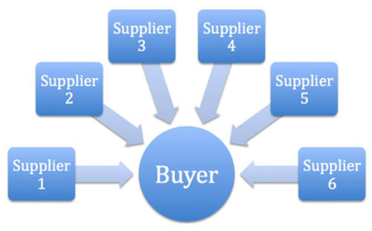
Definition
A procurement auction is a method of entering a competitive market to purchase products or services. When several sellers compete with one another to obtain the business of one buyer, the process is known as a procurement auction or reverse auction.

Slide 3
Suppliers must typically pre-qualify to participate in a procurement auction. Prequalification entails:
Fulfilling all requirements for obligatory supply
Accepting the terms and conditions of the auction and the contract, as well as the scope and requirements
This indicates that the vendors compete primarily on price during the auction.

Slide 4
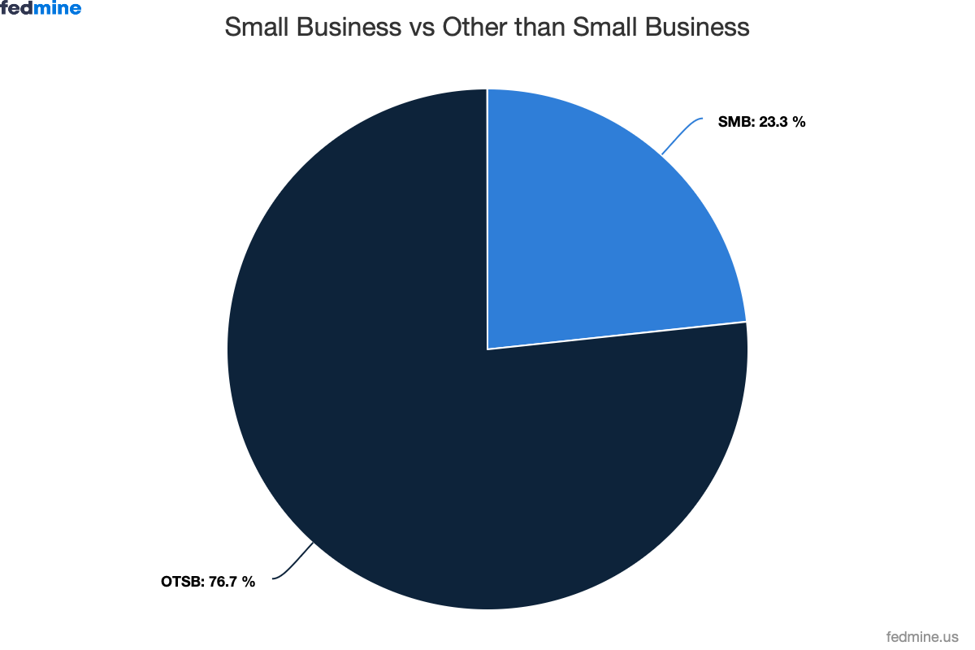
Contracts:
Federal contract awards totaled $773.68 billion in Fiscal Year 2024, according to GovSpend. The U.S. government awards millions of contracts annually. These contracts are a matter of public record, accessible through various channels.

Slide 5
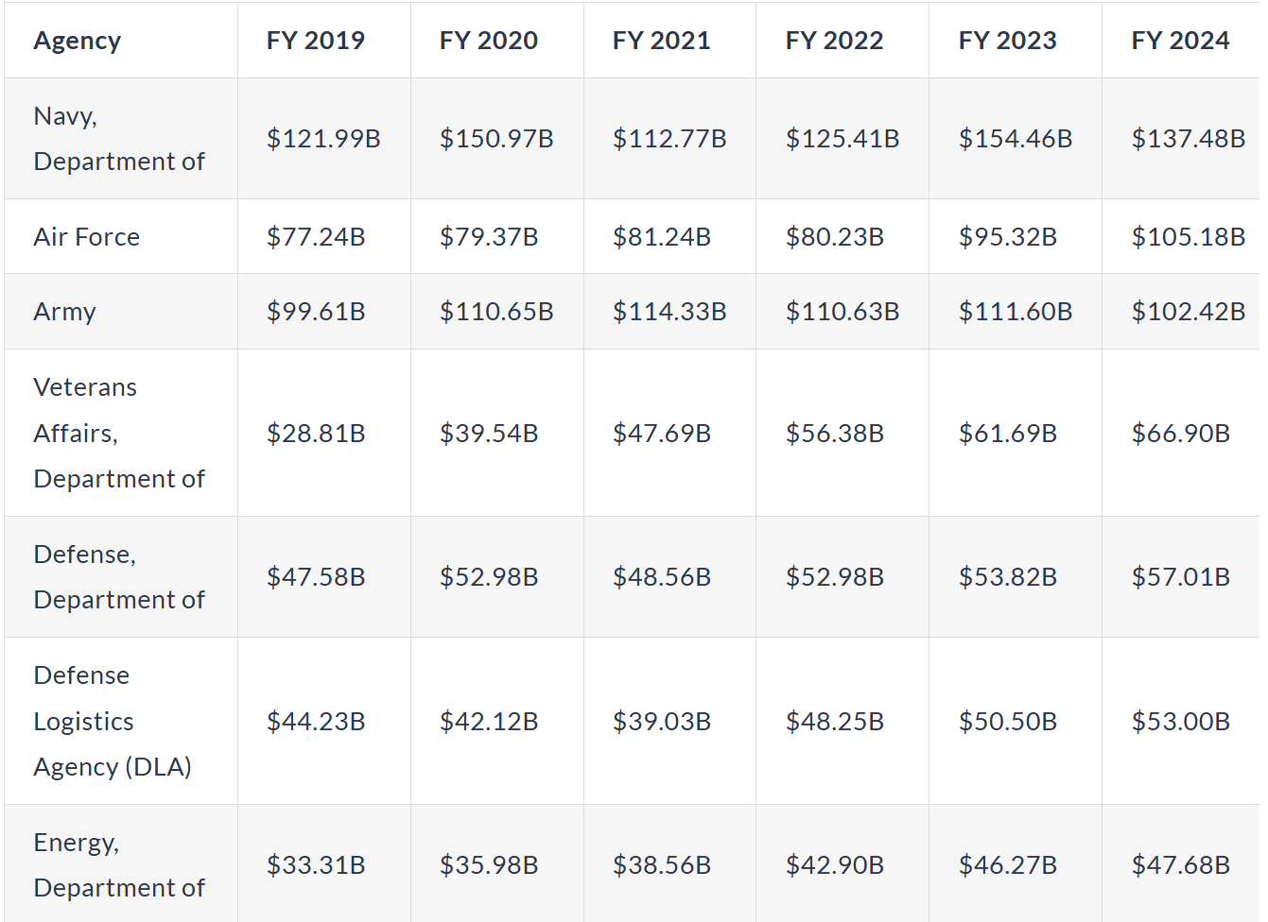

Slide 6
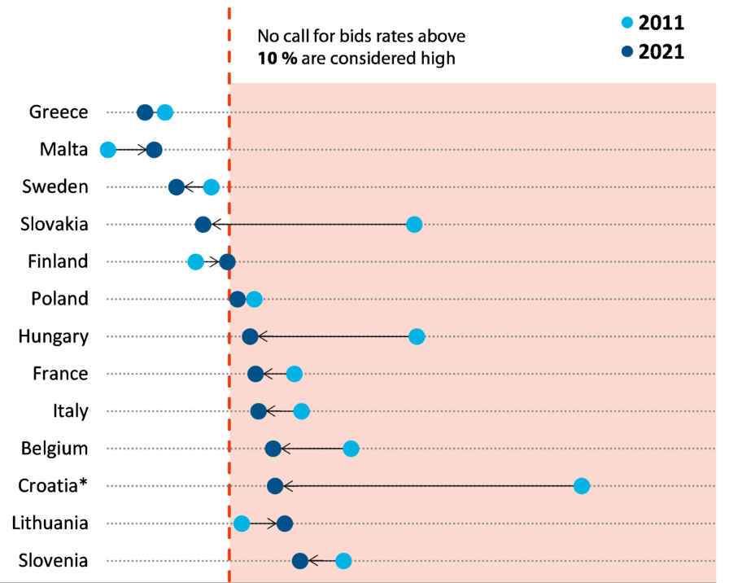

Slide 7
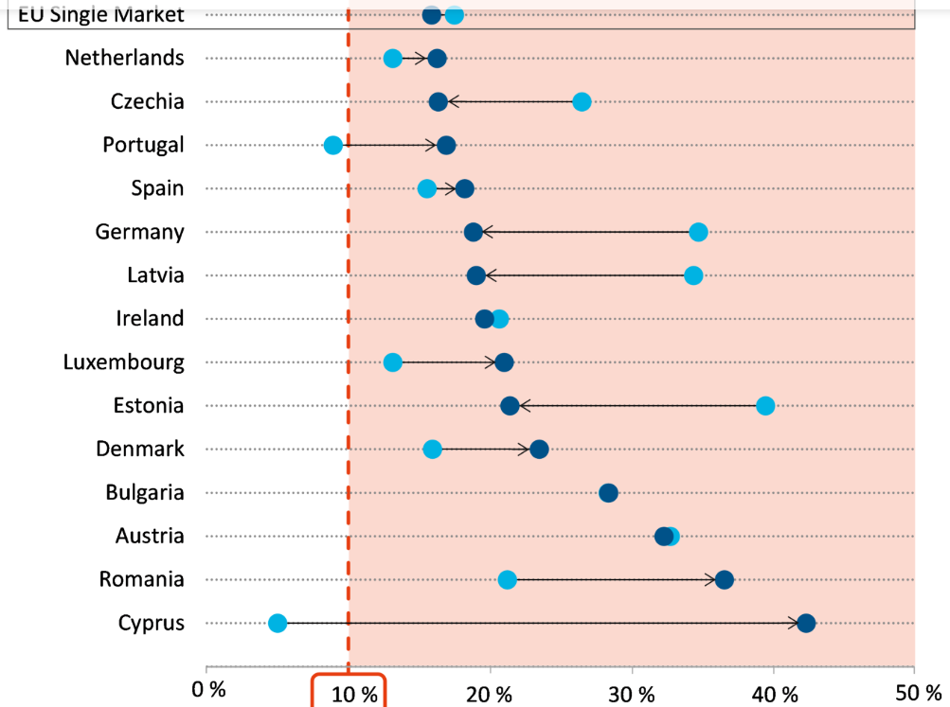

Slide 8
Examples of procurement auctions – Biodiversity:
The US Department of Agriculture has implemented auctions in which the landholders bid for payments for retiring their lands from farm production for a period of 10 to 15 years.
In Victoria (Australia) the government has developed an auction of conservation programs where the landholders bid for payments they can receive from undertaking conservation activities.

