Slide 1
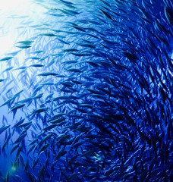
Common Pool Resources:
Strategic Behavior, Inefficiencies, and Incomplete Information
Introduction

Slide 2
Outline
What are Common Pool Resources (CPRs)?
Differences between CPRs and other goods
Overexploiting the commons
The tragedy of the commons- Static and dynamic components
The tragedy of the commons under incomplete information

Slide 3
What are
Common Pool Resources?

Slide 4
1.1 What are Common-Pool Resources?
If we ask you to find examples of Common pool resources (CPRs), you may think in:
Fishing grounds
hunting grounds
Forests, along with oil fields, pastures, irrigation systems, and aquifers
More examples:
The use of a computer facility
Wi-Fi internet connections that require no password

Slide 5
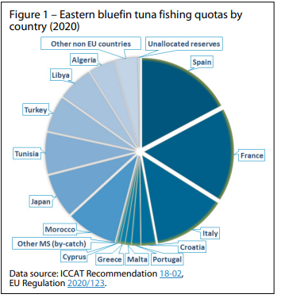
Bluefin tuna in the eastern Atlantic and the Mediterranean

Slide 6
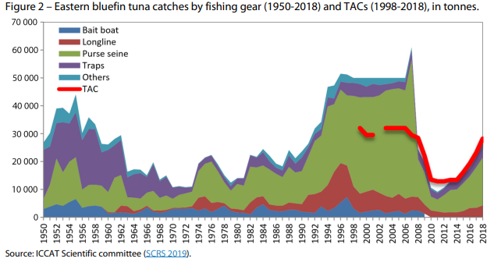
Bluefin tuna in the eastern Atlantic and the Mediterranean

Slide 7
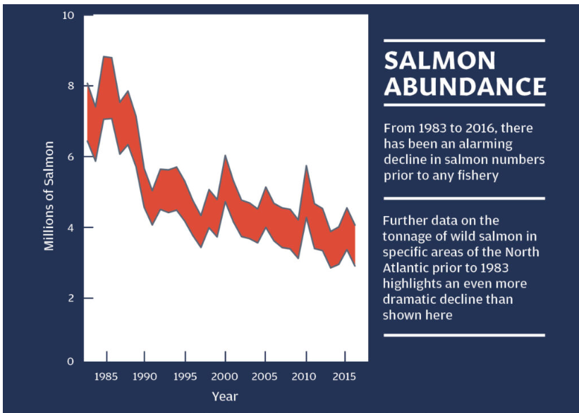
The State of North Atlantic Salmon
NASCO

Slide 8
What are the distinctive features these examples, and generally CPRs, exhibit ?
1.1 What are Common-Pool Resources?
But the question is……..
The are two important properties to qualify a good or service as a CPR;
1. It must be rival
2. It must be non-excludable

Slide 9
1.1 What are Common-Pool Resources?
1. It must be rival
  Its consumption by one individual reduces the amount of the good available to other individuals
  This property holds in all our examples. Why?
I. A larger fishing catch by one fisherman reduces the available stock that other fisherman can catch. (e.g. Fishing grounds)
II. The internet browsing by one more individual reduces the Wi-Fi speed other individuals can enjoy (e.g. Wi-Fi internet )

Slide 10
1.1 What are Common-Pool Resources?
2. It must be non-excludable
  It means that preventing an individual to not enjoy the good is costly, or impossible
  Our examples satisfy this property. Why?
I. Since preventing that a new fisherman accesses a fishing ground is relatively costly.

Slide 11
Differences between CPRs and other goods

Slide 12
1.2 Differences between CPRs and other goods
We classify different types of goods into 4 types
It depends on whether these goods satisfy the two properties: rival & non-excludable
From the section before we know that;
To qualify a good or service as CPR, it needs to satisfy two properties; rival & non-excludable
That leaving us with three other types of goods
(Describe in table 1.I)

Slide 13
1.2 Differences between CPRs and other goods
Summary the different types of goods
 | Excludable | Non-Excludable
Rival | Private goods (e.g. Apple) | Common Pool Resources (e.g. Fishing ground)
Non- rival | Club goods (e.g. Gym) | Public goods (e.g. National defense)
Table 1.1. Different types of goods.
The discussion of three types of goods is on the next slide.

Slide 14
1.2 Differences between CPRs and other goods
Common Pool Resources CPRs;
CPRs are rival in consumption but non-excludable.
e.g. fishing grounds, hunting grounds
II. Private goods;
It is consumption is rival and excludable.
e.g. Apple
(if you eat it, I cannot enjoy the same apple) and (if you don't pay for an apple, you cannot eat it)

Slide 15
1.2 Differences between CPRs and other goods
III. Club goods;
Club goods are non-rival and excludable.
e.g. Gym membership, Satellite TV, or pay TV channels
Non-rival: The good can be enjoyed by several members without affecting each other’s utility.
Excludable: Gym owners can easily prevent non-members from accessing the center.

Slide 16
1.2 Differences between CPRs and other goods
IV. Public goods;
Public goods are non-rival and non-excludable
E.g. national defense, clean air, public fireworks, official statistics, and publicly available inventions through unpatented R&D
Non-rival:
Its consumption by one individual does not reduce the amount of the good available to other individuals.
Non-excludable:
Preventing an individual to not enjoy the good is extremely expensive, or impossible

Slide 17
Overexploiting the commons

Slide 18
1.3 Overexploiting the commons
CPRs share a key feature with public goods.
Both are non-excludable making it difficult preventing individuals or firms from enjoying the good.
Unlike public goods, CPRs are rival in consumption which makes things worse. Why?
Consider a fishing ground. As a rival good, each fisherman’s appropriation (e.g., 10 tons of fish) cannot be appropriated by other fishermen;
A feature that does not apply to public goods where all agents can benefit from the public good without affecting each others’ utility.

Slide 19
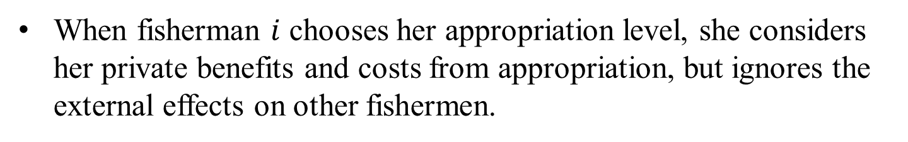
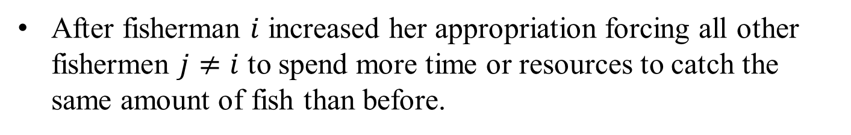
1.3 Overexploiting the commons
The rivalry feature of CPRs can be understood as a negative externality. Why?
When a fisherman appropriates one more ton of fish, this ton is not available to other fishermen which increases their appropriation costs if they seek to maintain their appropriation level unaltered.
After fisherman $i$ increased her appropriation forcing all other fishermen $j≠i$ to spend more time or resources to catch the same amount of fish than before.
When fisherman $i$ chooses her appropriation level, she considers her private benefits and costs from appropriation, but ignores the external effects on other fishermen.

Slide 20
1.3 Overexploiting the commons
If, instead, all fishermen coordinated their appropriation decisions, or
If a regulator sets appropriation decisions to each fisherman using policy instruments like fishing quotas
they would consider the joint profits of all fishermen, internalizing the external effects that each of their appropriations impose on other fishermen’s costs

Slide 21
The tragedy of the commons - Static and dynamic components

Slide 22
1.4 The tragedy of the commons- Static and dynamic components
Equilibrium appropriation: The appropriation that each fisherman chooses when left unregulated exceeds the socially optimal level.
Socially optimal appropriation: the appropriation level that they would choose if they coordinated their decisions (as it maximizes welfare for all agents in the society).
This means that equilibrium appropriation is socially excessive or, more compactly, that the resource is overexploited
(tragedy of the commons)

Slide 23
1.4 The tragedy of the commons- Static and dynamic components
Tragedy of the commons:
Equilibrium appropriation exceeds the socially optimal appropriation.
Tragedy of the commons arises even in static settings where:
Fishermen exploit the commons during only one period
Firms interact during several periods in a dynamic setting
Firms face entry threats in future periods and use their current appropriation to deter entry of potential competitors.

Slide 24
1.4 The tragedy of the commons- Static and dynamic components
This can inform regulators about the relative size of the tragedy of the commons in different CPRs, being:
nil in those resources where a single firm operates during all periods, as this firm fully considers the effect of its appropriation decisions both in its current and future profits
larger in commons where more than a firm operate since they ignore the external effects that their individual appropriation impose on other firms’ costs or profits;

Slide 25
1.4 The tragedy of the commons- Static and dynamic components
larger in CPRs where a single firm expects (with certainty) that other firm/s will enter in future periods
even larger in those commons facing entry threats where the incumbent can use her current appropriation to deter the potential entrant from joining the CPR

Slide 26
Modeling the Common Pool Resources CPR

Slide 27
2.2 Modeling the Common Pool Resources CPR
Assumption
Assume that $N$ firms (or individuals) have free access to the resource.
Perfect competition (Every unit of appropriation is sold in the international market)
Every fisherman’s appropriation represents a small share of industry catches, thus not affecting market prices for this variety of fish
Every firm takes the market price $p$ as given (normalize to $p=\$1$)

Slide 28
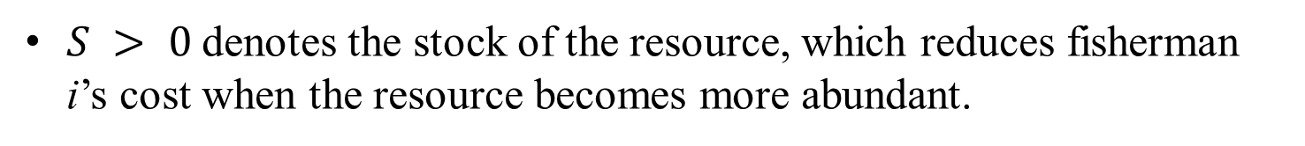
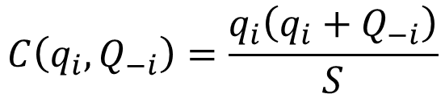
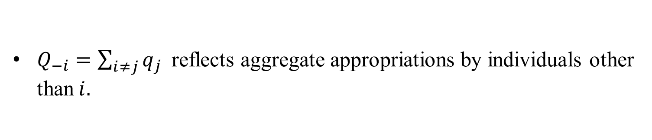
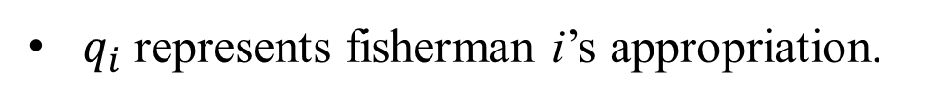
2.2 Modeling the Common Pool Resources CPR
Every firm faces the following cost function;
$$C\left(q_{i},Q_{−i}\right)=\frac{q_{i}\left(q_{i}+Q_{−i}\right)}{S}$$
Where;
$S > 0$denotes the stock of the resource, which reduces fisherman i’s cost when the resource becomes more abundant.
$q_{i}$ represents fisherman i’s appropriation.
$Q_{−i}=\sum_{i≠j}{q_{j} }$reflects aggregate appropriations by individuals other than$i.$

Slide 29
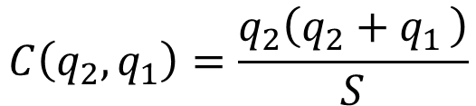
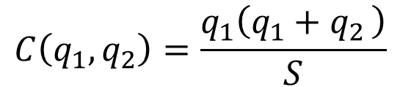
2.2 Modeling the Common Pool Resources CPR
Case 1: Having only two fishermen exploit the resource.
The total cost function simplifies to
$$C\left(q_{1},q_{2}\right)=\frac{q_{1}\left(q_{1}+q_{2 }\right)}{S}$$
for fisherman 1
$$C\left(q_{2},q_{1}\right)=\frac{q_{2}\left(q_{2}+q_{1 }\right)}{S}$$
for fisherman 2

Slide 30
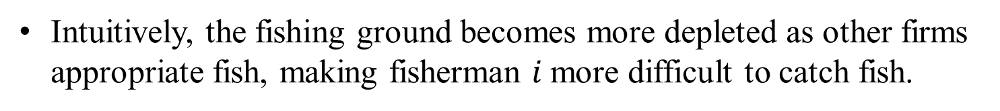
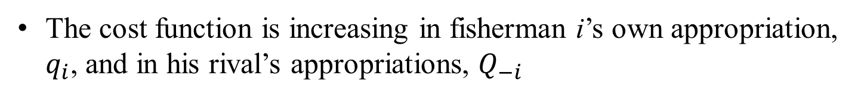
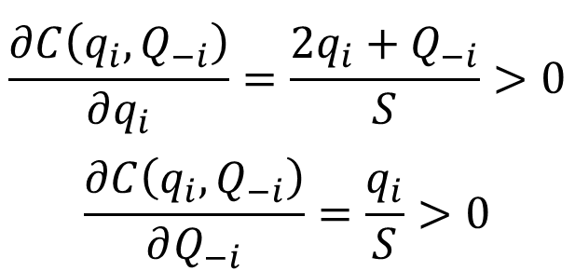
Propositions on Cost Functions:
The cost function is increasing in fisherman i’s own appropriation, $q_{i}$, and in his rival’s appropriations, $Q_{−i}$
Intuitively, the fishing ground becomes more depleted as other firms appropriate fish, making fisherman $i$more difficult to catch fish.
Case 2: What if we have three fishermen exploiting the resource?
The same principle applies, as seen from the following derivatives.
$$\frac{∂C\left(q_{i},Q_{−i}\right)}{∂q_{i}}=\frac{2q_{i}+Q_{−i}}{S}>0$$
$$\frac{∂C\left(q_{i},Q_{−i}\right)}{∂Q_{−i}}=\frac{q_{i}}{S}>0$$

Slide 31
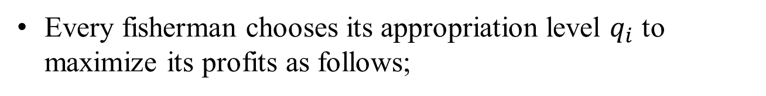
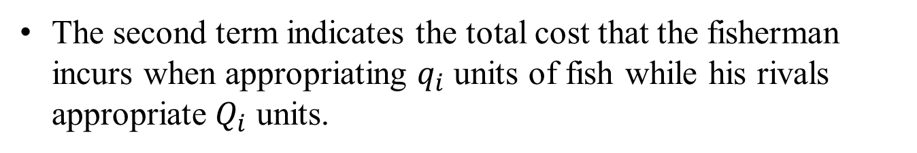
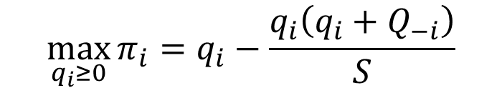
2.2 Modeling the Common Pool Resources CPR
Agent i’s profit-maximization problem
Every fisherman chooses its appropriation level $q_{i}$ to maximize its profits as follows;
$$\max_{q_{i}≥0}{π_{i}}=q_{i}−\frac{q_{i}\left(q_{i}+Q_{−i}\right)}{S}$$
The first term represents the fisherman’s revenue from additional units of appropriation (recalling that p_{i} = $1).
The second term indicates the total cost that the fisherman incurs when appropriating $q_{i}$ units of fish while his rivals appropriate $Q_{i}$ units.

Slide 32
Finding equilibrium appropriation
2.3.1 Comparative statics
2.3.2 Extension - What if fishermen have some market power?

Slide 33
2.3 Finding equilibrium appropriation
Goal: Find the appropriation that each fisherman chooses in equilibrium.
Every agent chooses its appropriation level simultaneously.
The information about the stock and agents’ cost functions is common knowledge (complete information).
Cournot game of simultaneous quantity competition
How to solve this game?
Step 1: Solve each player’s profit maximization problem which provides us with the players best response function
Step 2: Use the best response function of all players (step 1) to identify the Nash equilibrium of the game.

Slide 34
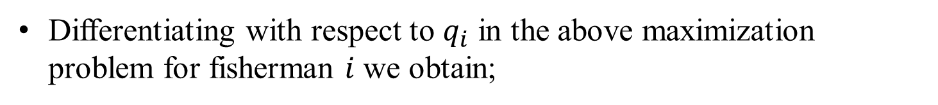
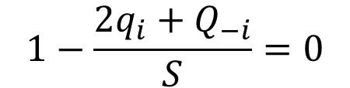
2.3 Finding equilibrium appropriation
Step 1: Find fisherman i’s best response function.
Differentiating with respect to $q_{i}$ in the above maximization problem for fisherman $i$ we obtain;
$$1−\frac{2q_{i}+Q_{−i}}{S}=0$$
MR
MC
The first term captures the marginal revenue from catching additional units of fish.
The second term indicates the marginal cost that the firm experiences from these additional catches.

Slide 35
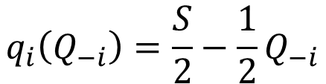

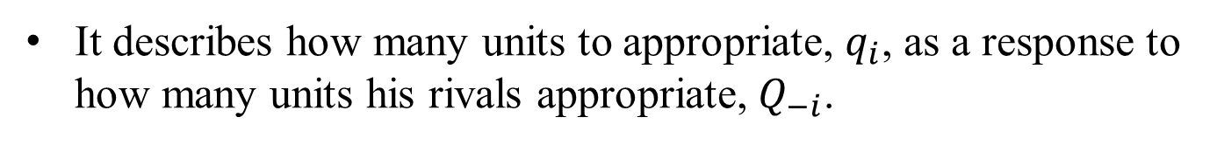

2.3 Finding equilibrium appropriation
That is, the fisherman increases appropriation until the marginal revenue and marginal cost exactly offset each other.
Rearranging the expression yields
$$S=2q_{i}+Q_{−i}$$
Fisherman i’s best response function is
$$q_{i}\left(Q_{−i}\right)=\frac{S}{2}−\frac{1}{2}Q_{−i}$$
$$(BRF_{i})$$
It describes how many units to appropriate, $q_{i}$, as a response to how many units his rivals appropriate, $Q_{−i}$.

Slide 36
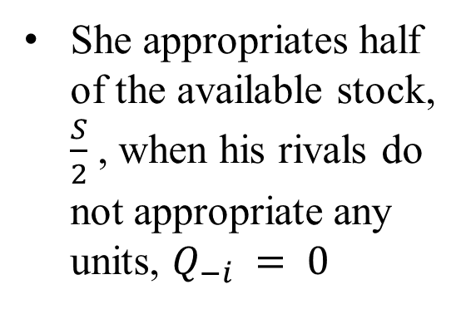
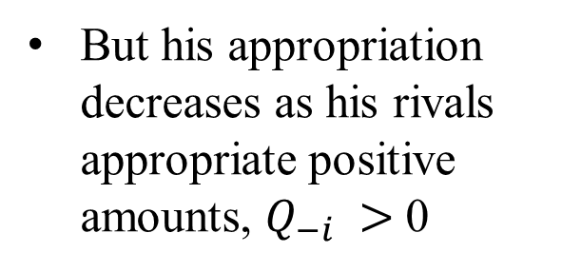
2.3 Finding equilibrium appropriation
She appropriates half of the available stock, $\frac{S}{2}$ , when his rivals do not appropriate any units, $Q_{−i} = 0$
But his appropriation decreases as his rivals appropriate positive amounts, $Q_{−i} >$0
Figure 2.1.

Slide 37

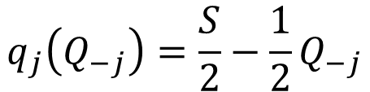
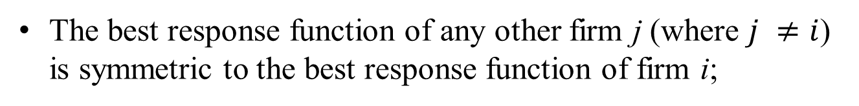
2.3 Finding equilibrium appropriation
Fisherman j’s best response function
Since firms face the same price for each unit of fish ($1)
And they face the same cost function (symmetric)
The best response function of any other firm j (where $j ≠i$) is symmetric to the best response function of firm i;
$$q_{j}\left(Q_{−j}\right)=\frac{S}{2}−\frac{1}{2}Q_{−j}$$
$$(BRF_{j})$$

Slide 38
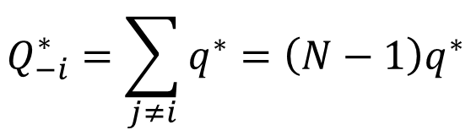
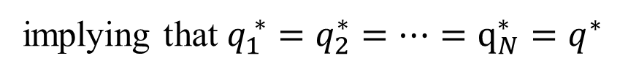
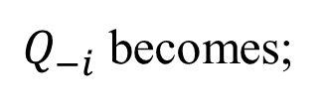
2.3 Finding equilibrium appropriation
Step 2: Using best response functions to find the Nash equilibrium.
In a symmetric equilibrium; each fisherman appropriates the same amount of fish
implying that $q_{1}^{ ∗}=q_{2}^{∗}=…=q_{N}^{∗}=q^{∗}$
All firms’ catches coincide
$Q_{−i}^{ }$ becomes;
$$Q_{−i}^{∗}=\sum_{j≠i}{q^{∗}}=\left(N−1\right)q^{∗}$$

Slide 39
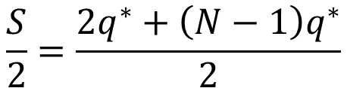
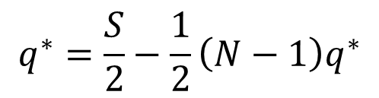
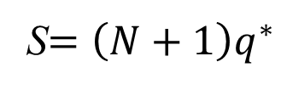
2.3 Finding equilibrium appropriation
Inserting this result in the best response function yields
$$q_{ }^{∗}=\frac{S}{2}−\frac{1}{2}\left(N−1\right)q^{∗}$$
S is the stock
N is the number of fishermen
Rearranging the above expression yields;
$$\frac{S}{2}=\frac{2q^{∗}+\left(N−1\right)q^{∗}}{2}$$
or
S$=\left(N+1\right)q^{∗}$

Slide 40
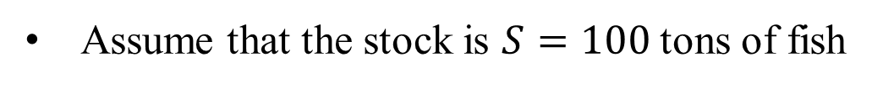
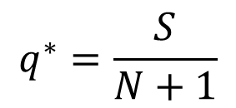
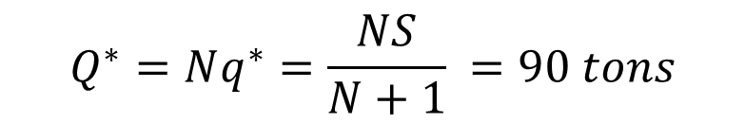

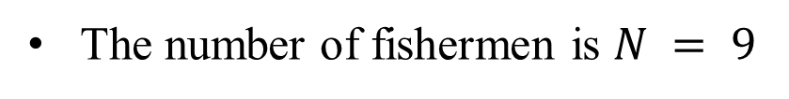
2.3 Finding equilibrium appropriation
The equilibrium appropriation becomes ;
$$q^{∗}=\frac{S}{N+1}$$
Numerical example
Assume that the stock is $S=100$ tons of fish
The number of fishermen is $N = 9$
The equilibrium and the aggregate appropriations become
$${Q^{∗}=Nq^{∗}=\frac{NS}{N+1}}^{ }=90 tons$$
$$q^{∗}=10 tons$$

Slide 41
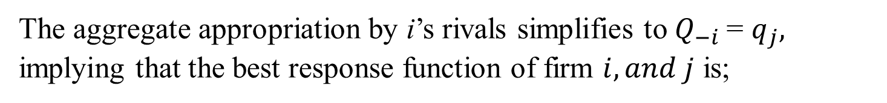


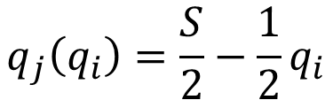
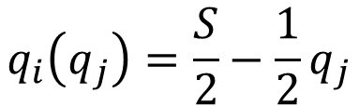
2.3 Finding equilibrium appropriationv
Case: Having two firms $(N=2)$, $i and j$.
The aggregate appropriation by i’s rivals simplifies to $Q_{−i}$= $q_{j},$ implying that the best response function of firm $i,and j$ is;
$$q_{i}\left(q_{j}\right)=\frac{S}{2}−\frac{1}{2}q_{j}$$
$$(BRF_{i})$$
$$q_{j}\left(q_{i}\right)=\frac{S}{2}−\frac{1}{2}q_{i}$$
$$(BRF_{j})$$
Figure 2.2 depicted the Nash equilibrium where both firms’ best response functions cross each other….. (Next slide)

Slide 42
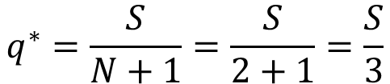
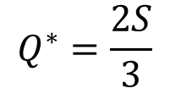
2.3 Finding equilibrium appropriation
Since we have two firms N = 2;
The equilibrium appropriation becomes;
$$q^{∗}=\frac{S}{N+1}=\frac{S}{2+1}=\frac{S}{3}$$
The aggregate appropriation becomes
$$Q^{∗}=\frac{2S}{3}$$
Figure 2.2

Slide 43
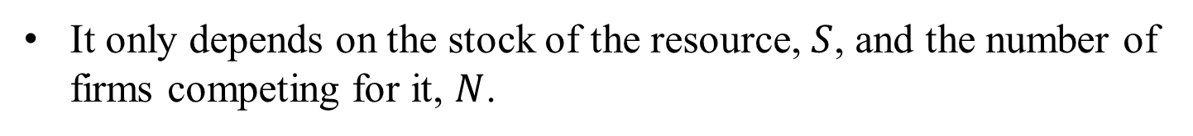
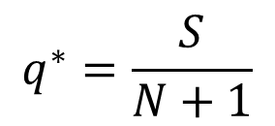
2.3.1 Finding equilibrium appropriation - Comparative static-
Comparative statics
Discuss how the result is affected by changes in one of the parameters.
Example 1
The equilibrium appropriation;
$$q^{∗}=\frac{S}{N+1}$$
It only depends on the stock of the resource, $S$, and the number of firms competing for it, $N$.

Slide 44
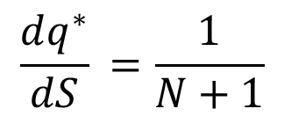
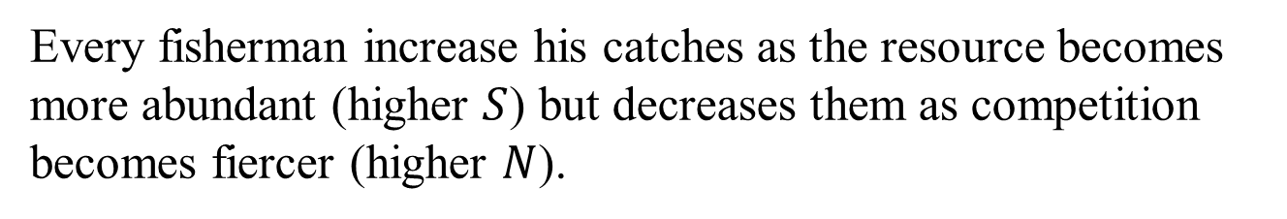
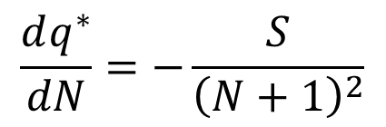
2.3.1 Finding equilibrium appropriation - Comparative static-
$${\frac{dq^{∗}}{dS}}^{ }=\frac{1}{N+1}$$
We can observe the equilibrium appropriation $q^{∗}$ increases in $S$
$$\frac{dq^{∗}}{dN}=−\frac{S}{{\left(N+1\right)}^{2}}$$
We can observe the equilibrium appropriation $q^{∗}$ decreases in $N$
Intuitively
Every fisherman increase his catches as the resource becomes more abundant (higher $S$) but decreases them as competition becomes fiercer (higher $N$).

Slide 45
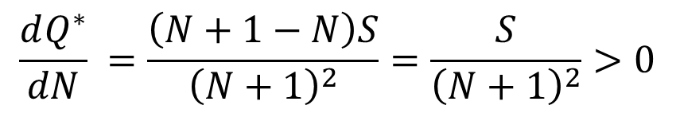

2.3.1 Finding equilibrium appropriation - Comparative static-
Example 2
The aggregate appropriation is
$$Q^{∗}=\frac{NS}{N+1}$$
$${\frac{dQ^{∗}}{dN}}^{ }=\frac{\left(N+1−N\right)S}{{\left(N+1\right)}^{2}}=\frac{S}{{\left(N+1\right)}^{2}}>0$$
We can observe the aggregate appropriation $Q^{∗}$ increases in $N$

Slide 46
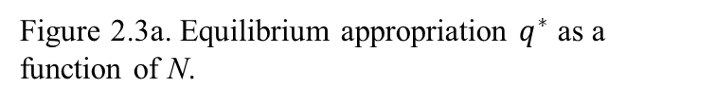
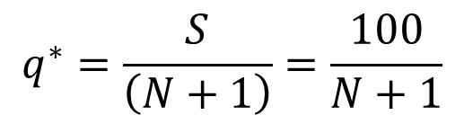
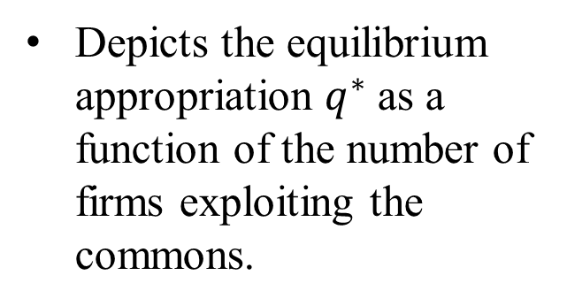
2.3.1 Finding equilibrium appropriation - Comparative static-
Figure 2.3a.
Depicts the equilibrium appropriation $q^{∗}$ as a function of the number of firms exploiting the commons.
$$q^{∗}=\frac{S}{\left(N+1\right)}=\frac{100}{N+1}$$
Figure 2.3a. Equilibrium appropriation $q^{∗}$ as a function of N.

Slide 47



2.3.1 Finding equilibrium appropriation - Comparative static-
Figure 2.3b.
Illustrates the aggregate equilibrium appropriation.
$S=100$
$$Q^{∗}=\frac{NS}{N+1}=\frac{100N}{N+1}$$
Figure 2.3b. Aggregate equilibrium appropriation $Q^{∗}$ as a function of N.

Slide 48




2.3.1 Finding equilibrium appropriation - Comparative static-
Figure 2.4
Depicts $q^{∗}$ as a function of the available stock, $S$
$N=2$
$$q^{∗}=\frac{S}{N+1}=\frac{S}{3}$$
Figure 2.4. Equilibrium appropriation $q^{∗}$ as a function of $S$.

Slide 49
2.3.2 Extension - What if fishermen have some market power?
In this stetting, we assume that;
Finite number of firms selling homogeneous products.
Other CPRs can be characterized by a few firms.
Each selling a relatively large share of total appropriations
( Ex. North Sea, the Bering Sea, and the Western Pacific)
In this setting, we can no longer assume that fishermen take prices as given.

Slide 50



2.3.2 Extension - What if fishermen have some market power?
Modelling the CPRs
The market demand
$$p\left(Q\right)=a−bQ$$
$Q$denotes the aggregate appropriation
where $Q=q_{i}+Q_{−i}$
is the sum of fisherman i’s and those of all his rivals
$a≥1$ and $b≥0$ are both positive parameters
$b≥0$ indicates a larger appropriation decreases the market price at which all fishermen sell their product.

Slide 51


2.3.2 Extension - What if fishermen have some market power?
Continue modelling the CPRs
Every firm faces the following cost function;
$$C\left(q_{i},Q_{−i}\right)=\frac{q_{i}\left(q_{i}+Q_{−i}\right)}{S}$$
The market demand can be expressed as
$$p\left(Q\right)=a−bq_{i}−{bQ}_{−i}$$

Slide 52

2.3.2 Extension - What if fishermen have some market power?
Fisherman i’s profit maximization problem
$$\max_{q_{i}≥0}{{ π}_{i}}=\left(a−bq_{i}−{bQ}_{−i}\right)q_{i}−\frac{q_{i}\left(q_{i}+Q_{−i}\right)}{S}$$
Total revenue
Total costs
How to solve this game?
Step 1: Finding fisherman i’s best response function.
Step 2: Using best response functions to find the Nash equilibrium.

Slide 53



2.3.2 Extension - What if fishermen have some market power?
Step 1: Finding fisherman i’s best response function.
Differentiating the profit function with respect to $q_{i}$ yields
$$a−2bq_{i}−bQ_{−i}=\frac{2q_{i}+Q_{−i}}{S}$$
Solving for $q_{i};$
$$q_{i}\left(Q_{−i}\right)=\frac{aS}{2\left(1+bS\right)}−\frac{1}{2}Q_{−i}$$
$$\left(BRF_{i }\right)$$

Slide 54


2.3.2 Extension - What if fishermen have some market power?
Numerical example
When $a = 1$and $b = 0$
I. The market price collapses to $p\left(Q\right) = \$1$,
II. The best response function simplifies to
$$q_{i}\left(Q_{−i}\right)=\frac{S}{2}−\frac{1}{2}Q_{−i}$$
The market prices are insensitive to sales (due to $b=0$)

Slide 55


2.3.2 Extension - What if fishermen have some market power?
Numerical example
When $N>1$ and $b>0$
I. The best response function simplifies to
$$q_{i}\left(Q_{−i}\right)=\frac{aS}{2\left(1+bS\right)}−\frac{1}{2}Q_{−i}$$
II. When b increases, the vertical intercept of the best response function decreases.
producing a downward shift without affecting its slope, $−\frac{1}{2}$

Slide 56


2.3.2 Extension - What if fishermen have some market power?
Intuitively,
For a given appropriation by i’s rivals, and by treating $Q_{−i}$ as given ;
the appropriation by fisherman i decreases when the market price becomes more sensitive to aggregate appropriation (when parameter $b$ increases)
The opposite effect arises when demand increases (as captured by an increase in $a$), as the vertical intercept of the best response function, $\frac{aS}{2\left(1+bS\right)}$now increases, shifting the function upwards.

Slide 57


2.3.2 Extension - What if fishermen have some market power?
Step 2: Using best response functions to find the Nash equilibrium.
In a symmetric equilibrium; each fisherman appropriates the same amount of fish
implying that $q_{1}^{ ∗}=q_{2}^{∗}=…=q_{N}^{∗}=q^{∗}$
All firms’ catches coincide
$so Q_{−i}^{ }$ becomes;
$$Q_{−i}^{∗}=\sum_{j≠i}{q^{∗}=\left(N−1\right)q^{∗}}$$

Slide 58


2.3.2 Extension - What if fishermen have some market power?
Inserting this result in the best response function yields
$$q_{ }^{∗}=\frac{aS}{2\left(1+bS\right)}−\frac{1}{2}\left(N−1\right)q^{∗}$$
The equilibrium appropriation becomes
$$q^{∗}=\frac{aS}{\left(N+1\right)\left(1+bS\right)}$$

Slide 59


2.3.2 Extension - What if fishermen have some market power?
Numerical example
When $a = 1$and $b= 0$
I. The equilibrium appropriation simplifies to
$$q^{∗}=\frac{S}{N+1}$$

Slide 60



2.3.2 Extension - What if fishermen have some market power?
Numerical example
When $N>1$ and $b>0$
I. The equilibrium appropriation simplifies to
$$q^{∗}=\frac{aS}{\left(N+1\right)\left(1+bS\right)}$$
II. When b increases every firm decreases its equilibrium appropriation $q^{∗}$.
III. Its sales create now a negative effect on the market price which did not exist when such a price was given.

Slide 61


2.3.2 Extension - What if fishermen have some market power?
Intuitively, the firm anticipates that selling more units will reduce market prices, so that it does not appropriate as much fish as when prices are insensitive to its catches.
The aggregate equilibrium appropriation is
$${Q^{∗}=Nq^{∗}= \frac{aNS}{\left(N+1\right)\left(1+bS\right)}}^{ }$$
which is increasing in N and S but decreasing in b because
$$\frac{∂Q^{∗}}{∂b}=−\frac{aNS^{2}}{\left(N+1\right){\left(1+bS\right)}^{2}}<0$$
$$\frac{∂Q^{∗}}{∂N}=\frac{aS}{{\left(N+1\right)}^{2}\left(1+bS\right)}>0$$
$$\frac{∂Q^{∗}}{∂S}=\frac{aN}{\left(N+1\right){\left(1+bS\right)}^{2}}>0$$

Slide 62



2.3.2 Extension - What if fishermen have some market power?
The aggregate appropriation can be supported if
$$\frac{aNS}{\left(N+1\right)\left(1+bS\right)}≤S$$
that we rearrange to yield
$$S≥\underline{S}≡\frac{N\left(a−1\right)−1}{b\left(N+1\right)}$$
which is increasing in a and N but decreasing in b because
$$\frac{∂\underline{S}}{∂N}=\frac{a−1}{{b\left(N+1\right)}^{2}}>0$$
Intuitively, more resources are needed to support more firms.

Slide 63




2.3.2 Extension - What if fishermen have some market power?
When $N→∞$, the aggregate appropriation becomes
$${\lim_{N→∞}{Q^{∗}}=\lim_{N→∞}{\frac{aNS}{\left(N+1\right)\left(1+bS\right)}}=\frac{aS}{1+bS}}^{ }$$
which is admissible if it falls below $S$, that is
$$\frac{aS}{1+bS}≤S$$
that we rearrange to yield
$$S ≥\frac{a−1}{b}$$

Slide 64
Common pool resources
Socially optimal appropriation

Slide 65


2.4 Common pool resources Socially optimal appropriation
Question….!
Is equilibrium appropriation excessive from a social point of view?
To answer that question, we start by defining the socially optimal appropriation;
Definition 1:
The socially optimal appropriation is the one maximizing the fishermen’s joint profits
$$W=PS$$
$where PS=\sum_{i=1}^{N}{π_{i}}$ denotes the sum of all firms’ profits

Slide 66



2.4 Common pool resources Socially optimal appropriation
In the case of only two fishermen (a CPR cartel)
$$W collapses to W = π_{1} + π_{2}$$
Definition 2:
General welfare function is the sum of consumer and producer surplus;
$$W = CS + PS$$
$$where CS = \int_{0}^{Q}{p\left(Q\right)dQ−p\left(Q\right)Q}$$
denotes consumer surplus

Slide 67

2.4 Common pool resources Socially optimal appropriation
Continue definition 2:
Welfare function in definition 2 is more common in CPRs where catches are sold in the domestic market, thus affecting domestic consumers.
Definition 3:
Welfare function can be further generalized to
$$W =\left(1 − λ\right) CS +λPS$$
where;
$λ$ : the weight that the social planner assigns to producer surplus
$\left(1 − λ\right)$ captures the weight that she assigns to consumer surplus

Slide 68



2.4 Common pool resources Socially optimal appropriation
Special cases on $λ$;
When $λ =1$
The welfare function collapses to;
$$W = PS$$
Indicating that the social planner does not care about consumer surplus.
This case happened when all appropriation is sold overseas so domestic consumers are not affected by the price of the good as, in short, they do not buy the product

Slide 69





2.4 Common pool resources Socially optimal appropriation
When $λ =\frac{1}{2}$
The welfare function becomes
$$W =\frac{CS+ PS}{2}$$
Since $\frac{1}{2}$enters as a constant, it can be graphically understood as a vertical shifter of $CS +PS$, and as a result;
$$W =\frac{CS+ PS}{2}$$
coincides with that maximizing
$$W=CS+PS$$

Slide 70



2.4 Common pool resources Socially optimal appropriation
When $λ =0$
The welfare function collapses to
$$W =CS$$
Indicating that the social planner does not assign any weight to fishermen’s profits
This case happened if they are all foreign firms operating at a $CPR$ overseas which does not have effects on domestic welfare, other than those channeled through the demand function and $CS$
$$.$$

Slide 71

2.4 Common pool resources Socially optimal appropriation
Find the socially optimal appropriation that maximizes welfare
In the next slides we will discuss how to find the socially optimal appropriation under special cases when;
Only profits matter (In section 2.4.1)
Consumers and profits matter (In section 2.4.2)
We focus on the case in which;
Fishermen take prices as given $p=\$1$
There are two fishermen $N = 2$

Slide 72





2.4.1 Socially optimal appropriation when only profits matter
When $λ =1$
The social planner considers the welfare function
$$W = PS$$
$$\max_{q_{1},q_{2}≥0}{W} = PS=π_{1}+π_{2}$$
which can be rewritten as
$$\max_{q_{1},q_{2}≥0}{π_{1}+π_{2}}=\left(q_{1}−\frac{q_{1}\left(q_{1}+q_{2}\right)}{S}\right)+\left(q_{2}−\frac{q_{2}\left(q_{2}+q_{1}\right)}{S}\right)$$
This problem is equivalent to that of a fishermen cartel where fishermen 1 and 2 coordinate their catches, $q_{1}$ and $q_{2}$, to maximize their joint profits

Slide 73


2.4.1 Socially optimal appropriation when only profits matter
Differentiating with respect to $q_{1},q_{2}$;
$$1−\frac{2\left(q_{1}+q_{2}\right)}{S}=0$$
Intuitively
The first term represents the marginal revenue (MR) from additional catches
The second term captures fisherman i’s marginal cost (MC)
Increasing catches produces twice as much marginal costs. Why?
Since every fisherman takes into account not only the increase in his own costs but also the increase in his rival’s cost

Slide 74





2.4.1 Socially optimal appropriation when only profits matter
In brief;
Every fisherman internalizes the cost externality that his appropriation generates on other fishermen, as a larger $q_{i}$ increases the cost of fisherman j.
$$S=2\left(q_{1}+q_{2}\right)$$
Solving for $q_{1};$
$$q_{1}\left(q_{2}\right)=\frac{S}{2}−q_{2}$$
for fisherman 1
$$q_{2}\left(q_{1}\right)=\frac{S}{2}−q_{1}$$
for fisherman 2

Slide 75
2.4.1 Socially optimal appropriation when only profits matter
The discussion in the next slide.
Figure 2.5. Equilibrium vs. joint profit maximization in the commons

Slide 76


2.4.1 Socially optimal appropriation when only profits matter
Figure 2.5 indicates the following:
For a given amount of appropriation from firm 2 ($q_{2})$, firm 1 chooses to appropriate fewer units when firms coordinate their exploitation of the resource (jointly maximizing profits) than when every firm independently selects its own appropriation
If fisherman 2 appropriates half of the available stock, $q_{2} =\frac{S}{2}$, fisherman 1 responds by not appropriating anything, $q_{1}=0$
Question…!
How to find the horizontal intercept of expression $q_{1}\left(q_{2}\right)=\frac{S}{2}−q_{2}$?

Slide 77



2.4.1 Socially optimal appropriation when only profits matter
Confirm the finding;
Let us simultaneously solve for appropriation levels $q_{1}$ and $q_{2}$
$$q_{1}\left(q_{2}\right)=\frac{S}{2}−q_{2}$$
for fisherman 1
$$q_{2}\left(q_{1}\right)=\frac{S}{2}−q_{1}$$
for fisherman 2
We consider that, among all optimal pairs, a natural equilibrium is that in which both firms appropriate the same amount.
Since firms are symmetric, the socially optimal output, $q^{SO}$, becomes
$$q_{1}^{SO}=q_{2}^{SO}=q^{SO}$$

Slide 78



2.4.1 Socially optimal appropriation when only profits matter
Inserting $q_{1}^{SO}=q_{2}^{SO}=q^{SO}$ in the equation for fisherman 1
$$q^{SO}=\frac{S}{2}−q^{SO}$$
and solving for $q^{SO};$
$$q^{SO}=\frac{S}{4}$$

Slide 79



2.4.1 Socially optimal appropriation when only profits matter
IV. When agents are independent,
$$q^{∗}=\frac{S}{N+1}$$
Evaluating at the case of $N = 2$ fishermen;
$$q^{∗}=\frac{S}{2+1}=\frac{S}{3}$$

Slide 80


2.4.1 Socially optimal appropriation when only profits matter
Comparing the results
$$q^{∗} >q^{SO}$$
$$\frac{S}{3}>\frac{S}{4}$$
In words,
The agents exploit the resource less intensively when they coordinate their appropriation decisions (and thus internalize the cost externalities their appropriation generates on others) than when they do not coordinate their exploitation.
“The tragedy of the commons”

Slide 81


2.4.2 Socially optimal appropriation with consumers and profits matter
When the social planner considers welfare function
$$W=\left(1−λ\right)CS+λPS$$
She chooses the level of catches $q_{1}$ and $q_{2}$ to solve
$\max_{q_{1},q_{2}≥0}{W=}$ $\left(1−λ\right)CS+λPS$
where
$$CS=\int_{0}^{Q}{p\left(Q\right)dQ−p\left(Q\right)Q}$$

Slide 82



2.4.2 Socially optimal appropriation with consumers and profits matter
The inverse demand function;
$$p\left(Q\right)= 1 −Q$$
is linear in the aggregate appropriation
Consumer surplus can be expressed as the area of the triangle below the demand function;
$$CS=\frac{1}{2}\left[1−\left(1−Q\right)\right]\left(Q−0\right)=\frac{1}{2}Q^{2}$$
The aggregate appropriation can be expanded as;
$$Q=q_{1}+q_{2}$$

Slide 83




2.4.2 Socially optimal appropriation with consumers and profits matter
The social welfare can be rewritten as;
$\max_{q_{1},q_{2}≥0}{W=}$ $\left(1−λ\right){\frac{1}{2}\left(q_{1}+q_{2}\right)}^{2}+λ\left(π_{1}+π_{2}\right)$
Differentiating with respect to $q_{1}$ and $q_{2}$
$$\frac{∂W}{∂q_{1}}=\left(1−λ\right)\left(q_{1}+q_{2}\right)+λ\left(1−\frac{2\left(q_{1}+q_{2}\right)}{S}\right)=0$$
$$\frac{∂W}{∂q_{2}}=\left(1−λ\right)\left(q_{1}+q_{2}\right)+λ\left(1−\frac{2\left(q_{1}+q_{2}\right)}{S}\right)=0$$

Slide 84




2.4.2 Socially optimal appropriation with consumers and profits matter
In a symmetric social optimum, firms exploit the CPR at the same rate;
$$q_{1}^{SO}=q_{2}^{SO}=q^{SO}$$
$$\left(1−λ\right)\left(q^{SO}+q^{SO}\right)+λ\left(1−\frac{2\left(q^{SO}+q^{SO}\right)}{S}\right)=0$$
$$2\left(1−λ\right)q^{SO}+λ\left(1−\frac{4q^{SO}}{S}\right)=0$$
Solving for $q^{SO}$, we obtain the socially optimal appropriation,
$$q^{SO}=\frac{Sλ}{2[2λ−S\left(1−λ\right)]}$$

Slide 85




2.4.2 Socially optimal appropriation with consumers and profits matter
The socially optimal aggregate appropriation is
$$Q^{SO}=2q^{SO}=\frac{Sλ}{2λ−S\left(1−λ\right)}$$
which is admissible if it falls below $S$, that is
$$\frac{Sλ}{2λ−S\left(1−λ\right)}≤S$$
that we rearrange to yield
$$S≤\frac{λ}{1−λ}$$
The next figure plots this condition.

Slide 86



2.4.2 Socially optimal appropriation with consumers and profits matter
The socially optimal aggregate appropriation is
$$S≤\frac{λ}{1−λ}$$
To understand this cutoff:
For example, when $λ=1$, any positive value of $S$ is admitted.
However, when $λ=\frac{1}{2}$, resource cannot be too much, i.e., $S≤1$.
Finally, when $λ=0$, no resource can support the social optimum!

Slide 87


2.4.2 Socially optimal appropriation with consumers and profits matter
Case: when $λ=1$
The socially optimal appropriation simplifies to
$$q^{SO}=\frac{S}{4}$$
The social planner only considered producer surplus ($λ=1$)
Question..!
What is the impact of change in the weight on producer surplus on the socially optimal appropriation level?

Slide 88



2.4.2 Socially optimal appropriation with consumers and profits matter
General case
$$q^{SO}=\frac{Sλ}{2\left[2λ−S\left(1−λ\right)\right]}$$
Differentiating with respect to $λ$
$$\frac{∂q^{SO}\left(λ\right)}{∂λ}=−\frac{S^{2}}{2{\left[2λ−S\left(1−λ\right)\right]}^{2}}$$
(which is negative)
Intuitively,
The regulator decreases the socially optimal appropriation when she assigns a larger weight to producer surplus.

Slide 89
Facing our first inefficiency

Slide 90

2.5 Facing our first inefficiency
From previous section,
Our results help us to identify the first inefficiency in the exploitation of the commons by individual firms.
Firms’ equilibrium appropriation is larger than that a social planner would select. This happens regardless of the welfare function that she considers, that is, both when;
she only seeks to maximize firms’ joint profits
$$W=π_{1}+π_{2}$$

Slide 91

2.5 Facing our first inefficiency
her objective is to maximize a weighted sum of consumer and producer surplus
$$W=\left(1−λ\right)CS+λPS$$
Intuitively;
Every individual fisherman ignores the negative cost externality that his appropriation produces on the other fishermen, and thus exploits the resource above the socially optimal level.
Ex. The Chilean jack mackerel in the Southeast Pacific, and the Peruvian anchovy in the Southeast Pacific.

Slide 92
2.5 Facing our first inefficiency
Our result is analogous to that in the standard Cournot model of quantity competition, where firms tend to produce too much, relative to the output that would maximize their joint profits in a cartel,
Since they ignore the negative effect that their sales generate on their rivals’ revenues
(as these sales decrease the market price which, in turn, reduce the total revenue of all firms in the industry)
This negative effect is, however, internalized when firms coordinate their production decisions to maximize their joint profits or, more generally, when a social planner determines individual output levels

Slide 93
Inefficient exploitation with more general functions

Slide 94



2.6 Inefficient exploitation with more general functions
In this section, we want to show that;
The appropriation is excessive relative to the social optimum,
Or more compactly, the equilibrium appropriation is socially excessive
$$q^{∗} >q^{SO}$$
We show this result without assuming a specific cost function
Our previous analysis considered a specific cost function for every firm $i$
$$C_{i}\left(q_{i},Q_{−i}\right)=\frac{q_{i}\left(q_{i}+Q_{−i}\right)}{S}$$

Slide 95




2.6 Inefficient exploitation with more general functions
$$MC_{i}=\frac{∂C_{i}\left(q_{i},Q_{−i}\right)}{∂q_{i}}$$
We only assume that firm i’s marginal cost
satisfies the following properties:
Assumption 1:
Positive, ${MC}_{i}>0$, and increasing in firm i’s own appropriation, $\frac{∂MC_{i}}{∂q_{i}}>0$;
Assumption 2:
Decreasing in the available stock, $\frac{∂MC_{i}}{∂S}<0$;
Assumption 3:
Increasing in the appropriation of any rival firm $j$, $\frac{∂MC_{i}}{∂q_{j}}>0$, where $j≠i$.

Slide 96



2.6 Inefficient exploitation with more general functions
Intuitively;
Assumption 1 says that every fisherman $i$ faces a positive and increasing cost for every additional unit the firm appropriates.
Assumption 2 suggests that fisherman $i$ can capture $q_{i}$ tons of fish more easily when the stock becomes more abundant.
Assumption 3 indicates that, when other fishermen increase their appropriation $Q_{−i}$, the resource becomes more scarce, increasing the time and effort that fisherman $i$ needs to spend in order to appropriate a given amount.

Slide 97



2.6 Inefficient exploitation with more general functions
$$C_{ }\left(q_{i},Q_{−i}\right)=\frac{q_{i}\left(q_{i}+Q_{−i}\right)}{S}$$
Given that
we have
$$\frac{∂C_{ }\left(q_{i},Q_{−i}\right)}{∂q_{i}}=\frac{2q_{i}+Q_{−i}}{S}=MC_{i}$$
which is
Positive and increasing in $q_{i}$ (as required by Assumption 1)
Decreasing in the stock $S$ (as required by Assumption 2)
Increasing in the appropriation by firm i’s rivals, $Q_{−i}$
(as required by Assumption 3)

Slide 98




2.6 Inefficient exploitation with more general functions
Equilibrium appropriation
$$\max_{q_{i}≥0}{ π_{i}=q_{i}−C_{i}\left(q_{i},Q_{−i}\right)}$$
$$\frac{∂π_{i}}{∂q_{i}}=1−\frac{∂C_{i}\left(q_{i},Q_{−i}\right)}{∂q_{i}}=0$$
We can express the above result more compactly as
$$MC_{i}=1$$
In words,
every fisherman $i$ increases his individual appropriation until the point where his marginal revenue from additional sales coincides with the marginal cost of this additional appropriation.

Slide 99

2.6 Inefficient exploitation with more general functions
The discussion in the next slide….!
Figure 2.6. Equilibrium appropriation $q_{i}^{∗}$

Slide 100



2.6 Inefficient exploitation with more general functions
Figure 2.6 depicts condition $MC_{i}= 1$, by separately plotting the price $p=\$1$ and the marginal cost ${MC}_{i}$. This marginal cost is increasing in firm i’s appropriation $q_{i}$ since, by Assumption 1, $\frac{∂MC_{i}}{∂q_{i}} >0$.
When firm $j$ increases its individual appropriation $q_{j}$, firm i’s marginal cost $MC_{i}$ increases, since $\frac{∂MC_{i}}{∂q_{j}} >0$by Assumption 3; whereas the marginal revenue in the right-hand side of $MC_{i}=1$is unaffected.
In Figure 2.6, curve $MC_{i}$ shifts upward, entailing that the crossing point between$MC_{i}$ and $1 moves to the left, reducing firm i’s equilibrium appropriation $q_{i}$.

Slide 101

2.6 Inefficient exploitation with more general functions
The socially optimal appropriation
Assuming the welfare function considers only joint profits, the social planner solves a problem, that is
$$\max_{q_{1},….,q_{N}≥0}{W}=PS=\sum_{i=1 }^{N}{π_{i}}=\sum_{i=1}^{N}{[q_{i}−C_{i}\left(q_{i},Q_{−i}\right)]}$$

Slide 102



2.6 Inefficient exploitation with more general functions
Which can be expanded as the sum of firm i’s profits plus the profits of all its rivals $π_{i}+\sum_{j≠i}{π_{j}}$, as follows
$$\max_{q_{i},…,q_{N}≥0}{W}=\left[q_{i}−C_{i}\left(q_{i},Q_{−i}\right)\right]+\sum_{j≠i}{\left[q_{j}−C_{j}\left(q_{j},Q_{−j}\right)\right]}$$
Differentiating with respect to every $q_{i}$, we find
$$1−\frac{∂C_{i}\left(q_{i},Q_{−i}\right)}{∂q_{i}}−\sum_{j≠i}{\frac{∂C_{j}\left(q_{j},Q_{−j}\right)}{∂q_{i}}}=0$$

Slide 103



2.6 Inefficient exploitation with more general functions
Since $Q_{−j}$ includes $q_{i}$ as one of its components,
we can rearrange the expression as;
$$MC_{i}+\sum_{j≠i}{\frac{∂C_{j}\left(q_{j},Q_{−j}\right)}{∂q_{i}}}=1$$
Our result then coincides with equilibrium condition $MC_{i}=1$, except for the new term $\sum_{j≠i}{\frac{∂C_{j}\left(q_{j},Q_{−j}\right)}{∂q_{i}}}$.

Slide 104

2.6 Inefficient exploitation with more general functions
Intuitively,
Every firm $i$ increases its individual appropriation until the point where its marginal revenue from appropriating one more unit $(p=\$1)$ coincides with the sum of its own additional cost, $MC_{i}$, and the additional cost that its appropriation generates on all other firms, $\sum_{j≠i}{\frac{∂C_{j}\left(q_{j},Q_{−j}\right)}{∂q_{i}}}$.

Slide 105



2.6 Inefficient exploitation with more general functions
Relative to the equilibrium condition $MC_{i} = 1$, every firm now internalizes the negative cost externality that its individual appropriation $q_{i}$ produces on its rivals.
As a result of this additional cost, firm $i$ chooses a lower exploitation in the social optimum than in equilibrium, $q_{i}^{SO}<q_{i}^{∗}$
Figure 2.7 illustrates this result and compares it against that emerging from equilibrium condition, $MC_{i}=1$.

Slide 106
2.6 Inefficient exploitation with more general functions
Figure 2.7. Equilibrium and socially optimal appropriation

Slide 107
2.7 Policy instruments
In this section,
We discuss some policy instruments to correct the socially excessive exploitation that we identified in our previous results.
Two policy instruments
Quotas
Appropriation fees

Slide 108

2.7.1. Policy instruments-Quotas-
The regulator can set a quota that lets fisherman $i$ catch as much fish as the socially optimal level, $q_{i}^{SO}$, facing stringent penalties if it exceeds this allowance.
Quotas are rather common in several CPRs such as;
Common Fisheries Policy in the European Union, which sets quotas on which types of fish each member state can fish.
Individual transferable quotas assigned to each fisherman in the U.S. or New Zealand.
These quotas are also known as Catch Share

Slide 109
2.7.1. Policy instruments-Quotas-
How these quotas work?
The regulator starts by setting a total allowable catch for each species of fish and for a given time period;
and then a dedicated portion is assigned to individual fishermen in the form of quotas, which are transferable, and thus can be bought, sold, and leased to other fishermen.
Example;
In 2008, 148 major fisheries and 100 smaller fisheries around the world had adopted some from of individual transferable quota.

Slide 110
2.7.1. Policy instruments-Quotas-
How do these quotas assign?
Quotas are often initially assigned according to the recent catch history of the fishermen, implying that those who more intensively appropriate the resource receive larger quotas.
This assignment rule can, then, induce fishermen to increase their relative appropriation of the resource to receive a larger transferable quota, which they can keep or sell in future periods.

Slide 111
2.7.1. Policy instruments-Quotas-
Quota auctions
Quota auctions have been proposed as an alternative allocation mechanism, which may prevent the previous perverse incentives to increase appropriation before the quota is allocated and, in addition, raises public funds for access to fisheries.
Quotas in aquifers
Quotas in aquifers are less common, but countries such as Mexico and Spain set limits on private use; otherwise, the farmer can lose his water permit.

Slide 112
2.7.1 Policy instruments-Appropriation fees
Other command-and-control regulations
Other command-and-control regulations include restrictions on the boat size, fishing gear (such as mesh or net size), limits on the days certain boats can fish, or prohibiting the catch of juvenile fish; among others.

Slide 113


2.7.2 Policy instruments-Appropriation fees
Appropriation fees
The regulator can set an appropriation fee to fisherman $i,t_{i},$that induces this fisherman appropriate the socially optimal level $q_{i}^{SO}$.
In this setting,
Every fisherman $i$ solves a problem analogous to
$$\max_{q_{i}≥0}{π_{i}}=q_{i}−\frac{q_{i}\left(q_{i}+Q_{−i}\right)}{S}$$
but with marginal costs increased by $t_{i}$.

Slide 114




2.7.2 Policy instruments-Appropriation fees
Fisherman i’s objective function now becomes
$$\max_{q_{i}≥0}{π_{i}}=q_{i}−\frac{q_{i}\left(q_{i}+Q_{−i}\right)}{S}−q_{i}t_{i}$$
First-order condition with respect to $q_{i}$
$$1−\frac{2q_{i}+Q_{−i}}{S}−t_{i}=0$$
Solving for appropriation $q_{i}$, we find best response function
$$q_{i}\left(Q_{−i}\right)=\frac{S\left(1−t_{i}\right)}{2}−\frac{1}{2}Q_{−i}$$

Slide 115




2.7.2 Policy instruments-Appropriation fees
When the appropriation fee is absent, $t_{i}=0$
$$q_{i}\left(Q_{−i}\right)=\frac{S}{2}−\frac{1}{2}Q_{−i}$$
$(BRF_{i}$)
It coincides with that in section 2.3
When the appropriation fee is present $t_{i}$
A more stringent fee decreases the vertical intercept of the best response function, $\frac{S\left(1−t_{i}\right)}{2}$, without affecting its slope.

Slide 116

2.7.2 Policy instruments-Appropriation fees
Graphically;
We can imply a parallel downward shift of fisherman i’s best response function.
(Try to draw it on Figure 2.1)
Intuitively,
For a given aggregate appropriation from his rivals $Q_{−i}$, fisherman $i$ decreases his individual appropriation when facing a more stringent fee.
This comes as no surprise since this fee increases the fisherman’s marginal cost of additional appropriation, reducing his incentives to exploit the resource.

Slide 117

2.7.2 Policy instruments-Appropriation fees
In a symmetric equilibrium,
$q_{i}^{∗}=q_{j}^{∗}=q^{∗}$, which entails that $Q_{−i}^{∗}=\left(N−1\right)q_{i}^{∗}$.
Inserting this property in the above best response function;
$$q^{∗}=\frac{S\left(1−t_{i}\right)}{2}−\frac{1}{2}\left(N−1\right)q^{∗}$$
Rearranging yields $q^{∗}\left(N+1\right)=S\left(1−t_{i}\right)$

Slide 118



2.7.2 Policy instruments-Appropriation fees
Solving for $q^{∗};$
$$q^{∗}\left(t_{i}\right)=\frac{S\left(1−t_{i}\right)}{N+1 }$$
“The equilibrium appropriation”
Case 1: When the appropriation fee is absent, $t_{i}=0$
$$q^{∗}\left(0\right)=\frac{S}{N+1 }$$
Case 2: When the appropriation fee is present, $t_{i}>0$
Nonetheless, equilibrium appropriation is lower

Slide 119


2.7.2 Policy instruments-Appropriation fees
Questions…!
How can the regulator find the appropriation fee $t_{i}$ that induces fisherman i exploit the resource at the socially optimal level $q_{i}^{SO}?$
What appropriation fee $t_{i}$, inserted in fisherman i’s equilibrium appropriation $q^{∗}\left(t_{i}\right)$, induces this fisherman to appropriate $q_{i}^{SO}$?

Slide 120







2.7.2 Policy instruments-Appropriation fees
The regulator seeks to achieve $q^{∗}\left(t_{i}\right)= q_{i}^{SO} ;$
$$q^{∗}\left(t_{i}\right)=\frac{S\left(1−t_{i}\right)}{N+1}$$
$$q_{i}^{SO}=\frac{S}{2N}$$
and
Setting $q^{∗}\left(t_{i}\right)=q_{i}^{SO}$, yields
$$\frac{S\left(1−t_{i}\right)}{N+1}=\frac{S}{2N}$$
Solving for $t_{i}^{∗}$, we obtain
$$t_{i}^{∗}=\frac{N−1}{2N}$$

Slide 121


2.7.2 Policy instruments-Appropriation fees
Note that $t_{i}^{∗}$ is increasing in the number of firms since
$$\frac{∂t_{i}^{∗}}{∂N}=\frac{1}{2N^{2}}>0$$
Intuitively, the regulator seeks to induce the same socially optimal aggregate output, $Q^{SO}=\frac{S}{2}$ , regardless of the number of firms.
When $N=1$, the above fee reduces to $t_{i}^{∗}=\frac{1−1}{2×1}=0$, since the monopoly chooses socially optimal appropriation, and thus, does not require appropriation fee to adjust its production behavior.

Slide 122


2.7.2 Policy instruments-Appropriation fees
When $N→∞$, the above fee becomes $t_{i}^{∗}=\lim_{N→∞}{\frac{1−\frac{1}{N}}{2}}=\frac{1}{2}$.

Slide 123


2.7.2 Policy instruments-Appropriation fees
What is the impact of the number of firms on the equilibrium appropriation $q^{∗}(t_{i})$?
When few firms operate in the commons, the equilibrium exploitation of each firm, $q^{∗}(t_{i})$, exceeds $q_{i}^{SO}$, requiring a positive fee to reduce exploitation. When several firms compete, the equilibrium appropriation of each firm, $q^{∗}(t_{i})$, is relatively low, while $q_{i}^{SO}=\frac{S}{2N}$ decreases more rapidly in $N$, leading the regulator to set a more stringent appropriation fee.
While appropriation fees are less common in fisheries, they are relatively frequent in groundwater agricultural use.

Slide 124
The tragedy of the commons under incomplete information

Slide 125
Outline
Symmetrically uninformed firms
– Everyone is in the dark
Asymmetrically uninformed firms
– Only some firms are in the dark

Slide 126
Symmetrically uninformed firms – Everyone is in the dark

Slide 127
6.2 Symmetrically uninformed firms
Assumption
Assume that N firms have free access to the resource.
Every firm i must simultaneously and independently choose its appropriation level $x_{i}$.
All firms face a common uncertainty: They cannot observe the available stock, S, but knows that it is high $S_{H}$ with probability $p$ or low $S_{L}$ with probability $1−p$, where $p∈\left[0,1\right]$.
The unobservability of the stock can be rationalized as (i) poor technology, or (ii) higher variations of the stock due to weather conditions.

Slide 128
6.2 Symmetrically uninformed firms
Every firm faces the following cost function;
$$C\left(x_{i},X_{−i}\right)=\frac{x_{i}\left(x_{i}+X_{−i}\right)}{S}$$
where
$S>0$ denotes the stock of the resource, which reduces firm i’s extraction cost when the resource is more abundant.
$x_{i}$ represents firm i’s appropriation level.
$X_{−i}=\sum_{i≠j}{x_{j}}$ are aggregate appropriations by firms other than i.
Every firm i takes market price $p$ as given (normalize to $p=\$1$).

Slide 129
6.2 Symmetrically uninformed firms
Every firm i chooses appropriation $x_{i}$ to maximize its expected profit:
$$\max_{x_{i}≥0} p\left(x_{i}−\frac{x_{i}\left(x_{i}+X_{−i}\right)}{S_{H}}\right)+\left(1−p\right) \left(x_{i}−\frac{x_{i}\left(x_{i}+X_{−i}\right)}{S_{L}}\right)$$
Profit if stock is high
Profit if stock is low
Intuitively, firm i chooses its appropriation level $x_{i}$ without being able to condition its choice on the stock of the resource.
Differentiating with respect to $x_{i}$, we obtain
$$p−\frac{p\left(2x_{i}+X_{−i}\right)}{S_{H}}+1−p−\frac{\left(1−p\right)\left(2x_{i}+X_{−i}\right)}{S_{L}}=0$$
where subscripts H and L indicate high and low stock, respectively.

Slide 130
6.2 Symmetrically uninformed firms
Rearranging the first-order condition, we have
$$\left[pS_{L}+\left(1−p\right)S_{H}\right]\left(2x_{i}+X_{−i}\right)=S_{L}S_{H}$$
Solving for $x_{i}$, the best response function becomes
$$x_{i}\left(X_{−i}\right)=\frac{S_{L}S_{H}}{2\left[pS_{L}+\left(1−p\right)S_{H}\right]}−\frac{1}{2}X_{−i}$$
which decreases in aggregate appropriation of all its rivals, $X_{−i}$.
When $p=1$, all firms know that the stock is high, and the above best response function collapses to $x_{i}\left(X_{−i}\right)=\frac{S_{H}}{2}−\frac{1}{2}X_{−i}$.
When $p=0$, all firms observes a low stock, and the above best response function simplifies to $x_{i}\left(X_{−i}\right)=\frac{S_{L}}{2}−\frac{1}{2}X_{−i}$.

Slide 131
6.2 Symmetrically uninformed firms
In a symmetric equilibrium, $x_{i}^{∗}=x_{j}^{∗}=x^{∗}$ entails $X_{−i}^{∗}=\left(N−1\right)x^{∗}$.
Substituting into the above best response function yields
$$x^{∗}=\frac{S_{L}S_{H}}{2\left[pS_{L}+\left(1−p\right)S_{H}\right]}−\frac{1}{2}{\left(N−1\right)x}^{∗}$$
Solving for $x^{∗}$, we find the equilibrium appropriation level
$$x^{∗}=\frac{S_{L}S_{H}}{\left(N+1\right)\left[pS_{L}+\left(1−p\right)S_{H}\right]}$$
When $p=1$, equilibrium appropriation $x^{∗}$ reduces to $x_{H}=\frac{S_{H}}{N+1}$.
When $p=0$, equilibrium appropriation $x^{∗}$ becomes $x_{L}=\frac{S_{L}}{N+1}$.

Slide 132
6.2 Symmetrically uninformed firms
When the resource is low, total appropriation becomes
$${Nx}^{∗}=\frac{NS_{L}S_{H}}{\left(N+1\right)\left[pS_{L}+\left(1−p\right)S_{H}\right]}≤S_{L}$$
which we simplify to
$$p\left(N+1\right)S_{L}+\left[\left(N+1\right)\left(1−p\right)−N\right]S_{H}≥0$$
Since $S_{H}>S_{L}$, the above inequality becomes
$$\left[p\left(N+1\right)+\left(N+1\right)\left(1−p\right)−N\right]S_{L}≥0$$
that further reduces to $S_{L}>0$ which holds by definition.

Slide 133
6.2 Symmetrically uninformed firms
When the resource is high, total appropriation becomes
$${Nx}^{∗}=\frac{NS_{L}S_{H}}{\left(N+1\right)\left[pS_{L}+\left(1−p\right)S_{H}\right]}≤S_{H}$$
which we simplify to
$$\left[p\left(N+1\right)−N\right]S_{L}+\left(N+1\right)\left(1−p\right)S_{H}≥0$$
Since $S_{H}>S_{L}$, the above inequality becomes
$$\left[p\left(N+1\right)−N+\left(N+1\right)\left(1−p\right)\right]S_{L}≥0$$
that further reduces to $S_{L}>0$ which holds by definition.

Slide 134
6.2.1 Comparing equilibrium appropriation in different information contexts – I
Comparing equilibrium appropriation under incomplete information, $x^{∗}$, against its complete information counterpart, $x_{H}$, we have
$$x_{H}−x^{∗}=\frac{S_{H}}{N+1}−\frac{S_{L}S_{H}}{\left(N+1\right)\left[pS_{L}+\left(1−p\right)S_{H}\right]}=\frac{S_{H}\left[1−\frac{S_{L}}{pS_{L}+\left(1−p\right)S_{H}}\right]}{N+1}$$
which is positive if
$$1−\frac{S_{L}}{pS_{L}+(1−p)S_{H}}>0$$
or rearranging, $pS_{L}+(1−p)S_{H}>S_{L}$ that simplifies to $S_{H}>S_{L}$.

Slide 135
6.2.1 Comparing equilibrium appropriation in different information contexts – I
Comparing equilibrium appropriation under incomplete information, $x^{∗}$, against its complete information counterpart, $x_{L}$, we have
$$x_{L}−x^{∗}=\frac{S_{L}}{N+1}−\frac{S_{L}S_{H}}{\left(N+1\right)\left[pS_{L}+(1−p)S_{H}\right]}=\frac{S_{L}\left[1−\frac{S_{H}}{pS_{L}+(1−p)S_{H}}\right]}{N+1}$$
which is negative if
$$1−\frac{S_{H}}{pS_{L}+\left(1−p\right)S_{H}}<0$$
or rearranging, $pS_{L}+\left(1−p\right)S_{H}<S_{H}$ that simplifies to $S_{H}>S_{L}$.

Slide 136

6.2.1 Comparing equilibrium appropriation in different information contexts – I
From $x_{H}>x^{∗}>x_{L}$, every firm exploits the resources more (less) intensively when informed of the stock being high (low) than when facing some uncertainty about the stock’s value.
Figure 6.1: Equilibrium appropriation under complete and incomplete information

Slide 137
6.2.1 Comparing equilibrium appropriation in different information contexts – I
Figure 6.1
Equilibrium appropriation under incomplete information $x^{∗}$ lies between complete information when stock is high and low, $x_{H}>x^{∗}>x_{L}$, and $x^{∗}$ increases in the probability that the stock is high.
When $p=0$, $x^{∗}=x_{L}$ but when $p=1$, $x^{∗}=x_{H}$.
For illustration purposes, consider $S_{H}=10$, $S_{L}=5$, and $N=2$.
$$x^{∗}=\frac{5×10}{\left(2+1\right)\left[5p+10(1−p)\right]}=\frac{10}{3\left(2−p\right)}$$
$$x_{H}=\frac{10}{2+1}=3\frac{1}{3}≈3.33$$
$$x_{L}=\frac{5}{2+1}=1\frac{2}{3}≈1.67$$

Slide 138
6.2.2 Comparative Statics
Differentiating $x^{∗}$ with respect to $p$, $S_{L}$, and $S_{H}$
$$\frac{∂x^{∗}}{∂p}=\frac{{(S}_{H}{−S}_{L})S_{L}S_{H}}{\left(N+1\right){\left[pS_{L}+(1−p)S_{H}\right]}^{2}}>0$$
$$\frac{∂x^{∗}}{∂S_{H}}=\frac{pS_{L}^{2}}{\left(N+1\right){\left[pS_{L}+(1−p)S_{H}\right]}^{2}}>0$$
$$\frac{∂x^{∗}}{∂S_{L}}=\frac{(1−p)S_{H}^{2}}{\left(N+1\right){\left[pS_{L}+(1−p)S_{H}\right]}^{2}}>0$$
Equilibrium appropriation increases as the stock becomes more abundant, either $S_{H}$ or $S_{L}$, and in probability $p$ that the stock is high.
Yet, $x^{∗}$ decreases in the number of firms competing for the commons.

