Slide 1
Review Session
Final Exam
Chapters 13-17
Notes:
Cover Credits: Currency Exchange Stock Chart: cemagraphics/Getty Images, Social Media Montage: SEAN GLADWELL/Getty Images, Circuit Pattern: somsak Tangdamrongsub/Getty Images, Cargo Containers: urzine/Getty Images

Slide 2
Important Dates
Thursday Dec 5th: No class [Office Hours].
Friday Dec 6th: Homework #14 (Chapters 16 & 17).
Wednesday Dec 11th at 1:30pm: Final Exam.

Slide 3
Important Dates
Tuesday
Thursday
Friday
Wednesday
Review Session
12/03
No Class
12/05
HW #14
12/06
Final Exam
1:30pm
12/11

Slide 4
Final Exam
20 Questions, multiple choice.
Chapters 13 (Rational Consumer), 14 (Production), 15 (Perfect Competition), 16 (Monopoly) and 17 (Oligopoly).
2 hour and 30 minutes.
No phones are allowed.
You can bring a calculator.
No extra credit assignments!

Slide 5

Final Exam – Scantron answer sheet

Slide 6

The Rational Consumer (Chapter 13)
  Marginal utility (MU) is the change in utility from consuming an additional unit.
  Diminishing marginal utility is the fact that each additional unit of a good adds less to utility than the previous unit.

Slide 7
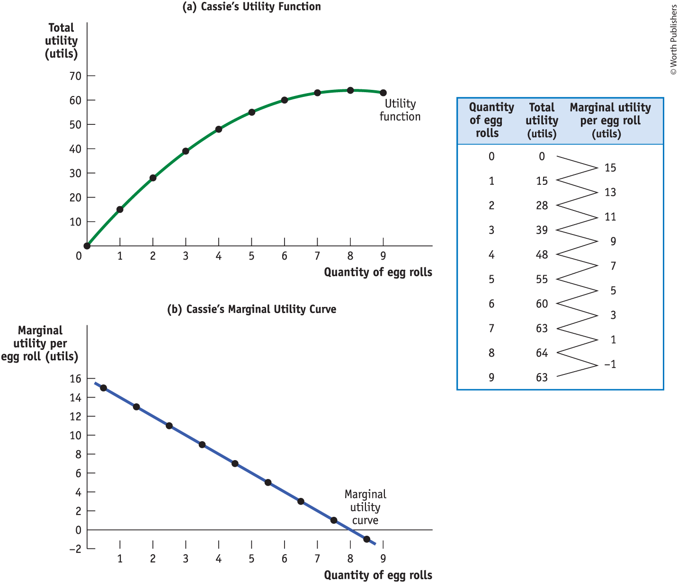
CASSIE’S TOTAL UTILITY AND MARGINAL UTILITY
Each additional egg roll gives Cassie less additional utility than the previous egg roll.

Slide 8

BUDGET CONSTRAINTS AND BUDGET LINES
Because the amount of money a consumer can spend is limited, a decision to consume more of one good is also a decision to consume less of some other good.
A budget constraint requires that the cost of a consumer’s consumption bundle be no more than the consumer’s income.

Slide 9
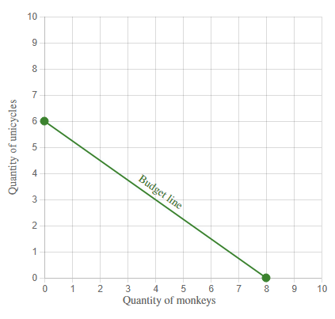





LEARN BY DOING: PRACTICE QUESTION
The graph shows Mauricio's initial budget constraint. The price per unicycle is $120, and the price per monkey is $90.
What is Mauricio's budget for monkeys and unicycles?
$$\frac{Income}{{Price}_{Unicycles}}$$
$$6=\frac{Income}{{Price}_{Unicycles}}$$
$$6=\frac{Income}{120}$$
$$6×120=Income$$
$$Income=720$$

Slide 10
MARGINAL UTILITY PER DOLLAR
The marginal utility per dollar spent on a good or service is the additional utility from spending one more dollar on that good or service.

Slide 11
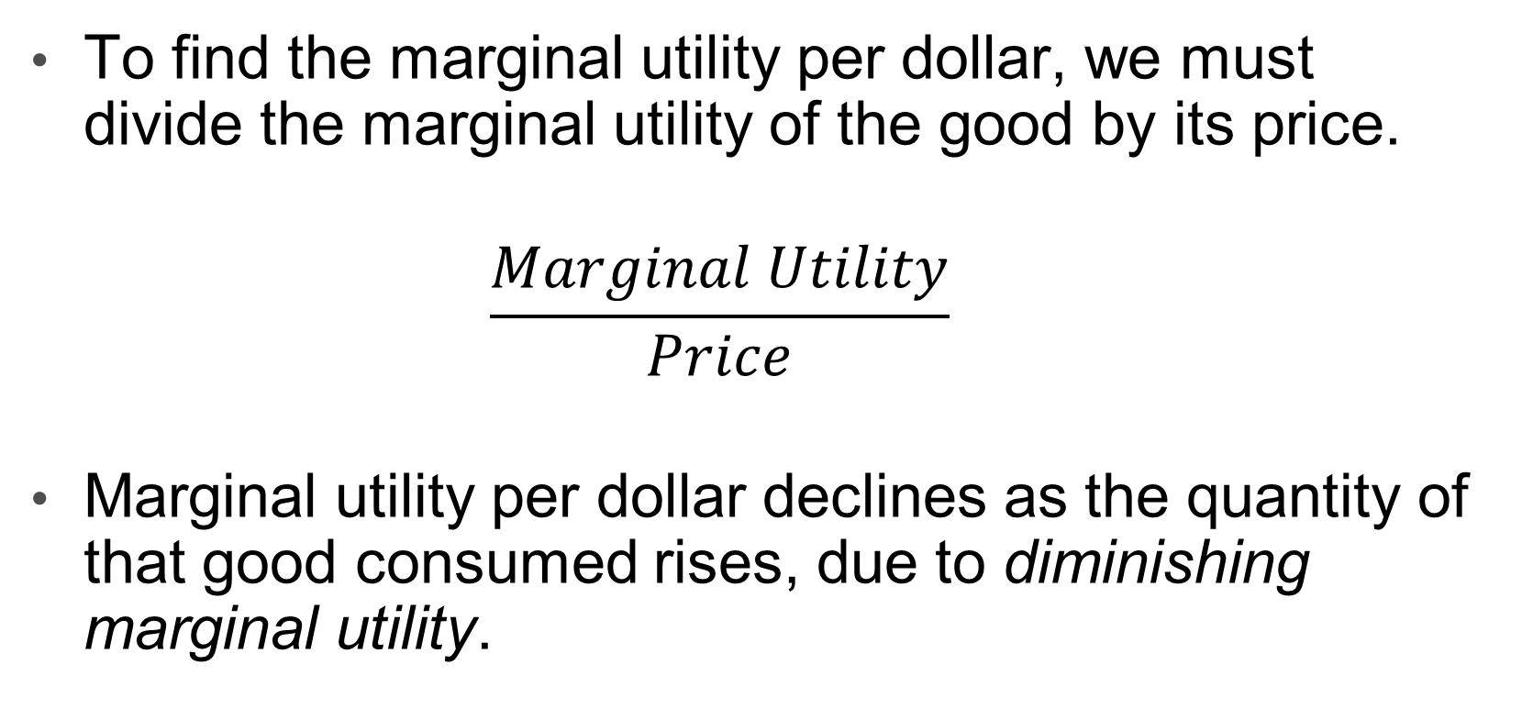
MARGINAL UTILITY PER DOLLAR
To find the marginal utility per dollar, we must divide the marginal utility of the good by its price.
  $$\frac{Marginal Utility}{Price}$$
Marginal utility per dollar declines as the quantity of that good consumed rises, due to diminishing marginal utility.

Slide 12


PRODUCTION (Chapter 14)
A fixed input is an input whose quantity is fixed for a period of time and cannot be varied.
A variable input is an input whose quantity the firm can vary at any time.

Slide 13

INPUTS AND OUTPUT
The long run is the period in which all inputs can be varied.
The short run is the period in which at least one input is fixed.
The total product curve shows how the quantity of output depends on the quantity of the variable input for a given quantity of the fixed input.

Slide 14
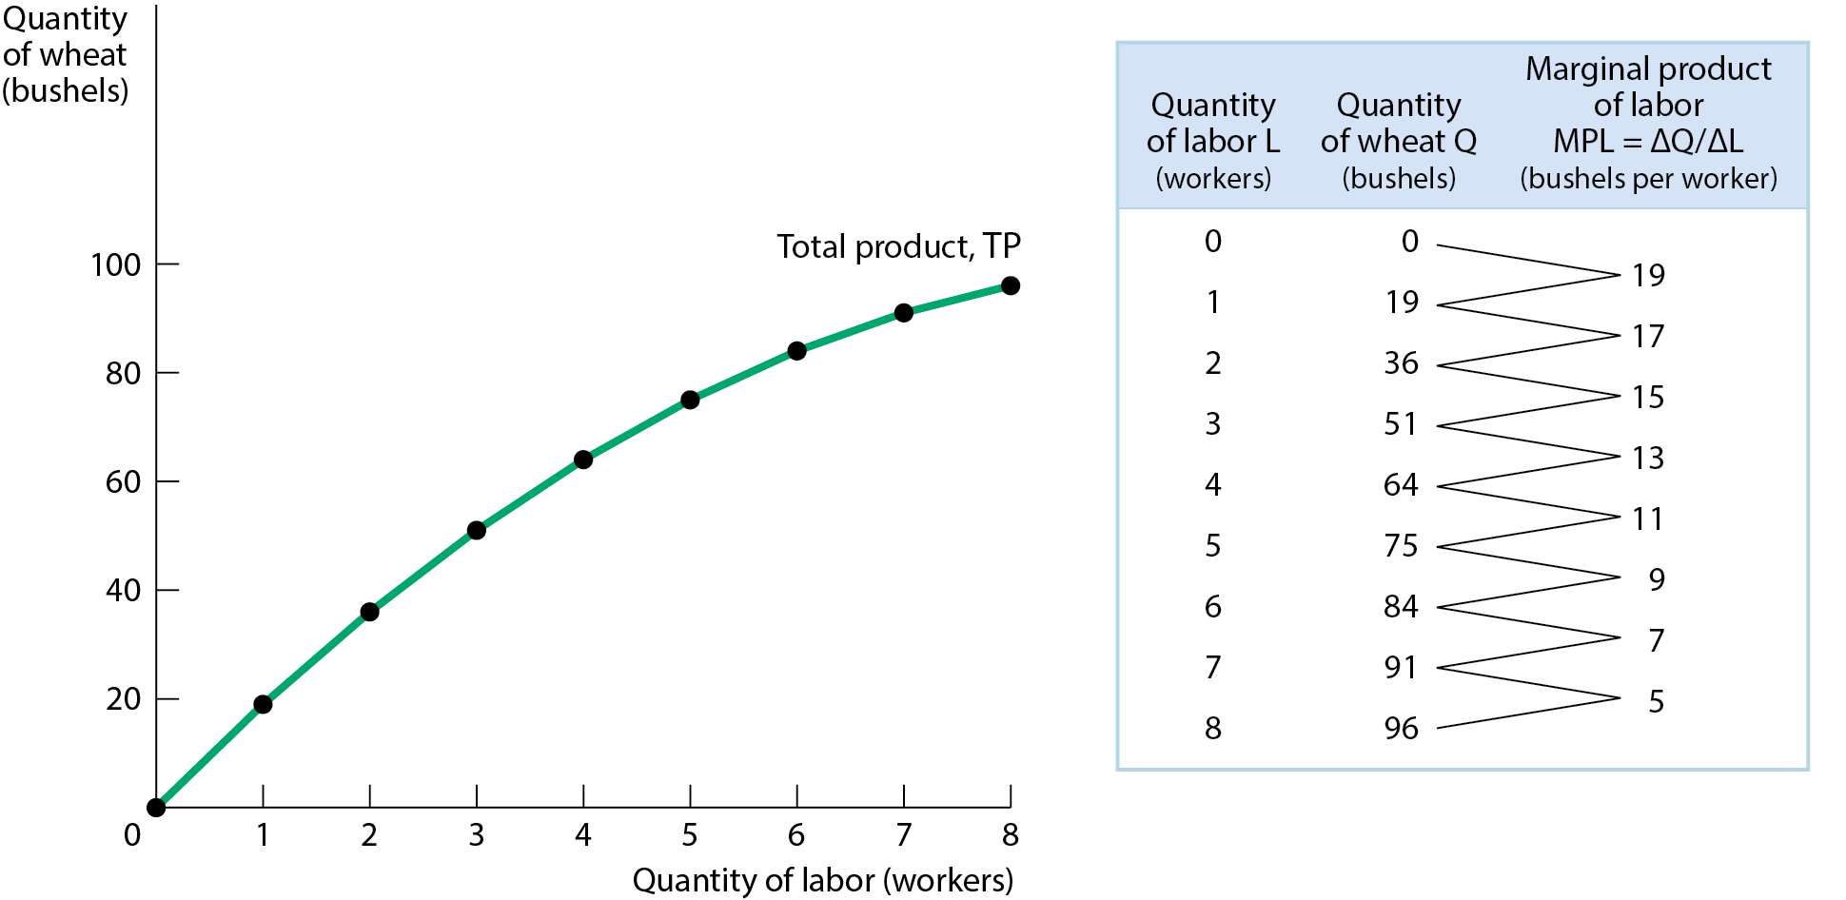
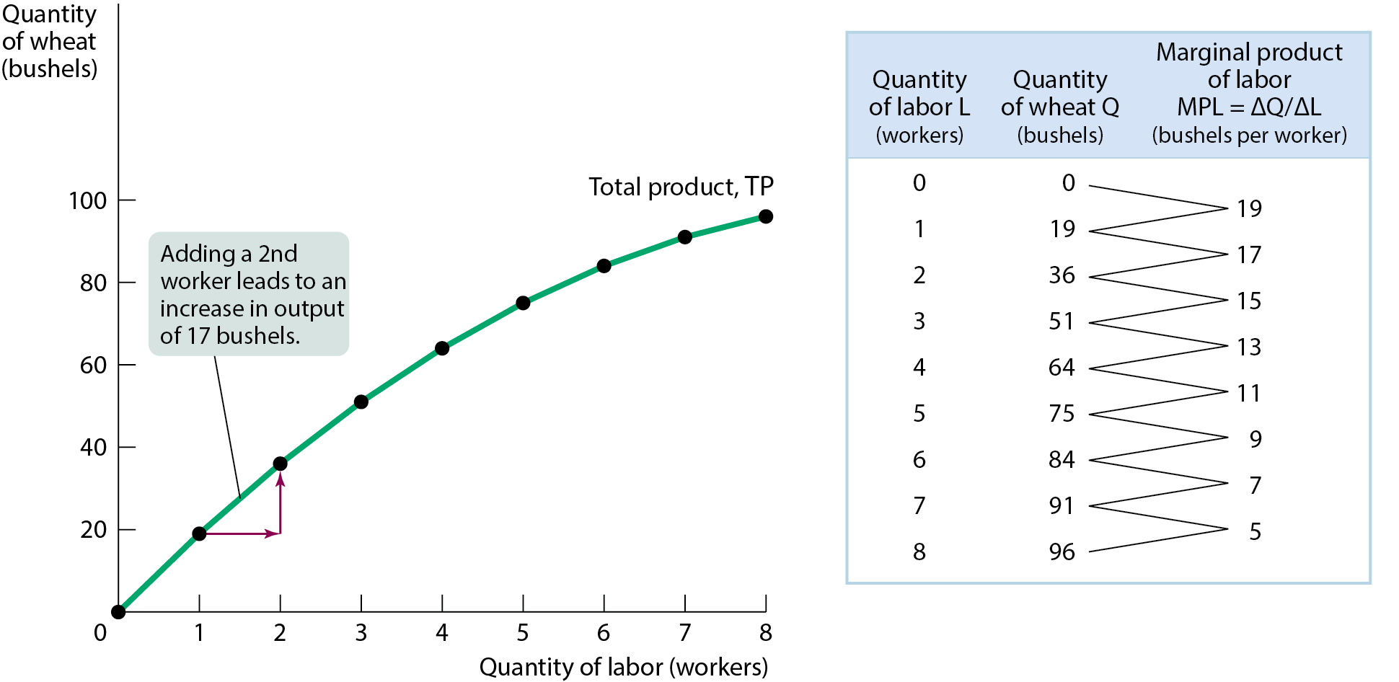
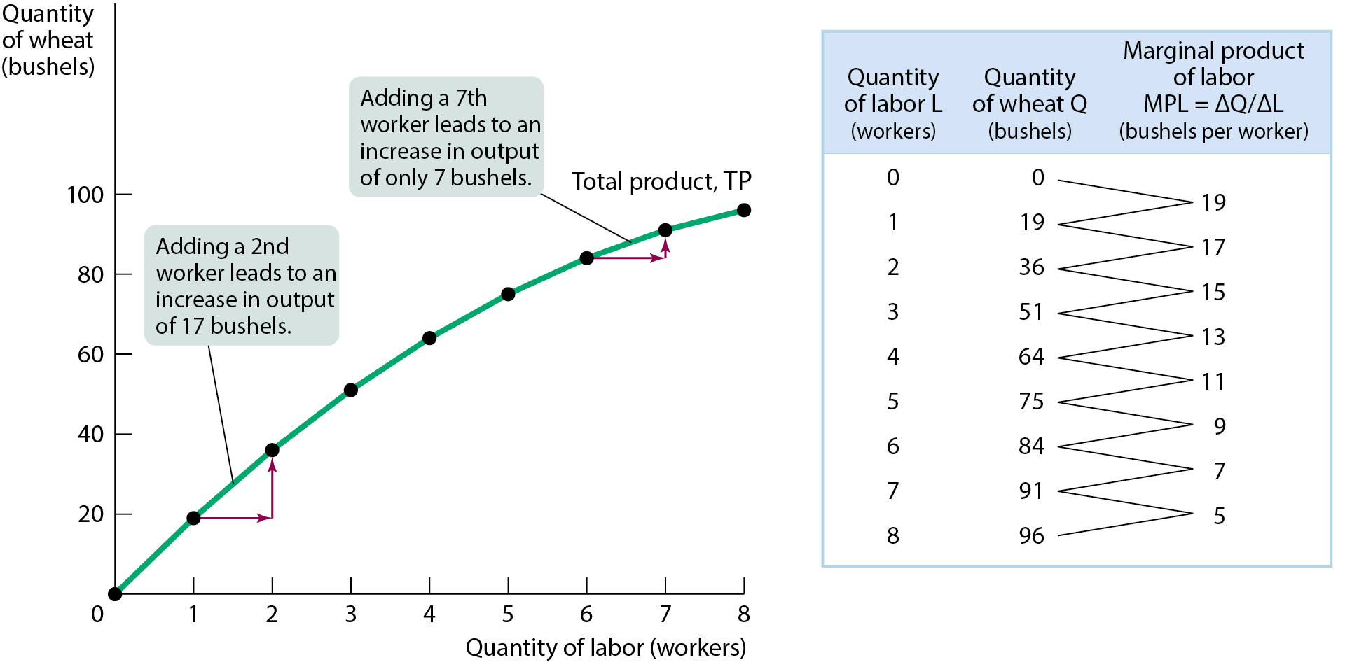
PRODUCTION FUNCTION AND TOTAL PRODUCT CURVE
The curve slopes upward because more wheat is produced as more workers are employed. It becomes flatter because the marginal product of labor declines as more workers are employed.
Figure 1

Slide 15
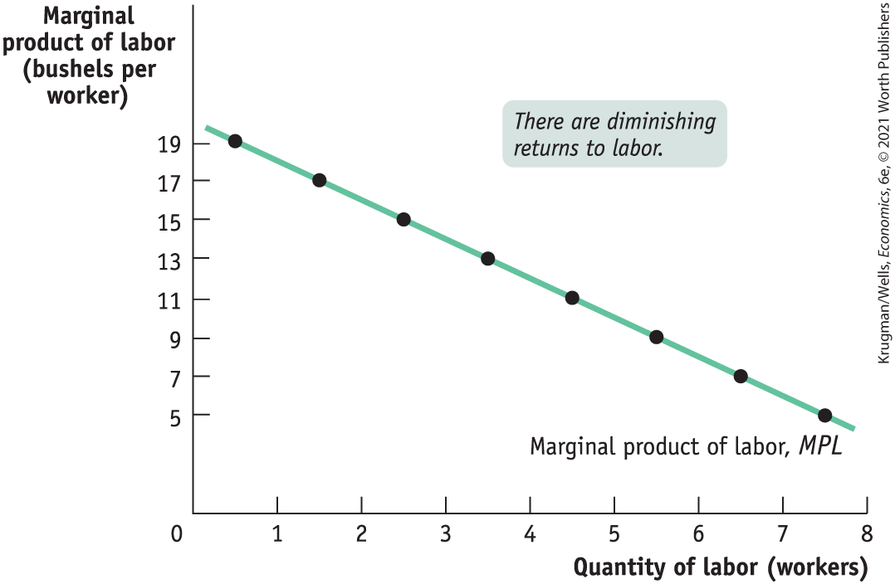
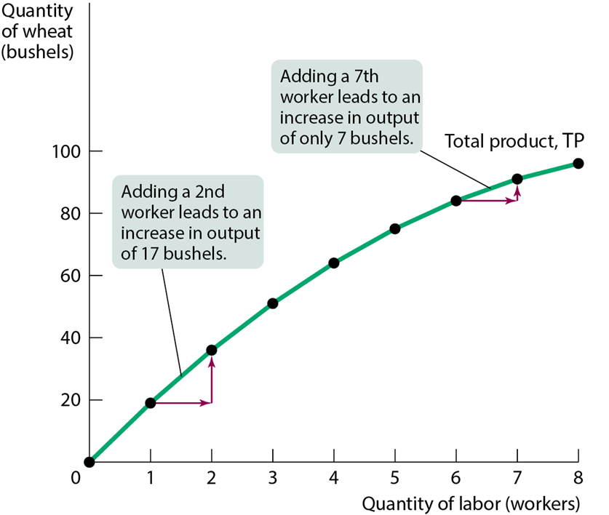
PRODUCTION FUNCTION AND TOTAL PRODUCT CURVE
MPL equals the slope of the total product curve.
MPL declines as more workers are hired. As employment increases, the total product curve gets flatter.
Figure 2 shows how MPL depends on the number of workers.

Slide 16
DIMINISHING RETURNS TO AN INPUT
Diminishing returns to an input: an increase in the quantity of that input, holding the levels of all other inputs fixed, reduces that input’s marginal product.
Figure 2

Slide 17
Production (Chapter 14)
Quantity of variable inputs | Quantity of output
0 | 0
2 | 200
4 | 500
6 | 1,000
8 | 1,400
Marginal Product
0
200
300
500
400
The firm’s production experiences diminishing returns to labor when it hires.
A. the second unit of labor.
B. the fourth unit of labor.
C. the sixth unit of labor.
D. the eighth unit of labor.

Slide 18
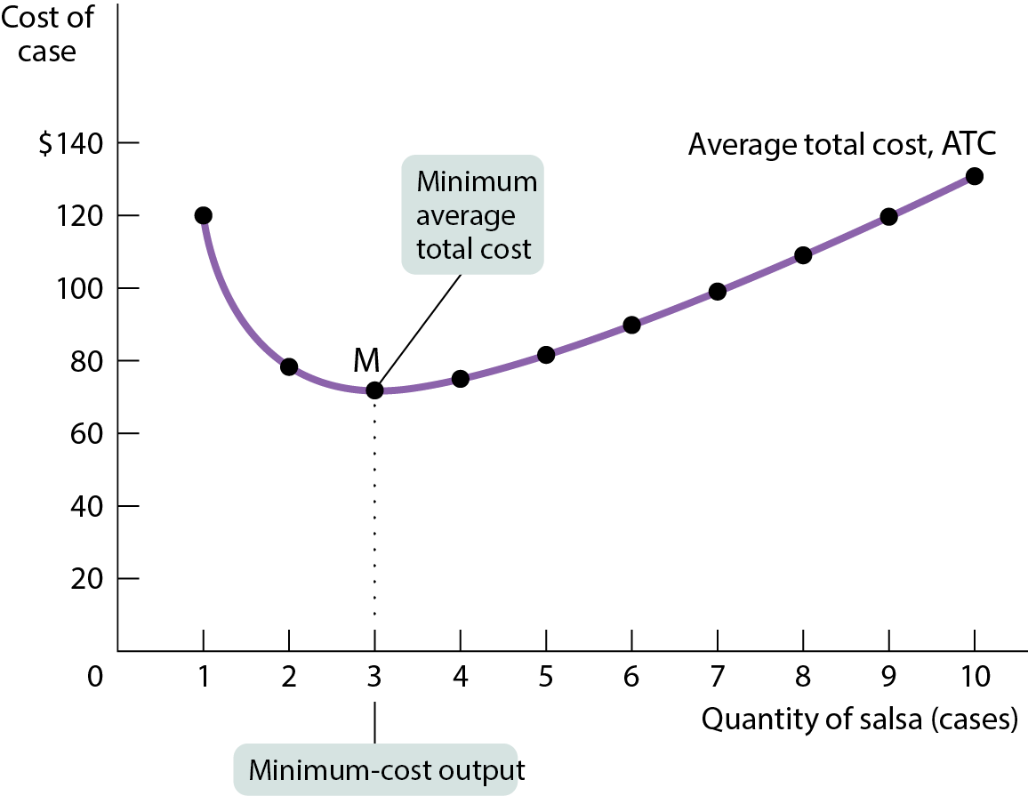
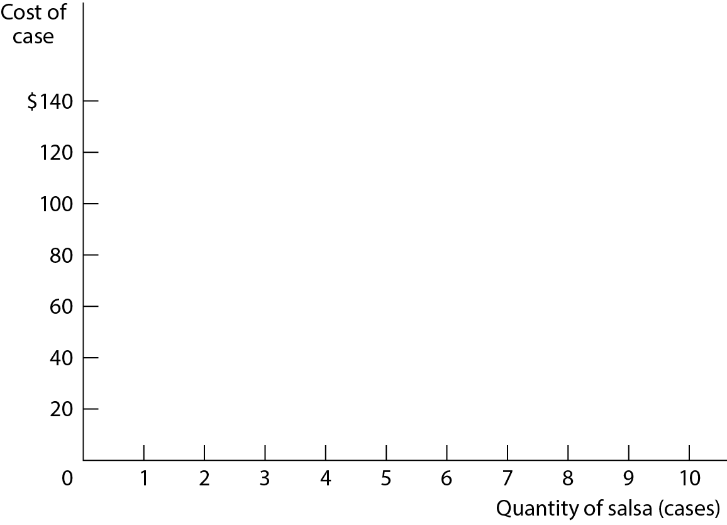
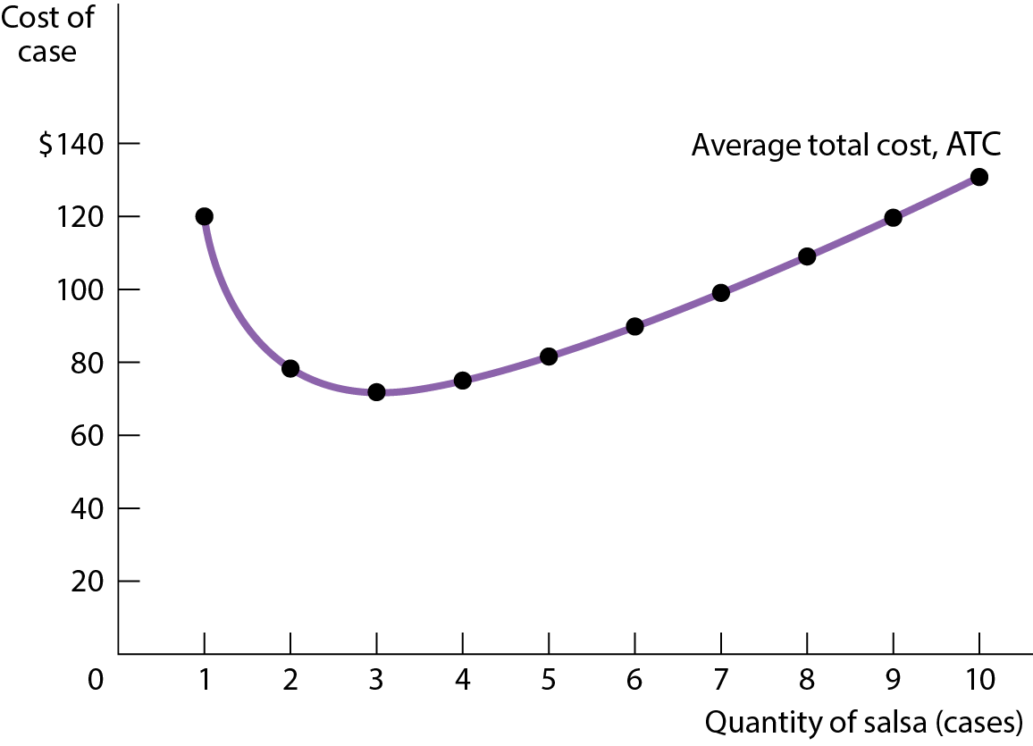
AVERAGE TOTAL COST CURVE FOR SELENA’S GOURMET SALSAS
Figure 7

Slide 19
AVERAGE TOTAL COST CURVE
Increasing output has two opposing effects on average total cost:
  The spreading effect: The larger the output, the more output over which fixed cost is spread, leading to lower average fixed cost.
  The diminishing returns effect: The larger the output, the more variable input required to produce additional units, which leads to higher average variable cost.

Slide 20
SHORT-RUN VERSUS LONG-RUN COSTS
All inputs are variable in the long run. This means that in the long run, fixed cost (like factory size) may also vary.
The firm will choose its fixed cost in the long run based on the level of output it expects to produce.

Slide 21
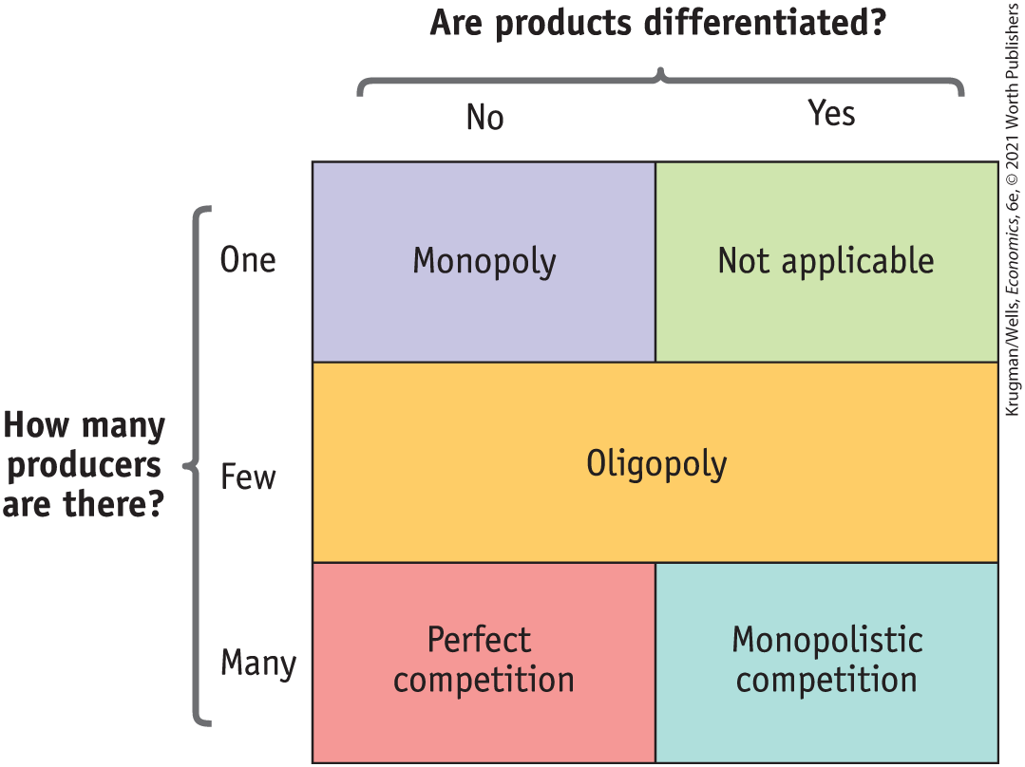
TYPES OF MARKET STRUCTURE, VISUALLY
Figure 1

Slide 22
PERFECT COMPETITION (Chapter 15)
All market participants, both consumers and producers, are price-takers.
There are many producers, each with a small market share.
  Market share: the fraction of the total industry output accounted for by that producer’s output.
  This means both sellers and buyers are price-takers; their actions have no effect on price.
Consumers regard the products of all producers as equivalent.
  The product is standardized across sellers.

Slide 23
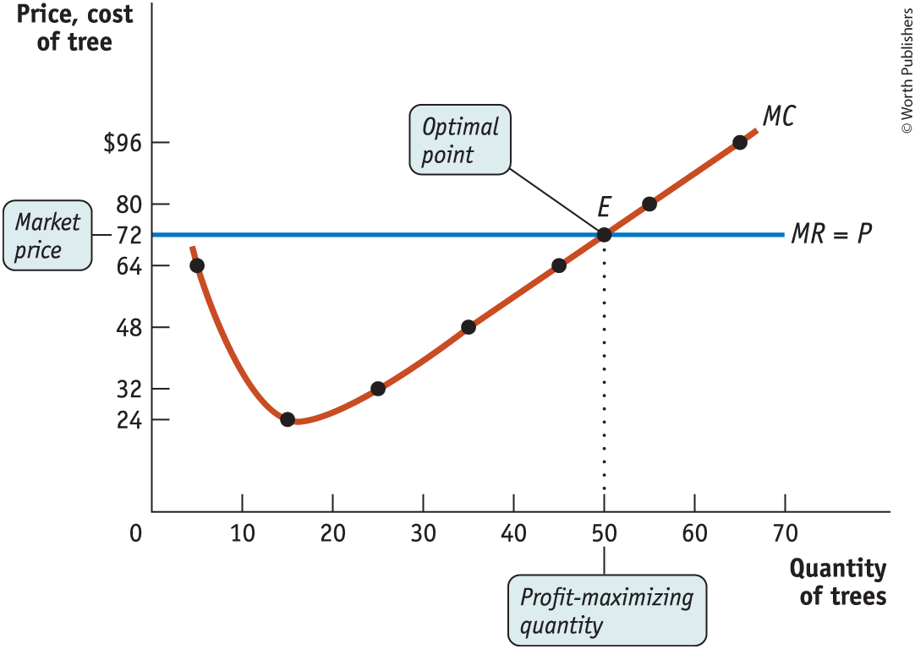
THE PRICE-TAKING FIRM’S PROFIT-MAXIMIZING QUANTITY OF OUTPUT
Figure 1

Slide 24
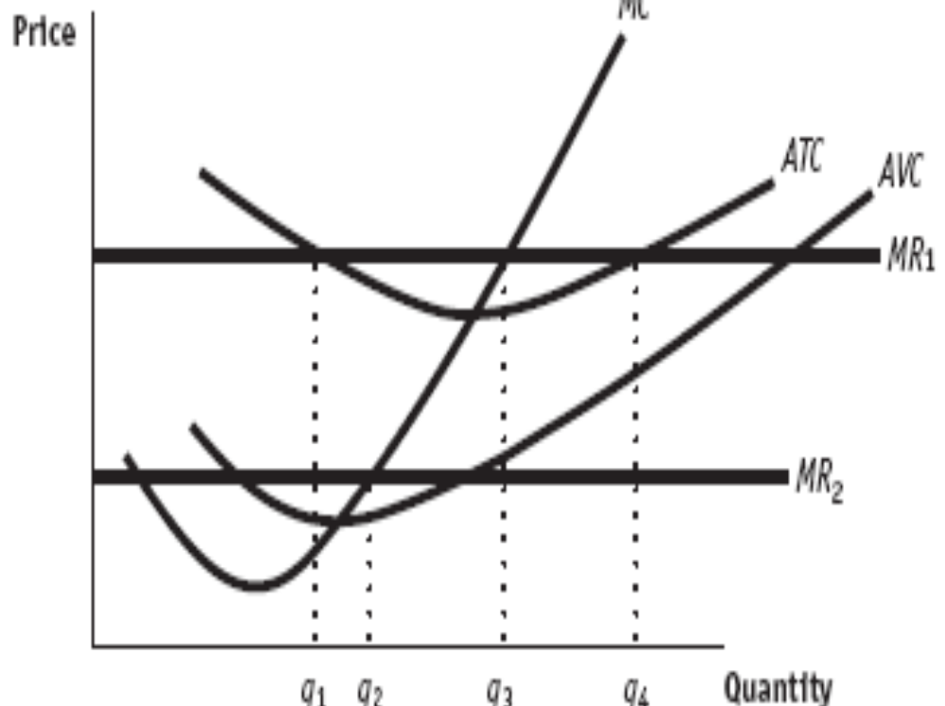
What is the output level? + or – profits?
Short
Run

Slide 25


MONOPOLY (Chapter 16)
Monopolist: a firm that is the only producer of a good with no close substitutes.
Monopoly: an industry controlled by a monopolist.
Market power: the ability of a firm to raise prices.

Slide 26
INCREASING RETURNS TO SCALE
Increasing returns to scale (economies of scale): When average total cost falls as output increases, firms tend to grow larger.
The source of increasing returns to scale is large fixed costs.
Increasing returns to scale can give rise to and sustain monopoly.
A monopoly created and sustained by increasing returns to scale is called a natural monopoly.
The most visible natural monopolies are utilities—water, natural gas, power generation, and fiber optic cable.

Slide 27
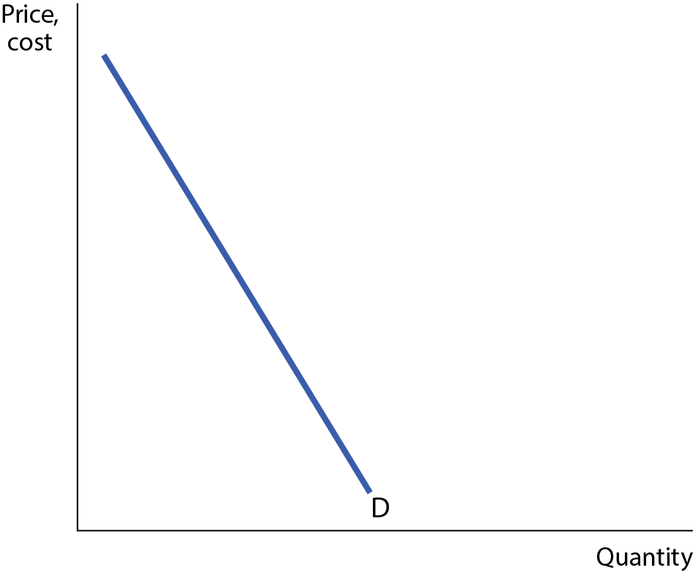
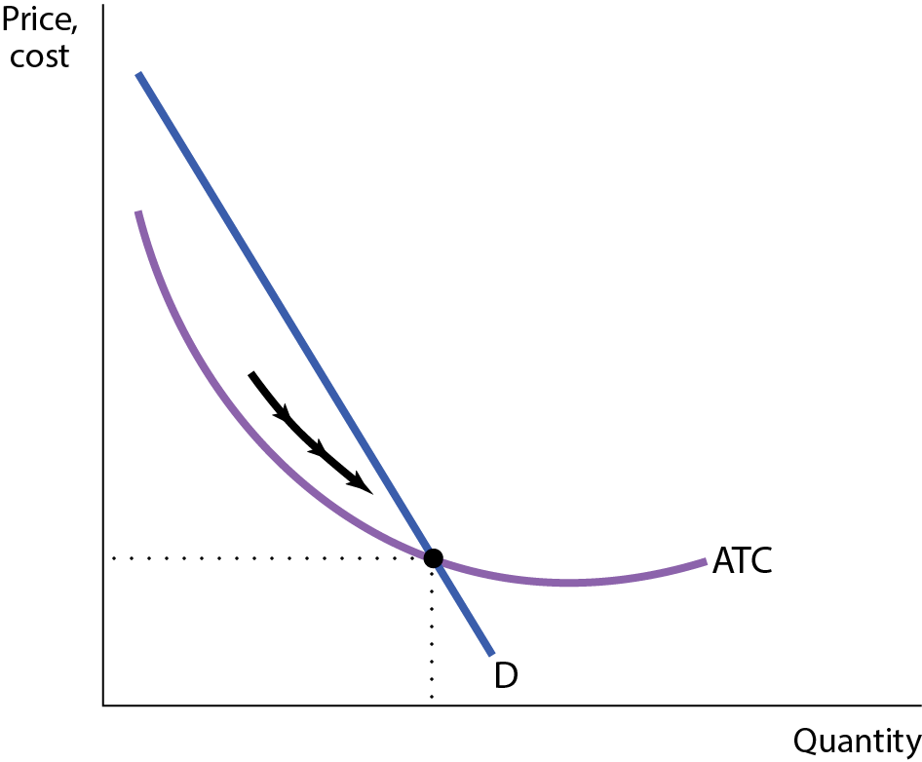
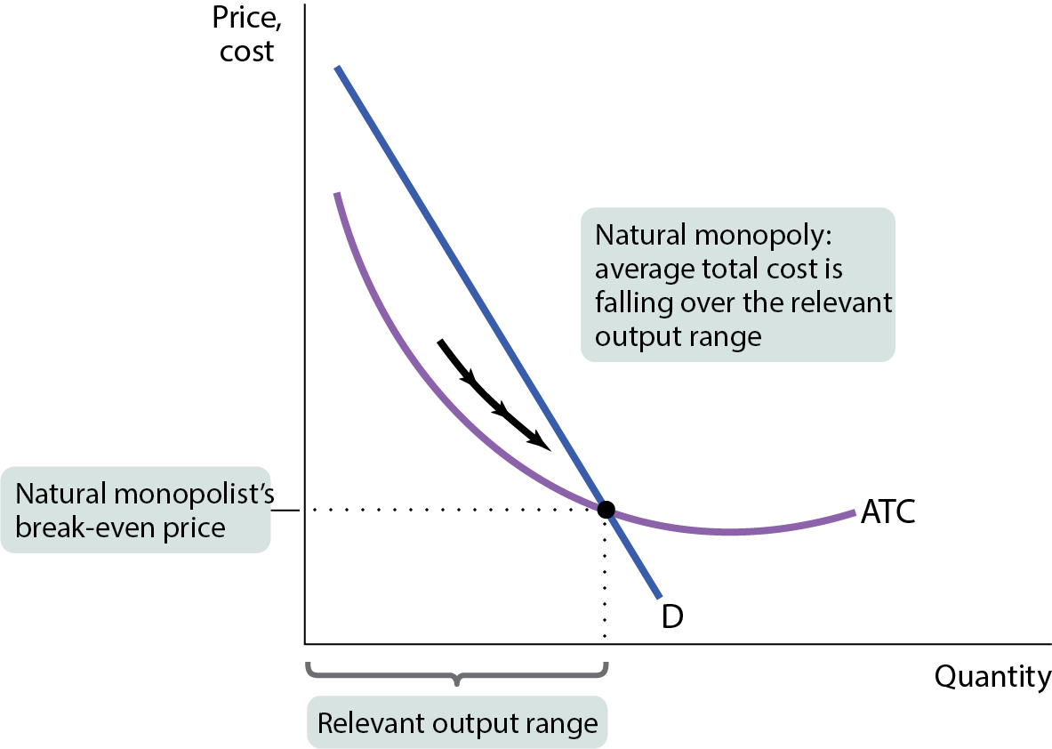
Natural Monopoly
Figure 3
A given quantity of output is produced more cheaply by one large firm than by two or more smaller firms.

Slide 28
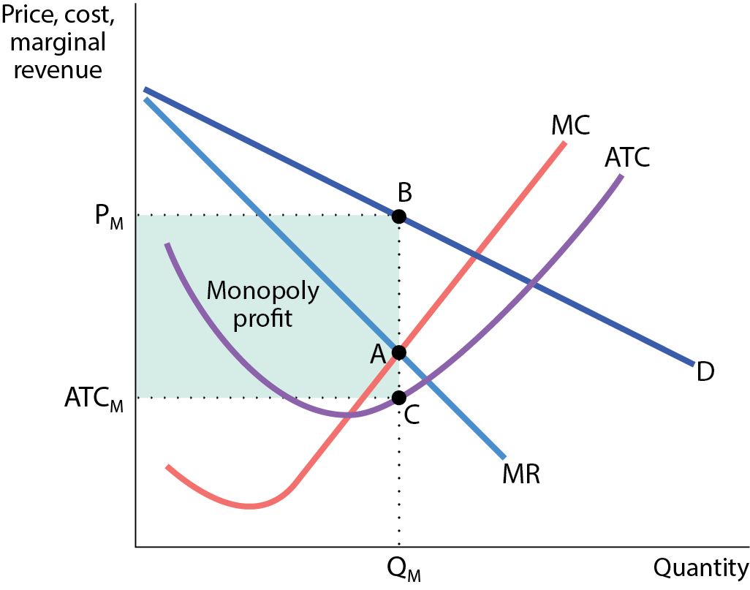
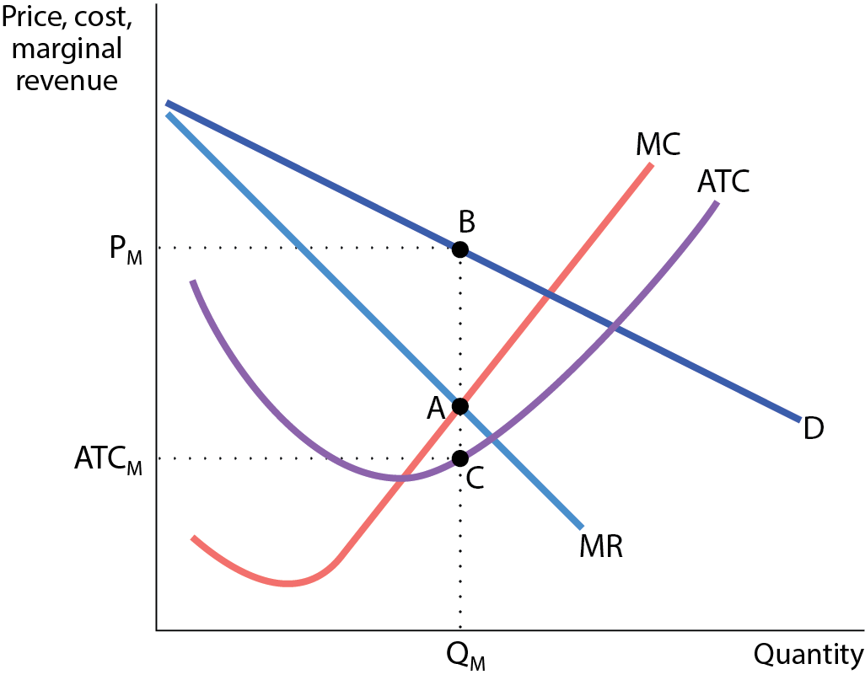
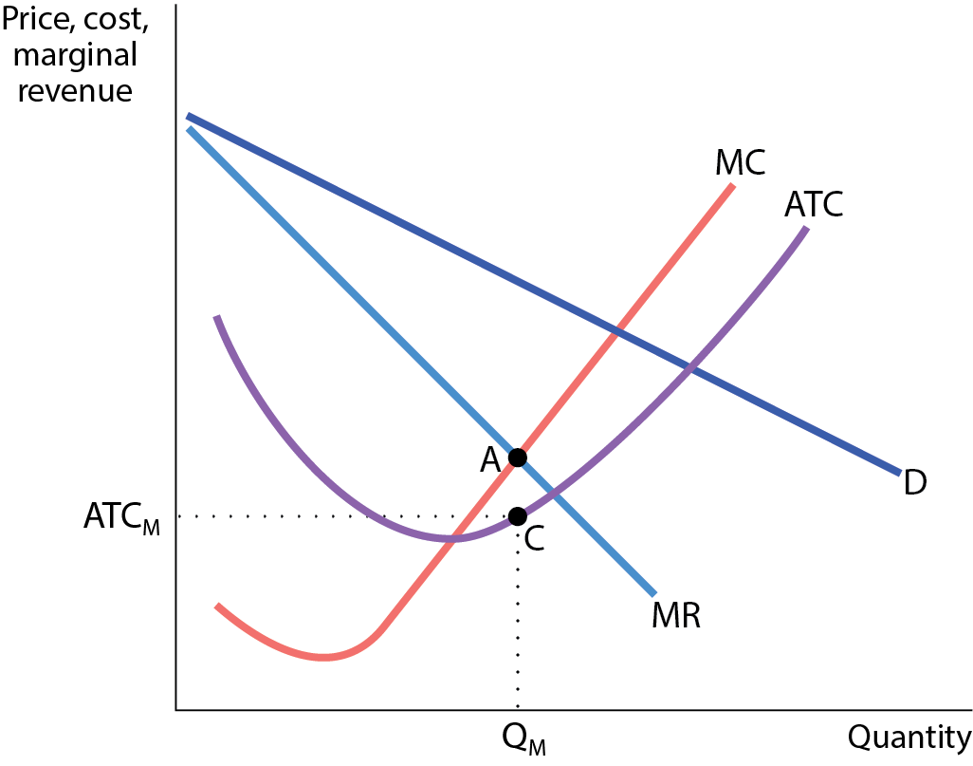
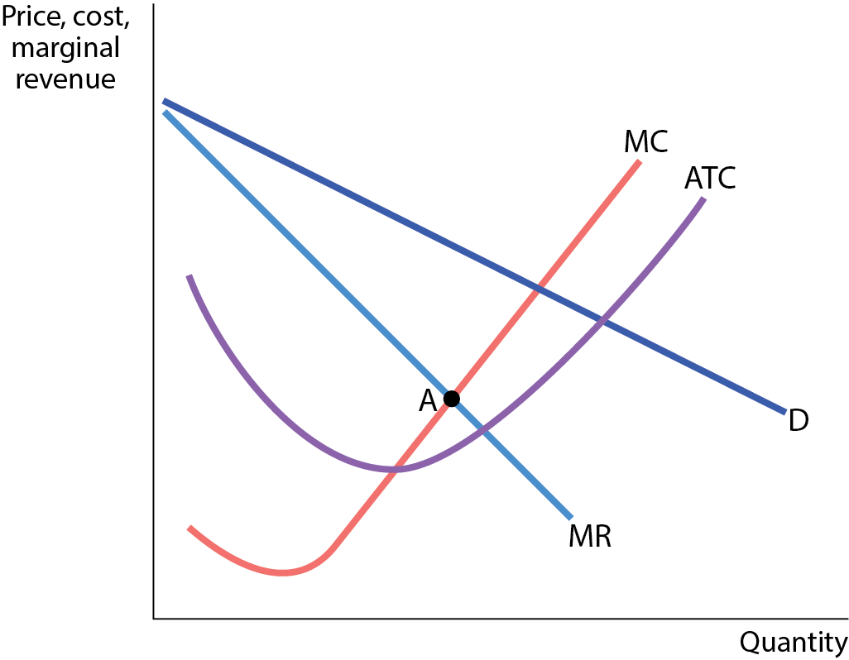
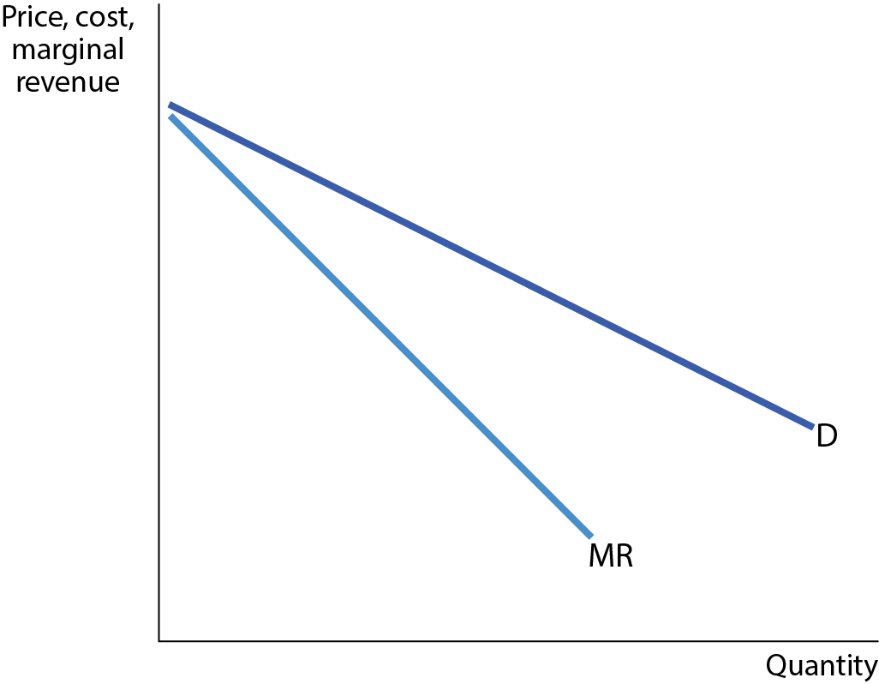
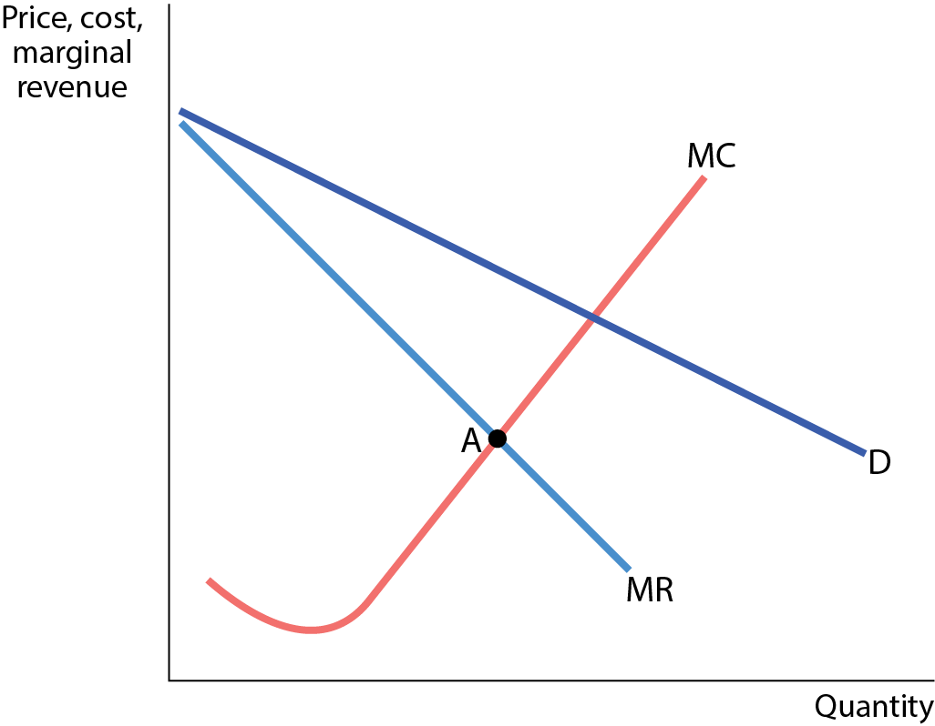
GRAPHING THE MONOPOLIST’S PROFIT
Figure 7
As long as the monopoly has strong barriers to entry, profit will stay.

Slide 29
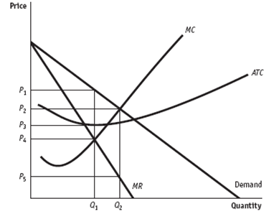
GRAPHING THE MONOPOLIST’S PROFIT
What is the DWL?
Monopoly
Perfect Competition

Slide 30
MARGINAL REVENUE AND THE DEMAND CURVE
MR is below the demand curve …
An increase in production by a monopolist has two opposing effects on revenue:
  A quantity effect: one more unit is sold, increasing total revenue by the price at which the unit is sold.
  A price effect: to sell the last unit, the monopolist must cut the market price on all units sold; this decreases total revenue.

Slide 31
PRICE DISCRIMINATION
So far we’ve been assuming our firm is a single-price monopolist: it offers its product to all consumers at the same price.
Some firms practice price discrimination: they charge different prices to different consumers for the same good.

Slide 32
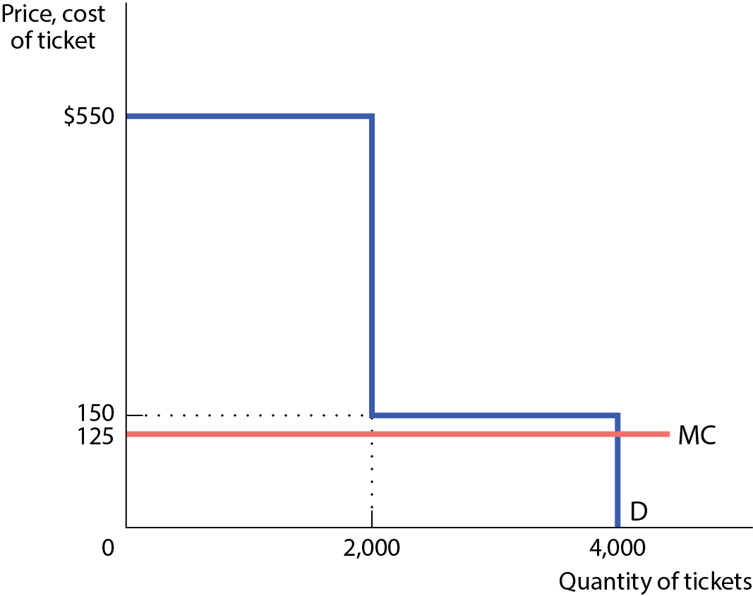
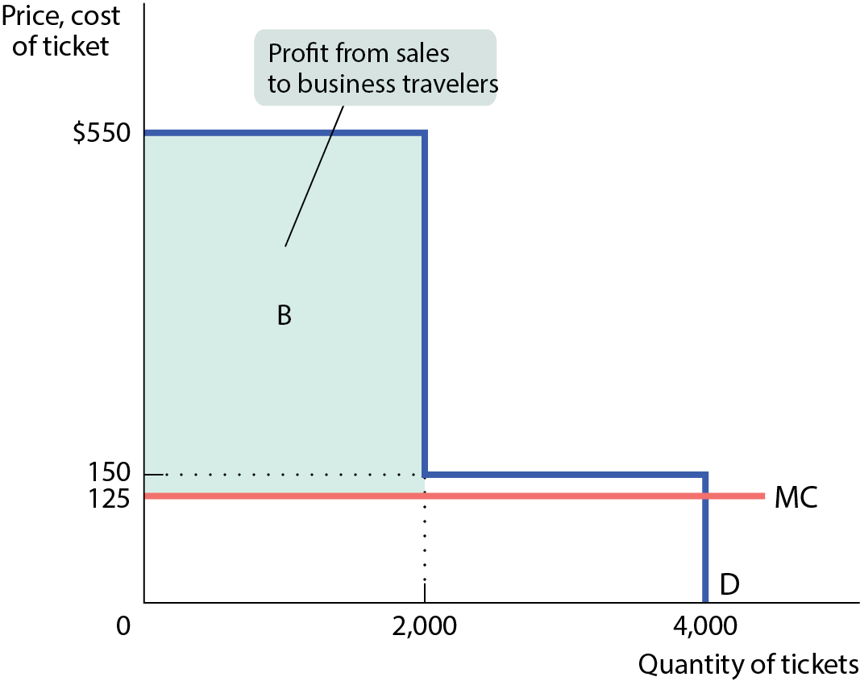
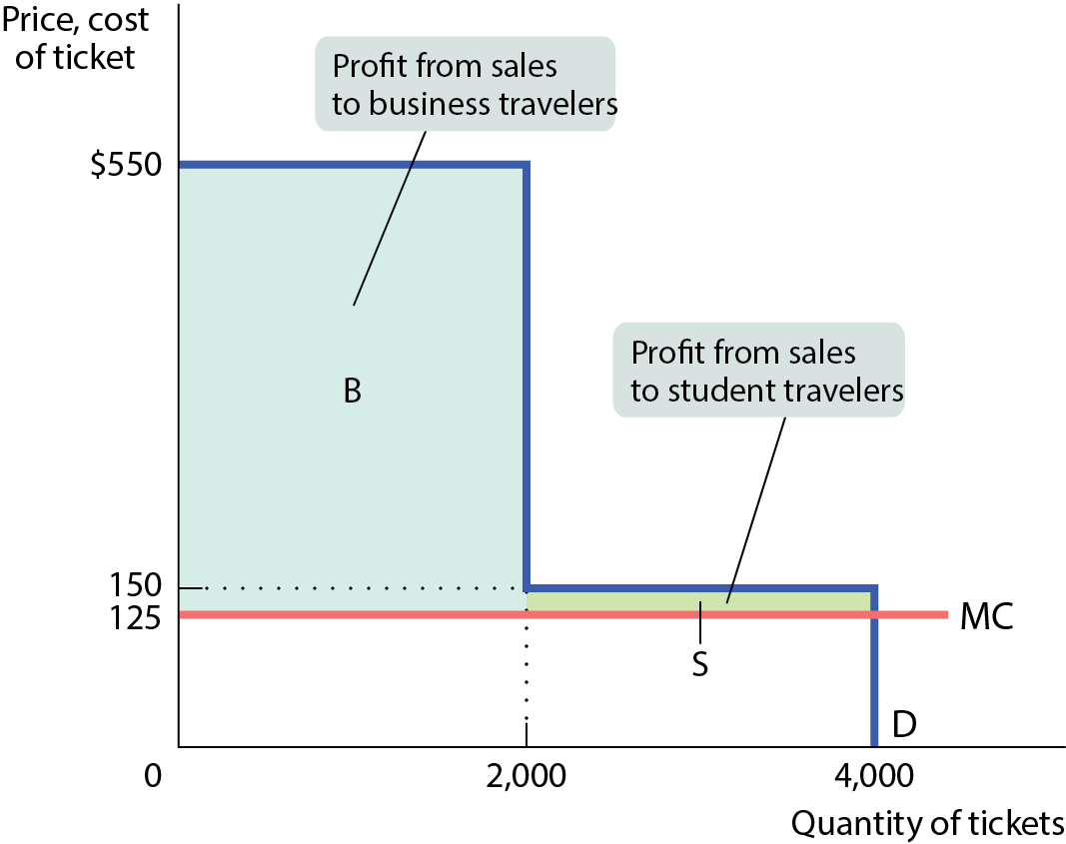
THE LOGIC OF PRICE DISCRIMINATION
Figure 10
If the airline could charge two types of customers two different prices, it would capture of all of the consumer surplus as profit.

Slide 33
PRICE DISCRIMINATION AND ELASTICITY
Firms would distinguish between groups of customers based on their sensitivity to the price—their price elasticity of demand.
Example: Business travelers have lower price elasticity of demand than nonbusiness travelers.

Slide 34
PRACTICE QUESTION
Person A reserves a car online weeks before a trip; person B walks up to a Hertz counter after she walks off an airplane after a four-hour flight. Who probably has more elastic demand for a Hertz rental car? Who probably gets charged less?
Person B has a more elastic demand and will be charged less.
Person B has a more elastic demand and will be charged more.
Person A has a more elastic demand and will be charged more.
Person A has a more elastic demand and will be charged less.

Slide 35
Important Points
A perfectly competitive industry produces an efficient level of output since P = MC for the last unit produced in this industry.
A monopoly produces an efficient level of output since MR = MC for the last unit produced by this monopoly.
A perfectly price-discriminating monopolist produces an efficient level of output, since the value consumers are willing to pay for the last unit sold is equal to the cost of producing this last unit

Slide 36
OLIGOPOLY (Chapter 17)
An oligopoly is a market that is dominated by a small number of firms.
Economists refer to a situation in which firms compete but also possess market power—which enables them to affect market prices—as imperfect competition.
Two forms of imperfect competition: oligopoly and monopolistic competition.

Slide 37
Herfindahl–Hirschman Index
To get a better picture of market structure, economists often use the Herfindahl–Hirschman Index, or HHI.
The HHI for an industry is the sum of the squares of each firm’s share of market sales.
  HHI of less than 1,000 indicates a strongly competitive market.
  HHI of 1,000 to 1,800 indicates a somewhat competitive market.
  HHI above 1,800 indicates an oligopoly.
  If HHI is above 1,000, a merger that results in a significant increase in the HHI will receive special scrutiny and is likely to be disallowed.

Slide 38
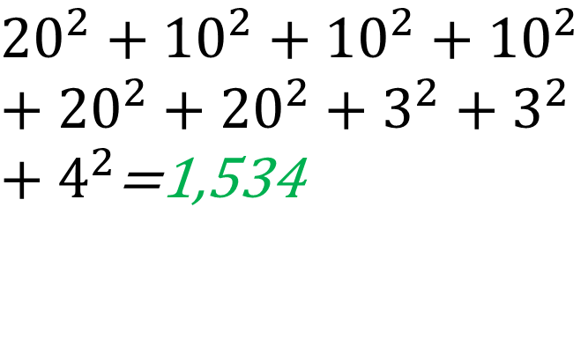
PRACTICE QUESTION
There are ten firms in an industry:
(i) 5 of these firms each have sales equal to 10% of the total market.,
(ii) 2 of the other five firms each have sales equal to 20% of the total market,
(iii) 2 of the other five firms each have sales equal to 3% of the total market, and
(iv) the remaining firm has sales equal to 4% of the total market.
If two of the firms with market share of 10% each were to merge, what would the new HHI equal?
${20}^{2}+{10}^{2}+{10}^{2}+{10}^{2}+{20}^{2}+{20}^{2}+3^{2}+3^{2}+4^{2}$=1,534
10%
10%
10%
10%
10%
20%

Slide 39
COLLUSION AND COMPETITION
Will oligopolists engage in collusion or in noncooperative behavior?
Noncooperative behavior: each firm acts in its own self-interest, and firms ignore the effects of their actions on each others’ profits.
Collusion between firms is illegal, but sometimes firms ignore the rules and collude.
By acting as if they were a single monopolist, oligopolists form a cartel.

Slide 40
Game Theory
The reward received by a player in a game, such as the profit earned by an oligopolist, is that player’s payoff.
A payoff matrix shows how the payoff to each of the participants in a two-player game depends on the actions of both.

Slide 41
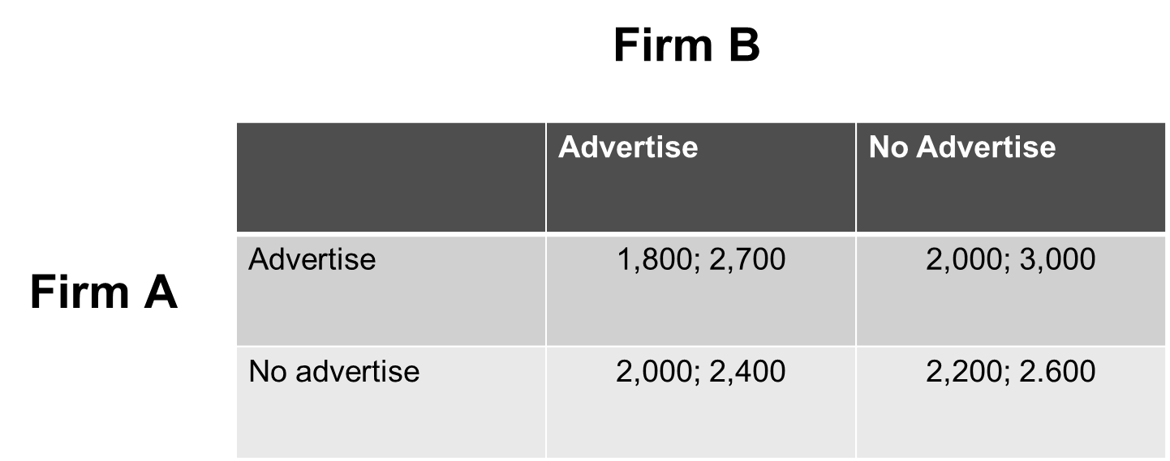
Payoff Matrix
Two actions: {Advertise, no advertise}
Payoff Firm A: First number
Payoff Firm B: Second number

Slide 42
Payoff Matrix – Dominant Strategy
What is a dominant strategy for Firm A?
Fix the strategy of the other firm and identify the highest possible payoff for firm A.

Slide 43
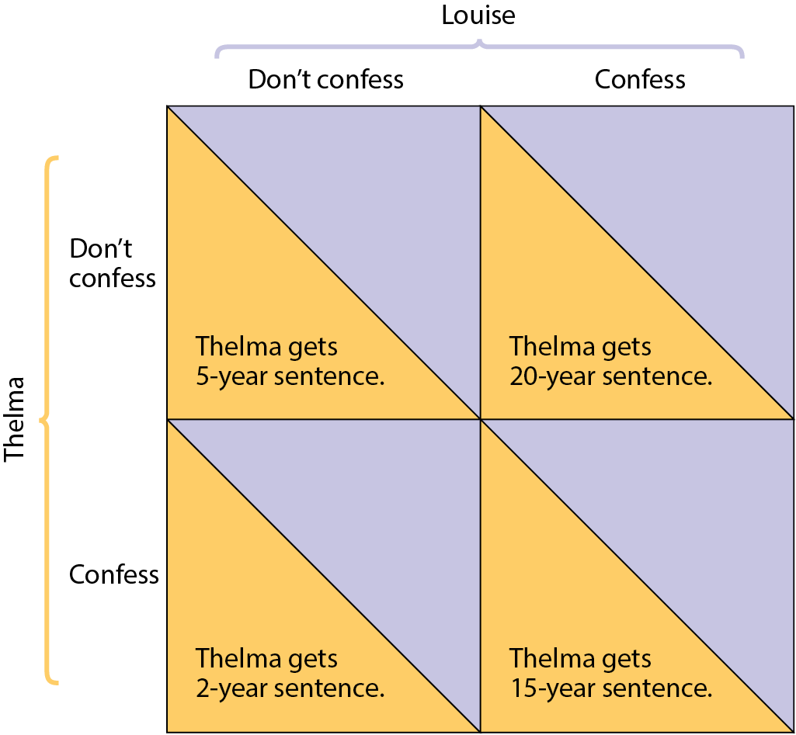
THE PRISONERS’ DILEMMA
Louise gets
5-year sentence
Louise gets
2-year sentence
Louise gets
20-year sentence
Louise gets
15-year sentence

Slide 44

THE PRISONERS’ DILEMMA
Both prisoners will confess.
To confess is a dominant strategy: the player’s best action regardless of the action taken by the other player.
The prisoners’ dilemma is a situation when each player has an incentive to cheat, and both players end up being worse off.

Slide 45
OLIGOPOLY IN PRACTICE: TACIT COLLUSION
Many do succeed in achieving tacit collusion (unspoken agreements).
However, tacit collusion is limited by a number of factors, including:
  less concentration.
  complex products and pricing scheme.
  differences in interests.
  bargaining power of buyers.

