Slide 1

Oligopoly
17
Notes:
Cover Credits: Currency Exchange Stock Chart: cemagraphics/Getty Images, Social Media Montage: SEAN GLADWELL/Getty Images, Circuit Pattern: somsak Tangdamrongsub/Getty Images, Cargo Containers: urzine/Getty Images

Slide 2
WHAT YOU WILL LEARN IN THIS CHAPTER
What is oligopoly, and why does it occur?
Why do oligopolists benefit from collusion, and how are consumers hurt by it?
How do the insights gained from game theory help us to understand the strategic behavior of oligopolists?
Why is antitrust policy—policy which is aimed at preventing collusion among oligopolists—a critical function of government?

Slide 3
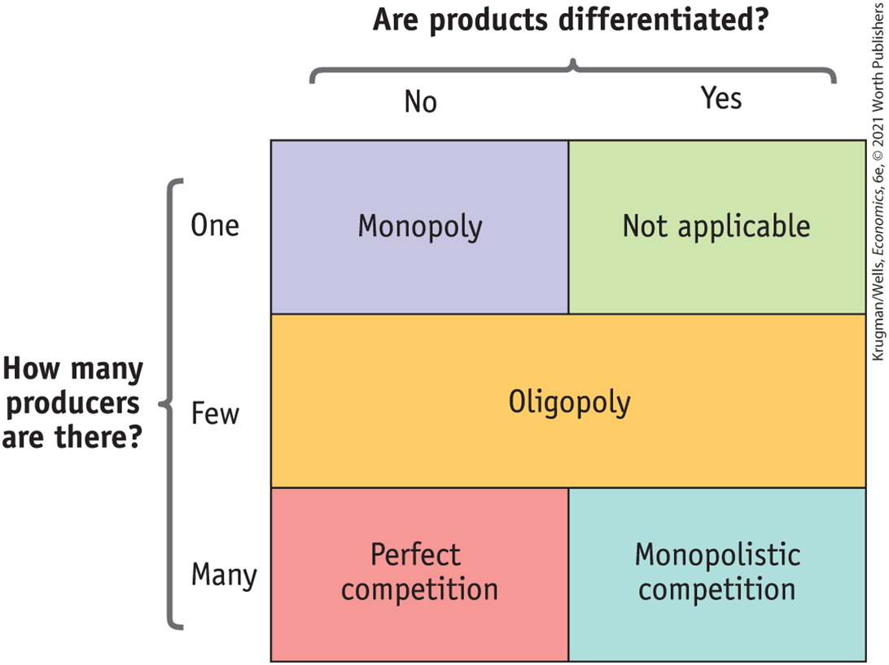
WHAT YOU WILL LEARN IN THIS CHAPTER

Slide 4
THE PREVALENCE OF OLIGOPOLY (1 of 3)
An oligopoly is a market that is dominated by a small number of firms.
A firm in such an industry is known as an oligopolist.
Economists refer to a situation in which firms compete but also possess market power—which enables them to affect market prices—as imperfect competition.
Two forms of imperfect competition: oligopoly and monopolistic competition.

Slide 5


Slide 6
THE PREVALENCE OF OLIGOPOLY (2 of 3)
Why are oligopolies so prevalent?
Oligopoly is the result of the same factors that produce monopoly, but in weaker form. The most important one is the existence of increasing returns to scale.
When these effects are very strong, they lead to monopoly; when they are moderately strong, they lead to oligopoly.

Slide 7
THE PREVALENCE OF OLIGOPOLY (3 of 3)
To get a better picture of market structure, economists often use the Herfindahl–Hirschman Index, or HHI.
The HHI for an industry is the sum of the squares of each firm’s share of market sales.

Slide 8
THE PREVALENCE OF OLIGOPOLY (3 of 3)
For example, if there are three firms with 60%, 25%, and 15% market share each:
HHI = 60² + 25² + 15² = 4,450
  HHI of less than 1,000 indicates a strongly competitive market.
  HHI of 1,000 to 1,800 indicates a somewhat competitive market.
  HHI above 1,800 indicates an oligopoly.
  If HHI is above 1,000, a merger that results in a significant increase in the HHI will receive special scrutiny and is likely to be disallowed.

Slide 9
LEARN BY DOING: PRACTICE QUESTION 1
What is the HHI in the search engine market if Google has 67% market share, Bing has 18% market share, Yahoo! has 11% market share, Ask has 3% market share, and AOL has 1% market share?
  100
  6,724
  4,944
  7,018
  6,818

Slide 10
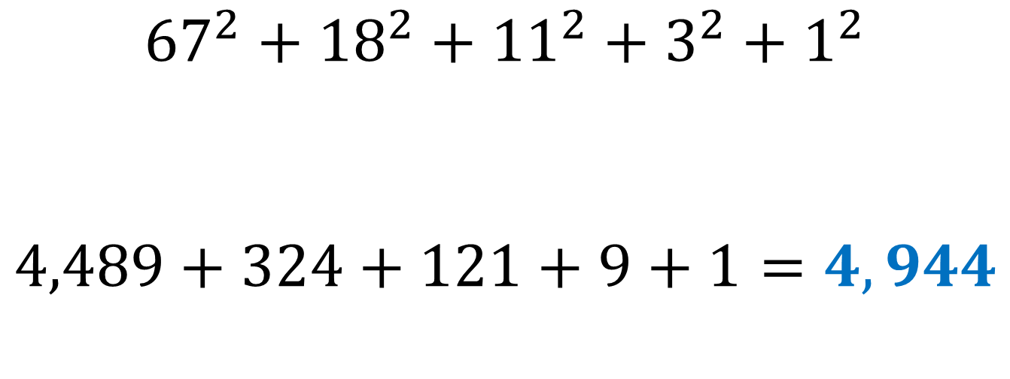
Google:67% market share,
Bing:18% market share,
Yahoo!: 11% market share,
Ask: 3% market share, and
AOL:1% market share
$${67}^{2}+{18}^{2}+{11}^{2}+3^{2}+1^{2}$$
$$4,489+324+121+9+1=4,944$$
HHI above 1,800 indicates an oligopoly

Slide 11
LEARN BY DOING: PRACTICE QUESTION 1
(ANSWER)
What is the HHI in the search engine market if Google has 67% market share, Bing has 18% market share, Yahoo! has 11% market share, Ask has 3% market share, and AOL has 1% market share?
  100
  6,724
  4,944 (correct answer)
  7,018
  6,818

Slide 12

UNDERSTANDING OLIGOPOLY
Oligopolists operate in a state of interdependence: the decisions of one firm affect the profits of its rivals.
An oligopoly consisting of only two firms is a duopoly. Each firm is known as a duopolist.

Slide 13
UNDERSTANDING OLIGOPOLY
Sellers engage in collusion when they cooperate to raise their joint profits. A cartel is an agreement among several producers to obey output restrictions to increase their joint profits.
The world’s most famous cartel is the Organization of Petroleum Exporting Countries (OPEC).

Slide 14
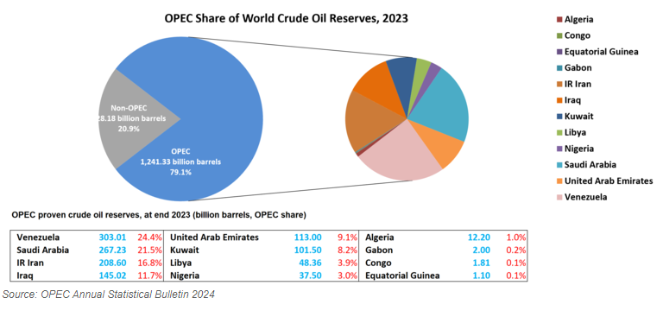
UNDERSTANDING OLIGOPOLY

Slide 15
COLLUSION AND COMPETITION
Will oligopolists engage in collusion or in noncooperative behavior?
Noncooperative behavior: each firm acts in its own self-interest, and firms ignore the effects of their actions on each others’ profits.
Collusion between firms is illegal, but sometimes firms ignore the rules and collude.

Slide 16
COLLUSION AND COMPETITION
By acting as if they were a single monopolist, oligopolists form a cartel.
Each firm has an incentive to cheat and produce more. There are two principal outcomes: successful collusion or behaving noncooperatively by cheating.

Slide 17
COLLUSION AND COMPETITION
In recent years, industries that produce tuna, beer, milk, chocolate, poultry, text messaging, and the white pigment titanium dioxide all have made headlines for alleged price fixing.
The U.S. Department of Justice defines price fixing as “an agreement among competitors to raise, fix, or otherwise maintain the price at which their goods or services are sold.”

Slide 18

GAMES OLIGOPOLISTS PLAY
Each oligopolist realizes that it is interdependent: its profit depends on what its competitor does, and its competitor’s profit depends on what it does.
The firms are playing a game in which the profit of each player depends not only on its own actions but on those of the other players.

Slide 19

GAMES OLIGOPOLISTS PLAY
To understand how oligopolists behave, economists and mathematicians developed game theory.
Game theory: the study of behavior in situations of interdependence; a way of predicting outcomes in strategic situations like oligopolies.

Slide 20
THE PRISONERS’ DILEMMA (1 of 3)
The reward received by a player in a game, such as the profit earned by an oligopolist, is that player’s payoff.
A payoff matrix shows how the payoff to each of the participants in a two-player game depends on the actions of both.

Slide 21
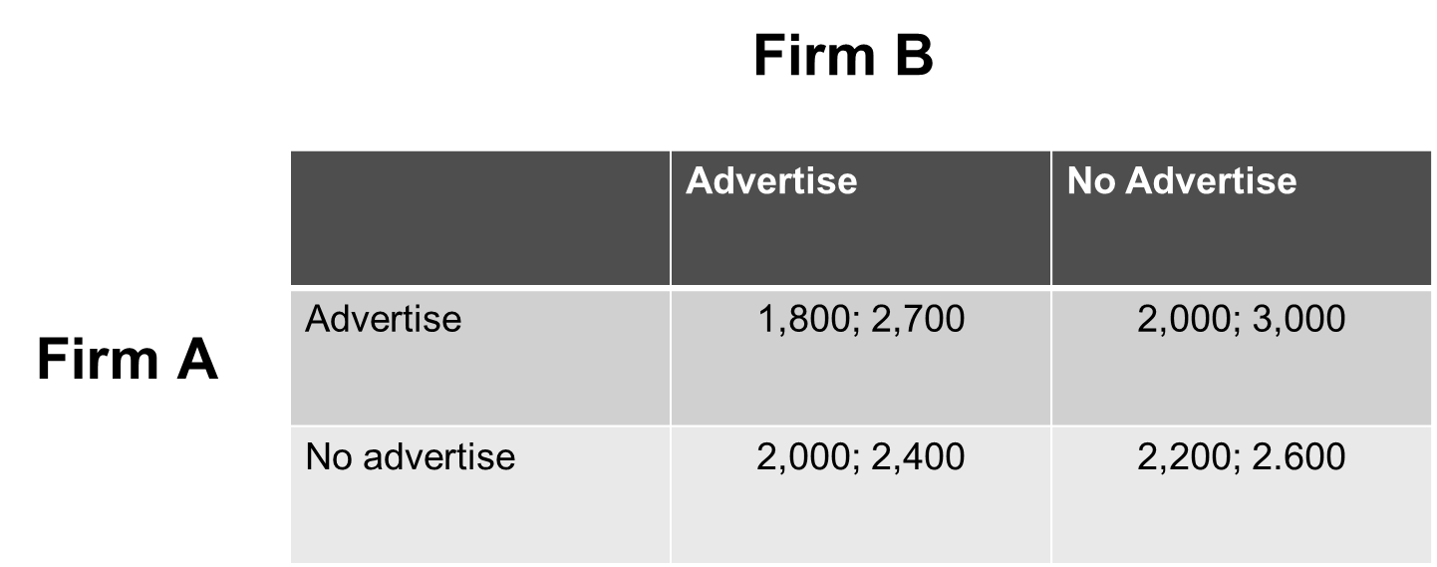
THE PRISONERS’ DILEMMA (1 of 3)
Two actions: {Advertise, no advertise}
Payoff Firm A: First number
Payoff Firm B: Second number

Slide 22
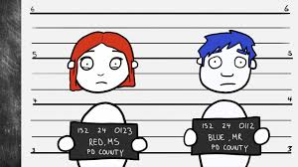
THE PRISONERS’ DILEMMA (1 of 3)
Thelma and Louise are caught by the police. The police put them in separate cells and say:
If neither of you confesses, we’ll send you to jail for 5 years.
If you confess and implicate your partner, and she doesn’t do the same, we’ll reduce your sentence from 5 years to 2.
But if your partner confesses and you don’t, you’ll get the maximum 20 years.
If both of you confess, we’ll give you both 15 years. And if you both remain silent, we’ll give you 5 years each.

Slide 23
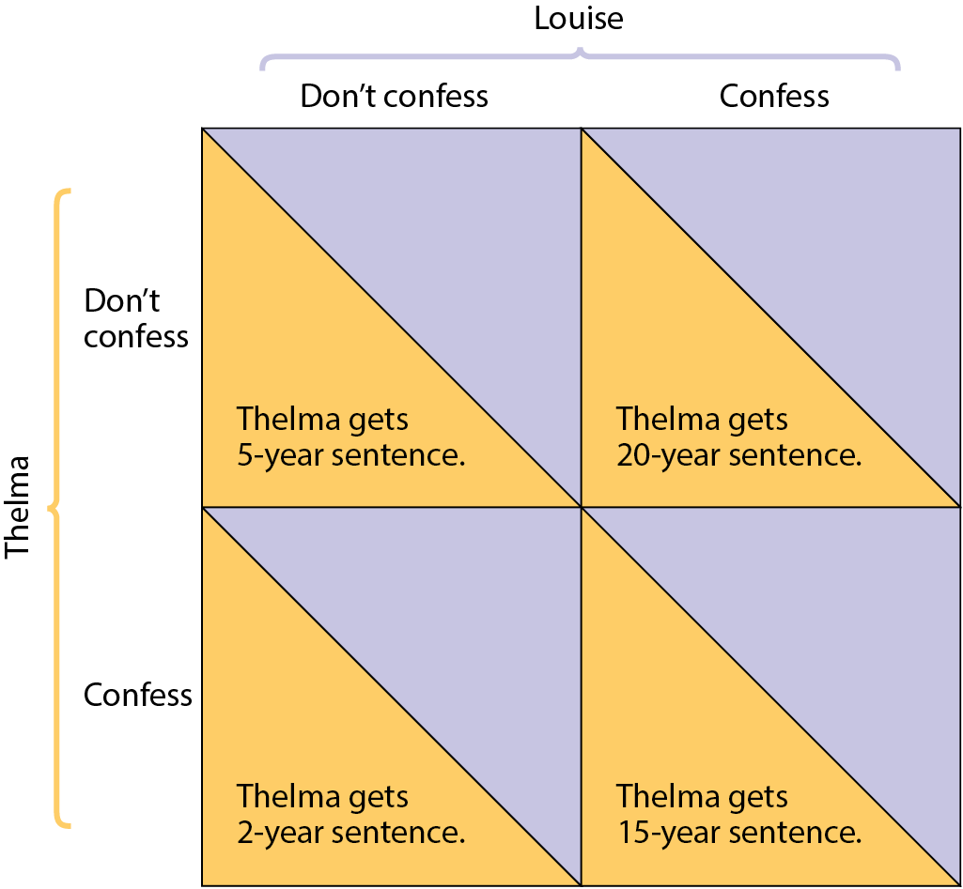
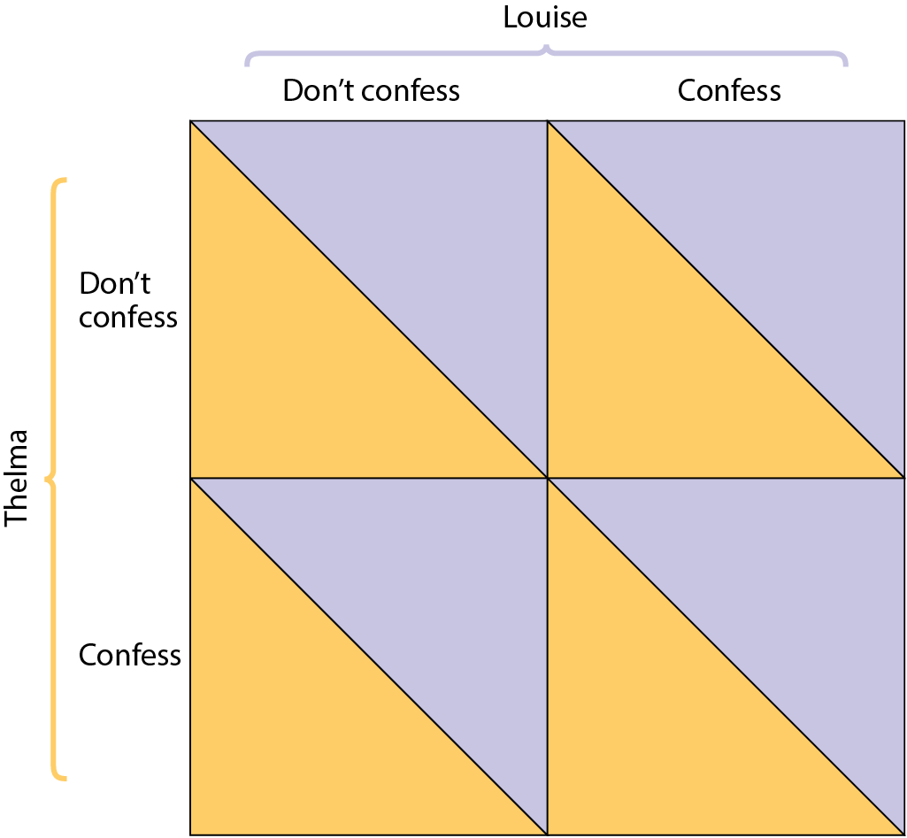
THE PRISONERS’ DILEMMA (2 of 3)
Figure 3

Slide 24
THE PRISONERS’ DILEMMA (2 of 3)
Louise gets
5-year sentence
Louise gets
2-year sentence
Louise gets
20-year sentence
Louise gets
15-year sentence

Slide 25
THE PRISONERS’ DILEMMA (3 of 3)
Both prisoners will confess.
To confess is a dominant strategy: the player’s best action regardless of the action taken by the other player.
The prisoners’ dilemma is a situation when each player has an incentive to cheat, and both players end up being worse off.

Slide 26

THE PRISONERS’ DILEMMA (3 of 3)
A Nash equilibrium (also known as noncooperative equilibrium) results when each player chooses the action that maximizes their payoff given the actions of other players, ignoring the effects of their action on the payoffs received by other players.
John Nash: American mathematician who was awarded the 1994 Nobel Prize for Economics
The game is based on two premises:
  Each player has an incentive to choose an action that benefits them at the other player’s expense.
  When both players act in this way, both are worse off than if they had acted cooperatively.

Slide 27
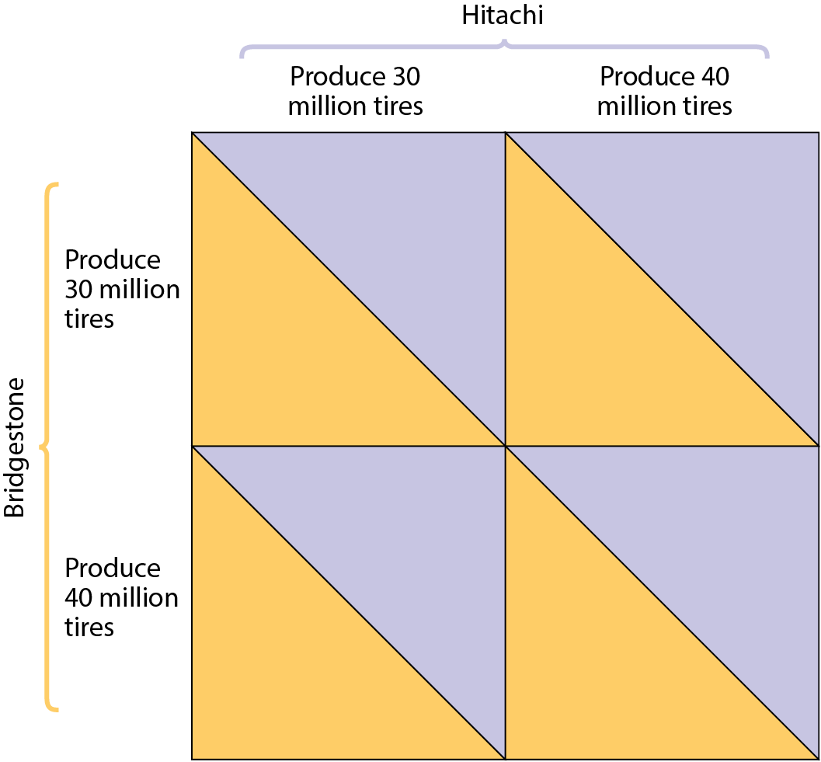
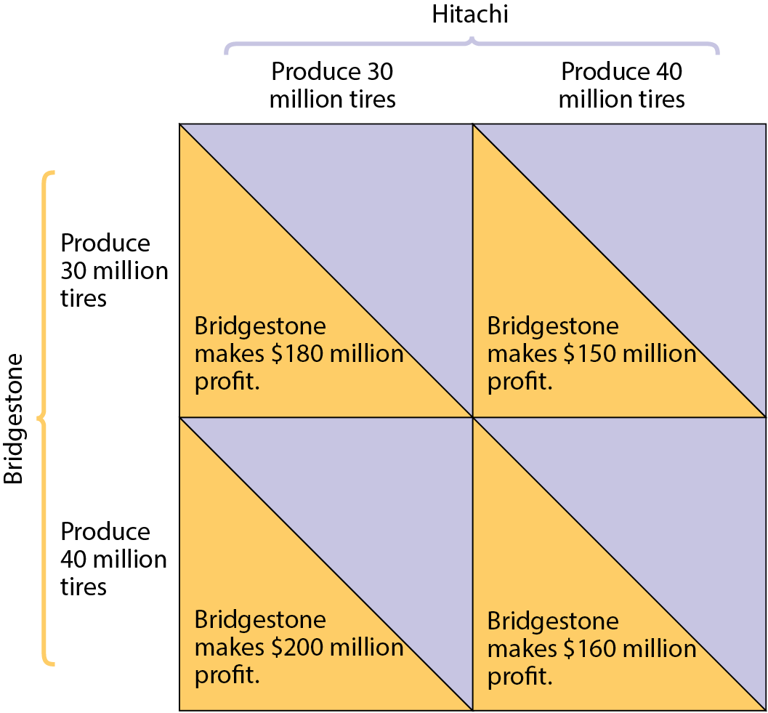
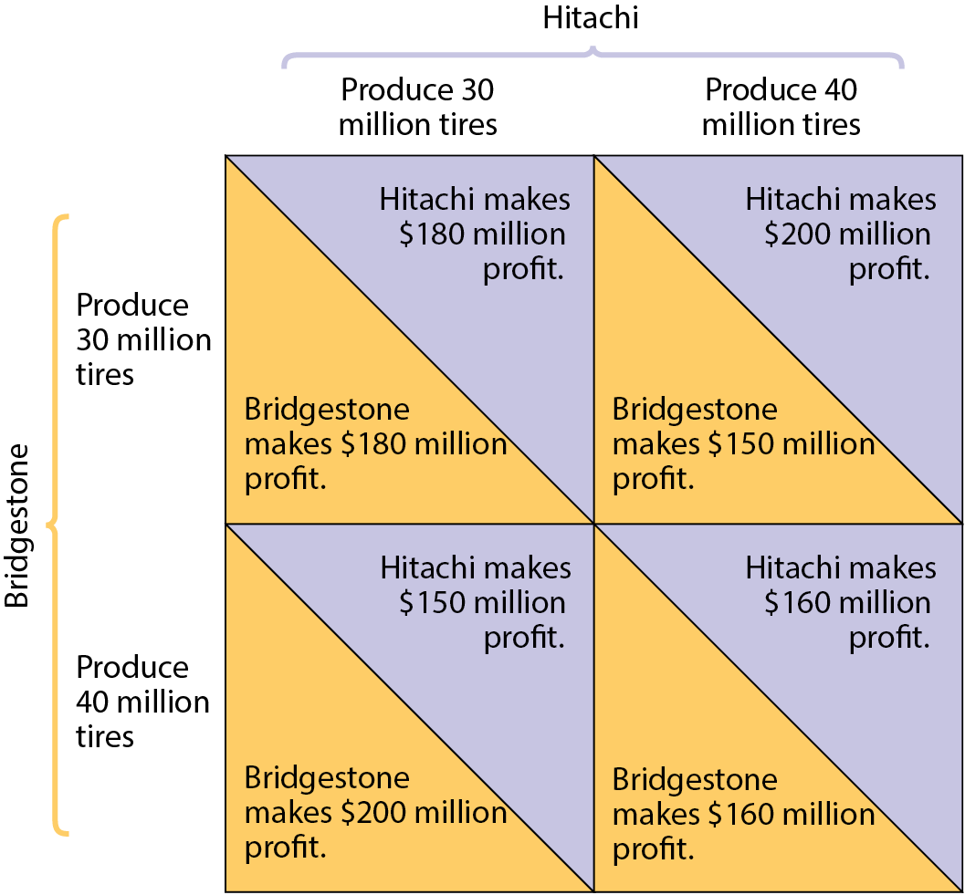
THE PRISONERS’ DILEMMA FOR FIRMS: PAYOFF MATRIX

Slide 28
LEARN BY DOING: PRACTICE QUESTION 2
In game theory, the strategy that has a higher payoff than any other strategy—no matter what the other player does—is also known as the:
  superior strategy.
  Nash equilibrium.
  dominant strategy.
  best possible outcome.

Slide 29
LEARN BY DOING: PRACTICE QUESTION 2
(ANSWER)
In game theory, the strategy that has a higher payoff than any other strategy—no matter what the other player does—is also known as the:
  superior strategy.
  Nash equilibrium.
  dominant strategy. (correct answer)
  best possible outcome.

Slide 30
LEARN BY DOING: PRACTICE QUESTION 3
Two firms are the only producers in a market. Each firm is trying to decide whether to advertise. If firm B advertises, firm A earns $2,000 in profit without advertising and $1,800 if A does advertise. (The advertising increases its costs more than its revenues.) If B does not advertise, A earns $2,200 in profit without advertising and $2,000 if A does advertise. If A advertises, B earns $3,000 in profit without advertising and $2,700 if B does advertise. If A does not advertise, B earns $2,600 without advertising and $2,400 if B does advertise. What is firm B’s dominant strategy?
advertise
do not advertise
firm B does not have a dominant strategy

Slide 31
LEARN BY DOING: PRACTICE QUESTION 3
Firm B
 | Advertise | No Advertise
Advertise | 1,800; 2,700 | 2,000; 3,000
No advertise | 2,000; 2,400 | 2,200; 2.600
Firm A

Slide 32
LEARN BY DOING: PRACTICE QUESTION 3
(ANSWER)
Two firms are the only producers in a market. Each firm is trying to decide whether to advertise. If firm B advertises, firm A earns $2,000 in profit without advertising and $1,800 if A does advertise. (The advertising increases its costs more than its revenues.) If B does not advertise, A earns $2,200 in profit without advertising and $2,000 if A does advertise. If A advertises, B earns $3,000 in profit without advertising and $2,700 if B does advertise. If A does not advertise, B earns $2,600 without advertising and $2,400 if B does advertise. What is firm B’s dominant strategy?
advertise
do not advertise (correct answer)
firm B does not have a dominant strategy

Slide 33
OVERCOMING THE PRISONERS’ DILEMMA
Repeated interaction and tacit collusion
Players who don’t take their interdependence into account arrive at a Nash, or noncooperative, equilibrium.
But if a game is played repeatedly, players may engage in strategic behavior, sacrificing short-run profit to influence future behavior.
Tit for tat: a strategy of playing cooperatively at first, then doing whatever the other player did in the previous period.

Slide 34
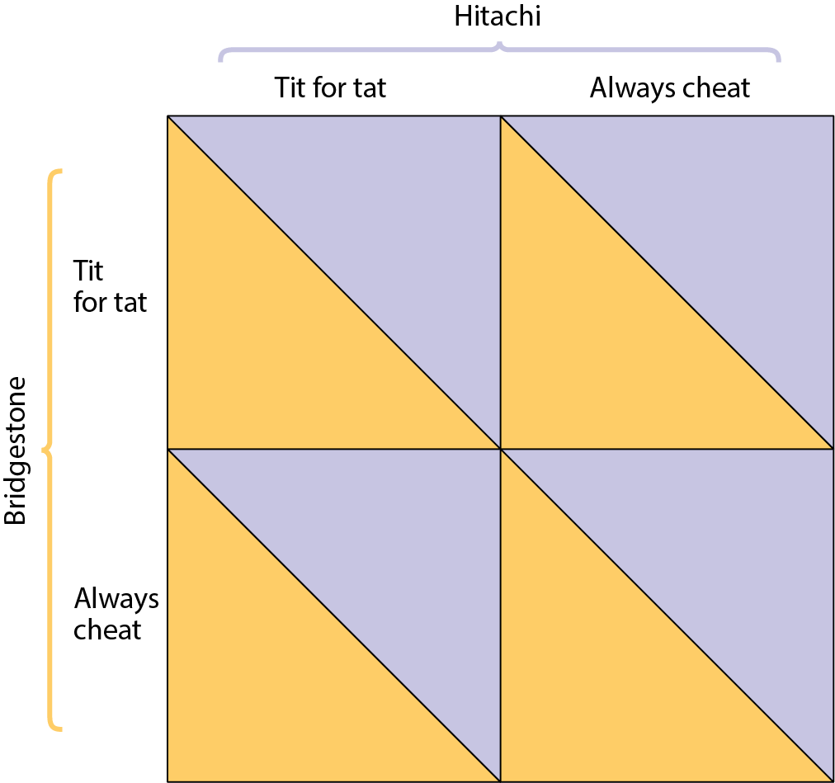
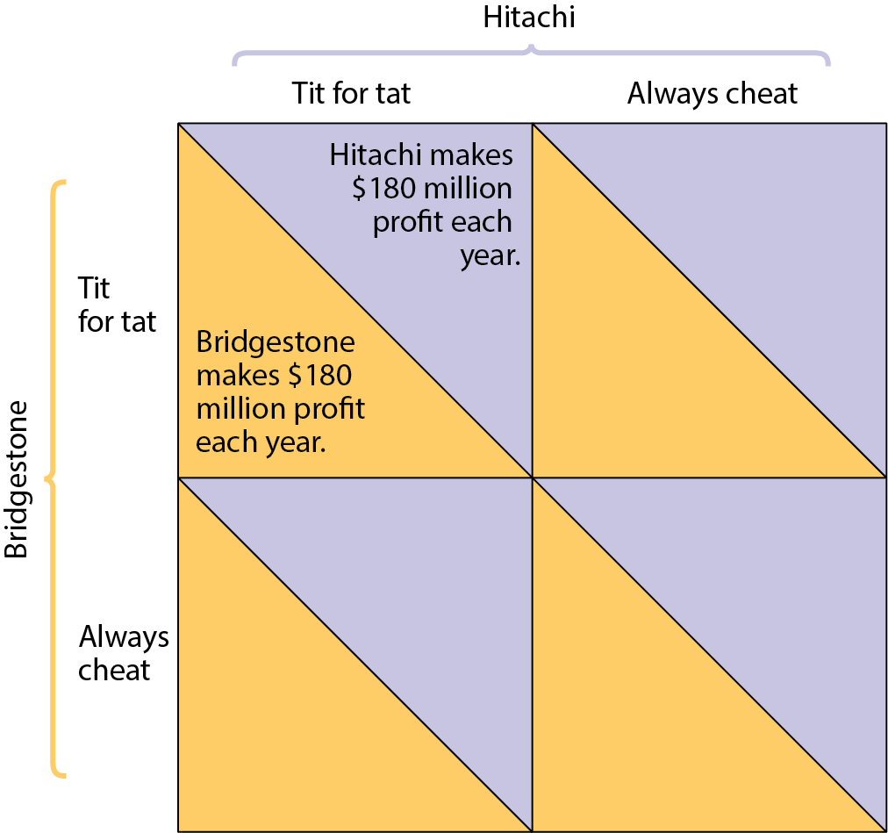
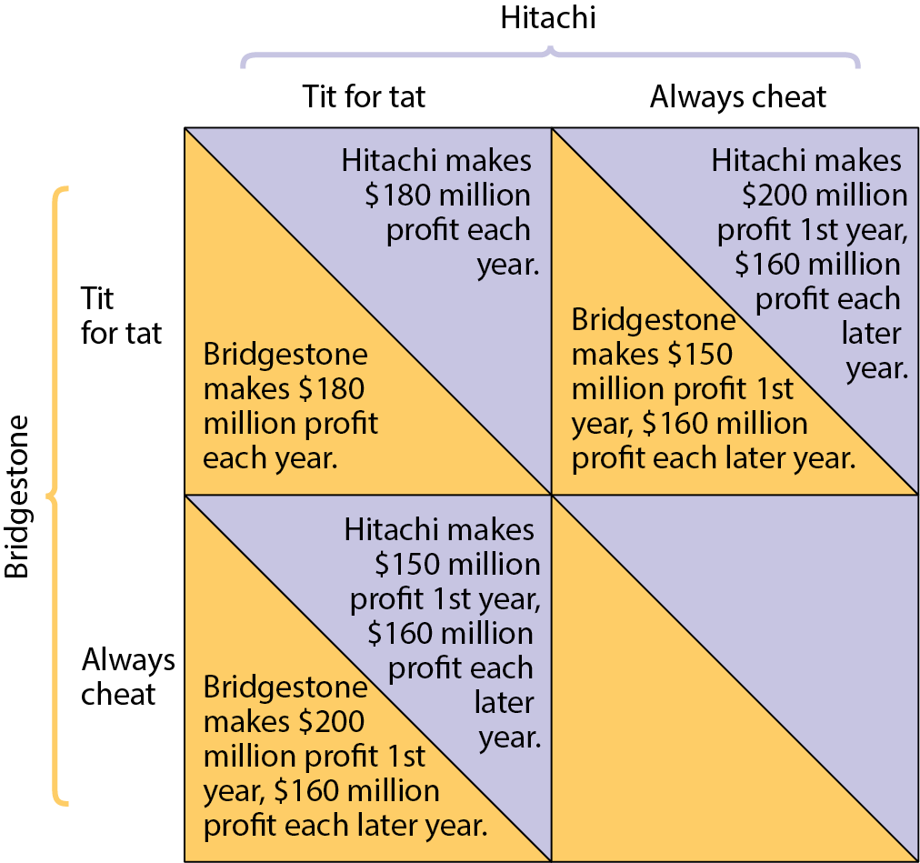
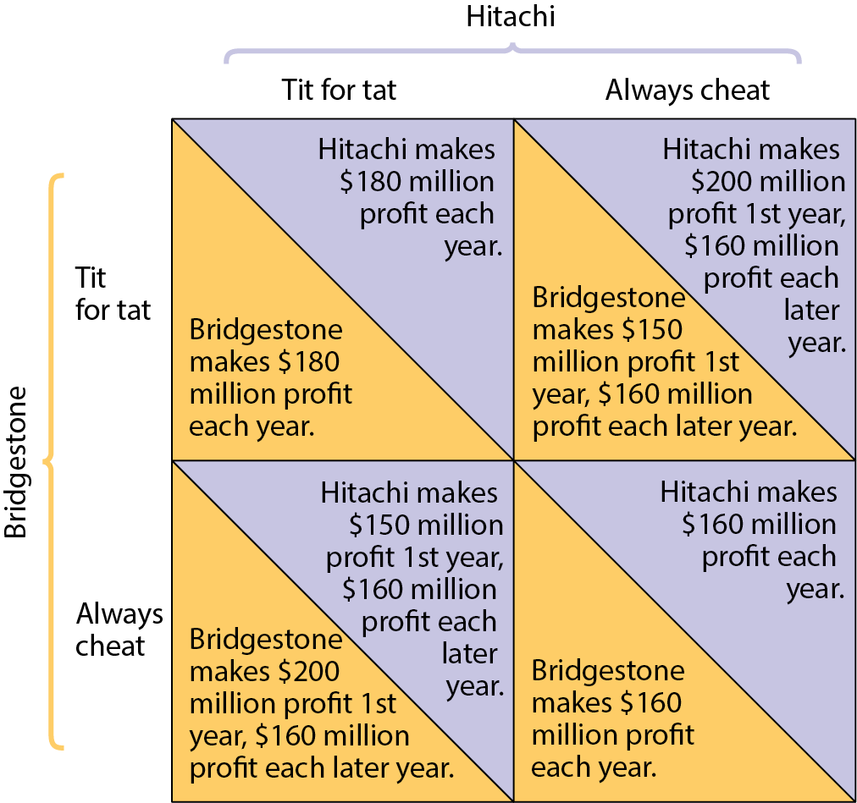
HOW REPEATED INTERACTION CAN SUPPORT COLLUSION
Figure 4

Slide 35
OLIGOPOLY IN PRACTICE: THE LEGAL FRAMEWORK
In the nineteenth century, when the growth of railroads created a national market, large firms emerged and formed cartels.
Many cartel members violated agreements and produced more.
Antitrust policies: efforts undertaken by the government to prevent oligopolistic industries from becoming or behaving like monopolies.

Slide 36
OLIGOPOLY IN PRACTICE: TACIT COLLUSION
Many do succeed in achieving tacit collusion (unspoken agreements).
However, tacit collusion is limited by a number of factors, including:
  less concentration.
  complex products and pricing scheme.
  differences in interests.
  bargaining power of buyers.

Slide 37
PRODUCT DIFFERENTIATION AND PRICE LEADERSHIP (1 of 2)
When collusion breaks down and prices collapse, there is a price war.
To limit competition, oligopolists often engage in product differentiation, an attempt by a firm to convince buyers that its product is different from the products of other firms in the industry.

Slide 38
PRODUCT DIFFERENTIATION AND PRICE LEADERSHIP (1 of 2)
Airline price wars of 1992.
  American Airlines, Northwest Airlines, and other U.S. carriers went toe-to-toe in matching and exceeding one another’s reduced fares, the result was record volumes of air travel—and record losses.
  Price wars are becoming more common because managers tend to view a price change as an easy, quick, and reversible action.

Slide 39
PRODUCT DIFFERENTIATION AND PRICE LEADERSHIP (2 of 2)
In price leadership, one firm sets its price first, and other firms follow: one firm tacitly sets prices for the whole industry.
Firms that have a tacit agreement not to compete on price often engage in nonprice competition through advertising and other means instead.

Slide 40
LEARN BY DOING: DISCUSSION QUESTION 1
Explain whether you think each of these factors will increase or decrease the likelihood that a firm will collude with other firms in an oligopoly to restrict output.
  The firm has a cost advantage over its rivals.
  The firm and its rivals are currently operating at maximum production capacity, which cannot be altered in the short run.
Decrease
  Increase

Slide 41
HOW IMPORTANT IS OLIGOPOLY?
Given the prevalence of oligopoly, is the analysis of perfect competition still useful?
The answer is yes:
  Even though many markets are oligopolistic, limits to collusion keep prices close to marginal costs—the markets behave almost as if they were perfectly competitive.
  Predictions from supply and demand analysis are often valid for oligopolies.

Slide 42
HOW IMPORTANT IS OLIGOPOLY?
The analysis of oligopoly is more difficult and messier than that of perfect competition. Keep in mind important issues, from antitrust policies to price wars, while trying to understand oligopolies.
Spring Semester:
  Intermediate Microeconomics (EconS 301)

