Slide 1

Monopoly
16
Notes:
Cover Credits: Currency Exchange Stock Chart: cemagraphics/Getty Images, Social Media Montage: SEAN GLADWELL/Getty Images, Circuit Pattern: somsak Tangdamrongsub/Getty Images, Cargo Containers: urzine/Getty Images

Slide 2
Important Dates
Homework #13 is due tomorrow Wednesday November 20^{th.}
  Chapters 14 and 15 (Production & Perfect Competition)
Quiz #6 is due tomorrow Wednesday November 20^{th.}
  ^{Chapters 12 and 13}
Homework #14 is due on Friday December 6^{th.}
  ^{Chapters 16 and 17}
Review Session: Tuesday December 3rd
Final Exam is on Wednesday December 11^{th.}
  ^{Chapters 13, 14, 15, 16 and 17}

Slide 3
WHAT YOU WILL LEARN IN THIS CHAPTER
What is the significance of monopoly, a type of industry in which only one producer, a monopolist, operates?
How does being a monopolist affect a firm’s price and output decisions?
Why does the presence of monopoly typically reduce social welfare?
What tools do policy makers use to address the problem of monopoly?
What is price discrimination, and why is it so prevalent in certain industries?
How do digital giants like Amazon, Google, and Meta fit into our model of monopoly, and what special challenges do they represent?

Slide 4
TYPES OF MARKET STRUCTURE
In order to develop models and make predictions about how producers will behave, economists have developed four principal models of market structure:
  perfect competition
  monopoly
  oligopoly
  monopolistic competition
  This system of market structures is based on two dimensions:
  The number of firms in the market (one, few, or many).
  Whether the goods offered are identical or differentiated.

Slide 5
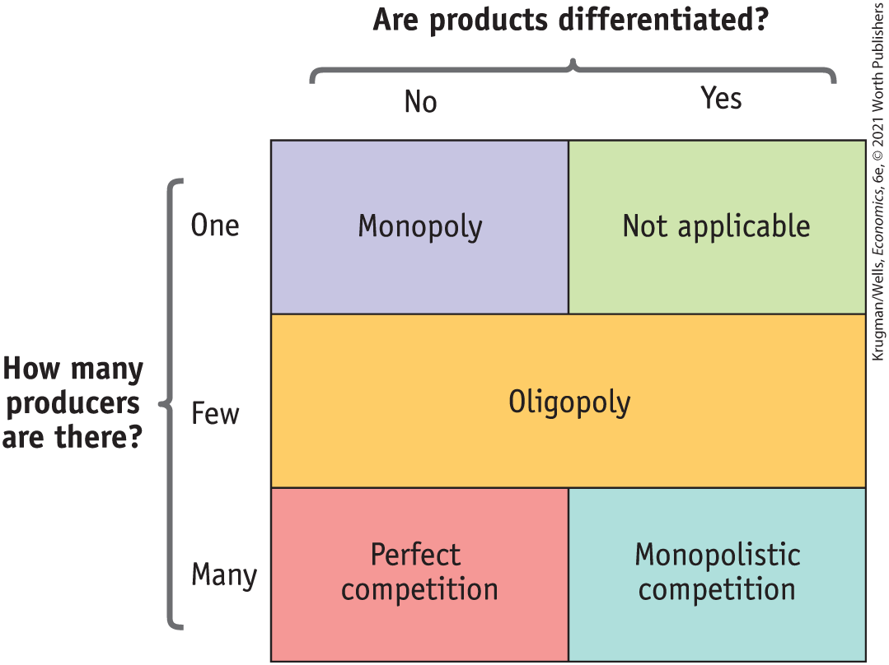
TYPES OF MARKET STRUCTURE, VISUALLY
Figure 1

Slide 6


THE MEANING OF MONOPOLY
Monopolist: a firm that is the only producer of a good with no close substitutes.
Monopoly: an industry controlled by a monopolist.
Market power: the ability of a firm to raise prices.

Slide 7
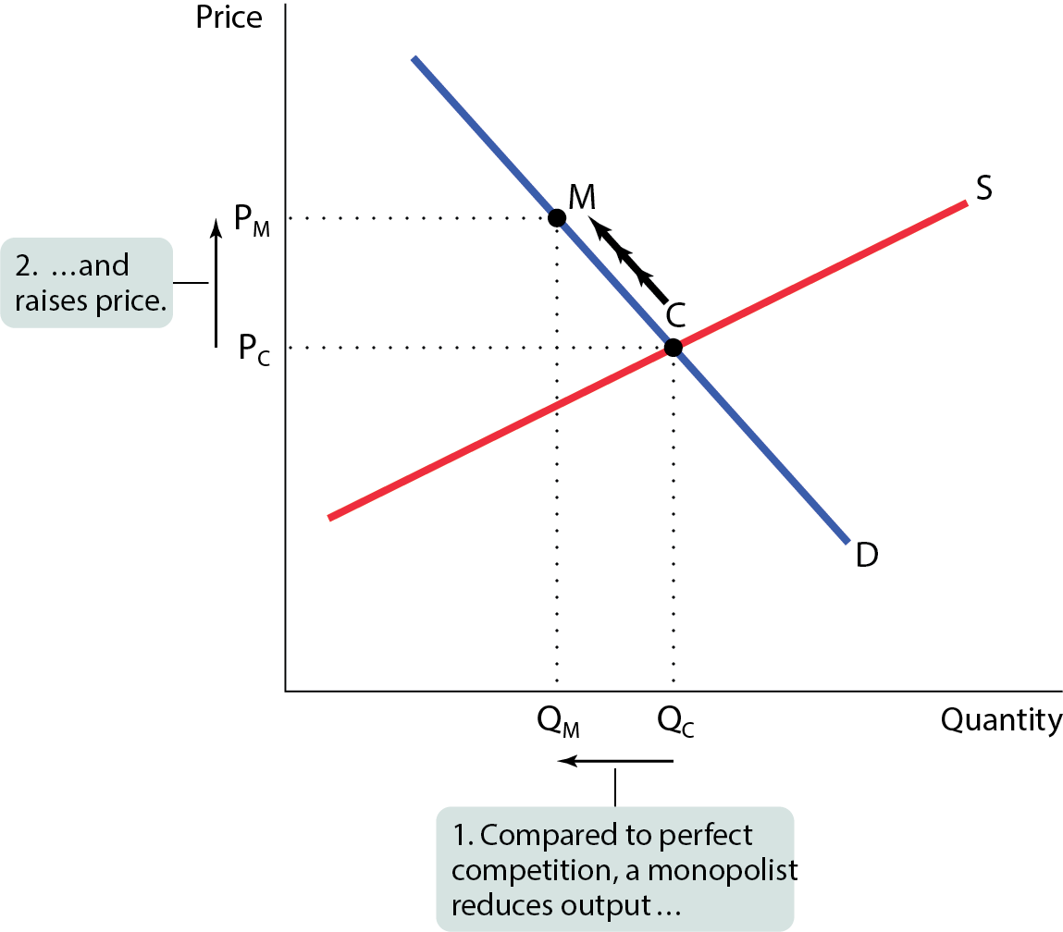
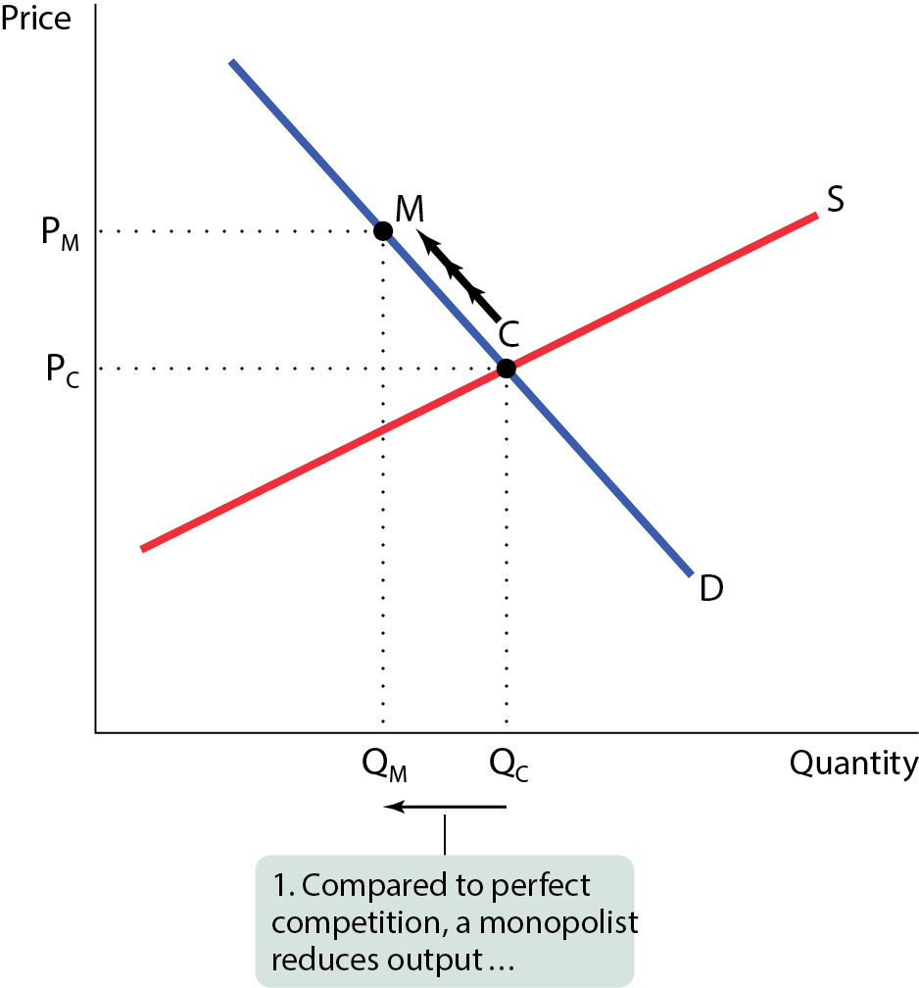
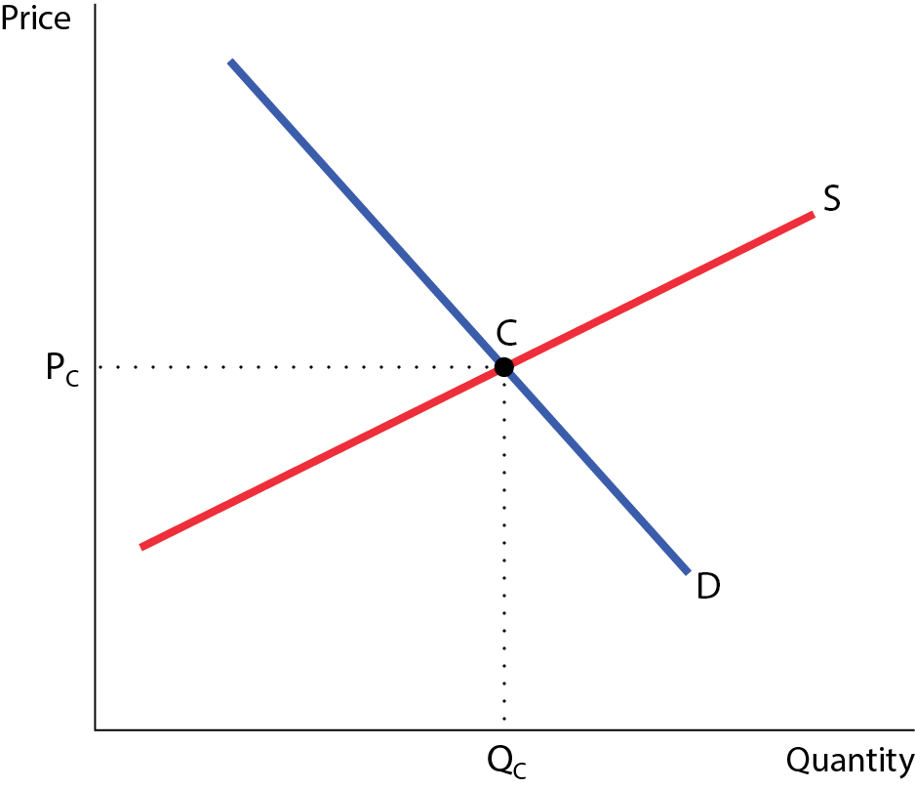
WHAT A MONOPOLIST DOES
Figure 2
A monopolist reduces the quantity supplied to Q_{M} and moves up the demand curve from C to M, raising the price to P_{M}.

Slide 8
WHY DO MONOPOLIES EXIST?
If a monopolist makes profits, why don’t other firms grab a piece of action and drive prices and profits down?
For a monopoly to persist, something must keep others from going into the same business: a barrier to entry.

Slide 9

Microsoft Windows version 3.0 in 1990 cemented Microsoft's position as a software monopoly.
Soon after Windows 3.0 was released, Microsoft released Excel 3.0 for Windows and Word for Windows 2.0.
These products received great reviews and became the top sellers of their categories. (New York Times, 11/5/95)

Slide 10
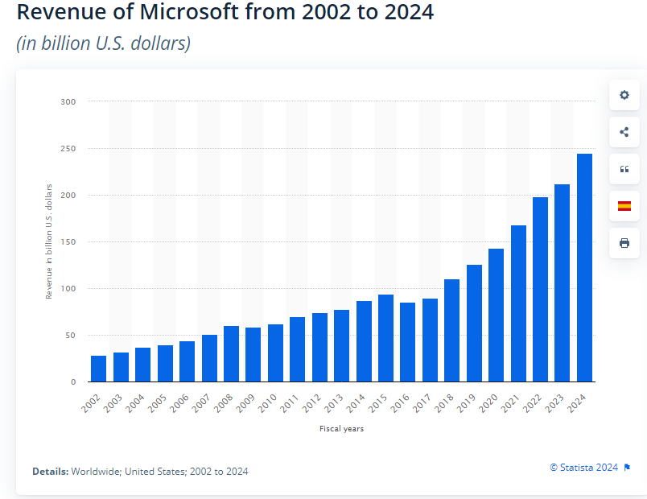

Slide 11
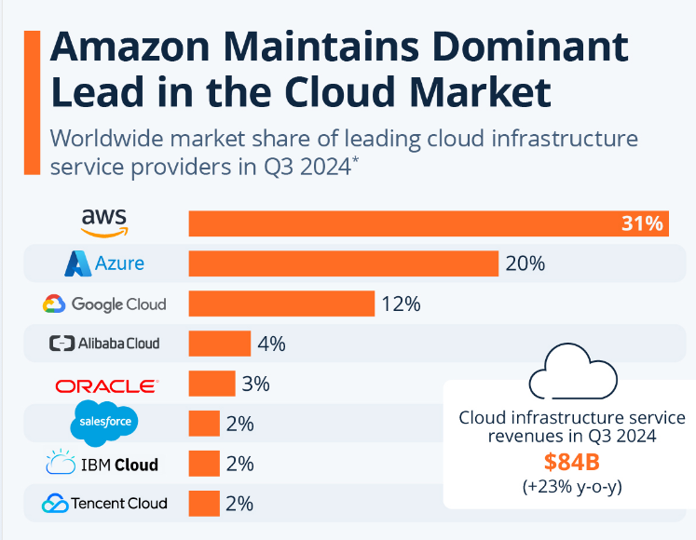

Slide 12
WHY DO MONOPOLIES EXIST?
There are five principal types of barriers to entry:
Control of a scarce resource or input
Increasing returns to scale
Technological superiority
Network externalities
Government-made barriers

Slide 13

BARRIER #1: CONTROL OF A SCARCE RESOURCE OR INPUT
A monopolist that controls a crucial resource or input can prevent other firms from entering its market.
The barriers to entry in the oil and gas sector are extremely strong and include high resource ownership, high startup costs, patents and copyrights in association with proprietary technology, government, environmental regulations, and high fixed operating costs.

Slide 14
BARRIER #2: INCREASING RETURNS TO SCALE
Increasing returns to scale (economies of scale): When average total cost falls as output increases, firms tend to grow larger.
The source of increasing returns to scale is large fixed costs.
In such an industry, larger companies are more profitable and drive out smaller ones.
Increasing returns to scale can give rise to and sustain monopoly.
A monopoly created and sustained by increasing returns to scale is called a natural monopoly.
The most visible natural monopolies are utilities—water, natural gas, power generation, and fiber optic cable.

Slide 15


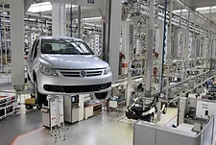
High fixed cost companies are airlines, automobile manufacturers, and pharmaceutical companies

Slide 16
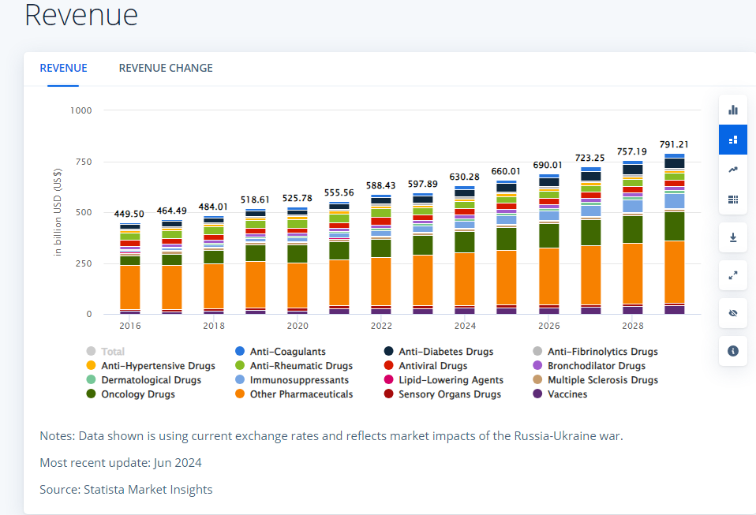
Pharmaceuticals U.S.

Slide 17
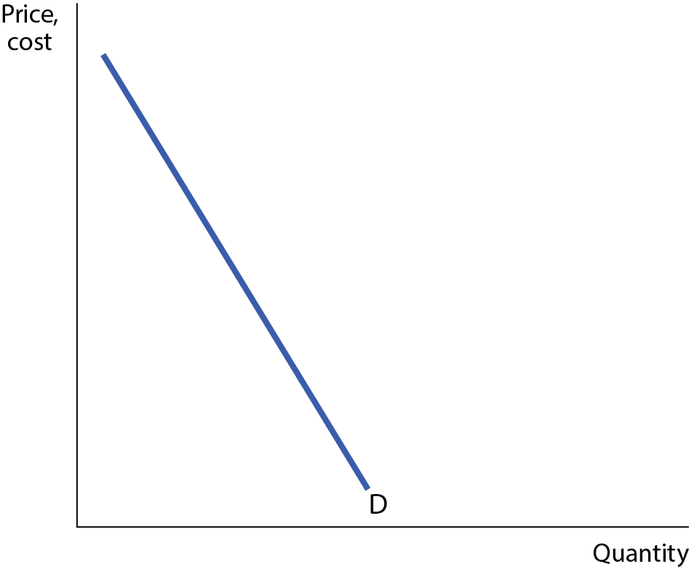
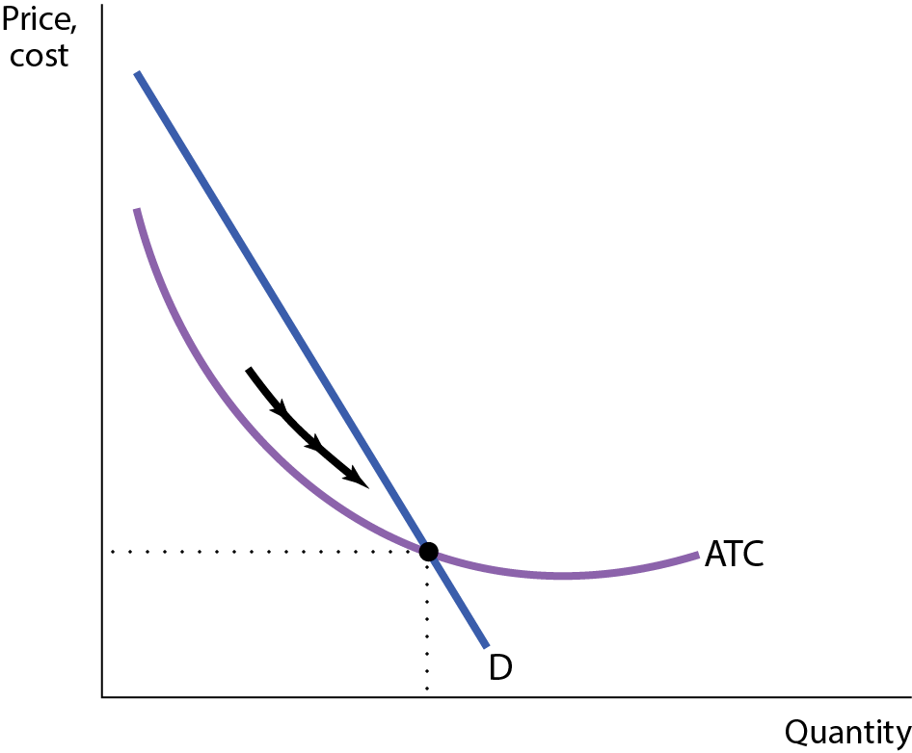
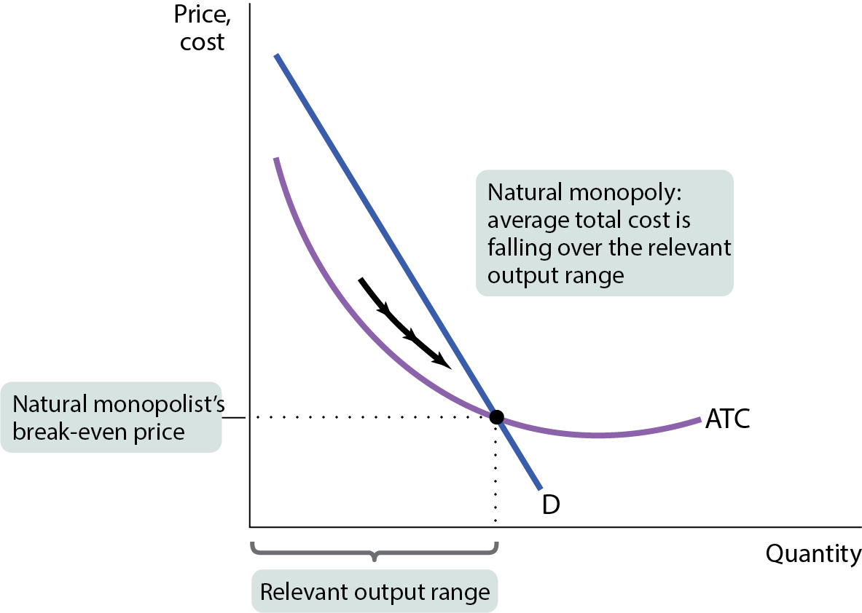
BARRIER #2 IN A GRAPH
Figure 3
A given quantity of output is produced more cheaply by one large firm than by two or more smaller firms.

Slide 18
BARRIER #3: TECHNOLOGICAL SUPERIORITY
A firm that maintains a consistent technological advantage over potential competitors can establish itself as a monopolist.
Example: Intel was technologically superior over other firms from the 1970s to the 1990s.
Technological superiority is typically not a barrier to entry over the longer term.

Slide 19
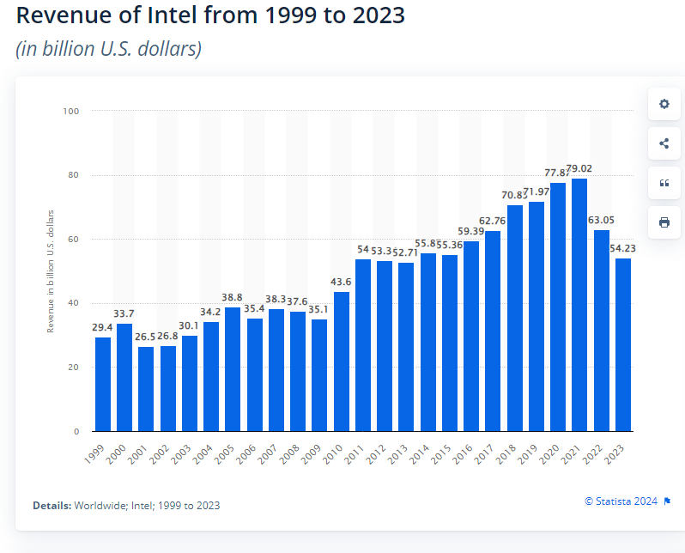

Slide 20
BARRIER #4: NETWORK EXTERNALITY
Network externality: the value of a good or service to an individual increases as more individuals use the same good or service.
The firm with the largest network of customers may become a monopolist.
Examples: eBay, Meta, Amazon, Netflix, Google, Venmo, and TikTok.

Slide 21
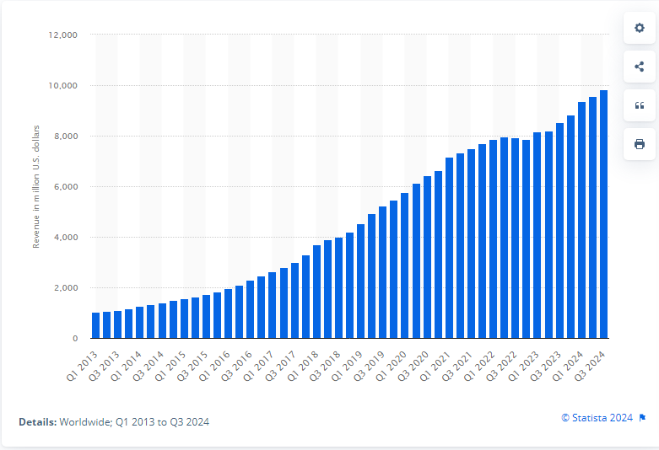

Revenue generated by Netflix from 1st quarter 2013 to 3rd quarter 2024(in million U.S. dollars)

Slide 22
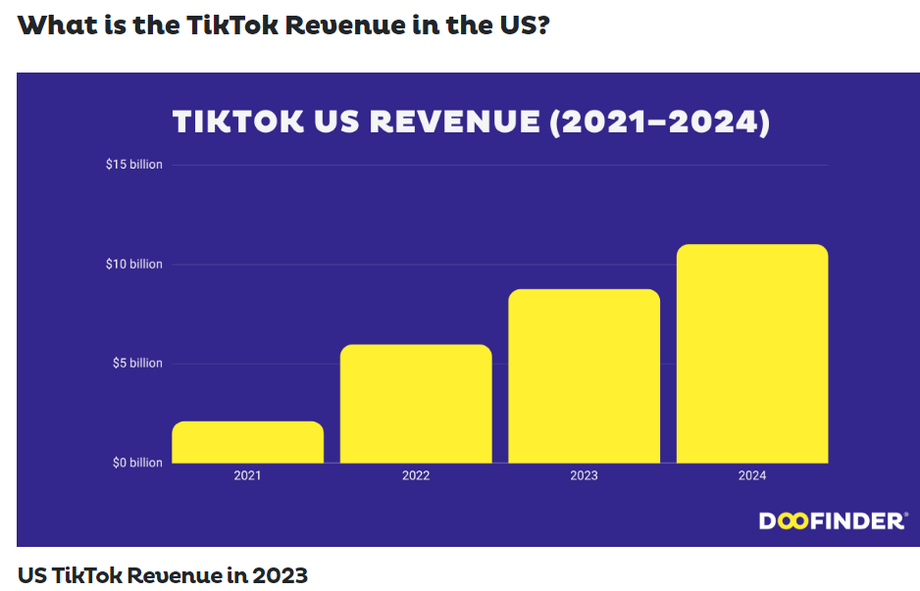

Slide 23
BARRIER #5: GOVERNMENT-CREATED BARRIER
A patent gives an inventor a temporary monopoly in the use or sale of an invention.
A copyright gives the creator of a literary or artistic work sole rights to profit from that work.
The justification for patents and copyrights is a matter of incentives: The law allows a monopoly to exist temporarily by granting property rights that encourage invention and creation.

Slide 24
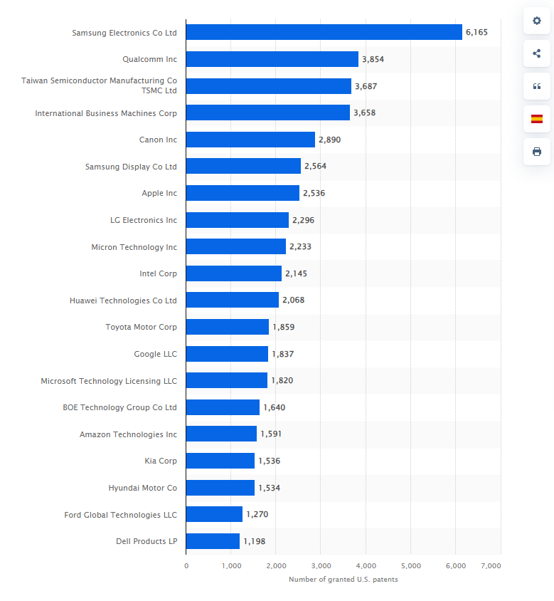
Companies with the most U.S patents granted in 2023

Slide 25
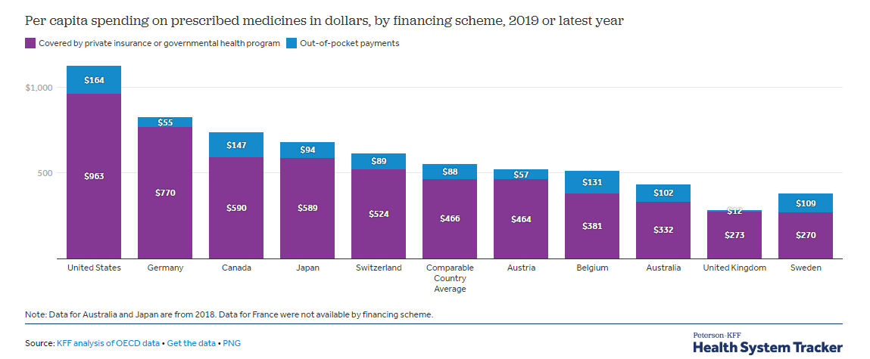
GLOBAL COMPARISON: DRUG PRICES
Different drug prices in different countries reflect willingness to pay; they also reflect that governments in other countries regulate drug prices more actively than the U.S. government does.

Slide 26
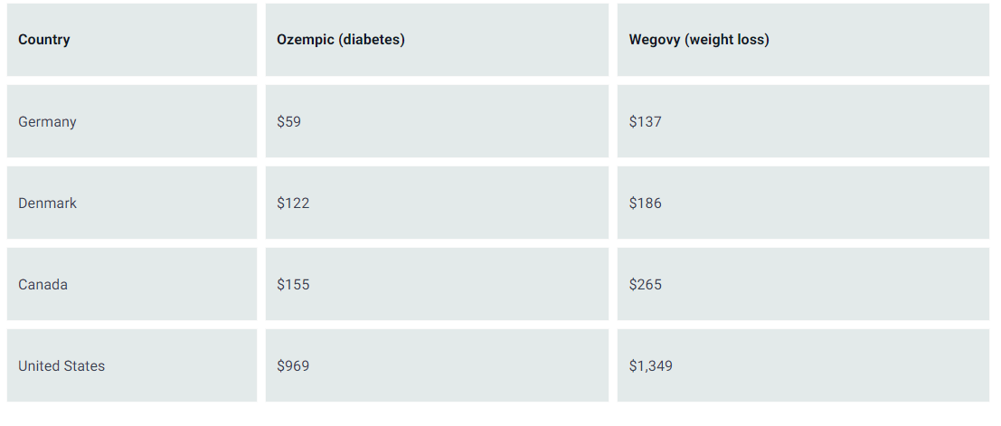
The price of diabetes and weight loss drugs in the U.S. are some of the highest in the world.

Slide 27
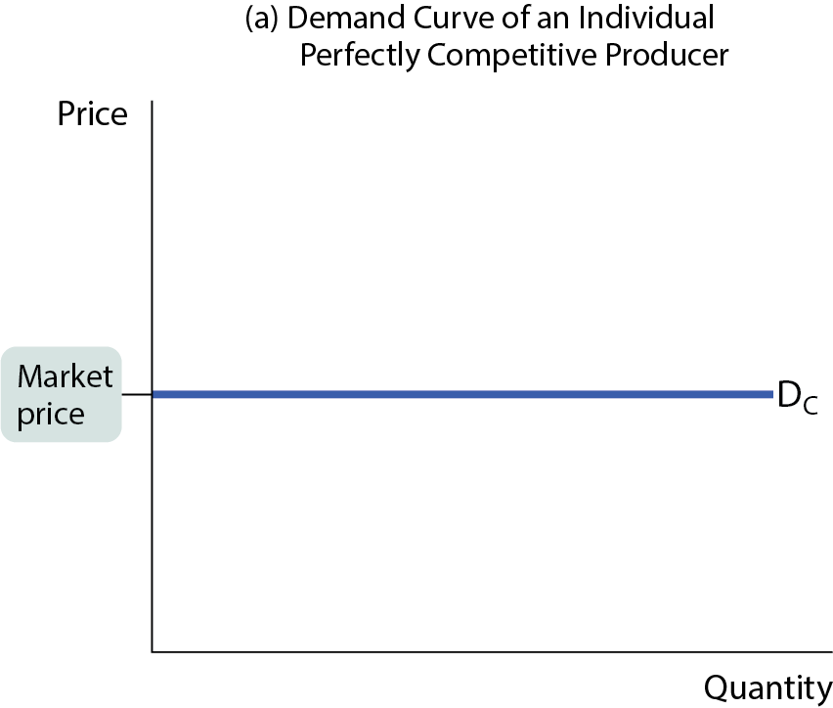
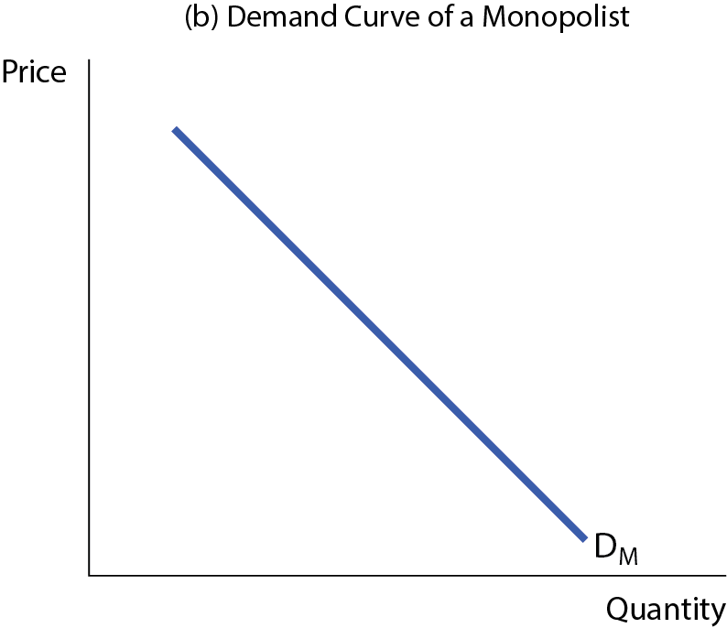
HOW A MONOPOLIST MAXIMIZES PROFIT
Competitive firms cannot choose price.
Monopolists can.
Figure 4 (a,b)

Slide 28
PROFIT-MAXIMIZING RULE
All firms follow the same rule: Profit is maximized at the Q where MR = MC.
So what does MR look like?
MR = ∆TR / ∆Q

Slide 29
MARGINAL REVENUE AND THE DEMAND CURVE
MR is below the demand curve …
An increase in production by a monopolist has two opposing effects on revenue:
  A quantity effect: one more unit is sold, increasing total revenue by the price at which the unit is sold.
  A price effect: to sell the last unit, the monopolist must cut the market price on all units sold; this decreases total revenue.
  A monopolist’s marginal revenue curve is always below the demand curve because of the price effect: To sell an additional unit, the monopolist must cut the market price on all units sold.

Slide 30
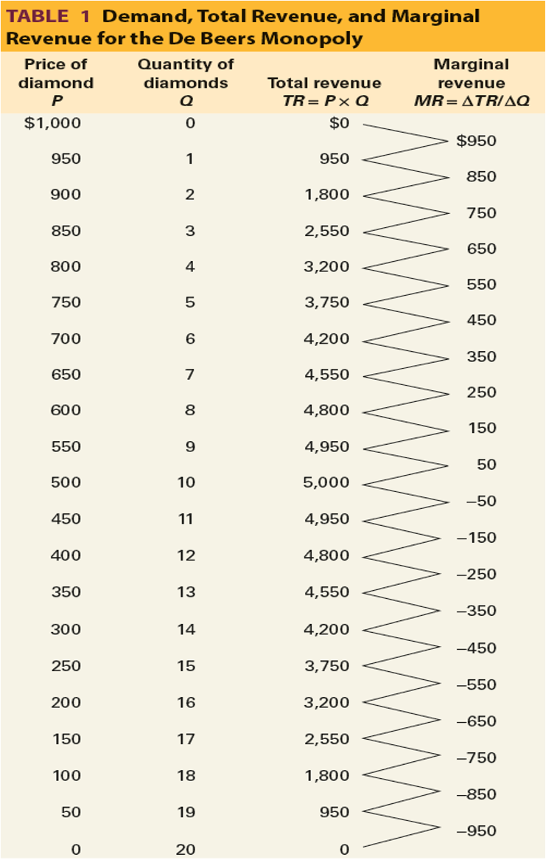
DEMAND, TOTAL REVENUE, AND MARGINAL REVENUE
TABLE 1 Demand, Total Revenue, and Marginal Revenue for the De Beers Monopoly

Slide 31
LEARN BY DOING: PRACTICE QUESTION 1
Suppose that a monopolist can sell 5 units of output at a price of $5, or 6 units of output at a price of $4. What is the marginal revenue of the sixth unit?
$24
$49
–$1
$10
Units | Price | Revenue
5 | $5 | 25
6 | $4 | 24

Slide 32
LEARN BY DOING: PRACTICE QUESTION 1
(ANSWER)
Suppose that a monopolist can sell 5 units of output at a price of $5, or 6 units of output at a price of $4. What is the marginal revenue of the sixth unit?
$24
$49
–$1 (correct answer)
$10

Slide 33
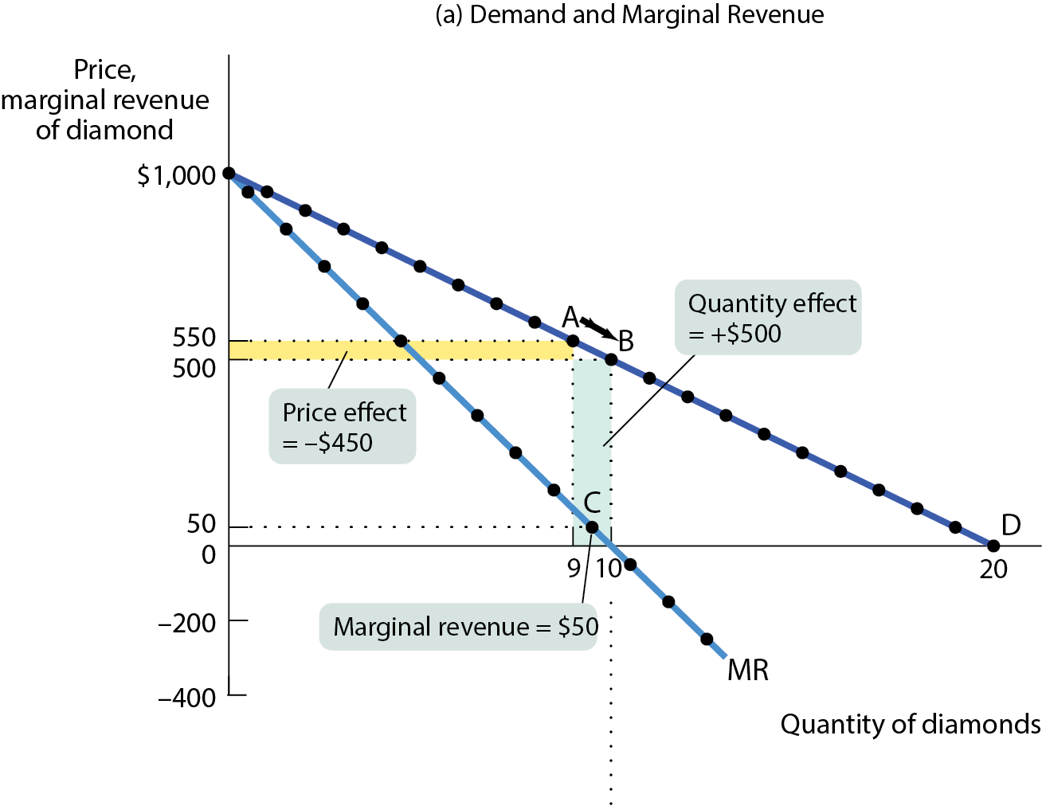
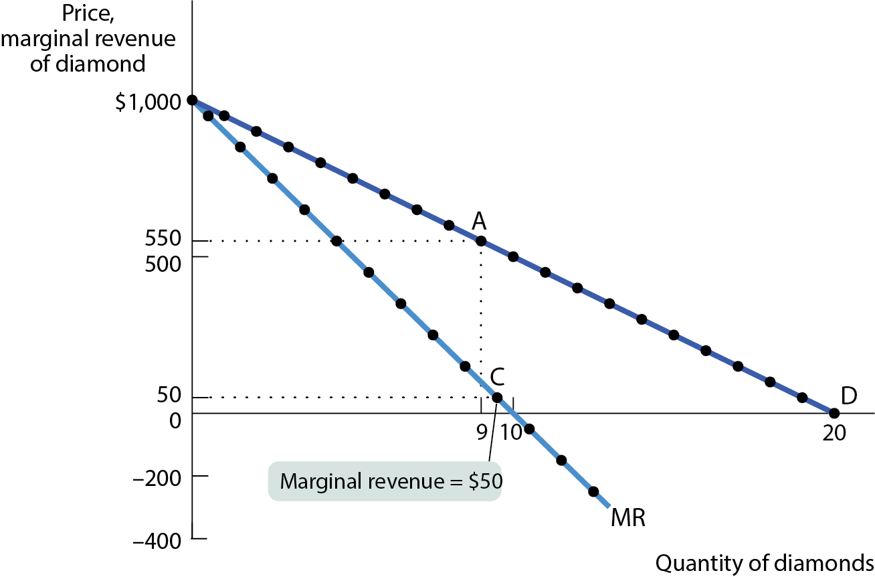
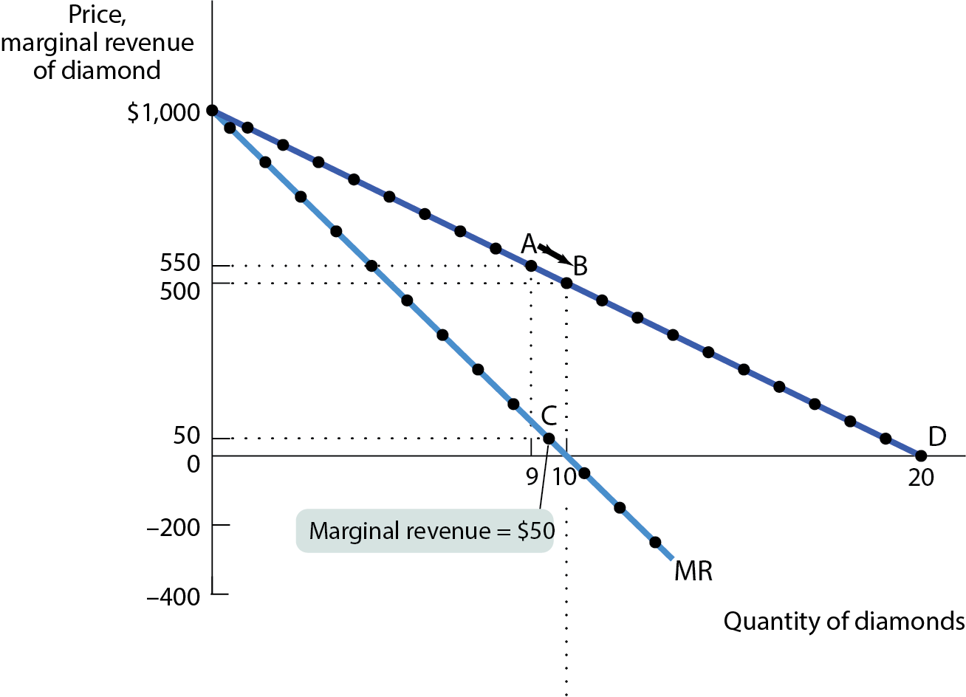
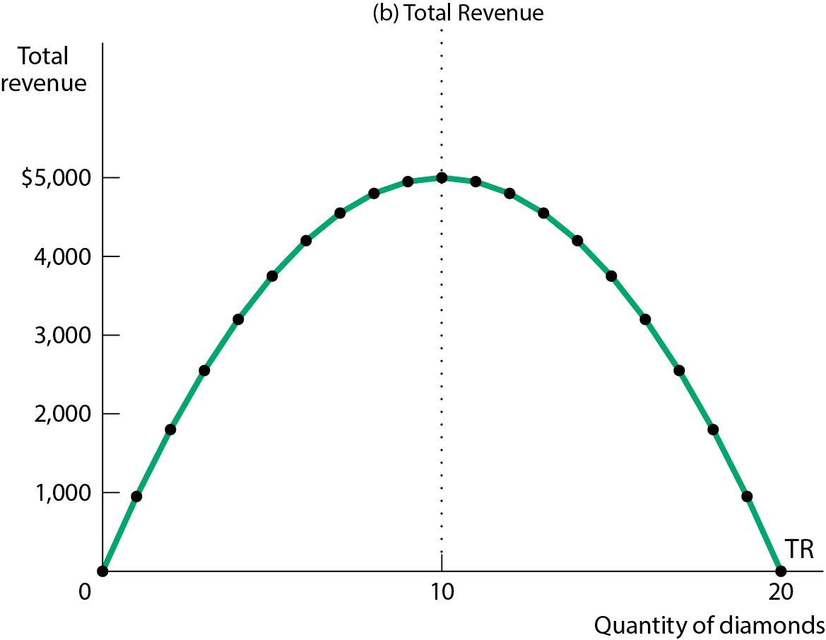
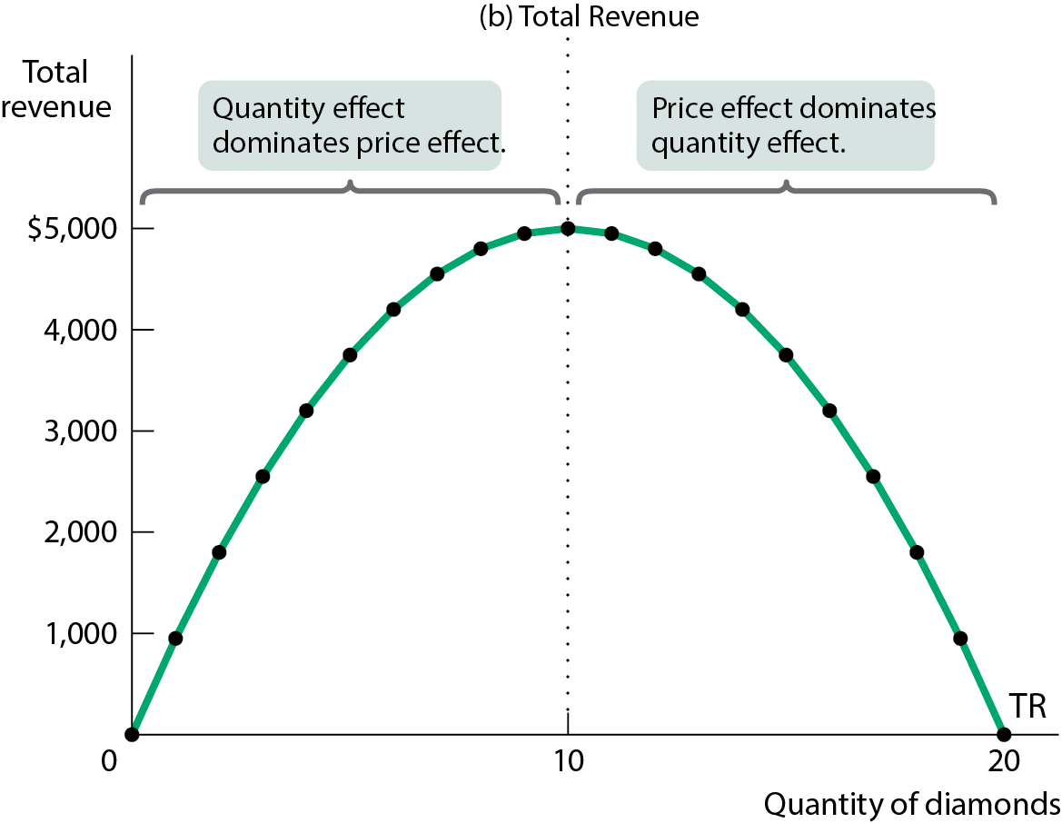
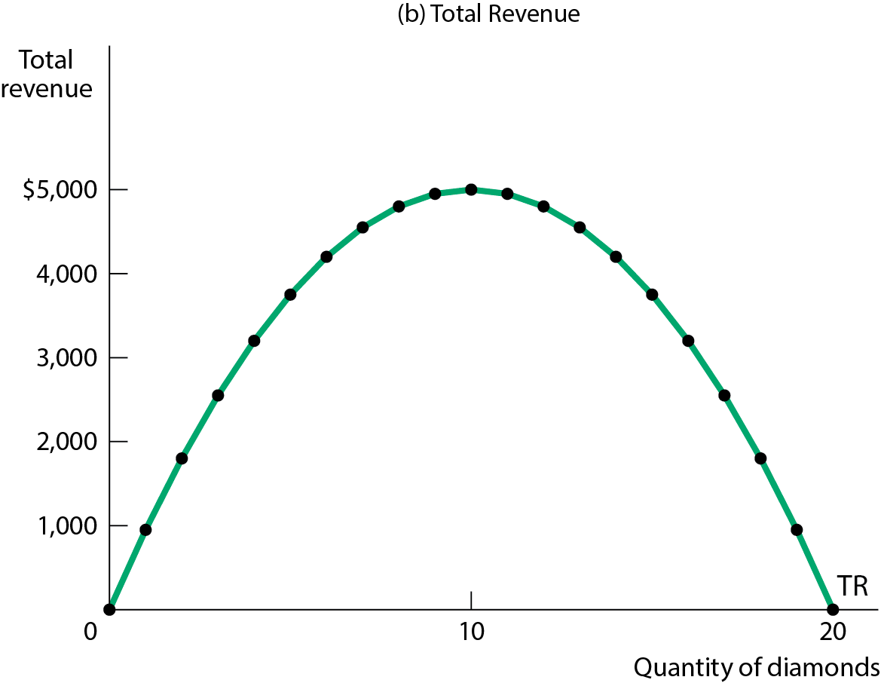
A MONOPOLIST’S DEMAND, TOTAL REVENUE, AND MARGINAL REVENUE CURVES
Figure 5 (a,b)

Slide 34
PROFIT MAXIMIZATION FOR A MONOPOLY
Profit maximization consists of two steps:
Choosing a quantity
Rule: Choose Q where MR = MC
Choosing a price
    Choose the highest price you can get away with, which is the highest price consumers will pay for that quantity.
Rule: Once you’ve picked your quantity, follow the graph to the demand curve, which shows you how much consumers will pay.

Slide 35
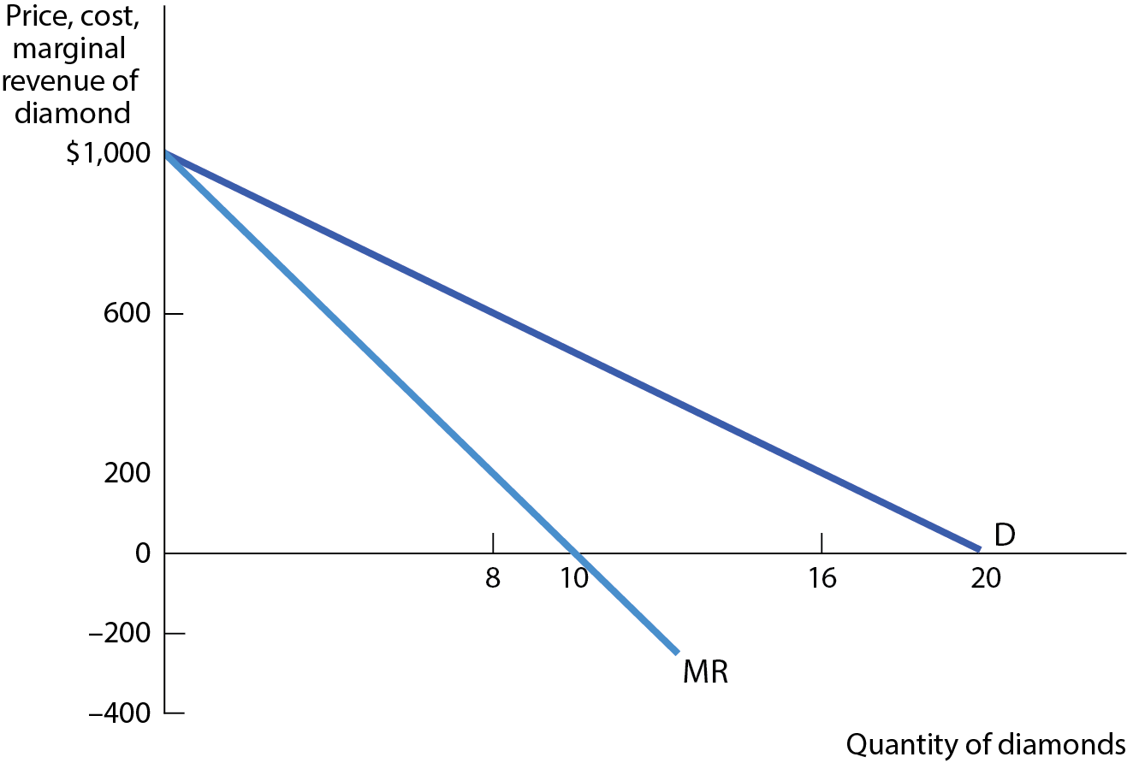
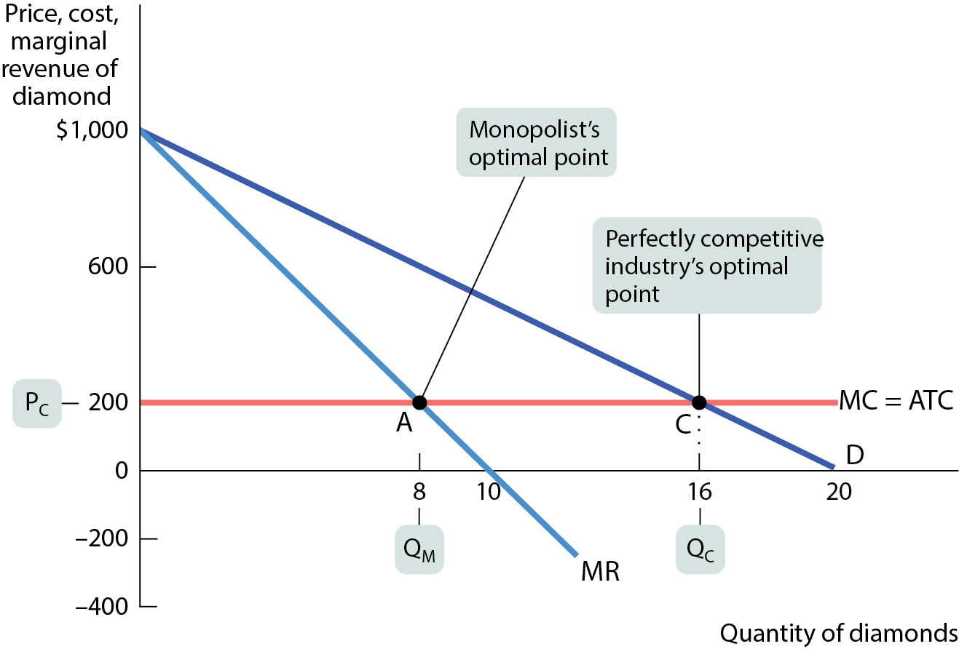
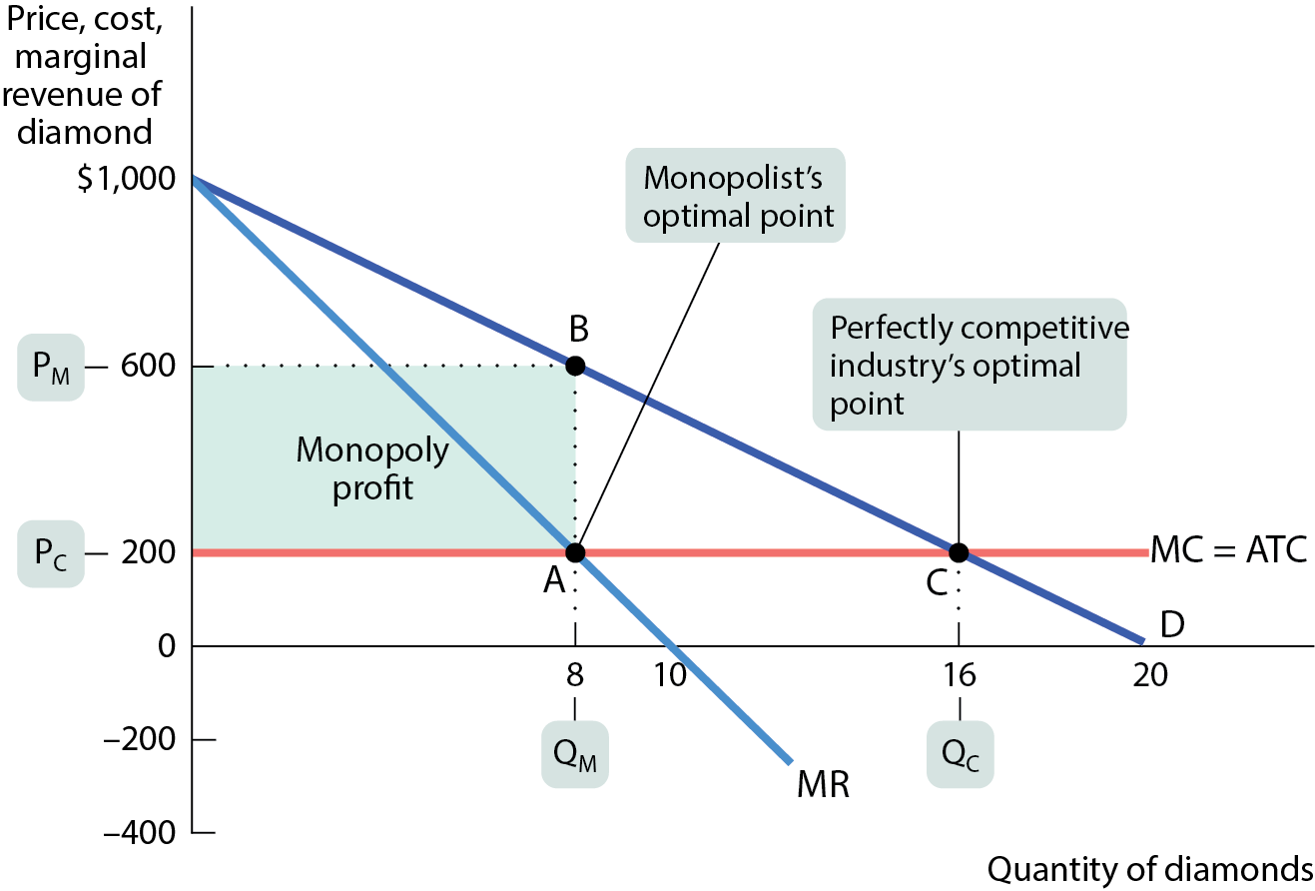
THE MONOPOLIST’S PROFIT-MAXIMIZING OUTPUT AND PRICE
Note: Here the MC curve is simplified to be constant. We will relax this simplification later.
Figure 6

Slide 36
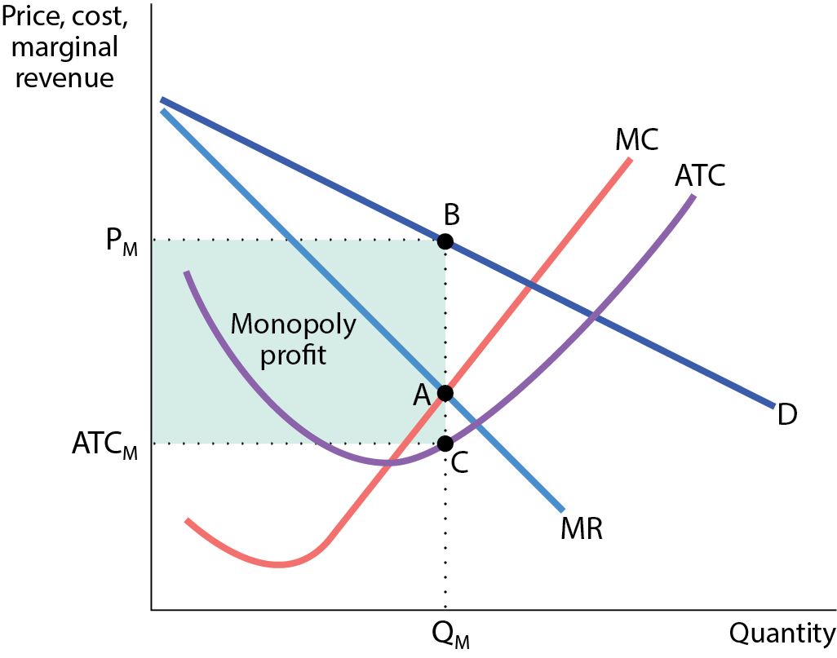
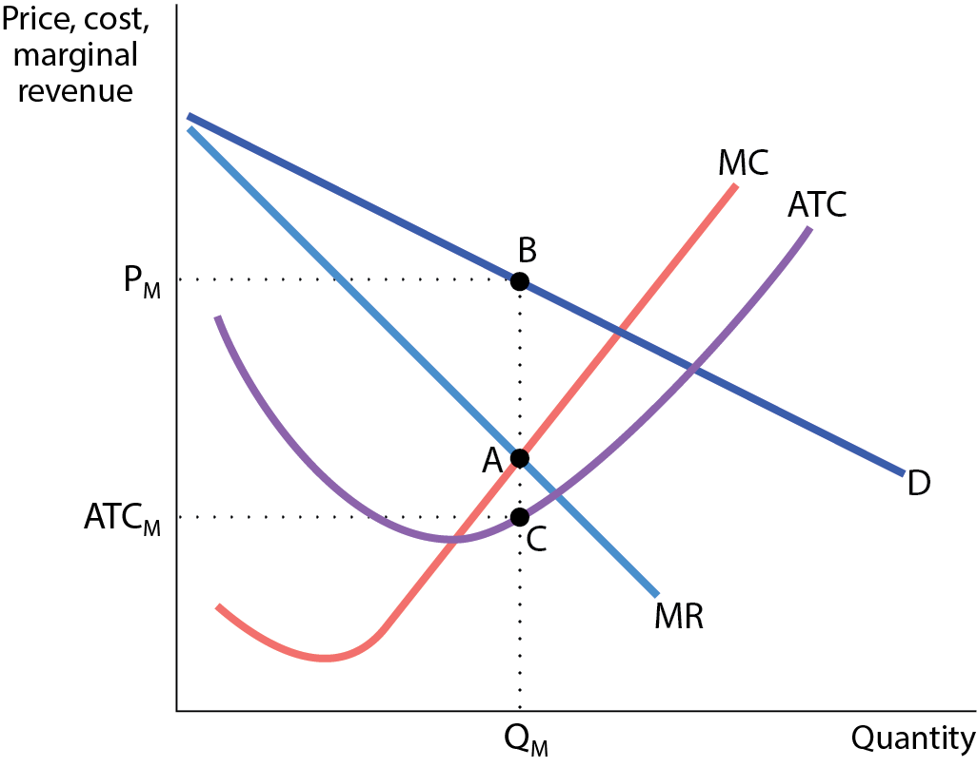
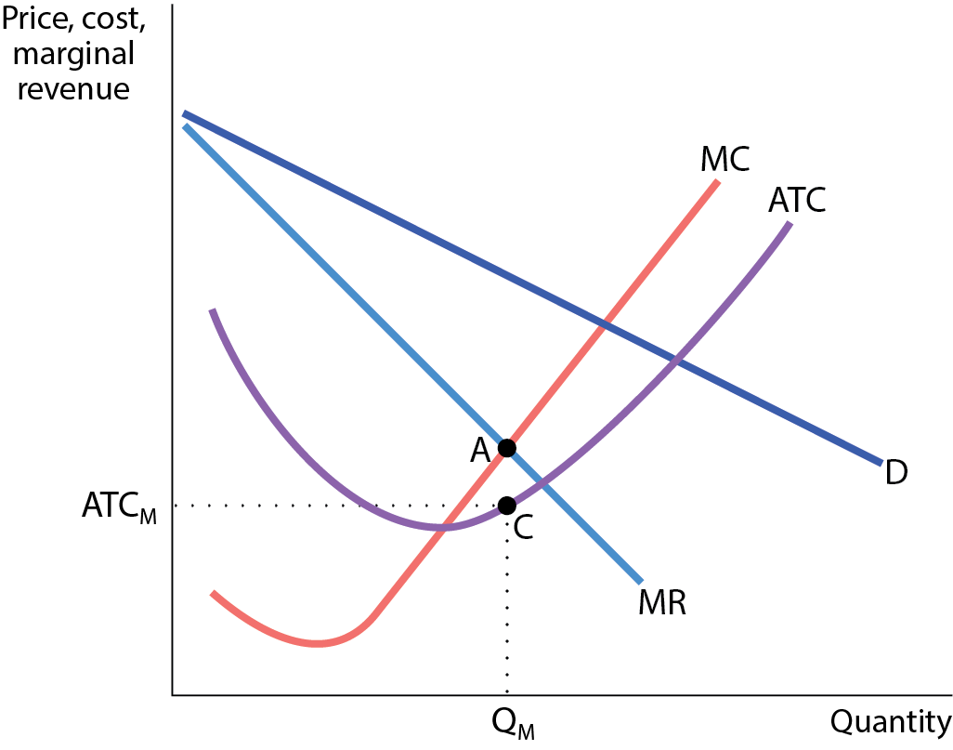
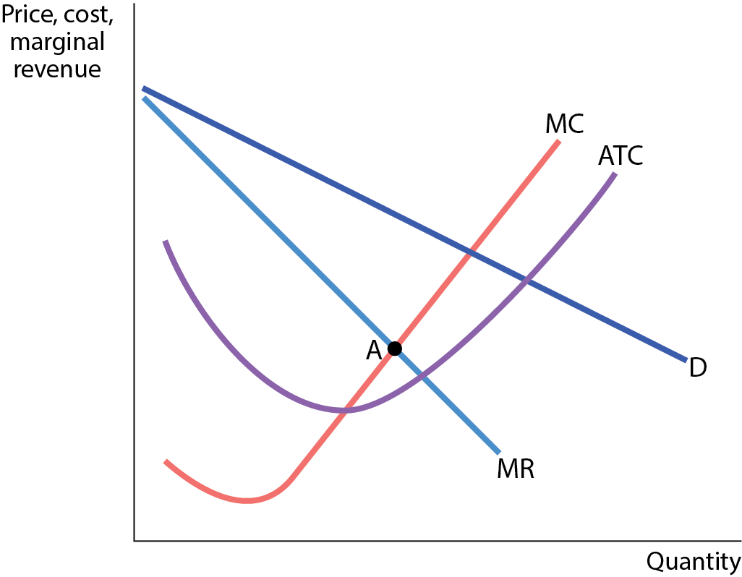
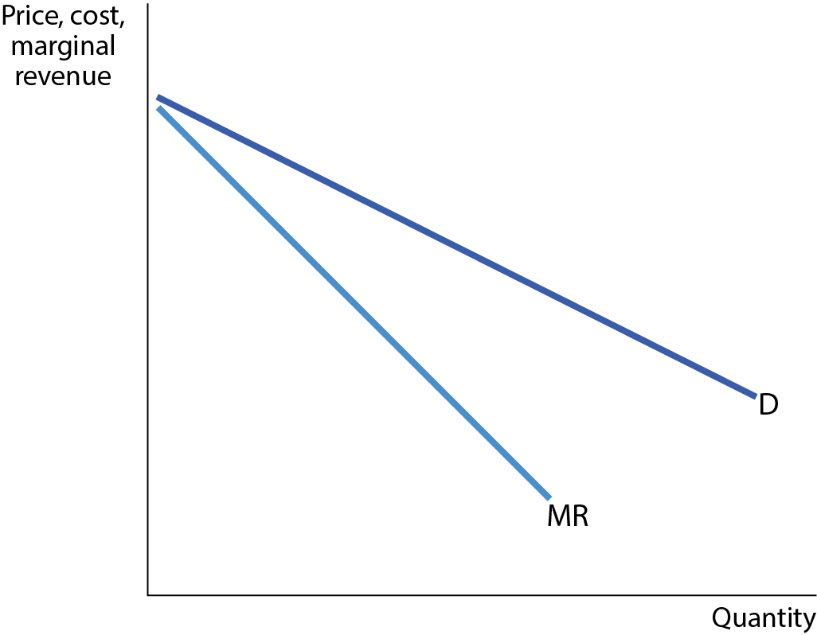
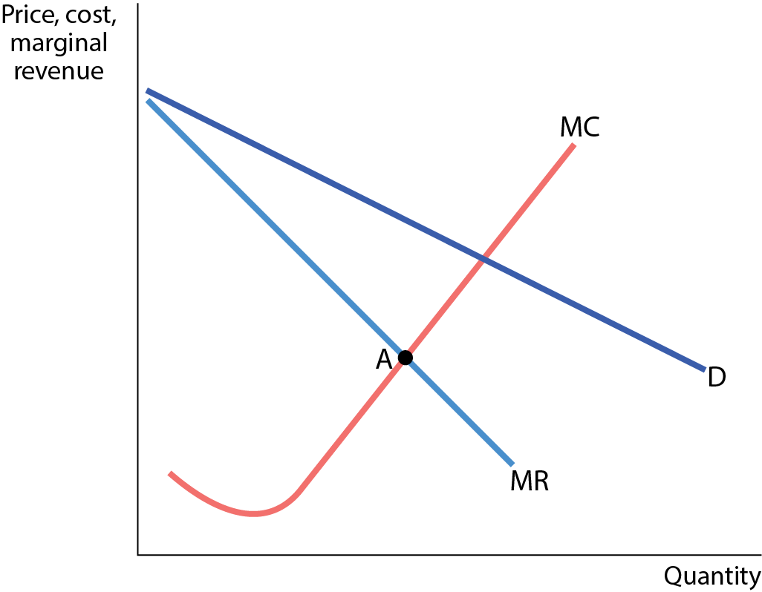
GRAPHING THE MONOPOLIST’S PROFIT
Figure 7
As long as the monopoly has strong barriers to entry, profit will stay.

Slide 37
PITFALLS: IS THERE A MONOPOLY SUPPLY CURVE?
You might be tempted to ask about the supply curve of a monopolist. But this is a meaningless question.
Monopolists don’t have supply curves—since they control prices there is no set relationship between price and quantity supplied.

Slide 38
LEARN BY DOING: PRACTICE QUESTION 2
If the market for some good were converted from a competitive industry to a monopoly, which of these would occur as a result?
Prices would fall on the output produced by the monopolist.
Some consumer surplus would be reallocated to the monopolist as profit.
The overall level of profit earned in the industry would decrease.
More output would be produced by the monopolist.

Slide 39
LEARN BY DOING: PRACTICE QUESTION 2
(ANSWER)
If the market for some good were converted from a competitive industry to a monopoly, which of these would occur as a result?
Prices would fall on the output produced by the monopolist.
Some consumer surplus would be re-allocated to the monopolist as profit. (correct answer)
The overall level of profit earned in the industry would decrease.
More output would be produced by the monopolist.

Slide 40
MONOPOLY AND PUBLIC POLICY
A monopolist, by reducing output and raising prices, benefits at the expense of consumers.
Monopoly is a source of inefficiency: the losses to consumers from monopoly behavior are larger than the gains to the monopolist.
Monopoly leads to net losses to society’s welfare.
Governments often try to either prevent or to limit monopolies.

Slide 41
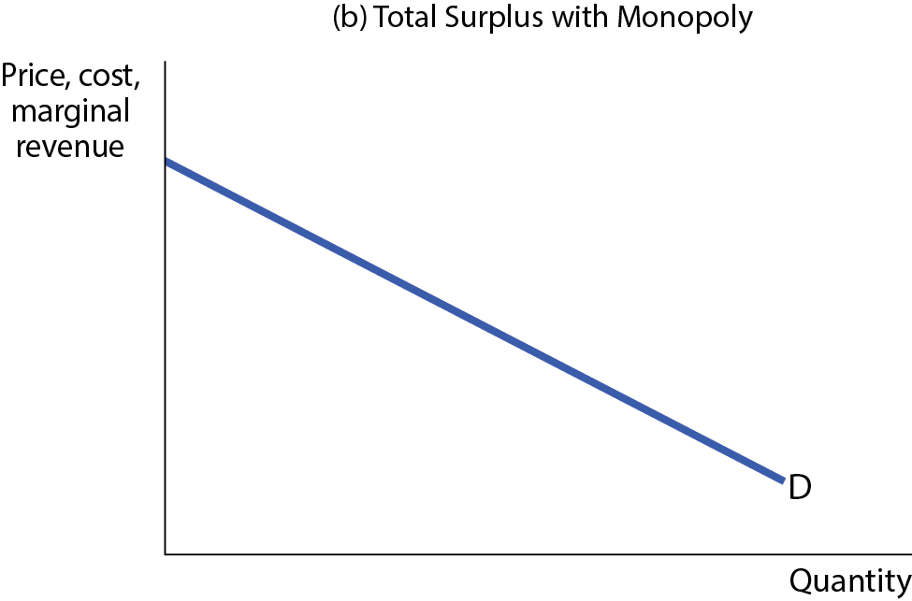
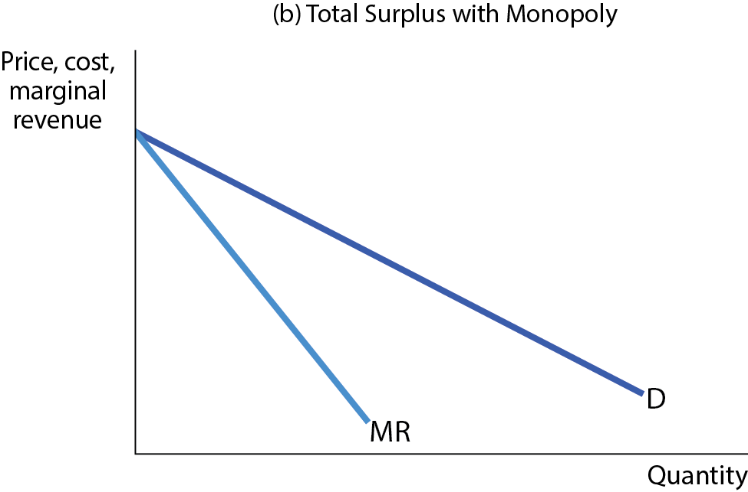
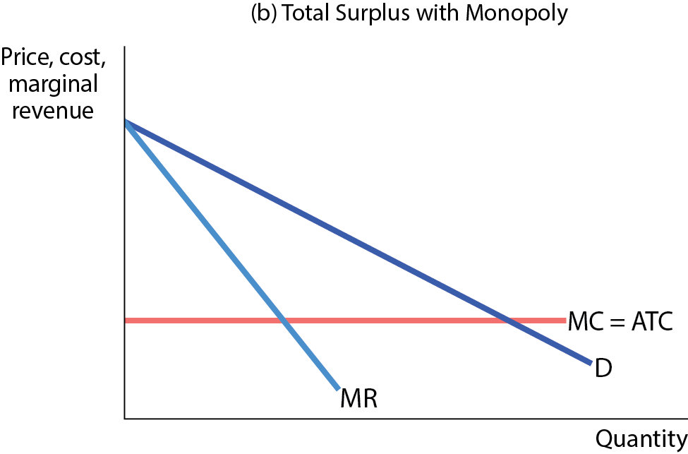
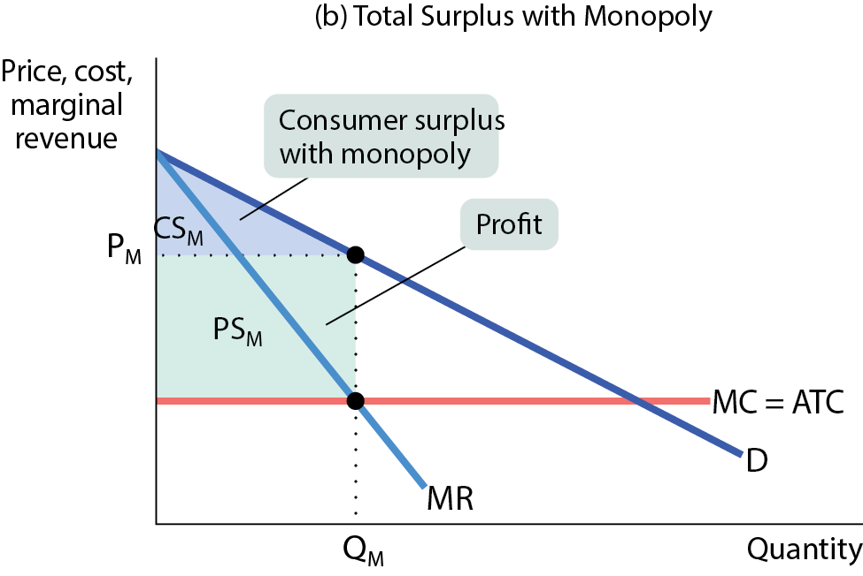
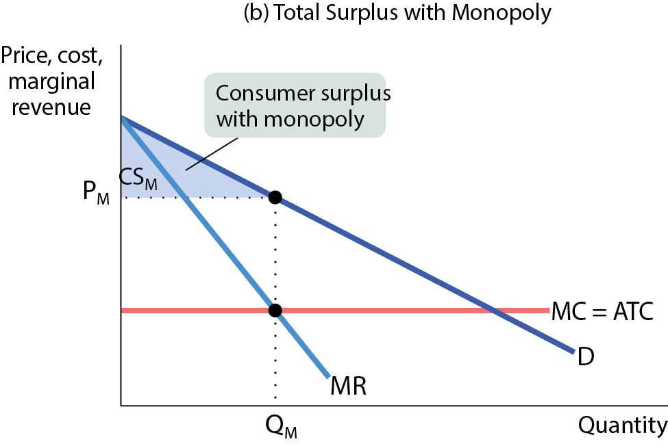
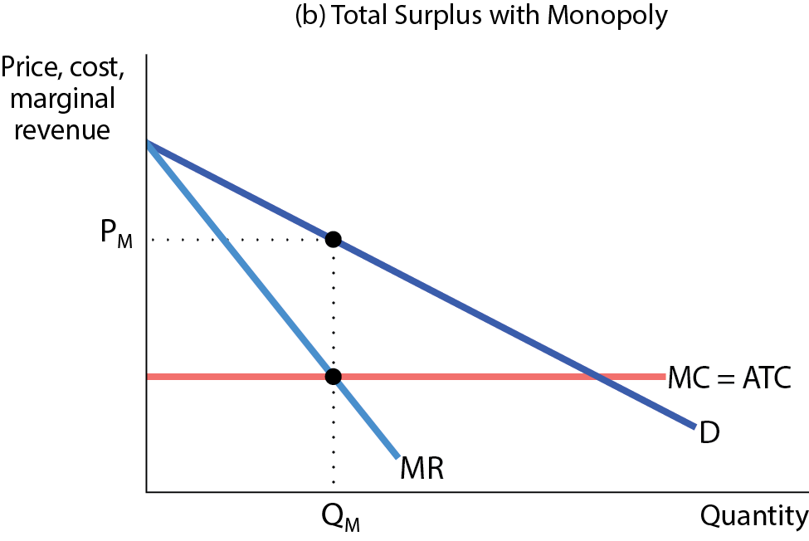
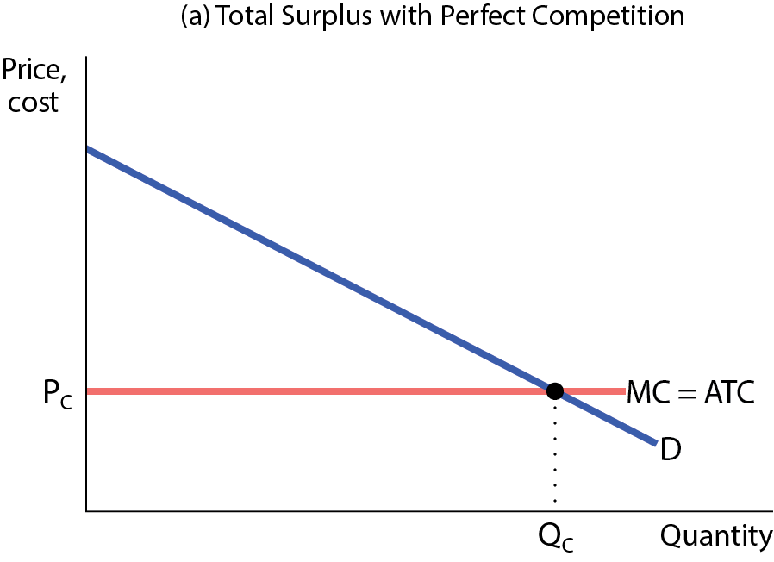
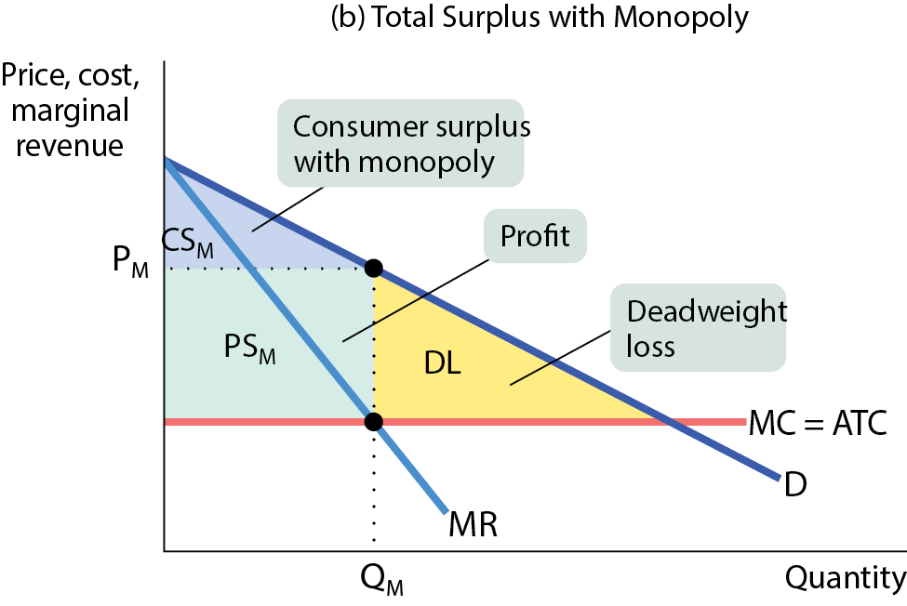
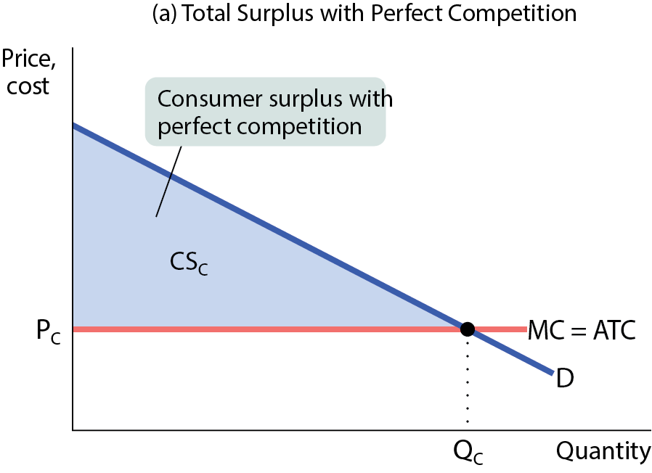
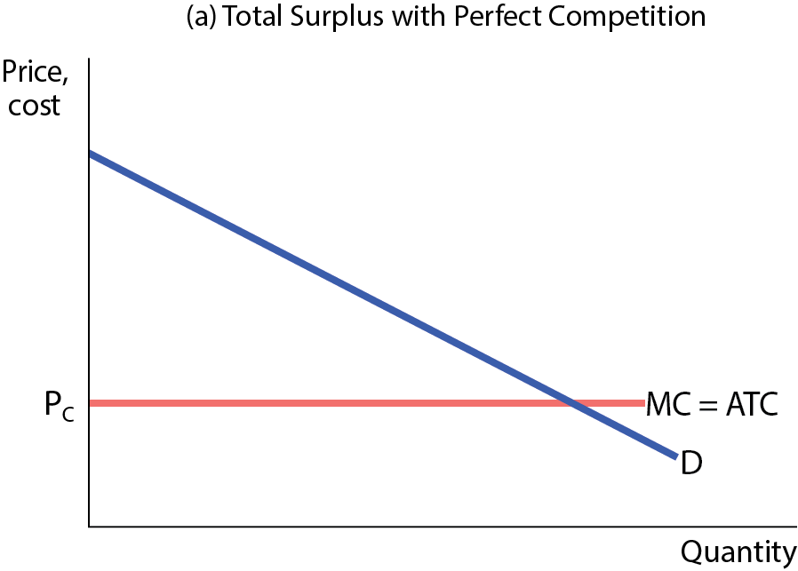
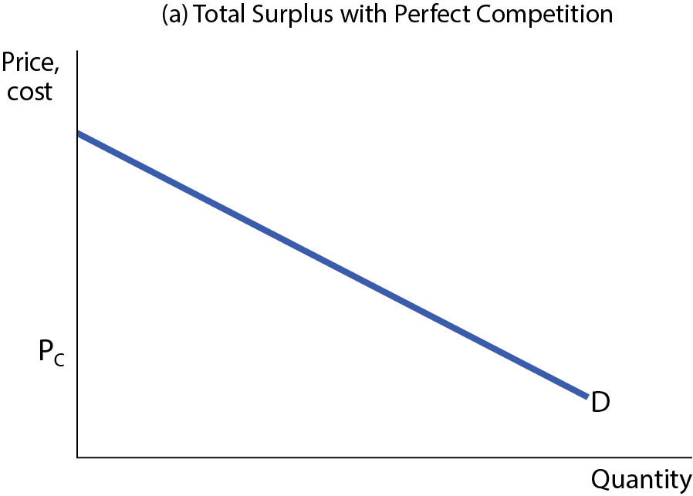
MONOPOLY CAUSES INEFFICIENCY
Figure 8
Panel (a), perfect competition: since price equals the producer’s ATC, there’s no profit and no producer surplus. Total surplus, equal to consumer surplus, is the entire shaded area.
Panel (b), monopoly: the monopolist decreases output to Q_{M} and charges P_{M}. The blue area shows consumer surplus; the green area shows profit; and the yellow area is a deadweight loss. As a result, total surplus falls.

Slide 42
POLICY REMEDIES TO MONOPOLY
If it’s a natural monopoly or a network externality industry, bigger is better for a consumer. These monopolies provide value for consumers.
If neither of those conditions apply, the best policy is to prevent monopoly from arising or to break it up if it already exists.

Slide 43
POLICY REMEDIES TO MONOPOLY
Example: By 1878, John D. Rockefeller’s Standard Oil controlled almost all U.S. oil refining. But in 1911, a court order broke the company into a number of smaller units, including the companies that later became Exxon and Mobil (and merged in 1999 to become ExxonMobil).
The government policies used to prevent or limit monopolies are known as antitrust policies.

Slide 44
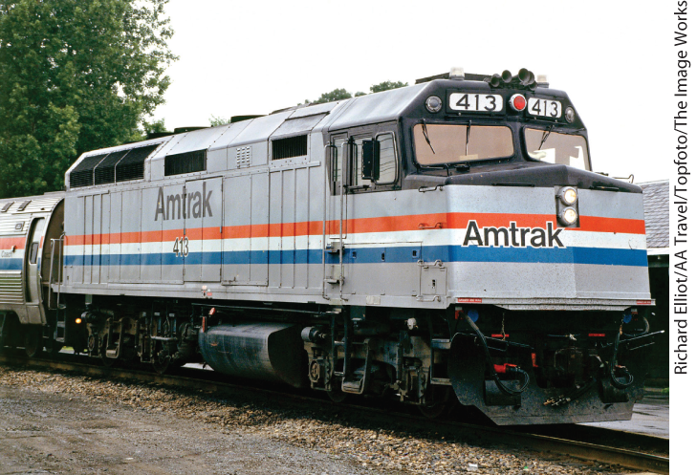
DEALING WITH NATURAL MONOPOLY
Natural monopolies are a different story: a large producer has lower average total cost than small producers and shouldn’t be broken up.
Yet, even a natural monopolist causes inefficiencies. Two policy options:
  Public ownership: the government establishes a public agency to provide the good and protect consumers’ interests.
  Regulation: a price ceiling imposed on a monopolist does not create shortages if it is not set too low.

Slide 45
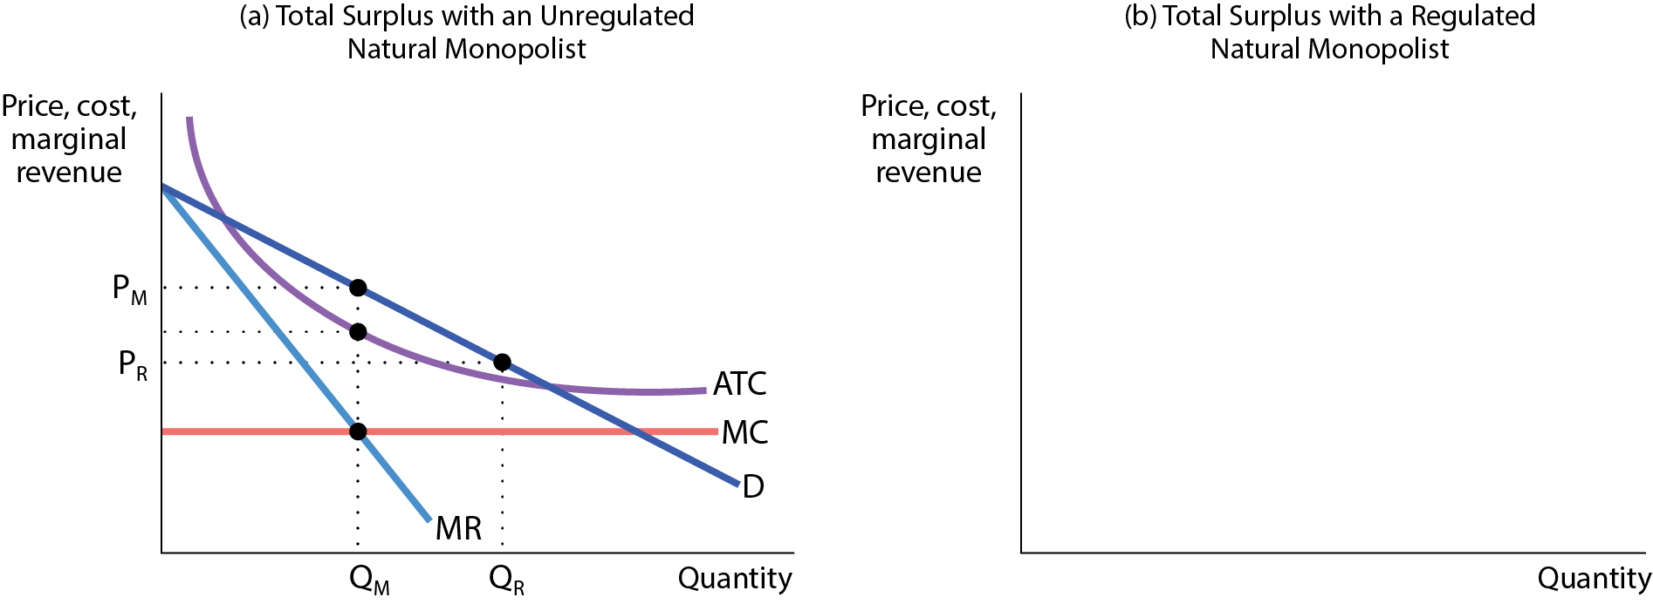
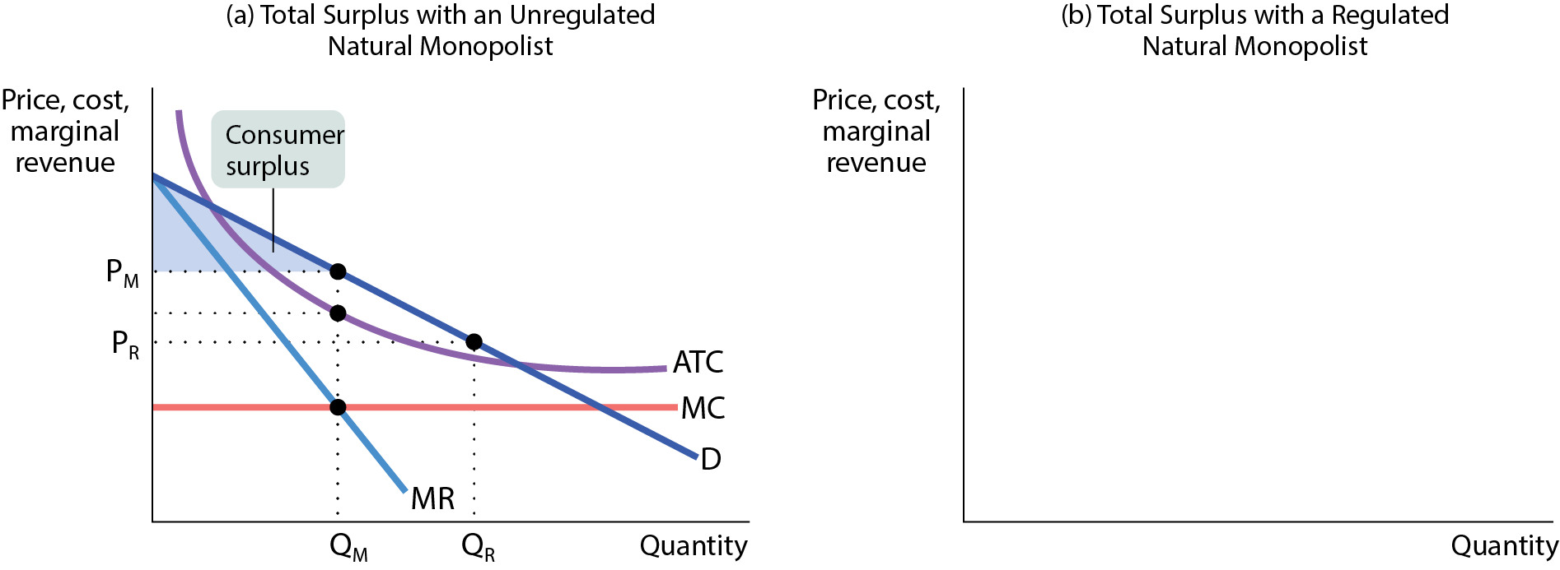
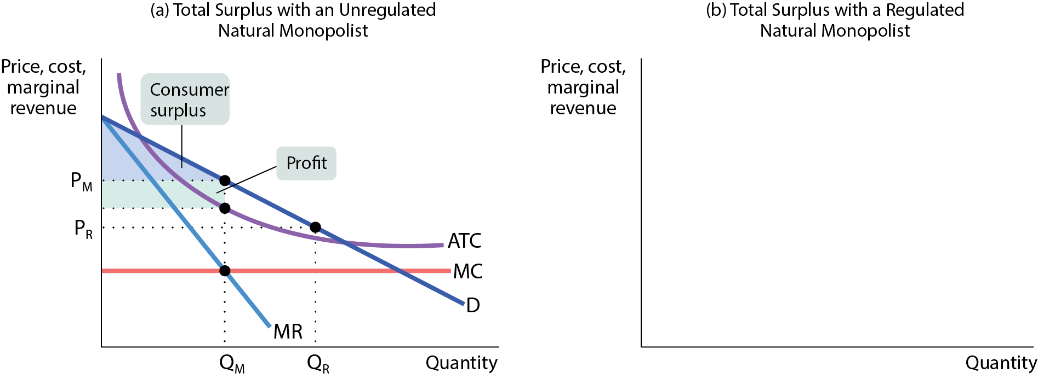





UNREGULATED AND REGULATED NATURAL MONOPOLY
If the monopoly’s price is regulated at P_{R}, consumer surplus rises (and profits fall).
Figure 9

Slide 46
PRICE DISCRIMINATION
So far we’ve been assuming our firm is a single-price monopolist: it offers its product to all consumers at the same price.
Some firms practice price discrimination: they charge different prices to different consumers for the same good.

Slide 47
PRICE DISCRIMINATION AND PROFIT MAXIMIZATION
Recall the profit-maximizing rule for firms with monopoly power:
  Produce the Q at which MR = MC.
  Based on that Q, charge as much as the market will bear (found by the position of the demand curve).
But what if you sell to more than one market, each with its own demand curve?
  Example: senior citizens and young people, business travelers and leisure travelers.

Slide 48



THE LOGIC OF PRICE DISCRIMINATION
Figure 10
If the airline could charge two types of customers two different prices, it would capture of all of the consumer surplus as profit.

Slide 49
PRICE DISCRIMINATION AND ELASTICITY
Firms would distinguish between groups of customers based on their sensitivity to the price—their price elasticity of demand.
Example: Business travelers have lower price elasticity of demand than nonbusiness travelers.
Airlines impose rules that indirectly charge business and nonbusiness travelers different fares: fares are higher if you don’t stay over a Saturday night.

Slide 50


Slide 51
LEARN BY DOING: PRACTICE QUESTION 3
Person A reserves a car online weeks before a trip; person B walks up to a Hertz counter after she walks off an airplane after a four-hour flight. Who probably has more elastic demand for a Hertz rental car? Who probably gets charged more?
Person B has a more elastic demand and will be charged less.
Person B has a more elastic demand and will be charged more.
Person A has a more elastic demand and will be charged more.
Person A has a more elastic demand and will be charged less.

Slide 52
LEARN BY DOING: PRACTICE QUESTION 3
(ANSWER)
Person A reserves a car online weeks before a trip; person B walks up to a Hertz counter after she walks off an airplane after a four-hour flight. Who probably has more elastic demand for a Hertz rental car? Who probably gets charged more?
Person B has a more elastic demand and will be charged less.
Person B has a more elastic demand and will be charged more.
Person A has a more elastic demand and will be charged more.
Person A has a more elastic demand and will be charged less. (correct answer)

Slide 53



PRICE DISCRIMINATION INCREASES SALES AND PROFITS
Figure 11

Slide 54
PERFECT PRICE DISCRIMINATION
When perfect price discrimination can be employed, a firm will charge each customer a different price, the maximum price each is willing to pay.
Under perfect price discrimination, the firm captures all consumer surplus as profit.

Slide 55


GRAPHING PERFECT PRICE DISCRIMINATION
There is no deadweight loss because all mutually beneficial transactions are exploited.
There is zero consumer surplus because the entire surplus is captured by the monopolist in the form of profit.
Figure 11

Slide 56


COMMON TECHNIQUES FOR PRICE DISCRIMINATION
Advance purchase restrictions
Prices are lower for those who purchase well in advance.
Volume discounts
The price is lower if you buy a large quantity.

Slide 57
COMMON TECHNIQUES FOR PRICE DISCRIMINATION
Two-part tariffs
A customer pays a flat fee upfront and then a per-unit fee on each item purchased.
Sales and outlet stores
Holding regular sales such as Black Friday sales, Labor Day sales, and so on; building an outlet store at a distance from the center of the city.
Digital personalized pricing
Online retailers gather personal information on shoppers and adjust prices accordingly.

Slide 58



A NEW GENERATION OF MARKET POWER
The rise of the digital economy and the network externalities provide new ways of gaining market power and of becoming a monopolist: Facebook, Microsoft, Apple, Google, eBay, Uber, and PayPal.
“Bigger is better”: the biggest firm in the industry gets bigger, while smaller firms shrink.

Slide 59
A NEW GENERATION OF MARKET POWER
The dominant firm creates a deadweight loss and another inefficiency: stifling innovation.
A federal court found Microsoft guilty of using its market dominance against rivals.
The EU’s antitrust authorities accused Google of stifling innovation by blocking rivals across platforms.

Slide 60
MONOPSONY
A monopsony exists when there is only one buyer of a good.
The classic example is a single employer in a small town that is hiring workers.
A monopsonist distorts the competitive market equilibrium and creates a deadweight loss.
  Apple is currently the subject of several anti-trust cases, with many claiming that the Apple App Store is an example of monopsony behavior arising from a network externality.

