Slide 1

Behind the Supply Curve: Inputs and Costs
14
Notes:
Cover Credits: Currency Exchange Stock Chart: cemagraphics/Getty Images, Social Media Montage: SEAN GLADWELL/Getty Images, Circuit Pattern: somsak Tangdamrongsub/Getty Images, Cargo Containers: urzine/Getty Images

Slide 2
WHAT YOU WILL LEARN IN THIS CHAPTER
What is a firm’s production function?
Why is production often subject to diminishing returns to inputs?
What types of costs does a firm face, and how does the firm generate its marginal and average cost curves?
Why does a firm’s costs differ in the short run and in the long run?
What is increasing returns to scale, and what advantage does it give?

Slide 3

THE PRODUCTION FUNCTION
A firm is an organization that produces goods or services for sale.
Production is the process of turning inputs into outputs.
A production function is the relationship between the quantity of inputs a firm uses and the quantity of output it produces.

Slide 4


THE PRODUCTION FUNCTION
A fixed input is an input whose quantity is fixed for a period of time and cannot be varied.
A variable input is an input whose quantity the firm can vary at any time.

Slide 5

INPUTS AND OUTPUT
The long run is the period in which all inputs can be varied.
The short run is the period in which at least one input is fixed.
The total product curve shows how the quantity of output depends on the quantity of the variable input for a given quantity of the fixed input.

Slide 6
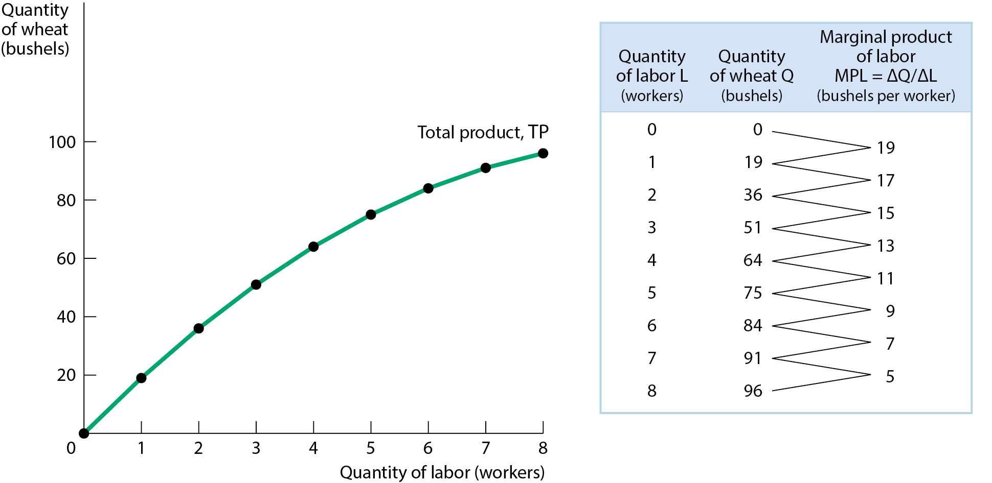
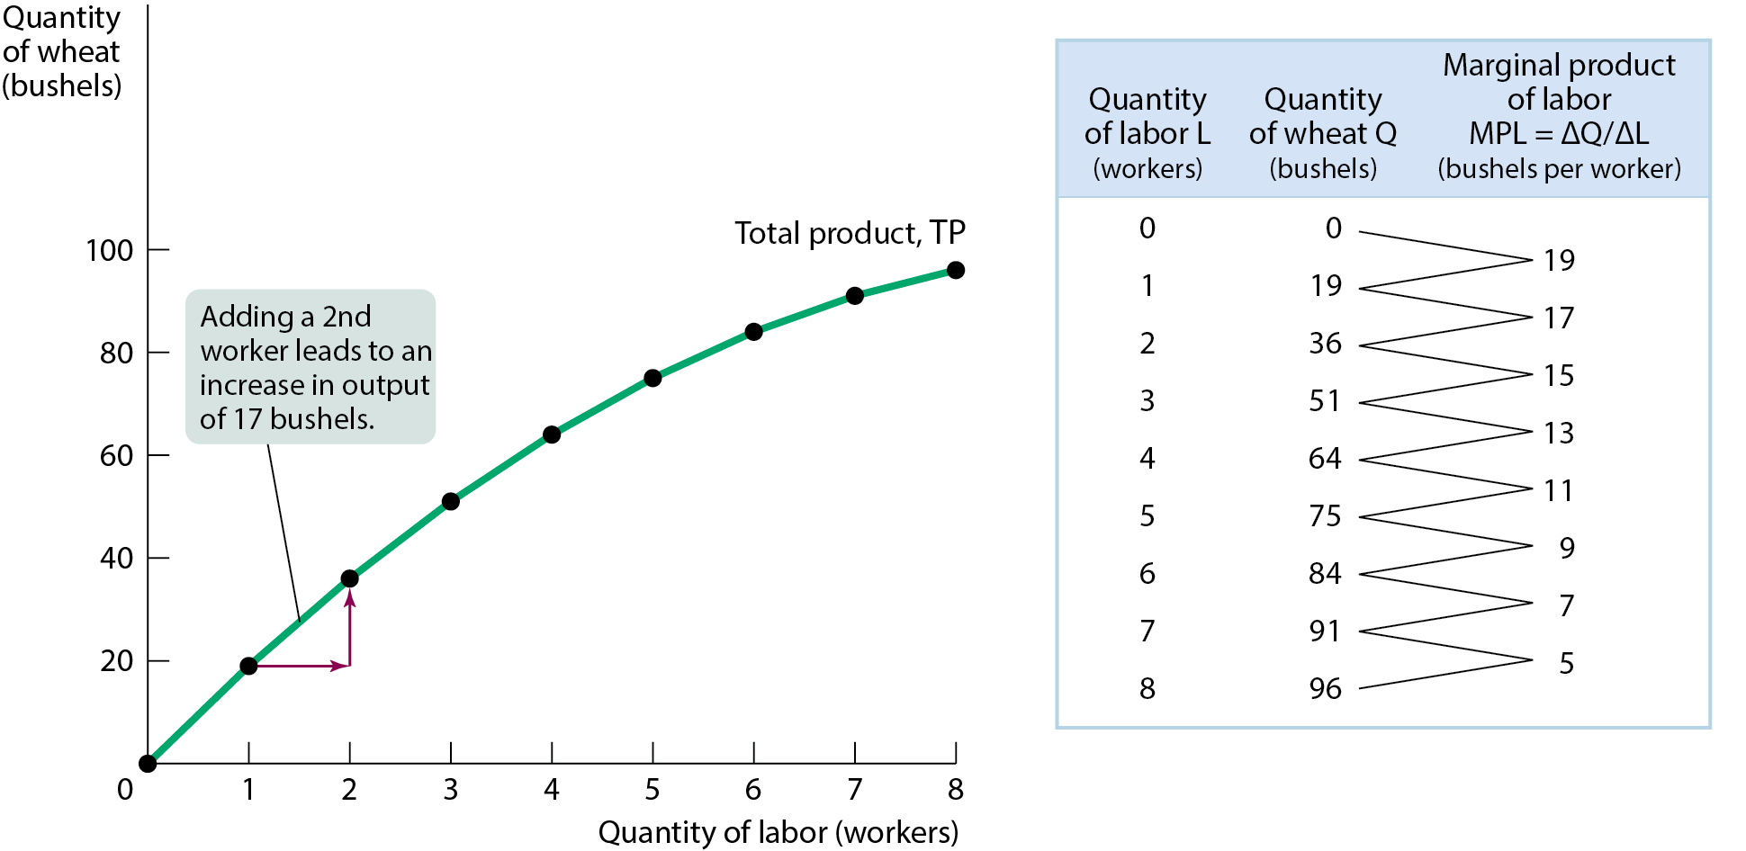
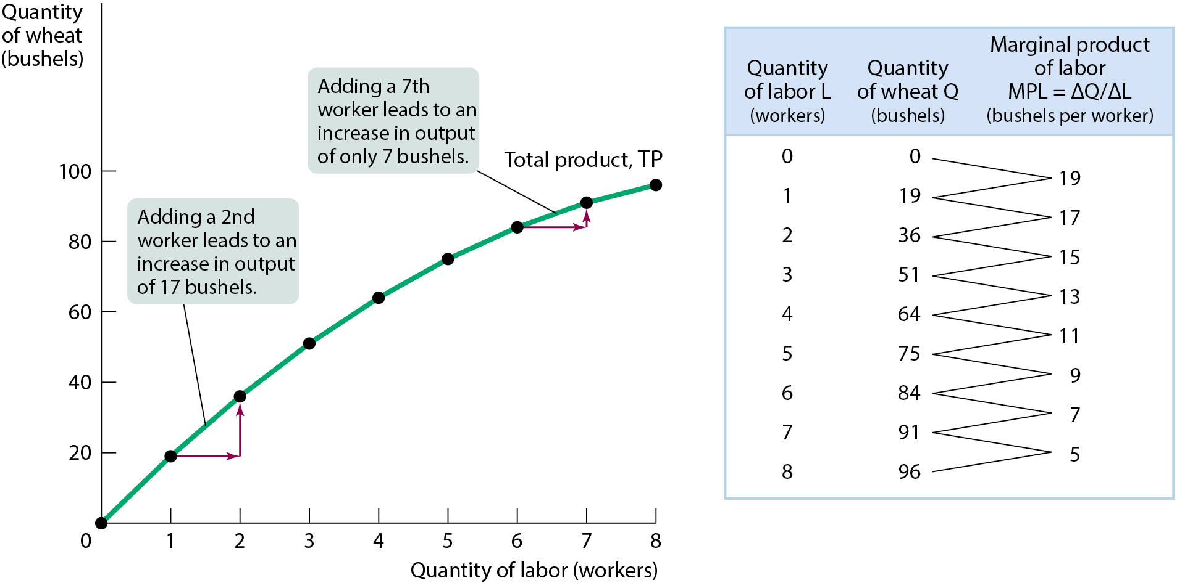
PRODUCTION FUNCTION AND TOTAL PRODUCT CURVE
The curve slopes upward because more wheat is produced as more workers are employed. It becomes flatter because the marginal product of labor declines as more workers are employed.
Figure 1

Slide 7
PRODUCTION FUNCTION AND TOTAL PRODUCT CURVE
The marginal product of an input is the additional quantity of output that is produced by using one more unit of that input.
Marginal product of labor (MPL) is the change in output resulting from a one-unit increase in the amount of labor input (ΔQ/ΔL)

Slide 8
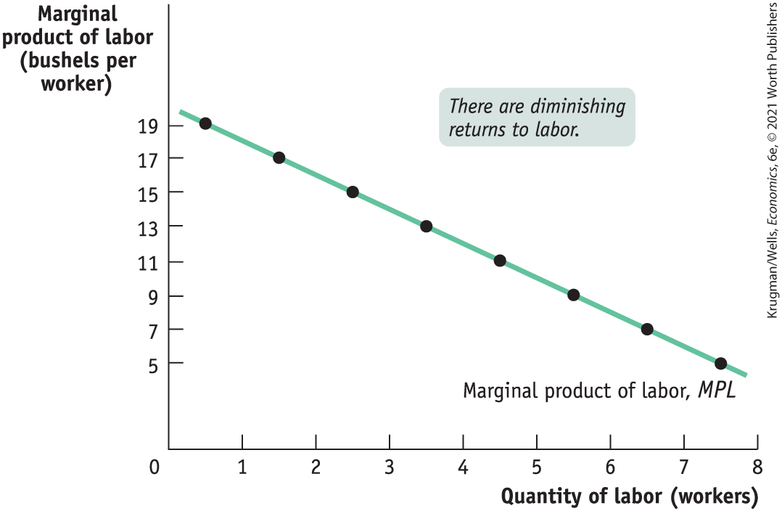
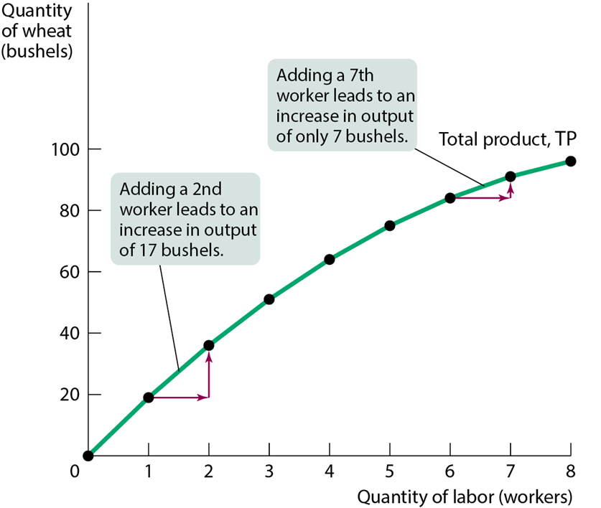
PRODUCTION FUNCTION AND TOTAL PRODUCT CURVE
MPL equals the slope of the total product curve.
In Figure 1, MPL declines as more workers are hired. As employment increases, the total product curve gets flatter.
Figure 2 shows how MPL depends on the number of workers.

Slide 9
DIMINISHING RETURNS TO AN INPUT
Diminishing returns to an input: an increase in the quantity of that input, holding the levels of all other inputs fixed, reduces that input’s marginal product.
Figure 2

Slide 10
LEARN BY DOING: PRACTICE QUESTION 1
If one worker makes 14 baskets,
two workers make 34 baskets,
three workers make 45 baskets, and
four workers make 50 baskets, which worker yielded the highest marginal product?
the first worker
the second worker
the third worker
the fourth worker
# Labor | Total Output | MP_{L}
1 | 14 | 14
2 | 34 | 20 (34-14)
3 | 45 | 11 (45-34)

Slide 11
LEARN BY DOING: PRACTICE QUESTION 1
(ANSWER)
If one worker makes 14 baskets,
two workers make 34 baskets,
three workers make 45 baskets, and
four workers make 50 baskets, which worker yielded the highest marginal product?
the first worker
the second worker (correct answer)
the third worker
the fourth worker

Slide 12
LEARN BY DOING: PRACTICE QUESTION 2
Marginal product is the slope of the:
marginal cost curve.
total product curve.
long-run average total cost curve.
total cost curve.

Slide 13
LEARN BY DOING: PRACTICE QUESTION 2
(ANSWER)
Marginal product is the slope of the:
marginal cost curve.
total product curve. (correct answer)
long-run average total cost curve.
total cost curve.

Slide 14
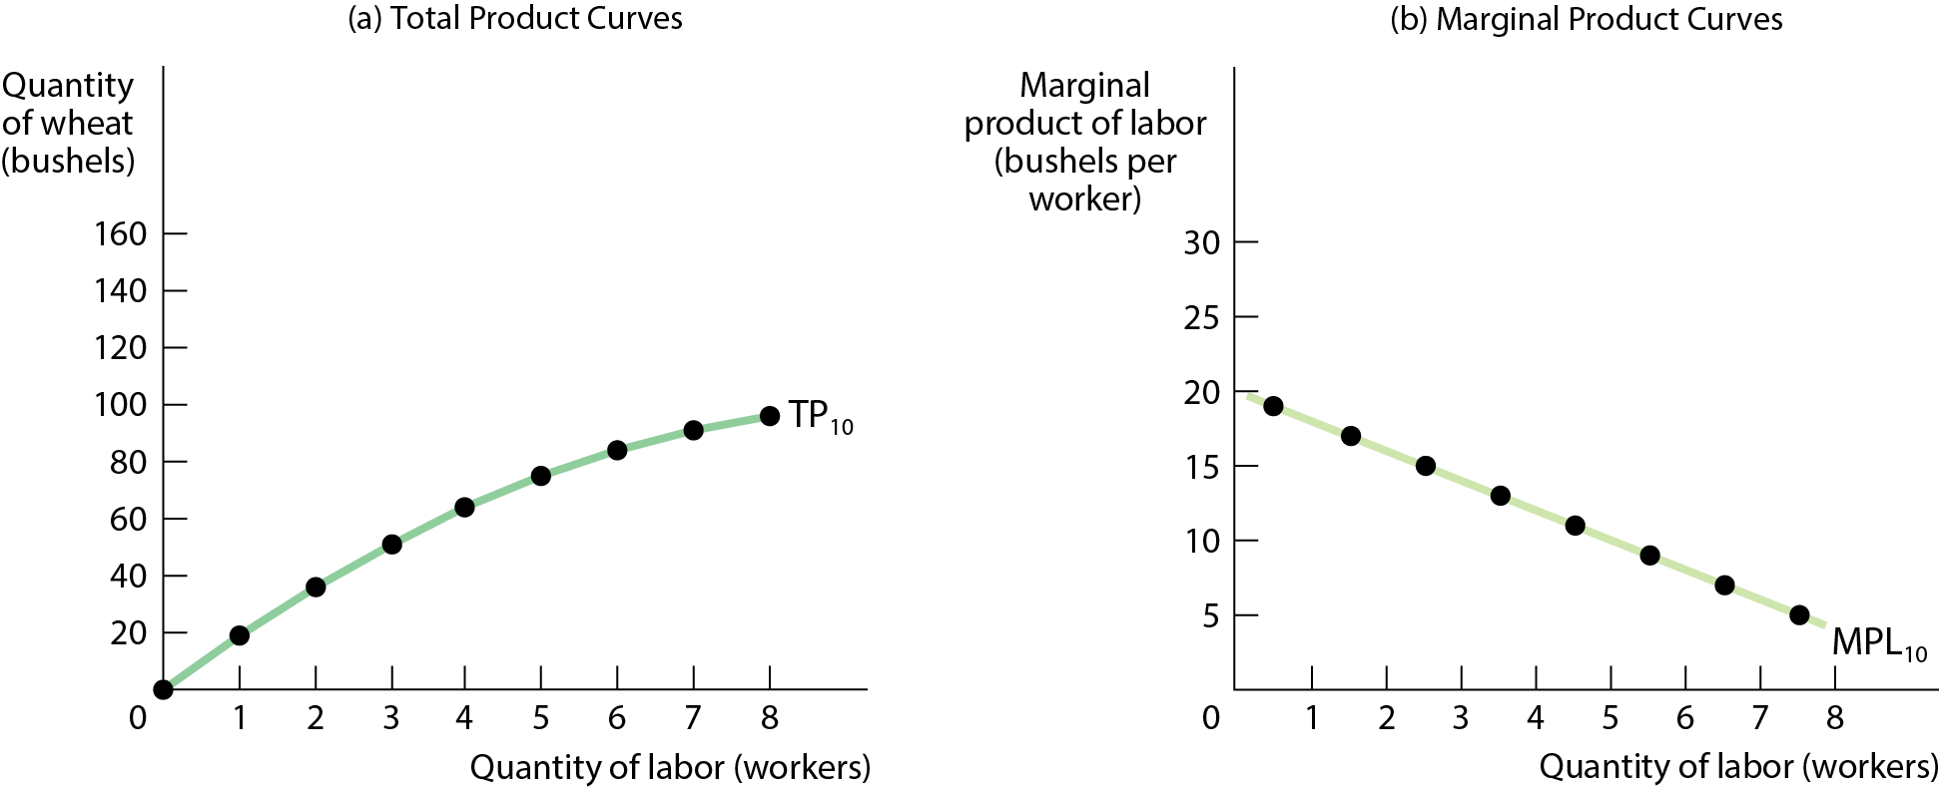
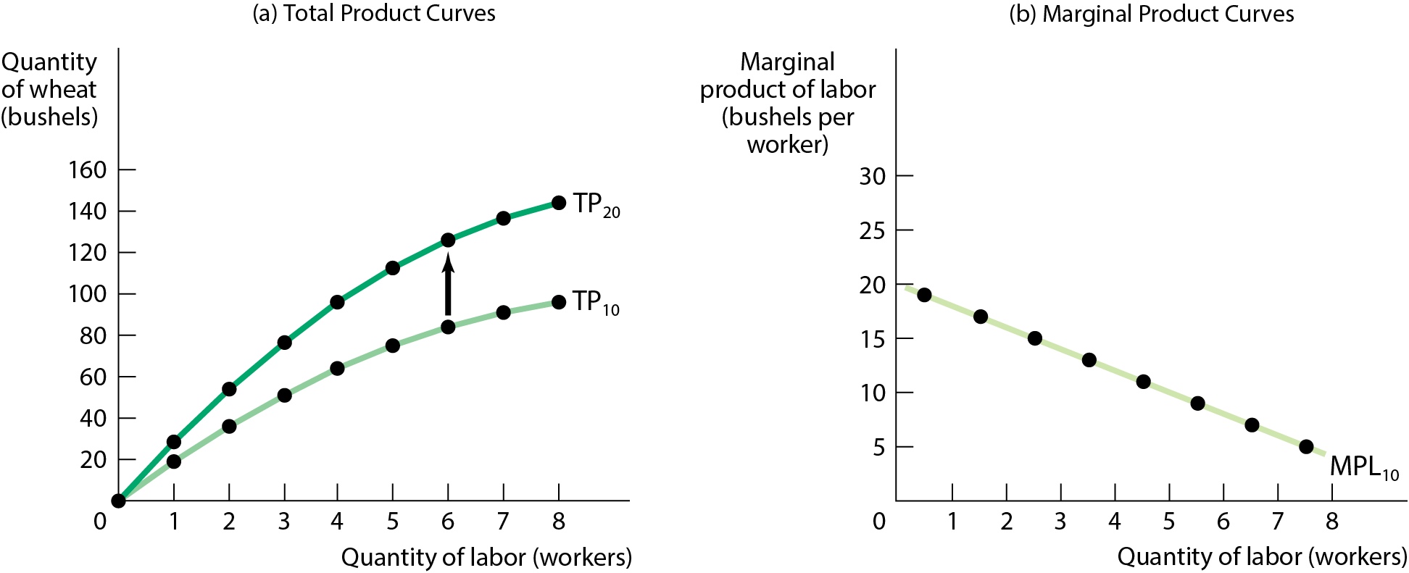
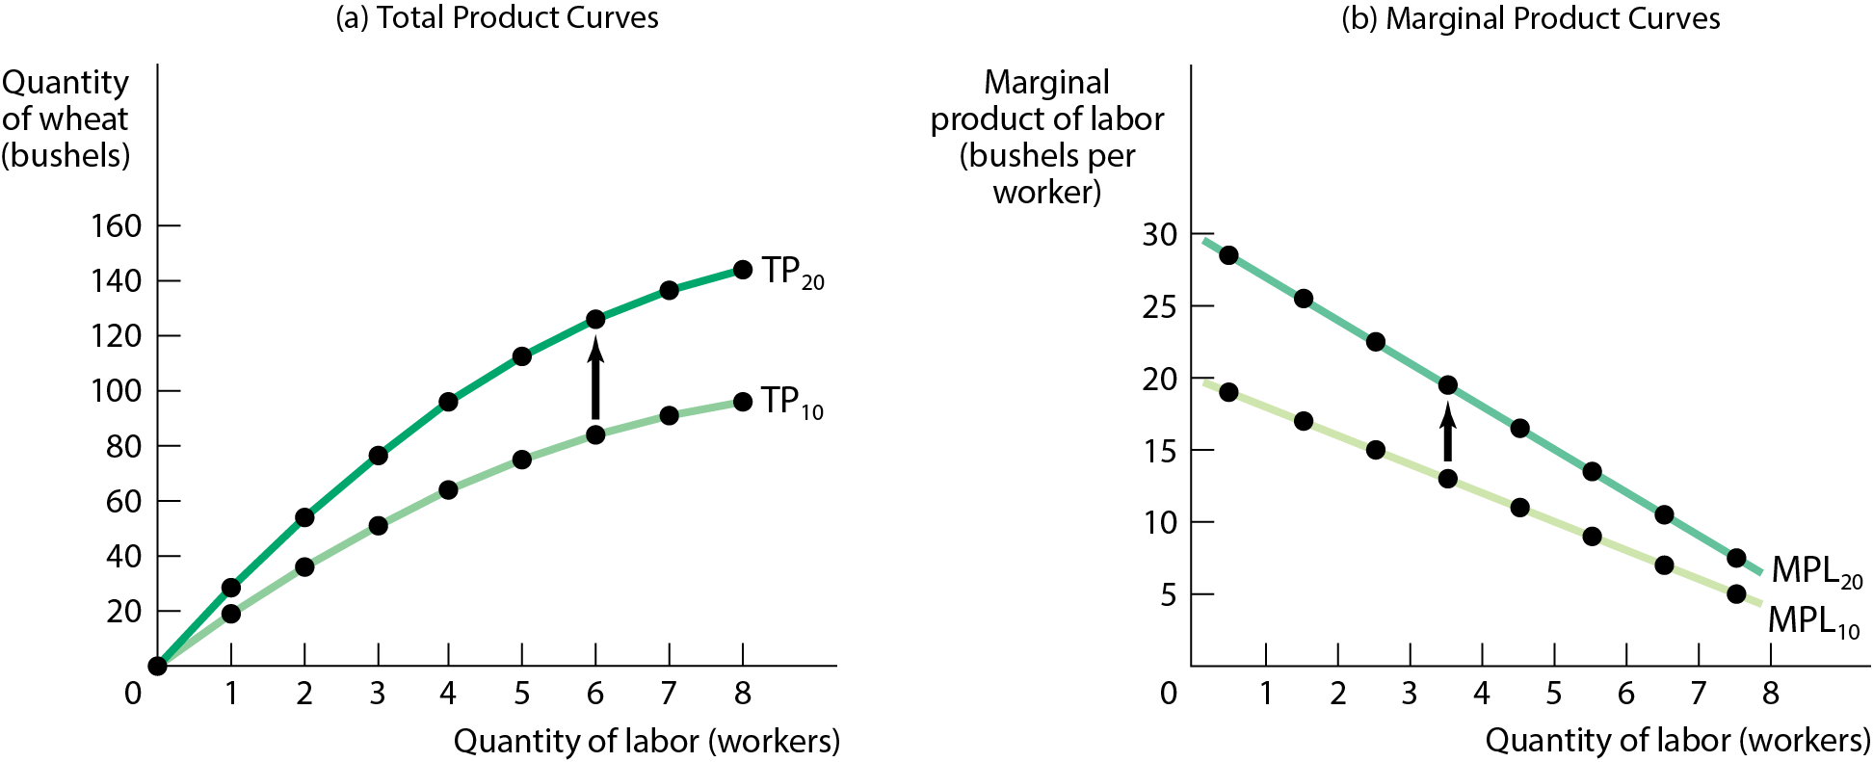
TOTAL PRODUCT, MARGINAL PRODUCT, AND FIXED INPUT
With more land (fixed input) each worker can produce more. This shifts the total product curve up.
So the MPL of each worker is higher when the farm is larger; the MPL curve shifts up, too.
Figure 3

Slide 15
LEARN BY DOING: DISCUSSION
Thomas Malthus (1766–1834) predicted that as population grew, the economy’s diminishing ability to produce food from a given set of resources would necessarily lead to insufficient food. However, population continues to grow, and so does food production.
What aspect of food production did Malthus fail to anticipate?

Slide 16
PITFALLS: WHAT’S A UNIT?
The MPL is defined as the increase in the quantity of output when you increase the quantity of that input by one unit.
What do we mean by a unit of labor? Is it an additional hour of labor, an additional week, or a person-year?
The answer is that it doesn’t matter, as long as you are consistent.

Slide 17


FROM THE PRODUCTION FUNCTION TO COST CURVES
A fixed cost is a cost that does not depend on the quantity of output produced. It is the cost of the fixed input.
A variable cost is a cost that depends on the quantity of output produced. It is the cost of the variable input.

Slide 18
LEARN BY DOING: PRACTICE QUESTION 3
You own a deli. Which of these is MOST likely a fixed input at your deli?
the dining room
the bread used to make sandwiches
the tomato base used to make soups
the employees

Slide 19
LEARN BY DOING: PRACTICE QUESTION 3
(ANSWER)
You own a deli. Which of these is MOST likely a fixed input at your deli?
the dining room (correct answer)
the bread used to make sandwiches
the tomato base used to make soups
the employees

Slide 20
TOTAL COST CURVE
The total cost of producing a given quantity of output is the sum of the fixed cost and the variable cost of producing that quantity of output.
TC = FC + VC
The total cost curve shows how total cost depends on the quantity of output.
The total cost curve becomes steeper as more output is produced, a result of diminishing returns.
With diminishing returns, additional units of output require more and more labor; therefore, the cost increases.

Slide 21
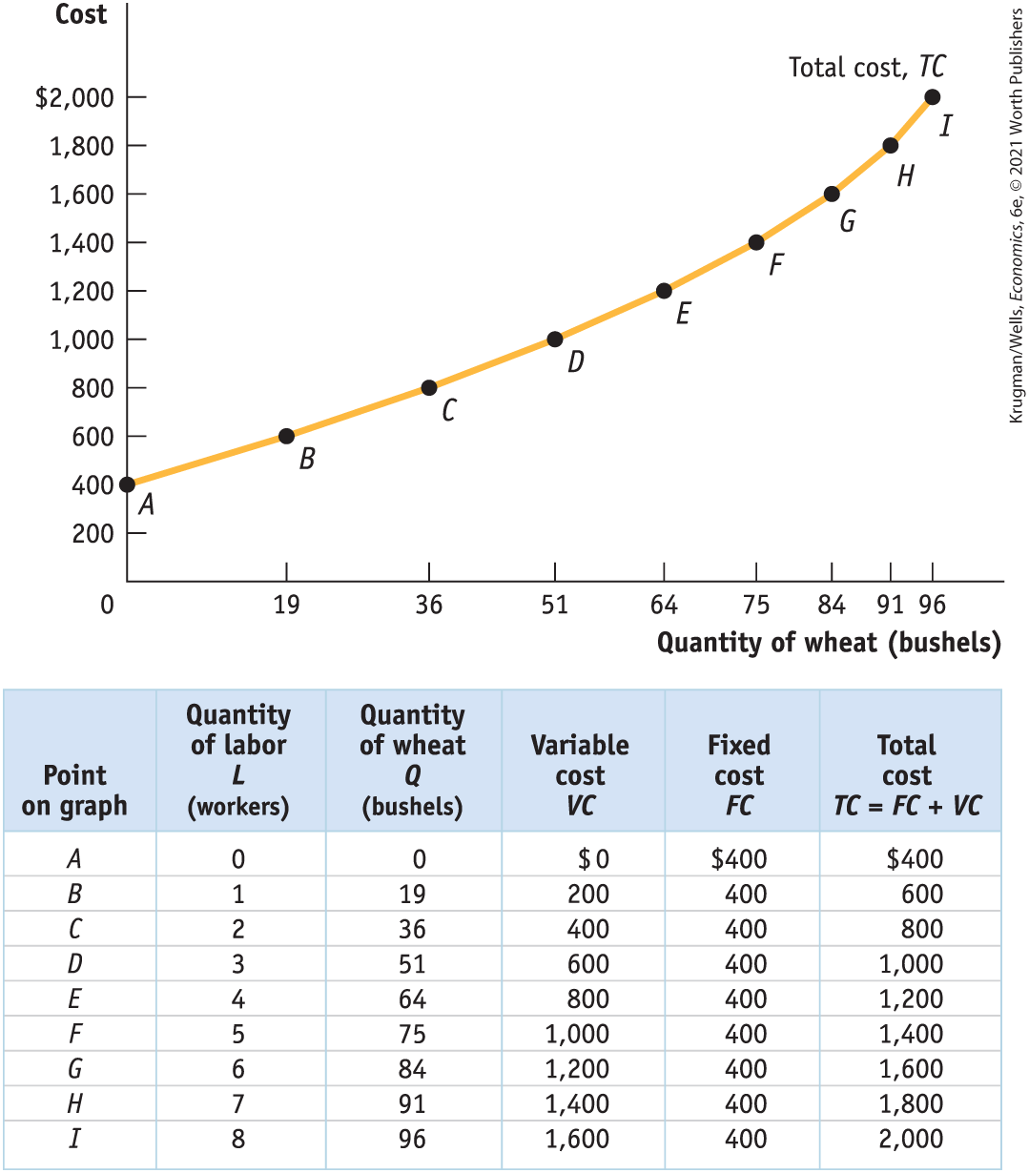
TOTAL COST CURVE GRAPHED
The curve gets steeper as output increases due to diminishing returns to labor. (See Figure 4.)

Slide 22
MARGINAL COST
The marginal cost is the change in total cost generated by one additional unit of output.
MC = ΔTC/ΔQ
where Δ = change, TC = total cost, and Q = quantity of output.

Slide 23
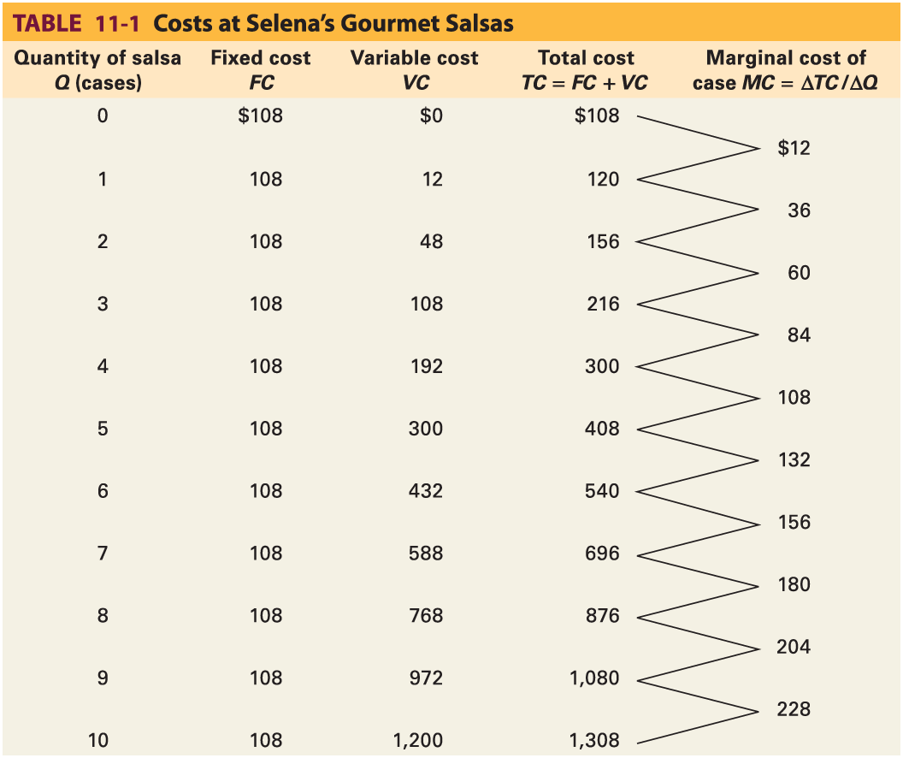
MARGINAL COST EXAMPLE
TABLE 1 Costs at Selena’s Gourmet Salsas
120-108
156-120
216-156

Slide 24
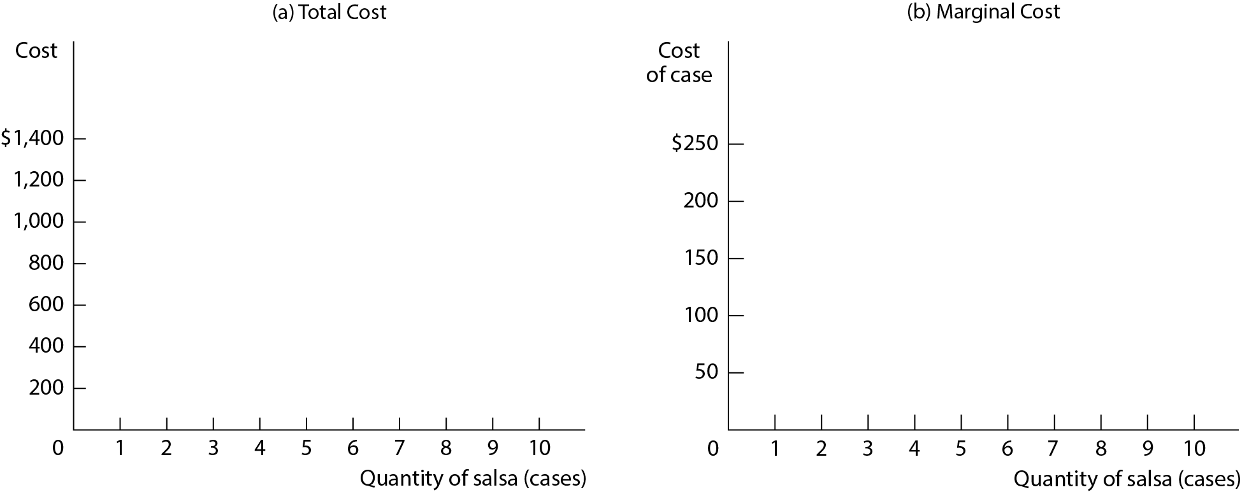
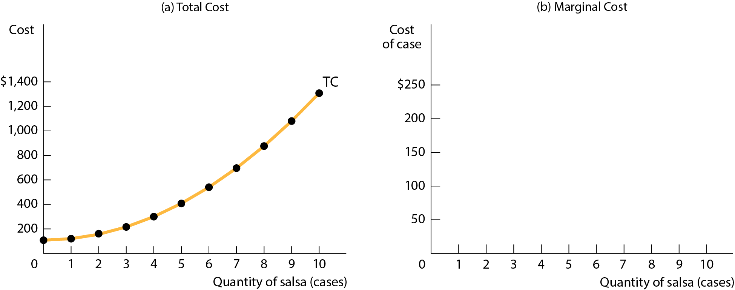
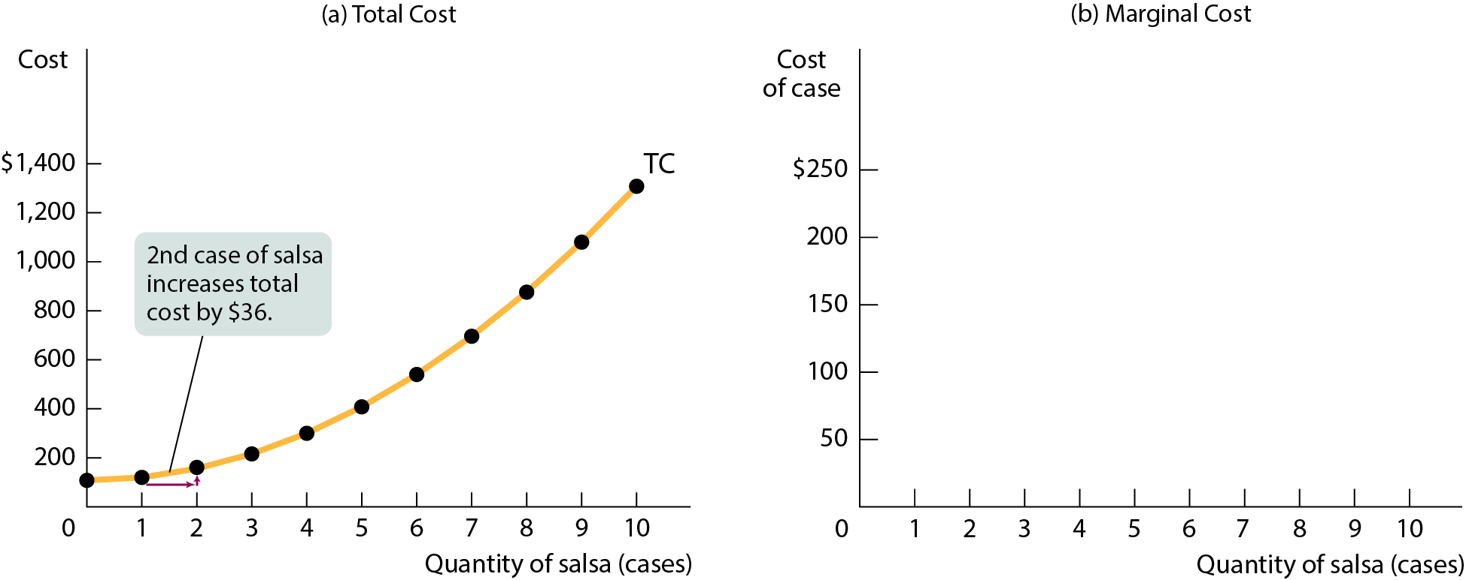
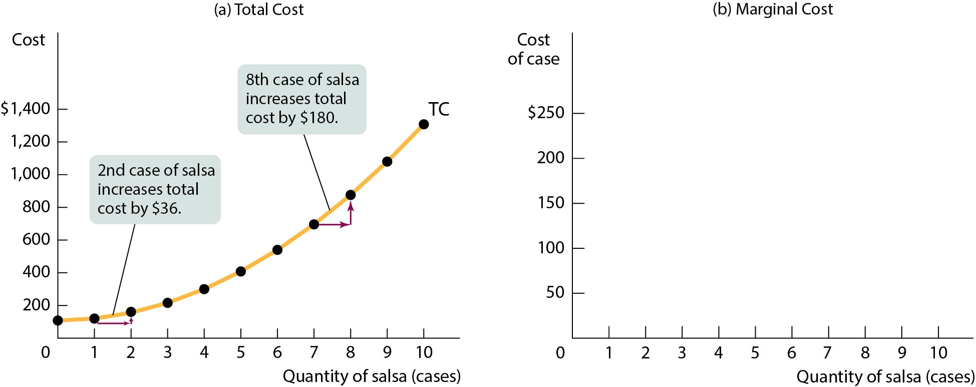
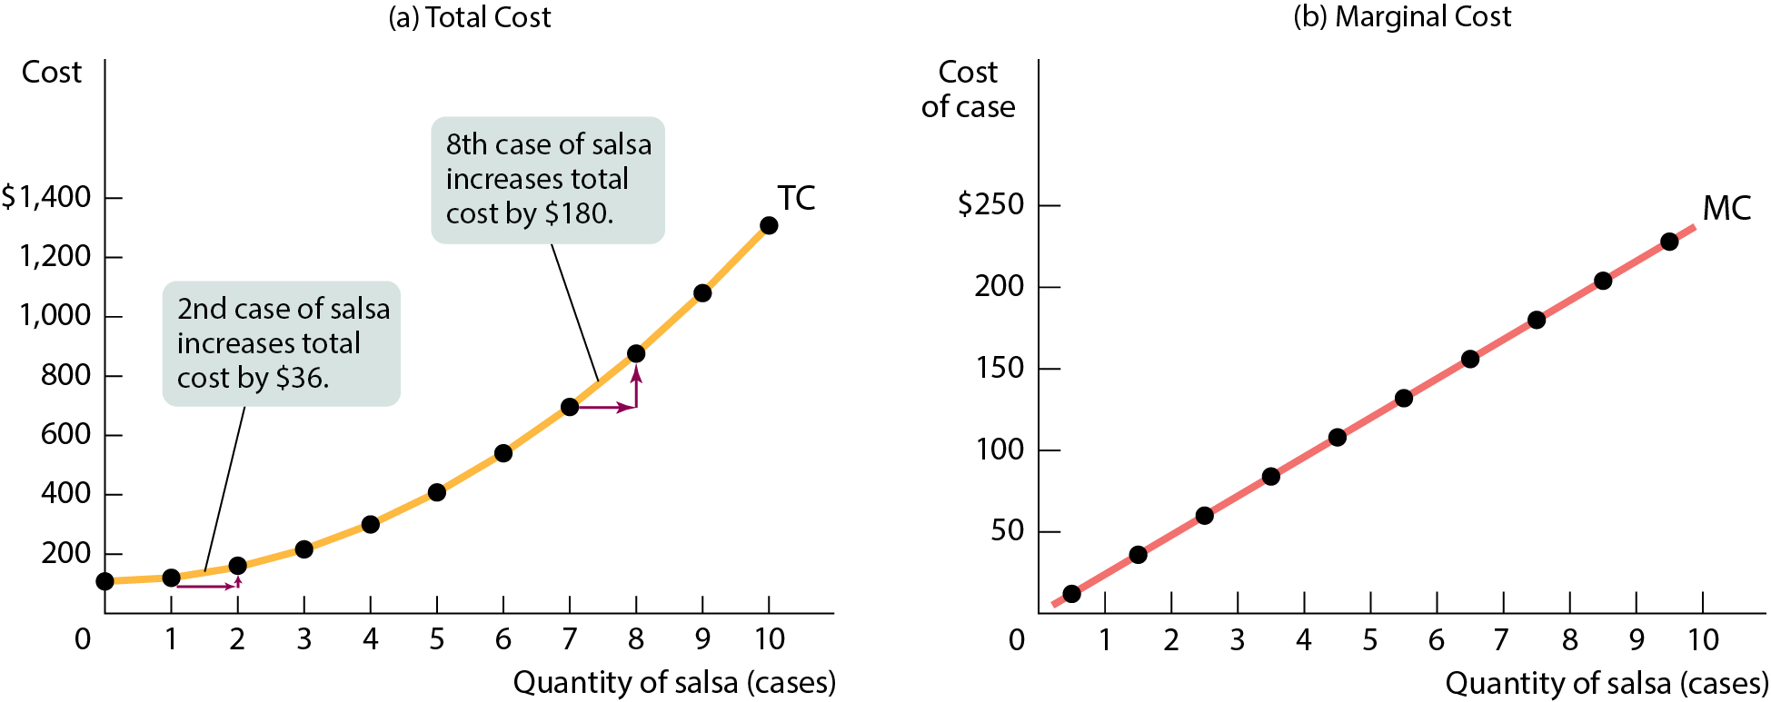
MARGINAL COST GRAPHS
Figure 6

Slide 25
WHY IS THE MARGINAL COST CURVE UPWARD SLOPING?
Because there are diminishing returns to inputs in this example. As output increases, the marginal product of the variable input declines.
This implies that more and more of the variable input must be used to produce each additional unit of output as the amount of output already produced rises.
And since each unit of the variable input must be paid for, the cost per additional unit of output also rises.

Slide 26
AVERAGE COST
Average total cost (often referred to simply as average cost) = total cost per unit of output produced.
ATC = TC/Q
Average fixed cost = fixed cost per unit of output produced.
AFC = FC/Q
Average variable cost = variable cost per unit of output produced.
AVC = VC/Q

Slide 27
LEARN BY DOING: PRACTICE QUESTION 4
You produce widgets. Currently you produce 4 widgets at a total cost of $40.
Suppose you could produce one more widget (the fifth) at a marginal cost of $5. If you do produce that fifth widget, what will your average total cost be? Has your average total cost increased or decreased?
Your average total cost has decreased to $11.
Your average total cost has decreased to $9.
Your average total cost has increased to $9.
Your average total cost has increased to $11.

Slide 28
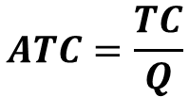
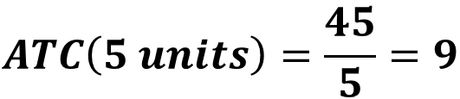

PRACTICE QUESTION 4: (ANSWER)
You produce widgets. Currently you produce 4 widgets at a total cost of $40.
Suppose you could produce one more widget (the fifth) at a marginal cost of $5. If you do produce that fifth widget, what will your average total cost be? Has your average total cost increased or decreased?
Units | Total Cost | Marginal Cost
4 | 40
5 | 45 | 5
$$ATC=\frac{TC}{Q}$$
$$ATC\left(4 units\right)=\frac{40}{4}=10$$
$$ATC\left(5 units\right)=\frac{45}{5}=9$$

Slide 29
LEARN BY DOING: PRACTICE QUESTION 4
(ANSWER)
You produce widgets. Currently you produce 4 widgets at a total cost of $40.
Suppose you could produce one more widget (the fifth) at a marginal cost of $5. If you do produce that fifth widget, what will your average total cost be? Has your average total cost increased or decreased?
Your average total cost has decreased to $11.
Your average total cost has decreased to $9. (correct answer)
Your average total cost has increased to $9.
Your average total cost has increased to $11.

Slide 30



AVERAGE COSTS FOR SELENA’S GOURMET SALSAS
TABLE 2 Average Costs for Selena’s Gourmet Salsas
Quantity of salsa Q (cases) | Total cost TC | Average total cost of case ATC = TC/Q | Average fixed cost of case AFC = FC/Q | Average variable cost of case AVC = VC/Q
1 | $120 | $120.00 | $108.00 | $12.00
2 | 156 | 78.00 | 54.00 | 24.00
3 | 216 | 72.00 | 36.00 | 36.00
4 | 300 | 75.00 | 27.00 | 48.00
5 | 408 | 81.60 | 21.60 | 60.00
6 | 540 | 90.00 | 18.00 | 72.00
7 | 696 | 99.43 | 15.43 | 84.00
8 | 876 | 109.50 | 13.50 | 96.00
9 | 1,080 | 120.00 | 12.00 | 108.00
10 | 1,308 | 130.80 | 10.80 | 120.00
$$\frac{300}{4}$$
$$\frac{108}{4}$$
$$12×4$$

Slide 31
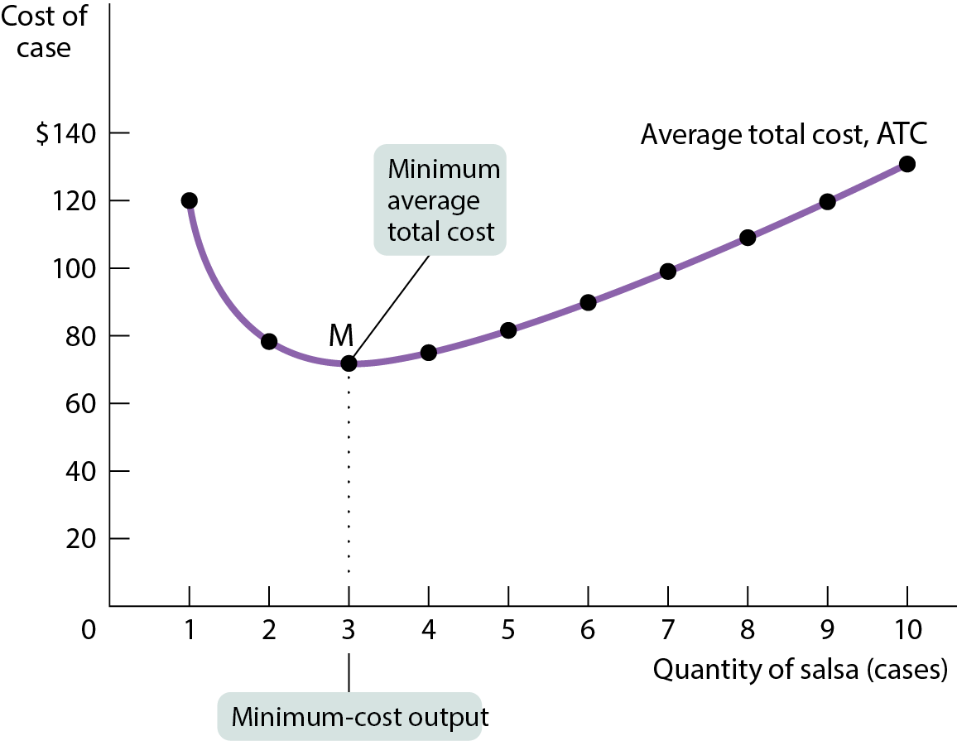
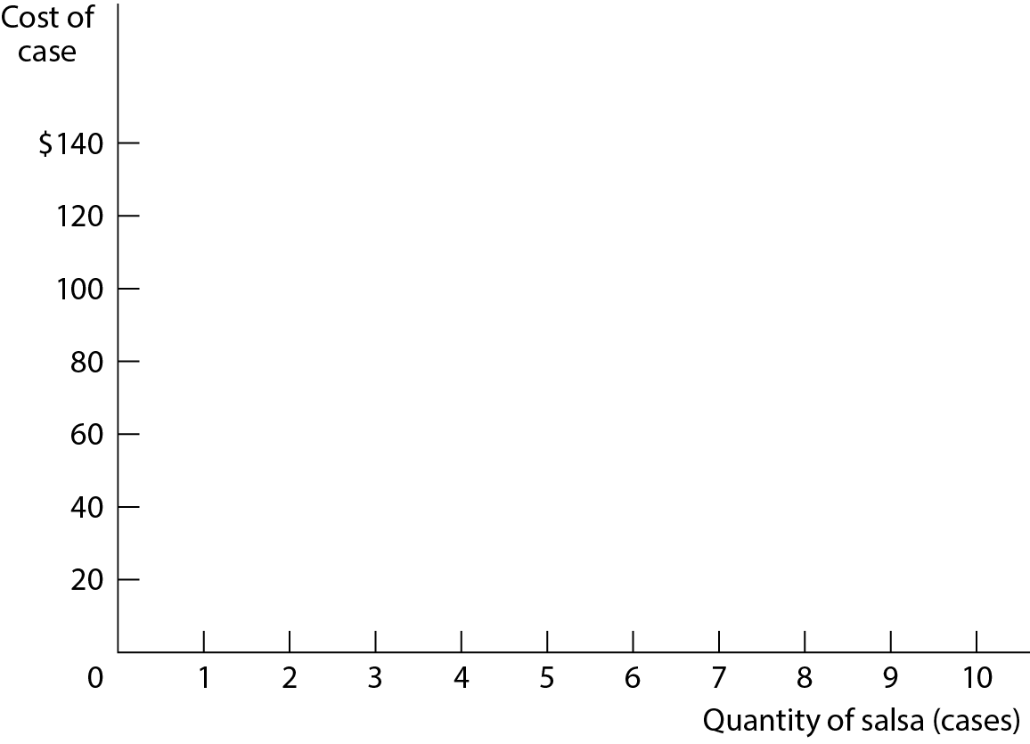
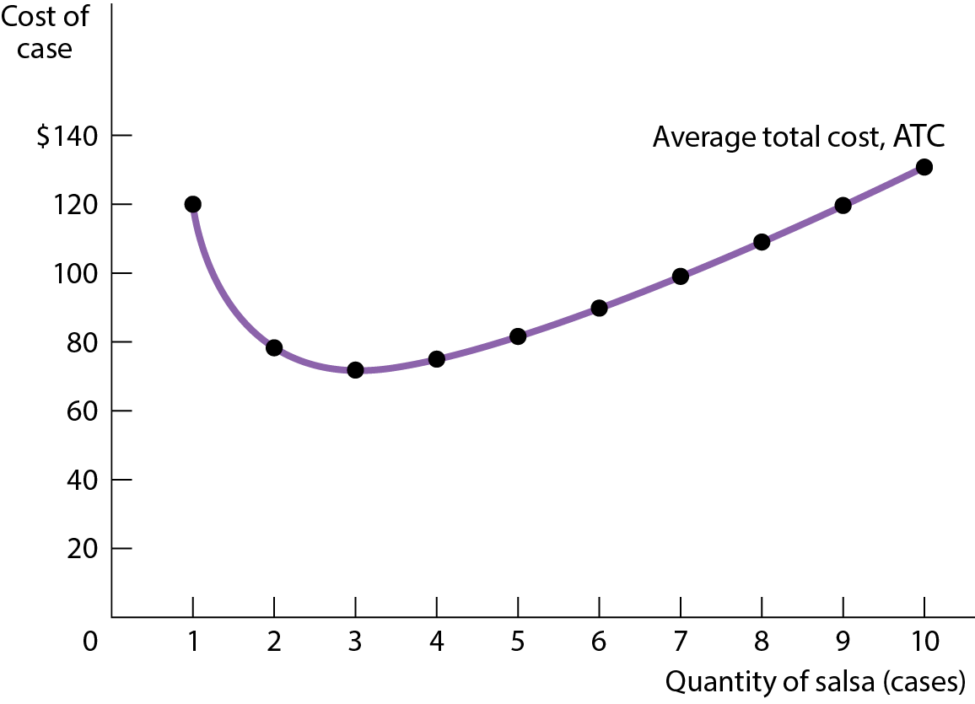
AVERAGE TOTAL COST CURVE FOR SELENA’S GOURMET SALSAS
Figure 7

Slide 32
AVERAGE TOTAL COST CURVE
Increasing output has two opposing effects on average total cost:
  The spreading effect: The larger the output, the more output over which fixed cost is spread, leading to lower average fixed cost.
  The diminishing returns effect: The larger the output, the more variable input required to produce additional units, which leads to higher average variable cost.

Slide 33
PUTTING THE FOUR COST CURVES TOGETHER
Note that:
Marginal cost slopes upward because of diminishing returns.
Average variable cost also slopes upward but is flatter than the marginal cost curve.
Average fixed cost slopes downward because of the spreading effect.
The marginal cost curve intersects the average total cost curve from below, crossing it at its lowest point.

Slide 34
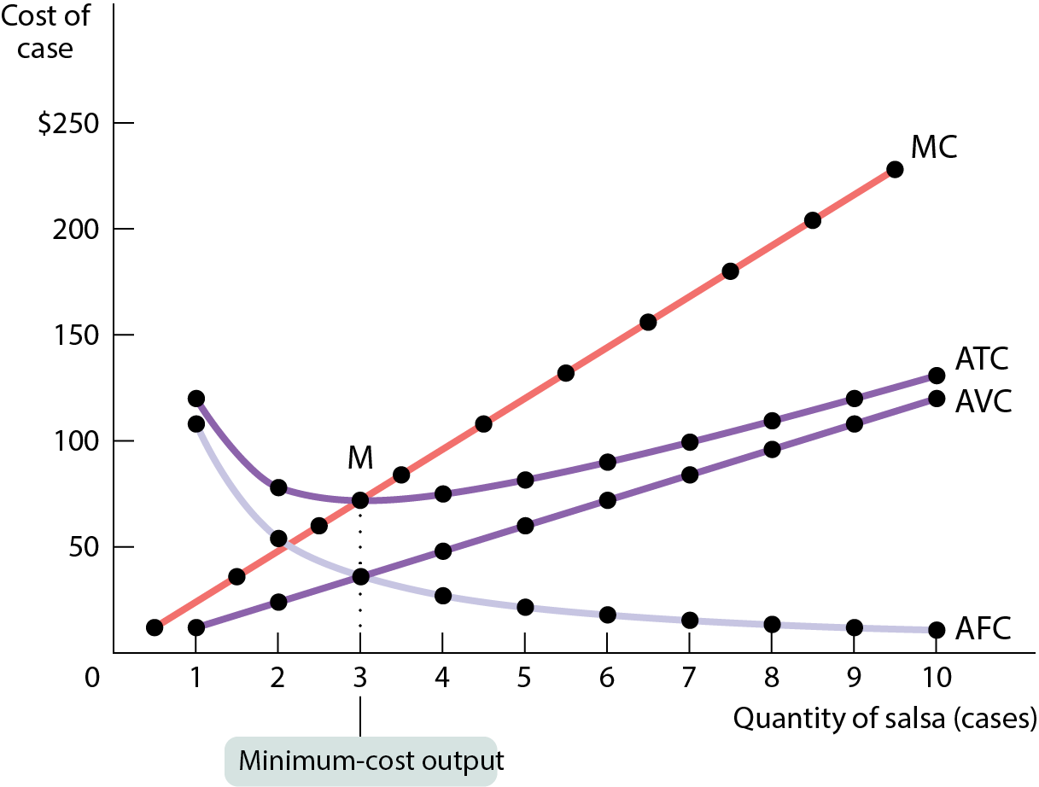
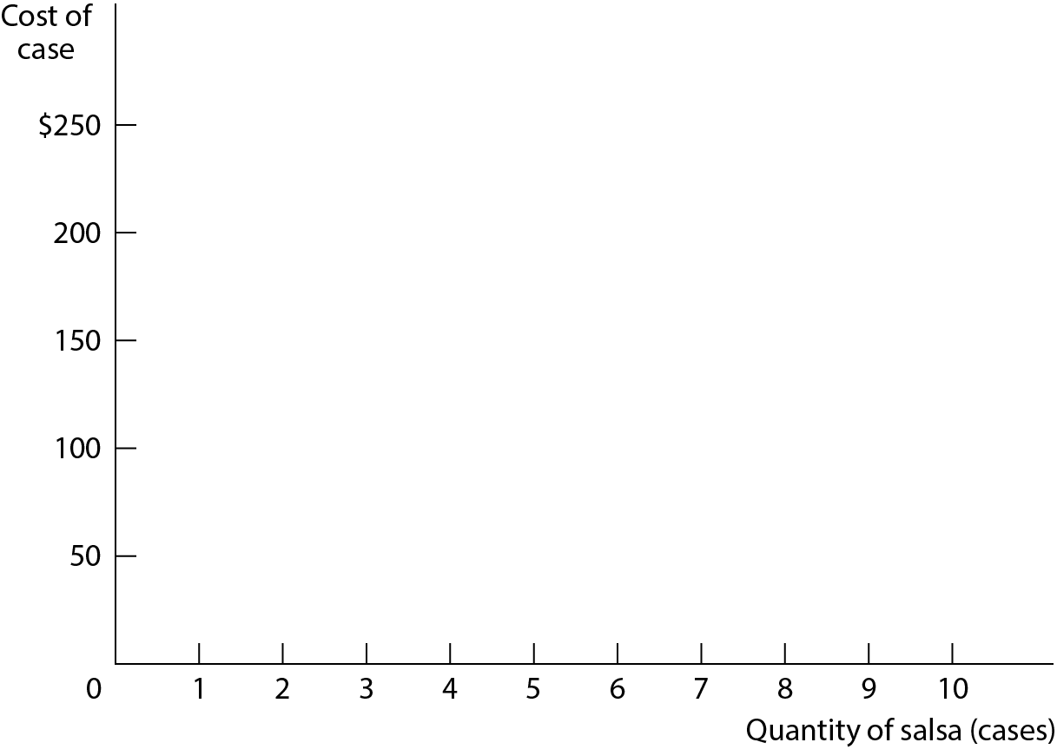
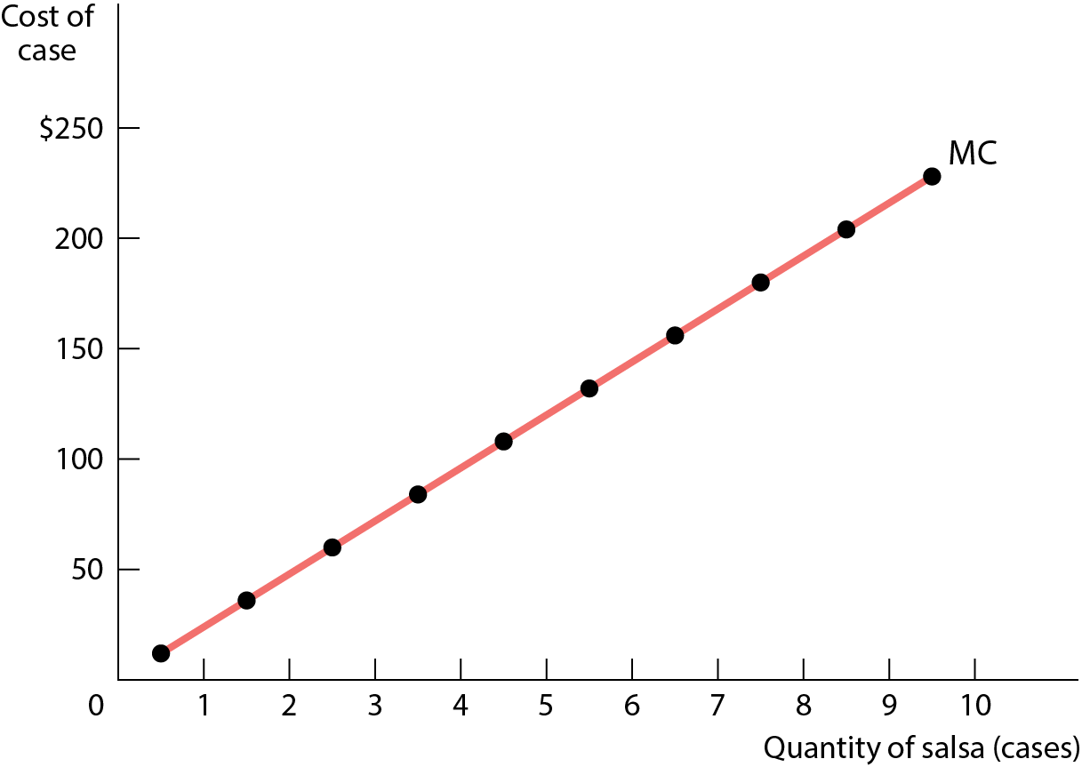
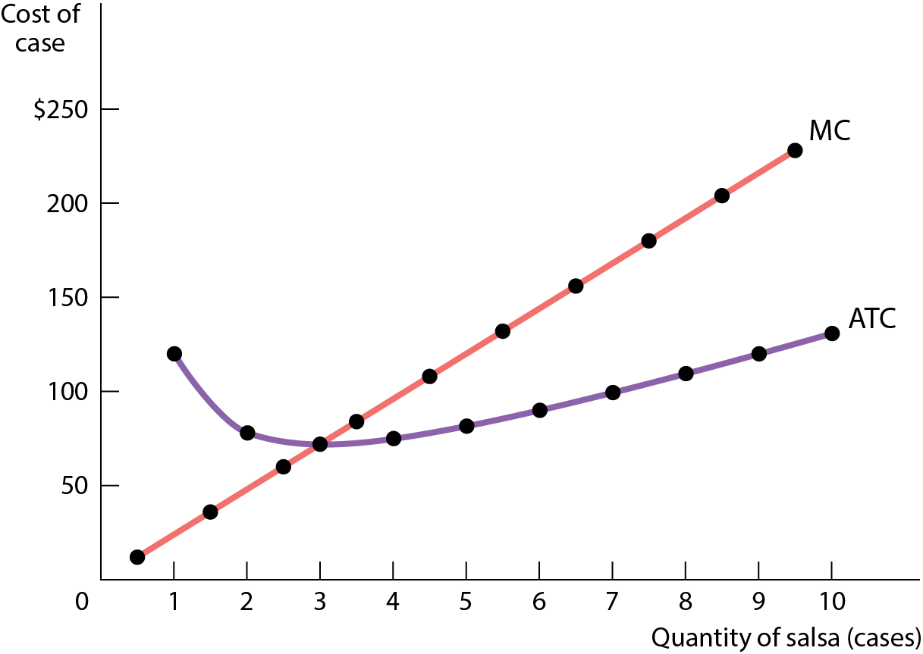
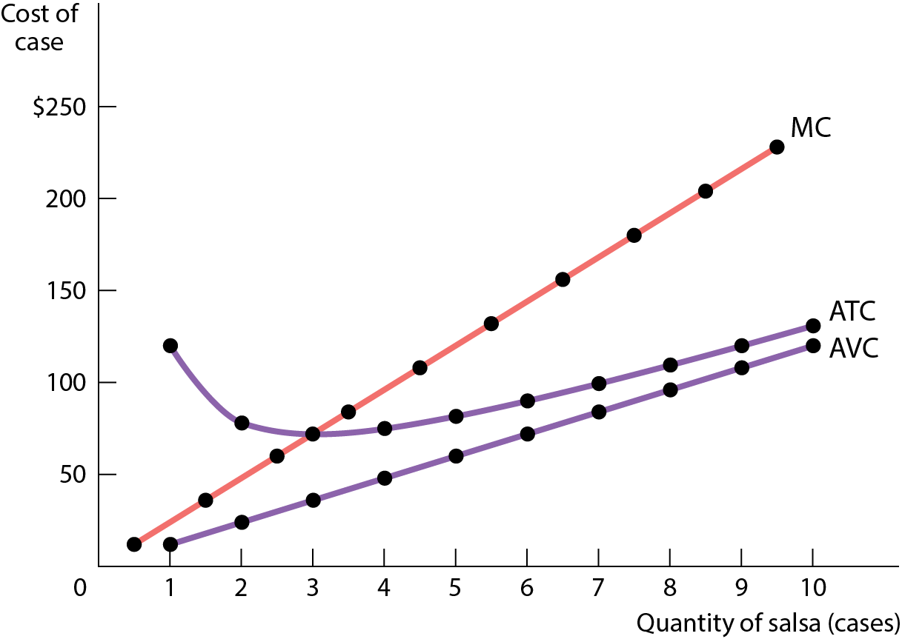
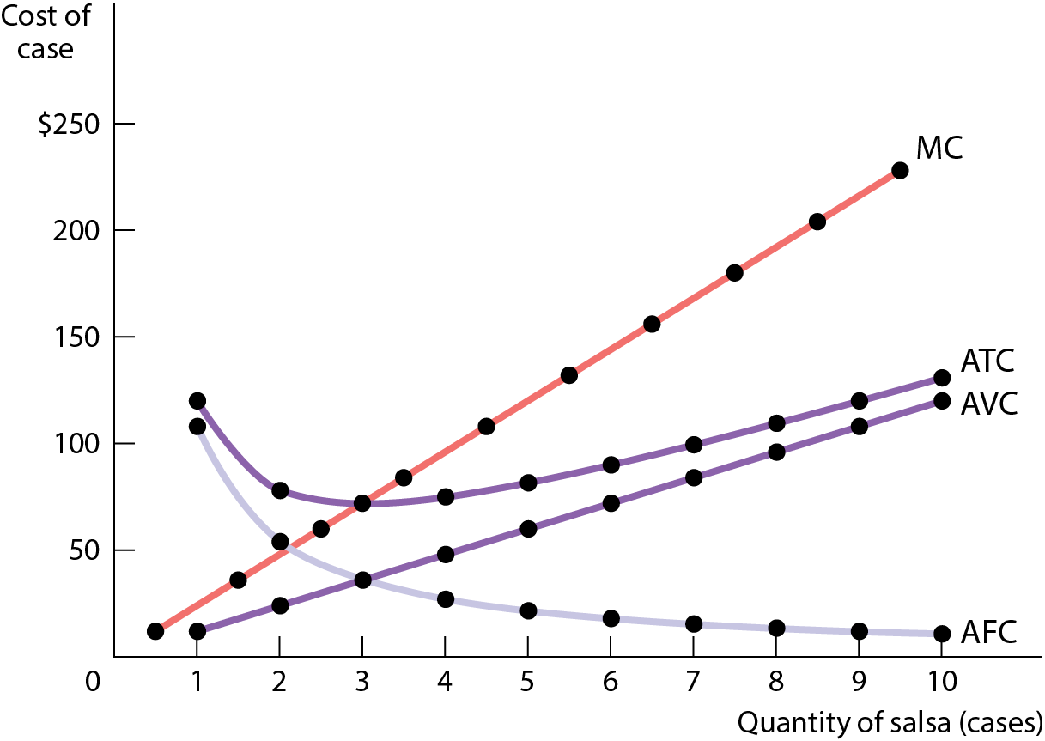
MARGINAL COST AND AVERAGE COST CURVES FOR SELENA’S GOURMET SALSAS
Figure 8

Slide 35
LEARN BY DOING: PRACTICE QUESTION 5
At high levels of output, the spreading effect is:
stronger than the diminishing returns effect.
weaker than the diminishing returns effect.

Slide 36
LEARN BY DOING: PRACTICE QUESTION 5
(ANSWER)
At high levels of output, the spreading effect is:
stronger than the diminishing returns effect.
weaker than the diminishing returns effect. (correct answer)

Slide 37
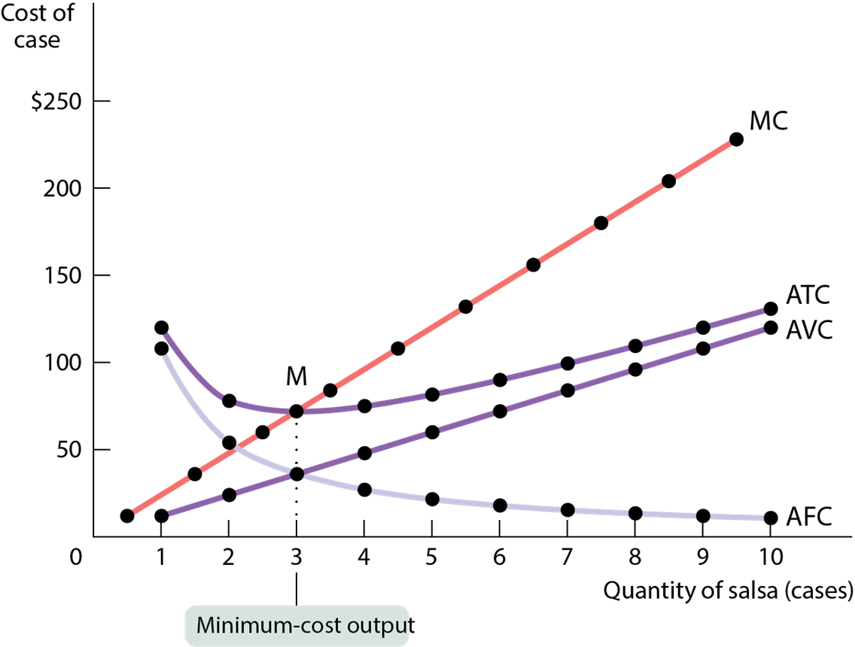
MINIMUM AVERAGE TOTAL COST
The minimum-cost output is the quantity of output at which average total cost is lowest—the bottom of the U-shaped average total cost curve.

Slide 38
MINIMUM AVERAGE TOTAL COST
Three general principles are always true about a firm’s marginal cost and average total cost curves:
At the minimum-cost output, average total cost is equal to marginal cost.
At output less than the minimum-cost output, marginal cost is less than average total cost and average total cost is falling.
At output greater than the minimum-cost output, marginal cost is greater than average total cost and average total cost is rising.

Slide 39
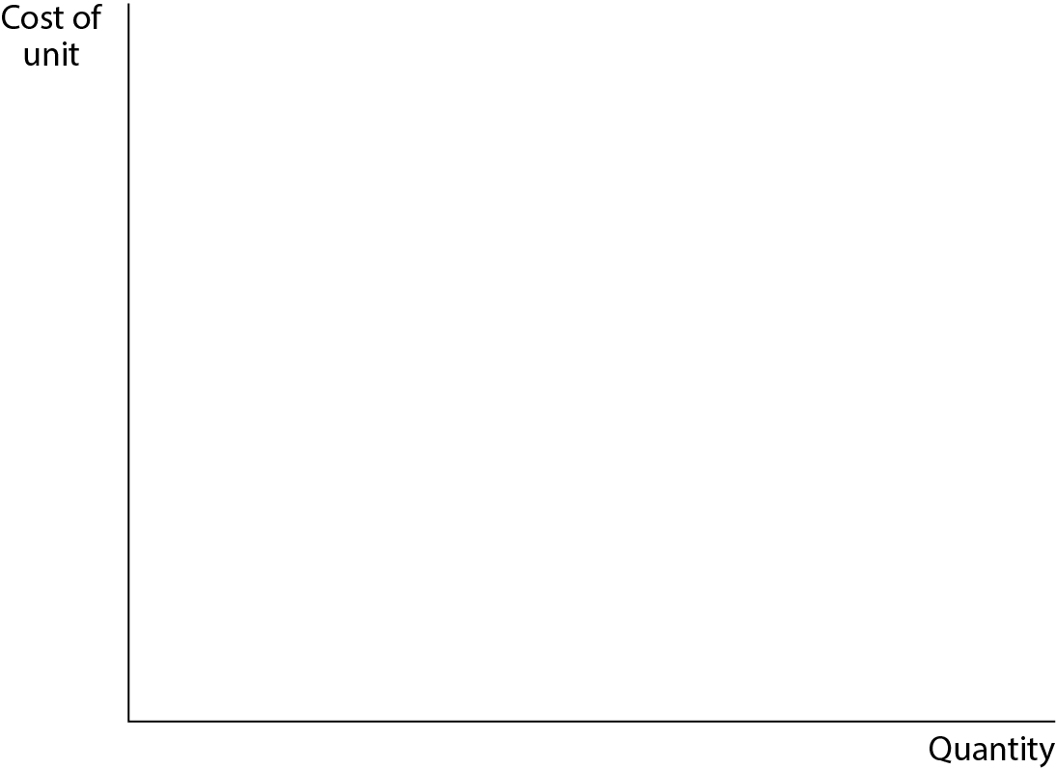
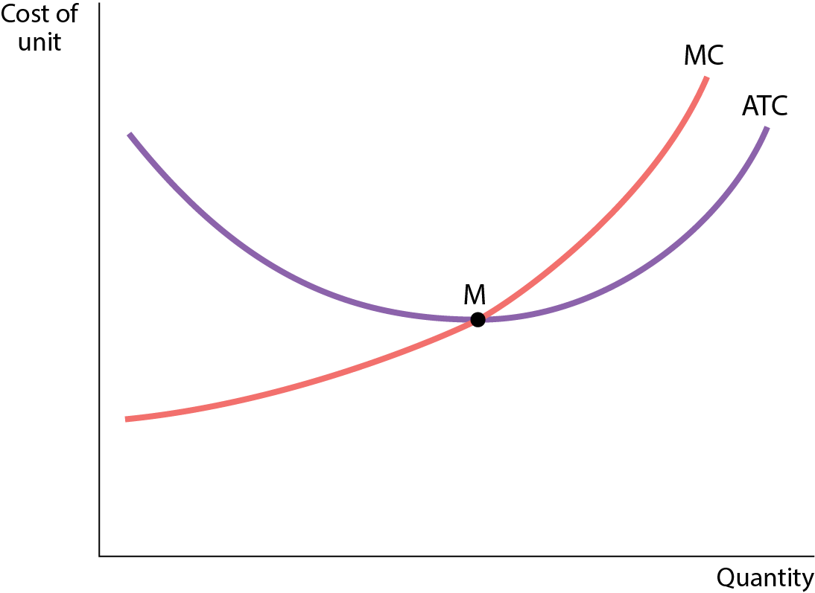
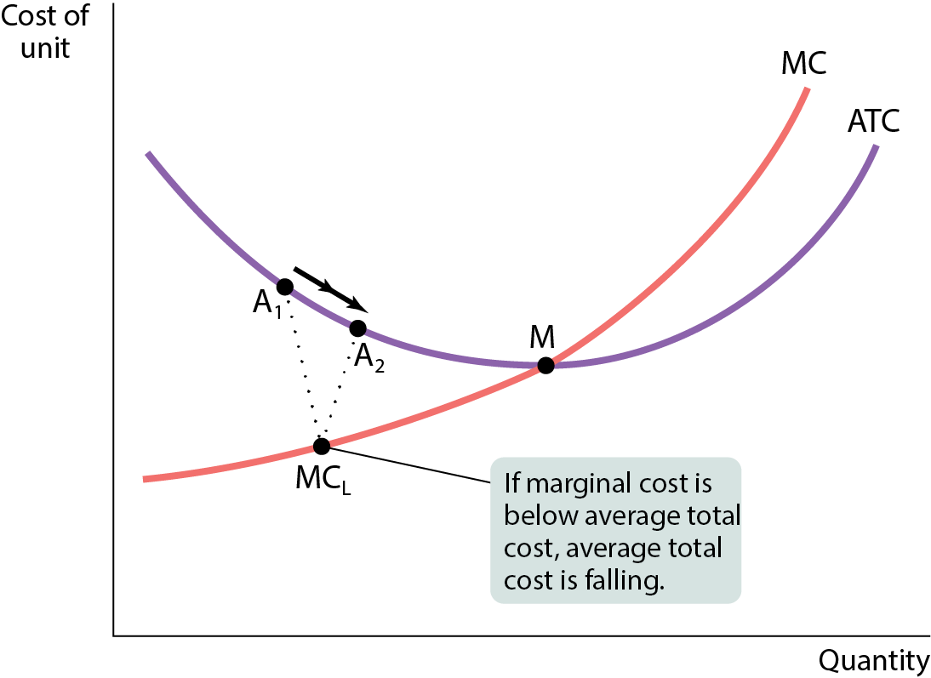
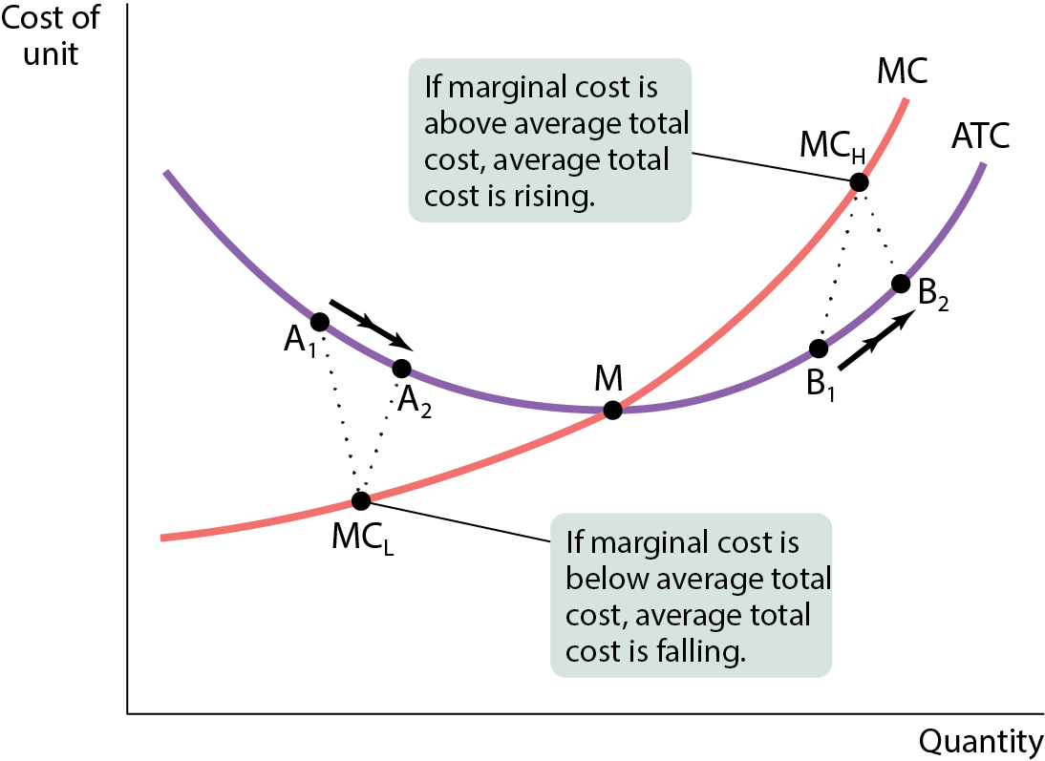
THE RELATIONSHIP BETWEEN THE AVERAGE TOTAL COST AND THE MARGINAL COST CURVES
Figure 9

Slide 40
DOES THE MARGINAL COST CURVE ALWAYS SLOPE UPWARD?
Marginal cost curves often slope downward as the output goes from zero up to some low level, and they slope upward at higher levels of production.
The initial downward slope occurs when employing more workers allows them to specialize in various tasks.
This specialization leads to increasing returns to the hiring of additional workers and results in the marginal cost curve sloping downward.
Once enough workers exhaust the benefits of specialization, diminishing returns to labor set in and the marginal cost curve slopes upward.
Typical marginal cost curves have the “swoosh” shape.

Slide 41
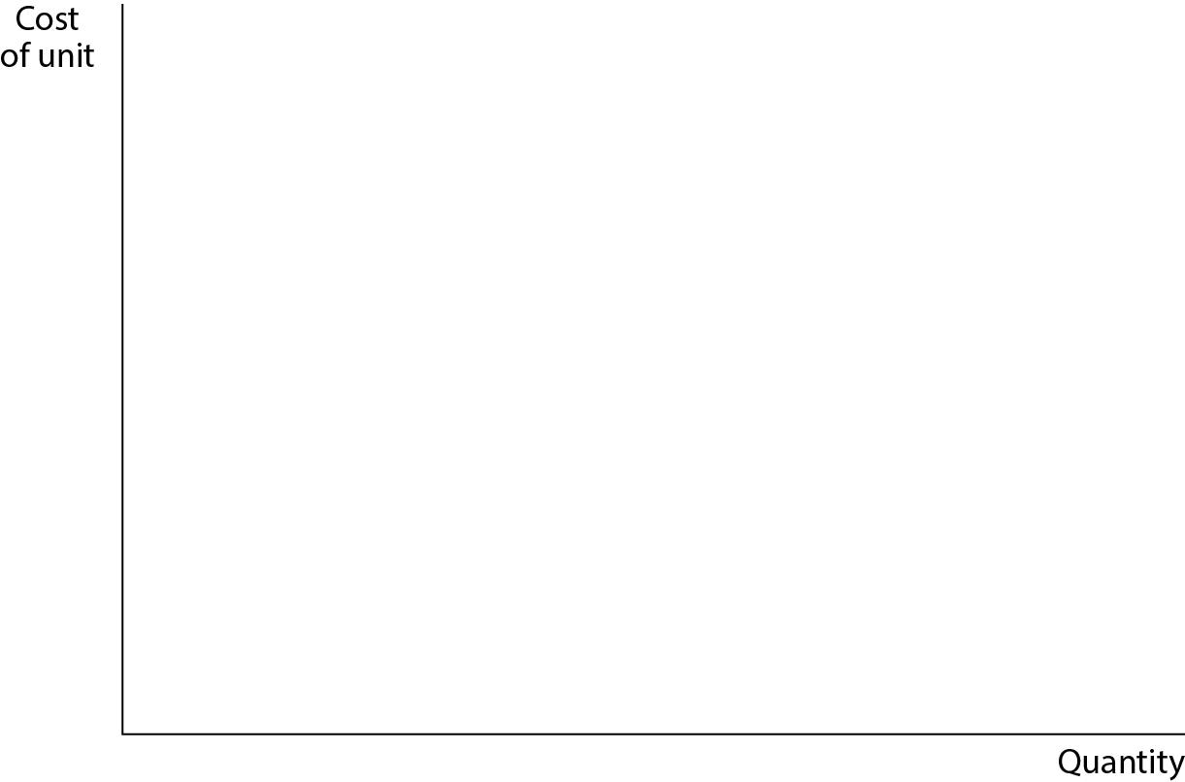
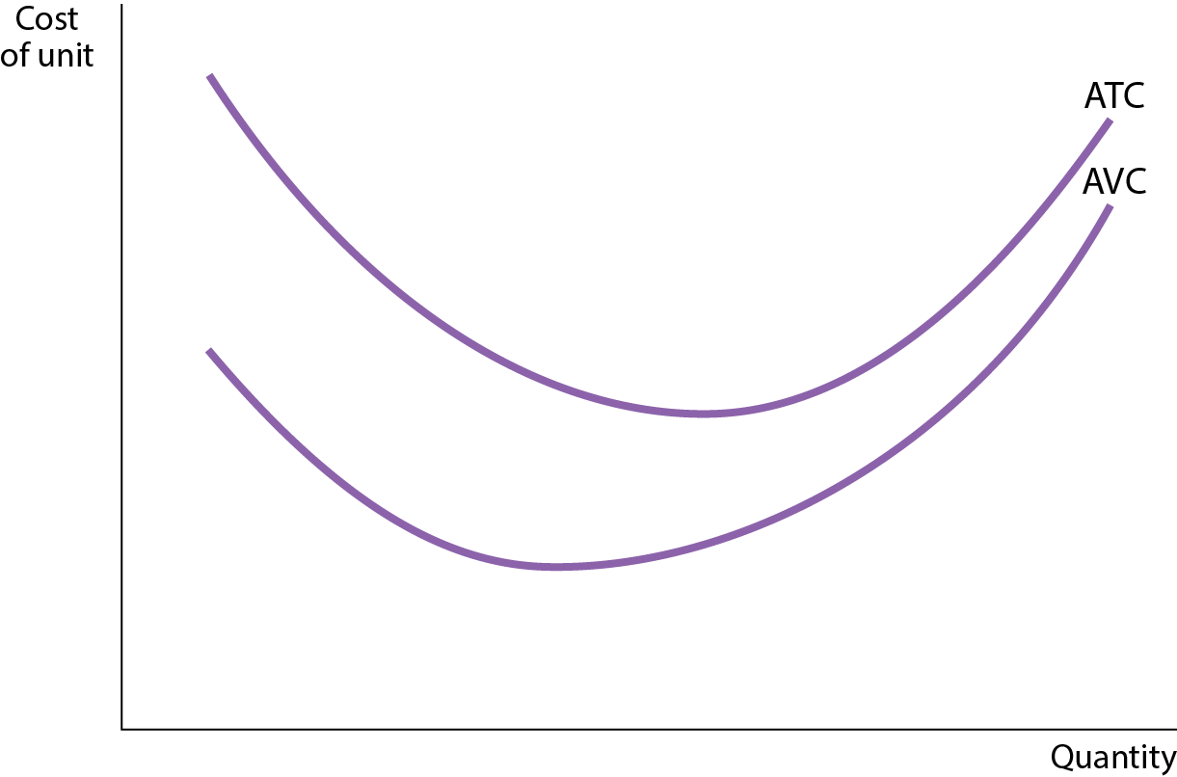
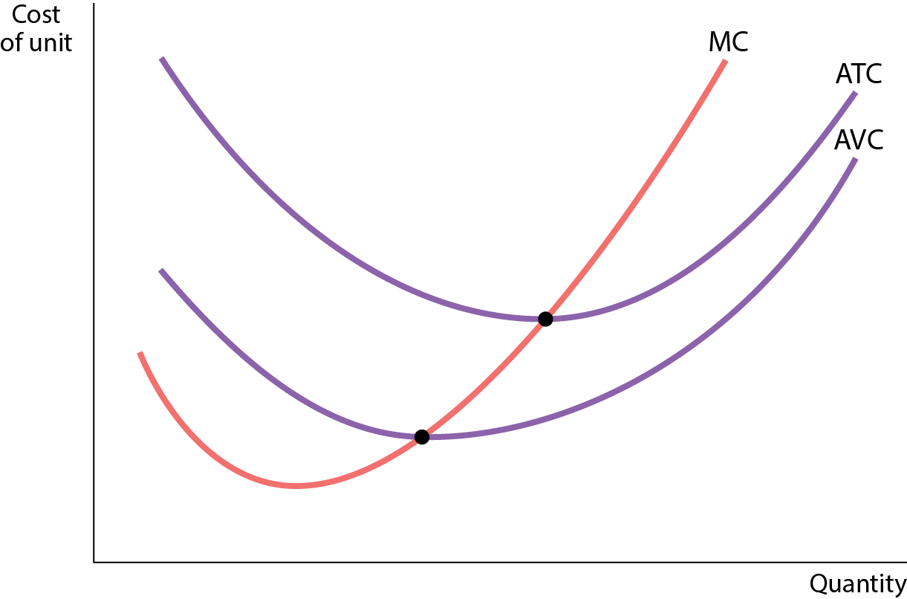
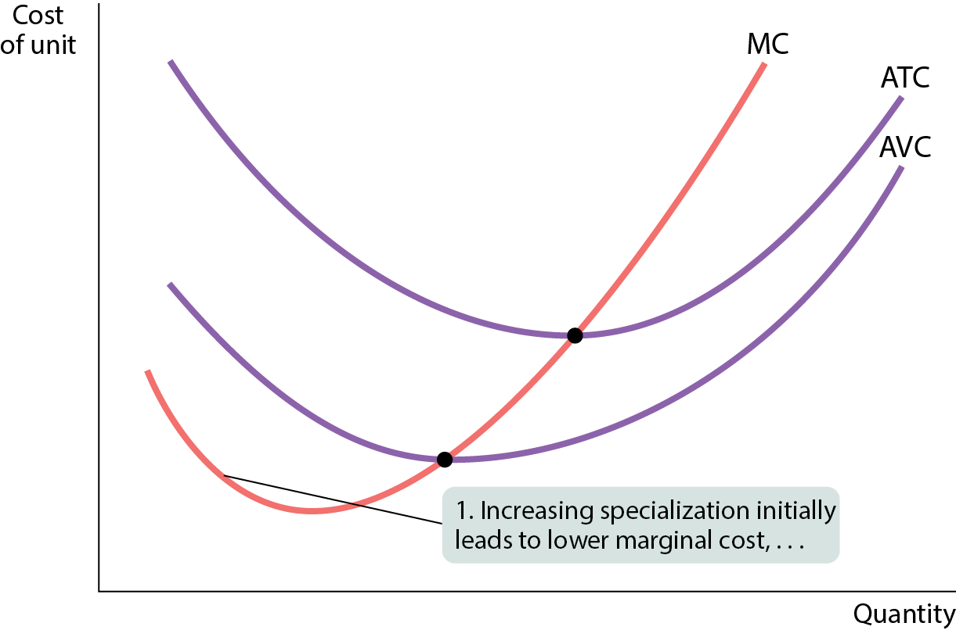
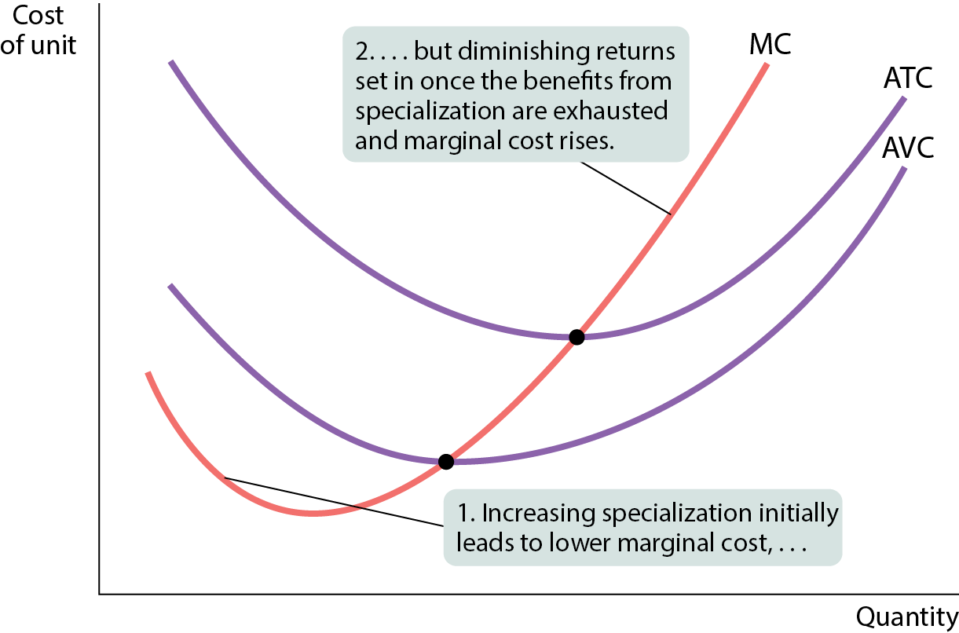
DOES THE MARGINAL COST CURVE ALWAYS SLOPE UPWARD? (2 of 2)
Figure 10

Slide 42
SHORT-RUN VERSUS LONG-RUN COSTS
All inputs are variable in the long run. This means that in the long run, fixed cost (like factory size) may also vary.
The firm will choose its fixed cost in the long run based on the level of output it expects to produce.

Slide 43
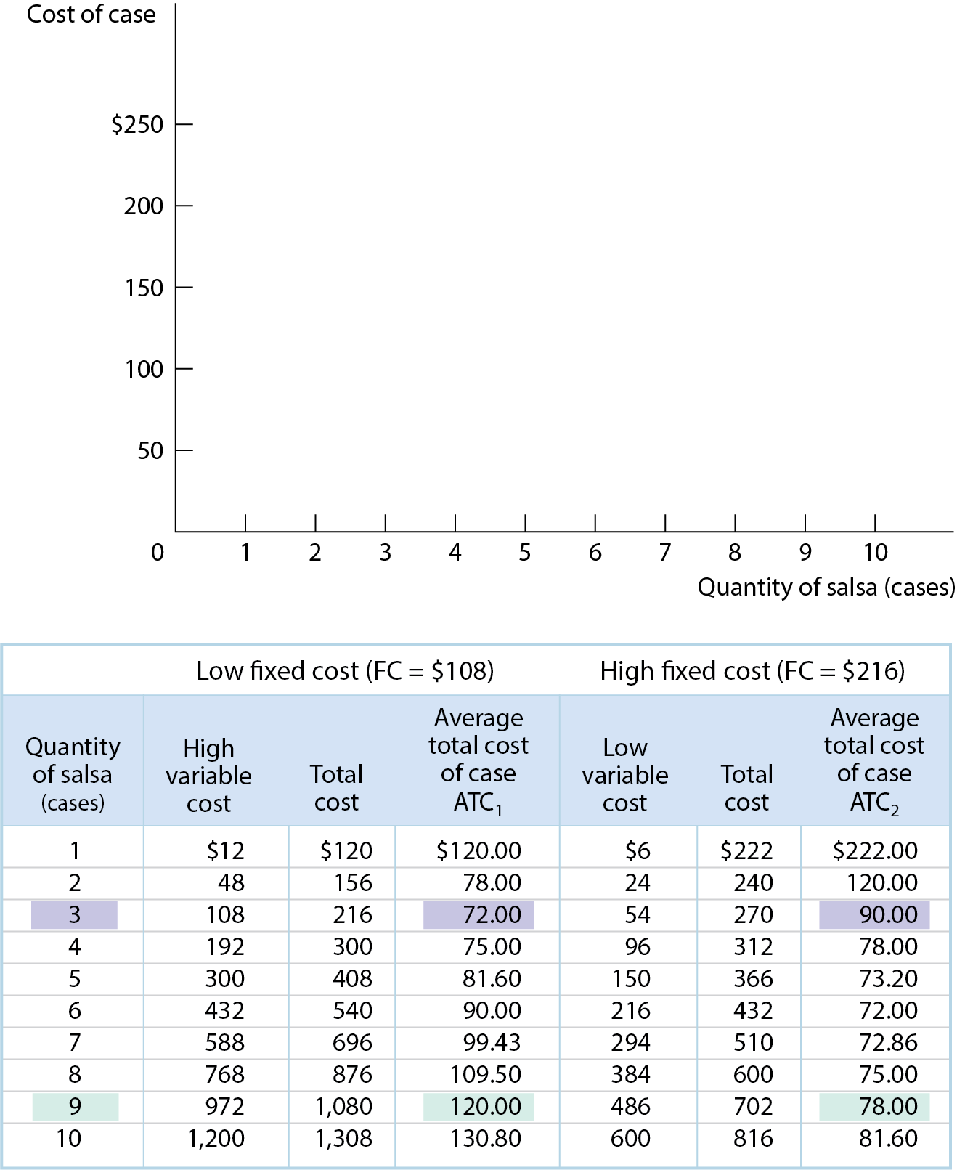
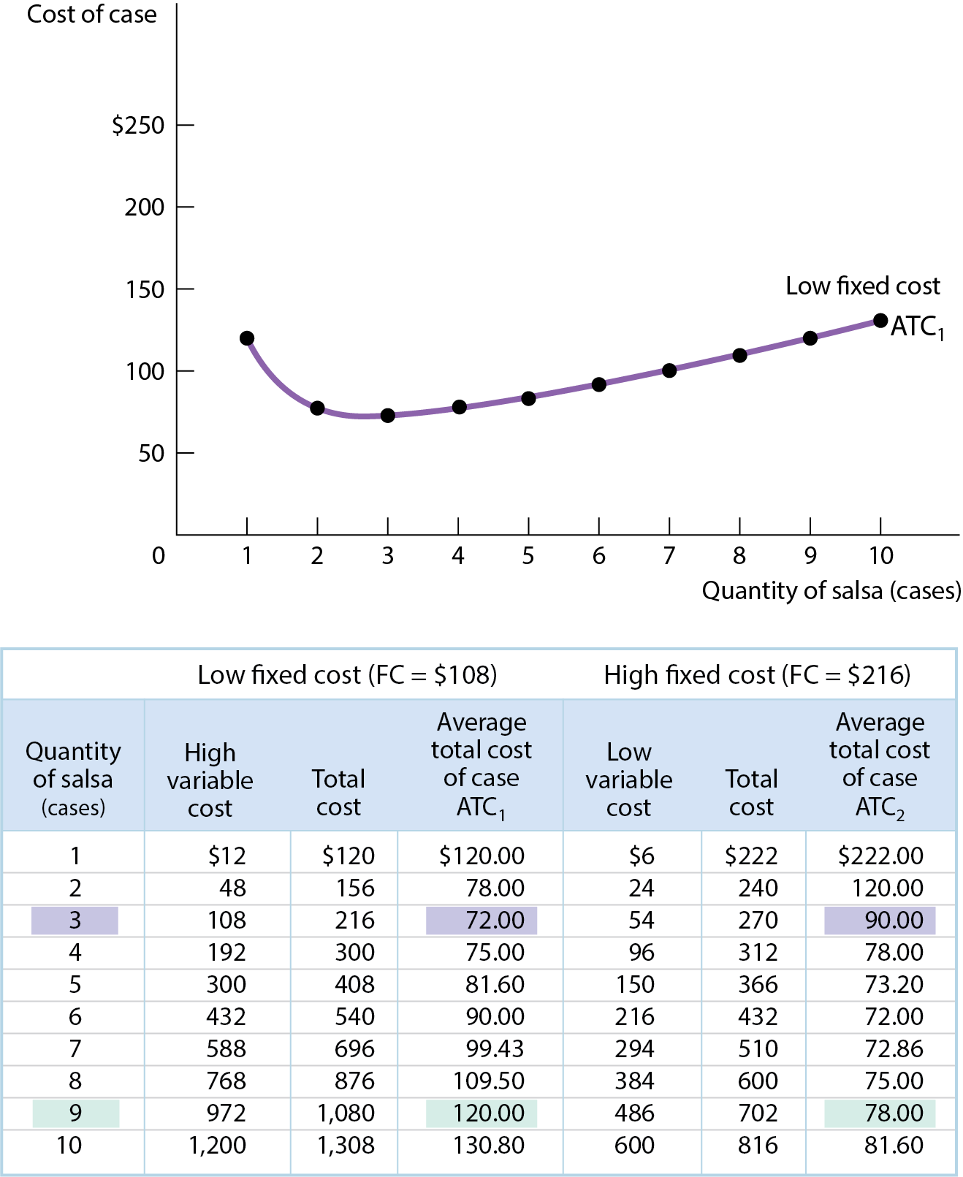
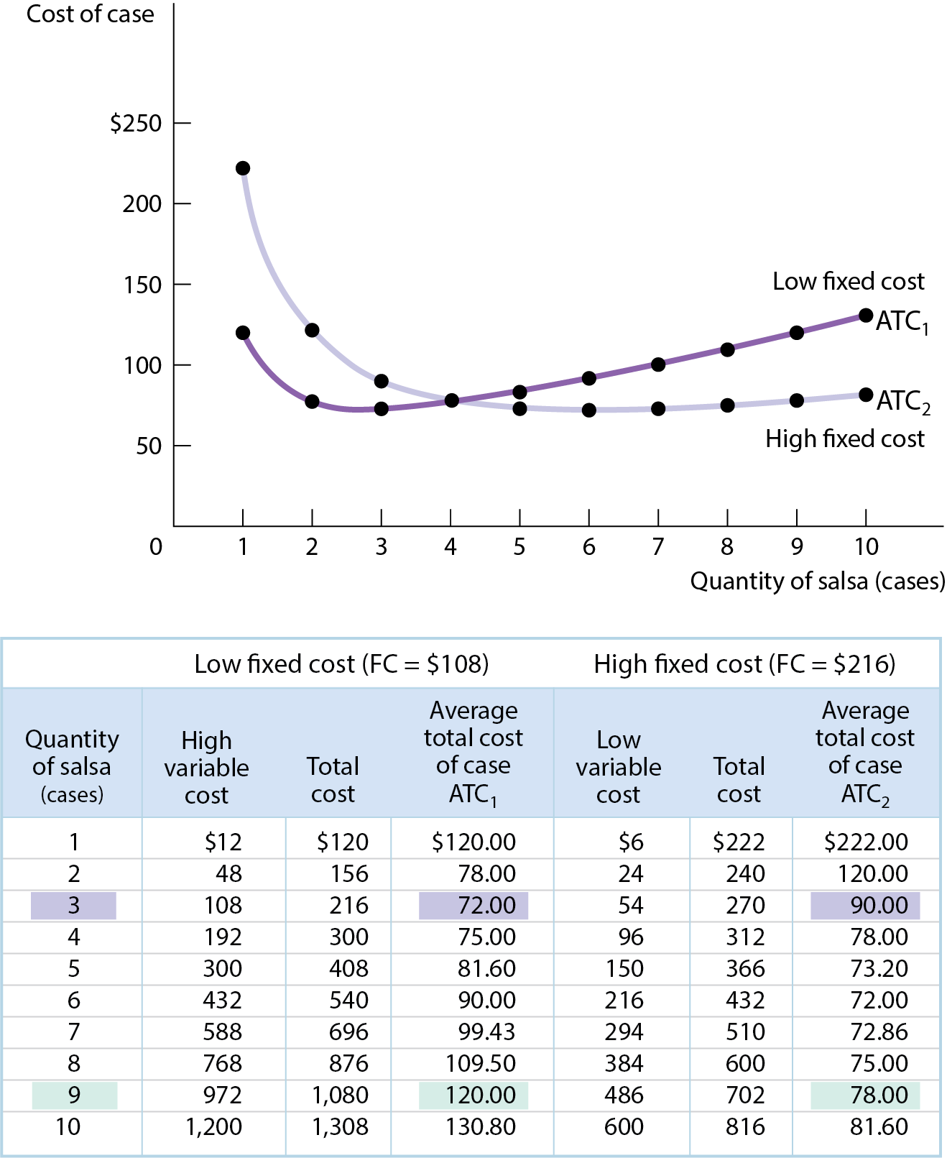
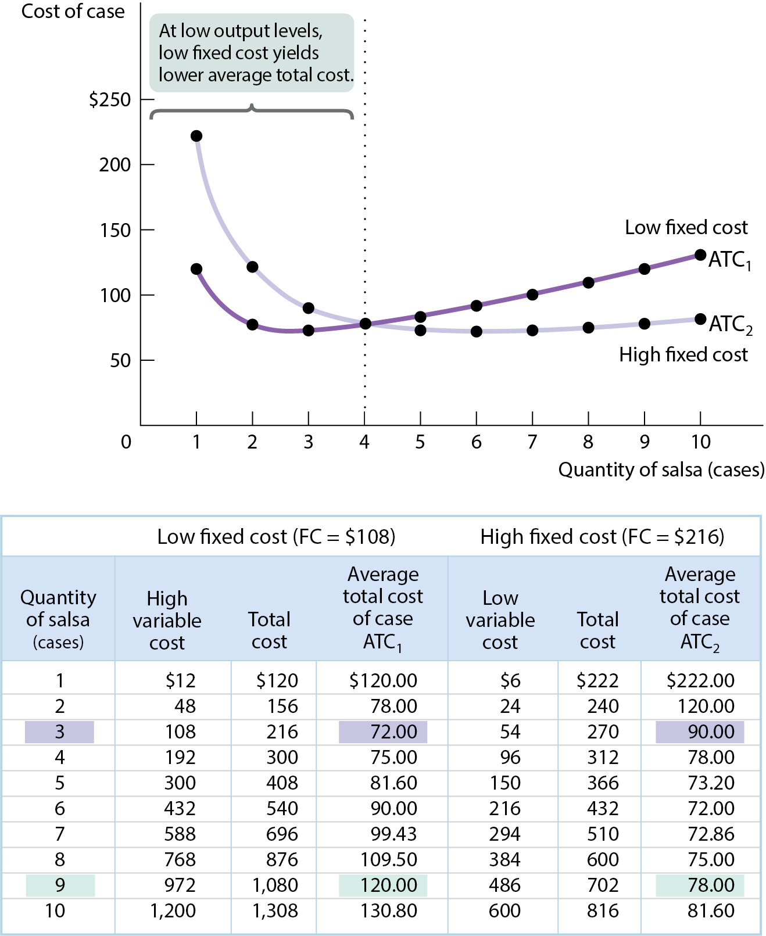
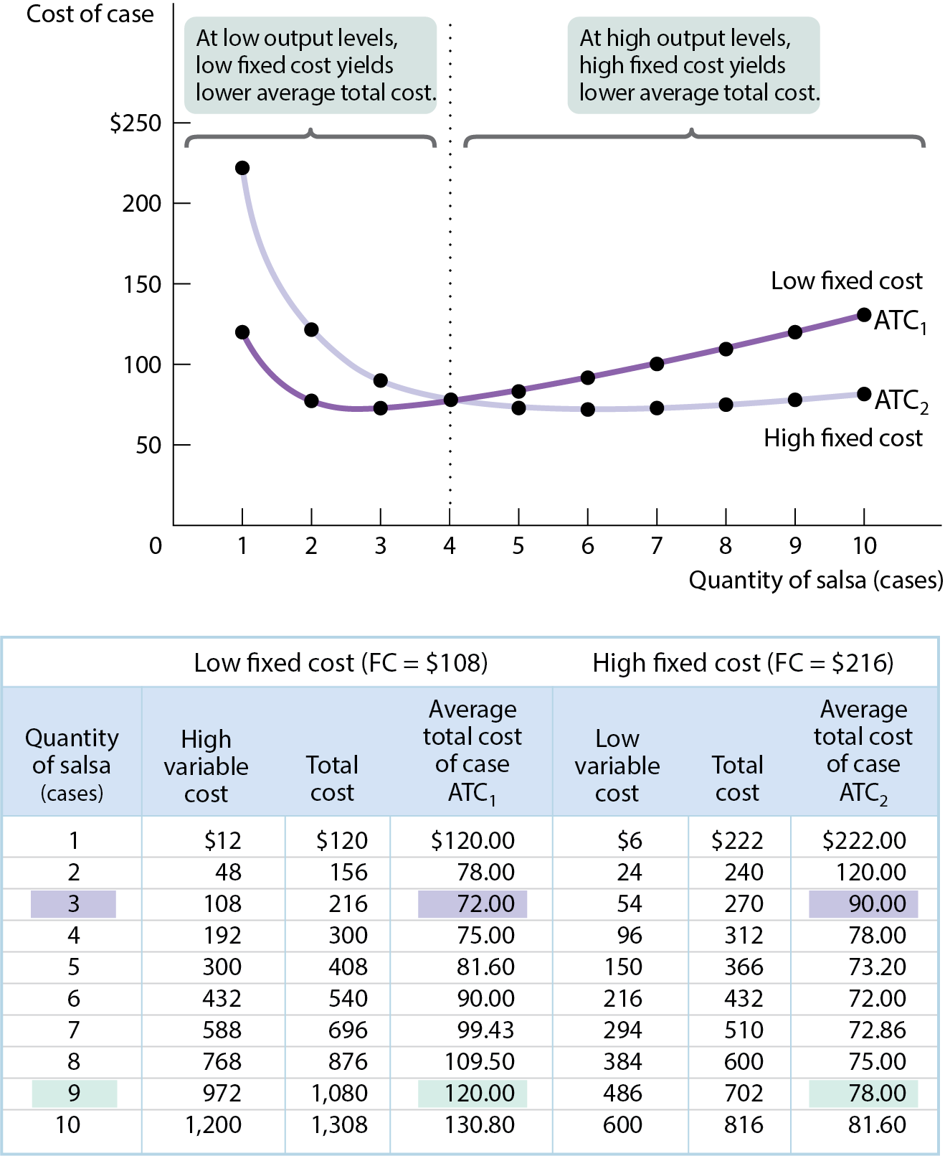
CHOOSING THE LEVEL OF FIXED COST
Figure 11
There is a trade-off between higher fixed cost and lower variable cost for any given output level, and vice versa.

Slide 44
THE LONG-RUN AVERAGE TOTAL COST CURVE
The long-run average total cost curve shows the relationship between output and average total cost when fixed cost has been chosen to minimize average total cost for each level of output.
  (We assume the firm has chosen the cheapest plant size for each output level.)

Slide 45
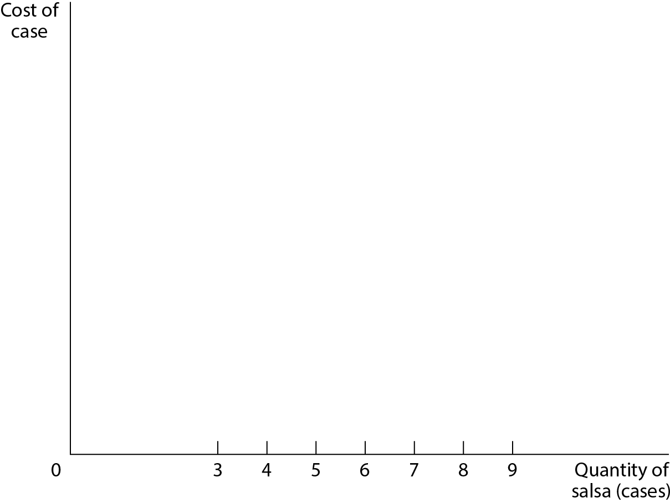
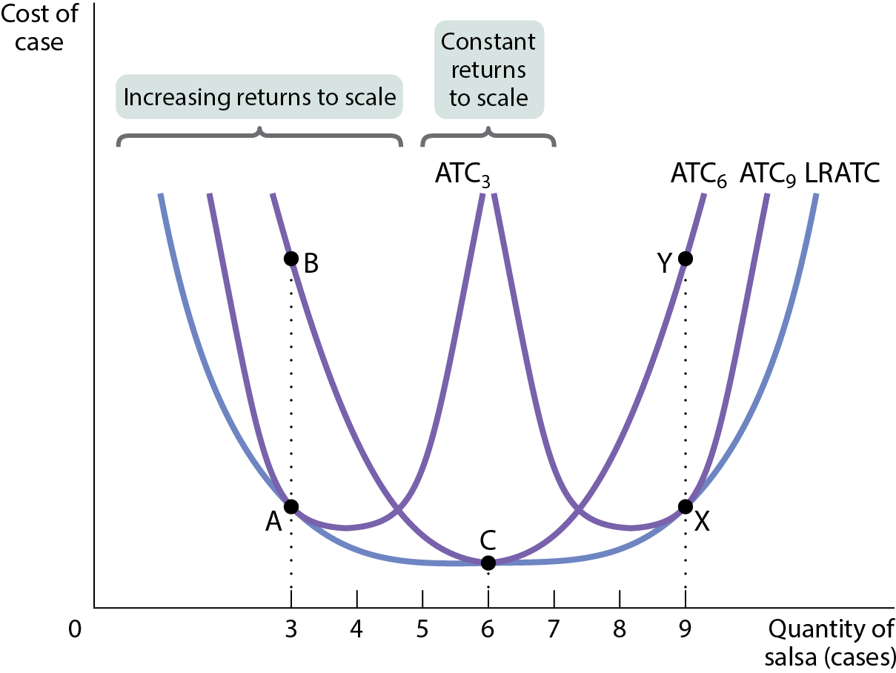
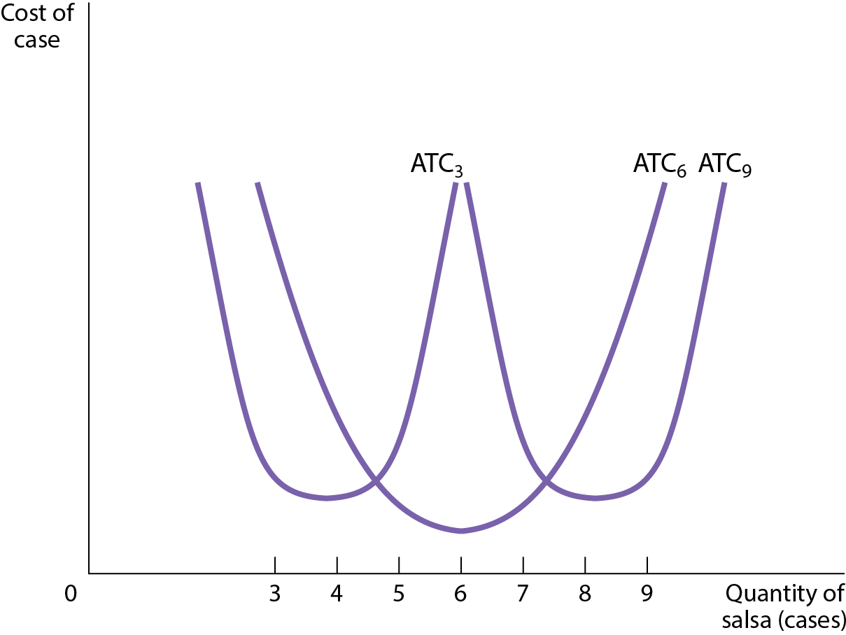
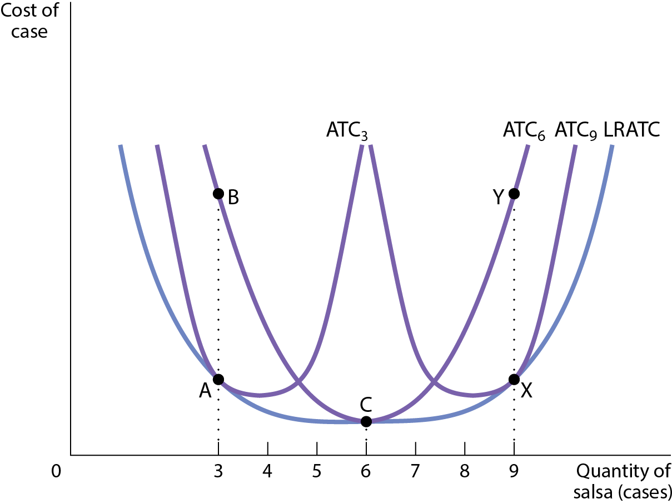
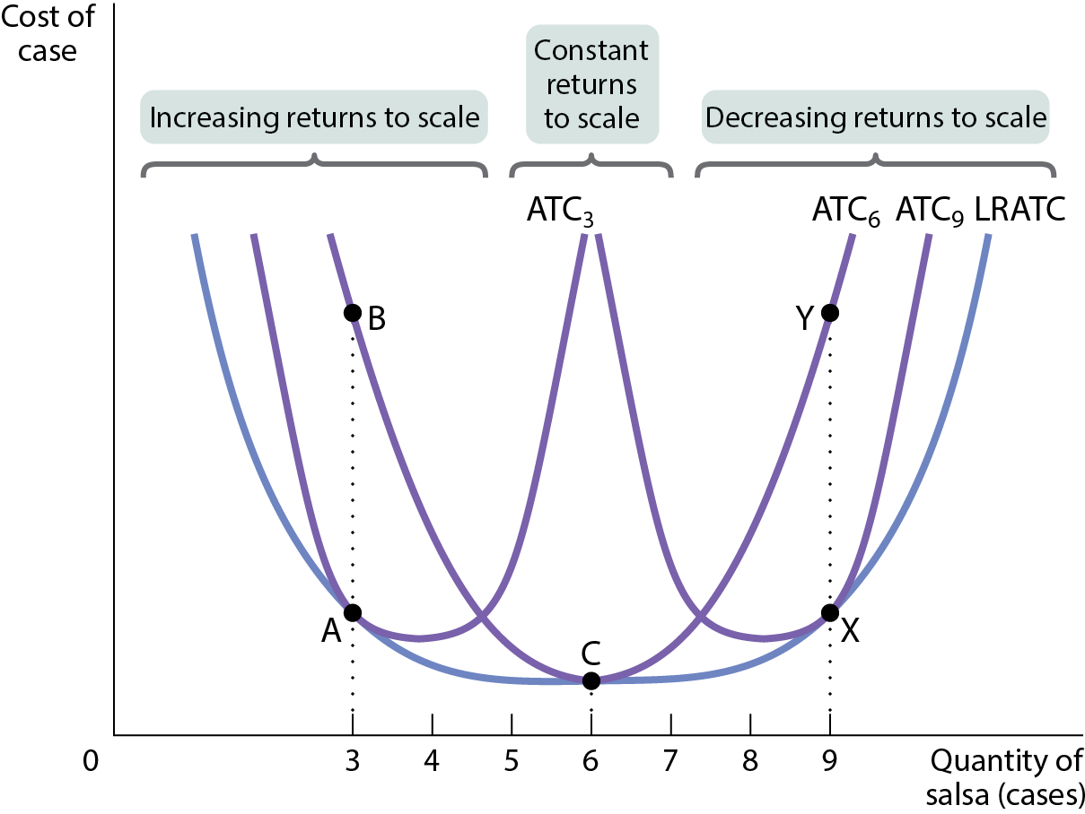
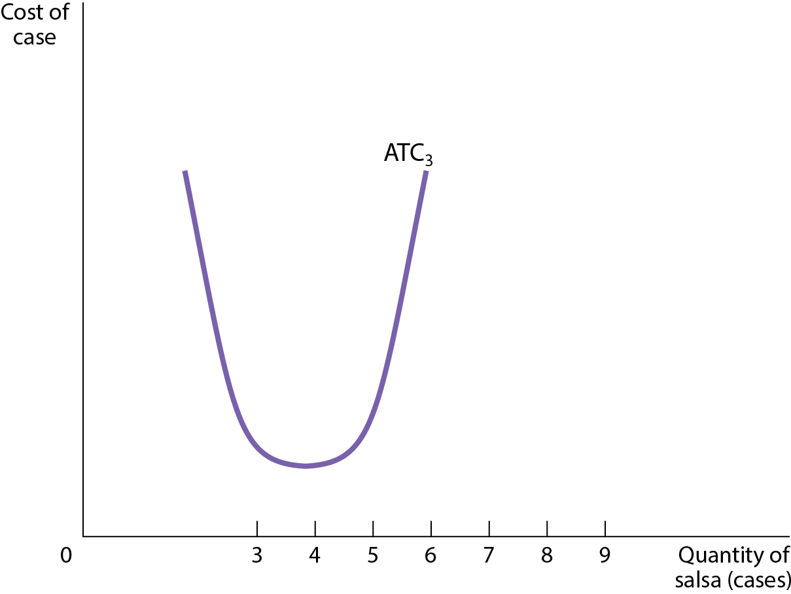
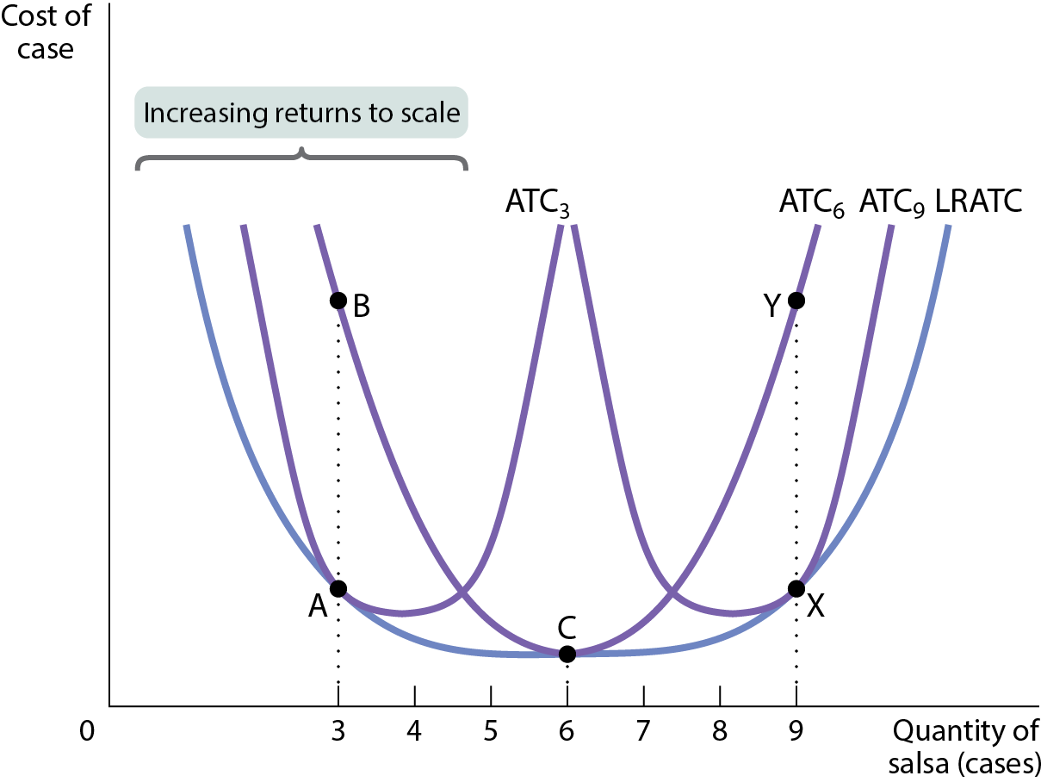
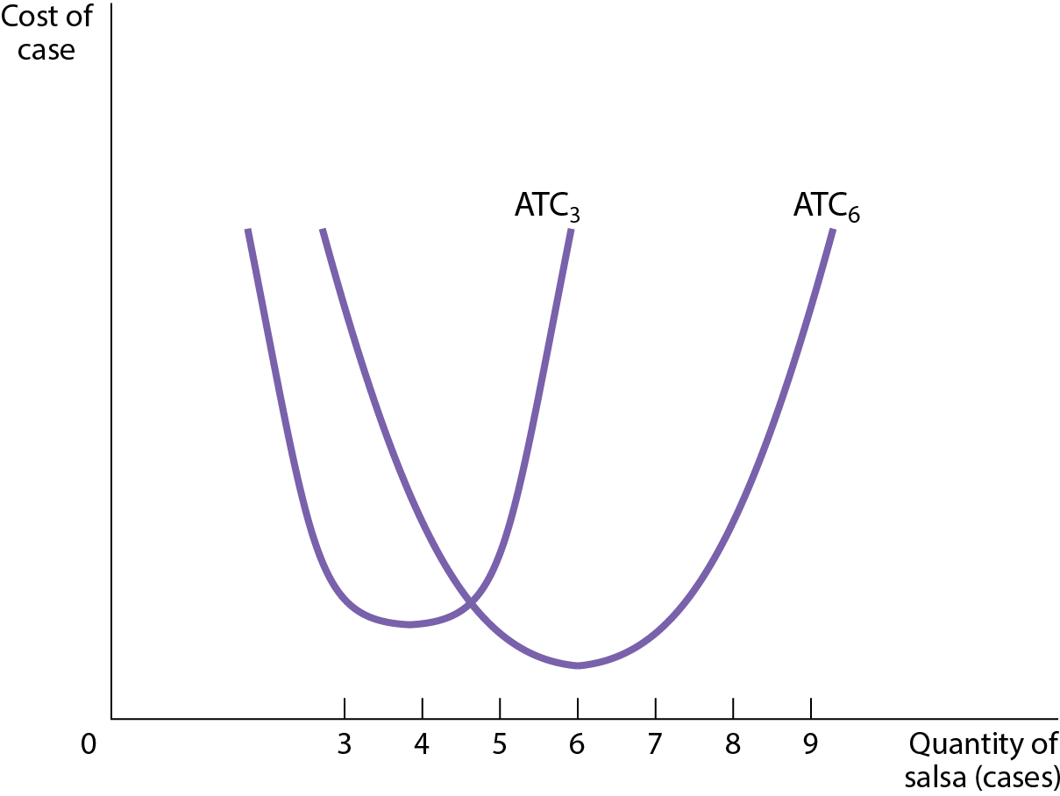
SHORT-RUN AND LONG-RUN AVERAGE TOTAL COST CURVES
Figure 12
Short-run and long-run average total cost curves differ because a firm can choose its fixed cost in the long run.
If the firm chooses the fixed cost that minimizes short-run ATC at an output of 6, and produces 6, it’s at point C.
If it produces only 3, it’ll move to point B.
If the firm expects to produce 3 cases for a long time, it’ll reduce its fixed cost and move to point A.
If it produces 9 (point Y) and expects to continue this for a long time, it’ll increase its fixed cost and move to point X.

Slide 46
RETURNS TO SCALE
There are increasing returns to scale (economies of scale) when long-run average total cost declines as output increases.
There are decreasing returns to scale (diseconomies of scale) when long-run average total cost increases as output increases.
There are constant returns to scale when long-run average total cost is constant as output increases.

Slide 47
Perfect Competition and the Supply Curve
15
Notes:
Cover Credits: Currency Exchange Stock Chart: cemagraphics/Getty Images, Social Media Montage: SEAN GLADWELL/Getty Images, Circuit Pattern: somsak Tangdamrongsub/Getty Images, Cargo Containers: urzine/Getty Images

Slide 48
DEFINING PERFECT COMPETITION
All market participants, both consumers and producers, are price-takers.
There are many producers, each with a small market share.
  Market share: the fraction of the total industry output accounted for by that producer’s output.
  This means both sellers and buyers are price-takers; their actions have no effect on price.
  Each participant is a drop in the bucket.
Consumers regard the products of all producers as equivalent.
  The product is standardized across sellers.
  Standardized product (aka commodity): consumers regard different sellers’ products as the same.

Slide 49
LEARN BY DOING: PRACTICE QUESTION 1
Which of these markets is likely to be the MOST competitive?
cable television
automobiles and trucks
oil refining
farm commodities

Slide 50
LEARN BY DOING: PRACTICE QUESTION 1
(ANSWER)
Which of these markets is likely to be the MOST competitive?
cable television
automobiles and trucks
oil refining
farm commodities (correct answer)

Slide 51
FREE ENTRY AND EXIT
Most perfectly competitive industries are also characterized by free entry and exit:
  New producers can easily enter into an industry, and existing producers can easily leave that industry.

Slide 52

ECONOMICS IN ACTION
What’s a standardized product?
Is Japanese kimchi different from (and inferior to) the Korean “real thing”)?
As far as economists are concerned, the products are different only if the consumers believe them to be.

Slide 53
PRODUCTION AND PROFITS (1 of 2)
Each firm’s total revenue is equal to price × quantity sold, or
TR = P × Q
And profit = total revenue − total cost, or
Profit = TR – TC

Slide 54
PRODUCTION AND PROFITS (2 of 2)
When market price = $72, profit is highest at Q = 50.
TABLE 1 Profit for Noelle’s Farm When Market Price Is $72
Quantity of trees Q | Total revenue TR | Total cost TC | Profit TR – TC
0 | $0 | $560 | −$560
10 | 720 | 1,200 | −480
20 | 1,440 | 1,440 | 0
30 | 2,160 | 1,760 | 400
40 | 2,880 | 2,240 | 640
50 | 3,600 | 2,880 | 720
60 | 4,320 | 3,680 | 640
70 | 5,040 | 4,640 | 400
But there is another way to think about it…

Slide 55
MARGINAL ANALYSIS AND THE PROFIT-MAXIMIZING OUTPUT (1 of 2)
Recall the profit-maximizing principle of marginal analysis: the optimal amount of an activity is the level at which marginal benefit equals marginal cost.
Marginal revenue: change in total revenue generated by an additional unit of output
  MR = ΔTR/ΔQ
  Since the firm is a price-taker, MR equals the price: Its marginal revenue curve is a horizontal line at the market price.
  Since the firm is a price-taker, the firm faces a horizontal, perfectly elastic demand curve that is equivalent to its marginal revenue curve.
Optimal output rule: profit is maximized by producing the quantity of output at which the marginal revenue of the last unit produced is equal to its marginal cost.

Slide 56
MARGINAL ANALYSIS AND THE PROFIT-MAXIMIZING OUTPUT (2 of 2)
Why is profit maximized where MR = MC?
Each time the firm produces another unit, there are extra costs and extra revenues.
If producing another unit adds more to revenue than it costs, profit will increase.
  If MR > MC, producing more will add to profit;
  If MR < MC, producing less will add to profit.
Since MR = P for competitive firms, the profit-maximizing rule is to choose the quantity of output where P = MC.

Slide 57
TABLE 2 Short-Run Costs for Noelle’s Farm
As long as increasing production by one more unit creates more MR than MC, it makes sense to do it.
Quantity of trees | Variable cost VC | Total cost TC | Marginal cost of a tree | Marginal revenue of a tree | Net gain of a tree
0 | $0 | 560
10 | 640 | 1,200 | 64 | 72 | 8
20 | 880 | 1,440 | 24 | 72 | 48
30 | 1,200 | 1,760 | 32 | 72 | 40
40 | 1,680 | 2,240 | 48 | 72 | 24
50 | 2,320 | 2,880 | 64 | 72 | 8
60 | 3,120 | 3,680 | 80 | 72 | -8
70 | 4,080 | 4,640 | 96 | 72 | -24

Slide 58
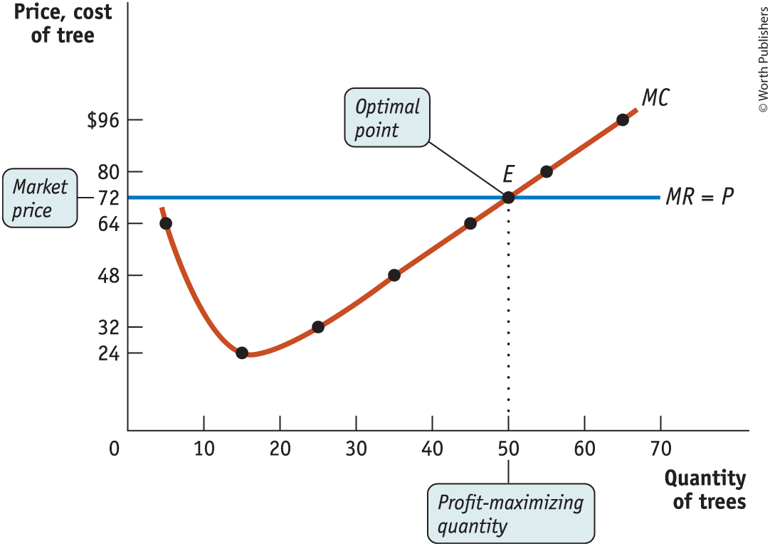
THE PRICE-TAKING FIRM’S PROFIT-MAXIMIZING QUANTITY OF OUTPUT
Figure 1

Slide 59
WHEN IS PRODUCTION PROFITABLE?
Recall that we are using economic profit—the profit that includes the implicit cost (the forgone benefits of the firm’s resources) and the explicit cost (cash outlays).
If TR > TC, the firm is profitable.
If TR = TC, the firm breaks even.
If TR < TC, the firm incurs a loss.
We can also express this idea in terms of average revenue and cost per unit of output:
If the firm produces a quantity at which P > ATC, the firm is profitable.
If the firm produces a quantity at which P = ATC, the firm breaks even.
If the firm produces a quantity at which P < ATC, the firm incurs a loss.

Slide 60

COSTS AND PRODUCTION IN THE SHORT RUN
Figure 2

