Slide 1
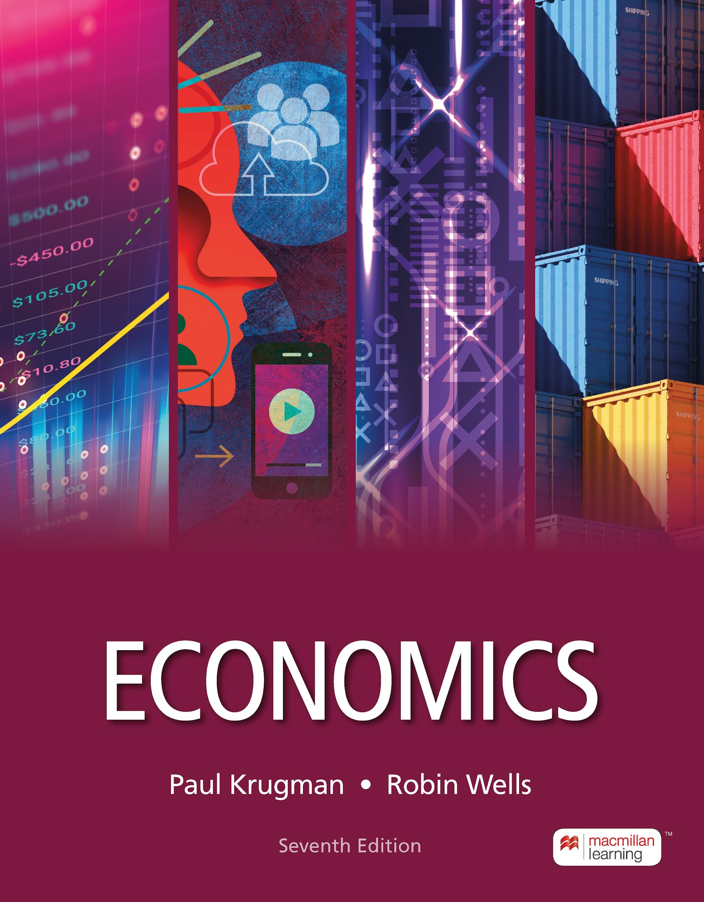
The Rational Consumer
13
Notes:
Cover Credits: Currency Exchange Stock Chart: cemagraphics/Getty Images, Social Media Montage: SEAN GLADWELL/Getty Images, Circuit Pattern: somsak Tangdamrongsub/Getty Images, Cargo Containers: urzine/Getty Images

Slide 2

Midterm #2

Slide 3
Midterm #2
12. Economists are excited because they have just discovered a good that is nonrival in consumption but excludable. To maximize consumer surplus, this good:
will be very expensive, since it’s so rare.
should be free, since the marginal cost of an individual’s consumption is zero if the good is produced at the socially optimal level.
will be overproduced, since the price of the good is less than the marginal cost of producing it.
None of the above.
Artificially Scare Goods

Slide 4
Midterm #2
Extra Credit Assignment:
5 Questions
10 points
Due this Friday November 8th at 11:59pm
Points will be added to your Midterm 2 grade

Slide 5
WHAT YOU WILL LEARN IN THIS CHAPTER
What factors determine how consumers spend their income?
Why do economists use the concept of utility to describe people’s tastes?
Why does the principle of diminishing marginal utility accurately describe consumer behavior?
What is the optimal consumption bundle, and why do we use marginal analysis to determine it?
How do income and substitution effects show the effects of changes in income and prices on consumers’ choices?

Slide 6

UTILITY AND CONSUMPTION
  We suppose that everyone is trying to maximize satisfaction gained from consumption.
  Utility is the value or satisfaction from consumption.
An individual’s consumption bundle is the collection of all the goods and services consumed by that individual.
An individual’s utility function gives the total utility generated by their consumption bundle.

Slide 7

UTILITY AND CONSUMPTION
  Util is a unit of utility
  Marginal utility (MU) is the change in utility from consuming an additional unit.
  Diminishing marginal utility is the fact that each additional unit of a good adds less to utility than the previous unit.

Slide 8
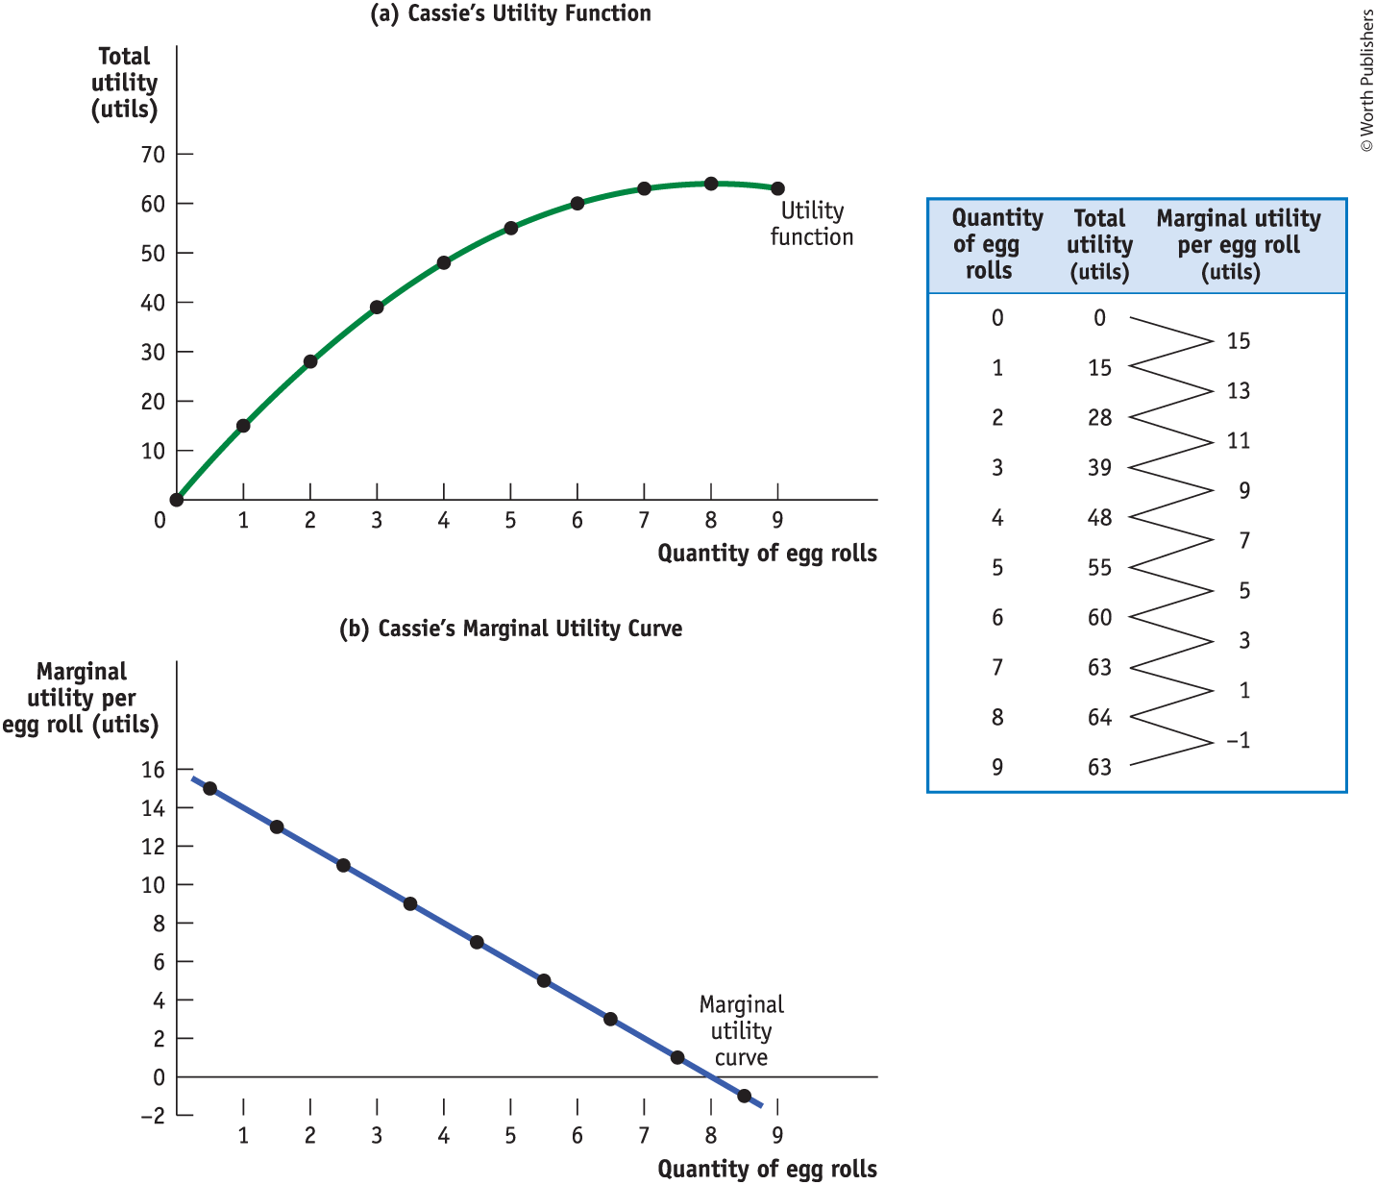
CASSIE’S TOTAL UTILITY AND MARGINAL UTILITY
Each additional egg roll gives Cassie less additional utility than the previous egg roll. (See Figure 1.)

Slide 9
LEARN BY DOING: PRACTICE QUESTION 1
Assume that the marginal utilities for the first three units of a good consumed are 200, 150, and 125, respectively. The total utility when two units are consumed is:
  150.
  200.
  350.
  475.
 | Total Utility | Mg. Utility
1 | 200 | 200
2 | 350 | 150

Slide 10
LEARN BY DOING: PRACTICE QUESTION 1
(ANSWER)
Assume that the marginal utilities for the first three units of a good consumed are 200, 150, and 125, respectively. The total utility when two units are consumed is:
  150.
  200.
  350. (correct answer)
  475.

Slide 11
LEARN BY DOING: DISCUSSION QUESTION 1
Discuss: If food is pleasurable, why wouldn’t a person eat all the food in an all-you-can-eat buffet?
Does eating more and more at the buffet increase the total utility?
Does eating more and more at the buffet increase the marginal utility?

Slide 12

BUDGET CONSTRAINTS AND BUDGET LINES
Because the amount of money a consumer can spend is limited, a decision to consume more of one good is also a decision to consume less of some other good.
A budget constraint requires that the cost of a consumer’s consumption bundle be no more than the consumer’s income.

Slide 13
BUDGET CONSTRAINTS AND BUDGET LINES
A consumer’s consumption possibilities are the set of all consumption bundles that can be consumed given the consumer’s income and prevailing prices.
A consumer’s budget line shows the consumption bundles available to a consumer who spends all of their income.

Slide 14
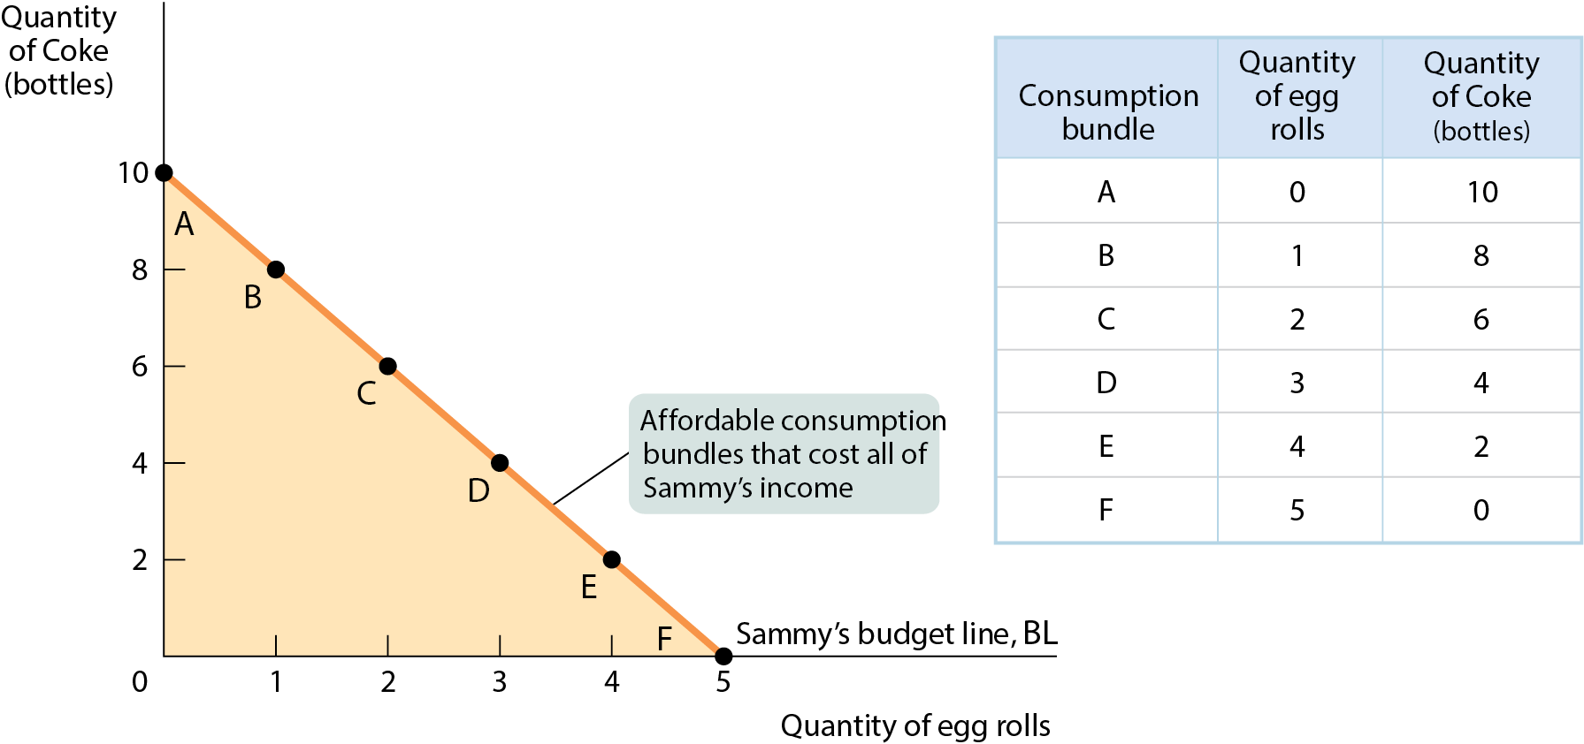
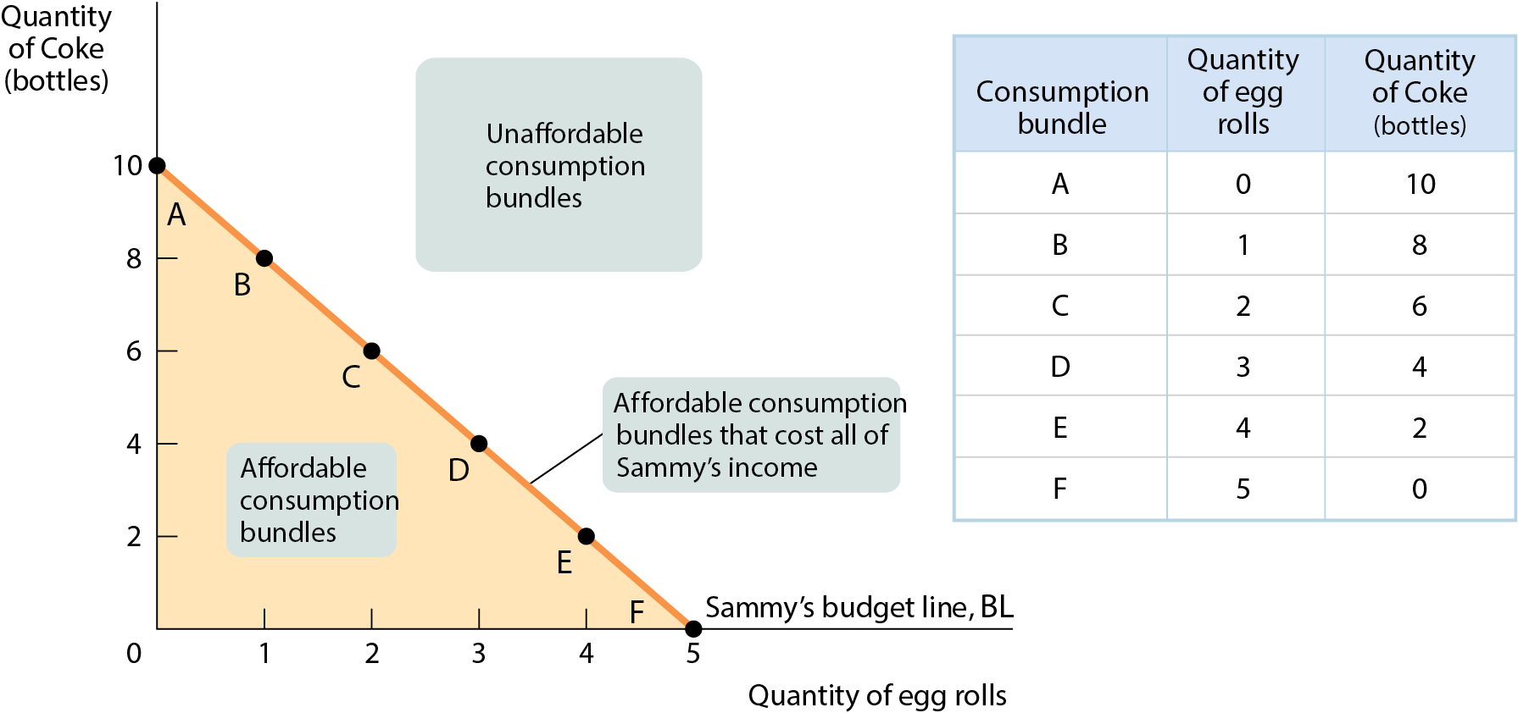
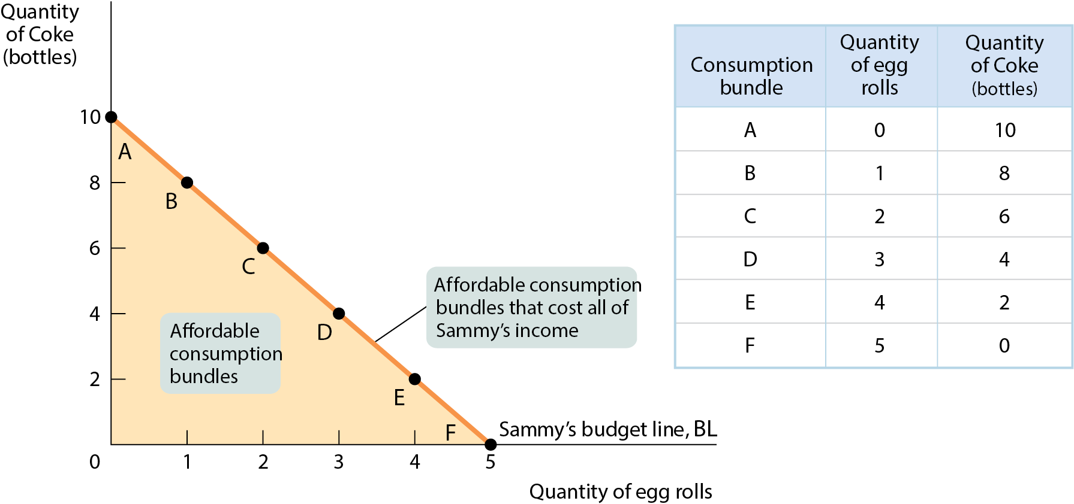
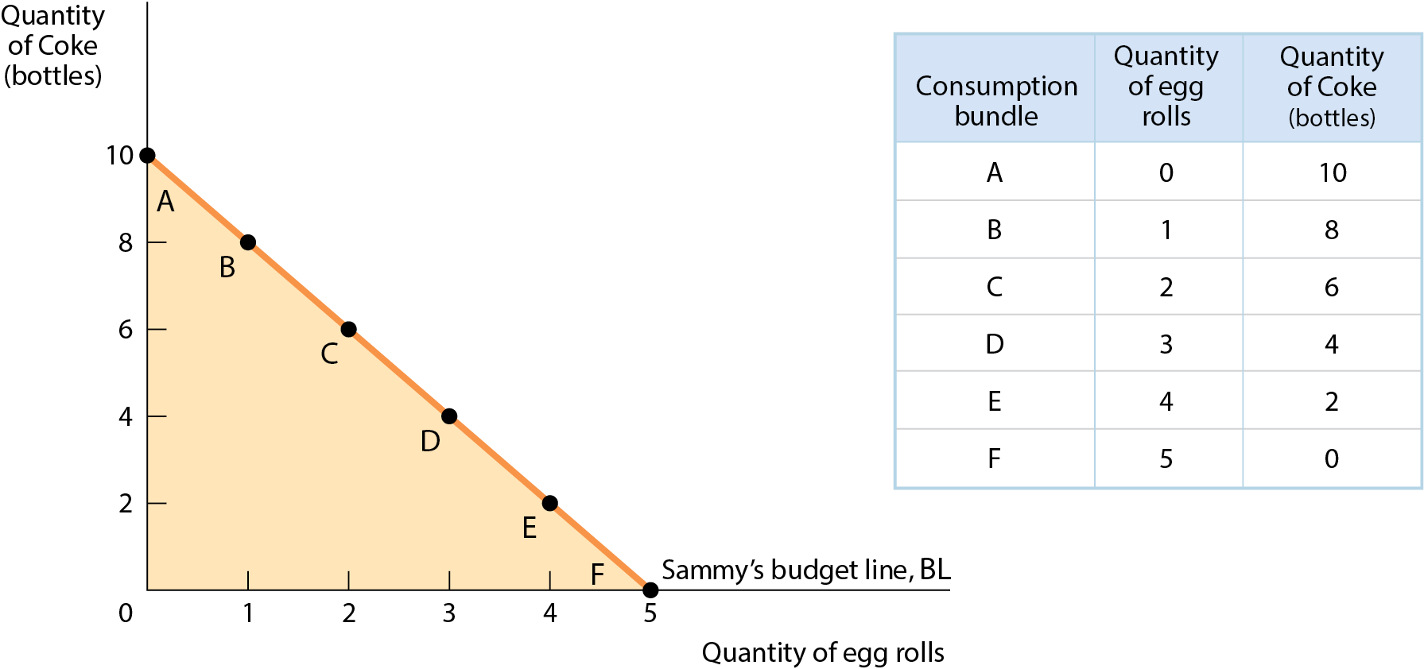
GRAPHING THE BUDGET LINE
Sam has a weekly income of $20; he spends all of it on egg rolls and Coke. Egg rolls cost $4 per roll, and Coke costs $2 per bottle.
Figure 2

Slide 15
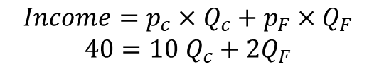
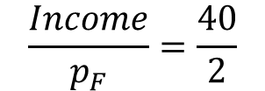
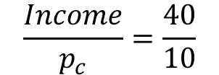
LEARN BY DOING: PRACTICE QUESTION 2
Your income is $40. The price of each unit of food is $2, and the price of each unit of clothing is $10.
Draw a graph of your budget line.
Quantity of clothing
$$Income=p_{c}×Q_{c}+p_{F}×Q_{F}$$
$40=10$ $Q_{c}+2Q_{F}$
$$\frac{Income}{p_{c}}=\frac{40}{10}$$
4
$$\frac{Income}{p_{F}}=\frac{40}{2}$$
Quantity of food
20

Slide 16
LEARN BY DOING: PRACTICE QUESTION 3
Your income rises to $50, and the prices of food and clothing remain the same.
Draw a graph of your new budget line.

Slide 17
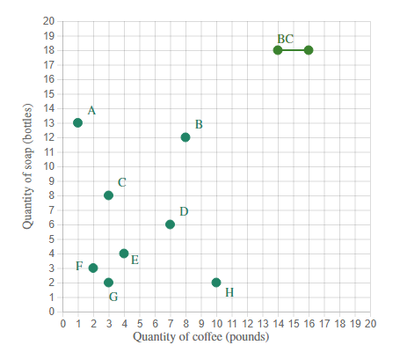
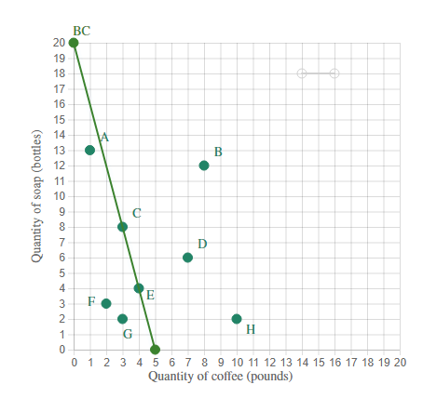


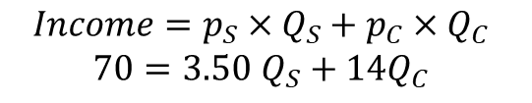
LEARN BY DOING: PRACTICE QUESTION 4
Maria is in school learning to be a welder. She spends long hours studying (and drinking coffee) and long hours practicing in the hot, dirty shop (and therefore takes frequent showers). Maria has $70.00 per month to spend on the soap and coffee. In the accompanying graph, move the BC line to correctly depict Maria's budget constraint, assuming the soap costs $3.50 per bottle, and the coffee costs $14.00 per pound.
$$Income=p_{S}×Q_{S}+p_{C}×Q_{C}$$
$70=3.50$ $Q_{S}+14Q_{C}$
$$Q_{S}=\frac{70}{3.5}$$
$$Q_{C}=\frac{70}{14}$$

Slide 18
LEARN BY DOING: PRACTICE QUESTION 4
Then choose the best description of the lettered points according to whether they describe baskets of goods that are unaffordable, affordable and exhaust Maria's budget, or affordable with money left over.
Affordable with money left over
Point A?
Unaffordable
Point B?
Point C?
Affordable and exhaust the budget
Unaffordable
Point D?

Slide 19
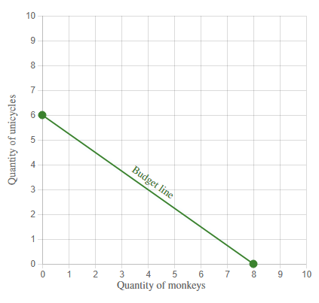




LEARN BY DOING: PRACTICE QUESTION 4
The graph shows Mauricio's initial budget constraint. The price per unicycle is $120, and the price per monkey is $90.
What is Mauricio's budget for monkeys and unicycles?
$$6=\frac{Income}{{Price}_{Unicycles}}$$
$$6=\frac{Income}{120}$$
$$6×120=Income$$
$$Income=720$$

Slide 20
OPTIMAL CONSUMPTION BUNDLE (1 of 2)
Table 2: Sam’s Budget and Total Utility
Consumption bundle | Quantity of egg rolls | Utility from egg rolls (utils) | Quantity of Coke (bottles) | Utility from Cokes (utils) | Total utility (utils)
A | 0 | 0 | 10 | 56.7 | 56.7
B | 1 | 15 | 8 | 53.2 | 68.2
C | 2 | 25 | 6 | 47.0 | 72.0
D | 3 | 31 | 4 | 36.8 | 67.8
E | 4 | 34 | 2 | 21.4 | 55.4
F | 5 | 36 | 0 | 0 | 36.0

Slide 21
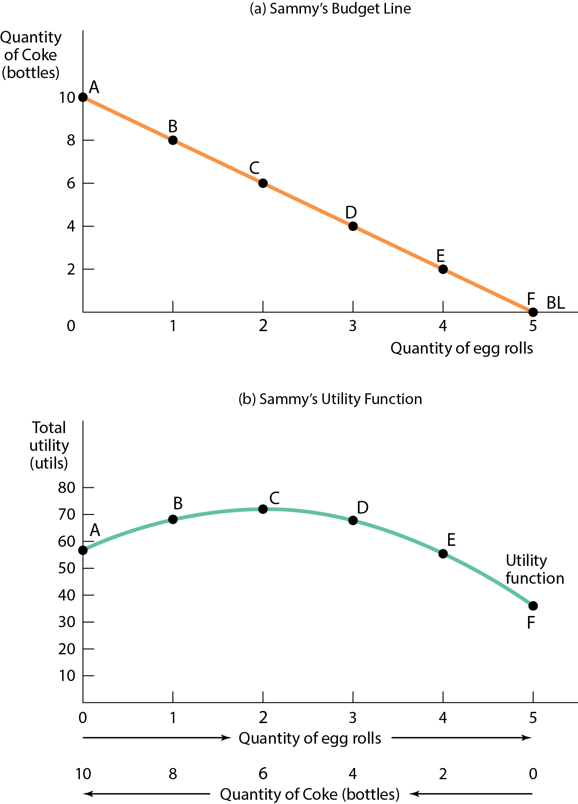
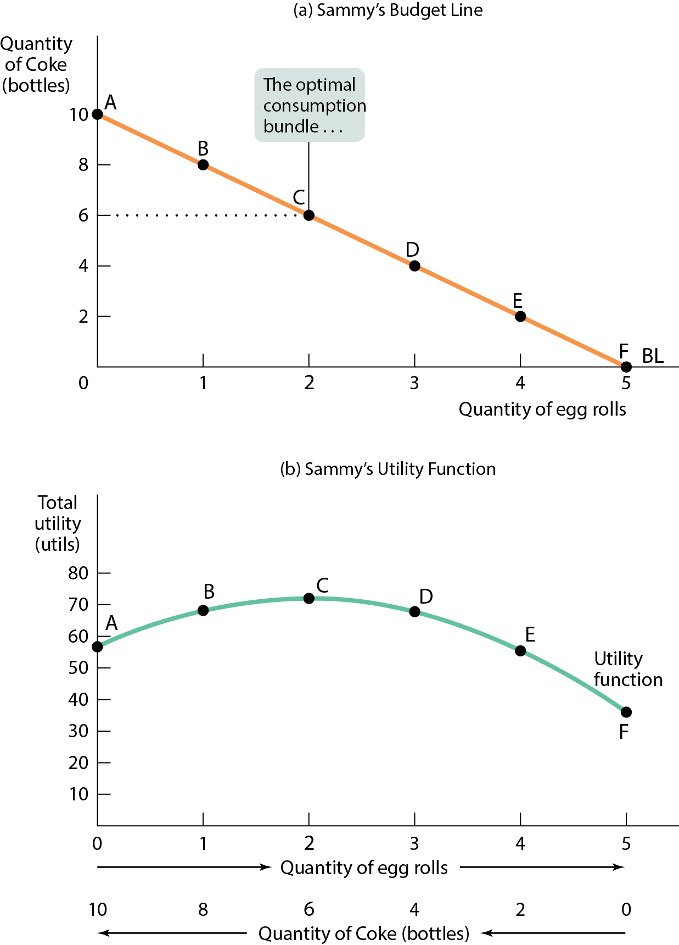
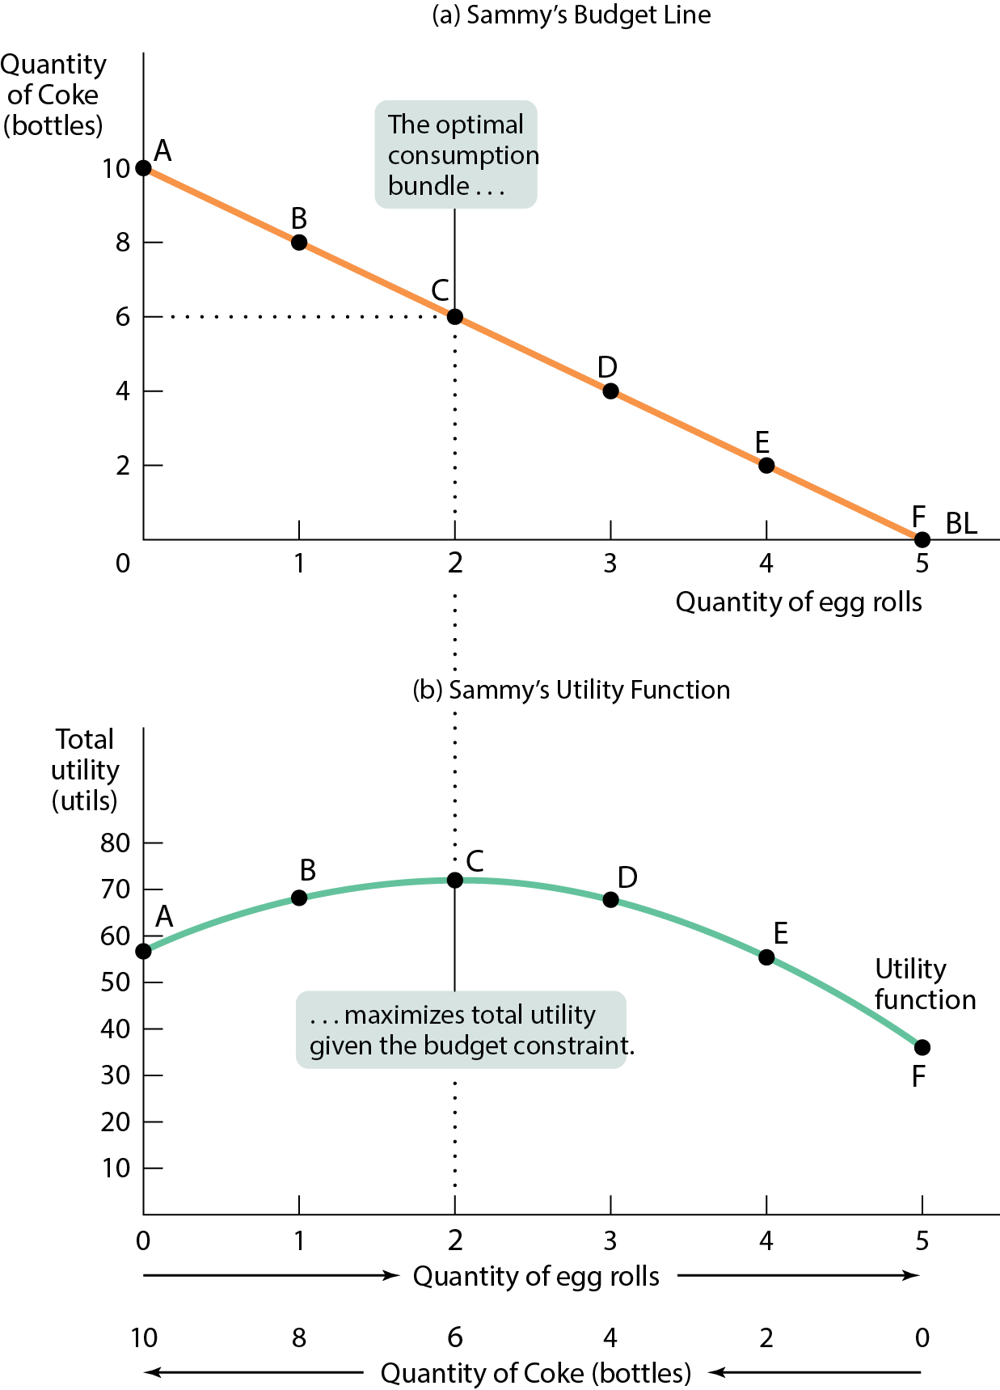
OPTIMAL CONSUMPTION BUNDLE (2 of 2)
Figure 3
The optimal consumption bundle is the one that maximizes a consumer’s total utility given their budget constraint.

Slide 22
SPENDING THE MARGINAL DOLLAR
We can find optimal consumption choice by choosing the bundle at which total utility is maximized.
But we can use marginal analysis instead, turning it into a “how much” problem.
We ask if the consumer can make themselves better off by spending a little bit more on either good.
To answer this question, we must calculate the marginal utility per dollar.

Slide 23
MARGINAL UTILITY PER DOLLAR
Marginal utility is the additional utility the consumer gets from consuming one more unit of a good or service.
The marginal utility per dollar spent on a good or service is the additional utility from spending one more dollar on that good or service.

Slide 24
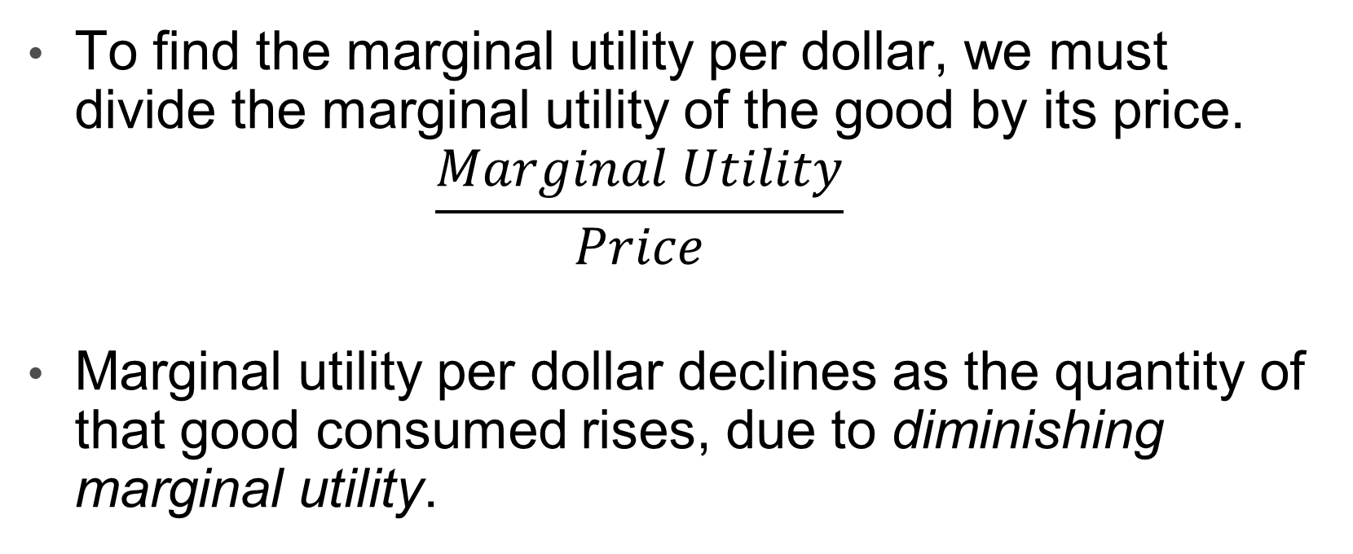
MARGINAL UTILITY PER DOLLAR
To find the marginal utility per dollar, we must divide the marginal utility of the good by its price.
  $$\frac{Marginal Utility}{Price}$$
Marginal utility per dollar declines as the quantity of that good consumed rises, due to diminishing marginal utility.

Slide 25
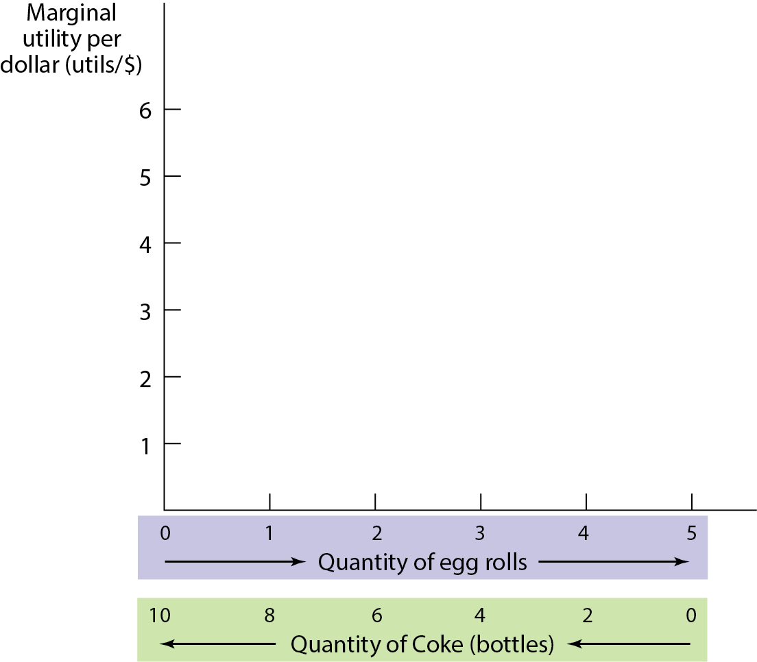
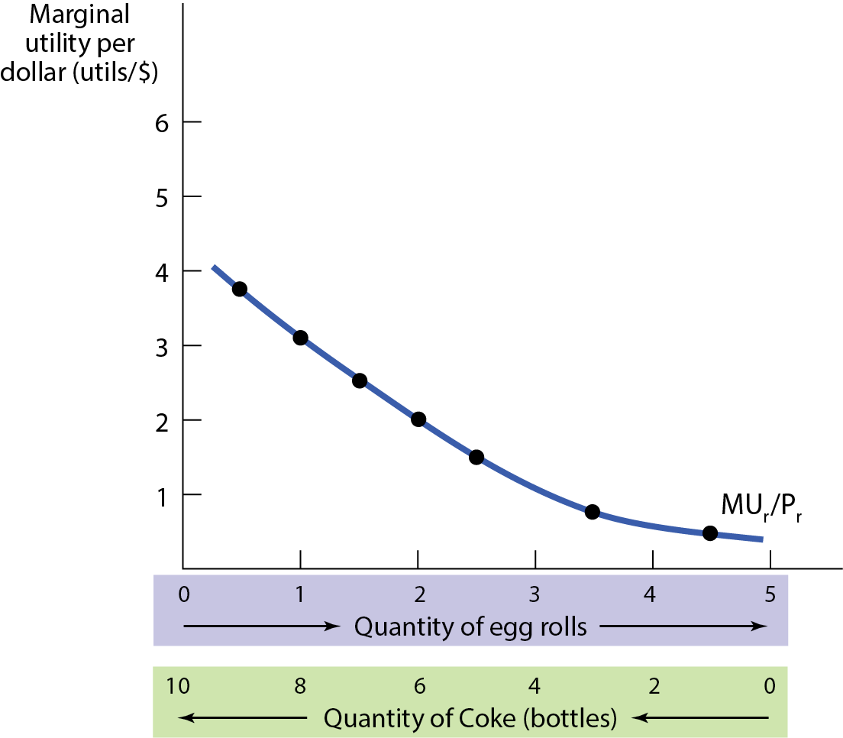
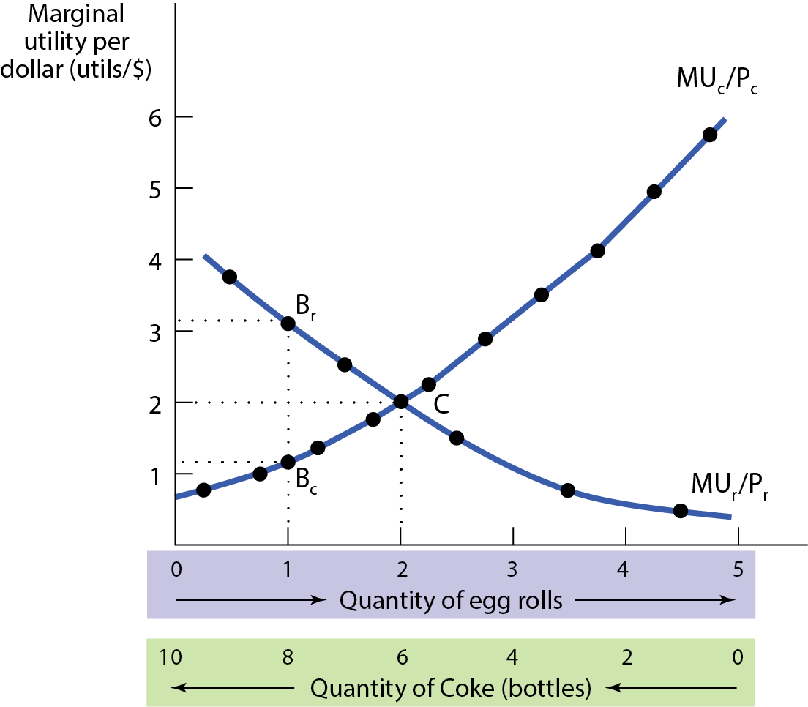
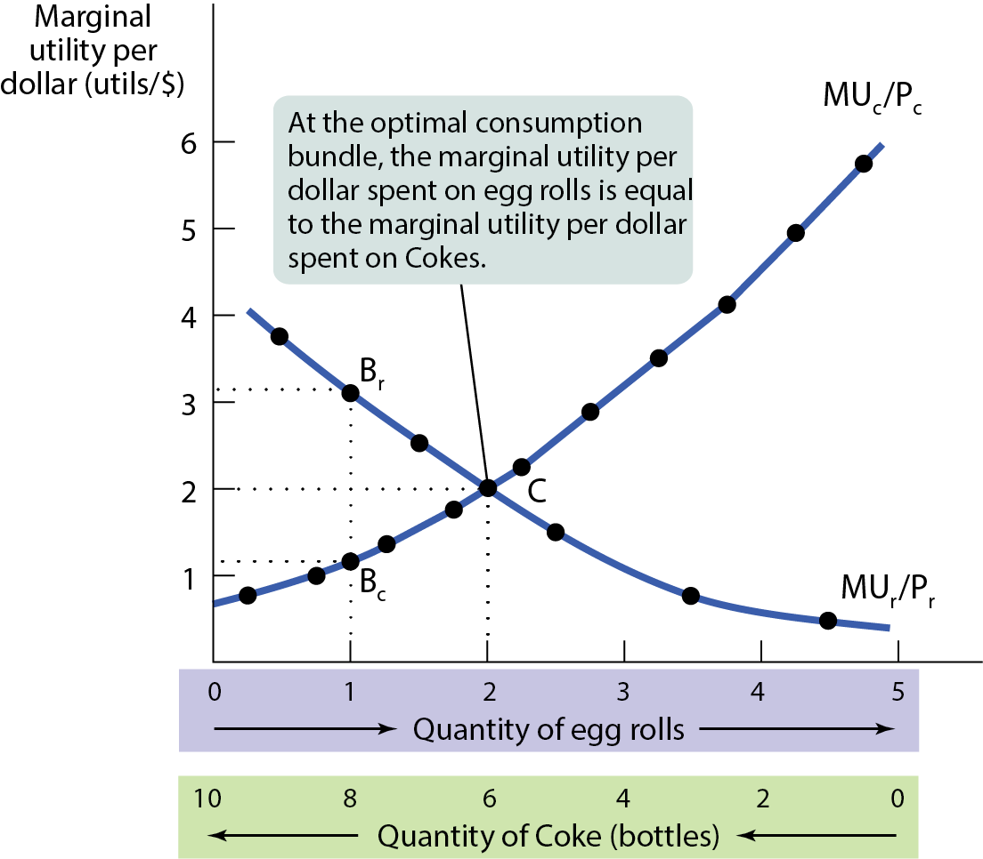
GRAPHING MARGINAL UTILITY PER DOLLAR
Sam’s optimal consumption bundle is at point C, where his marginal utility per dollar spent on egg rolls, MUr /Pr, is equal to his marginal utility per dollar spent on Cokes, MUc /Pc. (See Figure 4.)

Slide 26

COMPARING MU TO PRICE
The general rule: Compare the MU and the price for all goods, and then adjust your spending toward the goods that give you MORE marginal utility per dollar.
Example: P_{GUM}= $0.25, P_{ICE CREAM}= $1.00,
MU_{GUM} = 1, MU_{ICE CREAM}= 2,
What can you do to increase total utility?
$\frac{{MU}_{Gum}}{P_{Gum}}=\frac{1}{\$0.25}>\frac{{MU}_{Ice cream}}{P_{Ice cream}}=\frac{2}{1}$, so buy more gum!
Gum makes you happier, dollar for dollar, than ice cream.

Slide 27
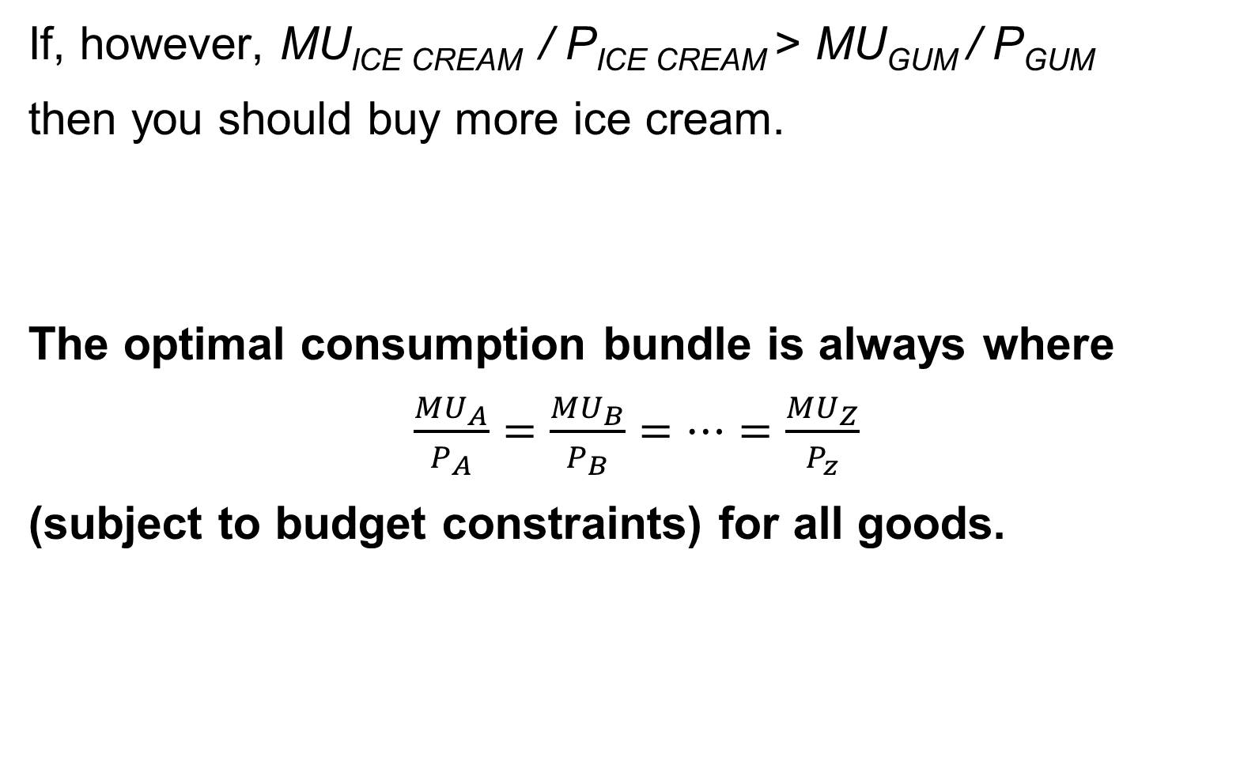
ADJUSTING TOWARD THE OPTIMAL BUNDLE
If, however, MU_{ICE CREAM} / P_{ICE CREAM} > MU_{GUM} / P_{GUM}
then you should buy more ice cream.
The optimal consumption bundle is always where
$\frac{{MU}_{A}}{P_{A}}$ $=\frac{{MU}_{B}}{P_{B}}=…=\frac{{MU}_{Z}}{P_{z}}$
(subject to budget constraints) for all goods.

Slide 28


ADJUSTING TOWARD THE OPTIMAL BUNDLE
If marginal utility per dollar is higher for ice cream than for gum, buying more ice cream and less gum would increase her total utility.
If marginal utility per dollar on gum is higher, she can increase her utility by spending less on ice cream and more on gum.
If she has chosen her optimal consumption bundle, her marg. utility per dollar on ice cream and gum must be equal.

Slide 29

UTILITY-MAXIMIZING PRINCIPLE OF MARGINAL ANALYSIS
Utility-maximizing principle of marginal analysis: when a consumer maximizes utility in the face of a budget constraint, the marginal utility per dollar spent on each good or service in the consumption bundle is the same.
Marginal utility per dollar spent on the good falls, and the consumer can increase their utility by buying less of this good and more of other goods.

Slide 30
PITFALLS
The right marginal comparison:
Production decisions set the marginal benefit of some activity equal to its marginal cost.
Consumption decisions set the marginal utility per dollar equal for each good.

Slide 31

PITFALLS
Unlike producers, consumers face budget constraints. Consuming more of one good requires consuming less of another.
The right marginal decision sets the marginal utility per dollar equal for each good (the “bang per buck” is the same across all goods). Only then is there no way to rearrange consumption and get more utility from one’s budget.

Slide 32
LEARN BY DOING: PRACTICE QUESTION 5
An increase in the price of good X while holding income and the price of good Y constant will:
  increase the marginal utility provided by good X.
  increase the marginal utility per dollar spent on good Y.
  decrease the marginal utility per dollar spent on good X.
  reduce the individual’s preference for good X.

Slide 33
LEARN BY DOING: PRACTICE QUESTION 5
(ANSWER)
An increase in the price of good X while holding income and the price of good Y constant will:
  increase the marginal utility provided by good X.
  increase the marginal utility per dollar spent on good Y.
  decrease the marginal utility per dollar spent on good X. (correct answer)
  reduce the individual’s preference for good X.

Slide 34
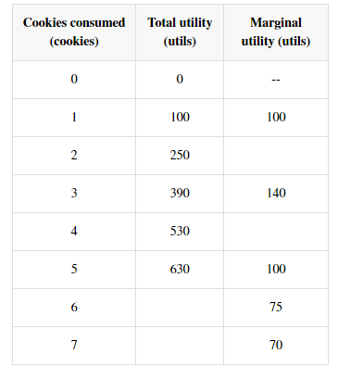
LEARN BY DOING: PRACTICE QUESTION 6
Cookie Monster loves cookies! The table shows how his utility varies with cookie consumption, but the table is missing some numbers.
Cookie Monster's marginal utility from the fourth cookie is….
150
What is Cookie Monster's total utility when he eats 6 cookies?
140
Cookie number __________ tastes the best to Cookie Monster.
705

Slide 35
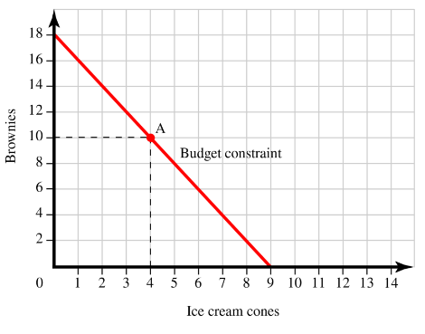
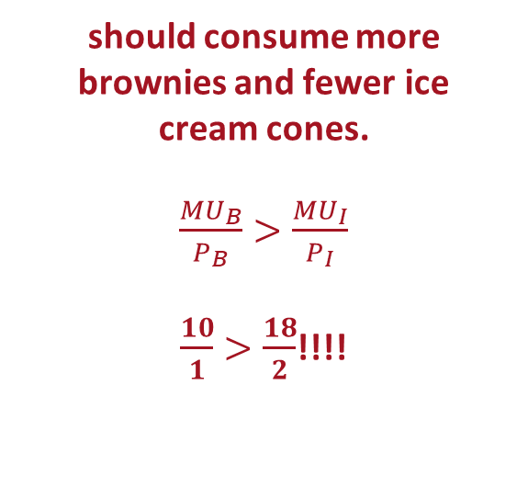
LEARN BY DOING: PRACTICE QUESTION 7
Assume that this person has a total of $18 to spend on brownies and ice cream cones.
1; Note that the intercept is 18, hence, 18/P_{B}=18, which implies that P_{B}=1
How much does a brownie cost?
should consume more brownies and fewer ice cream cones.
$\frac{{MU}_{B}}{P_{B}}$ $>\frac{{MU}_{I}}{P_{I}}$
$\frac{10}{1}$ $>\frac{18}{2}$!!!!
Assume that at point A, the marginal utility from a brownie is 10, and the marginal utility for an ice cream cone is 18. This person

Slide 36

THE DEMAND CURVE AND SUBSTITUTION EFFECT
The substitution effect (of a change in the price of a good) is the change in the quantity consumed of that good as the consumer substitutes the good that has become relatively cheaper for the good that has become relatively more expensive.

Slide 37


THE DEMAND CURVE AND INCOME EFFECT
The income effect (of a change in the price of a good) is the change in the quantity consumed of a good that results from a change in the consumer’s purchasing power (or real income) due to the change in the price of the good:
A change in the price of a good effectively changes a consumer’s income.

Slide 38
THE DEMAND CURVE AND INCOME EFFECT
For most goods, the income effect has no significant effect on consumption. Most market demand curves slope downward because of the substitution effect.
When it matters at all, income effect reinforces the substitution effect.

Slide 39

GIFFEN GOODS
  In the case of an inferior good, the income and substitution effects work in opposite directions.
  Giffen good: a very rare inferior good for which the income effect outweighs the substitution effect, and the demand curve slopes upward.
    Example: Rice and noodles in rural China. As the price of rice and noodles goes up, so does the consumption among rural Chinese laborers.
    Rice and noodles are cheap, but when the price of either good goes up, consumption of more expensive foods (fish or meat) must be curtailed so that more rice and noodles can be purchased.

Slide 40
LEARN BY DOING: PRACTICE QUESTION 8
An increase in the price of good X while holding income and the price of good Y constant will:
  have a positive substitution effect, leading the consumer to increase consumption of good X because of the increase in the marginal utility per dollar spent on good X.
  have a negative substitution effect, leading the consumer to decrease consumption of good X because of the decrease in the marginal utility per dollar spent on good X.
  cause the consumer to substitute away from good Y toward good X.
  cause the consumer to purchase more units of good X because of the income effect.

Slide 41
LEARN BY DOING: PRACTICE QUESTION 8
(ANSWER)
An increase in the price of good X while holding income and the price of good Y constant will:
  have a positive substitution effect, leading the consumer to increase consumption of good X because of the increase in the marginal utility per dollar spent on good X.
  have a negative substitution effect, leading the consumer to decrease consumption of good X because of the decrease in the marginal utility per dollar spent on good X. (correct answer)
  cause the consumer to substitute away from good Y toward good X.
  cause the consumer to purchase more units of good X because of the income effect.

