Slide 1
Review Session
Midterm #2
Chapters 6-12
Notes:
Cover Credits: Currency Exchange Stock Chart: cemagraphics/Getty Images, Social Media Montage: SEAN GLADWELL/Getty Images, Circuit Pattern: somsak Tangdamrongsub/Getty Images, Cargo Containers: urzine/Getty Images

Slide 2
Important Dates
Wednesday Oct 30th: Homework #10 (CH 11).
Thursday Oct 31st : No class [Office Hours].
Sunday Nov 3rd: Quiz #5 (CH 10 and 11).
Monday Nov 4th: Homework #11 (CH 12).

Slide 3

Important Dates
Tuesday
Wednesday
Thursday
Sunday
Monday
Tuesday
Review Session
10/29
HW #10
10/30
No Class
10/31
Quiz #5
11/03
HW #11
10/04
Midterm #2
10/05

Slide 4
Midterm #2
20 Questions, multiple choice.
Chapters 6, 7, 9, 10, 11 and 12.
1 hour and 15 minutes.
No phones are allowed.
You can bring a calculator.

Slide 5

Midterm #2 – Scantron answer sheet

Slide 6
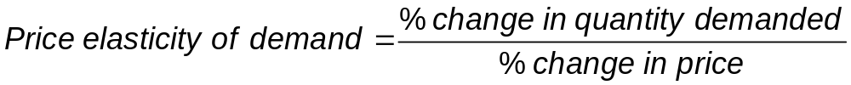
CALCULATING THE PRICE ELASTICITY OF DEMAND (Chapter 6)
Price elasticity of demand = the percentage change in quantity demanded divided by the percentage change in price.

Slide 7
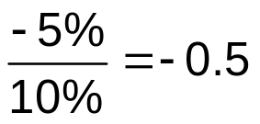
CALCULATING THE PRICE ELASTICITY OF DEMAND
Example:
  If the price of oil increases by 10% and the quantity demanded falls by 5%, then the price elasticity of demand for oil is:
    Note: since we know that price and quantity demanded will always move in opposite directions (law of demand) we usually drop the minus sign (for price elasticity of demand only).

Slide 8
INTERPRETING THE PRICE ELASTICITY OF DEMAND
Classification of price elasticity of demand:
A good can have a price elasticity as low as zero or as high as infinity.
If a price elasticity <1, the demand curve is inelastic.
If a price elasticity >1, the demand curve is elastic.
If a price elasticity =1, the demand curve is unit-elastic.
Price elasticity >1: the quantity effect of lower prices is stronger than the price effect

Slide 9
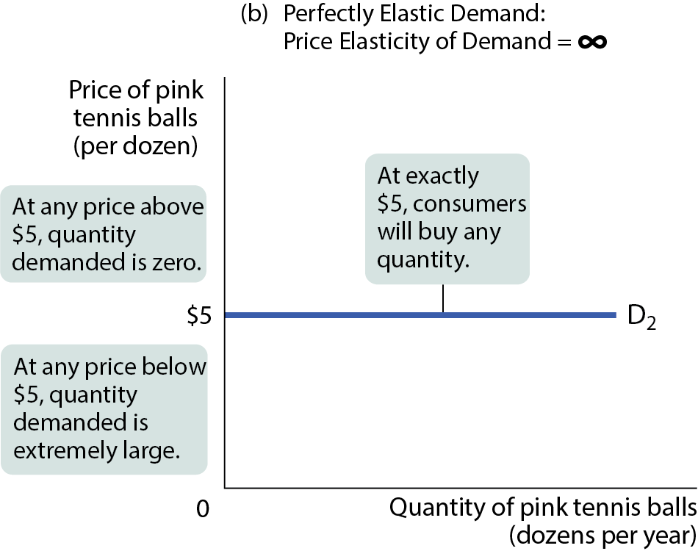
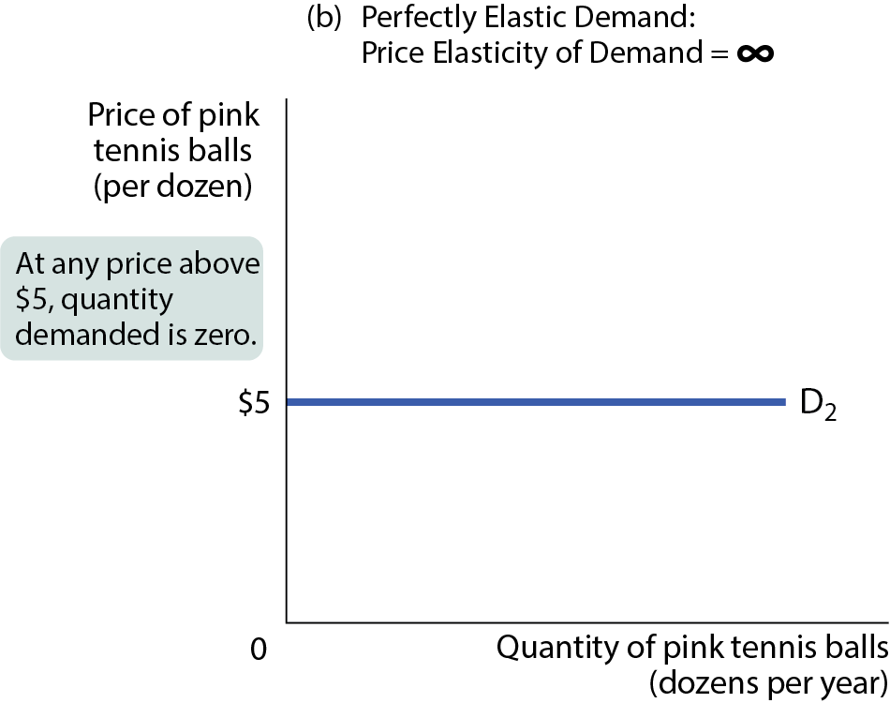
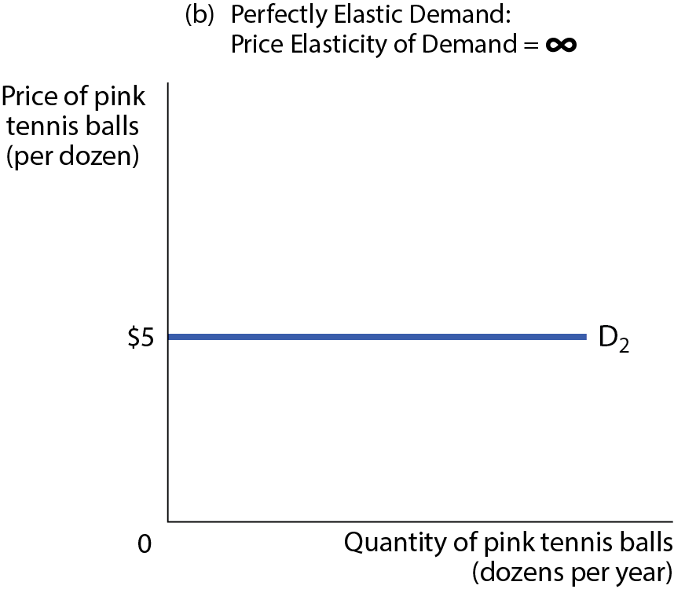
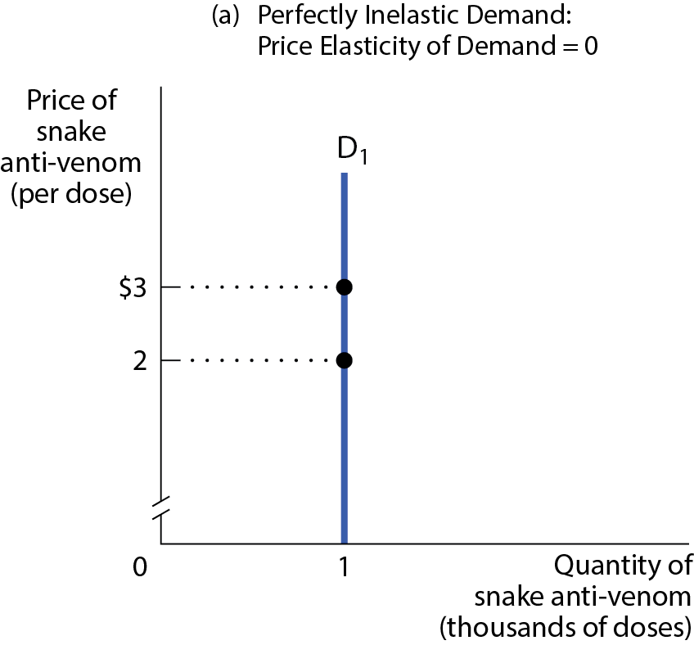
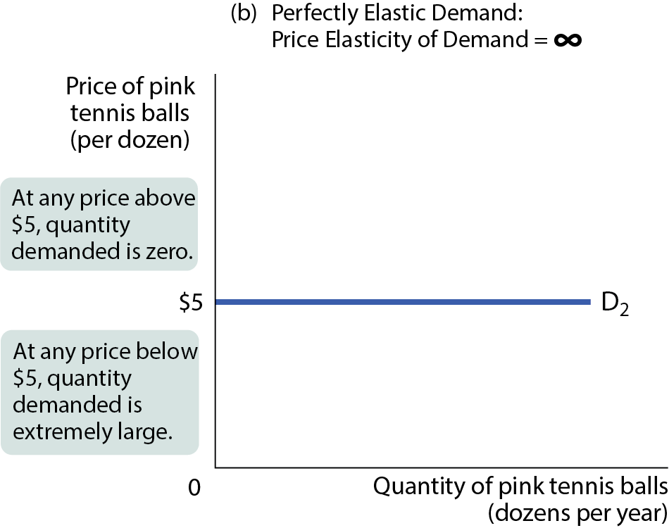
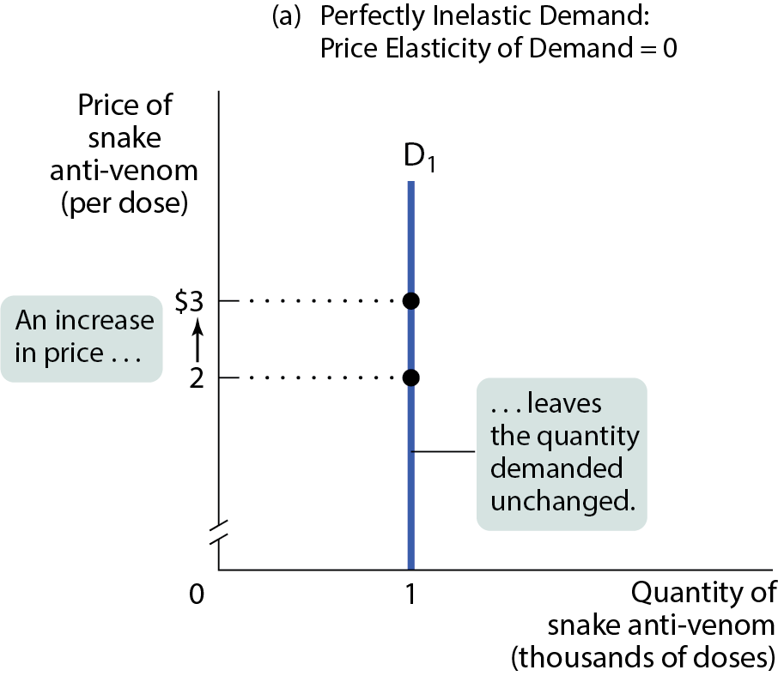
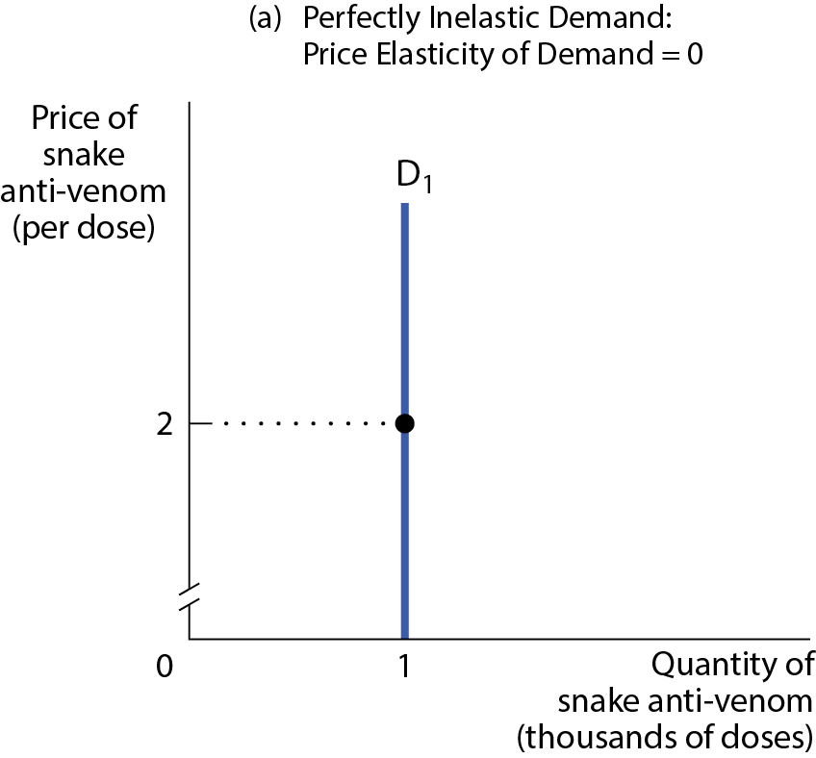

TWO EXTREME CASES OF PRICE ELASTICITY OF DEMAND
Figure 2

Slide 10
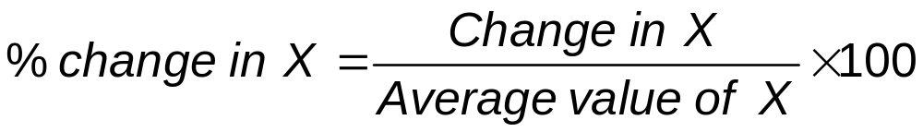
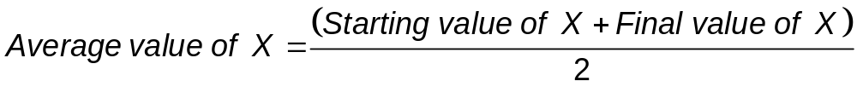
THE MIDPOINT METHOD
We calculate the price elasticity of demand using the midpoint formula for percentage changes.
Instead of dividing by the initial quantity or price, we’ll use the average quantity or price.

Slide 11
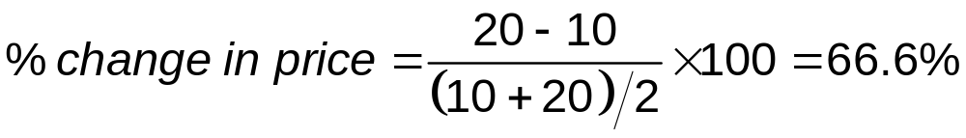
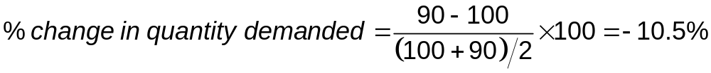
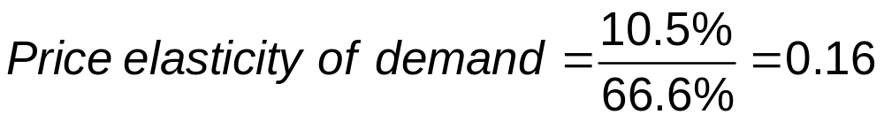
THE MIDPOINT METHOD
Example: At the initial price of $10, the quantity demanded is 100. When the price rises to $20, the quantity demanded is 90.

Slide 12
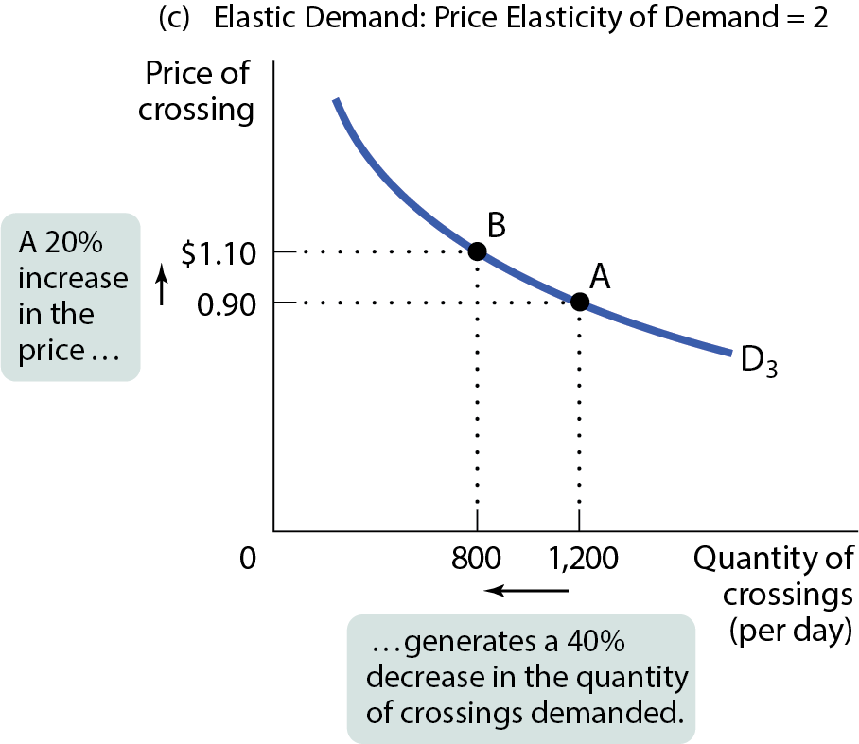
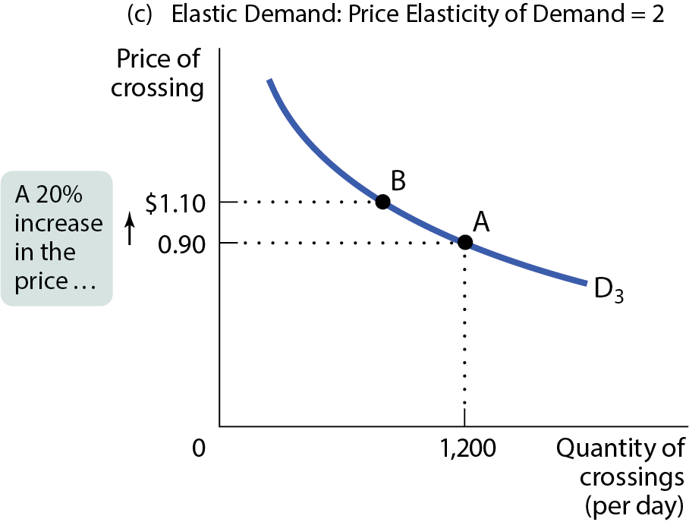
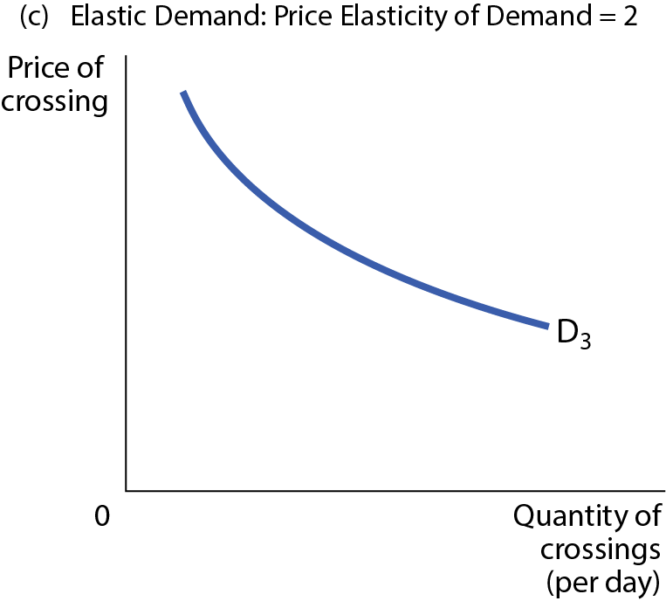
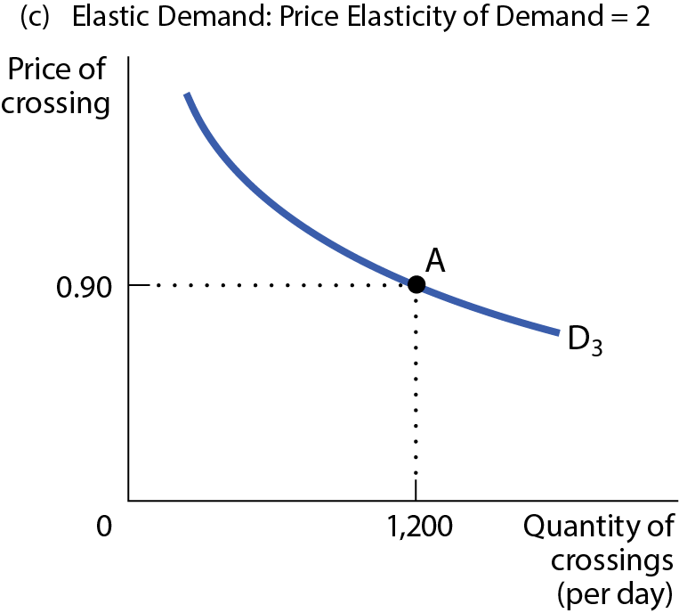
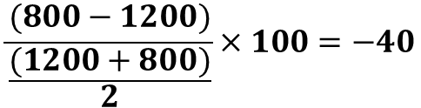
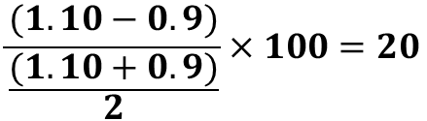
ELASTIC DEMAND
Figure 3(c)
$$\frac{(800−1200)}{\frac{(1200+800)}{2}}×100=−40$$
$$\frac{(1.10−0.9)}{\frac{(1.10+0.9)}{2}}×100=20$$

Slide 13
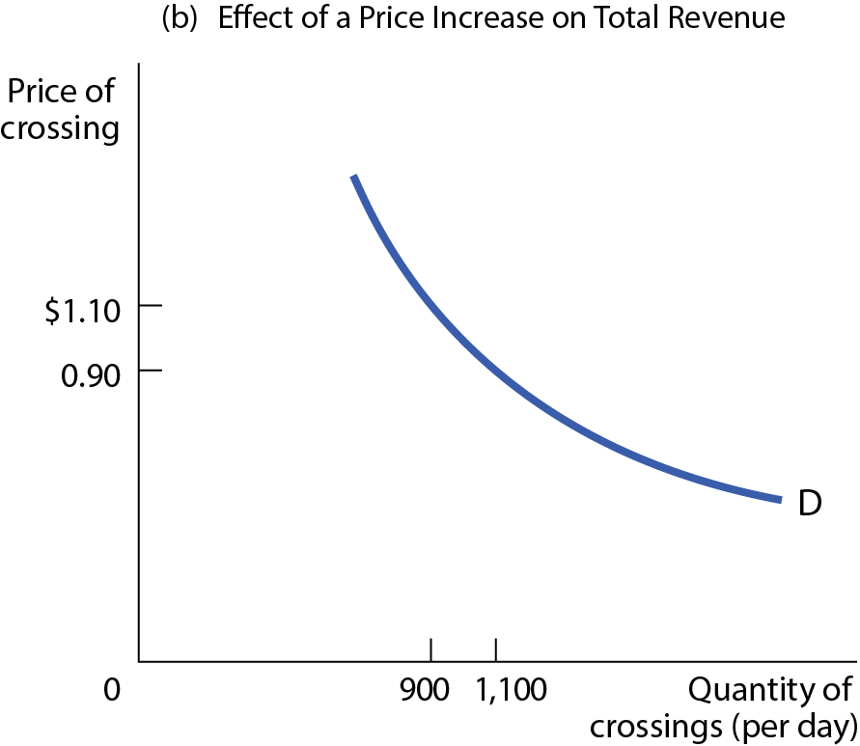
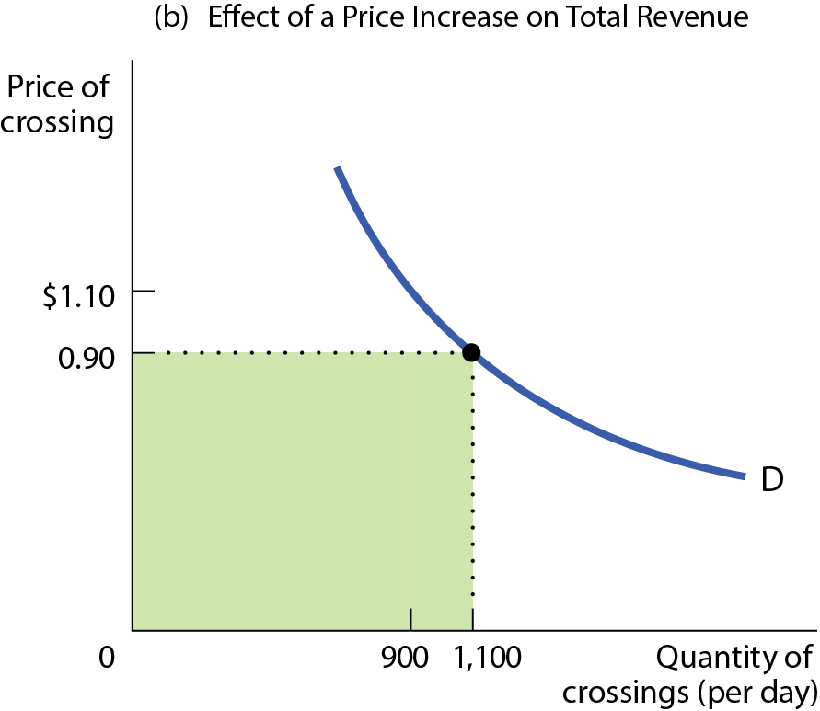
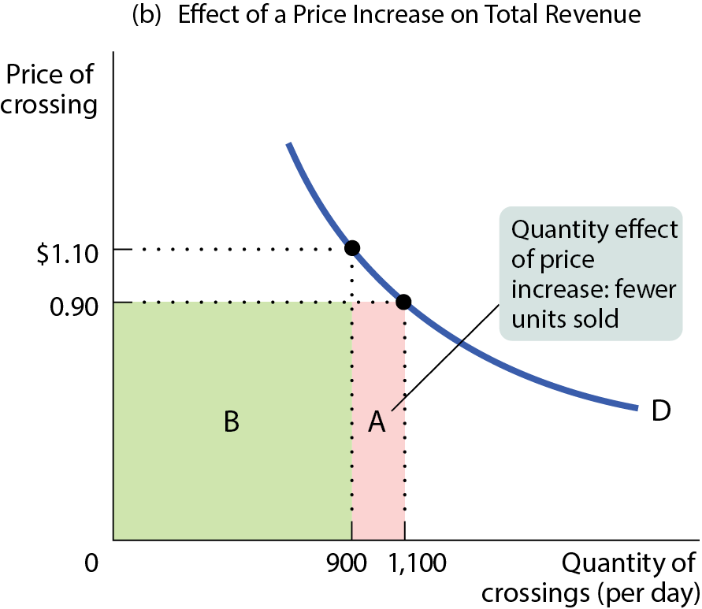
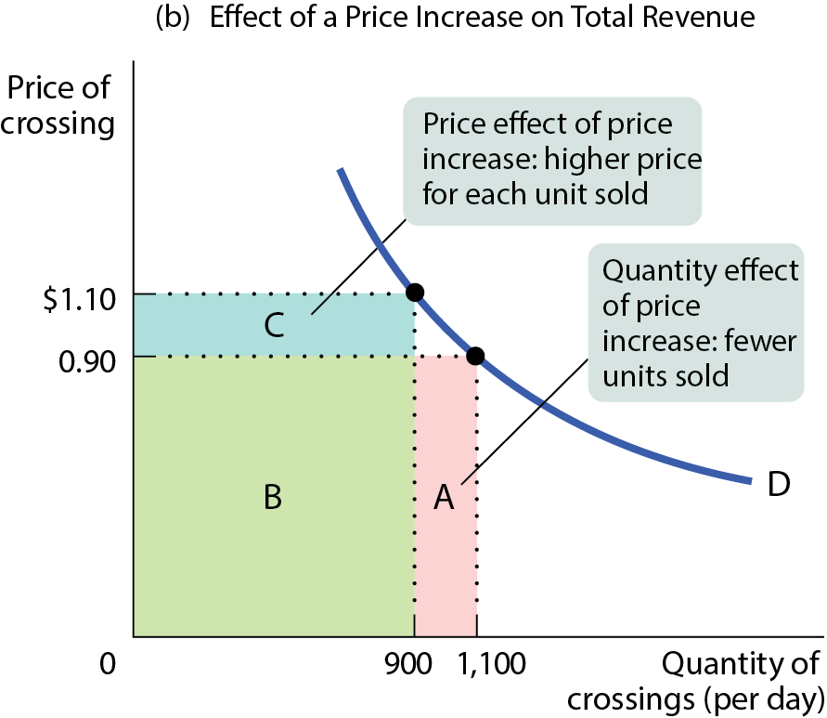
EFFECT OF A PRICE INCREASE ON TOTAL REVENUE
Figure 4(b)

Slide 14
ELASTICITY AND TOTAL REVENUE
When demand is inelastic, the price effect dominates the quantity effect.
So an increase in price will cause only a slight reduction in the quantity demanded.
In this instance, total revenue will rise when the price rises (and vice versa).

Slide 15
ELASTICITY AND TOTAL REVENUE
When demand is elastic, the quantity effect dominates the price effect.
  So an increase in price will cause significant reduction in the quantity demanded.
  In this instance, total revenue will fall when the price rises.
Consider a decrease in price:
  It increases or decreases revenue?
  Why?

Slide 16
ELASTICITY AND TOTAL REVENUE
When demand is unit-elastic, the quantity effect equals the price effect.
So an increase in price exactly balances the reduction in the quantity demanded.
In this instance, total revenue doesn’t change.

Slide 17
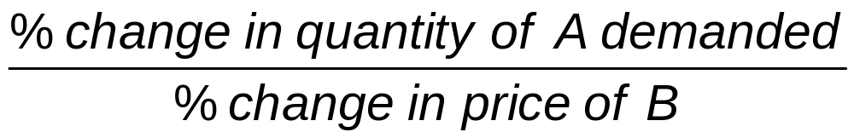
OTHER DEMAND ELASTICITIES
The cross-price elasticity of demand measures how sensitive the quantity demanded of good A is to the price of good B.
Cross-price elasticity of demand =

Slide 18
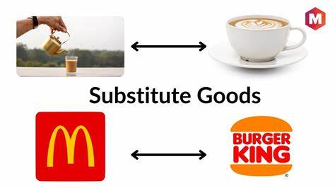
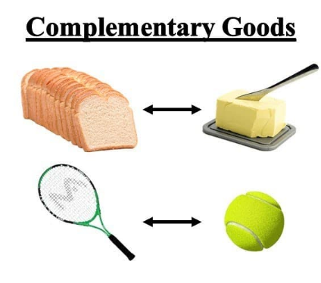
CROSS-PRICE ELASTICITY OF DEMAND
For substitutes, cross-price elasticity of demand is positive.
For complements, cross-price elasticity of demand is negative.

Slide 19
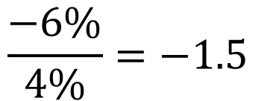
LEARN BY DOING: PRACTICE QUESTION 5
(ANSWER)
The price of good B increases by 4%, causing the quantity demanded of good A to decrease by 6%. The cross-price elasticity of demand is _____, and the goods are ______.
  1.5; substitutes
  –1.5; complements (correct answer)
  0.67; complements
  –2.4; substitutes
$$\frac{−6\%}{4\%}=−1.5$$

Slide 20
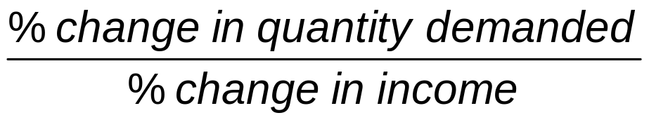
INCOME ELASTICITY OF DEMAND PART 2
The income elasticity of demand can be used to distinguish normal from inferior goods.
  For normal goods, income elasticity is positive.
  For inferior goods, income elasticity is negative.

Slide 21
INCOME ELASTICITY OF DEMAND PART 3
Normal goods can be income-elastic or not.
For income-elastic goods, income elasticity is greater than 1.
For income-inelastic goods, income elasticity is positive but less than 1.
The percentage change in the quantity demanded of this good is larger than the percentage change in income

Slide 22
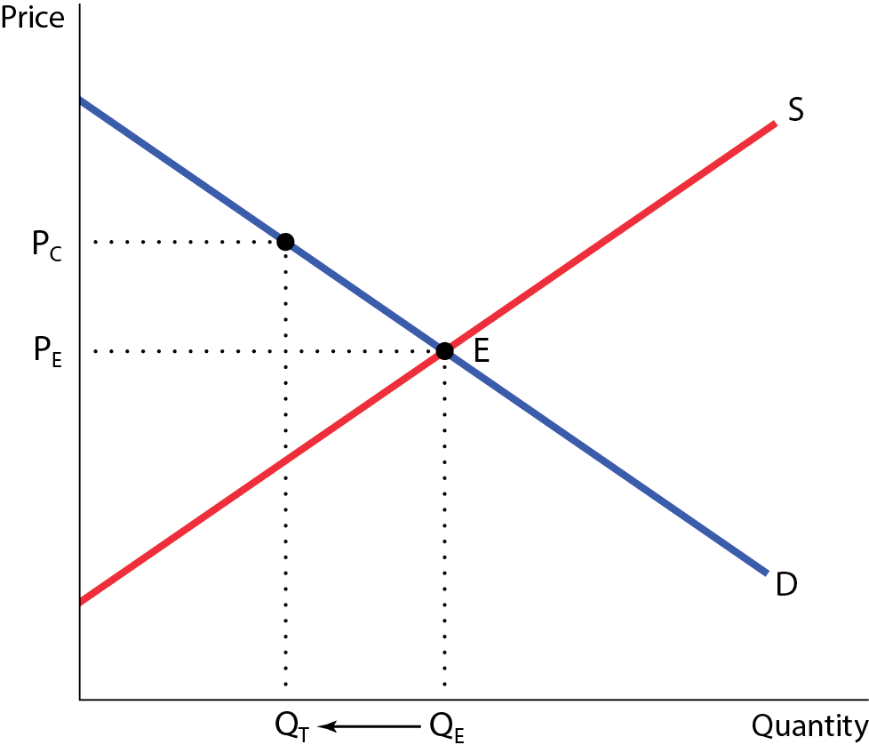
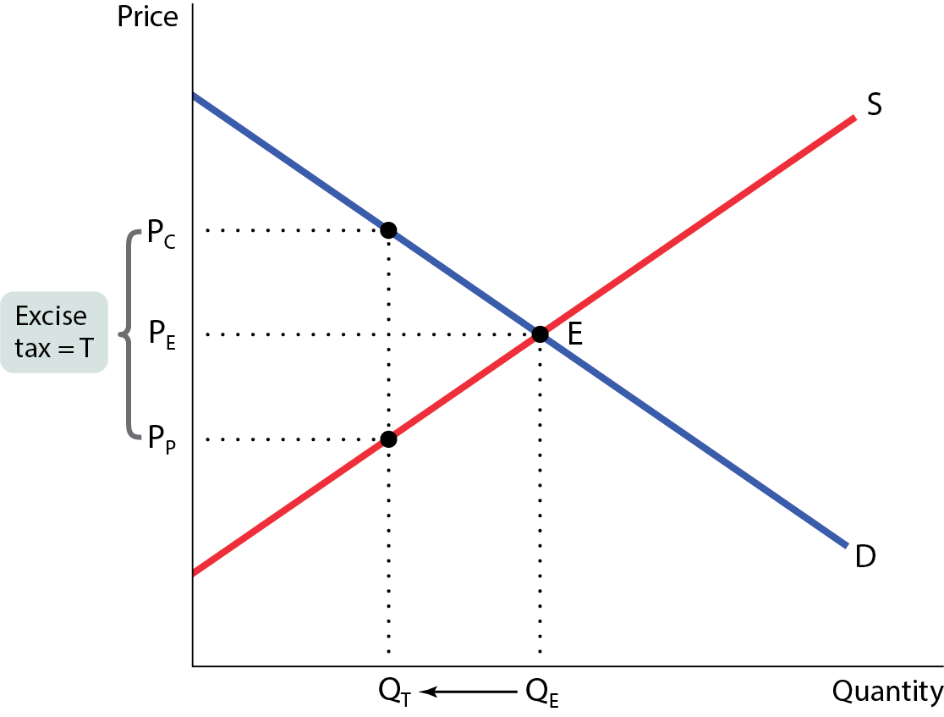
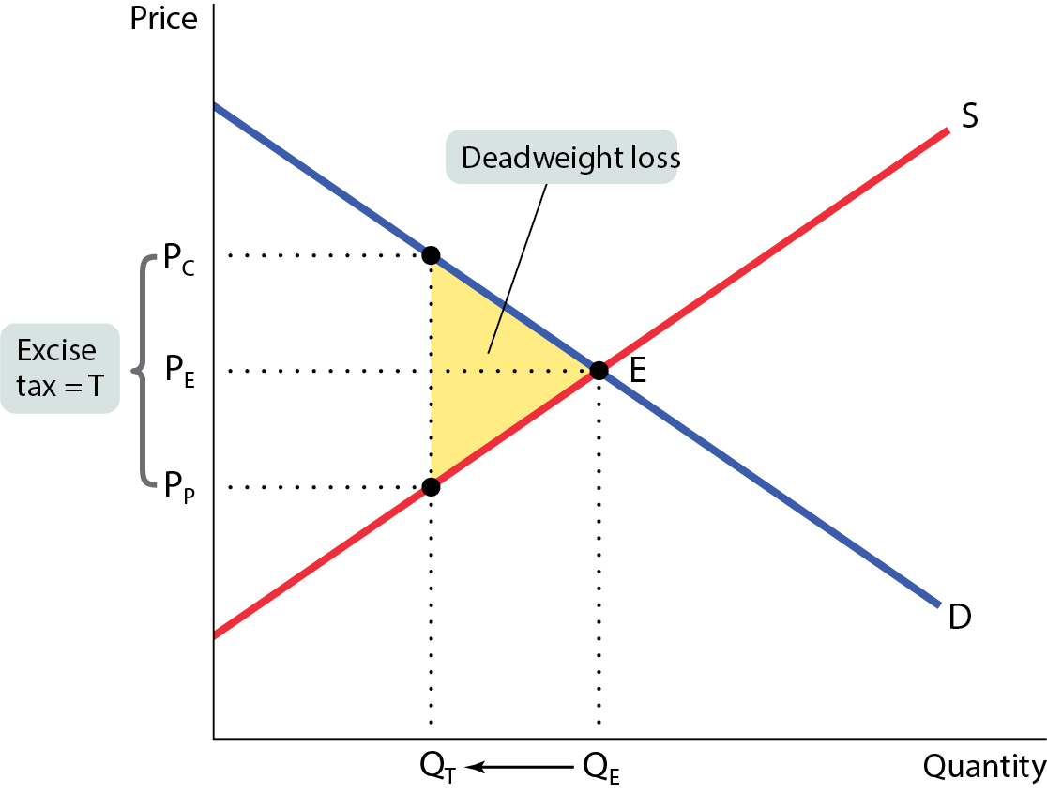
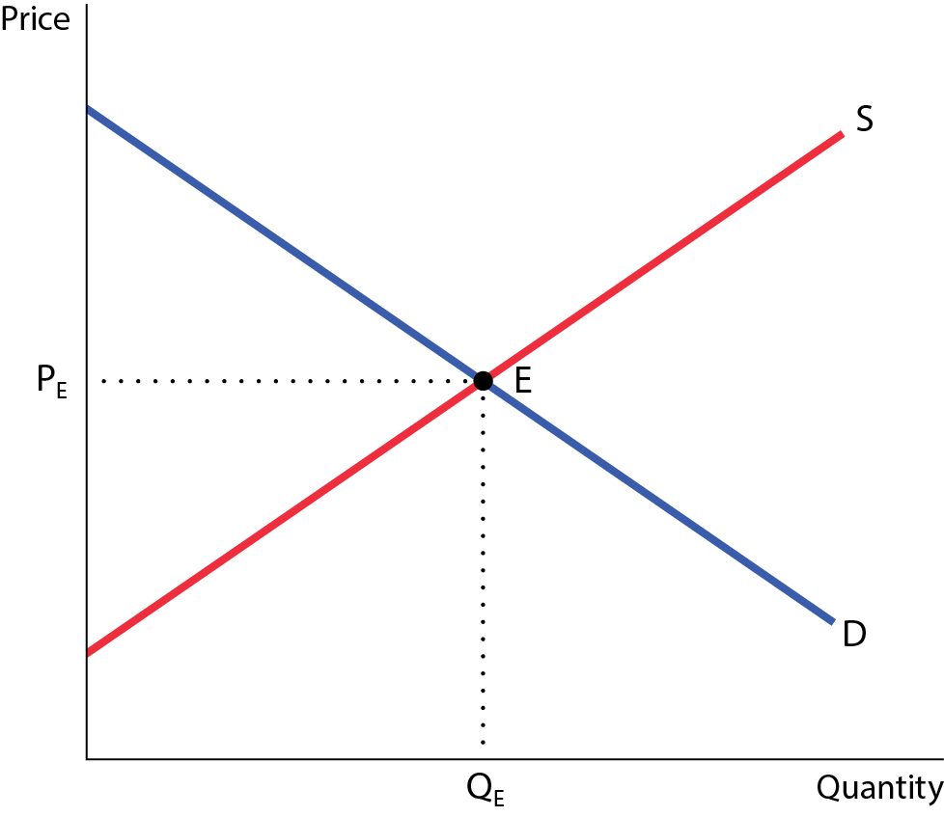


THE COSTS OF TAXATION (Chapter 7)
A tax generates revenue and creates a deadweight loss.
Figure 9
$$DWL: \frac{(60−44)×(80−64)}{2}=128$$
60
T=16
$$Tax Revenue:\left(60−44\right)×64=1,024$$
44
$$Loss in CS:2,000−1,280=720$$
$$Loss in PS:1,200−768=432$$
$$Total:720+432=1,152$$
64
80
$$Total Loss −Tax Revenue:1,152−1,024=128$$

Slide 23
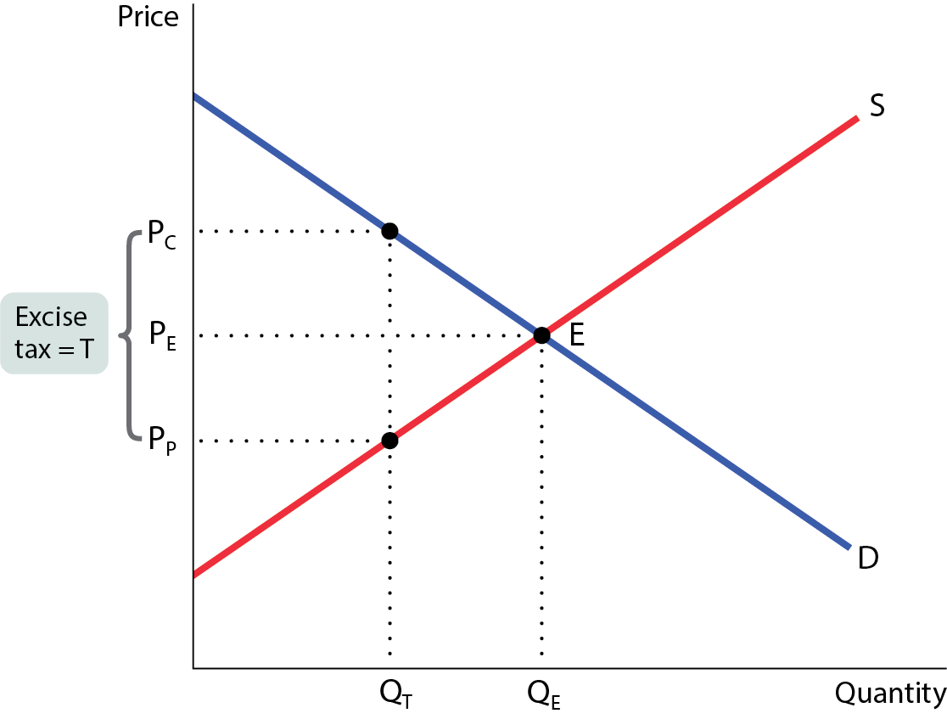
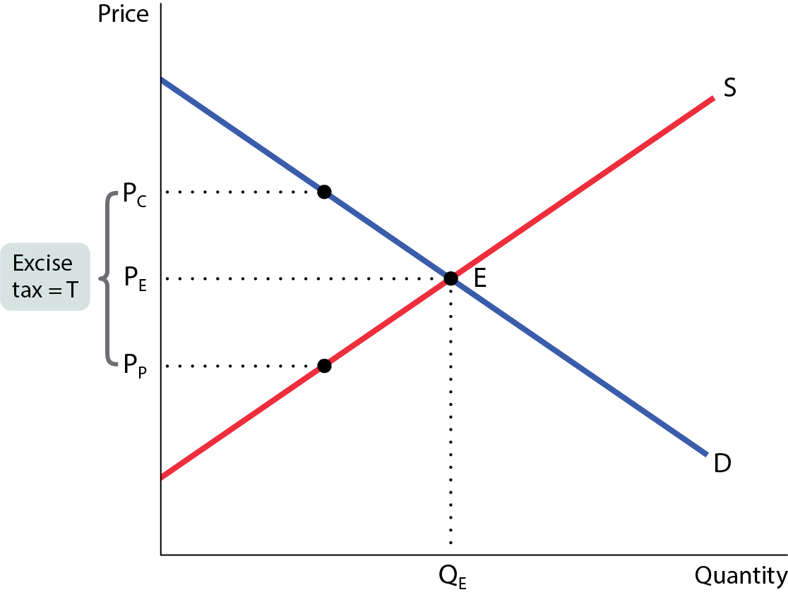

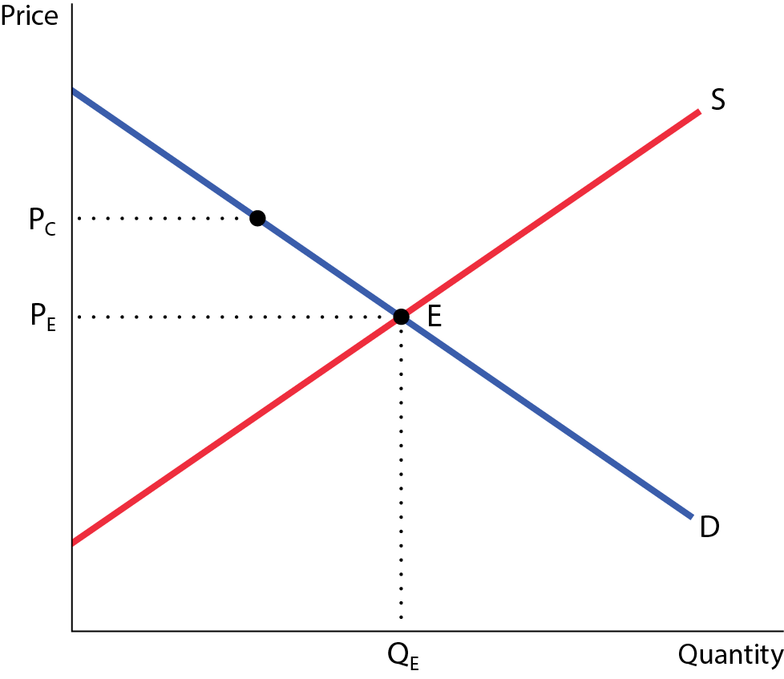
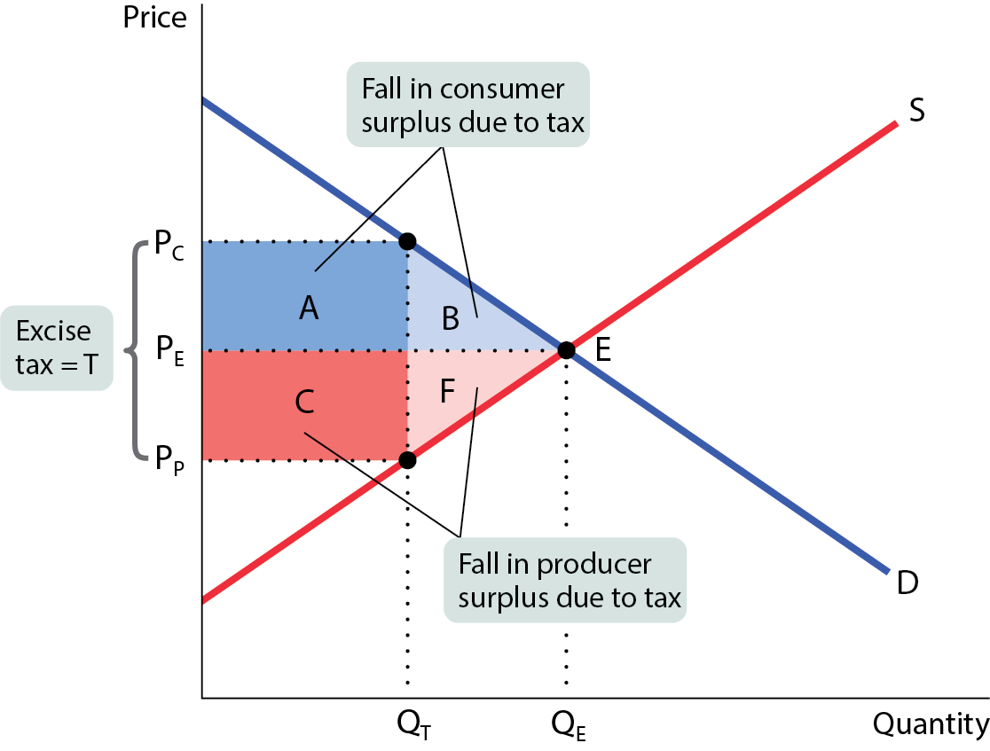
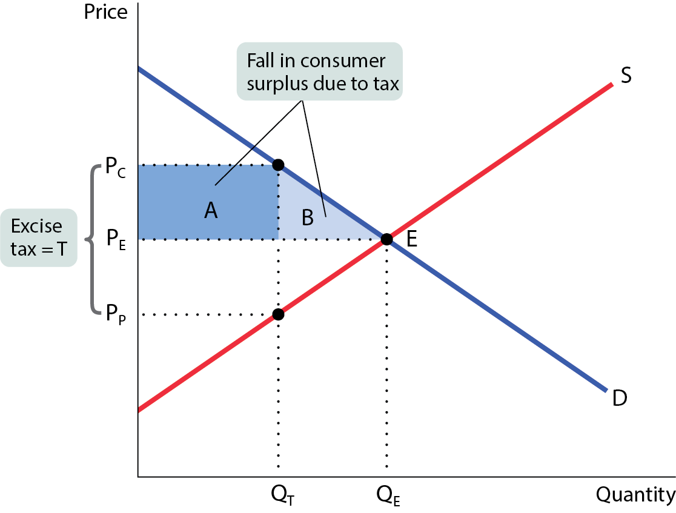
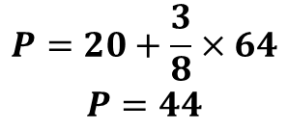
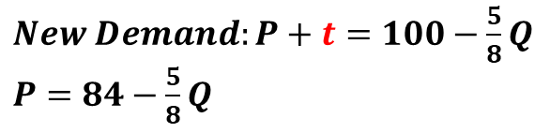
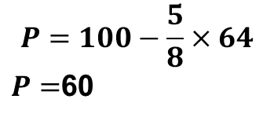
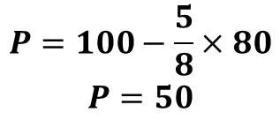
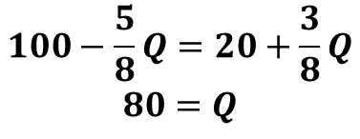
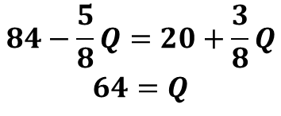
THE COSTS OF TAXATION
Consider that the demand is P=100-5/8Q and Supply is P=20+3/8Q. If a $16 per unit tax is imposed, what is the tax incidence on producers?
$$100−\frac{5}{8}Q=20+\frac{3}{8}Q$$
$$80=Q$$
$$P=100−\frac{5}{8}×80$$
$$P=50$$
$$Incidence on Producers=\left(50−44\right)=6$$
$New Demand:P+t=$ $100−\frac{5}{8}Q$
$P=$ $84−\frac{5}{8}Q$
100
60
$$84−\frac{5}{8}Q=20+\frac{3}{8}Q$$
$$64=Q$$
T=16
50
$$P=100−\frac{5}{8}×64$$
$P=$60
44
20
$$P=20+\frac{3}{8}×64$$
$$P=44$$
64
80

Slide 24
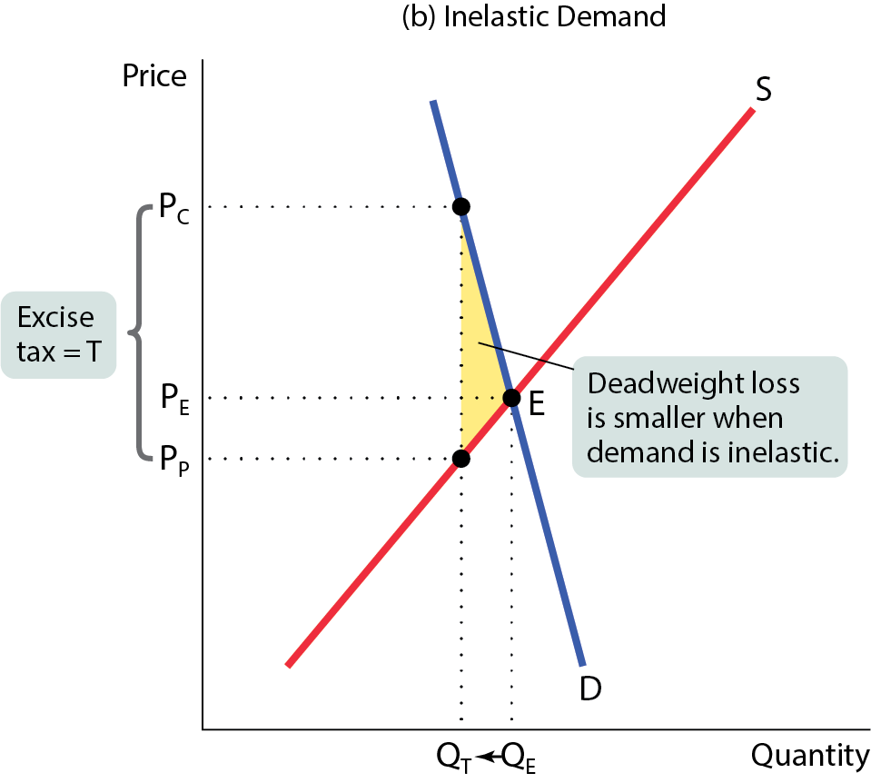
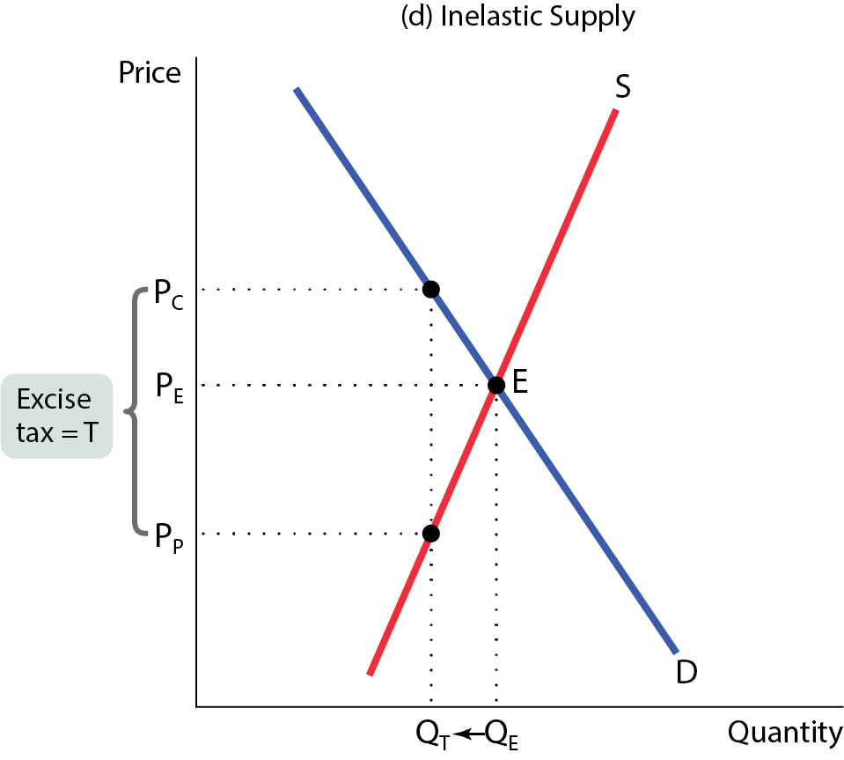
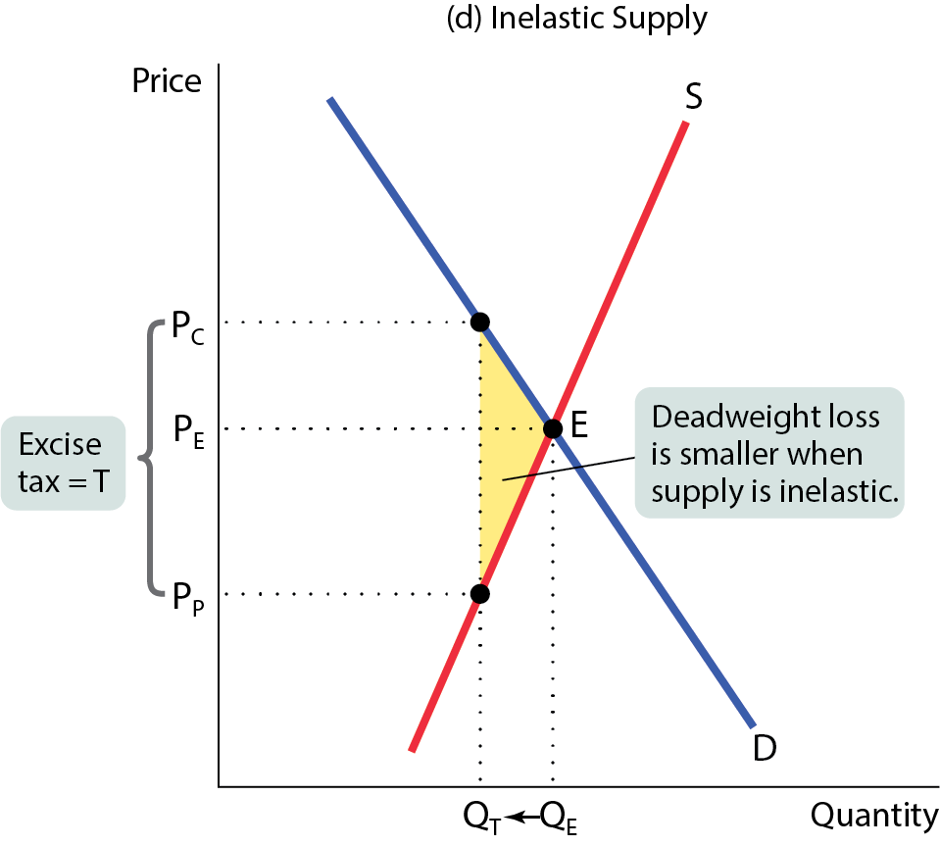
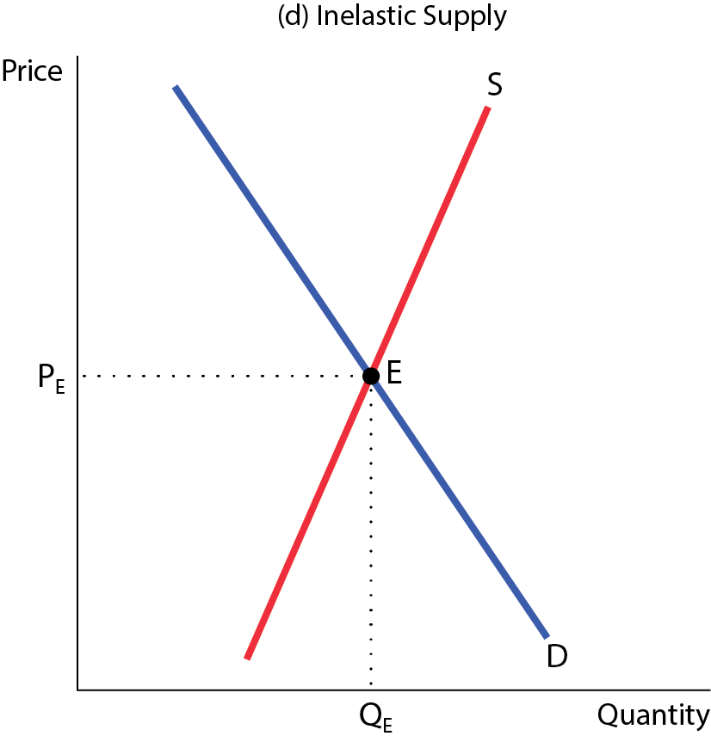
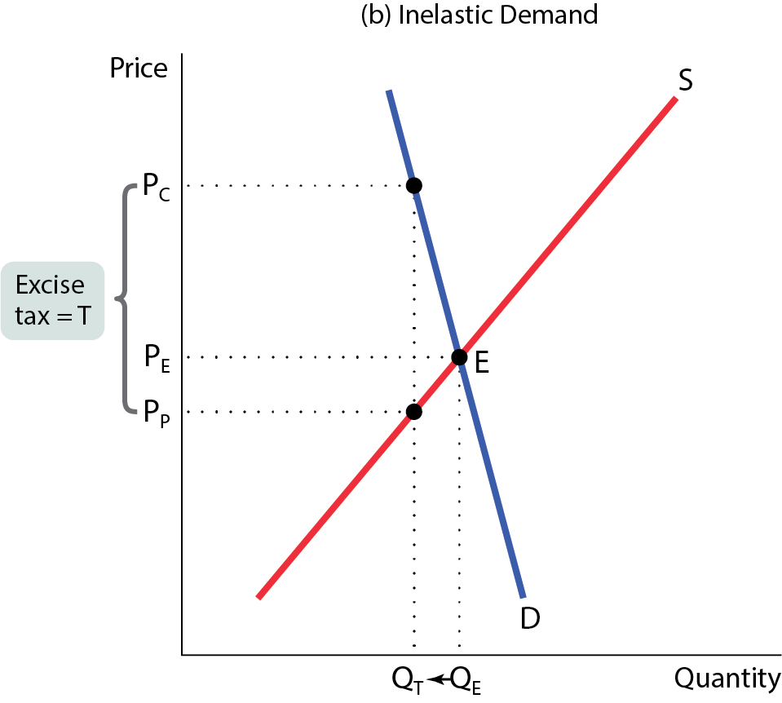
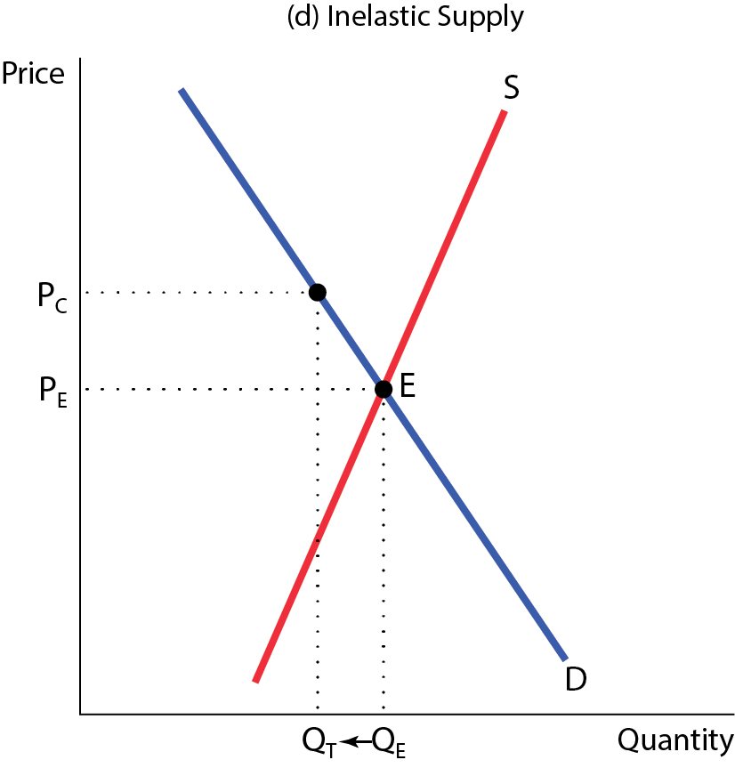


ELASTICITIES AND DEADWEIGHT LOSS
The lower the price elasticity of demand or supply, the smaller the tax-induced fall in the quantity transacted and the smaller the deadweight loss.
Figure 10 (b,d)

Slide 25

A mathematical expression for the deadweight loss caused by this excise tax is

Slide 26


UNDERSTANDING EXTERNALITIES
(Chapter 10)
An external cost is an uncompensated cost that an individual or firm imposes on others.
External benefits are benefits that individuals or firms confer on others without receiving compensation.

Slide 27




THE SOCIALLY OPTIMAL QUANTITY OF POLLUTION
Figure 1
The socially optimal quantity of pollution isn’t zero.
It’s Q_{OPT}, where the marginal social benefit and marginal social cost are equal.

Slide 28

THE SOCIALLY OPTIMAL QUANTITY OF POLLUTION
At 400: MSC is below than the MSB
At 400: We can produce more pollution

Slide 29

PRIVATE SOLUTIONS TO EXTERNALITY PROBLEMS
Can the private sector solve the problem of externalities without government intervention?
The Coase theorem: The economy can reach an efficient solution, even in the presence of externalities, if the costs of making a deal are sufficiently low.
Problem: transaction costs are often high, making negotiations difficult.

Slide 30

Emission Tax
Regulators have discovered that the optimal level of this pollutant is 1,000 tons of pollution each year. Suppose that regulators limit each firm's annual pollution to 500 tons each.
Adjust the Emissions Tax line on the graph to show the optimal corrective tax to reduce total emissions to 1,000 tons per year.
By how much will each firm reduce its emissions?
400 each =(900-500)
Under this tax, by how much will firm X reduce emissions, compared to the situation in which there are no regulations?
500=(900-400)

Slide 31
POSITIVE EXTERNALITIES
Sometimes a market includes benefits that bystanders receive.
External benefit: a benefit received by people other than the consumers or producers trading in the market.
Positive externalities are the mirror images of negative externalities.
Left on its own, the market will produce too little of a good that generates external benefits.
But society as a whole is better off when policies are adopted that increase the supply of such a good.

Slide 32

Public Goods and Common Resources
(Chapter 11)

Slide 33

PUBLIC GOODS
A public good is a good that is both nonexcludable and nonrival in consumption. Examples: disease prevention, defense, scientific research.
Because these goods are nonexcludable, they suffer from the free-rider problem, so no private firm would be willing to produce them.

Slide 34

Suppose that a small town wants to install street-lamps, which are nonrival in consumption and nonexcludable. Each of the 25 people in the town value them according to the given schedule. Each street-lamp costs $250 to install.
30x25=750
26x25=650
10x25=250
MB=MC
What is the socially optimal number?
6
Suppose that 20 of the 25 townspeople decide that they will not help pay for street lamps and instead enjoy (for free) the street lamps built by the other 5 people. What is the maximum number of street lamps that remaining five people will build?
0 Note that for the 1st unit MB=30x5=150<250=MC

Slide 35
Suppose that education was not financed by the state and that everyone had to pay for his or her own education from kindergarten through high school. One would expect that:
More or Less Education will be acquired?

Slide 36

COMMON RESOURCES
A common resource is nonexcludable and rival in consumption.
They tend to be overused if left to the market: individuals ignore the fact that their use depletes the amount of the resource remaining for others.
  When one person catches a fish, there are fewer fish available for everyone else.
  Each person has the incentive to fish before others.

Slide 37



A COMMON RESOURCE
Figure 4
In an unregulated market, the quantity of the common resource used, Q_{MKT}, exceeds the efficient quantity, Q_{OPT}.

Slide 38
THE EFFICIENT USE AND MAINTENANCE OF A COMMON RESOURCE (1 of 2)
Because common resources pose problems similar to those created by negative externalities, the solutions are also similar:
  Tax or regulate the use of the common resource.
  Create a system of tradable licenses for the right to use the common resource.
  Make it excludable and assign property rights to it.
Why property rights?
Because it allows property owners to exclude users and manage the resource more efficiently.

Slide 39
ARTIFICIALLY SCARCE GOODS
An artificially scarce good is a good that is excludable but nonrival in consumption.
The marginal cost of allowing one more person to consume the good is zero.
However, because it is excludable, sellers charge a positive price, which leads to inefficiently low consumption.

