Slide 1
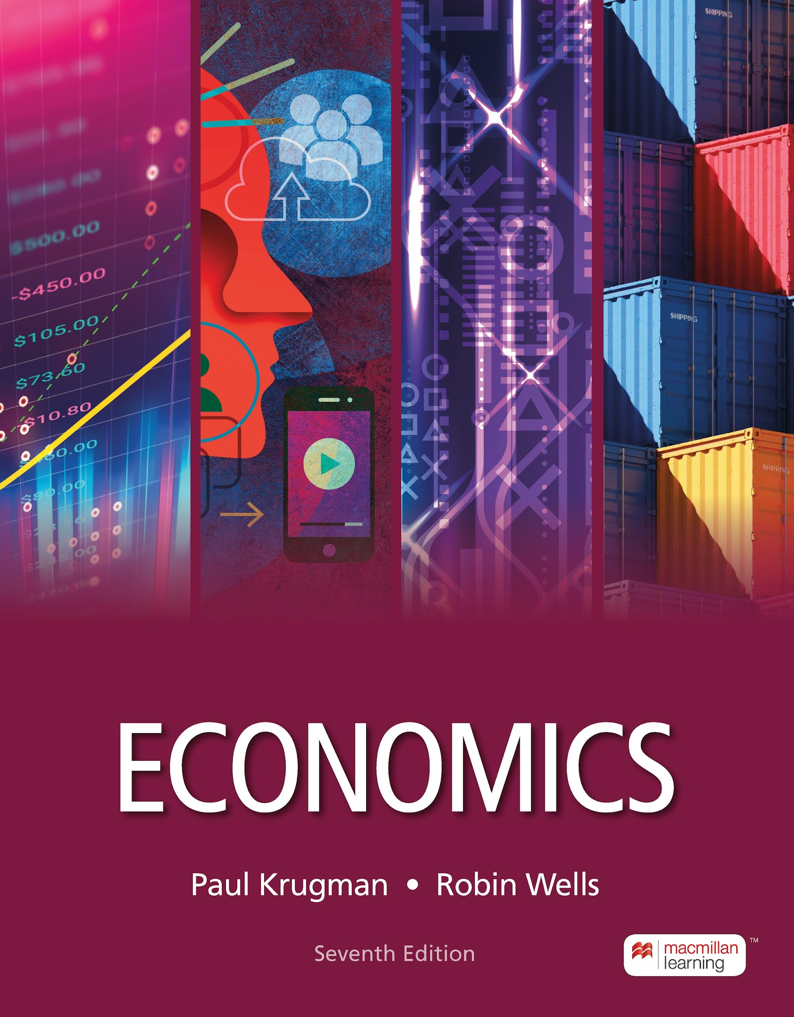
Decision Making
9
Notes:
Cover Credits: Currency Exchange Stock Chart: cemagraphics/Getty Images, Social Media Montage: SEAN GLADWELL/Getty Images, Circuit Pattern: somsak Tangdamrongsub/Getty Images, Cargo Containers: urzine/Getty Images

Slide 2
WHAT YOU WILL LEARN IN THIS CHAPTER
Why does good decision making depend on accurately defining costs and benefits?
What is the difference between explicit and implicit costs?
What is the difference between accounting profit and economic profit, and why is economic profit the correct basis for decisions?
What are the three types of economic decisions?
Why do people behave in irrational yet predictable ways sometimes?
Why are decisions involving time different, and how they should be made? (In this chapter’s appendix.)

Slide 3
COSTS, BENEFITS, AND PROFITS
Our decisions depend on comparing costs with benefits.
Recall opportunity cost:
Because resources are scarce, the true cost of anything is what you must give up to get it.
  Example: Whether you continue in school or leave to find a job, each choice has costs and benefits.
  Because your time is scarce, you cannot be a full-time student and a full-time worker. The opportunity cost of choosing to be a full-time student is the income you would’ve earned at a full-time job.

Slide 4
EXPLICIT VERSUS IMPLICIT COSTS
An explicit cost is a cost that requires an outlay of money (for example, an explicit cost of another year in school includes tuition).
An implicit cost does not require an outlay of money; it is measured by the value, in dollar terms, of benefits that are forgone (wages forgone because of being a full-time student).
Opportunity cost = Total explicit cost + Total implicit cost

Slide 5
ACCOUNTING VERSUS ECONOMIC PROFIT
Accounting profit = Revenue – Explicit cost
Economic profit = Revenue – Opportunity cost
          = Revenue – (Explicit cost + Implicit cost)
Economic profit:
  equals revenue minus the opportunity cost of all resources used.
  is less than accounting profit.
  shows a more complete picture of costs.
  helps businesses and individuals make better-informed decisions.
  is the measure economists use.

Slide 6
LEARN BY DOING: DISCUSSION QUESTION 1
In The Price of Motherhood, Ann Crittenden claims the total cost for a college-educated couple to have a child is $1 million. She discusses the following items as costs of an educated woman having a child. With a partner, classify these as explicit or implicit.
  Unearned Social Security credits
  Forgone promotions
  Salary lost by not working
  Expenses for baby’s room
  Loss of experience at work
  Depreciation of work skills
  Food and clothing for the child
  Loss of pension and 401(k) benefits
  Awards and kudos for excellence doing a paid job
  Babysitting fees
  Preschool expenses
  Earnings from paid work contributed by an employer to a retirement account
  Doctor visits & medical expenses
  Costs of decorating child’s room
  Lost training opportunities at work
Implicit
Implicit
Implicit
Explicit
Implicit
Implicit
Explicit

Slide 7
LEARN BY DOING: PRACTICE QUESTION 1
All of these are considered implicit costs, EXCEPT:
  paying rent on an existing building.
  interest that could have been earned from the savings account if the money were not used on the existing business.
  the wages the entrepreneur could have earned if they chose to pursue a career in corporate America.
  forgone entrepreneurial income.

Slide 8
LEARN BY DOING: PRACTICE QUESTION 1
(ANSWER)
All of these are considered implicit costs, EXCEPT:
  paying rent on an existing building. (correct answer)
  interest that could have been earned from the savings account if the money were not used on the existing business.
  the wages the entrepreneur could have earned if they chose to pursue a career in corporate America.
  forgone entrepreneurial income.

Slide 9
LEARN BY DOING: PRACTICE QUESTION 2
Sandy owns a firm with annual revenue of $1 million. Wages, rent, and other costs are $900,000. Suppose that instead of being an entrepreneur, Sandy could get a job with an annual salary of $250,000. Assume that a job would be as satisfying to Sandy as being an entrepreneur. Calculate Sandy’s economic profit.
  $100,000
  $50,000
  $0
  $150,000

Slide 10
LEARN BY DOING: PRACTICE QUESTION 2
(ANSWER)
Sandy owns a firm with annual revenue of $1 million. Wages, rent, and other costs are $900,000. Suppose that instead of being an entrepreneur, Sandy could get a job with an annual salary of $250,000. Assume that a job would be as satisfying to Sandy as being an entrepreneur. Calculate Sandy’s economic profit.
  $100,000
  $50,000
  $0
  $150,000 (correct answer)
Notes:
Answer is D

Slide 11
THE IMPLICIT COST OF CAPITAL
Capital is the total value of assets owned by an individual or firm—physical assets plus financial assets.
The implicit cost of capital is the opportunity cost of the use of one’s own capital; that is, the income earned if the capital had been employed in its next best alternative use (for example, forgone interest income).

Slide 12
“HOW MUCH” VERSUS “EITHER–OR” DECISIONS
There are two different types of decisions:
  A choice between two alternatives (“either–or”)
  A more complex choice that requires us to choose at the margin (“how much”)
“Should I go to college?
Should I take an extra class?”

Slide 13
Median Salaries from the U.S. Dept of Education’s College Score Card, Bachelor’s degrees
CAHNRS, WSU
  Economics $95,097
  Food Science & Technology $70,646
  Natural Resources Conservation $65,084
  Ag. Production & Tech $61,466
  Apparel & Textiles $57,364
  Human Development $48,017
  Animal Science $47,320
  Wildlife & Wetlands Science $45,453
Carson College of Business, WSU
  International Business $83,952
  Finance $82,433
  Marketing $82,094
  Mgt Information Systems (MIS) $81,392
  Entrepreneurship $77,036
  Business Administration $69,669
  Hospitality Business Mgt. $55,920
Univ. of Washington
  Economics $92,399
Salaries based on students 10 years after they started college, regardless of when they completed. Retrieved 8/22/2024.

Slide 14
MAKING “EITHER–OR” DECISIONS
Principle of “either–or” decision making
When faced with an “either–or” choice between two activities (all else equal), choose the one with the positive economic profit.
  Jenny faces an “either-or” decision: spend two years in graduate school to obtain a degree in pharmacology or start work.
  Job she is currently offered has a total lifetime earnings of $557,000.
  If she goes to school and works as a pharmacist two years later, her total lifetime earnings are $556,000.
  Going to work immediately gives Jenny an economic profit of $1,000.

Slide 15
PITFALLS PART 1
What if, instead of just two options, there are three or more? Does the principle of “either–or” decision making still apply?
Yes. Any choice between three or more options can always be boiled down to a series of choices between two alternatives.

Slide 16
MAKING “HOW MUCH” DECISIONS: THE ROLE OF MARGINAL ANALYSIS
“How much” is a decision at the margin.
Marginal analysis: comparing the benefit of doing a little bit more of something with the cost of doing little bit more of something—comparing marginal benefit with marginal cost.
Marginal cost of producing a good or service is the additional cost incurred by producing one more unit of that good or service.

Slide 17
MARGINAL COST (1 of 2)
The marginal cost curve shows how the cost of producing one more unit depends on the quantity that has already been produced.
Each product has a unique marginal cost. Some basic shapes:
Increasing marginal cost: Each additional unit costs more to produce than the previous one (for example, because of paying costly overtime wages).
Constant marginal cost: Each additional unit costs the same to produce as the previous one (in plant nurseries, for example, the cost of growing one more plant is the same regardless of how many plants have been produced).
Decreasing marginal cost: Each additional unit costs less to produce than the previous one (often due to learning effects in production when workers gain skills and experience).

Slide 18
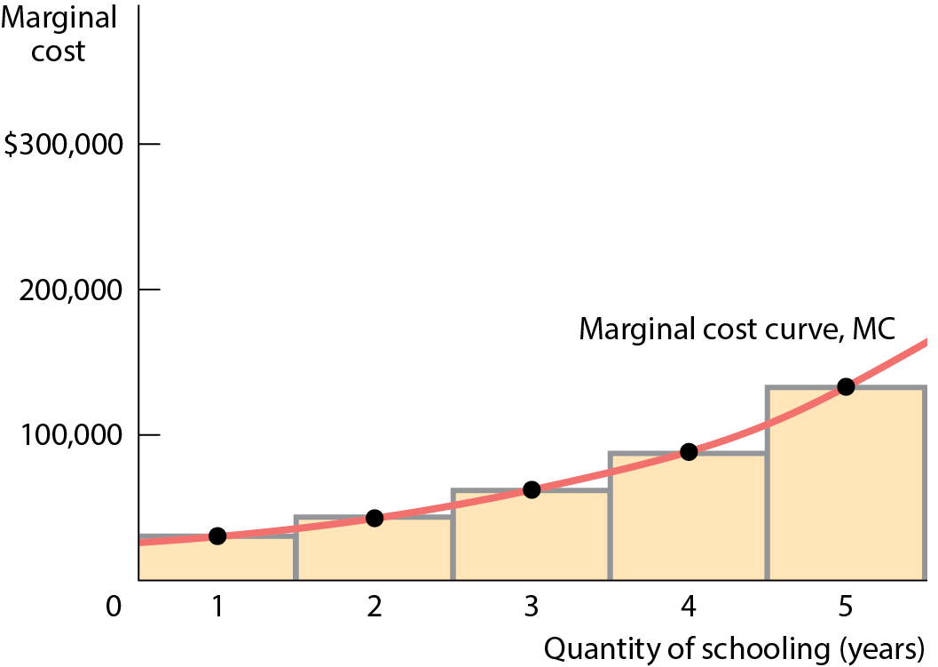
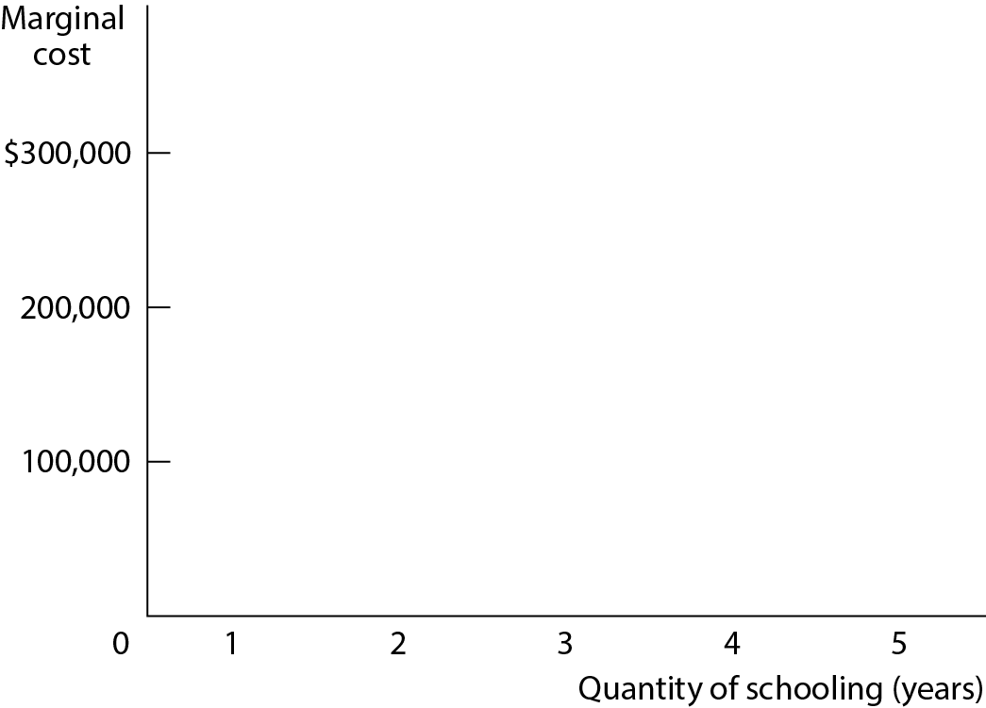
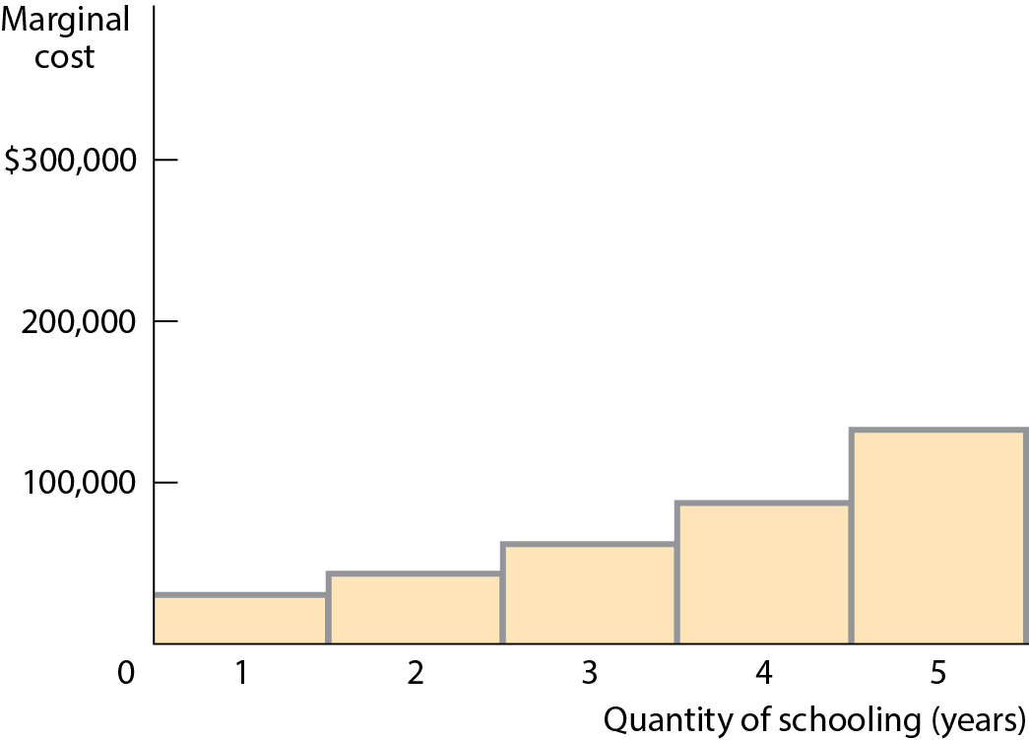
MARGINAL COST (2 of 2)
Each year of schooling costs more than the previous years. As a result, Alexa has increasing marginal cost and the marginal cost curve, the line connecting the midpoints at the top of each bar, is upward sloping.

Slide 19
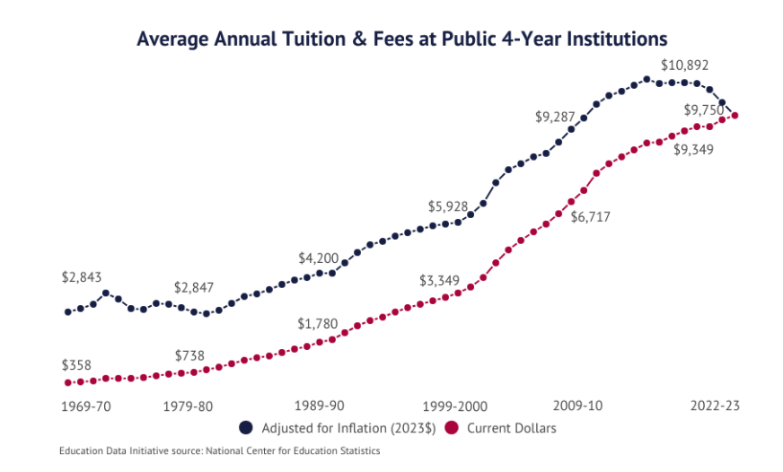

Slide 20
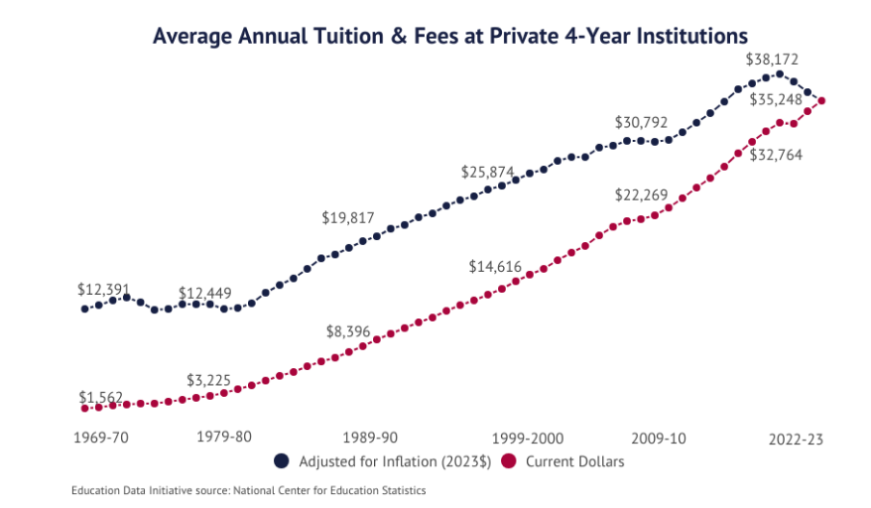

Slide 21
PITFALLS PART 2
Total Cost versus Marginal Cost
It can be easy to conclude that marginal cost and total cost must always move in the same direction.
But if the marginal cost of producing the first widget is $5, the second $4, and the third $3, total cost rises as marginal cost falls.

Slide 22
MARGINAL BENEFIT (1 of 2)
Marginal benefit: the additional benefit derived from producing one more unit of a good or service.
There is decreasing marginal benefit from an activity when each additional unit of the activity yields less benefit than the previous unit.
The marginal benefit curve shows how the benefit from producing one more unit depends on the quantity that has already been produced.

Slide 23
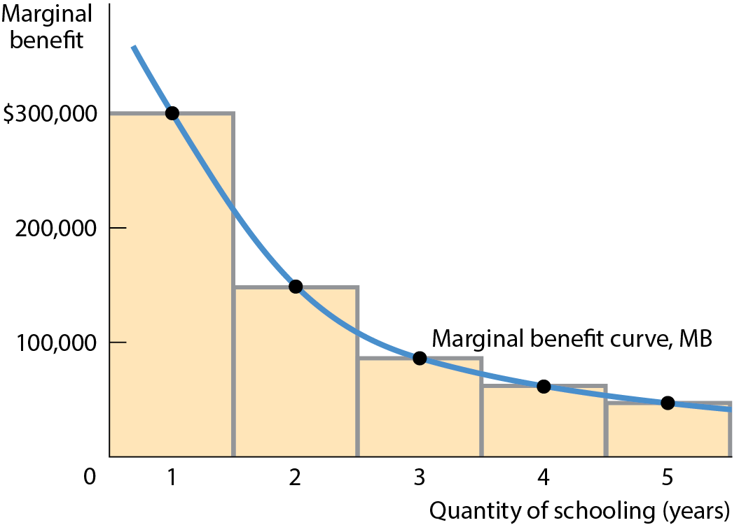
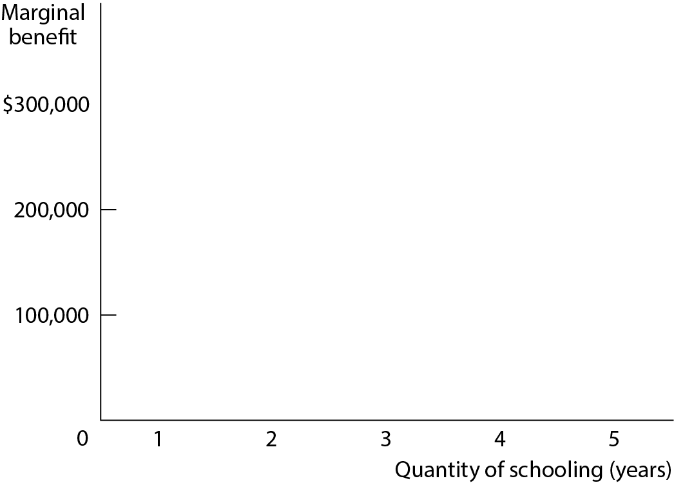
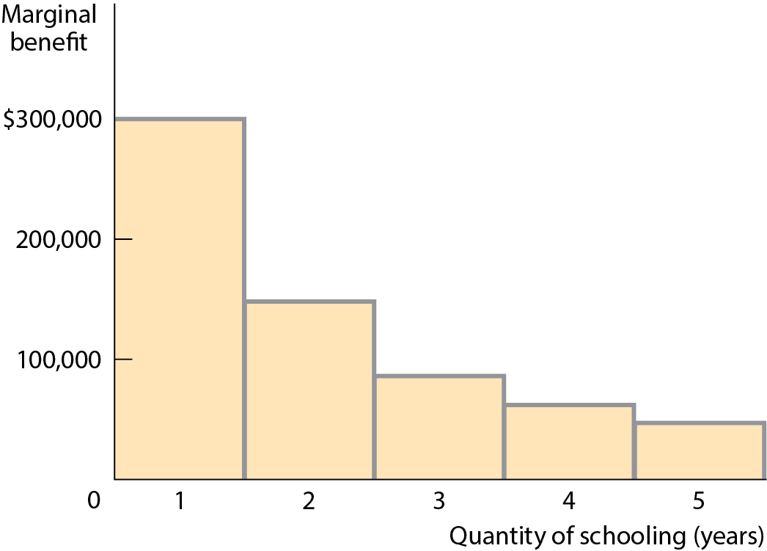
MARGINAL BENEFIT (2 of 2)
Each additional year of schooling has decreasing marginal benefit. As a result, Alexa’s marginal benefit curve, the curve connecting the midpoints at the top of each bar, is downward sloping.
Figure 2

Slide 24
MARGINAL ANALYSIS (1 of 2)
Optimal quantity: the quantity that generates the highest possible total profit.
Profit-maximizing principle of marginal analysis: the largest quantity at which the marginal benefit is greater than or equal to marginal cost.

Slide 25
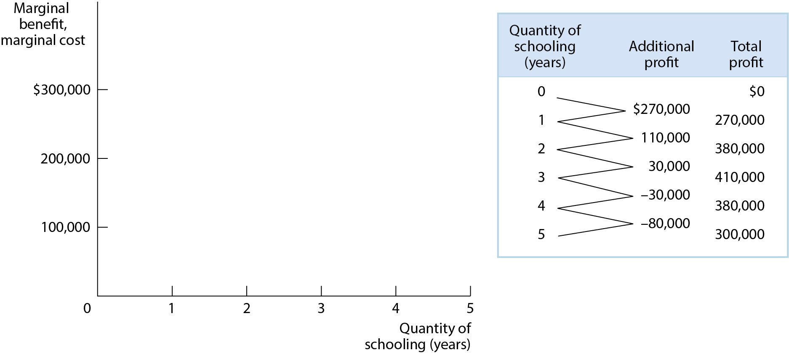
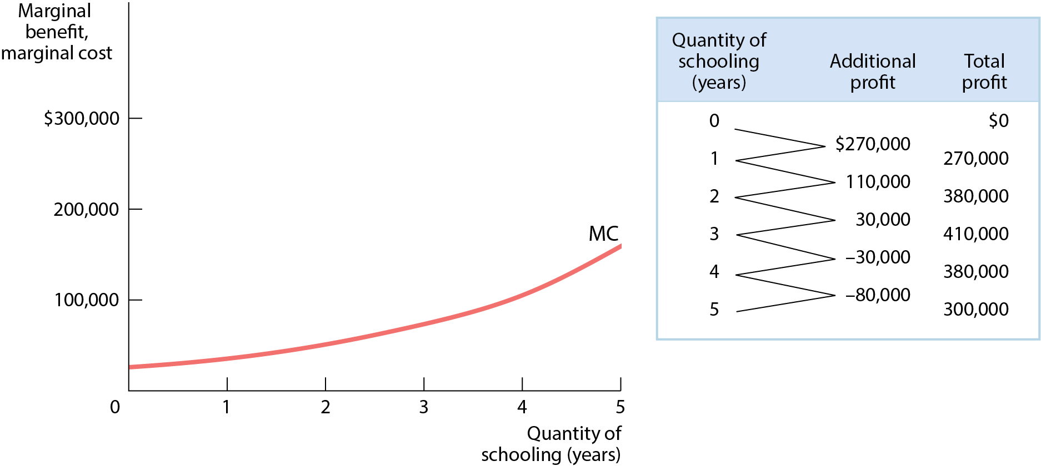
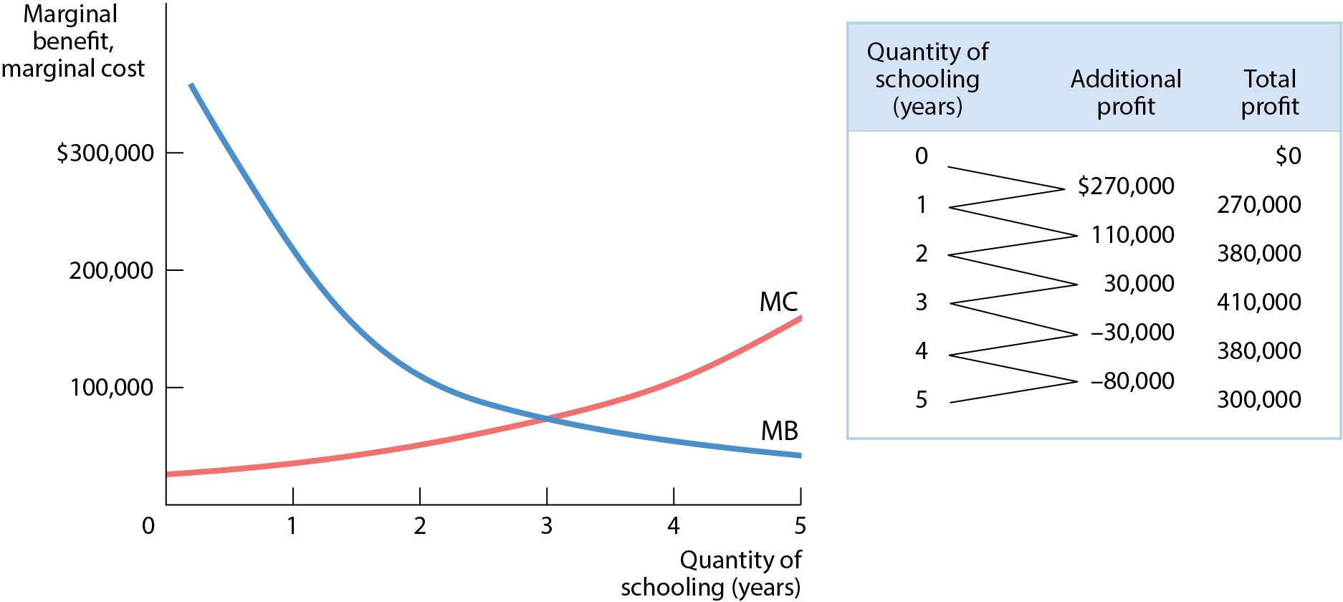
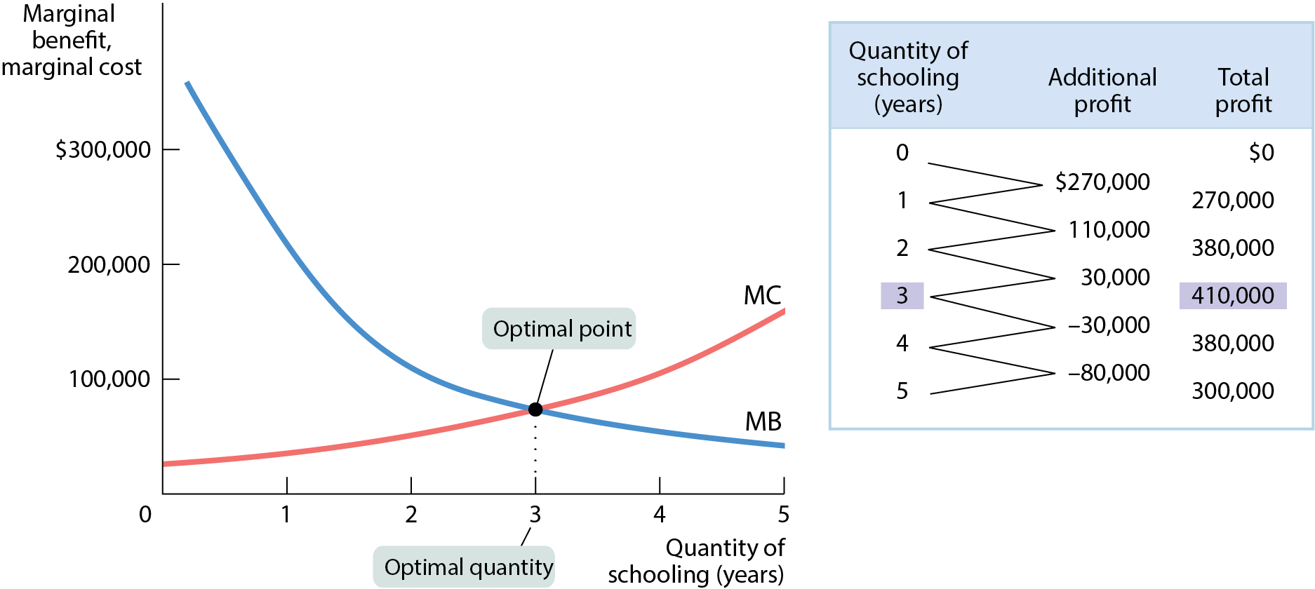
MARGINAL ANALYSIS (2 of 2)
The quantity at which the marginal benefit and marginal cost curves intersect leads to the maximum total profit of $410,000.
Figure 3

Slide 26
LEARN BY DOING: DISCUSSION QUESTION 2
Estimate how long you plan to spend studying for the next economics exam. Write your estimate in your notes in a visible place.
Now share your number with a partner and discuss why your estimates may be different.

Slide 27
PITFALLS PART 3
Aren’t we trying to maximize the difference between benefits and costs?
Yes.
What we are doing here is setting marginal (not total) benefit and cost equal to each other.
Only when marginal benefit and marginal cost are equal, the difference between total benefit and total cost is at maximum.

Slide 28
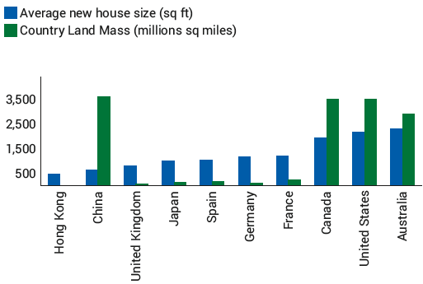
HOUSE SIZES AROUND THE WORLD
Larger homes can be explained by the lower average prices for land in some countries—but also by relative income.

Slide 29
SUNK COSTS
Sunk cost: a cost that has already been incurred and is not recoverable.
    A sunk cost should be ignored in decisions about future actions (but this is sometimes hard to do).
    If you lose your concert tickets, the $80 you’ve already spent on them is irrelevant to the decision whether to replace them—it is a sunk cost.

Slide 30
BEHAVIORAL ECONOMICS
We assume humans are mostly rational.
A rational decision maker always chooses the available option that leads to the outcome they most prefer.
Are there limits to human rationality?

Slide 31
RATIONAL, BUT HUMAN, TOO
Four reasons people might rationally choose a worse payoff:
  Concerns about fairness: Providing for others sometimes trumps self-interest.
  2. Nonmonetary rewards: Experiences that feel good such as travel, quality time spent with family and friends, playing a sport, etc.
  3. Bounded rationality: Making a choice that is close to but not exactly the one that gives you the best payoff—the “good enough” method of decision making. Choosing the best option requires mental effort, and if it’s too costly, it might make sense to choose a “good enough” option.
  4. Risk aversion: Willingness to sacrifice some economic payoff to avoid a potential loss. Because risk makes most people uncomfortable, they give up some potential gain to avoid risk.

Slide 32
IRRATIONALITY: AN ECONOMIST’S VIEW
An irrational decision maker chooses an option that leaves them worse off than choosing another available option that would have left them better off.

Slide 33
DECISION-MAKING MISTAKES
There are seven common mistakes in economic decision making:
Misperceptions of opportunity costs
Overconfidence
Unrealistic expectations
Counting dollars unequally
Loss aversion
Framing bias
Fear of missing out (FOMO)
Status quo bias

Slide 34
EIGHT COMMON MISTAKES IN DECISION MAKING PART 1
Misperceptions of opportunity costs
  People tend to ignore opportunity costs when they are nonmonetary.
  Another misconception is the sunk cost fallacy (believing that a sunk cost is an opportunity cost).

Slide 35
EIGHT COMMON MISTAKES IN DECISION MAKING PART 2
Overconfidence
  We tend to think that we know more than we actually do:
  Students often underestimate the time it takes to complete their thesis
  People often believe that they are in better financial health than they actually are.
  Nonprofessional investors who engage in speculative investing have significantly worse results than professional brokers because of their misguided faith in their ability to spot a winner.

Slide 36
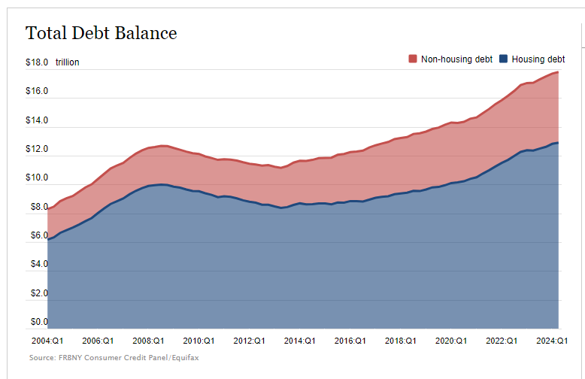
EIGHT COMMON MISTAKES IN DECISION MAKING PART 2

Slide 37
EIGHT COMMON MISTAKES IN DECISION MAKING PART 3
Unrealistic expectations about future behavior
  Most of us are overly optimistic about our future behavior and level of discipline.
  We tend to overestimate the likelihood that good things will happen to us and underestimate the likelihood of bad things. Scientists call this optimism bias, and it’s one of our most pervasive cognitive illusions.

Slide 38
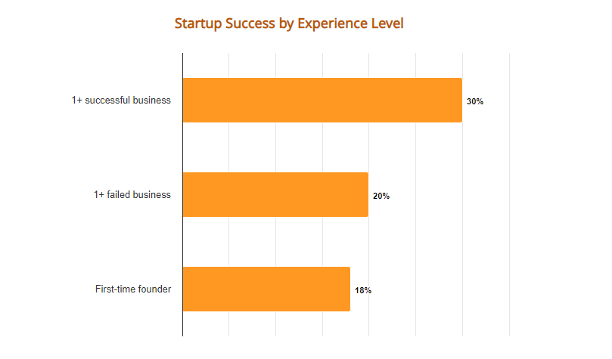
In the United States, more than 80% of startups fail in their first year, with a success rate of 20%

Slide 39
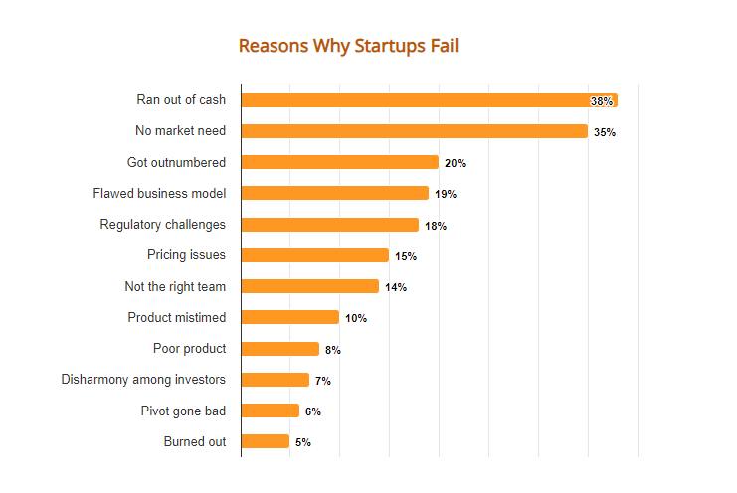
In the United States, more than 80% of startups fail in their first year, with a success rate of 20%

Slide 40
EIGHT COMMON MISTAKES IN DECISION MAKING PART 4
Counting dollars unequally
  Mental accounting: the habit of mentally assigning dollars to different accounts so that some dollars are worth more than others (for example, spending more with credit cards than cash).

Slide 41
LEARN BY DOING: PRACTICE QUESTION 3
Remember those concert tickets?
If you lost your $80 concert tickets, would you replace them?
  Yes
  No

Slide 42
LEARN BY DOING: PRACTICE QUESTION 4
Now consider an alternative:
If you lost $80 cash that you were going to use for the concert tickets, would you still attend the concert?
  Yes
  No
Was your answer different from the first scenario? Then you have been using different mental accounts.

Slide 43
EIGHT COMMON MISTAKES IN DECISION MAKING PART 5
Loss aversion: an oversensitivity to loss that leads to an unwillingness to recognize a loss and move on.
Many investors are reluctant to admit that they have lost money on a stock.
Most people feel the misery of losing $100 twice as much as they feel the pleasure of gaining $100.

Slide 44
EIGHT COMMON MISTAKES IN DECISION MAKING PART 6
Framing bias: the tendency to make a decision based on how the choices are presented.
Shoppers perceive $0.99 as more attractive than $1.
Shoppers will more likely buy a medicine if it’s “effective in 75% cases” than if it’s “ineffective in 25% cases,” although both statements are equally true.
Shoppers buy more when prices are perceived to be low for a limited amount of time (Labor Day sales, for example).

Slide 45
EIGHT COMMON MISTAKES IN DECISION MAKING PART 7
Fear of missing out (FOMO): the tendency to invest in an asset based on past performance arising from the fear that one is a “loser” if one doesn’t make a big profit like earlier investors.
  Ever felt a wave of envy directed at those who bought Bitcoin back in 2010, when the value of a single Bitcoin went from a fraction of a penny to 9 cents?
  Many early Bitcoin buyers are now millionaires.
  But, for those of us who didn’t buy Bitcoin early on buying it now based on past performance is a type of irrational behavior.
  Responsible investment advisors warn “past performance is no guarantee of future results.”

Slide 46
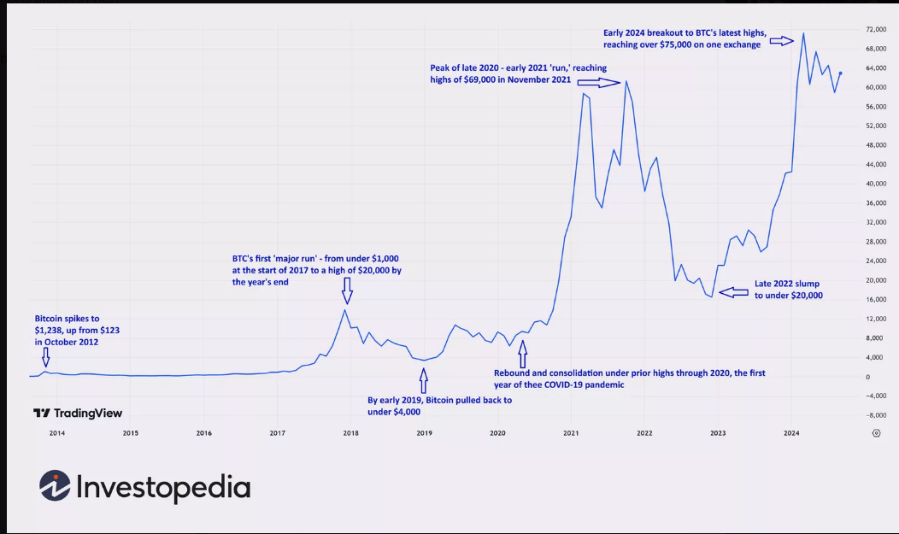
Bitcoin's Price History

Slide 47
EIGHT COMMON MISTAKES IN DECISION MAKING PART 8
Status quo bias: the tendency to avoid making a decision altogether.
  When companies have an automatic enrollment in a 401(k) program, with an opt-out option, employees tend to not opt-out and rather go with the status quo.

Slide 48
RATIONAL MODELS FOR IRRATIONAL PEOPLE?
Why do economists still use models based on rational behavior when people are at times irrational?
Rational models still provide robust predictions about how people behave. For example, we buy less when prices rise, which is rational behavior.
Market forces compel people to behave more rationally over time. When people are disciplined for their mistakes, rationality will win out over time.
It makes modeling simpler. Remember that models are built on generalizations, and it’s much harder to extrapolate from messy, irrational behavior.

Slide 49
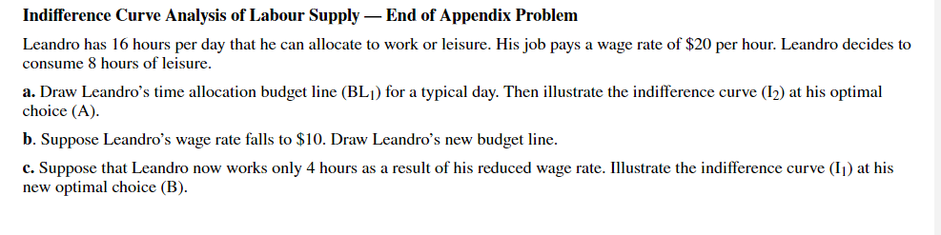
Homework 7

Slide 50
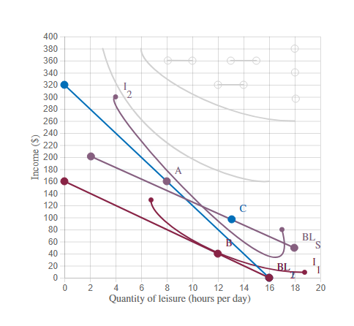
Homework 7
A to C: Substitution Effect
C to B: Income effect Effect
Substitution Effect is Stronger

