Slide 1
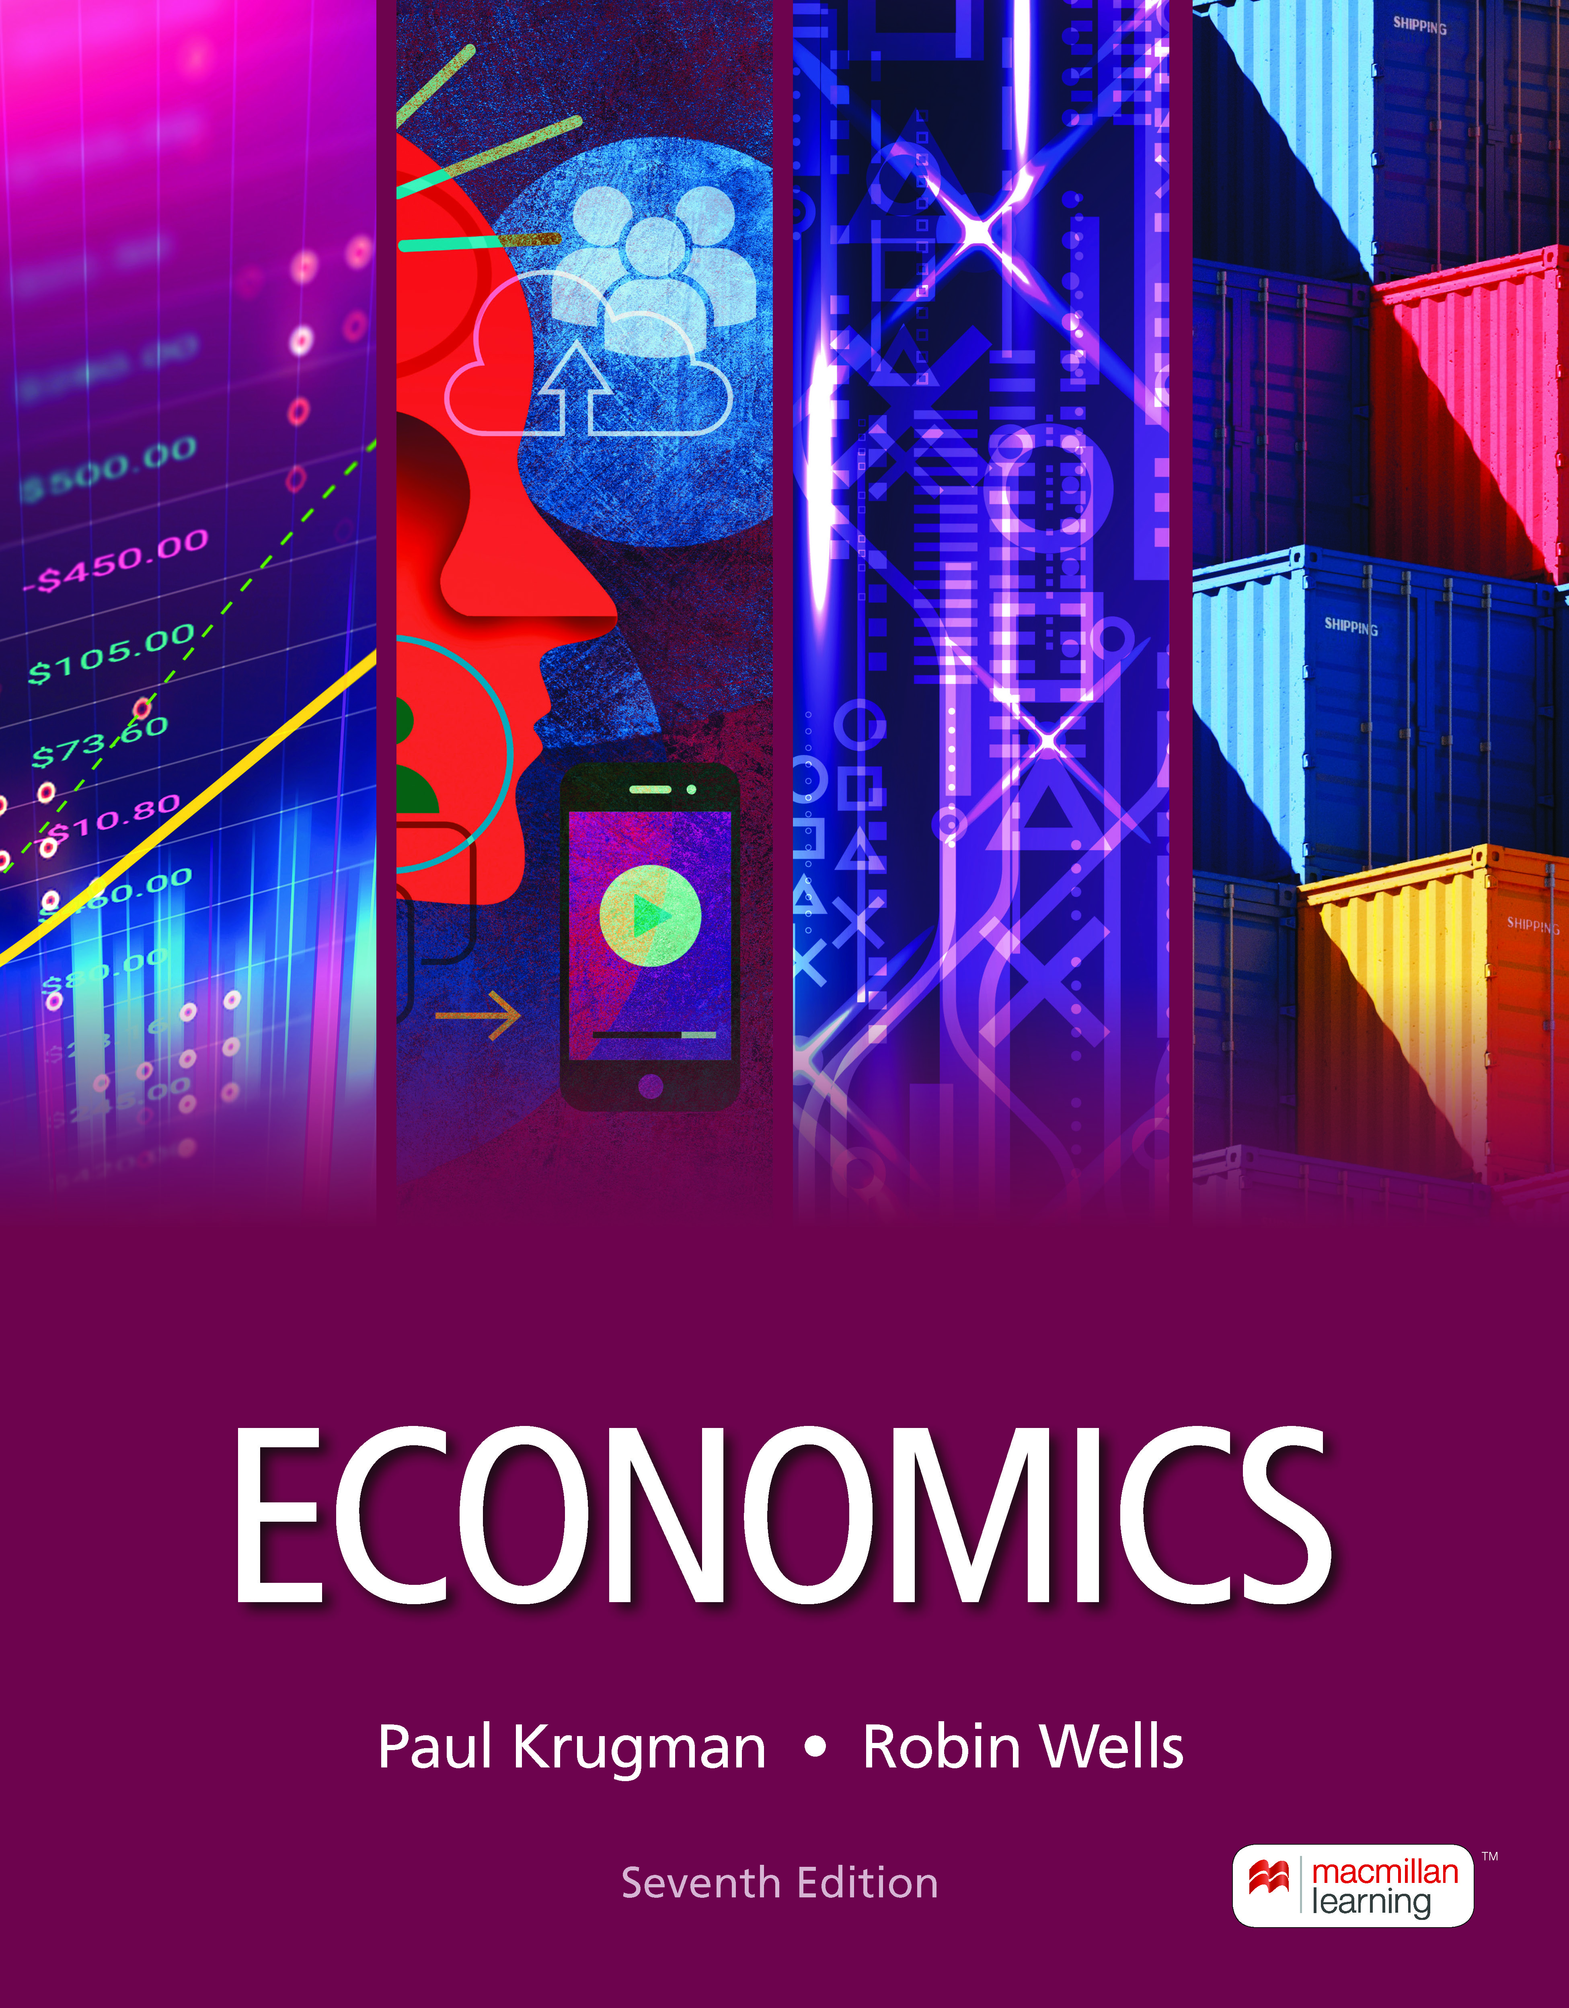
Taxes
7
Notes:
Cover Credits: Currency Exchange Stock Chart: cemagraphics/Getty Images, Social Media Montage: SEAN GLADWELL/Getty Images, Circuit Pattern: somsak Tangdamrongsub/Getty Images, Cargo Containers: urzine/Getty Images

Slide 2
What is next..
Homework #6 (Chapter 6 – Elasticity) is due tomorrow Wednesday October 2nd
Quiz #3 (Chapters 5 and 6) is due on Tuesday October 8th.

Slide 3
WHAT YOU WILL LEARN IN THIS CHAPTER
How do taxes affect supply and demand?
What factors determine who bears the burden of a tax?
What are the costs and benefits of a tax, and why is the cost greater than the tax revenue generated?
What is the difference between progressive and regressive taxes?
Why is there a trade-off between equity and efficiency in the design of a tax system?
How is the U.S. tax system structured?

Slide 4
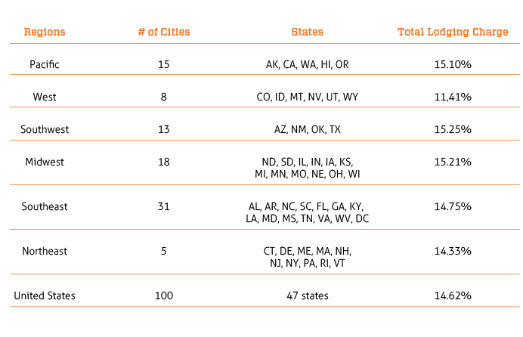
No matter where you stay overnight in a short-term rental in America, you will likely pay some form of lodging tax
Lodging tax charged and is made up of a combination of a 6% state tax, a 7% county tax, a 2% city tax, and a 2% tax by the body that oversees sports venues.

Slide 5
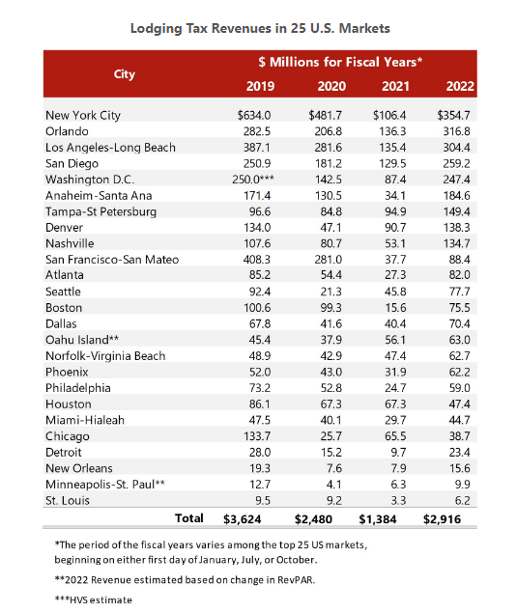
HVS | 2023 HVS Lodging Tax Report - USA

Slide 6
Tourist taxes in Europe
France: The rates range from €0.65 to €8,13 per person, per night. An additional tax can also be added by the counties and regions. From 1 January 2024, the tourist tax in Paris will be 5,20€ per person per night when staying at a 3-star hotel, and 8,13€ per night per person when staying at a 4-star hotel.
England: Manchester is the first and only British city to charge a £1 tourist tax to visitors staying in the city-centre hotels or rental apartments.
Ireland: There are currently no tourist taxes in Ireland.
Netherlands: there is a tourist tax of €3 per person per night payable locally.
Italy: the amount of the tourist tax depends on the city. In Rome, you will be charged between €3 - €7 per person, per night. In other cities, the rates vary from €2 to €5.

Slide 7
THE EFFECT OF AN EXCISE TAX ON QUANTITIES AND PRICES
Taxes drive a wedge between the price buyers pay and the price sellers receive.
To analyze the effects, we’ll graph two scenarios:
    when the tax is levied on sellers
    when the tax is levied on buyers
The incidence of a tax is a measure of who really pays it.

Slide 8
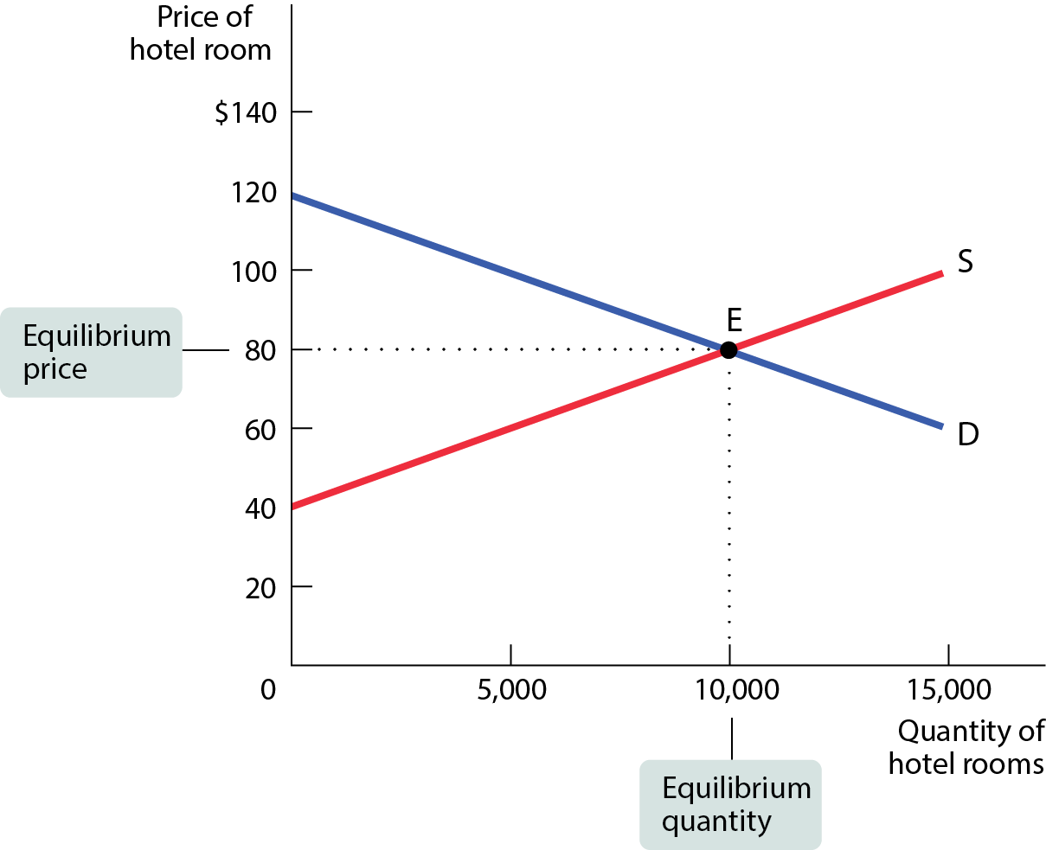
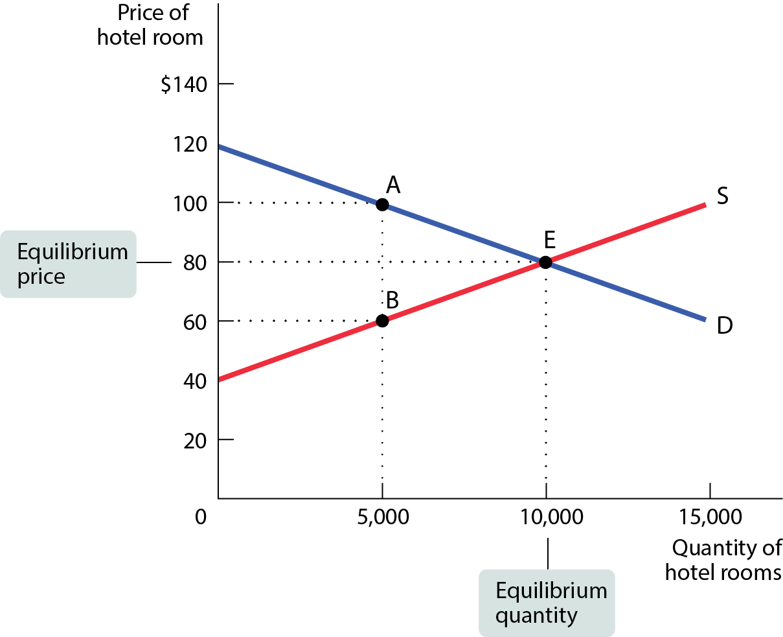
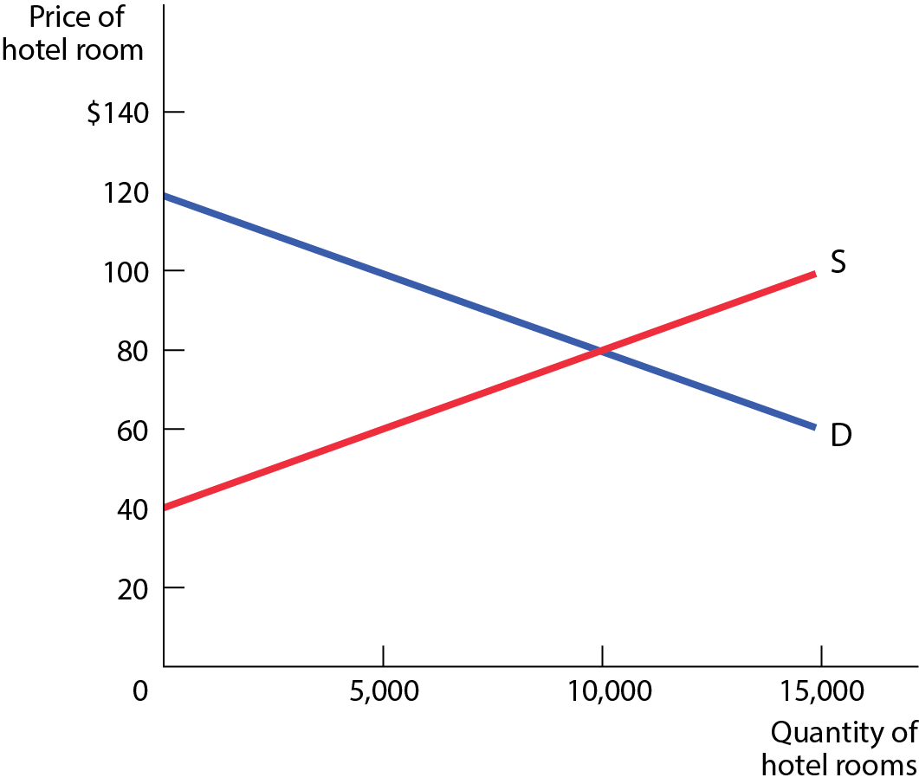
THE SUPPLY AND DEMAND FOR HOTEL ROOMS IN POTTERVILLE
Figure 1

Slide 9
AN EXCISE TAX IMPOSED ON HOTEL OWNERS (1 of 2)
The $40 excise tax (a tax charged on each unit sold) is shared between buyers and sellers.
The equilibrium price of hotel rooms rises to $100 a night.
Hotel guests bear some of the burden as price RISES from $80 to $100.
Hotel owners also bear some of the burden as their price (net of the tax paid) FALLS from $80 to $60.

Slide 10
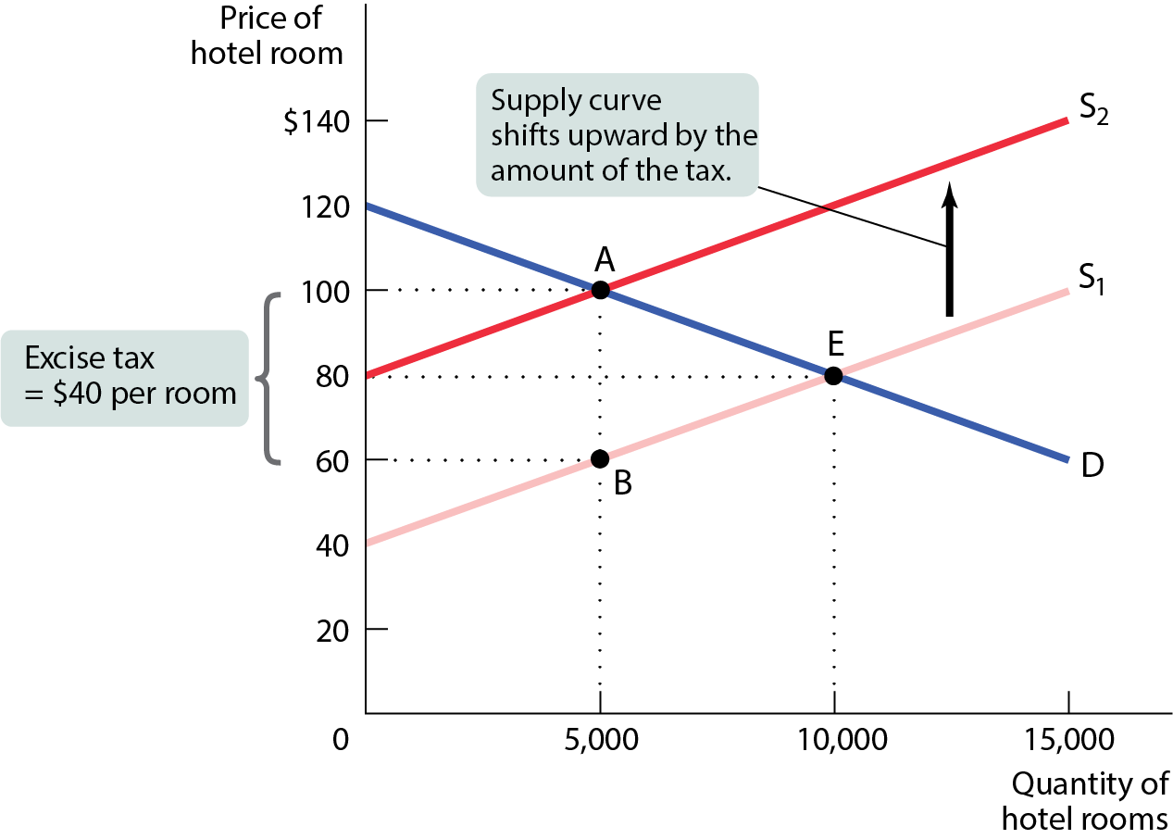
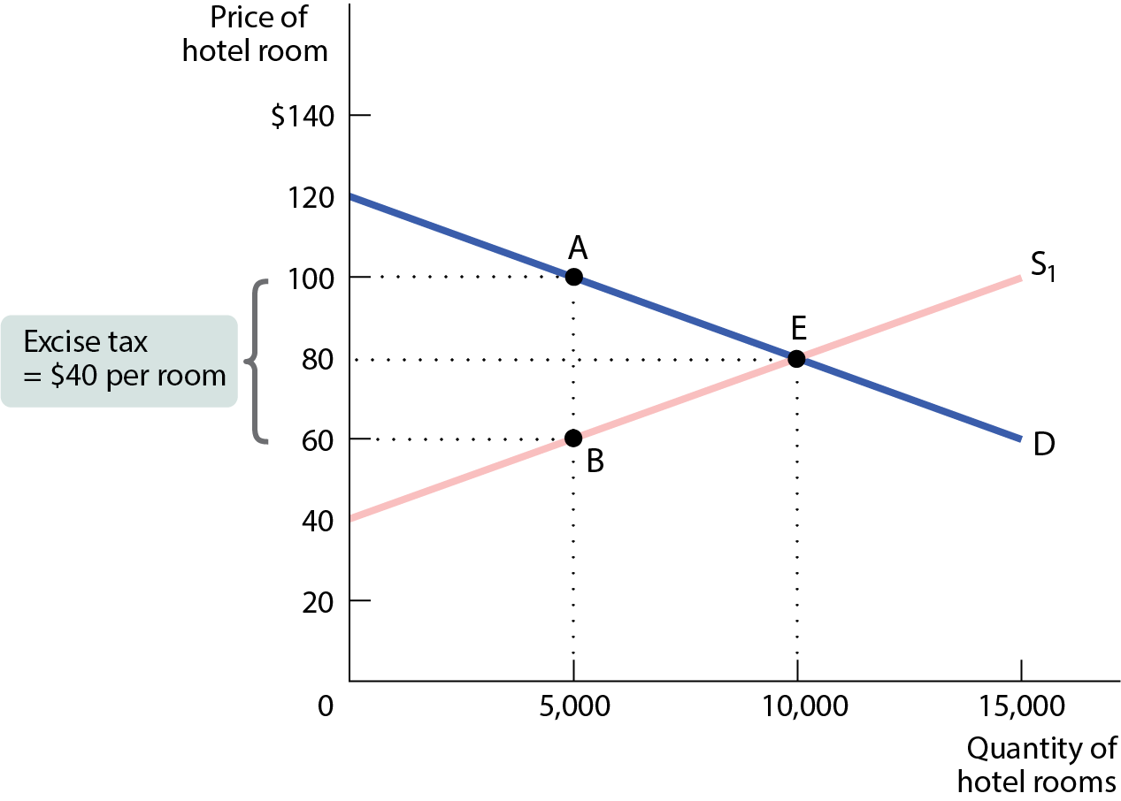
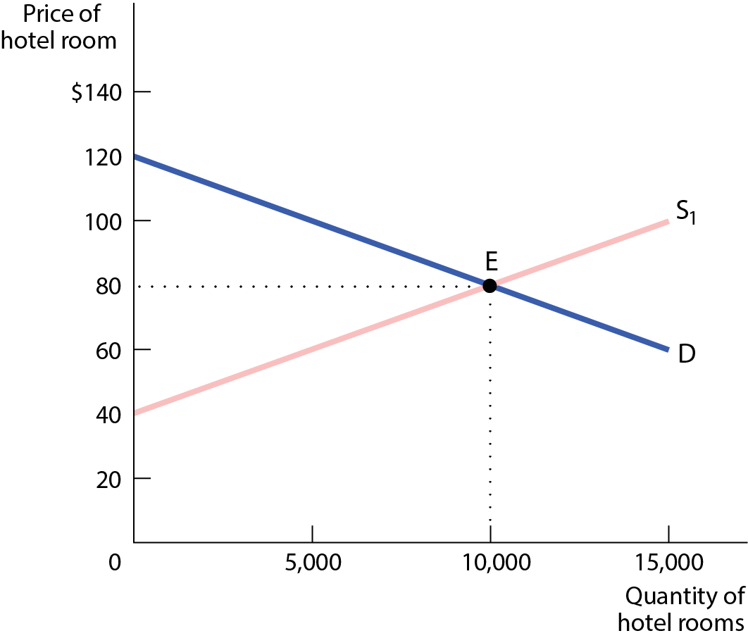
AN EXCISE TAX IMPOSED ON HOTEL OWNERS (2 of 2)
Figure 2

Slide 11
AN EXCISE TAX IMPOSED ON HOTEL GUESTS (1 of 2)
The $40 excise tax is shared between buyers and sellers.
The equilibrium price of hotel rooms falls to $60 a night.
Hotel guests bear some of the burden as price paid by the guests (price plus tax) RISES from $80 to $100.
Hotel owners also bear some of the burden as their price FALLS from $80 to $60.

Slide 12
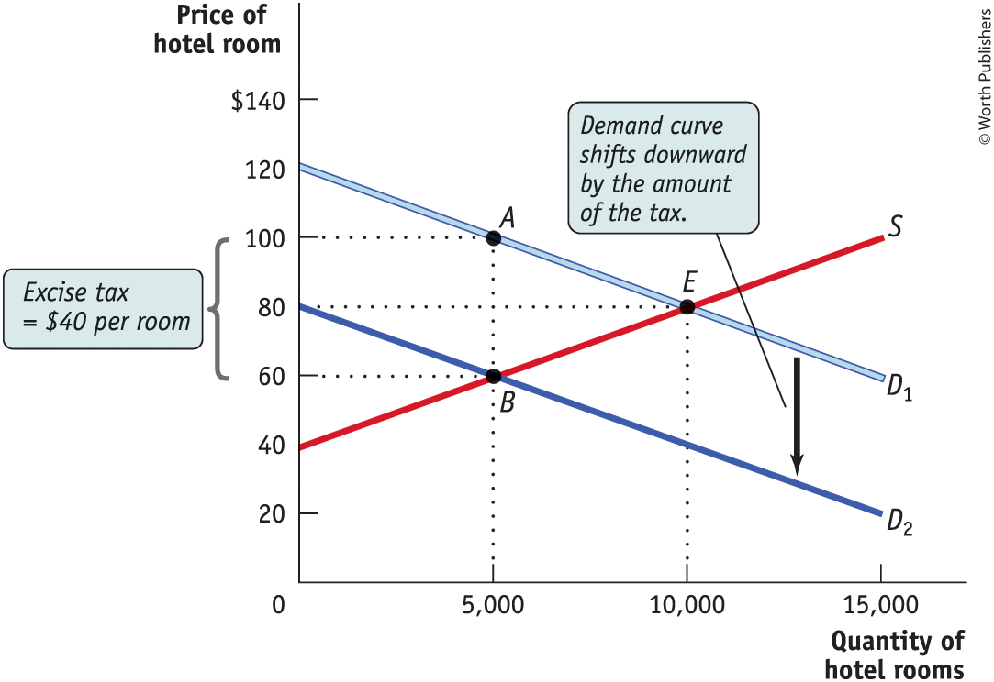
AN EXCISE TAX IMPOSED ON HOTEL GUESTS (2 of 2)
The incidence of an excise tax doesn’t depend on who officially pays the tax.
Figure 3

Slide 13
PRICE ELASTICITIES AND TAX INCIDENCE
Although both buyer and seller share the burden of the tax, it’s not necessarily an equal burden.
In a long-distance relationship, for example, who will do more of the driving?
Does the “tax” fall more heavily to the more committed partner?

Slide 14
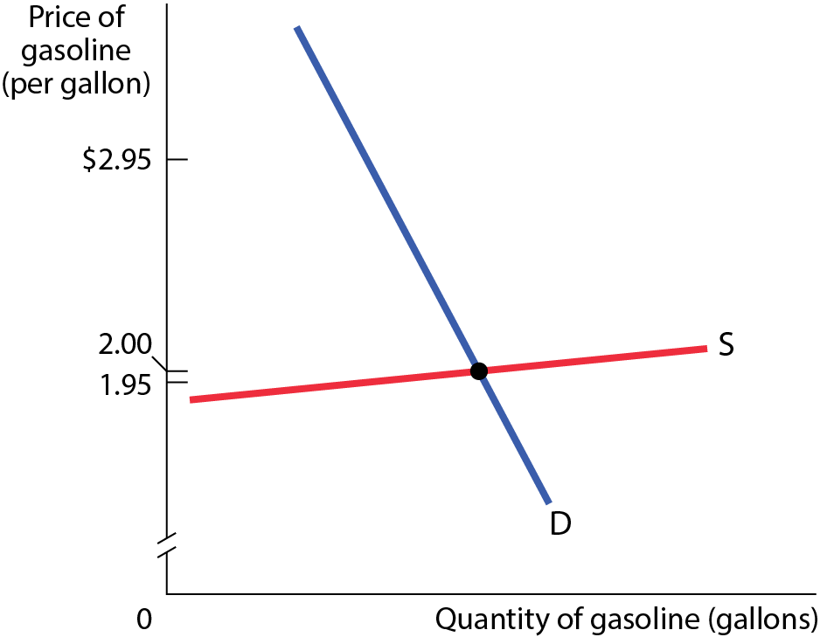
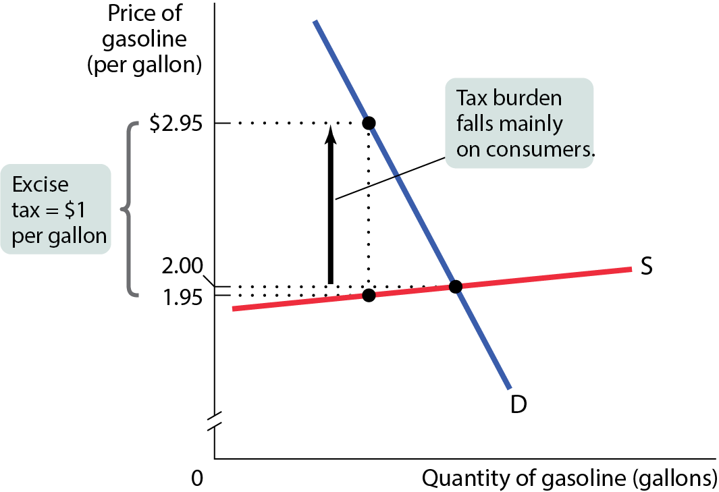
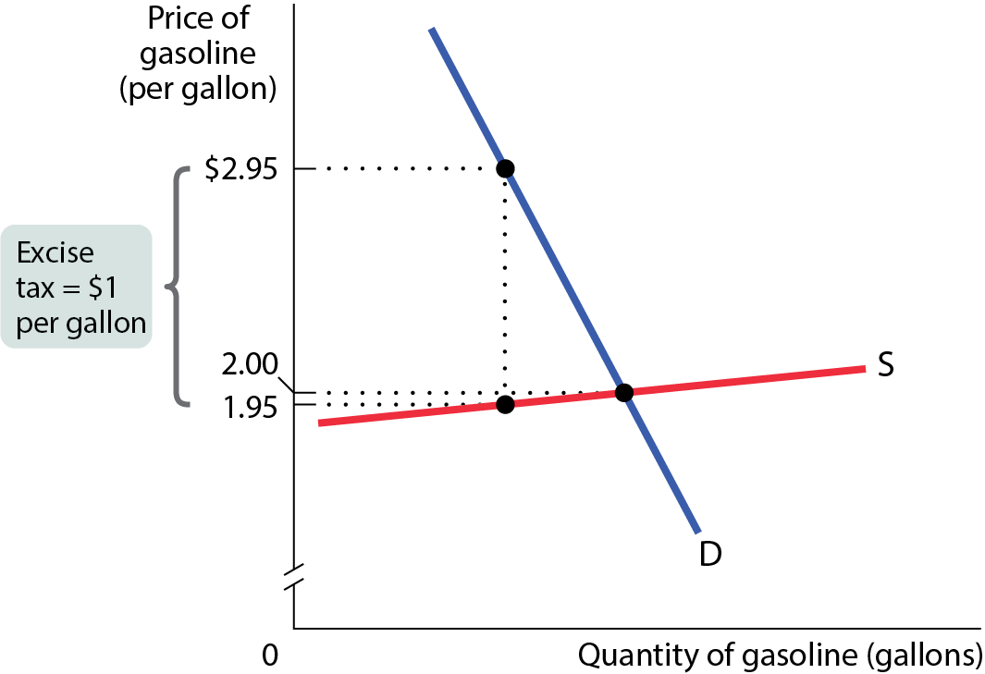
WHEN AN EXCISE TAX IS PAID MAINLY BY CONSUMERS
When the price elasticity of demand is low and the price elasticity of supply is high, the burden of an excise tax falls mainly on consumers.
Figure 4

Slide 15
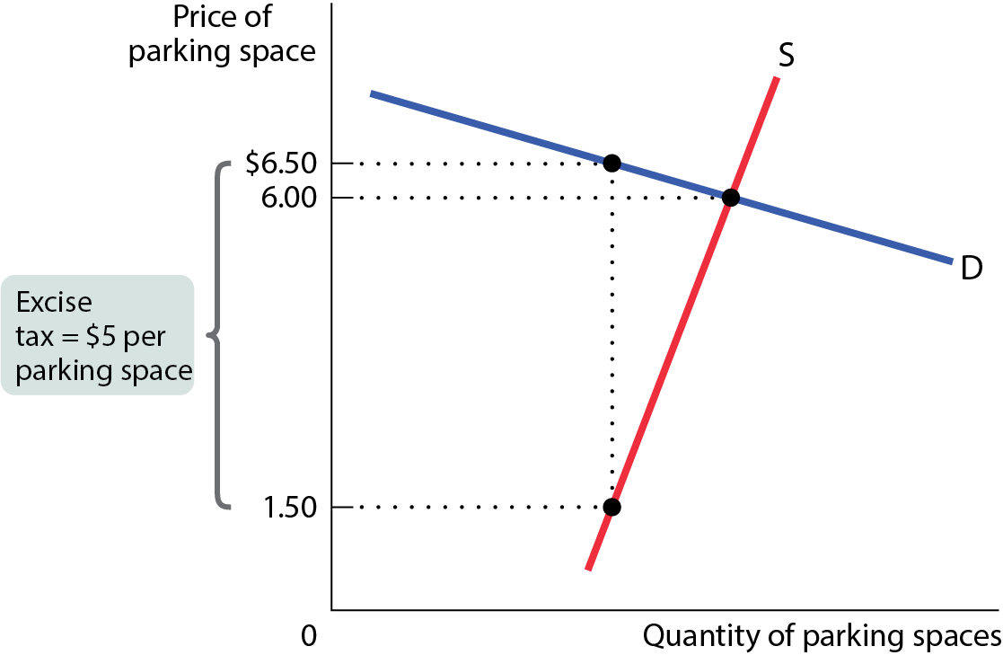
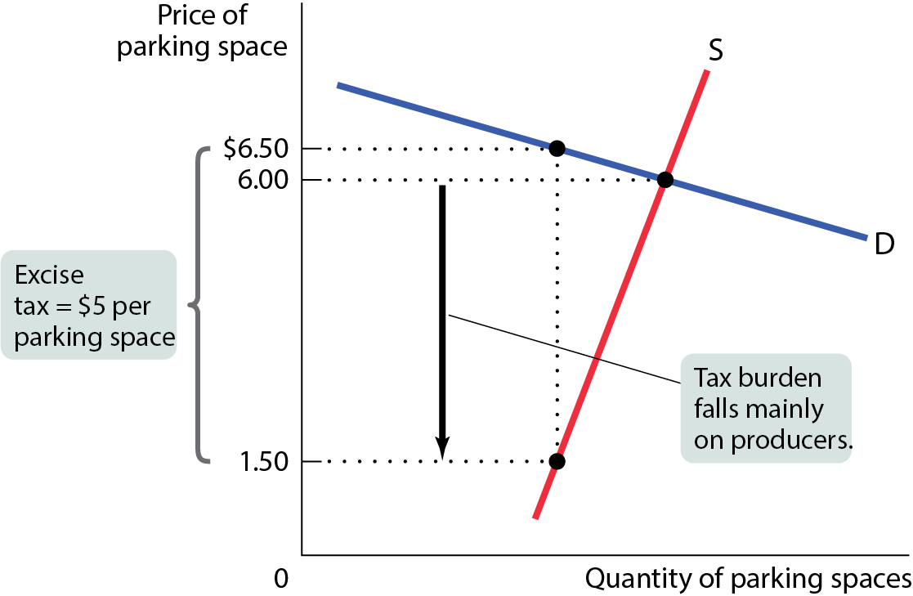
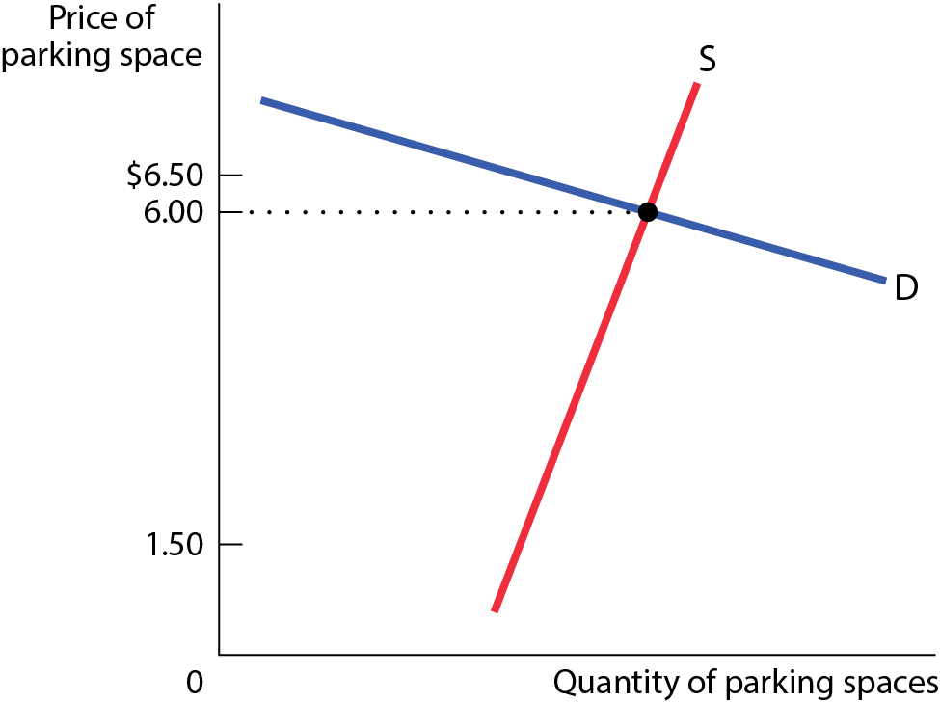
WHEN AN EXCISE TAX IS PAID MAINLY BY PRODUCERS
When the price elasticity of demand is high and the price elasticity of supply is low, the burden of an excise tax falls mainly on producers.
Figure 5

Slide 16
LEARN BY DOING: PRACTICE QUESTION 1
If demand of some good is more elastic than supply and a tax is imposed on the consumption of the good, who will bear more of the burden of the tax?
producers, because consumers have a greater ability to change their behavior in response to the tax
both parties will share the burden equally
consumers, because they pay the tax out of pocket
the government, because the tax will cause less of the good to be produced and consumed

Slide 17
LEARN BY DOING: PRACTICE QUESTION 1
(ANSWER)
If demand of some good is more elastic than supply and a tax is imposed on the consumption of the good, who will bear more of the burden of the tax?
producers, because consumers have a greater ability to change their behavior in response to the tax (correct answer)
both parties will share the burden equally
consumers, because they pay the tax out of pocket
the government, because the tax will cause less of the good to be produced and consumed

Slide 18
LEARN BY DOING: PRACTICE QUESTION 2
Junk food has been criticized for being too cheap, enticing the poor to adopt unhealthful lifestyles. Suppose that the state of Oklahansas imposes a tax on junk food. What has to be true for the tax to deter most people from eating junk food: Should junk food demand be elastic, or should it be inelastic?
Demand should be inelastic.
Demand should be elastic.

Slide 19
LEARN BY DOING: PRACTICE QUESTION 2
(ANSWER)
Junk food has been criticized for being too cheap, enticing the poor to adopt unhealthful lifestyles. Suppose that the state of Oklahansas imposes a tax on junk food. What has to be true for the tax to deter most people from eating junk food: Should junk food demand be elastic, or should it be inelastic?
Demand should be inelastic.
Demand should be elastic. (correct answer)

Slide 20
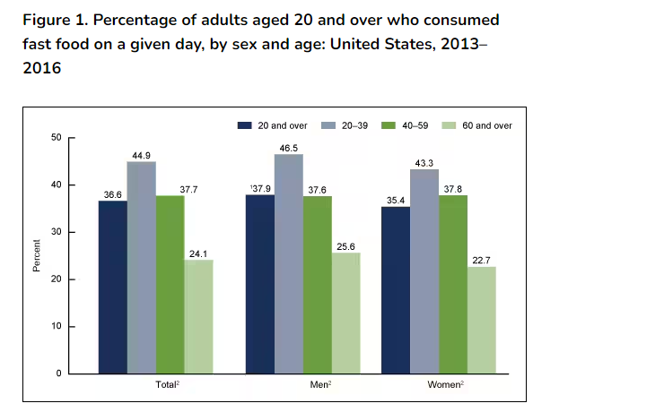
Junk Food in USA
Products - Data Briefs - Number 320 - September 2018 (cdc.gov)

Slide 21
Junk Food in USA
Although a US federal excise tax on junk food is legally and administratively feasible,13 junk or snack food taxes to date have only been initiated at the state level (including by tribal governments and the District of Columbia [DC]) and typically assessed as low-level sales taxes for revenue production goals on specific “snack food” products (e.g., chips, pretzels, nuts) that are not necessarily unhealthy.
Denmark targeted its attack on saturated fats, unveiling a levy of €2.41 per kilogram of saturated fat used in the production of a particular food. The effect is to levy a heavier tax on higher fat foods, such as hamburgers or butter.
http://ec.europa.eu/enterprise/tris/pisa/app/search/index.cfm?fuseaction=getdraft&inum=1627030.

Slide 22
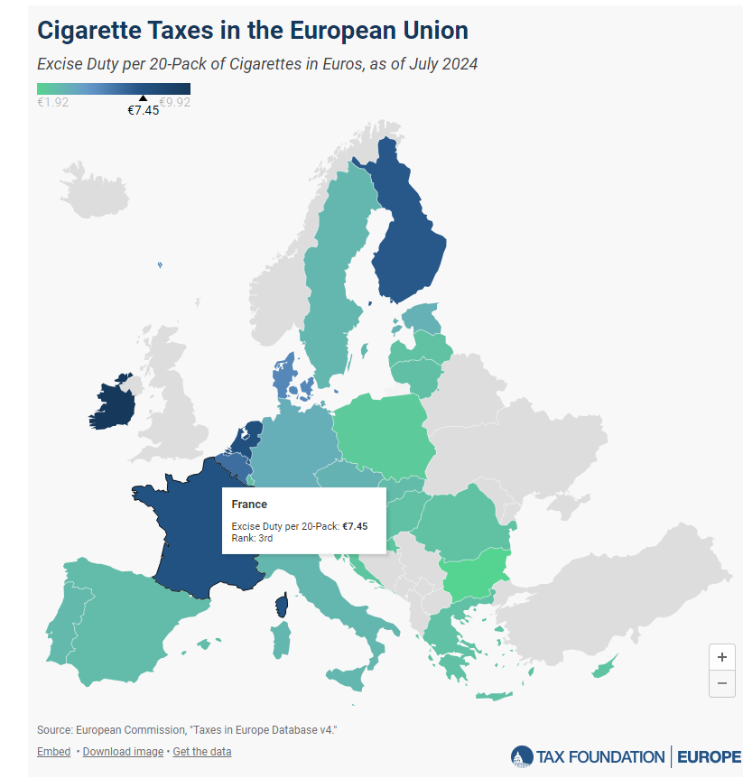
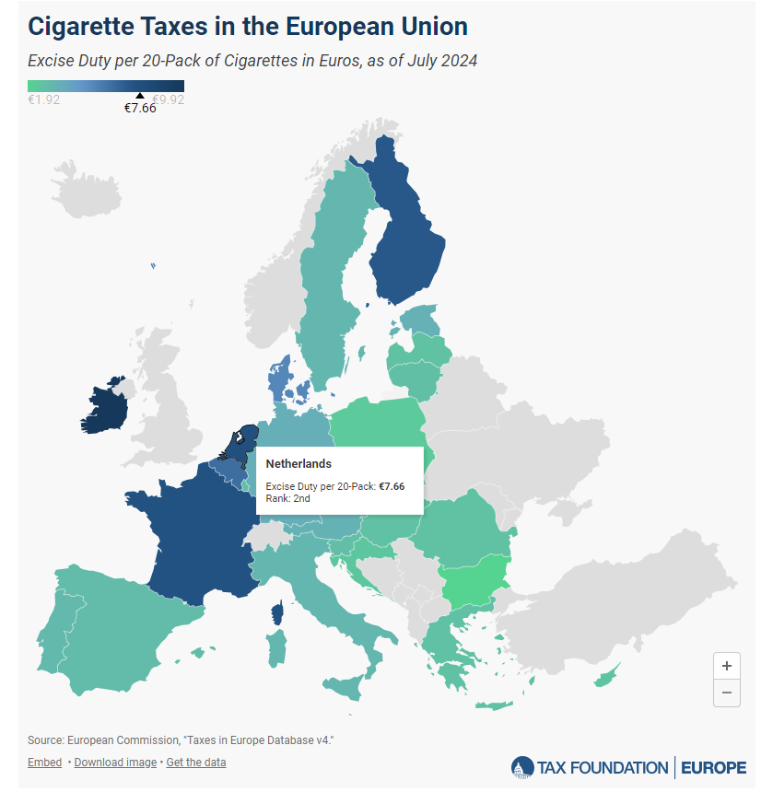
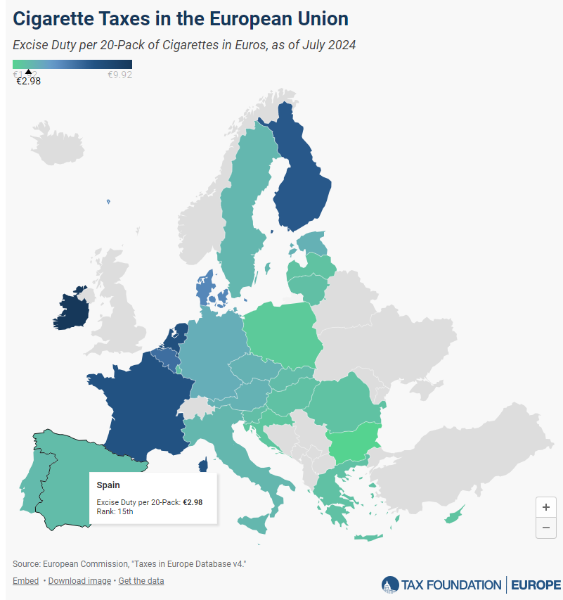

Slide 23
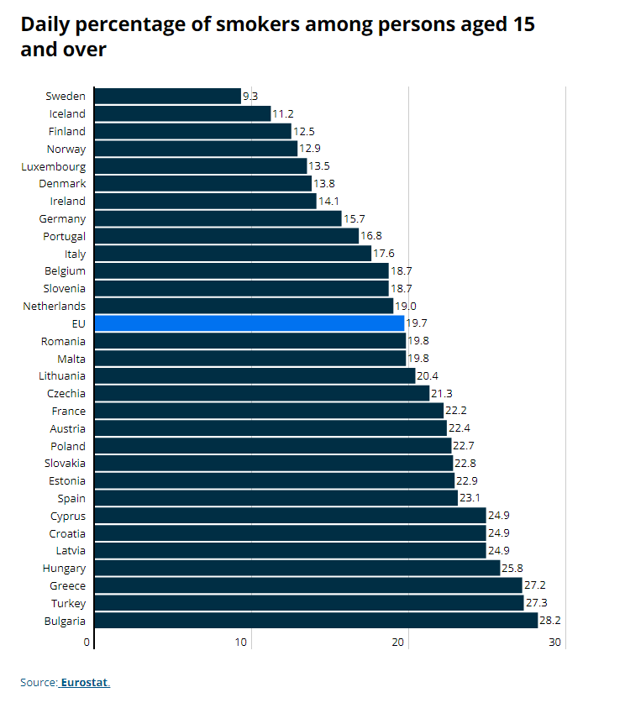

Slide 24
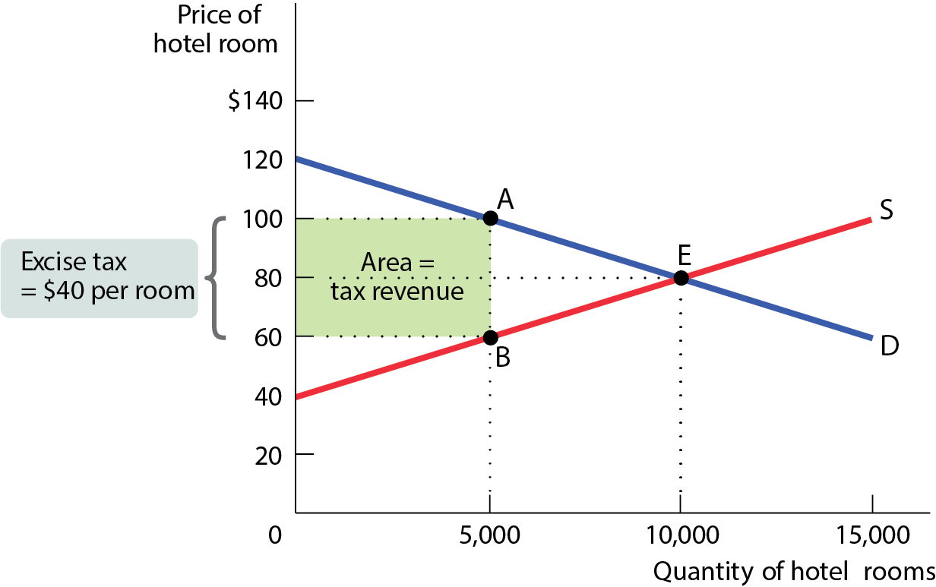
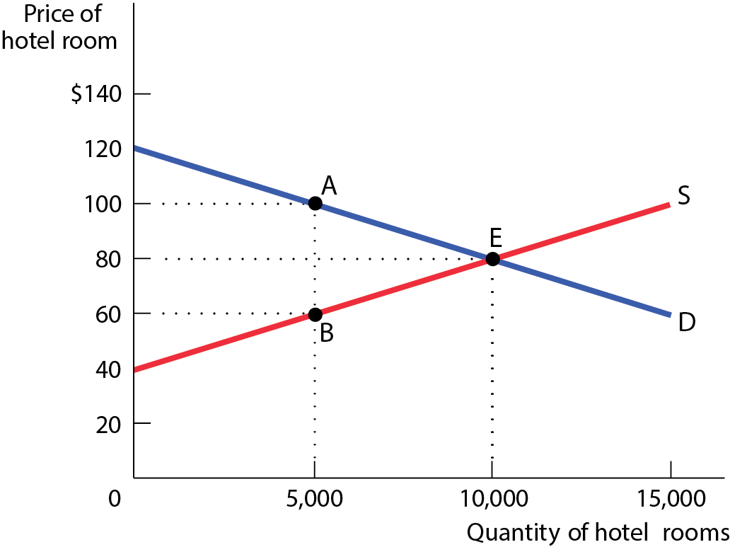
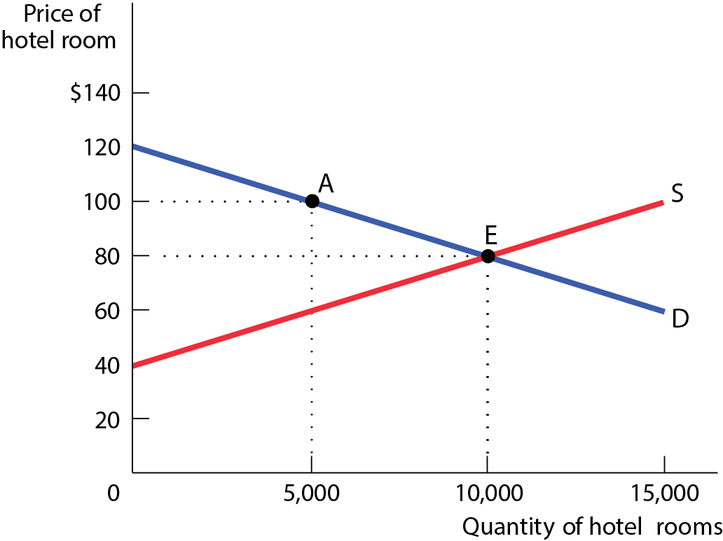
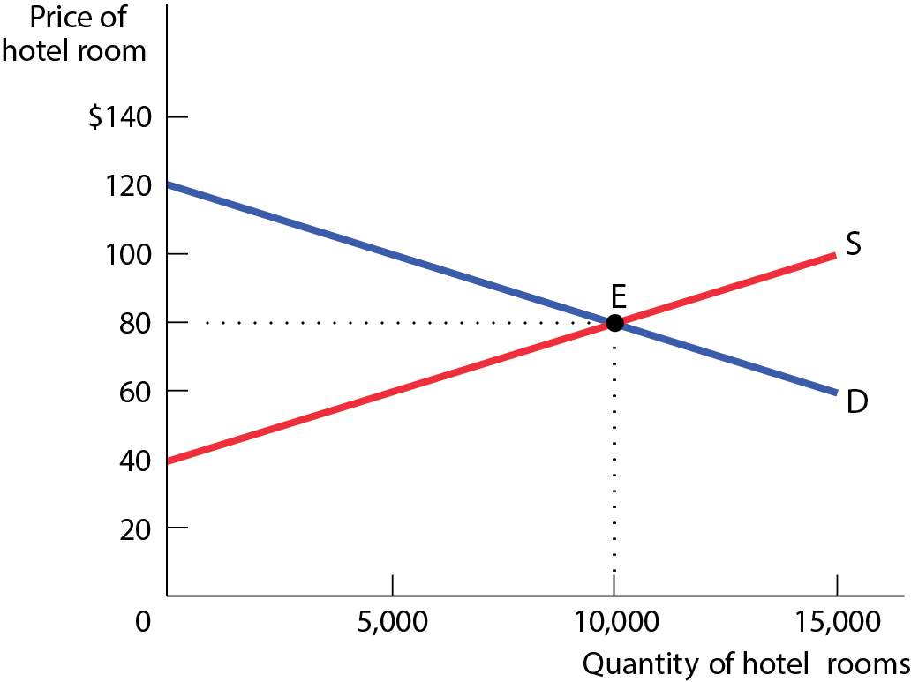
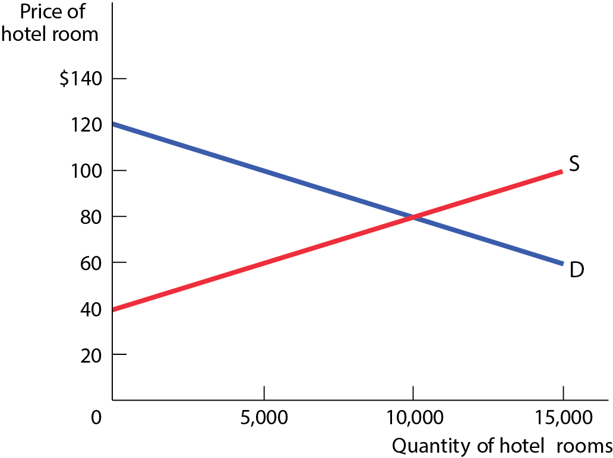
THE REVENUE FROM AN EXCISE TAX
The tax revenue collected = Height × Width
= $40 per room × 5,000 rooms = $200,000
Figure 6

Slide 25
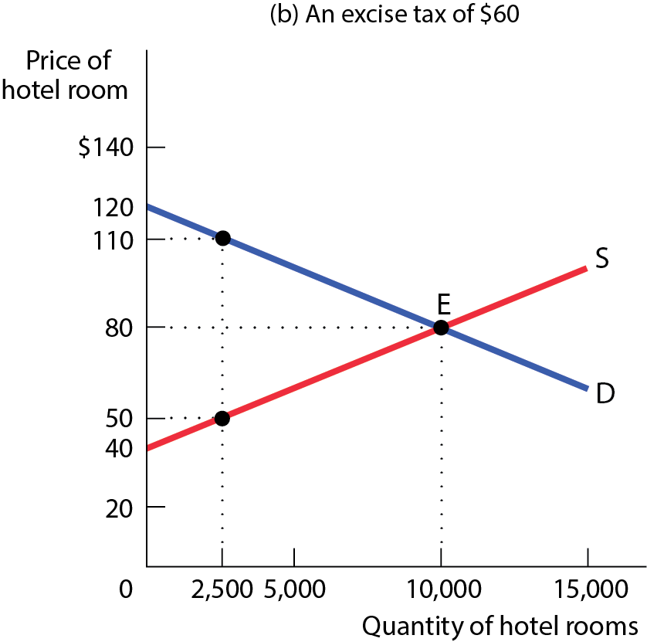
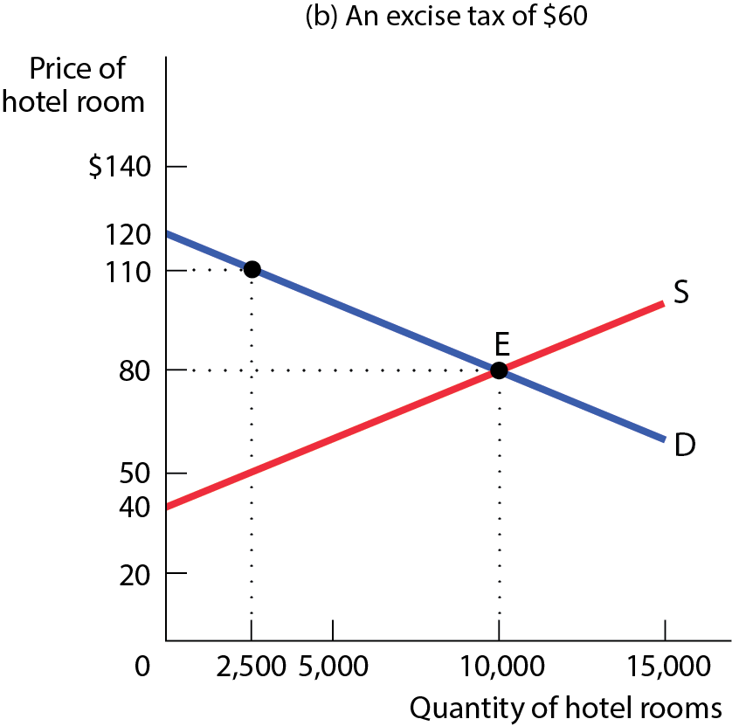
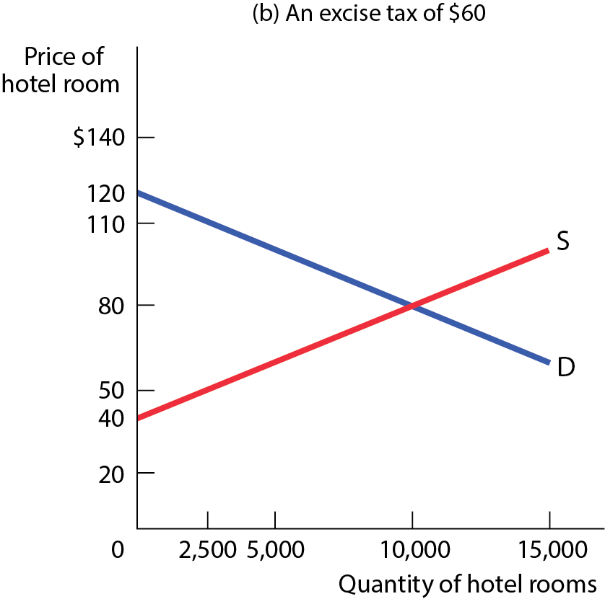
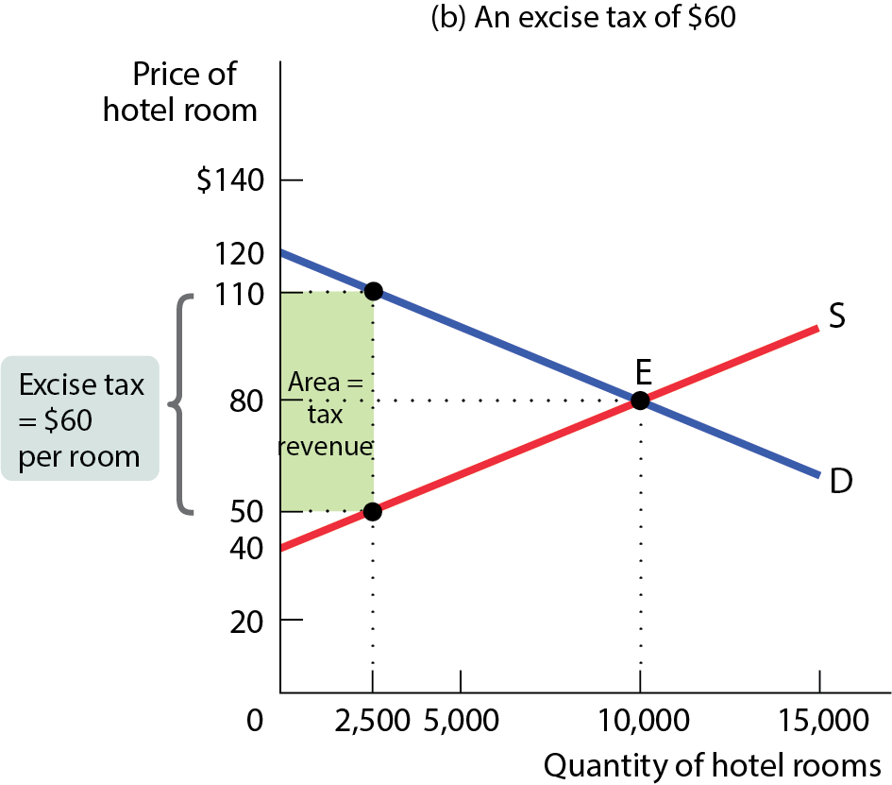
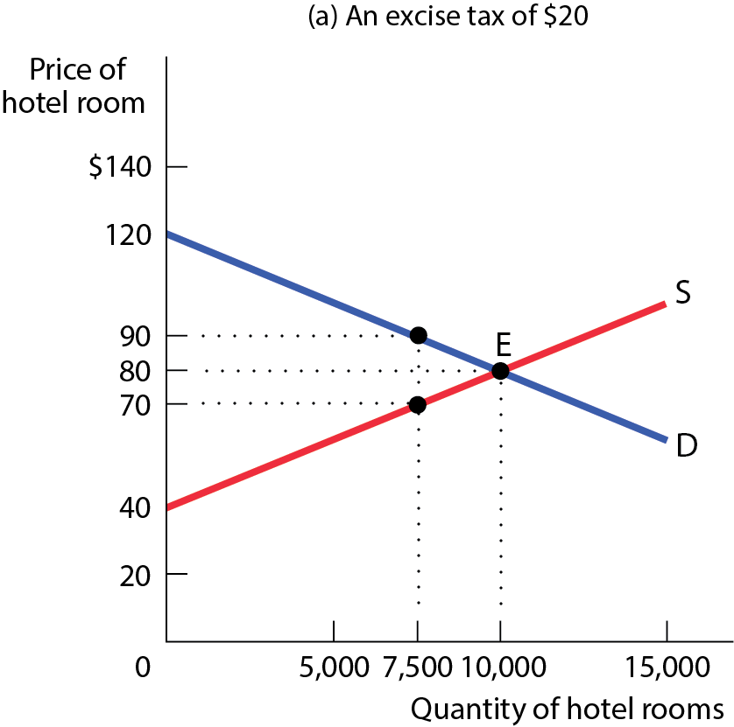
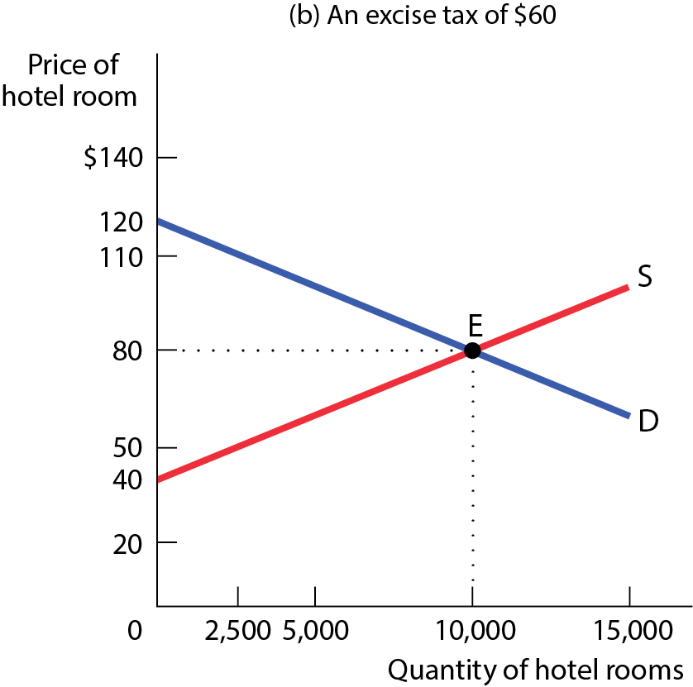
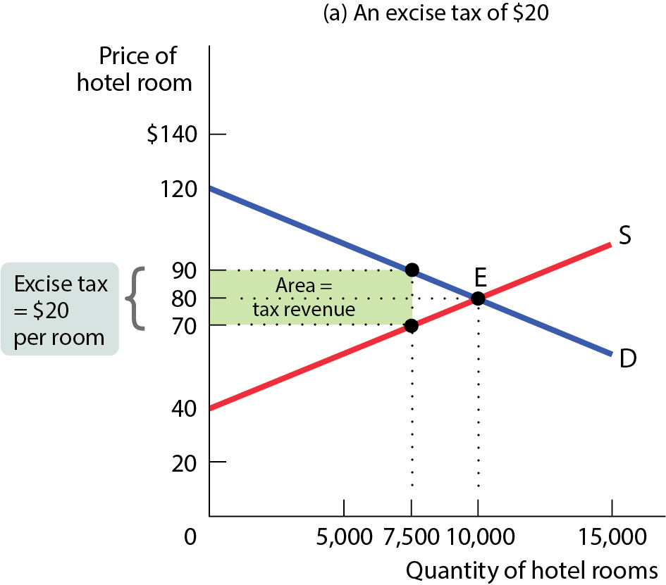
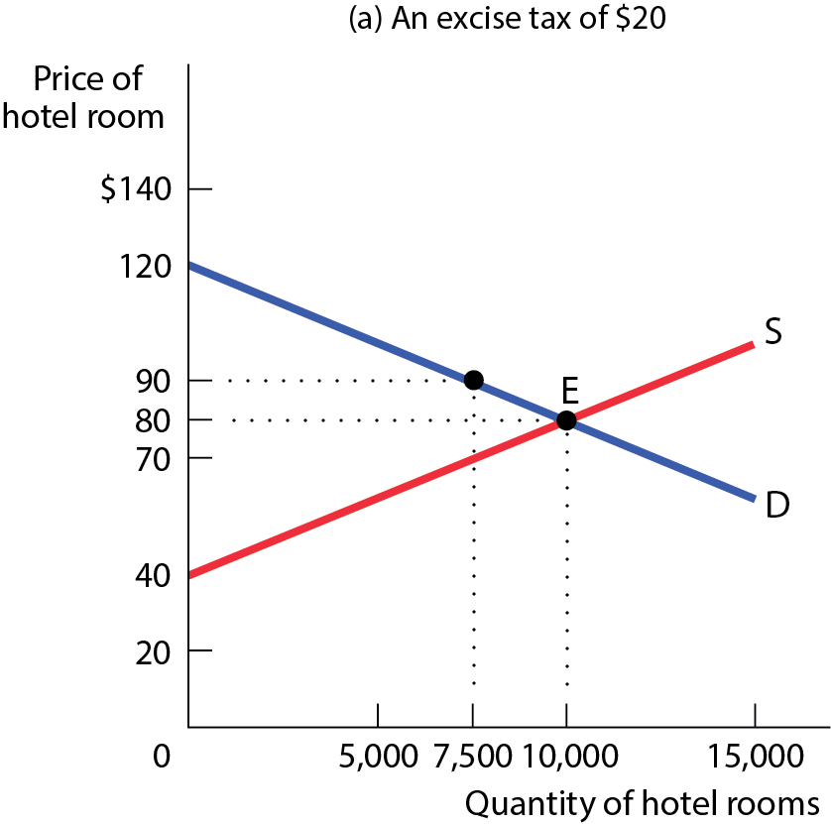
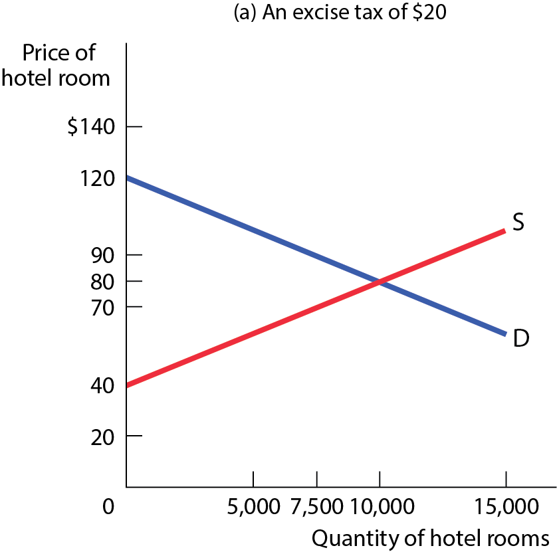
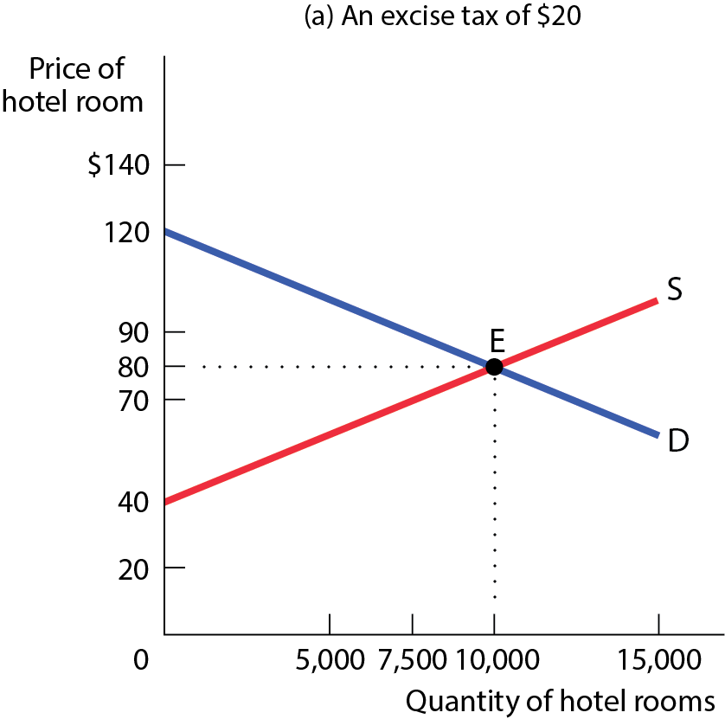
INCREASING THE TAX RATE DOES NOT NECESSARILY INCREASE REVENUE (1 of 2)
On one side, the tax increase means that the government raises more revenue for each unit sold, which increases tax revenue. On the other side, it reduces the quantity of sales, which decreases tax revenue.
Figure 7
$$\left(90−70\right)×7,500=150,000$$
$$\left(110−50\right)×2,500=150,000$$

Slide 26
INCREASING THE TAX RATE DOES NOT NECESSARILY INCREASE REVENUE (2 of 2)
If the price elasticities of both supply and demand are low, the tax increase won’t reduce the quantity of the good sold very much, so tax revenue will definitely rise.
If the price elasticities are high enough, the tax reduces the quantity sold so much that tax revenue falls.
If the price elasticities are high, the result is less certain and dependent on how high or low the initial tax rate was.

Slide 27
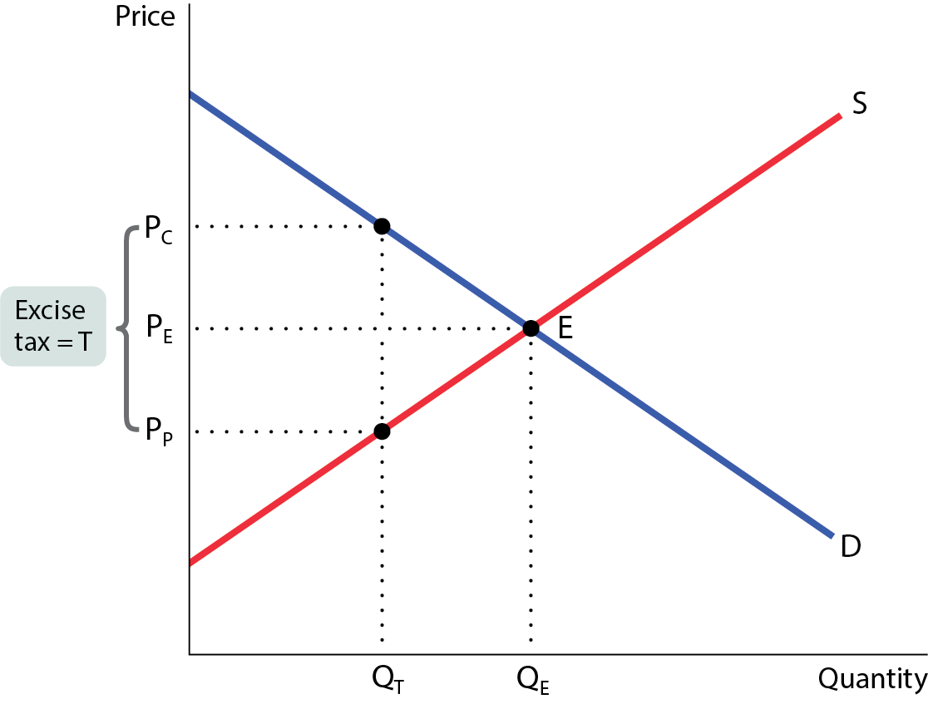
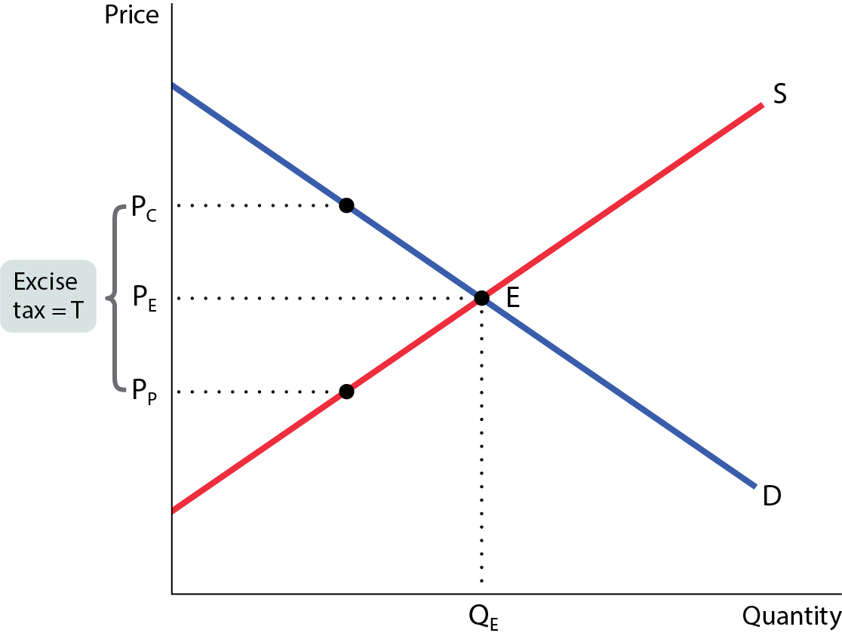
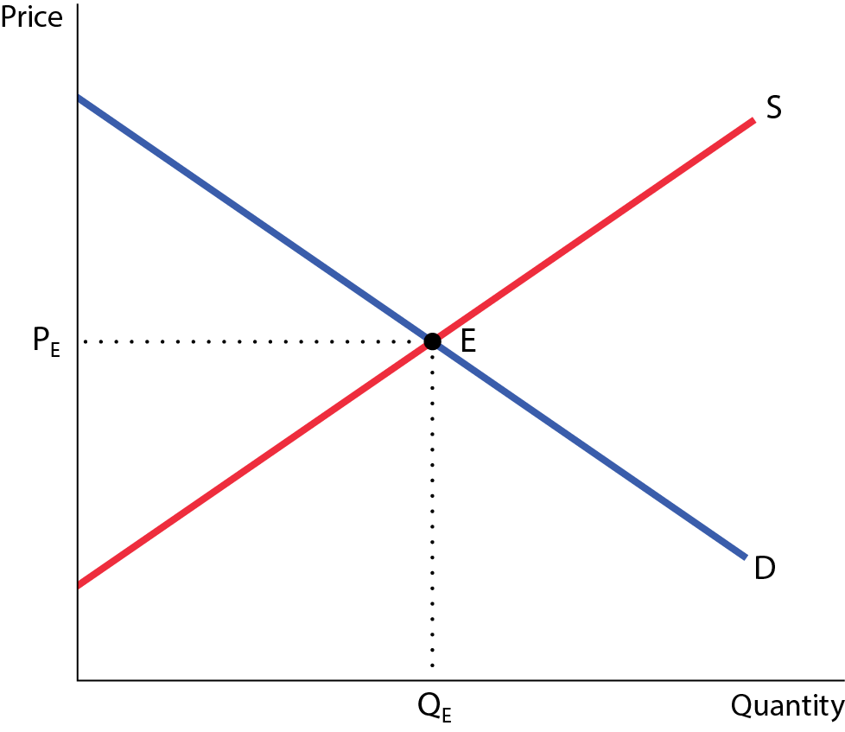
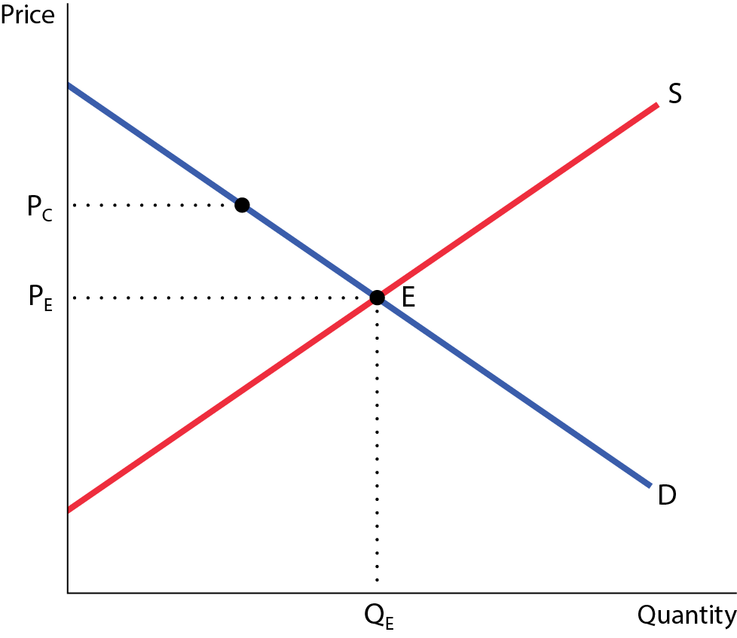
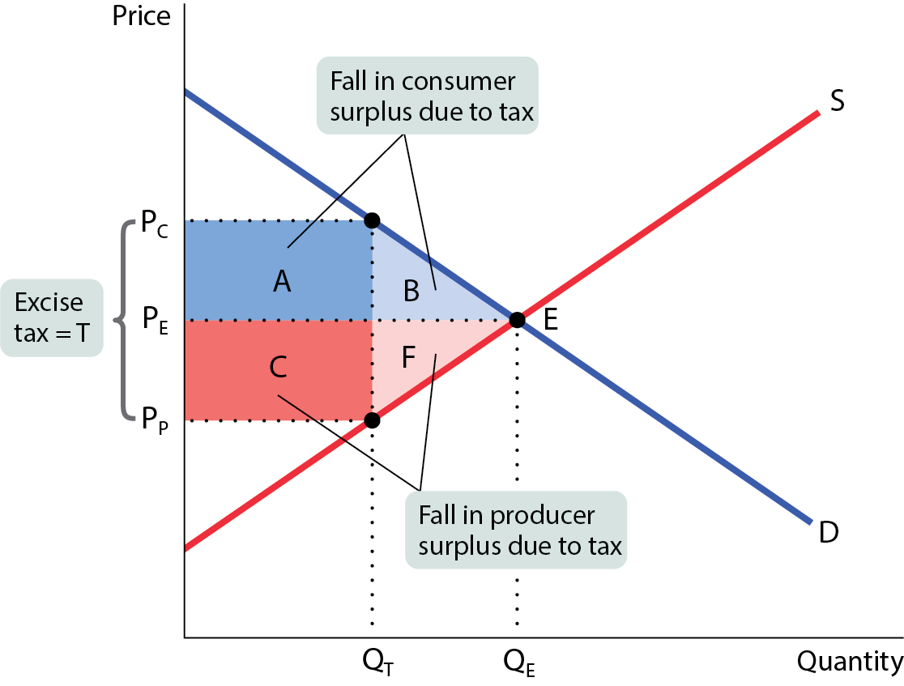
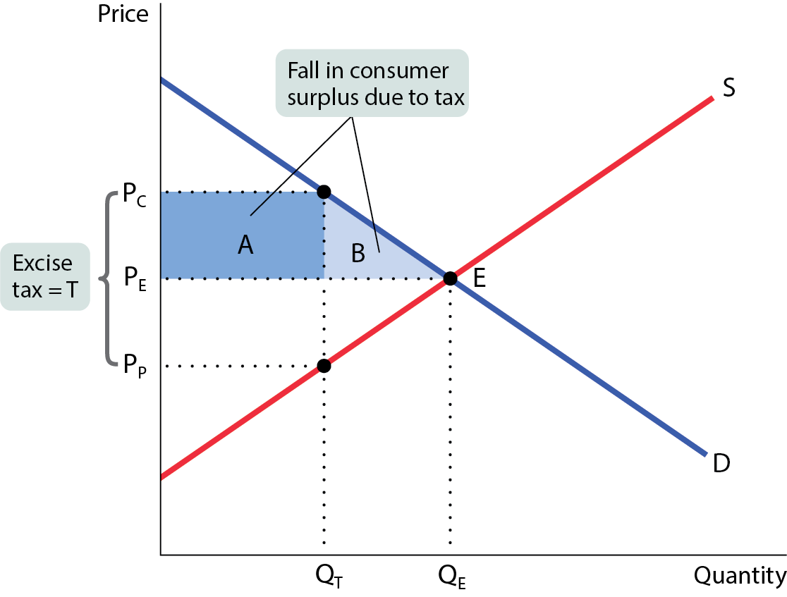




THE COSTS OF TAXATION (1 of 3)
An excise tax imposes costs because it prevents mutually beneficial transactions (Q_{E} – Q_{T}). The value of such transactions is called the deadweight loss (areas B and F).
Figure 8
$$Intital CS: \frac{(100−50)×80}{2}=2,000$$
$$New CS: \frac{(100−60)×64}{2}=1,280$$
100
60
$$Intital PS: \frac{(50−20)×80}{2}=1,200$$
T=16
50
$$New PS: \frac{(44−20)×64}{2}=768$$
44
20
$$Loss in CS:2,000−1,280=720$$
$$Loss in PS:1,200−768=432$$
64
80

Slide 28
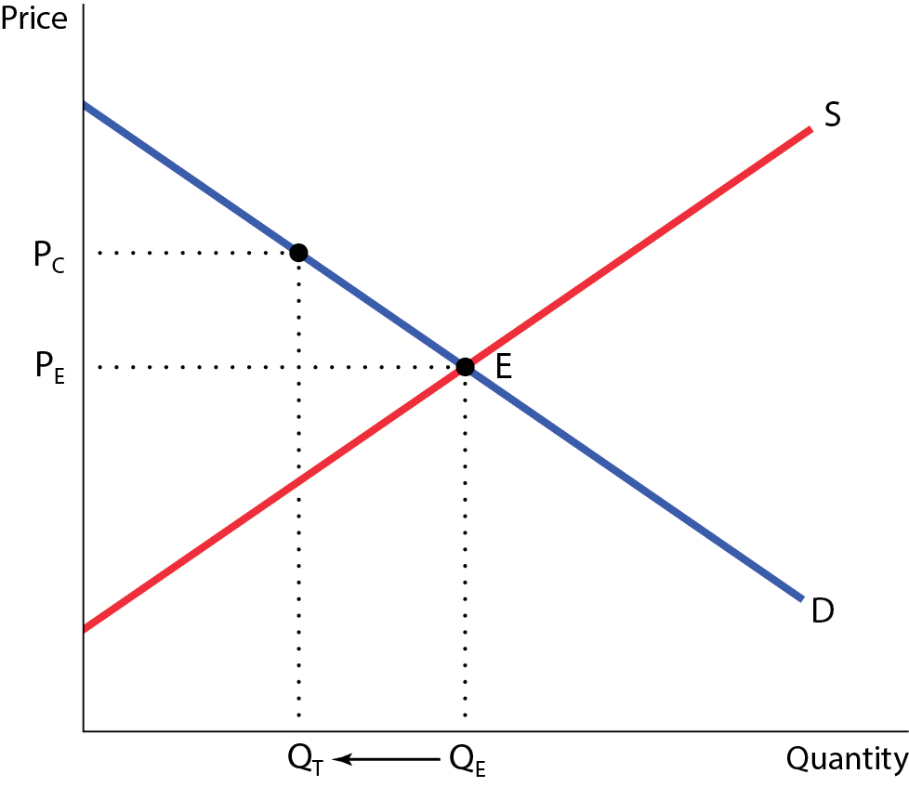
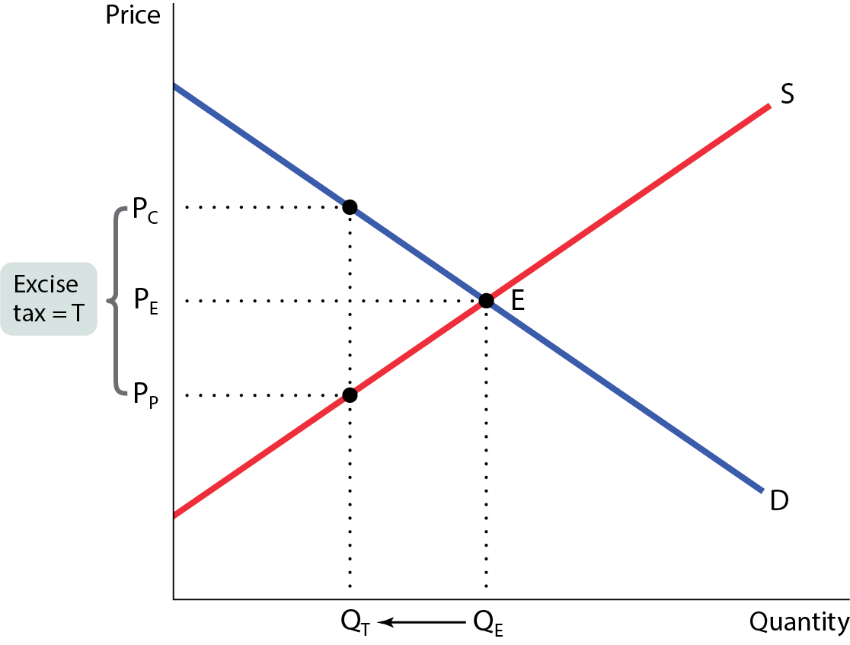
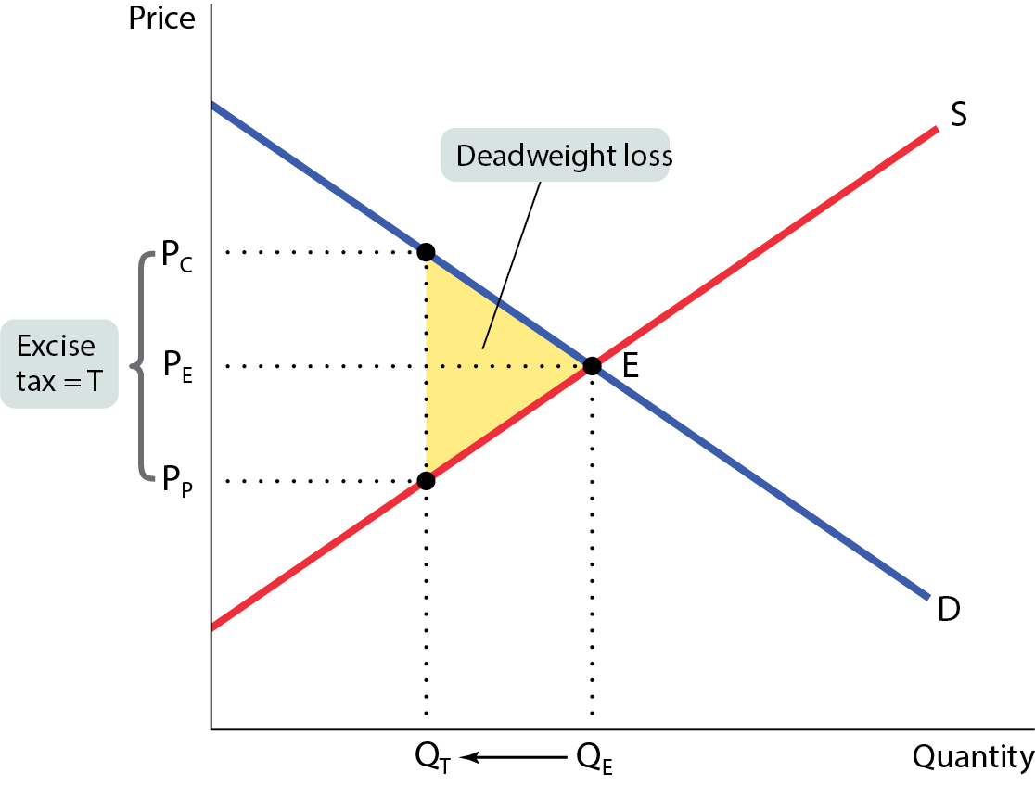



THE COSTS OF TAXATION (2 of 3)
A tax generates revenue and creates a deadweight loss.
Figure 9
$$DWL: \frac{(60−44)×(80−64)}{2}=128$$
60
T=16
$$Tax Revenue:\left(60−44\right)×64=1,024$$
44
$$Loss in CS:2,000−1,280=720$$
$$Loss in PS:1,200−768=432$$
$$Total:720+432=1,152$$
64
80
$$Total Loss −Tax Revenue:1,152−1,024=128$$

Slide 29
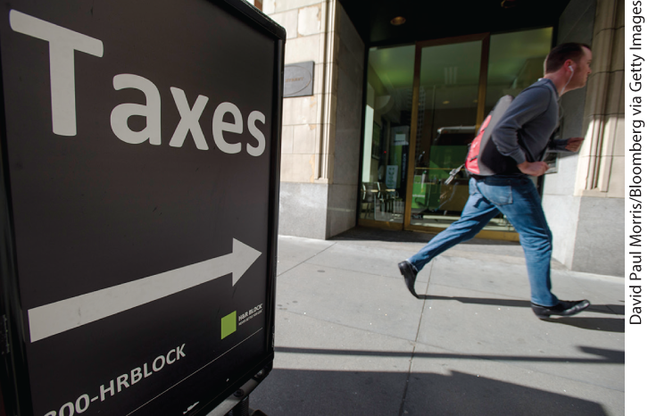
THE COSTS OF TAXATION (3 of 3)
There are also costs not shown in Figure 9: the administrative costs of a tax are the resources used for its collection, for the method of payment, and for any attempts to evade the tax. Taxes cost society time and effort that could have been used elsewhere.
Total inefficiency of tax = Deadweight loss + Administrative costs

Slide 30
LEARN BY DOING: PRACTICE QUESTION 3
Draw two demand curves, one elastic and one inelastic. Show how, all else equal, the size of the deadweight loss is larger with elastic demand.
For each graph, label the:
  consumer and producer price and new quantity traded.
  area of government revenue.
  consumer and producer surplus before and after the tax.
  area of deadweight loss.

Slide 31
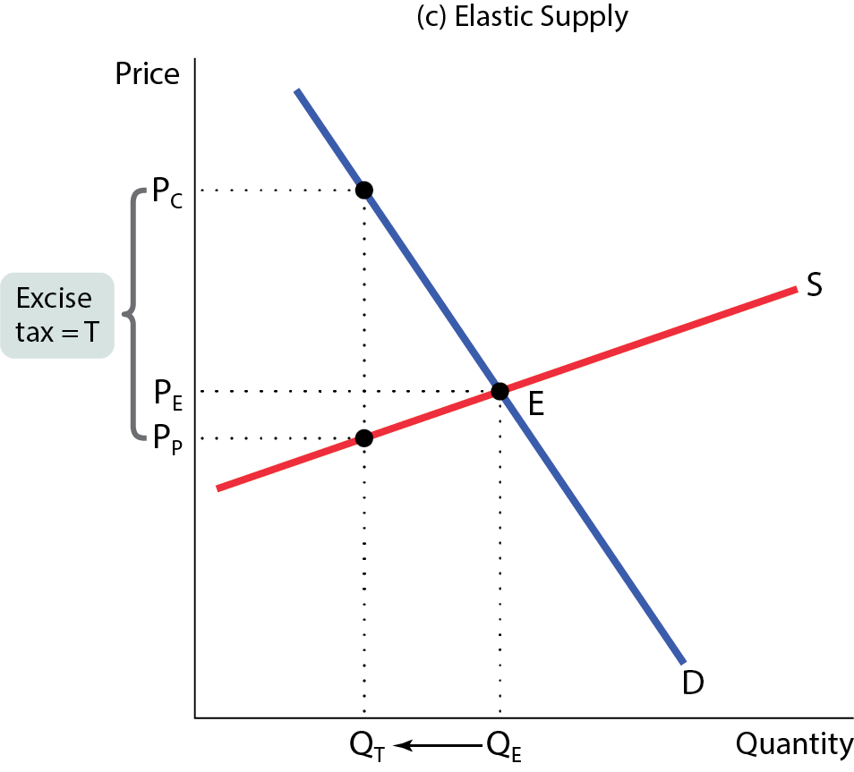
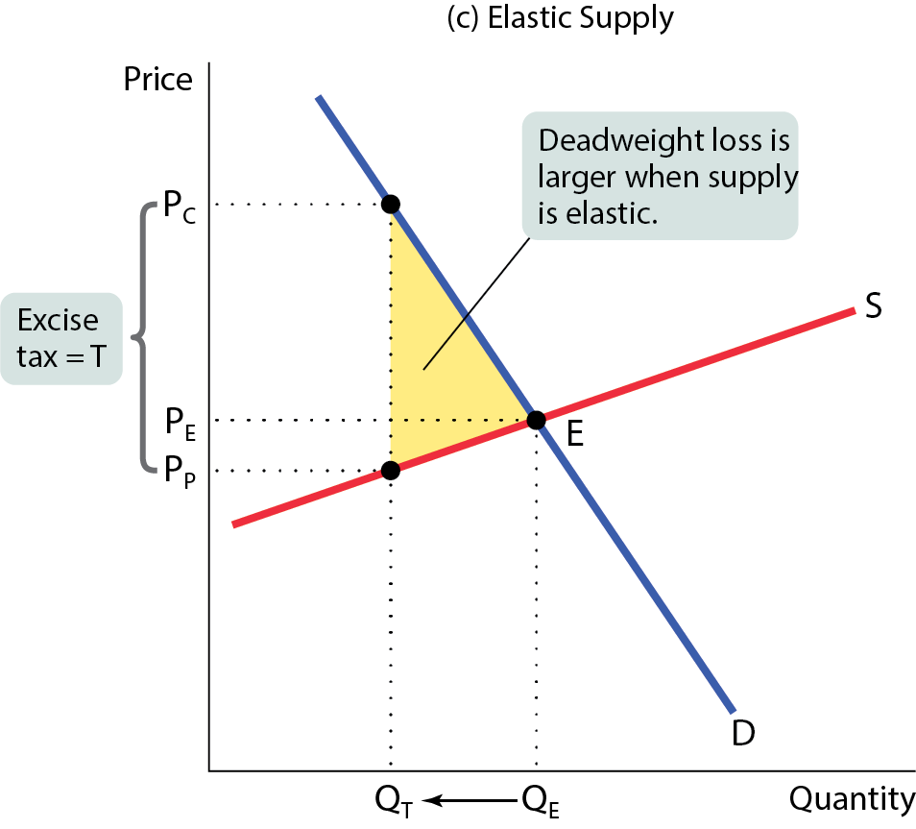
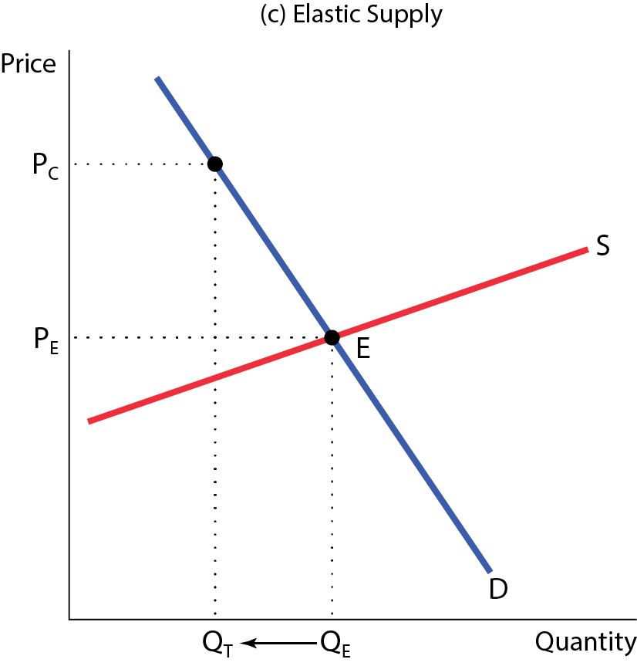
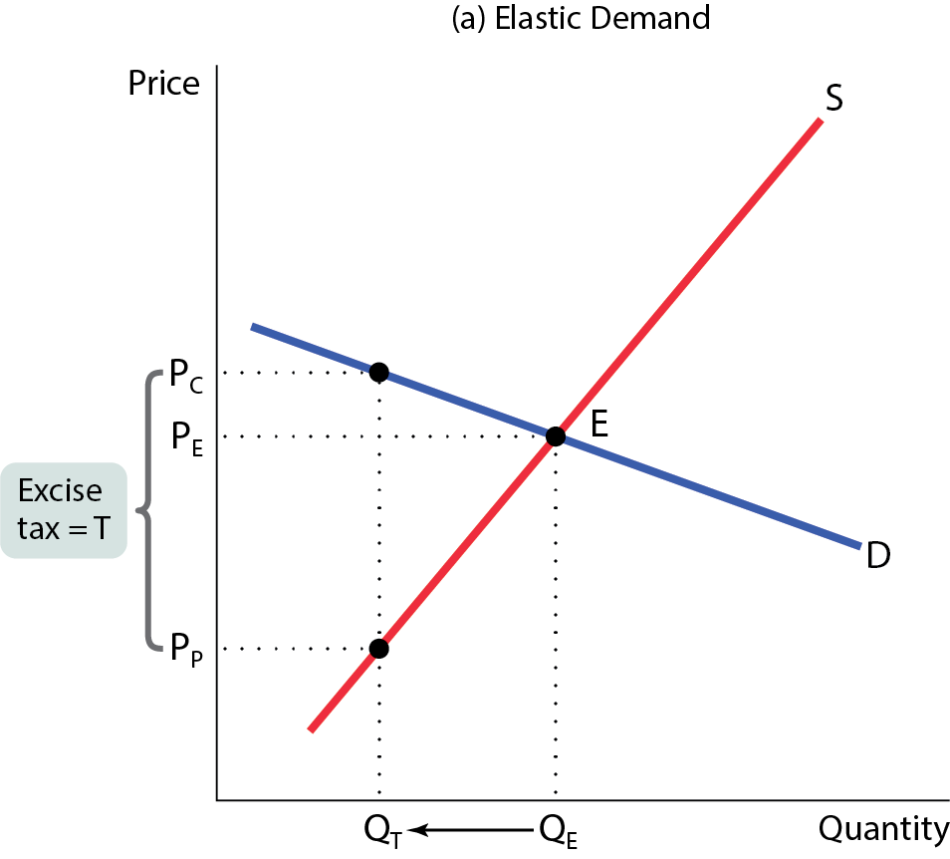




ELASTICITIES AND DEADWEIGHT LOSS (1 of 3)
The greater the price elasticity of demand or supply, the greater the tax-induced fall in the quantity transacted.
Figure 10 (a,c)

Slide 32








ELASTICITIES AND DEADWEIGHT LOSS (2 of 3)
The lower the price elasticity of demand or supply, the smaller the tax-induced fall in the quantity transacted and the smaller the deadweight loss.
Figure 10 (b,d)

Slide 33
ELASTICITIES AND DEADWEIGHT LOSS (3 of 3)
If the goal in tax policy is efficiency (minimizing deadweight loss), then policy makers should choose the goods with the lowest price elasticities.
A tax on insulin would be efficient—but not necessarily fair.

Slide 34
TAX FAIRNESS AND TAX EFFICIENCY
Two principles of tax fairness:
The benefits principle: Those who benefit from public spending should bear the burden of the tax that pays for that spending. Example: Those who use a road should pay for that road’s upkeep.
The ability-to-pay principle: Those with greater ability to pay a tax should pay more. The Whiskey Rebellion of 1791, for example, was a protest against the fact that small distillers paid a higher share of their income than large distillers.
There is usually a trade-off between equity and efficiency: The system can be made more efficient only by making it less fair, and vice versa.

Slide 35
UNDERSTANDING THE TAX SYSTEM (1 of 2)
The tax base is the measure, such as income or property value, that determines how much tax an individual or firm pays.
Income tax depends on income from wages and investments.
Payroll tax depends on the earnings an employer pays an employee.
Sales tax depends on the value of goods sold.
Profits tax depends on a firm’s profit.
Property tax depends on the value of property such as a home.
Wealth tax is a tax that depends on an individual’s wealth.

Slide 36
UNDERSTANDING THE TAX SYSTEM (2 of 2)
The tax structure specifies how the tax depends on the tax base.
A progressive tax takes a larger share of the income of high-income taxpayers than that of low-income taxpayers.
A regressive tax takes a smaller share of the income of high-income taxpayers than that of low-income taxpayers.
The marginal tax rate is the percentage of an increase in income that is taxed away.

Slide 37
TAXES IN THE UNITED STATES (1 of 2)
Tax competition: a state or local government that imposes high taxes on people with high incomes faces the prospect that those people may move to other locations where taxes are lower.
TABLE 4 Major Taxes in United States, 2022
Federal taxes ($ billion) | State and local taxes ($ billion)
Income $2,107.8 | Income $512.2
Payroll 1,518.0 | Sales 499.5
Profits 278.6 | Profits 95.8
 | Property 645.5
Data from: Bureau of Economic Analysis.

Slide 38
TAXES IN THE UNITED STATES (2 of 2)
TABLE 5 Federal, State, and Local Taxes as a Percentage of Income, by Income Category, 2018 and 2019
Income group | Federal | State and local
Bottom quintile | 0.5% | 11.4%
Second quintile | 8.9 | 10.1
Third quintile | 13.0 | 9.9
Fourth quintile | 16.7 | 9.5
Next 15% | 20.8 | 8.9
Next 4% | 24.4 | 8.0
Top 1% | 30.0 | 7.4
Average | 19.4 | 9.4
Data from: Institute on Taxation and Economic Policy.

Slide 39

Washington
WA does not have a personal or corporate income tax.
Property tax: 0.98 percent of a home’s assessed market value (average).
Sales tax: The average combined rate is 9.38 percent, giving Washington the fourth-highest sales tax rate in the nation

Slide 40

Idaho
ID has a flat 5.8 percent individual income tax rate and a 5.8 percent corporate income tax rate.
Property tax: 0.47 percent effective property tax rate on owner-occupied housing value.
Sales tax: The average combined rate is 6.00 percent, and an average combined state and local sales tax rate of 6.03 percent.

Slide 41

Oregon
OR has a graduated state individual income tax, with rates ranging from 4.75 percent to 9.9 percent. The corporate income tax ranges from 6.6 percent to 7.6 percent
Property tax: 0.47 percent effective property tax rate on owner-occupied housing value.
Sales tax: Oregon does not have a state sales tax. Oregon has a 40 cents per gallon gas tax rate and a $3.33 cigarette excise tax rate.

Slide 42
Tax Revenue 2023
WA: US$ 38.03 Billion
OR: US$ 20.88 Billion
ID: US$ 7.38 Billion
CA: US$ 250.59 Billion
State government tax revenue by state U.S. 2023 | Statista

Slide 43

YOU THINK YOU PAY HIGH TAXES?

Slide 44



Extra Exercises
$\frac{29811.21}{90337}×100=33$%
What is Sally's tax rate?
$\frac{72082.32}{300343}×100=24$%
What is Pat's tax rate?
What is the nature of this income tax system?

