Slide 1
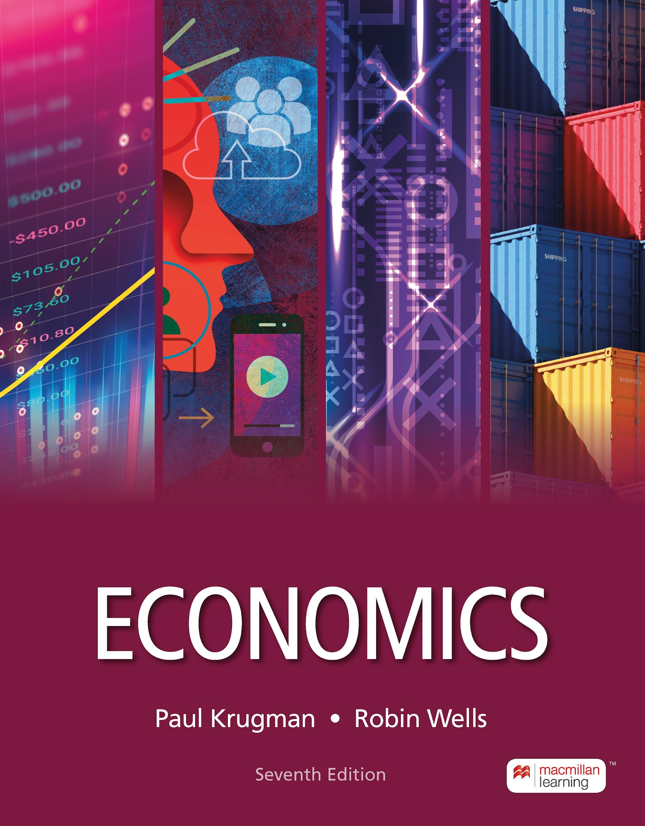
The Economics of the Welfare State
12
Notes:
Cover Credits: Currency Exchange Stock Chart: cemagraphics/Getty Images, Social Media Montage: SEAN GLADWELL/Getty Images, Circuit Pattern: somsak Tangdamrongsub/Getty Images, Cargo Containers: urzine/Getty Images

Slide 2
Important Dates
Homework # 9 (Chapter 10) is due tomorrow.
Homework #10 (Chapter 11) is due on Wednesday October 30th.
Tuesday October 29th we will have a review session for Midterm #1 (Tuesday November 5th).
No class on Thursday October 31st.
Quiz #5 (chapters 10 and 11) is due on Sunday November 3rd.
Homework #11 (Chapter 12) is due on Monday November 4th.

Slide 3

Important Dates
Tuesday
Wednesday
Thursday
Sunday
Monday
Tuesday
Review Session
10/29
HW #10
10/30
No Class
10/31
Quiz #5
11/03
HW #11
10/04
Midterm #2
10/05

Slide 4
WHAT YOU WILL LEARN IN THIS CHAPTER
What is the welfare state, and how does it benefit the society?
What are the causes and consequences of poverty?
How has income inequality in the United States changed over time?
How do social insurance programs like Social Security affect poverty and income inequality?
Why is there debate over the size of the welfare state?
What are the special concerns about private health insurance, and how have governments acted to address them?

Slide 5
POVERTY, INEQUALITY, AND PUBLIC POLICY
The welfare state is the collection of government programs designed to alleviate economic hardship.
A large share of it consists of government transfers—payments by the government to individuals and families.

Slide 6
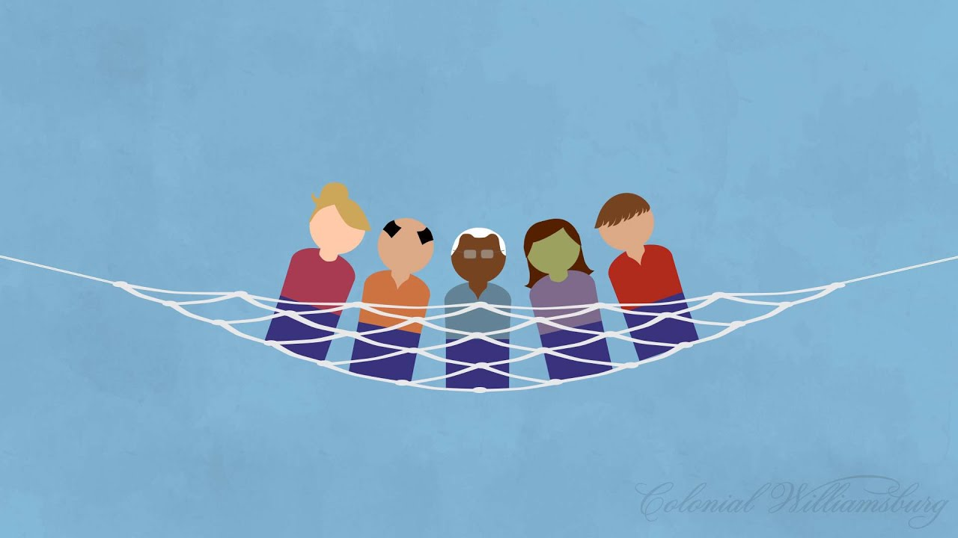
POVERTY, INEQUALITY, AND PUBLIC POLICY
Social safety net programs are designed to help people with low incomes meet their food, housing, and healthcare needs.
Dating to President Lyndon B. Johnson’s War on Poverty in the US, the objective of these programs is “not only to relieve the symptom of poverty, but to cure it and, above all, to prevent it.”

Slide 7
THE LOGIC OF THE WELFARE STATE
What’s the rationale for the welfare state?
  Alleviating income inequality
  Because a marginal dollar is worth more to a poor person than to a rich one, modest transfers from the rich to the poor do more good than harm. Programs that are designed to aid the poor are known as poverty programs.

Slide 8
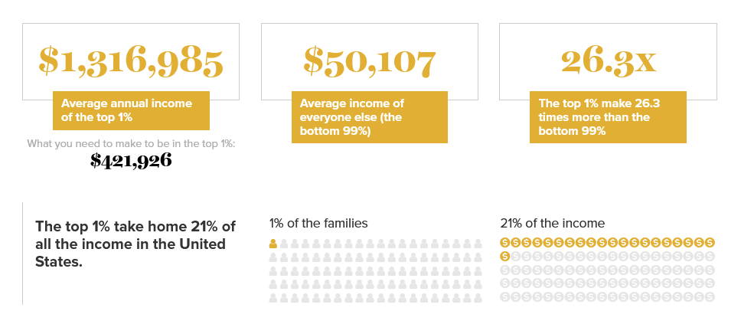
Income inequality in the United States

Slide 9
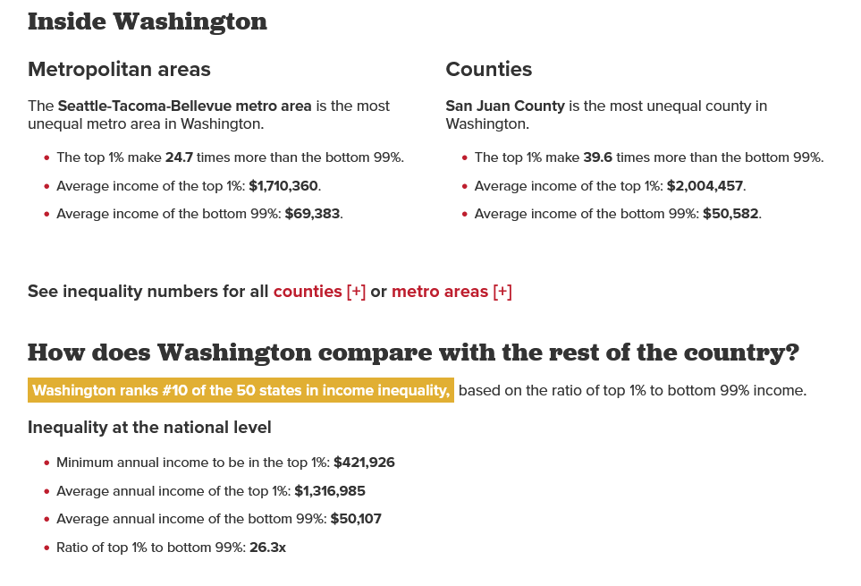
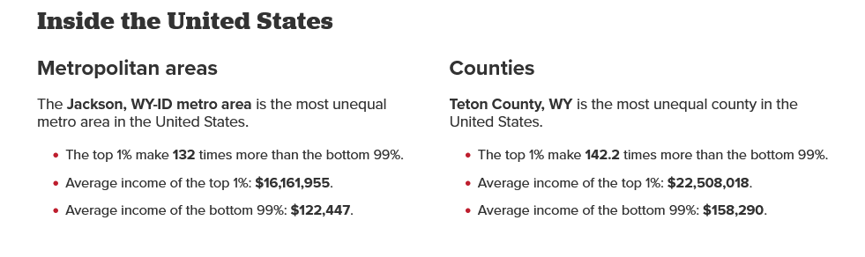
Income inequality in the United States

Slide 10
THE LOGIC OF THE WELFARE STATE
What’s the rationale for the welfare state?
  Alleviating economic insecurity
  Government programs that provide protection against unpredictable financial distress (known as social insurance programs) make all families feel safer.
  These two rationales for the welfare state are closely related to the ability-to-pay principle.
Social Insurance Programs
Old-Age, Survivors, and Disability Insurance (OASDI)
Unemployment Insurance
Workers' Compensation
Temporary Disability Insurance

Slide 11
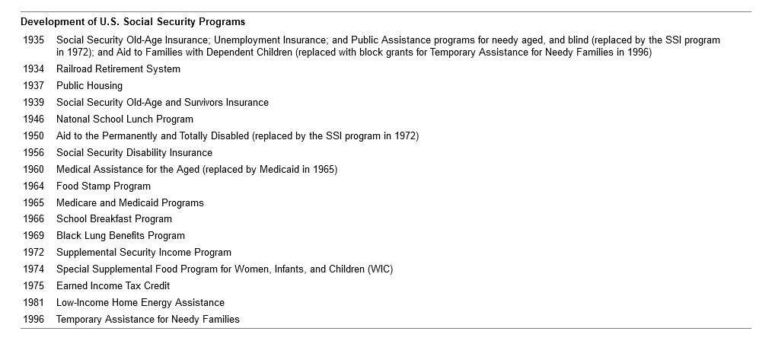
THE LOGIC OF THE WELFARE STATE
Franklin D. Roosevelt
Franklin D. Roosevelt
Franklin D. Roosevelt
Harry S. Truman
Harry S. Truman
Dwight D. Eisenhower
Dwight D. Eisenhower
Lyndon B. Johnson
Lyndon B. Johnson
Lyndon B. Johnson
Lyndon B. Johnson
Richard M. Nixon
Richard M. Nixon
Gerald R. Ford
Jimmy Carter
Bill Clinton

Slide 12
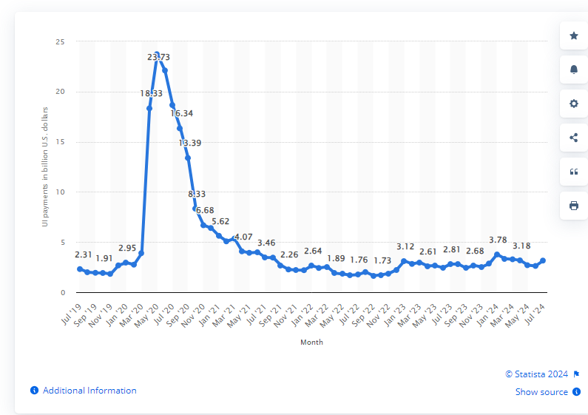
Total monthly unemployment insurance benefits paid in the US from July 2019 to July 2024

Slide 13
THE LOGIC OF THE WELFARE STATE
What’s the rationale for the welfare state?
  Reducing poverty and providing access to health care
  Programs that help to alleviate poverty and provide access to health care generate external benefits to society by helping disadvantaged people avoid unemployment, crime, and chronic health problems.
Department of Agriculture
Supplemental Nutrition Assistance Program (SNAP)
National School Lunch Program.
Special Supplemental Nutrition Program for Women, Infants, and Children (WIC)
Child and Adult Care Food Program.
School Breakfast Program.
Summer Food Service Program.
Commodity Supplemental Food Program.

Slide 14
THE LOGIC OF THE WELFARE STATE
Today, SNAP remains the second largest anti-poverty program for children and the most important program for reducing deep child poverty.
In 2022, SNAP raised 3.7 million people out of poverty. Food Stamps also supported millions of families affected by the Covid-19 pandemic.

Slide 15
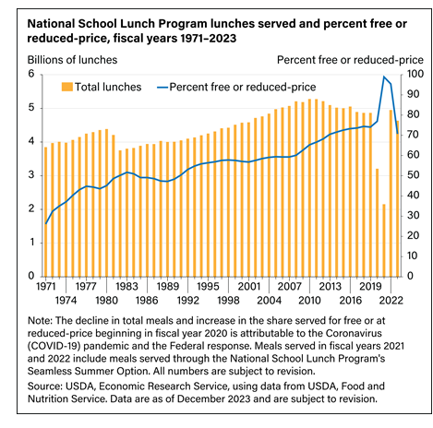
National School Lunch Program:
In fiscal year (FY) 2023, the program provided 4.6 billion lunches at a total cost of $17.2 billion.

Slide 16
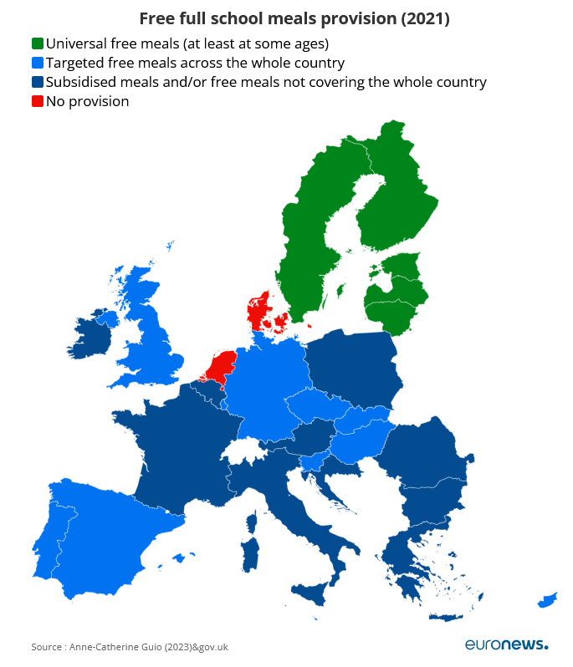

Slide 17
LEARN BY DOING: DISCUSSION QUESTION 1
Discuss with a partner: If the government imposes a modest tax on the very rich and gives that money to the very poor, what is the harm to the rich? What is the benefit to the poor? Does the benefit outweigh the harm? Would you recommend modest transfers from the rich to the poor?
Discuss the trade-off between efficiency and equity when it comes to taxing the rich and giving money to the poor.

Slide 18
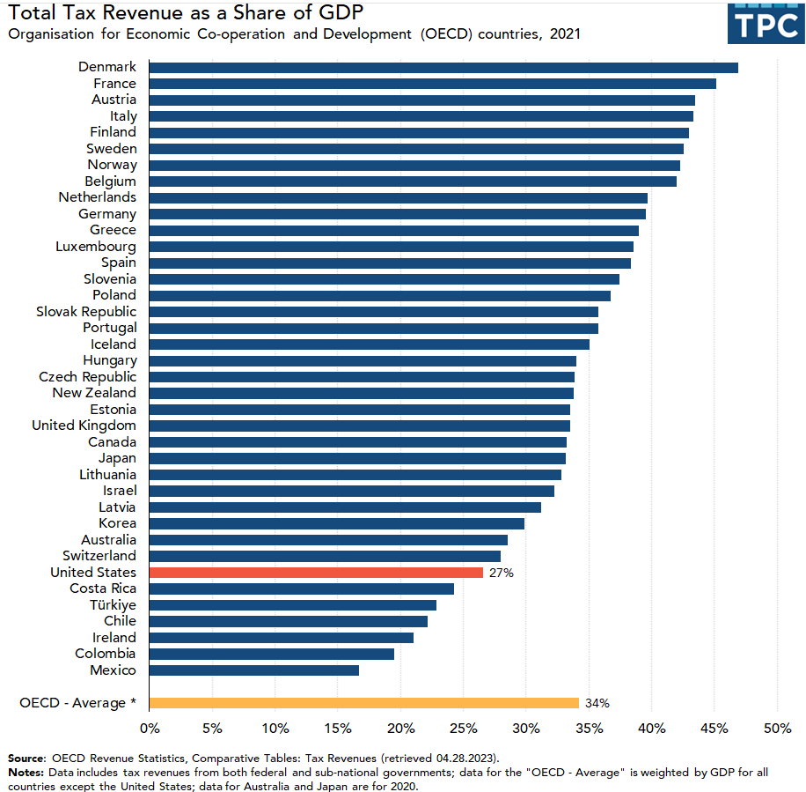

Slide 19
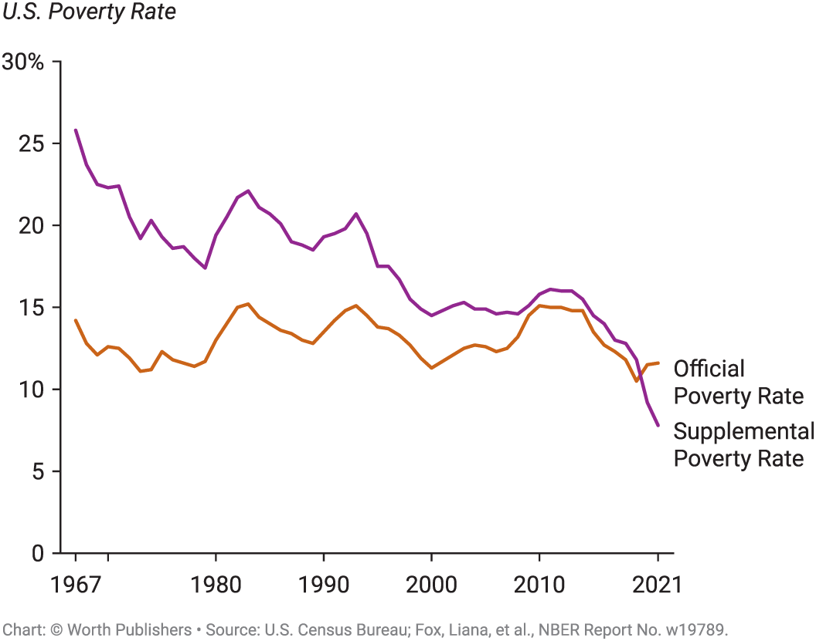
THE PROBLEM OF POVERTY
The poverty threshold is the annual income below which a family is officially considered poor.
The poverty rate is the percentage of the population with income below the poverty threshold.
A Supplemental Poverty Measure includes income from government aid, a measure that experts consider to be more accurate.
Figure 1

Slide 20
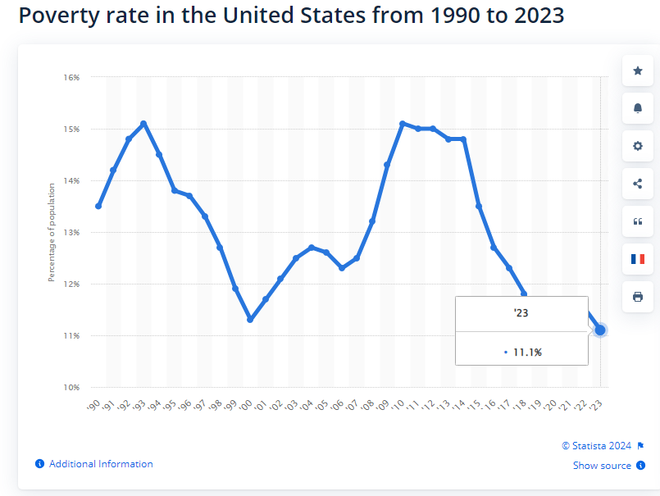

Slide 21
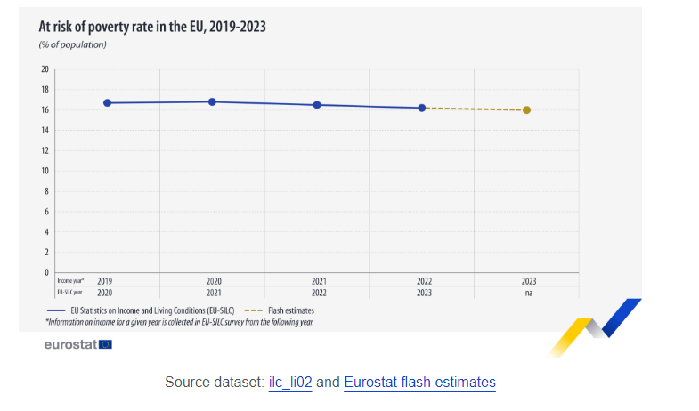

Slide 22
WHO ARE THE AMERICANS LIVING IN POVERTY? (1 of 2)
In 2021, 37.9 million Americans were living at the poverty threshold—11.6% of the population, or slightly more than one in nine persons.
41.7% of the poor are non-Hispanic Whites;
28.2% are Hispanics;
22.6% are Black; and
5.1% are Asians.
However, Blacks, Hispanics, and Asians are more likely to be poor than non-Hispanic Whites.
One-third of all people in poverty are children.

Slide 23
WHO ARE THE AMERICANS LIVING IN POVERTY? (2 of 2)
Female-headed families with no spouse present had a very high poverty rate: 23.5%.
The link between poverty and inadequate employment: Many industries, particularly in the retail and service sectors, rely on part-time workers with low pay, and no health plans, paid vacation days, or retirement benefits.
The working poor: workers whose incomes fall at or below the poverty threshold.

Slide 24
WHAT CAUSES POVERTY?
In 2022 the median weakly wage of men with a bachelor degree was 87% higher than a men with only a high school diploma. “college premium”
Lack of education
Lack of proficiency in English
Racial and gender discrimination toward non-white population groups and women
Bad luck (illness, job losses)
Lower income than English-Speaking men.
Harlan County, Kentucky, former coal-mining center has been left behind. More than 40% of residents are below the poverty line.

Slide 25
PERSISTENT POVERTY AND POVERTY SPILLOVER EFFECTS
Poverty spillover effects: poverty among unrelated households in a given location leads to a higher incidence of persistent poverty.
  Operating much like a negative externality, poverty has spillover effects
Low-income neighborhoods are more likely to be affected by crime and property crime than high-income neighborhoods.
Types of violence include, but are not limited to, child abuse and neglect, firearm violence, intimate partner violence, sexual violence, and elder abuse

Slide 26
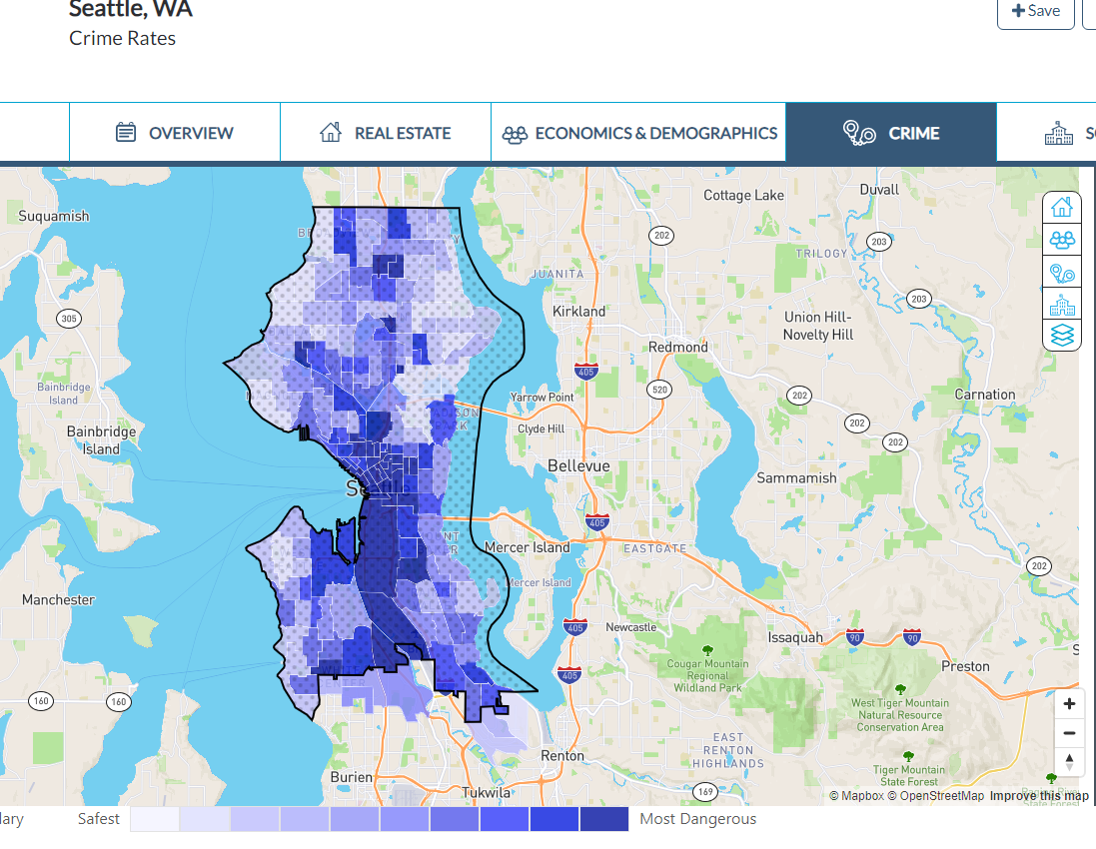

Slide 27
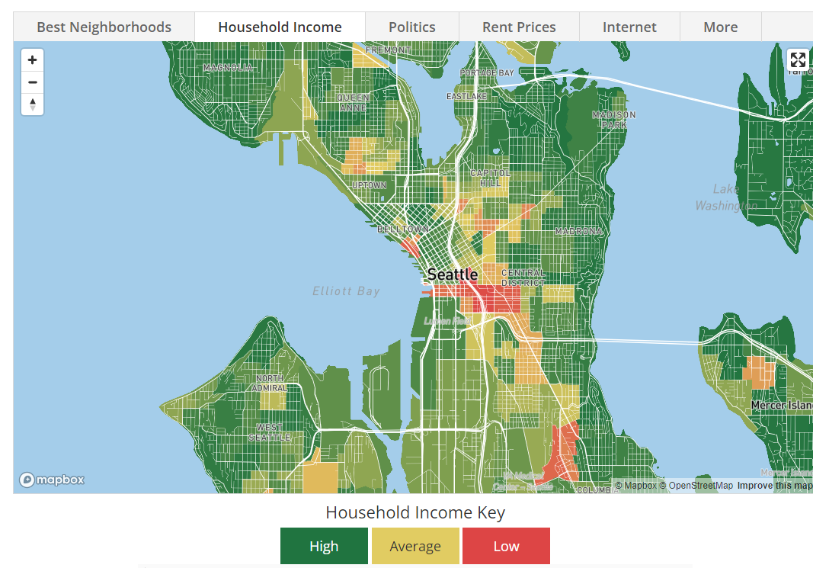

Slide 28
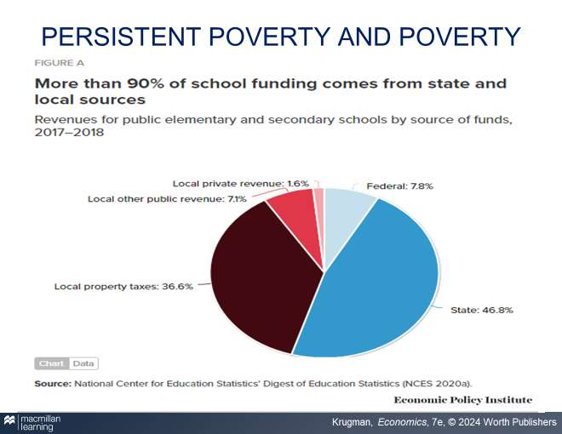
WHY DO POOR NEIGHBORHOODS PERPETUATE POVERTY?
Lack of quality education
Lack of positive role models and strong support networks
Lack of jobs

Slide 29
CONSEQUENCES OF POVERTY
Poverty is associated with lack of access to health care, which can lead to health problems that erode the ability to attend school and work later in life.
Affordable housing is also frequently a problem, leading poor families to move often, disrupting school and work schedules.
Children raised in severe poverty tend to suffer from lifelong learning disabilities.
Poor children who grew up in highly segregated neighborhoods were much less likely to be employed as adults than those who were equally poor but grew up in areas that were economically diverse and less segregated.

Slide 30
ECONOMIC INEQUALITY
Mean household income: the average income across all households.
Median household income: the income of the household lying at the exact middle of the income distribution.
Economists prefer median income to mean income because mean income is strongly affected by the incomes of a few very rich Americans, and median income is not.
TABLE 1 U.S. Income Distribution in 2021
Income group | Income range | Average income | Percent of total income
Bottom quintile | $28,007 and under | $14,859 | 2.9%
Second quintile | $28,008 to $55,000 | 41,025 | 8.0
Third quintile | $55,001 to $89,744 | 70,879 | 13.9
Fourth quintile | $89,745 to $149,131 | 115,462 | 22.6
Top quintile | $149,132 and over | 269,356 | 52.7
Top 5% | $289,304 and over | 480,236 | 23.5
Mean income | $102,316 | Median income | $70,784

Slide 31
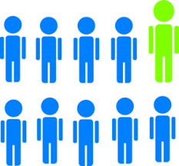
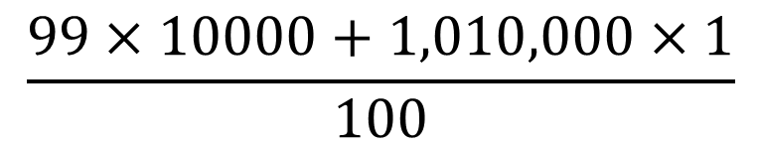
ECONOMIC INEQUALITY
There are 100 households in the economy of Equalor. Initially, 99 of them have an income of $10,000 each, and one household has an income of $1,010,000.
a. What is the median and mean income in this economy?
Median Income: 10,000
$$\frac{99×10000+1,010,000×1}{100}$$
Mean Income: 20,000

Slide 32
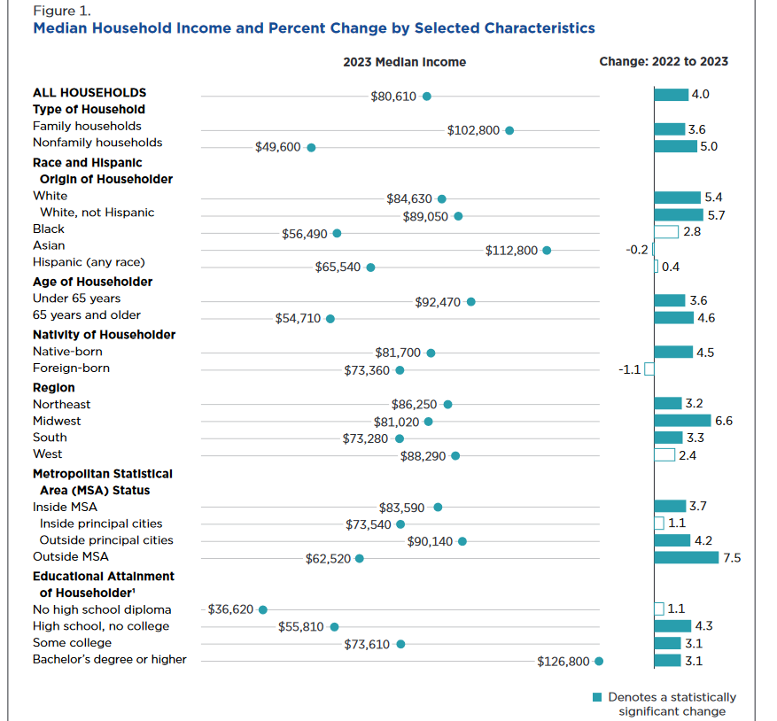


US Census Bureau

Slide 33
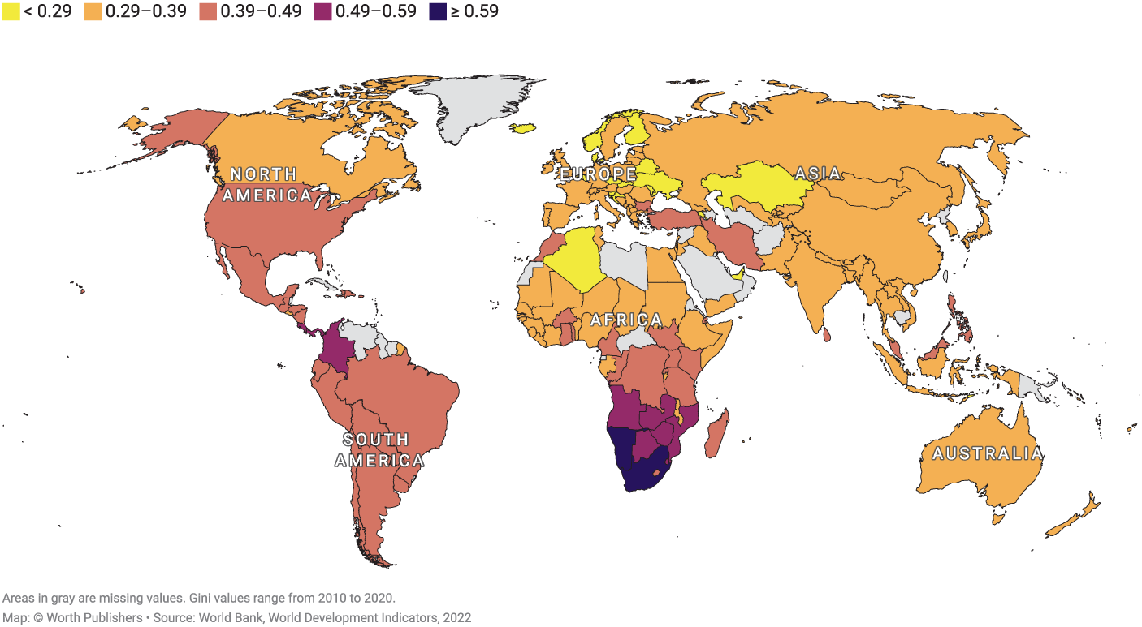
INTERNATIONAL COMPARISONS OF INEQUALITY
The Gini coefficient (from 0 to 1; higher Gini coefficient = less equal) measures a country’s income inequality. The highest levels of income inequality are found in Africa and Latin America. The most equal distributions of income are in Europe. The United States has unusually high inequality.

Slide 34
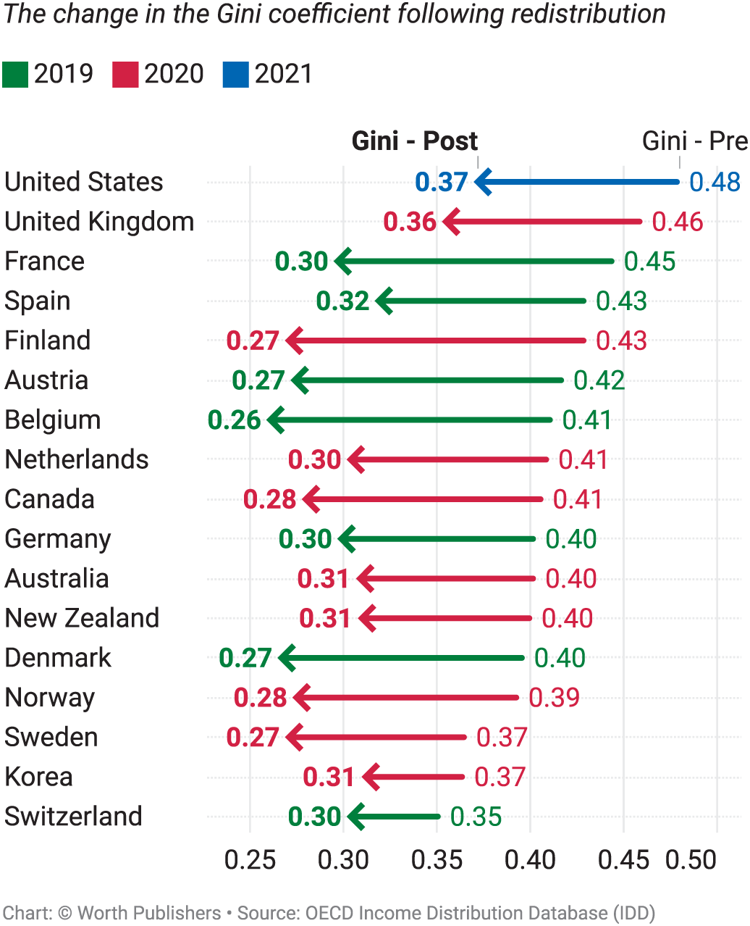
INCOME, REDISTRIBUTION, AND INEQUALITY IN RICH COUNTRIES
In Denmark, the rich aren’t as rich and the poor aren’t as poor. Why?
The role of government: European nations do a lot more income redistribution than the United States does.

Slide 35
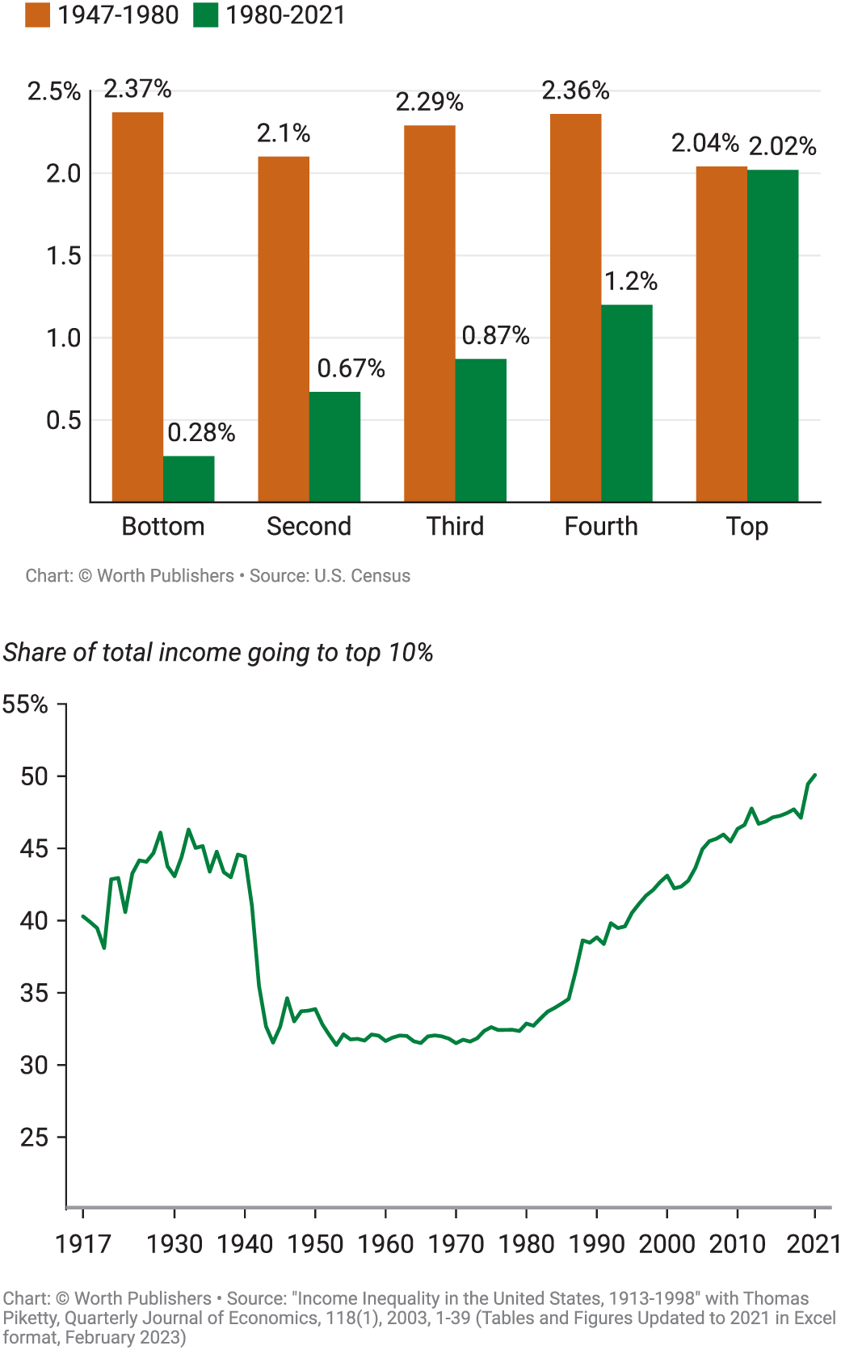
ECONOMICS IN ACTION: ECONOMIC INSECURITY (1 of 2)
Long-term trends in U.S. income inequality. Rate of Income Growth since 1947.

Slide 36
ECONOMICS IN ACTION: ECONOMIC INSECURITY (2 of 2)

Slide 37
WHEN IS INEQUALITY A PROBLEM?
Some level of income inequality is desirable. A lot of income inequality represents economic rewards to skill, effort, innovation, and education.
Yet high income inequality means that a lot of people are not sharing in the country’s overall prosperity. In the United States, for example, inequality has been rising for 40 years.

Slide 38
WHEN IS INEQUALITY A PROBLEM?
Another concern is that children of poor parents are more likely to be poor than children of affluent parents—a correlation that is stronger in the United States than in other rich countries.
Extreme inequality can limit opportunities for the poor and spur social and political instability.

Slide 39
ECONOMIC INSECURITY
Economic insecurity afflicts even relatively well-off families:
  Risk of a sudden loss of income.
  For example, in the wake of the COVID-19 pandemic in the Spring of 2020, the unemployment rate jumped from less than 5% to nearly 15%.
  Economic inequality sharply increased as 40% of low-income Americans reported losing their jobs while only 13% of households with incomes above $100,000 reported a job loss.

Slide 40
THE U.S. WELFARE STATE
Means-tested programs benefit individuals or families whose incomes fall below a certain level.
In-kind benefit: a benefit in the form of goods or services
Negative income tax: a government program that supplements the income of low-income working families.
TABLE 12 Major U.S. Welfare State Programs, 2021
 | Monetary transfers | In-kind
Means-tested | Temporary Assistance for Needy Families: $20.7 billion | Supplemental Nutrition Assistance Program (SNAP): $134.5 billion
Means-tested | Supplemental Security Income: $53.3 billion | Medicaid: $520.6 billion
Means-tested | Earned Income Tax Credit: $57.6 billion | Affordable Care Act: $64.6 billion
Not means-tested | Social Security: $1,128.8 billion | Medicare: $688.8 billion
Not means-tested | Unemployment insurance: $390.9 billion
Data from: Office of Management and Budget and Congressional Budget Office

Slide 41
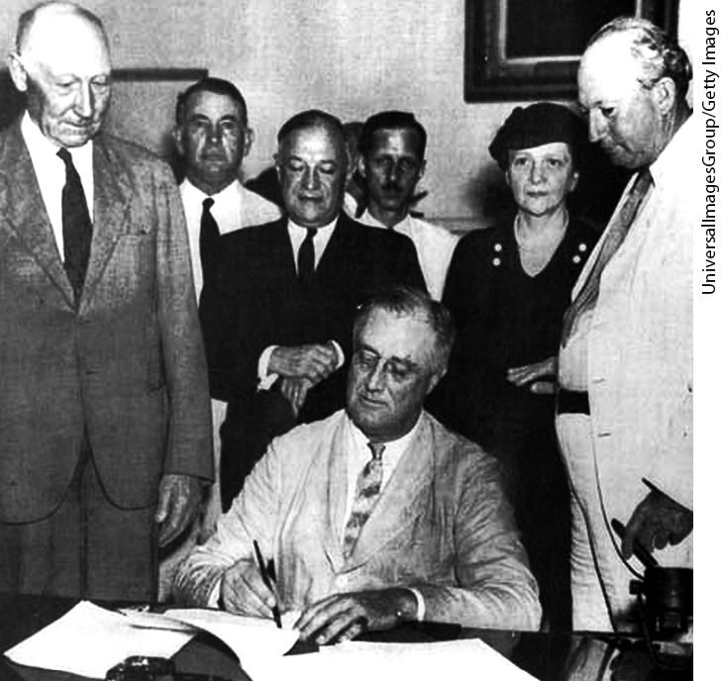
SOCIAL SECURITY AND UNEMPLOYMENT INSURANCE
President Franklin D. Roosevelt signed the Social Security Act in 1935, creating the modern welfare state.
Social Security: a non-means-tested program that guarantees retirement income to older Americans and provides benefits to disabled workers and “survivor benefits” to family members of workers who die. It’s supported by the payroll tax.
Unemployment insurance: a non-means-tested program that pays workers who lose their job with about 45% of previous salary until they find a new job or until 26 weeks have passed.

Slide 42
EFFECTS OF THE WELFARE STATE ON POVERTY AND INEQUALITY PART 1
TABLE 3 Effects of Government Programs on Reducing the Rate of Poverty, 2012
 | All People | Children | Adults (16 to 64 years) | 65 Years and Older
Social Security | 8.56% | 1.97% | 4.08% | 39.86%
Refundable tax credits | 3.02 | 6.66 | 2.25 | 0.2
SNAP (Food Stamps) | 1.62 | 3.01 | 1.27 | 0.76
Unemployment insurance | 0.79 | 0.82 | 0.88 | 0.31
Supplemental Security Income | 1.07 | 0.84 | 1.12 | 1.21
Housing subsidies | 0.91 | 1.39 | 0.66 | 1.12
School lunch | 0.38 | 0.91 | 0.25 | 0.03
Temporary Assistance for Needy Families | 0.21 | 0.46 | 0.14 | 0.05
WIC (supplemental nutrition program for Women, Infants, and Children) | 0.13 | 0.29 | 0.09 | 0
Statistics show only the direct effect of taxes and transfers, not the indirect effect, such as changes in behavior (for example, how many older Americans would be working if they didn’t receive Social Security checks?). Statistics can’t capture indirect effects; still, the results are striking.

Slide 43
EFFECTS OF THE WELFARE STATE ON POVERTY AND INEQUALITY PART 2
Effects of taxes and transfers on income distribution
TABLE 4 Effects of Taxes and Transfers on Income Distribution, 2019
Quintiles | Share of aggregate income without taxes and transfers | Share of aggregate income with taxes and transfers
Bottom quintile | 4.0% | 7.7%
Second quintile | 8.7 | 10.7
Third quintile | 13.6 | 14.5
Fourth quintile | 20.4 | 20.2
81st–99th percentiles | 38.7 | 35.5
Top 1% | 15.9 | 13.0
Data from: Congressional Budget Office.

Slide 44
DISCUSSION QUESTION 3
The country of Marxland has the following income tax and social insurance system. Each citizen’s income is taxed at an average tax rate of 100%. A social insurance system then provides transfers to each citizen such that each citizen's after-tax income is exactly equal. That is, each citizen gets (through a government transfer payment) an equal share of the income tax revenue.
Each citizen has an incentive:
a) not to work at all but to accept an equal share of total income.
b) to work as hard as possible to maximize total income.
c) to work hard because extra effort will result in a larger total income and therefore a larger share for each Marxlandian.

Slide 45
DISCUSSION QUESTION 3
The country of Marxland has the following income tax and social insurance system. Each citizen’s income is taxed at an average tax rate of 100%. A social insurance system then provides transfers to each citizen such that each citizen's after-tax income is exactly equal. That is, each citizen gets (through a government transfer payment) an equal share of the income tax revenue.
Each citizen has an incentive:
a) not to work at all but to accept an equal share of total income.
b) to work as hard as possible to maximize total income.
c) to work hard because extra effort will result in a larger total income and therefore a larger share for each Marxlandian.

Slide 46
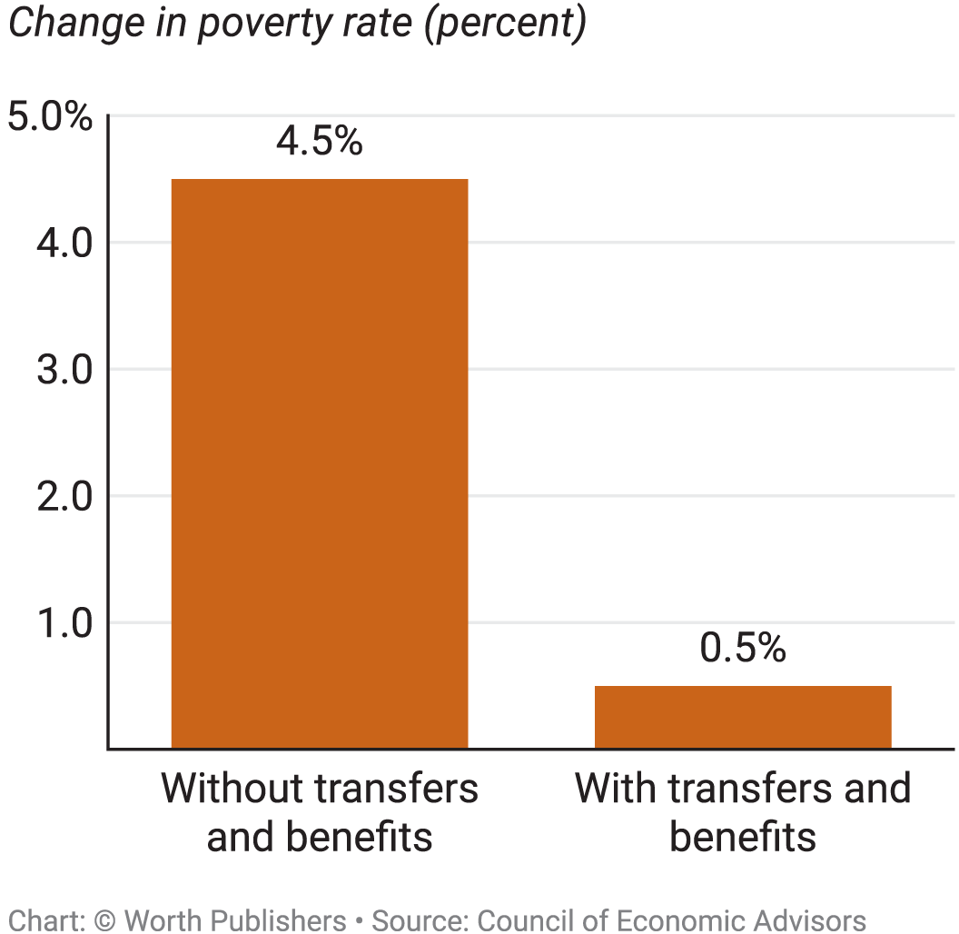
ECONOMICS IN ACTION: WELFARE STATE PROGRAMS AND POVERTY RATES IN THE GREAT RECESSION, 2007–2010
Poverty rose much faster in the Great Depression than in the Great Recession: why?
Government antipoverty programs protected the poor. (See Figure 4.)

Slide 47
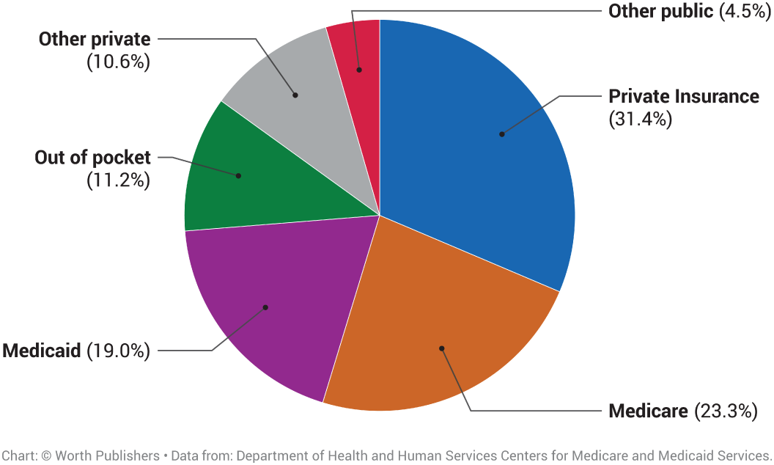
THE ECONOMICS OF HEALTH CARE
2021: U.S. personal health care expenses were $12,914 per person—18.3% of gross domestic product. Who actually foots the bill?

Slide 48
THE PROBLEM WITH PRIVATE HEALTH INSURANCE
Anyone can suddenly need very expensive medical treatment, costing thousands of dollars in a very short time. As a result, most people would like to be covered by health insurance—insurance that covers the costs of medical bills.
Private health insurance: each member of a large pool of individuals pays a fixed amount annually to a private company that agrees to pay most of the medical expenses of the pool’s members.

Slide 49
THE PROBLEM WITH PRIVATE HEALTH INSURANCE
Private health insurance is subject to market failure.
People typically don’t buy health insurance until they are already sick. As a result, the average person who buys a private health insurance policy is sicker than the average person.
  Premiums must be raised to account for the higher medical expenses, which leads more healthy people to stop buying insurance and leave the pool.
  In the end, only very sick are left in the pool: the private health insurance market death spiral.

Slide 50
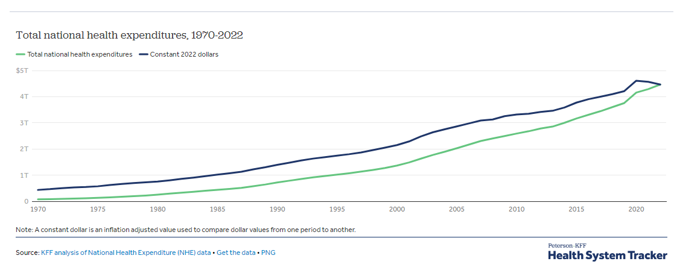
Health spending totaled $74.1 billion in 1970. By 2000, health expenditures had reached $1.4 trillion, and in 2022 the amount spent on health tripled to $4.5 trillion.

Slide 51
LEARN BY DOING: PRACTICE QUESTION 1 (1 of 2)
Edenville, a country of 100 people, decides to provide health care insurance to all. Each person will pay the same premium. Initially, everyone in Edenville endorses this plan and willingly pays. In Edenville,
  20% of the population never get sick.
  40% of the population get sick occasionally (and face $500 yearly expenses per person).
  The last 40% get sick often and face $5,000 yearly expenses per person.
  Initially, no one in Edenville knows their own category.

Slide 52

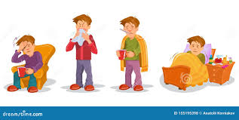
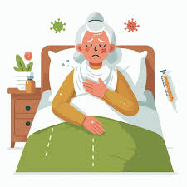
PRACTICE QUESTION 1
How much money will Edenville need to collect in total? Per person?
If each person contributes the same amount, the premium will equal $2,200 per person.
100*20%=20 people cost $0
100*40%=40 people
Total cost $500x40=$20,000
$220,000
100*40%=40 people
Total cost $5000x40=$200,000

Slide 53
PRACTICE QUESTION 1
Suppose healthy people conclude they are getting a raw deal and petition to be exempted from the insurance pool. Now, how much must be collected overall?
If the 20 healthy people leave the pool, the $220,000 in medical costs must be paid by the remaining 80 people. The premium per person would therefore equal $2,750.

Slide 54
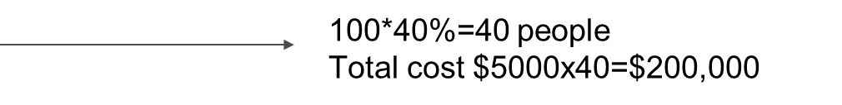
PRACTICE QUESTION 1
Suppose the relatively healthy 40% also opt out of the insurance pool. What’s the remaining total medical cost for Edenville? Per person remaining in the insurance pool?
If only the 40 sick people are left in the program, the health care insurance premium will be equal to $5,000 ($200,000/40).

Slide 55
EMPLOYMENT-BASED HEALTH INSURANCE
Private insurers can avoid the death spiral by selling insurance to employers rather than to individuals.
The advantage of employment-based health insurance is that employees enrolled are likely to be a representative mix of healthy and less healthy people, rather than a group of people who want insurance because they expect to incur high medical bills.

Slide 56
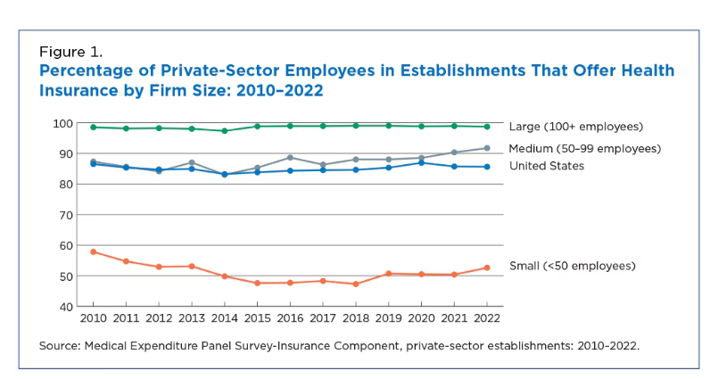
EMPLOYMENT-BASED HEALTH INSURANCE

Slide 57
GOVERNMENT HEALTH INSURANCE (1 of 2)
However, many people don’t receive employment-based health insurance: older Americans, many part-time workers, and the unemployed.
The majority of those who didn’t have private insurance were covered by two government programs, Medicare and Medicaid.
Medicare, financed by payroll taxes, is available to all Americans 65 and older, regardless of their income.
Medicaid is a means-tested program, paid for with federal and state government revenues.

Slide 58
GOVERNMENT HEALTH INSURANCE (2 of 2)
TABLE 5 Number of Americans Covered by Health Insurance, 2021 (millions)
Covered by private health insurance | 216.4
Employment-based | 178.4
Direct purchase | 33.6
Covered by government | 117.1
Medicaid | 61.9
Medicare | 60.2
Military health care | 3.2
Uninsured/not covered | 27.2
Data from: U.S. Census Bureau.

Slide 59
HEALTH CARE IN OTHER COUNTRIES (1 of 2)
TABLE 6 Health Care Systems in Advanced Countries, 2020
 | Government share of health care spending | Health care spending per capita (US$, purchasing power parity) | Life expectancy (total population at birth, years) | Infant mortality (deaths per 1,000 live births)
United States | 55.4% | $11,859 | 77.3 | 5.4
United Kingdom | 82.8 | 5,019 | 80.9 | 3.6
Canada | 74.9 | 5,828 | 81.8 | 4.4
Switzerland | 73.2 | 7,179 | 83.1 | 3.5
Australia | 71.5 | 5,627 | 83.2 | 3.1
Austria | 76.4 | 5,883 | 81.2 | 3.0

Slide 60
HEALTH CARE IN OTHER COUNTRIES
The United States is very different from other wealthy countries:
We rely much more on private health insurance than any other wealthy country does.
We spend much more on health care per person.
We remain the only wealthy country in which substantial numbers of people lack health insurance.
Single-payer system: a health care system in which the government is the principal payer of medical bills funded through taxes (Medicare in the United States, and health care in Canada).

Slide 61
THE AFFORDABLE CARE ACT
Name:
  The Patient Protection and Affordable Care Act (PPACA)—or ACA, for short
Aims:
Covering the uninsured
    Closely follows the Massachusetts plan (“Romneycare”): requires everyone, including healthy people, to buy health insurance
    Cost control
    The premise: the current U.S. medical system has skewed incentives that waste resources.

Slide 62
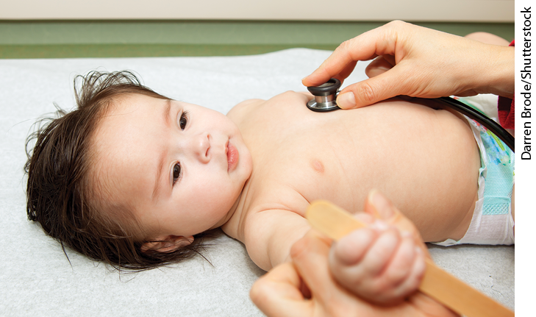
ECONOMICS IN ACTION: MEDICAID
Does Medicaid really help the poor? A budget crisis resulted in a natural experiment in Oregon (2008).
Those lucky enough to receive Medicaid through lottery benefited in many ways.

Slide 63
THE DEBATE OVER THE WELFARE STATE (1 of 2)
Should we tax the rich at higher rates by using the ability-to-pay principle?
Or should we worry more about incentives: will higher taxes reduce incentives to work hard and make society as a whole poorer?
One way to reduce the cost of the welfare state is to means-test benefits: make them available only to those who need them.

Slide 64
THE DEBATE OVER THE WELFARE STATE (1 of 2)
Means-testing creates a benefits notch:
Suppose there is a $2,000 per year benefit, available only to families with annual incomes less than $20,000. The family currently has an income of $19,500. One family member is deciding whether to take a new job that will raise the family’s income to $20,500.
Taking that job will actually make the family worse off because it will gain $1,000 in earnings but lose the $2,000 in government benefits.

Slide 65
THE DEBATE OVER THE WELFARE STATE (2 of 2)
The politics of the welfare state
Differences in opinions on the welfare state reflect differences in values and philosophy.
Economics can’t resolve those differences, especially as political polarization has increased.

Slide 66
LEARN BY DOING: DISCUSSION QUESTION 4
What would happen if the government removed all social safety nets from the economy?
What would happen if the government provided for all financial needs of its citizens?

Slide 67
LEARN BY DOING: PRACTICE QUESTION 3
The program that provides health insurance coverage to all Americans aged 65 and older, regardless of their income, is:
  Medicaid.
  Medicare.

Slide 68
LEARN BY DOING: PRACTICE QUESTION 3
(ANSWER)
The program that provides health insurance coverage to all Americans aged 65 and older, regardless of their income, is:
  Medicaid.
  Medicare. (correct answer)

Slide 69
LEARN BY DOING: PRACTICE QUESTION 4
Health care expenditure per person in the United States is:
  about the same as in Britain, Canada, and Switzerland.
  lower than in Britain, Canada, and Switzerland.
  higher than in Britain, Canada, and Switzerland.
  higher than in Canada and Switzerland but lower than in Britain.

Slide 70
LEARN BY DOING: PRACTICE QUESTION 4
(ANSWER)
Health care expenditure per person in the United States is:
  about the same as in Britain, Canada, and Switzerland.
  lower than in Britain, Canada, and Switzerland.
  higher than in Britain, Canada, and Switzerland. (correct answer)
  higher than in Canada and Switzerland but lower than in Britain.

