Slide 1
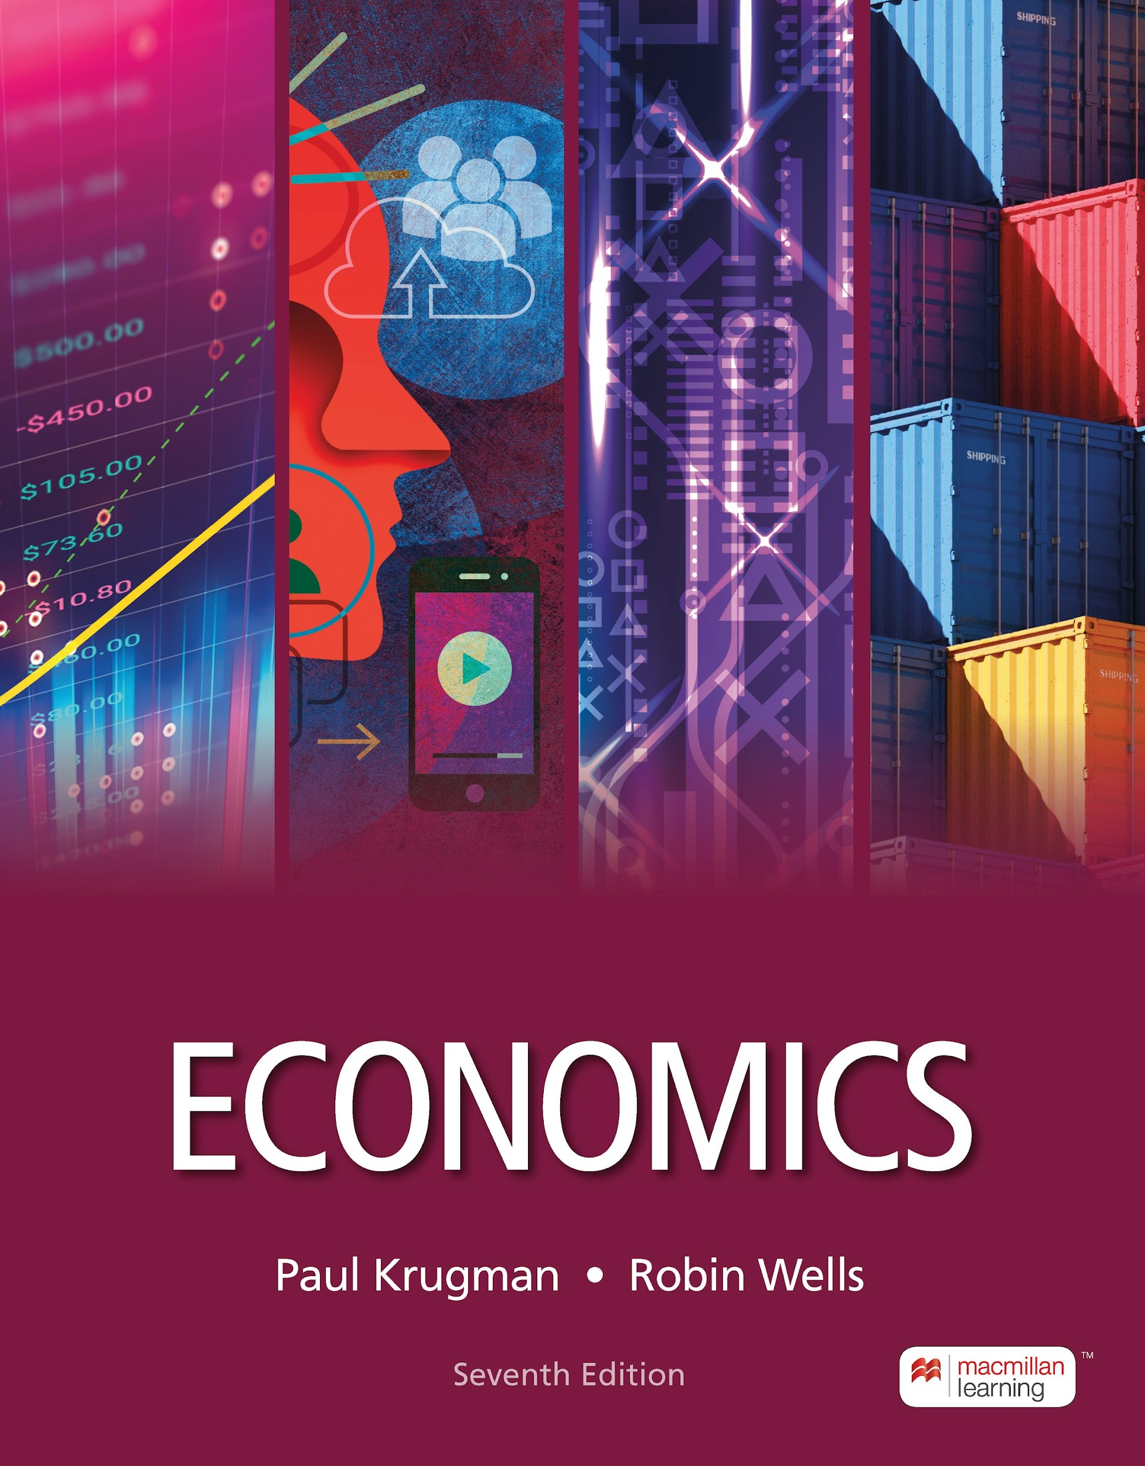
Public Goods and Common Resources
11
Notes:
Cover Credits: Currency Exchange Stock Chart: cemagraphics/Getty Images, Social Media Montage: SEAN GLADWELL/Getty Images, Circuit Pattern: somsak Tangdamrongsub/Getty Images, Cargo Containers: urzine/Getty Images

Slide 2
Important Dates
Writing Assignment 2 is due this Saturday October 19th.
Quiz #4 (Chapters 7 & 9) is due this coming Sunday October 20th.
Homework #9 is due on Wednesday October 23rd.

Slide 3
WHAT YOU WILL LEARN IN THIS CHAPTER
What is a public good, and how is it different from a private good?
What is a common resource, and why is it overused?
What is an artificially scarce good, and why is it underconsumed?
Why do markets typically fail to supply these types of goods efficiently?
How can government intervention make society better off in the production and consumption of these types of goods?

Slide 4
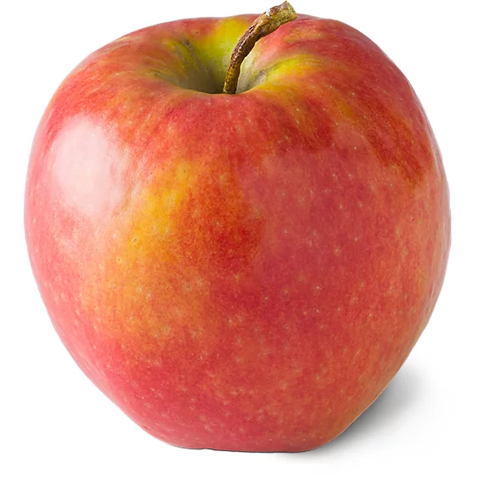

CHARACTERISTICS OF GOODS
  Excludable: People who don’t pay can be easily prevented from using a good.
    Example: jeans
  Rival in consumption: The same unit of the good cannot be consumed by more than one person at a time (or at all).
    Example: cheeseburger
    Your Happy Meal: both excludable and rival.
  Nonexcludable: People who don’t pay cannot be easily prevented from using a good.
    Example: national defense
  Nonrival: More than one person can consume the same unit of the good at the same time.
    Example: digital music

Slide 5
FOUR TYPES OF GOODS (1 of 2)
Private goods are excludable and rival in consumption, like wheat.
Public goods are nonexcludable and nonrival in consumption, like a public sewer system.
Common resources are goods that are nonexcludable but rival in consumption, like water in a river.
Artificially scarce goods are excludable but nonrival in consumption, like on-demand movies on Amazon Prime.

Slide 6
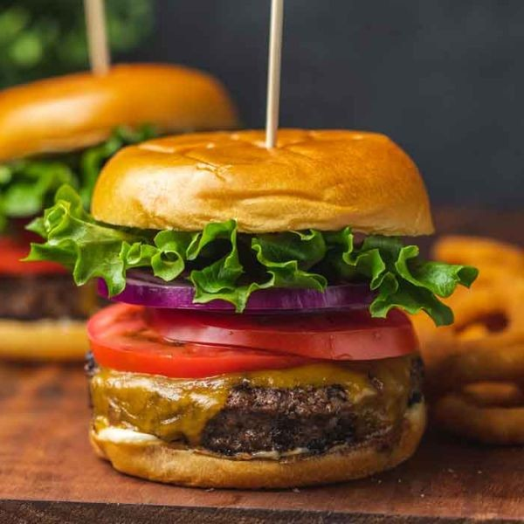
FOUR TYPES OF GOODS (1 of 2)
Private goods are excludable and rival in consumption, like wheat.

Slide 7
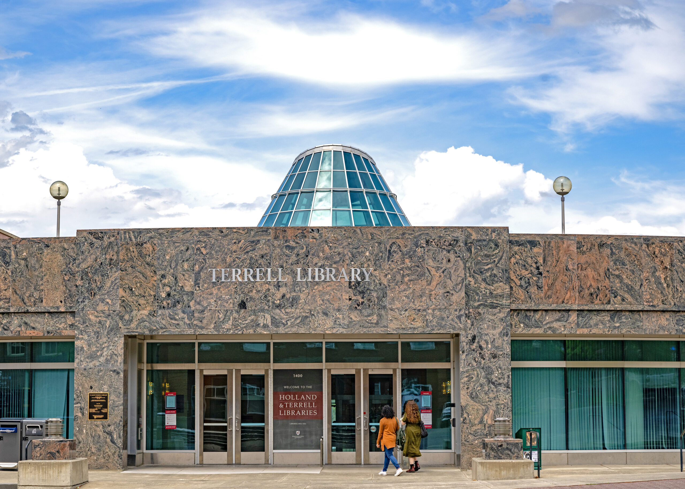
FOUR TYPES OF GOODS (1 of 2)
2. Public goods are nonexcludable and nonrival in consumption, like a public sewer system.

Slide 8
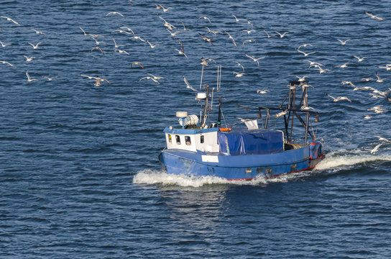
FOUR TYPES OF GOODS (1 of 2)
3. Common resources are goods that are nonexcludable but rival in consumption, like water in a river.

Slide 9
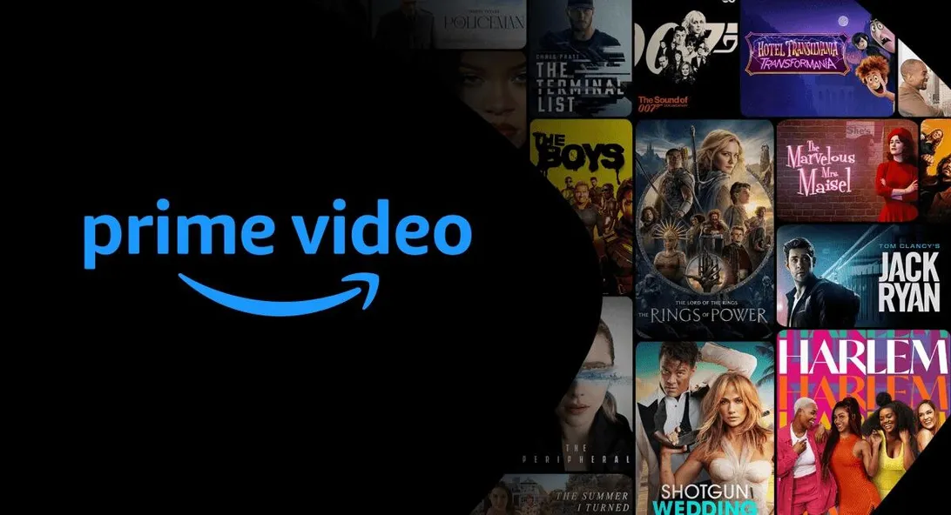
FOUR TYPES OF GOODS (1 of 2)
4. Artificially scarce goods are excludable but nonrival in consumption, like on-demand movies on Amazon Prime.

Slide 10
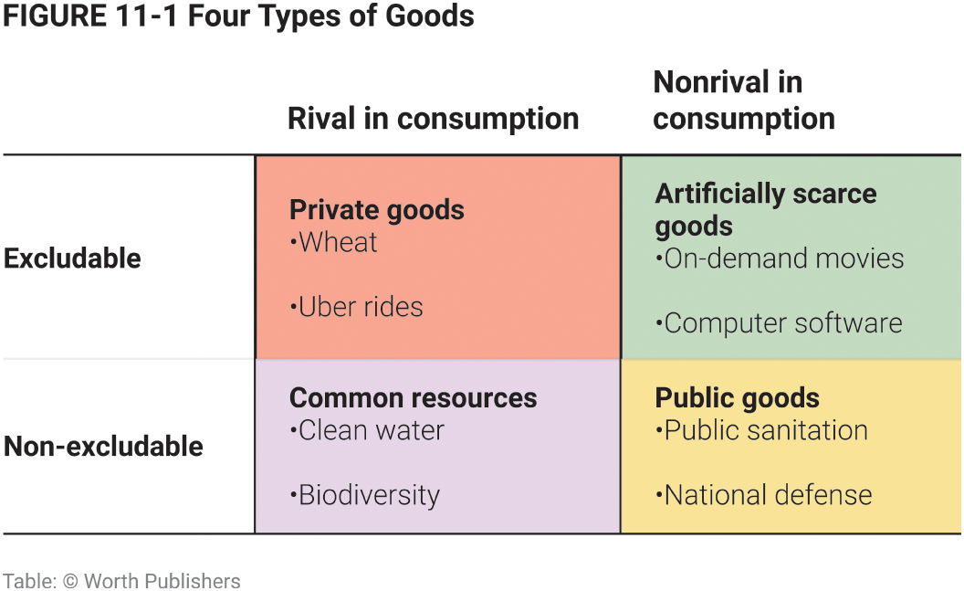
FOUR TYPES OF GOODS (2 of 2)
Figure 1

Slide 11
WHY MARKETS CAN SUPPLY ONLY PRIVATE GOODS EFFICIENTLY
Markets cannot supply goods and services efficiently unless they are private goods—excludable and rival in consumption.
Nonexcludable goods have the free-rider problem: many individuals are unwilling to pay for consumption of nonexcludable goods and instead will take a “free ride” on anyone who does pay.

Slide 12
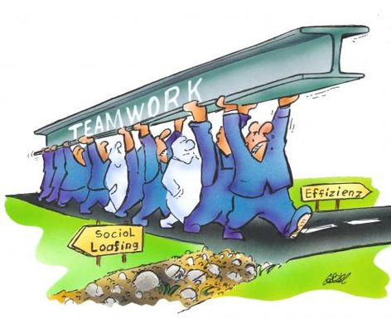
Free-rider problem
The free rider problem is an economic concept of a market failure that occurs when people are benefiting from resources, goods, or services that they do not pay.
Example: in a student group project, shirkers free ride on someone else’s effort.

Slide 13
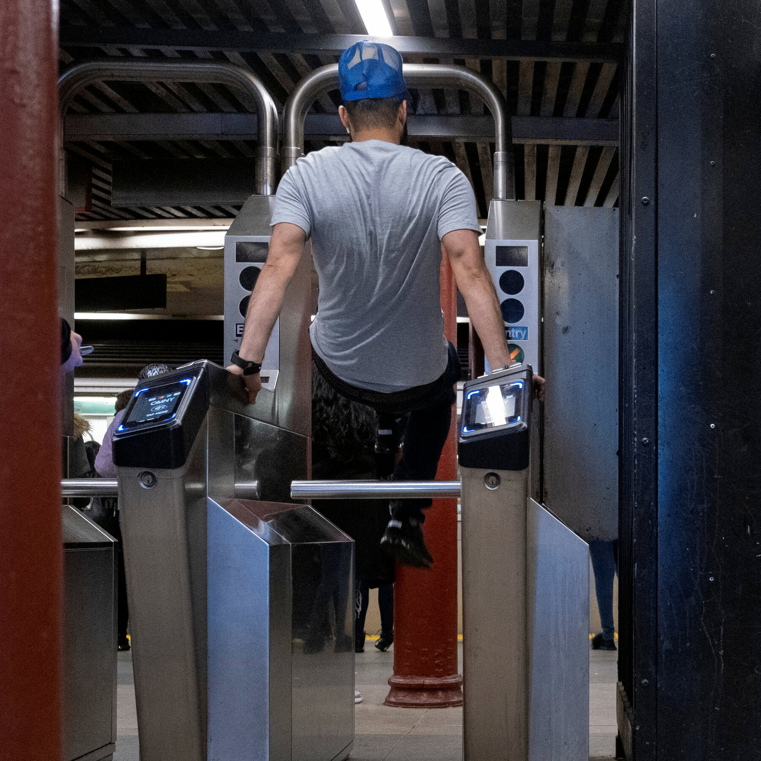
Free-rider problem
Yet even after a dramatic increase in enforcement, the NY transit system lost $690 million to fare evasion in 2022.
Potential solutions:
A program that subsidizes the cost of public transit for low-income New Yorkers.
Posting more advertisements urging riders to pay.
Adding new fare gates that are harder to climb.

Slide 14

WHY MARKETS CAN SUPPLY ONLY PRIVATE GOODS EFFICIENTLY
Nonexcludable goods suffer from inefficiently low production—they are undersupplied.
Goods that are excludable and nonrival in consumption suffer from inefficiently low consumption—they are underconsumed.
Example: Amazon Prime has a marginal cost of zero but charges $4 per movie so that viewers will only consume movies up to the point where their marginal benefit is $4 instead of zero.

Slide 15
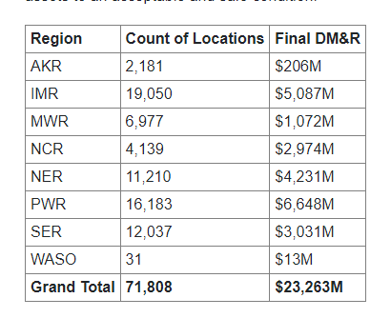
Fiscal Year 2023 Quarter 4 Deferred Maintenance and Repair by Region
Intermountain Region (IMR) is a National Park Service (NPS) region that includes parks in eight Western states: Arizona, Colorado, Montana, New Mexico, Oklahoma, Texas, Utah, and Wyoming

Slide 16
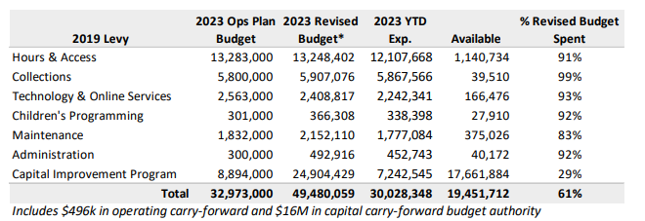
The Seattle Public Library
2023 Operations Plan Budget plus encumbrances and unspent budget authority from prior years in the revised budget columns.

Slide 17
LEARN BY DOING: PRACTICE QUESTION 1
Street cleaning is best characterized as a:
private good.
nonrival private good.
common resource.
public good.

Slide 18
LEARN BY DOING: PRACTICE QUESTION 1
(ANSWER)
Street cleaning is best characterized as a:
private good.
nonrival private good.
common resource.
public good. (correct answer)

Slide 19
LEARN BY DOING: PRACTICE QUESTION 2
Toilet paper is a rival good because:
there is a lot of competition in the toilet paper market.
it is a substitute good for a bidet.
if one person uses several sheets of toilet paper, no one else can.
it is made from natural resources.

Slide 20
LEARN BY DOING: PRACTICE QUESTION 2
(ANSWER)
Toilet paper is a rival good because:
there is a lot of competition in the toilet paper market.
it is a substitute good for a bidet.
if one person uses several sheets of toilet paper, no one else can. (correct answer)
it is made from natural resources.

Slide 21
LEARN BY DOING: PRACTICE QUESTION 3
Characterize each of these items as excludable or nonexcludable.
Central Park, New York
Cable television
Both I and II are excludable.
I is excludable; II is nonexcludable.
I is nonexcludable; II is excludable.
Both I and II are nonexcludable.

Slide 22
LEARN BY DOING: PRACTICE QUESTION 3
(ANSWER)
Characterize each of these items as excludable or nonexcludable.
Central Park, New York
Cable television
Both I and II are excludable.
I is excludable; II is nonexcludable.
I is nonexcludable; II is excludable. (correct answer)
Both I and II are nonexcludable.

Slide 23
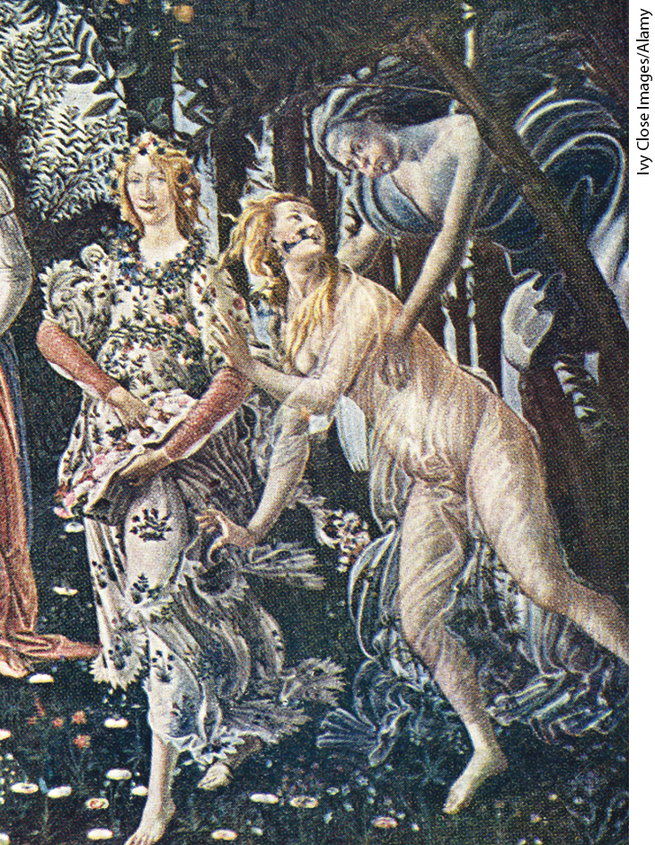
FROM MAYHEM TO RENAISSANCE
The murder rate during the European Middle Ages was 30 to 40 times higher than it is today.
What changed? Italian city-states created public institutions of law and order.

Slide 24
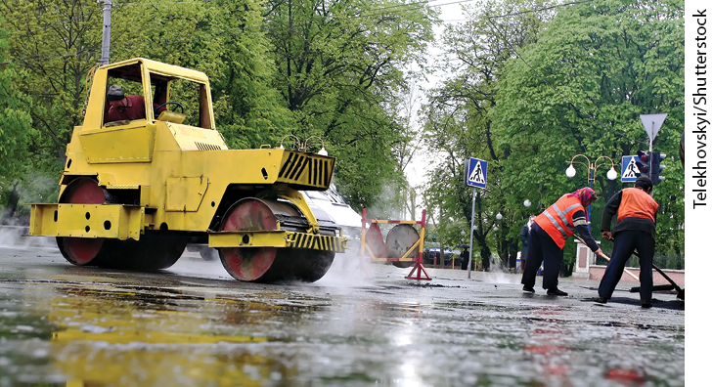
PUBLIC GOODS
A public good is a good that is both nonexcludable and nonrival in consumption. Examples: disease prevention, defense, scientific research.
Because these goods are nonexcludable, they suffer from the free-rider problem, so no private firm would be willing to produce them.
And because they are nonrival in consumption, it would be inefficient to charge people for consuming them.
Society must find nonmarket methods for providing these goods.

Slide 25

US public investment in development of mRNA covid-19 vaccines
The US government invested at least $31.9bn to develop, produce, and purchase mRNA covid-19 vaccines, including sizeable investments in the three decades before the pandemic through March 2022.
These public investments translated into millions of lives saved and were crucial in developing the mRNA vaccine technology.

Slide 26
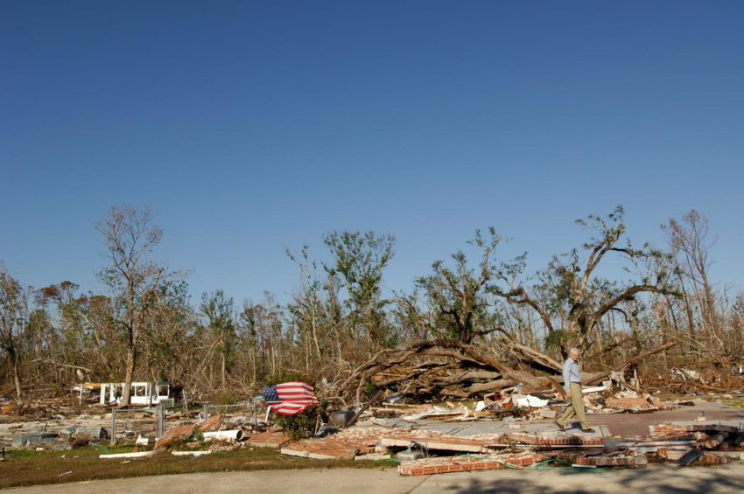
Hurricane Katrina
Hurricane Katrina struck the Gulf Coast of the United States on August 29, 2005, as a Category 3 hurricane.
The economic cost of Hurricane Katrina's damage was estimated to be approximately $125 billion, making it one of the costliest natural disasters in U.S. history

Slide 27
PROVIDING PUBLIC GOODS
Public goods are provided through a variety of means:
Voluntary contributions (example: private donations for scientific research);
Individuals or firms who make money in an indirect way (example: meta supplies social media platforms—almost entirely supported by advertising);
Social encouragement or pressure in small communities (example: volunteer fire departments);
The government (most important public goods—national defense, the legal system, disease control, and so on—are provided by government and paid for by taxes).

Slide 28
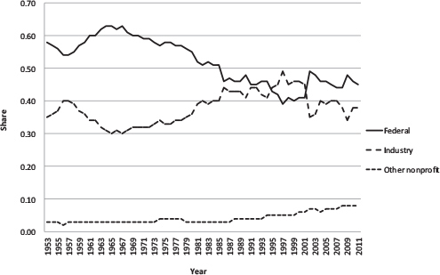
Federal, industry, and nonprofit shares of total funding for U.S. basic and applied research, 1953-2011

Slide 29
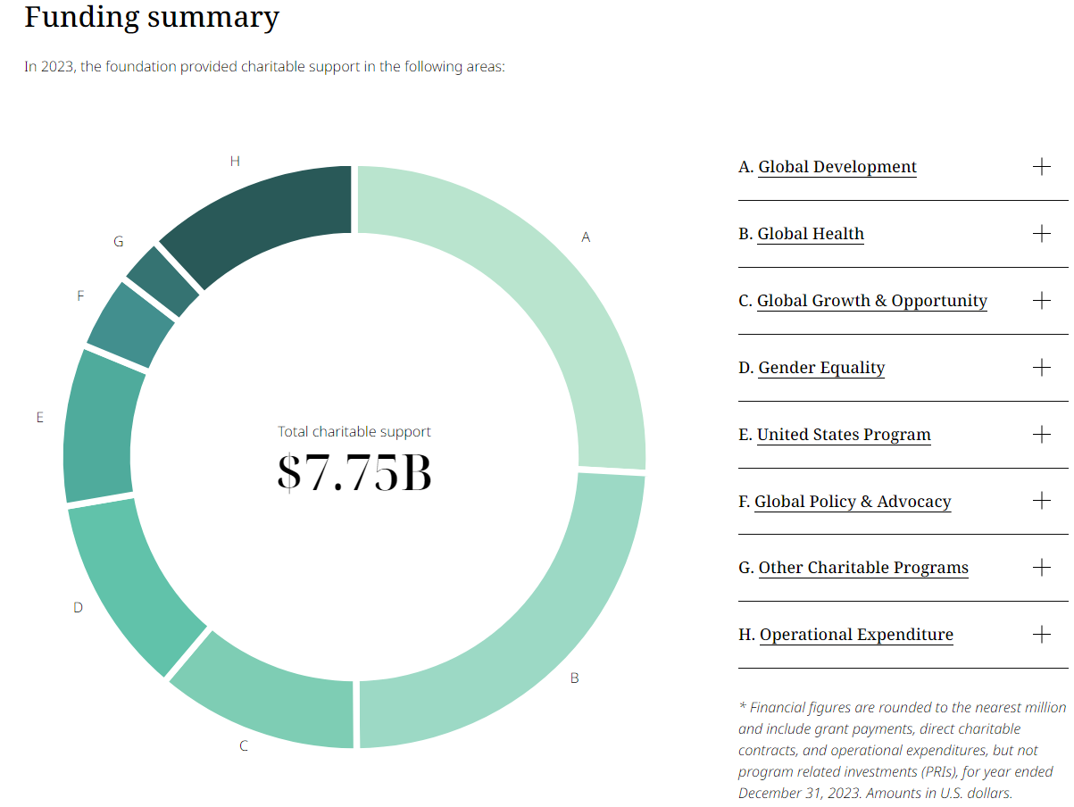
Gates Foundation 2023

Slide 30
HOW MUCH OF A PUBLIC GOOD SHOULD BE PROVIDED? (1 of 3)
If the government provides the public good, how much should it produce?
Produce the quantity where marginal social benefit of a public good equals marginal cost of producing it.
The marginal social benefit of a public good is equal to the sum of the individual marginal benefits enjoyed by all consumers (the sum of each consumer’s willingness to pay for that unit).

Slide 31
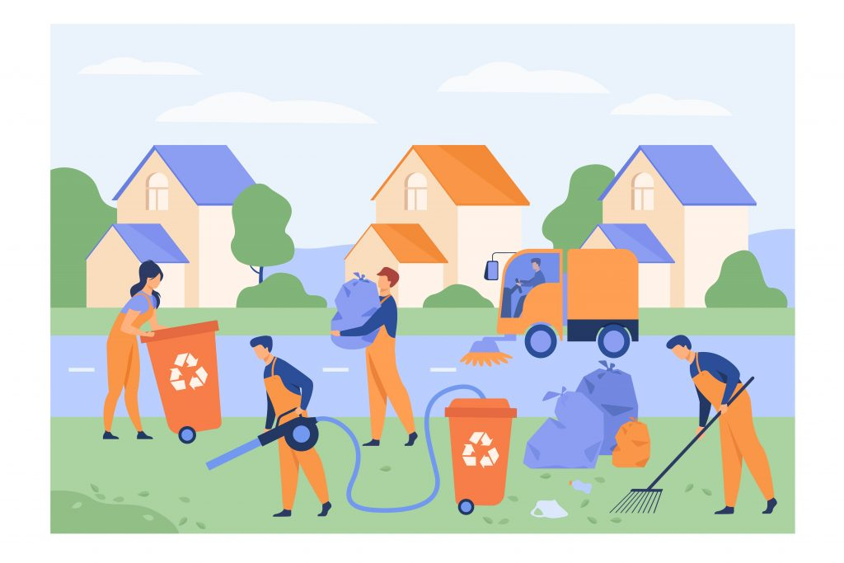
HOW MUCH OF A PUBLIC GOOD SHOULD BE PROVIDED? (1 of 3)
Imagine a city with two residents, Theo and Abby. Assume that Theo and Abby truthfully tell the government their willingness to pay for another unit of the public good—they tell the government their marginal benefits.
The efficient quantity of a public good is the quantity at which the marginal social benefit is equal to the marginal cost of providing it.

Slide 32
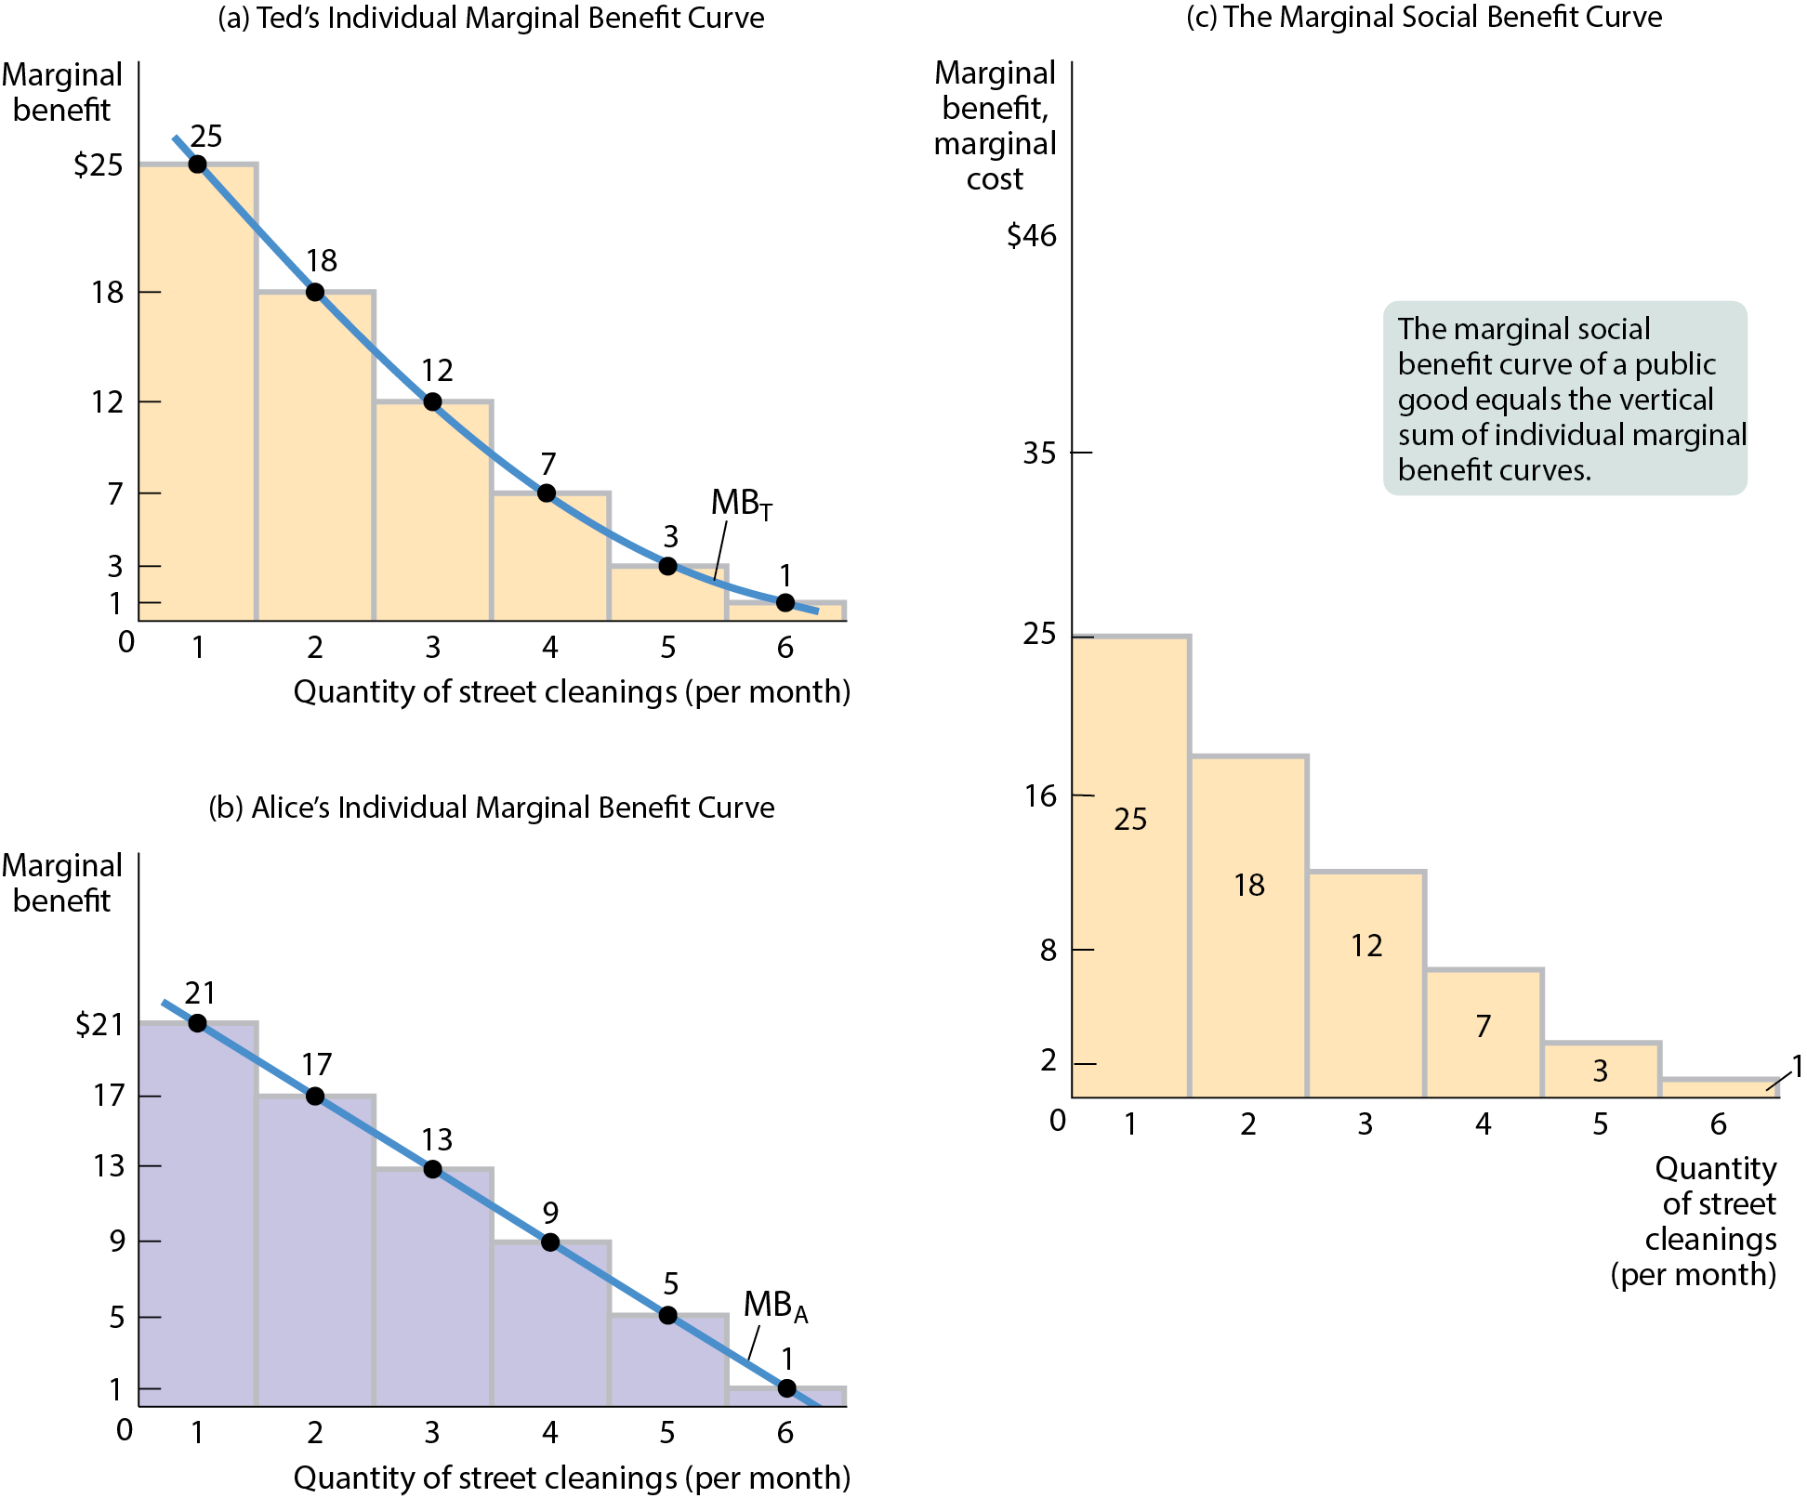
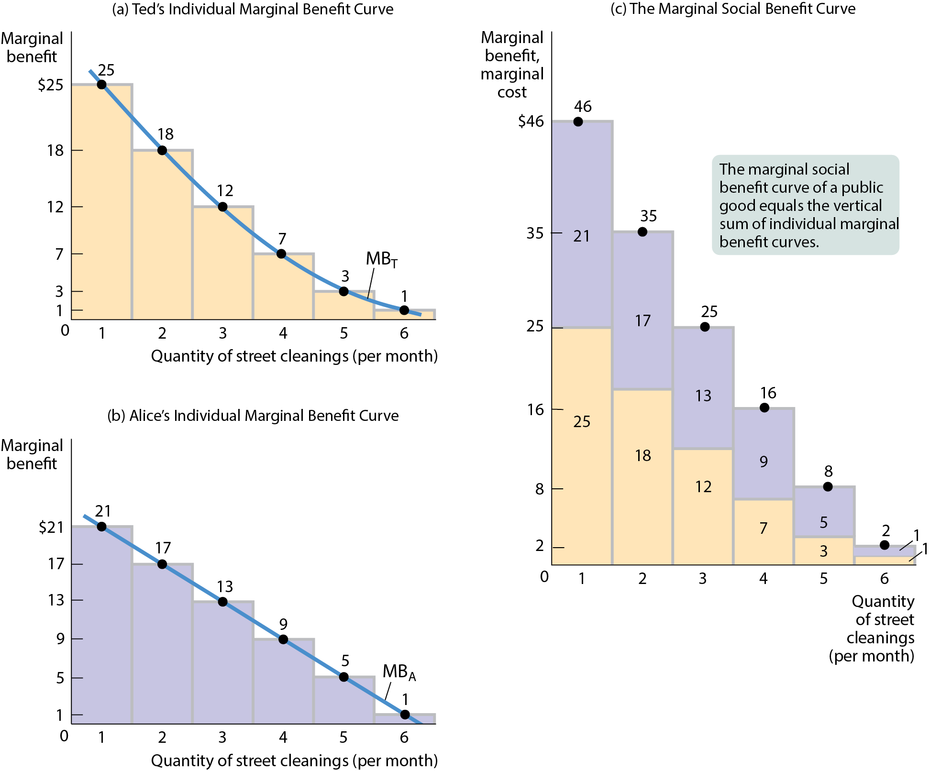


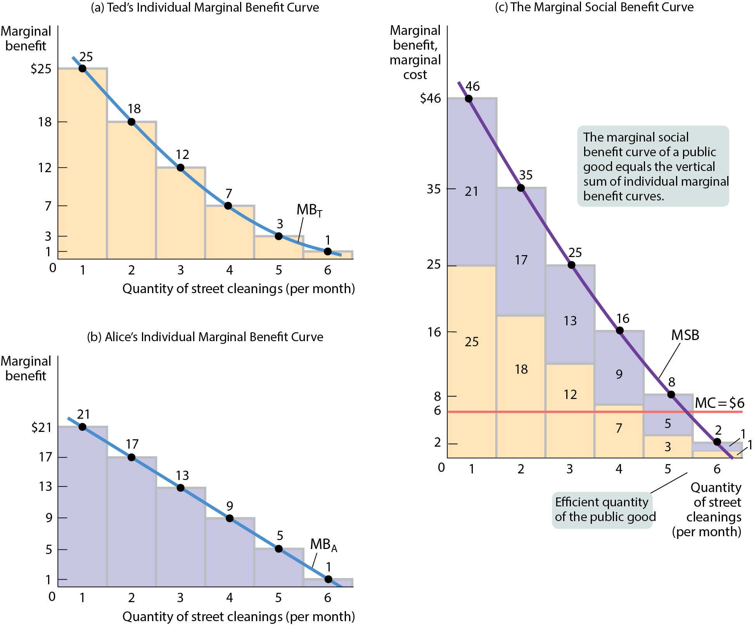
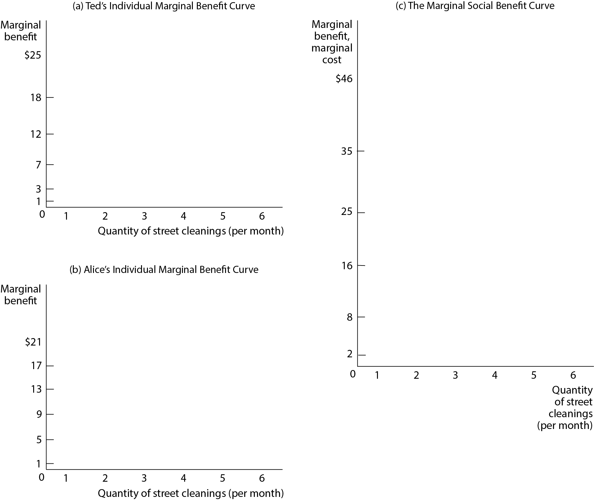
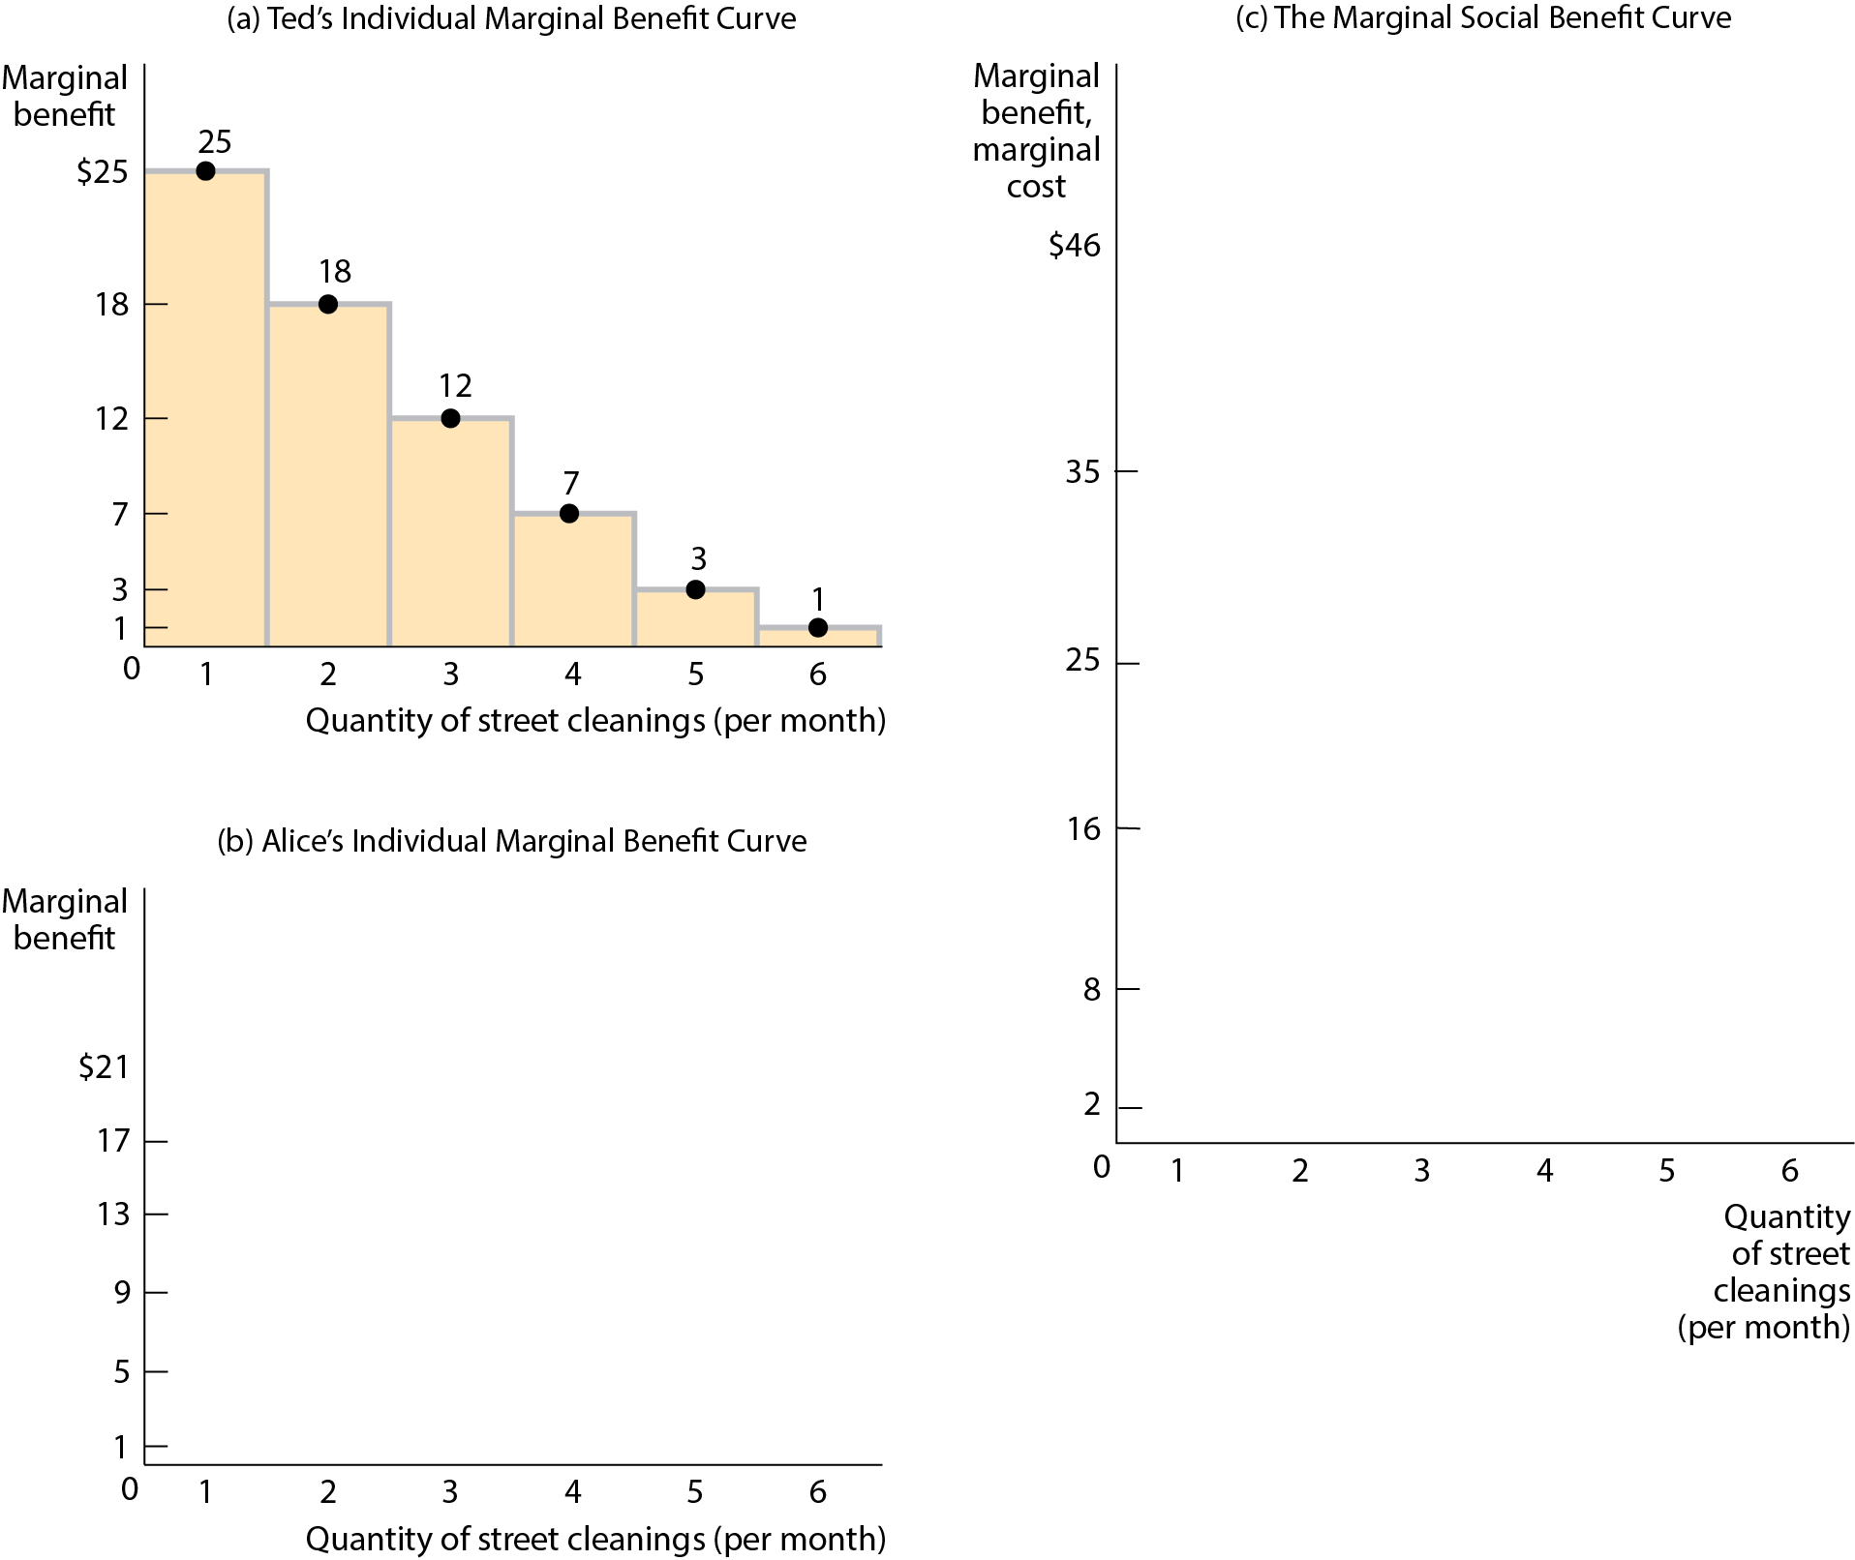
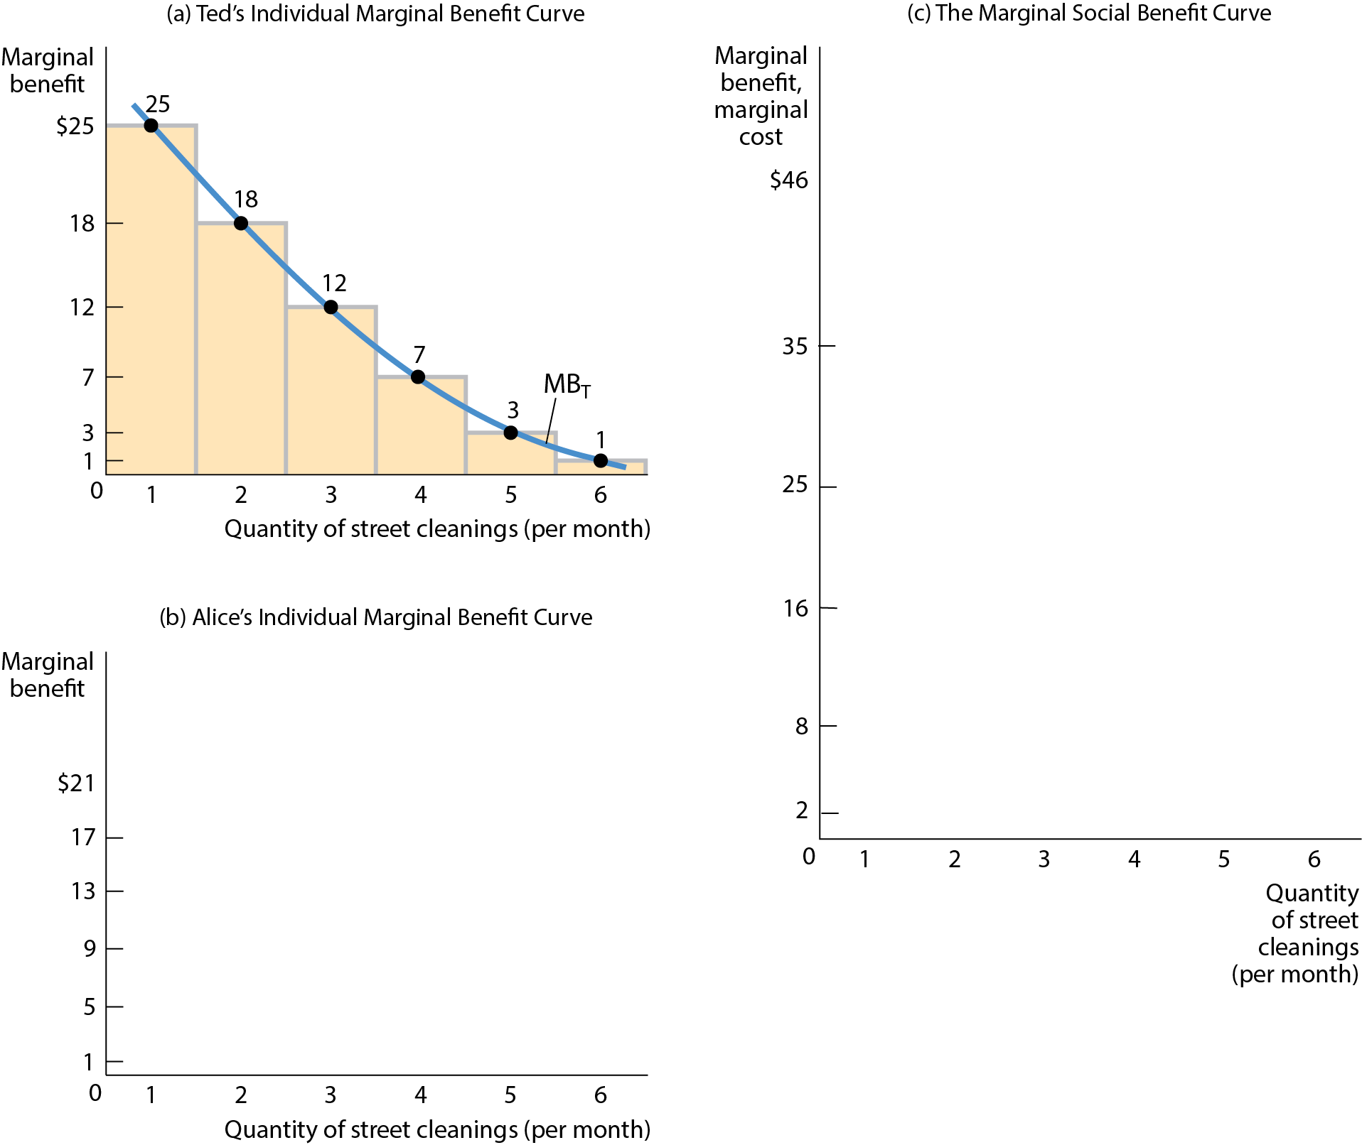
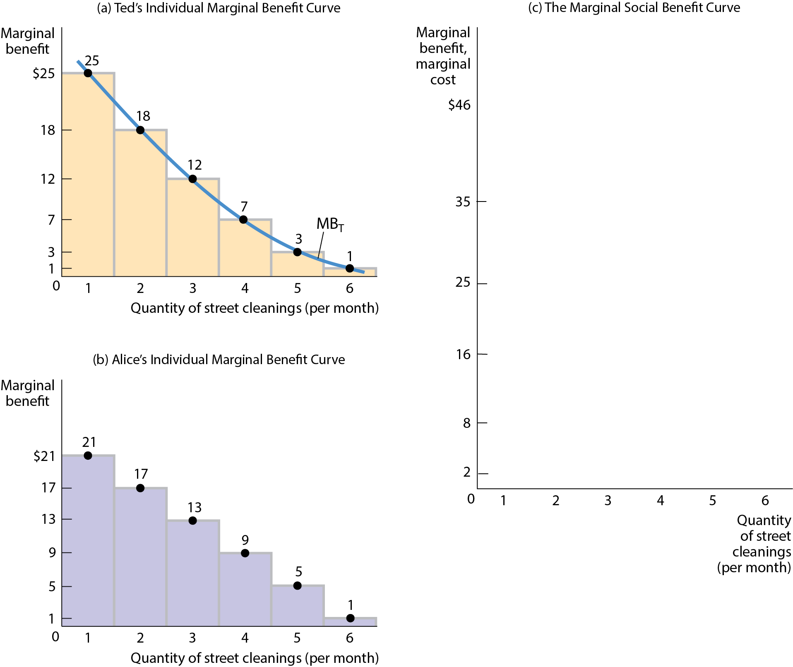
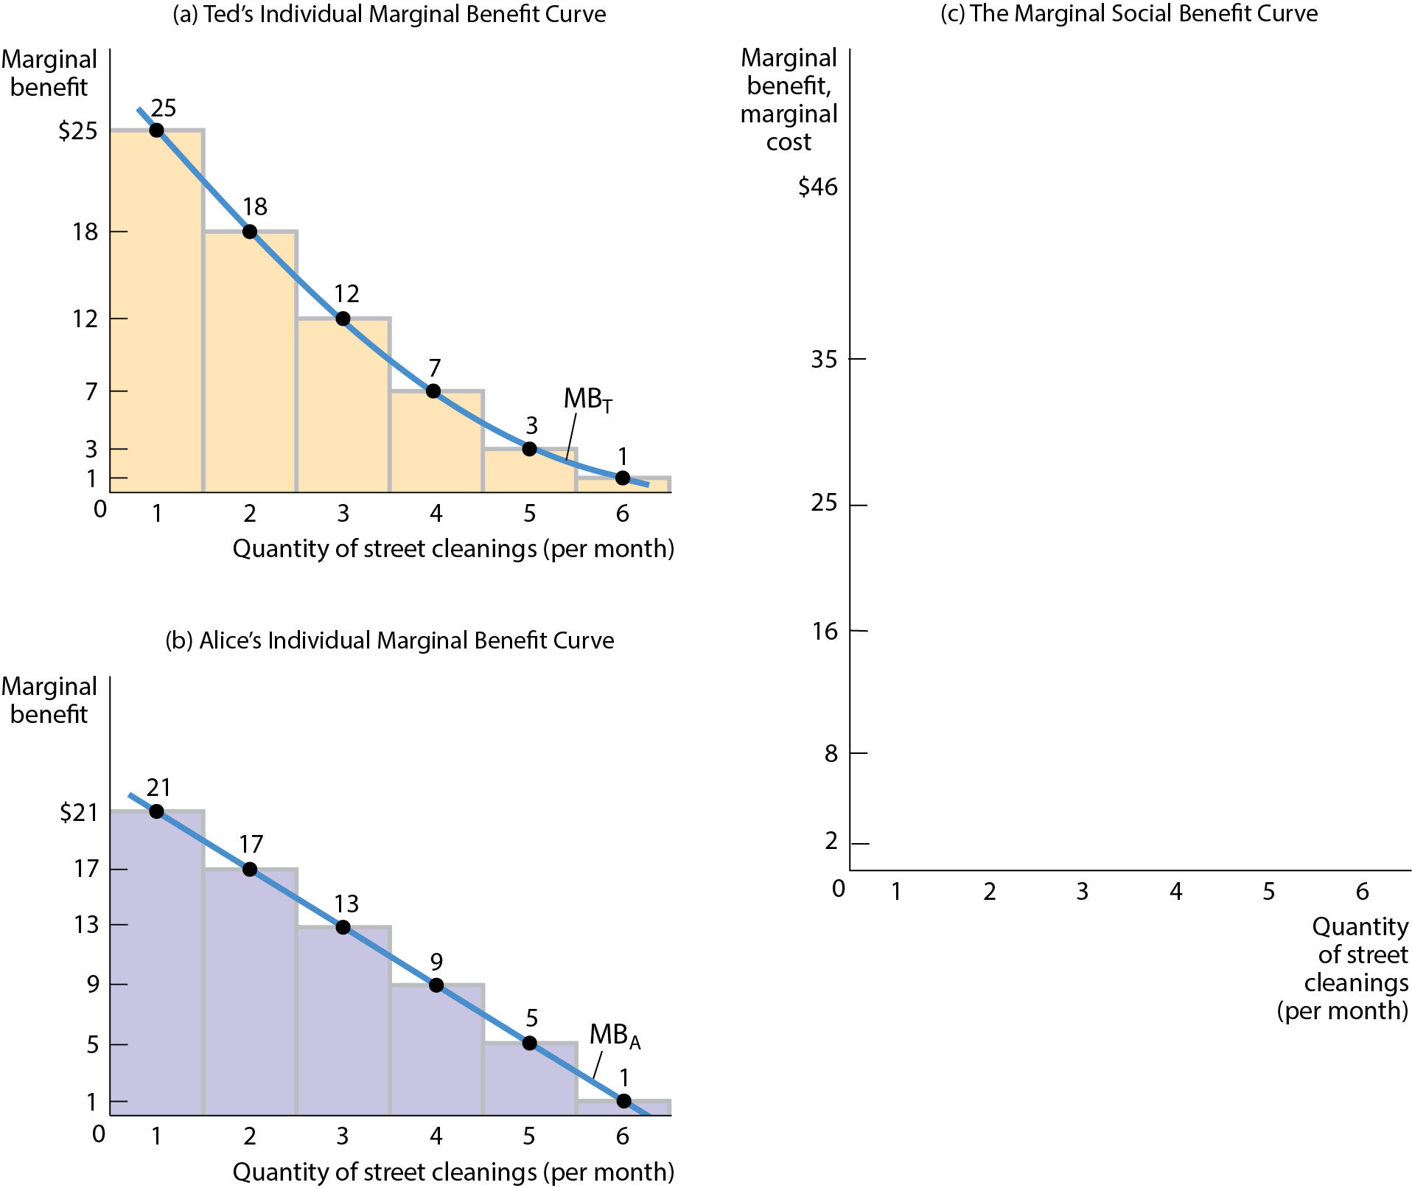
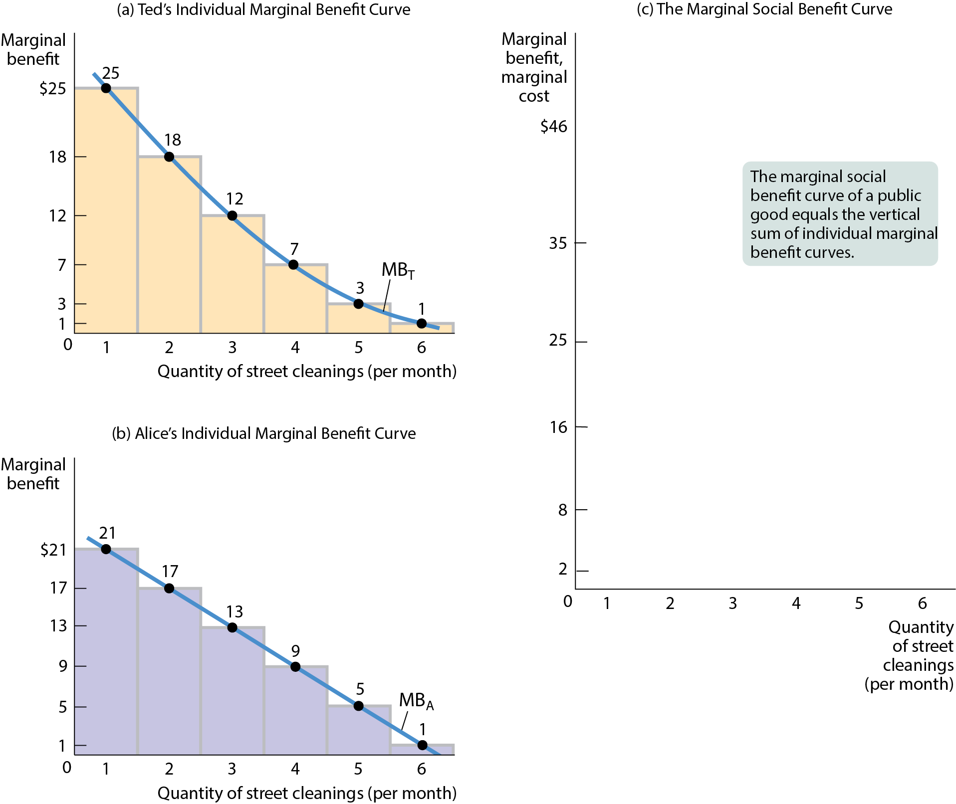
HOW MUCH OF A PUBLIC GOOD SHOULD BE PROVIDED? (2 of 3)
Figure 2

Slide 33
HOW MUCH OF A PUBLIC GOOD SHOULD BE PROVIDED? (3 of 3)
The marginal social benefit of one more unit of a public good is always greater than the individual marginal benefit. That is why no individual is willing to pay for the efficient quantity of the good.
The problem of providing public goods is similar to the problem of positive externalities: there is a market failure that calls for government intervention.
Residents could and would vote to tax themselves to pay for provision of public goods.

Slide 34
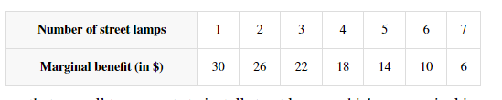
Suppose that a small town wants to install street-lamps, which are nonrival in consumption and nonexcludable. Each of the 25 people in the town value them according to the given schedule. Each street-lamp costs $250 to install.
30x25=750
26x25=650
10x25=250
MB=MC
What is the socially optimal number?
6
Suppose that 20 of the 25 townspeople decide that they will not help pay for street lamps and instead enjoy (for free) the street lamps built by the other 5 people. What is the maximum number of street lamps that remaining five people will build?
0 Note that for the 1st unit MB=30x5=150<250=MC

Slide 35
Suppose that a small town wants to install street-lamps, which are nonrival in consumption and nonexcludable. Each of the 25 people in the town value them according to the given schedule. Each street-lamp costs $250 to install.
Suppose the town government decides to build street lamps and pay for the street lamps through taxation. How much should each person be taxed to pay for the optimal number of street lamps if everyone is taxed equally?
$60
6x$250=$1500/25=$60

Slide 36
COST-BENEFIT ANALYSIS
It’s straightforward to estimate the cost of supplying a public good.
Estimating the benefit is harder because governments can’t just ask people their willingness to pay for it (their individual marginal benefit).

Slide 37
COST-BENEFIT ANALYSIS
For example, if street cleaning were scheduled according to the stated wishes of homeowners, the streets would be cleaned every day—an inefficient level of provision.
If governments relied on the public’s statements when deciding how much of a public good to provide, they would likely provide too much. In contrast, relying on voting has problems as well—and is likely to lead to too little of the public good being provided.

Slide 38
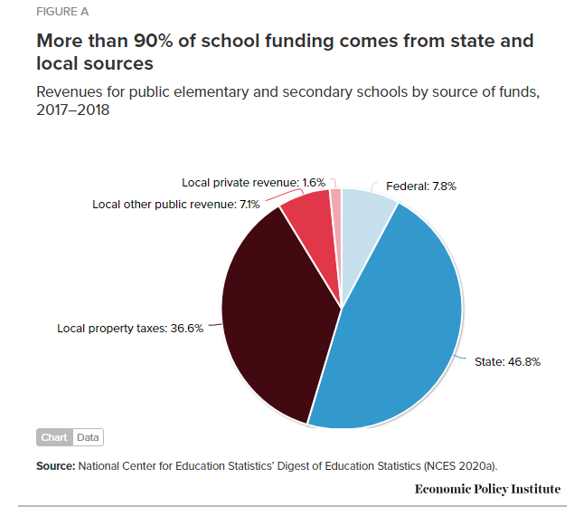
Percentage distribution of total revenue for U.S. public elementary and secondary schools for the 2017–2018 school year, on average.

Slide 39
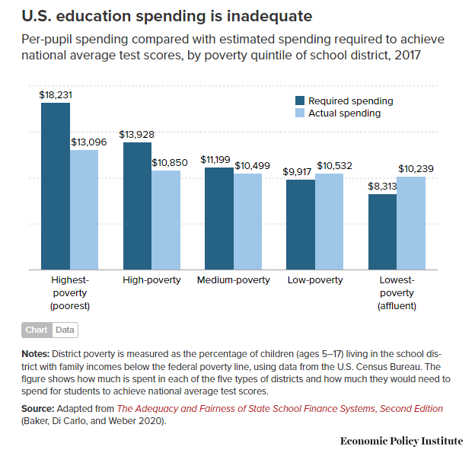
Percentage distribution of total revenue for U.S. public elementary and secondary schools for the 2017–2018 school year, on average.

Slide 40
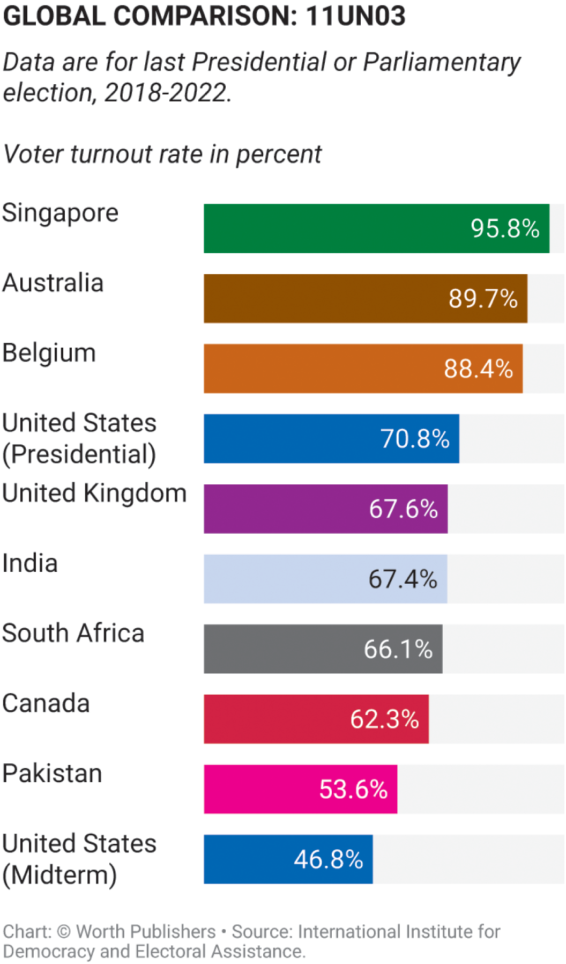
LEARN BY DOING: DISCUSSION QUESTION 3
Discuss with a partner: Because voting suffers from a free-rider problem, voting should be made mandatory.
Articulate at least one argument for and one argument against the statement.

Slide 41
LEARN BY DOING: DISCUSSION QUESTION 4
Assume the university is planning to plant more trees on campus. It will collect contributions from students and then decide how many trees to plant based on how much they collect. Take out a piece of paper and write down how much you are willing to donate.
Do you think it’s fair that some people pay and some do not? Would be better to have the university charge each student a flat fee as part of tuition to pay for the trees?

Slide 42
LEARN BY DOING: PRACTICE QUESTION 4
The rise of the internet and file sharing has turned media such as movies and music into public goods. How?
It has made those goods nonexcludable.
It has made those goods nonrival.
It has made those goods excludable.
It has made those goods rival.

Slide 43
LEARN BY DOING: PRACTICE QUESTION 4
(ANSWER)
The rise of the internet and file sharing has turned media such as movies and music into public goods. How?
It has made those goods nonexcludable. (correct answer)
It has made those goods nonrival.
It has made those goods excludable.
It has made those goods rival.

Slide 44

COMMON RESOURCES
A common resource is nonexcludable and rival in consumption.
They tend to be overused if left to the market: individuals ignore the fact that their use depletes the amount of the resource remaining for others.
  When one person catches a fish, there are fewer fish available for everyone else.
  Each person has the incentive to fish before others.

Slide 45
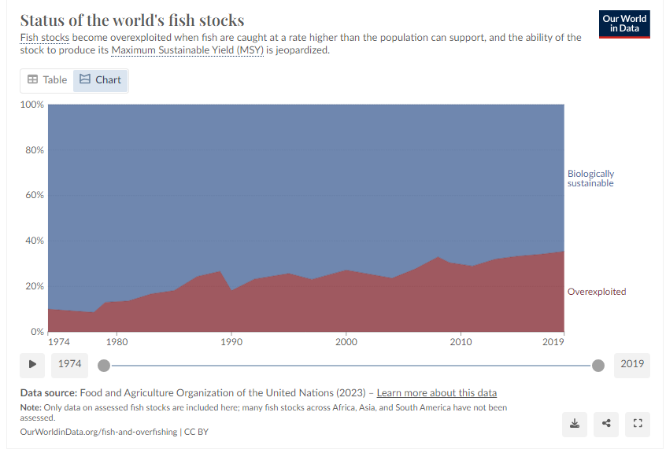
The level of overfishing has been increasing in recent decades and the number of overfished stocks is now three times higher than in 1970. In 2024, it is estimated that over 37% of these fish stocks were overfished.

Slide 46
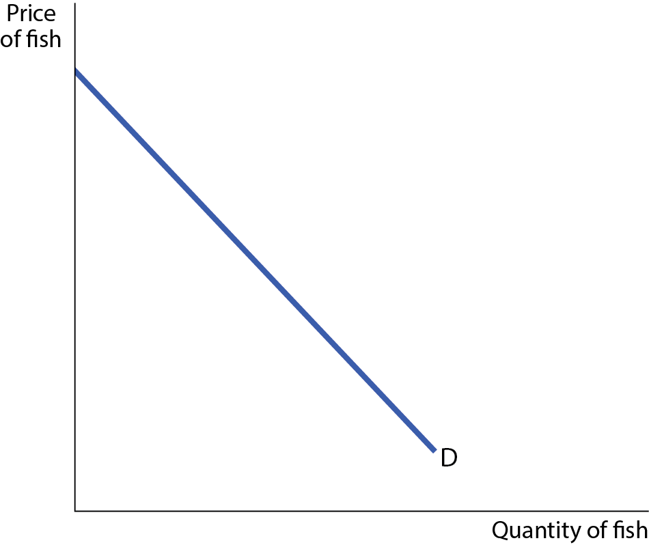
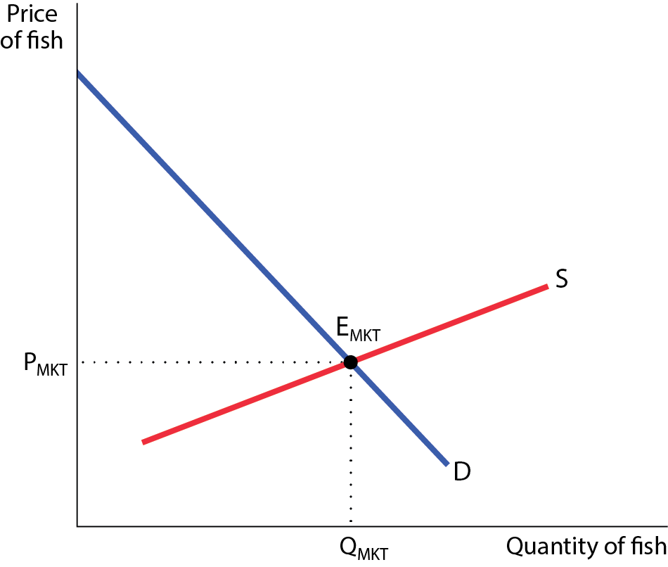
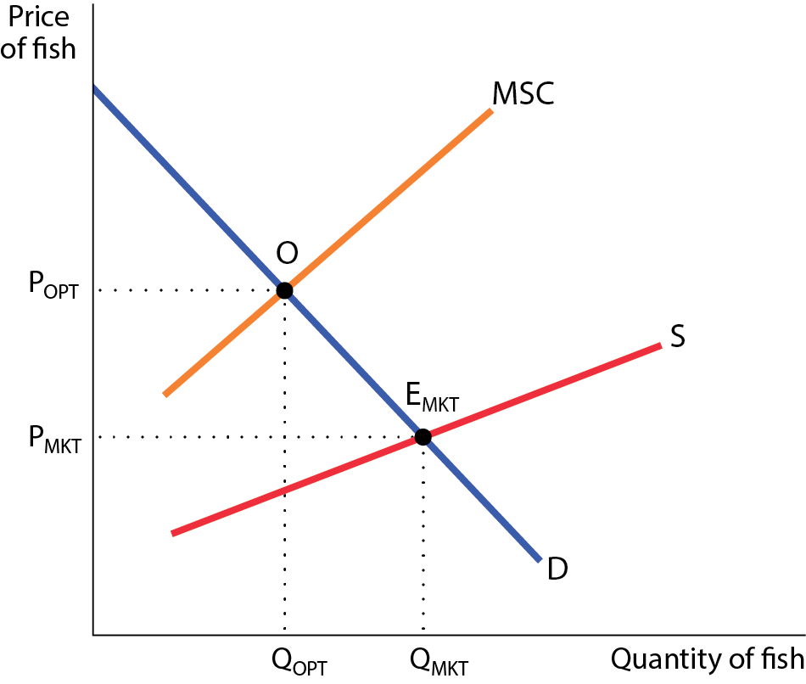
A COMMON RESOURCE
Figure 4
In an unregulated market, the quantity of the common resource used, Q_{MKT}, exceeds the efficient quantity, Q_{OPT}.

Slide 47
THE EFFICIENT USE AND MAINTENANCE OF A COMMON RESOURCE (1 of 2)
Because common resources pose problems similar to those created by negative externalities, the solutions are also similar:
  Tax or regulate the use of the common resource.
  Create a system of tradable licenses for the right to use the common resource.
  Make it excludable and assign property rights to it.

Slide 48
THE EFFICIENT USE AND MAINTENANCE OF A COMMON RESOURCE (2 of 2)
  A Pigouvian tax can reduce the use of a common resource to the efficient quantity. For example, when visitors to national parks pay a fee, the number of visitors falls.

Slide 49
THE EFFICIENT USE AND MAINTENANCE OF A COMMON RESOURCE (2 of 2)
  Create a system of tradable licenses: The policy maker issues the number of licenses that corresponds to the efficient level of use of the good.
  Example: individual transferable quotas, or ITQs, help reverse the collapse of fisheries because each ITQ holder has a financial interest in the long-term maintenance of his fishery.

Slide 50

Ocean salmon fishing quotas and opening set for Coastal Washington
  Recreational anglers will have the opportunity to reel in Chinook and hatchery-marked coho salmon off the Washington coast beginning June 22 at Ilwaco, Neah Bay, and La Push (Marine Areas 1, 4, and 3), and June 30 at Westport-Ocean Shores (Marine Area 2).
  Pacific Fishery Management Council approved a recreational Chinook catch quota of 41,000 fish, up slightly from last year’s quota of 39,000.

Slide 51
THE EFFICIENT USE AND MAINTENANCE OF A COMMON RESOURCE (2 of 2)
  The most natural solution is to assign property rights: Make the good excludable and assign property rights over it to someone. The owner then will have an incentive to protect the good.

Slide 52
ARTIFICIALLY SCARCE GOODS
An artificially scarce good is a good that is excludable but nonrival in consumption.
Example: on-demand movies.
The marginal cost of allowing one more person to consume the good is zero.
However, because it is excludable, sellers charge a positive price, which leads to inefficiently low consumption.
The problems of artificially scarce goods are similar to those posed by a natural monopoly.

Slide 53
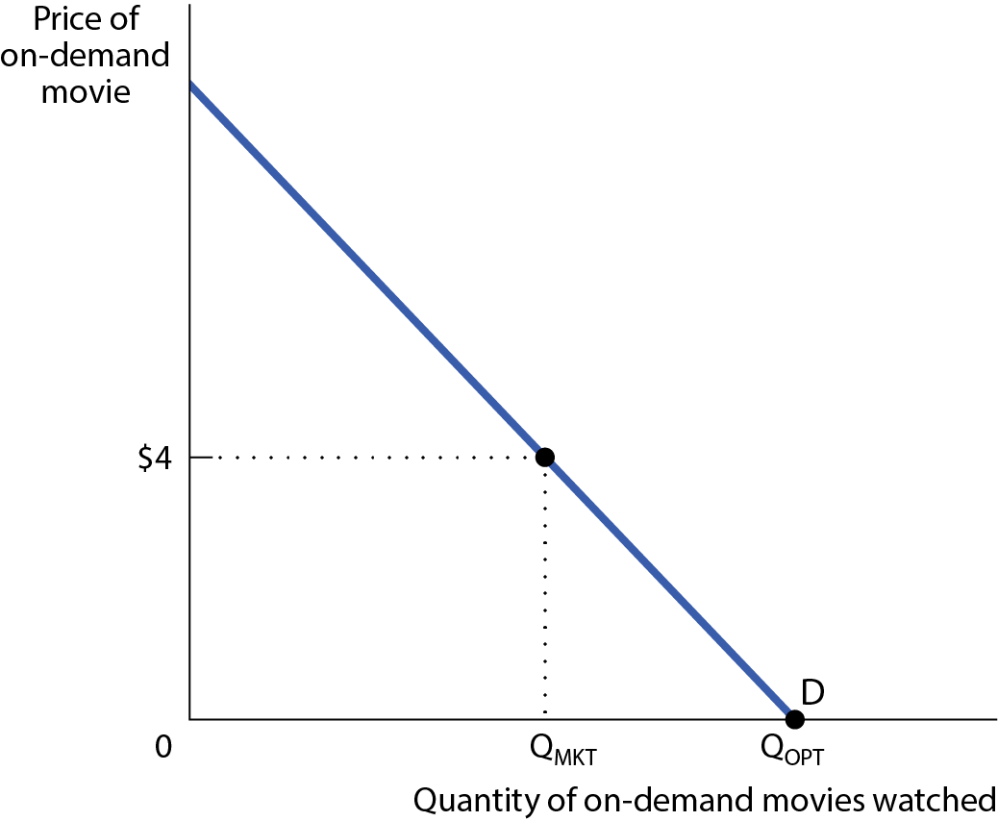
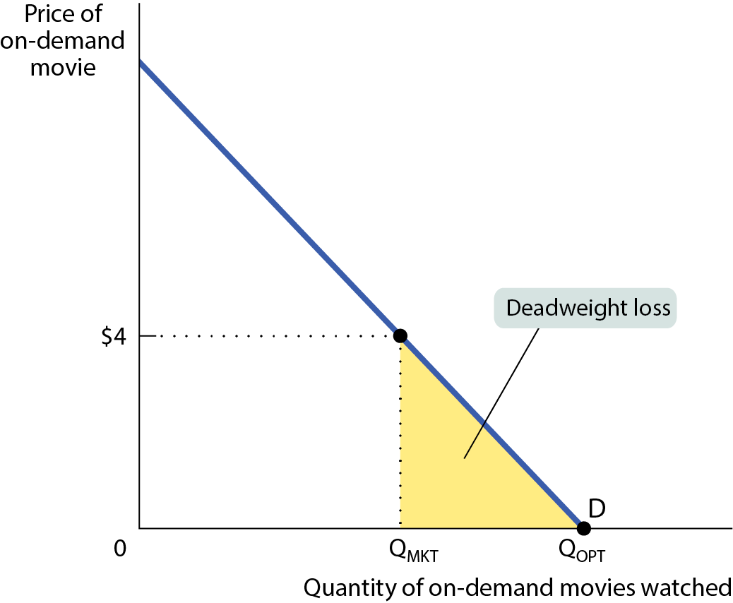
AN ARTIFICIALLY SCARCE GOOD
Figure 5

Slide 54
LEARN BY DOING: PRACTICE QUESTION 5
London recently started charging a fee to drive in certain parts of the city during peak traffic times to address the problem of traffic congestion. It has worked! This fee has:
encouraged consumers to drive less than they otherwise would.
encouraged consumers to drive at times when traffic congestion is less of a problem.
made a common resource excludable: those who pay for the right to drive can drive, and those unwilling to pay must forgo driving.
Answers (a), (b), and (c) are all true.

Slide 55
LEARN BY DOING: PRACTICE QUESTION 5
(ANSWER)
London recently started charging a fee to drive in certain parts of the city during peak traffic times to address the problem of traffic congestion. It has worked! This fee has:
encouraged consumers to drive less than they otherwise would.
encouraged consumers to drive at times when traffic congestion is less of a problem.
made a common resource excludable: those who pay for the right to drive can drive, and those unwilling to pay must forgo driving.
Answers (a), (b), and (c) are all true. (correct answer)

Slide 56
LEARN BY DOING: PRACTICE QUESTION 6
Economists are excited because they have just discovered a good that is nonrival in consumption but excludable. To maximize consumer surplus, this good:
will be very expensive, since it’s so rare.
should be free, since the marginal cost of an individual’s consumption is zero if the good is produced at the socially optimal level.
will be overproduced, since the price of the good is less than the marginal cost of producing it.

Slide 57
LEARN BY DOING: PRACTICE QUESTION 6
(ANSWER)
Economists are excited because they have just discovered a good that is nonrival in consumption but excludable. To maximize consumer surplus, this good:
will be very expensive, since it’s so rare.
should be free, since the marginal cost of an individual’s consumption is zero if the good is produced at the socially optimal level. (correct answer)
will be overproduced, since the price of the good is less than the marginal cost of producing it.

Slide 58
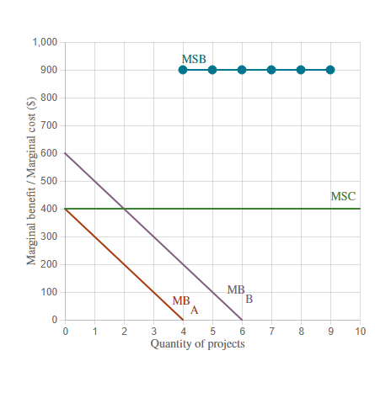
Draw the marginal social benefits (MSB) curve.

Slide 59
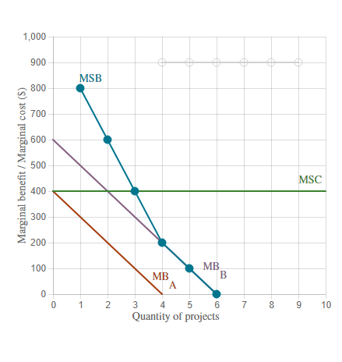
What is the optimal quantity of city beautification projects?

