Slide 1

Externalities
10
Notes:
Cover Credits: Currency Exchange Stock Chart: cemagraphics/Getty Images, Social Media Montage: SEAN GLADWELL/Getty Images, Circuit Pattern: somsak Tangdamrongsub/Getty Images, Cargo Containers: urzine/Getty Images

Slide 2
Next Assignments:
Homework 8 (CH 9) due on Wednesday October 16th
Writing Assignment 2 due on Saturday October 19th
  U.S. military’s efforts to reduce the opium trade in Afghanistan (Chapter 6 – Elasticity)
Quiz #4 (Chapters 7 and 9) due on Sunday October 20th

Slide 3
Important points CH 9
Accounting profits ignore implicit costs; economic profits consider them.
Differences between "either-or" decision or a "how much" decision.
Marginal Cost: the cost of producing one more unit of a good or service.
Marginal Benefit: the benefit experienced from undertaking one more unit of an activity.
Optimal Quantity: the amount that, when produced or consumed, results in the greatest possible net gain.

Slide 4
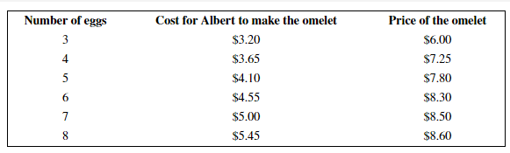
Important points CH 9
How many eggs should Albert include in the omelet?
MC=0.45
MB=1.25
MC=0.45
MB=0.55
MC=0.45
MB=0.50
MC=0.45
MB=0.20

Slide 5
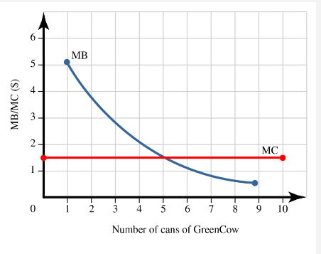
Important points CH 9
Optimal amount?

Slide 6
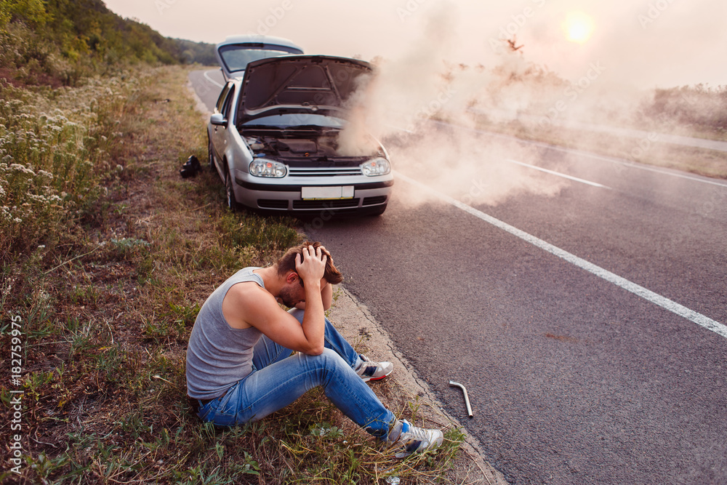
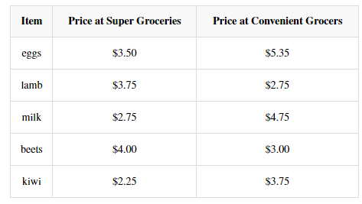
Important points CH 9
Which three items should you save?

Slide 7
Important points CH 9
Decision making is affected by:
Bounded Rationality
Concerns about Fairness.
Risk Aversion

Slide 8
Important points CH 9
Factors to contribute to irrationality in decision-making:
Overconfidence
Reluctant to change mind
Fairness
Time preference

Slide 9
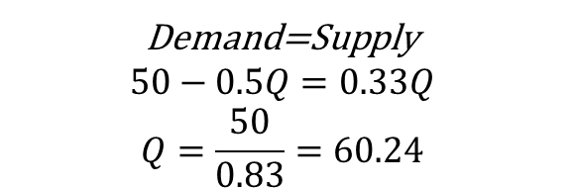
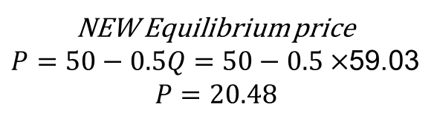
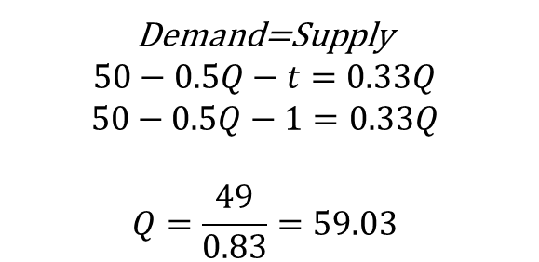
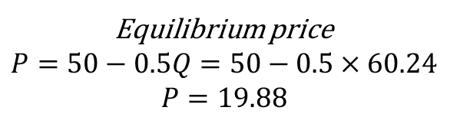
Quiz #4
Demand: P = 50 − 0.5Q and Supply: P = 0.33Q, where P is the price per mug, and Q is the quantity of mugs.
If a $1 per unit tax is imposed, the per-unit tax incidence on consumers is equal to (round all calculations to two decimal places):
Demand=Supply
$$50−0.5Q−t=0.33Q$$
$$50−0.5Q−1=0.33Q$$
$$Q=\frac{49}{0.83}=59.03$$
Demand=Supply
$$50−0.5Q=0.33Q$$
$$Q=\frac{50}{0.83}=60.24$$
P
20.48
$0.60
19.88
NEW Equilibrium price
$P=50−0.5Q=50−0.5×$59.03
$$P=20.48$$
Equilibrium price
$$P=50−0.5Q=50−0.5×60.24$$
$$P=19.88$$
59.03
60.24
Q

Slide 10
WHAT YOU WILL LEARN IN THIS CHAPTER
What are externalities, and why do they lead to inefficiency and government intervention in the market?
How do negative externalities, positive externalities, and network externalities differ?
What is the Coase theorem?
Why are some government policies to deal with externalities efficient while others are not?
Why are network externalities an important feature of high-tech industries?

Slide 11
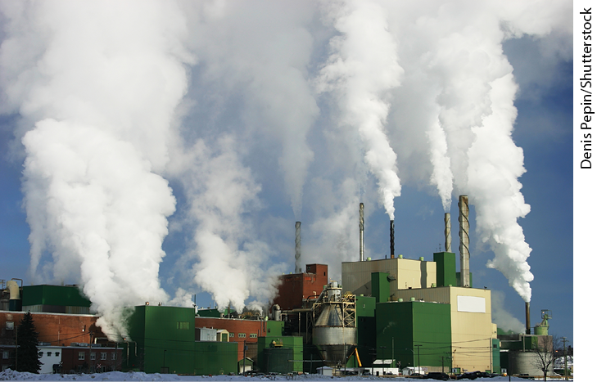
UNDERSTANDING EXTERNALITIES (1 of 3)
An external cost is an uncompensated cost that an individual or firm imposes on others.
Examples of external costs:
  air and water pollution
  texting while driving
  chemical runoff that affects fish stocks

Slide 12

UNDERSTANDING EXTERNALITIES (2 of 3)
External benefits are benefits that individuals or firms confer on others without receiving compensation.
Examples of external benefits:
  beehives next to almond orchards
  education
  preserved farmland

Slide 13
UNDERSTANDING EXTERNALITIES (3 of 3)
External costs and benefits are known as externalities.
External costs are negative externalities, and external benefits are positive externalities.
Externalities (spillovers): the impact on third parties of a transaction between others.
If fracking pollutes drinking water, it is a negative externality.

Slide 14
LEARN BY DOING: PRACTICE QUESTION 1
The extra safety your neighbor might have because everyone else in the area has purchased burglar alarms is a(n):
private cost.
external cost.
private benefit.
external benefit.

Slide 15
LEARN BY DOING: PRACTICE QUESTION 1
(ANSWER)
The extra safety your neighbor might have because everyone else in the area has purchased burglar alarms is a(n):
private cost.
external cost.
private benefit.
external benefit. (correct answer)

Slide 16

FOR INQUIRING MINDS: DRIVING WHILE DISTRACTED
One in four accidents are caused by cell phone use.
A driver is 23 times more likely to have an accident while texting.
In 2022, there were more than 3,000 deaths were attributed to distracted driving.
The risk posed by distracted driving isn’t just the risk to the driver; it’s a safety risk to others.

Slide 17
THE COSTS AND BENEFITS OF POLLUTION
The marginal social cost of pollution is the additional cost imposed on society as a whole by an additional unit of pollution.
  Acid rain, smog, contaminated water, etc.

Slide 18
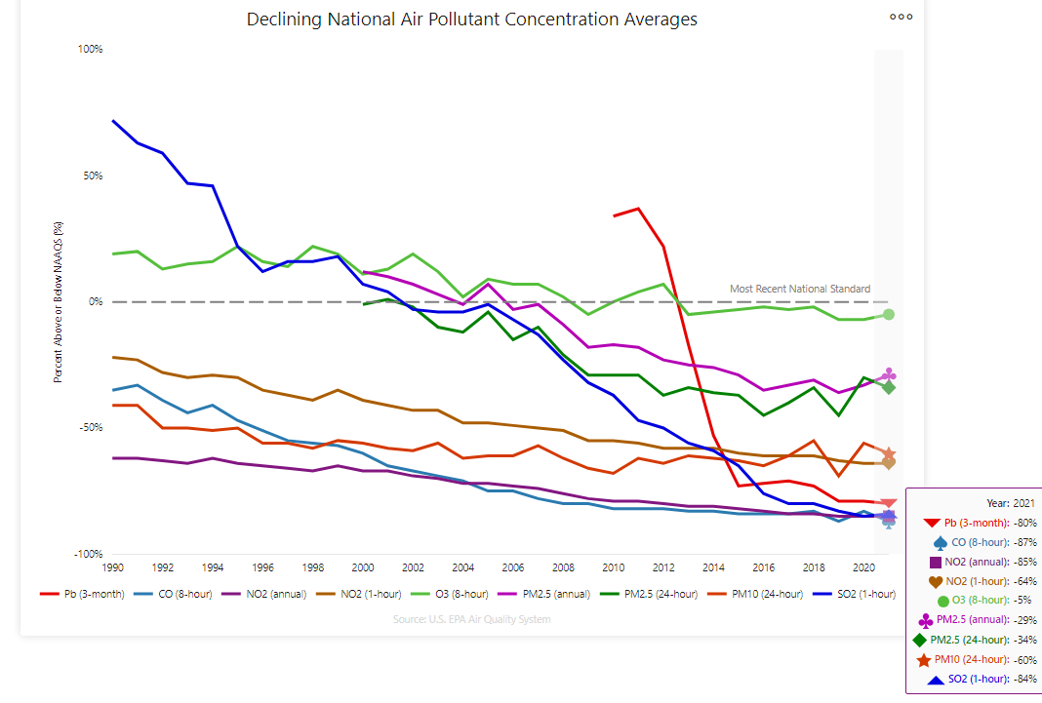
Our Nation's Air 2022 (epa.gov)

Slide 19
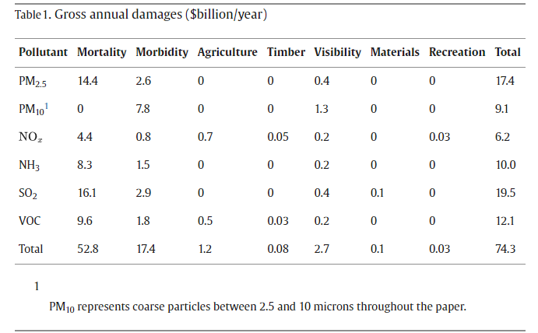

Measuring the damages of air pollution in the United States (Muller and Mendelsohn, 2007, JEEM)
PM2.5 (Fine Particulate Matter) refers to particles in the air that measure less than 2.5 micrometers (μm) in diameter. These particles can include smoke, soot, liquid or solid aerosol particles, and biological matter like mold, bacteria, pollen, and animal dander.
The largest source of SO₂ in the atmosphere is the burning of fossil fuels by power plants and other industrial facilities.

Slide 20
The psychological, economic, and social costs of air pollution
Air pollution causes decreases in happiness and increases in depression.
    Research has shown that people living in places with excessive amounts of PM_{2.5} have a heightened risk for dementia by 92%.
Cognitively, it impairs functioning and decision-making.
Economically, it hurts work productivity. And socially, it exacerbates criminal behavior.
In a study that analyzed a nine-year panel of 9,360 U.S. cities, air pollution positively predicted both violent crimes (murder, rape, robbery, and assault) and property crimes (burglary and motor vehicle theft).

Slide 21
THE COSTS AND BENEFITS OF POLLUTION
The marginal social benefit of pollution is the additional gain to society as a whole from an additional unit of pollution.
  Reducing pollution has an opportunity cost: It requires scarce resources that could have been used to produce other goods and services.
  The marginal social benefit of pollution is the goods and services that could be had by society if it tolerated another unit of pollution.

Slide 22
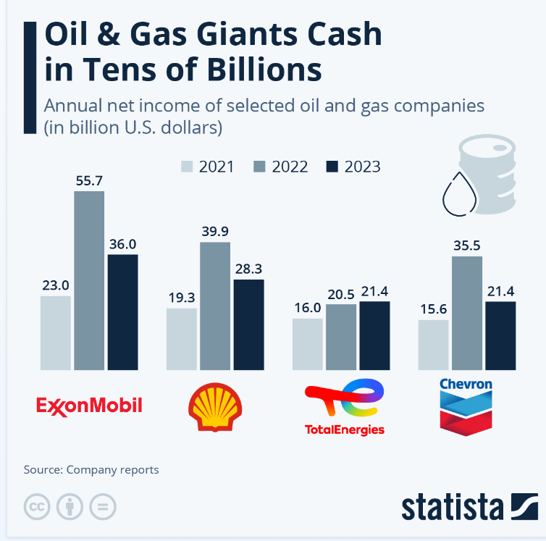
THE COSTS AND BENEFITS OF POLLUTION

Slide 23
THE COSTS AND BENEFITS OF POLLUTION
The socially optimal quantity of pollution is the quantity society would choose if all costs and benefits were fully accounted for.
Will a market economy, left to itself, arrive at the socially optimal quantity? No, it won’t.

Slide 24
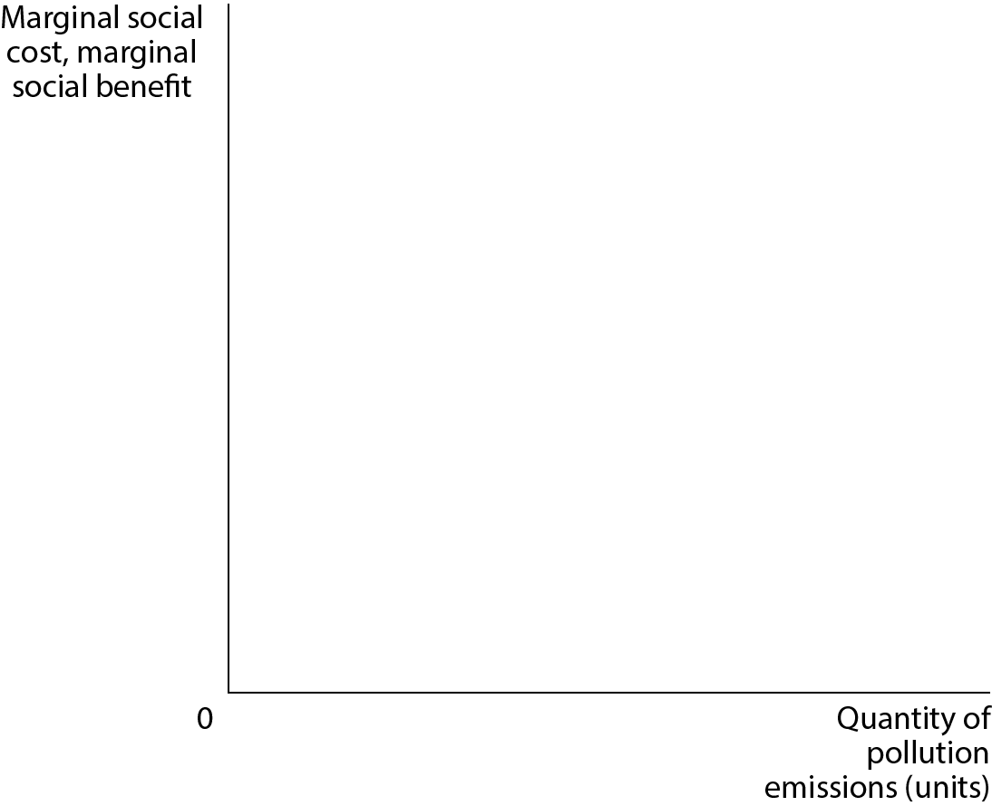
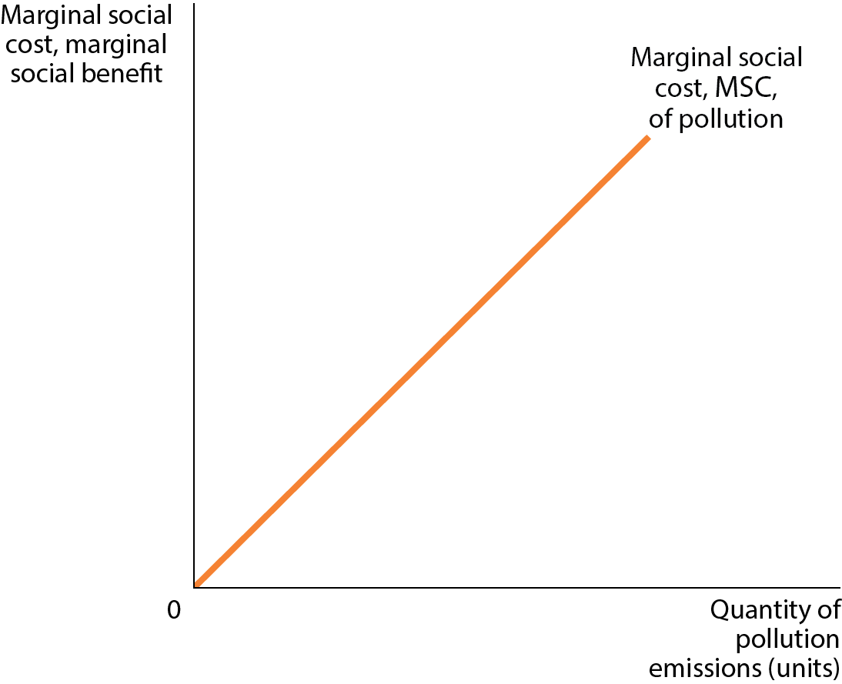
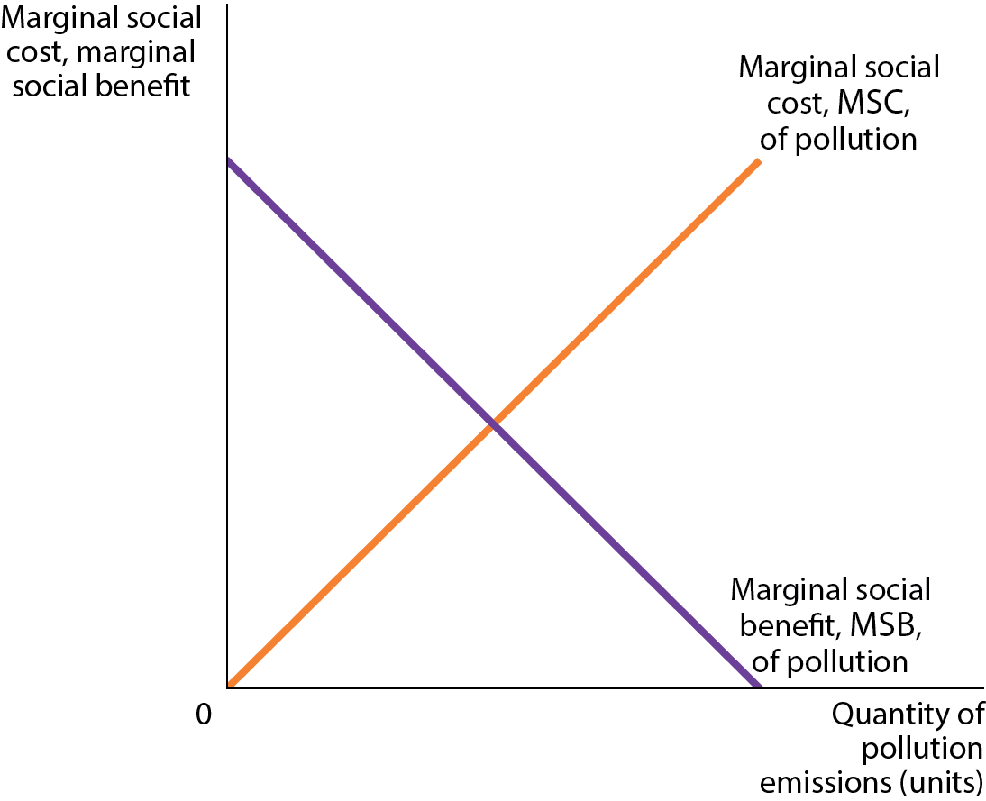
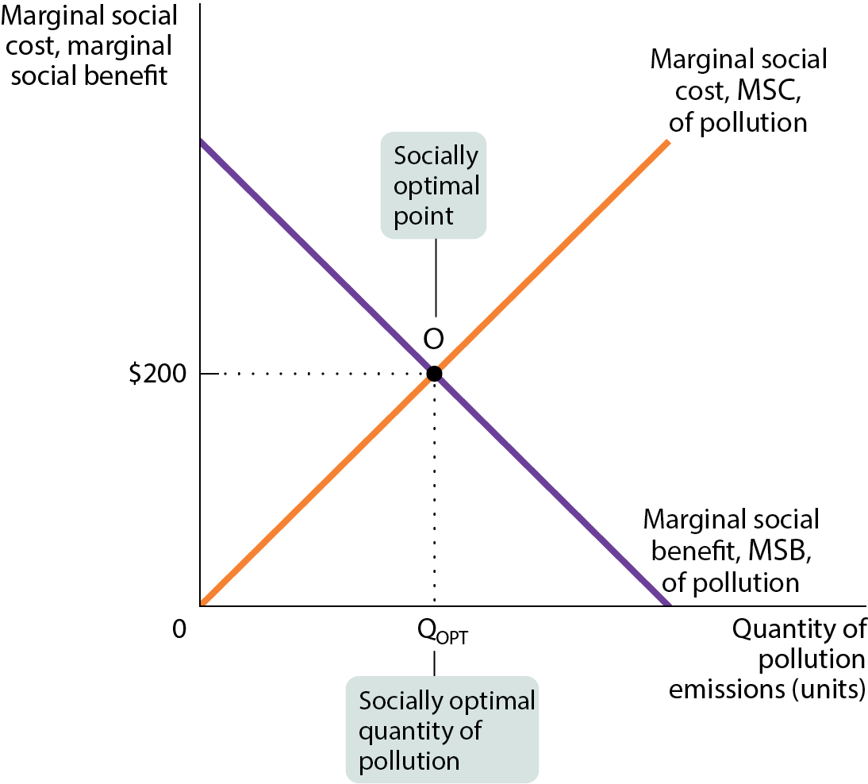
THE SOCIALLY OPTIMAL QUANTITY OF POLLUTION
Figure 1
The socially optimal quantity of pollution isn’t zero.
It’s Q_{OPT}, where the marginal social benefit and marginal social cost are equal.

Slide 25
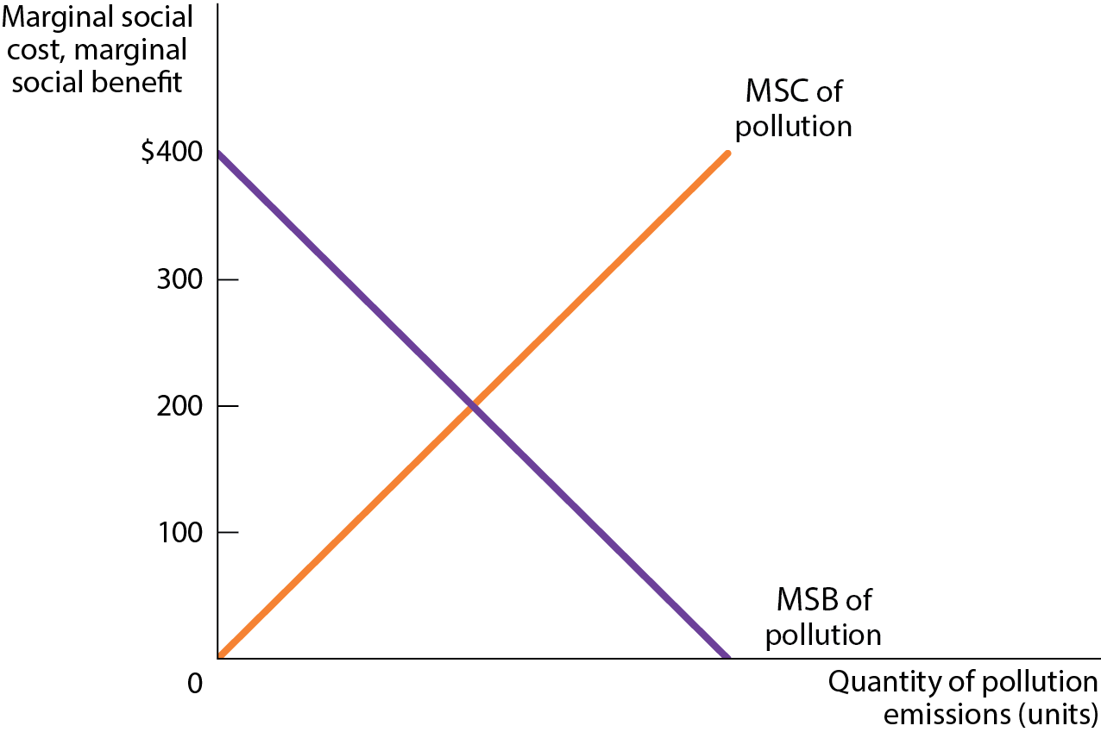
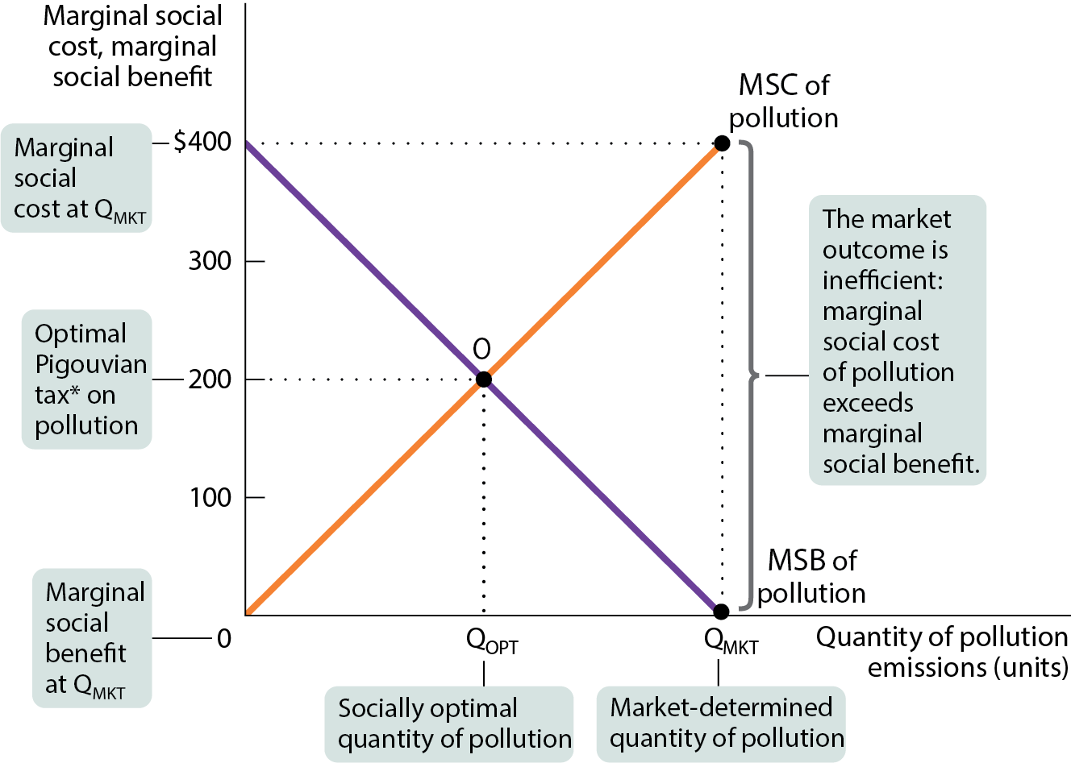
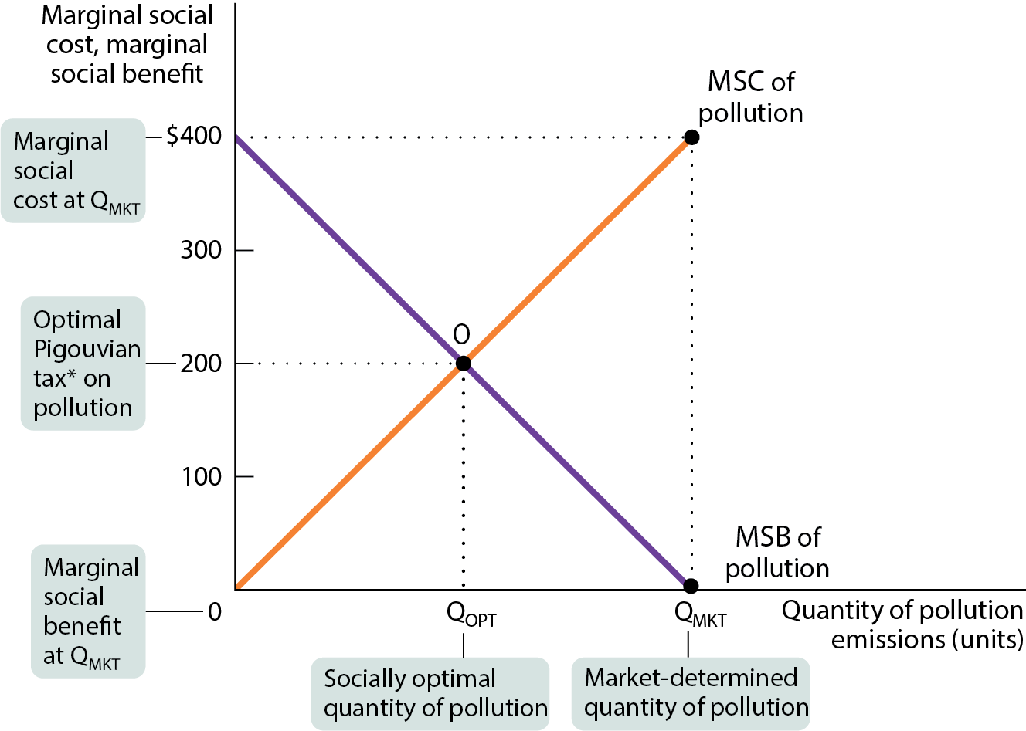
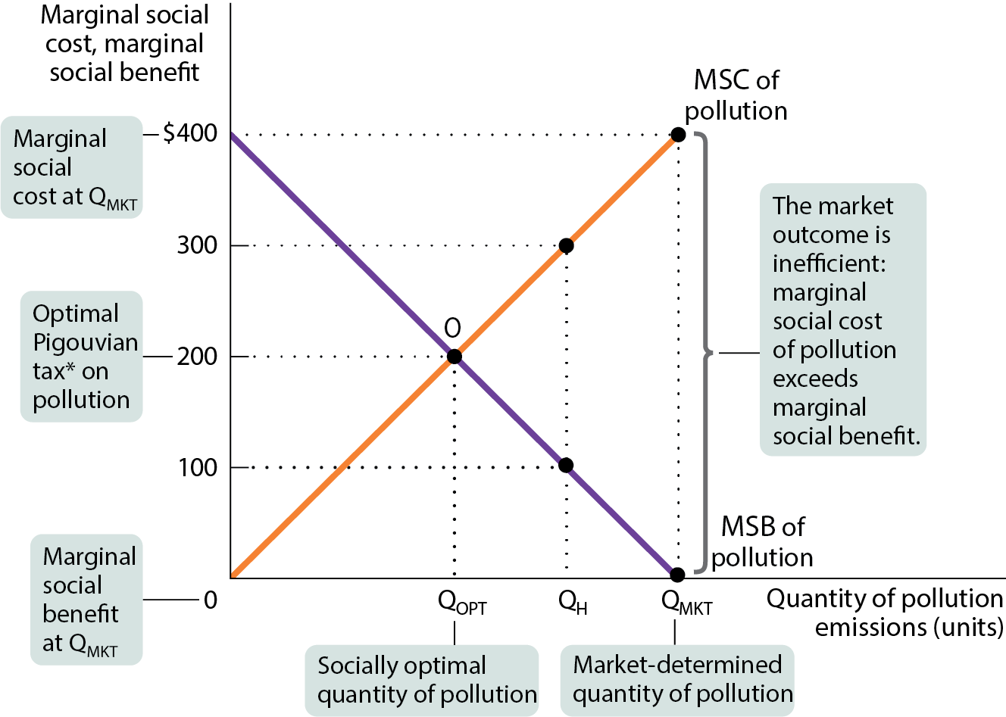
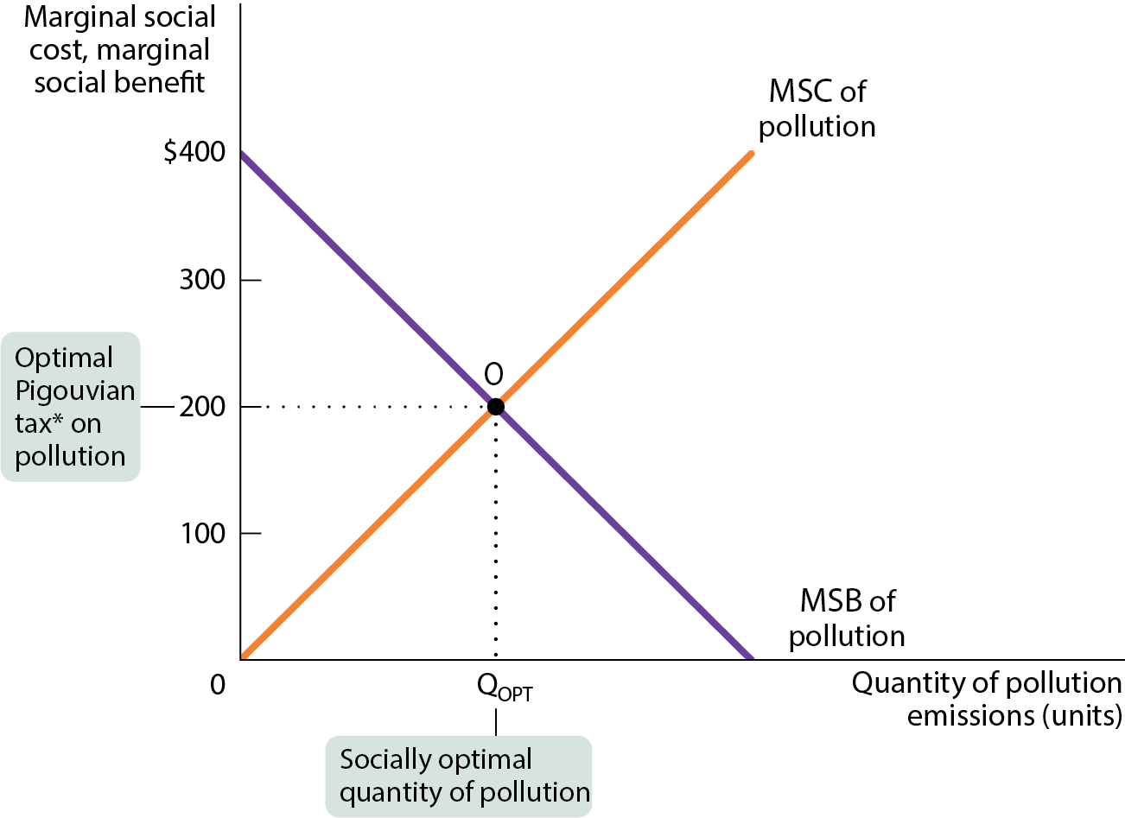
WHY A MARKET ECONOMY PRODUCES TOO MUCH POLLUTION (1 of 2)
Figure 2

Slide 26
WHY A MARKET ECONOMY PRODUCES TOO MUCH POLLUTION (2 of 2)
In a market economy without government intervention, polluters are the only ones who decide how much to pollute. They consider private benefits of pollution rather than social costs.
So instead of producing the socially optimal quantity, Q_{OPT}, they will produce Q_{MKT}.
At Q_{MKT}, the marginal social benefit of an additional unit of pollution is zero, while the marginal social cost of an additional unit is much higher.

Slide 27
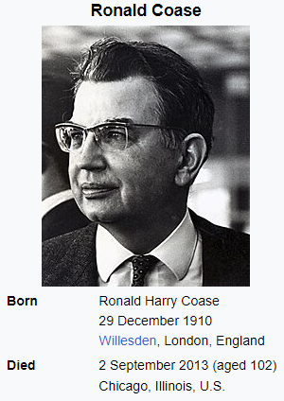
PRIVATE SOLUTIONS TO EXTERNALITY PROBLEMS (1 of 2)
Can the private sector solve the problem of externalities without government intervention?
The Coase theorem: The economy can reach an efficient solution, even in the presence of externalities, if the costs of making a deal are sufficiently low.

Slide 28

PRIVATE SOLUTIONS TO EXTERNALITY PROBLEMS (1 of 2)
Example: a family agrees to stop playing loud music during their next-door neighbor child’s naptime in exchange for use of the lawnmower.
When individuals take externalities into account, they internalize the externality. In that case, the outcome is efficient without government intervention.

Slide 29
PRIVATE SOLUTIONS TO EXTERNALITY PROBLEMS (1 of 2)
My neighbor likes tall trees
  does she have the right to plant a tree on her property that shades my pool?
  do I have a right to an unobstructed view? or an unshaded pool?
You want to have a party
  do you have the right to make noise in your house/dorm?
  does your neighbor have the right to good nights sleep in their house/dorm?
I own a small plant located on a river
  do I have a right to use the river for cooling?
  do I have a right to pollute as much as I want?

Slide 30
PRIVATE SOLUTIONS TO EXTERNALITY PROBLEMS (2 of 2)
Why don’t private parties always internalize externalities? The problem is transaction costs—the costs of making a deal. They often prevent a mutually beneficial trade from occurring.
When those who are hurt by the externality are widely dispersed, cost of communication and negotiation is simply too high to achieve an efficient outcome.
Example: greenhouse gases.
When transaction costs prevent the private sector from dealing with externalities, it is time to look for government solutions.

Slide 31
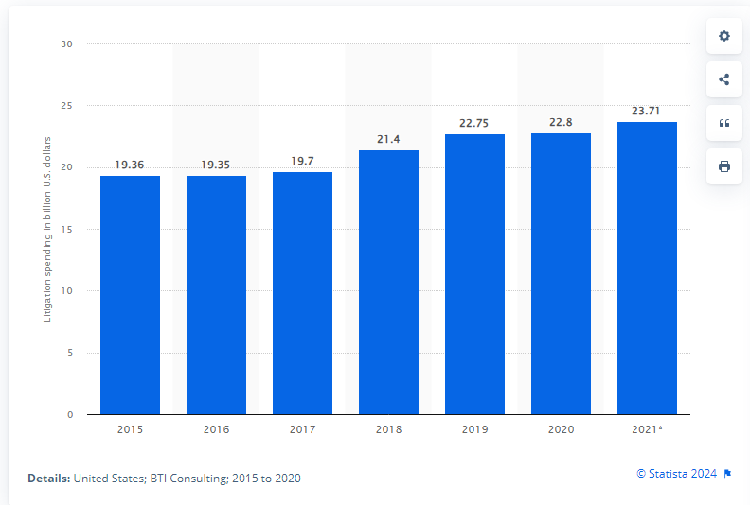
Litigation spending by large companies in the U.S. from 2015 to 2021(in billion U.S. dollars)

Slide 32
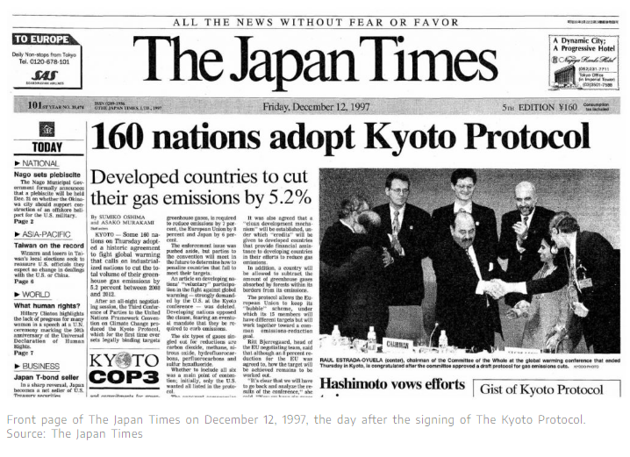
Was the Kyoto Protocol successful?

Slide 33
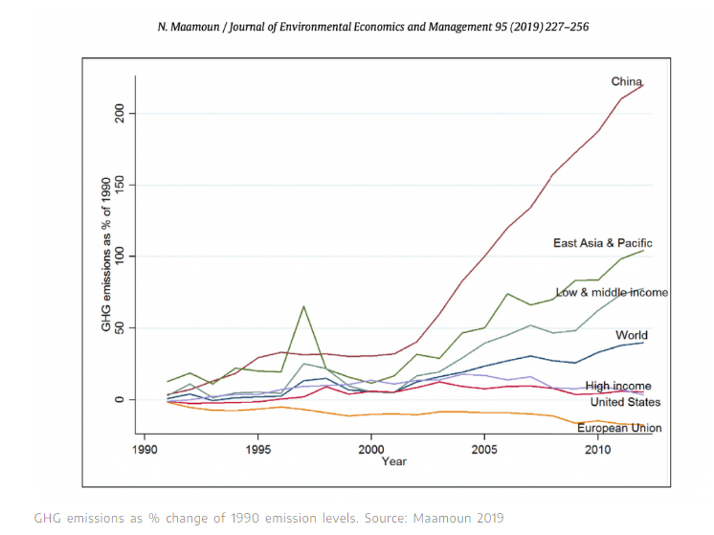
Was the Kyoto Protocol successful?

Slide 34
LEARN BY DOING: PRACTICE QUESTION 2
In reality, the Coase theorem is unlikely to work because:
most people don’t care if they are affected by an external cost.
externalities are rare and difficult to identify.
transaction costs are often high, making negotiations difficult.
prices will increase as a result of ending the externality.

Slide 35
LEARN BY DOING: PRACTICE QUESTION 2
(ANSWER)
In reality, the Coase theorem is unlikely to work because:
most people don’t care if they are affected by an external cost.
externalities are rare and difficult to identify.
transaction costs are often high, making negotiations difficult. (correct answer)
prices will increase as a result of ending the externality.

Slide 36
GOVERNMENT POLICIES AND POLLUTION
(1 of 4)
If the market won’t solve its own externality problems, then what?
The three types of policies governments use to deal with pollution:
environmental standards,
emissions taxes, and
tradable emissions permits.

Slide 37
GOVERNMENT POLICIES AND POLLUTION
(2 of 4)
Environmental standards: rules that protect the environment by specifying actions by producers and consumers.
In the United States, the Environmental Protection Agency is the principal enforcer of environmental policies at the national level.
Examples:
Asbestos
Safe Drinking Water Act (SDWA) is the main federal law that ensures the quality of Americans' drinking water.
Clean Air Act
EPA regulates household, industrial, and manufacturing solid and hazardous wastes under the Resource Conservation and Recovery Act (RCRA)
Pesticides

Slide 38
Use of Pesticides
The EU has more comprehensive and protective pesticide regulations than the US. The EU requires the pesticide industry to prove that their products are safe for humans and the environment.
US allows the use of 85 pesticides that have been banned or are being phased out in the EU, China or Brazil, according to a peer-reviewed study published in Environmental Health.
Organic farming is associated with a reduction in chemical pesticide use in Europe. The EU's Farm to Fork strategy aims to increase the area under organic farming by 25% by 2030.

Slide 39
GOVERNMENT POLICIES AND POLLUTION
(3 of 4)
An emissions tax: cost depends on the amount of pollution a firm produces.
Pigouvian taxes: taxes designed to reduce external costs (example: an emissions tax designed to reduce coal production).

Slide 40
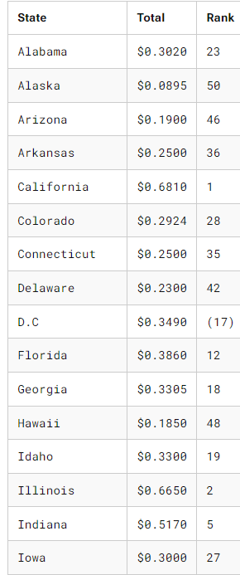
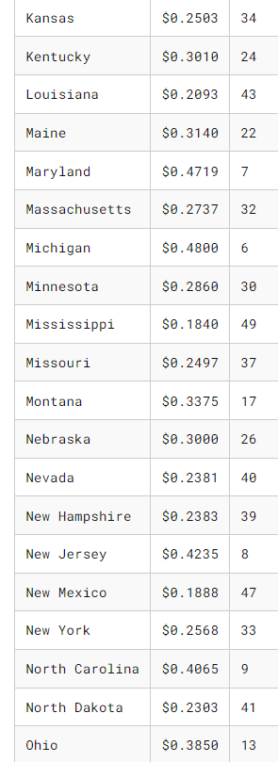
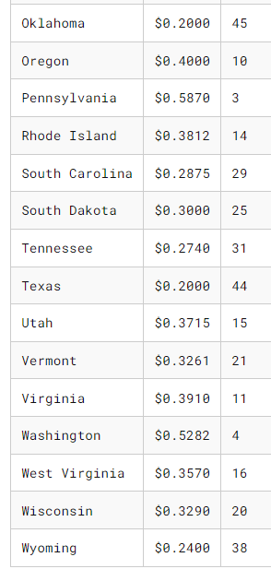
How High are Gas Taxes in Your State?
US Gas Tax Rate, Cents per Gallon, January 2024

Slide 41
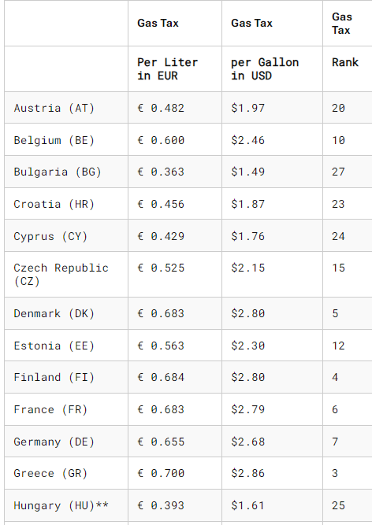
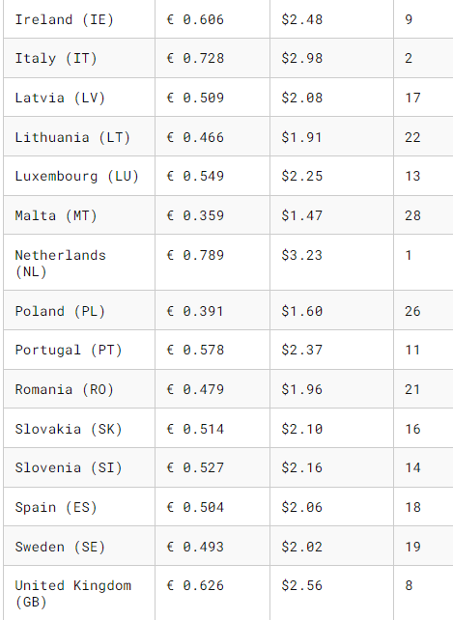
How High are Gas Taxes in Europe?
Excise Duties on Gas and Diesel in the EU, 2024

Slide 42
GOVERNMENT POLICIES AND POLLUTION
(4 of 4)
Tradable emissions permits: licenses to emit limited quantities of pollutants; the licenses can be bought and sold by polluters.
Currently the largest emissions permit trading system is the European Union system for controlling emissions of carbon dioxide.

Slide 43
GOVERNMENT POLICIES AND POLLUTION
(4 of 4)
How does the EU ETS work?
Companies must buy or receive allowances corresponding to their CO2 emissions, making power production from burning coal and other fossil fuels more expensive, and clean power sources more attractive.
The EU ETS follows a ‘cap-and-trade’ approach: the EU sets a cap on how much CO2 can be emitted – which decreases each year – and companies need to have a European Emission Allowance (EUA) for every ton of CO2 they emit within one calendar year.
Companies face a fine if they emit more CO2 than they have covered by emission allowances. The fine is 100 euros per excess ton.

Slide 44
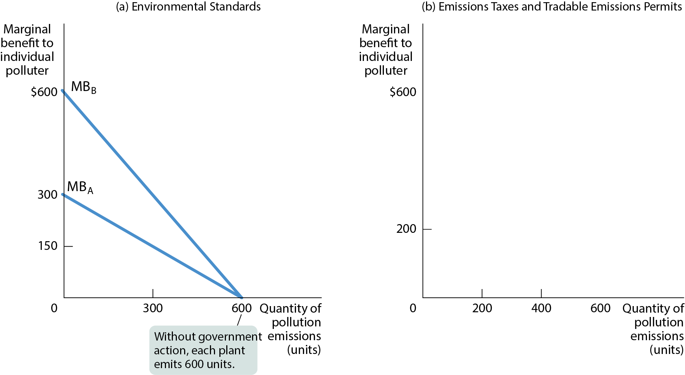
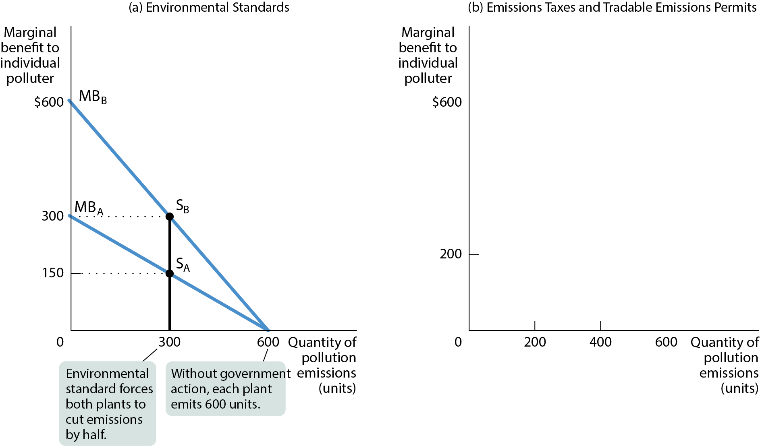
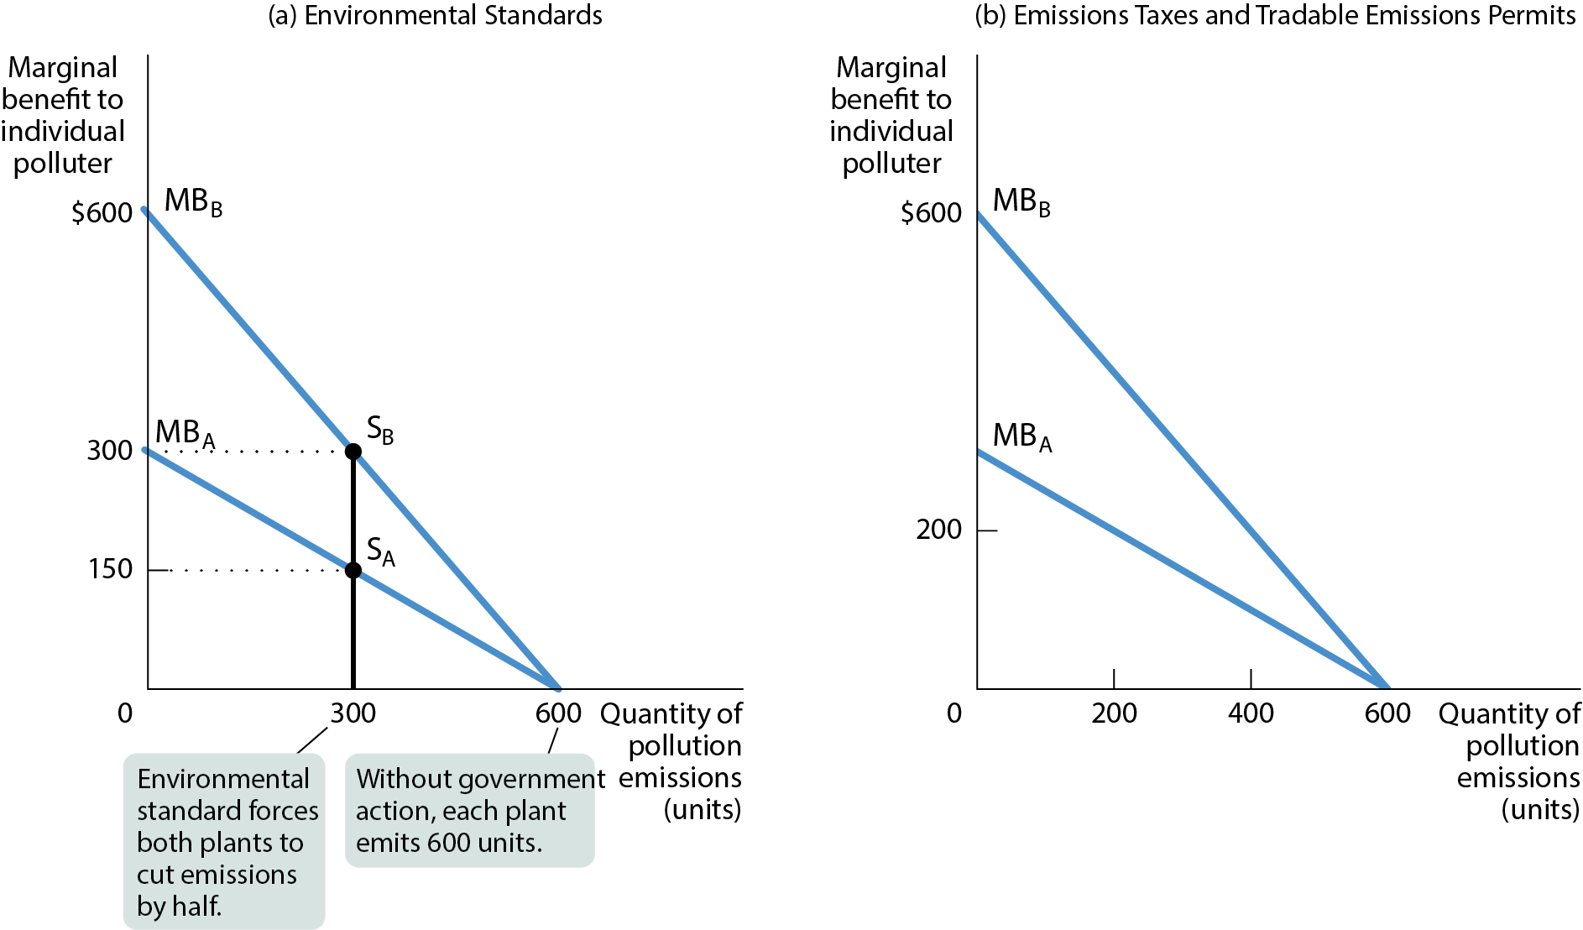
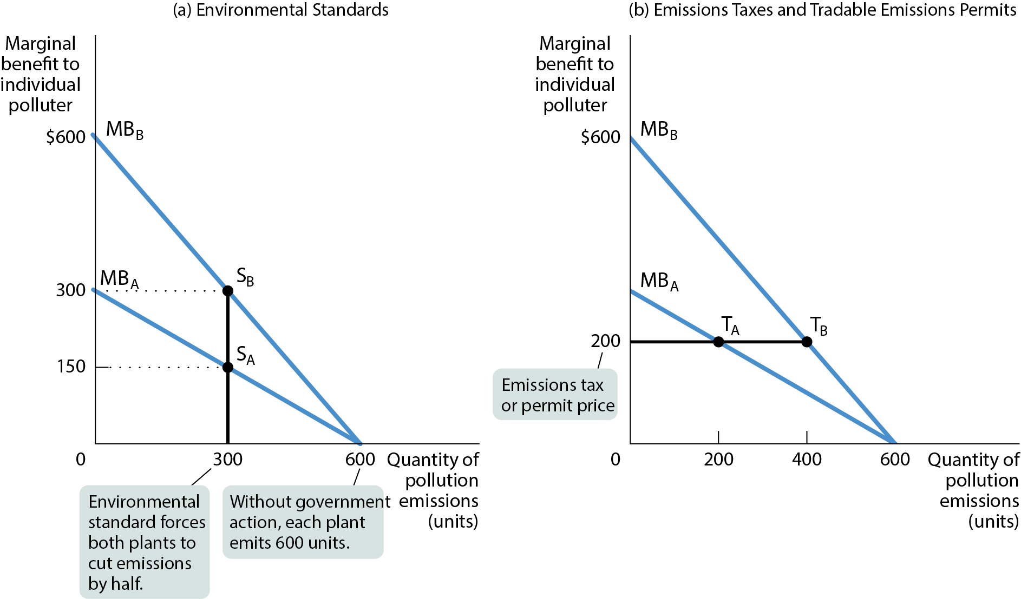
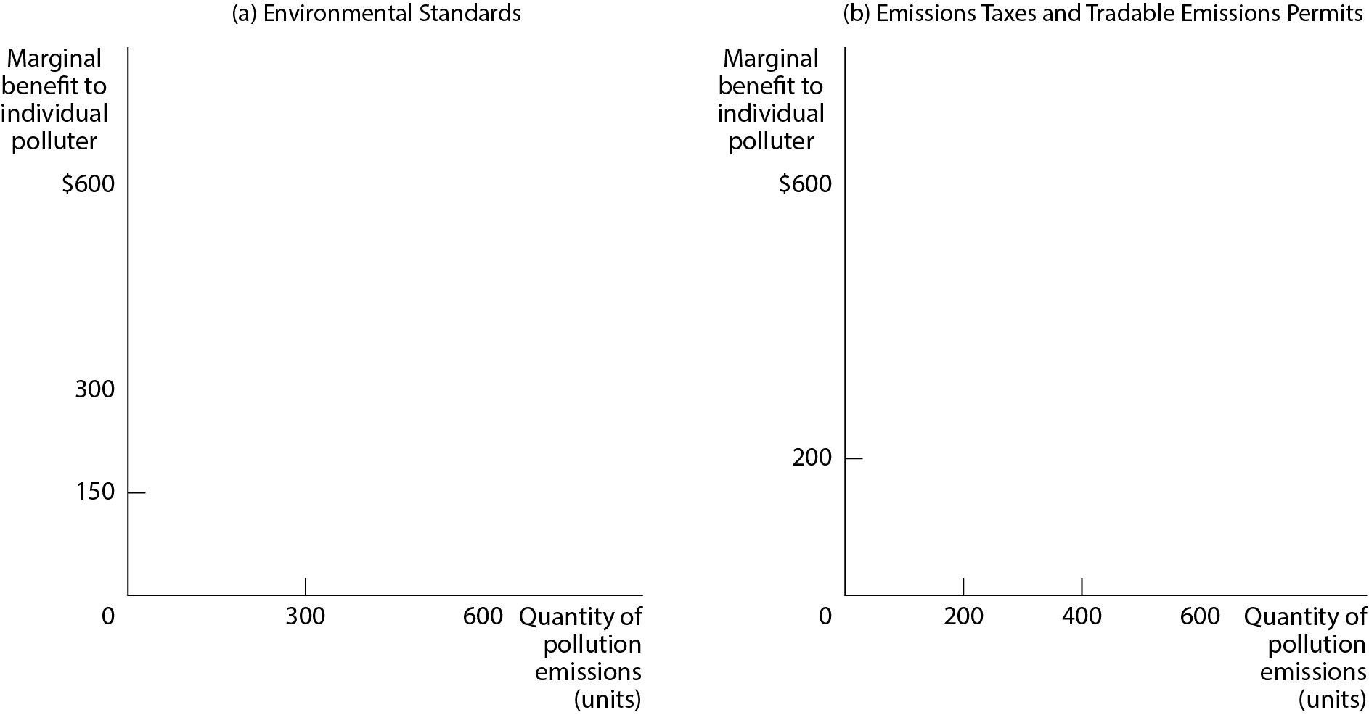
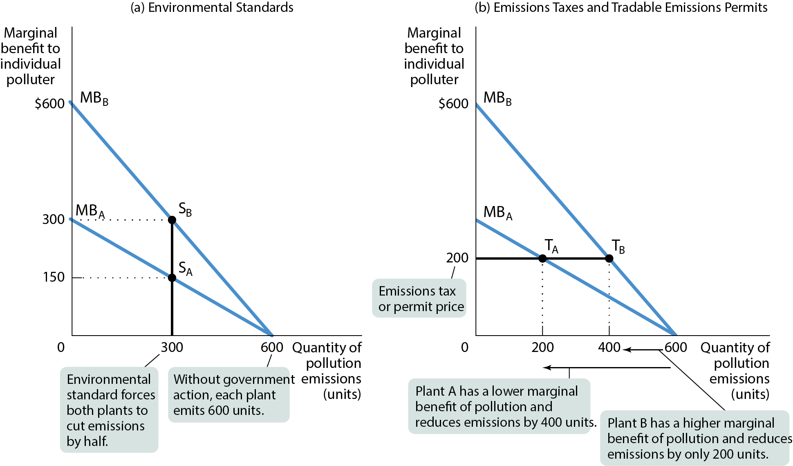
COMPARING ENVIRONMENTAL POLICIES (1 of 2)
Figure 3

Slide 45
COMPARING ENVIRONMENTAL POLICIES
(2 of 2)
Two plants, A and B:
Plant A uses newer technology so that A’s marginal benefit curve lies below B’s marginal benefit curve.
An environmental standard requires both plants to cut emissions in half; this is inefficient, because it leaves the marginal benefit of pollution higher for B than for A.
An emissions tax as well as tradable permits achieve the same quantity of overall pollution efficiently.

Slide 46
SUBSIDIES
Subsidies encourage polluters to switch from high-polluting activities to low-polluting activities.
For example, the Inflation Reduction Act (IRA) of 2022 gives a $7,500 tax credit for the purchase of an electric vehicle for qualifying buyers.

Slide 47
CAP AND TRADE
Since 1994, the United States has had an SO₂ cap-and-trade system, and acid rain has been reduced by 94% from 1994 to 2022—relatively cheaply.
In 2005, the first cap and trade system for trading greenhouse gases—called carbon trading—was launched in the EU. Nearly two decades later, carbon trading has grown rapidly around the world. In 2021, approximately $850 billion in permits were traded globally.

Slide 48
LEARN BY DOING: PRACTICE QUESTION 3
Suppose a government decides to issue a limited number of tradable pollution permits.
Which of the following statements is true?
Firms that can easily and cheaply reduce their level of pollution will find it beneficial to purchase these tradable pollution permits.
When the government issues these tradable pollution permits, it effectively creates a market for the right to pollute.
Firms that sell their tradable pollution permits do not fully understand the costs they will incur when they try to reduce the level of pollution they create.
None of the statements is true.

Slide 49
LEARN BY DOING: PRACTICE QUESTION 3
(ANSWER)
Suppose a government decides to issue a limited number of tradable pollution permits.
Which of the following statements is true?
Firms that can easily and cheaply reduce their level of pollution will find it beneficial to purchase these tradable pollution permits.
When the government issues these tradable pollution permits, it effectively creates a market for the right to pollute. (correct answer)
Firms that sell their tradable pollution permits do not fully understand the costs they will incur when they try to reduce the level of pollution they create.
None of the statements is true.

Slide 50
THE ECONOMICS OF CLIMATE CHANGE
Climate change is the human-made change in Earth’s climate from the accumulation of greenhouse gases caused by the use of fossil fuels.
Greenhouse gases are gases that trap heat in Earth’s atmosphere.

Slide 51
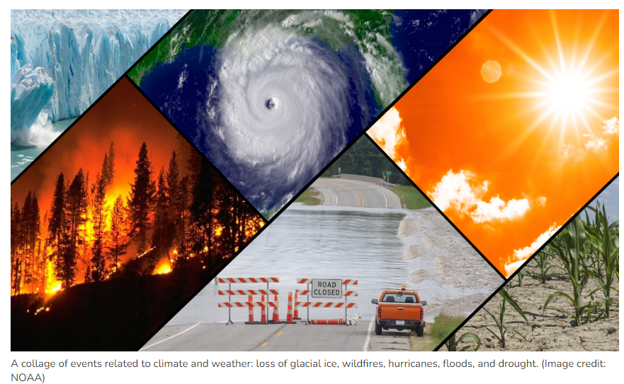
Climate change impacts

Slide 52
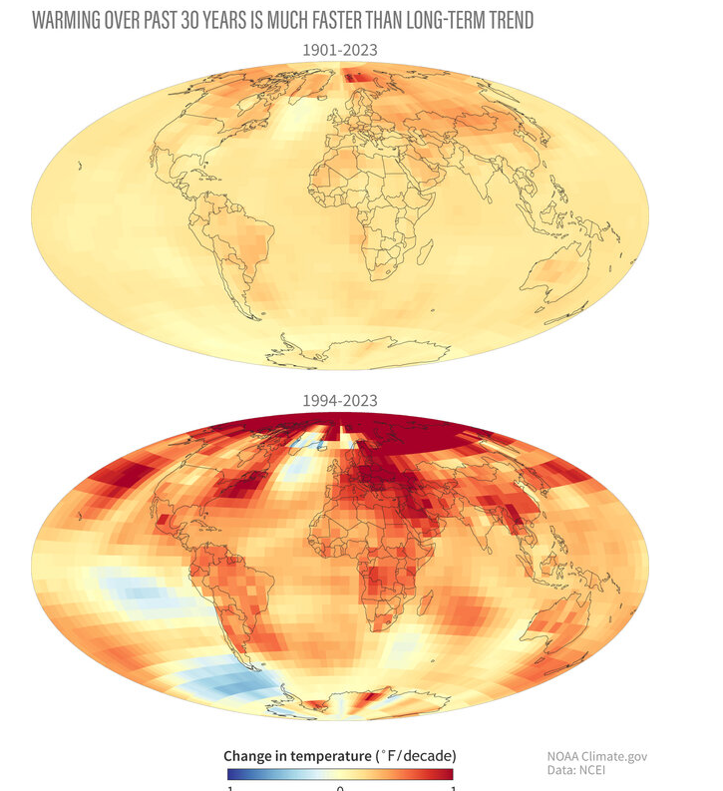
According to the 2023 Global Climate Report from NOAA in July, August, and September, global temperatures were more than 1.0°C (1.8°F) above the long-term average—the first time in NOAA's record any month has breached that threshold.

Slide 53
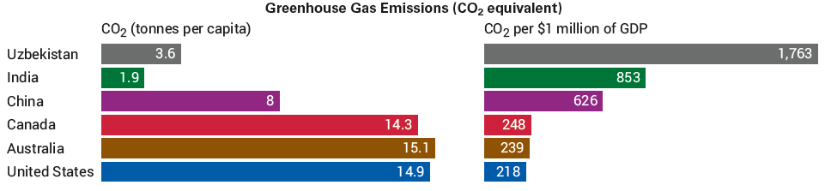
ECONOMIC GROWTH AND GREENHOUSE GASES IN SIX COUNTRIES
At first glance, Canada, the United States, and Australia are the worst offenders.
But it’s more meaningful to compare emissions per $1 million of a country’s GDP. Then, the United States, Canada, and Australia are “green” countries, but China, India, and Uzbekistan are not.
Poor countries have argued that they are too poor to afford the same environmental priorities as wealthy countries.

Slide 54
THE CAUSES OF CLIMATE CHANGE
Fossil fuel is fuel derived from fossil sources such as coal and oil.
Renewable energy sources are energy sources that are inexhaustible, unlike fossil fuel sources, which are exhaustible.
Clean energy sources are energy sources that do not emit greenhouse gases. Renewable energy sources are also clean energy sources.
World energy consumption remains overwhelmingly dependent upon fossil fuels. In 2021, they accounted for approximately 83.4% of total consumption, renewables accounted for only 12.6%, and nuclear energy accounted for approximately 4%.

Slide 55
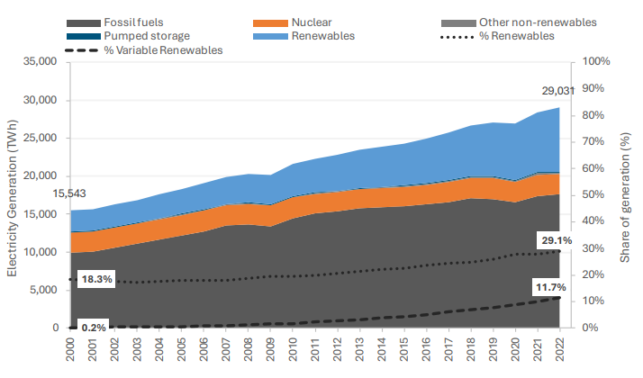
Renewable energy sources accounted for 29.1% of electricity generation globally in 2022

Slide 56
POLICIES TO ADDRESS CLIMATE CHANGE
Government subsidies to R&D: Since the 1980s, the U.S. government has provided billions of dollars in subsidies for R&D dedicated to lowering the cost of clean energy sources.
Multilateral agreements: They set common objectives and allocate burden-sharing across countries. In 2015, 196 countries signed the Paris Agreement, with a common goal of limiting the increase in the Earth’s temperature to 2° centigrade.

Slide 57
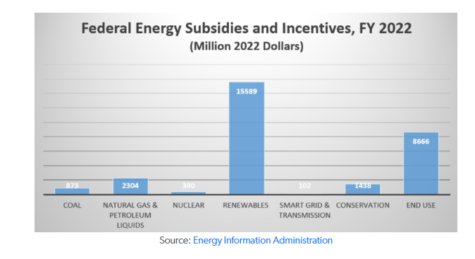
POLICIES TO ADDRESS CLIMATE CHANGE
The US has shifted its subsidies from fossil fuels to renewable energy, with renewables receiving 77% of energy subsidies in 2022 compared to fossil fuels' 16%. This is a reversal from 2017, when fossil fuels received 70% of energy subsidies worldwide
Renewable subsidies more than doubled between FY 2016 and FY 2022, increasing to $15.6 billion in fiscal year 2022 from $7.4 billion in fiscal year 2016 (both in 2022 dollars).

Slide 58
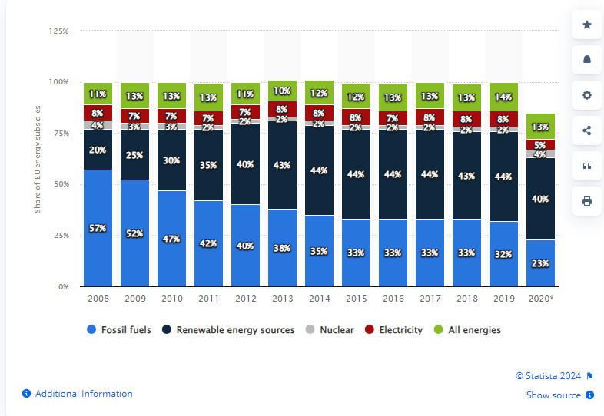
POLICIES TO ADDRESS CLIMATE CHANGE
In 2008 renewable energy subsidies accounted for 20 percent of EU energy subsidies. By 2020, this figure had doubled.

Slide 59
CLIMATE CHANGE MITIGATION
Are the costs of addressing climate change too high?
Global losses from runaway climate change are estimated at 20% of GDP by 2100.
4.6 million people die annually from air pollution caused by burning fossil fuels.
The health benefits of switching to clean energy is estimated to be 5% of global GDP.
In 2019, more than 3,500 economists advocated for a carbon tax to fight climate change.

Slide 60
THE ECONOMICS OF POSITIVE EXTERNALITIES
Sometimes a market includes benefits that bystanders receive.
External benefit: a benefit received by people other than the consumers or producers trading in the market.
Do motorcycle riders provide an external benefit to those waiting for an organ transplant?
Positive externalities are the mirror images of negative externalities.
Left on its own, the market will produce too little of a good that generates external benefits.
But society as a whole is better off when policies are adopted that increase the supply of such a good.

Slide 61
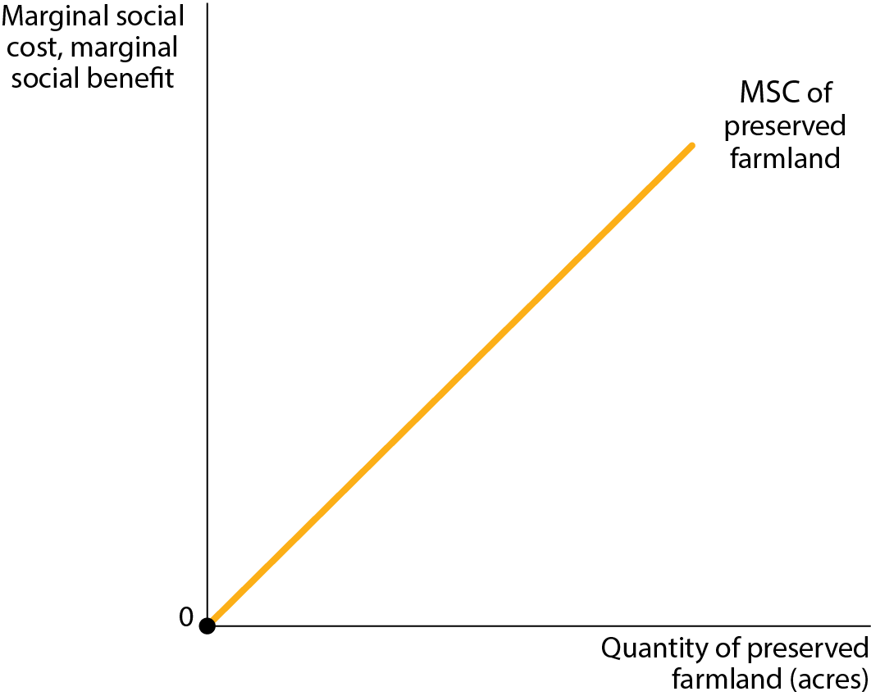
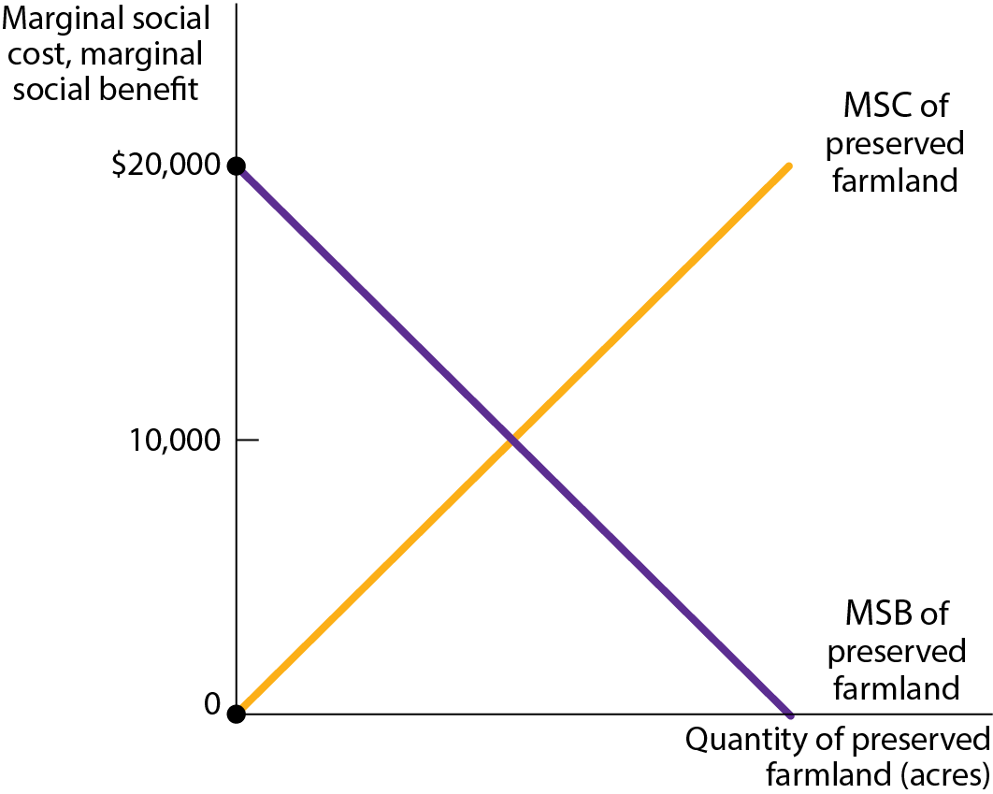
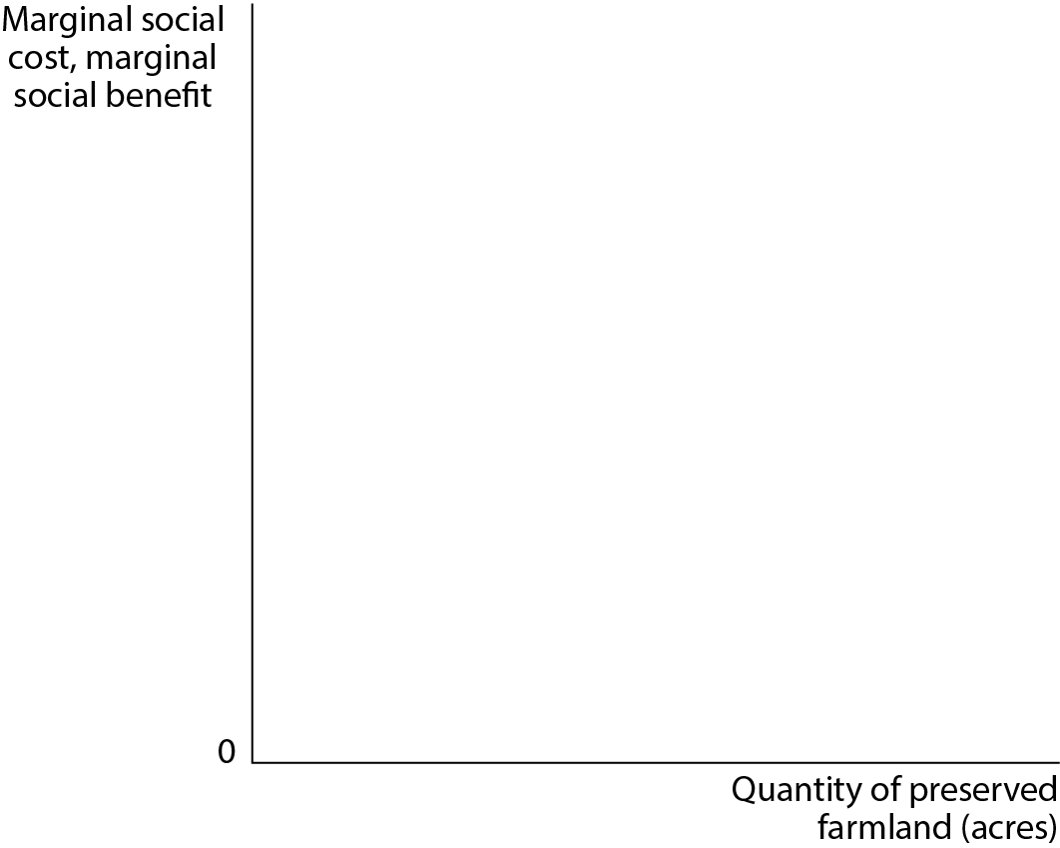
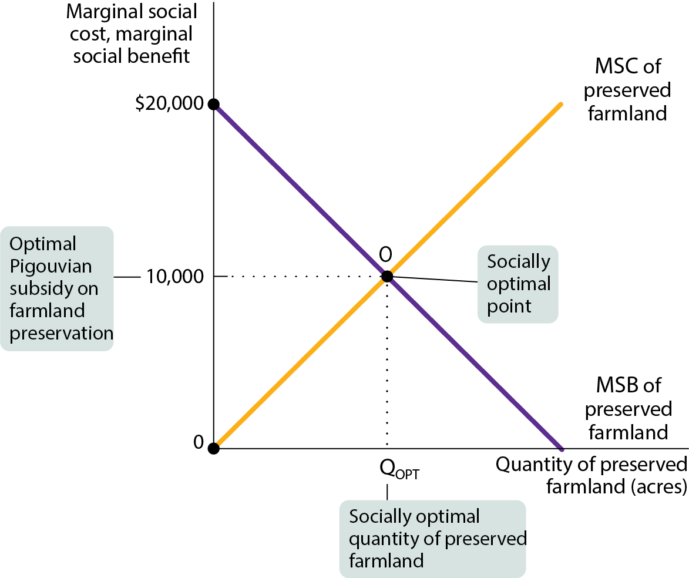
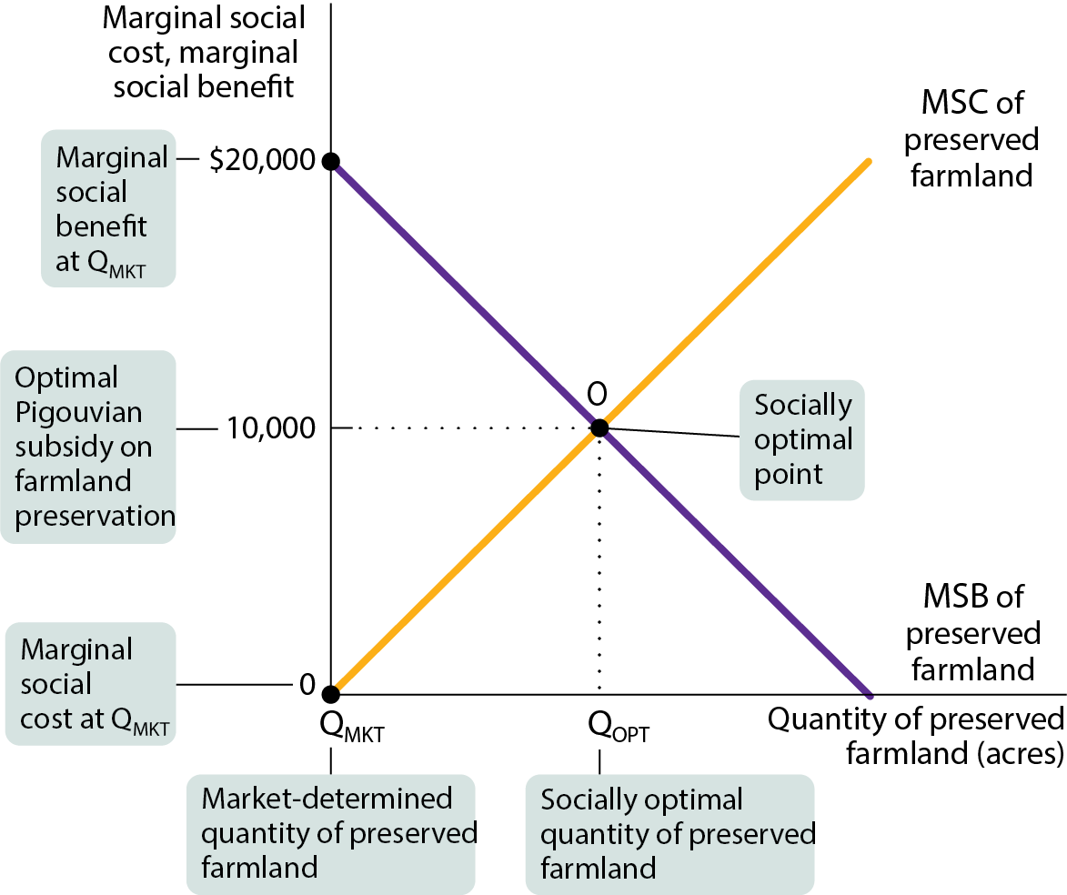
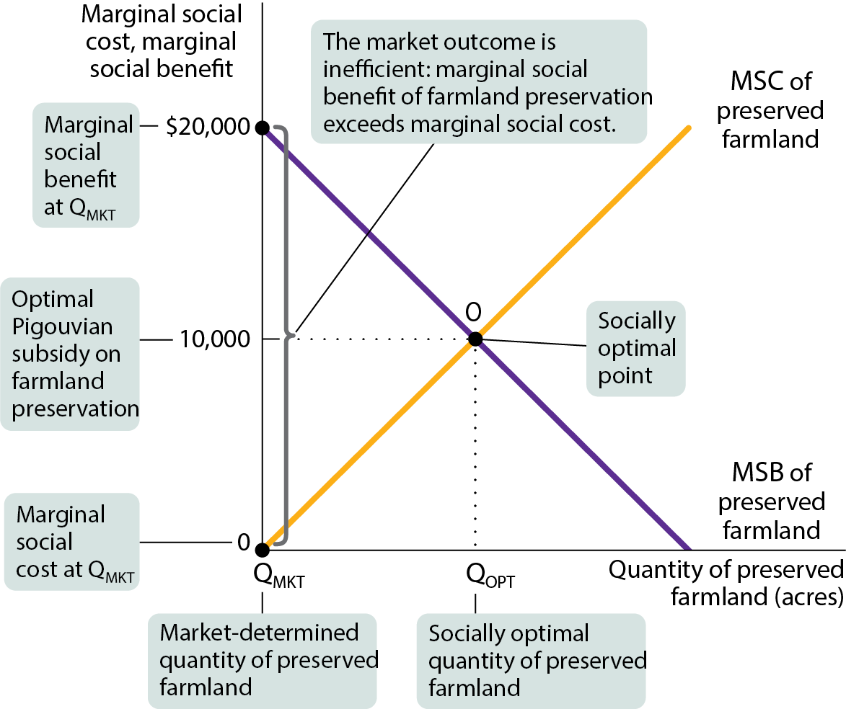
WHY A MARKET ECONOMY PRESERVES TOO LITTLE FARMLAND (1 of 2)
Without government intervention, the quantity of preserved farmland will be zero. (See Figure 6.)

Slide 62
WHY A MARKET ECONOMY PRESERVES TOO LITTLE FARMLAND (2 of 2)
At the socially optimal point O, the marginal social cost equals the marginal social benefit, and Q_{OPT} acres of farmland are preserved.
The market alone will preserve zero acres of farmland, Q_{MKT}.
Because farmers bear the entire cost of preservation but gain none of the benefits, they will preserve an inefficiently low quantity of acres.
How can the economy produce the socially optimal Q_{OPT}? Use a Pigouvian subsidy, the payment designed to encourage activities that generate positive externalities.

Slide 63
PIGOUVIAN SUBSIDY
A Pigouvian subsidy: a payment designed to encourage activities that yield external benefits.
The socially optimal quantity can be achieved by a Pigouvian subsidy equal to the marginal social benefit at the optimal quantity.

Slide 64
POSITIVE EXTERNALITIES IN TODAY’S ECONOMY
The single most important source of positive externalities is the creation and spreading of knowledge, known as a technology spillover.
A technology spillover is a positive externality that results from knowledge spread among individuals and firms.
One of the best-known research clusters is the Research Triangle in North Carolina, anchored by several universities, hospitals, and companies such as IBM, Pfizer, and Qualcomm.

Slide 65
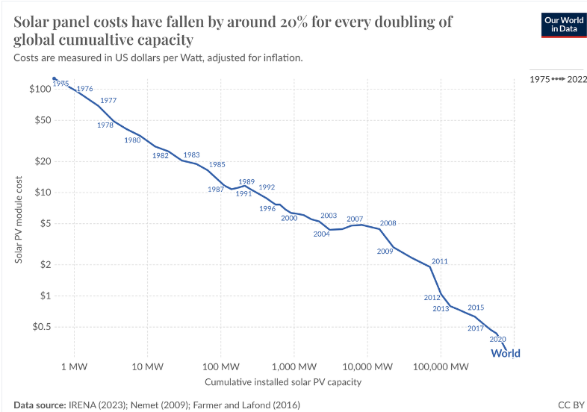
Solar photovoltaic costs have fallen by 90% in the last decade, onshore wind by 70%, and batteries by more than 90%.

Slide 66
NETWORK EXTERNALITIES (1 of 2)
A good is subject to a network externality when the value of the good to an individual is greater when more people also use the good.
  Examples include:
    Communication systems such as telephones, telegraphs, fax machines
    Railway systems
    Hub-and-spoke air travel

Slide 67

NETWORK EXTERNALITIES (2 of 2)
A good is subject to positive feedback, also known as a bandwagon effect, when success breeds greater success and failure breeds failure.
The more popular Windows is, the more software is made for it and the more popular it becomes.

Slide 68
Many of the world's most popular companies and startups benefit from network effects, including:
Social media: Facebook, Twitter, Instagram, Snapchat, Pinterest, TikTok, LinkedIn
E-commerce: Amazon, eBay, Etsy, Alibaba, Shopify, JD.com
Food delivery: Uber Eats, Grubhub, DoorDash, Postmates, Instacart, Shipt, Gopuff
Ridesharing: Uber, Lyft
User review sites: Yelp, TripAdvisor, Google
Travel platforms: Expedia, Hotels.com
Communication applications: WhatsApp, Messenger
Freelancing sites: Fiverr, Upwork, Thumbtack
Payment networks: PayPal, Cash App

Slide 69
LEARN BY DOING: PRACTICE QUESTION 4
When the consumption of a good generates positive external benefits, the market tends to produce:
too much of the good, since there are positive external benefits from the consumption of the good.
too little of the good, since the market does not take into account the positive external benefits from the consumption of the good.

Slide 70
LEARN BY DOING: PRACTICE QUESTION 4
(ANSWER)
When the consumption of a good generates positive external benefits, the market tends to produce:
too much of the good, since there are positive external benefits from the consumption of the good.
too little of the good, since the market does not take into account the positive external benefits from the consumption of the good. (correct answer)

Slide 71
LEARN BY DOING: PRACTICE QUESTION 5
For most pollutants, the socially efficient level of pollution is zero.
True
False

Slide 72
LEARN BY DOING: PRACTICE QUESTION 5
(ANSWER)
For most pollutants, the socially efficient level of pollution is zero.
True
False (correct answer)

Slide 73
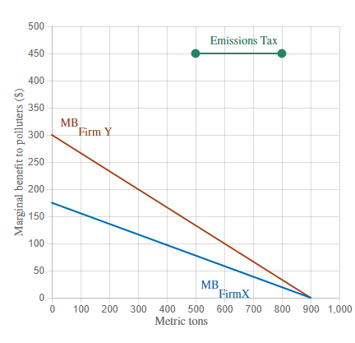
LEARN BY DOING
Regulators have discovered that the optimal level of this pollutant is 1,000 tons of pollution each year. Suppose that regulators limit each firm's annual pollution to 500 tons each.
Adjust the Emissions Tax line on the graph to show the optimal corrective tax to reduce total emissions to 1,000 tons per year.
By how much will each firm reduce its emissions?
400 each =(900-500)
Under this tax, by how much will firm X reduce emissions, compared to the situation in which there are no regulations?
500=(900-400)

Slide 74
Classify the statements as true or false.
Emissions taxes encourage firms to find innovative ways to remove pollution.
Firms generate the same level of pollution regardless of any emissions taxes that are imposed.
An emissions tax is a type of Pigouvian tax.
Environmental standards are typically more efficient than emissions taxes.
With an emissions tax, firms must pay a fine if they pollute more than the legally specified amount.
True
False
True
False
False

