Slide 1
Review Session
Midterm #1
Chapters 1-5
Notes:
Cover Credits: Currency Exchange Stock Chart: cemagraphics/Getty Images, Social Media Montage: SEAN GLADWELL/Getty Images, Circuit Pattern: somsak Tangdamrongsub/Getty Images, Cargo Containers: urzine/Getty Images

Slide 2
Important Dates
Homework #4 (Chapter 4) is due on Wednesday September 18th.
No class on Thursday September 19th.
Quiz #2 (chapters 3 and 4) is due on September 22nd. [Available this Friday – 1 hour]
Homework #5 is due on Monday September 23rd.
Writing assignment due on Thursday September 19th.

Slide 3
Important Dates
Tuesday
Wednesday
Thursday
Sunday
Monday
Tuesday
Review Session
09/17
HW #4
09/18
No Class
09/19
Quiz #2
09/22
HW #5
09/23
Midterm #1
09/24
Writing
Assignment
09/19 - CANVAS

Slide 4
Midterm #1
20 Questions, multiple choice.
Chapters 1- 5.
1 hour and 15 minutes.
No phones are allowed.
You can bring a calculator.

Slide 5
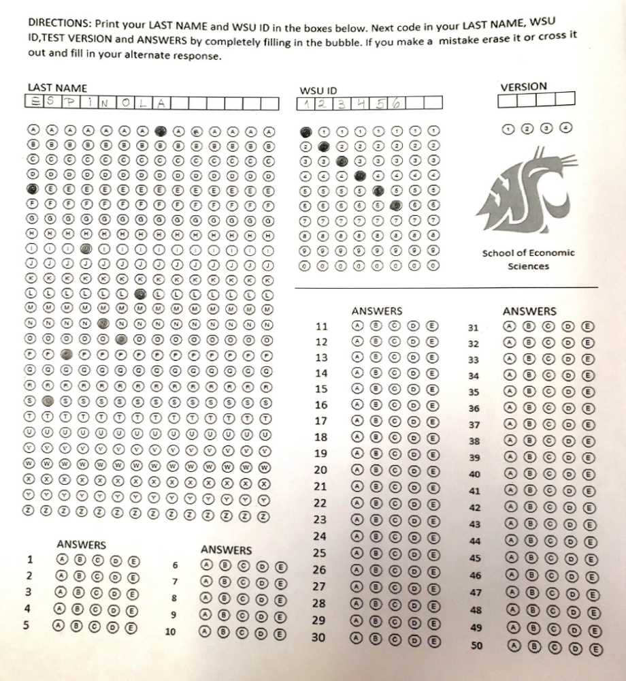
Midterm #1 – Scantron answer sheet

Slide 6
When does the quantity supplied change?
When price alone changes, there is movement along a supplied curve.
When does the supply change (supply shifters)?
  input prices.
  the prices of related goods or services.
  technology.
  expectations.
  the number of producers.

Slide 7
When does the quantity demanded change?
When price alone changes, there is movement along a demand curve.
When does the demanded change?
Changes in the prices of related goods or services (substitutes)
Changes in income
Changes in tastes
Changes in expectations
Changes in the number of consumers

Slide 8
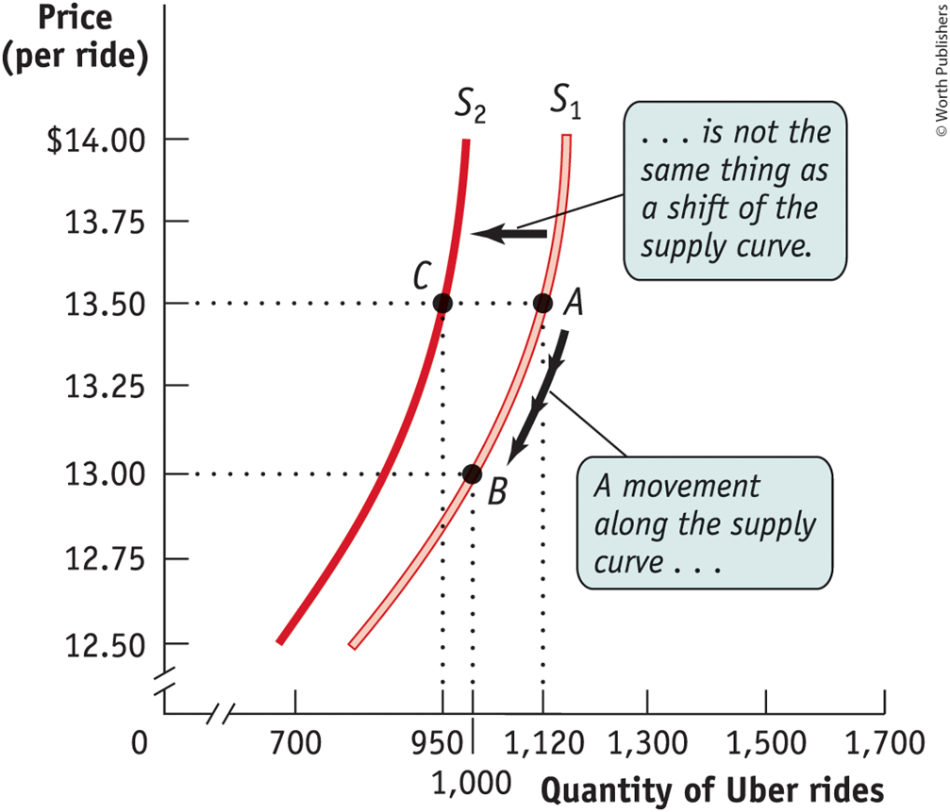
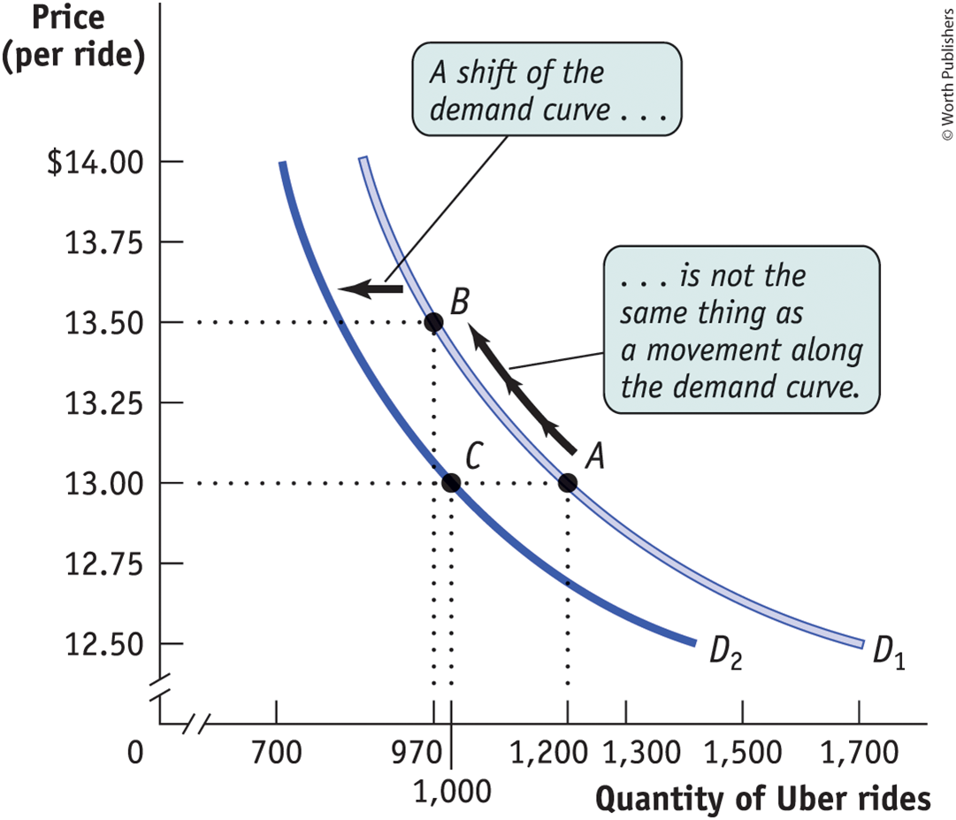
Graphically

Slide 9
Changes in demand
_{S}
_{Price}
_{P1}
_{P2}
_{D2}
_{D1}
_{Q2}
_{Q1}
_{Q}

Slide 10
Comparative vs Absolute Advantage
1. Who has an absolute advantage? Who has a comparative advantage in producing cheese?
 | Wine | Cheese
France | 10 | 8
Argentina | 4 | 2
OC^{C}_{F}:10/8=1.25
OC^{C}_{A}:4/2=2
France

Slide 11
Comparative Advantage
Suppose that in Australia, it takes 2 hours to harvest 10 bushels of apples and 4 hours to harvest 10 bushels of tomatoes. Suppose a worker in Brazil can harvest 10 bushels of apples in 4 hours or 10 bushels of tomatoes in 5 hours. Which of these statements is true?
Brazil has a comparative advantage in producing tomatoes.
Brazil has a comparative advantage in producing apples.
Brazil has an absolute advantage in producing both goods.
In trade between these two countries, Australia would gain, and Brazil would lose.

Slide 12
Comparative Advantage
Suppose that in Australia, it takes 2 hours to harvest 10 bushels of apples and 4 hours to harvest 10 bushels of tomatoes. Suppose a worker in Brazil can harvest 10 bushels of apples in 4 hours or 10 bushels of tomatoes in 5 hours. Which of these statements is true?
Australia:
Apples=10/2=5 per hour
Tomatoes= 10/4=2.5 per hour
Brazil:
Apples=10/4=2.5 per hour
Tomatoes= 10/5=2 per hour
Apples
Australia
Brazil
Apples
Australia:
OCApples=2.5/5 =0.5
OCTomatoes=5/2.5=2
Brazil:
OCApples=2/2.5 =0.8
OCTomatoes=2.5/2=1.25
2.5
5
2.5
Tomatoes
2
Tomatoes

Slide 13
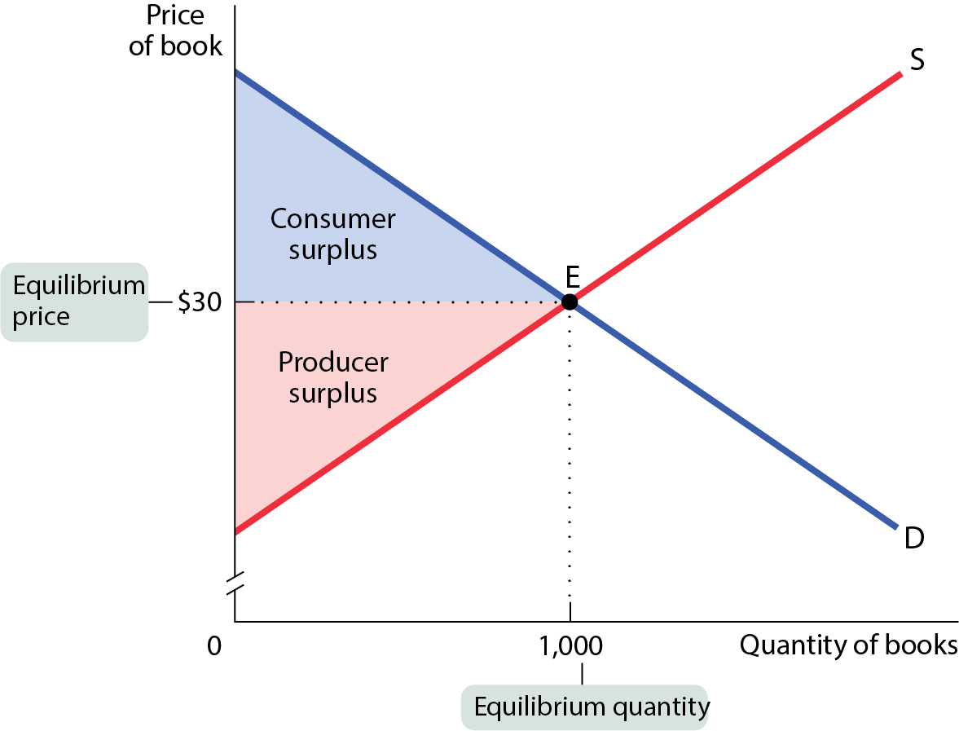
Consumer Surplus and Producer Surplus
50
(50-30)*(1000)/2=1000
Total Surplus=2,000
10
(30-10)*(1000)/2=1000

Slide 14
Exercise – CS, PS and TS
The management at Moose Park is considering whether to replace their portable toilets with flush toilets at the popular Moose Campground. They are also deciding how many flush toilets to install if they proceed.
They will install flush toilets if the total surplus exceeds a certain threshold in relation to the number of flush toilets and the cost per campsite per night.
Researchers have calculated that both the demand and supply curves for flush toilets at the park are perfectly straight lines. At a cost of $35 per campsite per night, no one will want flush toilets. At $0 per campsite per night, campers will demand 7 flush toilets.
Managers are currently willing to supply no flush toilets at the current campsite cost of $5 per night but are willing to supply 8 flush toilets at $25 per campsite per night.
Please use the supply, demand, and total surplus information to answer the following three questions.
What is the number of flush toilets desired at the equilibrium point?
What is the total surplus?
Will the managers install the number of flush toilets determined in the first question?

Slide 15
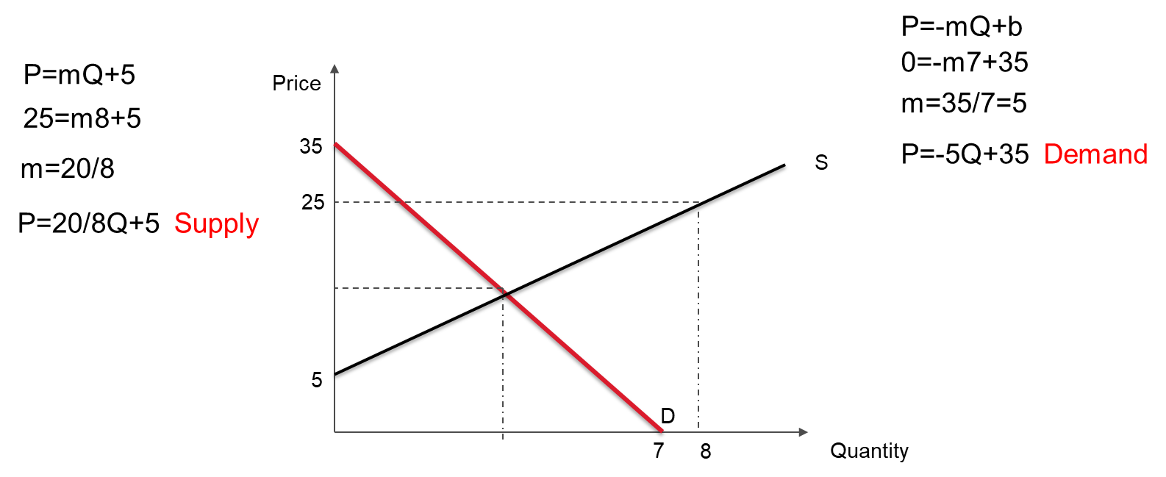
Exercise – CS, PS and TS
Researchers have calculated that both the demand and supply curves for flush toilets at the park are perfectly straight lines. At a cost of $35 per campsite per night, no one will want flush toilets. At $0 per campsite per night, campers will demand 7 flush toilets. Managers are currently willing to supply no flush toilets at the current campsite cost of $5 per night but are willing to supply 8 flush toilets at $25 per campsite per night.
What is the number of flush toilets desired at the equilibrium point?
What is the total surplus?
Will the managers install the number of flush toilets determined in the first question?
PS=40+20=60
CS=(35-15)*4/2=40
-5Q+35=20/8Q+5
-40Q+280=20Q+40
280=60Q
Q=4
P=15
PS=(15-5)*4/2=20
Q=4

Slide 16
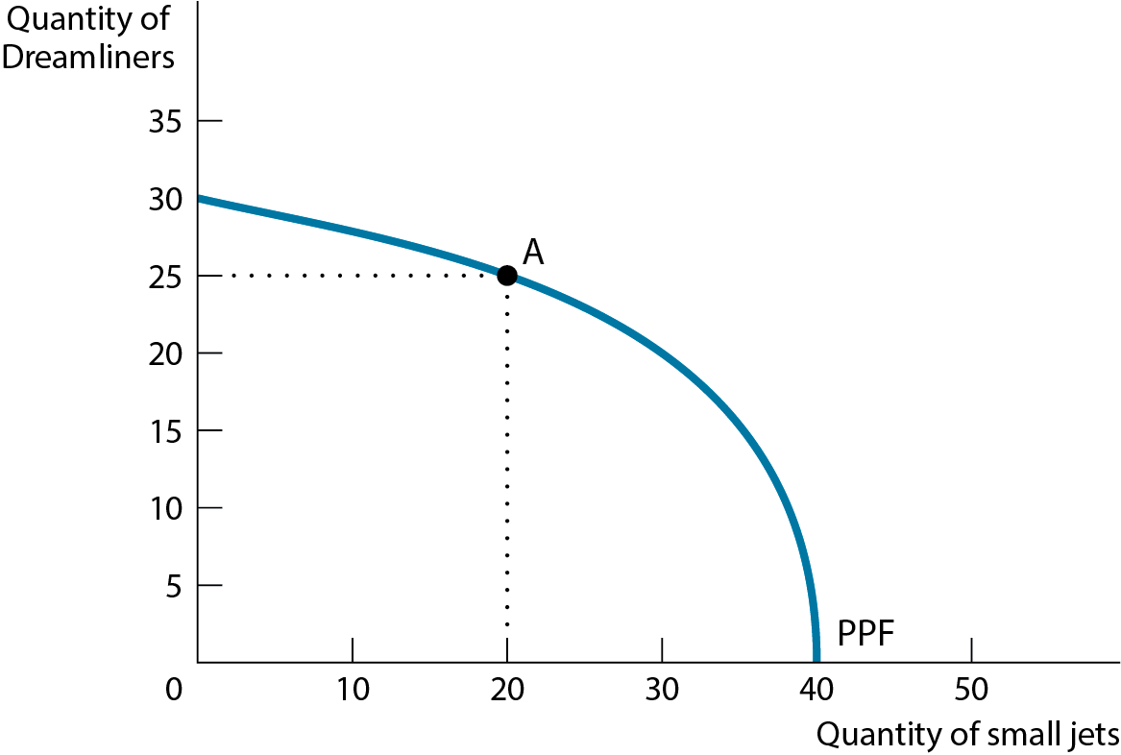
Production Possibility Frontier (PPF)
Some resources are better suited for producing one good than another, which means that there are diminishing returns when moving such resources away from producing what they are best suited for.

Slide 17
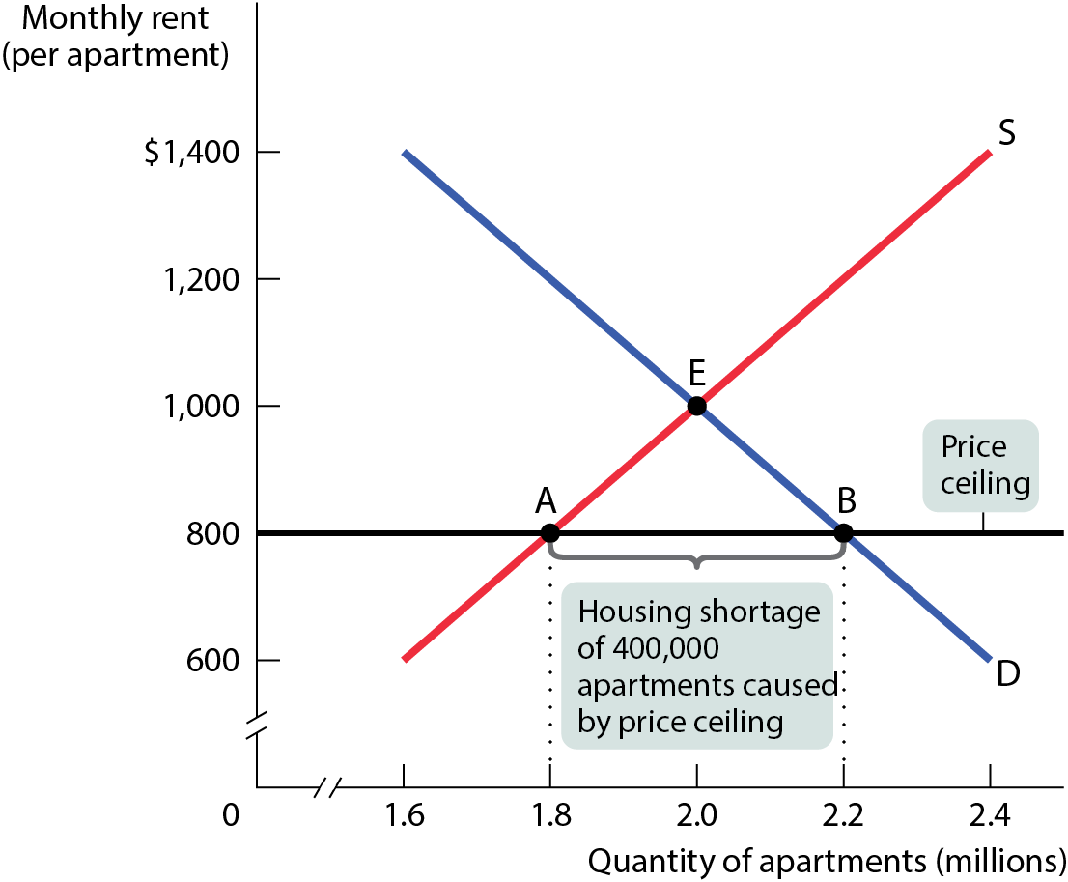
MODELING A PRICE CEILING
Rent/month | Quantity demanded | Quantity supplied
$1,400 | 1.6 | 2.4
$1,200 | 1.8 | 2.2
$1,000 | 2.0 | 2.0
$800 | 2.2 | 1.8
$600 | 2.4 | 1.6
This price ceiling creates a persistent shortage of 400,000 units: 400,000 households who want apartments at the legal rent of $800 but cannot get them.

Slide 18
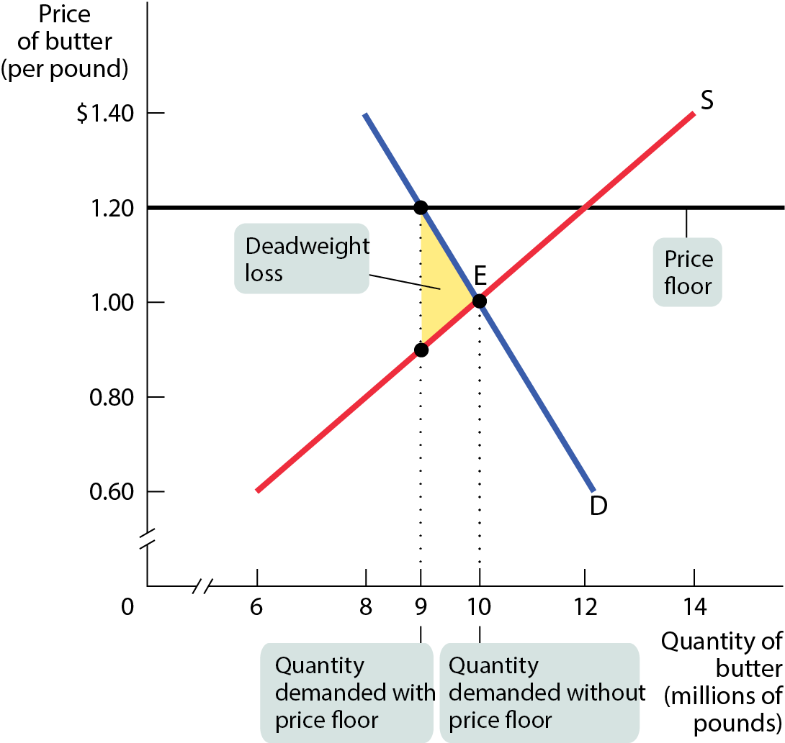
MODELING A PRICE FLOOR
DWL=(1.20-0.85)*(10-9)/2=0.175
[1.20-0.85]
0.85
[10-9]

Slide 19
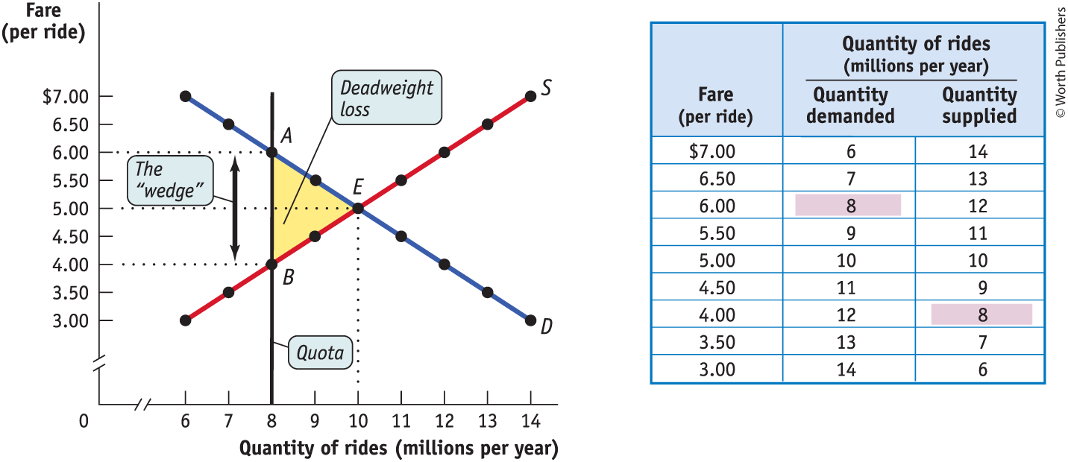
Quota
(6-4)*(10-8)/2=2

