Slide 1

Elasticity
6
Notes:
Cover Credits: Currency Exchange Stock Chart: cemagraphics/Getty Images, Social Media Montage: SEAN GLADWELL/Getty Images, Circuit Pattern: somsak Tangdamrongsub/Getty Images, Cargo Containers: urzine/Getty Images

Slide 2
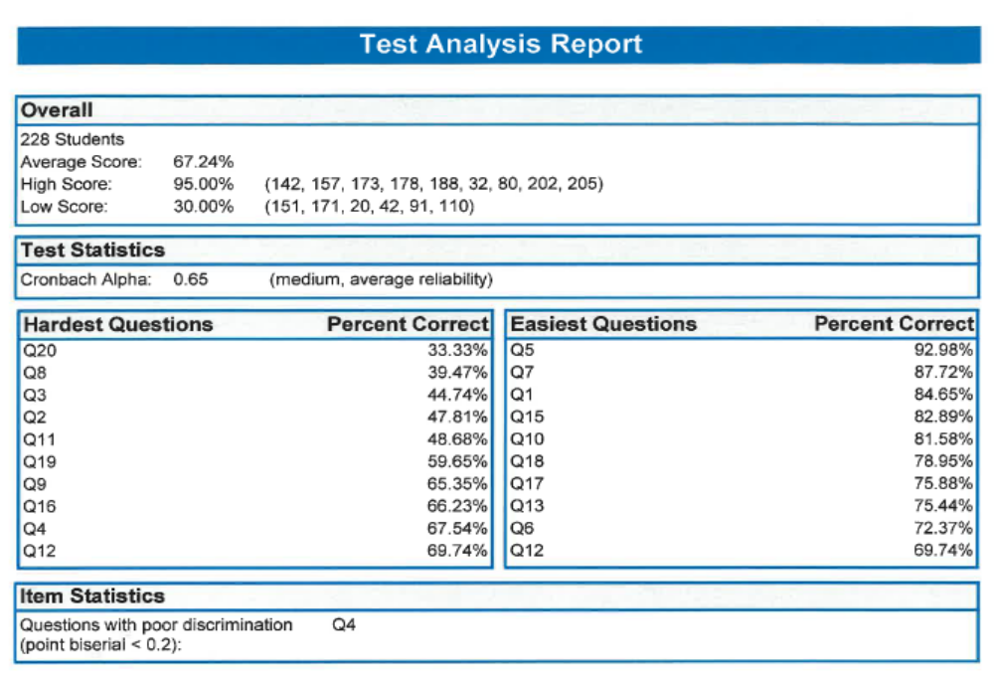
Midterm #1

Slide 3
Midterm #1
Extra Credit Assignment:
5 Questions
10 points
Due this Friday September 27th at 11:59pm
Points will be added to your Midterm 1 grade

Slide 4
WHAT YOU WILL LEARN IN THIS CHAPTER
Why is elasticity used to measure the response to changes in prices or income?
What are the different elasticity measures, and what do they mean?
What factors influence the size of these various elasticities?
Why is it vitally important to determine the size of the relevant elasticity before setting prices or government fees?

Slide 5

TAKEN FOR A RIDE
Taken for a ride: $1,772.41 for driving nine miles in an ambulance for a nonemergency treatment.
How are ambulance services able to charge thousands of dollars whether or not an ambulance is actually needed?
The answer is price responsiveness of consumers to price—the price elasticity of demand.

Slide 6
PRICE ELASTICITY OF DEMAND
Price elasticity of demand is the measure of price responsiveness:
A demand is elastic when an increase in price reduces the quantity demanded a lot.
A demand is inelastic when an increase in price reduces quantity demanded just a little.

Slide 7
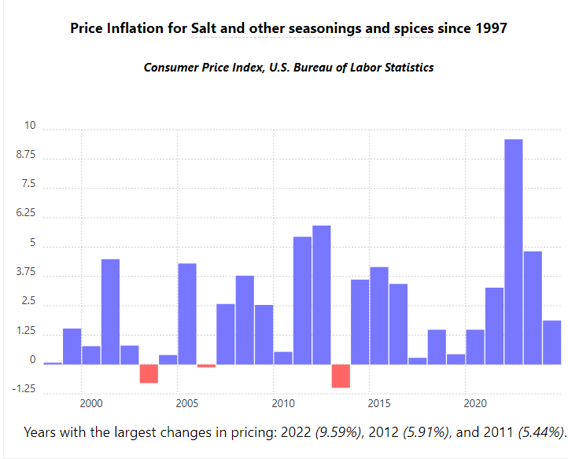

Slide 8
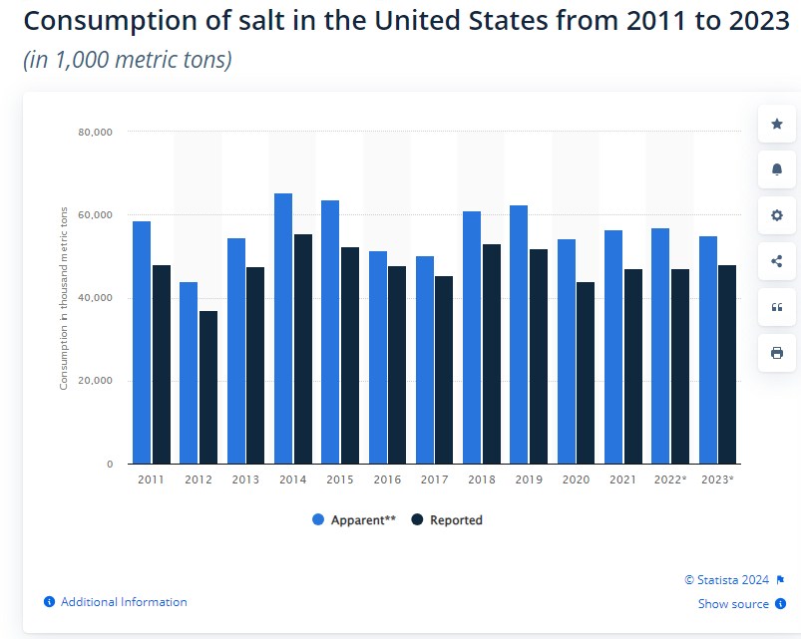

Slide 9
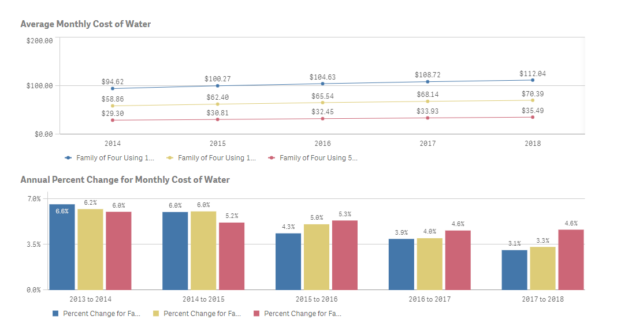
Five years of water rates data from 30 major U.S. cities
Water Pricing - Circle of Blue

Slide 10
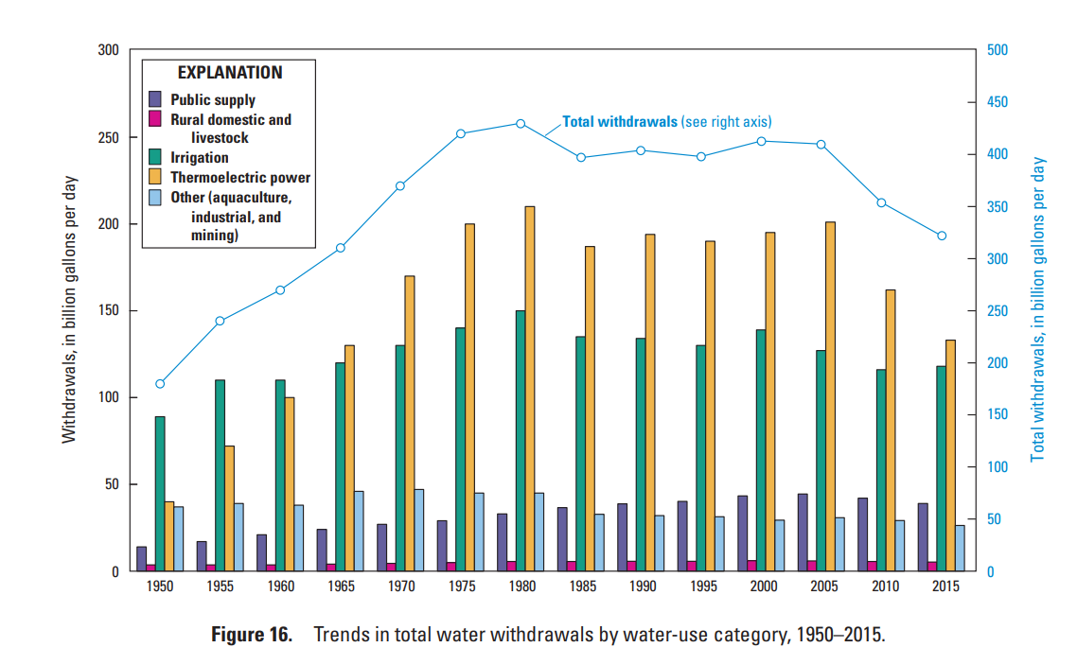
Trends in estimated water use in the United States, 1950–2015
circ1441.pdf - Estimated Use of Water in the United States in 2015 (usgs.gov)

Slide 11
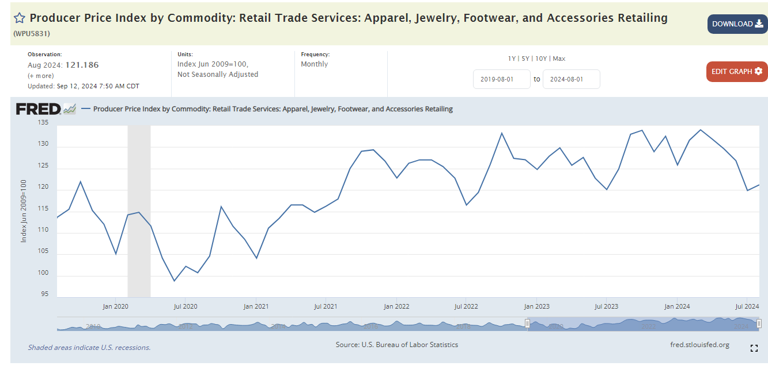
Producer Price Index by Commodity: Retail Trade Services: Apparel, Jewelry, Footwear, and Accessories Retailing (WPU5831) | FRED | St. Louis Fed (stlouisfed.org)

Slide 12
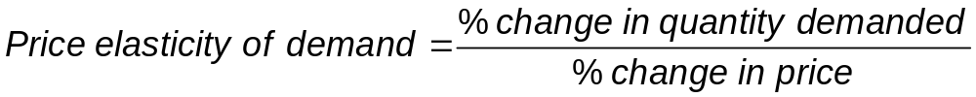
CALCULATING THE PRICE ELASTICITY OF DEMAND (1 of 2)
Price elasticity of demand = the percentage change in quantity demanded divided by the percentage change in price.

Slide 13
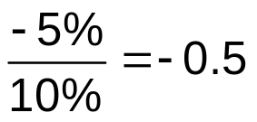
CALCULATING THE PRICE ELASTICITY OF DEMAND (2 of 2)
Example:
  If the price of oil increases by 10% and the quantity demanded falls by 5%, then the price elasticity of demand for oil is:
    Note: since we know that price and quantity demanded will always move in opposite directions (law of demand) we usually drop the minus sign (for price elasticity of demand only).

Slide 14
THE MIDPOINT METHOD (1 of 3)
There is a problem: Our percent change calculation depends on our choice of starting point.
Example: Gasoline costs three times as much per gallon in Europe as it does in the United States. What is the percent difference between American and European gas prices? It depends on which way you measure it:
European prices are 200% higher;
American prices are 66.67% lower.

Slide 15
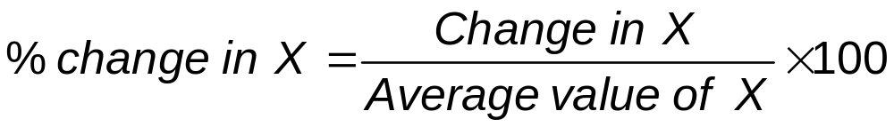
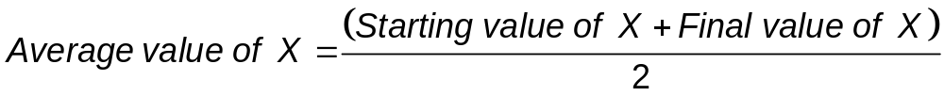
THE MIDPOINT METHOD (2 of 3)
To solve this problem, we calculate the price elasticity of demand using the midpoint formula for percentage changes.
Instead of dividing by the initial quantity or price, we’ll use the average quantity or price.

Slide 16
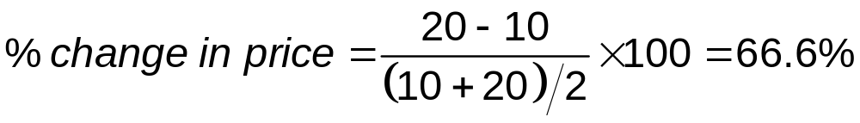
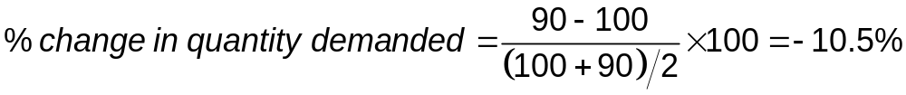
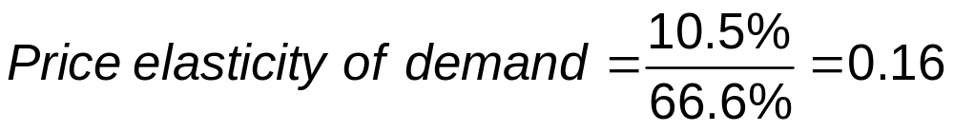
THE MIDPOINT METHOD (3 of 3)
Example: At the initial price of $10, the quantity demanded is 100. When the price rises to $20, the quantity demanded is 90.

Slide 17



LEARN BY DOING: PRACTICE QUESTION 1
If the price of a sushi roll drops from $8 to $4 and sales rise from 20 to 40 units, what is the absolute value of the price elasticity of demand using the midpoint formula?
  0.5
  0.66
  1
  2
% change in price=$\frac{\$4−\$8}{(\$8+\$4)/2}$x100=-66.6%
% change in quantity=$\frac{\$40−\$20}{(\$20+\$40)/2}$x100=66.6%
Price elasticity of demand=$\frac{\text{66.6}\text{\%}}{\text{66.6}\text{\%}}$=1

Slide 18
LEARN BY DOING: PRACTICE QUESTION 1
(Answer)
If the price of a sushi roll drops from $8 to $4 and sales rise from 20 to 40 units, what is the absolute value of the price elasticity of demand using the midpoint formula?
  0.5
  0.66
  1 (correct answer)
  2

Slide 19
ESTIMATING ELASTICITIES
Good | Price elasticity of demand
Inelastic demand
Gasoline (short-run) | 0.09
Gasoline (long-run) | 0.24
College (in-state tuition) | 0.60–0.75
Airline travel (business) | 0.80
Soda | 0.80
Elastic demand
Housing | 1.2
College (out-of-state tuition) | 1.2
Airline travel (leisure) | 1.5
Coke/Pepsi | 3.3
Economists (and many others) are interested in price elasticity of demand.
Estimating elasticity is crucial to understanding and predicting market outcomes.
TABLE 1 Some Estimated Price Elasticities of Demand

Slide 20
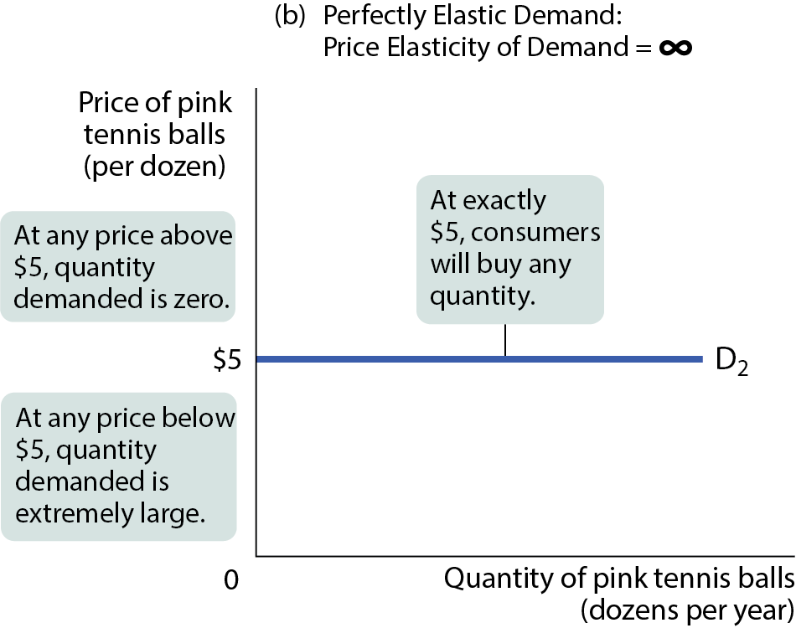
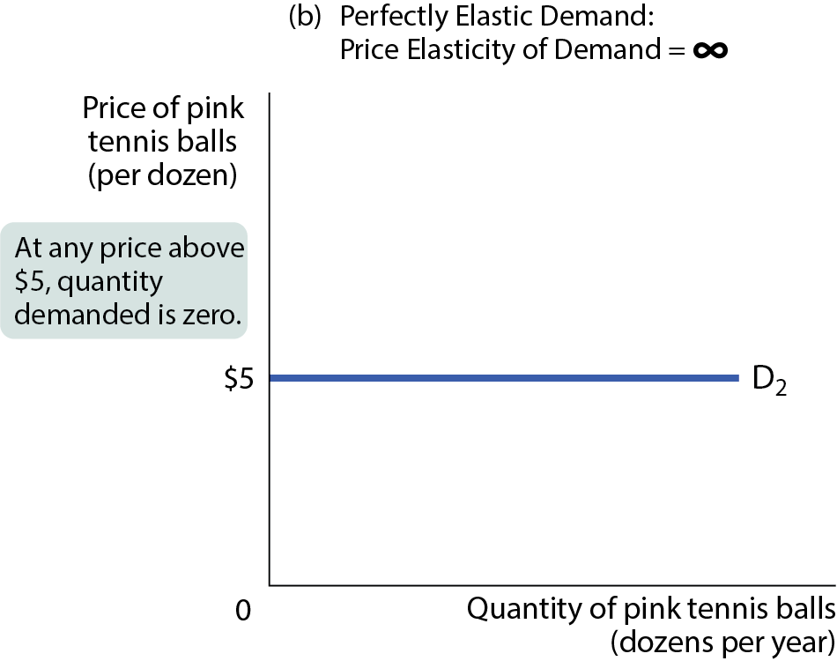
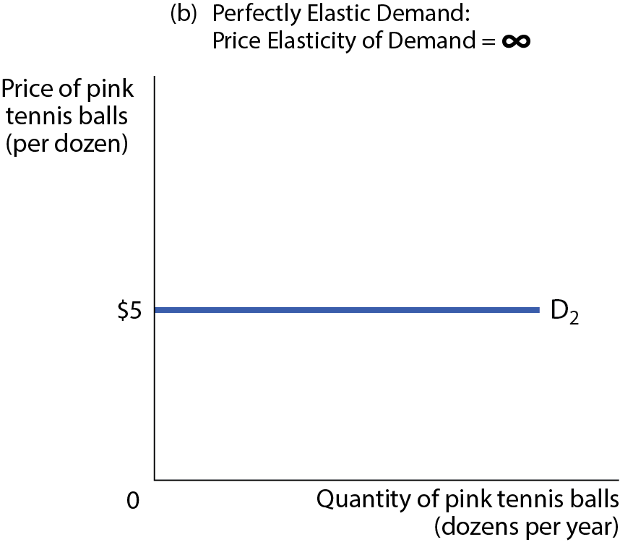
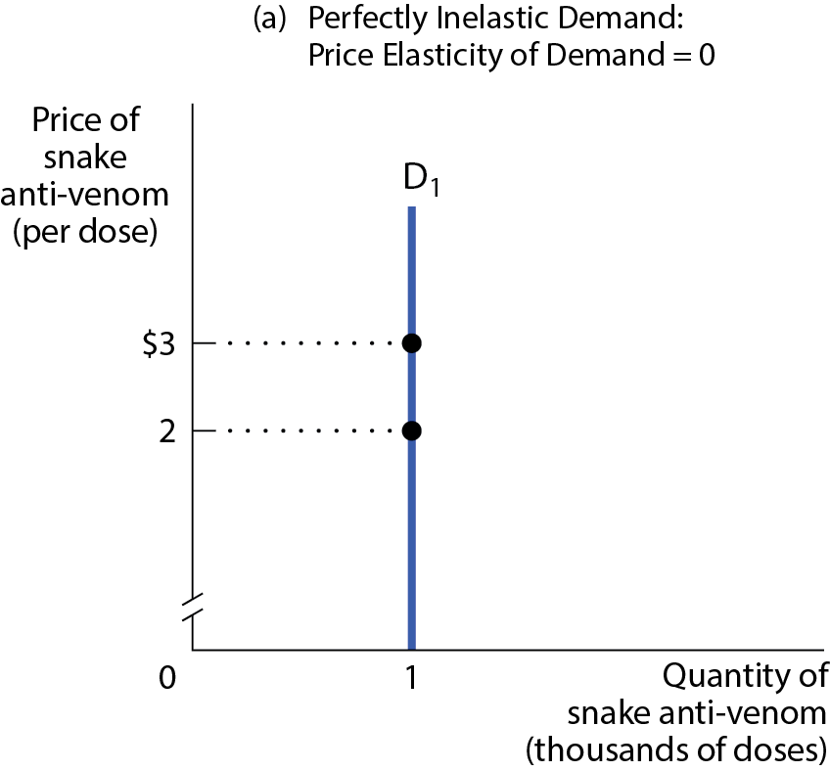
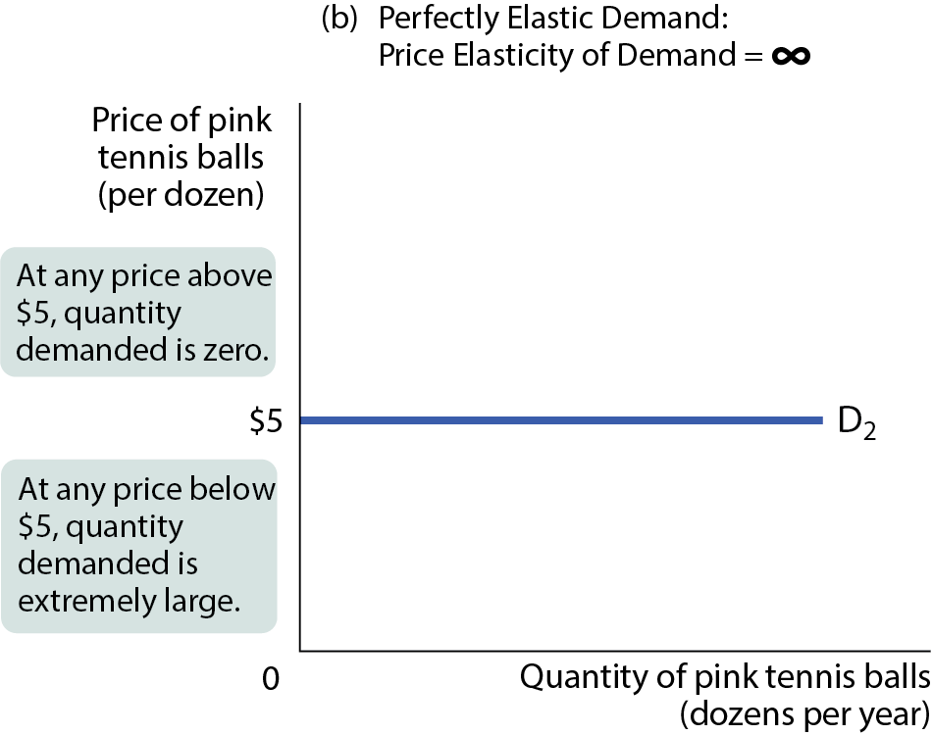
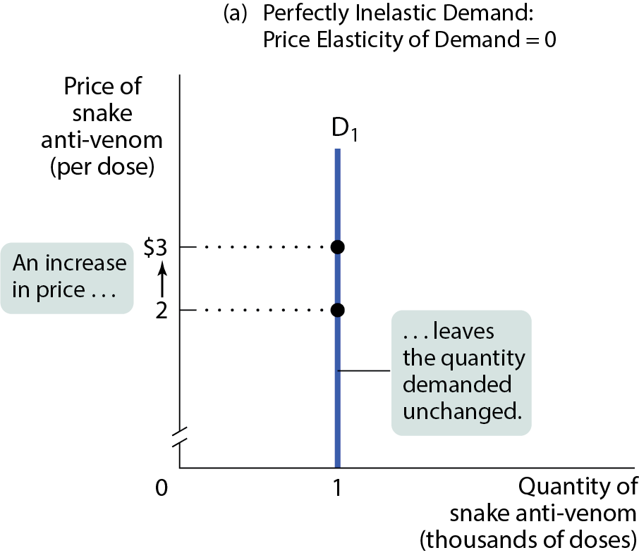
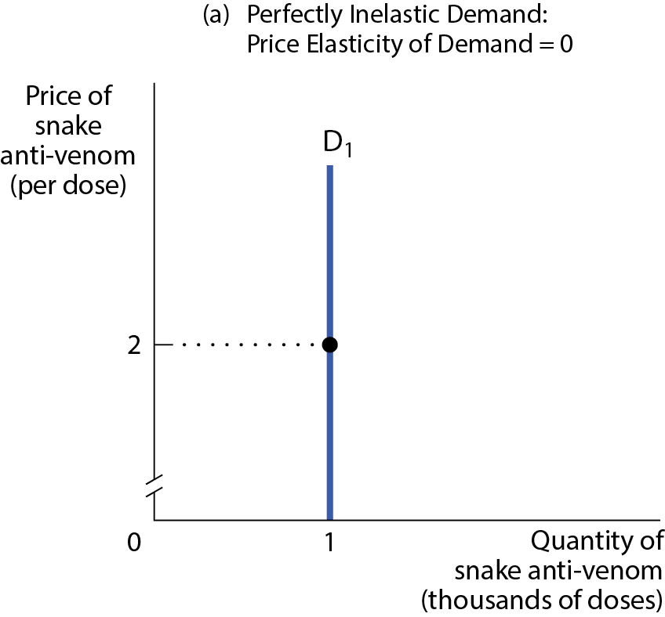

TWO EXTREME CASES OF PRICE ELASTICITY OF DEMAND
Figure 2

Slide 21
INTERPRETING THE PRICE ELASTICITY OF DEMAND
Classification of price elasticity of demand:
A good can have a price elasticity as low as zero or as high as infinity.
If a price elasticity <1, the demand curve is inelastic.
If a price elasticity >1, the demand curve is elastic.
If a price elasticity =1, the demand curve is unit-elastic.

Slide 22
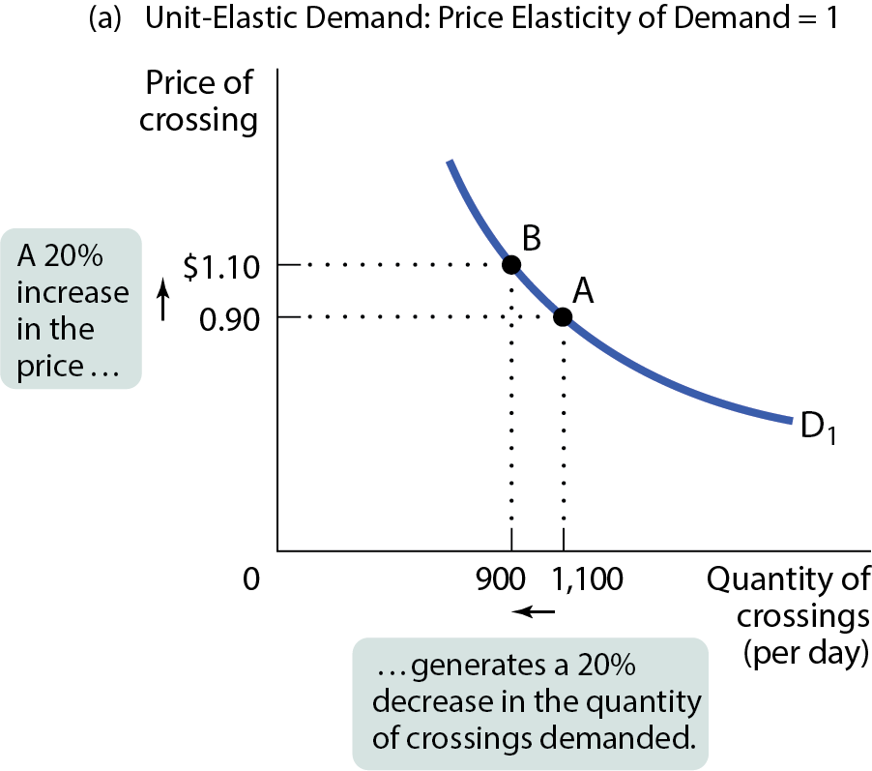
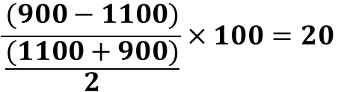
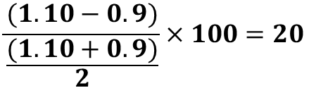
UNIT-ELASTIC DEMAND
Figure 3(a)
$$\frac{(900−1100)}{\frac{(1100+900)}{2}}×100=20$$
$$\frac{(1.10−0.9)}{\frac{(1.10+0.9)}{2}}×100=20$$

Slide 23
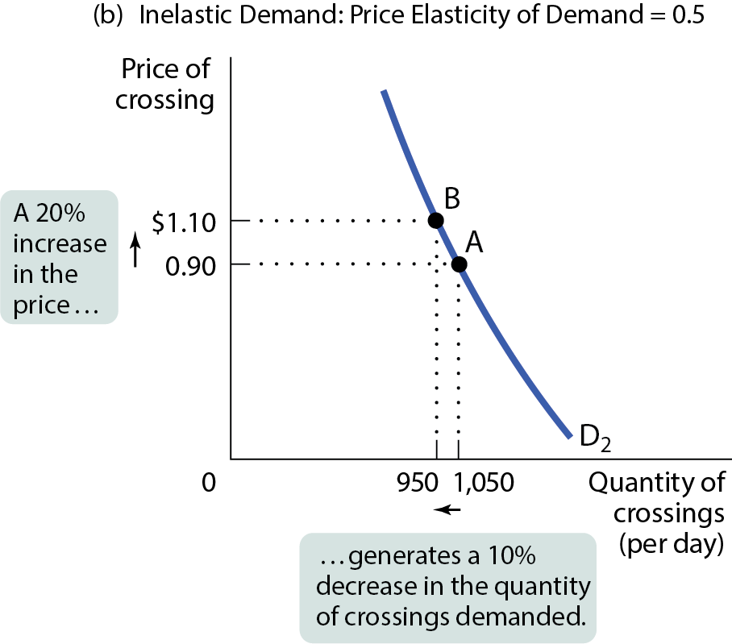
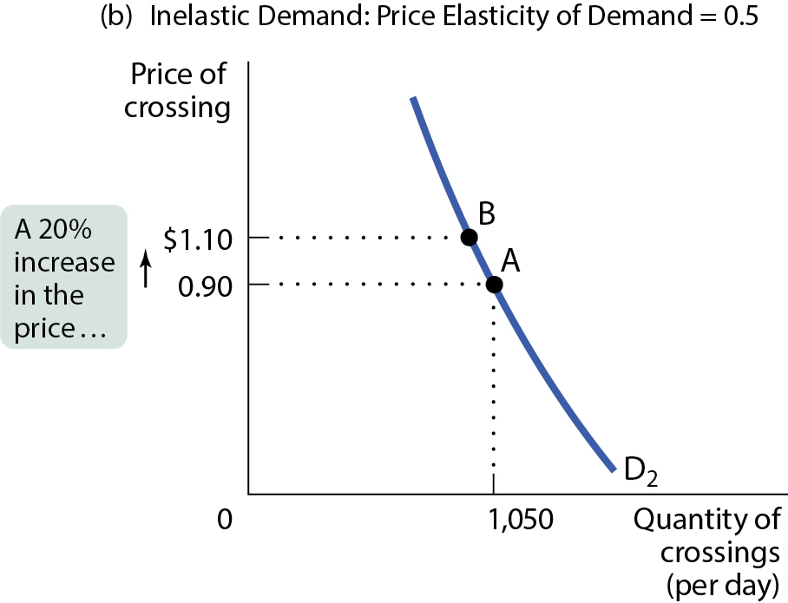
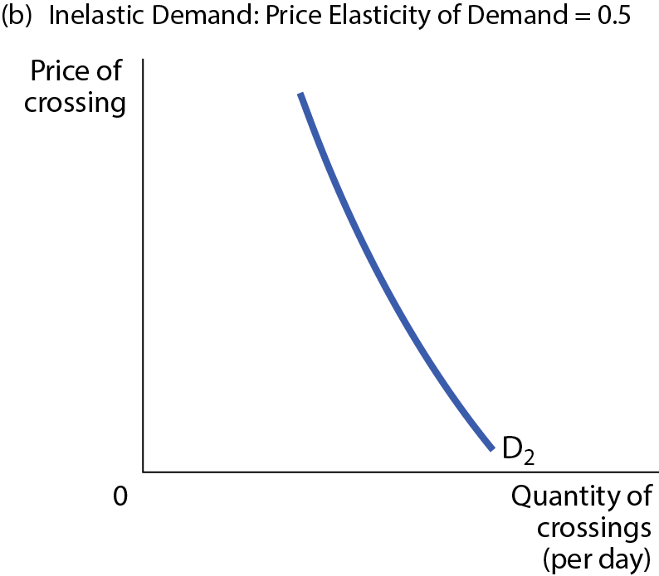
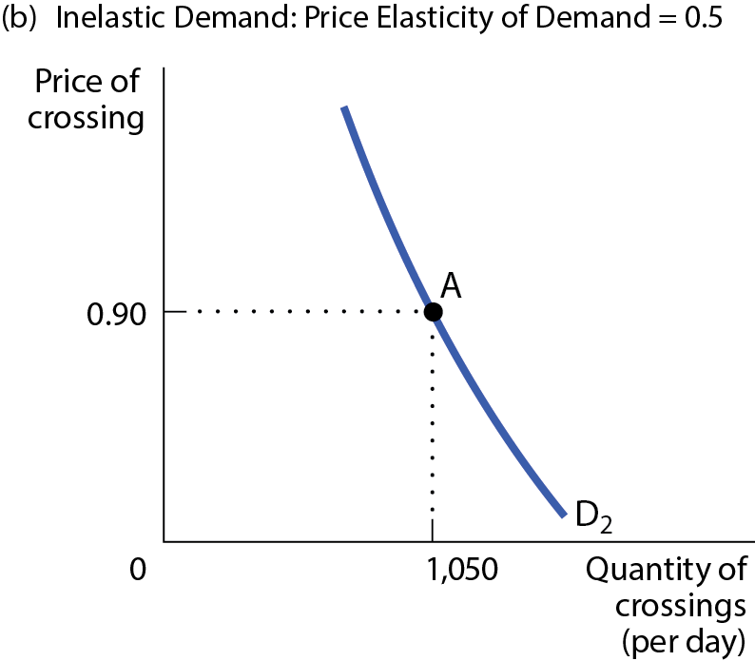
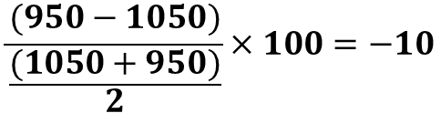
INELASTIC DEMAND
Figure 3(b)
$$\frac{(950−1050)}{\frac{(1050+950)}{2}}×100=−10$$
$$\frac{(1.10−0.9)}{\frac{(1.10+0.9)}{2}}×100=20$$

Slide 24
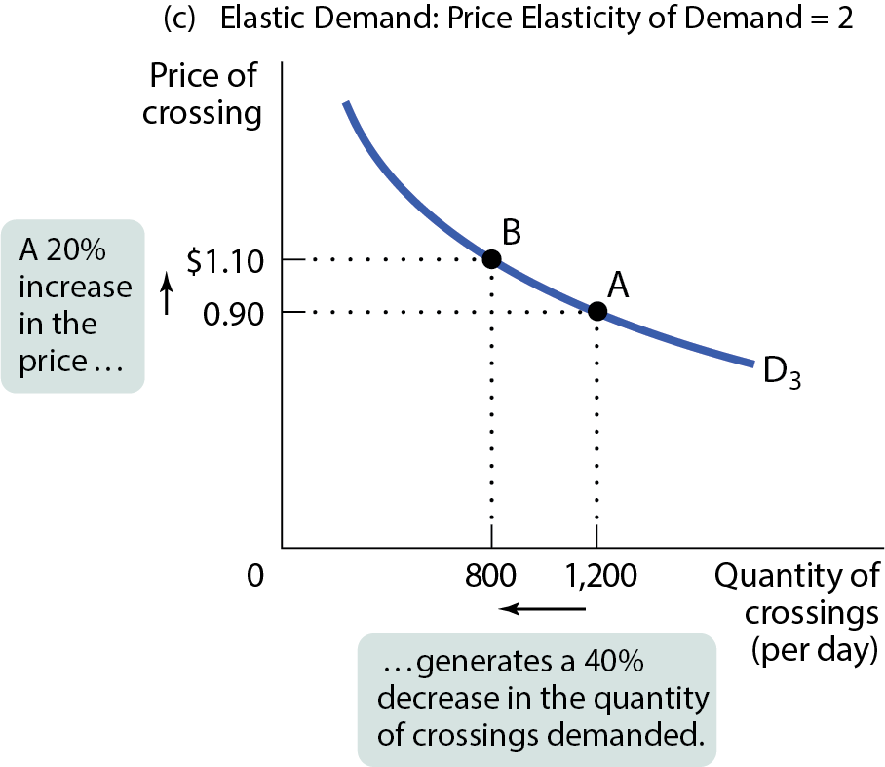
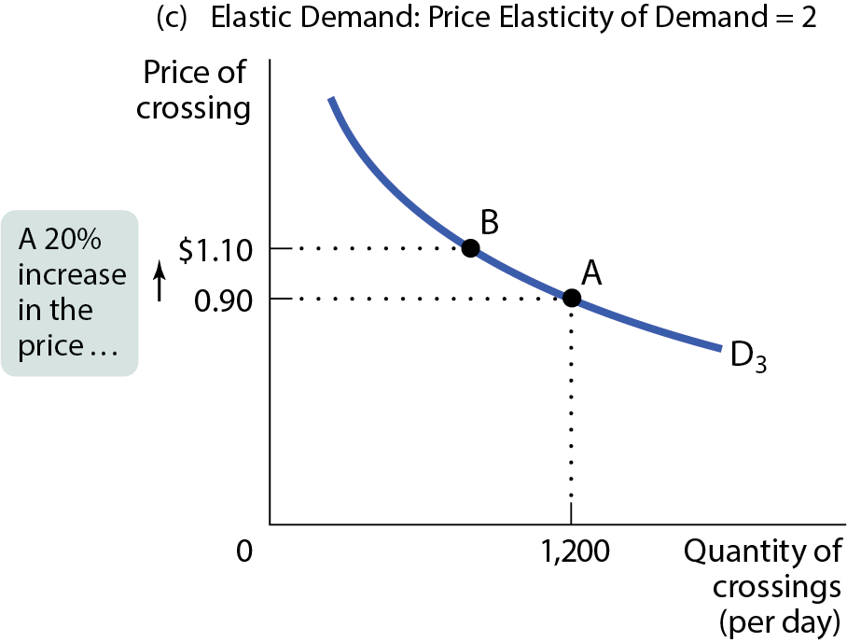
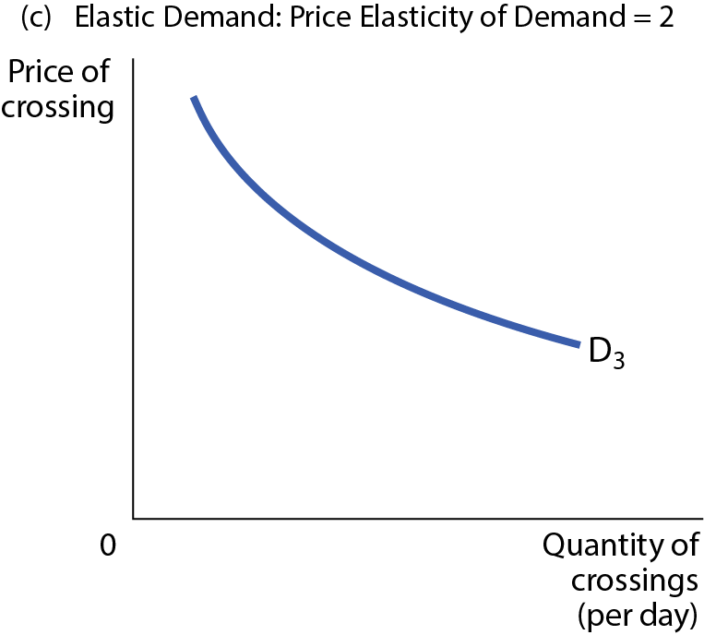
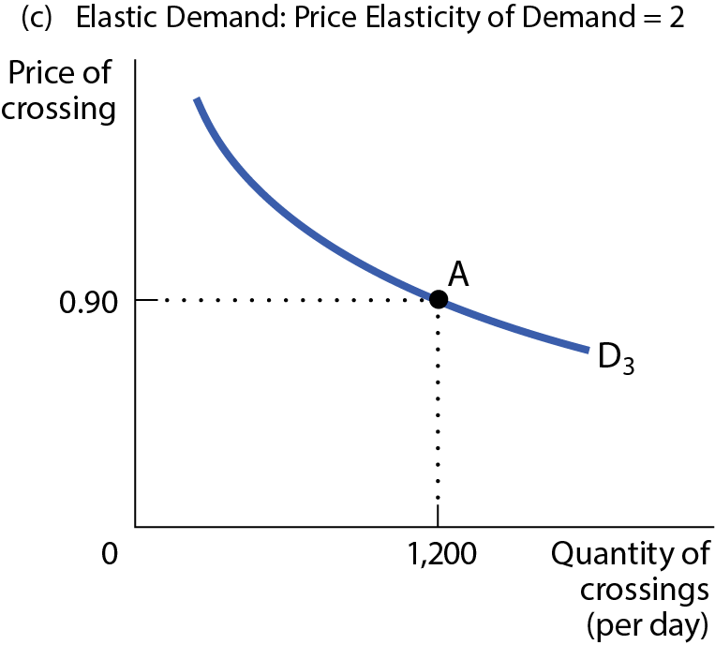
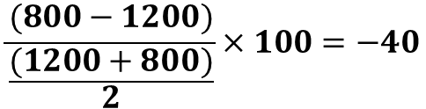
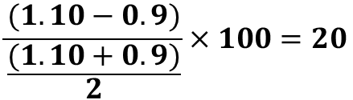
ELASTIC DEMAND
Figure 3(c)
$$\frac{(800−1200)}{\frac{(1200+800)}{2}}×100=−40$$
$$\frac{(1.10−0.9)}{\frac{(1.10+0.9)}{2}}×100=20$$

Slide 25
ELASTICITY AND TOTAL REVENUE PART 1
Total revenue: price times quantity sold.
TR = P × Q
Sellers need to know how elastic demand is so they can plan.

Slide 26
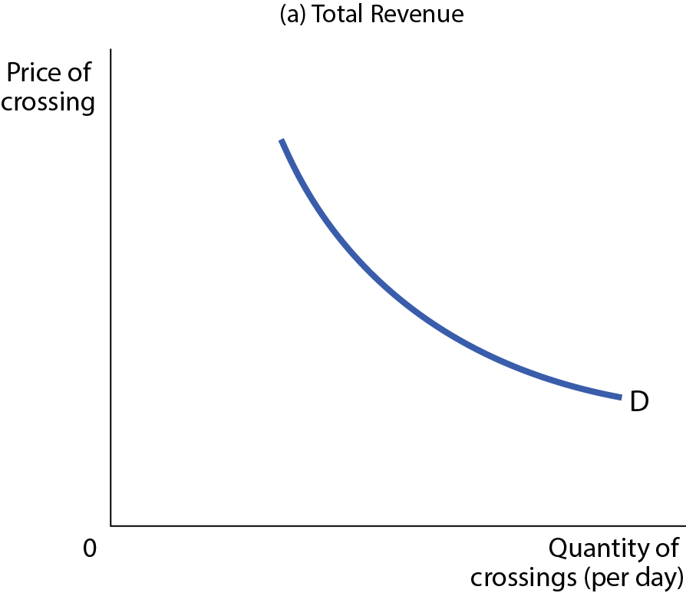
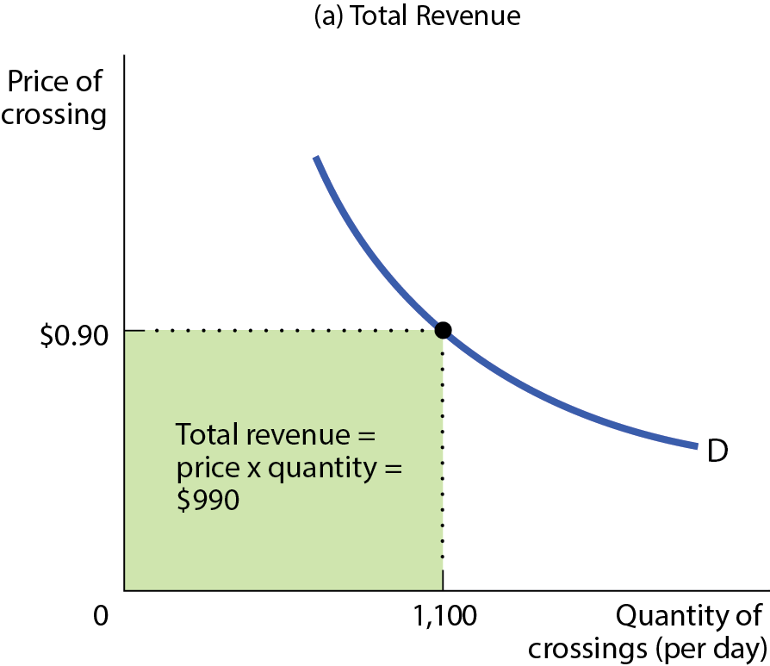
TOTAL REVENUE BY AREA
Figure 4(a)

Slide 27
PRICE EFFECT AND QUANTITY EFFECT
When a seller raises the price of a good, there are two countervailing effects:
A price effect: After a price increase, each unit sells at a higher price, which tends to raise revenue.
A quantity effect: After a price increase, fewer units are sold, which tends to lower revenue.

Slide 28
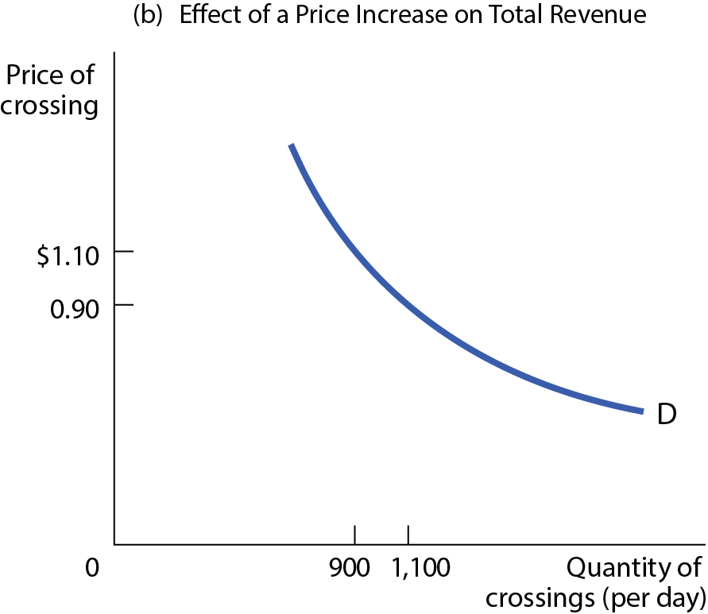
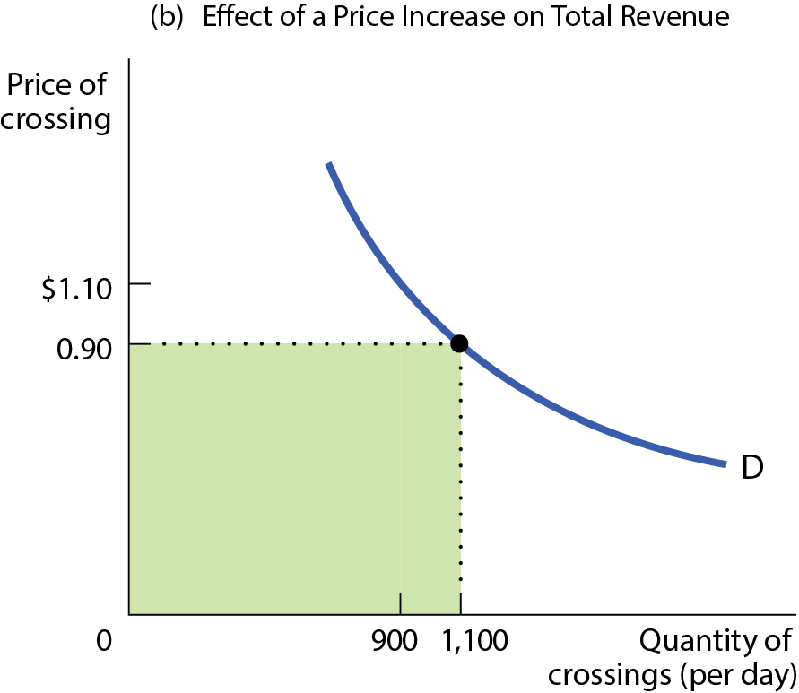
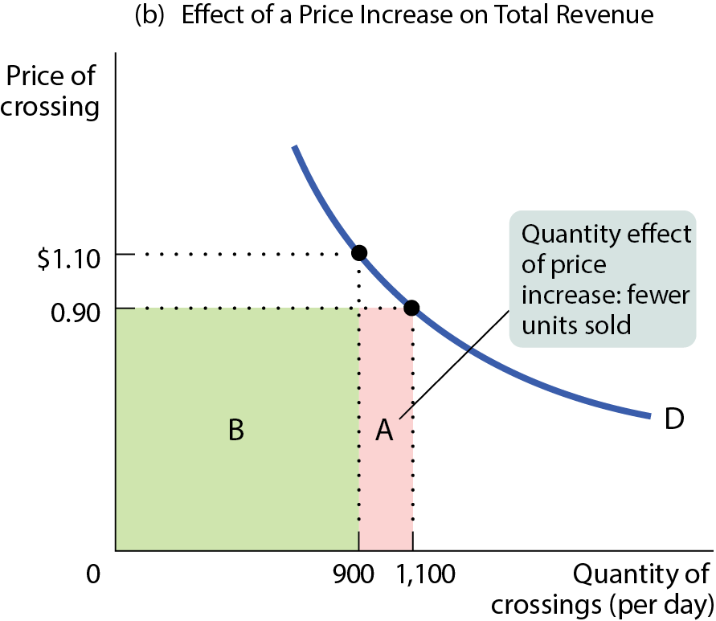
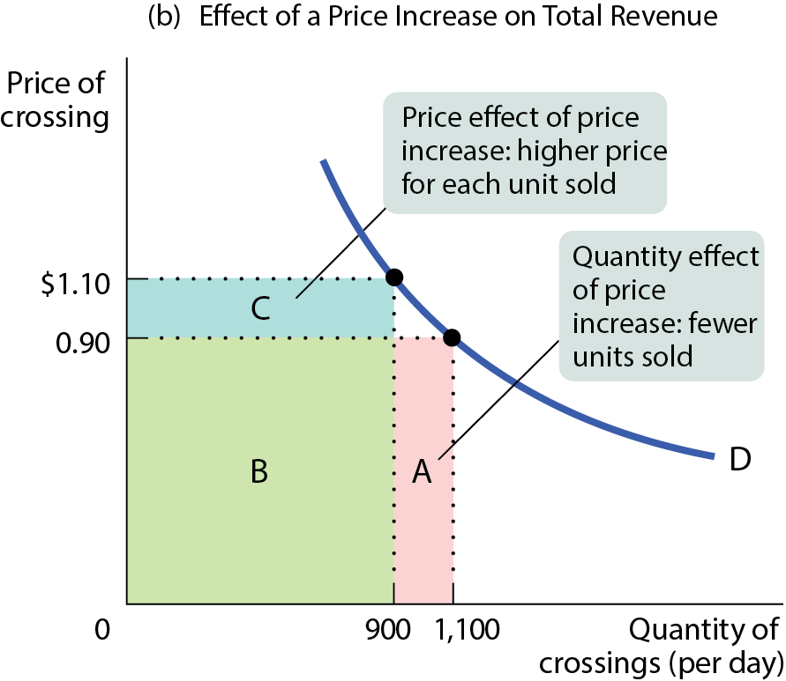
EFFECT OF A PRICE INCREASE ON TOTAL REVENUE
Figure 4(b)

Slide 29
ELASTICITY AND TOTAL REVENUE PART 2
When demand is inelastic, the price effect dominates the quantity effect.
So an increase in price will cause only a slight reduction in the quantity demanded.
In this instance, total revenue will rise when the price rises (and vice versa).
What happens if salt prices go up? TR will likely rise.

Slide 30
Avista – WA (Asotin and Whitman)
Avista Utilities is seeking rate hikes for natural gas and electricity in Washington state.
An average Avista electricity customer in WA now pays $105.76 per month. That amount would climb by $12.94 per month or 13.3% in December, to $118.70 per month. In December 2025, customers would see an increase of $6.87 per month, to $125.57 per month.
The rate hike is expected to increase annual revenue by $77.1 million. The one that would start in December 2025 is anticipated to increase annual revenue by $53.7 million.
https://dnews.com/local/avista-officials-provide-additional-details-about-washington-natural-gas-and-electricity-rate-hikes/article_5ab24684-7b11-11ef-afda-03b32b8ebbd0.html?fbclid=IwZXh0bgNhZW0CMTEAAR1uXx-cVwwjRKzlEmVLYjdBp_ptjSxtwm_5vBc2tveDPtxZrtxp6ZbtM3M_aem_aGLKkozG-vnyNh58wCg3kw

Slide 31
ELASTICITY AND TOTAL REVENUE PART 3
When demand is elastic, the quantity effect dominates the price effect.
  So an increase in price will cause significant reduction in the quantity demanded.
  In this instance, total revenue will fall when the price rises.

Slide 32
ELASTICITY AND TOTAL REVENUE PART 4
When demand is unit-elastic, the quantity effect equals the price effect.
So an increase in price exactly balances the reduction in the quantity demanded.
In this instance, total revenue doesn’t change.
What happens if tire prices go up? TR will not change.

Slide 33
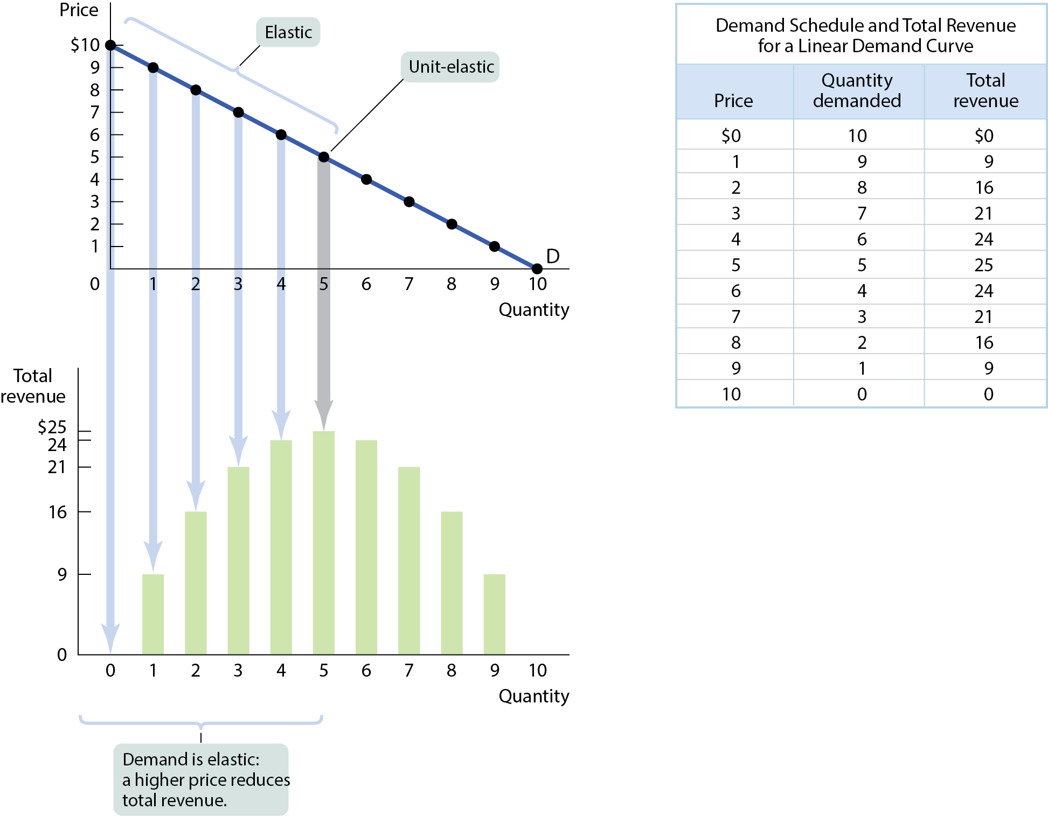
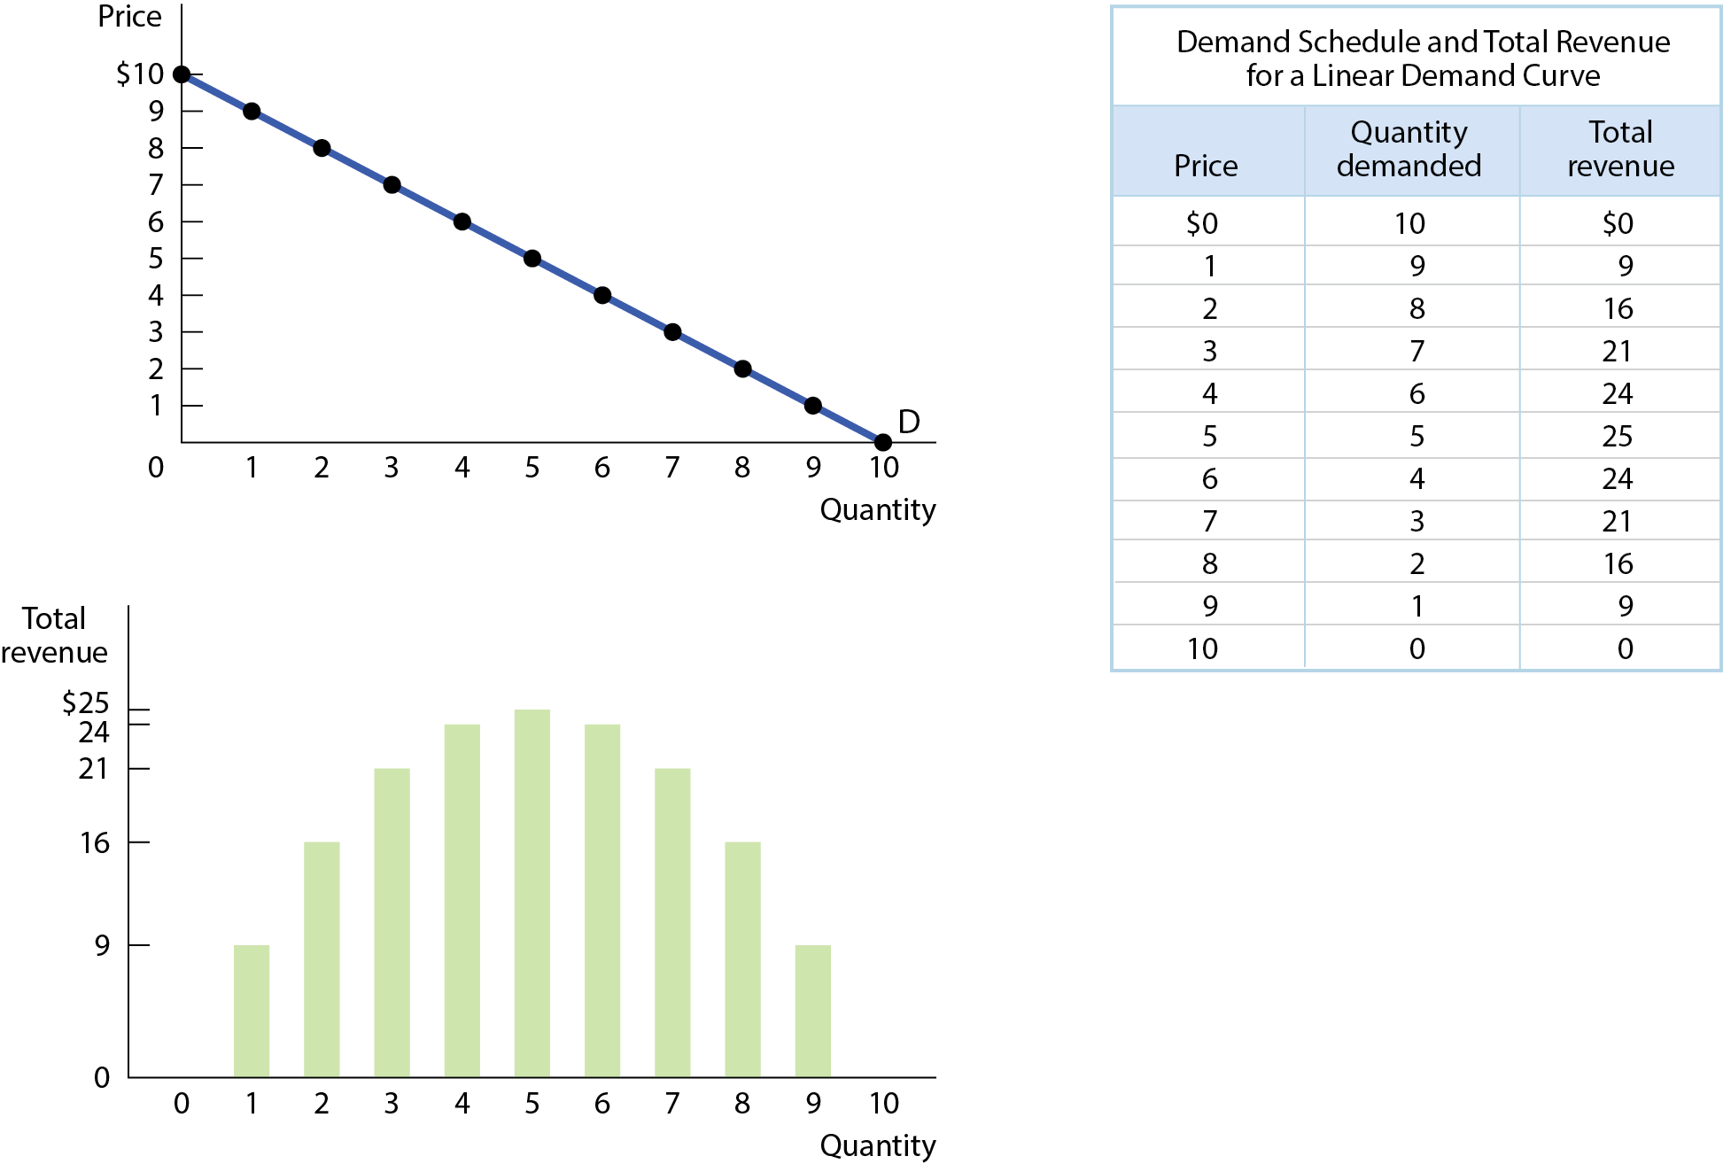
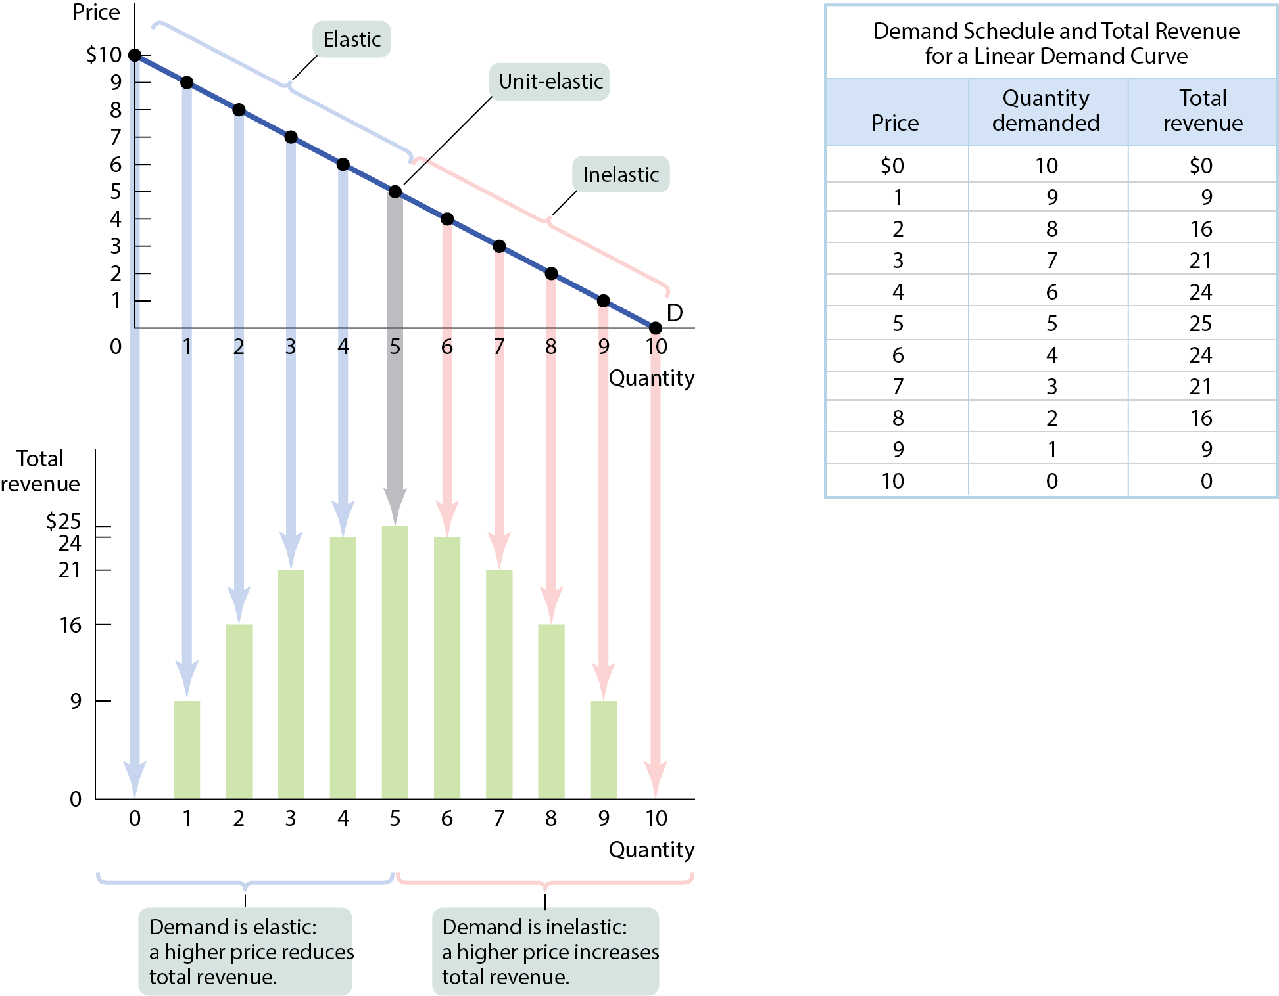

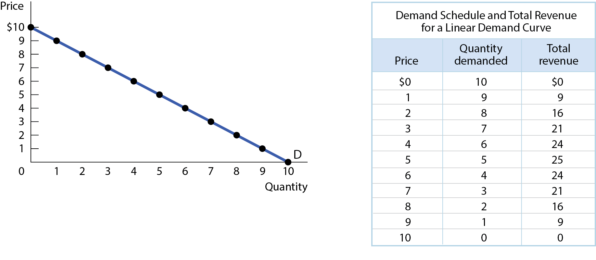
DEMAND SCHEDULE AND TOTAL REVENUE
The price elasticity of demand changes along the demand curve.
Figure 5

Slide 34
LEARN BY DOING: PRACTICE QUESTION 2
The elasticity of demand for eggs has been estimated to be 0.1. If egg producers raise their prices by 10%, what will happen to their total revenue?
  It will increase.
  It will decrease.
  It won’t change.

Slide 35
LEARN BY DOING: PRACTICE QUESTION 2
(ANSWER)
The elasticity of demand for eggs has been estimated to be 0.1. If egg producers raise their prices by 10%, what will happen to their total revenue?
  It will increase. (correct answer)
  It will decrease.
  It won’t change.

Slide 36
LEARN BY DOING: PRACTICE QUESTION 3
The price of t-shirts increases by 25%. As a result, t-shirt manufacturers experience an increase in total revenue. What does this tell you about the demand for t-shirts over the range of prices?
  Demand is inelastic.
  Demand is elastic.
  Demand is unit elastic.

Slide 37
LEARN BY DOING: PRACTICE QUESTION 3 (ANSWER)
The price of t-shirts increases by 25%. As a result, t-shirt manufacturers experience an increase in total revenue. What does this tell you about the demand for t-shirts over the range of prices?
  Demand is inelastic. (correct answer)
  Demand is elastic.
  Demand is unit elastic.

Slide 38
WHAT FACTORS DETERMINE THE PRICE ELASTICITY OF DEMAND PART 1
Whether the good is a necessity or a luxury:
    For necessities, quantity demanded does not change much in response to a change in P.
    For luxuries, quantity demanded is more sensitive to a change in price.

Slide 39
WHAT FACTORS DETERMINE THE PRICE ELASTICITY OF DEMAND PART 2
The availability of close substitutes:
  Fewer substitutes make it harder for consumers to adjust Q when P changes, so demand is inelastic.
  Many substitutes make it easier for consumers to switch brands when prices change, so demand is elastic.

Slide 40
LEARN BY DOING: PRACTICE QUESTION 4
When the patent expires on a brand-name drug and five generic drugs come on the market, what happens to elasticity of demand for the original drug?
  It rises.
  It falls.

Slide 41
LEARN BY DOING: PRACTICE QUESTION 4
(ANSWER)
When the patent expires on a brand-name drug and five generic drugs come on the market, what happens to elasticity of demand for the original drug?
  It rises. (correct answer)
  It falls.

Slide 42
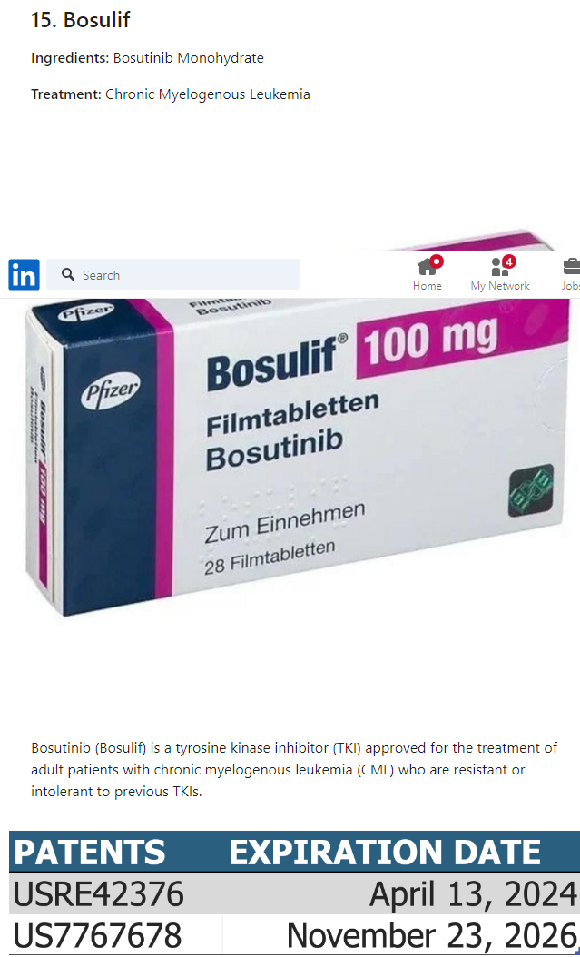
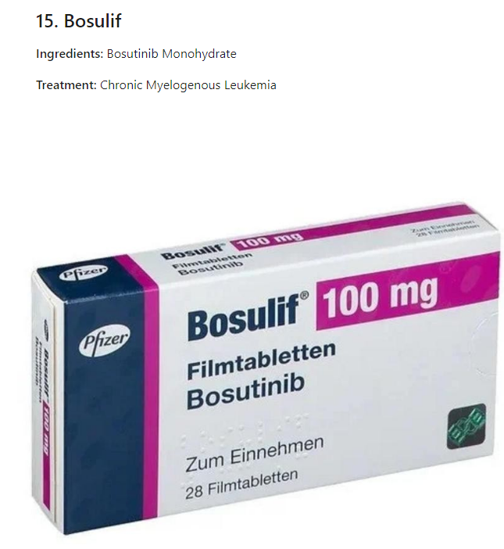

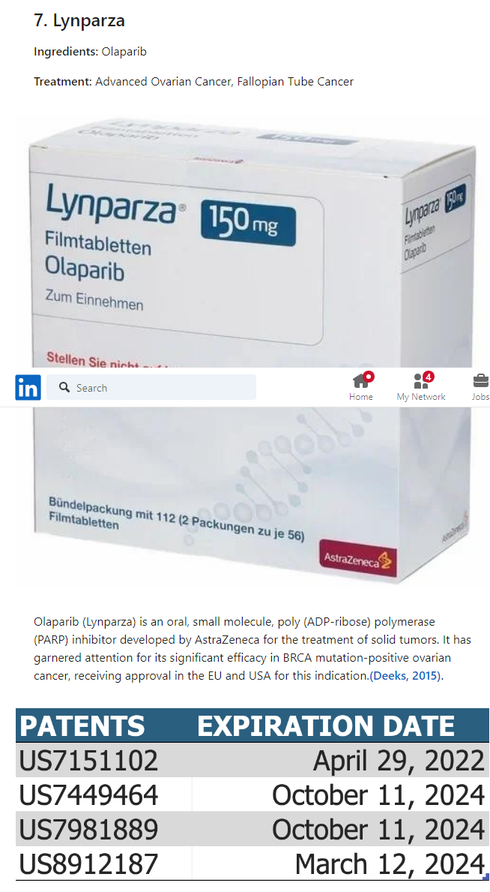
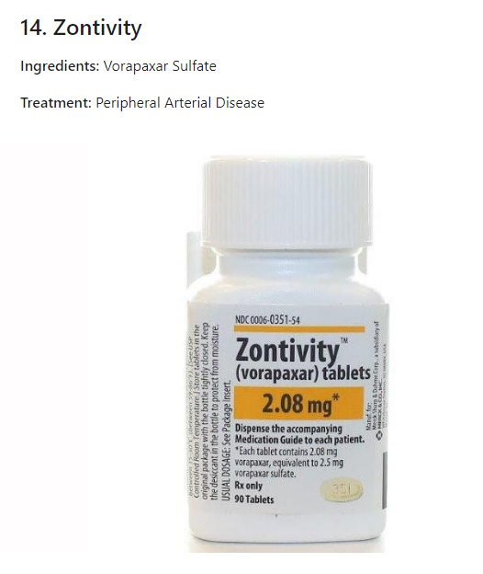


Slide 43
WHAT FACTORS DETERMINE THE PRICE ELASTICITY OF DEMAND PART 3
The share of income spent on the good:
  It feels cheaper when we spend a smaller share of income on the good.
  It feels more expensive when we spend a greater share of income on the good.

Slide 44
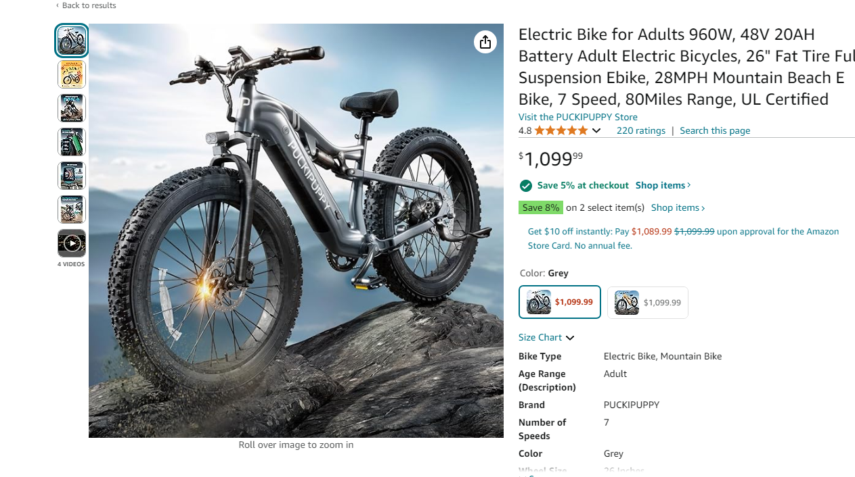

WHAT FACTORS DETERMINE THE PRICE ELASTICITY OF DEMAND PART 3

Slide 45
WHAT FACTORS DETERMINE THE PRICE ELASTICITY OF DEMAND PART 4
Time elapsed since the price change:
  Less time to adjust means lower elasticity.
  Over time consumers can adjust their behavior by finding substitutes (making demand more elastic).

Slide 46
APPLICATIONS OF ELASTICITY OF DEMAND
Why the war on drugs is hard to win:
  Because demand for most illegal drugs is inelastic, drug dealers earn greater revenue and gain more power as the war on drugs reduces the supply.

Slide 47
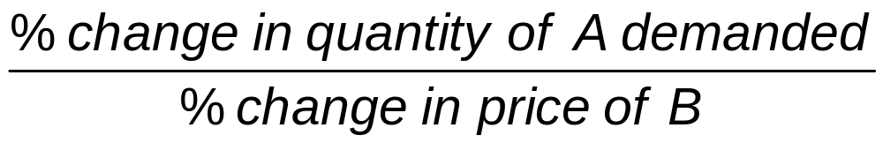
OTHER DEMAND ELASTICITIES
The cross-price elasticity of demand measures how sensitive the quantity demanded of good A is to the price of good B.
Cross-price elasticity of demand =

Slide 48
CROSS-PRICE ELASTICITY OF DEMAND
For substitutes, cross-price elasticity of demand is positive.
  An increase in the price of one brand of cookies will increase the demand for other brands.
  The size of the cross-price elasticity shows how closely substitutable the two goods are.
For complements, cross-price elasticity of demand is negative.
  An increase in the price of milk causes a decrease in demand for Oreos.
  The size of the cross-price elasticity shows how closely complementary the two goods are.

Slide 49
LEARN BY DOING: PRACTICE QUESTION 5
The price of good B increases by 4%, causing the quantity demanded of good A to decrease by 6%. The cross-price elasticity of demand is _____, and the goods are ______.
  1.5; substitutes
  –1.5; complements
  0.67; complements
  –2.4; substitutes

Slide 50

LEARN BY DOING: PRACTICE QUESTION 5
(ANSWER)
The price of good B increases by 4%, causing the quantity demanded of good A to decrease by 6%. The cross-price elasticity of demand is _____, and the goods are ______.
  1.5; substitutes
  –1.5; complements (correct answer)
  0.67; complements
  –2.4; substitutes
$$\frac{−6\%}{4\%}=−1.5$$

Slide 51

INCOME ELASTICITY OF DEMAND PART 1
The income elasticity of demand measures how sensitive the quantity demanded of a good is to changes in income.
Income elasticity of demand =

Slide 52
INCOME ELASTICITY OF DEMAND PART 2
The income elasticity of demand can be used to distinguish normal from inferior goods.
  For normal goods, income elasticity is positive.
  For inferior goods, income elasticity is negative.

Slide 53
INCOME ELASTICITY OF DEMAND PART 3
Normal goods can be income-elastic or not.
For income-elastic goods, income elasticity is greater than 1.
For income-inelastic goods, income elasticity is positive but less than 1.

Slide 54


LEARN BY DOING: PRACTICE QUESTION 6
Tonya consumes 10 boxes of ramen noodles a year when her yearly income is $40,000. After her income falls to $30,000 a year, she consumes 40 boxes of ramen noodles a year. Calculate her income elasticity of demand for ramen noodles using the midpoint method.
  4.2
  –4.2
  –2.25
  2.25
% change in Income=$\frac{\$30,000−\$40,000}{(\$30,000+\$40,000)/2}$x100=-28.57%
% change in quantity=$\frac{\$40−\$10}{(\$10+\$40)/2}$x100=120%
Price elasticity of demand=$\frac{\text{120\%}}{\text{−28.57}\text{\%}}$=-4.20

Slide 55
LEARN BY DOING: PRACTICE QUESTION 6
(ANSWER)
Tonya consumes 10 boxes of ramen noodles a year when her yearly income is $40,000. After her income falls to $30,000 a year, she consumes 40 boxes of ramen noodles a year. Calculate her income elasticity of demand for ramen noodles using the midpoint method.
  4.2
  –4.2 (correct answer)
  –2.25
  2.25

Slide 56

MEASURING THE PRICE ELASTICITY OF SUPPLY
Usually, sellers offer more when prices are higher, but how strong is that relationship?
Similar to price elasticity of demand:

Slide 57








TWO EXTREME CASES OF PRICE ELASTICITY OF SUPPLY
Elasticity of supply captures the sensitivity of quantity supplied to changes in price.
Figure 6 (a,b)

Slide 58
ELASTICITY OF SUPPLY
Supply curve is elastic if a rise in price increases the quantity supplied a lot.
Supply curve is inelastic if a rise in price increases the quantity supplied just a little.

Slide 59
WHAT FACTORS DETERMINE THE PRICE ELASTICITY OF SUPPLY (1 of 2)
Availability of inputs
  If an increase in production is very expensive (inputs are not easily available or cannot be shifted), then the supply will be inelastic.
  If production can be increased cheaply, then the supply will be elastic.

Slide 60
WHAT FACTORS DETERMINE THE PRICE ELASTICITY OF SUPPLY (2 of 2)
Time
  Price elasticity of supply increases as producers have more time to respond to price changes.
  Long-run price elasticity of supply is usually higher than the short-run elasticity.

Slide 61
LEARN BY DOING: PRACTICE QUESTION 7
A computer manufacturer makes an experimental computer chip that critics praise, leading to a huge increase in the demand for the chip. How elastic is supply in the short run? What about the long run? Graph both.

Slide 62
PRACTICE QUESTION
The Metropolitan Bus Service currently charges $0.77 for an all-day ticket, and has an average of 472 riders a day. The bus company is not earning a profit, but according to their contract with the city, it cannot cut the number of buses on the road. It must therefore find a way to increase revenues.
The bus company is considering increasing the ticket price to $0.99. The marketing department's studies indicate this price increase would reduce usage to 208 riders per day.
Calculate the absolute value of the price elasticity of demand for bus tickets, using the simple percentage change method. Round your answer to one decimal place.

Slide 63



PRACTICE QUESTION
Initial price $0.77 and initial quantity 472 riders a day.
New price $0.99 and new quantity 208 riders per day.
Price elasticity of demand for bus tickets, using the simple percentage change method. Round your answer to one decimal place.
% change in price=$\frac{\$0.99−\$0.77}{0.77}$x100=28.57%
% change in quantity=$\frac{208−472}{472}$x100=-55.93%
Price elasticity of demand=$\frac{\text{55.93}\text{\%}}{\text{28.57}\text{\%}}$=1.95~2

Slide 64
PRACTICE QUESTION
ments is true?
Which of the statements is true?:
(a) Demand is elastic, so increasing ticket prices will increase revenue.
(b) Demand is inelastic, so increasing ticket prices will increase revenue.
(c) Demand is inelastic, so decreasing ticket prices will increase revenue.
(d) Demand is elastic, so decreasing ticket prices will increase revenue.

Slide 65
PRACTICE QUESTION
ments is true?
Which of the statements is true?:
(a) Demand is elastic, so increasing ticket prices will increase revenue.
(b) Demand is inelastic, so increasing ticket prices will increase revenue.
(c) Demand is inelastic, so decreasing ticket prices will increase revenue.
(d) Demand is elastic, so decreasing ticket prices will increase revenue.

