Slide 1

Price Controls and Quotas: Meddling with Markets
5
Notes:
Cover Credits: Currency Exchange Stock Chart: cemagraphics/Getty Images, Social Media Montage: SEAN GLADWELL/Getty Images, Circuit Pattern: somsak Tangdamrongsub/Getty Images, Cargo Containers: urzine/Getty Images

Slide 2
Important Dates
Homework #4 (Chapter 4) is due on Wednesday September 18th.
Tuesday September 17th we will have a review session for Midterm #1 (Tuesday September 24th).
No class on Thursday September 19th.
Quiz #2 (chapters 3 and 4) is due on September 22nd. [Available this Friday – 1 hour]
Homework #5 is due on Monday September 23rd.
Writing assignment due on Thursday September 19th.

Slide 3
Important Dates
Tuesday
Wednesday
Thursday
Sunday
Monday
Tuesday
Review Session
09/17
HW #4
09/18
No Class
09/19
Quiz #2
09/22
HW #5
09/23
Midterm #1
09/24
Writing
Assignment
09/19 - CANVAS

Slide 4
WHAT YOU WILL LEARN IN THIS CHAPTER
What is a market intervention, and why are price controls and quantity controls the two main forms it takes?
Why do price and quantity controls create deadweight losses?
Who benefits and who loses from market interventions?
Why are economists often skeptical of market interventions? And why do governments undertake market interventions even though they create losses to society?

Slide 5
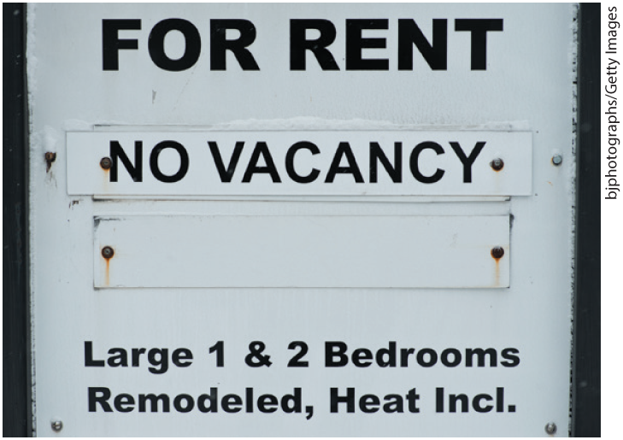
INTERFERENCE IN MARKETS HAS CONSEQUENCES
Because of rent control policies, an affordable and available rental apartment is hard to find in New York City.

Slide 6
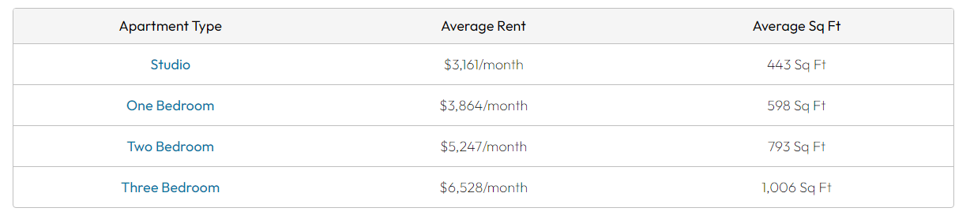
INTERFERENCE IN MARKETS HAS CONSEQUENCES
As of September 2024, the average rent in NY is $3,864 per month. This is 147% higher than the national average rent price of $1,563/month, making New York one of the most expensive cities to rent an apartment in the US.

Slide 7
WHY GOVERNMENTS CONTROL PRICES
Market prices do not necessarily please buyers or sellers: they may lobby the government to help them by altering the price.
Price controls: legal restrictions on how high or low a market price may go. There are two main types:
  Price ceiling: maximum price sellers are allowed to charge for a good or service (usually set BELOW equilibrium).
  Price floor: minimum price buyers are required to pay for a good or service (usually set ABOVE equilibrium).

Slide 8
WHY GOVERNMENTS CONTROL PRICES
Price controls have been used in various industries throughout US history. Today, price controls still exist in certain notable sectors, including:
Public utilities like electrical power and sewage. Because public utilities are natural monopolies that have market power to set rates at any level they wish.
Rent. Many municipalities have rent control regulations that cap the maximum amount of rent landlords can charge or that limit the speed at which those rates can increase.
Health care. Various health care programs like Medicare and Medicaid establish rates of reimbursement for various goods and services, through what are effectively price controls

Slide 9
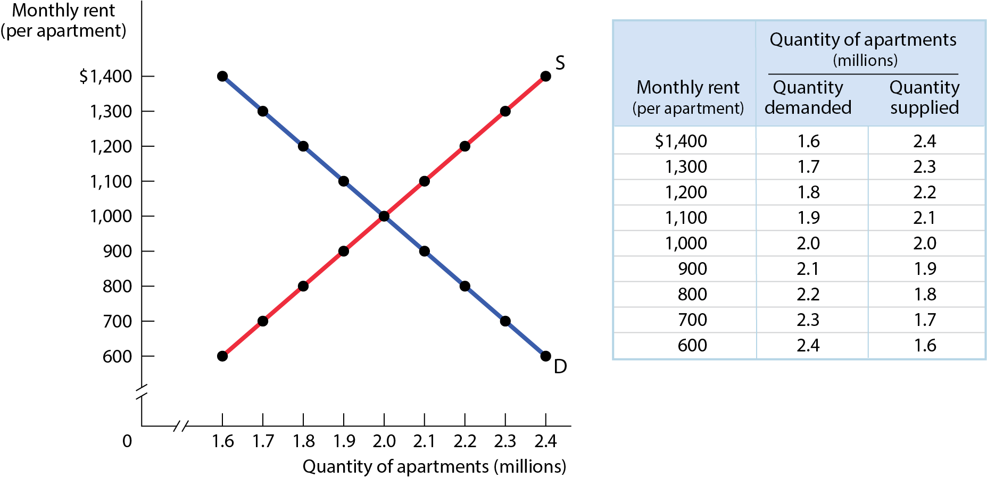
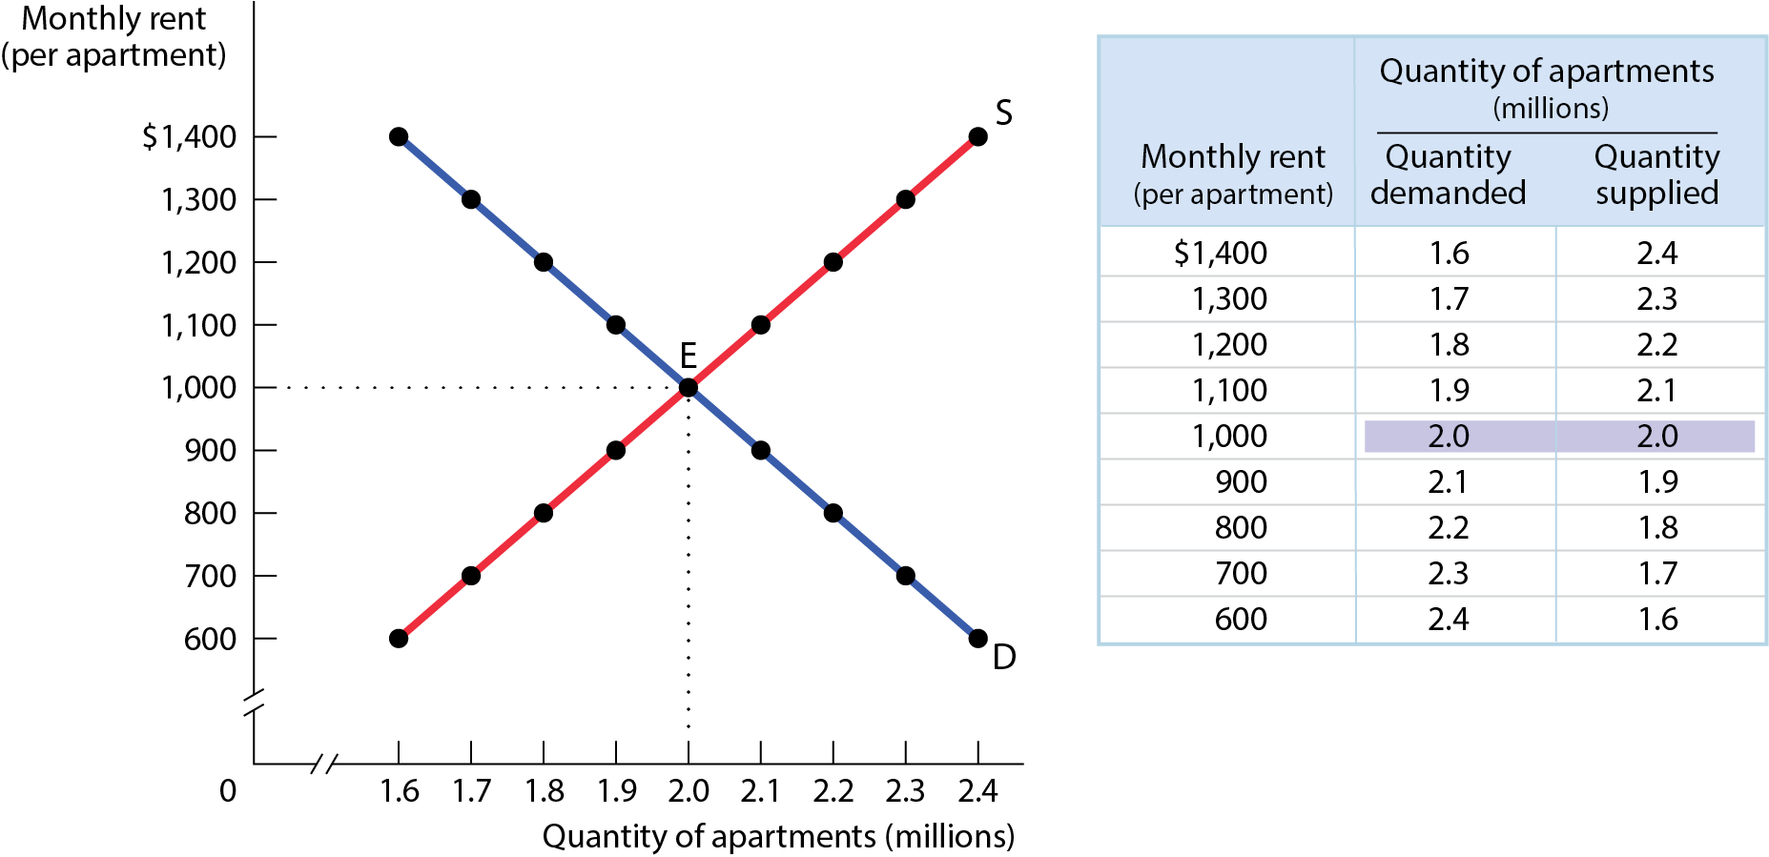
MODELING A PRICE CEILING (1 of 2)
Figure 1
Without government intervention, the market for apartments reaches equilibrium at point E with a market rent of $1,000 per month and 2 million apartments rented.

Slide 10
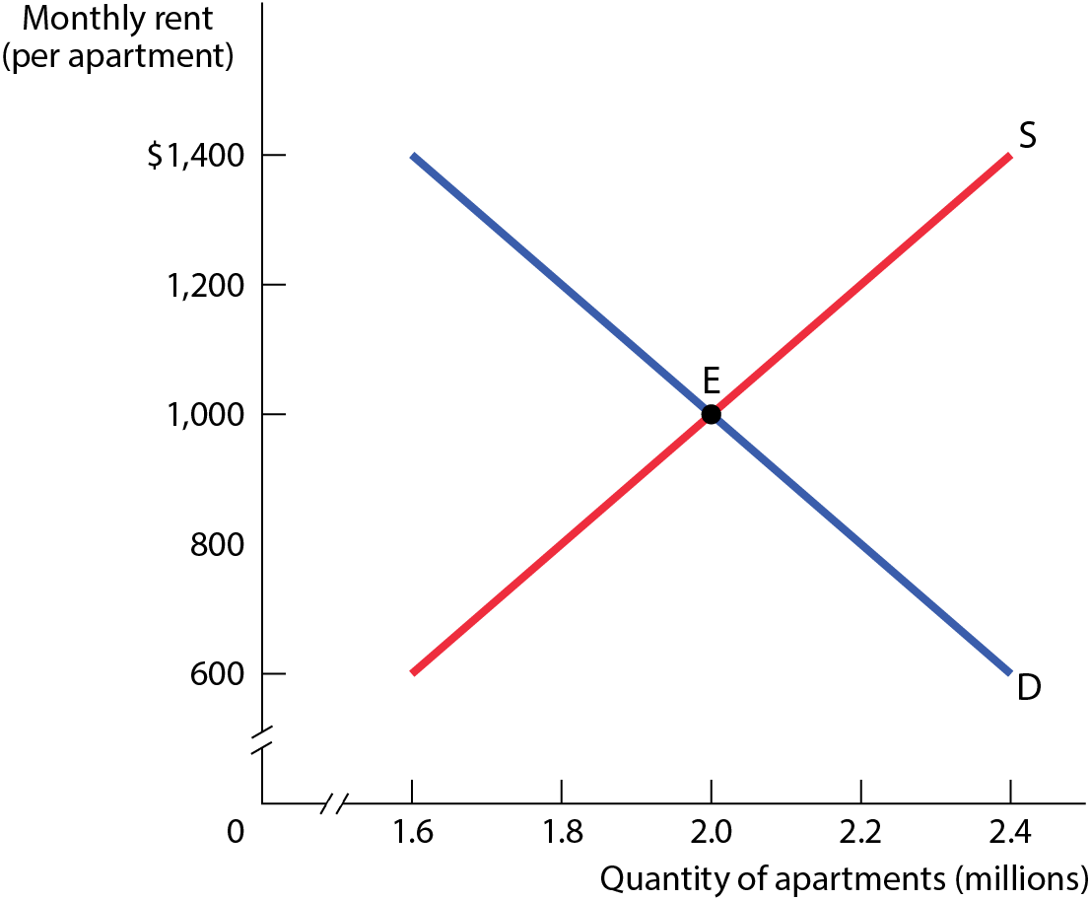
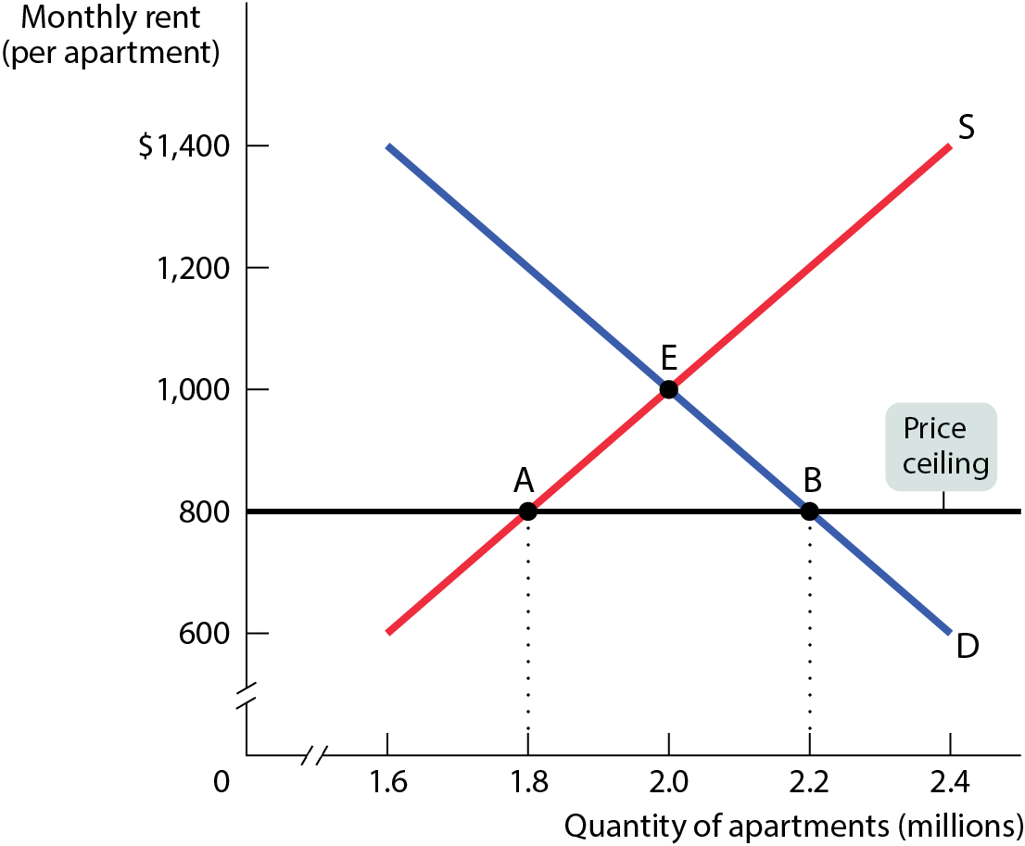
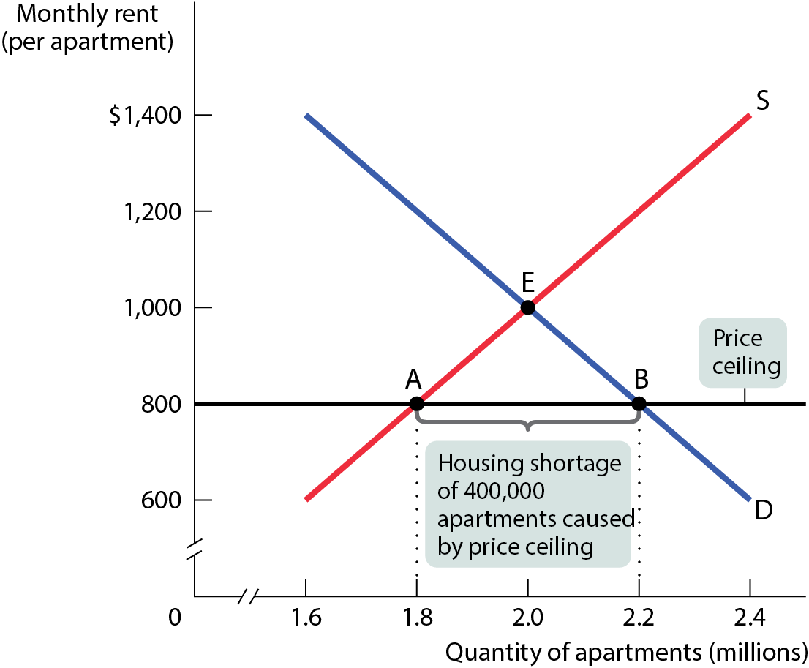
MODELING A PRICE CEILING (2 of 2)
Figure 2
This price ceiling creates a persistent shortage of 400,000 units: 400,000 households who want apartments at the legal rent of $800 but cannot get them.

Slide 11
MODELING A PRICE CEILING (2 of 2)
Housing Act Implemented (Spain, 2023): Ensure more affordable housing. Rent increases are capped at 2% in 2023 and 3% in 2024. (for existing contracts)
The number of price-capped products in French supermarkets will double to 5,000, as data revealed another month of double-digit food inflation. (CNN, August 2023)

Slide 12
HOW PRICE CEILINGS CAUSE INEFFICIENCY
Price ceilings cause predictable side effects:
  Inefficiently low quantity
  Inefficient allocation to customers
  Wasted resources
  Inefficiently low quality
  Black markets

Slide 13
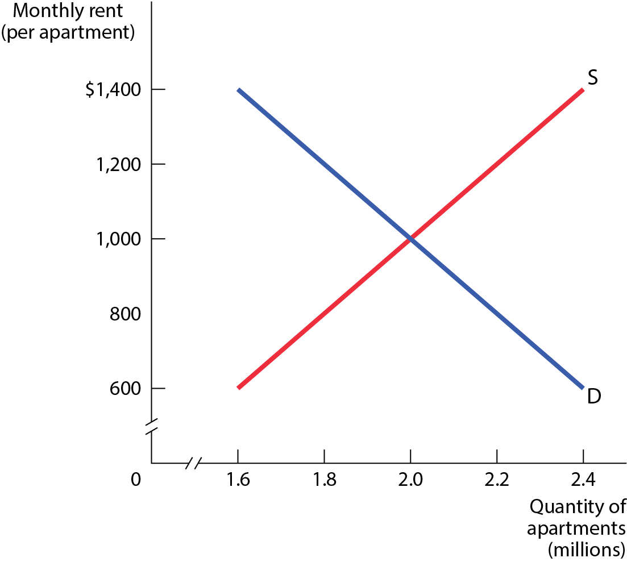
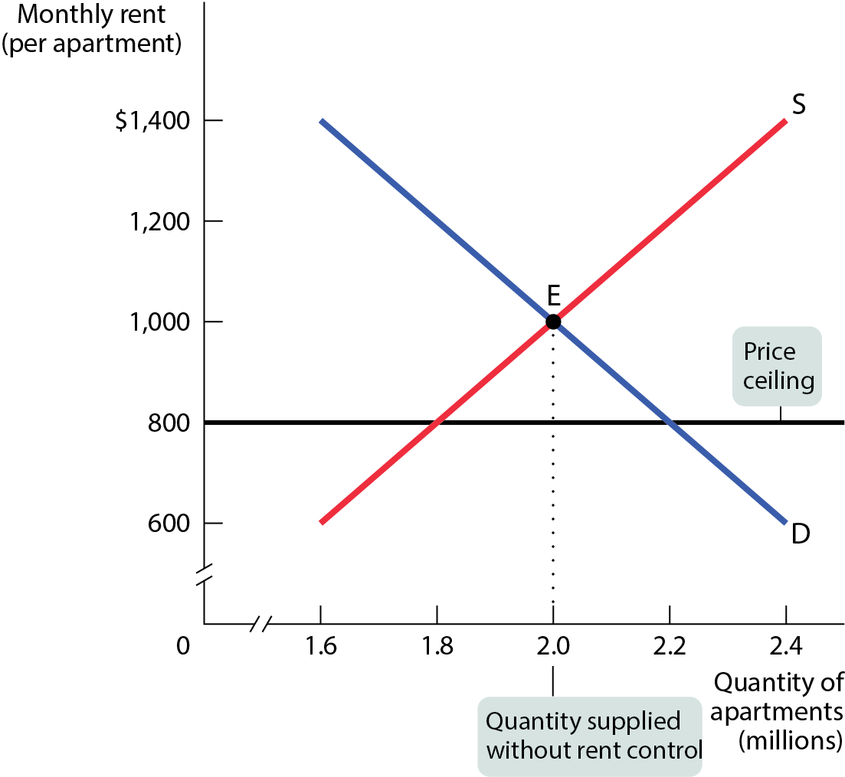
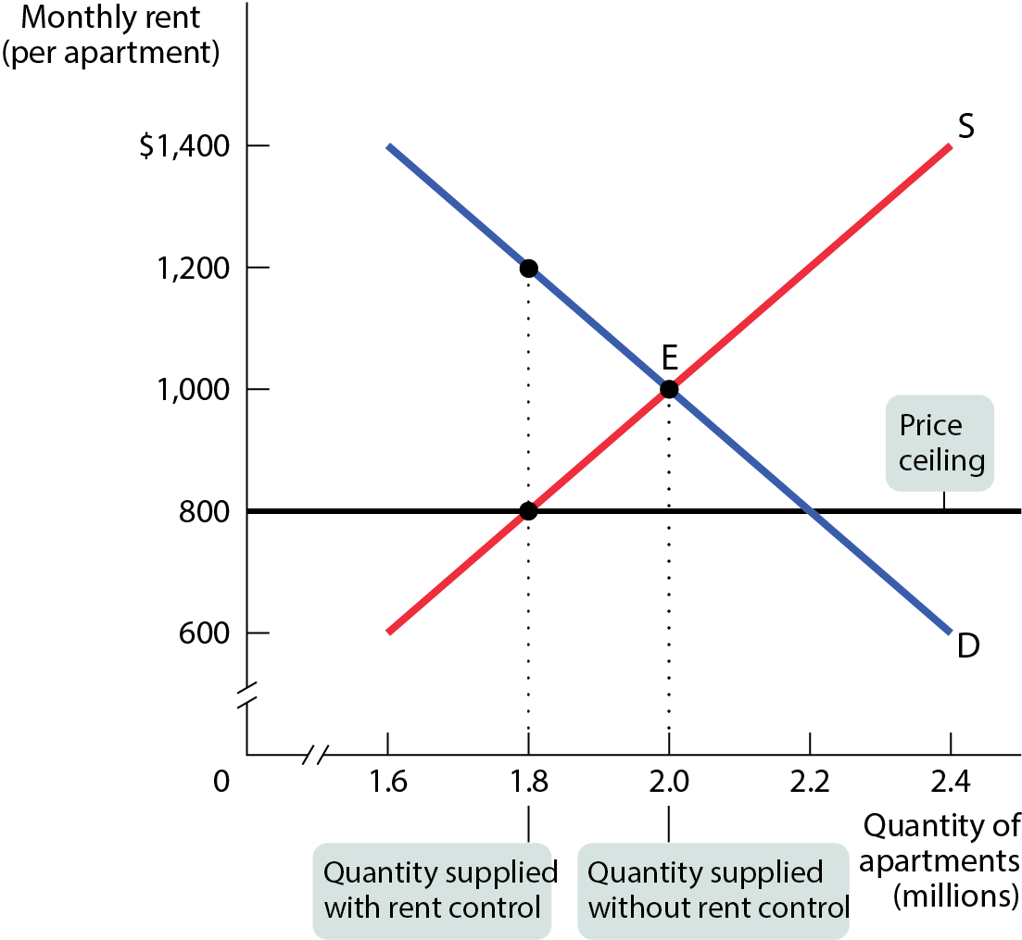
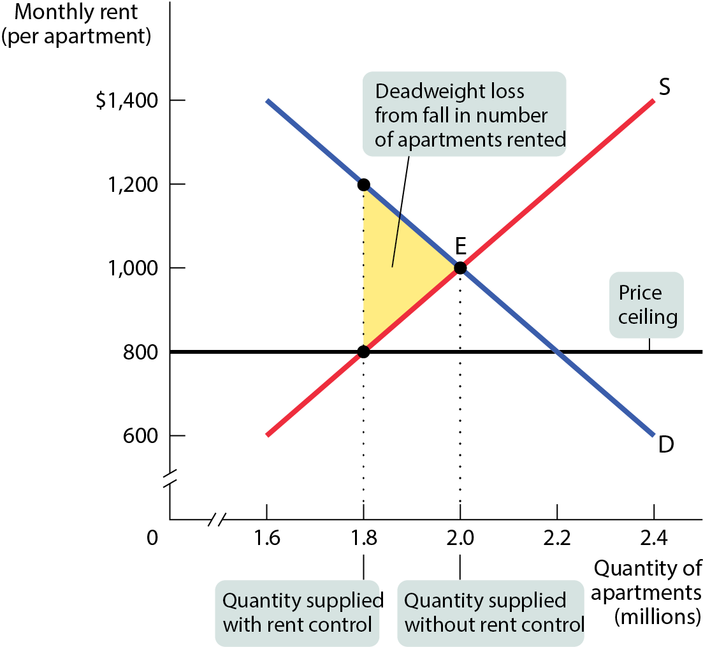
INEFFICIENTLY LOW QUANTITY GRAPHED
Figure 3
The area of the shaded triangle corresponds to the amount of total surplus lost due to the inefficiently low quantity transacted.

Slide 14
INEFFICIENT ALLOCATION TO CUSTOMERS
Price controls lead to misallocation of apartments: people who badly need a place to live may not find one, but some apartments may be occupied by people with much less urgent needs.
Under rent control, people usually get apartments through luck or personal connections.

Slide 15
WASTED RESOURCES
People expend money, effort, and time to cope with shortages caused by the price ceiling.
Back in 1979, U.S. price controls on gasoline led to shortages that forced millions of Americans to wait in line at gas stations for hours each week.
The opportunity cost of the time spent in lines—the wages not earned, the leisure time not enjoyed—constituted wasted resources.
Rent control creates missed opportunities.

Slide 16
INEFFICIENTLY LOW QUALITY
At the controlled price, sellers have more customers than goods.
  In a free market, this would be an opportunity to profit by raising prices.
  But when prices are controlled, sellers cannot raise prices.
  Sellers respond to this problem in two ways:
    Reduce quality
    Reduce service
Landlords of rent-controlled housing have no incentive to provide better conditions.

Slide 17
SHADOW MARKETS
A shadow market is a market in which goods or services are bought and sold illegally—either because they are prohibited or because the equilibrium price is illegal.
Some tenants are willing to bribe landlords.
Shadow markets encourage disrespect for the law in general and worsens the position of those who are honest.
Shadow markets can diminish some of the inefficiencies, but in the end, society as a whole is made worse.

Slide 18
The quality of New York City rent-regulated housing is getting substantially worse. (New York Post, 2023)
2022 Census Bureau Housing and Vacancy Survey: A third of rent-regulated units have “rodents” — almost twice the rate of unregulated apartments.
The regulated units also have twice as many leaks (23%, vs. 11%) and three times as many heating breakdowns (17%, vs. 5%).
Three times as many “stabilized units” have mold; twice as many have toilet and elevator breakdowns.

Slide 19
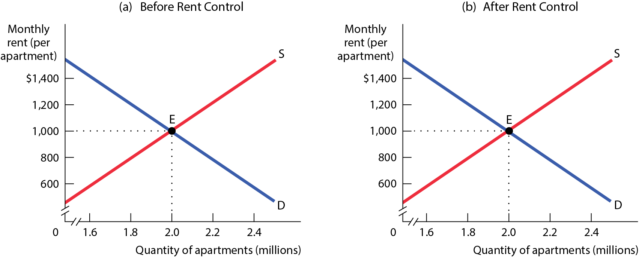
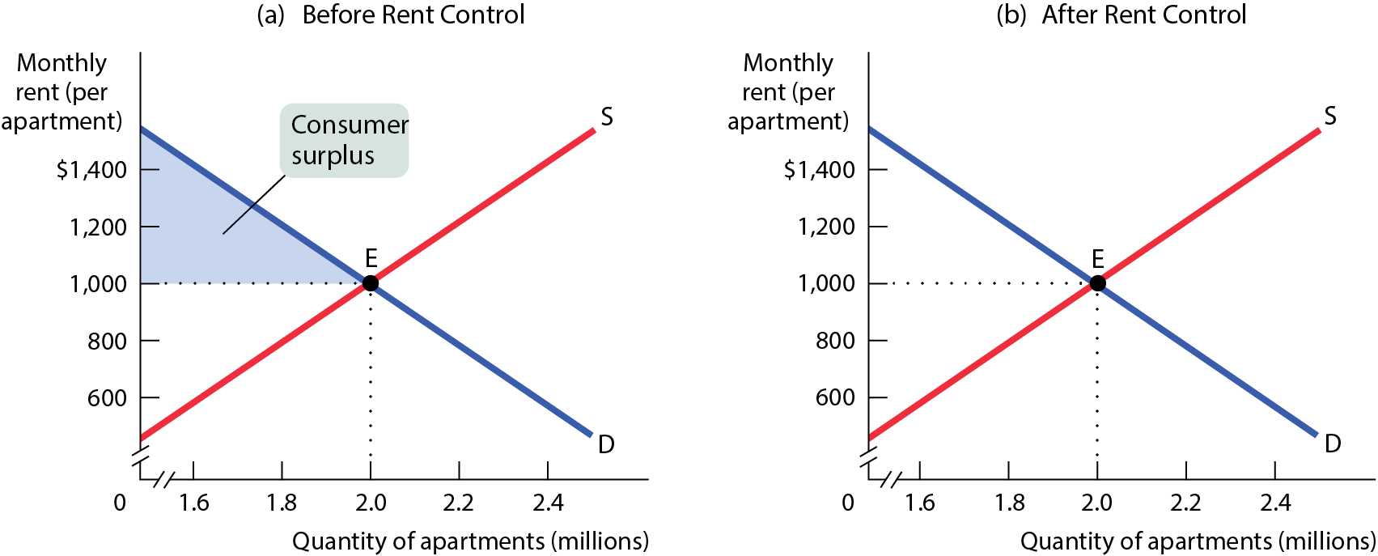
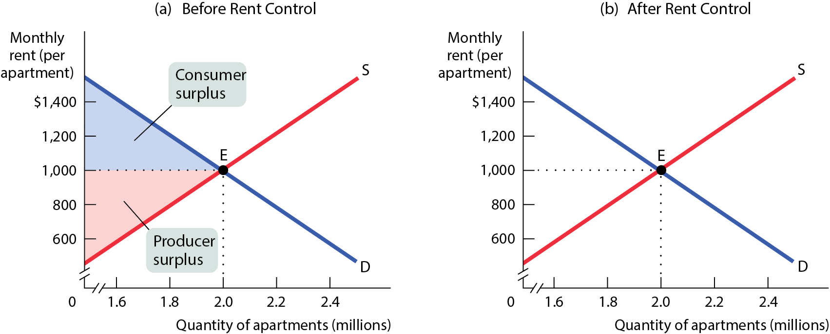
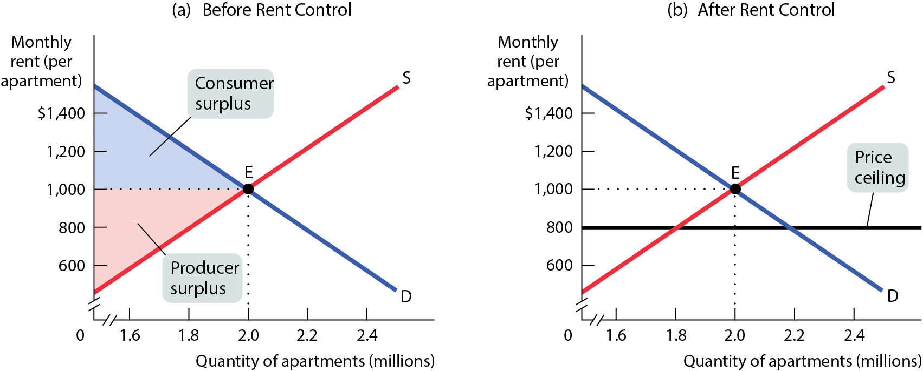

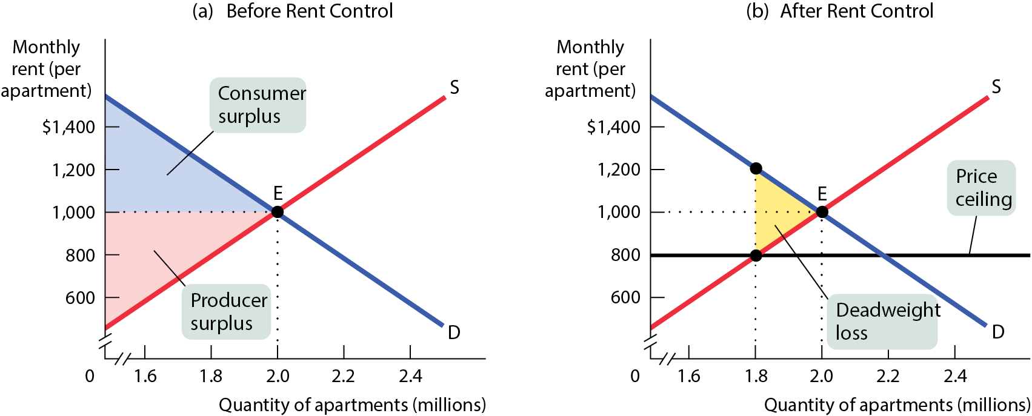
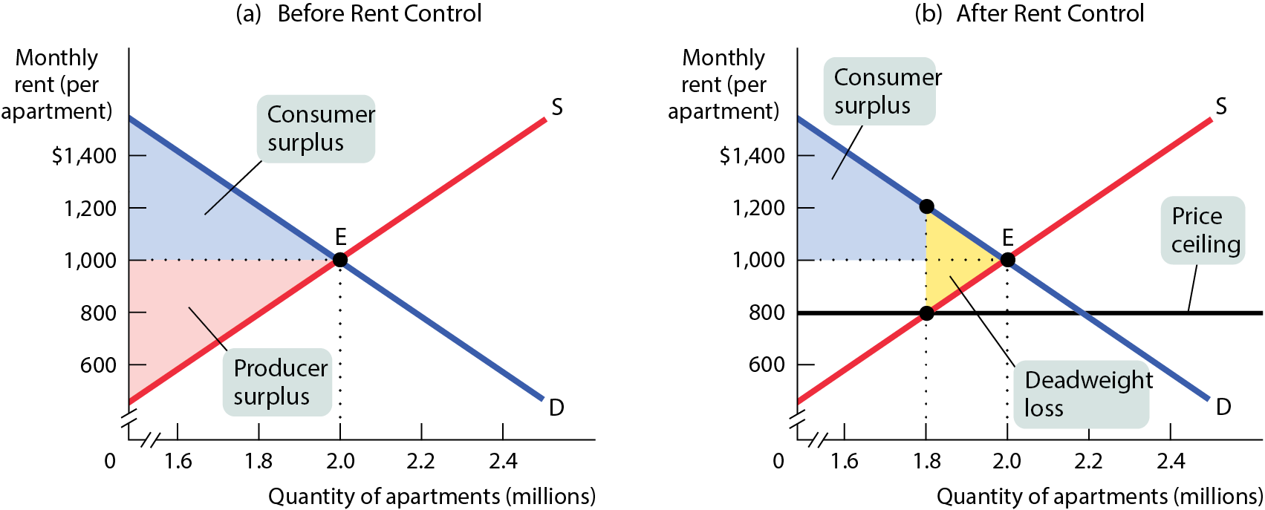
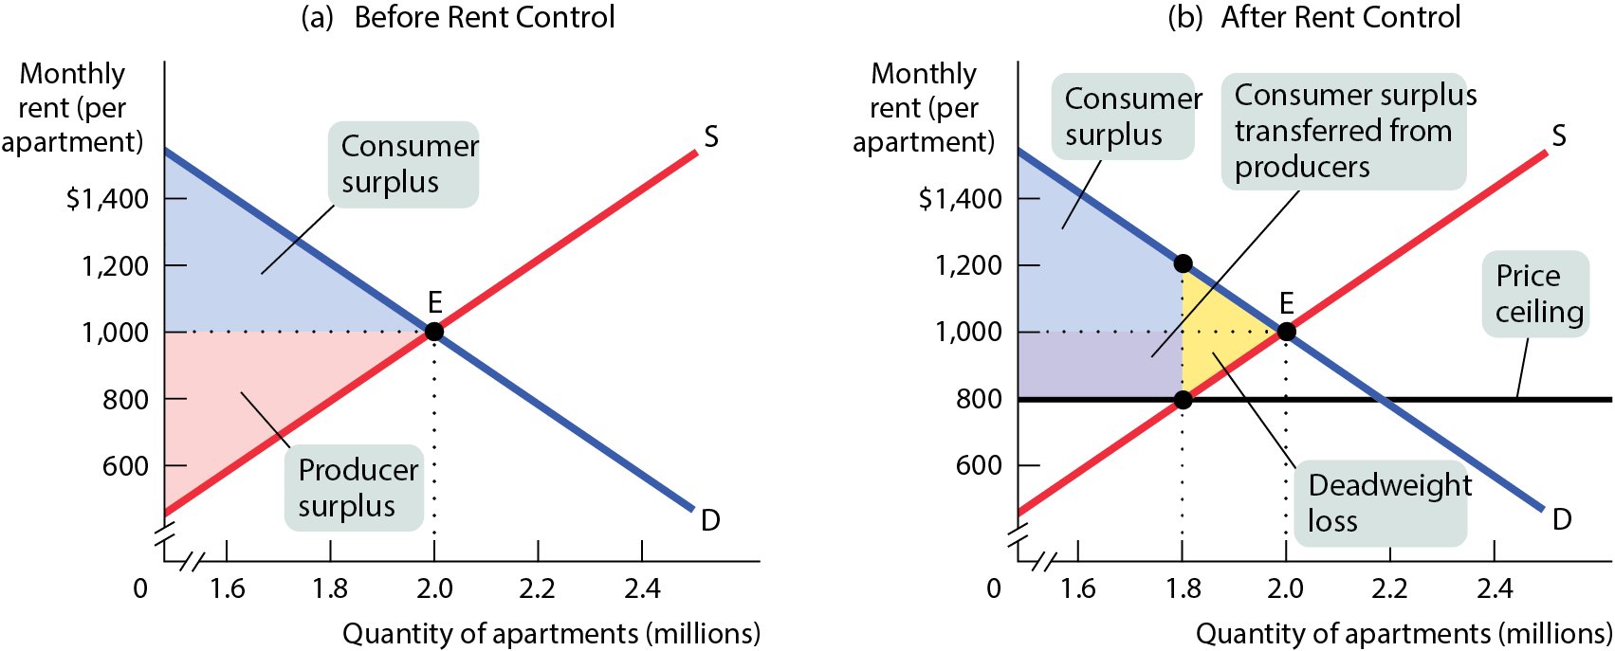
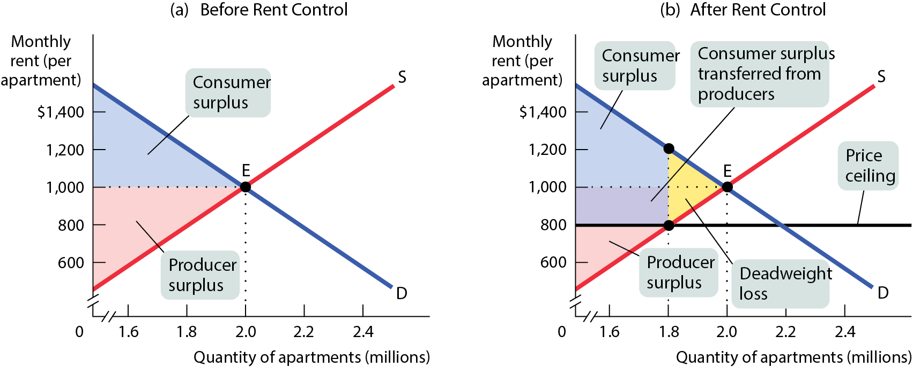
WINNERS AND LOSERS FROM RENT CONTROL
Figure 4
Producers lose; some lucky renters gain; and some unlucky but willing renters don’t get a place at all.

Slide 20
SO WHY ARE THERE PRICE CEILINGS?
They do benefit some people (who are typically better organized and more vocal than those who are harmed by them).
If the price ceiling has been in effect for a long time, buyers may not have a realistic idea of what would happen without it.
Government officials often do not understand supply and demand analysis.
Venezuela’s food shortages show how price controls disproportionately hurt the people they were designed to benefit.

Slide 21
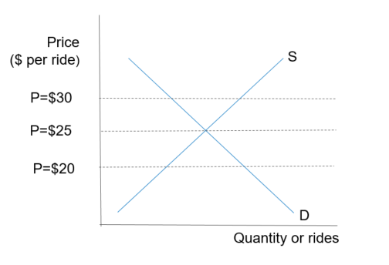
LEARN BY DOING: PRACTICE QUESTION 1
Suppose the accompanying graph represents the supply and demand for taxi rides. What is the equilibrium price in the market?
  $0
  $20
  $25
  $30

Slide 22
LEARN BY DOING: PRACTICE QUESTION 1 (ANSWER)
Suppose the accompanying graph represents the supply and demand for taxi rides. What is the equilibrium price in the market?
  $0
  $20
  $25 (correct answer)
  $30

Slide 23
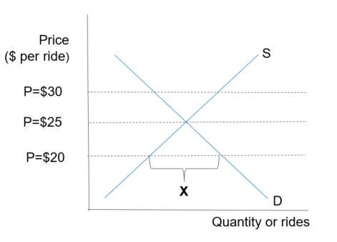
LEARN BY DOING: DISCUSSION QUESTION 1
Suppose the accompanying graph represents the supply and demand for taxi rides. If the government imposes a price ceiling of $20, what does X represent?
  equilibrium
  a shortage
  a surplus
  deadweight loss

Slide 24
LEARN BY DOING: DISCUSSION QUESTION 1 (ANSWER)
Suppose the accompanying graph represents the supply and demand for taxi rides. If the government imposes a price ceiling of $20, what does X represent?
  equilibrium
  a shortage (correct answer)
  a surplus
  deadweight loss

Slide 25
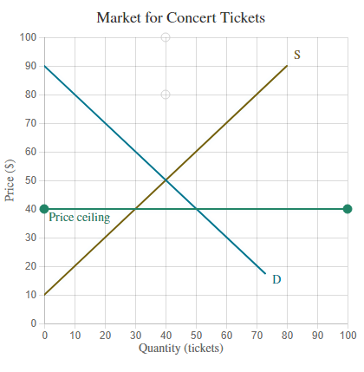
QUESTION 2
Suppose the graph depicts a hypothetical market for concert tickets at a local college venue. Because students are paying such high prices, a price ceiling of $40 per concert is being considered.
Move the price ceiling line to correctly depict the price ceiling of $40.
  By how much does consumer surplus (CS) increase if the price ceiling is imposed?
  By how much does producer surplus (PS) decrease if the price ceiling is imposed?
  DWL?

Slide 26
PRICE FLOORS
Sometimes governments intervene to push market prices up instead of down.
The generous minimum wage in many European countries has contributed to a high rate of unemployment and the flourishing of an illegal labor market.

Slide 27
PRICE FLOORS
Effective January 1, 2024, the state of Washington minimum wage is $16.28 per hour.
Effective January 1, 2024, Germany minimum wage is € 12.41 per hour.
The gross hourly minimum wage in France is now €11.65

Slide 28
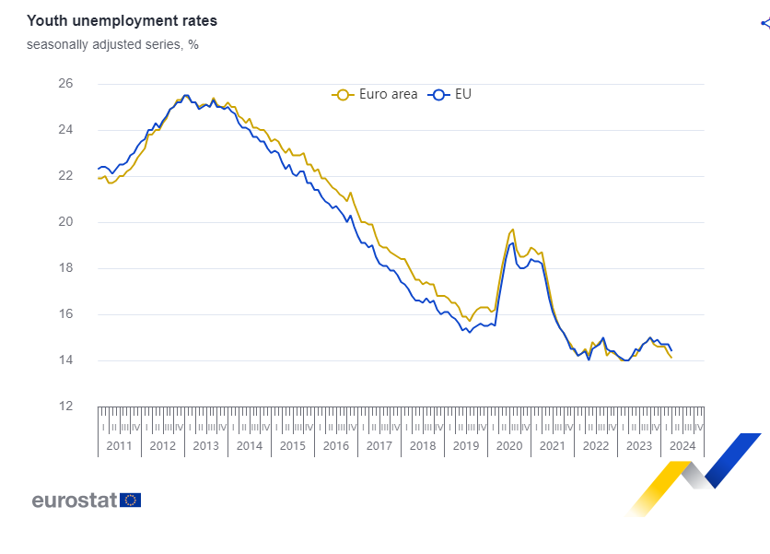
PRICE FLOORS

Slide 29
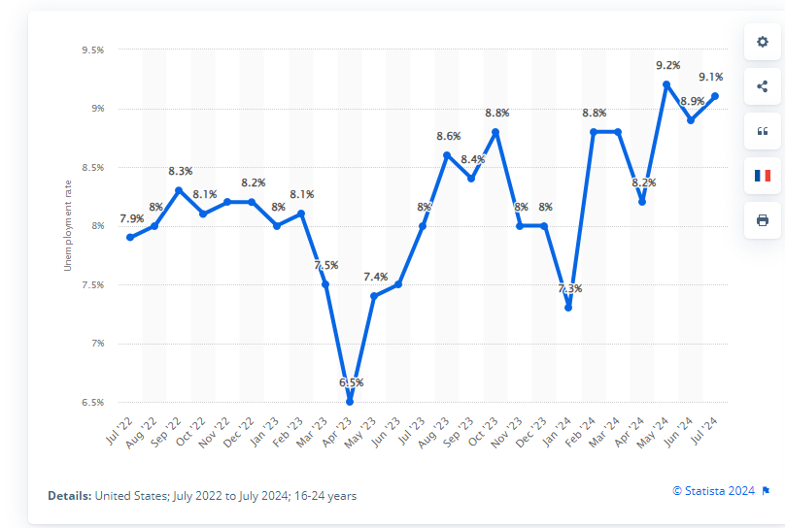
PRICE FLOORS
Monthly youth (16-24) unemployment rate in the United States from July 2022 to July 2024

Slide 30
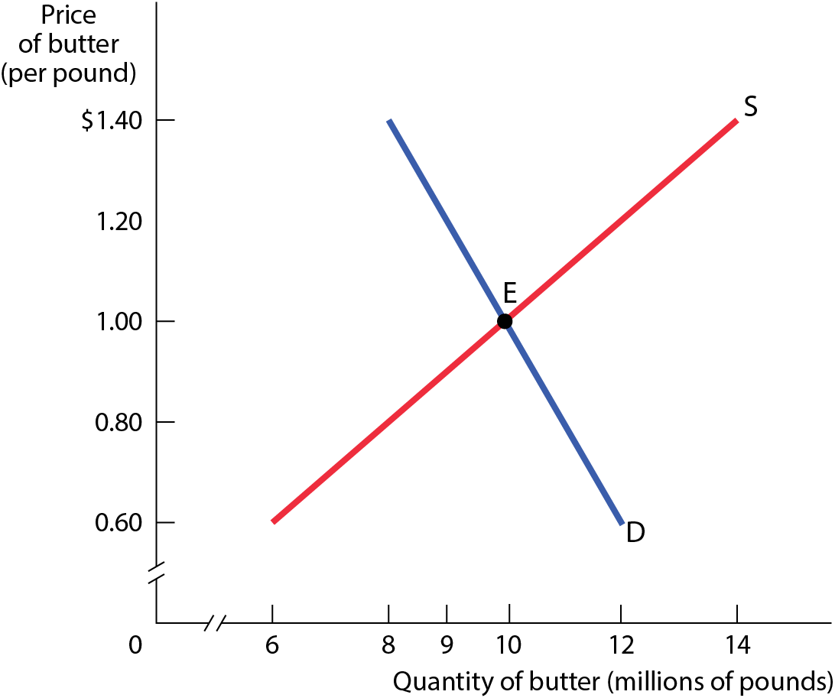
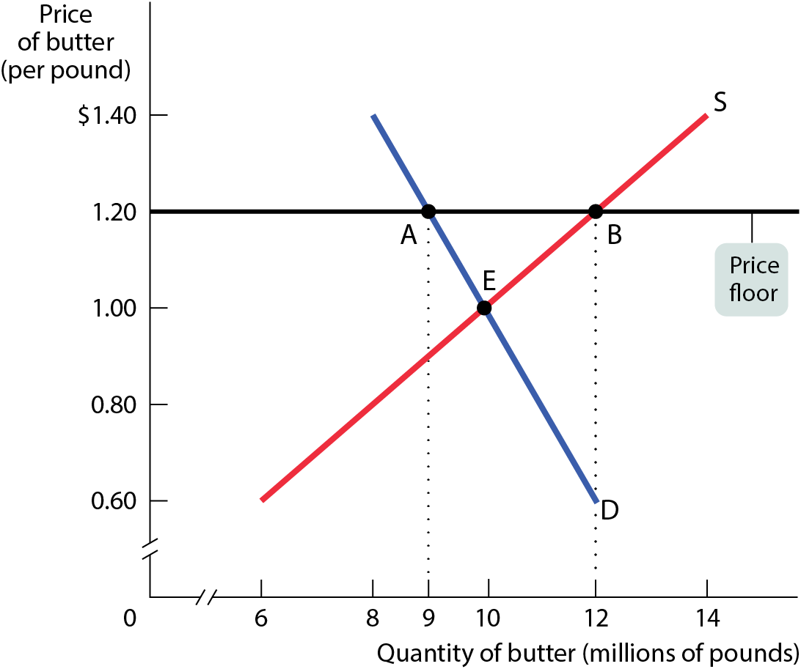
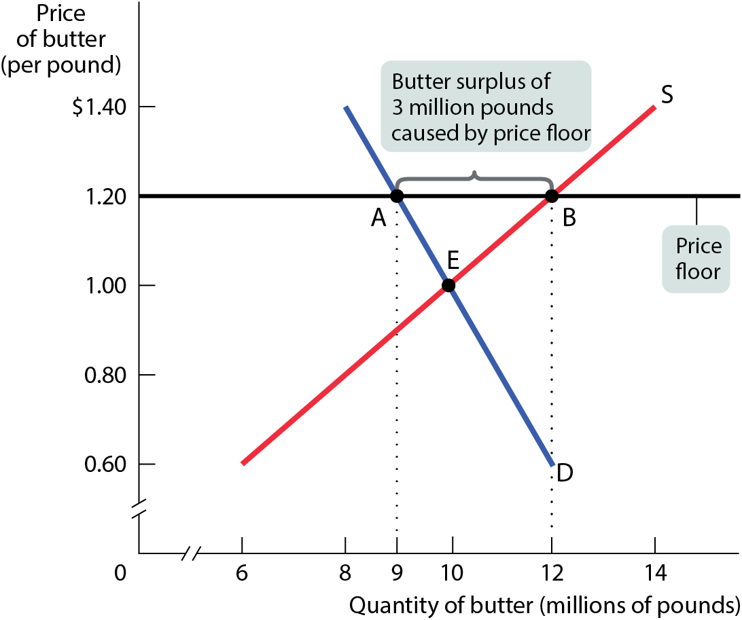
MODELING A PRICE FLOOR
The quantity of butter demanded falls to 9 million pounds, and the quantity supplied rises to 12 million pounds, generating a persistent surplus of 3 million pounds of butter.
Figure 6

Slide 31
HOW A PRICE FLOOR CAUSES INEFFICIENCY
Price floors cause predictable side effects:
Deadweight loss
Inefficient allocation of sales among sellers
Waste of resources
Inefficiently high quality
Temptation to break the law by selling below the legal price

Slide 32
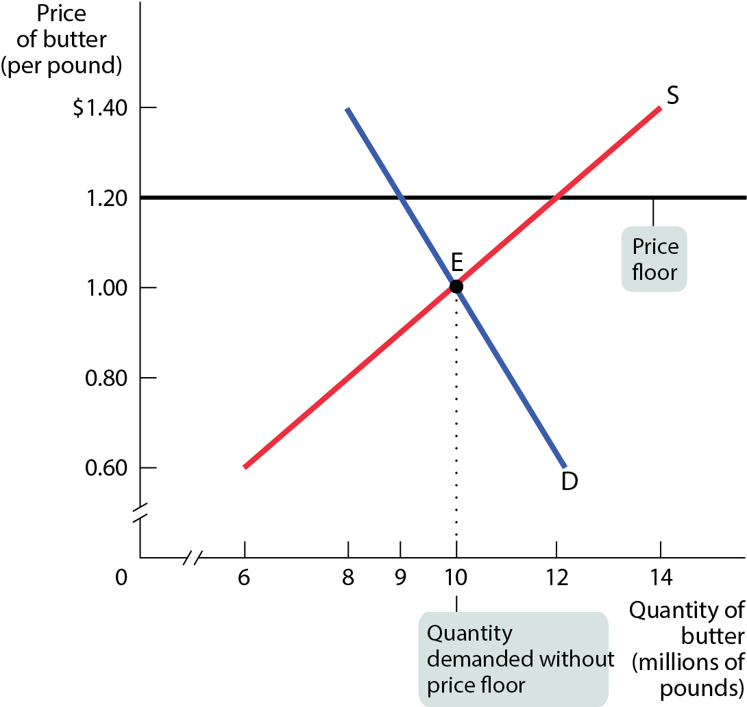
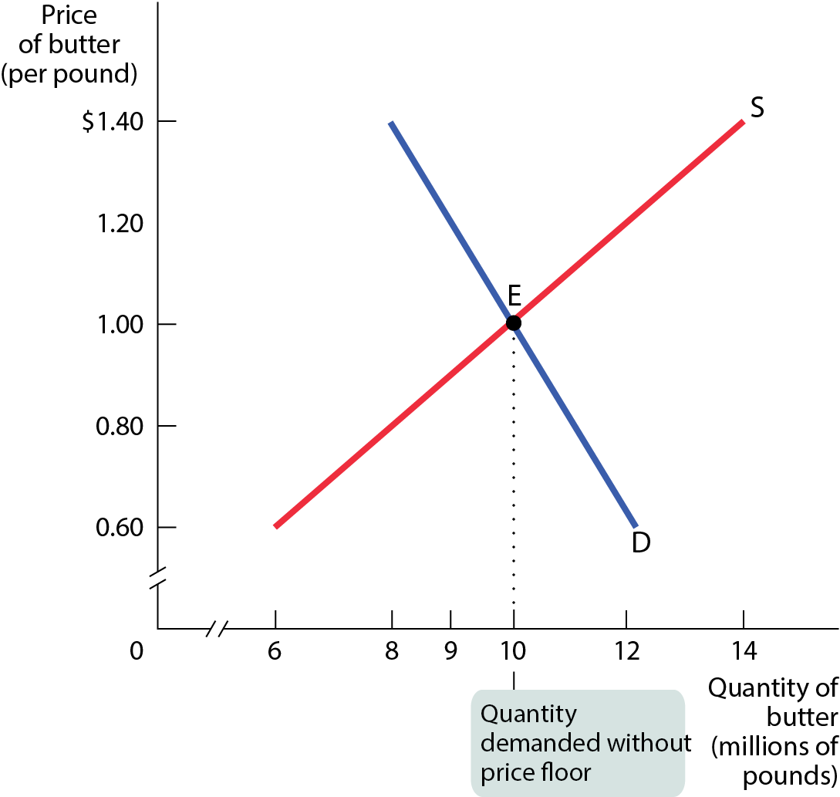
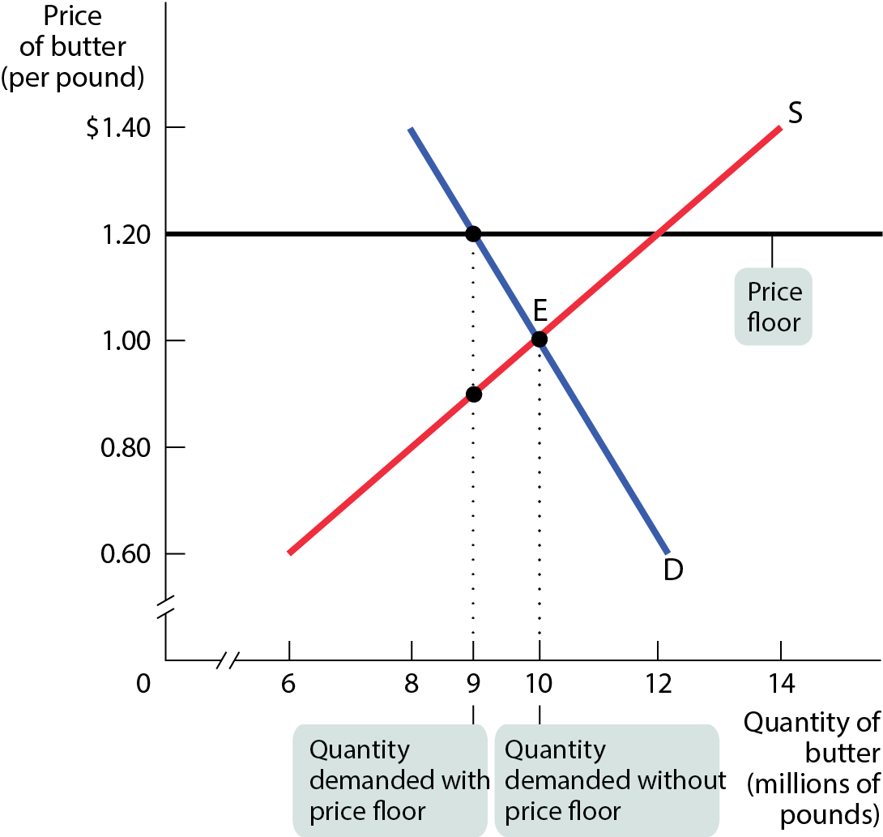
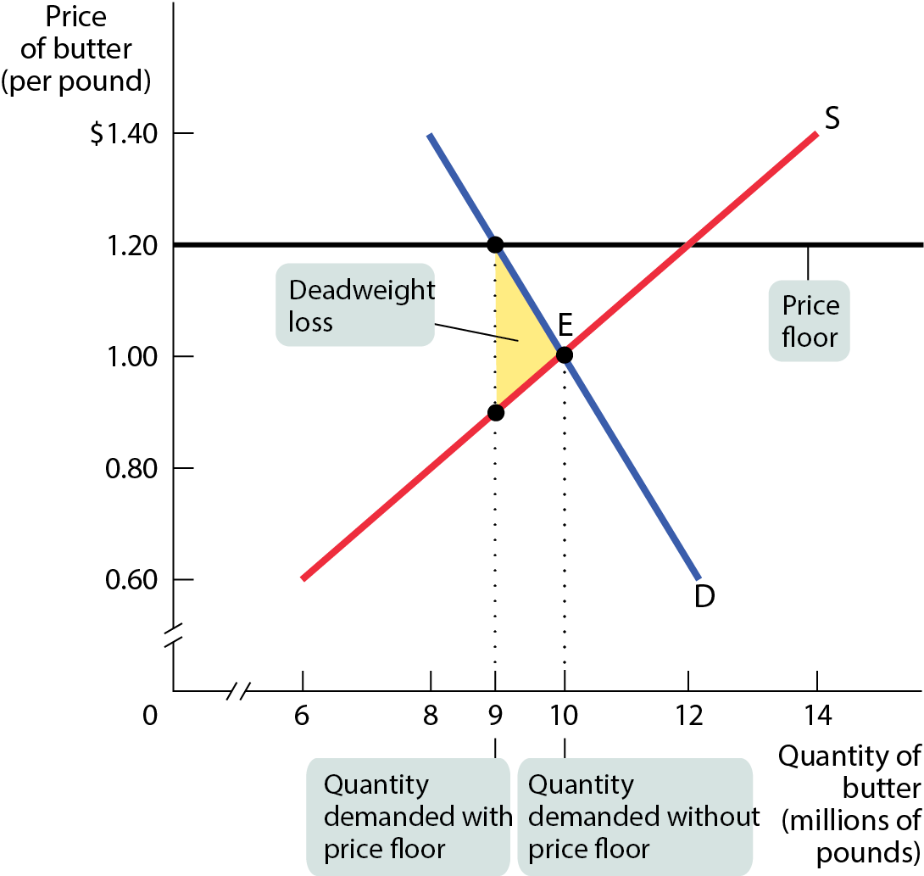
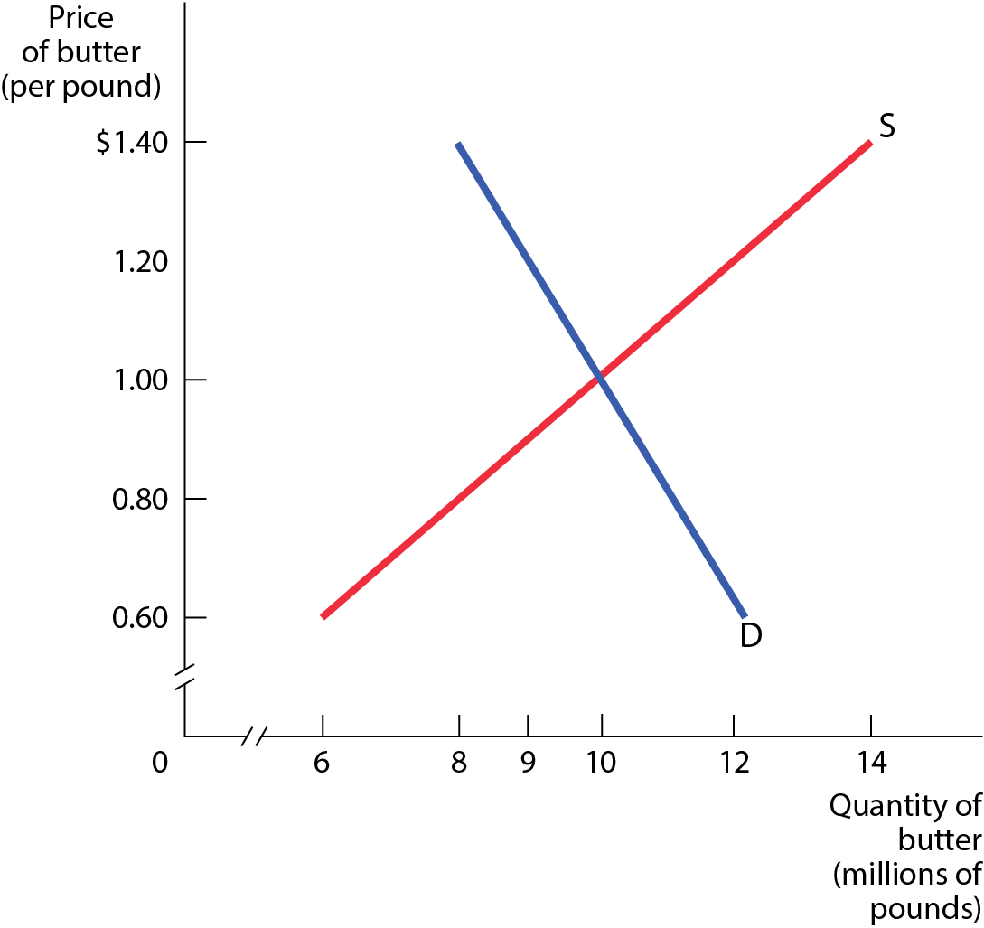
INEFFICIENTLY LOW QUANTITY
Figure 7
A price floor reduces the quantity demanded below the market equilibrium quantity and leads to a deadweight loss.

Slide 33
Price Floor - DWL
Price
S
8
Price Floor
5
3
D
Quantity
4
10

Slide 34
INEFFICIENT ALLOCATION OF SALES AMONG SELLERS
Price floors can lead to inefficient allocation of sales among sellers:
Sellers who are willing to sell at the lowest price are unable to make sales.
Sales go to the sellers who are only willing to sell at a higher price.
An example is the “two-tier” labor market found in many European countries.
A high minimum wage led to a two-tiered system, composed of the fortunate who had good jobs in the formal market and the rest who were locked out without any prospect of finding a good job.

Slide 35
WASTED RESOURCES: PRICE FLOORS
Price floors encourage waste.
To deal with the surplus generated by agricultural price floors, the U.S. government sometimes buys back the excess and donates or destroys it.

Slide 36
INEFFICIENTLY HIGH QUALITY
Price floors encourage sellers to offer goods of inefficiently high quality—the quality that is higher than buyers are willing to pay for.
When transatlantic airfares were set by international treaty, airlines could not offer lower prices, so they offered expensive services instead. Most flyers, however, would prefer lower airfares and less food.

Slide 37
ILLEGAL ACTIVITY
Price floors encourage shadow markets.
There are willing sellers (and buyers) at illegal prices, so they are tempted to break the law and trade with each other.

Slide 38
SO WHY ARE THERE PRICE FLOORS?
Same as price ceilings:
They do benefit some people (who are typically better organized and more vocal than those who are harmed by them).
Government officials often do not understand supply and demand analysis.

Slide 39
CONTROLLING QUANTITIES
Governments sometimes control quantity instead of price.
  Quota: an upper limit, set by the government, on the quantity of some good that can be bought or sold; also referred to as a quantity control.
Quota limit: the total amount of a good under a quota or quantity control that can be legally transacted.
  License: the right, conferred by the government, to supply a good.

Slide 40
LEARN BY DOING: PRACTICE QUESTION 2
Both price ceilings and price floors result in:
  wasted resources.
  inefficiently low quantity.
  inefficiently high quality.
  market equilibrium.

Slide 41
LEARN BY DOING: PRACTICE QUESTION 2 (ANSWER)
Both price ceilings and price floors result in:
  wasted resources. (correct answer)
  inefficiently low quantity.
  inefficiently high quality.
  market equilibrium.

Slide 42
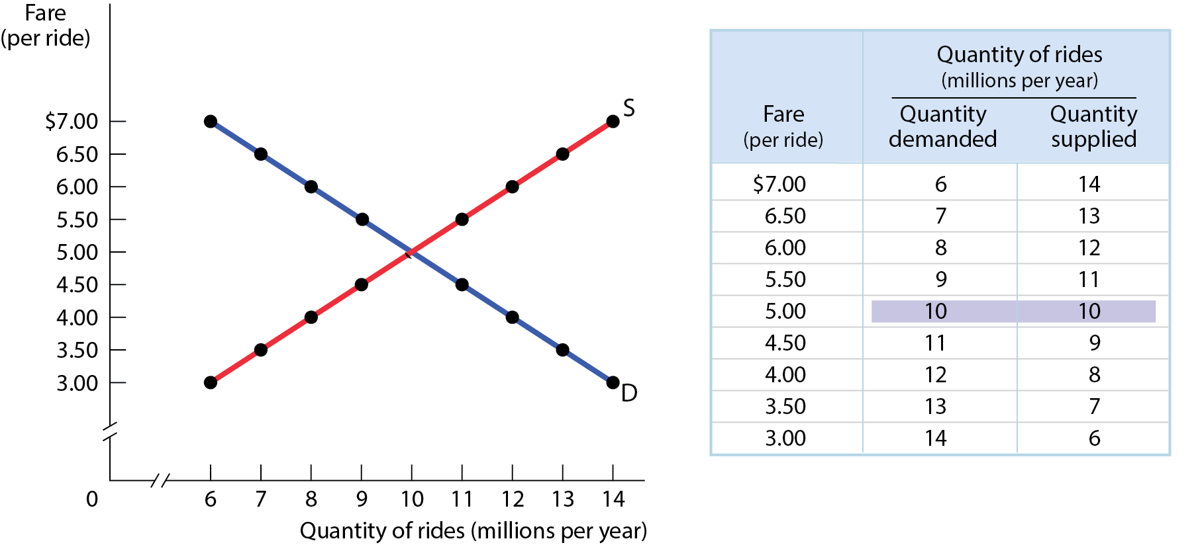
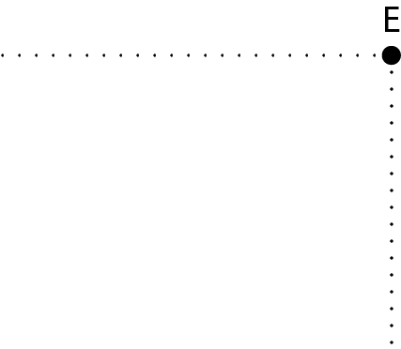
THE MARKET FOR TAXI RIDES IN THE ABSENCE OF GOVERNMENT CONTROLS
Figure 8
Without government intervention, the market reaches equilibrium with 10 million rides taken per year at a fare of $5 per ride.

Slide 43
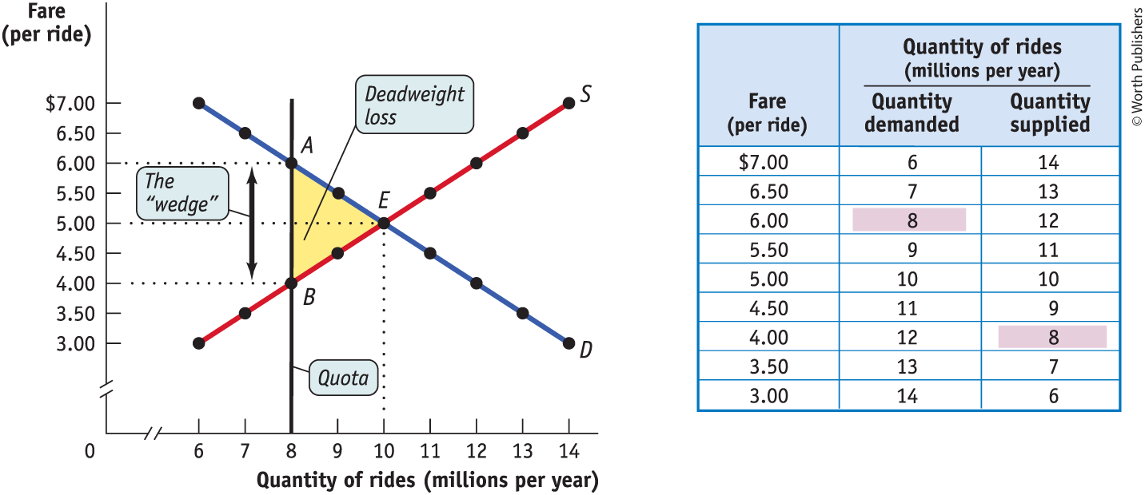
EFFECT OF A QUOTA ON THE MARKET
FOR TAXI RIDES PART 1
Demand price: the price of a given quantity at which consumers will demand that quantity.
Supply price: the price of a given quantity at which producers will supply that quantity.
Figure 9

Slide 44
EFFECT OF A QUOTA ON THE MARKET
FOR TAXI RIDES PART 2
The Wedge, or Quota, rent: the difference between the demand price and the supply price at the quota limit. Equal to the market price of the license when the license is traded.
Figure 9

Slide 45
THE COSTS OF QUANTITY CONTROLS
Like price controls, quotas impose losses on society.
  Deadweight loss (some mutually beneficial transactions don’t occur)
  Incentives for illegal activities
Unlicensed cabs are a side effect of quantity controls … but also an opportunity for alternate models like Uber.

Slide 46
LEARN BY DOING: DISCUSSION QUESTION 2
With a partner, choose either to:
defend the United States’ sugar import quotas or
attack them.
Imagine you are a young congressional staffer charged with collecting arguments to use for your side in Congress.
Brainstorm two or more arguments you would use and be ready to share.

