Slide 1

Consumer and Producer Surplus
4
Notes:
Cover Credits: Currency Exchange Stock Chart: cemagraphics/Getty Images, Social Media Montage: SEAN GLADWELL/Getty Images, Circuit Pattern: somsak Tangdamrongsub/Getty Images, Cargo Containers: urzine/Getty Images

Slide 2
Important!
HW#3 (due on Wednesday September 11th) is available. You can now start working on it.
Quiz #2 (CH1 and 2) is due on Sunday September 8th. [12 questions, 1 hour]
Remember that this class has two TAs:
  Jamil (amilhasan.imon@wsu.edu) and
  Romuald (r.rambikarison@wsu.edu).
Econ Help Desk: Zubaidur Rahman (zubaidur.rahman@wsu.edu). Following hours (all over Zoom):
  Monday: 1.00 pm to 7.00 pm
  Tuesday: 3.00 pm to 7.00pm
  Wednesday: 1.00pm to 7.00pm
  Thursday: 3.00pm to 7.00pm
  Zoom link for Monday, Tuesday, Wednesday and Thursday: https://wsu.zoom.us/j/94352018419

Slide 3
WHAT YOU WILL LEARN IN THIS CHAPTER
What is consumer surplus?
What is producer surplus?
What is total surplus, and why is it used to illustrate the gains from trade in a market?
What accounts for the importance of property rights and economic signals in a well-functioning market?
Why can a market sometimes fail and be inefficient?

Slide 4
MEASURING MARKET EFFICIENCY
The analysis of consumer surplus and producer surplus helps us calculate
How much benefit producers and consumers receive from the market, and
How the welfare of consumers and producers is affected by changes in prices.

Slide 5
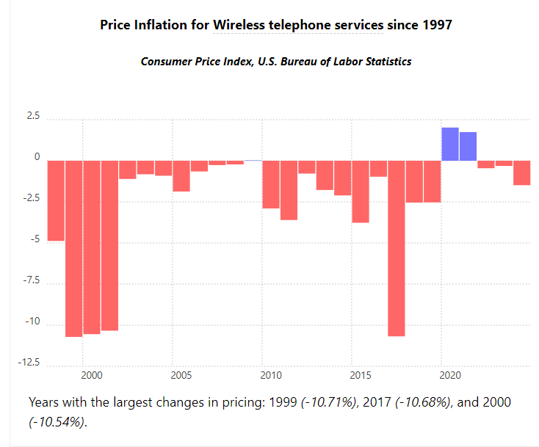
Increase in price
How do you feel when the price of your plan phone increases?
According to the U.S. Bureau of Labor Statistics, prices for wireless telephone services are 52.93% lower in 2024 versus 1997 (a $26.46 difference in value).

Slide 6
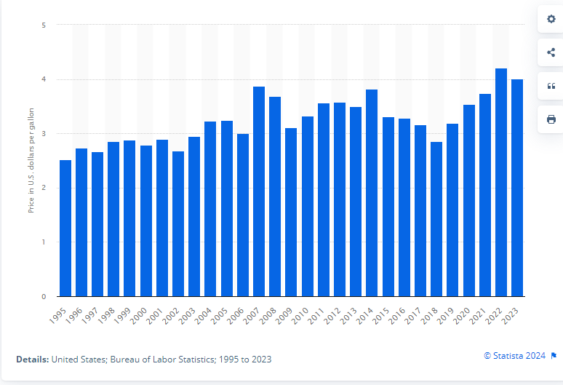
Increase in price
How do you feel when the price of milk increases?
Retail price of milk (fresh, whole, fortified) in the US from 1995 to 2023

Slide 7
CONSUMER SURPLUS PART 1
A consumer’s willingness to pay for a good is the maximum price at which they would buy that good.
Individual consumer surplus: the gain to an individual buyer from the purchase of a good; the difference between the price paid and what the buyer is willing to pay.
Total consumer surplus: the sum of individual consumer surpluses of all buyers in a market.
Economists often use the term consumer surplus to refer to both individual and total consumer surplus.

Slide 8

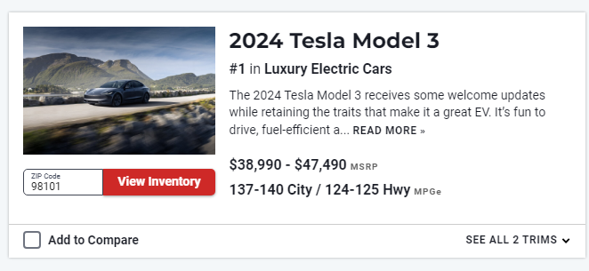
Consumer Surplus
Despite a federal tax credit of $7,500 for purchasing an electric vehicle, the Tesla Roadster's cost of $109,000 made it a luxury item in 2007.

Slide 9
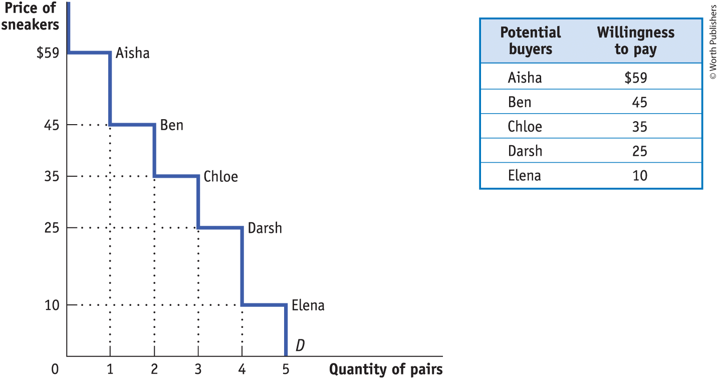
THE DEMAND CURVE FOR USED SNEAKERS
Figure 1

Slide 10
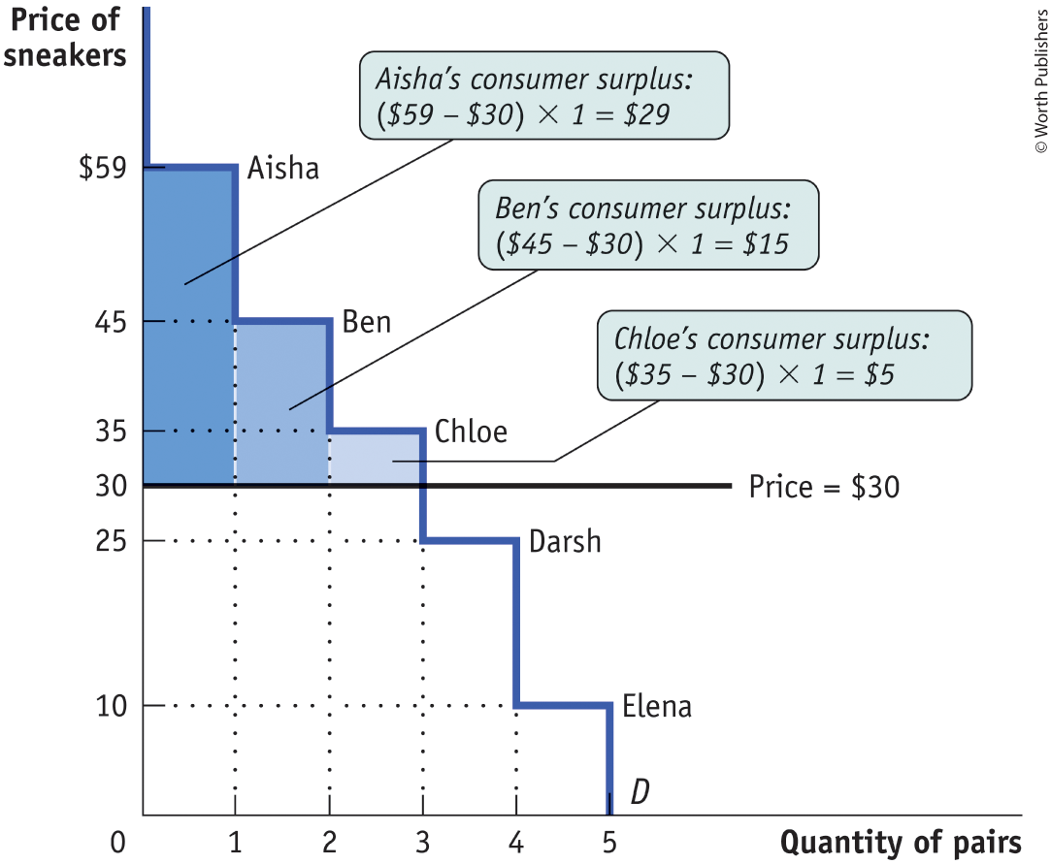
CONSUMER SURPLUS PART 2
Figure 2
The total consumer surplus is the entire shaded area—the sum of the individual consumer surpluses of Aisha, Ben, and Chloe ($29 + $15 + $5 = $49).

Slide 11
LEARN BY DOING: PRACTICE QUESTION 1
George is considering the purchase of some new shirts for work. He is willing to pay $35 for the first shirt, $25 for the second shirt, and $15 for the third one.
Oxford Clothiers, his favorite shirt manufacturer, is selling shirts for $28 each.
What is the efficient number of shirts for George to buy?
What is George’s consumer surplus?
Explain your answers.

Slide 12
LEARN BY DOING: PRACTICE QUESTION
Using the graph shown and supposing the price of sneakers is $30, calculate the total consumer surplus.
  a) $29
  b) $15
  c) $45
  d) $49

Slide 13
LEARN BY DOING: PRACTICE QUESTION 3
(Answer)
Using the graph shown and supposing the price of sneakers is $30, calculate the total consumer surplus.
  a) $29
  b) $15
  c) $45
  d) $49 (correct answer)

Slide 14
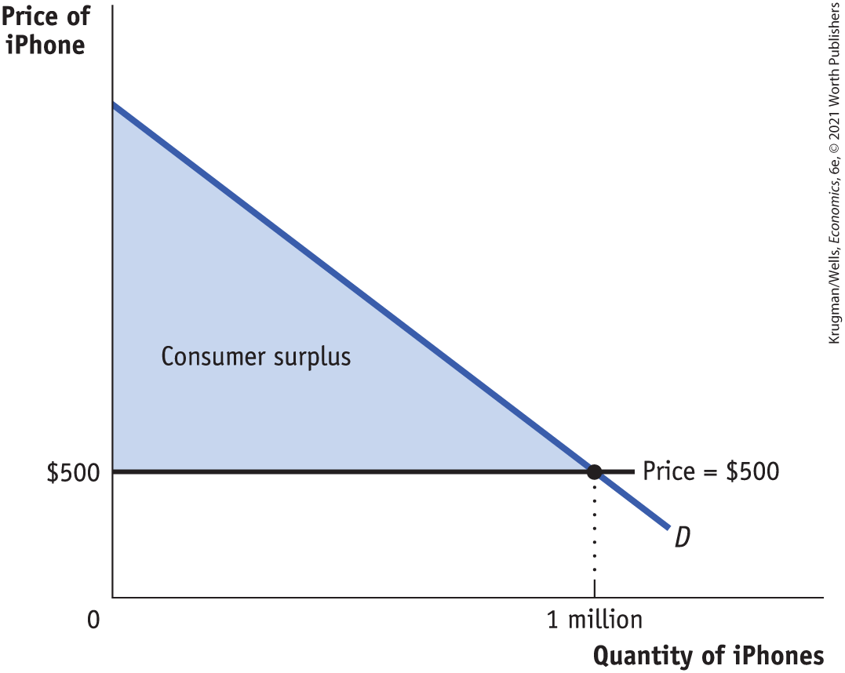

CONSUMER SURPLUS PART 3
Consumer surplus is the area below the demand curve but above the price.
Figure 3
$$CS=\frac{\text{Base} \text{x} \text{Height}}{2}$$

Slide 15
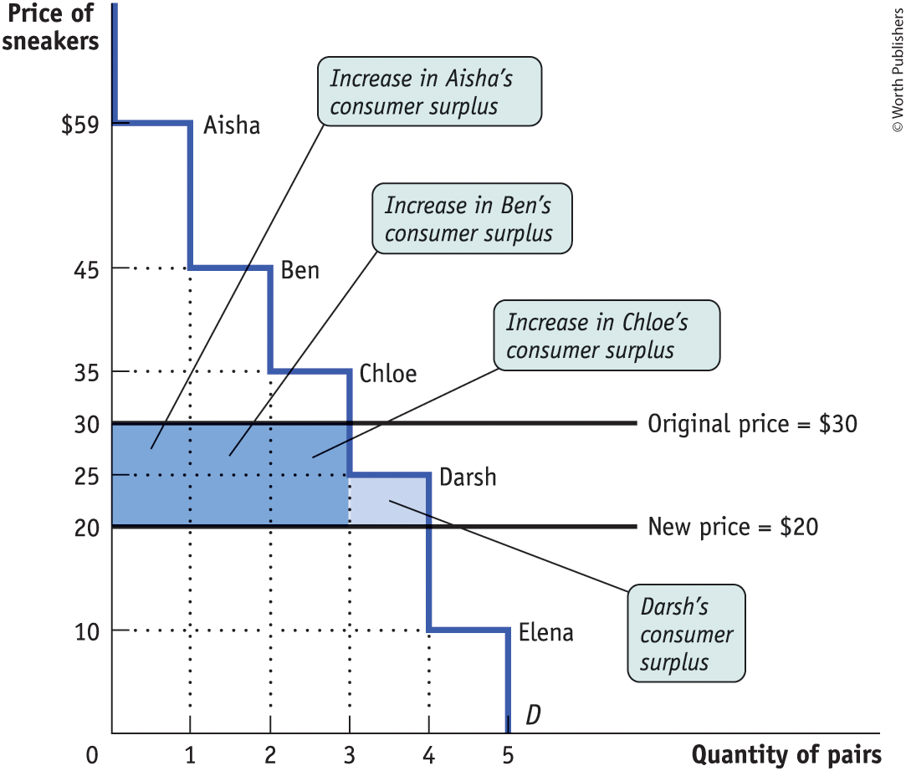
CONSUMER SURPLUS RISES WITH A FALL IN PRICE (1 of 2)
Figure 4

Slide 16
CONSUMER SURPLUS RISES WITH A FALL IN PRICE (2 of 2)
The gain in consumer surplus has two parts:
The dark blue rectangle shows the gain to those who would have bought the sneakers at the original price $30.
The light blue rectangle shows the gain to those who wouldn’t have bought the good at the original price of $30 but are willing to do so at the new price of $20.

Slide 17
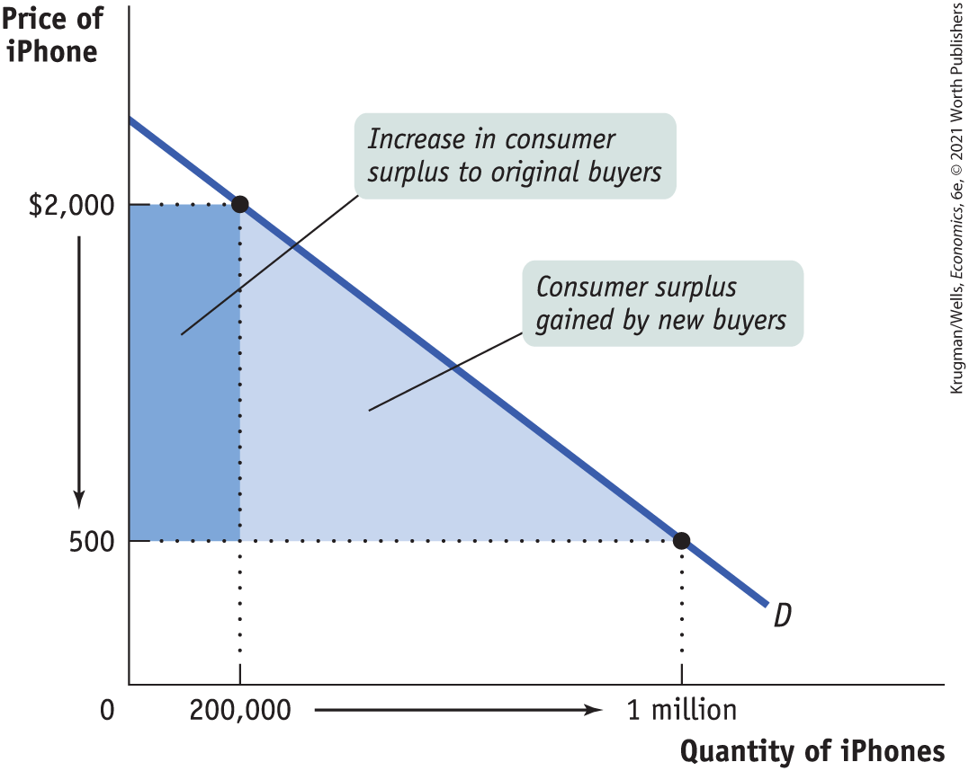
HOW THE GAINS IN CONSUMER SURPLUS ARE SPLIT
Figure 5

Slide 18
LEARN BY DOING: DISCUSS (1 of 2)
With a partner, discuss and be ready to share:
What is the best way to allocate the donated kidneys?
Sell kidneys on a free market.
A donated kidney would go to the person waiting the longest.
Distribute organs based on the “net survival benefit” when a kidney is matched to the recipient expected to achieve the greatest survival time from that kidney.

Slide 19
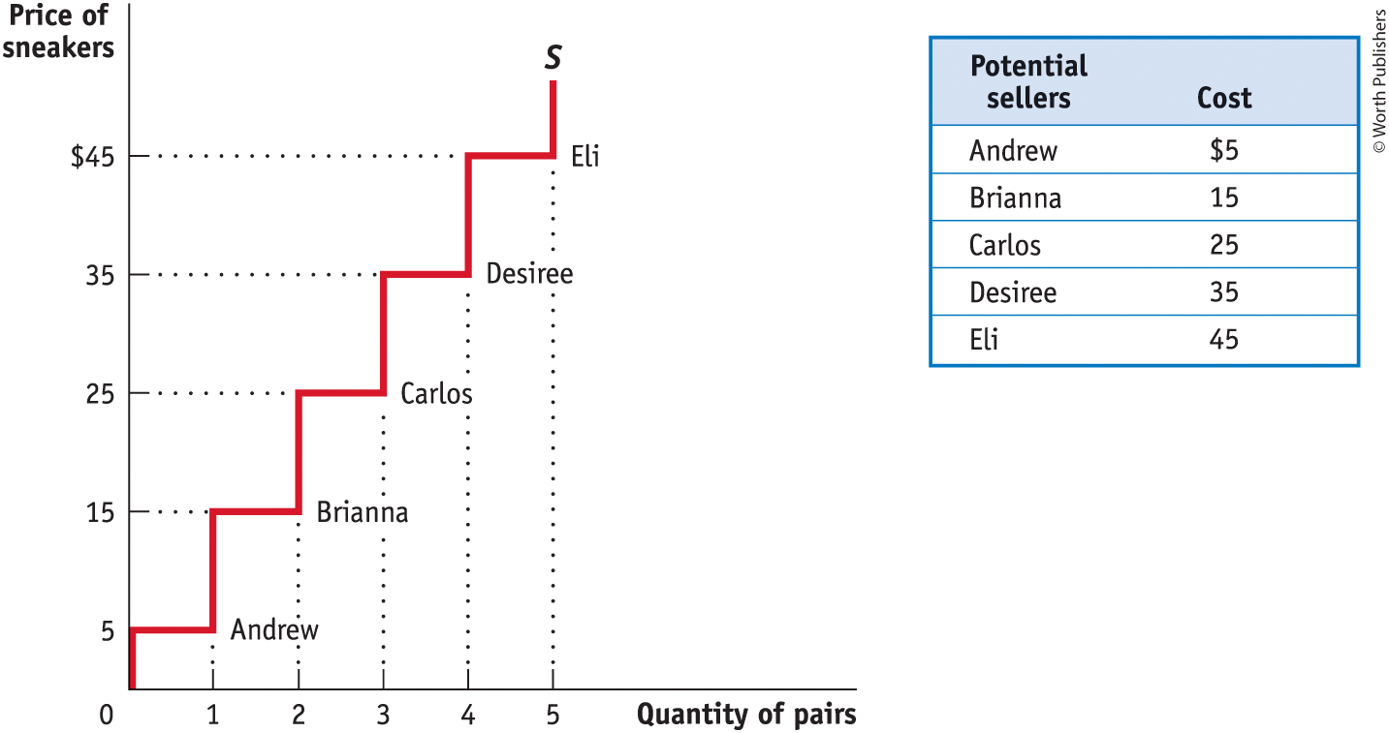
THE SUPPLY CURVE FOR USED SNEAKERS
Figure 6

Slide 20
PRODUCER SURPLUS PART 1
Producer surplus: the difference between market price and the price at which firms are willing to supply the product.
Individual producer surplus: the net gain to an individual seller from selling a good. It is equal to the difference between the price received and the seller’s cost (the seller’s cost includes monetary costs; it may also include other opportunity cost).
Total producer surplus: the sum of individual producer surpluses of all the sellers in a market.
Economists use the term producer surplus to refer both to individual and total producer surplus.

Slide 21
PRODUCER SURPLUS PART 2
TABLE 2 Producer Surplus When the Price of a Used Pair of Sneakers = $30
Potential seller | Cost | Price received | Individual producer surplus = Price received − Cost
Andrew | $5 | $30 | $25
Betty | 15 | 30 | 15
Carlos | 25 | 30 | 5
Donna | 35 | — | —
Engelbert | 45 | — | —
All sellers |  |  | Total producer surplus = $45

Slide 22
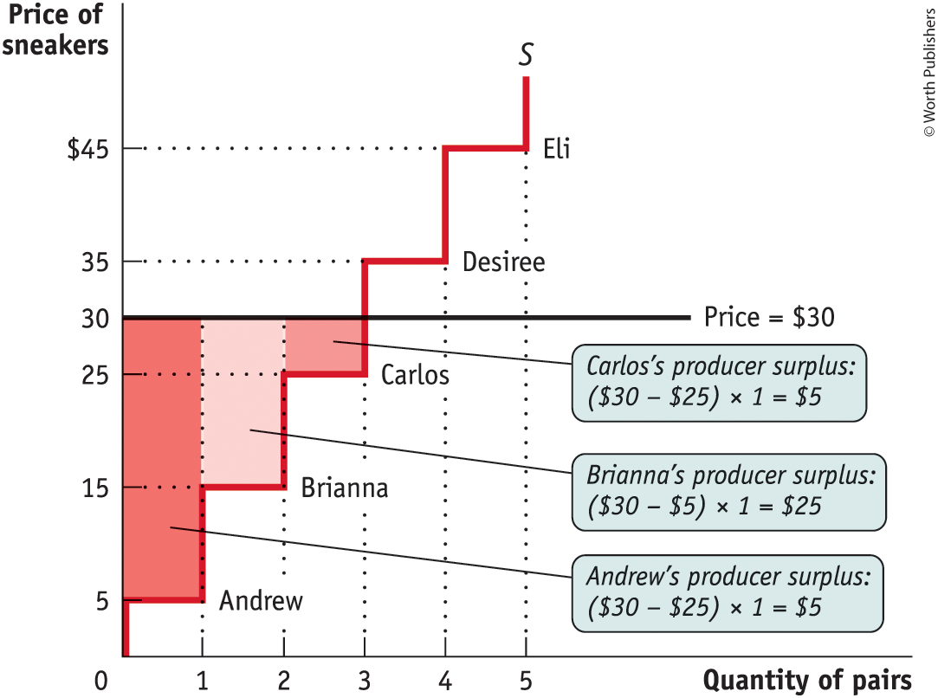
PRODUCER SURPLUS PART 3
Figure 7

Slide 23
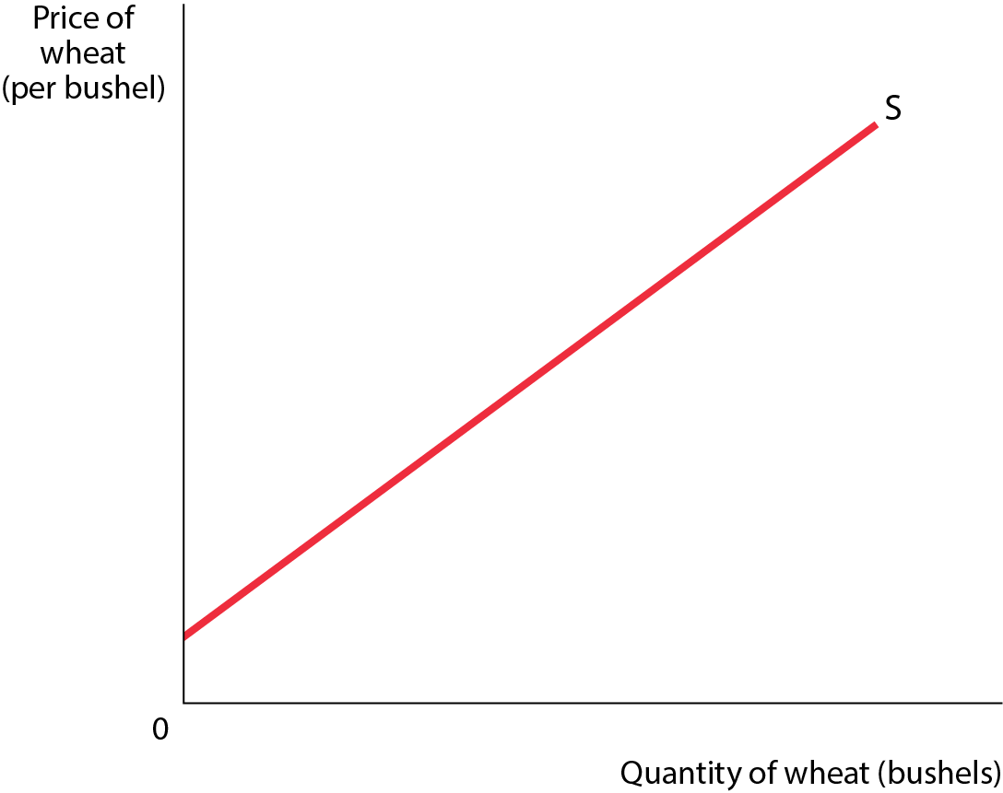
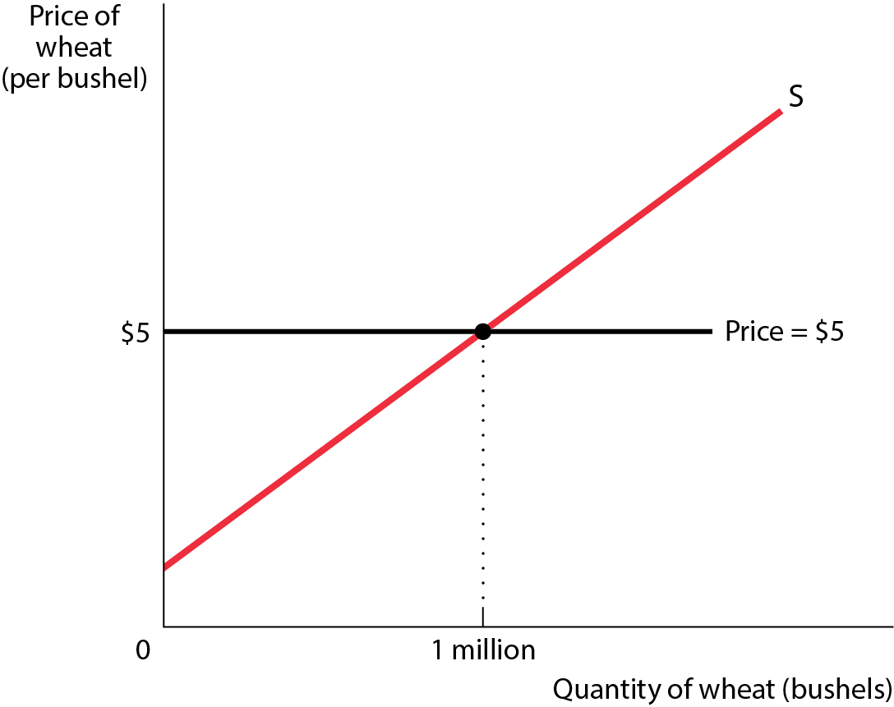
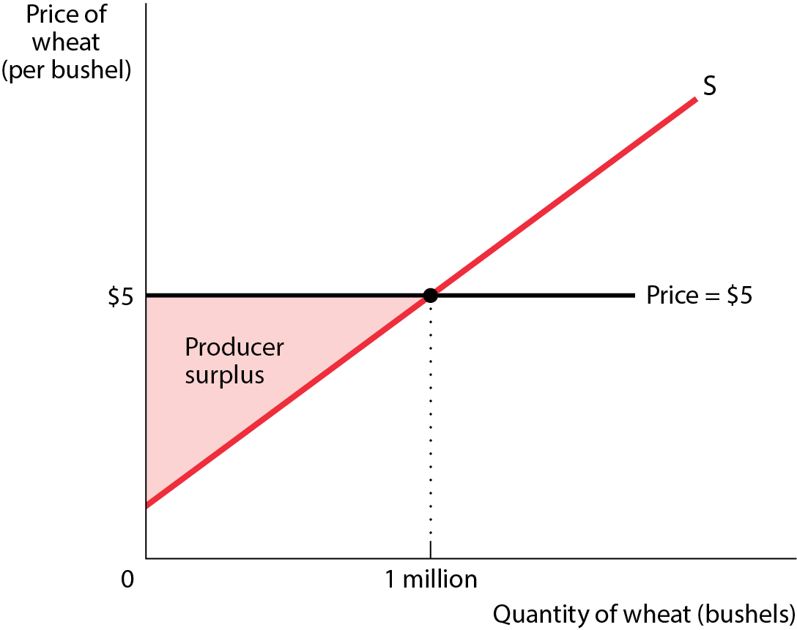
PRODUCER SURPLUS PART 4
Figure 8

Slide 24
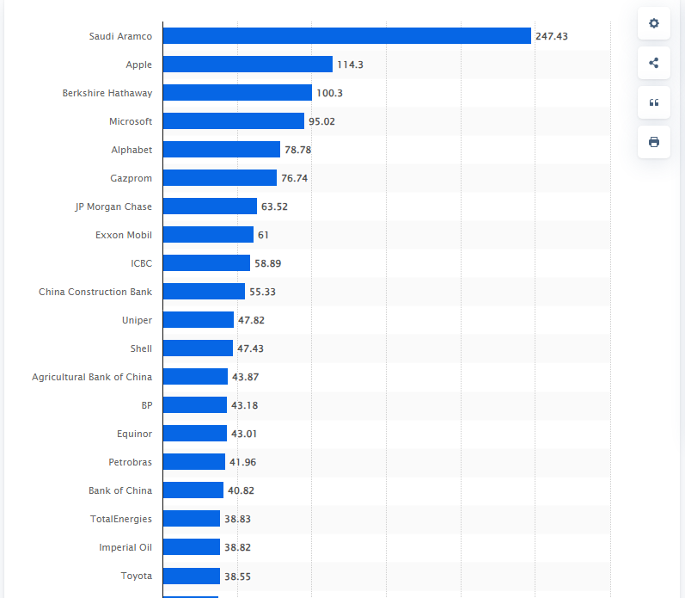
Leading companies in the world in 2023, by pre-tax income(in billion U.S. dollars)

Slide 25
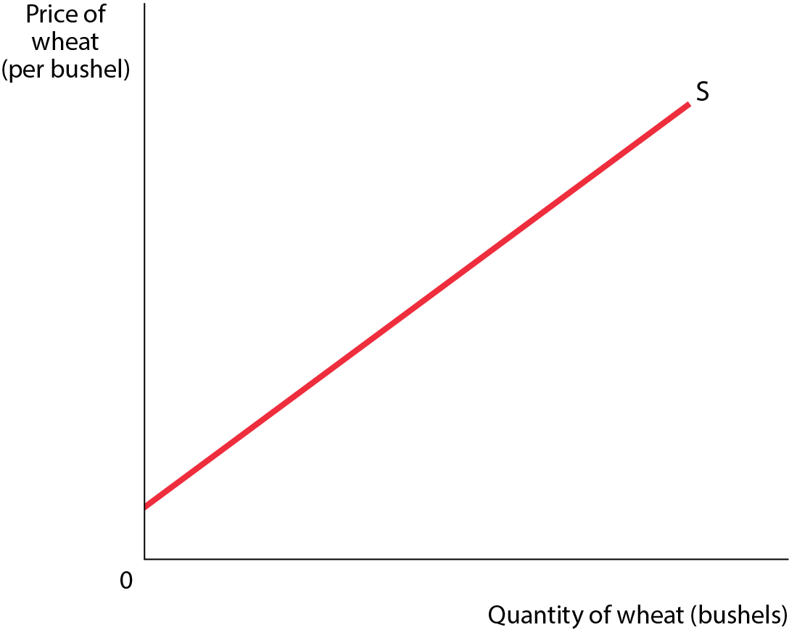
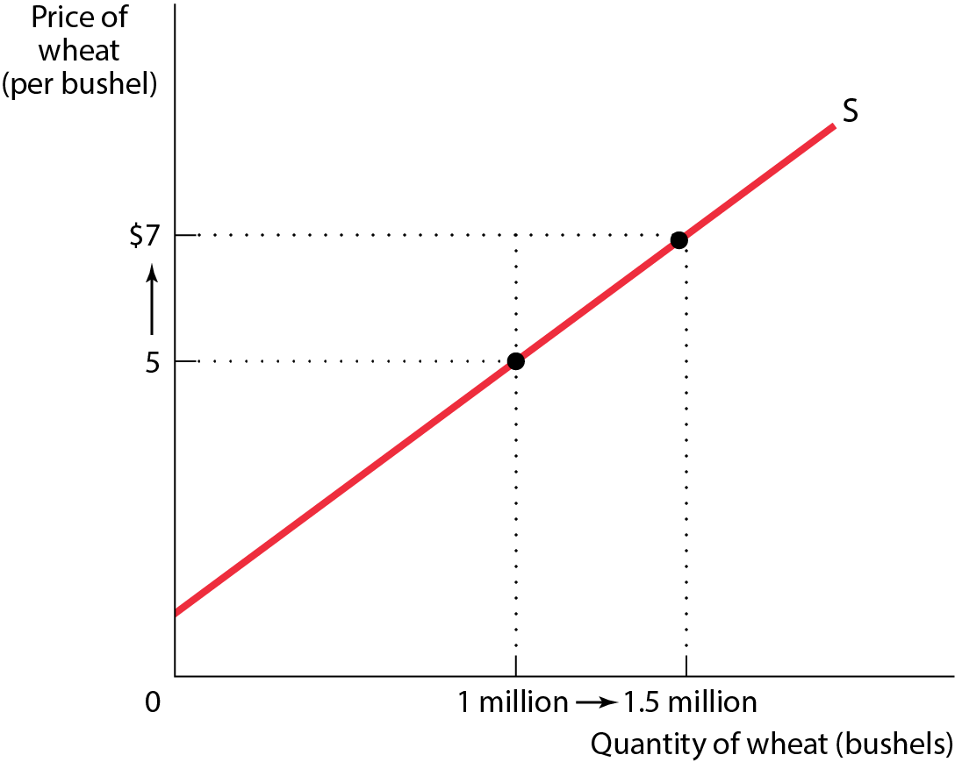
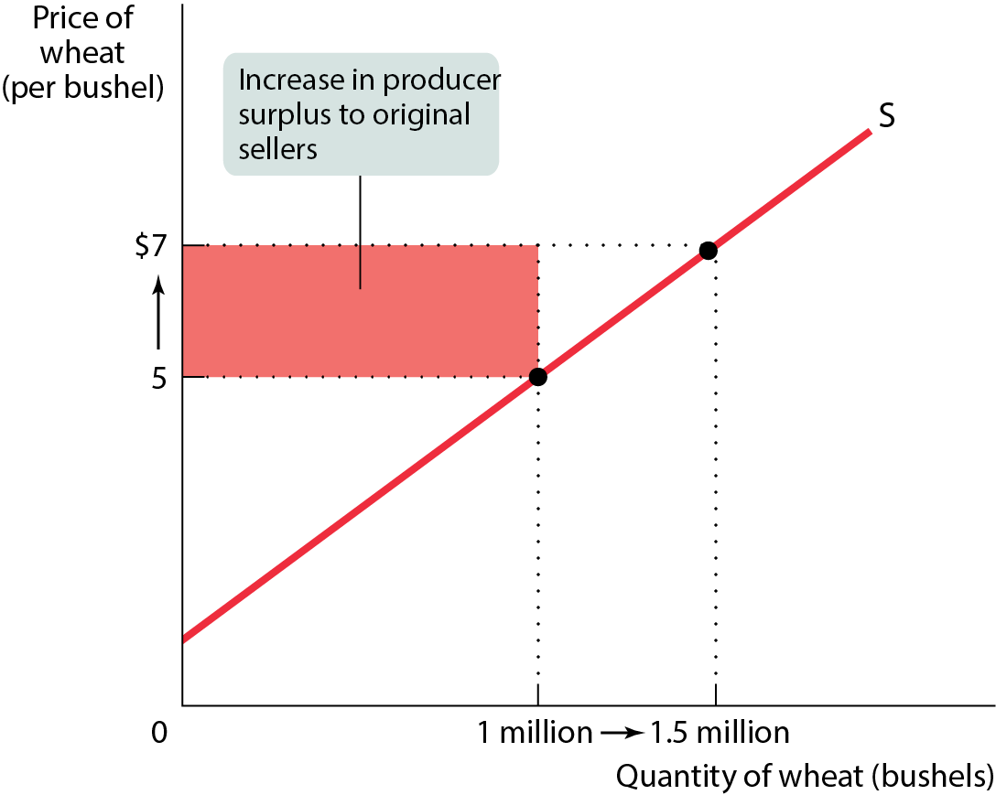
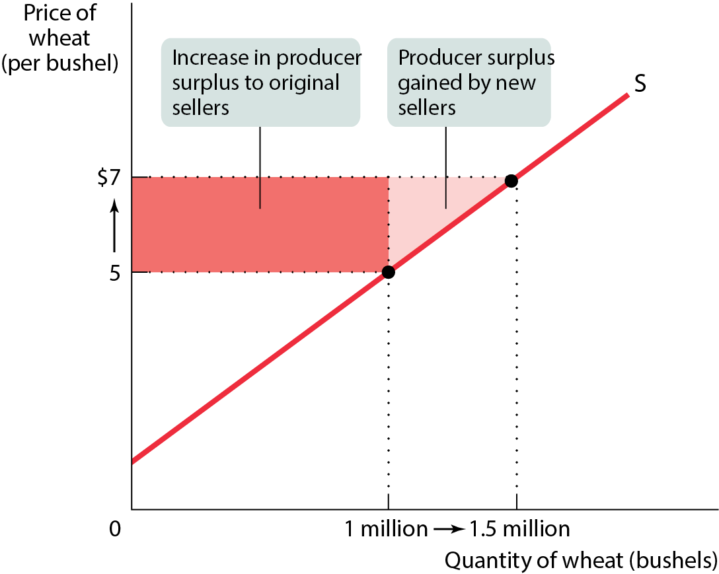
PRODUCER SURPLUS RISES IF THE PRICE INCREASES
Figure 9

Slide 26
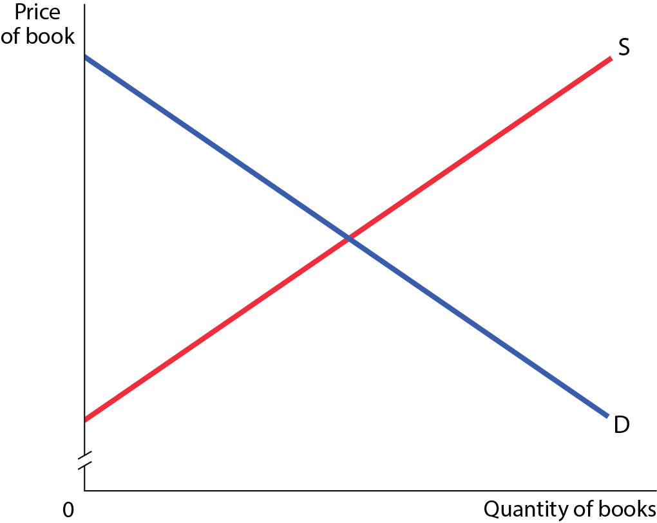
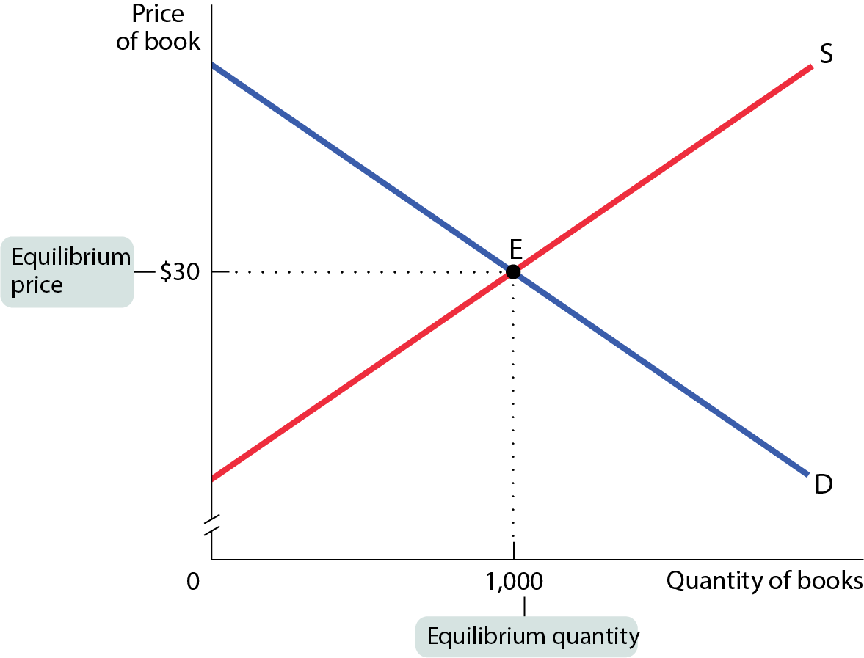
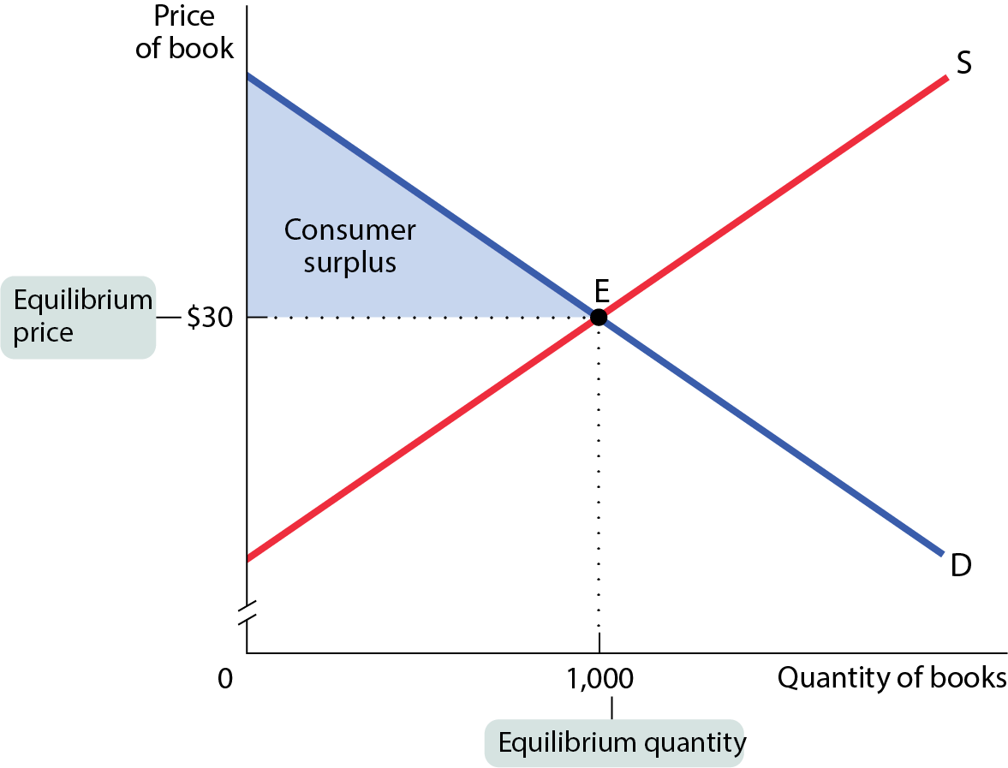
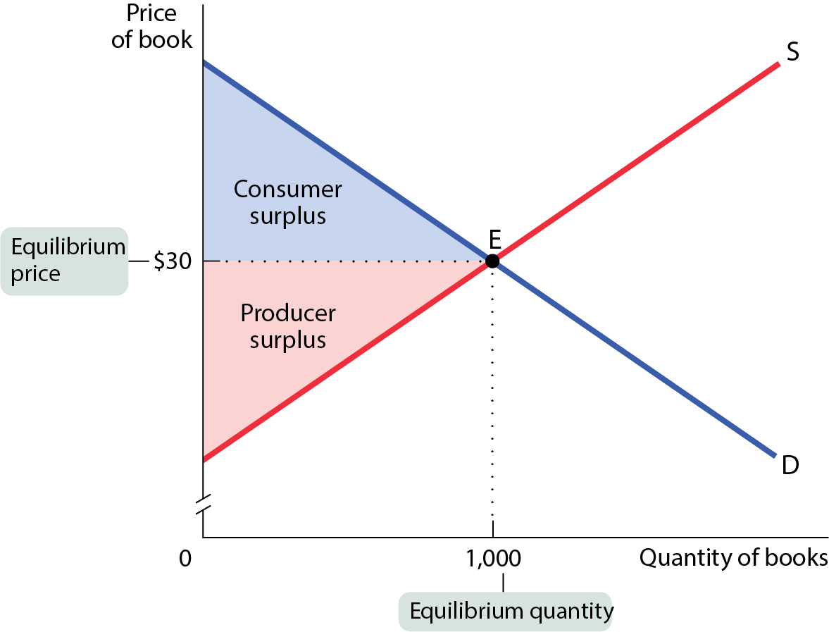
CONSUMER SURPLUS, PRODUCER SURPLUS, AND THE GAINS FROM TRADE
Total surplus: the sum of the producer and consumer surpluses.
Figure 11

Slide 27
CONSUMER SURPLUS, PRODUCER SURPLUS, AND THE GAINS FROM TRADE
The management at Moose Park is considering whether to replace their portable toilets with flush toilets at the popular Moose Campground. They are also deciding how many flush toilets to install if they proceed.
They will install flush toilets if the total surplus exceeds a certain threshold in relation to the number of flush toilets and the cost per campsite per night.
Researchers have calculated that both the demand and supply curves for flush toilets at the park are perfectly straight lines. At a cost of $35 per campsite per night, no one will want flush toilets. At $0 per campsite per night, campers will demand 7 flush toilets.
Managers are currently willing to supply no flush toilets at the current campsite cost of $5 per night but are willing to supply 8 flush toilets at $25 per campsite per night.
Please use the supply, demand, and total surplus information to answer the following three questions.
What is the number of flush toilets desired at the equilibrium point?
What is the total surplus?
Will the managers install the number of flush toilets determined in the first question?

Slide 28
CONSUMER SURPLUS, PRODUCER SURPLUS, AND THE GAINS FROM TRADE
At a cost of $35 per campsite per night, no one will want flush toilets. At $0 per campsite per night, campers will demand 7 flush toilets.
Managers are currently willing to supply no flush toilets at the current campsite cost of $5 per night but are willing to supply 8 flush toilets at $25 per campsite per night.
P=-mQ+b
P=mQ+5
0=-m7+35
Price
m=35/7=5
25=m8+5
m=20/8
35
S
P=-5Q+35 Demand
P=20/8Q+5 Supply
25
5
D
7
8
Quantity

Slide 29
THE EFFICIENCY OF MARKETS (1 of 3)
Markets are usually efficient: there is no way to make some people better off without making other people worse off.
Markets are usually efficient because they maximize total surplus.
Three ways you might (unsuccessfully) try to increase the total surplus
Reallocate consumption among consumers.
Reallocate sales among sellers.
Change the quantity traded.

Slide 30
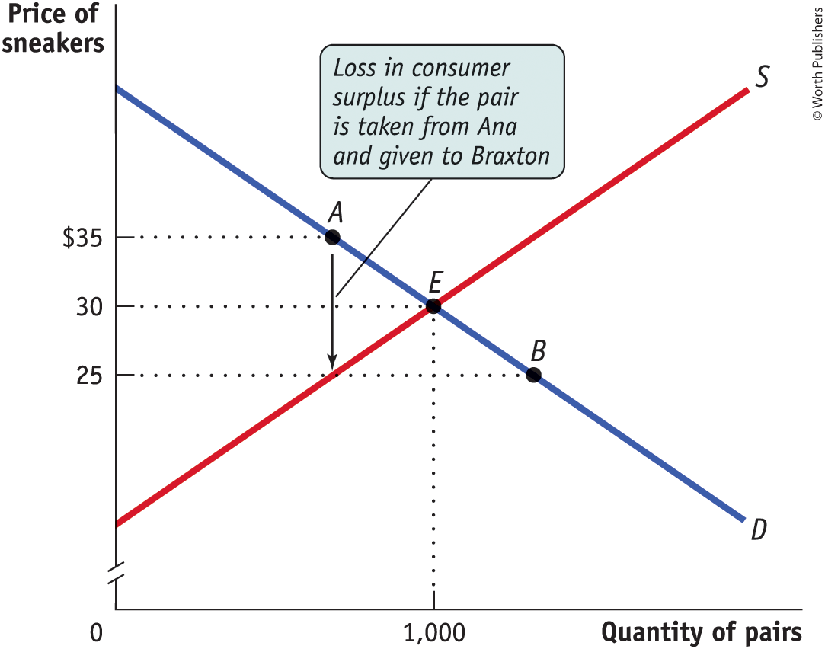
WHY REALLOCATING CONSUMPTION LOWERS CONSUMER SURPLUS
Figure 4-12
Everyone who buys a pair of sneakers at the market equilibrium has a willingness to pay of $30 or more, and everyone who doesn’t buy a pair of sneakers has a willingness to pay of less than $30.

Slide 31
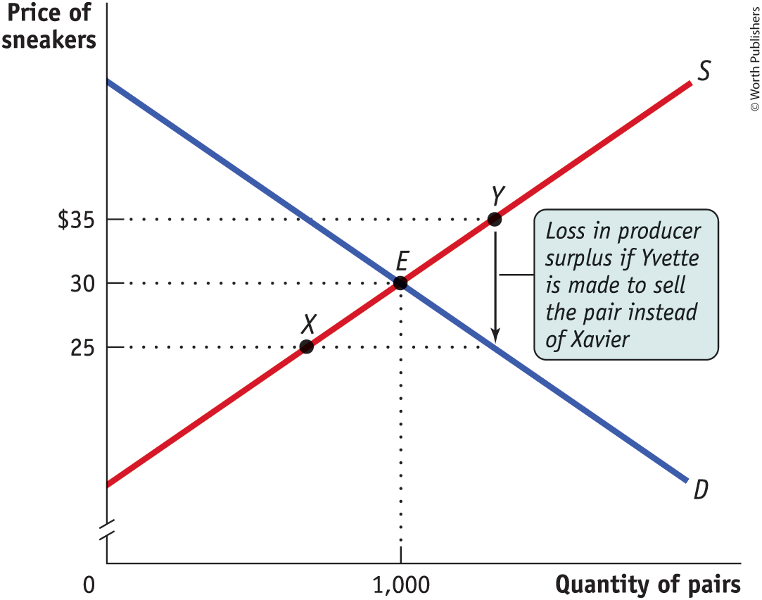
WHY REALLOCATING SALES LOWERS PRODUCER SURPLUS
Figure 13
Anyone who sells a pair of sneakers at the market equilibrium has a lower cost than anyone who keeps a pair of sneakers.

Slide 32
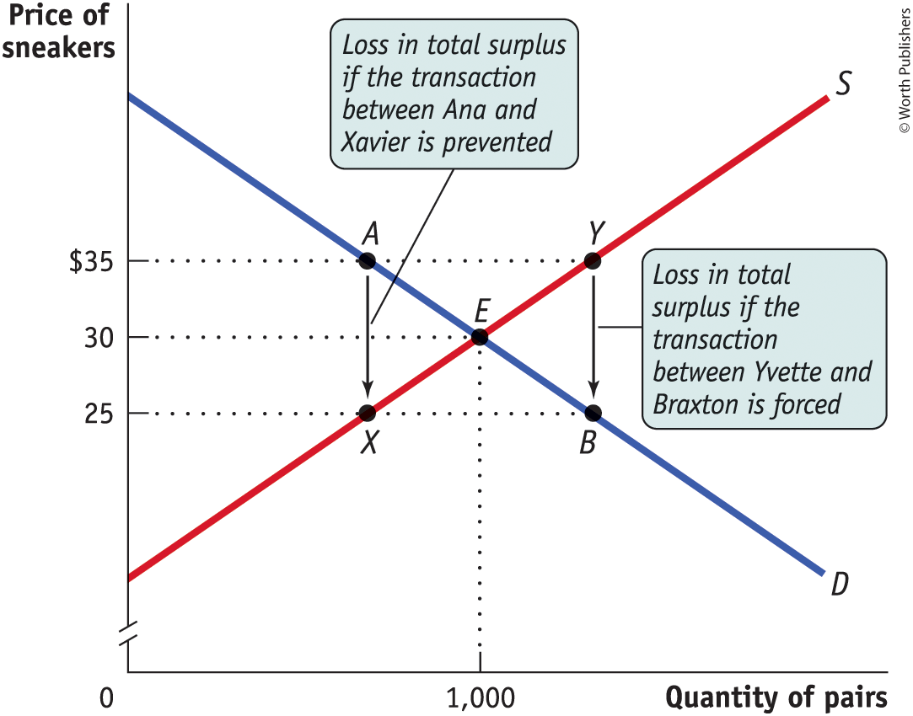
WHY CHANGING THE QUANTITY LOWERS TOTAL SURPLUS
Figure 14
Anyone who wouldn’t have bought a pair of sneakers has a willingness to pay of less than $30, and anyone who wouldn’t have sold a pair has a cost of more than $30.

Slide 33
THE EFFICIENCY OF MARKETS (2 of 3)
Competitive markets are usually efficient:
They allocate consumption of the good to the potential buyers who most value it.
They allocate sales to the potential sellers who most value the right to sell the good (e.g., who have the lowest cost).
They ensure that all transactions are mutually beneficial: Every consumer who makes a purchase values the good more than every seller who makes a sale.
They ensure that no mutually beneficial transactions are missed: Every potential buyer who doesn’t make a purchase values the good less than every potential seller who doesn’t make a sale.

Slide 34
THE EFFICIENCY OF MARKETS (3 of 3)
Three caveats to efficiency:
Although a market may be efficient, it isn’t necessarily fair.
Markets sometimes fail to deliver efficiency.
Even when the market equilibrium maximizes total surplus, this doesn’t mean that it results in the best outcome for every individual consumer or producer.

Slide 35
Leading companies in the world in 2023, by pre-tax income(in billion U.S. dollars)

Slide 36
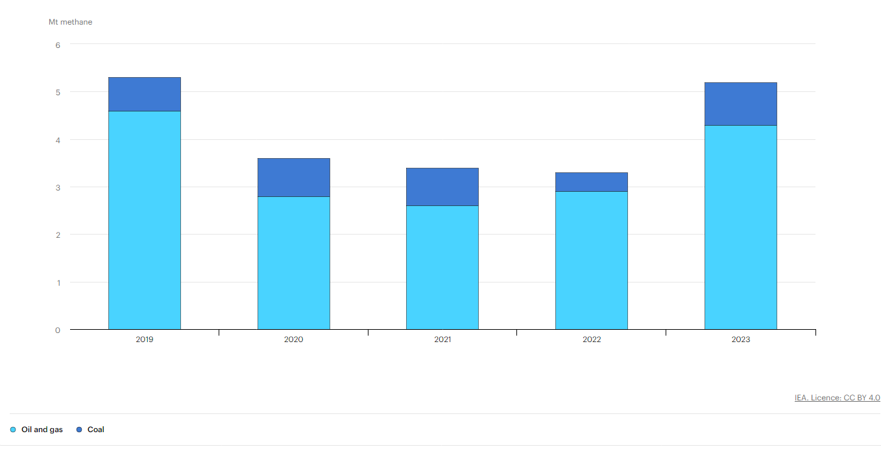
Production and use of fossil fuels put more than 120 million metric tons of methane into the atmosphere last year, a slight rise over 2022, (IEA, 2023).

Slide 37
EQUITY AND EFFICIENCY
Efficiency is important, but society also cares about equity.
Sometimes societies choose to have governments intervene in markets to increase equity, even though it reduces efficiency.

Slide 38

EQUITY AND EFFICIENCY
Covid -19: the high demand for vaccines can be resolved by expanding the global supply. However, slow vaccine production and the resultant low supply may lead to the rise of new and potentially more dangerous variants.
Solution: increasing vaccine production through the government waiving enforcement of vaccine patents held by major pharmaceutical companies like Pfizer, Moderna, and Johnson & Johnson.

Slide 39

EQUITY AND EFFICIENCY
Covid -19: “No matter which estimate we use, there are not enough ventilators for patients with COVID-19 in the upcoming months.” (Ranney et al., 2020)
Solution: US government invoked the Defense Production Act to push automotive manufacturers to partner with existing ventilator manufacturers to speed production. The FDA granted emergency use authorization for “splitters” to allow shared ventilation as well as for ventilators and ancillary equipment.

Slide 40
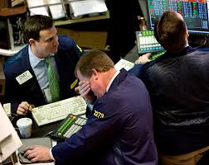
EQUITY AND EFFICIENCY
2008 Housing Crisis: The real causes of the housing and financial crisis were predatory private mortgage lending and unregulated markets.
Solution: The U.S. government announces it will seize control of federal mortgage insurers Fannie Mae and Freddie Mac, in what is considered Washington’s most dramatic intervention in the credit crisis to date.

Slide 41
WHY MARKETS TYPICALLY WORK SO WELL
Well-functioning markets are effective because of:
property rights.
economic signals.

Slide 42
WHY PRIVATE PROPERTY MATTERS
Property rights are the rights of owners of valuable items, whether resources or goods, to dispose of those items as they choose.
Private property rights create and protect incentives to trade with others and to innovate.

Slide 43


WHY PRIVATE PROPERTY MATTERS

Slide 44
LEARN BY DOING: PRACTICE QUESTION 2
In your opinion, which is the best way for society to distribute its goods? Why?
The free-market outcome should not be tampered with.
“From each according to their ability; to each according to their need.”
Distribute goods so that society’s total happiness is maximized, even if it requires taking some from the wealthiest to give to the poorest.

Slide 45
ECONOMIC SIGNALS
An economic signal is any piece of information that helps people make better economic decisions.
Prices are most important signals in a market economy because they convey information about other people’s costs and their willingness to pay.

Slide 46
What Experts See In Economic Signals For 2024
Claims for unemployment benefits through February reached approximately 1.9 million (up from 1.7M in 2023).
The Federal Reserve will likely cut interest rates before the end of the first half if the unemployment rate edges up to around 4% from its recent 3.7%.
The leading indicators are a way to see the future of the economy (12 components, including housing starts and new business orders). A reading above 50 indicates a future expansion; below 50 means a contraction.
  In 2022 the average monthly reading was 39, clearly a bad sign. However, in the year through December (the latest available figures at press time) the reading averaged 58.

Slide 47
LEARN BY DOING: DISCUSS (2 of 2)
Think, pair, share:
  Discuss with your neighbor “price gouging” (a sudden price increase) during natural disasters.
  Discuss why, although morally questionable, price gouging can increase consumer surplus.
  Stories of price gouging in Florida after Hurricane Matthew made headlines in 2016 when prices for gas, hotels, water, and other essentials skyrocketed during a declared state of emergency. The same issue arose in Texas following Hurricane Harvey in 2017.

Slide 48
A FEW WORDS OF CAUTION
Markets aren’t always efficient; sometimes they fail.
When markets are inefficient, there are missed opportunities. Some people could be made better off without making other people worse off.
When a market is inefficient, we have a market failure:
Markets can fail due to market power when a firm has the ability to raise the market price.
Markets can fail due to externalities when actions have side effects on the welfare of others.
Markets can fail when the nature of the good makes it unsuitable for efficient allocation by a market: public goods, common resources, and private information.
We’ll learn more about market failures later.

Slide 49
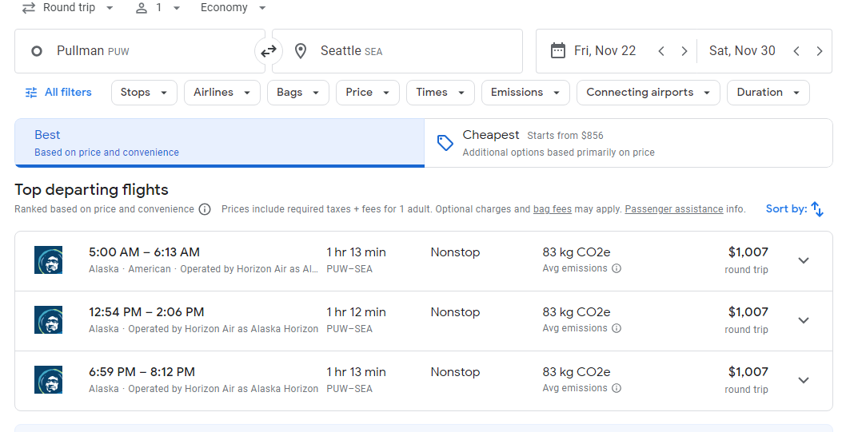
A FEW WORDS OF CAUTION
Markets can fail due to market power when a firm has the ability to raise the market price.

Slide 50
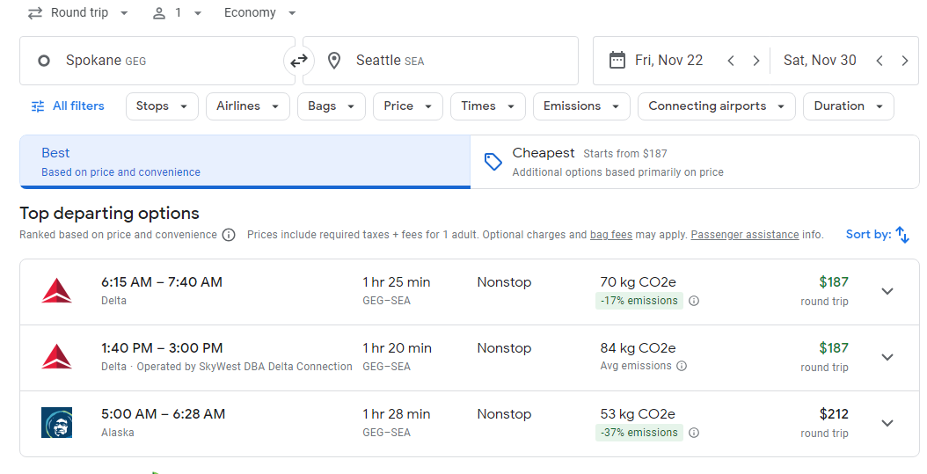
A FEW WORDS OF CAUTION
Markets can fail due to market power when a firm has the ability to raise the market price.

Slide 51
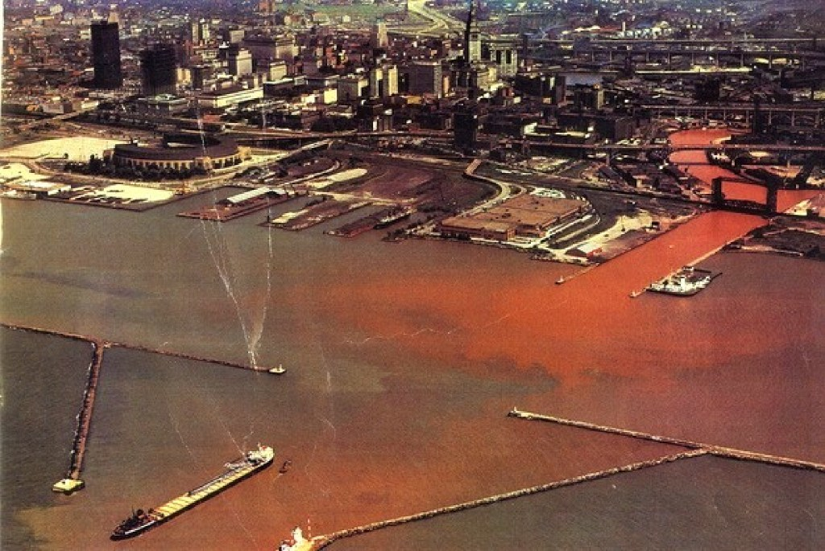
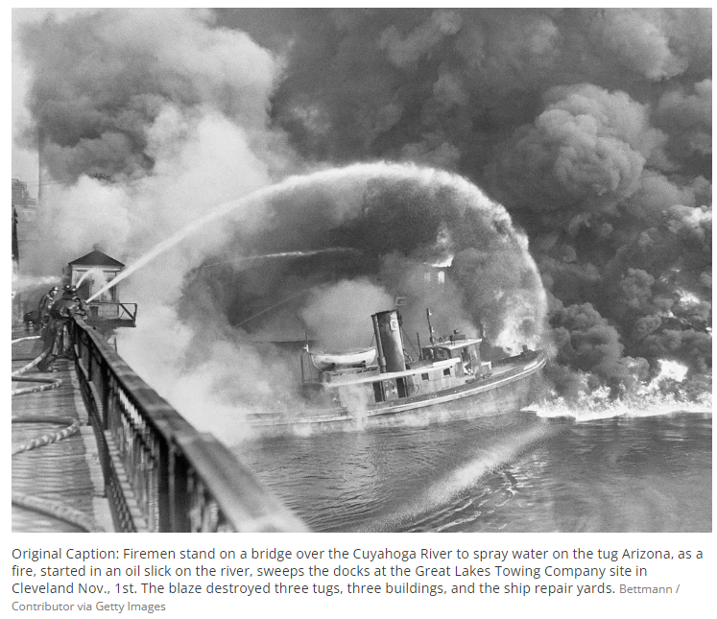
A FEW WORDS OF CAUTION
Cuyahoga River Fire: In 1969, the Cuyahoga River in Cleveland, Ohio caught fire due to pollution from industrial waste. The incident spurred environmental activism and led to the creation of the Environmental Protection Agency.

Slide 52
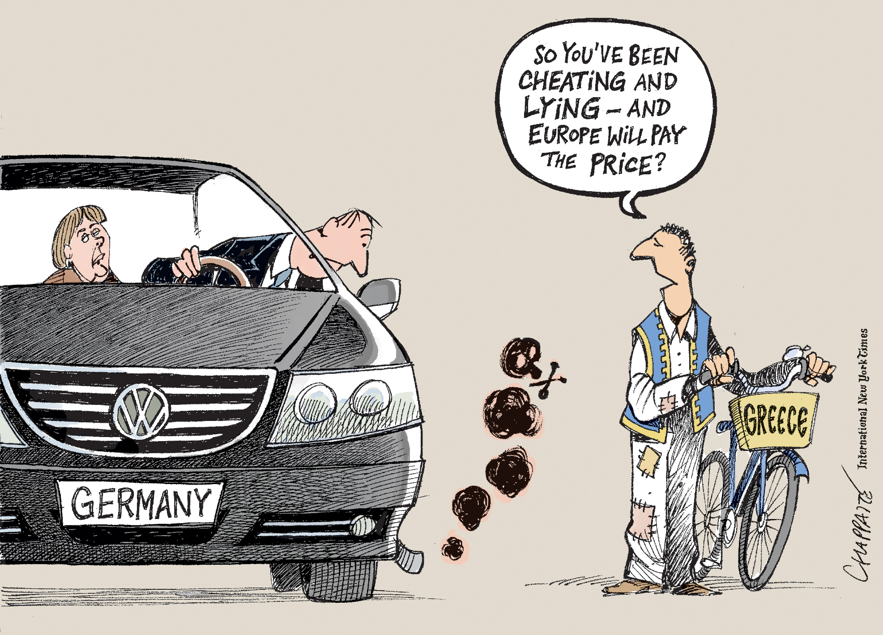

A FEW WORDS OF CAUTION
Volkswagen Emissions Scandal: In 2015, Volkswagen was found to have installed software in its diesel cars that allowed them to cheat on emissions tests. Volkswagen paid over $25 billion in settlements.

Slide 53
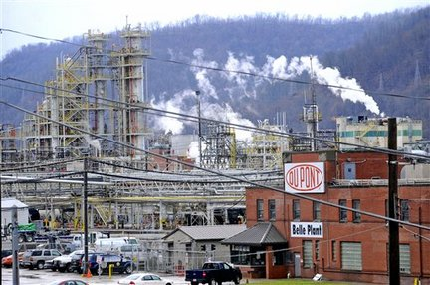
A FEW WORDS OF CAUTION
DuPont Chemical leak: In 2014, a chemical leak at a DuPont plant in West Virginia contaminated the drinking water of over 300,000 people. DuPont paid over $670 million in settlements.

Slide 54
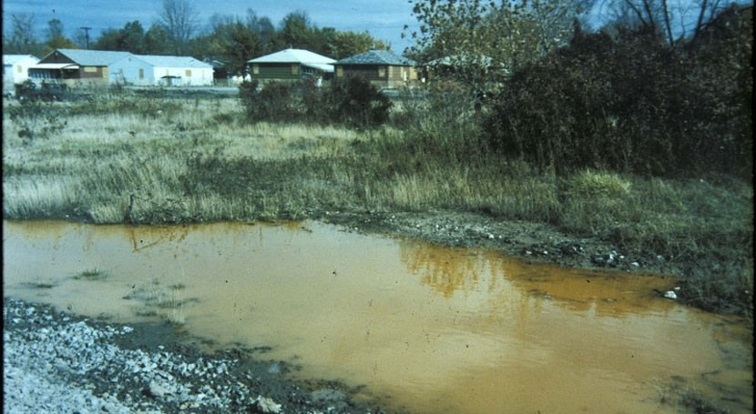
A FEW WORDS OF CAUTION
Love Canal: Occidental Petroleum dumped 21,000 tons of toxic waste into the Love Canal in Niagara Falls, New York, causing widespread contamination and birth defects. Occidental Petroleum paid over $130 million in settlements.

