Slide 1

Supply and Demand
3
Notes:
Cover Credits: Currency Exchange Stock Chart: cemagraphics/Getty Images, Social Media Montage: SEAN GLADWELL/Getty Images, Circuit Pattern: somsak Tangdamrongsub/Getty Images, Cargo Containers: urzine/Getty Images

Slide 2
Important!
Start working on Assignment #2 (Due on September 4th).
Quiz #2 (Chapter 1 and 2) is due on September 8th.
After Chapter 3 you can start working on the Writing Assignment (Due on September 19th).

Slide 3
WHAT YOU WILL LEARN IN THIS CHAPTER
What is a competitive market?
What are supply and demand curves?
How do supply and demand curves lead to an equilibrium price and equilibrium quantity in the market?
What are shortages and surpluses and why do price movements eliminate them?

Slide 4
COMPETITIVE MARKETS
A competitive market has many buyers and sellers of the same good or service, none of whom can influence the price.
The supply and demand model is a model of how a competitive market behaves.
The five key elements of this model:
  The demand curve
  The supply curve
  Factors that shift the demand curve and factors that shift the supply curve
  The market equilibrium
  Changes in the market equilibrium

Slide 5
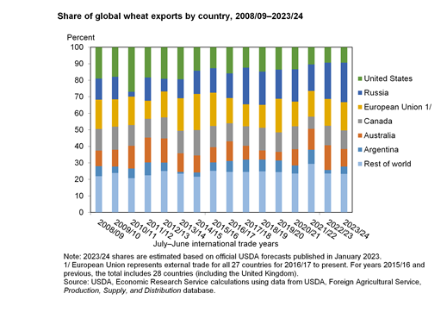
Examples

Slide 6
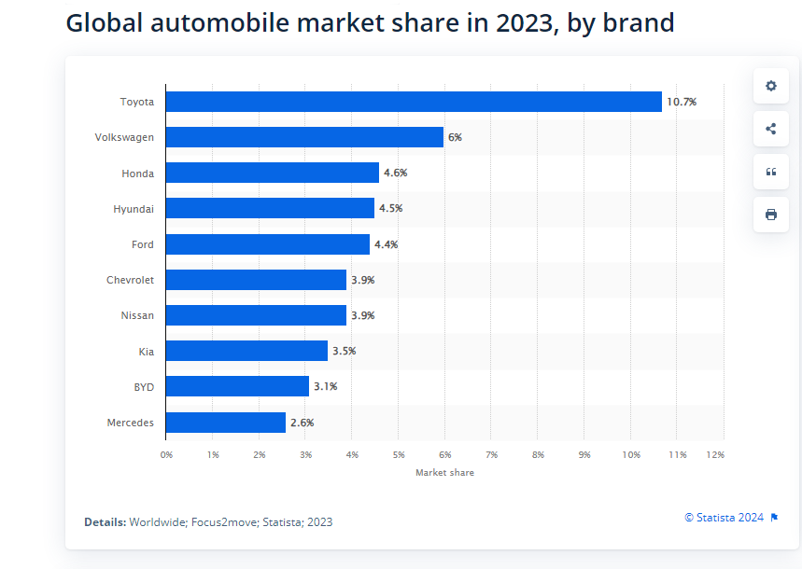
Examples

Slide 7
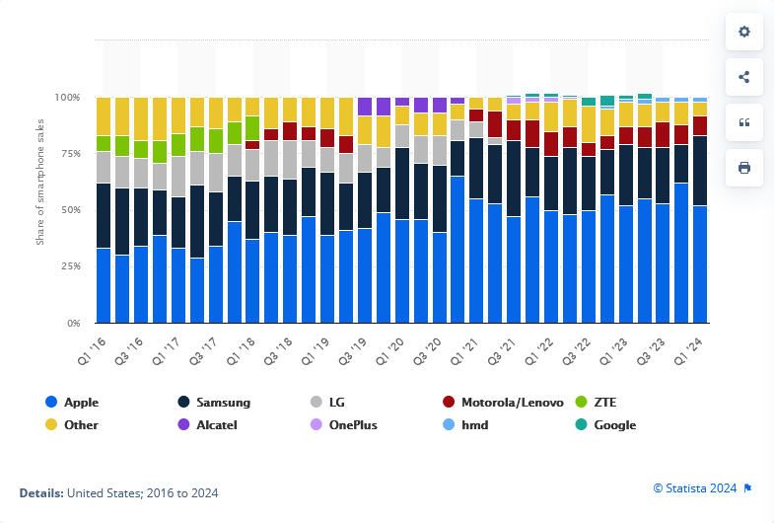
Examples

Slide 8
SUPPLY
Supply represents the behavior of sellers.
A supply schedule shows how much of a good or service would be supplied at different prices.
A supply curve shows the quantity supplied at various prices.
The quantity supplied is the quantity that producers are willing and able to sell at a particular price.

Slide 9
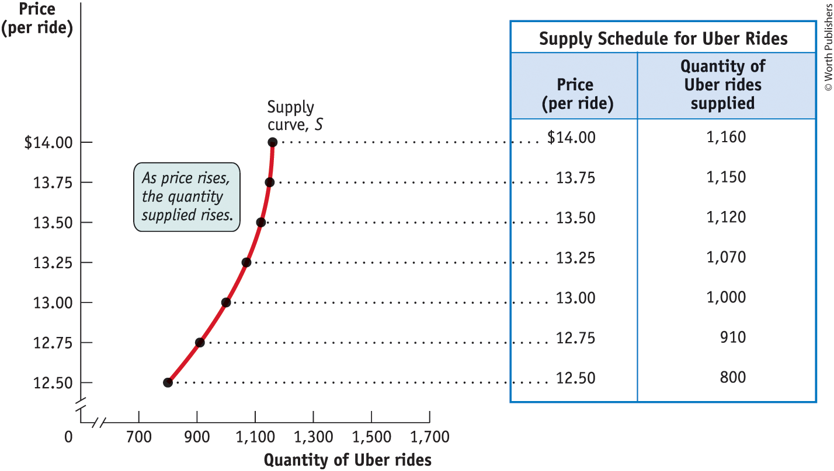
THE SUPPLY SCHEDULE
AND THE SUPPLY CURVE
Figure 1

Slide 10
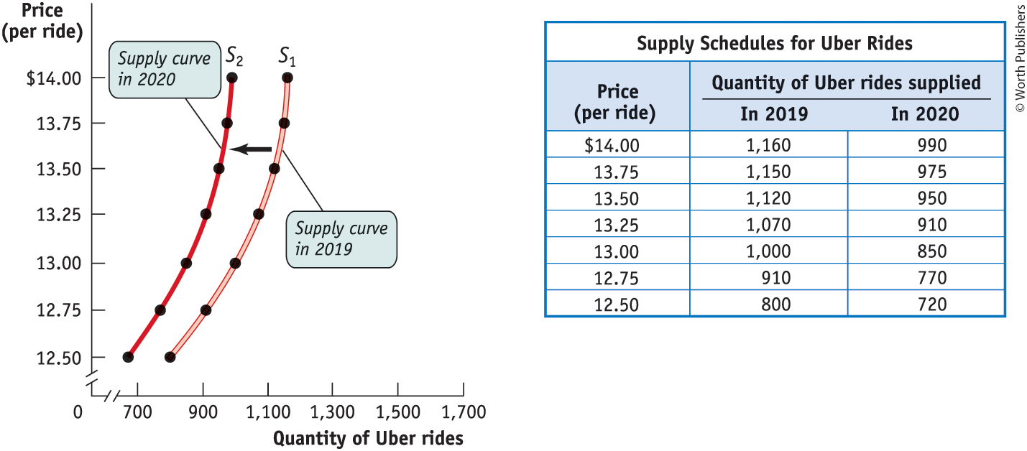
SHIFTS OF THE SUPPLY CURVE PART 1
Figure 2

Slide 11
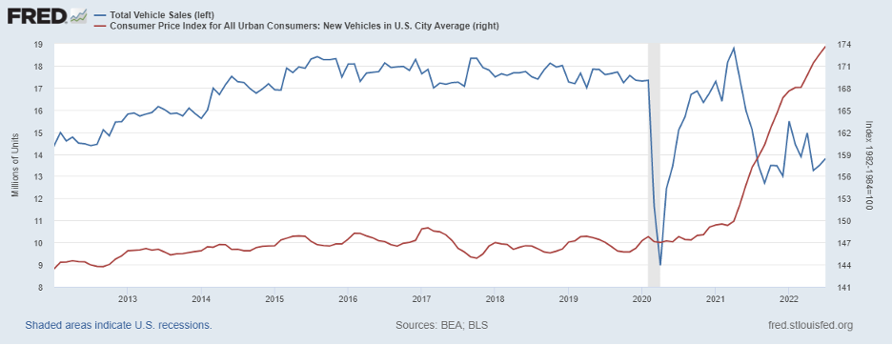
SHIFTS OF THE SUPPLY CURVE PART 1

Slide 12
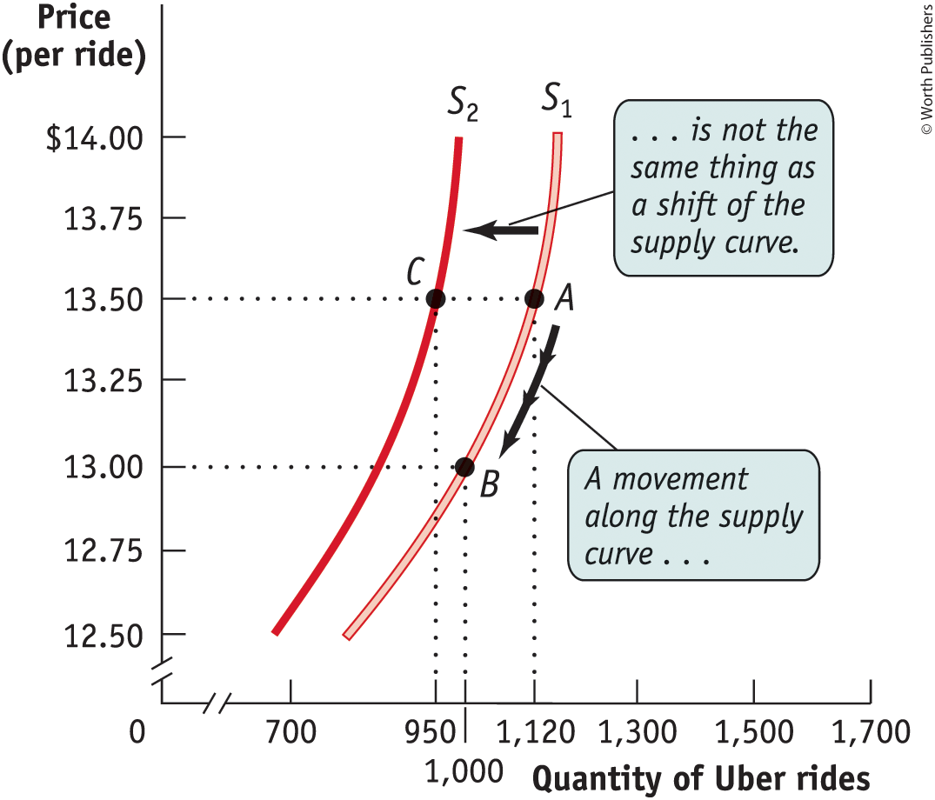
MOVEMENT ALONG THE SUPPLY CURVE VERSUS SHIFT OF THE SUPPLY CURVE
Figure 3

Slide 13
UNDERSTANDING SHIFTS OF THE SUPPLY CURVE
Important supply shifters include changes in:
  input prices.
  the prices of related goods or services.
  technology.
  expectations.
  the number of producers.

Slide 14
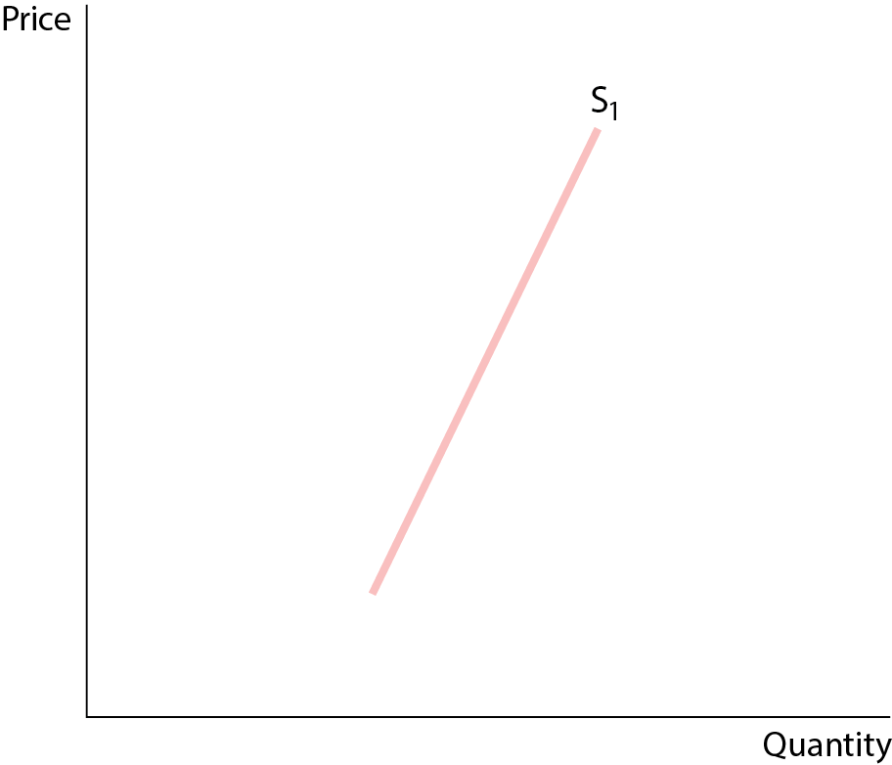
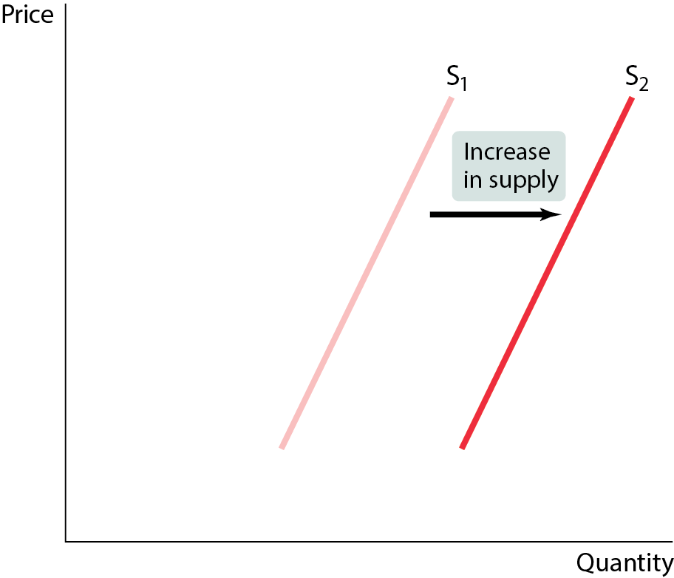
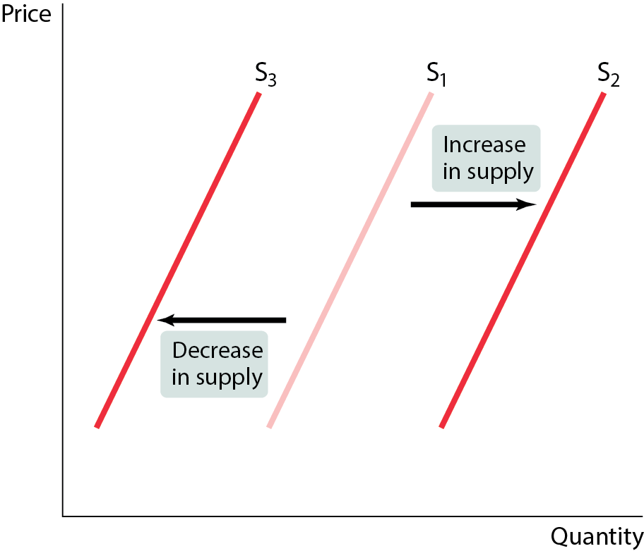
SHIFTS OF THE SUPPLY CURVE PART 2
Figure 4
A rightward shift of the supply curve means an increase in supply.
A leftward shift of the supply curve means a decrease in supply.

Slide 15
CHANGES IN INPUT PRICES
An increase in the price of an input makes the production more costly for sellers. Supply decreases.
A fall in the price of an input makes the production less costly for sellers. Supply increases.
  What will happen to the number of new businesses if the government reduces the fees and red tape associated with new business licenses? What happens if the fees rise?

Slide 16
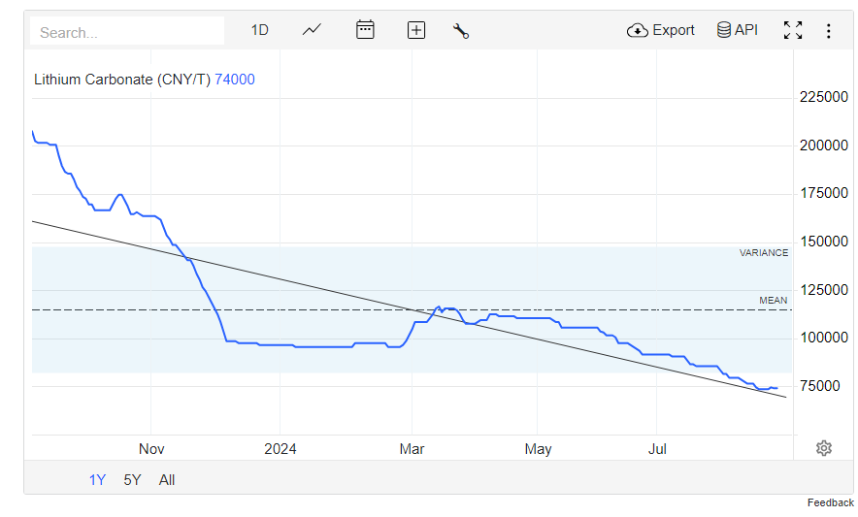
Input Prices

Slide 17
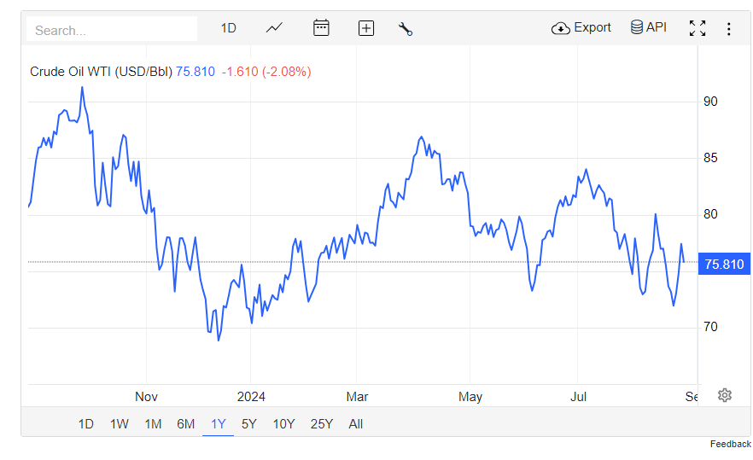
Input Prices

Slide 18
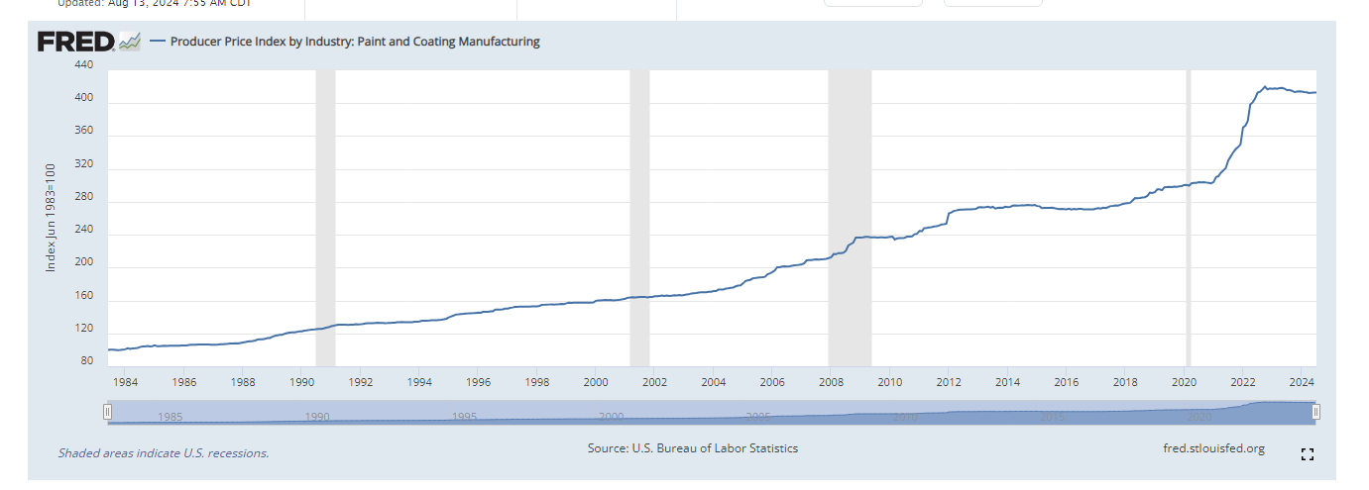
Input Prices

Slide 19
CHANGES IN PRICES OF RELATED GOODS
Inputs used in production have opportunity costs. Sellers will choose to use inputs whose profit is the highest.
  Sellers will supply less of a good if its profitability falls, and vice versa.
  There are substitutes and complements in production processes.
  Complement in pork processing? Lard.
  Substitute in corn production? Cotton.
What will happen to supply and the supply curve if the price of lard/cotton changes?

Slide 20
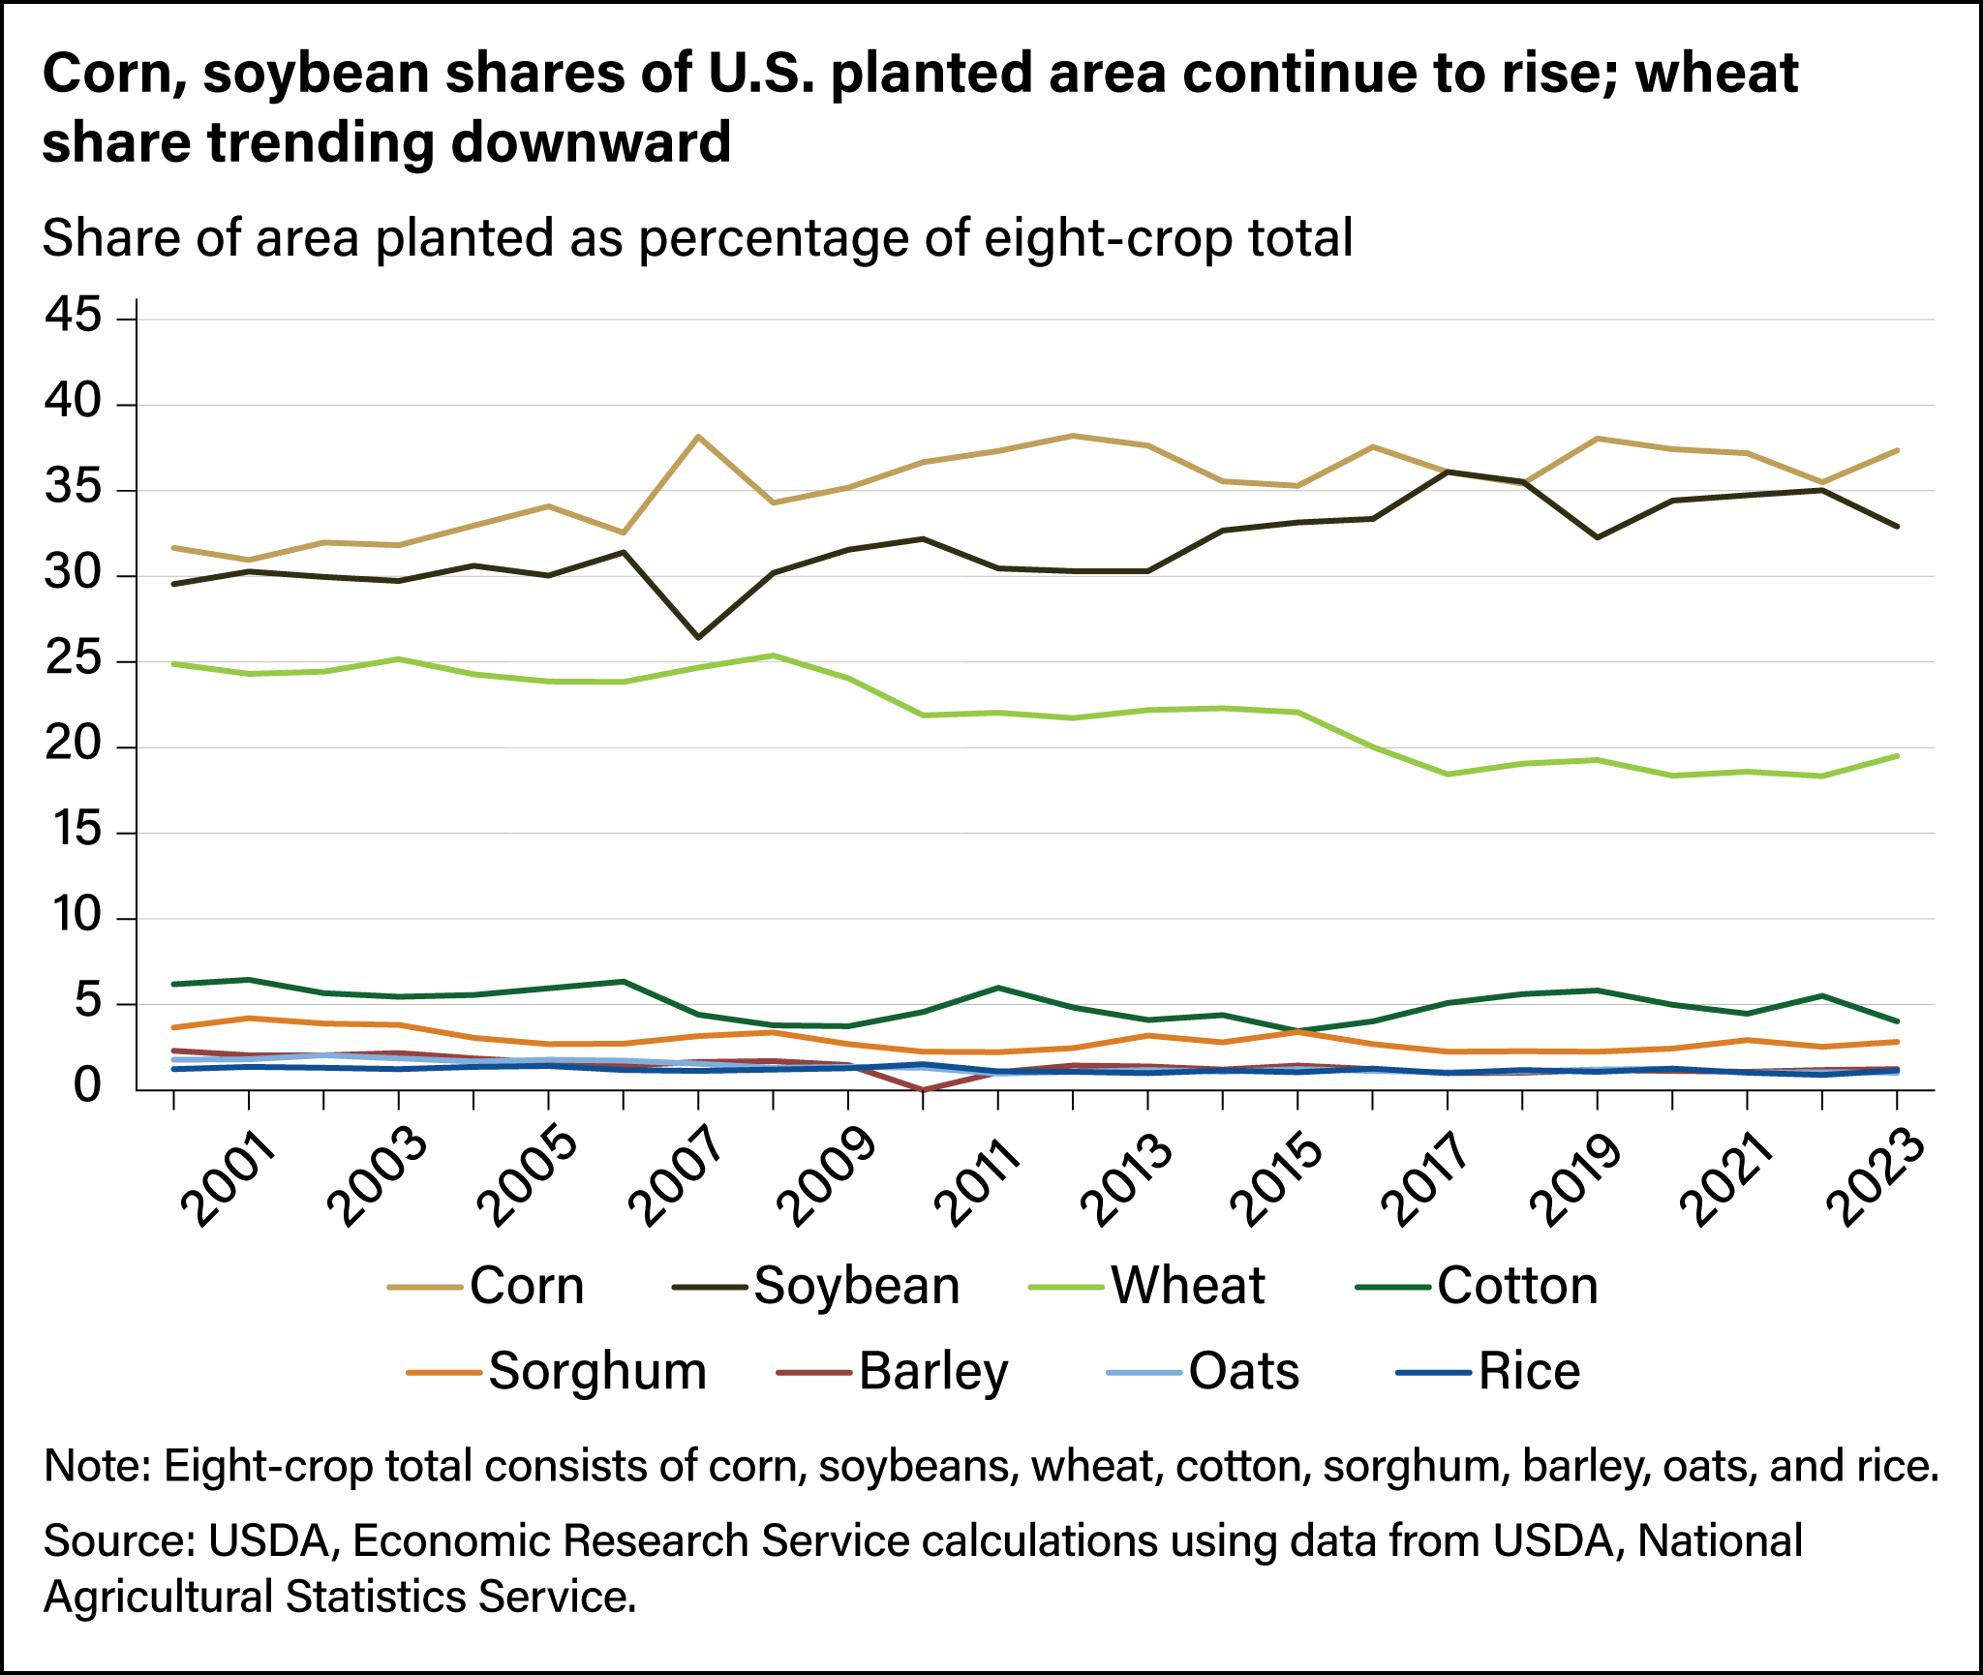
CHANGES IN PRICES OF RELATED GOODS

Slide 21
CHANGES IN TECHNOLOGY
New, better technology enables producers to spend less on inputs, yet still produces the same amount of output.
Supply increases.
What will happen to supply and the supply curve for a certain good if the underlying technology for producing it improves?

Slide 22

CHANGES IN TECHNOLOGY
Robotics, drones and AI are revolutionizing tasks like seeding, weeding and harvesting. They frequently offer more efficient and precise alternatives to traditional farming methods.

Slide 23
CHANGES IN EXPECTATIONS
The expectation of a higher price for a good in the future decreases current supply of the good—if sellers can store the good (and vice versa).
  Sellers will adjust their current offerings in anticipation of the direction of future prices to obtain the highest possible price.
What will happen to the supply and supply curve if there is an increase/decrease in the expectation of future prices?

Slide 24

CHANGES IN EXPECTATIONS

Slide 25
CHANGES IN NUMBER OF PRODUCERS
As producers enter and exit the market, the overall supply changes.
  Entry implies more sellers in the market, increasing supply.
  Exit implies fewer sellers in the market, decreasing supply.
    As more firms enter the solar installation market, the number of solar installations available for sale increases.
    What will be the impact of this on the supply and supply curve?

Slide 26
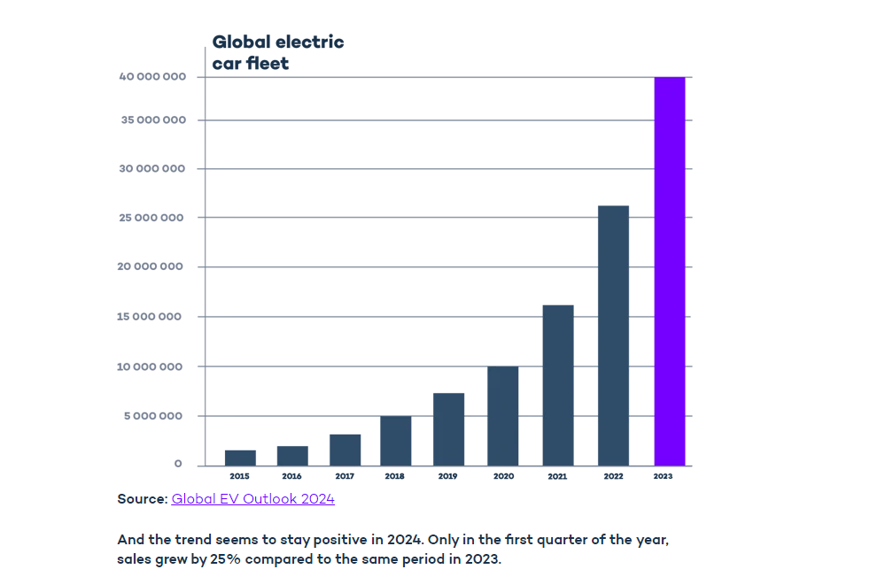
CHANGES IN NUMBER OF PRODUCERS

Slide 27
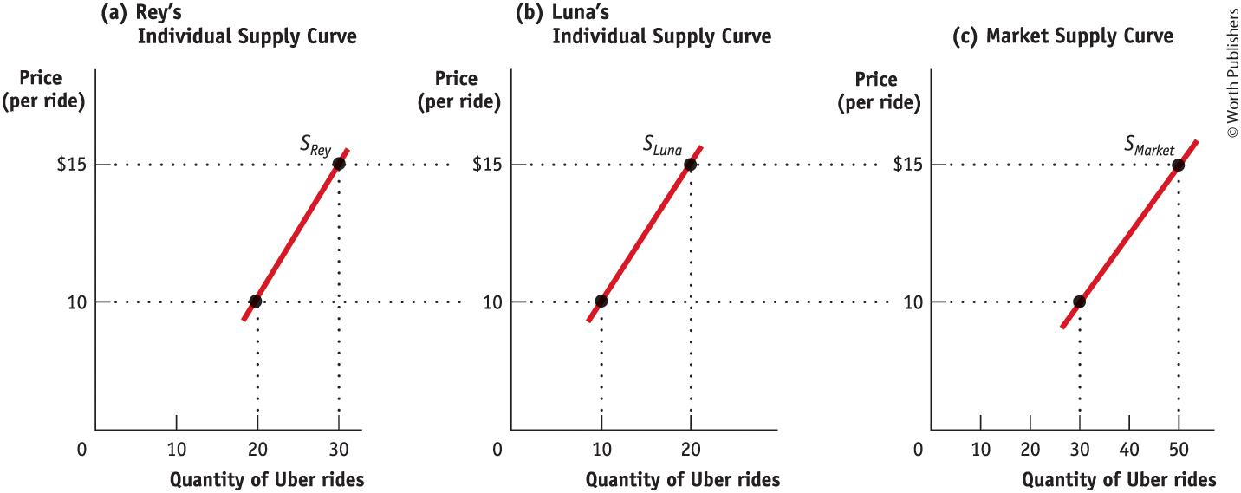
THE INDIVIDUAL SUPPLY CURVE AND THE MARKET SUPPLY CURVE
The market supply curve is the horizontal sum of the individual supply curves of all producers. (Figure 5)

Slide 28
DEMAND
Demand represents the behavior of buyers.
A demand schedule is a table showing how much of a good or service consumers will want to buy at different prices.
A demand curve shows the quantity demanded at various prices.
The quantity demanded is the quantity that buyers are willing (and able) to purchase at a particular price.
The law of demand: a higher price for a good leads people to demand a smaller quantity of that good, other things equal.

Slide 29
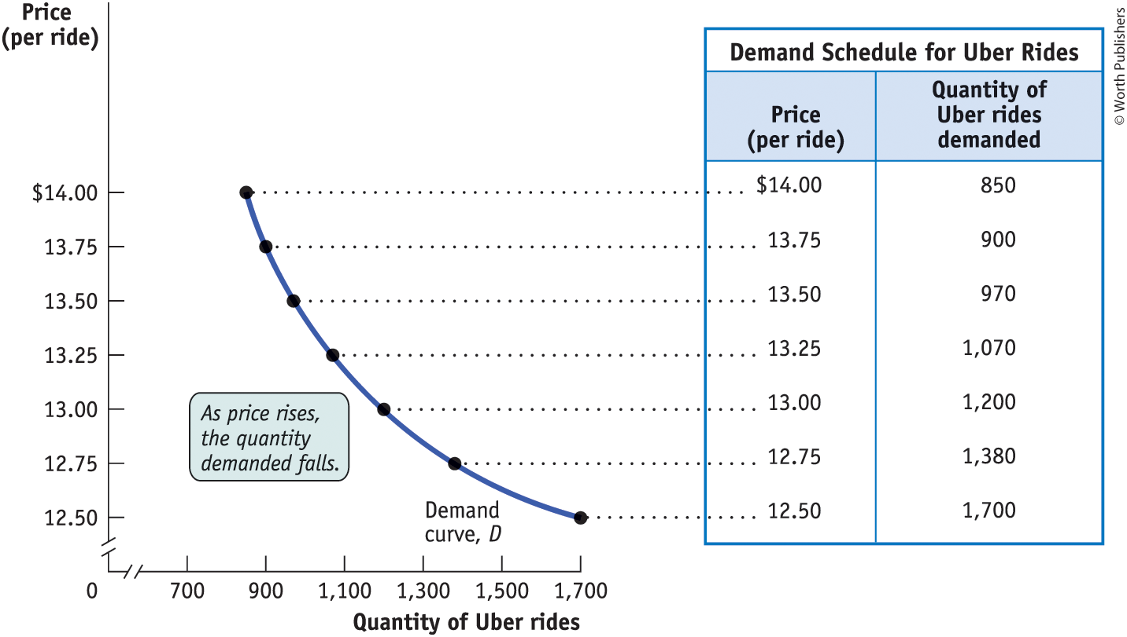
THE DEMAND SCHEDULE AND THE DEMAND CURVE
Figure 6

Slide 30
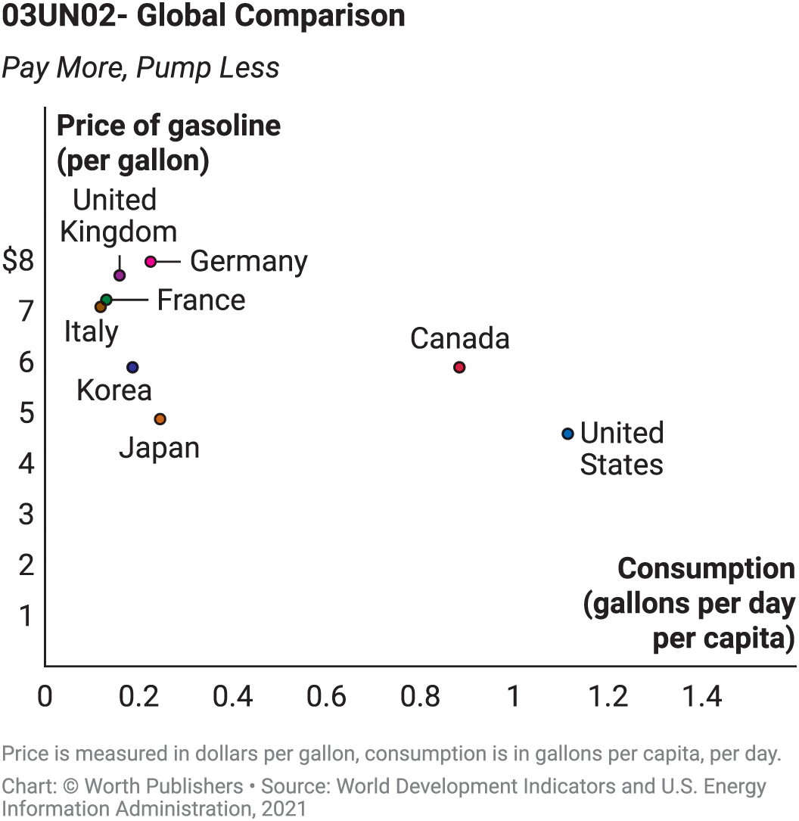
GLOBAL COMPARISON: PAY MORE, PUMP LESS
A real-world illustration of the law of demand: because of higher prices, Europeans buy less gasoline than Americans.

Slide 31
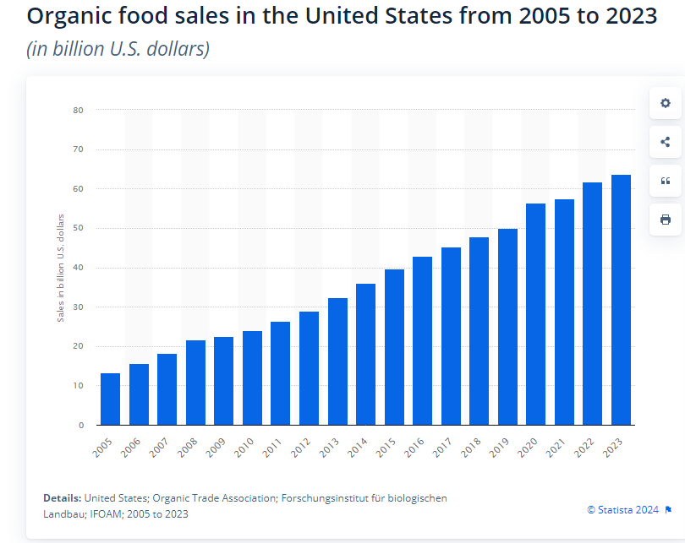
Pay less, eat more

Slide 32
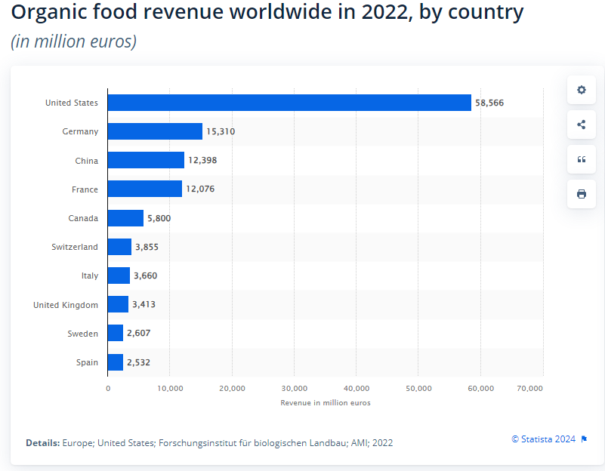
Pay less, eat more

Slide 33
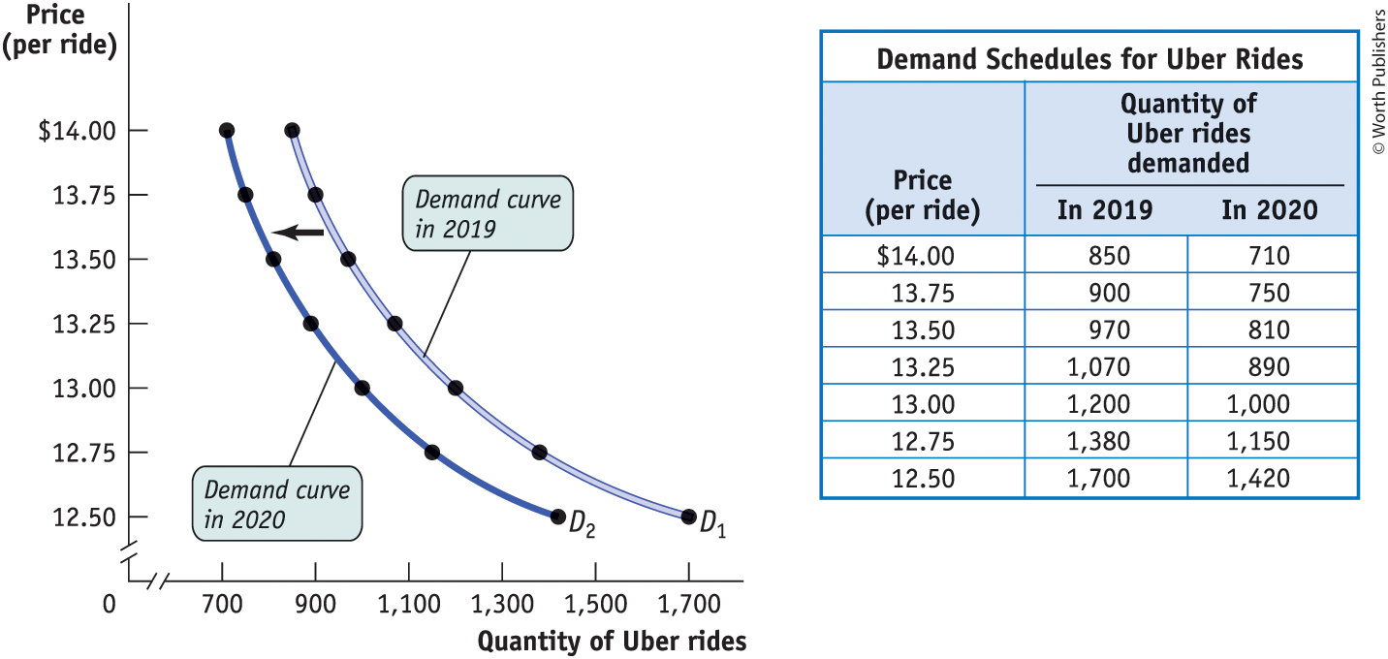
AN INCREASE IN DEMAND
A rightward shift of the demand curve means an increase in demand.
A leftward shift of the demand curve means a decrease in demand.
Figure 7

Slide 34
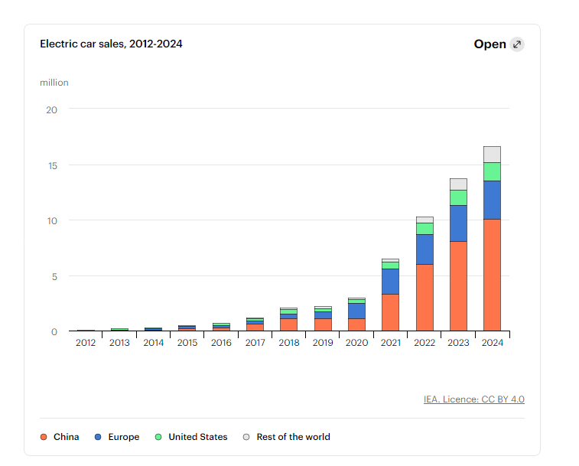
AN INCREASE IN DEMAND

Slide 35
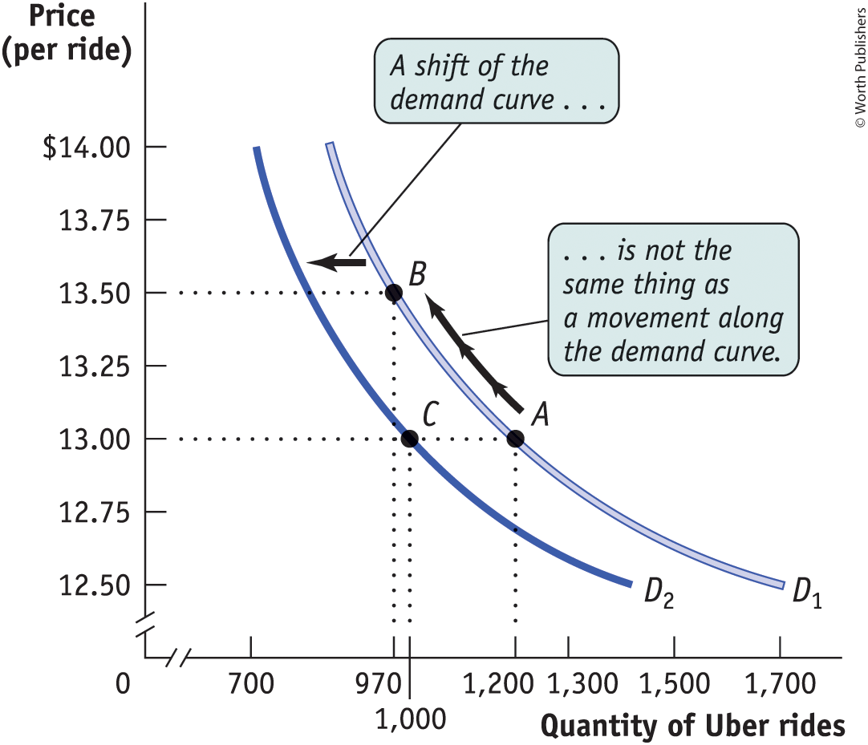
A MOVEMENT ALONG VERSUS A SHIFT
IN DEMAND
Figure 8
When price alone changes, there is movement along a demand curve.
When the demand shifts, people are buying more (or less) at every price.

Slide 36
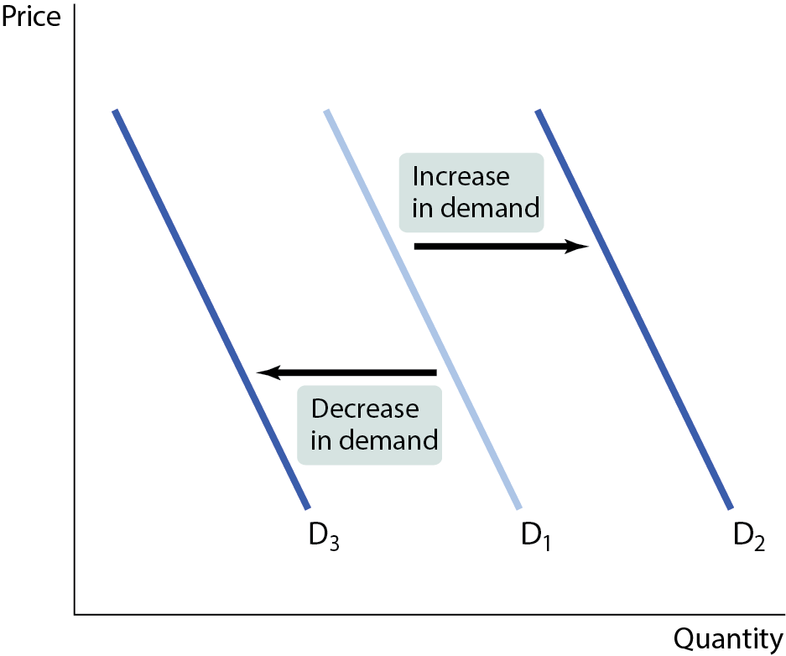
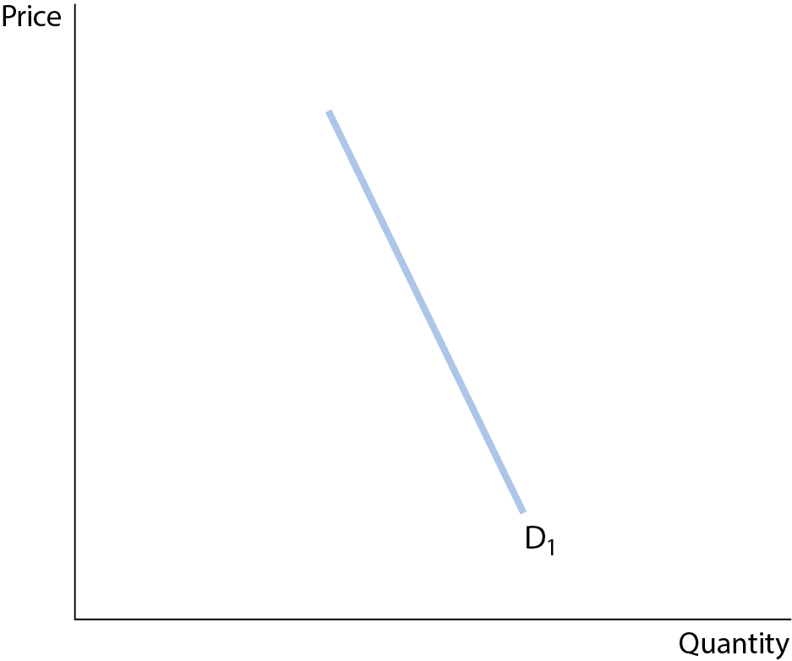
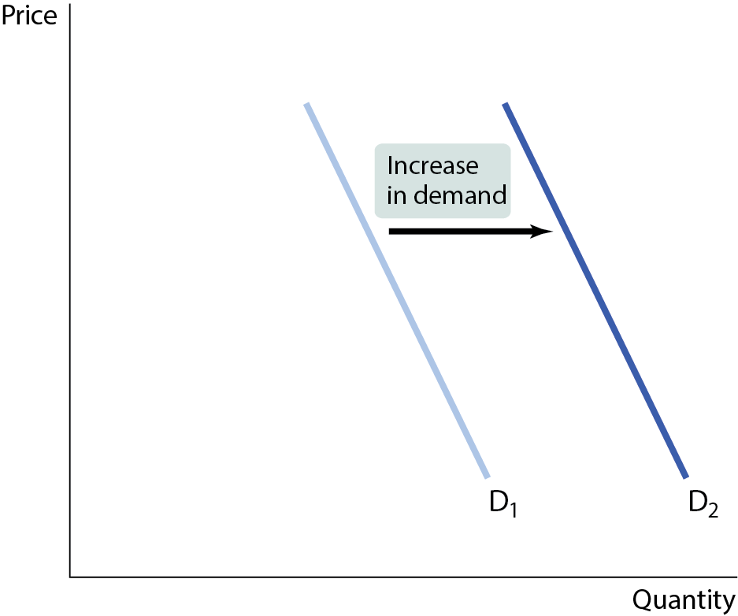
GRAPHING SHIFTS OF THE DEMAND CURVE
Five factors that shift the demand curve:
Changes in the prices of related goods or services
Changes in income
Changes in tastes
Changes in expectations
Changes in the number of consumers
Figure 9

Slide 37
CHANGES IN PRICE OF RELATED GOODS: SUBSTITUTES
Two goods are substitutes if a decrease in the price of one leads to a decrease in demand for the other (or vice versa).
Substitutes usually serve a similar function: coffee and tea, muffins and doughnuts, train rides and air flights.
What happens to demand and the demand curve if P of a substitute increases/decreases?

Slide 38

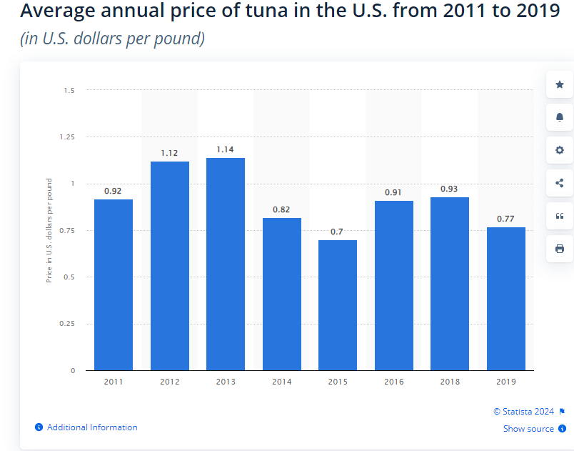
SUBSTITUTES
Salmon prices for 2019 took a dip for all but sockeyes, which averaged $1.45 per pound

Slide 39
CHANGES IN PRICE OF RELATED GOODS: COMPLEMENTS
Two goods are complements if a decrease in the price of one good leads to an increase in the demand for the other (or vice versa).
Complements are usually consumed together: smartphones and apps, cars and gasoline.
What happens to demand and the demand curve if P of a complement increases/decreases?

Slide 40
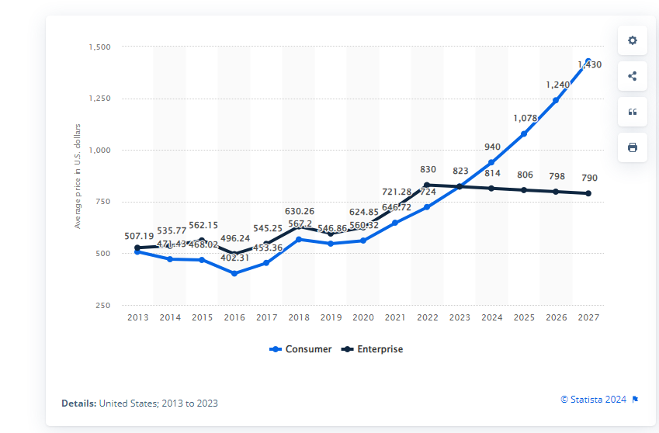
Average price of smartphones in the United States from 2013 to 2027, by segment (in U.S. dollars)

Slide 41
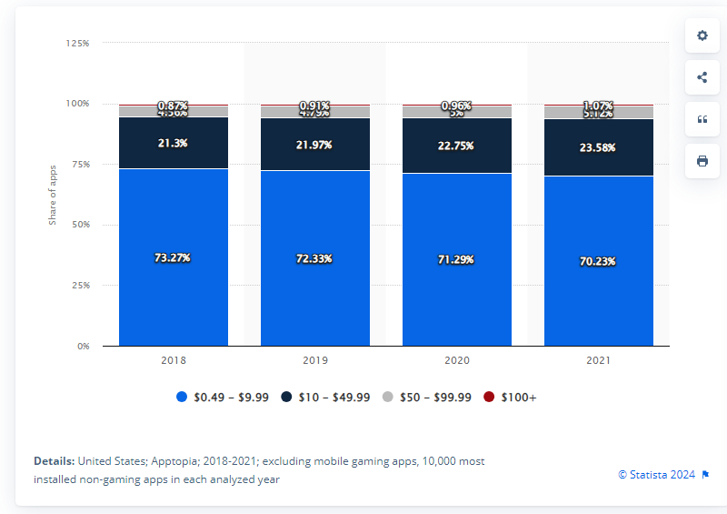
Distribution of in-app purchase prices on the Apple App Store in the US from 2018 to 2021

Slide 42
CHANGES IN INCOME
The effect of changes in income on demand depends on the nature of the good in question.
  A normal good: Demand increases when income increases.
  An inferior good: Demand decreases when income increases.
What happens to demand and the demand curve if income increases/decreases?

Slide 43
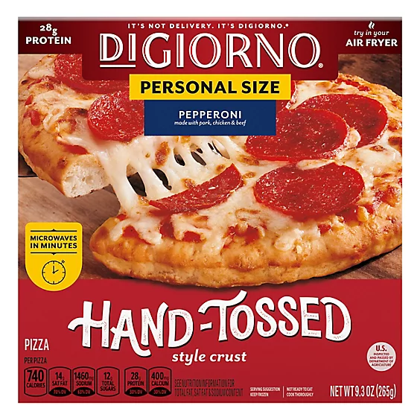
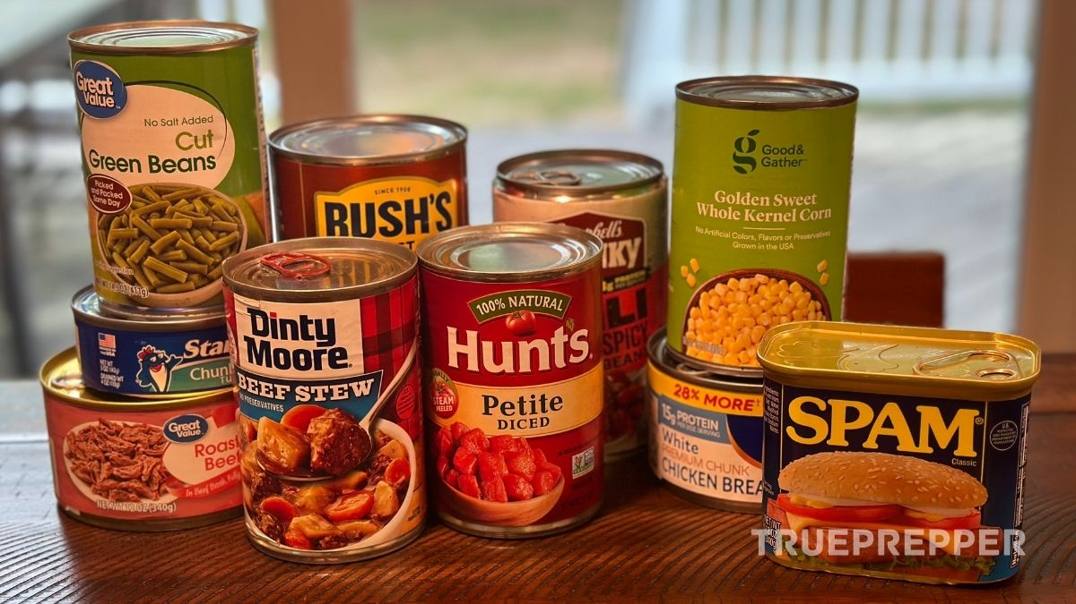
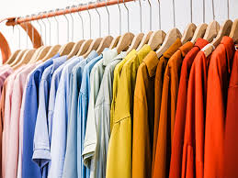

Inferior or Normal?

Slide 44
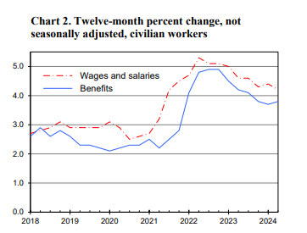
Changes in Income
Source: Bureau of Labor Statistics

Slide 45

CHANGES IN TASTES
Tastes and preferences are subjective and vary among consumers.
  Seasonal changes or fads have predictable effects on demand.
  What happens to demand for boots in October?

Slide 46
CHANGES IN EXPECTATIONS (1 of 2)
If consumers have a choice about the timing of a purchase, they buy according to expectations.
Buyers adjust current spending in anticipation of the direction of future prices in order to obtain the lowest possible price.
    If prices for the newest Xbox consoles are expected to drop right before Christmas, what will happen to sales during November?

Slide 47
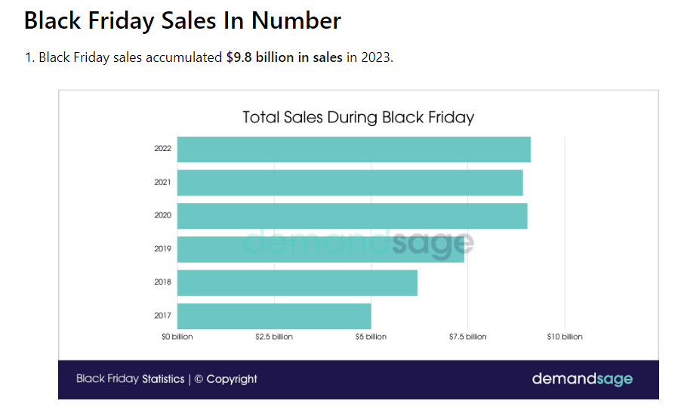
CHANGES IN EXPECTATIONS

Slide 48
CHANGES IN EXPECTATIONS
US consumers spent $9.8 billion on Black Friday in 2023 (an increase of 7.5% compared to 2022).
The online sale of the toys increased by 285% on Black Friday, compared to a normal day.
Sales of audio and electronic equipment increased by 200% compared to an average day.
Each consumer spends $256 on Black Friday and Cyber Monday combined.
US ranks in 8th position for per-person spending during this period. China leads the list with $483 per person spending, and Denmark follows by $262.

Slide 49
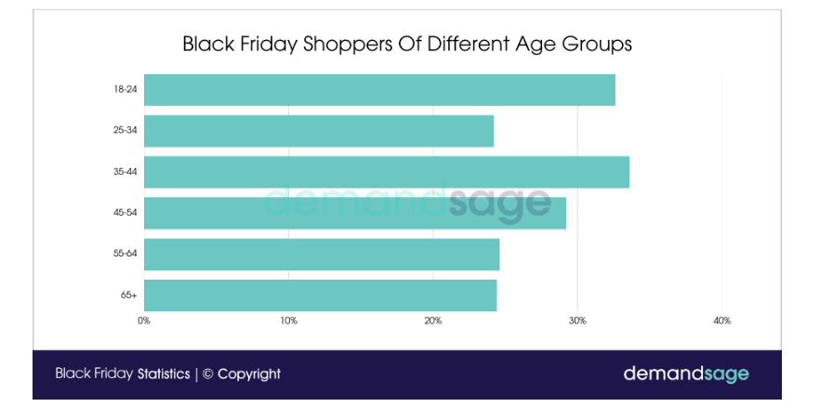
CHANGES IN EXPECTATIONS

Slide 50
LEARN BY DOING: PRACTICE QUESTION 1
When the price of petroleum goes up, the demand for solar power _____, and the demand for cars _____.
increases; increases
increases; decreases
decreases; increases
decreases; decreases

Slide 51
LEARN BY DOING: PRACTICE QUESTION 1
(ANSWER)
When the price of petroleum goes up, the demand for solar power _____, and the demand for cars _____.
increases; increases
increases; decreases (correct answer)
decreases; increases
decreases; decreases

Slide 52
CHANGES IN THE NUMBER OF CONSUMERS
As the population of an economy changes, the number of buyers of a particular good also changes, thereby changing its demand.
  What happens to the demand for diapers in Russia as birth rates drop?

Slide 53
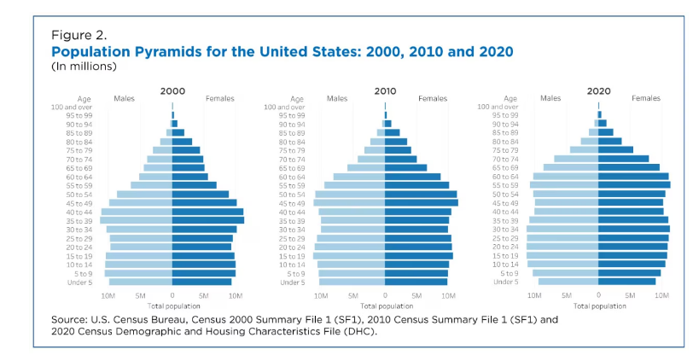
CHANGES IN THE NUMBER OF CONSUMERS

Slide 54
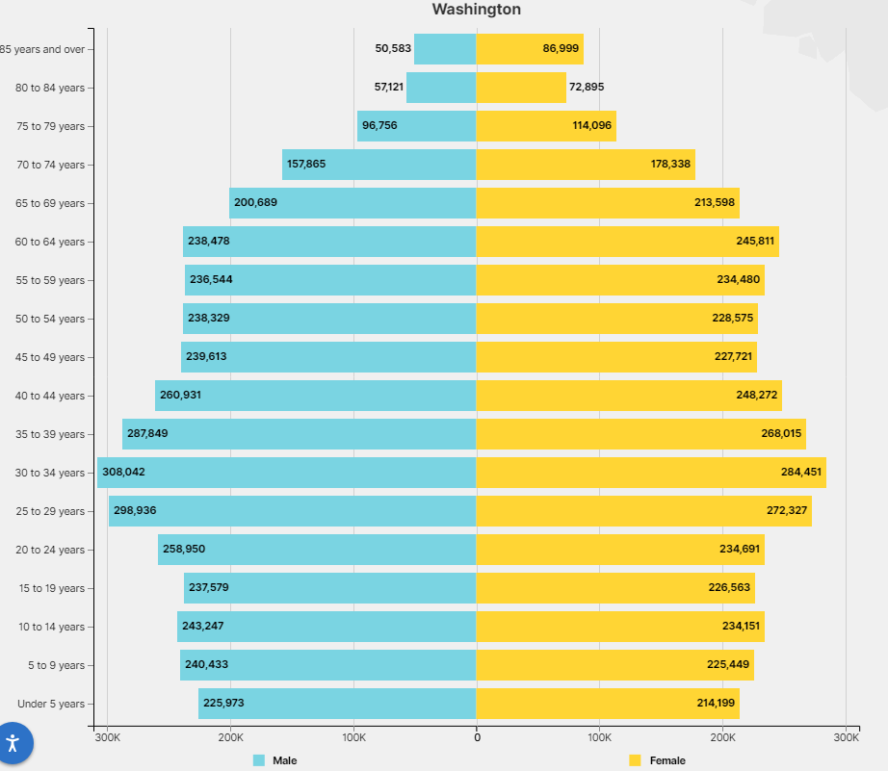
CHANGES IN THE NUMBER OF CONSUMERS

Slide 55
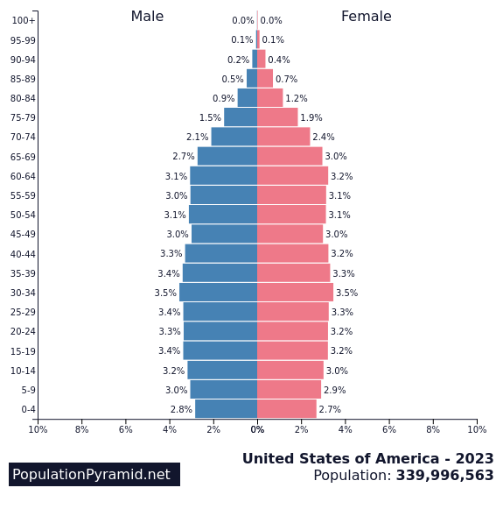
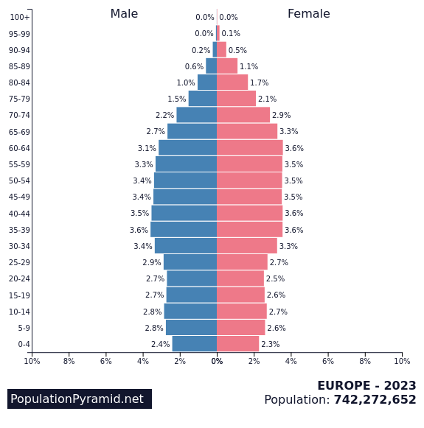
CHANGES IN THE NUMBER OF CONSUMERS

Slide 56
LEARN BY DOING: PRACTICE QUESTION 2
Which of the following will cause an increase in the demand for autos?
  Price of car tires increases because of a Malaysian rubber shortage.
  Concrete steel reinforcing rods are replaced by aluminum along the Atlantic coast to prevent rusting.
  Gasoline prices drop by 50% when OPEC nations increase production.
  McDonald’s increases its hamburger production in response to consumer trends.

Slide 57
LEARN BY DOING: PRACTICE QUESTION 2
(ANSWER)
Which of the following will cause an increase in the demand for autos?
  Price of car tires increases because of a Malaysian rubber shortage.
  Concrete steel reinforcing rods are replaced by aluminum along the Atlantic coast to prevent rusting.
  Gasoline prices drop by 50% when OPEC nations increase production.
  McDonald’s increases its hamburger production in response to consumer trends.

Slide 58
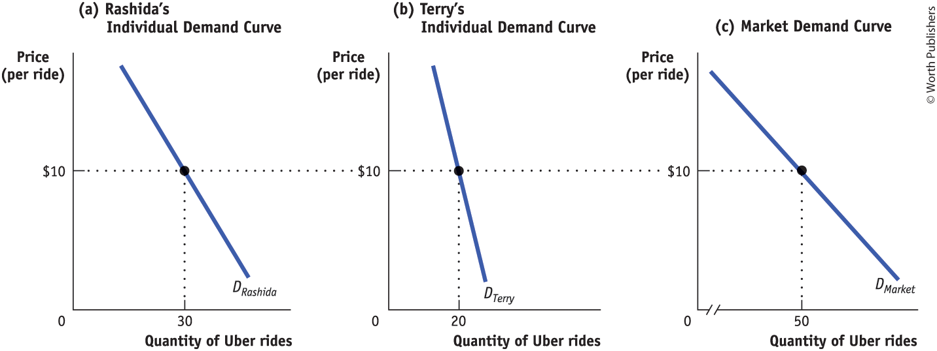
INDIVIDUAL DEMAND CURVES AND THE MARKET DEMAND CURVE
The market demand curve is the horizontal sum of the individual demand curves of all consumers.
Figure 10

Slide 59
SUPPLY, DEMAND, AND MARKET EQUILIBRIUM
When Q_{s} = Q_{d} at a certain price, the market is in equilibrium.
That is, the amount consumers would purchase at this price is matched exactly by the amount producers wish to sell.

Slide 60
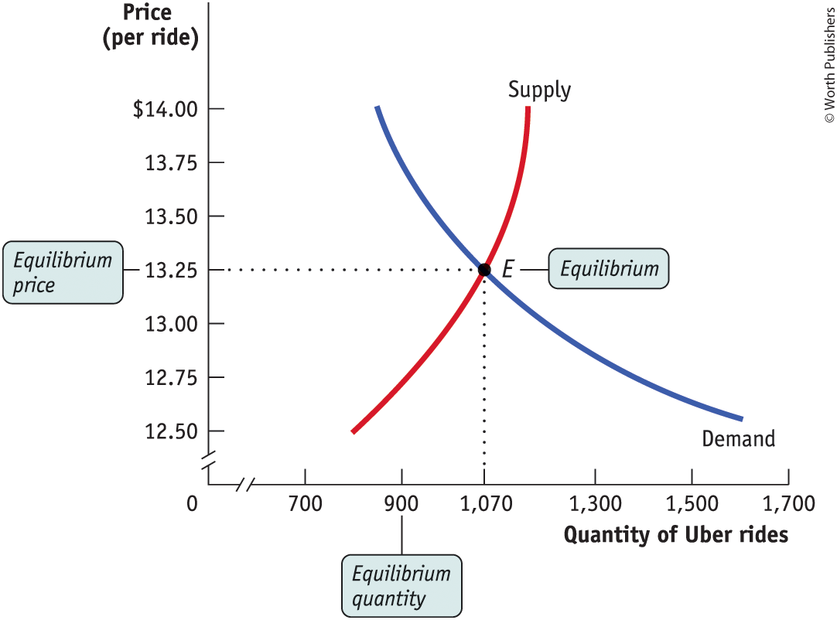
FINDING THE EQUILIBRIUM PRICE
AND QUANTITY
The price at which this takes place is the equilibrium price, also referred to as the market-clearing price. The quantity of the good or service bought and sold at that price is the equilibrium quantity.
Figure 11

Slide 61
WHY DO ALL SALES AND PURCHASES IN A MARKET TAKE PLACE AT THE SAME PRICE?
Where consumers don’t have time to compare prices (as in a tourist trap), different stores have different prices.
In well-established markets, there is a uniform price.
Uniform price is also called the market price.

Slide 62
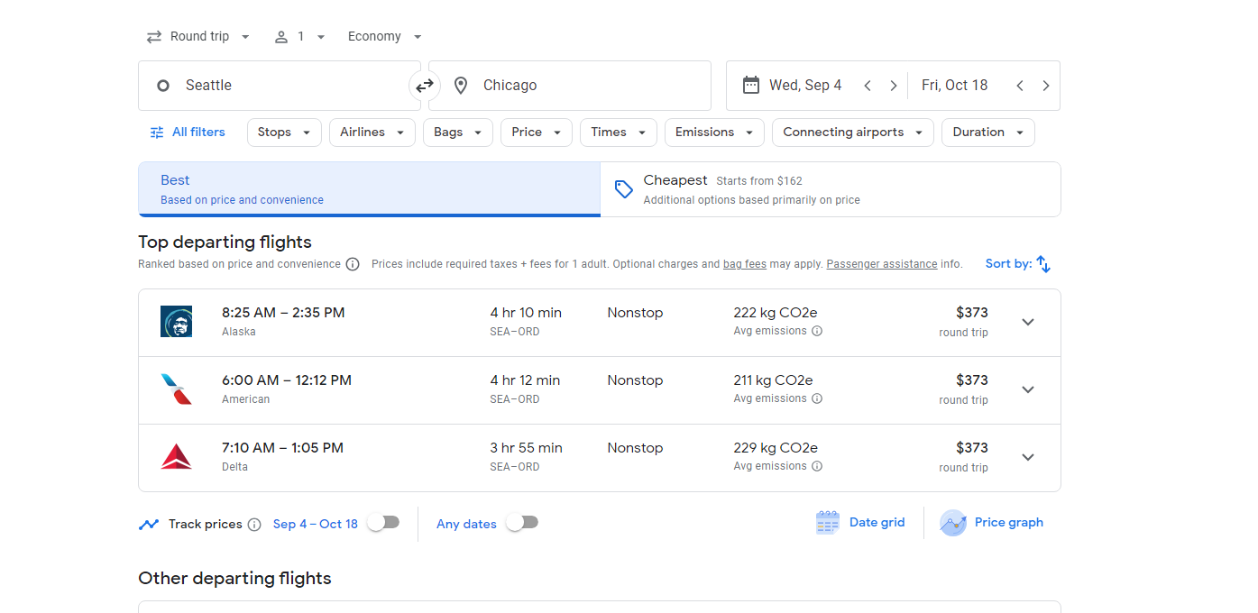
In well-established markets, there is a uniform price.

Slide 63
WHY DOES THE MARKET PRICE FALL IF IT IS ABOVE THE EQUILIBRIUM PRICE?
There is a surplus of a good when the quantity supplied exceeds the quantity demanded. Surpluses occur when the price is above its equilibrium level.
Surpluses do not last: sellers will reduce price so they can move goods off the shelves.

Slide 64
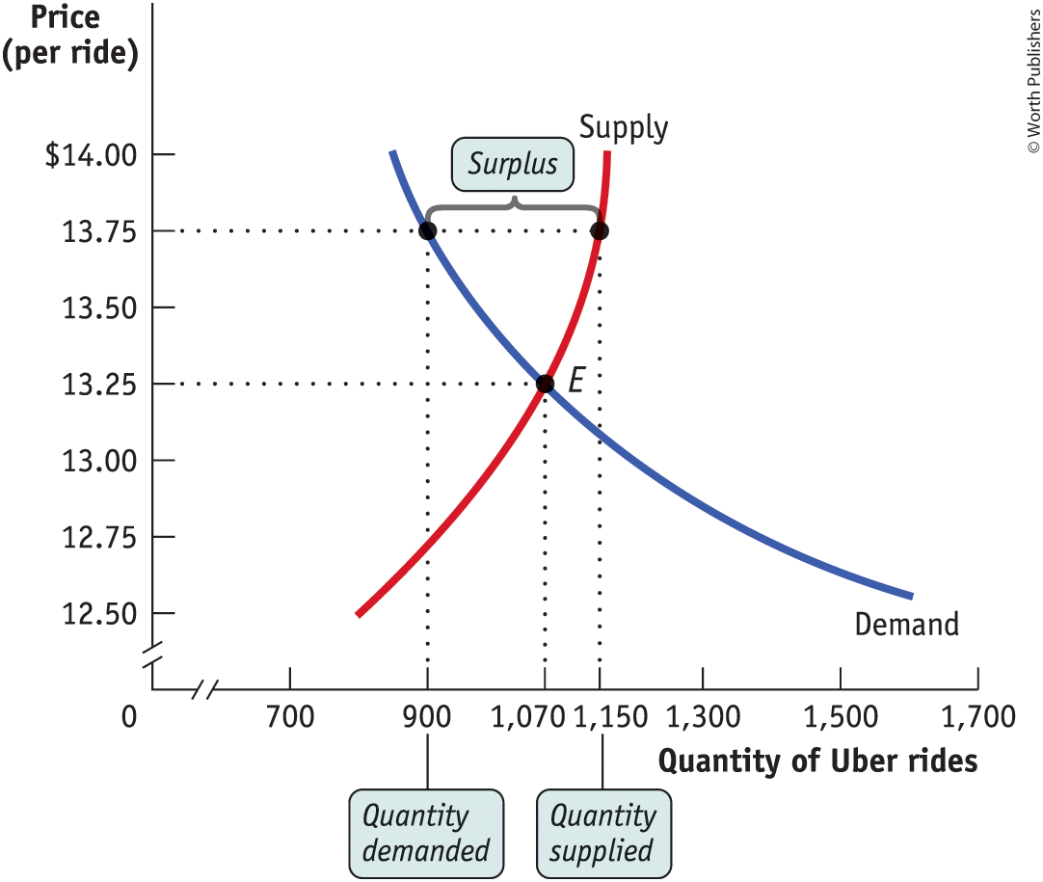
PRICE ABOVE ITS EQUILIBRIUM LEVEL CREATES A SURPLUS
This surplus will push the price down until it reaches the equilibrium price of $13.25.
Figure 12

Slide 65
WHY DOES THE MARKET PRICE RISE IF IT IS BELOW THE EQUILIBRIUM PRICE?
There is a shortage when the quantity demanded exceeds the quantity supplied. Shortages occur when the price is below its equilibrium level.
Shortages do not last: sellers will realize that they can charge higher prices.

Slide 66
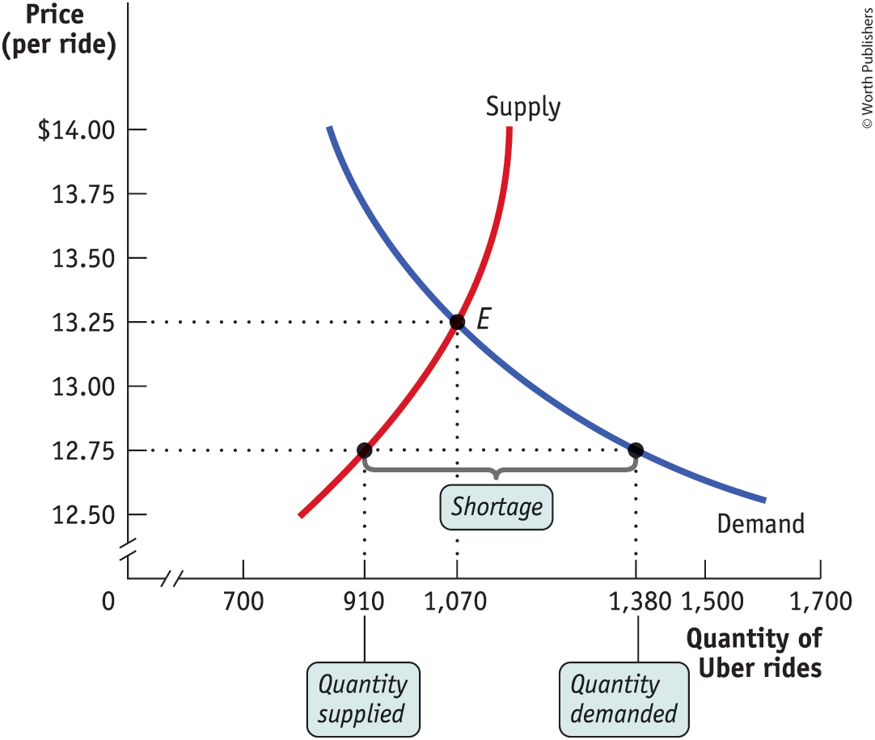
PRICE BELOW ITS EQUILIBRIUM LEVEL CREATES A SHORTAGE
This surplus will push the price down until it reaches the equilibrium price of $13.25.
Figure 13

Slide 67
PRICE BELOW ITS EQUILIBRIUM LEVEL CREATES A SHORTAGE
Retailers in the US and Canada have started limiting the number of toilet paper packs customers can buy in one trip. Some supermarkets in the UK are sold out. Grocery stores in Australia have hired security guards to patrol customers. (CNN, March 9, 2020)
Participants from Australia and the US (final N = 359) completed online self-report measures of panic buying, hoarding, shopping patterns, perceived scarcity, COVID-19 illness anxiety, selfishness, and intolerance of uncertainty.
Findings show that panic buying was most strongly related to greater perceived scarcity, hoarding was most related to a general intolerance of uncertainty. (David et al. 2021)

Slide 68
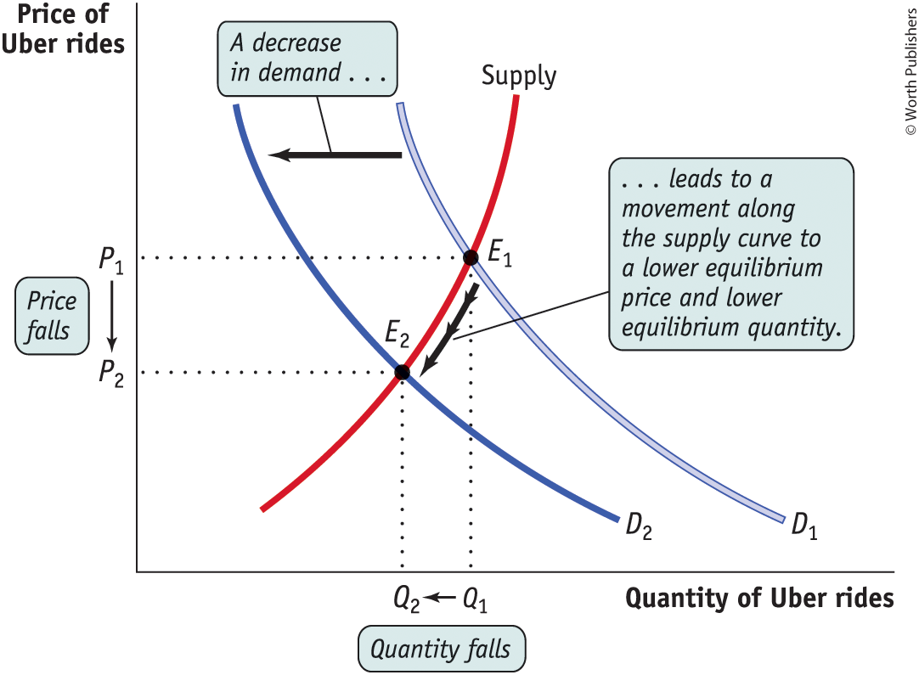
WHAT HAPPENS WHEN THE DEMAND CURVE SHIFTS?
A decrease in demand leads to a movement along the supply curve to a lower equilibrium price and lower equilibrium quantity.
What will happen to equilibrium price and quantity if demand increases?
Figure 14

Slide 69

WHAT HAPPENS WHEN THE DEMAND CURVE SHIFTS?
BlackBerry pioneered handheld devices but has lost market share to larger rivals like Apple.
The company grew by leaps and bounds from 1999 to 2007, as its innovative product lines were well received.
The launch of the touchscreen iPhone in 2007 triggered a dramatic shift away from BlackBerry handheld devices.
Hopes for a turnaround have been dashed as the company grapples with intense competition from larger technology companies.
BlackBerry has lost more than half of its market value in two years.

Slide 70
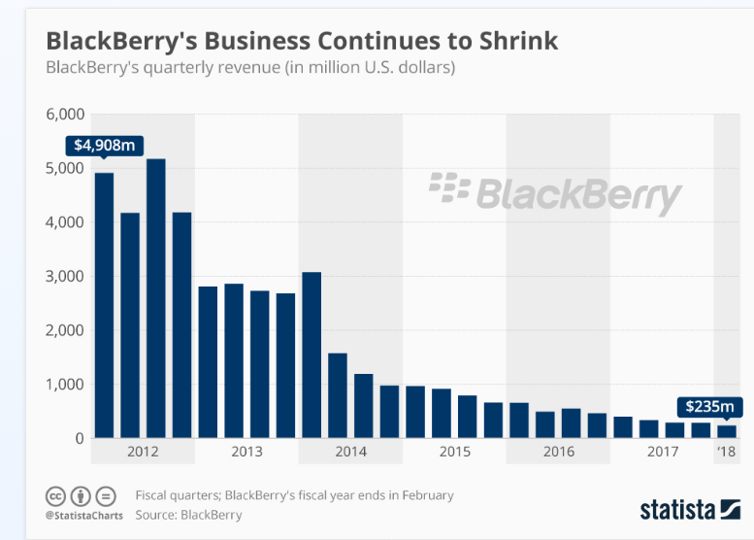
WHAT HAPPENS WHEN THE DEMAND CURVE SHIFTS?

Slide 71
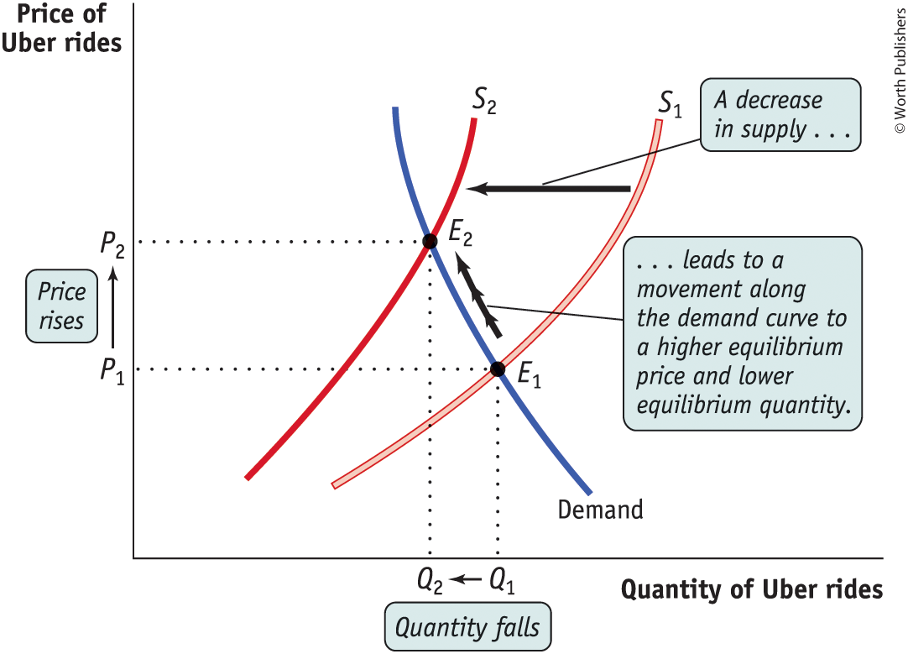
WHAT HAPPENS WHEN THE SUPPLY CURVE SHIFTS?
Figure 15
A decrease in supply leads to a movement along the demand curve to a higher equilibrium price and lower equilibrium quantity.
What will happen to equilibrium price and quantity if supply increases?

Slide 72
LEARN BY DOING: PRACTICE QUESTION 3
If garden gnomes regain popularity, what will happen?
  Equilibrium price and quantity both fall.
  Equilibrium price and quantity both rise.
  Equilibrium price falls and quantity rises.
  Equilibrium price rises and quantity falls.

Slide 73
LEARN BY DOING: PRACTICE QUESTION 3
(ANSWER)
If garden gnomes regain popularity, what will happen?
  Equilibrium price and quantity both fall.
  Equilibrium price and quantity both rise. (correct answer)
  Equilibrium price falls and quantity rises.
  Equilibrium price rises and quantity falls.

Slide 74
LEARN BY DOING: PRACTICE QUESTION 4
If the cost of wood falls, what will happen to equilibrium price and quantity in the violin market?
  Both fall.
  Both rise.
  Price falls and quantity rises.
  Price rises and quantity falls.

Slide 75
LEARN BY DOING: PRACTICE QUESTION 4
(ANSWER)
If the cost of wood falls, what will happen to equilibrium price and quantity in the violin market?
  Both fall.
  Both rise.
  Price falls and quantity rises. (correct answer)
  Price rises and quantity falls.

Slide 76
SIMULTANEOUS SHIFTS OF THE DEMAND AND SUPPLY CURVES
If the decrease in demand is relatively larger than the decrease in supply, the equilibrium price and quantity fall.
If the decrease in supply is large relative to the decrease in demand, the equilibrium quantity falls as the equilibrium price rises.
D₁
_{Price}
S₂
D₁
S₁
_{Price}
D₂
S₂
S₁
D₂
P₂
P₁
P₁
P₂
q₂
q₁
_{Q}
q₂
q₁
_{Q}
Figure A
Figure B

Slide 77
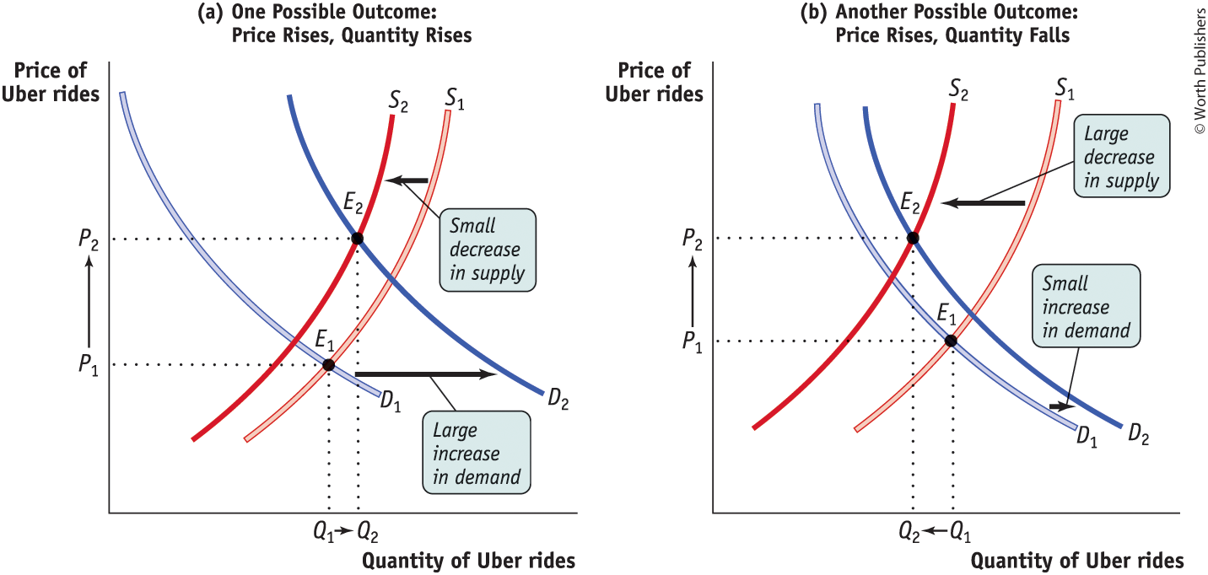
SIMULTANEOUS SHIFTS OF THE DEMAND AND SUPPLY CURVES

Slide 78
Simultaneous Shifts in Demand and Supply
 | Supply Increases | Supply Decreases
Demand Increases | Quantity increases, but price change is ambiguous (to see price change, check which change is relatively greater) | Price increases, but quantity change is ambiguous (to see quantity change, check which change is relatively greater)
Demand Decreases | Price decreases, but quantity change is ambiguous (to see quantity change, check which change is relatively greater) | Quantity decreases, but price change is ambiguous (to see the price change, check which change is relatively greater)

Slide 79
LEARN BY DOING: PRACTICE QUESTION 5
Consumers in Mayville consider houses and apartments to be substitutes. There is an increase in the price of houses in Mayville at the same time three new apartment buildings open there. In the market for apartments in Mayville, the equilibrium:
price will rise.
price will fall.
quantity will rise.
quantity will fall.

Slide 80
LEARN BY DOING: PRACTICE QUESTION 5 (ANSWER)
Consumers in Mayville consider houses and apartments to be substitutes. There is an increase in the price of houses in Mayville at the same time three new apartment buildings open there. In the market for apartments in Mayville, the equilibrium:
price will rise.
price will fall.
quantity will rise. (correct answer)
quantity will fall.

