Slide 1
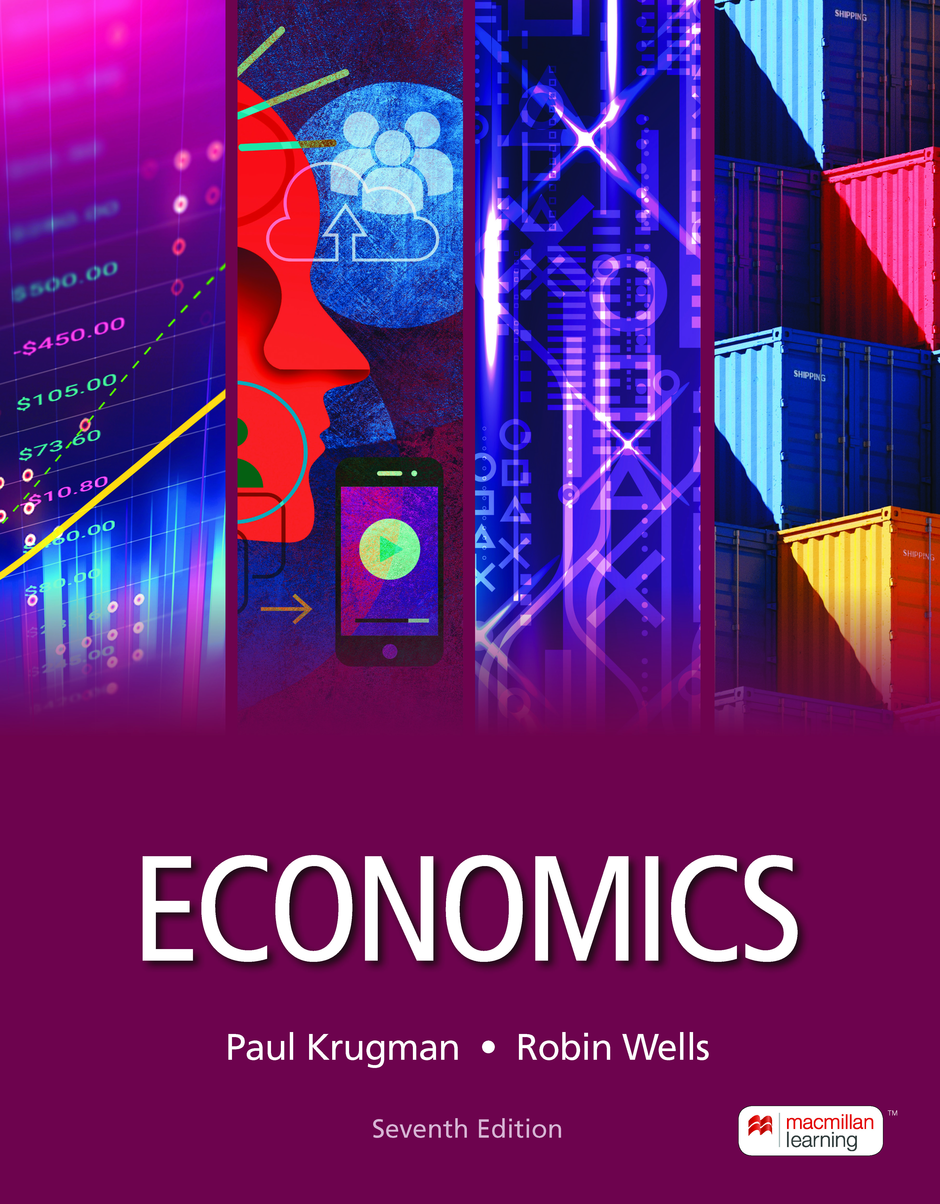
Economic Models:
Trade-offs and Trade
2
Notes:
Cover Credits: Currency Exchange Stock Chart: cemagraphics/Getty Images, Social Media Montage: SEAN GLADWELL/Getty Images, Circuit Pattern: somsak Tangdamrongsub/Getty Images, Cargo Containers: urzine/Getty Images

Slide 2
WHAT YOU WILL LEARN IN THIS CHAPTER
What are economic models, and why are they so important to economists?
How do three simple models—the production possibility frontier, comparative advantage, and the circular-flow diagram—help us understand how modern economies work?
Why is an understanding of the difference between positive economics and normative economics important for the real-world application of economic principles?
Why do economists sometimes disagree?

Slide 3
MODELS IN ECONOMICS
Model: a simplified representation of a real situation that is used to better understand real-life situations.
The other things equal assumption: all other relevant factors remain unchanged.
We try to treat economics as close to a laboratory science as possible—with only one variable allowed to change at a time.

Slide 4
General Statement
Which country has the highest labor productivity?

Slide 5
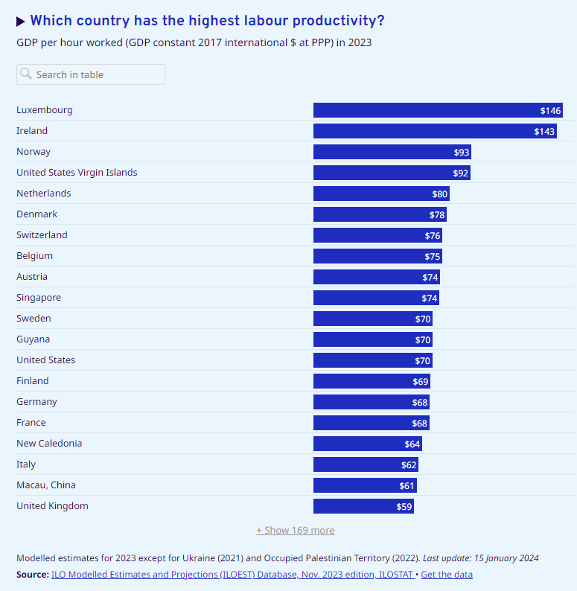
Foundations

Slide 6
Trade-offs
y = mx + b
y = good 1 x=good 2
m=slope (Opp. Cost)
b≥0

Slide 7
TRADE-OFFS: THE PPF (1 of 2)
The production possibilities frontier (PPF) is a diagram that shows the combinations of two goods that are possible for a society to produce at full employment.
The PPF helps us understand some aspects of the real economy:
  Efficiency,
  Opportunity cost, and
  Economic growth.

Slide 8
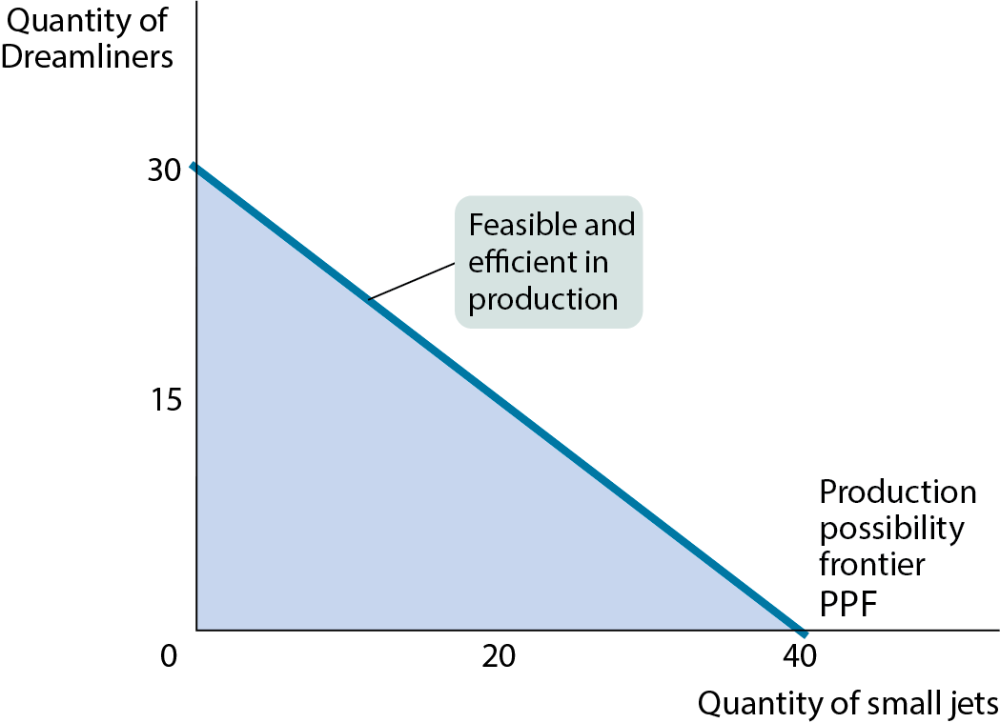
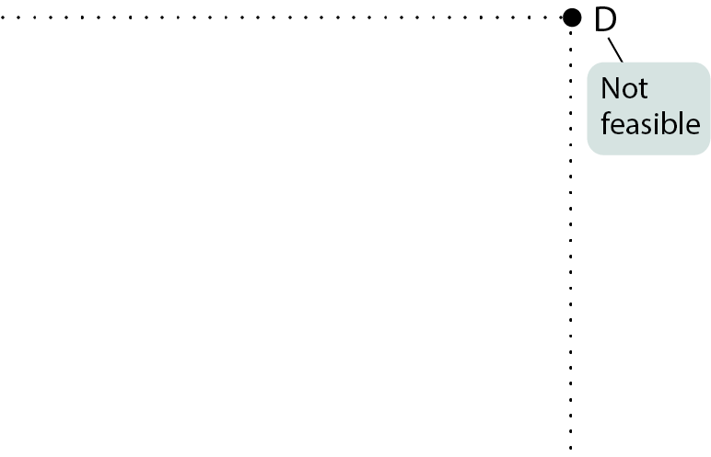

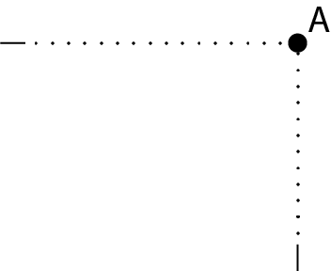
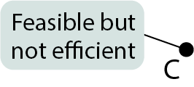
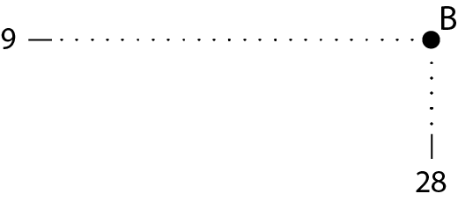

TRADE-OFFS: THE PPF (2 of 2)
Figure 1

Slide 9
TRADE-OFFS: THE PPF (2 of 2)
Figure 1

Slide 10
EFFICIENCY
Efficiency: an economy is efficient if there are no missed opportunities.
An economy is efficient in production if there are no missed opportunities in production. It’s efficient in production if it could not produce more of any one good without producing less of something else—if it’s on the PPF.
An economy is inefficient in production if it could produce more of some things without producing less of others.
The economy is efficient in allocation if it allocates its resources so that consumers are as well off as possible.
Efficiency requires both efficiency in production and efficiency in allocation.

Slide 11
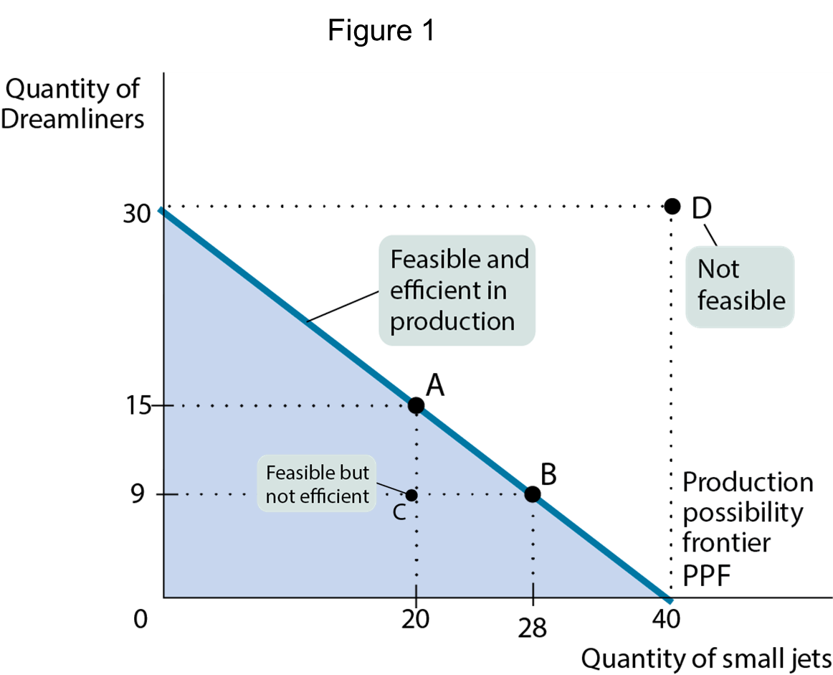
OPPORTUNITY COST
Opportunity Cost: what must be given up in order to get a good.
If Boeing decides to change its production from point A to point B, it will produce 8 more small jets but 6 fewer Dreamliners.
Therefore, each small jet has an opportunity cost of 6 / 8 = 3 / 4 of a Dreamliner.

Slide 12
LEARN BY DOING: PRACTICE QUESTION 1
Suppose you are stranded on an island. Luckily, this island is rich in potatoes and mangos. If you devote all your time to harvesting potatoes, you can get 100 Potatoes in a week. If you use all your time to collect mangos, you can find 200 mangos in a week.
Assume it is possible to collect fractional amounts of both goods and draw a sketch of your production possibility frontier for a week. (Place mangos on the x-axis and potatoes on the y-axis.)
Calculate the opportunity cost of each good.

Slide 13
LEARN BY DOING: PRACTICE QUESTION 1
If you devote all your time to harvesting potatoes, you can get 100 Potatoes in a week. If you use all your time to collect mangos, you can find 200 mangos in a week. Calculate the opportunity cost of each good.

Slide 14
LEARN BY DOING: PRACTICE QUESTION 2
With a partner, create your production possibilities curve for the following two activities: (a) drawing happy faces and (b) drawing elephants.
  Take turns timing each other for 30 seconds and recording the following:
        The maximum number of happy faces drawn
        The maximum number of elephants drawn
  Now construct your PPF with elephants on the vertical axis and faces on the horizontal axis.
  Calculate your opportunity cost for each good.

Slide 15
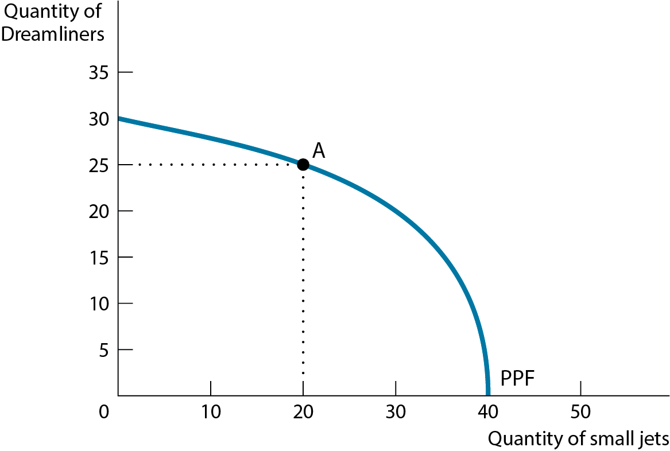
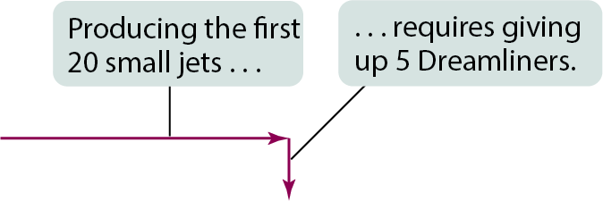
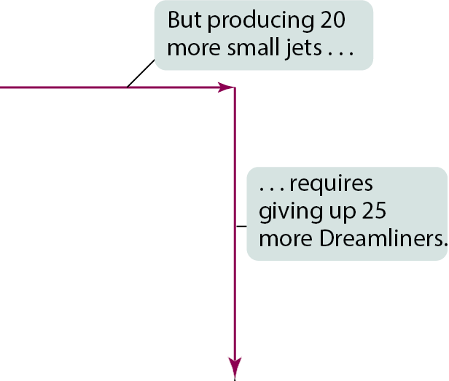
OPPORTUNITY COST
Increasing opportunity cost: the more small jets the economy produces, the more costly it is to produce yet another small jet in terms of forgone Dreamliners.
Figure 2

Slide 16
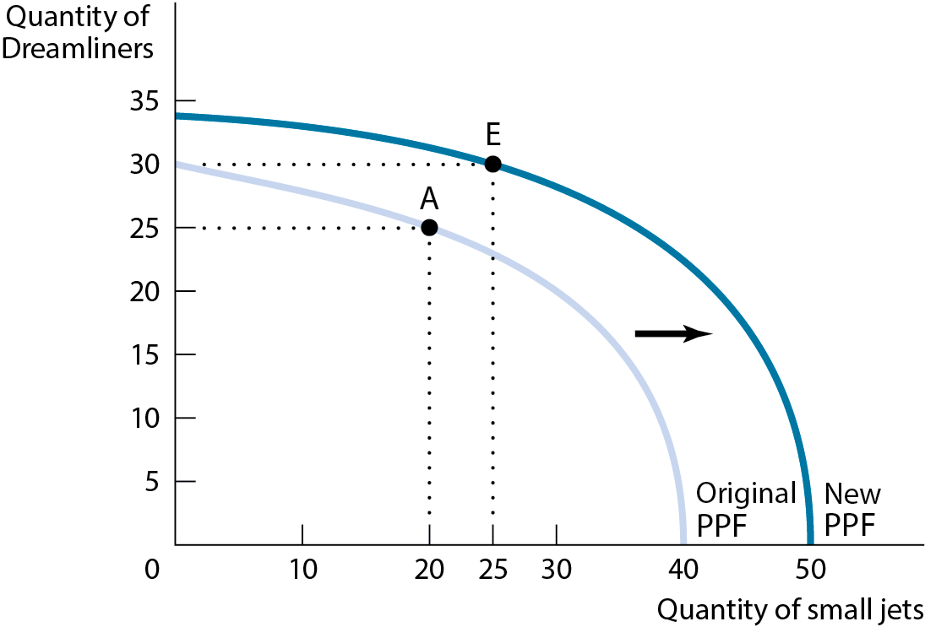
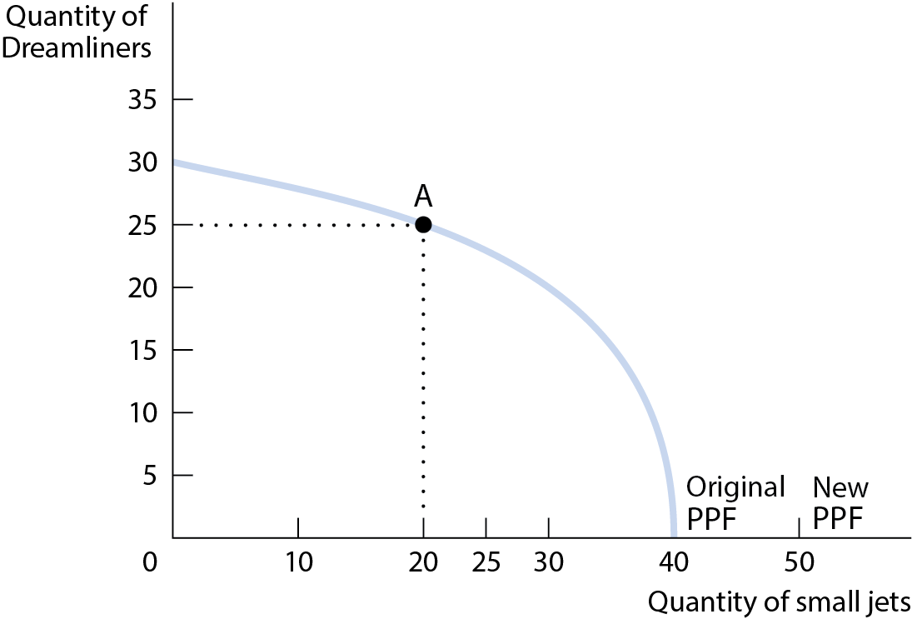
ECONOMIC GROWTH (1 of 2)
Economic growth means an expansion of the economy’s production possibilities.
Figure 3

Slide 17
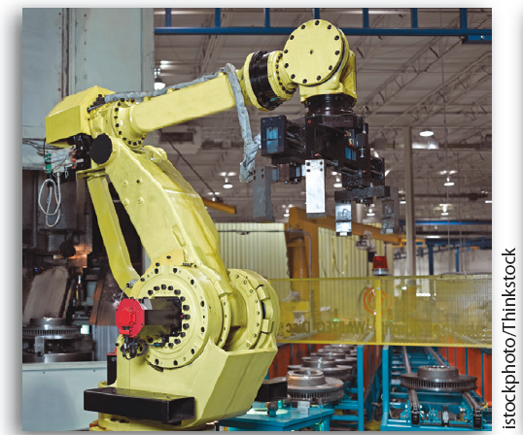

ECONOMIC GROWTH (2 of 2)
What causes economic growth? Two possibilities exist:
An increase in factors of production: resources used to produce goods and services (land, labor, physical capital, and human capital).
Better technology: the technical means for producing goods and services.

Slide 18

ECONOMIC GROWTH
Better technology:

Slide 19
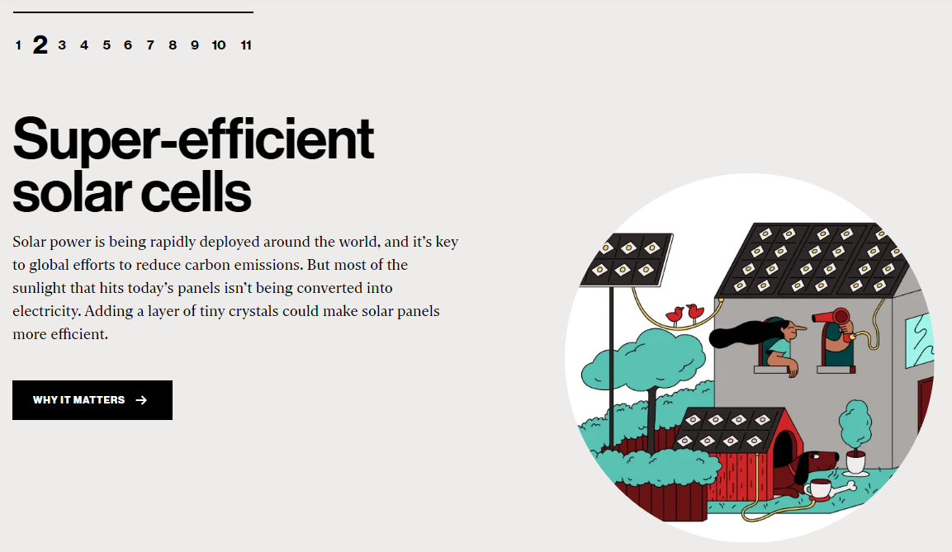
ECONOMIC GROWTH
Better technology:

Slide 20

ECONOMIC GROWTH
Better technology:

Slide 21
COMPARATIVE ADVANTAGE AND GAINS FROM TRADE (1 of 5)
Theory of Comparative Advantage: It makes sense to produce the things you’re especially good (relatively better) at producing and buy everything else from others.
A country has a comparative advantage in producing a good or service if its opportunity cost of producing the good or service is lower than for other countries.
An individual has a comparative advantage in producing a good or service if their opportunity cost of producing the good or service is lower than for other people.

Slide 22
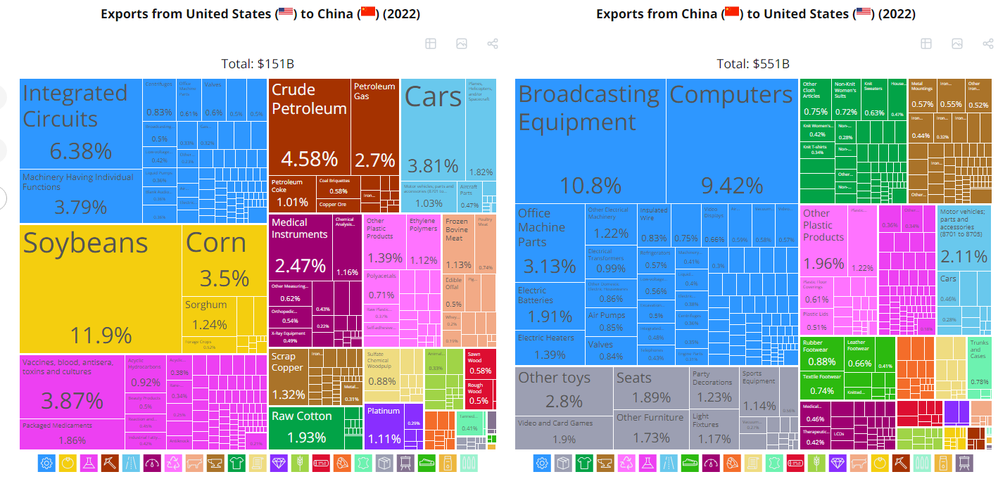
COMPARATIVE ADVANTAGE AND GAINS FROM TRADE (1 of 5)
United States (USA) and China (CHN) Trade | The Observatory of Economic Complexity (oec.world)

Slide 23
Men’s Tennis ATP Rankings 2024?
Jannik Sinner (Italy), Novak Djokovic (Servia) Carlos Alcaraz (Spain)
Women’s Tennis ATP Rankings 2024?
Iga Swiatek (Poland), Aryna Sabalenka (Belarus) Coco Gauff (USA)

Slide 24
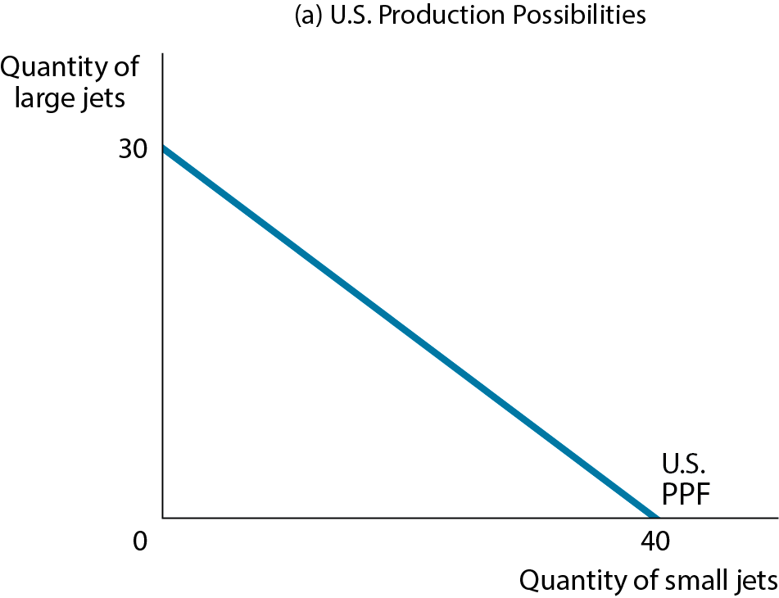
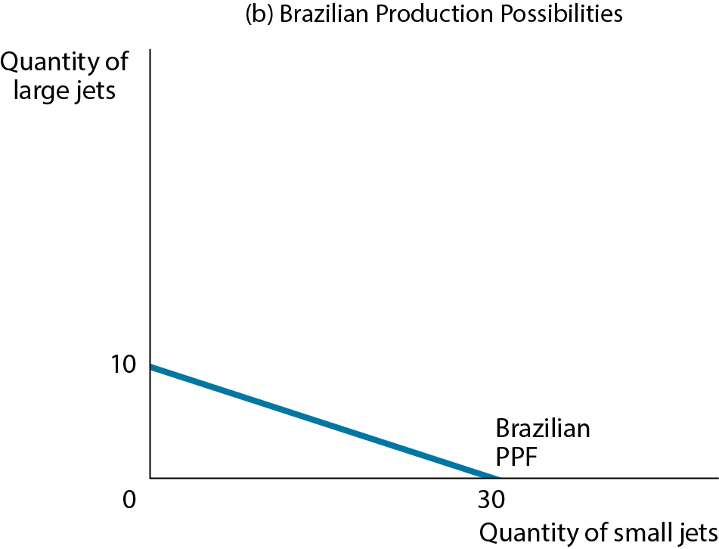
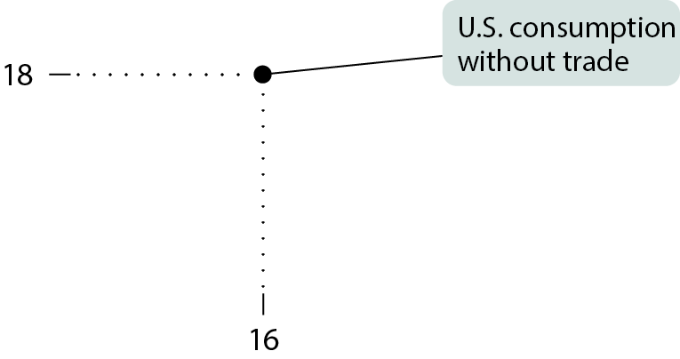
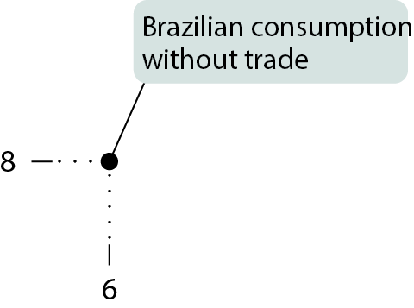








COMPARATIVE ADVANTAGE AND GAINS FROM TRADE (2 of 5)
Figure 4

Slide 25
COMPARATIVE ADVANTAGE AND GAINS FROM TRADE (3 of 5)
Since each country has a different opportunity cost, it makes sense to specialize and trade…
Table 1 U.S. and Brazilian Opportunity Costs of Small Jets and Large Jets
 | U.S. opportunity cost |  | Brazilian opportunity cost
1 small jet | 3/4 large jet | > | 1/3 large jet
1 large jet | 4/3 small jets | < | 3 small jets

Slide 26
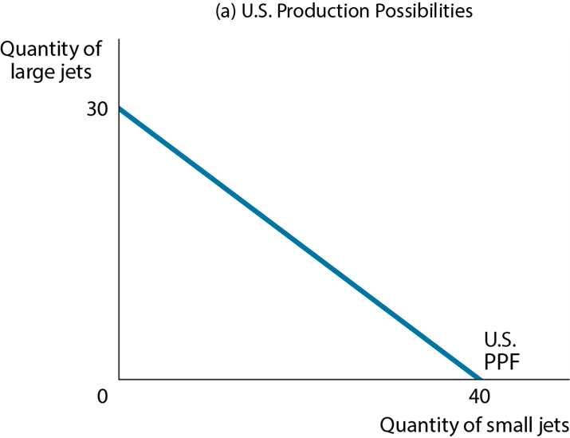
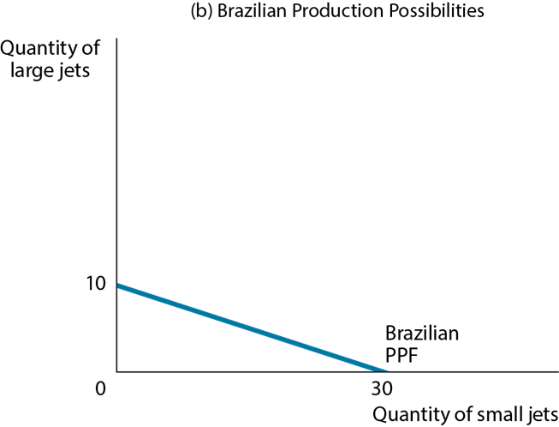
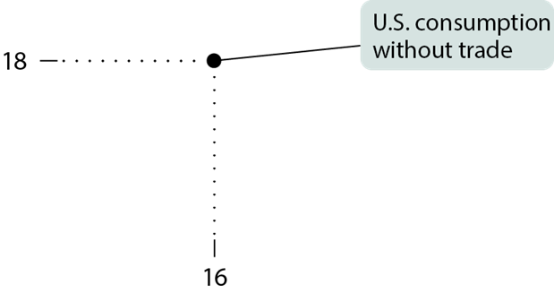
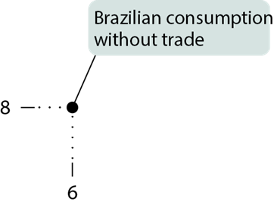
Table 2 How the United States and Brazil Gain from Trade
 |  | Without Trade: Production | Without Trade: Consumption | With Trade: Production | With Trade: Consumption | Gains from Trade
United States | Large jets | 18 | 18 | 30 | 20 | 2
United States | Small jets | 16 | 16 | 0 | 20 | 4
Brazil | Large jets | 8 | 8 | 0 | 10 | 2
Brazil | Small jets | 6 | 6 | 30 | 10 | 4
Through specialization and trade, both countries produce more and consume more than if they were self-sufficient.

Slide 27
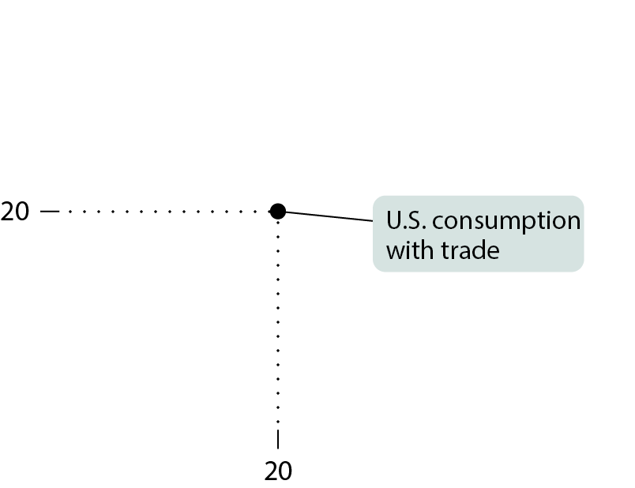
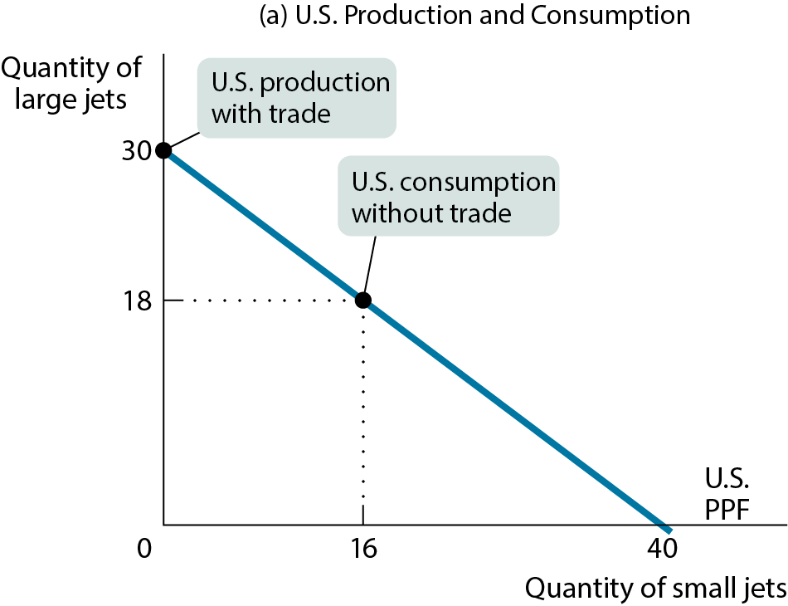
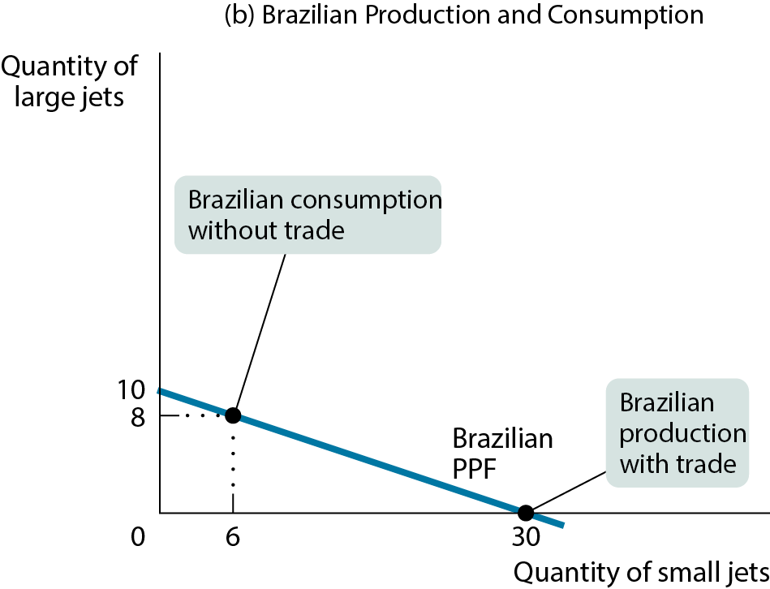
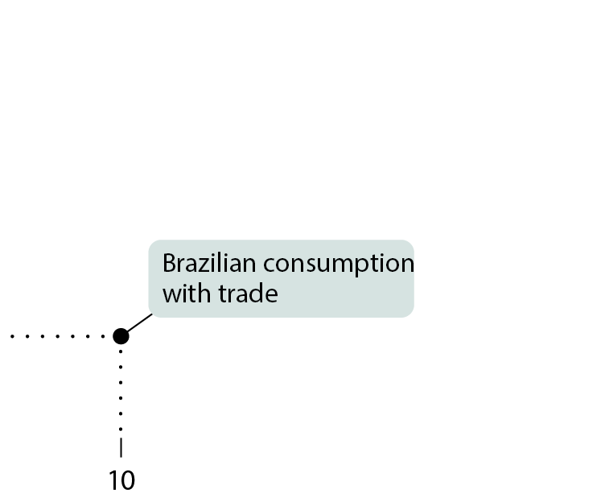
COMPARATIVE ADVANTAGE AND GAINS FROM TRADE (5 of 5)
Figure 5

Slide 28
ABSOLUTE VERSUS COMPARATIVE ADVANTAGE
Don’t confuse absolute with comparative advantage.
  Just because the United States can produce more of both goods doesn’t mean we’re better off without trade.
Pay attention to opportunity costs:
  If it’s cheaper for Brazil to produce small jets than it is for the United States, the United States will want to import small jets from Brazil.

Slide 29
LEARN BY DOING: PRACTICE QUESTION 3
If Texia specializes in food, it can produce 1,000 units of food and 0 units of clothing this year. If it specializes in clothing, it can produce 500 units of clothing and 0 units of food. This year Urbania can produce either 500 units of food and 0 units of clothing or 200 units of clothing and 0 units of food. (Assume linear production possibility frontiers.)
_____ has the absolute advantage in the production of clothing, and _____ has the absolute advantage in the production of food.
  Texia; Texia
  Texia; Urbania
  Urbania; Texia
  Urbania; Urbania

Slide 30
LEARN BY DOING: PRACTICE QUESTION 3
(ANSWER)
If Texia specializes in food, it can produce 1,000 units of food and 0 units of clothing this year. If it specializes in clothing, it can produce 500 units of clothing and 0 units of food. This year Urbania can produce either 500 units of food and 0 units of clothing or 200 units of clothing and 0 units of food. (Assume linear production possibility frontiers.)
_____ has the absolute advantage in the production of clothing, and _____ has the absolute advantage in the production of food.
  Texia; Texia (correct answer)
  Texia; Urbania
  Urbania; Texia
  Urbania; Urbania

Slide 31
LEARN BY DOING: PRACTICE QUESTION 3
(ANSWER)
If Texia specializes in food, it can produce 1,000 units of food and 0 units of clothing this year. If it specializes in clothing, it can produce 500 units of clothing and 0 units of food. This year Urbania can produce either 500 units of food and 0 units of clothing or 200 units of clothing and 0 units of food.
Texia
Urbania
Food
Food
Clothing
Clothing

Slide 32
LEARN BY DOING: PRACTICE QUESTION 4
If Texia specializes in food, it can produce 1,000 units of food and 0 units of clothing this year. If it specializes in clothing, it can produce 500 units of clothing and 0 units of food. This year Urbania can produce either 500 units of food and 0 units of clothing or 200 units of clothing and 0 units of food. (Assume linear production possibility frontiers.)
_____ has the comparative advantage in the production of clothing, and _____ has the comparative advantage in the production of food.
  Texia; Texia
  Texia; Urbania
  Urbania; Texia
  Urbania; Urbania

Slide 33
LEARN BY DOING: PRACTICE QUESTION 4
(ANSWER)
If Texia specializes in food, it can produce 1,000 units of food and 0 units of clothing this year. If it specializes in clothing, it can produce 500 units of clothing and 0 units of food. This year Urbania can produce either 500 units of food and 0 units of clothing or 200 units of clothing and 0 units of food. (Assume linear production possibility frontiers.)
_____ has the comparative advantage in the production of clothing and _____ has the comparative advantage in the production of food.
  Texia; Texia
  Texia; Urbania (correct answer)
  Urbania; Texia
  Urbania; Urbania

Slide 34
LEARN BY DOING: PRACTICE QUESTION 5
If a country specializes according to its own comparative advantage and then trades with other nations:
  it will operate at a point inside its production possibilities frontier.
  it can consume at a higher level than the domestic production possibilities frontier.
  its production possibilities frontier will shift or rotate inward.
  it can consume at the same level as the domestic production possibilities frontier.

Slide 35
LEARN BY DOING: PRACTICE QUESTION 5
(ANSWER)
If a country specializes according to its own comparative advantage and then trades with other nations:
  it will operate at a point inside its production possibilities frontier.
  it can consume at a higher level than the domestic production possibilities frontier. (correct answer)
  its production possibilities frontier will shift or rotate inward.
  it can consume at the same level as the domestic production possibilities frontier.

Slide 36
LEARN BY DOING: PRACTICE QUESTION 6
Write down, then discuss with a partner:
Would the U.S. economy be better off if we did not import so much clothing from China?
List the groups who you think would gain and the groups who would lose if Chinese clothing imports were restricted.

Slide 37
LEARN BY DOING: PRACTICE QUESTION 7
Suppose that in Australia, it takes 2 hours to harvest 10 bushels of apples and 4 hours to harvest 10 bushels of tomatoes. Suppose a worker in Brazil can harvest 10 bushels of apples in 4 hours or 10 bushels of tomatoes in 5 hours. Which of these statements is true?
Brazil has a comparative advantage in producing tomatoes.
Brazil has a comparative advantage in producing apples.
Brazil has an absolute advantage in producing both goods.
In trade between these two countries, Australia would gain, and Brazil would lose.

Slide 38
LEARN BY DOING: PRACTICE QUESTION 7
Suppose that in Australia, it takes 2 hours to harvest 10 bushels of apples and 4 hours to harvest 10 bushels of tomatoes. Suppose a worker in Brazil can harvest 10 bushels of apples in 4 hours or 10 bushels of tomatoes in 5 hours.
Apples
Australia
Brazil
Apples
Tomatoes
Tomatoes

Slide 39
LEARN BY DOING: PRACTICE QUESTION 7
(ANSWER)
Suppose that in Australia, it takes 2 hours to harvest 10 bushels of apples and 4 hours to harvest 10 bushels of tomatoes. Suppose a worker in Brazil can harvest 10 bushels of apples in 4 hours or 10 bushels of tomatoes in 5 hours. Which of these statements is true?
Brazil has a comparative advantage in producing tomatoes. (correct answer)
Brazil has a comparative advantage in producing apples.
Brazil has an absolute advantage in producing both goods.
In trade between these two countries, Australia would gain and Brazil would lose.

Slide 40
TRANSACTIONS: THE CIRCULAR-FLOW DIAGRAM (1 of 2)
Trade takes the form of barter when people directly exchange goods or services that they have for goods or services that they want.
The circular-flow diagram represents the transactions in an economy by flows around a circle.
A household is a person or a group of people that share their income.
A firm is an organization that produces goods and services for sale.

Slide 41
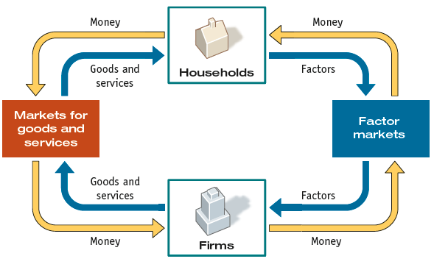
THE CIRCULAR-FLOW DIAGRAM

Slide 42
TRANSACTIONS: THE CIRCULAR-FLOW DIAGRAM (2 of 2)
Firms sell goods and services that they produce to households in markets for goods and services.
Firms buy the resources they need to produce goods and services in factor markets. Main factors of production are land, labor, physical capital, and human capital.
An economy’s income distribution is the way in which total income is divided among the owners of the various factors of production.

Slide 43
LEARN BY DOING: PRACTICE QUESTION 8
With a partner, trace the following events through the circular flow:
  the introduction of a new technology that boosts productivity
  the decision of consumers to save more money
  an increase in government spending

Slide 44
USING MODELS: POSITIVE VERSUS NORMATIVE ECONOMICS
Positive economics is the branch of economic analysis that describes the way the economy actually works.
Normative economics makes prescriptions about the way the economy should work.
Positive economics is about description; normative economics is about prescription.
A forecast is a simple prediction of the future.

Slide 45
POSITIVE VERSUS NORMATIVE ECONOMICS
Arguing for a higher minimum wage for the benefit of workers [normative argument], in that this argument is based on subjective values.
An assertion that higher minimum wages would lead to a higher GDP would be considered positive economics.
A study on rental costs would be an example of positive economics.
A study that claims that the rent is too high is an example of normative economics.
“Pollution is the most serious economic problem” Normative or Positive?

Slide 46
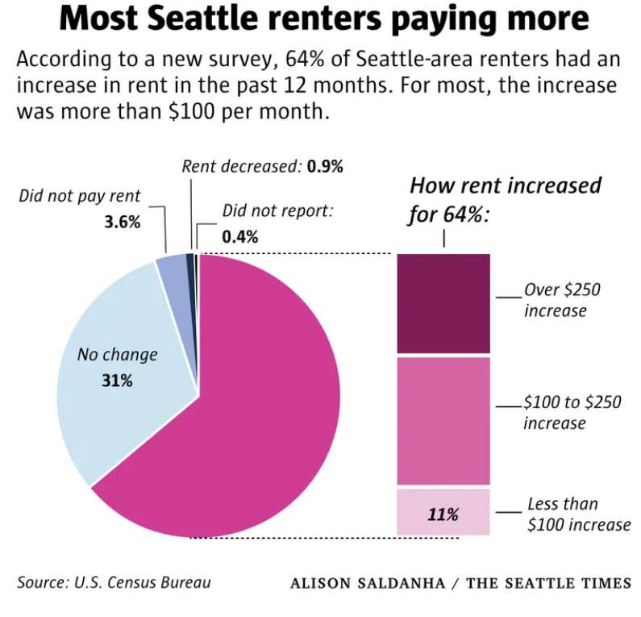
A study on rental costs

Slide 47
LEARN BY DOING: PRACTICE QUESTION 9
Label each of the following statements as normative or positive.
  More than 60% of women are in the labor market.
  Rent control laws should be implemented because they help to achieve equity or fairness in housing.
  Society should take measures to end gun violence.
  People who smoke pass on increased medical costs to the whole society.
  Single mothers are more than twice as likely as married mothers to be in poverty.

Slide 48
LEARN BY DOING: PRACTICE QUESTION 9
(ANSWER)
Label each of the following statements as normative or positive.
  More than 60% of women are in the labor market. (positive)
  Rent control laws should be implemented because they help to achieve equity or fairness in housing. (normative)
  Society should take measures to end gun violence. (normative)
  People who smoke pass on increased medical costs to the whole society. (positive)
  Single mothers are more than twice as likely as married mothers to be in poverty. (positive)

Slide 49
USING MODELS: WHEN AND WHY ECONOMISTS DISAGREE
Media coverage tends to exaggerate the real differences in views among economists.
Economics is often tied up in politics.
    Powerful interest groups find and promote economists who profess supportive opinions.
Diverse people have diverse values.
    Reasonable people can come to different conclusions because of their values.
Economic modeling requires simplifying assumptions.
    Two economists can legitimately disagree about which simplifications are appropriate.

