Slide 1

EconS 101:
Fundamentals of Microeconomics
1
Notes:
Cover Credits: Currency Exchange Stock Chart: cemagraphics/Getty Images, Social Media Montage: SEAN GLADWELL/Getty Images, Circuit Pattern: somsak Tangdamrongsub/Getty Images, Cargo Containers: urzine/Getty Images

Slide 2
Instructor:
Ana Espinola Arredondo (PhD in Economics)
Office hours: Fridays 10:00-11am., or by appointment.
Office: 111E Hulbert Hall e-mail: anaespinola@wsu.edu

Slide 3
TA: Romuald Rambikarison (PhD student)
Office hours: Mondays 11am-12:30pm or by appointment (Zoom meetings)
Office: 205G Hulbert Hall e-mail: r.rambikarison@wsu.edu
TA: Jamil Imon (PhD student)
Office hours: Fridays 12pm-1pm
Office: 207B Hulbert Hall or by appointment (Zoom meetings)
e-mail: jamilhasan.imon@wsu.edu

Slide 4
Lectures:
CUE 203 on Tuesdays and Thursdays 1:30-2:45p.m. Attendance is very important to your success in this class.

Slide 5
Required Textbook:
Paul Krugman and Robin Wells (KW) Microeconomics . New York, NY: Worth Publishers, 2023. (Seventh edition) ISBN 9781319481186.
Please enter Canvas and click on Macmillan Learning, it is important to use your WSU email!
Here is information about how to access Achieve: https://mhe.my.site.com/macmillanlearning/s/article/Students-Register-for-Achieve-courses-via-your-school-s-LMS#canvas

Slide 6
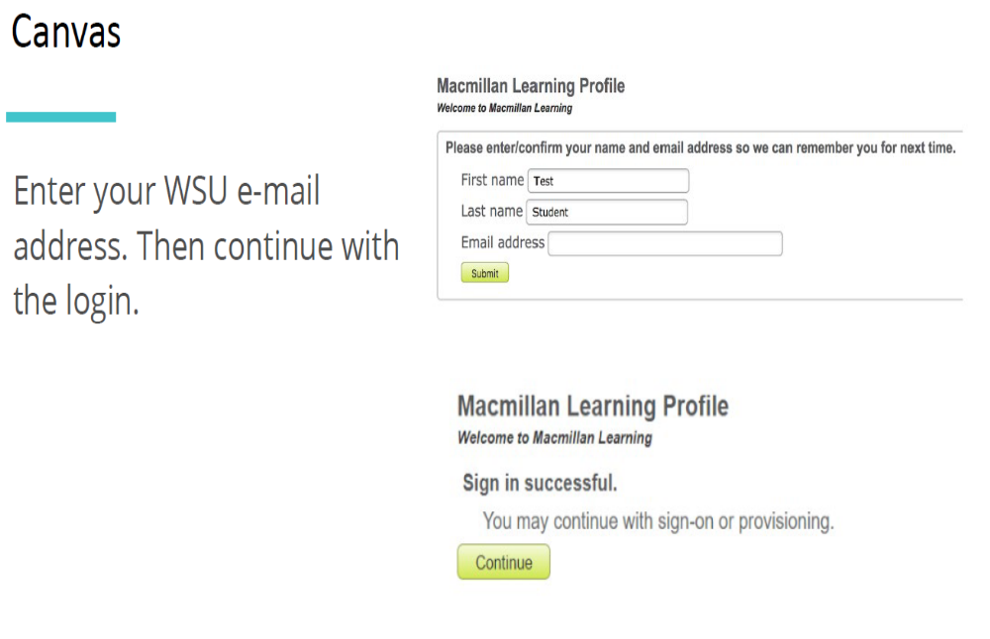

Slide 7
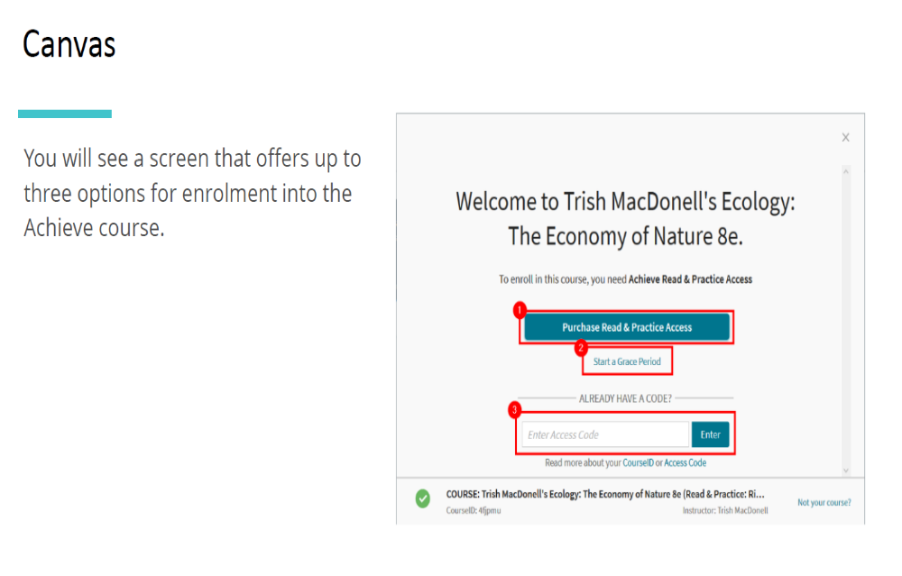


Slide 8
Grading:
Your grade for the course will be based on:
1. Problem sets (30%) [Achieve Macmillan Learning],
2. Two midterms (15% each) [in class],
3. Three writing Assignments (10%)[Canvas],
4. Six Quizzes. The lowest grade of the 6 quizzes will be dropped (10%) [Achieve Macmillan Learning],
5. Final exam (20%) [in class].

Slide 9
Important Dates:
1. Midterm 1: Tuesday, September 24th, in class,
2. Midterm 2: Thursday, November 5th, in class,
3. Final: Wednesday, December 11th, from 1:30pm. to 3:30p.m., in class.

Slide 10
Assignments
Important: Assignments every week, due date on Wednesdays 11.59pm. Problem sets must be completed and submitted on Achieve Macmillan Learning webpage before the due date.
Policies
Unlimited attempts per question. But -5% partial credit for incorrect attempts.
No time limit.
No late submissions. The graded homework assignments have a firm due date.

Slide 11
Assignments – Due Dates:
HW1-Ch. 1: First Principles | 08/28
HW2-Ch. 2: Economic Models | 09/04
HW3-Ch. 3: Supply and Demand | 09/11
HW4-Ch. 4: Consumer and Producer Surplus | 09/18
HW5-Ch. 5: Price Controls and Quotas | 09/23 (Monday)
HW6-Ch. 6: Elasticity | 10/02
HW7-Ch. 7: Taxes | 10/09
HW8-Ch. 9: Decision Making | 10/16
HW9-Ch. 10: Externalities | 10/23
HW10-CH11: Public Goods & Common Resources | 10/30
HW11-CH12: The Economics of the Welfare State | 11/04 (Monday)
HW12-CH13: The Rational Consumer | 11/13
HW13-CH14 & 15: The Production Decision | 11/20
HW14-CH16 & 17: Monopoly & Oligopoly | 12/06 (Friday)

Slide 12
Quizzes – Due Dates:
Policies:
1 hour time limit.
No late submissions.
View solution explanations after the due date.
Up to 4 retakes for a higher score (5 takes total).

Slide 13
Quizzes – Due Dates:
Quiz. 1: Chapters 1 and 2 | 09/08
Quiz 2: Chapters 3 and 4 | 09/22
Quiz. 3: Chapters 5 and 6 | 10/06
Quiz 4: Chapters 7 and 9 | 10/20
Quiz 5: Chapters 10 and 11 | 11/03
Quiz 6: Chapters 12 and 13 | 11/17

Slide 14
Writing Assignments
Writing assignments are completed and graded via NetTA. You access Net Tutor through Canvas. There are 3 assignments. After your first submission you will receive feedback from Net Tutor. After receiving feedback, you will have one chance to revise and resubmit your essay. I will count only the higher of the two grades for each assignment.

Slide 15
Writing Assignments Due dates
1. Writing Assignment 1: Thursday, Sept.19th.
2. Writing Assignment 2: Saturday, Oct. 19th.
3. Writing Assignment 3: Tuesday, Nov. 5th.

Slide 16
Grading Scale:
A | 88-100 | C | 55-59
A- | 80-87 | C- | 50-54
B+ | 74-79 | D+ | 45-49
B | 70-75 | D | 40-44
B- | 65-69 | F | 0-39
C+ | 60-64

Slide 17
Chapter 1:
First Principles

Slide 18
WHAT YOU WILL LEARN IN THIS CHAPTER
What four principles guide the choices made by individuals?
What four principles govern how individual choices interact?
What three principles illustrate economy-wide interactions?

Slide 19
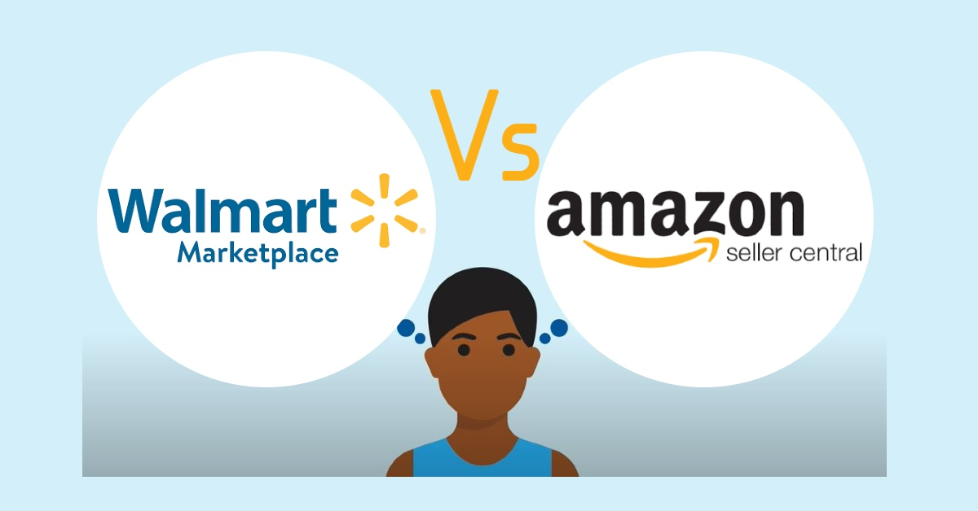
Principles that underline Individual Choices
Isn't economics if it isn’t about choice

Slide 20
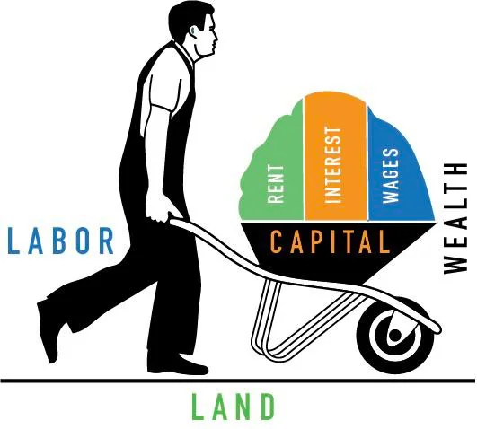

THE PRINCIPLES: INDIVIDUAL CHOICE, PART 1
Choices are necessary because resources are scarce.
Resource: anything that can be used to produce something else.
Scarce: a resource is scarce when there is not enough of the resource available to satisfy all the various ways a society wants to use it.

Slide 21
THE PRINCIPLES: INDIVIDUAL CHOICE, PART 2
The true cost of something is its opportunity cost.
  Opportunity cost: what you must give up in order to get something.

Slide 22
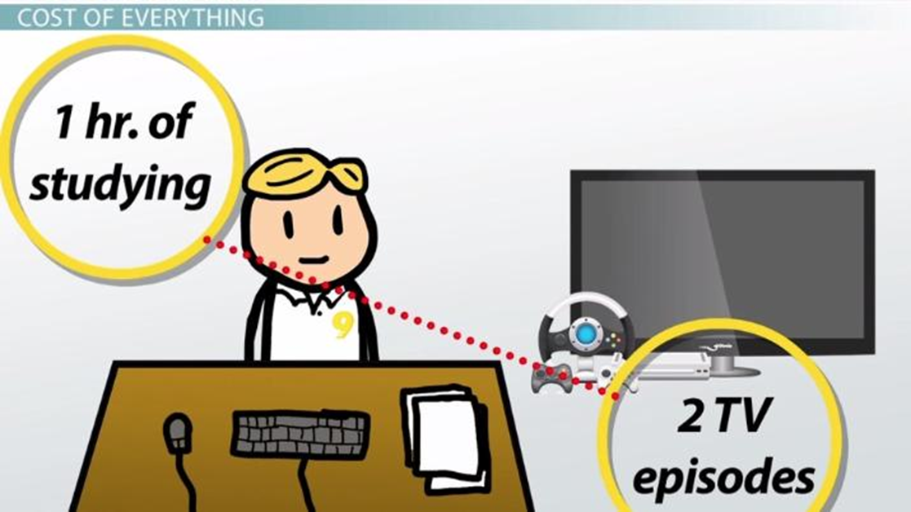
Opportunity cost
The choices we didn’t make, can lead to regret. Choosing WSU means you can’t go to other university. Dating this person means not dating that one. Choosing this desert (usually) means missing out on that one.

Slide 23
THE PRINCIPLES: INDIVIDUAL CHOICE, PART 3
“How much” is a decision at the margin.
  Trade-off: comparison of the costs and the benefits of doing something.
  Marginal decision: a decision made at the margins of an activity about whether to do a bit more or a bit less of that activity.
  Marginal analysis: the study of marginal decisions.

Slide 24
THE PRINCIPLES: INDIVIDUAL CHOICE, PART 5
People respond to incentives, exploiting opportunities to make themselves better off.
    Incentive: anything that offers rewards to people who change their behavior.
    Which policy would more effectively reduce pollution: educating manufacturers about climate change or offering them financial rewards for reducing pollution?

Slide 25
LEARN BY DOING: PRACTICE QUESTION 1
Suppose Costco offers unlimited free samples on the weekends and customers respond by eating samples until they are full without buying any of the product. Do the customers that eat the free samples face an opportunity cost?
  Yes
  No

Slide 26
LEARN BY DOING: PRACTICE QUESTION 1 — ANSWER
Suppose Costco offers unlimited free samples on the weekends and customers respond by eating samples until they are full without buying any of the product. Do the customers that eat the free samples face an opportunity cost?
  Yes (correct answer)
  No

Slide 27
LEARN BY DOING: PRACTICE QUESTION 2
Suppose Costco offers unlimited free samples on the weekends and customers respond by eating samples until they are full without buying any of the product. Economists would refer to this as an example of:
  efficiency.
  equity.
  bad incentives.
  marketing.

Slide 28
LEARN BY DOING: PRACTICE QUESTION 2 — ANSWER
Suppose Costco offers unlimited free samples on the weekends and customers respond by eating samples until they are full without buying any of the product. Economists would refer to this as an example of:
  efficiency.
  equity.
  bad incentives. (correct answer)
  marketing.

Slide 29
THE PRINCIPLES: INTERACTION OF INDIVIDUAL CHOICES, PART 1
There are gains from trade.
  Trade allows us all to consume more than we otherwise could.
  Gains from trade arise from specialization.
  Specialization: the situation in which each person specializes in the task that they are good at performing.
  Luxembourg, Switzerland, US, Ireland, Canada and the UK have absolute specialization in financial services

Slide 30
THE PRINCIPLES: INTERACTION OF INDIVIDUAL CHOICES, PART 2
Markets move toward equilibrium.
Because people respond to incentives, markets move toward equilibrium.
Equilibrium: an economic situation in which no individual would be better off doing something different.

Slide 31
THE PRINCIPLES: INTERACTION OF INDIVIDUAL CHOICES, PART 3
Resources should be used efficiently to achieve society’s goals.
Economy is efficient if it takes all opportunities to make some people better off without making other people worse off.
Equity: a condition in which everyone gets their “fair share.” (There are many definitions of equity.)
EQUITY AND EFFICIENCY ARE OFTEN AT ODDS.

Slide 32
THE PRINCIPLES: INTERACTION OF INDIVIDUAL CHOICES, PART 4
Markets usually lead to efficiency, but when they don’t, government intervention can improve society’s welfare.
People normally take opportunities to make themselves better off.
Efficiency: all the opportunities to make people better off have been exploited.
In cases of market failures, the pursuit of self-interest makes society worse off. When markets don’t achieve efficiency, government can intervene to improve society’s welfare.

Slide 33


Examples
Pollution
The housing-financial asset bubble

Slide 34
LEARN BY DOING: PRACTICE QUESTION 3
In most fast-food chains, there is one person to take the order, another to make each item of food, and another to bag the items up. This is referred to as:
  equilibrium.
  marginal.
  trade-offs.
  specialization.

Slide 35
LEARN BY DOING: PRACTICE QUESTION 3 — ANSWER
In most fast-food chains, there is one person to take the order, another to make each item of food, and another to bag the items up. This is referred to as:
  equilibrium.
  marginal.
  trade-offs.
  specialization. (correct answer)

Slide 36
LEARN BY DOING: PRACTICE QUESTION 4
A low-skilled worker may work full time and still earn an income that falls below the poverty line. Some economists consider this a failure related to:
  inefficiency.
  inequity.

Slide 37
LEARN BY DOING: PRACTICE QUESTION 4 — ANSWER
A low-skilled worker may work full time and still earn an income that falls below the poverty line. Some economists consider this a failure related to:
  inefficiency.
  inequity. (correct answer)

Slide 38
THE PRINCIPLES: ECONOMY-WIDE INTERACTIONS,
PART 1
One person’s spending is another person’s income.
During recessions, a drop in business spending leads to:
less income,
less spending, . . .
. . . and further drops in business spending, layoffs, and rising unemployment.

Slide 39
THE PRINCIPLES: ECONOMY-WIDE INTERACTIONS,
PART 2
Overall spending sometimes gets out of line with the economy’s productive capacity; when it does, government policy can change spending.
Overall spending (amount of goods and services that consumers and businesses want to buy) sometimes doesn’t match the amount the economy is capable of producing.
When the overall spending falls short of what is needed to keep workers employed, the economy experiences recession.
When overall spending outstrips the supply, the economy experiences inflation.
When the economy experiences shortfalls or an excesses in spending, government policies can be used to address the imbalances.

Slide 40
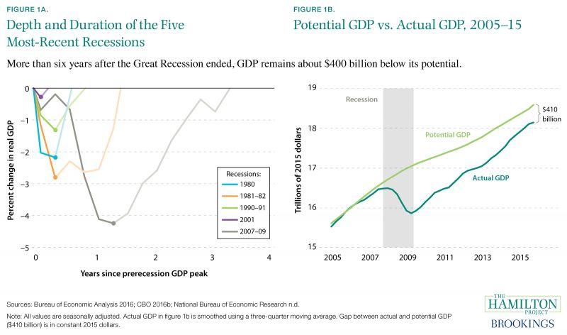
During recessions…..

Slide 41
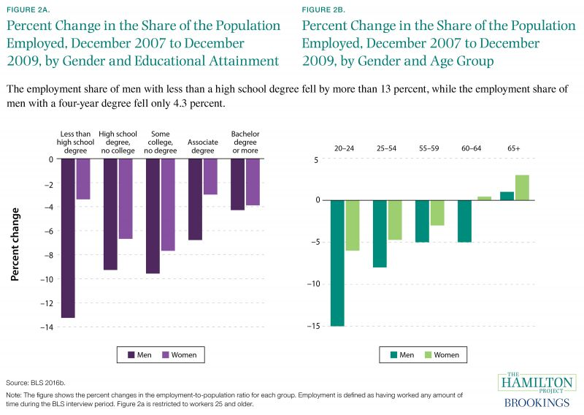
During recessions…..

Slide 42
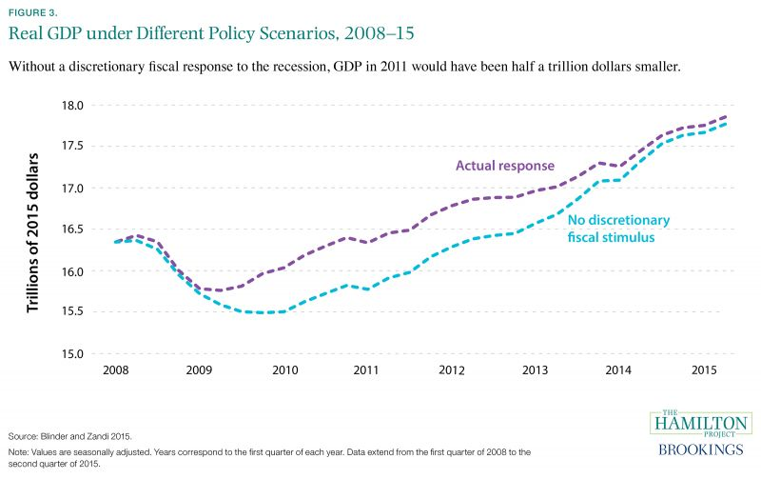
During recessions…..

Slide 43
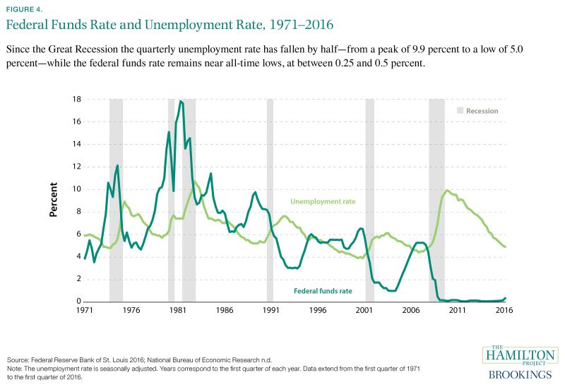
During recessions…..

Slide 44
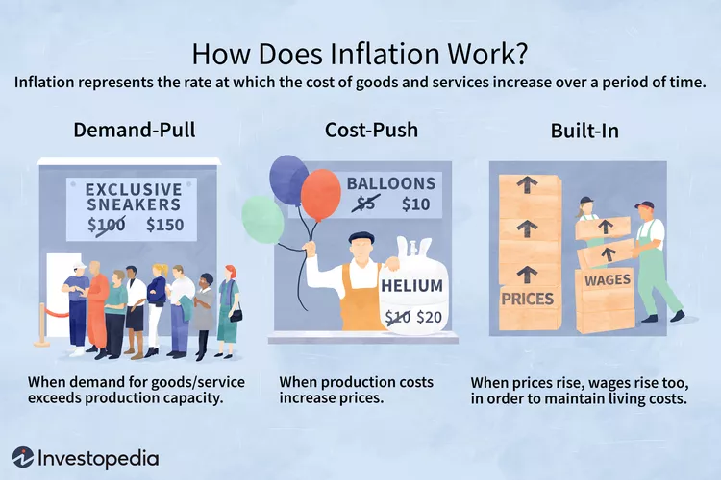
During Inflation…..

Slide 45
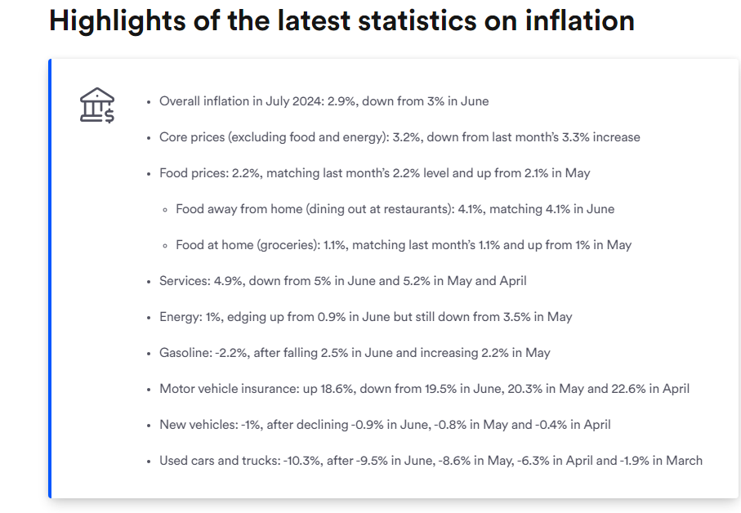
During Inflation…..
Source: Latest Inflation Statistics: The Prices Rising And Falling Most | Bankrate

Slide 46
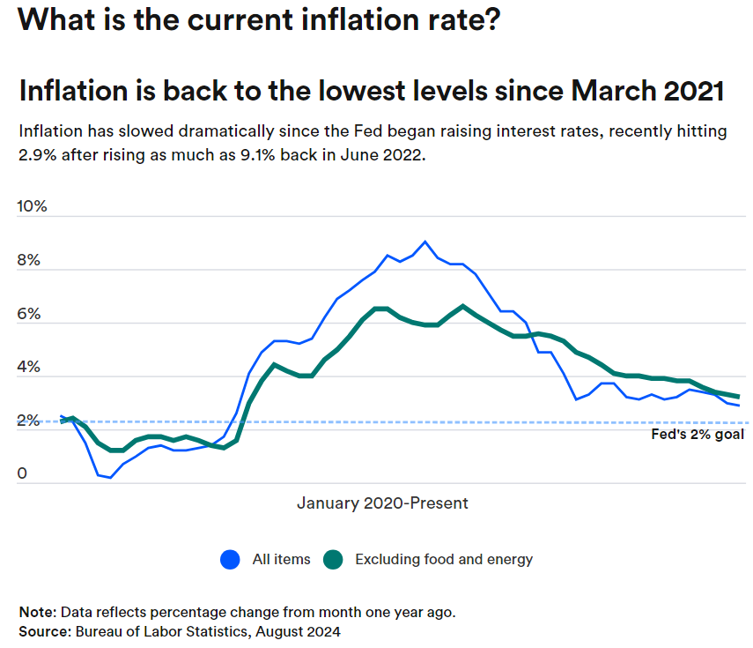

Slide 47
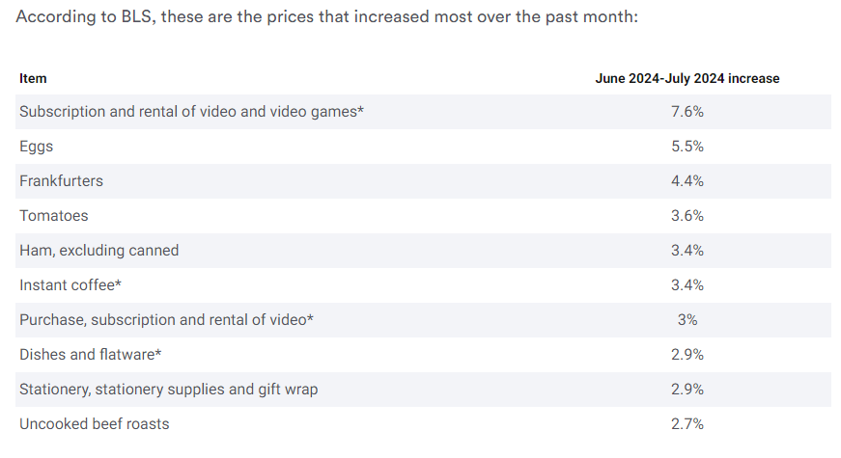

Slide 48
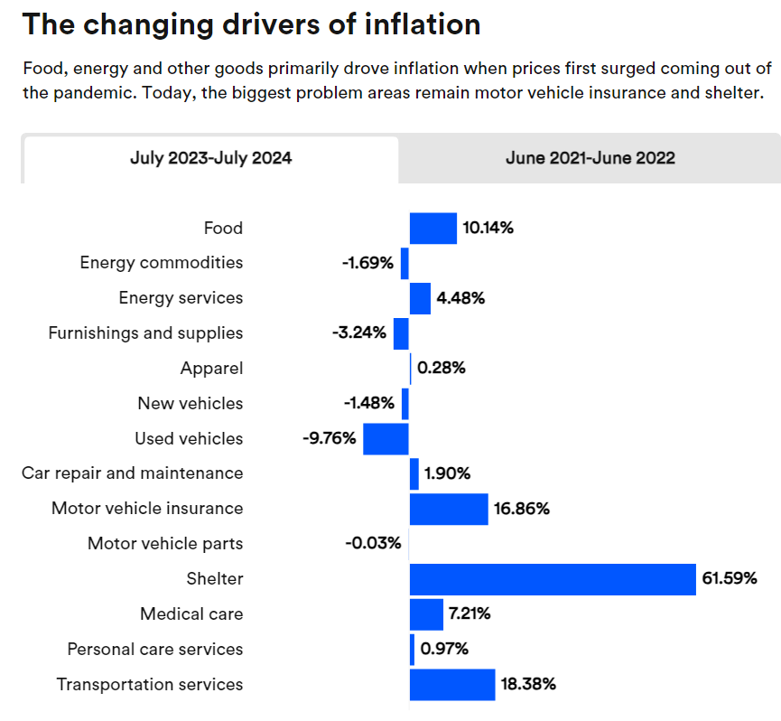

Slide 49
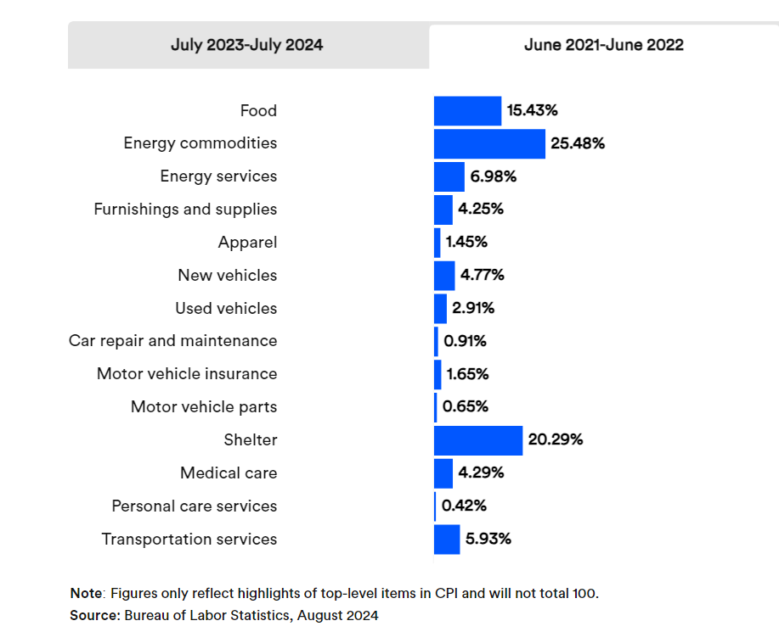

Slide 50
THE PRINCIPLES: ECONOMY-WIDE INTERACTIONS,
PART 3
Increases in the economy’s potential lead to economic growth over time.
Economic growth: the increase in living standards over time.
Economy’s potential: the total amount of goods and services it can produce.
Emergence of new technologies and increases in resources available for production boost the economy’s potential, hence living standards.
Increases in living standards are usually unequally distributed among a country’s residents, creating winners and losers.
For example, new sources of energy benefit the economy and the environment — they are winners. But at the same time, the reduced demand for coal has hurt mining communities, creating losers.

Slide 51
Quality of life Index
Measures eight indices:
purchasing power (including rent)
safety
health care
cost of living
property price to income ratio
traffic commute time
pollution

Slide 52
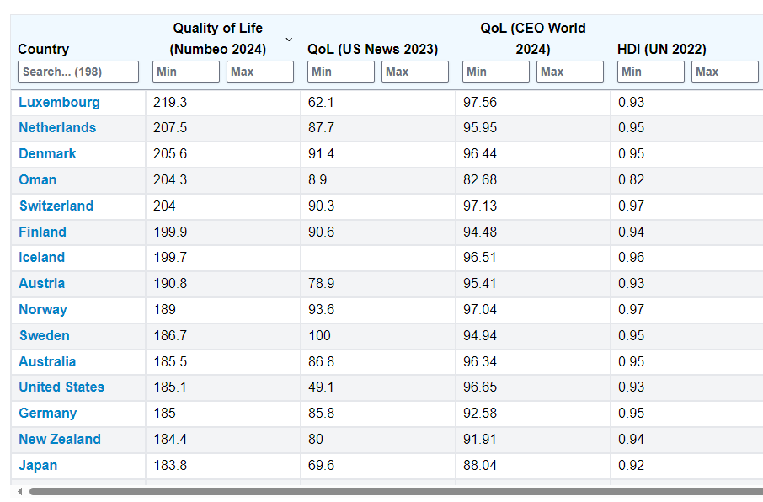
Quality of life Index

Slide 53
When markets do not achieve efficiency:
A) they achieve equity.
B) the government must be intervening in the economy
C) the government may intervene to improve society’s welfare
D) they also do not achieve equity

Slide 54
LEARN BY DOING: DISCUSSION QUESTION 2
Which situation demonstrates a scenario with no opportunity cost?
A) On Friday night you stay out talking to friends.
B) The Econ club is giving out free pizza for lunch.
C) Ana chooses to buy a book of mystery instead a book about math.
D) You get an offer from Boing and Amazon offering same salary. You are extremely happy and choose to work for Amazon.
E) All of the above have an opportunity cost.

Slide 55
LEARN BY DOING: DISCUSSION QUESTION 3
Do wealthy people such as Oprah Winfrey and Jeff Bezos face scarcity?

