Slide 1

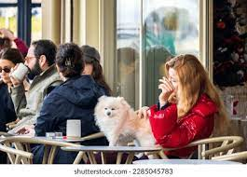
Positive or Negative?

Slide 2
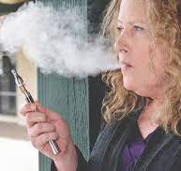
Positive or Negative?

Slide 3
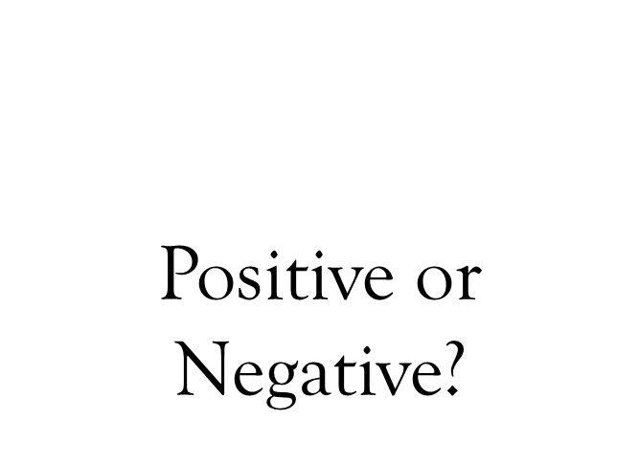


Slide 4

Positive or Negative?

Slide 5


